Slide 1


High Temperature Oven Development at IMP
IMP
L. Sun
Institute of Modern Physics, CAS, 730000, Lanzhou, China
PIBHI’25, April. 7~9, 2025, Acitrezza, Italy

Slide 2
Typical Methods for Metallic Ion Beams
Plasma Heating
MIVOC
Sputtering
RIKEN, MSU, IMP
Metallic oven (Resistance oven, Inductive oven, etc)
LBNL, MSU, RIKEN, GSI, IMP, JYFL…
Laser Ablation
Notes:
Needs: SHE, CEE, HIAF
HCI production: metallic beams with CAFe-2 (LECR5 & SECRAL 3), Uranium beam with HIRFL@SECRAL-I & SECRAL-II
New Techniques towards intense beams: HTO, Vlasov launcher, 2-frequency AG, Biased probe + AG effect
HIAF requirements in long range, FECR

Slide 3
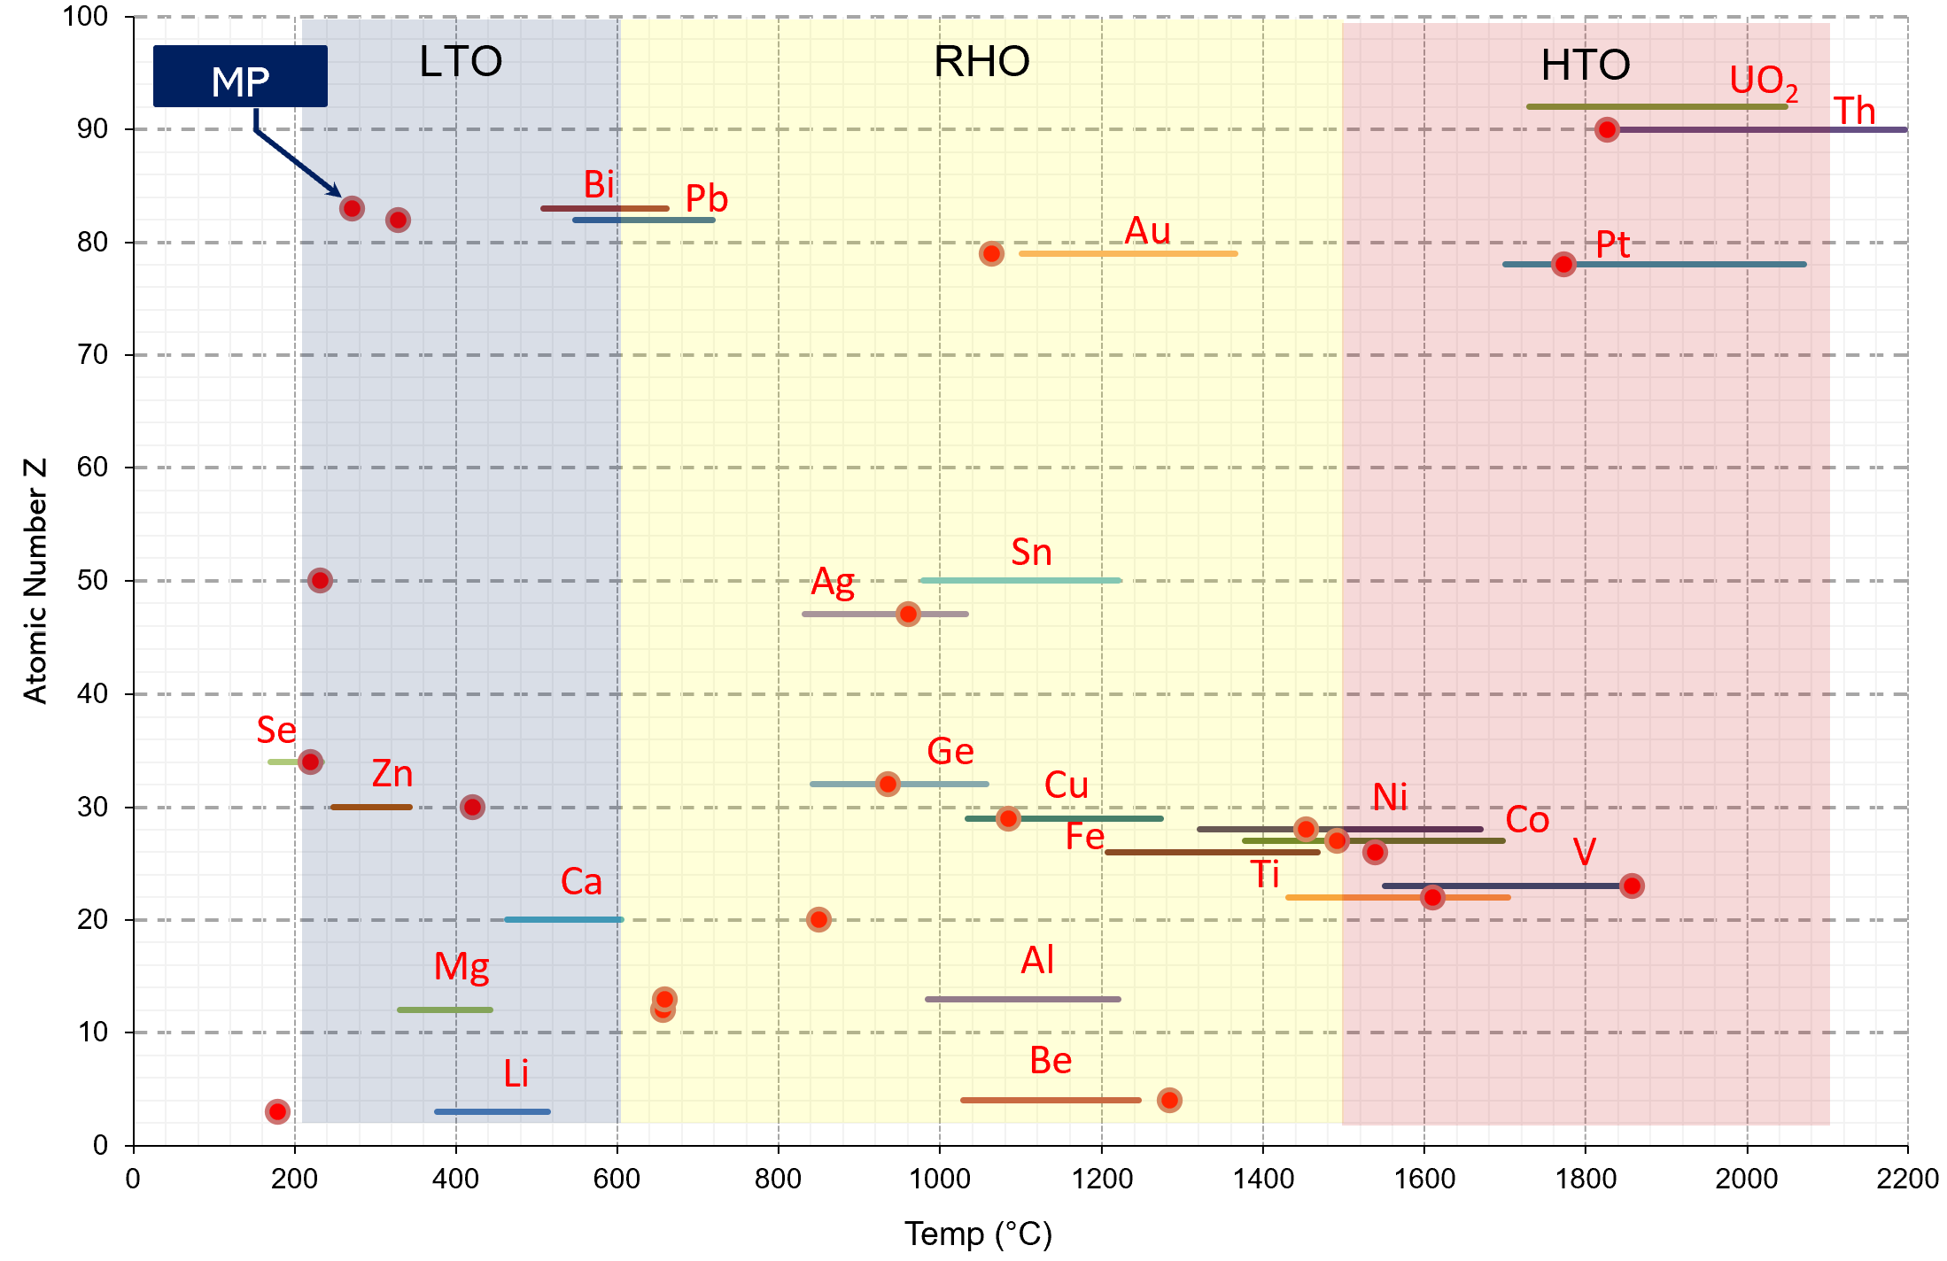
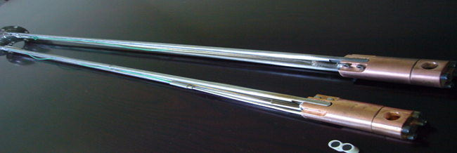
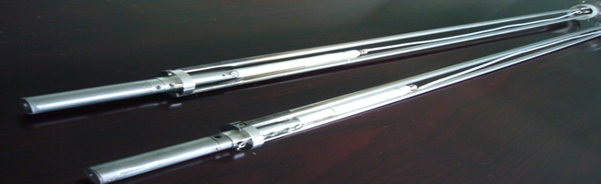
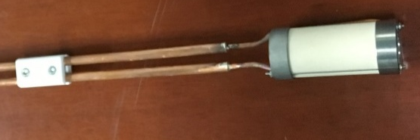
Ovens at IMP
Notes:
Needs: SHE, CEE, HIAF
HCI production: metallic beams with CAFe-2 (LECR5 & SECRAL 3), Uranium beam with HIRFL@SECRAL-I & SECRAL-II
New Techniques towards intense beams: HTO, Vlasov launcher, 2-frequency AG, Biased probe + AG effect
HIAF requirements in long range, FECR

Slide 4
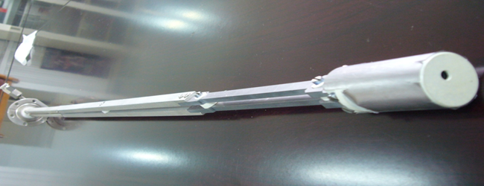
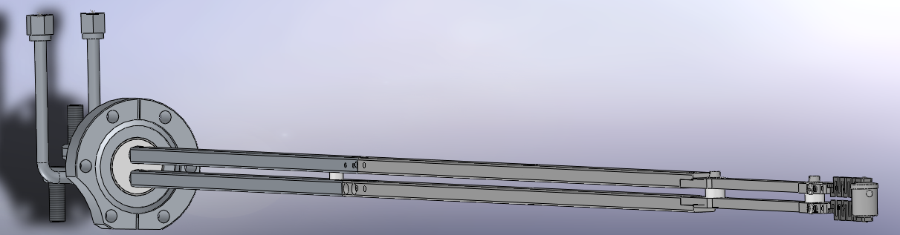
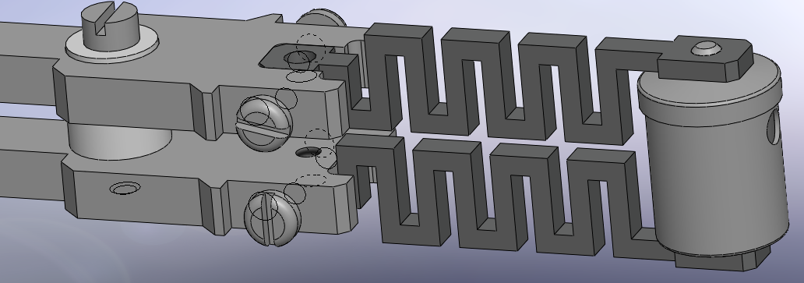
High Temp. Oven: Trial 1
Feedthrough
Copper Rod
304 SS Rod
Ta
W
Ta
Notes:
Needs: SHE, CEE, HIAF
HCI production: metallic beams with CAFe-2 (LECR5 & SECRAL 3), Uranium beam with HIRFL@SECRAL-I & SECRAL-II
New Techniques towards intense beams: HTO, Vlasov launcher, 2-frequency AG, Biased probe + AG effect
HIAF requirements in long range, FECR

Slide 5
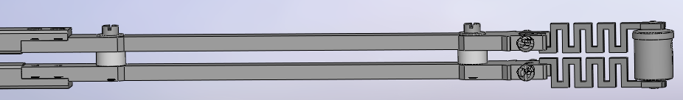
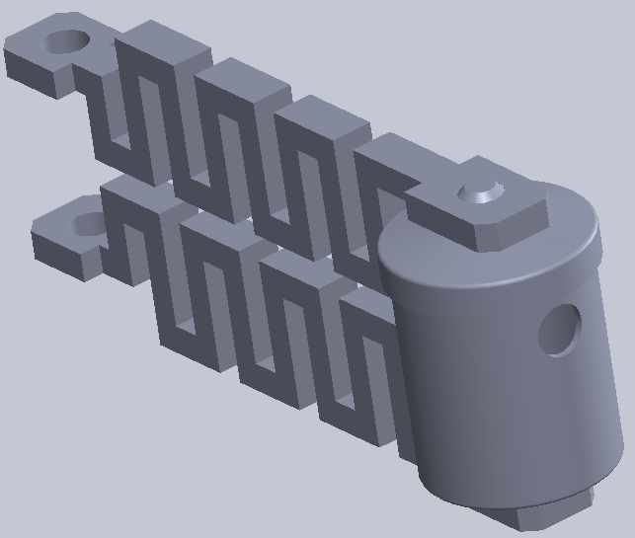
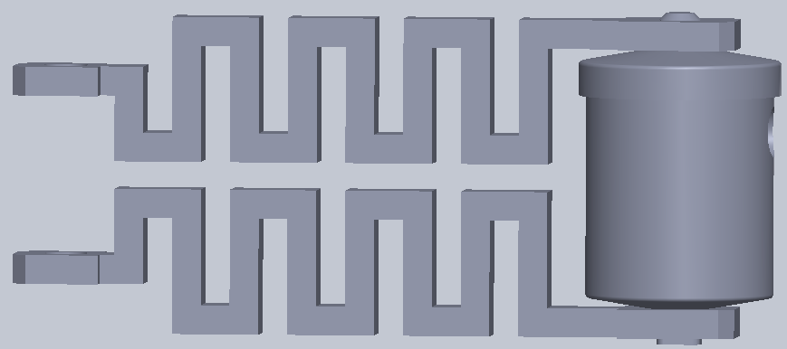
High Temp. Oven : Trial 1
Br
I_{oven}
Bz
Br
Fr
Fr
Fz
Forces caused by Br
Forces caused by Bz
Notes:
Needs: SHE, CEE, HIAF
HCI production: metallic beams with CAFe-2 (LECR5 & SECRAL 3), Uranium beam with HIRFL@SECRAL-I & SECRAL-II
New Techniques towards intense beams: HTO, Vlasov launcher, 2-frequency AG, Biased probe + AG effect
HIAF requirements in long range, FECR

Slide 6
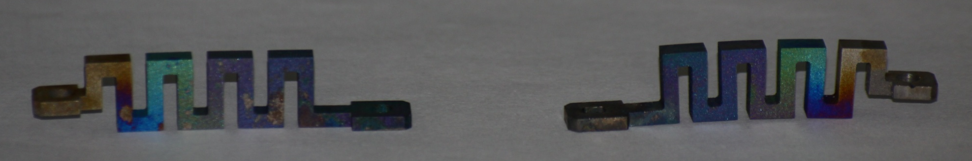
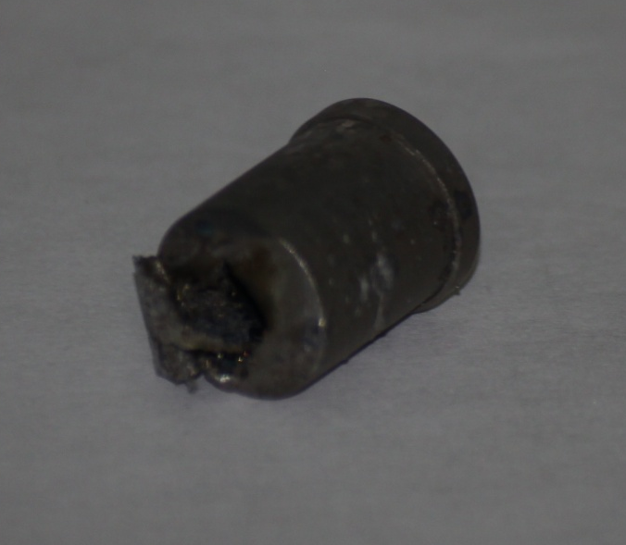
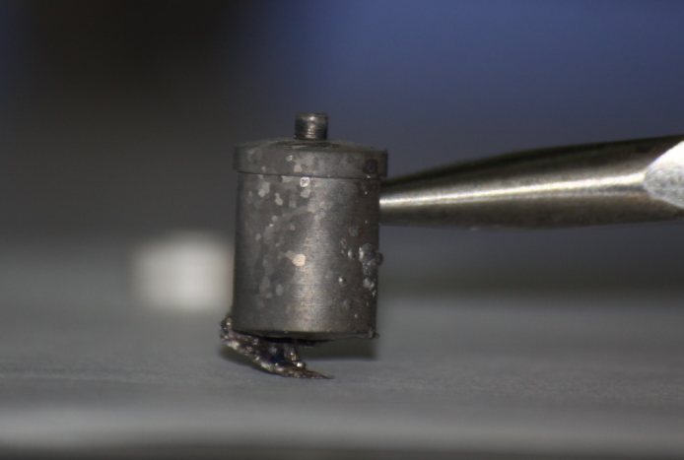
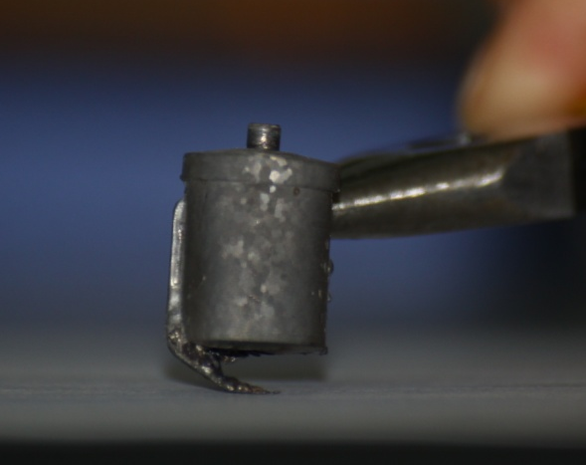
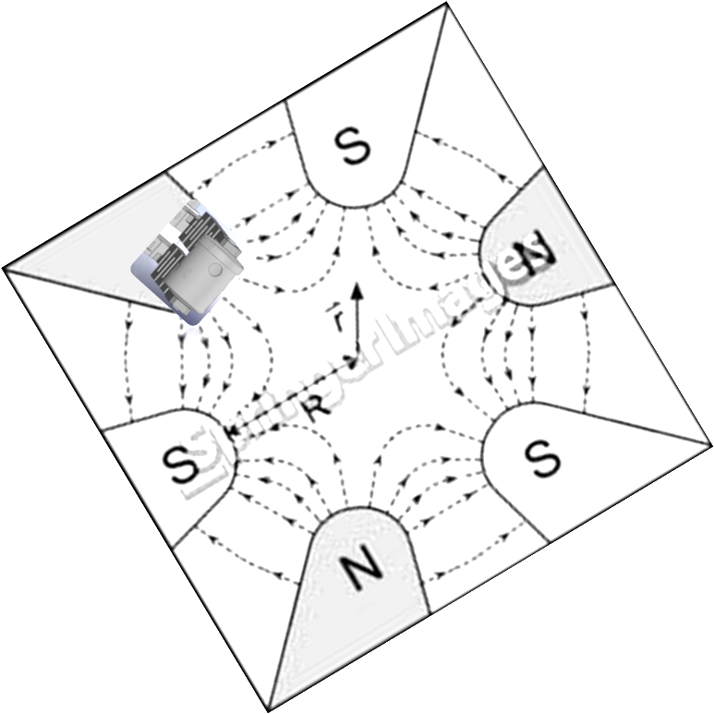
High Temp. Oven : Trial 1
Upper W lead
Lower W lead
Crucible connect point bent and melt caused by resistor heating caused by detaching
Ta crucible lower connector melted
Ta crucible bent
Ta crucible bent
Notes:
Needs: SHE, CEE, HIAF
HCI production: metallic beams with CAFe-2 (LECR5 & SECRAL 3), Uranium beam with HIRFL@SECRAL-I & SECRAL-II
New Techniques towards intense beams: HTO, Vlasov launcher, 2-frequency AG, Biased probe + AG effect
HIAF requirements in long range, FECR

Slide 7
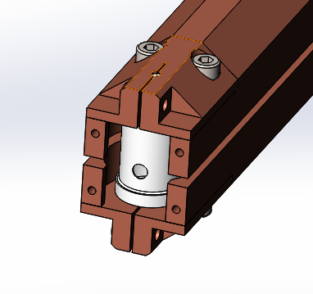
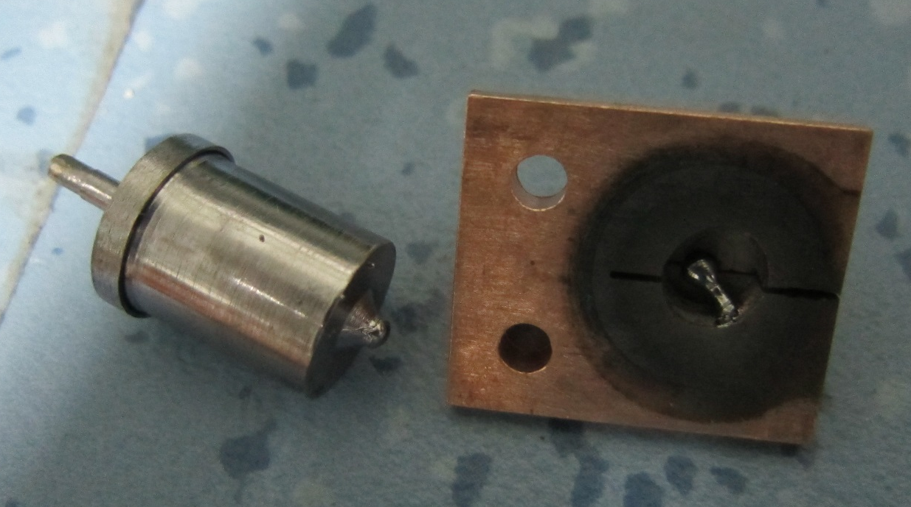
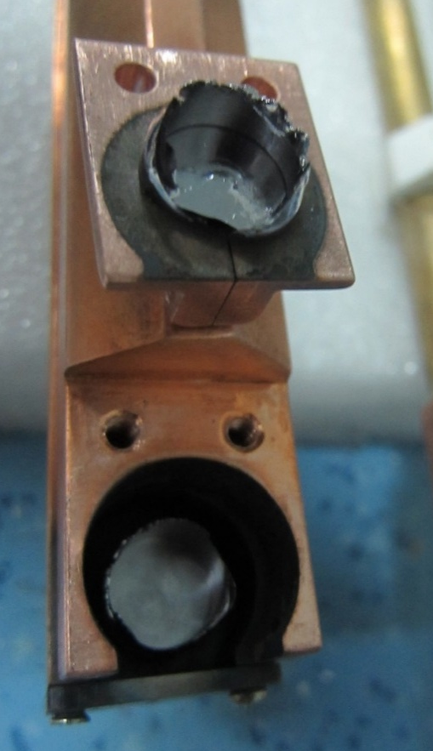
High Temp. Oven : Trial 2
Cu
Ta purity
Thermal expansion forces
Ta
Notes:
Needs: SHE, CEE, HIAF
HCI production: metallic beams with CAFe-2 (LECR5 & SECRAL 3), Uranium beam with HIRFL@SECRAL-I & SECRAL-II
New Techniques towards intense beams: HTO, Vlasov launcher, 2-frequency AG, Biased probe + AG effect
HIAF requirements in long range, FECR

Slide 8
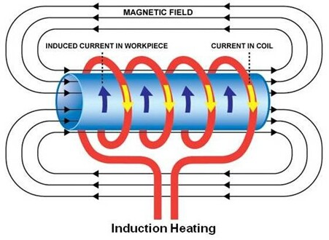
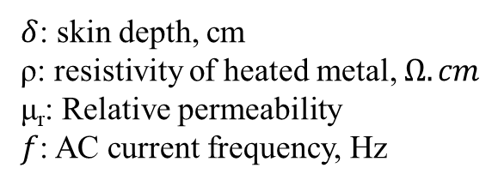
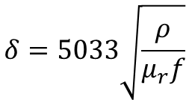
High Temp. Oven : Trial 3
Principle of inductive heating and its features
$$δ=5033\sqrt{\frac{ρ}{μ_{r}f}}$$
$δ$: skin depth, cm
ρ: resistivity of heated metal, $Ω. cm$
μ_{r}: Relative permeability
$f$: AC current frequency, Hz
Pros:
Challenges:
Lorenz force free when work in high magnetic field environment (B>3-6 T);
Fast temperature respond to the heating power;
Material compatibility under high temperature;
Thermal radiation and thermal conduction shielding;
With inductive heating oven, MSU got ~200 euA of U³³⁺ in 2012. But the performance of oven degrades quickly!
Notes:
Needs: SHE, CEE, HIAF
HCI production: metallic beams with CAFe-2 (LECR5 & SECRAL 3), Uranium beam with HIRFL@SECRAL-I & SECRAL-II
New Techniques towards intense beams: HTO, Vlasov launcher, 2-frequency AG, Biased probe + AG effect
HIAF requirements in long range, FECR

Slide 9
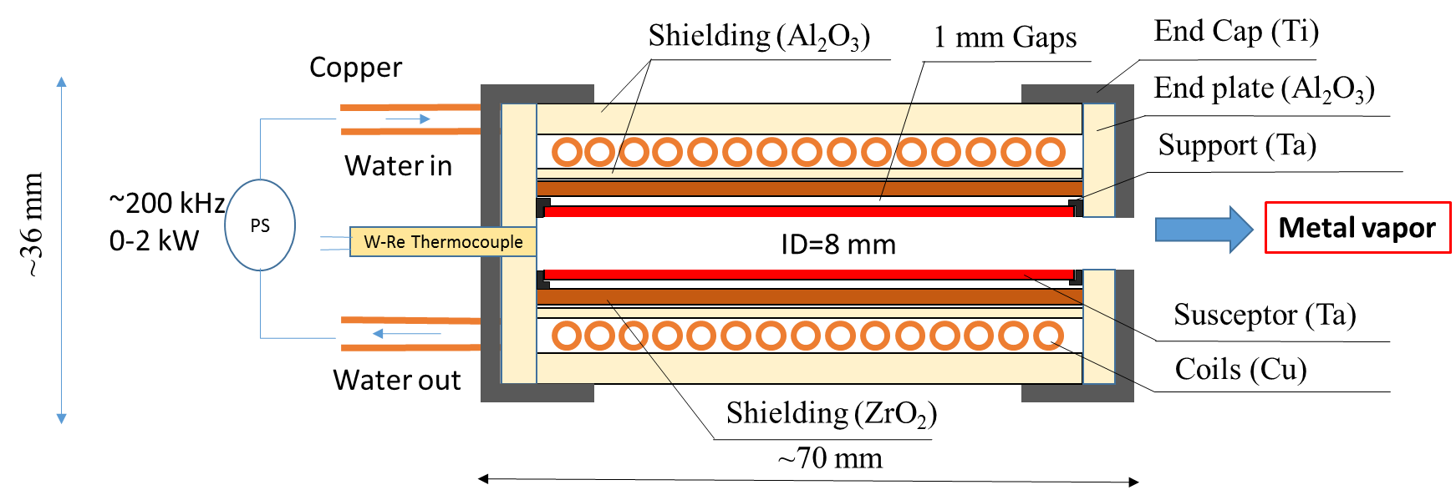
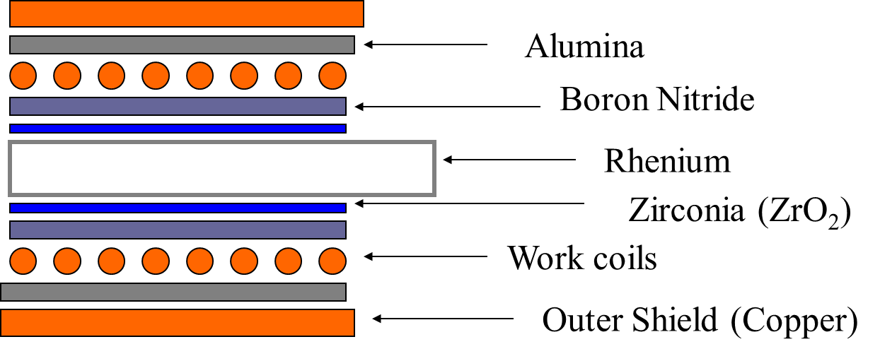
High Temp. Oven : Trial 3
Original Design at MSU
Sketch of inductive oven at IMP
Design temperature: 1800 -2100 ⁰C
Design working life: >200 hours
Control mode: Close loop (open loop at the first step)
Capacity: Ø8 mm×50 mm crucible
Main features: Add gap between crucible and ZrO₂
W. Lu in 2019
Notes:
Needs: SHE, CEE, HIAF
HCI production: metallic beams with CAFe-2 (LECR5 & SECRAL 3), Uranium beam with HIRFL@SECRAL-I & SECRAL-II
New Techniques towards intense beams: HTO, Vlasov launcher, 2-frequency AG, Biased probe + AG effect
HIAF requirements in long range, FECR

Slide 10
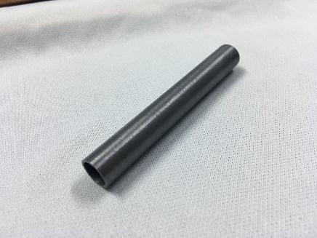
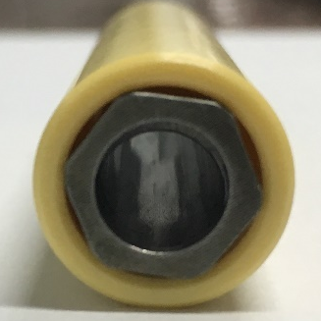
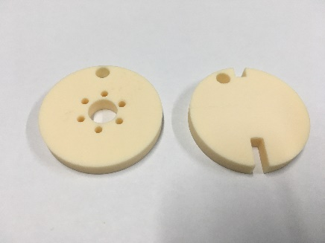
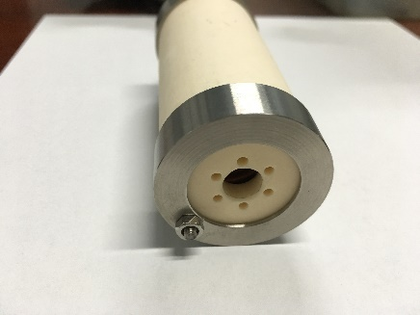
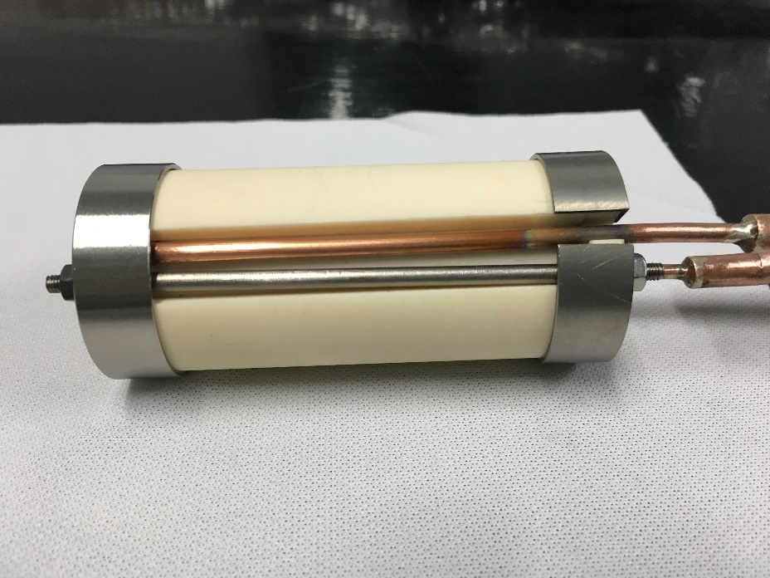
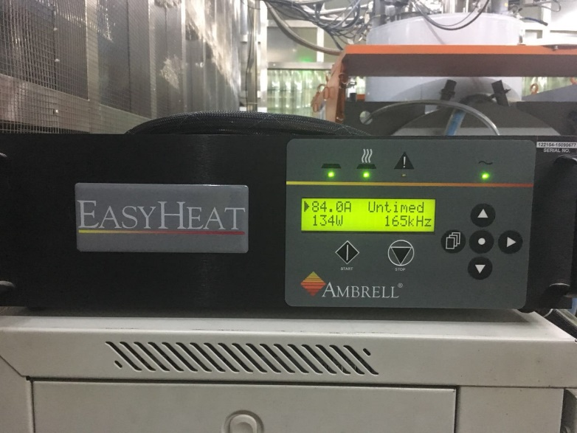
High Temp. Oven : Trial 3
Inductive oven assembling
Ta support
For pumping
1 mm of Susceptor (Ta)
2 mm of ZrO2
Al₂O₃ End plate
Inductive oven-2019
End cape and rod
Inductive oven after assembling
RF power generator (0-2 kW, 200 kHz)
Notes:
Needs: SHE, CEE, HIAF
HCI production: metallic beams with CAFe-2 (LECR5 & SECRAL 3), Uranium beam with HIRFL@SECRAL-I & SECRAL-II
New Techniques towards intense beams: HTO, Vlasov launcher, 2-frequency AG, Biased probe + AG effect
HIAF requirements in long range, FECR

Slide 11
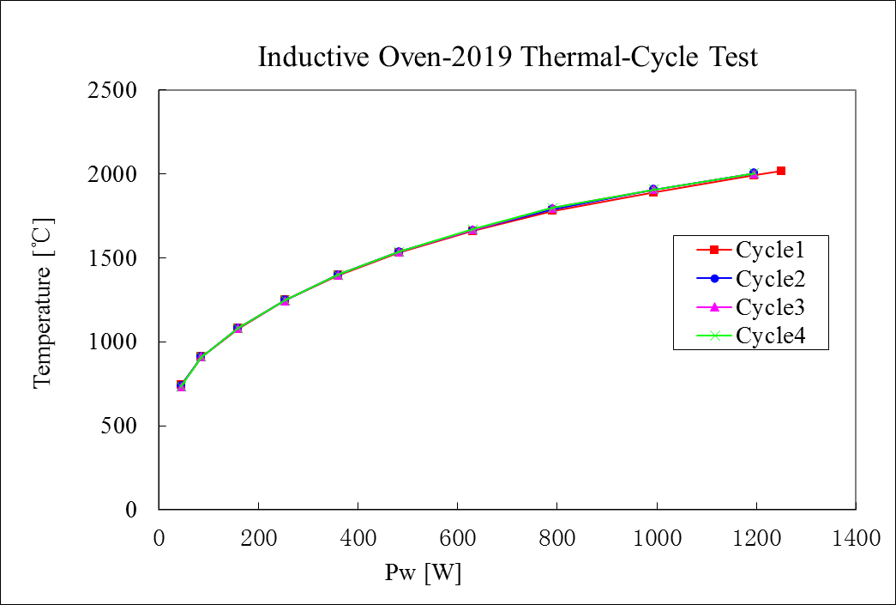
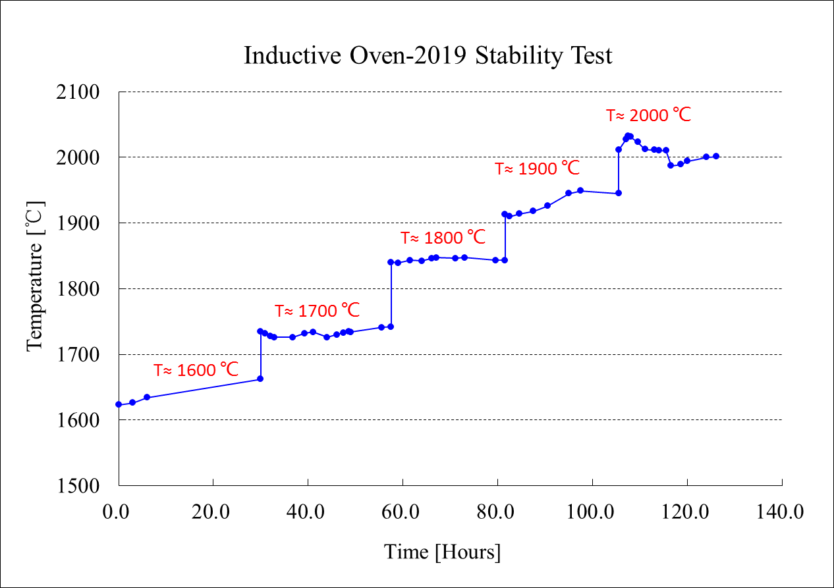
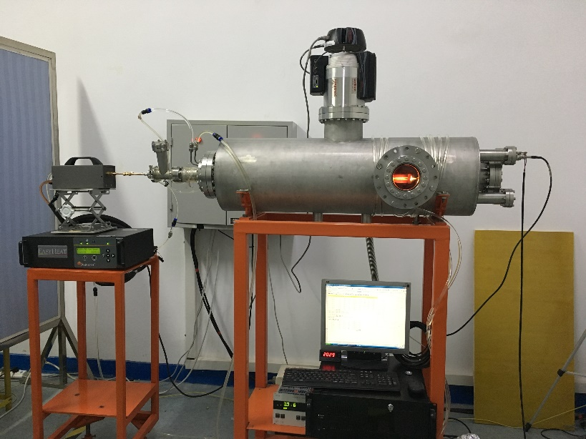
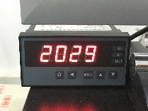
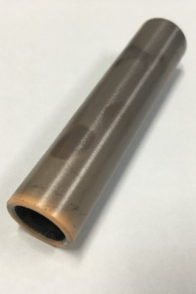
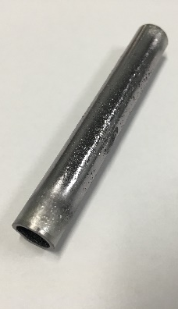
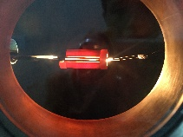
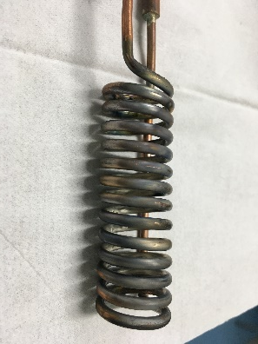
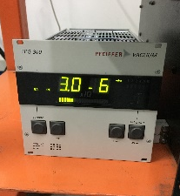
High Temp. Oven : Trial 3
Off-line Test
5 days continuous running
Heat station
Coil
ZrO₂
Ta crucible
ZrO₂ and Ta crucible survived
Similar performance in thermal-cycle test
Notes:
Needs: SHE, CEE, HIAF
HCI production: metallic beams with CAFe-2 (LECR5 & SECRAL 3), Uranium beam with HIRFL@SECRAL-I & SECRAL-II
New Techniques towards intense beams: HTO, Vlasov launcher, 2-frequency AG, Biased probe + AG effect
HIAF requirements in long range, FECR

Slide 12
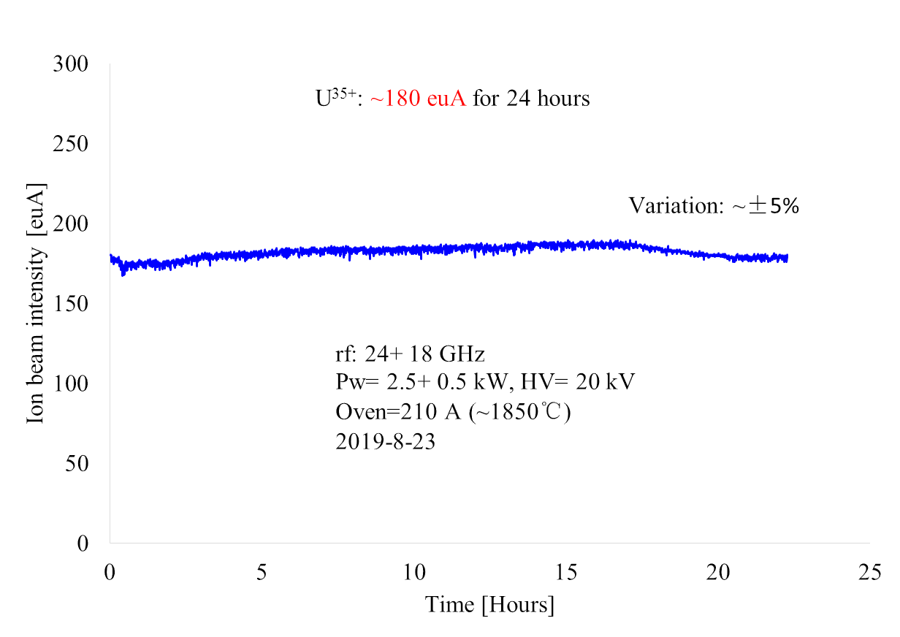
²³⁸U³⁵⁺ stability test
High Temp. Oven : Trial 3
Notes:
Needs: SHE, CEE, HIAF
HCI production: metallic beams with CAFe-2 (LECR5 & SECRAL 3), Uranium beam with HIRFL@SECRAL-I & SECRAL-II
New Techniques towards intense beams: HTO, Vlasov launcher, 2-frequency AG, Biased probe + AG effect
HIAF requirements in long range, FECR

Slide 13
Summary
High temperature oven is one key technology for ECRIS
Inductive heating oven is so far the most reliable HTO
Key issues for IHO:
Proper selection of materials
Thermal expansion control in mechanical design
Sufficient offline test
IHO is still facing challenges:
Very high current metallic ion beam long-term operation
Very refractory metallic ion beam production

