Slide 1



Metallic ion beam production and diagnostic with the CAPRICE ECRIS at GSI
Aleksandr Andreev
PIBHI Workshop, Aci Trezza, Italy, 7-9.04.25
GSI Helmholtzzentrum für Schwerionenforschung GmbH
Aleksandr Andreev

Slide 2
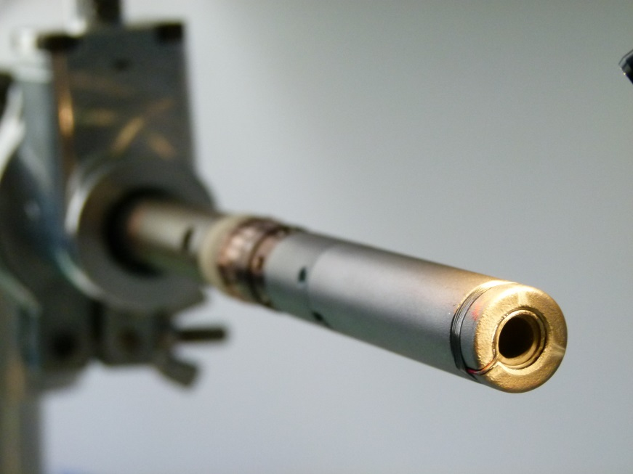
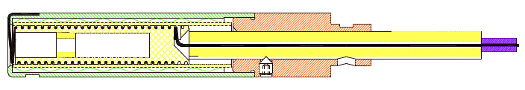
Evaporation technique for metal ion beam production @ HLI
Standard Temperature Oven (STO)
Layout
Resistively heated by current running around the heater body, central current entry
Aperture ring if the material is liquid at the required vapor pressure (e.g. Fe, Ni)
Crucible (Ta or W) to avoid chemical reactions with the heater ceramic (for e.g. Mg, Ca, Li)
Operating parameters
Power: 2-120W
Temperature: 400 -1550°C
Consumption: 0,2 – 5 mg/h
Lifetimes days: ⁴⁸Ca ≤ 30, ⁶⁴Ni ≤ 6
yellow = Al₂O₃; green = Ta; orange = Mo;
violet = CuBe₂; black = WRe(26%Re)
*
* Ti with High Temperature Oven (HTO)
Aleksandr Andreev

Slide 3
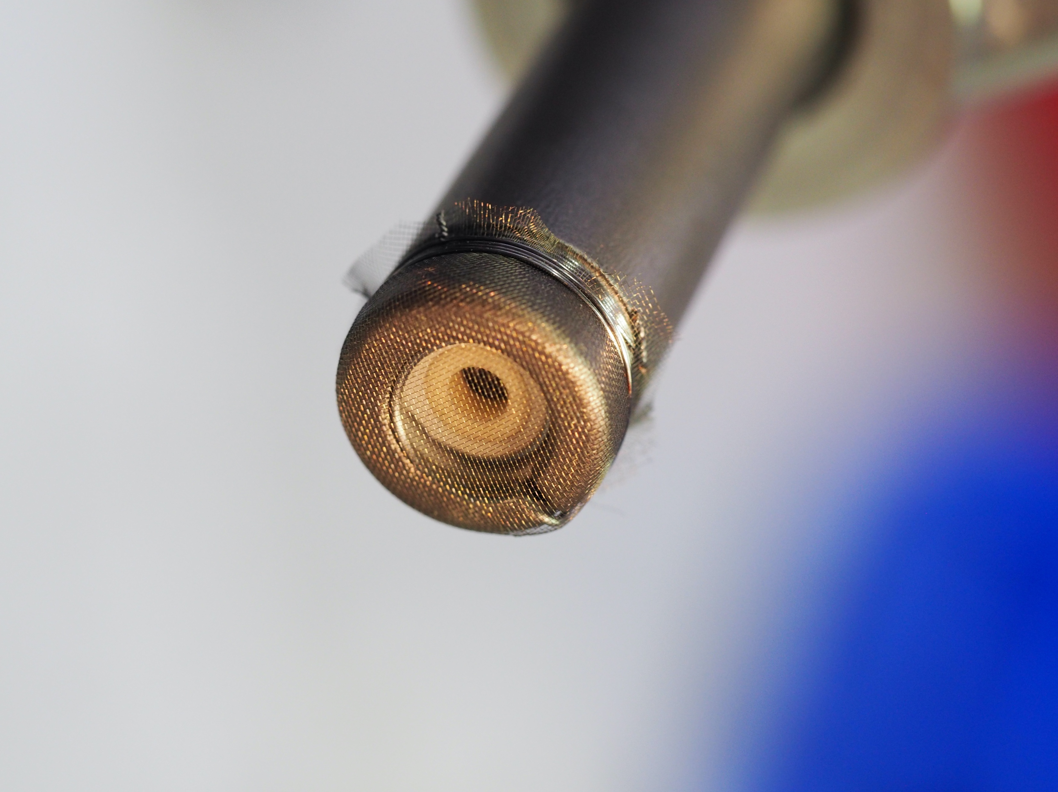
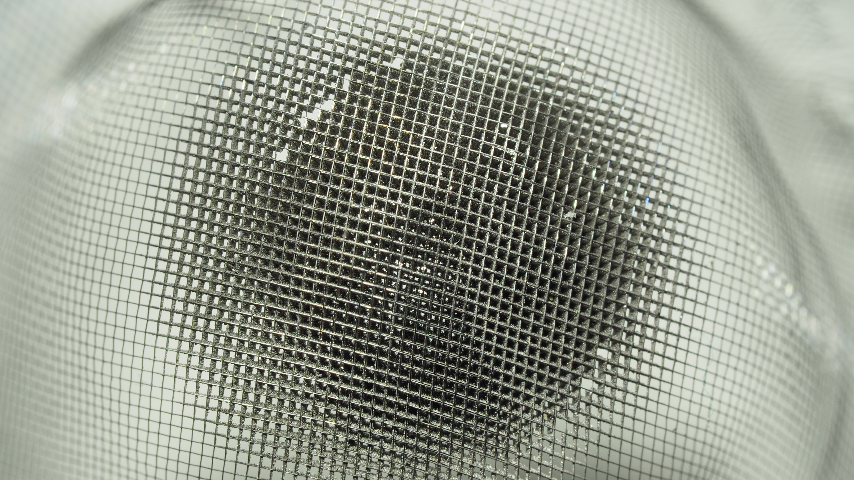
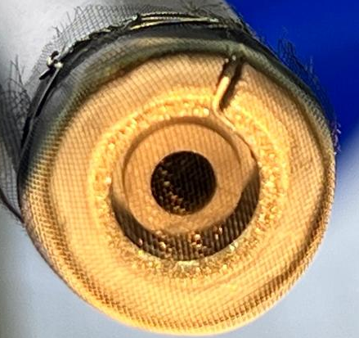
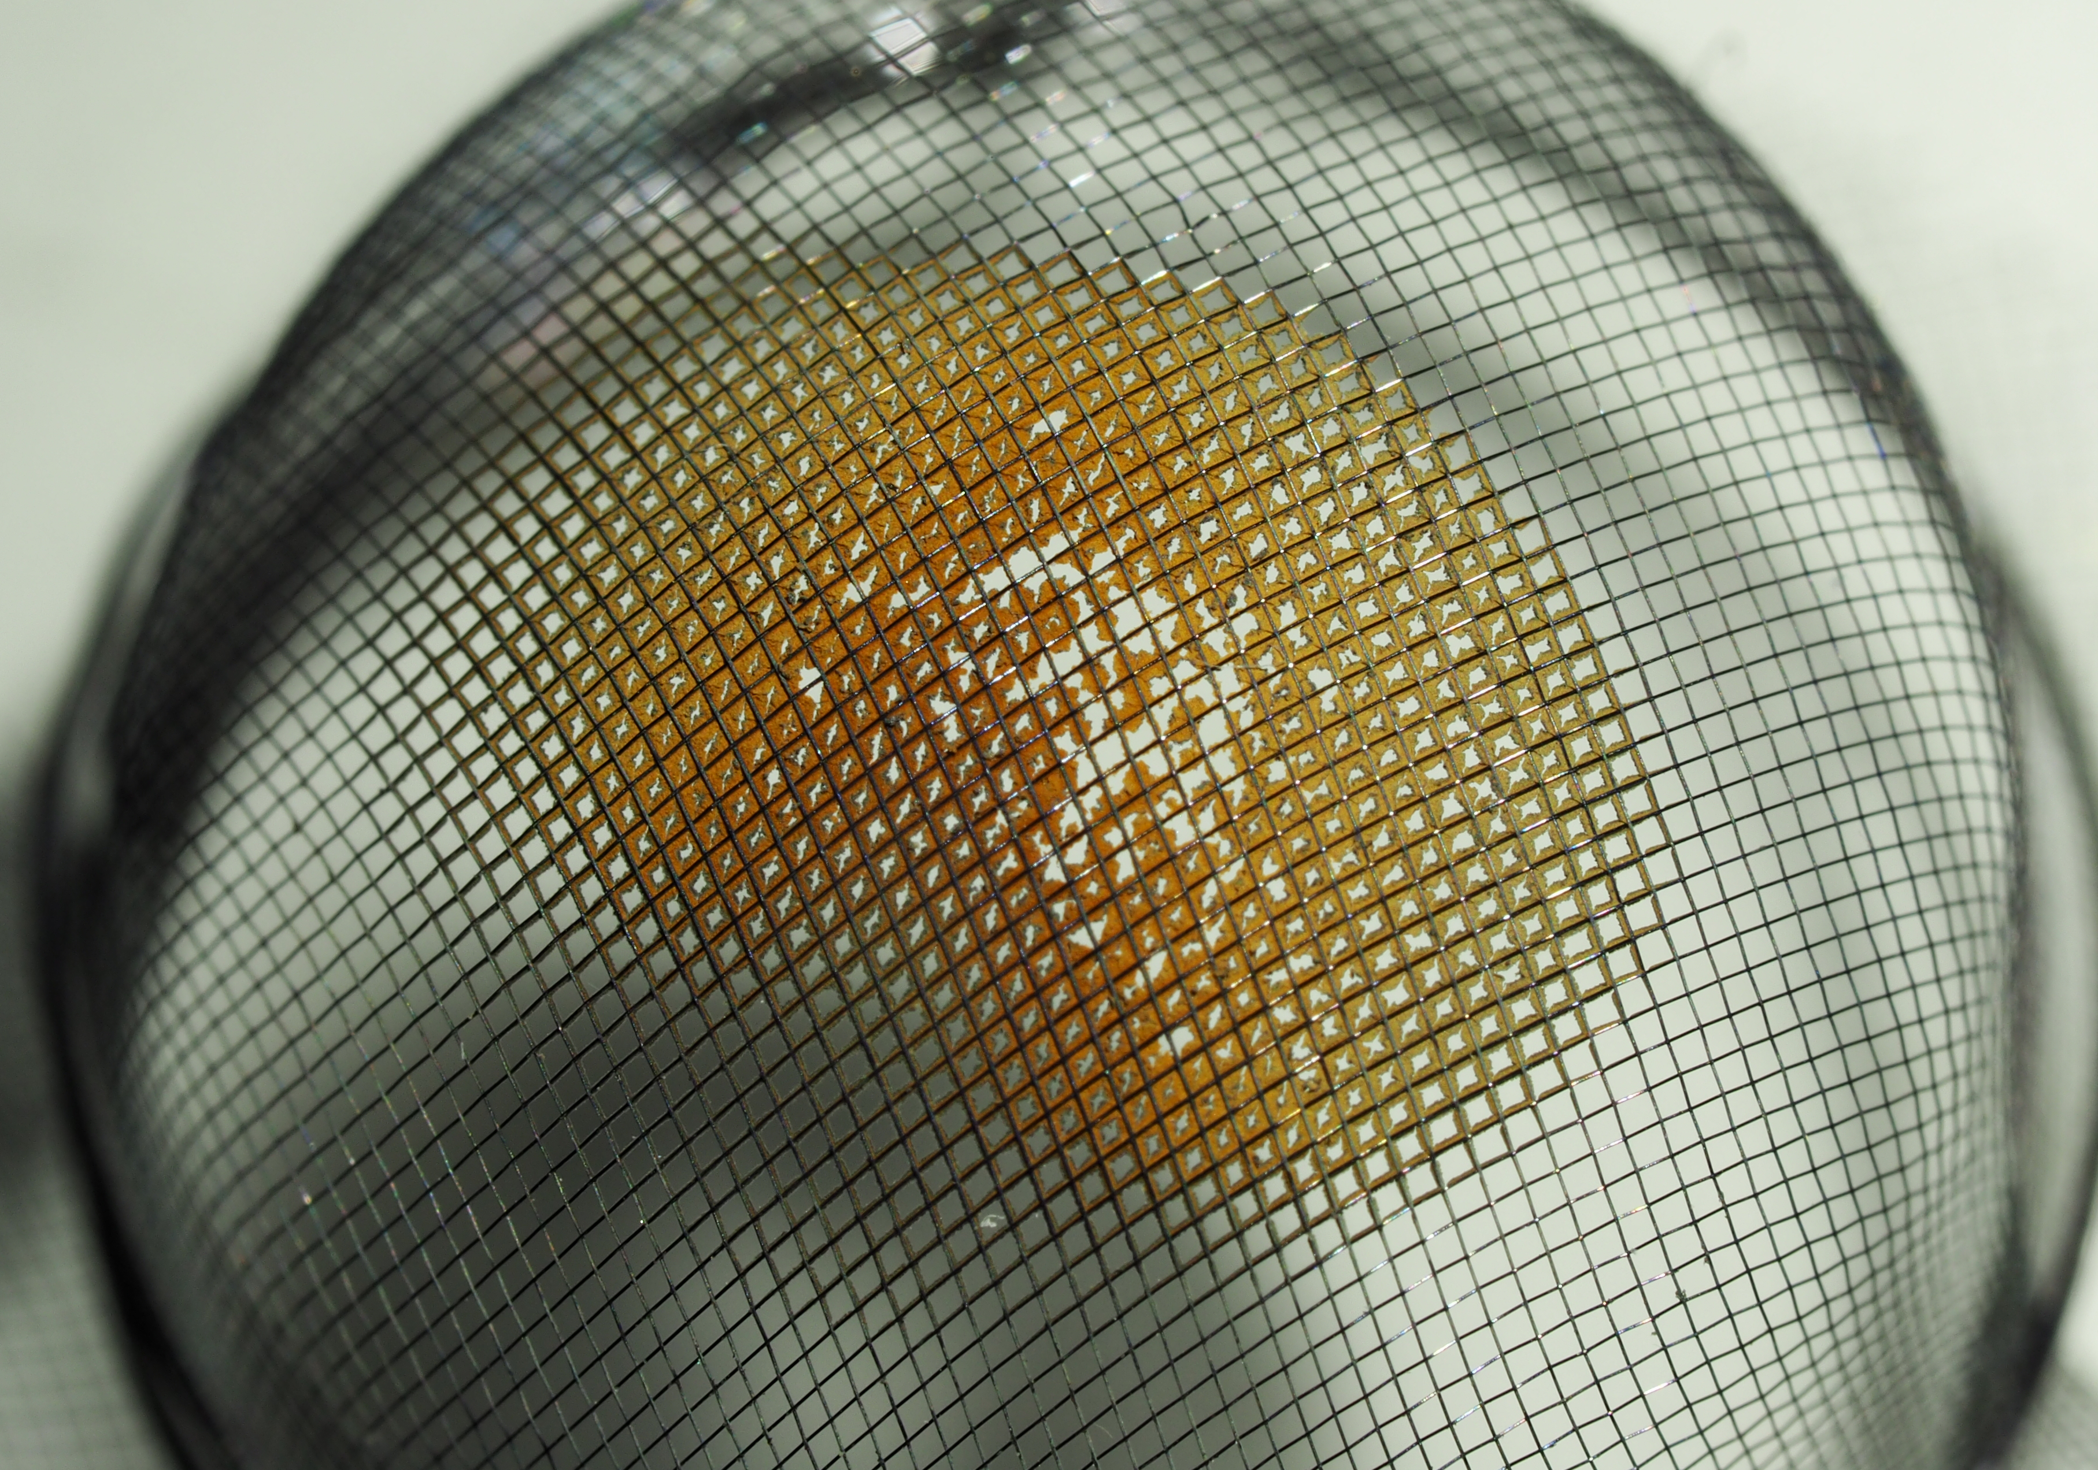
Tungsten mesh shielding: preventing passive MW heating
Tungsten mesh shielding used to prevent passive microwave heating of the oven during low sublimation temperature element operation (e.g. ⁴⁸Ca)
Specifications: Type 100 holes/inch, 25.4 µm wire, 81% transparency
Improves beam stability and reduces material consumption by protecting the oven from uncontrolled material evaporation
Observed Limitations:
Mesh performance depends on the element:
Successful for Ca (no clogging, stable beam)
Clogging for Cr and Mn, limiting long-term beam production
Clogged mesh limits material flow and reduces beam intensity
Microwave shielding
Mesh clogged after
few hours of ⁵⁴Cr operation
Mesh clogged after
one day of ⁵⁵Mn operation
Mesh after 1 month of
⁴⁸Ca operation
Aleksandr Andreev

Slide 4
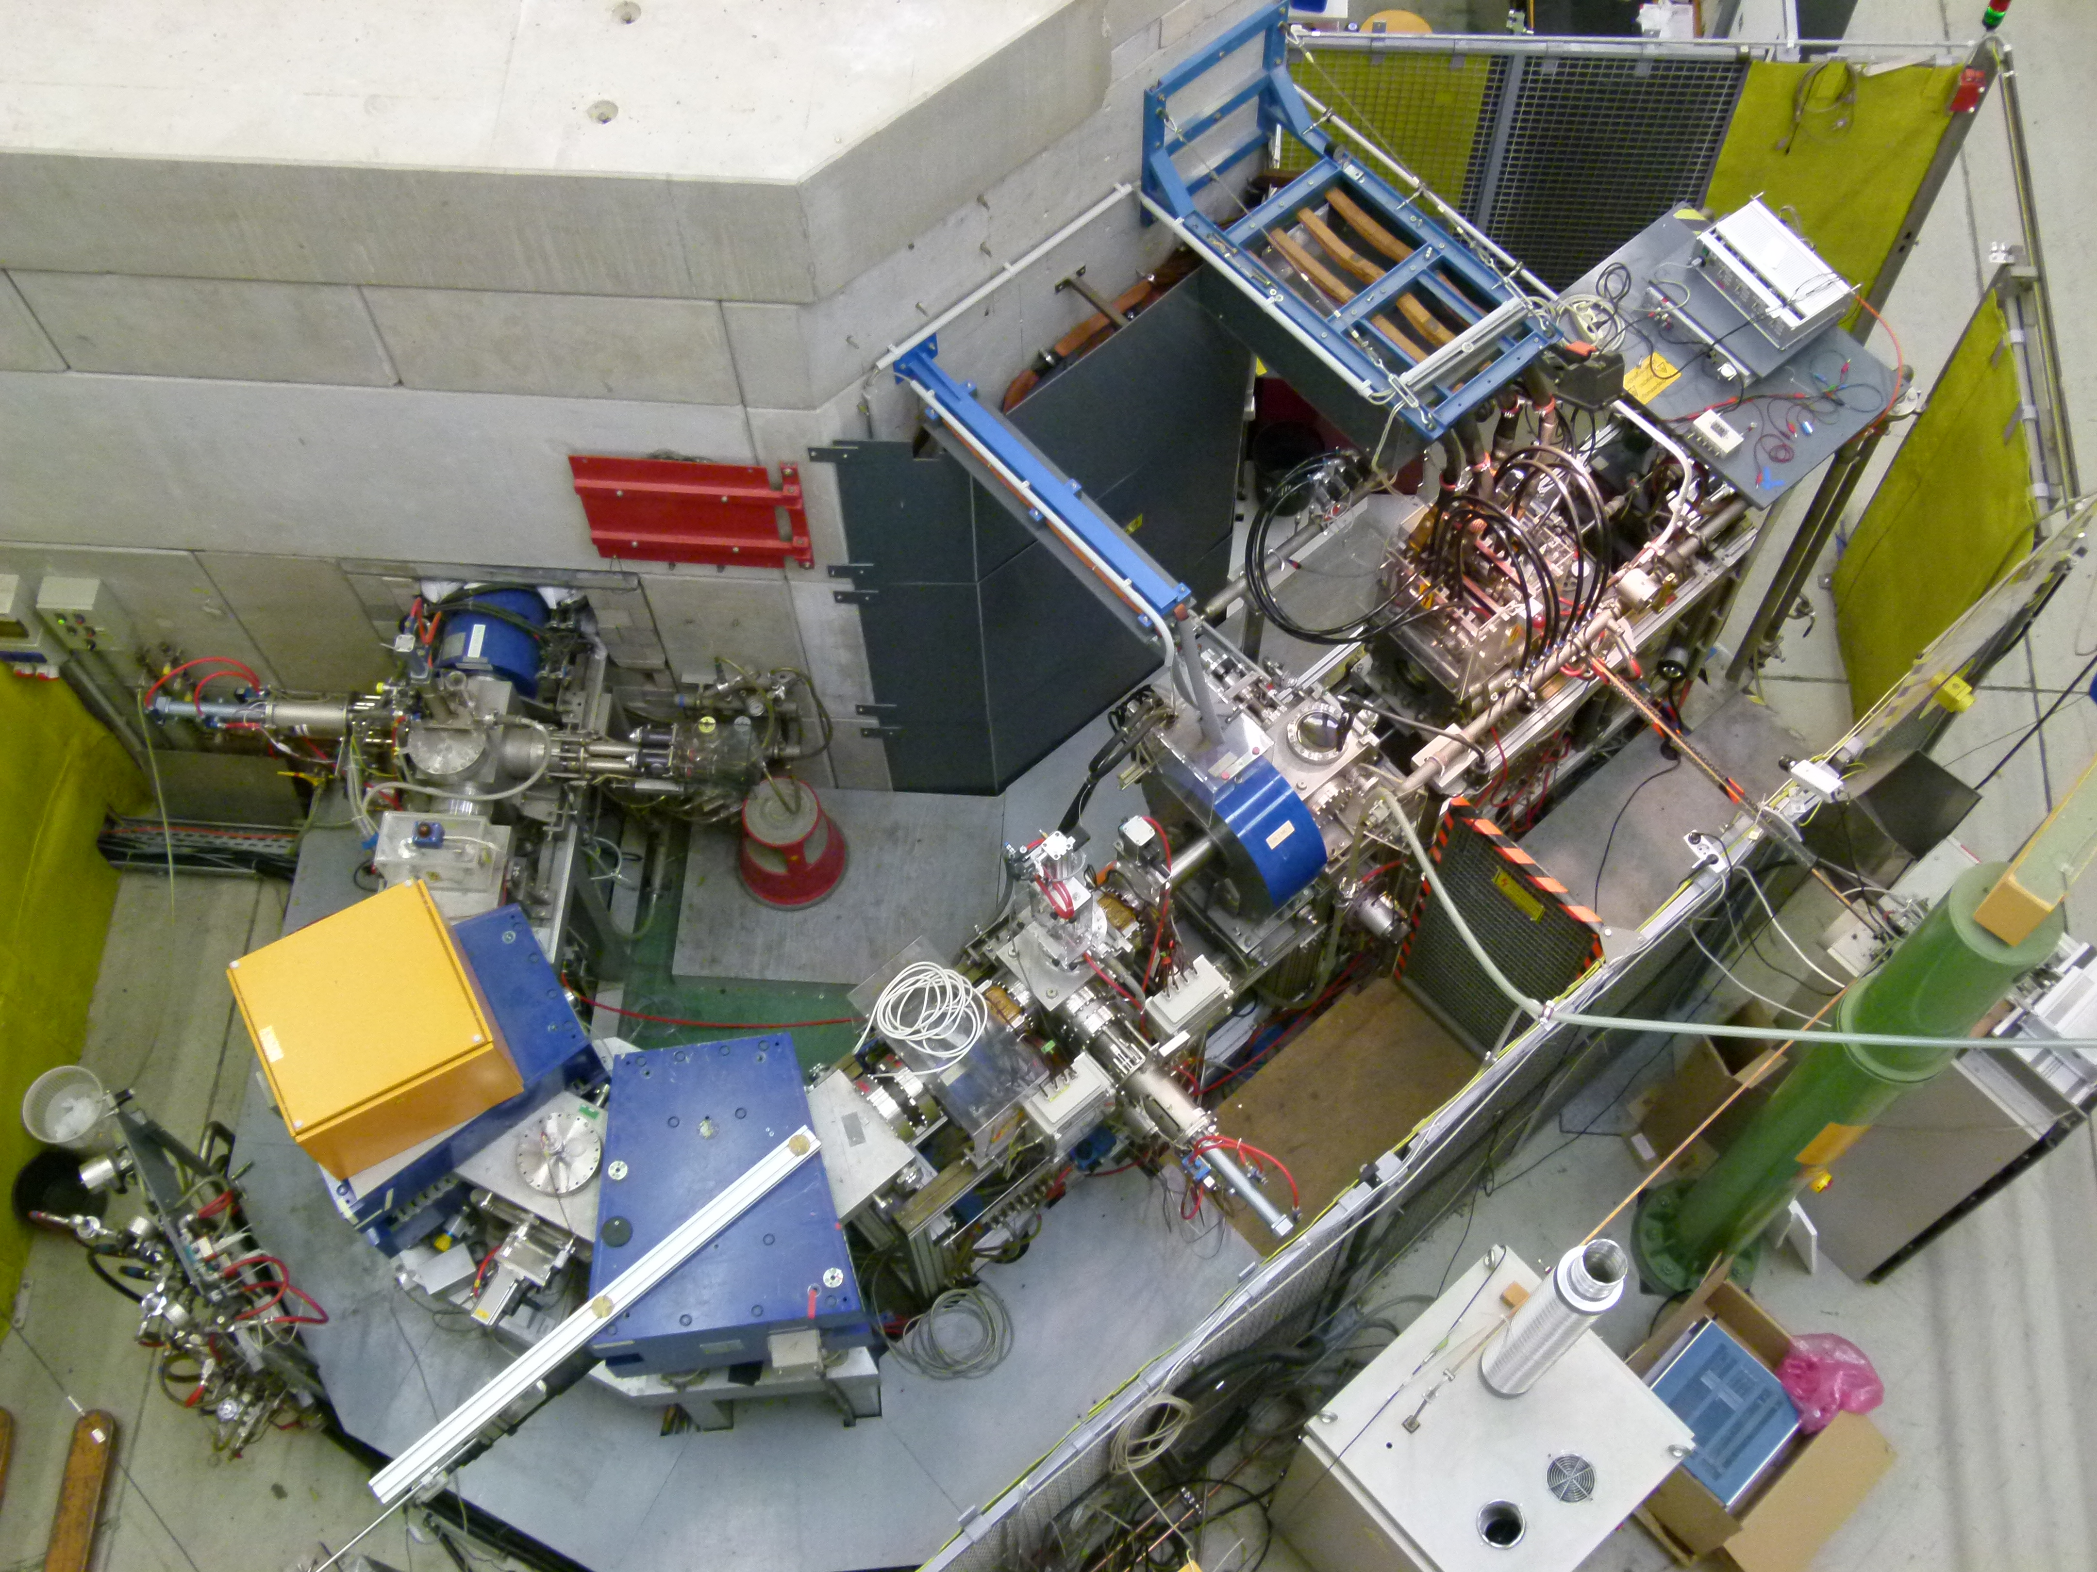
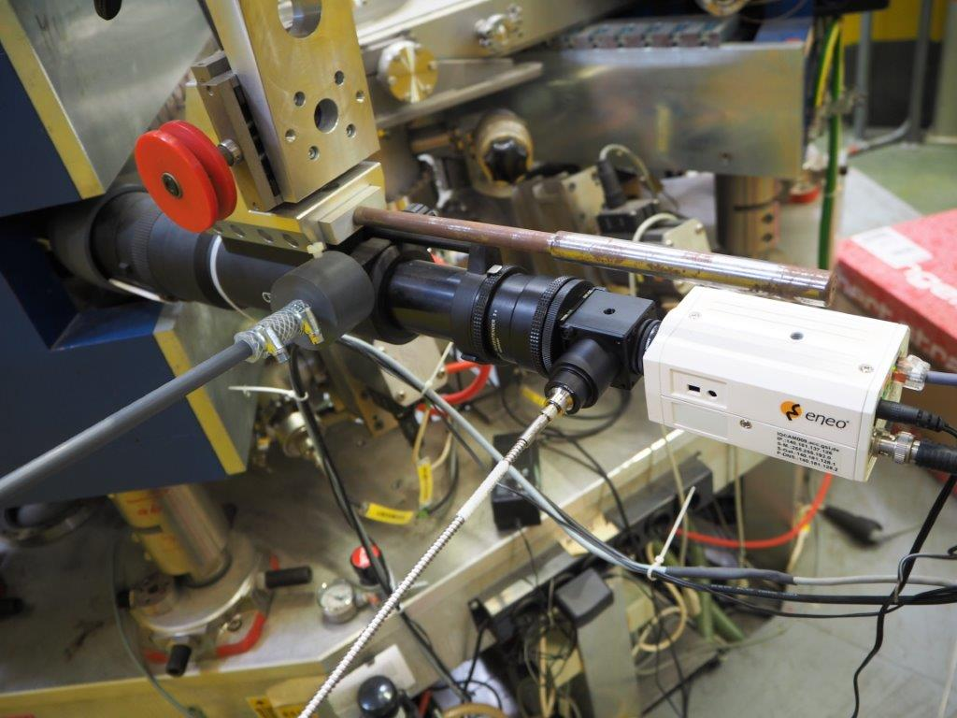
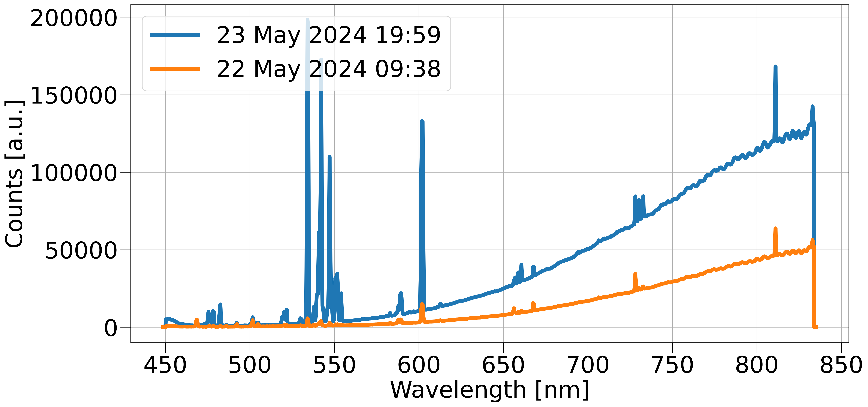
Optical diagnostic devices @ HLI
CAPRICE ECRIS
Telephoto Lens
Optical Beam Splitter and Glass Fiber
CCD Camera
Plasma Image
..to the Optical Emission Spectrometer
A CCD camera looks through the straight beam line and the extraction aperture into the plasma chamber
827 nm
810 nm
Mn II
Optical spectroscopy as a diagnostic tool for metal ion beam production with an ECRIS
F.Maimone, J.Mäder, R.Lang, P.T.Patchakui, K.Tinschert R.Hollinger , Rev. Sci. Instrum. 90, 123108, 2019
Aleksandr Andreev

Slide 5
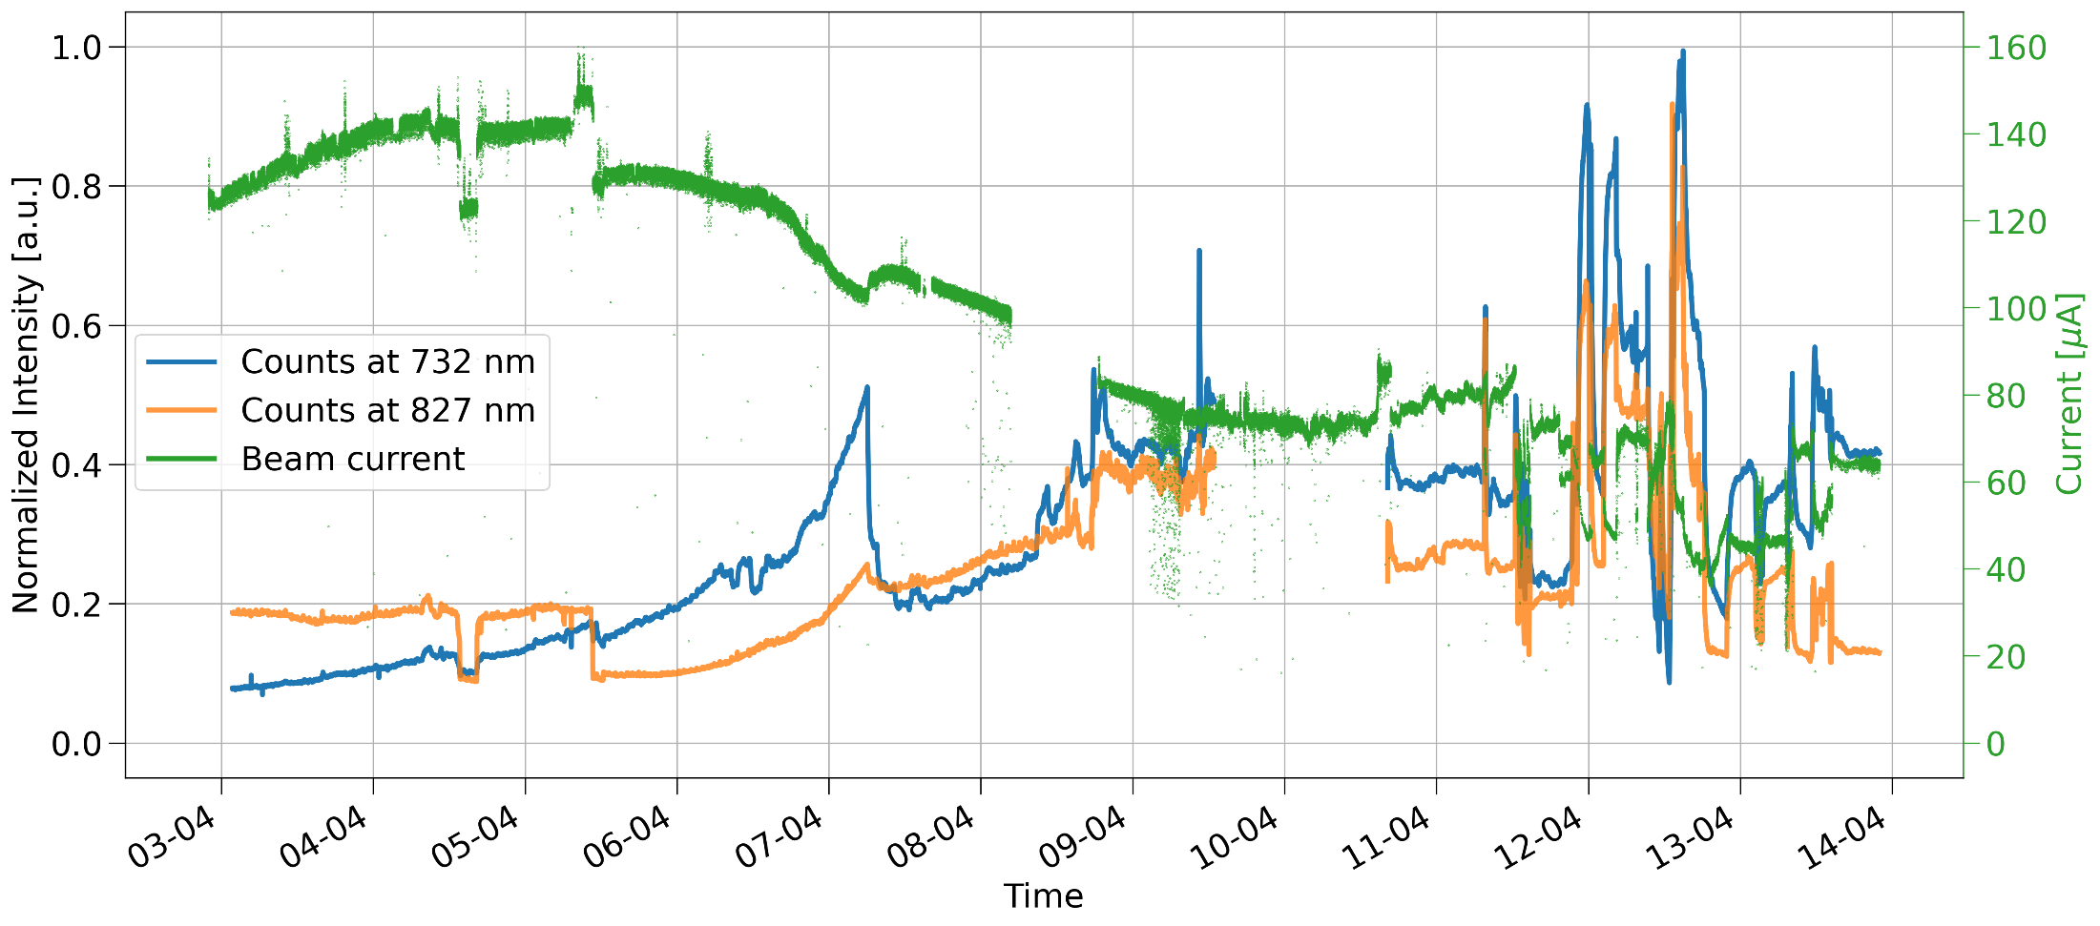
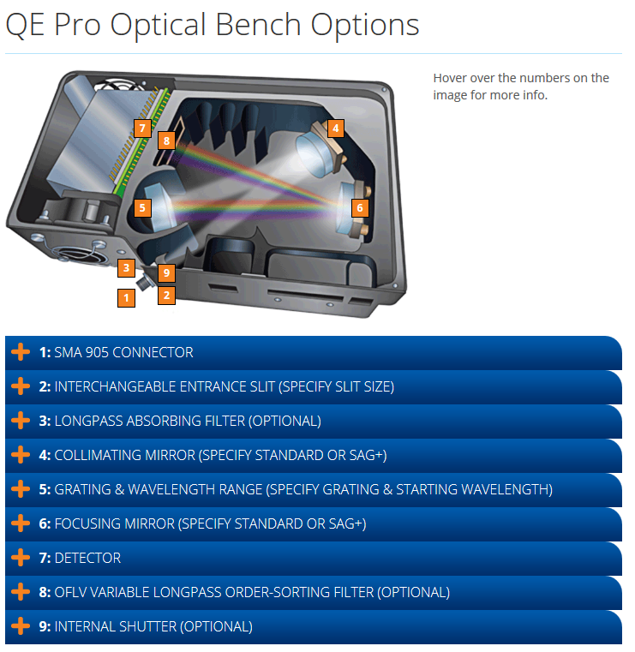
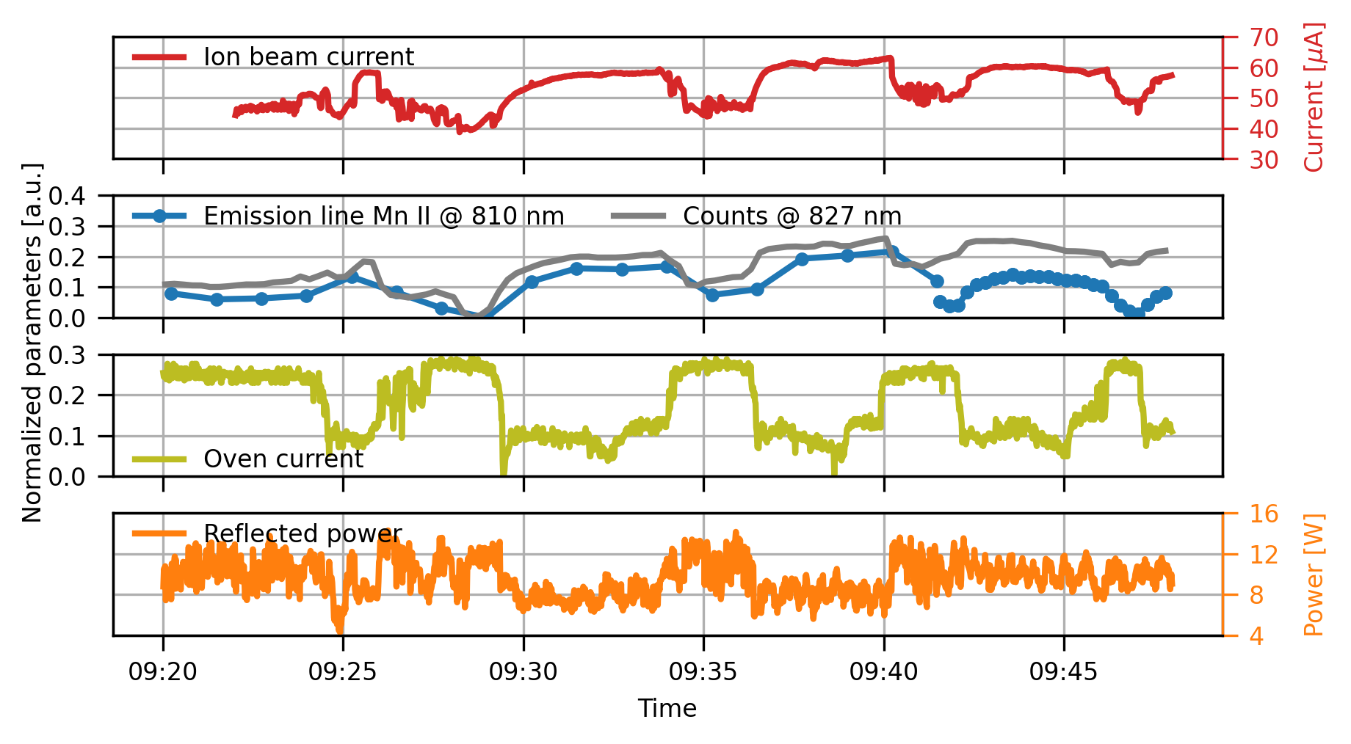
OES for metal ion beams
⁴⁸Ca¹⁰⁺ beam run in 2022
OCEAN OPTICS QE Pro
Entrance slits: 25 µm
Wavelenght Range 449-833 nm
Resolution 0.95 nm
auxiliary gas ↑
oven ↓
Ca burst
microwave power ↑
auxiliary gas ↑
oven ↓
⁵⁵Mn⁹⁺ beam establishment test in 2024
Provides early indicators of changes in plasma composition and oven temperature
Detects passive microwave heating of the oven
Allows for more stable ion source operation and higher average intensity
Enables proactive rather than reactive adjustments
Reduces on call interventions
Aleksandr Andreev

Slide 6
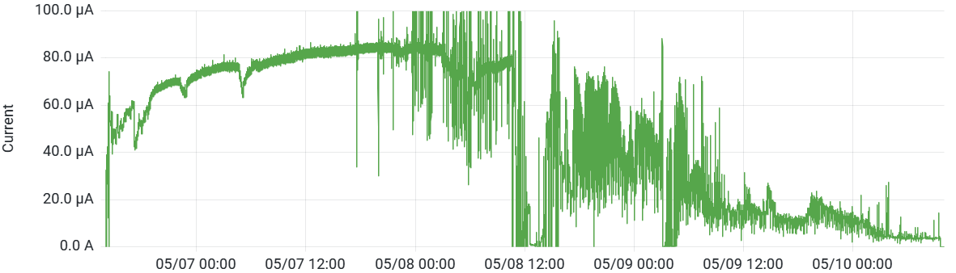
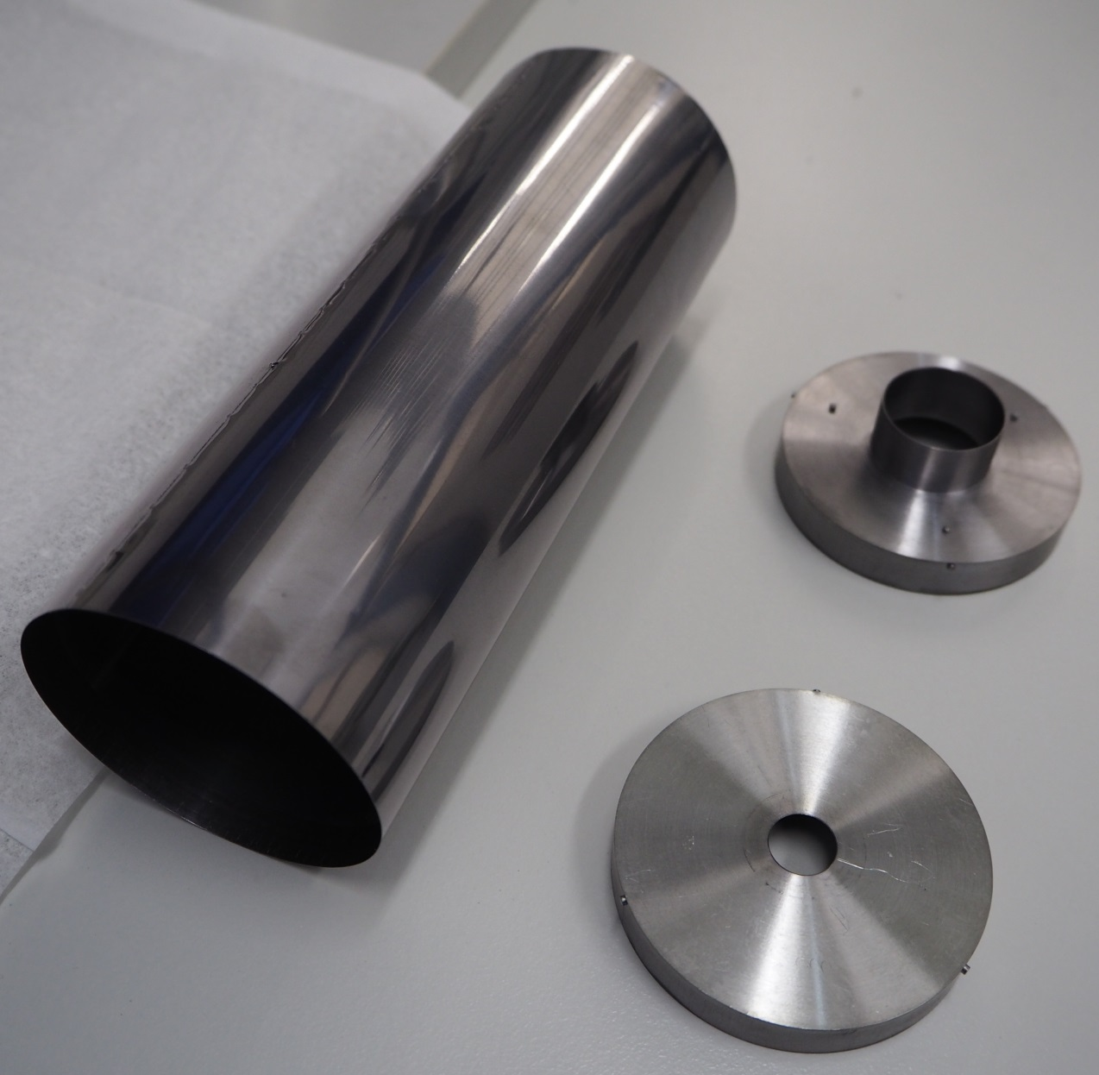
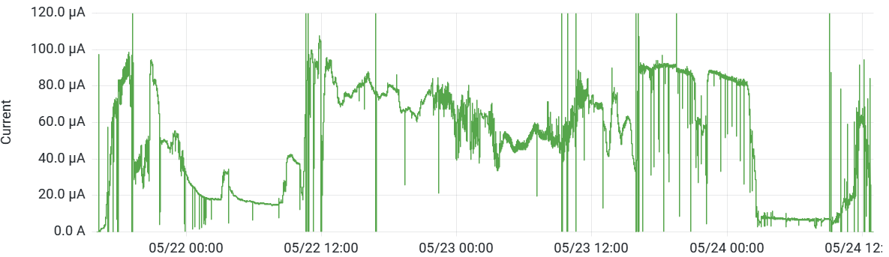
Ta liner: reducing material condensation
Without hot screen:
Discharges started on Day 1
Occurred once every few minutes
Strong impact on beam stability
⁵⁵Mn⁹⁺ intensity at the Faraday Cup w/o hot screen
With hot screen:
Discharges delayed until Day 2
Lower discharge frequency
Improved beam stability
Discharges appear
Ta Liner
Injection
cap
⁵⁵Mn⁹⁺ intensity at the Faraday Cup with hot screen
Discharges appear
Extraction cap
Aleksandr Andreev

Slide 7
Ta liner: reducing material condensation
Without hot screen:
Discharges started on Day 1
Occurred once every few minutes
Strong impact on beam stability
⁵⁵Mn⁹⁺ intensity at the Faraday Cup w/o hot screen
With hot screen:
Discharges delayed until Day 2
Lower discharge frequency
Improved beam stability
Discharges appear
Ta Liner
Injection
cap
⁵⁵Mn⁹⁺ intensity at the Faraday Cup with hot screen
Operational Experience:
Successfully used for Ca, Sr, Mg and Mn
Currently under testing for Cr
Improves long-term performance
Reduces material condensation and consumption
Discharges appear
Extraction cap
Aleksandr Andreev

Slide 8
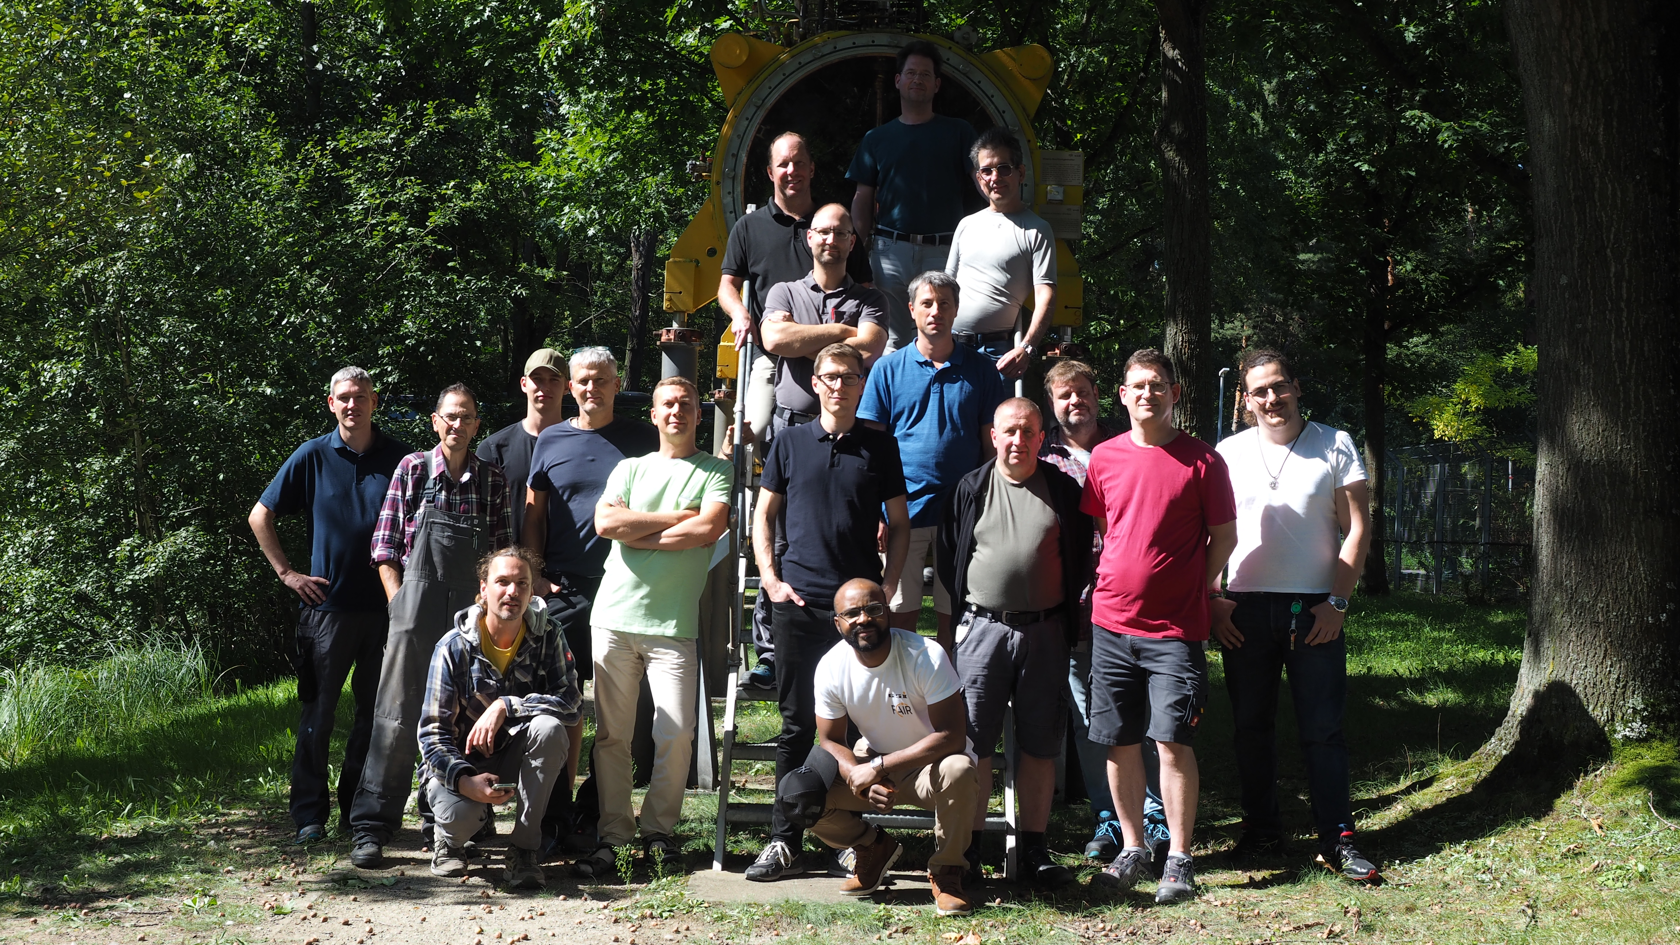
Thank you for your attention!
THE ECRIS TEAM
Ralph Hollinger (dpt. Leader)
Fabio Maimone
Michael Galonska
Ralf Lang
Jan Mäder
Michael Händler
Me

Slide 9
Ta liner: reducing material condensation
Without hot screen:
Discharges started on Day 1
Occurred once every few minutes
Strong impact on beam stability
⁵⁵Mn⁹⁺ intensity at the Faraday Cup w/o hot screen
With hot screen:
Discharges delayed until Day 2
Lower discharge frequency
Improved beam stability
Discharges appear
⁵⁵Mn⁹⁺ intensity at the Faraday Cup with hot screen
Operational Experience:
Successfully used for Ca, Sr, Mg and Mn
Currently under testing for Cr
Improves long-term performance
Reduces material condensation and consumption
Discharges appear
Aleksandr Andreev

Slide 10
Backup slides

Slide 11
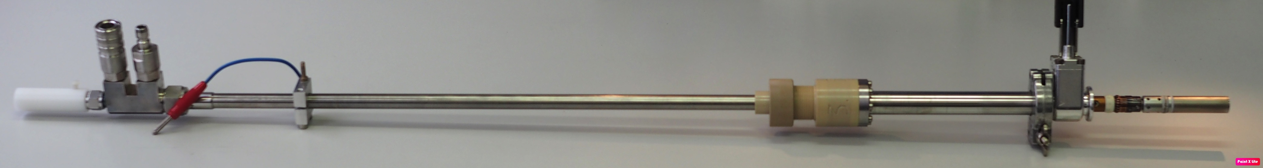
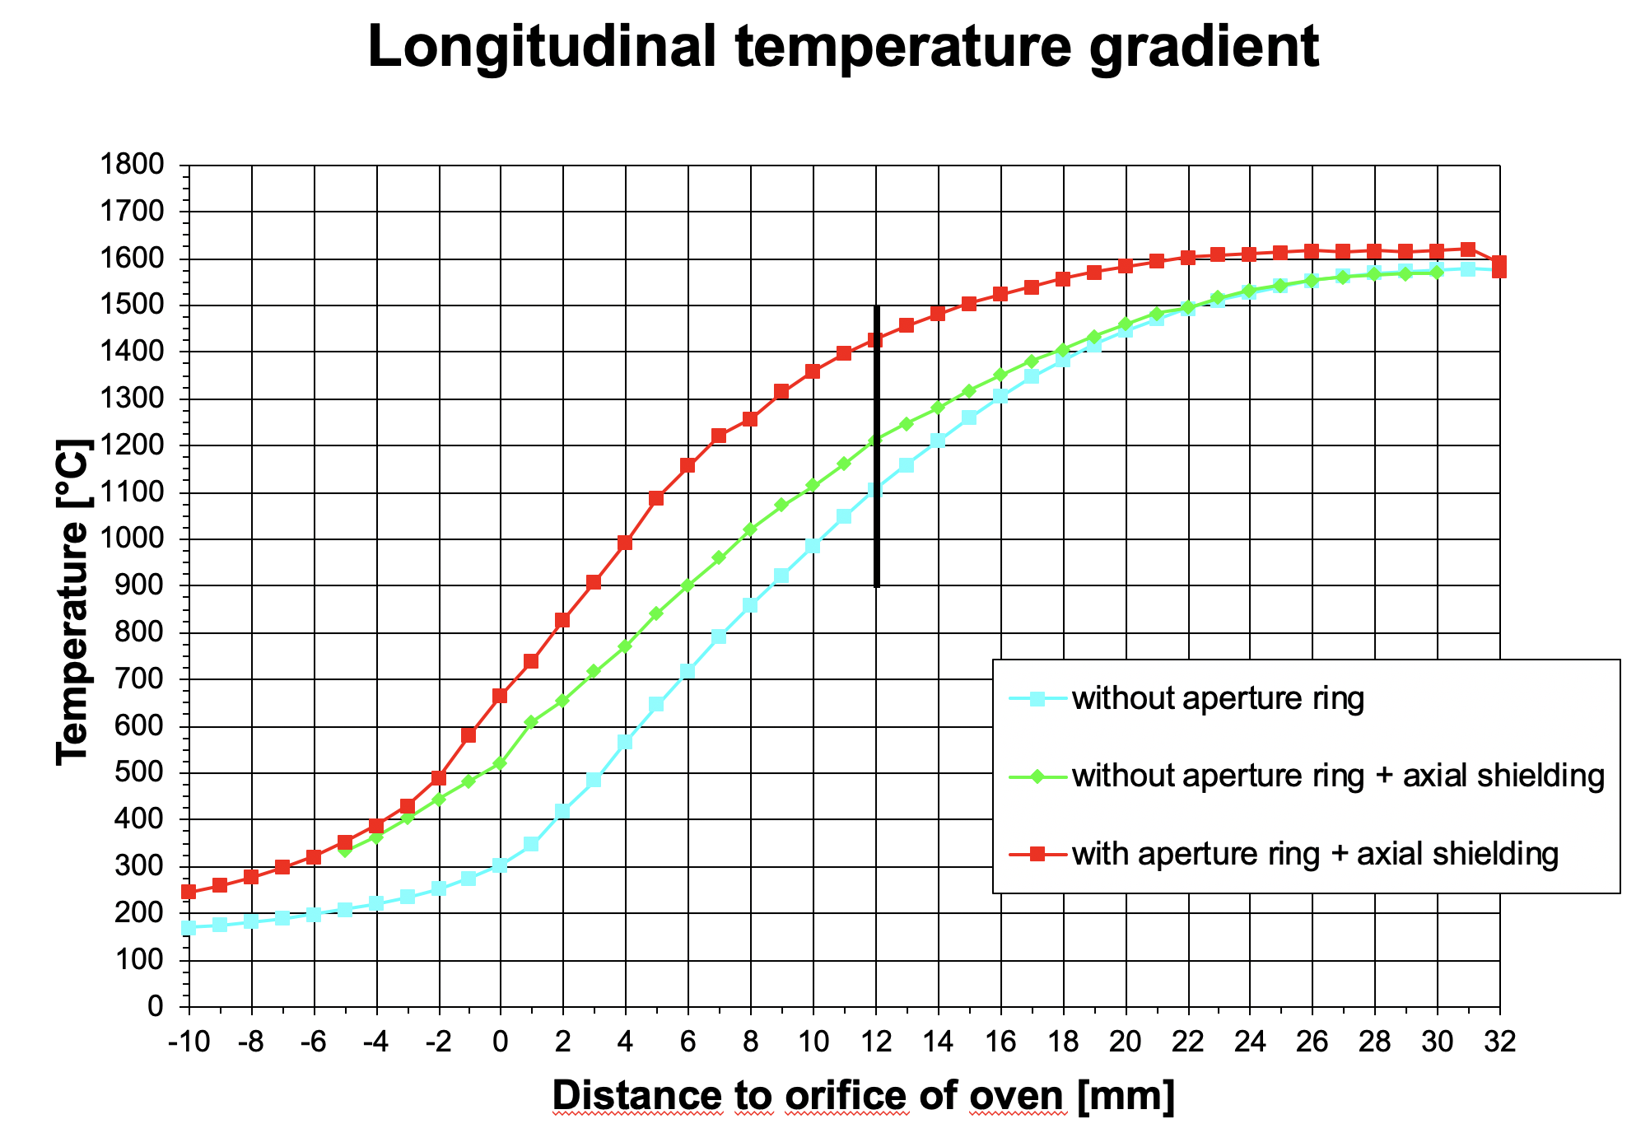
Evaporation technique for metal ion beam production @ HLI
Standard Temperature Oven (STO)
Enables stable and reproducible metal ion beam production with low material consumption
Modular assembly with the 3 main components:
Push Rod: Supplies heating current and cooling water
Sluice: Allows oven refilling or exchange without breaking the source vacuum
Oven head: Contains material for evaporation

Slide 12
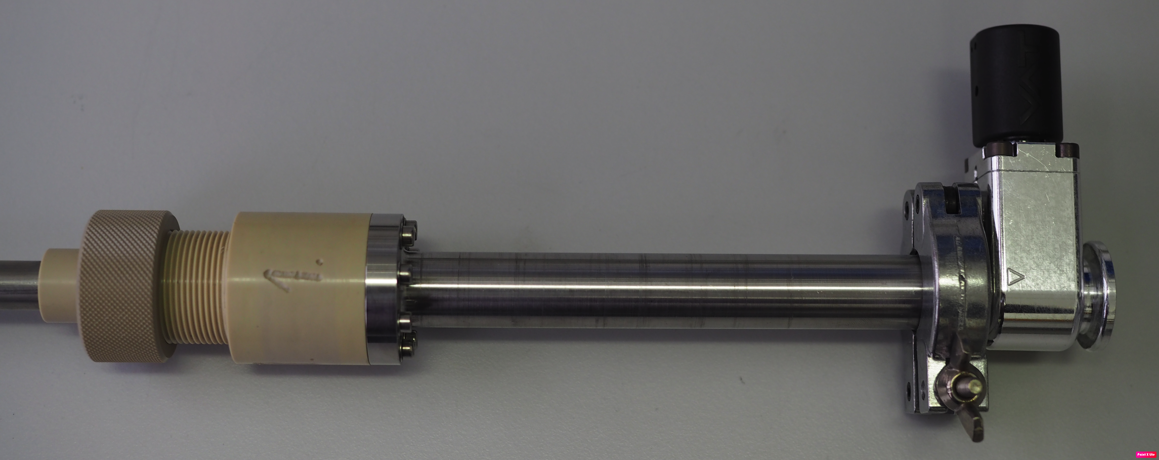
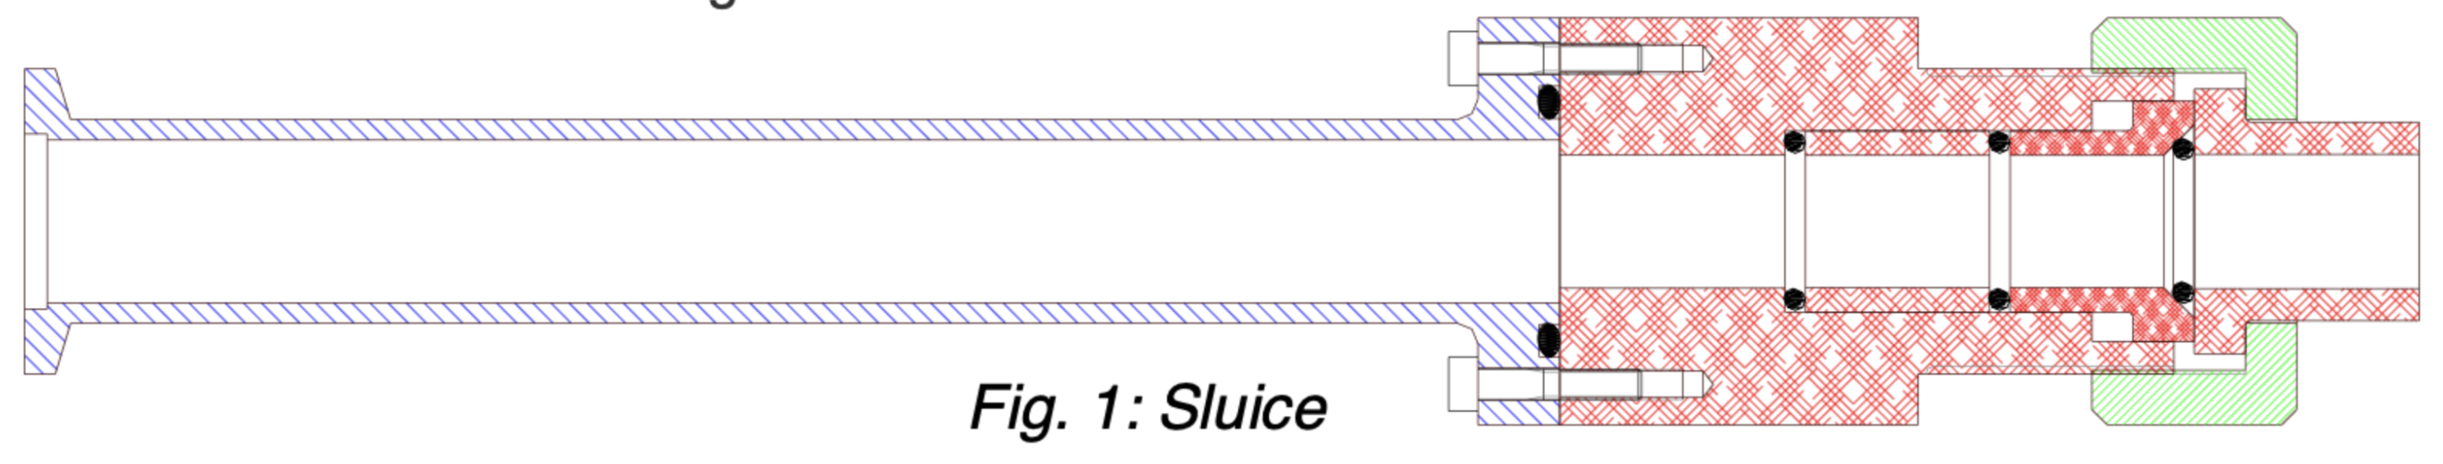
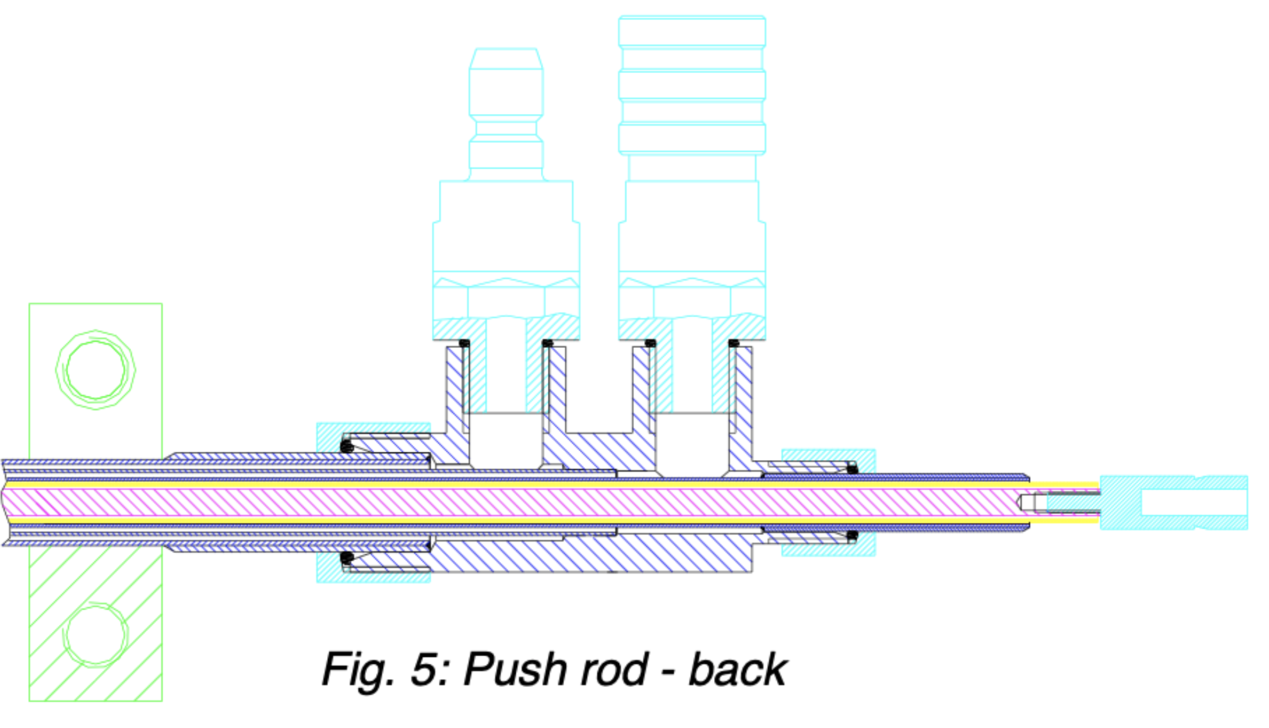
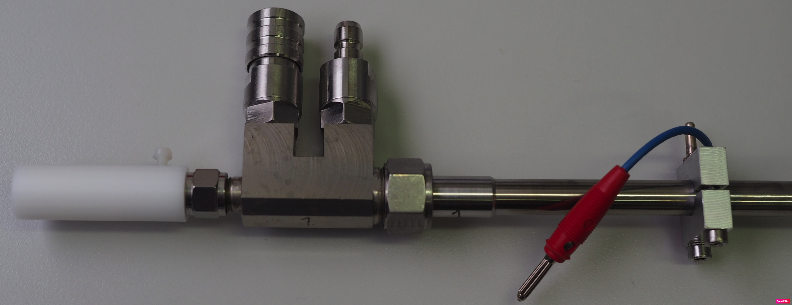
GSI Resistive Oven Concept
The oven head: Two types for different temperature ranges (STO and HTO)
The sluice (exactly the same for both oven types): Stainless steel part flanged with DN 16 ISO KF for oven exchange without breaking the vacuum (a gate valve is mated)
The push rod (nearly the same for both oven types): System of three concentric stainless steel tubes for cooling water flow. Inside the inner tube an Al₂O₃ insulated rod inserted for the current connection.

Slide 13
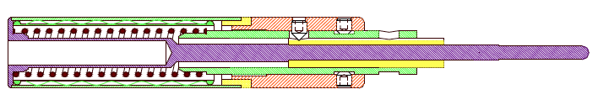
Resistive evaporation oven heads
Outer dimensions: length 70 mm, diameter 14.5 mm
STANDARD TEMPERATURE OVEN (STO)
yellow = Al₂O₃; green = Ta; orange = Mo; violet = CuBe₂; black = WRe(26%Re)
HIGH TEMPERATURE OVEN (HTO)
yellow = Al₂O₃; green = Ta; orange = Mo; violet = WL20; dark red = WVM

Slide 14
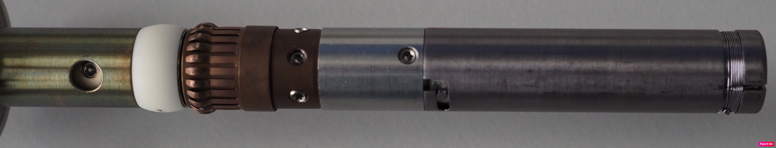
Resistive evaporation oven heads
Outer dimensions: length 70 mm, diameter 14.5 mm
STANDARD TEMPERATURE OVEN (STO)
yellow = Al₂O₃; green = Ta; orange = Mo; violet = CuBe₂; black = WRe(26%Re)
Tungsten wire wound around a ceramic body (heater)
Aperture ring necessary if the material is liquid at the required vapour pressure (i.e. Fe, Ni)
Ta or W crucible used inside the ceramic to avoid chemical reactions (i.e. Mg, Ca, Li)
Ta and Mo parts dismounted, cleaned and re-used

Slide 15
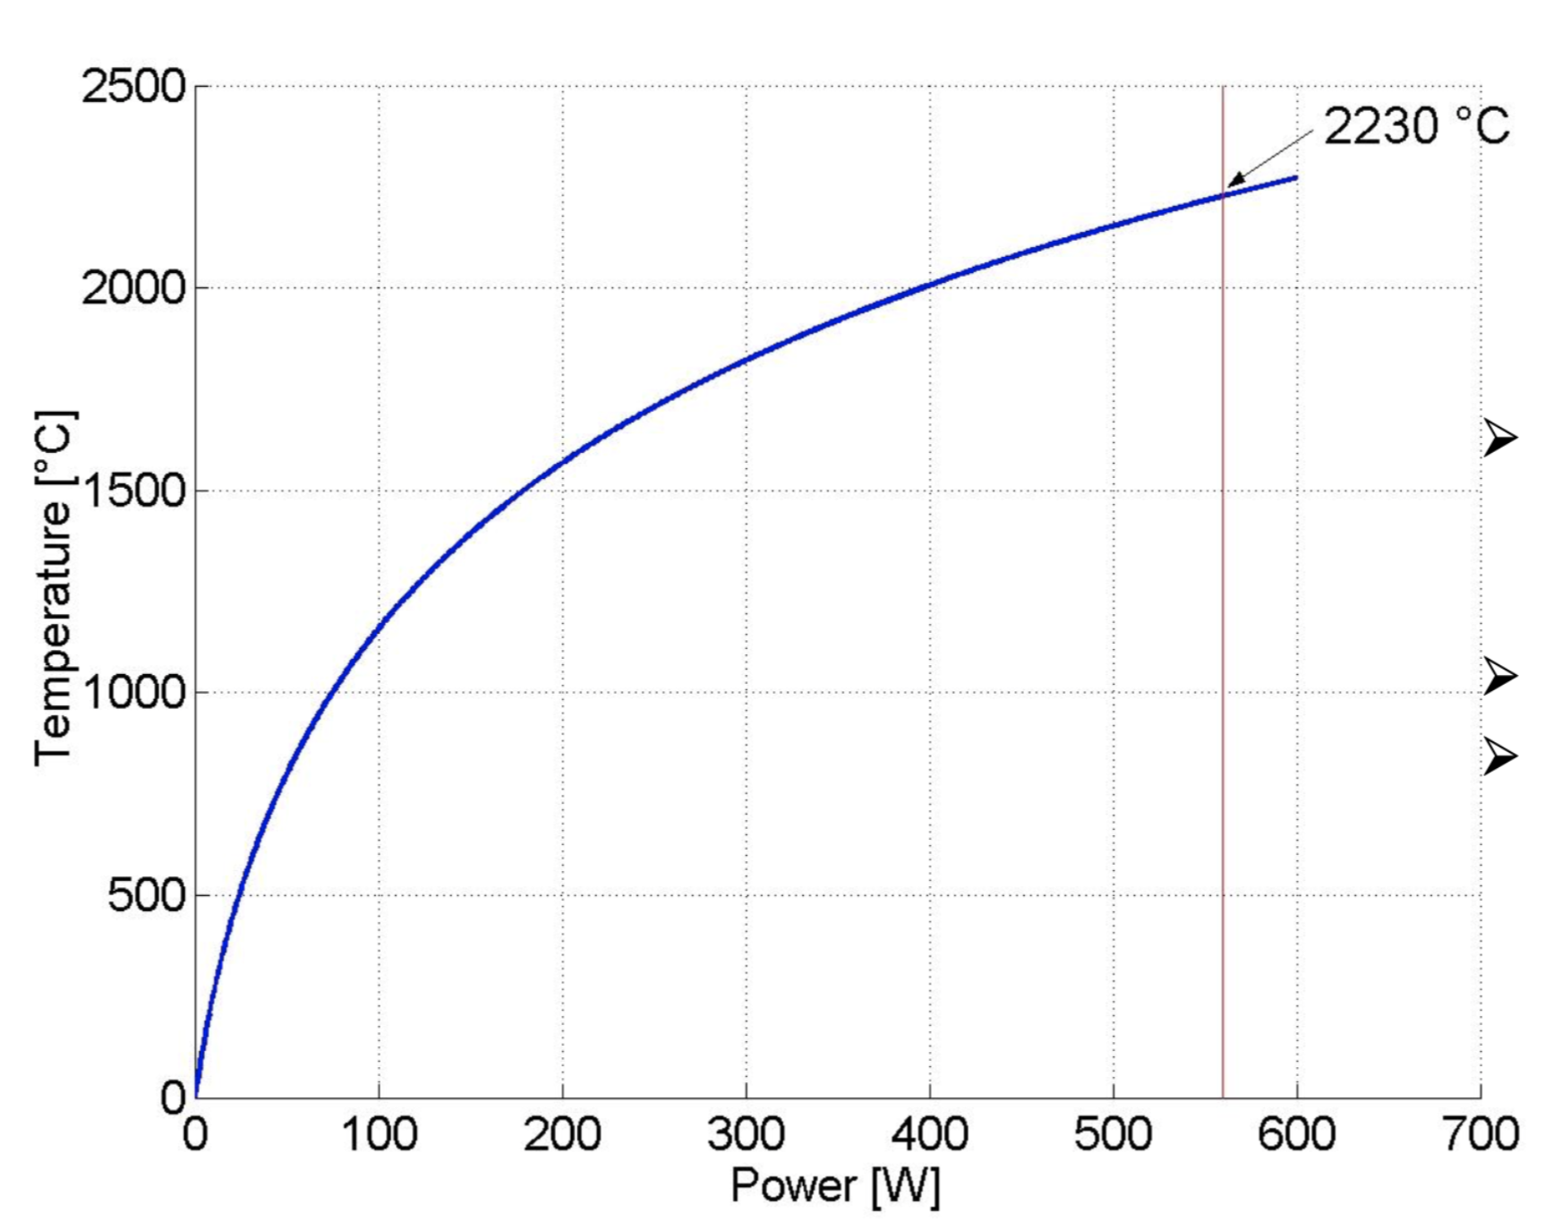
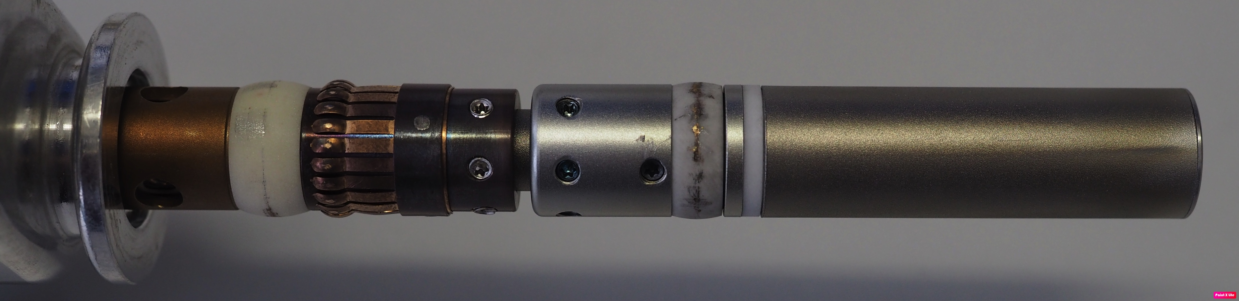
Resistive evaporation oven heads
Outer dimensions: length 70 mm, diameter 14.5 mm
Removed ceramic body (heater) and ceramic parts where high temperature is expected
Free standing heating wire made of an Aluminum Potassium Silicate doped Tungsten (WVM) (Plasnee GmbH company)
Crucible retainer made of a Tungsten alloy with 2% La₂O₃ (WL20 provided by Witstar company)
Test with TiO₂ at Testbench
2230 °C achieved at 560 W
Interpolated curve
based on
Thermocouple
Measurement
Extrapolated
data
HIGH TEMPERATURE OVEN (HTO)
yellow = Al₂O₃; green = Ta; orange = Mo; violet = WL20 dark red: WVM

Slide 16
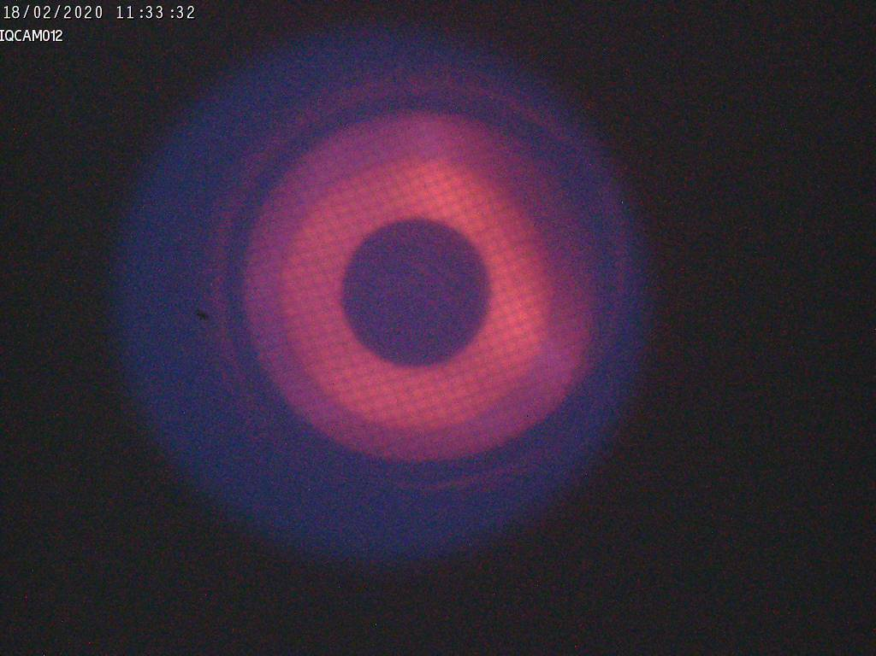
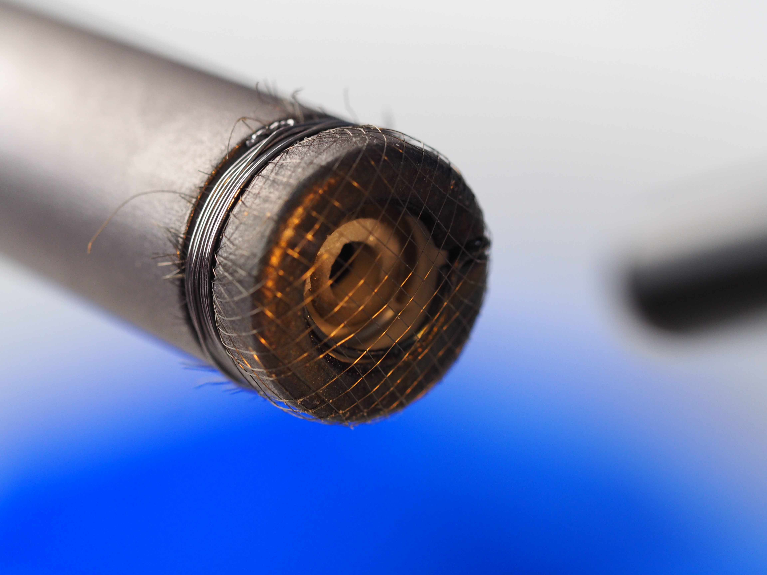
Microwave shielding of the
oven orifice
OES measurements for different oven powers without and with mesh at the oven head
MICROWAVE SHIELDING
Material: Tungsten
Mesh 18 (1 mm) - 50 µm wire
Measurements carried out with the shielded empty oven inserted inside the ECRIS.
Helium plasma generated by coupling up to 650 W microwave power.
Oven power settings: 8.4, 12.5, 17.4 W.
Up to 69% shielding due to the mesh.
Succesfull test at EIS testbench with ⁴⁰Ca
Mesh 100 (149 µm) – 25.4 µm wire
Optical spectroscopy as a diagnostic tool for metal ion beam production with an ECRIS
F.Maimone, J.Mäder, R.Lang, P.T.Patchakui, K.Tinschert R.Hollinger , Rev. Sci. Instrum. 90, 123108, 2019
Workshop Targets - Ion Sources, GANIL, 06-08 September 2023
24
Fabio Maimone

Slide 17
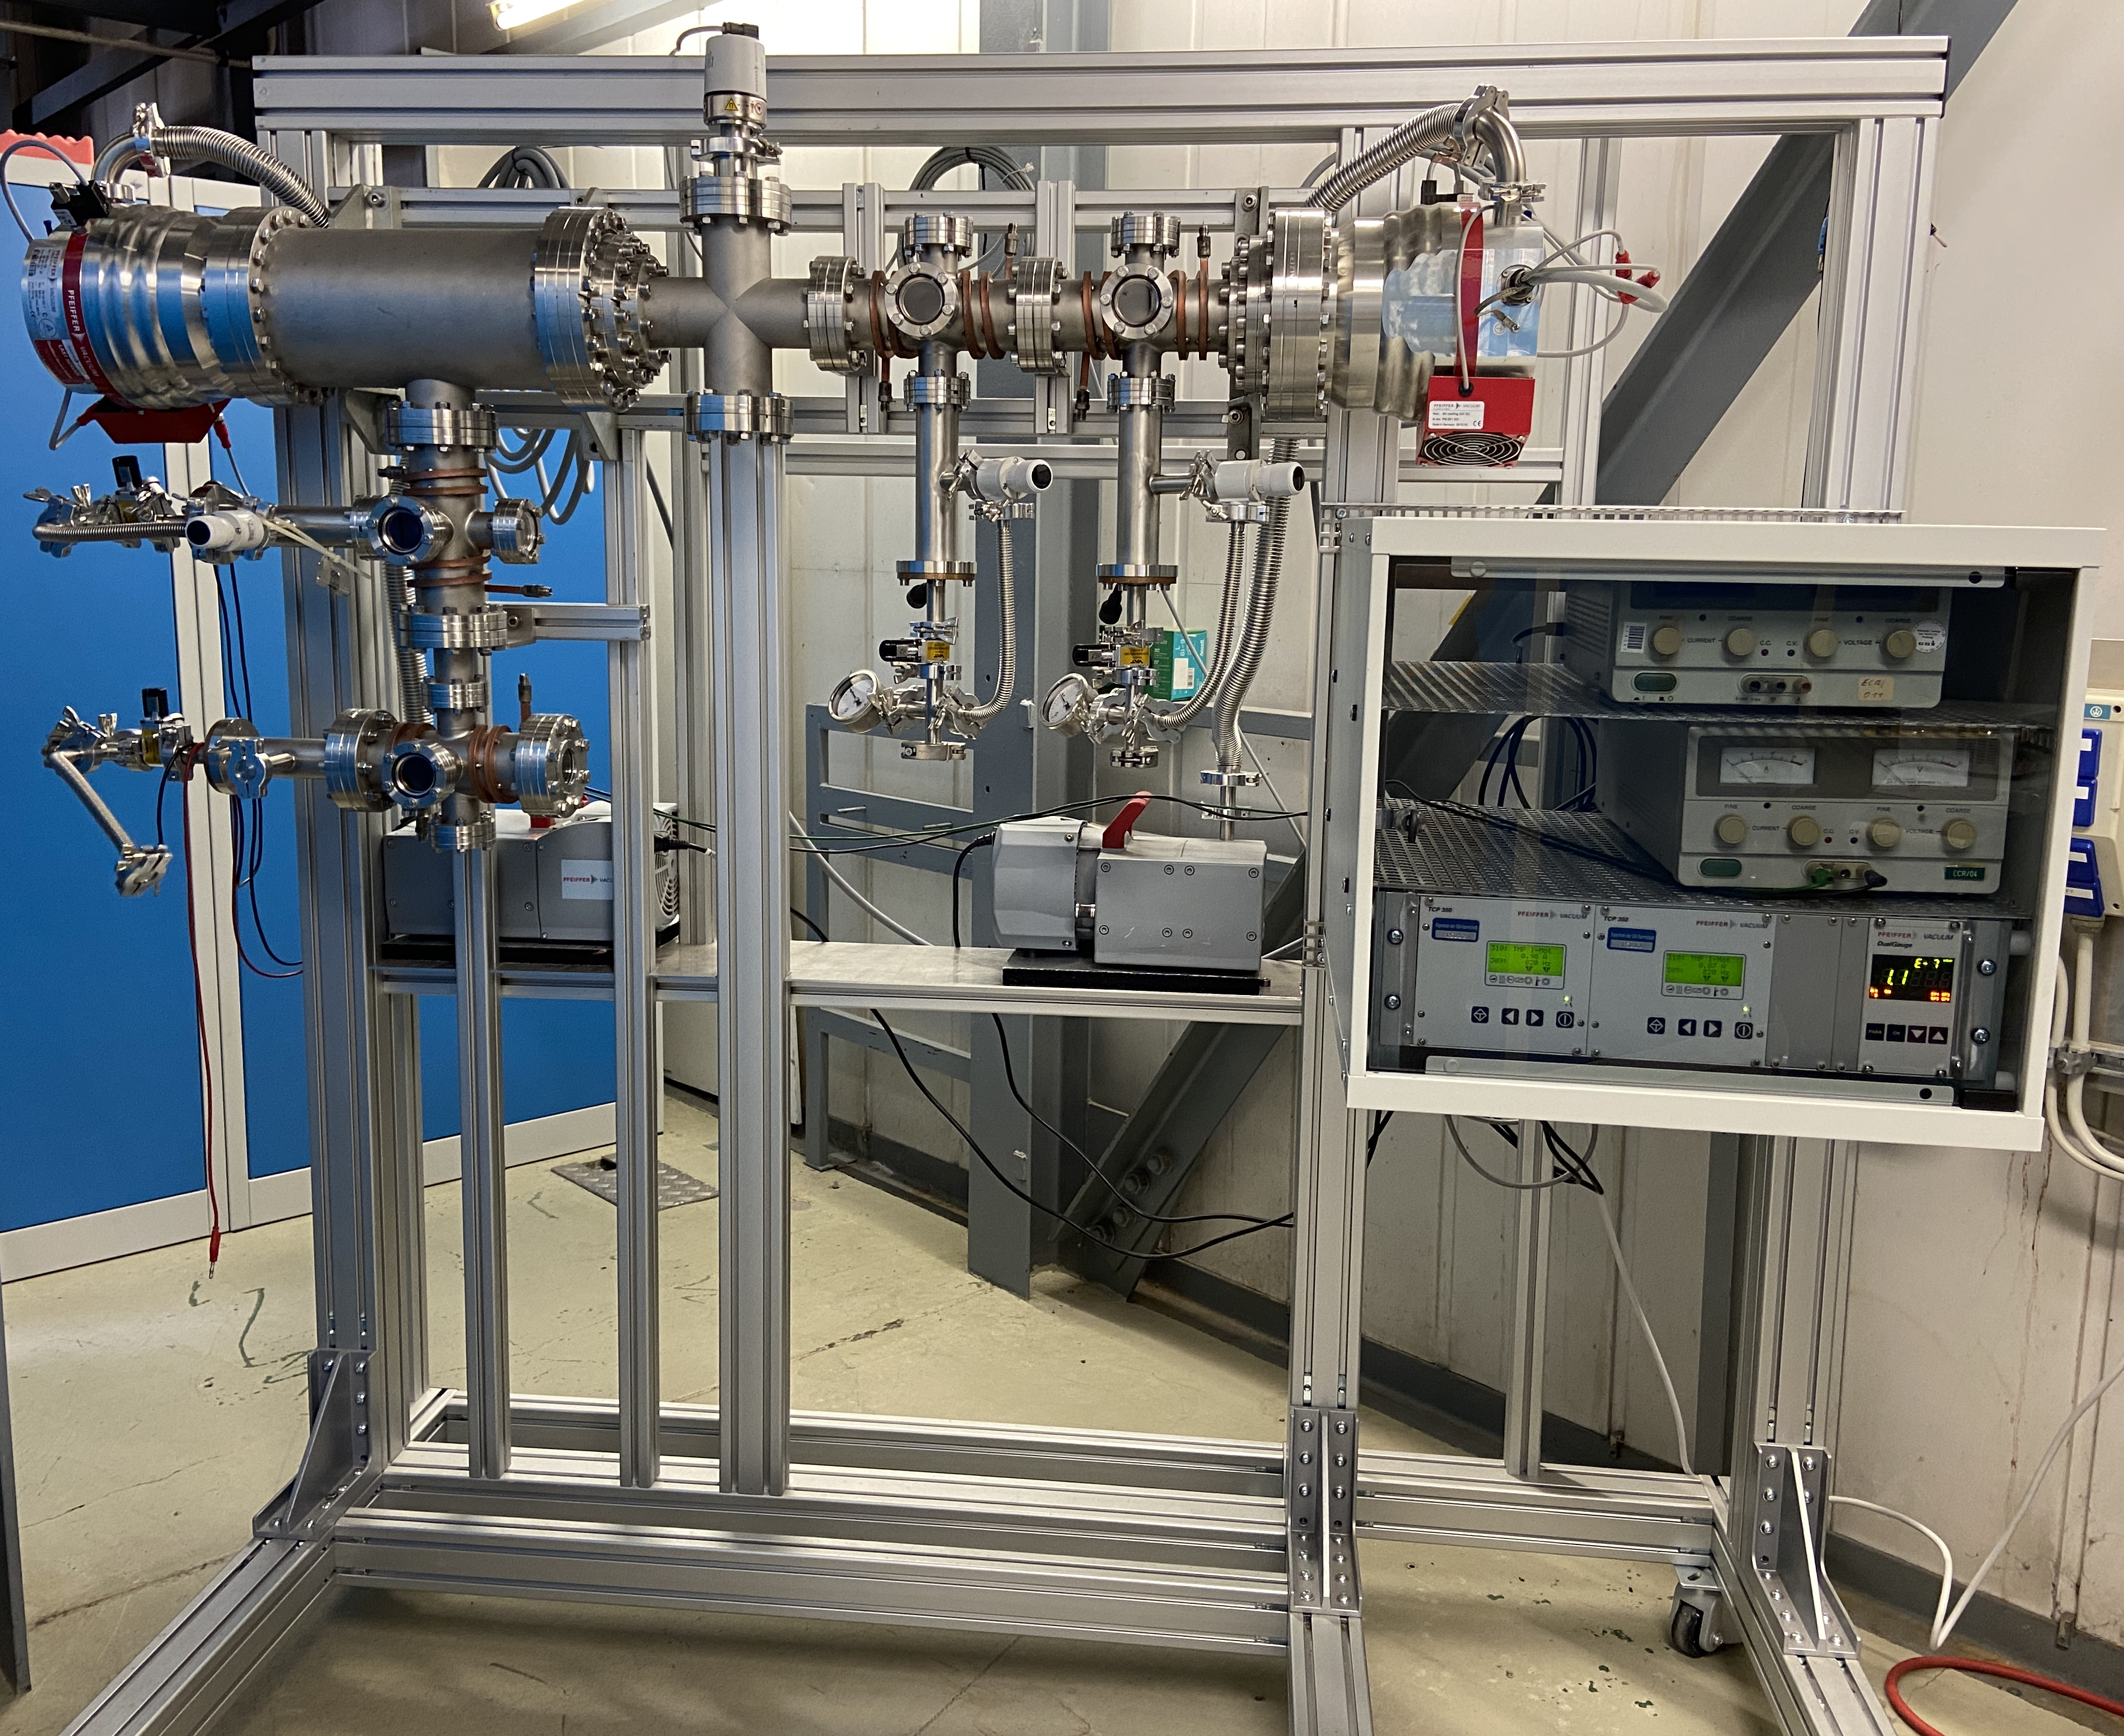
Oven preparation stand @ HLI
Purpose:
Essential tool for conditioning ovens before beam operation
Minimizes downtime during operation
Improves beam stability and reproducibility
Key features:
Controlled environment for oven outgassing and material preheating (e.g. Ni)
Simultaneous oven insertion with 6 airlocks (previously 4)
Water cooling system for ovens and the stand
Online monitoring (planned: 2-3 cameras) for material conditioning
Residual gas analyzer (planned) for better analysis and process control

Slide 18
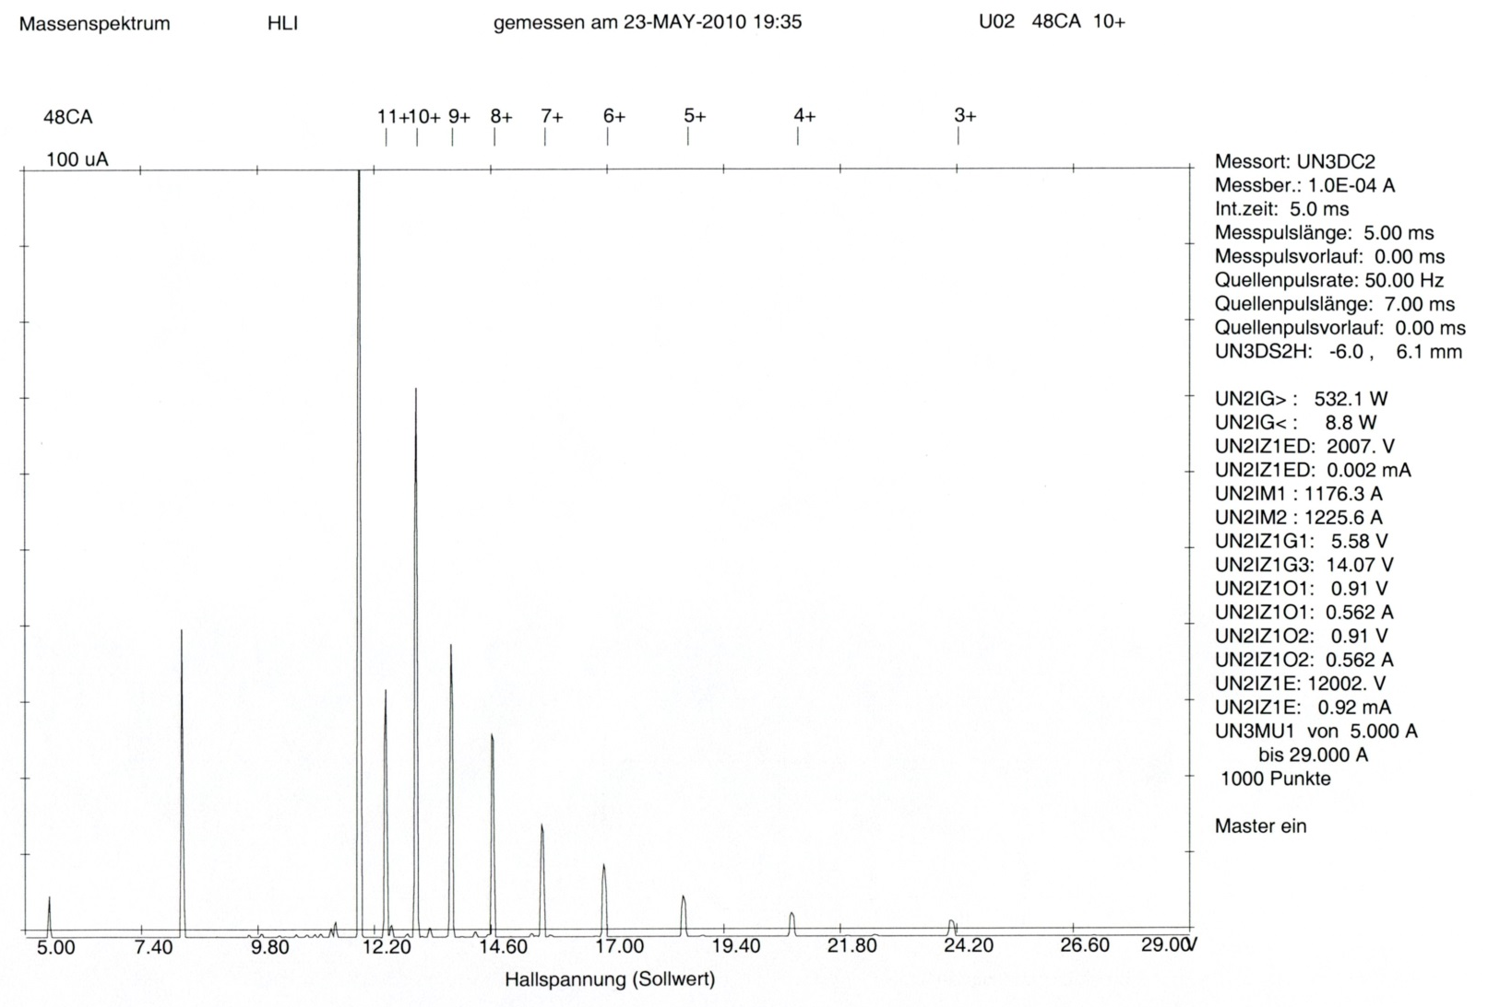
⁴⁸Ca charge states distributions and CCD plasma images
Plasma image recorded with the CCD camera
Plasma image recorded with the CCD camera
100 μA
⁴⁸Ca¹⁰⁺
⁴⁸Ca
Ion Current [μA]
Dipole Current [a.U.]
A CCD camera positioned to look through the straight beam line and the extraction aperture into the plasma chamber for plasma behavior monitoring
Changes in brightness and color → changes in plasma density and charge state distribution
Spectrum of ⁴⁸Ca + He optimized on ⁴⁸Ca¹⁰⁺
Changes in brightness and color → changes in plasma density and charge state distribution
Plasma image recorded with the CCD camera

Slide 19
⁴⁸Ca charge states distributions and CCD plasma images
Plasma image recorded with the CCD camera
100 μA
⁴⁸Ca¹⁰⁺
⁴⁸Ca
Ion Current [μA]
Dipole Current [a.U.]
Spectrum of ⁴⁸Ca + He optimized on ⁴⁸Ca¹⁰⁺
Changes in brightness and color → changes in plasma density and charge state distribution

Slide 20
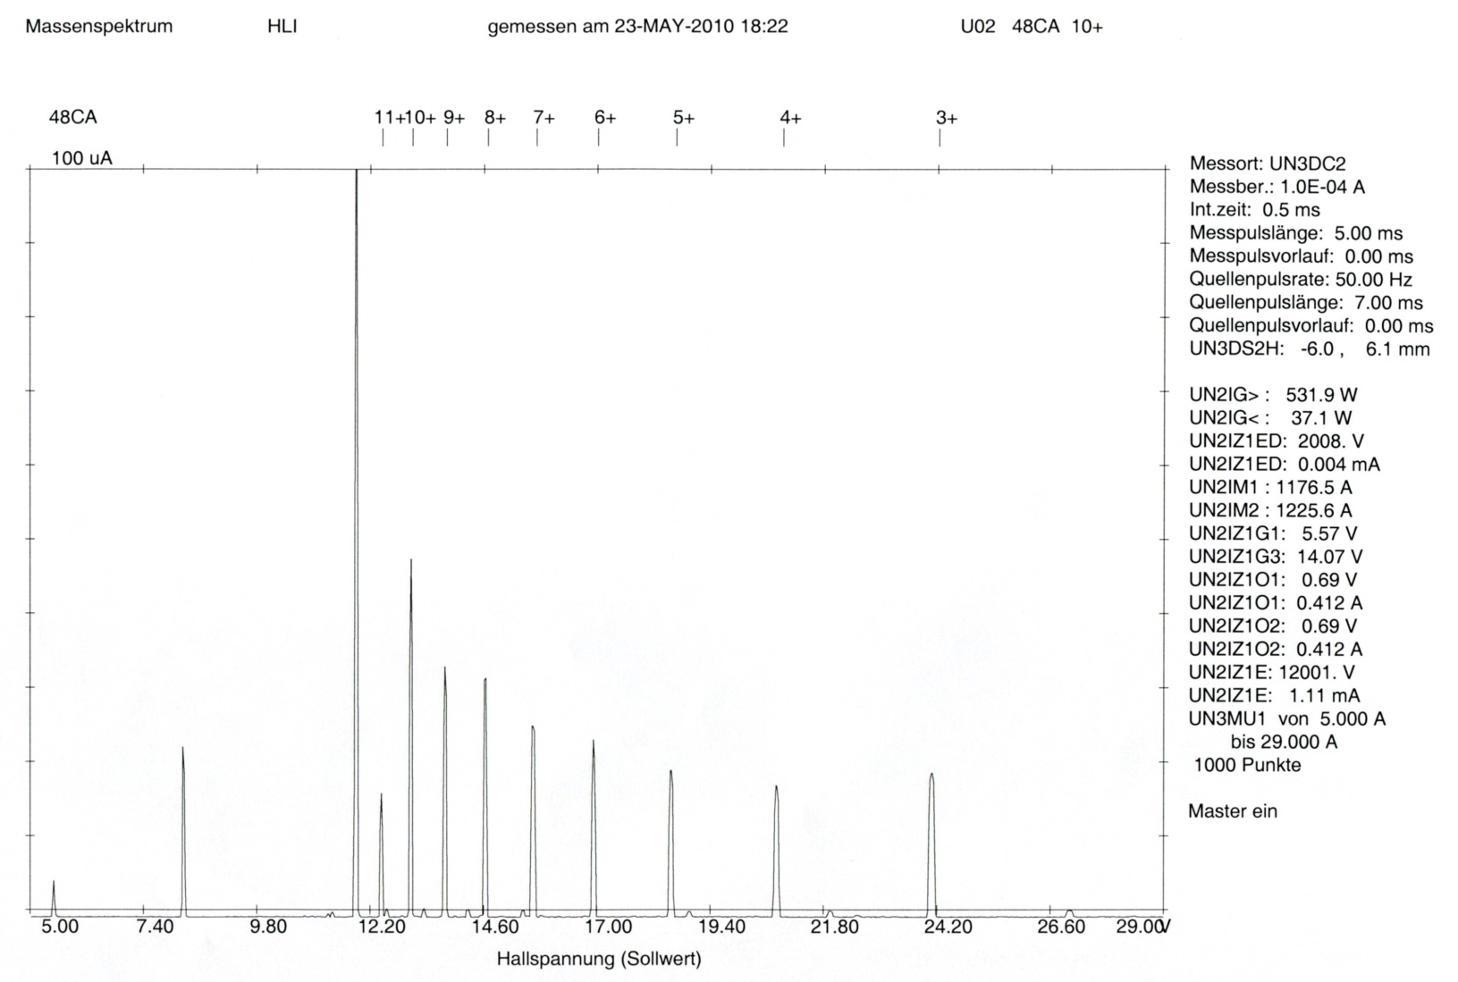
⁴⁸Ca charge states distributions and CCD plasma images
Plasma image recorded with the CCD camera
100 μA
⁴⁸Ca
⁴⁸Ca¹⁰⁺
Ion Current [μA]
Dipole Current [a.U.]
Spectrum of ⁴⁸Ca + He optimized on ⁴⁸Ca¹⁰⁺ after an excessive oven power increased
Brighter image compared to the optimized operation – higher amount of the evaporated material in the plasma

Slide 21
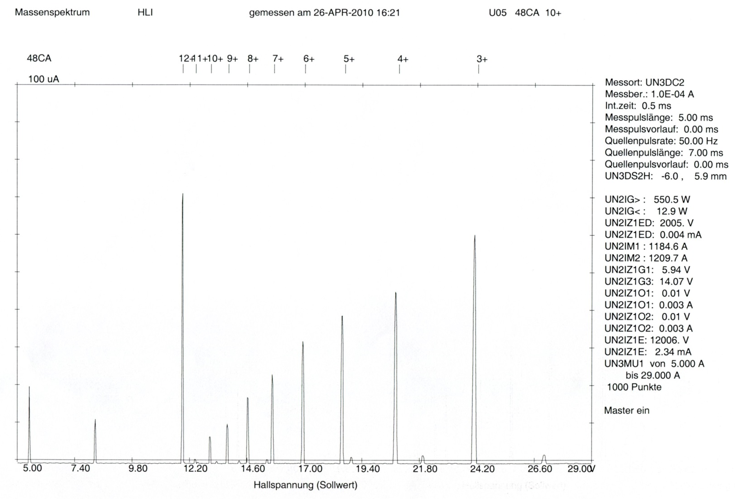
⁴⁸Ca charge states distributions and CCD plasma images
Plasma image recorded with the CCD camera
100 μA
⁴⁸Ca
⁴⁸Ca³⁺
Ion Current [μA]
Dipole Current [a.U.]
Spectrum of ⁴⁸Ca + He optimized on ⁴⁸Ca¹⁰⁺ during an overheating of the oven
Extremely bright image compared to the optimized operation – clear excess of the evaporated material in the plasma

Slide 22
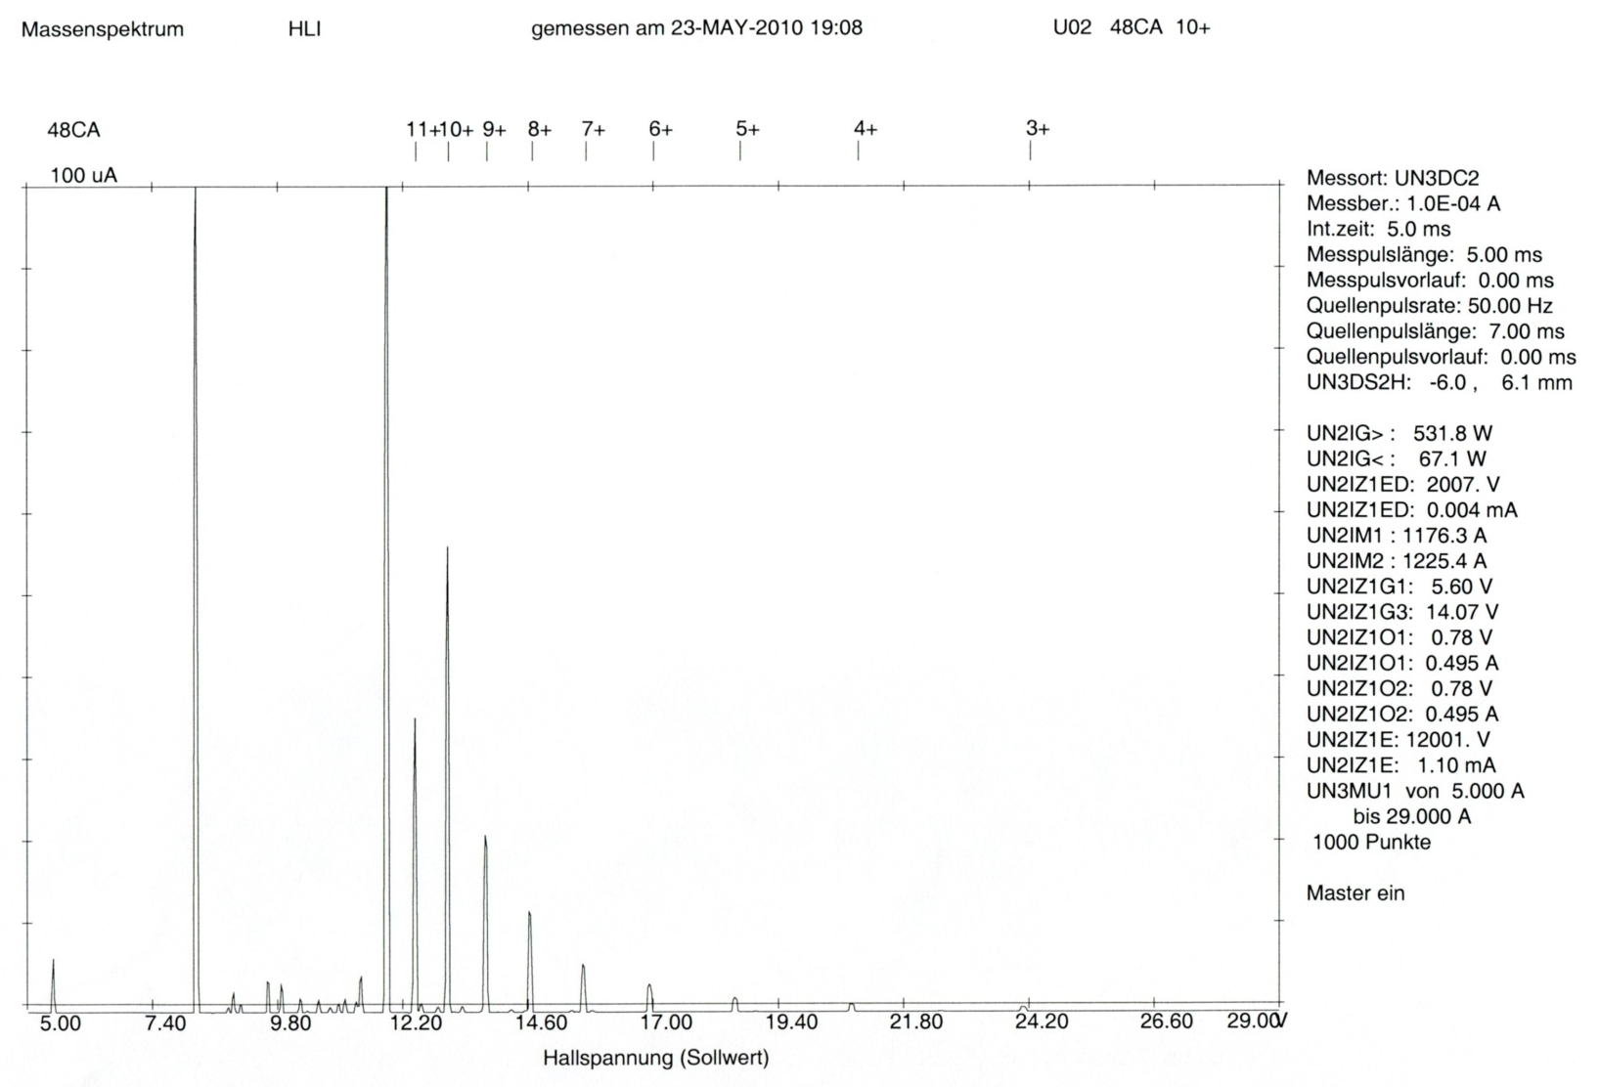
⁴⁸Ca charge states distributions and CCD plasma images
Plasma image recorded with the CCD camera
100 μA
⁴⁸Ca
⁴⁸Ca¹⁰⁺
Ion Current [μA]
Dipole Current [a.U.]
Spectrum of ⁴⁸Ca + He optimized on ⁴⁸Ca¹⁰⁺ after a power reduction of the oven
Darker image compared to the optimized operation – lower amount of the evaporated material in the plasma

Slide 23
⁴⁸Ca charge states distributions and CCD plasma images
Plasma image recorded with the CCD camera
100 μA
⁴⁸Ca¹⁰⁺
⁴⁸Ca
Ion Current [μA]
Dipole Current [a.U.]
Spectrum of ⁴⁸Ca + He re-optimized on ⁴⁸Ca¹⁰⁺
Similar image compared to the initial optimized state
Time consuming process – several hours of optimization
Increased consumption of a rare and expensive material
Reduced beam intensity for experiments

