Slide 1

Extraction and Transport of Intense Beams and other useful things about it
Tuske Olivier
DRF / Irfu / DACM / LEDA
8/4/2025
7–9 avr. 2025 International Workshop on Production of Intense Beams and Highly Charged Ions in Acitrezza (Catania), Italy

Slide 2

OUTLOOK
MDIS for Intense Beam
Space-charge and its compensation
Transport Simulations
What can we do ?
Extraction design and tricks
things you must check in your simulations
And other stuff to master

Slide 3
MDIS for Intense Beam
1

Slide 4
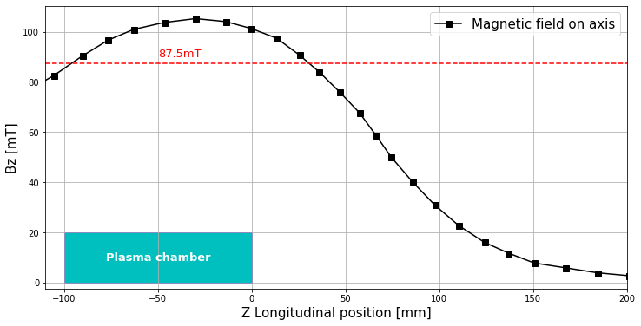
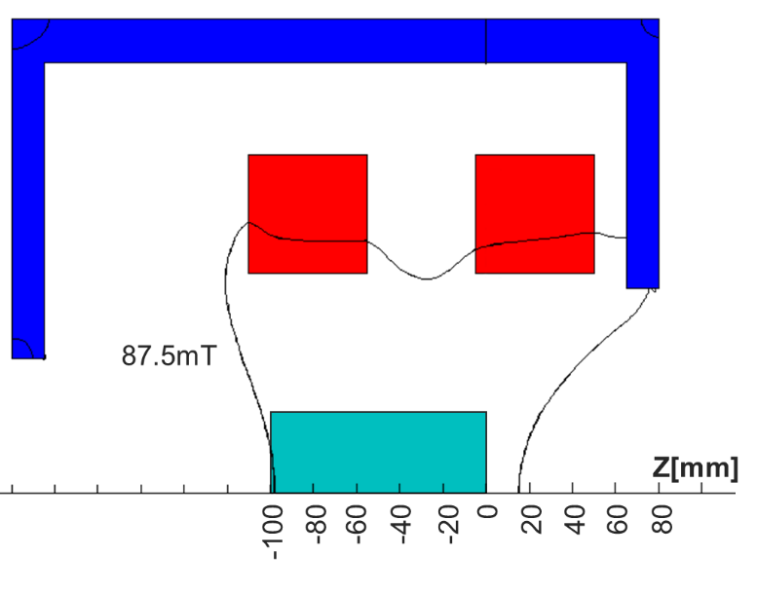
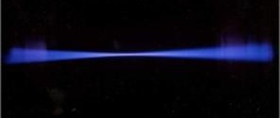
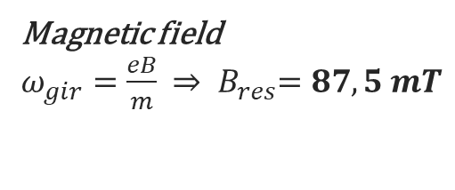
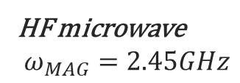
Intense Light Ion ECR Source : MDIS
Classical magnetic configuration
ECR Heating Process
(Electron Cyclotron Resonance)
HF microwave
$$ω_{MAG}=2.45GHz$$
Magnetic field
$ω_{gir}=\frac{eB}{m}$ ${⇒ B}_{res}=87,5 mT$
Ground
Magnetron
generator
2,45 GHz
Current : Faraday Cup - ACCT / DCCT
D⁺ D₂⁺ D₃⁺
H₂ / D₂
_{injection}
H⁺ H₂⁺ H₃⁺
Size, angle, position and proportion:
EMU; Wires Profiler/Camera; Wien filter
High Voltage 95 kV
65 kV
-3 kV
Plasma
Pentode extraction system
Diagnostics
Ion Source
LEBT
Ion Production
and
Electrostatic Acceleration
Transport
and
Beam characterization

Slide 5
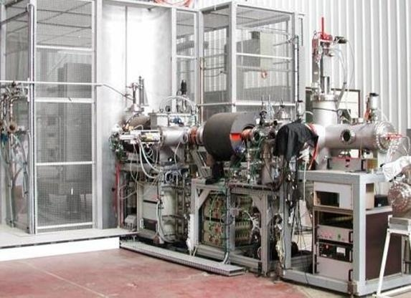
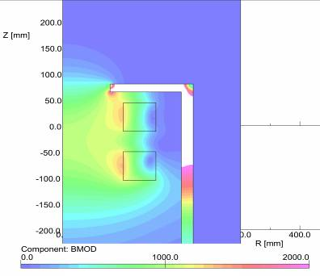
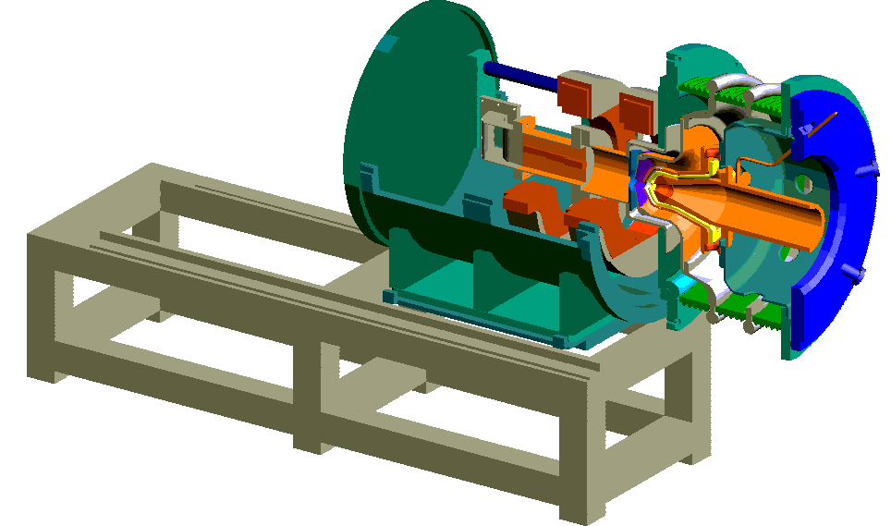
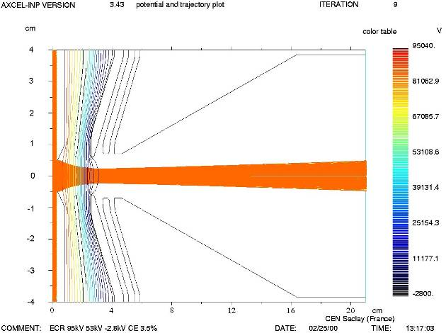
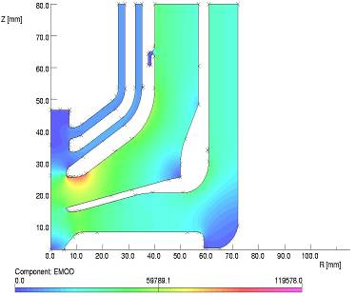
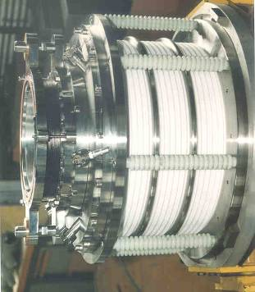
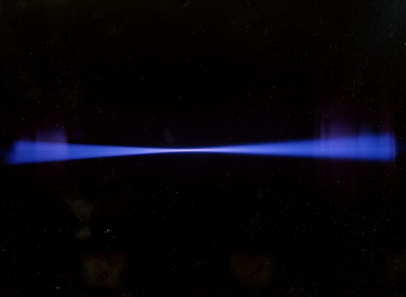
SILHI Source 1995
Magnetic and electrostatic calculations
➢ Beam Extraction (10 kW)
AXCEL CODE
Opera CODE
SILHI : H⁺ 100mA , 100 kV cw
The HV platform & HV cage & ion source were dismounted this year after more than 30 years
Deuteron beam

Slide 6
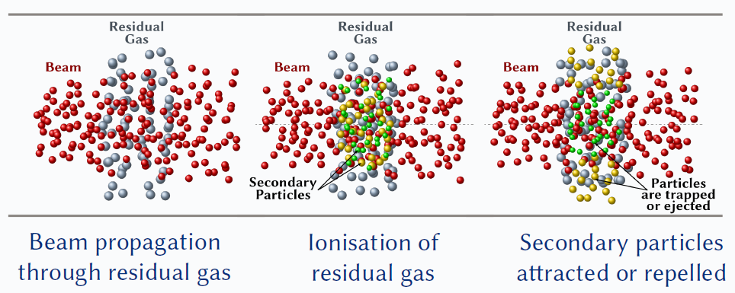

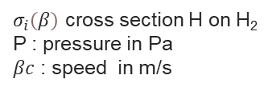
Space Charge and its Compensation
Space charge compensation DEGREE
Space charge compensation TIME
$$τ=\frac{kT}{σ_{i}\left(β\right)Pβc}$$
$σ_{i}\left(β\right)$ cross section H on H₂
P : pressure in Pa
$βc$ : speed in m/s
Beam charge can be compensated until 97%
➔ 100mA beam behave like a 3mA beam
100 keV H⁺ beam with H2 gas of 10⁻⁵ mbar: $τ$ = 49 µs
Huge amount of electrons are trapped in the beam potential well
Experimentally Space Charge Compensation Times are always faster than predicted

Slide 7
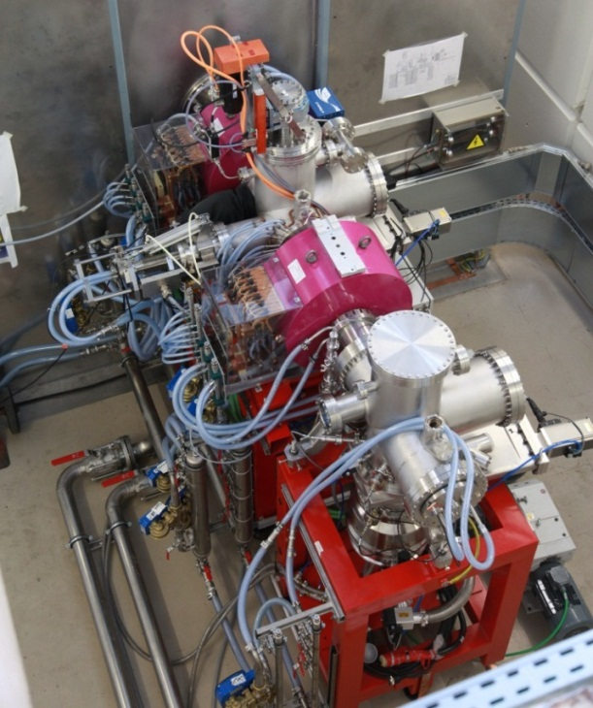
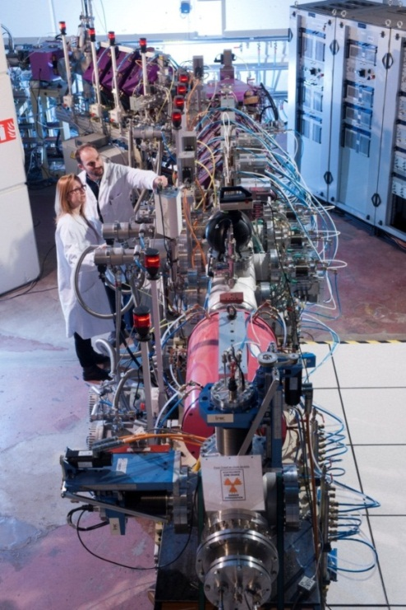
2 INJECTORS in Saclay for Deuteron beam production : IFMIF (2013) & SPIRAL2 (2014)
IFMIF :
D+ 125mA , 100 kV cw
Spiral2:
D⁺ , 10mA , 40 kV cw
H⁺ , 10mA , 20 kV cw
Photo P.Stroppa/CEA
IFMIF
LEBT 1m60
SPIRAL2
LEBT 12m

Slide 8
Beam Charge Compensation with Intense Beam
Interactions in a LEBT (non-exhaustive list)
Interactions induced by primary beam
Ionization of gas: H⁺ + A ➔ H⁺ + A⁺ + e⁻
Charge exchange with gas: H⁺ + A ➔ H + A⁺
Secondary electron emission on a metallic surface: H⁺ + Metal ➔ e⁻
Interactions induced by electrons
Ionization of gas: e⁻+ A ➔ A⁺ + 2e⁻
Dissociation reaction: e⁻ + A₂ ➔ A⁺ + A + 2e⁻
Interactions induced by secondary ions
Ionization of gas: A⁺ + A ➔ 2A⁺ + e⁻
Charge exchange with gas: A⁺ + A ➔ A + A⁺
Interactions to be considered in the simulations
Gas ionization by primary beam
Secondary electron emission
Charge exchange of primary beam
Gas ionization by electrons
SIMULATIONS
Tracking particle codes (Tracks, Parmilla, Trace3D, TraceWin …)are used with a constant space charge compensation degree along the beam line (or empirically dependant of z).
High intensity ion beams at low energy: a correct description the space charge compensation is necessary.
Use of a self-consistent code that simulate the beam interactions with the gas (ionization, neutralization …) and the beam line elements (secondary emission). The dynamics of main beam is calculated as well as the dynamics of the secondary particles.
Example of such codes: WARP.
@N. Chauvin

Slide 9
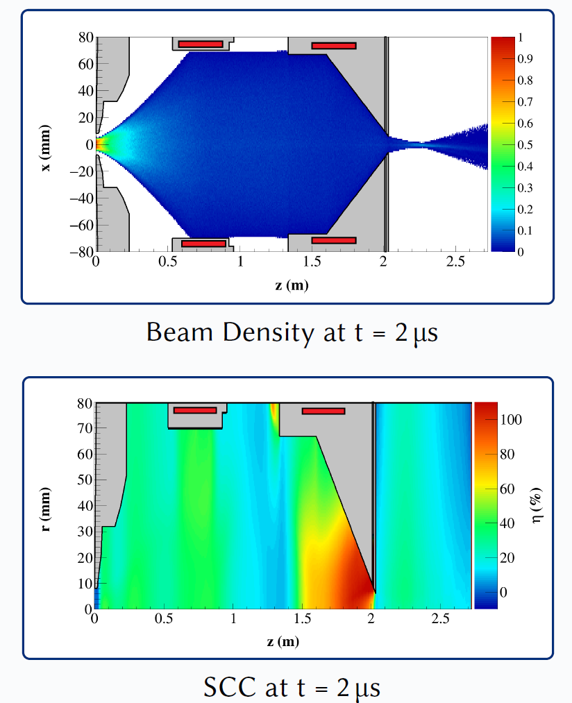
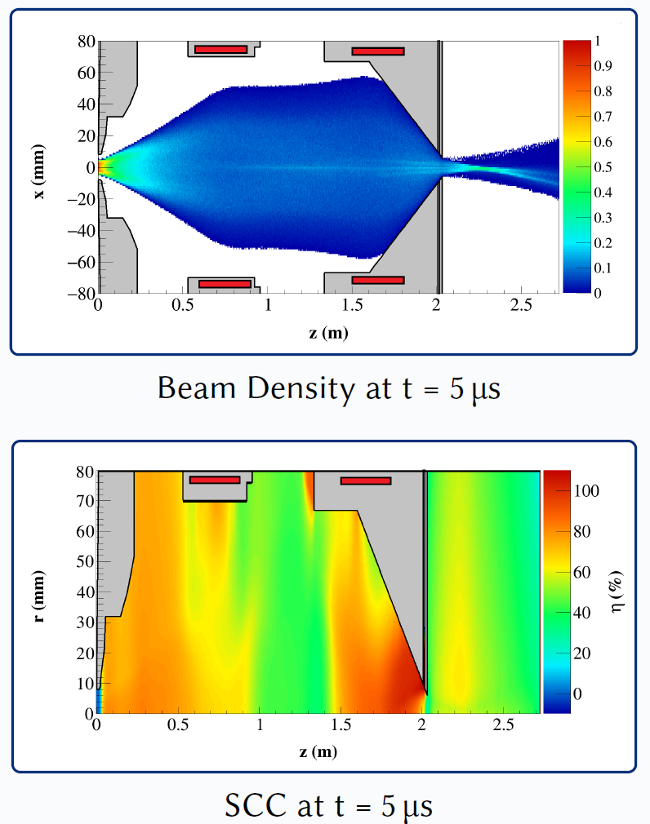
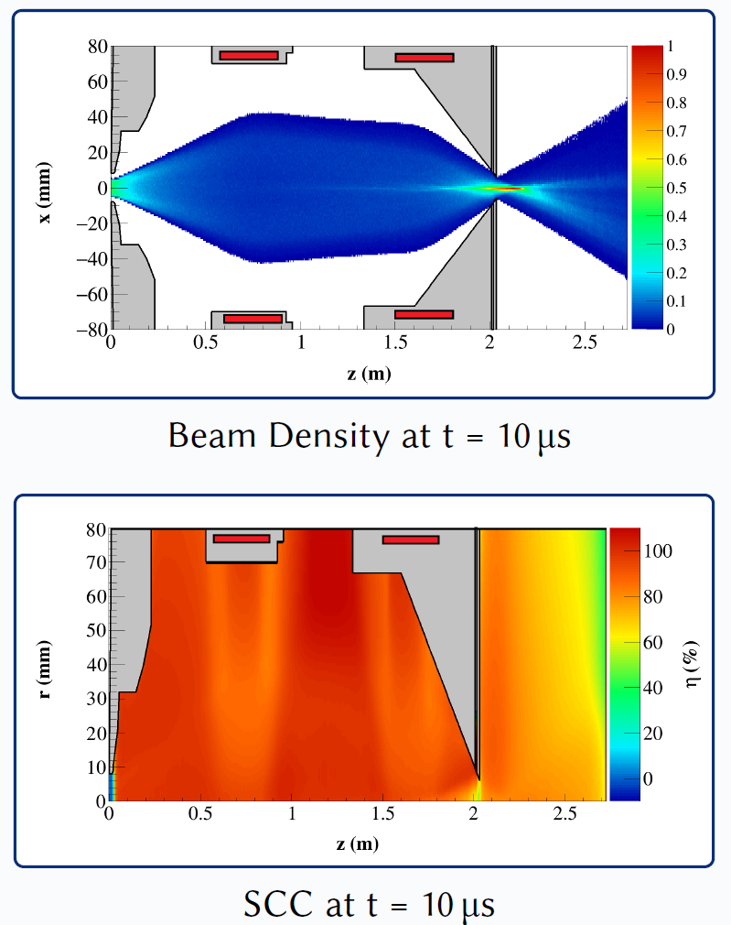
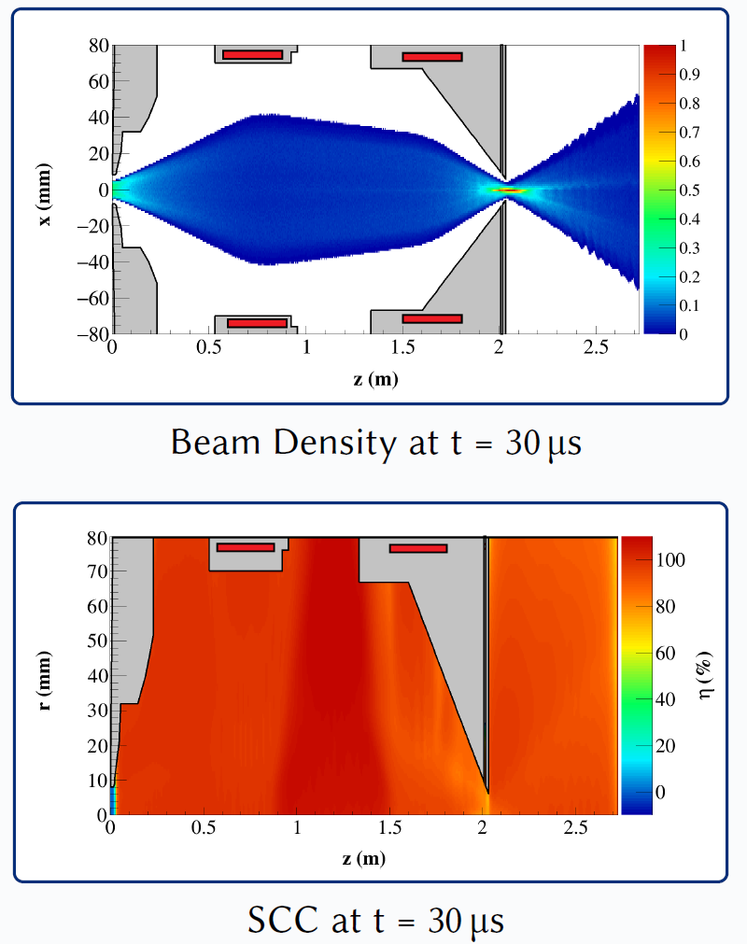
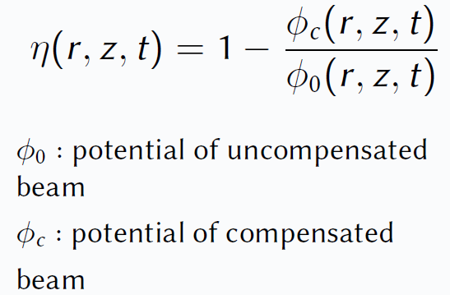
Space Charge Simulations for IFMIF
@N. Chauvin

Slide 10
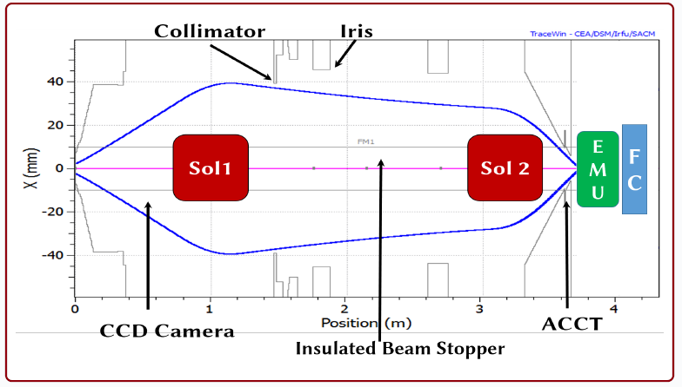
Intense Beam Transport Problematic at Low Energy
Context : Injection into RFQ
Pair of SOLENOIDS to control size and angle of beam
PROBLEMATIC: Emittance growth along LEBT
if Space Charge Compensation is perturbed by
► Electric field aberrations
► Magnetic & Fringe field
► Strong focalization while beam transport
RFQ
Simple solutions:
► Space charge compensation must be effective as soon as possible (noble gaz injection technic: Ar, Kr or Xe)
► Solenoid length reduction
► Transport beam smoothly avoid strong focalization
► Make LEBT short !!!
Notes:
What do we call a good or stable ion source ?
The source must fulfill the project requested value for extracted current, energy and emittance.
Naturally those measurements must be reproducible in time
The ion source must be reliable, so that meantime between failure must be the highest
And must have easy maintenance with the shortest the mean time to repair
Our context is to inject the beam into the RFQ so we must control the size and angle of the beam: this is done with a pair of solenoid in the LEBT
The intense beam interacts with the residual gas in the LEBT, it ionize the gas and free electrons are produced. Those electrons remain trapped by the transverse potential of the beam and so reduce the space charge of the beam. We called the process the Space charge compensation
There will be emittance growth in the LEBT if this space charge compensation process is perturbed
This perturbation is effectif if electric field is applied, but even with magnetic field, where the electron motion is diverted
Strong focalization and a cross over introduce an huge electric field that destroy this compensation
So the simple solution to reduce as much as possible this emittance growth is to leave the SCC to be effective as soon as possible
Reduce the Solenoid length
And transport the beam smoothly
In other word : the shorter LEBT, the better

Slide 11
Extraction design and tricks
2

Slide 12
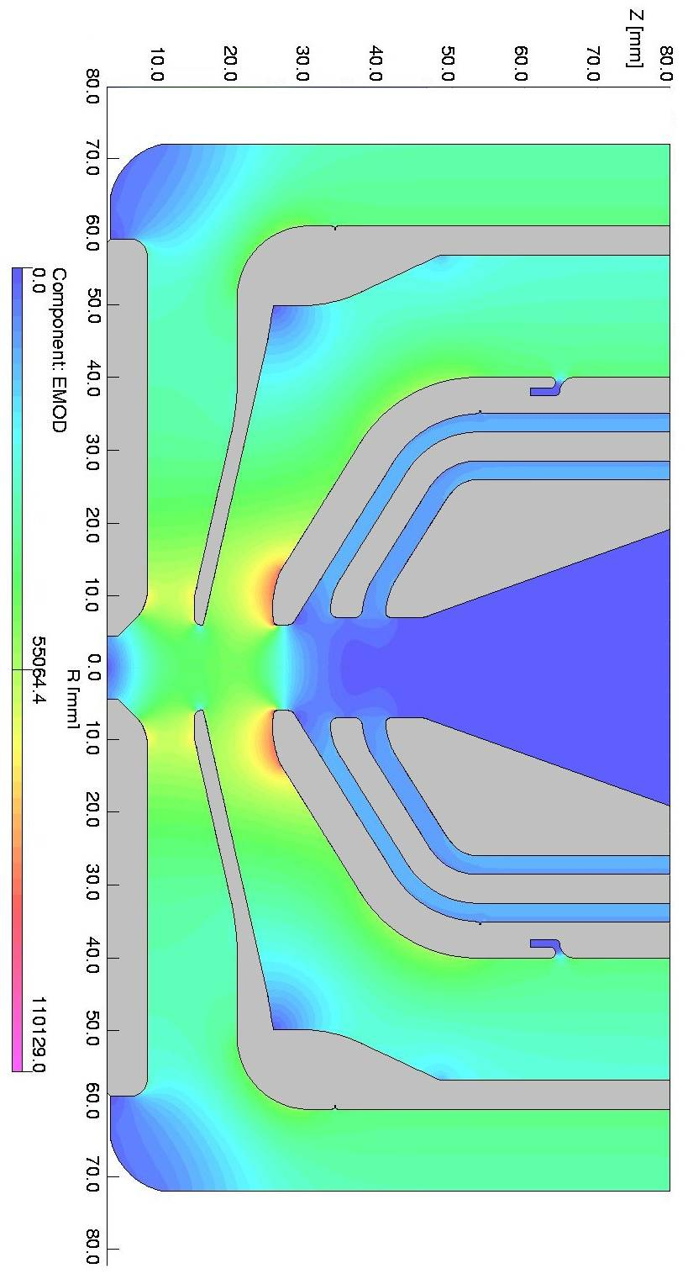
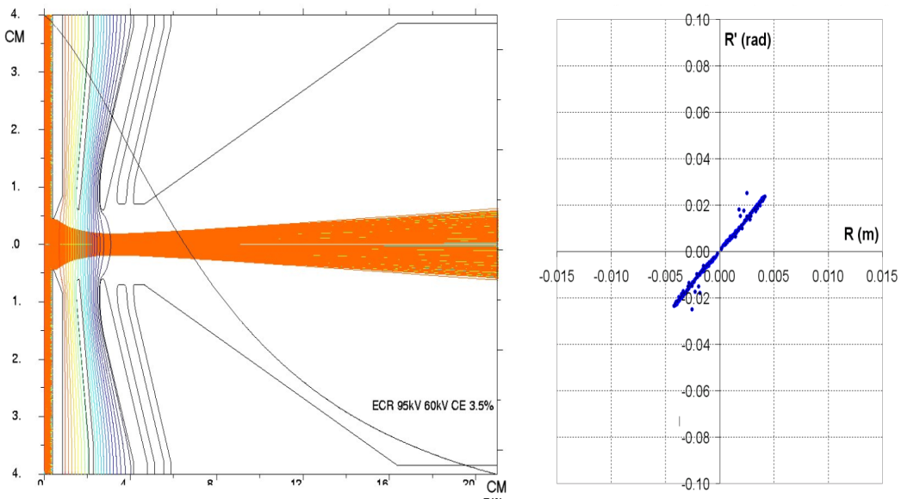
Design, first steps
α≅25 mrad
r_{f}=10 mm
AXCEL code
Opera code
Beam Divergence
Maximal electric field value reduction

Slide 13
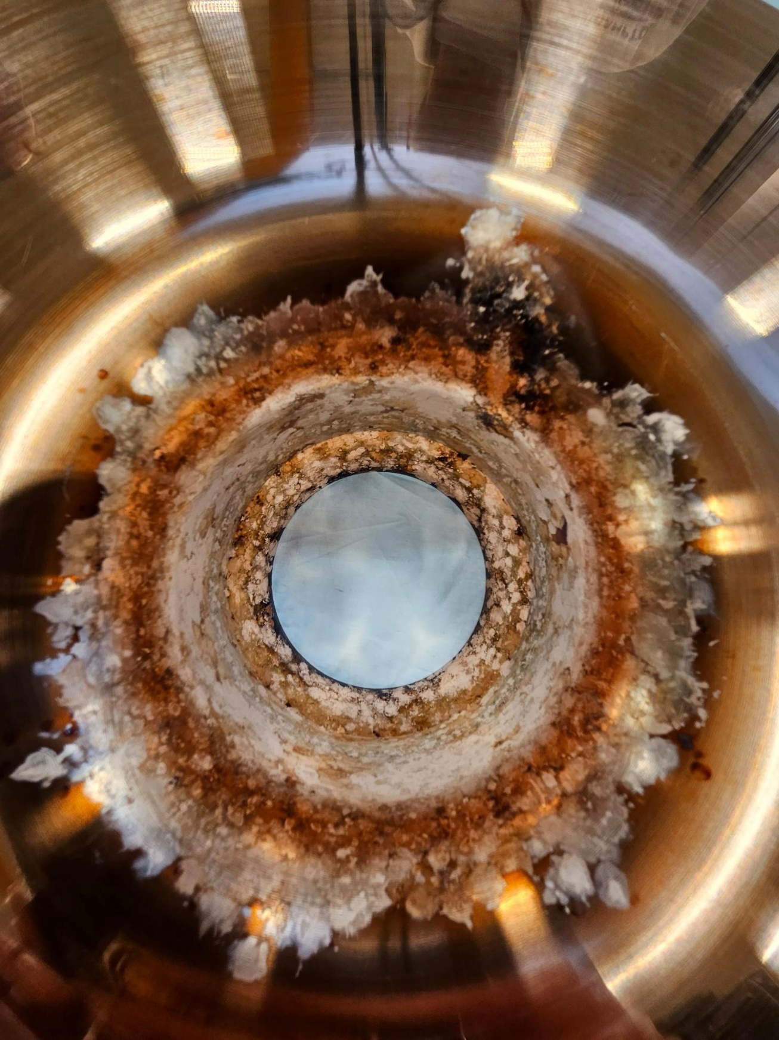
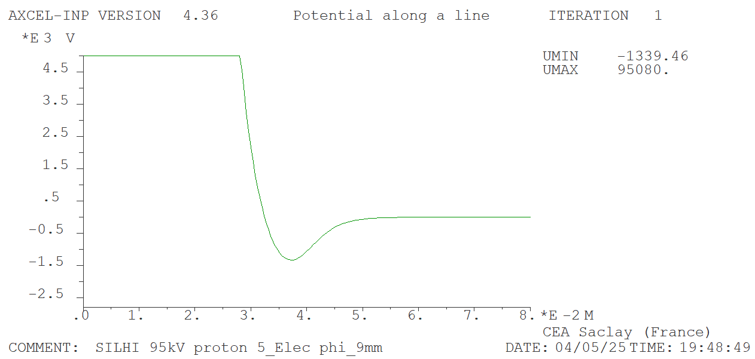
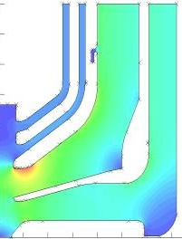
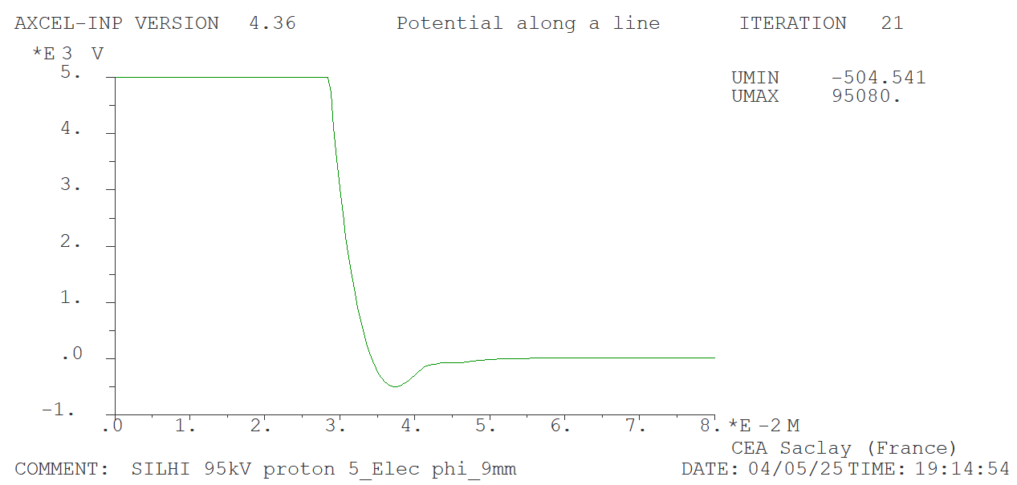
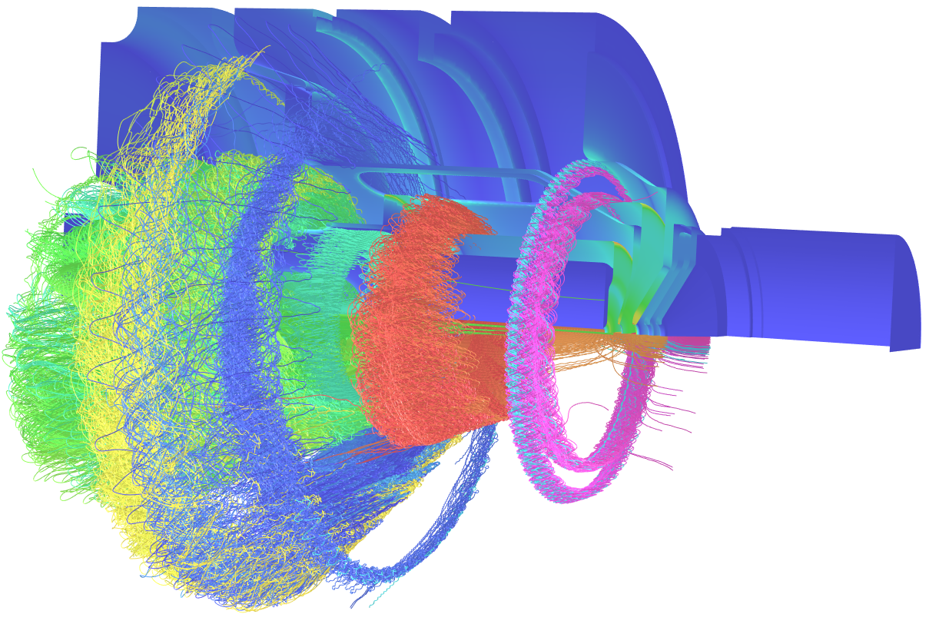
Things to checked in the Simulations
TO BE CHECKED #1
Check if we still have a good e-repeller bump
TO BE CHECKED #2
Presence of penning traps ?
Areas where B and E field are not collinear :
► Electrons are accelerated and trapped
► Hit on biased electrodes leading to the shutdown of source HV PS
EP 95kV
PUL 55kV
Without beam
Gnd1
REP -2.8kV
Gnd2
With beam
Axcel code
Opera code
► Space Charge Compensation “screen” potential applied on electrodes
► Avoid LEBT electrons (from the SSC process) to get accelerated by the Positive Electric Field in the accelerating column ➔ Bremsstrahlung ,X rays production
Change the slope of an electrode
Fill the empty space with material
Increase the bias voltage of the Repeller PS

Slide 14
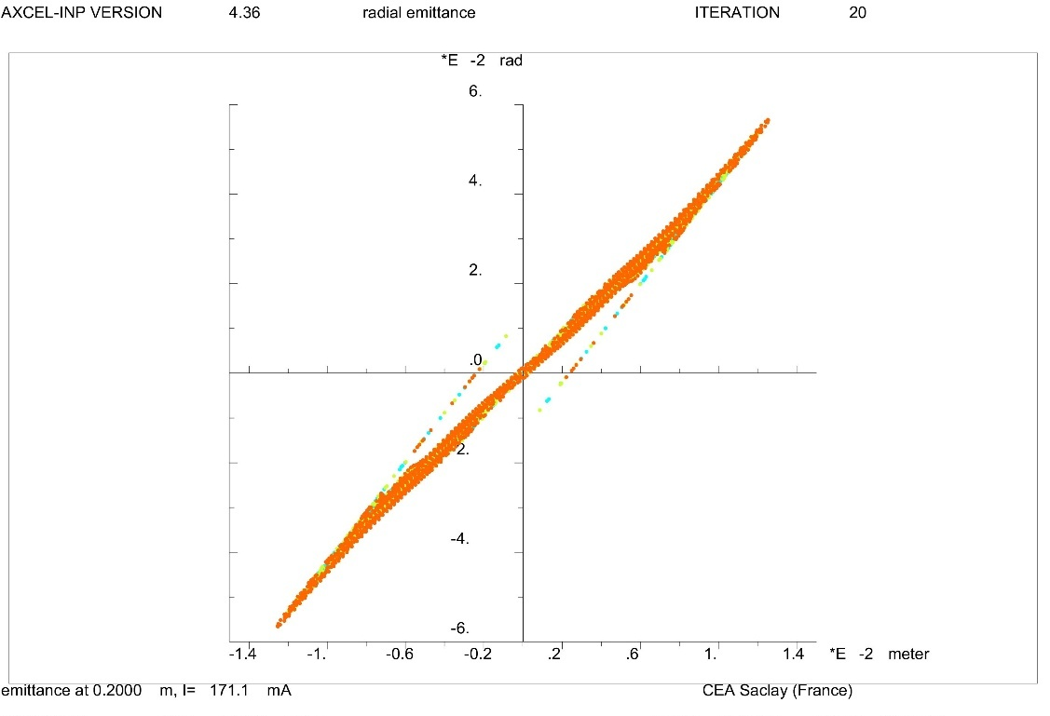
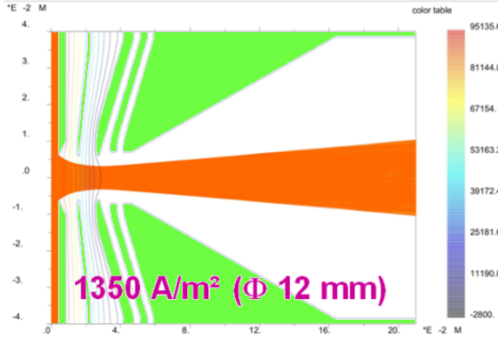
Extraction IFMIF
IFMIF : D+ 125mA , 100 kV cw
To make the extraction system shorter :
a first attempt with 4 electrodes extraction system configuration was simulated and built
SPARKS
Puller PS disruption
100kV
55kV
-17kV
0kV
Simulations can fit quite well to requirements,
but your first idea was impossible to achieve from technical point of view
Stay humble
We got back to 5 electrode system
100kV
70kV
0kV
-3kV
0kV

Slide 15
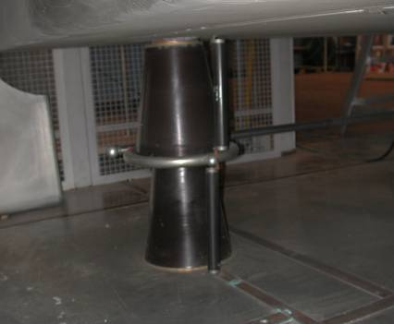
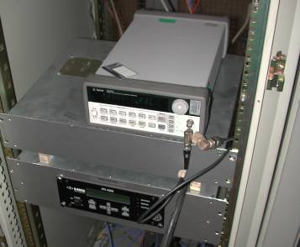
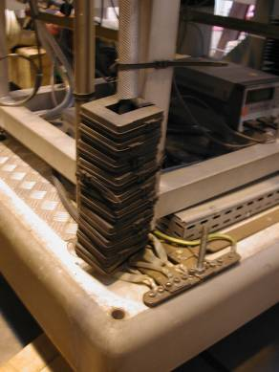
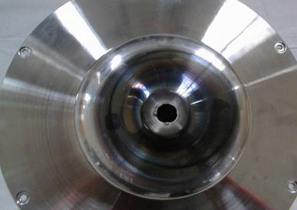
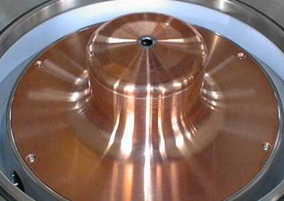
From the Mechanical Point of view
For High Current Production : need to master High Voltage knowledges :
➢ HV Technics
➢ EM Compatibility
➢ EM Interference shielding
SPARKES
RIPPLES
➢ Materials
DEGRADATION

Slide 16
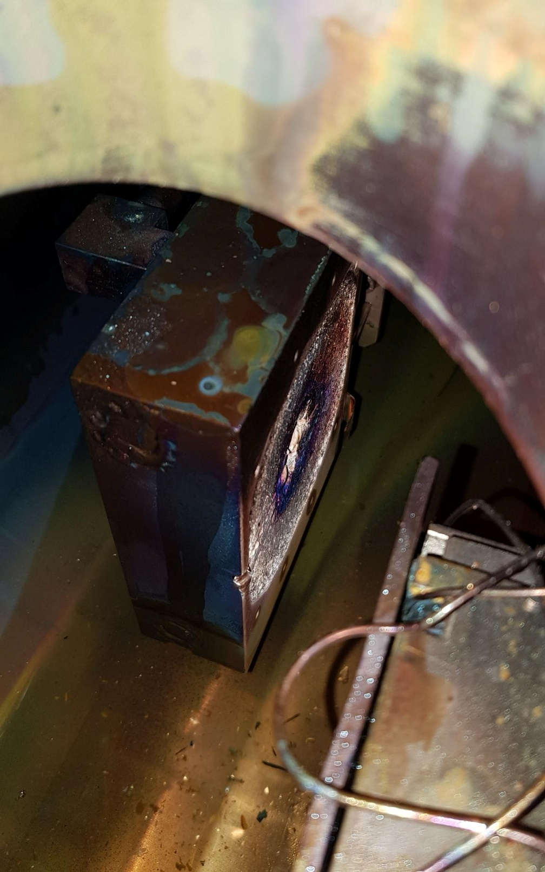
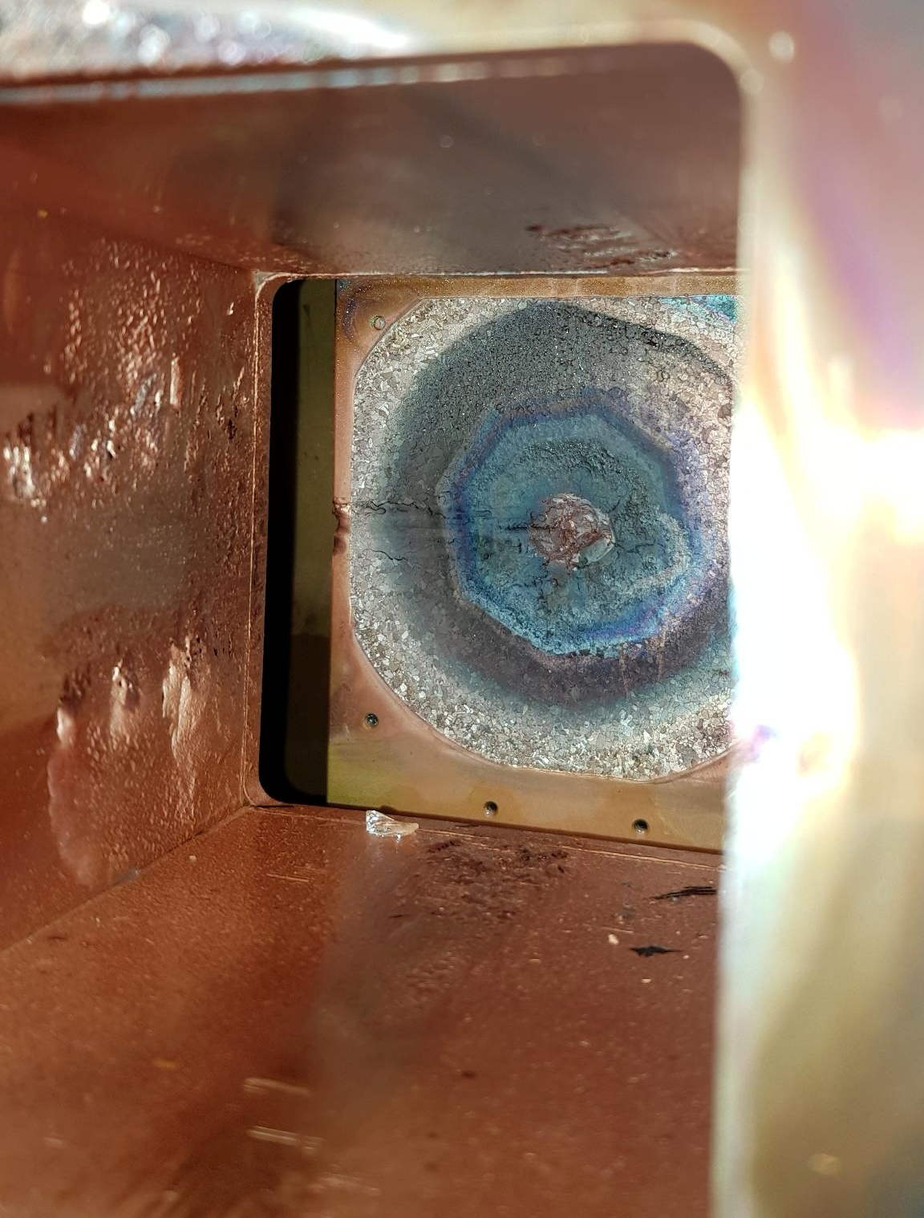
➢ As Beam Power can reach more than 10kW
don’t forget to cool down your interceptive diagnostics

Slide 17

Thank you for your attention
Thanks to :
N. Chauvin
R. Gobin
O. Delferriere
for their slides

