Slide 1


Space charge compensation of pulsed
hydrogen ion beams
Erin Flannigan, Olli Tarvainen, Benzi John, Kiran Jonathan, Dean Morris, Rob Abel, Alex Garcia-Sosa, David Emerson, Dan Faircloth
PIBHI’25 Aci Trezza, Italy
8th April 2025

Slide 2
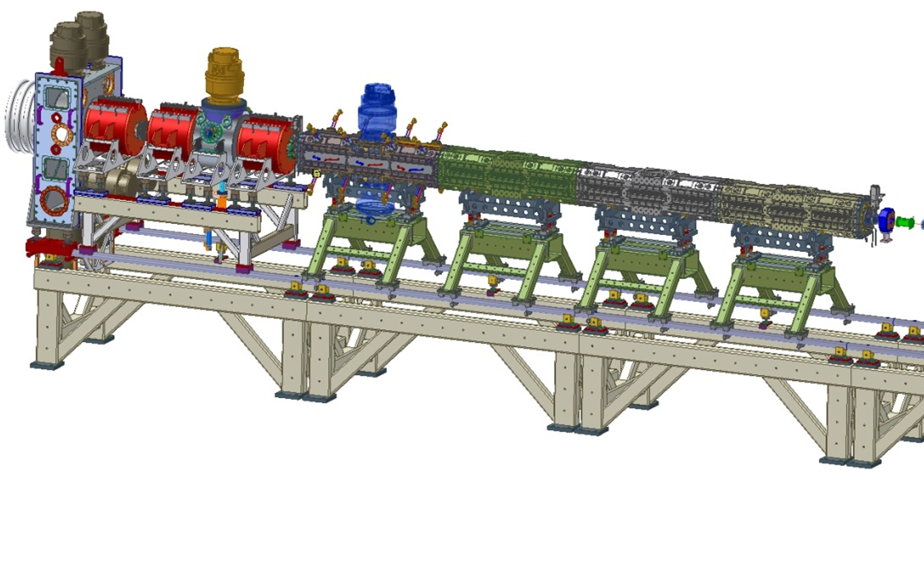
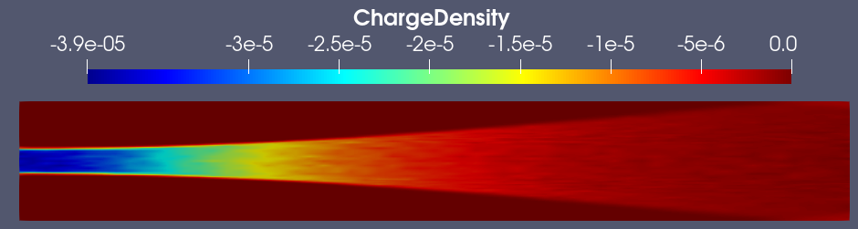
Low Energy Beam Transport
The LEBT transports the beam from the ion source and focuses it into the RFQ.
The ions in the high-current, low-energy beam repel each other, causing the beam to blow up.
Solenoid magnets in the LEBT can be used to focus the beam and act against the space charge effects.
Front End Test Stand (FETS) at ISIS

Slide 3
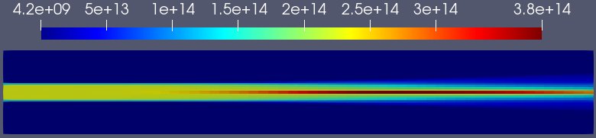
SCC of hydrogen ion beams
Space charge compensation (SCC) lowers the space charge of the ion beam through ionisation of a background gas, creating secondary compensating particles.
For example, an H- ion beam ionises the background gas by:
H⁻ + H₂ → H⁻ + H₂⁺ + e
The negative beam potential traps the H₂⁺ ions and expels electrons, reaching equilibrium.

Slide 4
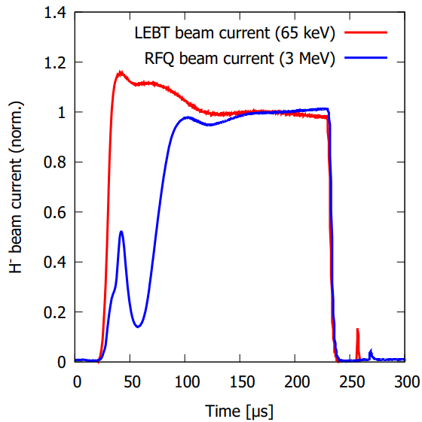
Importance of SCC
A significant amount of the beam is lost during SCC build-up. Beam is already lost through electron detachment from collisions with the background gas.
Beam losses must be avoided to minimise the erosion and activation of accelerating structures.
Minimising the pulse length saves energy.
40 mA H⁻ beam pulse at FETS

Slide 5
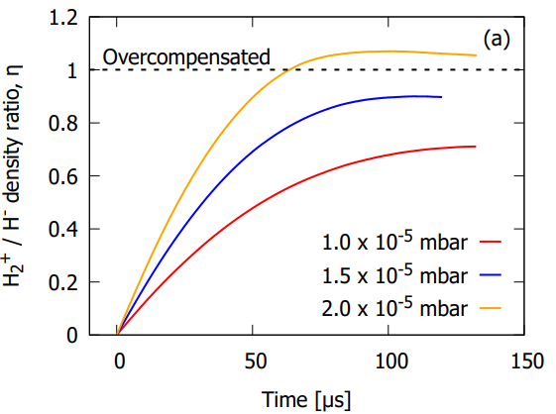
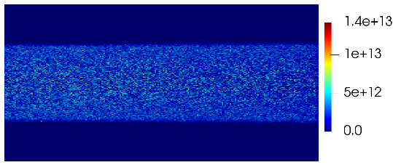
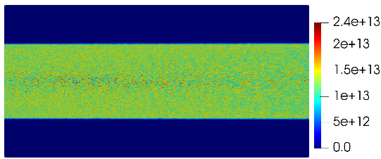
Particle-in-cell simulations
To model methods of decreasing SCC time without further beam losses we are using two codes to simulate the SCC process, PICLas and Vsim.
We are in the process of implementing:
Variation of basic parameters (current, energy, magnetic field)
Light emission and electron energy distribution as outputs
Realistic magnetic fields
Comparing H⁻ and H⁺
H₂⁺ accumulation for an H⁻ beam at 5 μs
H₂⁺ accumulation for an H⁻ beam at 80 μs

Slide 6
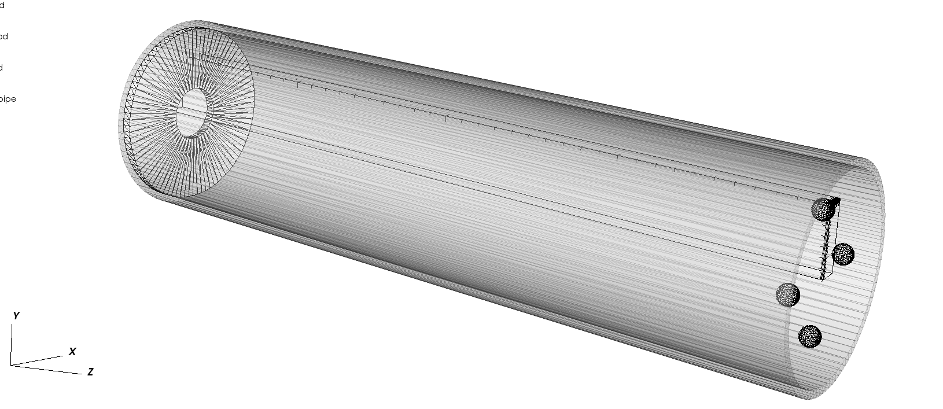
Simulation boundary conditions
While other PIC simulation of SCC are published, boundary conditions used are often not mentioned.
Our PICLas results indicate that the domain length affects the SCC time and degree.
Open, reflective, and specular boundaries provide non-physical results.
Potential solution is to model the entire LEBT, but this increases computational time significantly.

Slide 7
SCC Diagnostics
Many diagnostics techniques can be used to study the SCC degree and time:
Faraday cups
Toroids
Emittance meters
Beam profile monitors
Wire scanners
Retarding field analysers
Avalanche photodiodes
Spectrometers
These techniques are applicable to both positive and negative ion beams but have unique challenges based on the specific ion beam and residual gas used.
However, many of these techniques will affect the beams they measure.
Focus will be placed on these diagnostics techniques, which we are using to investigate the SCC process, including parametric studies.

Slide 8
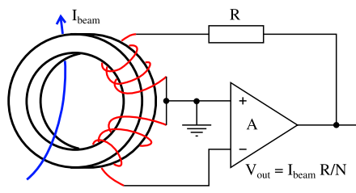
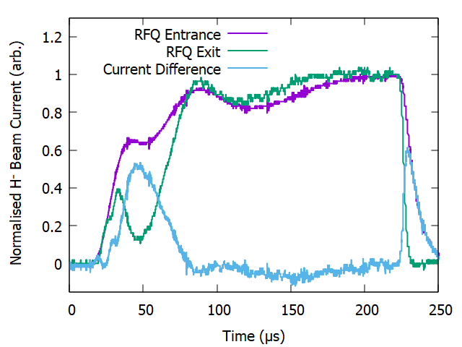
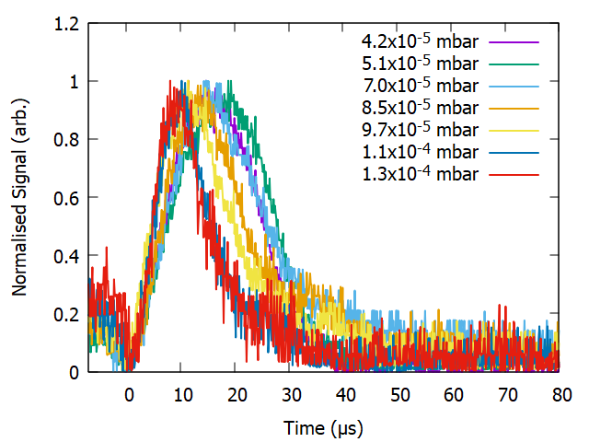
SCC Diagnostics - Toroid
The difference between the beam current measured at the RFQ entrance and RFQ exit provides an estimate of the SCC time. It can be used to determine the dependence of the SCC time on various basic parameters.
Our measured SCC time (~50-75 μs) matches well with back-of-the-envelope calculation and PIC models.

Slide 9
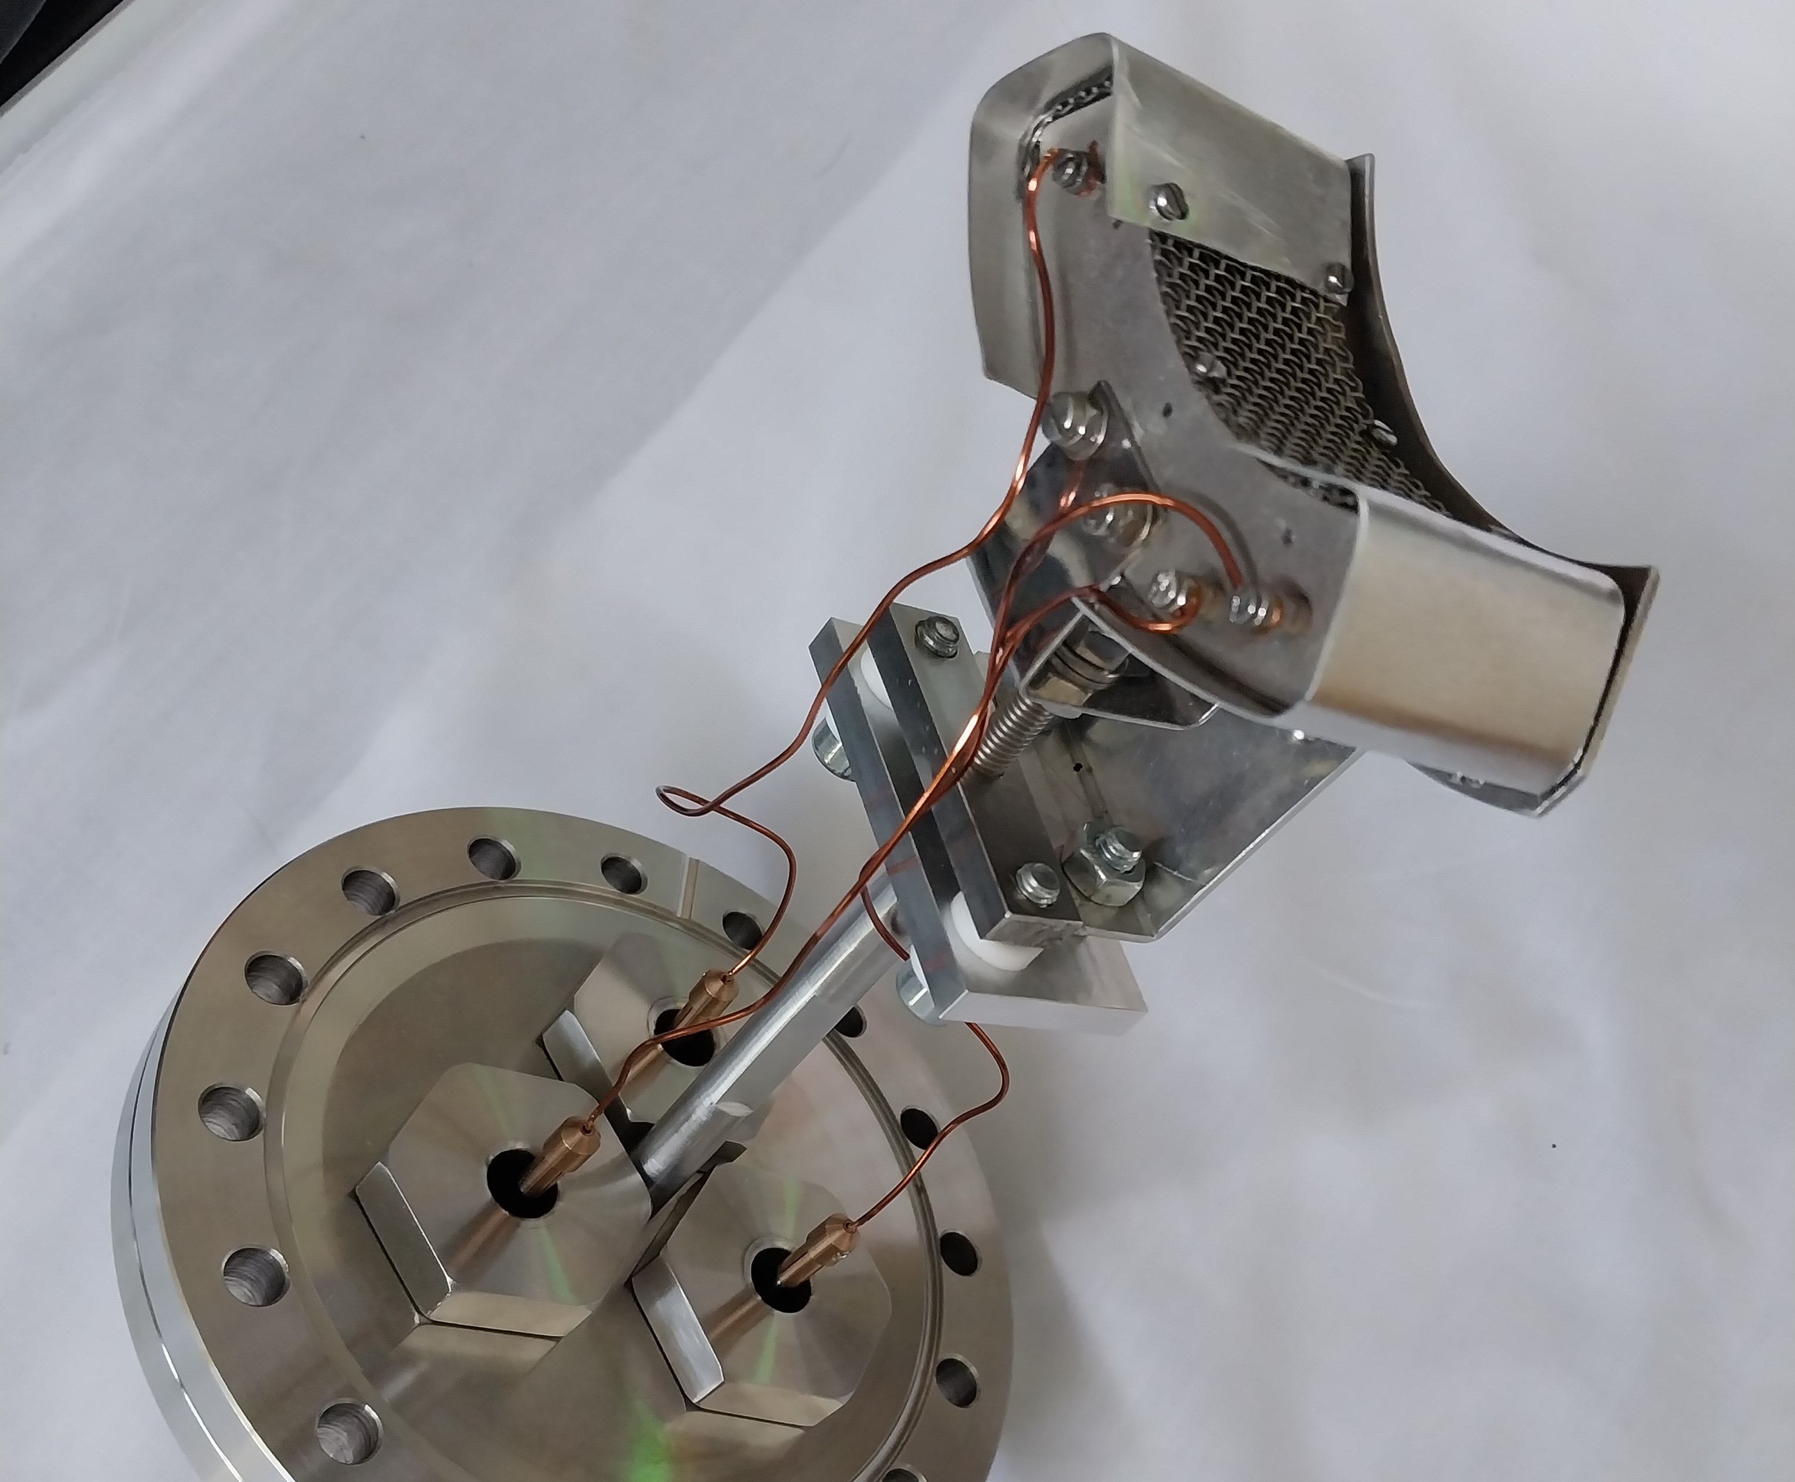
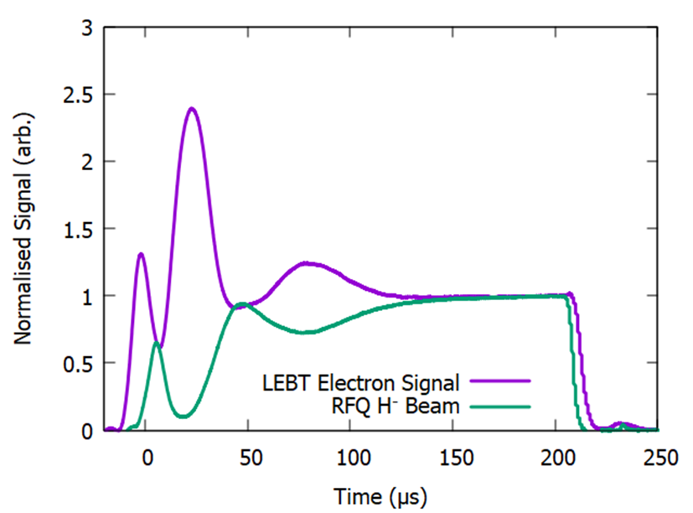
SCC Diagnostics – Retarding Field Analyser
An RFA consists of three grids in front of a collector plate. The middle grid can be biased to repel the secondary particles.
The RFQ transmission is mirrored by the electron signal. This signal can be used to measure the SCC time.
The energy of the secondary particles can provide the potential of the beam.
Complicated for an H- beam, where the secondary particles are electrons.
Measurements are planned using an H+, which would instead measure the energy of H₂⁺.

Slide 10
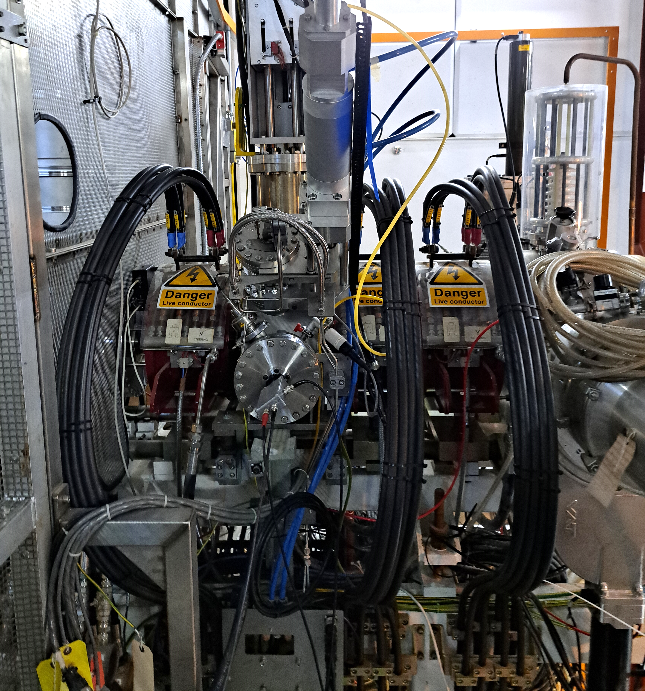
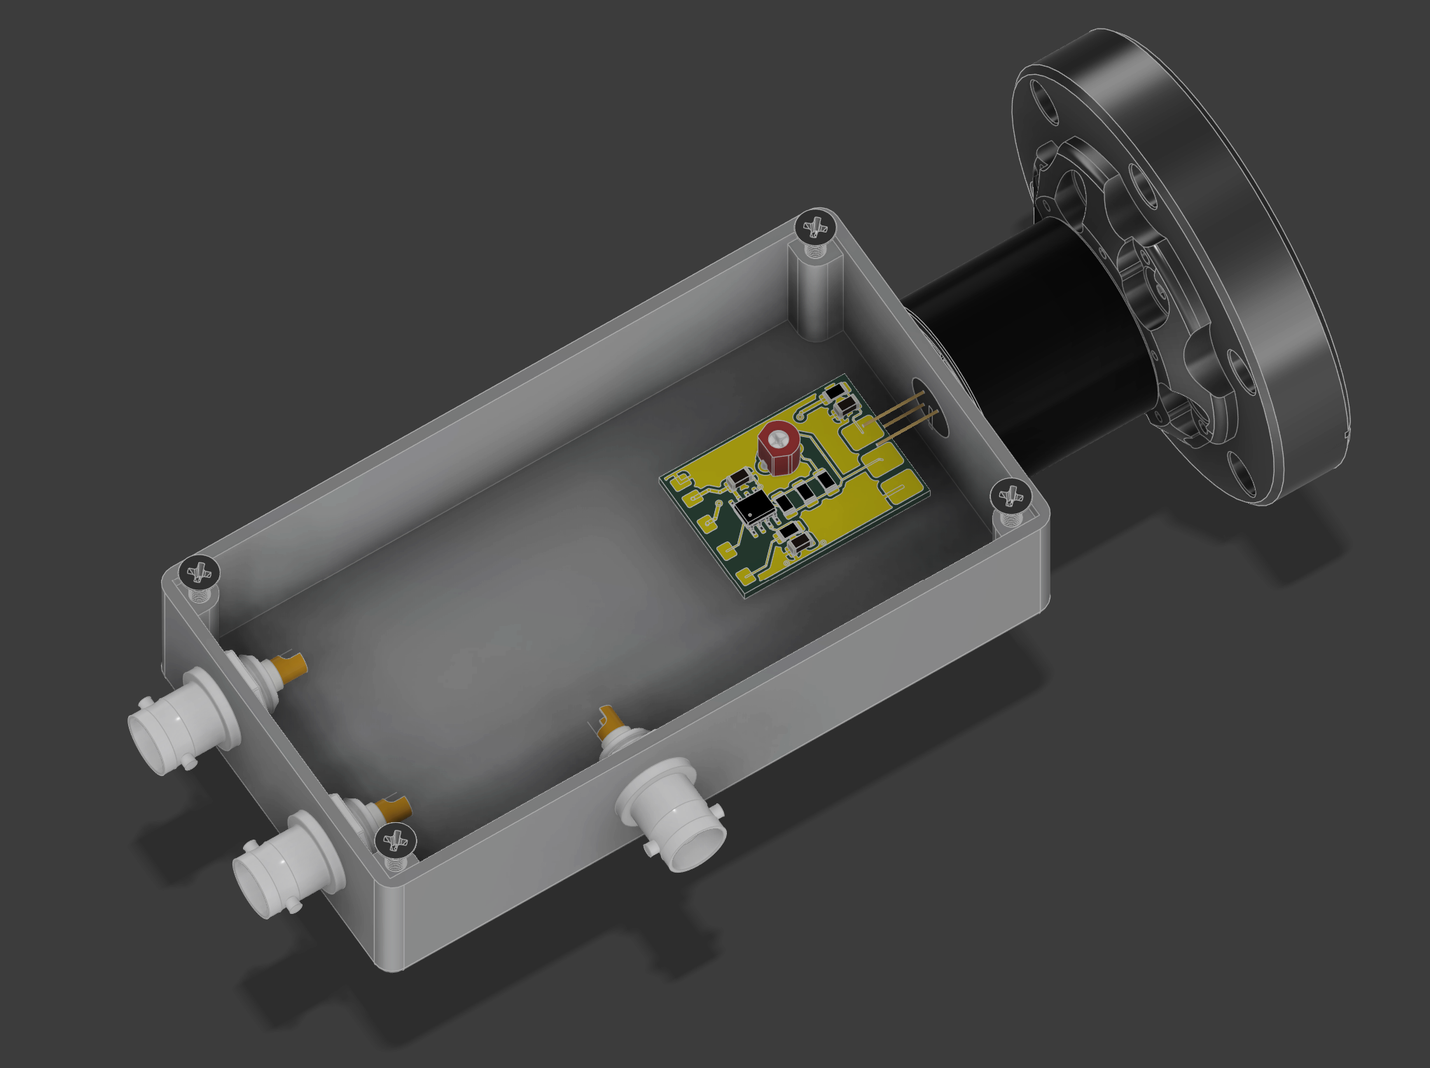
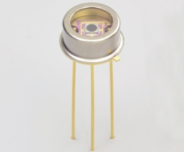
SCC Diagnostics – Avalanche Photodiode
Time-resolved light emission was measured in the LEBT using a MPPC (Multi-Pixel Photon Counter) with an amplifier. Plans are in place to upgrade this to a Single Photon Avalanche Diode (SPAD) for better gain and SNR.

Slide 11
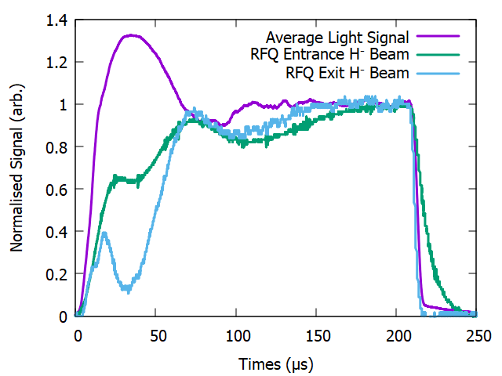
SCC Diagnostics – Avalanche Photodiode
Measurement of the light emission with an MPPC shows a peak in the beam-induced light emission corresponding with low transmission through the RFQ.

Slide 12
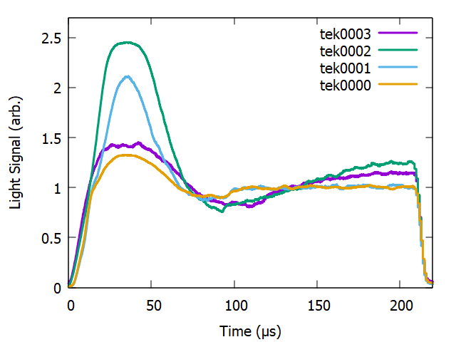
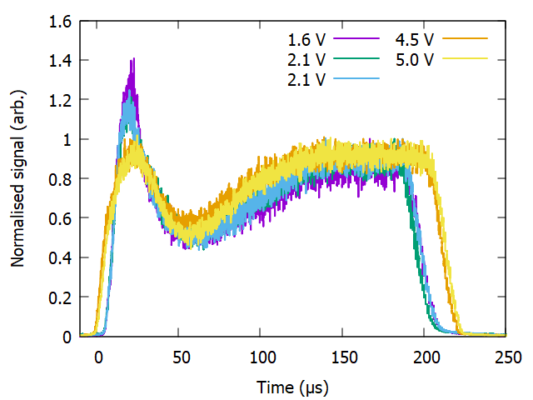
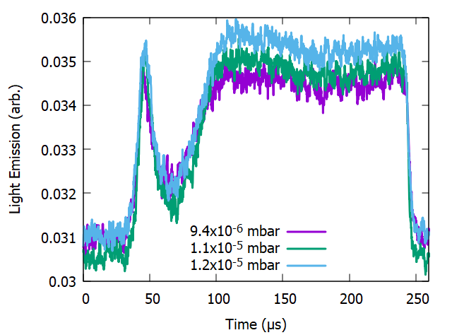
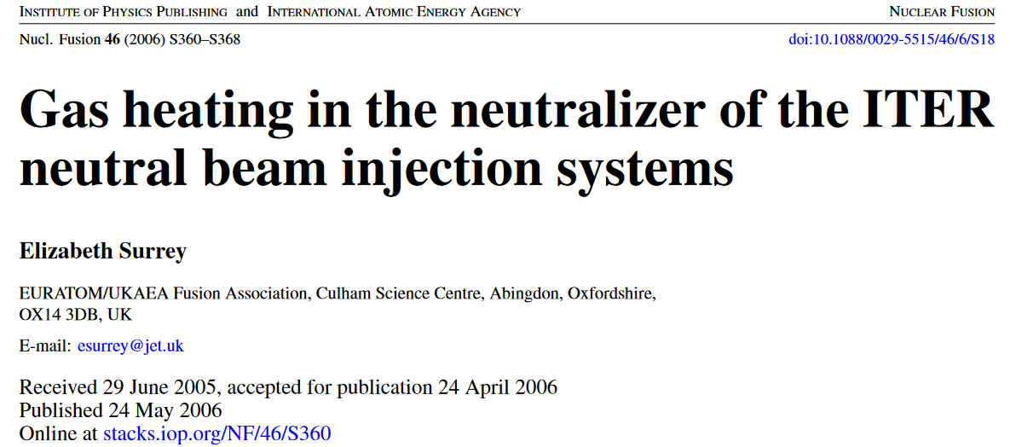
Beam-induced light emission
FETS
ISIS
ISDR
The peak in the light emission is measured with an H⁻ beam on multiple systems and with various settings.
Possible explanations for this peak:
Geometry of the beampipe?
Electron energy changes from changing beam potential?
Gas density?
Simulation shows no difference in photon count with 2.5 or 5 cm beam radius.
Preliminary PICLas results indicate that the electron energy does not change sufficiently.
Gas temperature increases by 600 K from an ion beam have been measured.
Validating experiments with an H⁺ beam are planned.

