Slide 1

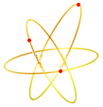
FECR: Prototype of the next generation ECR ion source
IMP
L. Sun
Institute of Modern Physics, CAS, 730000, Lanzhou, China
PIBHI’25, April. 7~9, 2025, Acitrezza, Italy

Slide 2
Outline
General introduction to FECR
Specs of FECR
FECR Developments
Magnet Development
First Commissioning
Scope and Summary
Notes:
Needs: SHE, CEE, HIAF
HCI production: metallic beams with CAFe-2 (LECR5 & SECRAL 3), Uranium beam with HIRFL@SECRAL-I & SECRAL-II
New Techniques towards intense beams: HTO, Vlasov launcher, 2-frequency AG, Biased probe + AG effect
HIAF requirements in long range, FECR

Slide 3
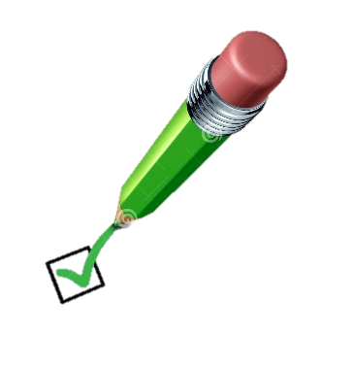
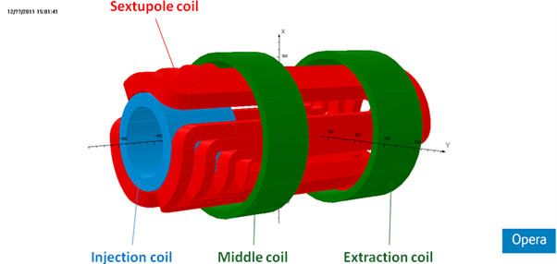
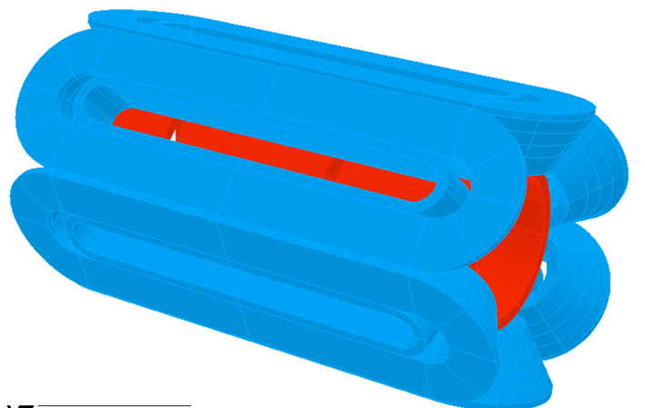
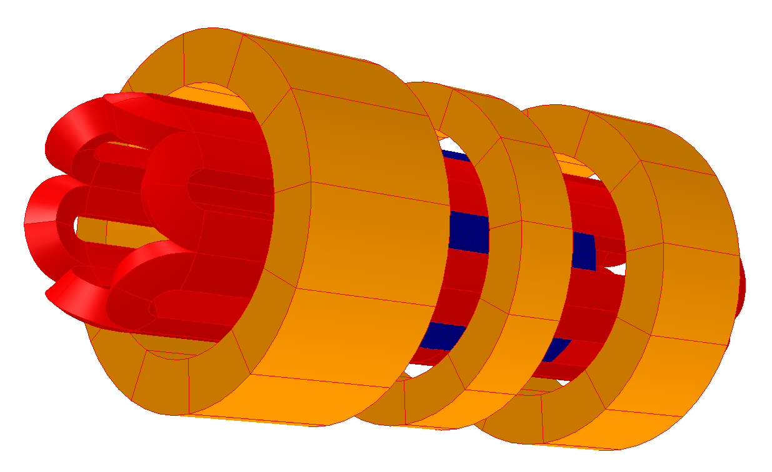
FECR Introduction
Conventional Structure: VENUS, SuSI, RIKEN-SCECRIS…
Ioffe-bar Structure
SECRAL Structure
Notes:
Needs: SHE, CEE, HIAF
HCI production: metallic beams with CAFe-2 (LECR5 & SECRAL 3), Uranium beam with HIRFL@SECRAL-I & SECRAL-II
New Techniques towards intense beams: HTO, Vlasov launcher, 2-frequency AG, Biased probe + AG effect
HIAF requirements in long range, FECR

Slide 4
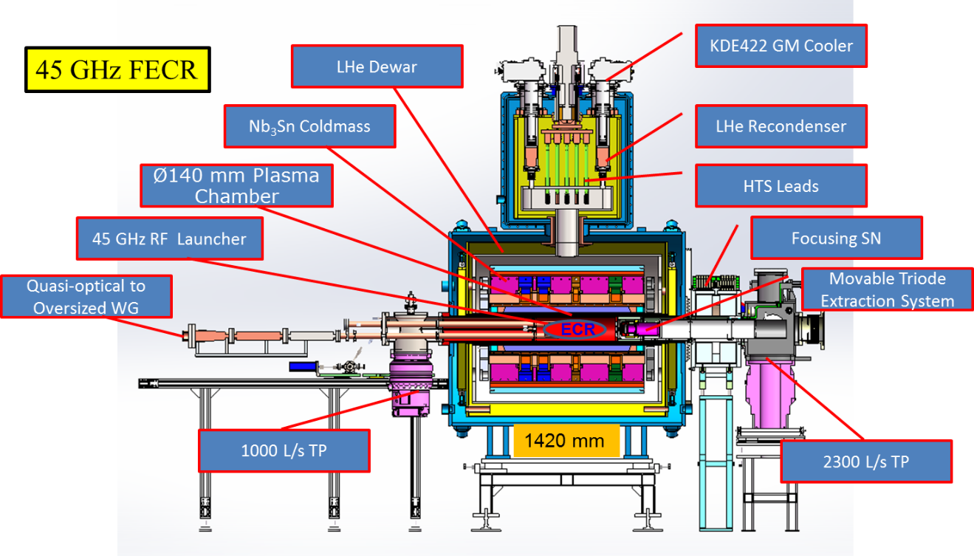
FECR Introduction
Specs. of FECR
Specs. | Unit | Value
Frequency | GHz | 45
RF Power | kW | 20
Chamber ID | mm | ≥Ø140
Mirror Fields | T | ≥6.4/3.2
B_{rad} | T | ≥3.2
Mirror Length | mm | ~500
B_{max} in conductor | T | ~11.8
Magnet coils | / | Nb₃Sn
Nb₃Sn | J_{c}>1500 A/mm²@12T
Cooling Capacity@4.2 K | W | >10.0
H. W. Zhao et al., Review of Scientific Instruments 89, 052301 (2018)
Notes:
Needs: SHE, CEE, HIAF
HCI production: metallic beams with CAFe-2 (LECR5 & SECRAL 3), Uranium beam with HIRFL@SECRAL-I & SECRAL-II
New Techniques towards intense beams: HTO, Vlasov launcher, 2-frequency AG, Biased probe + AG effect
HIAF requirements in long range, FECR

Slide 5
FECR Intro: Challenges
Specs. | Unit | FECR | Challenges
frequency | GHz | 45 | High frequency high power microwave coupling High power chamber cooling
Operational RF Power | kW | 20
B_{ECR} | T | 1.6 | Reliable High Field Magnet with min-B Field Configuration
B_{rad} | T | ≥3.2
B_{inj} | T | ≥6.4
B_{min} | T | 0.5~1.1
B_{ext} | T | ≥3.4
Plasma Chamber ID | mm | ≥140
Mirror Length | mm | 500
Cooling Capacity@4.2 K | W | ≥10.0 | Radiation degradation and dynamic heat load
U³⁵⁺ | mA | >1.0 | Intense solid material beam production
Pulsed Beam Frequency | Hz | 0.5~3 | High afterglow yield and pulse duration
Afterglow pulse width | ms | >2.0
Liangting Sun, ICFA-Newsletter 73, p34.
Notes:
Needs: SHE, CEE, HIAF
HCI production: metallic beams with CAFe-2 (LECR5 & SECRAL 3), Uranium beam with HIRFL@SECRAL-I & SECRAL-II
New Techniques towards intense beams: HTO, Vlasov launcher, 2-frequency AG, Biased probe + AG effect
HIAF requirements in long range, FECR

Slide 6
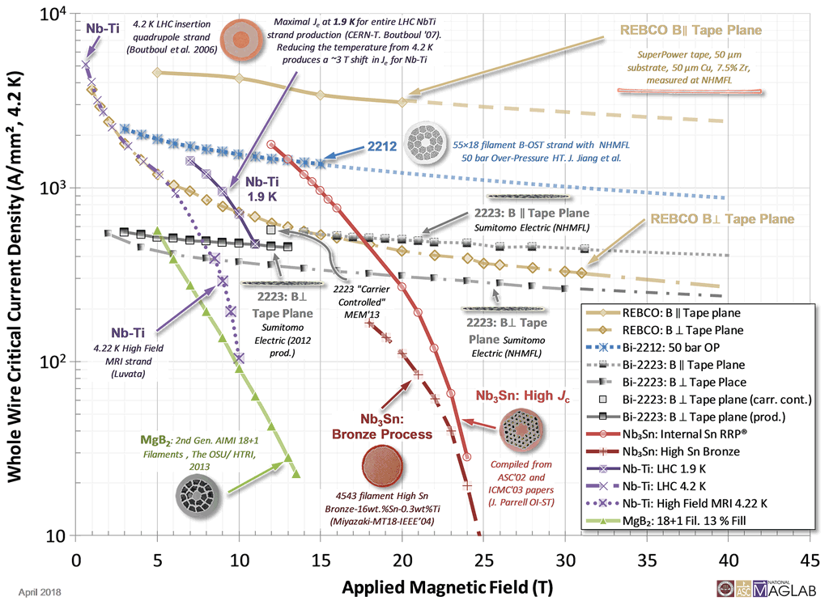
FECR Magnet
Nb₃Sn vs. NbTi:
Fragile
Treatment sensitive
Stress sensitive
1100
4th G ECRIS
3rd G ECRIS
500
7.0
12
Courtesy of MagLab
Notes:
Needs: SHE, CEE, HIAF
HCI production: metallic beams with CAFe-2 (LECR5 & SECRAL 3), Uranium beam with HIRFL@SECRAL-I & SECRAL-II
New Techniques towards intense beams: HTO, Vlasov launcher, 2-frequency AG, Biased probe + AG effect
HIAF requirements in long range, FECR

Slide 7
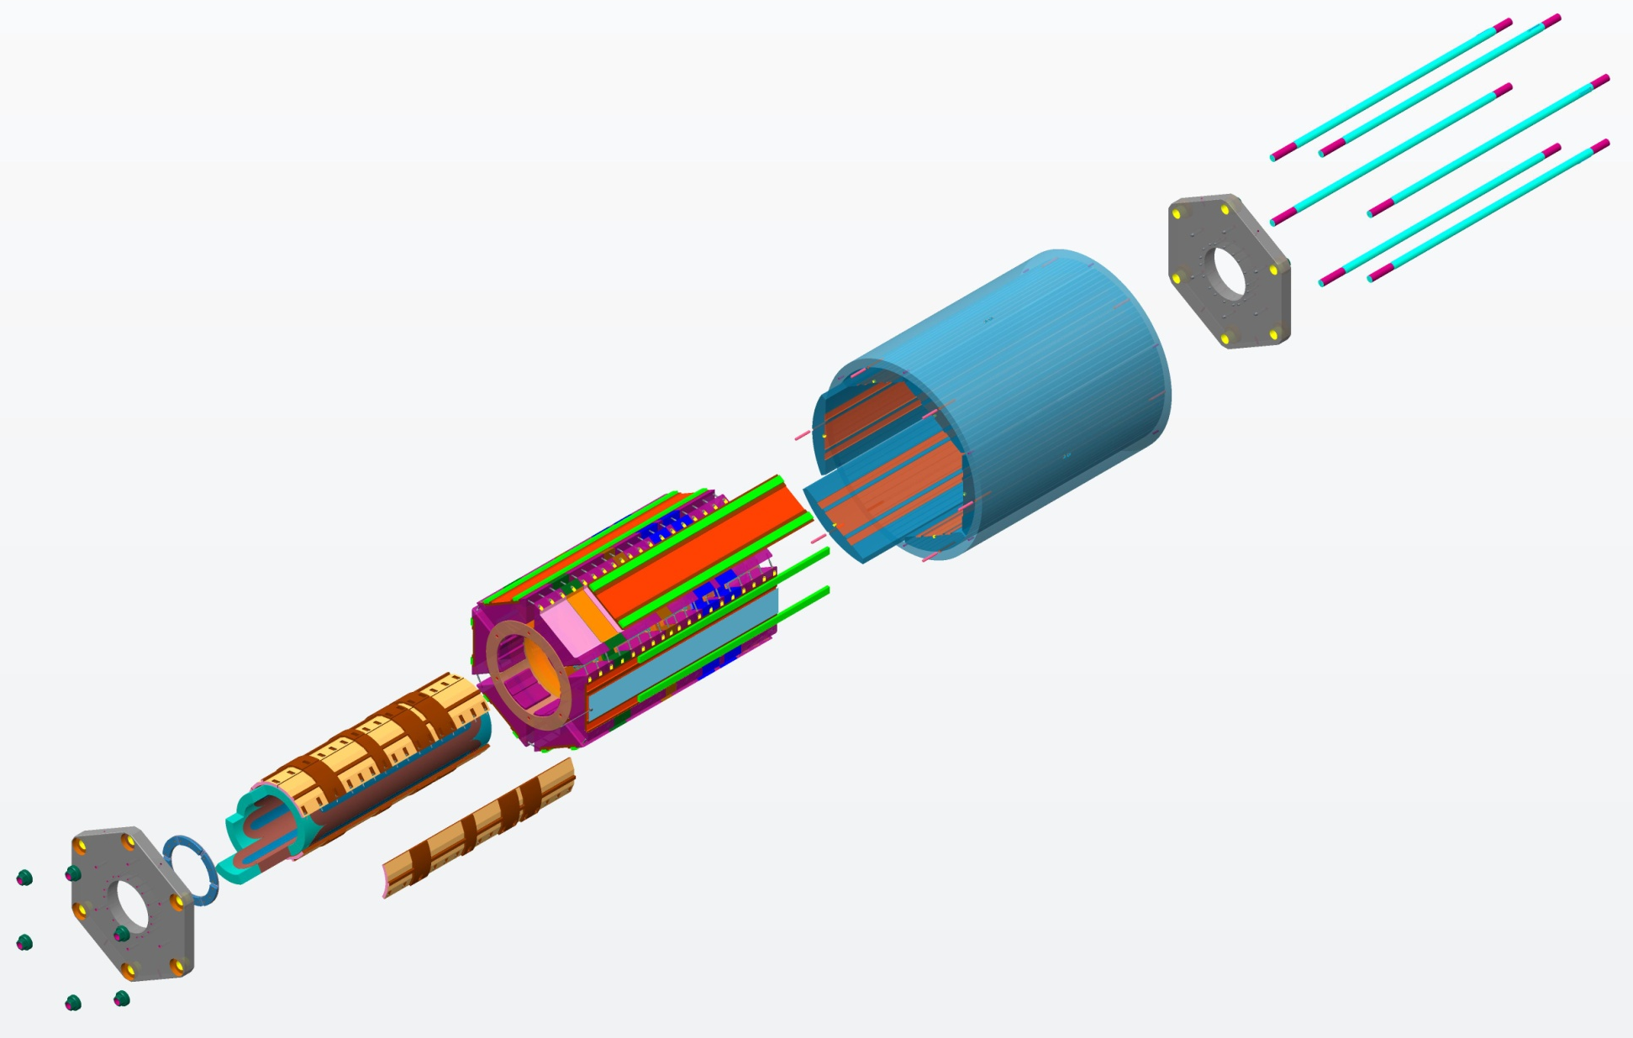
FECR Magnet
In collaboration with ATAP/LBNL（2016~2017）
AXIAL RODS
(Strain Gauged)
Bladder & Keys assembly
YOKE-SHELL
ALIGNMENT PINS
MASTER-KEY PLATES
SOLENOID
STRUCTURE
SUBASSEMBLY
COIL-PACK
SUBASSEMBLY
AXIAL-LOAD
END PLATE
SUBASSEMBLYS
YOKES
SHELL-YOKE
SUBASSEMBLY
(Shell is strain gauged)
COIL END
BLOCKS
LOAD-KEYS
BLADDER
SUBASSEMBLY
COLLARS
M. Juchno, et al., IEEE Trans. Appl. Supercond., 28(4), 2018, Art. 4005506
SEXTUPOLE
COILS
Key technologies and tests completed in close collaboration with XSMT (since 2016)
Notes:
Needs: SHE, CEE, HIAF
HCI production: metallic beams with CAFe-2 (LECR5 & SECRAL 3), Uranium beam with HIRFL@SECRAL-I & SECRAL-II
New Techniques towards intense beams: HTO, Vlasov launcher, 2-frequency AG, Biased probe + AG effect
HIAF requirements in long range, FECR

Slide 8
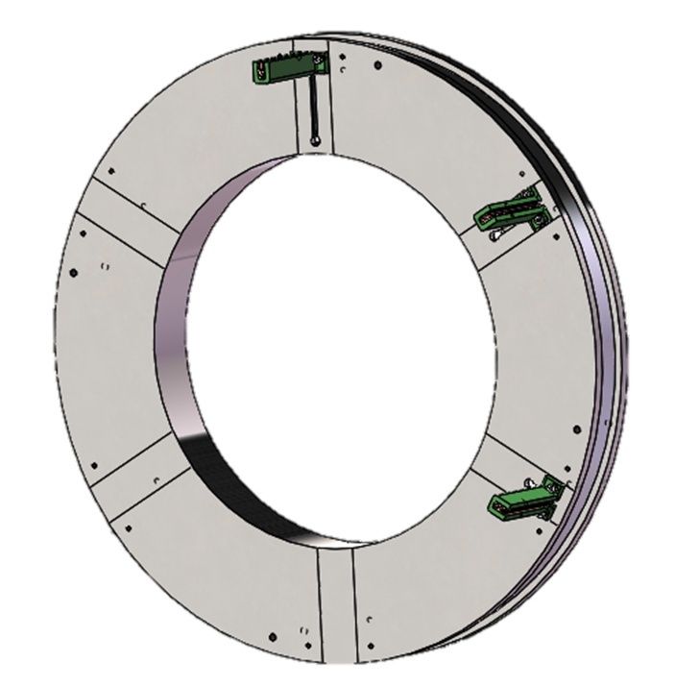
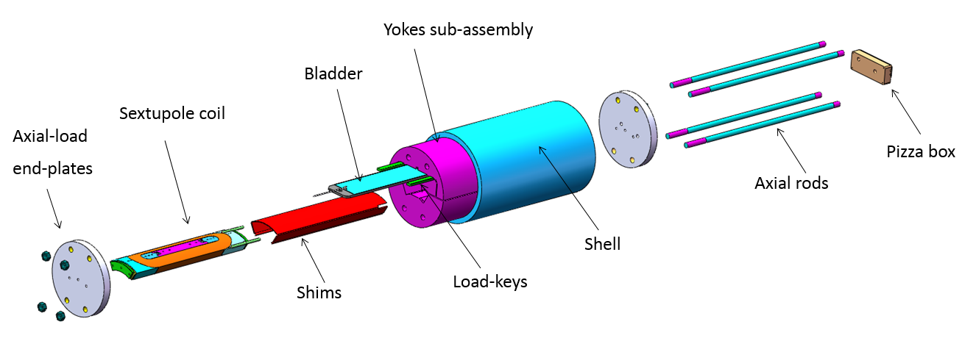
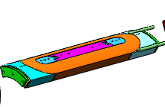
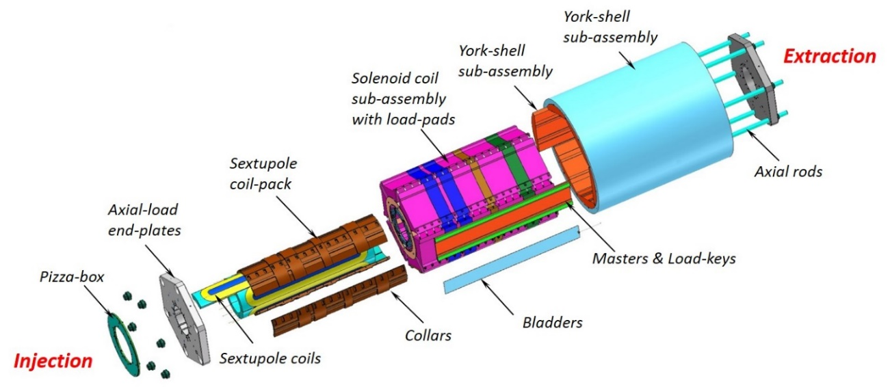
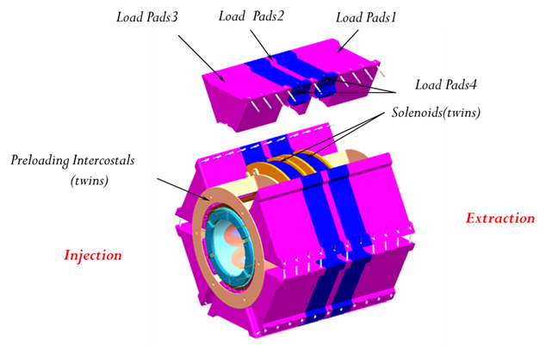
FECR Magnet
2015.07~2018.12
1. Coils prototyping
2. Key technologies validating and test
4. FECR full-length coldmass
（2021.10-2023.03）
3. ½ length coldmass prototype
（2017.11-2021.12）
Notes:
Needs: SHE, CEE, HIAF
HCI production: metallic beams with CAFe-2 (LECR5 & SECRAL 3), Uranium beam with HIRFL@SECRAL-I & SECRAL-II
New Techniques towards intense beams: HTO, Vlasov launcher, 2-frequency AG, Biased probe + AG effect
HIAF requirements in long range, FECR

Slide 9
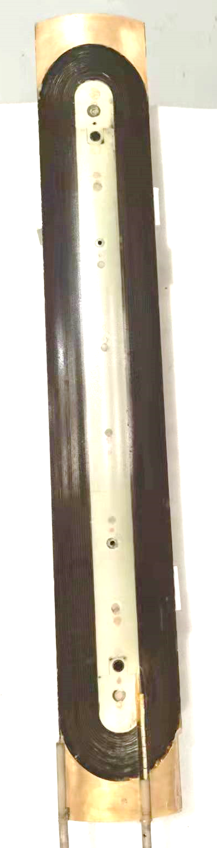
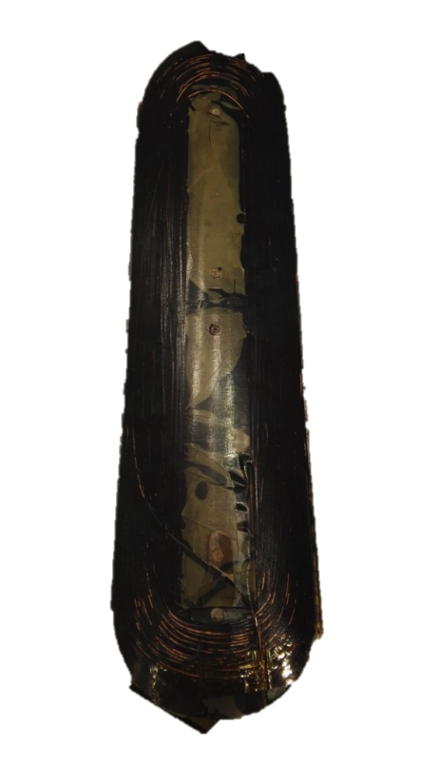
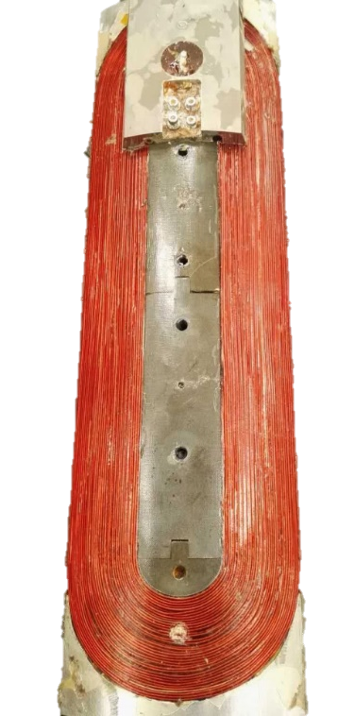
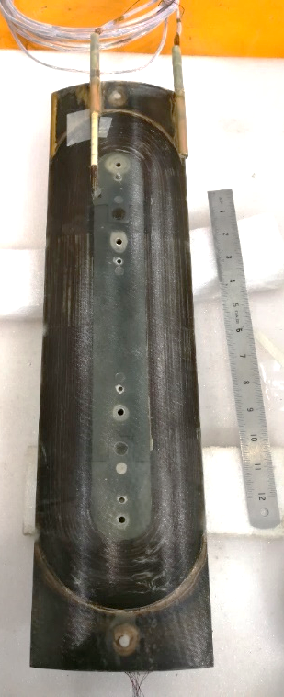
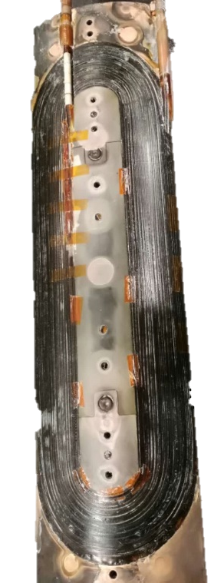
FECR Magnet
2017.02
2017.08
2018.03
2018.12
2021.03
Notes:
Needs: SHE, CEE, HIAF
HCI production: metallic beams with CAFe-2 (LECR5 & SECRAL 3), Uranium beam with HIRFL@SECRAL-I & SECRAL-II
New Techniques towards intense beams: HTO, Vlasov launcher, 2-frequency AG, Biased probe + AG effect
HIAF requirements in long range, FECR

Slide 10
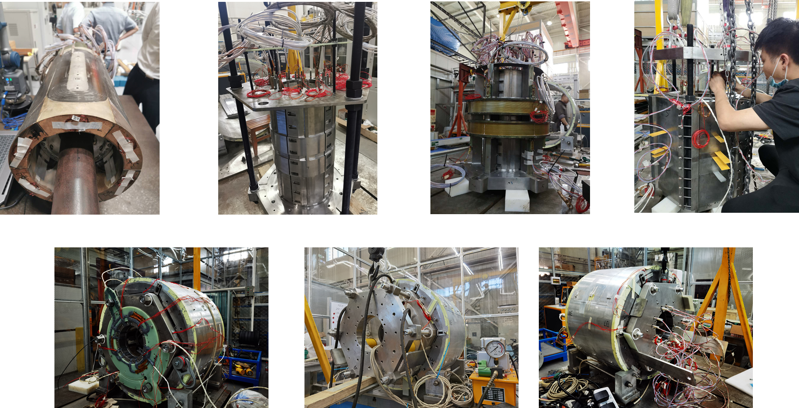
FECR Magnet
Notes:
Needs: SHE, CEE, HIAF
HCI production: metallic beams with CAFe-2 (LECR5 & SECRAL 3), Uranium beam with HIRFL@SECRAL-I & SECRAL-II
New Techniques towards intense beams: HTO, Vlasov launcher, 2-frequency AG, Biased probe + AG effect
HIAF requirements in long range, FECR

Slide 11
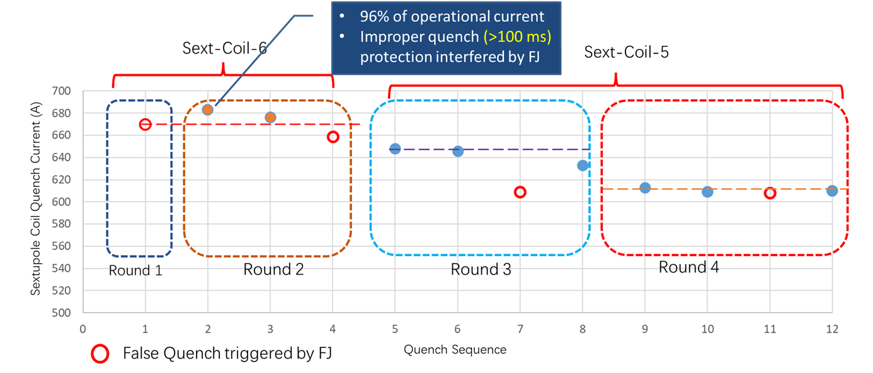
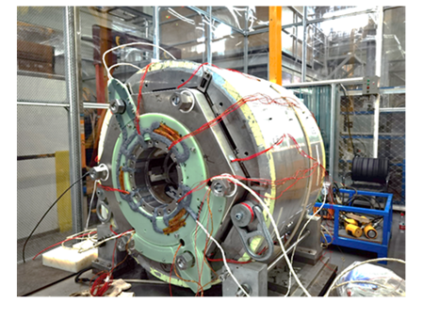
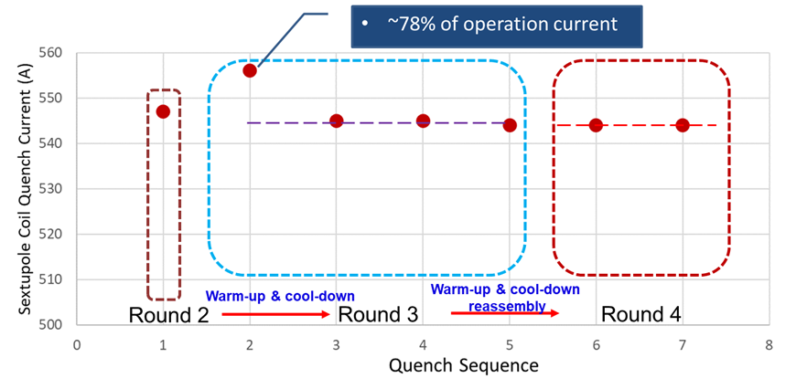
FECR Magnet
Solenoids & Sextupole coil both reach their 100% design currents
Sextupole coil assembly reaches its 96% design currents
Key issues:
Quench protection
Coils degradation
Notes:
Needs: SHE, CEE, HIAF
HCI production: metallic beams with CAFe-2 (LECR5 & SECRAL 3), Uranium beam with HIRFL@SECRAL-I & SECRAL-II
New Techniques towards intense beams: HTO, Vlasov launcher, 2-frequency AG, Biased probe + AG effect
HIAF requirements in long range, FECR

Slide 12
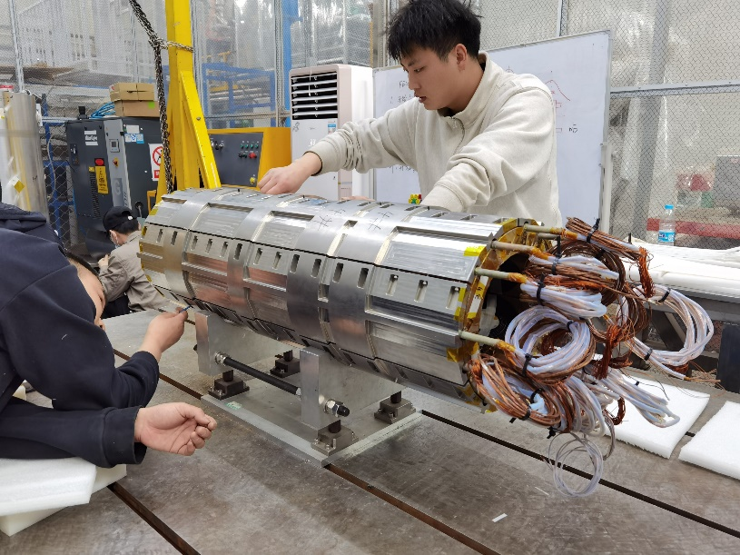
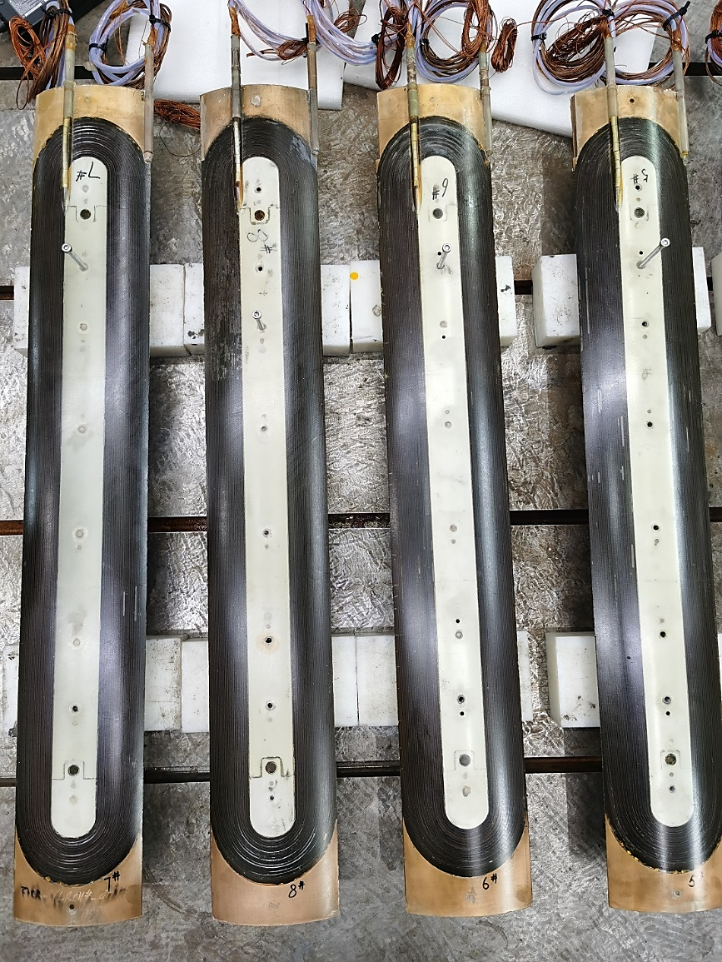
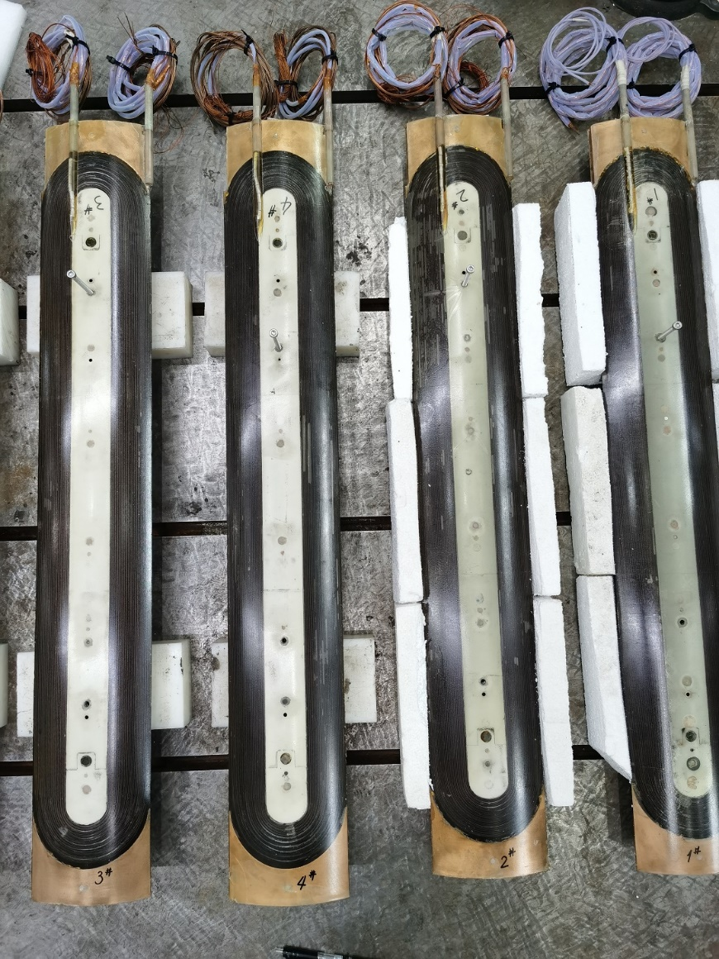
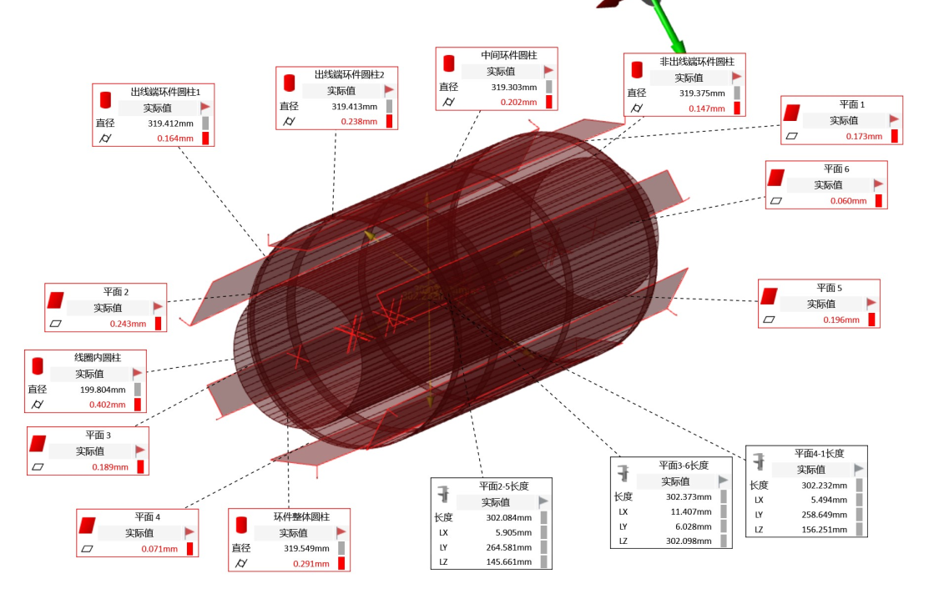
FECR Magnet
Notes:
Needs: SHE, CEE, HIAF
HCI production: metallic beams with CAFe-2 (LECR5 & SECRAL 3), Uranium beam with HIRFL@SECRAL-I & SECRAL-II
New Techniques towards intense beams: HTO, Vlasov launcher, 2-frequency AG, Biased probe + AG effect
HIAF requirements in long range, FECR

Slide 13
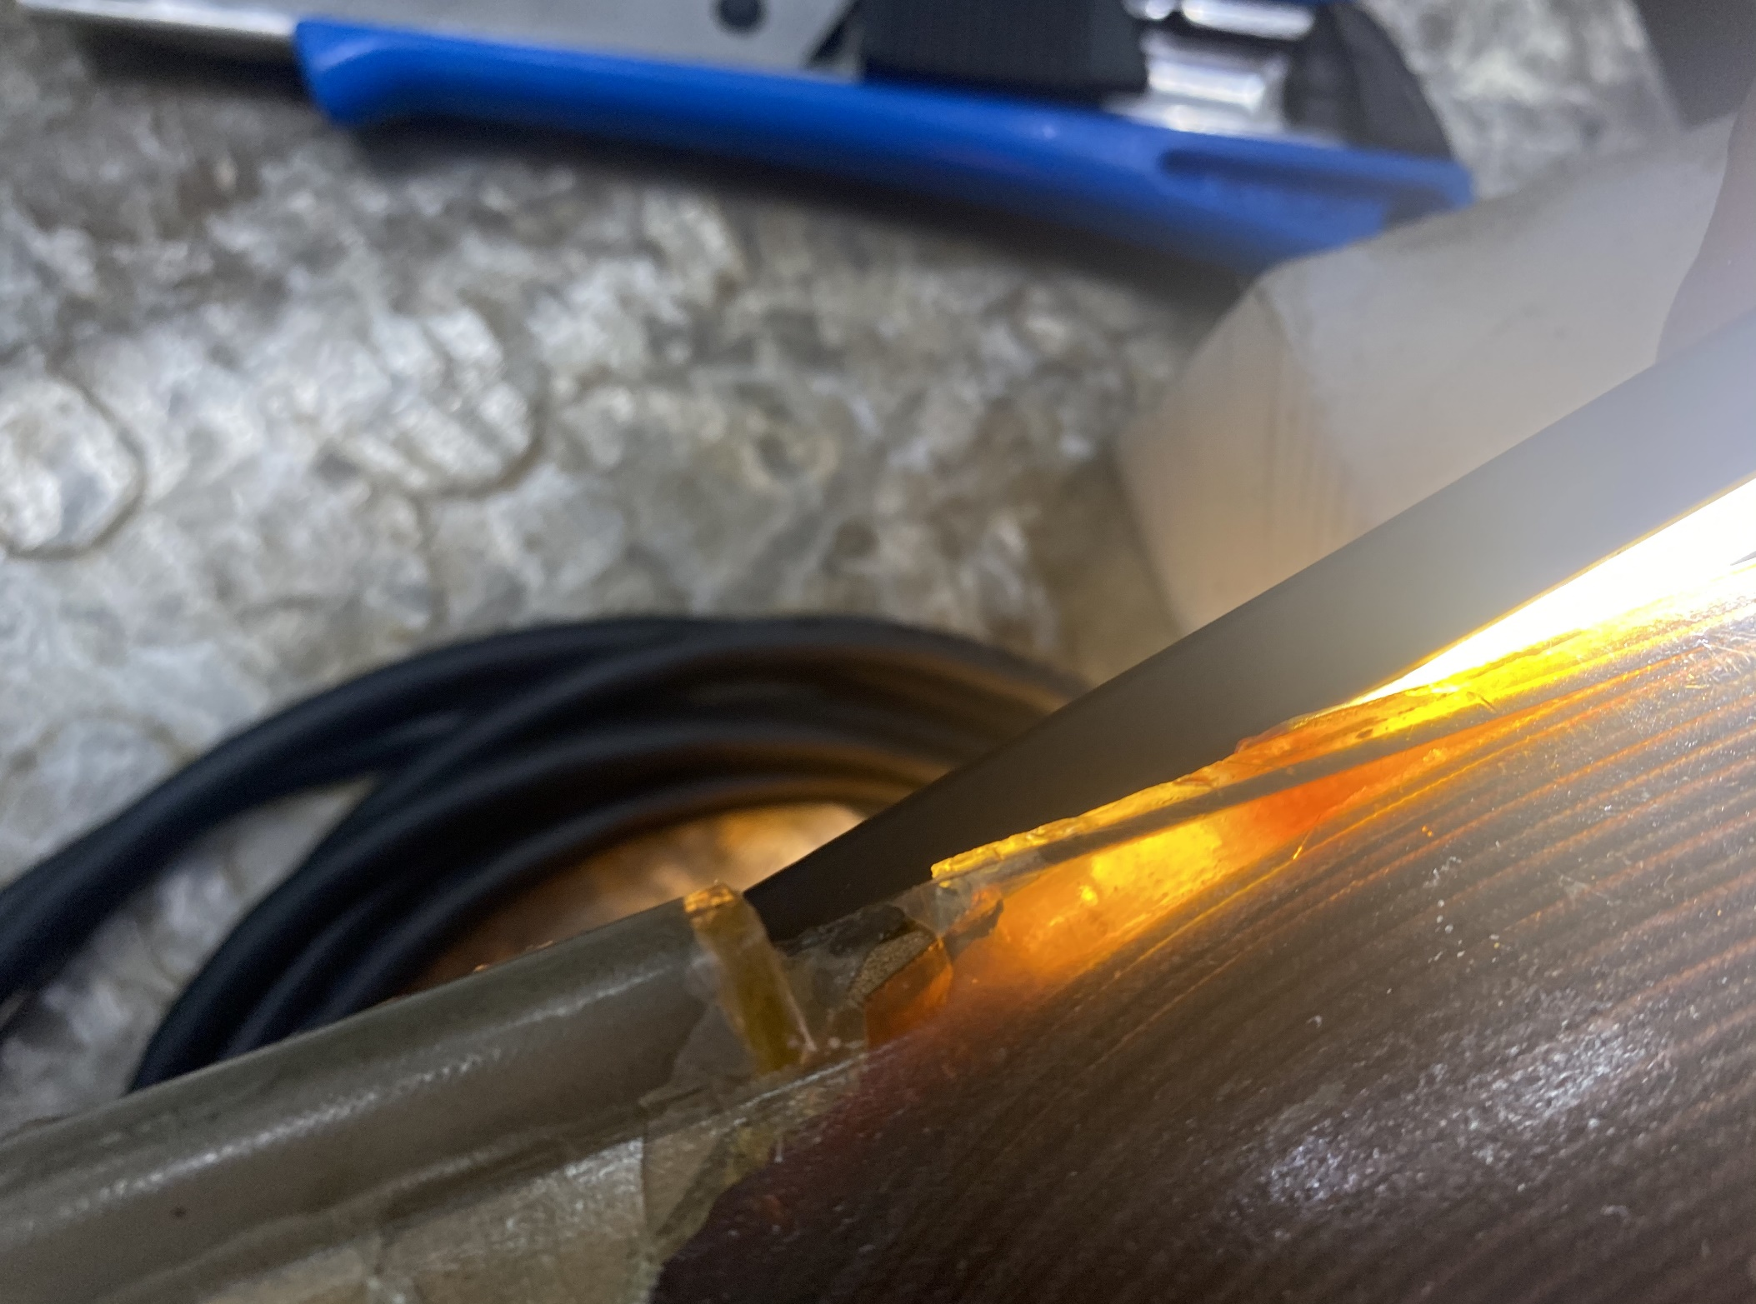
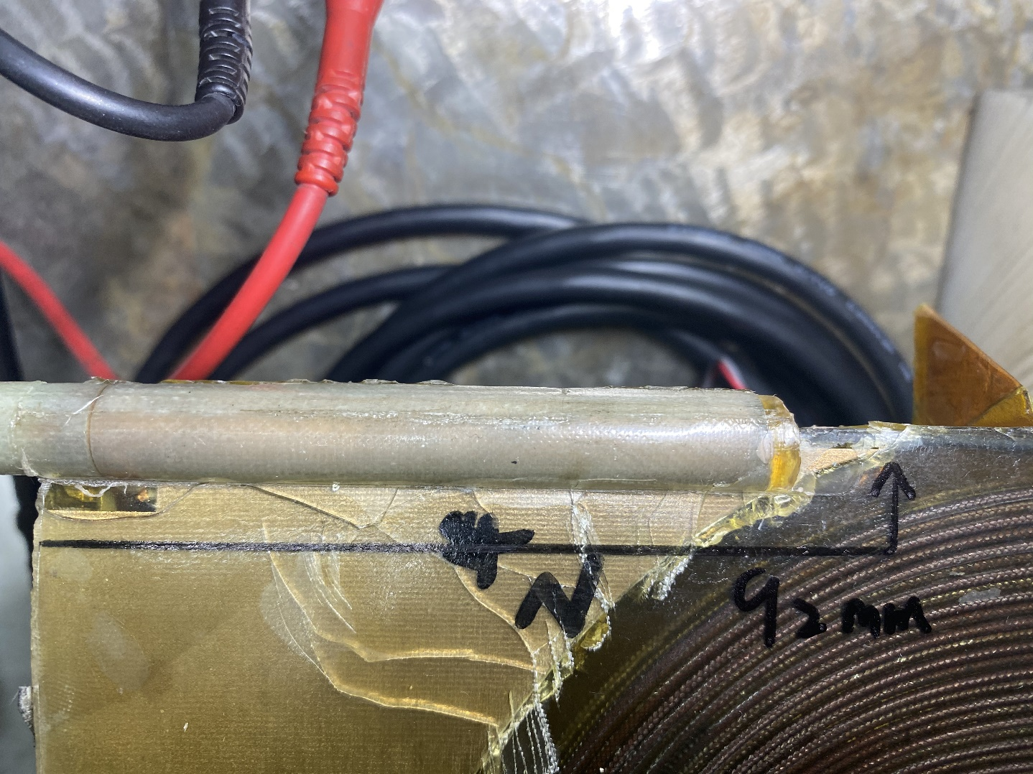
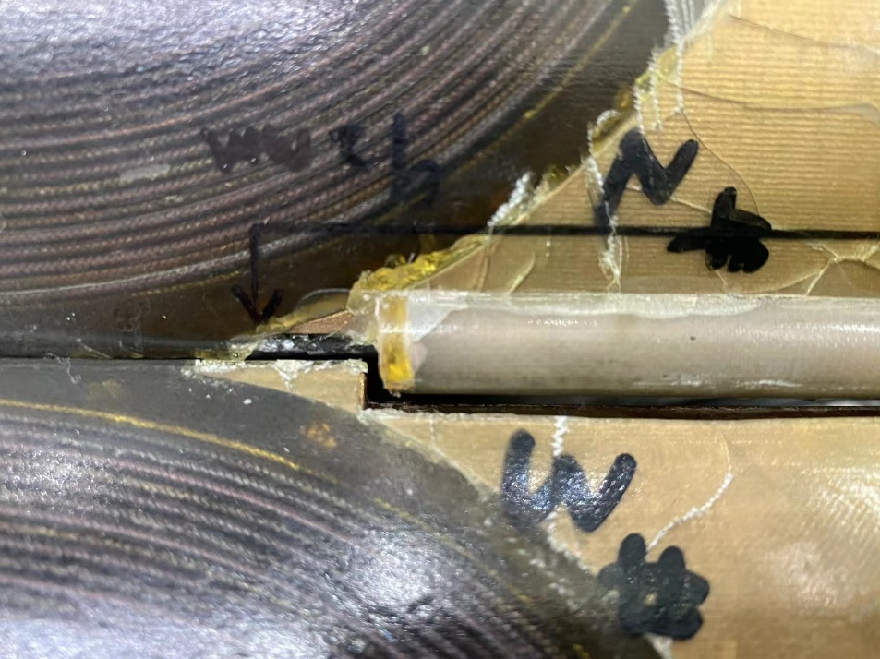
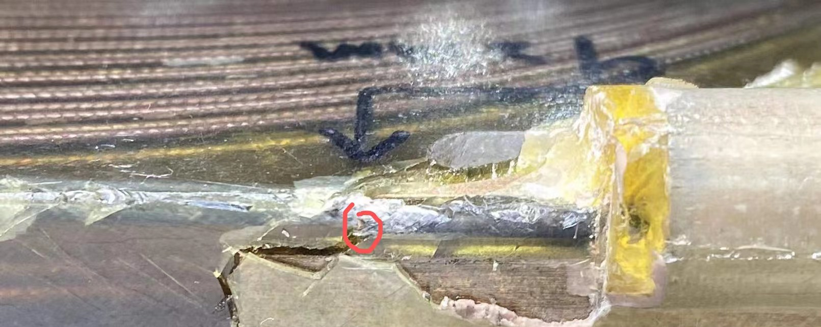
FECR Magnet
Notes:
Needs: SHE, CEE, HIAF
HCI production: metallic beams with CAFe-2 (LECR5 & SECRAL 3), Uranium beam with HIRFL@SECRAL-I & SECRAL-II
New Techniques towards intense beams: HTO, Vlasov launcher, 2-frequency AG, Biased probe + AG effect
HIAF requirements in long range, FECR

Slide 14
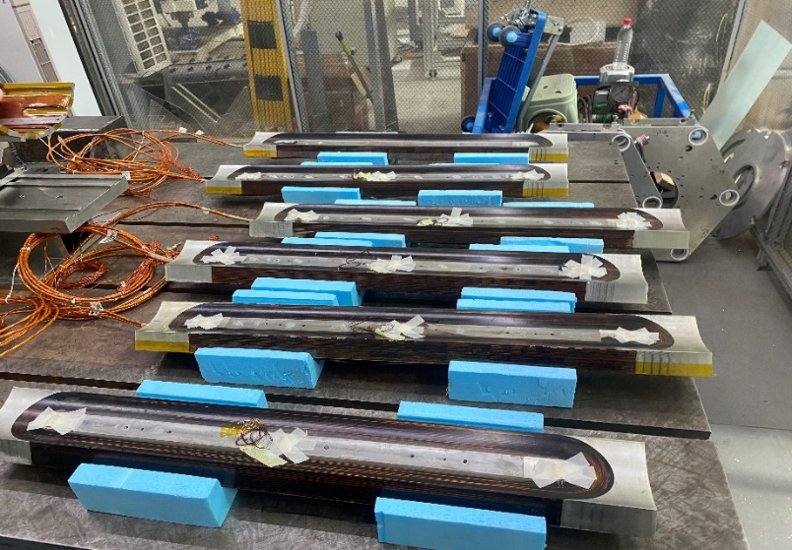
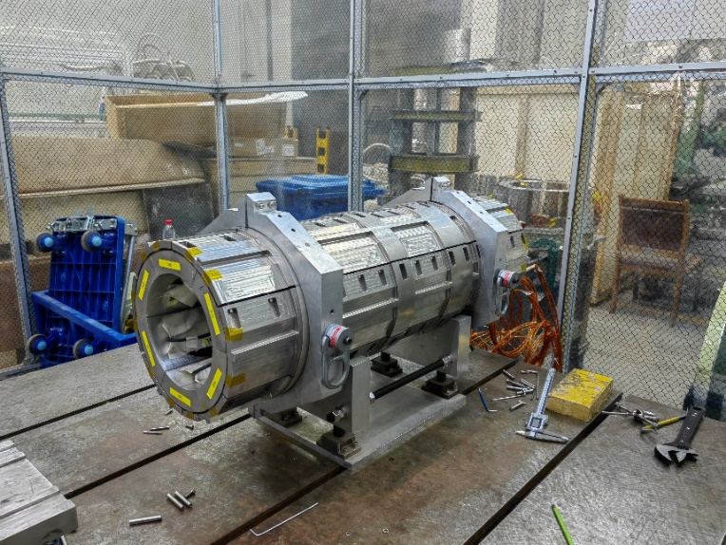
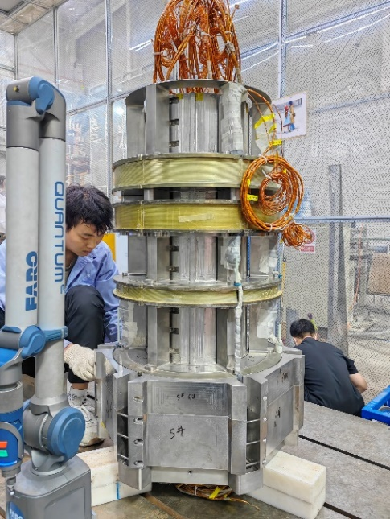
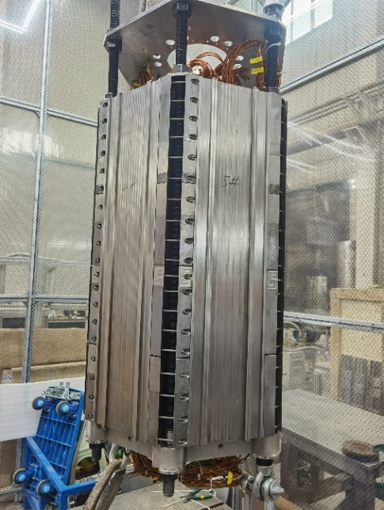
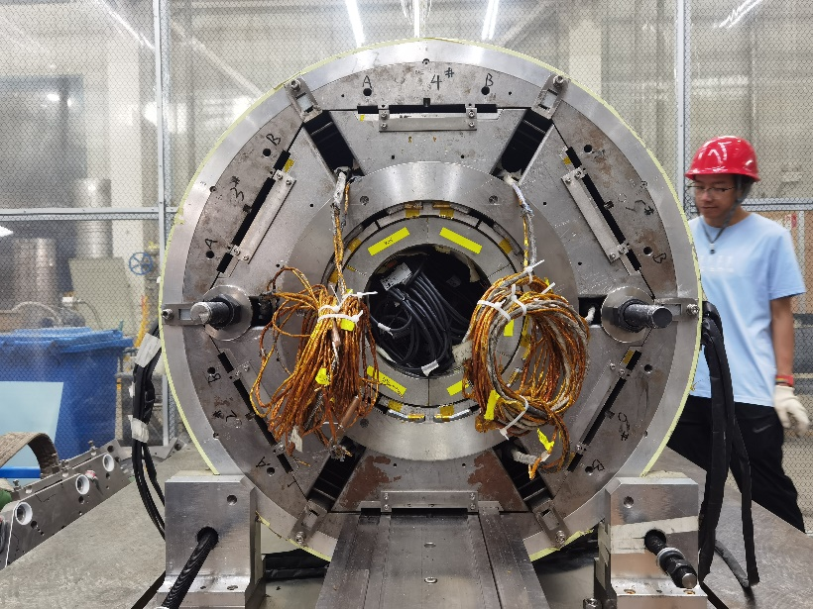
FECR Magnet
Using NbTi sextupole coils to replace Nb₃Sn ones
Maintain the cold mass structure identical to the previous design
Notes:
Needs: SHE, CEE, HIAF
HCI production: metallic beams with CAFe-2 (LECR5 & SECRAL 3), Uranium beam with HIRFL@SECRAL-I & SECRAL-II
New Techniques towards intense beams: HTO, Vlasov launcher, 2-frequency AG, Biased probe + AG effect
HIAF requirements in long range, FECR

Slide 15
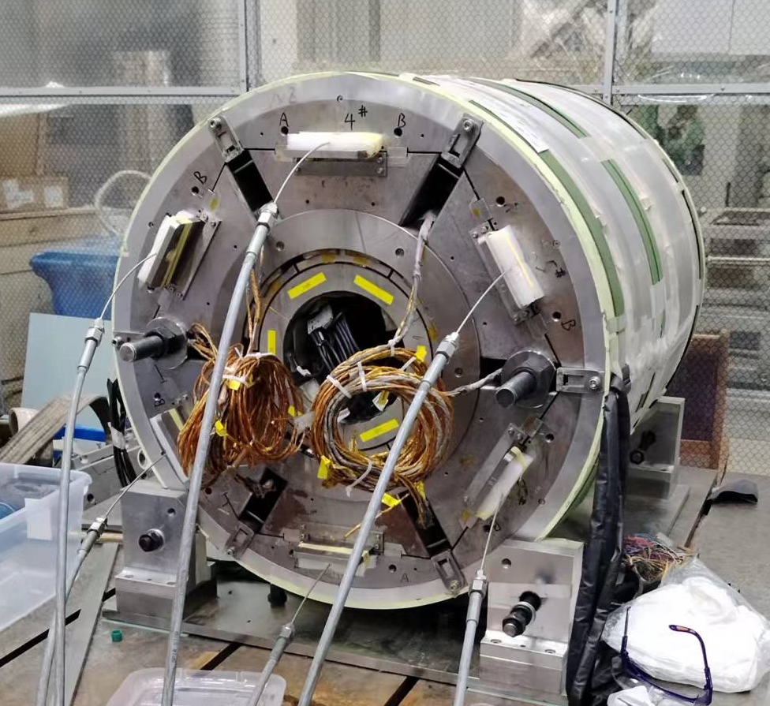
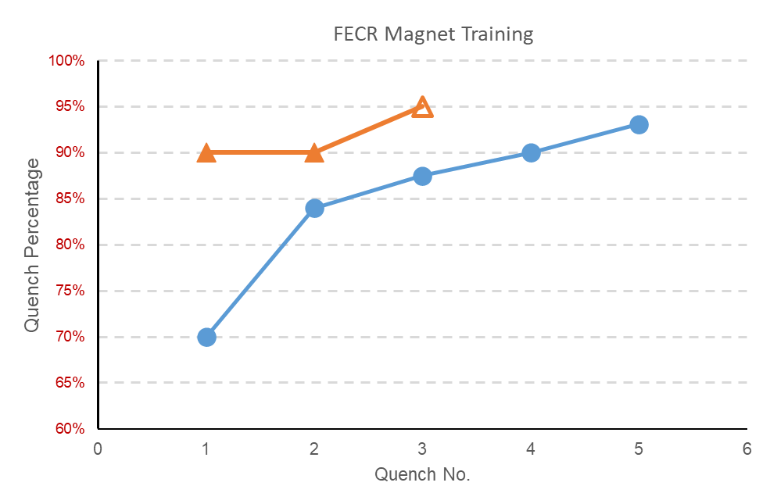
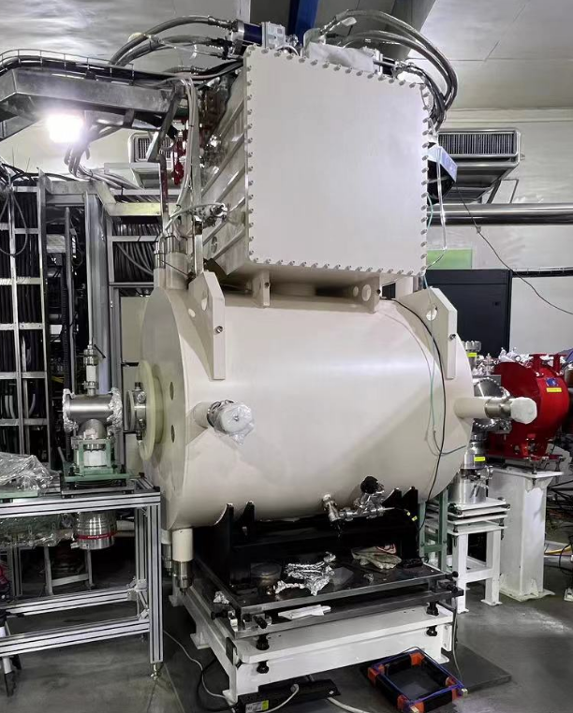
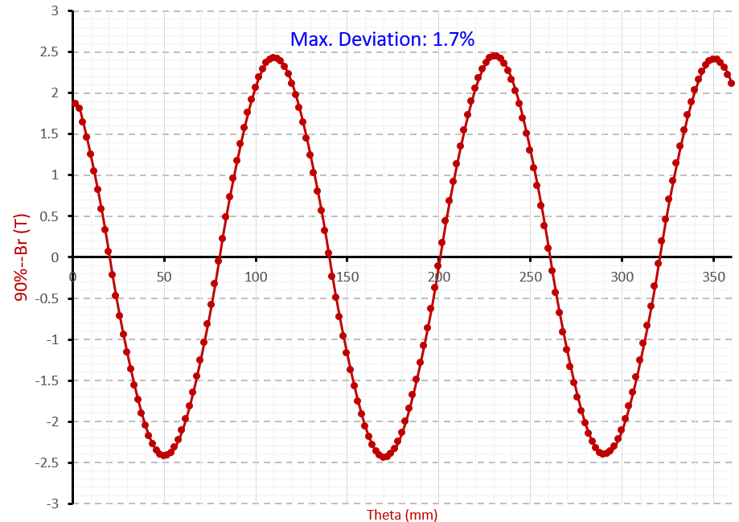
FECR Magnet
Magnet test
Coldmass test
FECR cold mass
Radial field mapping at 90% design currents
Br_{100%}~2.7 T
FECR Magnet
Notes:
Needs: SHE, CEE, HIAF
HCI production: metallic beams with CAFe-2 (LECR5 & SECRAL 3), Uranium beam with HIRFL@SECRAL-I & SECRAL-II
New Techniques towards intense beams: HTO, Vlasov launcher, 2-frequency AG, Biased probe + AG effect
HIAF requirements in long range, FECR

Slide 16
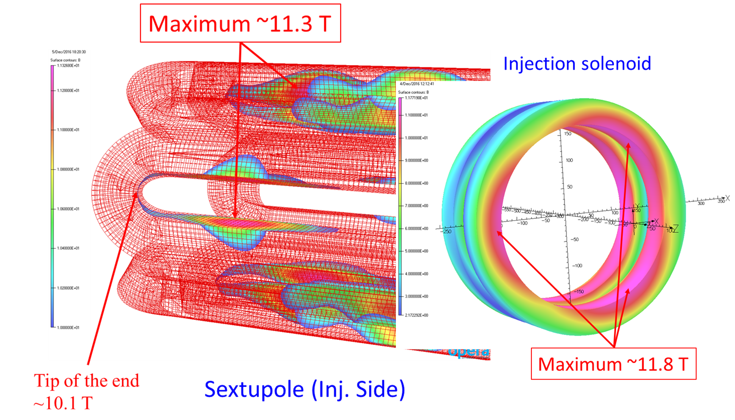
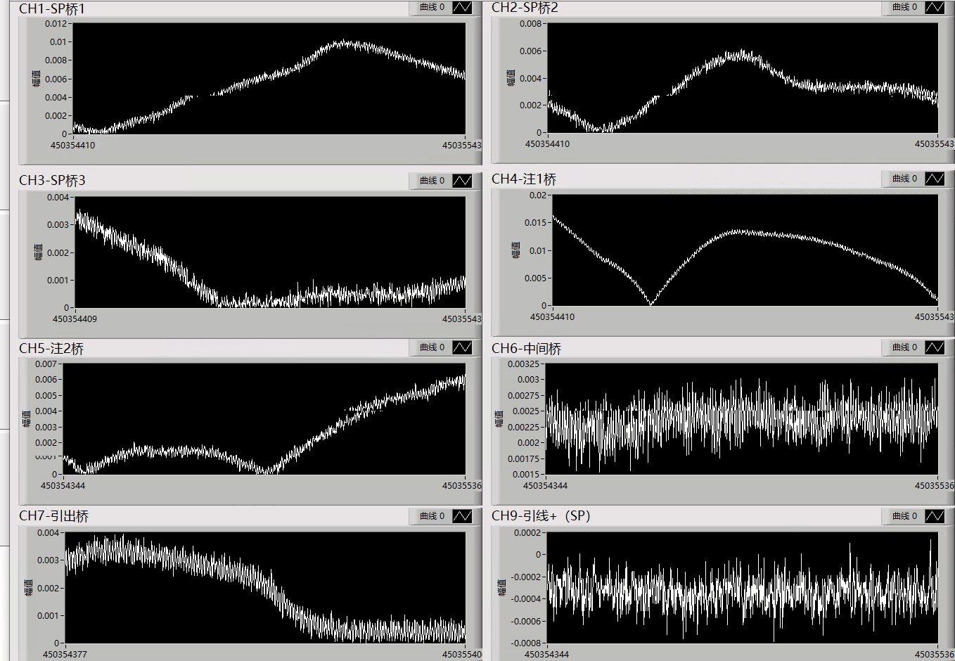
FECR Magnet
Strong Flux Jump Interferes Magnet Operation
Notes:
Needs: SHE, CEE, HIAF
HCI production: metallic beams with CAFe-2 (LECR5 & SECRAL 3), Uranium beam with HIRFL@SECRAL-I & SECRAL-II
New Techniques towards intense beams: HTO, Vlasov launcher, 2-frequency AG, Biased probe + AG effect
HIAF requirements in long range, FECR

Slide 17
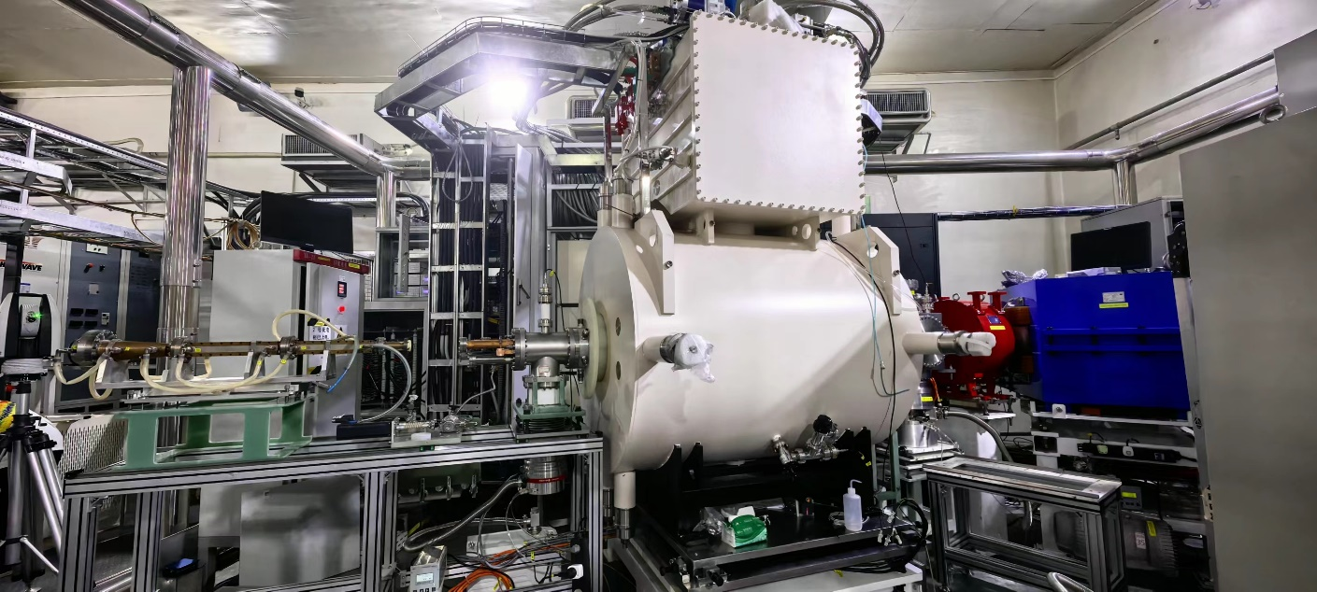
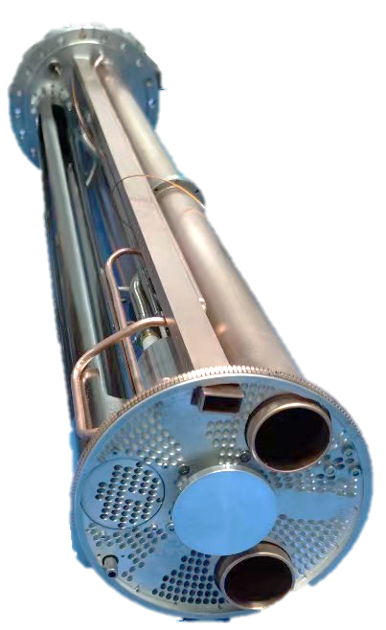
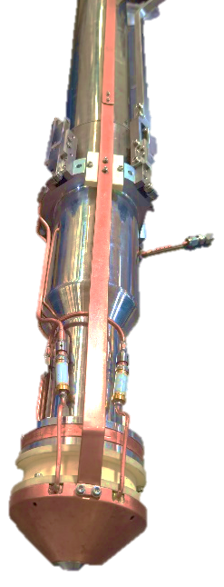
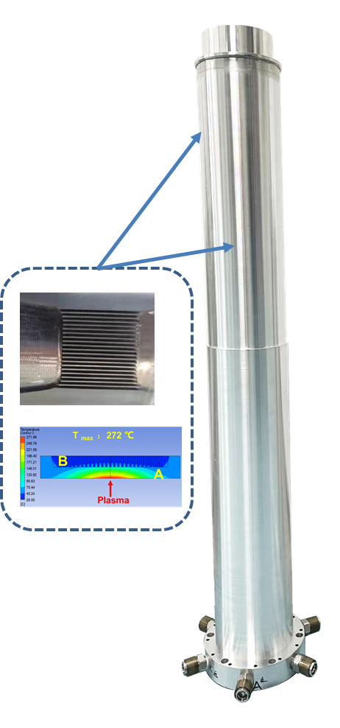
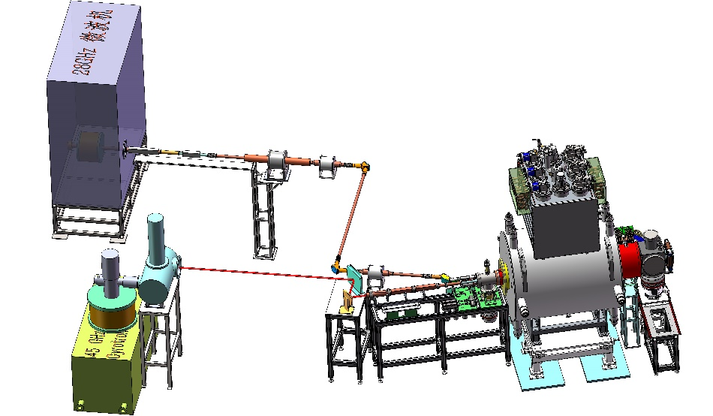
FECR Commissioning
Parameters | Value
Microwave | 45 GHz + 28 GHz
45 GHz Power | 20 kW
28 GHz Power | 10 kW
Typical operation fields | Mirror peaks: 3.9 T/2.1 T B_{r}= 2.3 T
Commissioned ions | O, Xe, Bi
Operation voltage | 25 kV
FECR
28 GHz
Oversized WG
FECR
45 GHz
Quasi-optical
Micro-channel plasma chamber
Conventional Injection setup
Movable Extraction electrodes
Notes:
Needs: SHE, CEE, HIAF
HCI production: metallic beams with CAFe-2 (LECR5 & SECRAL 3), Uranium beam with HIRFL@SECRAL-I & SECRAL-II
New Techniques towards intense beams: HTO, Vlasov launcher, 2-frequency AG, Biased probe + AG effect
HIAF requirements in long range, FECR

Slide 18
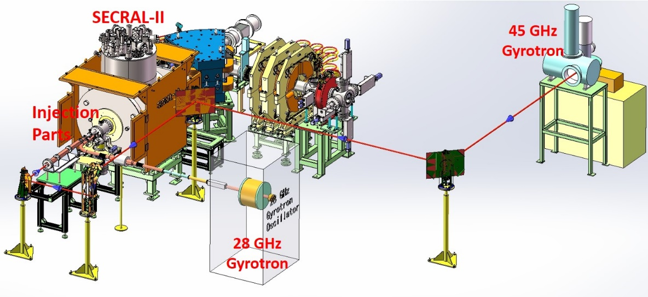
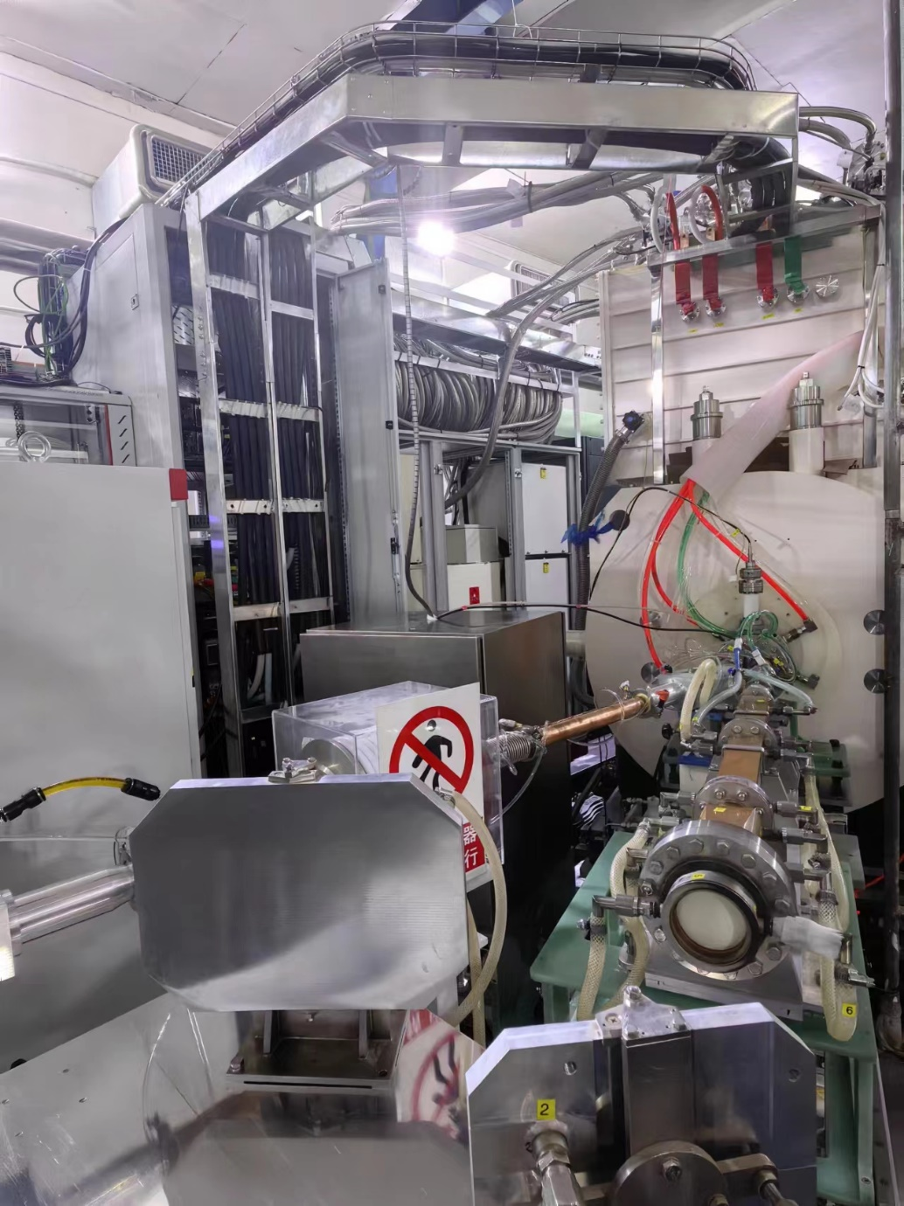
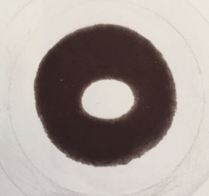
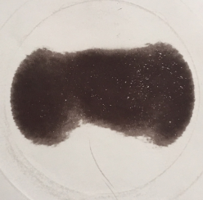
FECR Commissioning
Quasi optical microwave coupling
TE₀₁
HE₁₁
Notes:
Needs: SHE, CEE, HIAF
HCI production: metallic beams with CAFe-2 (LECR5 & SECRAL 3), Uranium beam with HIRFL@SECRAL-I & SECRAL-II
New Techniques towards intense beams: HTO, Vlasov launcher, 2-frequency AG, Biased probe + AG effect
HIAF requirements in long range, FECR

Slide 19

FECR Commissioning
Key Parameters | FECR Chamber | SECRAL-II Chamber
Max. Microwave Power | 25 kW | 12 kW
Max. Localized Power Density | 20 MW/m² | 10 MW/m²
Chamber ID | Ø140 mm | Ø125 mm
Chamber OD | Ø156 mm | Ø136 mm
Length | 1225 mm | 887 mm
Microchannel region | 15×15.6×1.5 mm³ | 15×15.6×1.0 mm³
Fins | 0.4 mm×19 | 0.4 mm×19
Channel | 0.4 mm×20 | 0.4 mm×20
Inside-wall thickness | 1.5 mm | 1.5 mm
Outside-wall thickness | 1.5 mm | 1.5 mm
Water pressure | 10 bar | 8.9 bar
Water flow per channel | ＞ 15 L/m | ＞ 4.0 L/m
Total water flow | ＞ 50 L/m | ＞ 13 L/m
FECR
Chamber
SECRAL-II
Chamber
Notes:
Needs: SHE, CEE, HIAF
HCI production: metallic beams with CAFe-2 (LECR5 & SECRAL 3), Uranium beam with HIRFL@SECRAL-I & SECRAL-II
New Techniques towards intense beams: HTO, Vlasov launcher, 2-frequency AG, Biased probe + AG effect
HIAF requirements in long range, FECR

Slide 20

FECR Commissioning
Layout of LEAF Platform
FC5
FECR
FC1
RFQ
Notes:
Needs: SHE, CEE, HIAF
HCI production: metallic beams with CAFe-2 (LECR5 & SECRAL 3), Uranium beam with HIRFL@SECRAL-I & SECRAL-II
New Techniques towards intense beams: HTO, Vlasov launcher, 2-frequency AG, Biased probe + AG effect
HIAF requirements in long range, FECR

Slide 21

FECR Commissioning
FECR
RFQ
HV
Platform
Notes:
Needs: SHE, CEE, HIAF
HCI production: metallic beams with CAFe-2 (LECR5 & SECRAL 3), Uranium beam with HIRFL@SECRAL-I & SECRAL-II
New Techniques towards intense beams: HTO, Vlasov launcher, 2-frequency AG, Biased probe + AG effect
HIAF requirements in long range, FECR

Slide 22


FECR Commissioning
Bi³⁵⁺
0.23 emA Bi³⁵⁺@60 mins
FECR: 360 eμA Bi³⁵⁺
CW acceleration of 0.23 emA @0.5 MeV/u Bi³⁵⁺
Notes:
Needs: SHE, CEE, HIAF
HCI production: metallic beams with CAFe-2 (LECR5 & SECRAL 3), Uranium beam with HIRFL@SECRAL-I & SECRAL-II
New Techniques towards intense beams: HTO, Vlasov launcher, 2-frequency AG, Biased probe + AG effect
HIAF requirements in long range, FECR

Slide 23



Scope and Summary
New Nb₃Sn coil
Quench Protection
Coils Safe Assembly
Notes:
Needs: SHE, CEE, HIAF
HCI production: metallic beams with CAFe-2 (LECR5 & SECRAL 3), Uranium beam with HIRFL@SECRAL-I & SECRAL-II
New Techniques towards intense beams: HTO, Vlasov launcher, 2-frequency AG, Biased probe + AG effect
HIAF requirements in long range, FECR

Slide 24
Scope and Summary
Prototype of next generation ECR ion source FECR is ready
Performance needs further exploration
Challenges
Magnet safety
Strategy of reliable operation
High operation current cryostat
Unseen issues during high performance commissioning

Slide 25

We are grateful to have all of you on board for this adventure!

