Slide 1
High frequency ECRIS: results and developments
High frequency (HF) : ≥ 24GHz
1. 28 GHz ECRIS may have not yet reached its peak performance? What new ideas and technologies may further enhance performance of 28 GHz ECRIS?
2. Maximum performance in tens minutes at high RF power for HF ECRIS, but practically accelerator needs moderate and very stable performance in long-term operation. Plasma stability and beam stability issues for HF ECRIS.
3. Hot electrons and microwave heating including multi-frequency heating issues for HF ECRIS.
New ideas, new technologies, particularly physical path might be the only way to continue the ECRIS future development in the community !

Slide 2
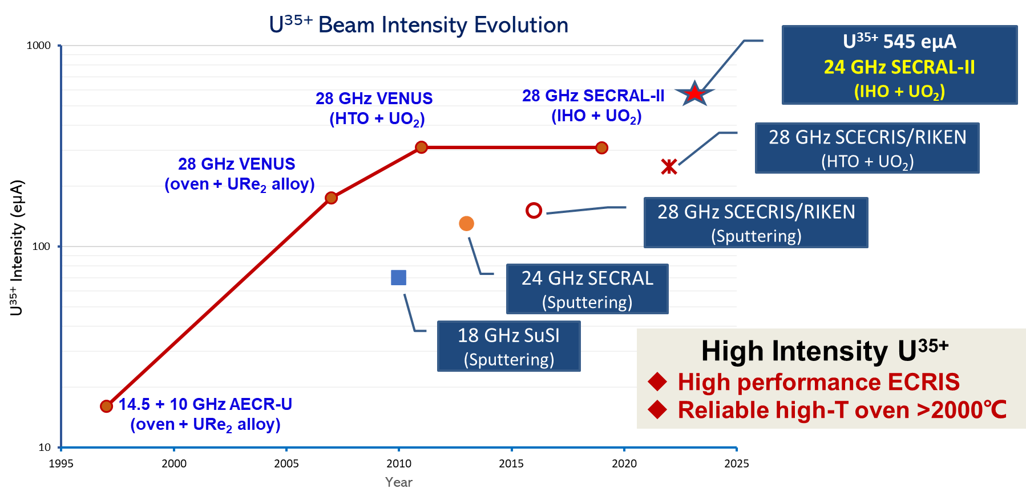
Discussion 1
1. 28 GHz SC ECRIS may have not yet reached its peak performance? What new ideas and technologies may further enhance 28 GHz SC ECRIS?

Slide 3
Discussion 2
2. Maximum performance in tens minutes at high RF power for HF ECRIS, but practically need moderate and very stable performance in long-term operation. Plasma stability and beam stability issues for HF ECRIS
Can HF ECRIS be in long-term operation (>5 day continuously) with better stability at its maximum performance with high RF power (>8 kW) ?
Why ECRIS performance is not stable at higher RF power and what is the physics behind?
Why beam stability at maximum performance is so sensitive to RF power, gas pressure and magnetic fields? Why so critical ?
How to reduce or get rid of the beam current oscillations on the scale of hundreds microseconds or tens---hundreds kHz? Is this related to ECR plasma kinetic instabilities driven by the hot electrons whose transverse velocity dominates over the longitudinal one?
Can AI and ML help and improve the long-term stability for the HF ECRIS?

Slide 4
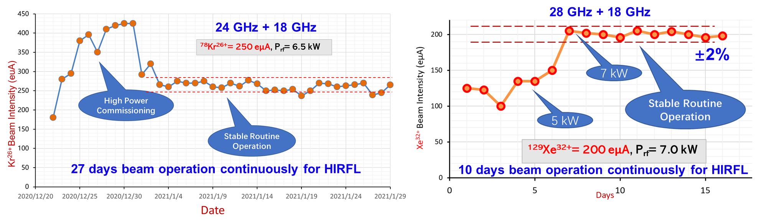
SECRAL-II examples
±7.6%

Slide 5
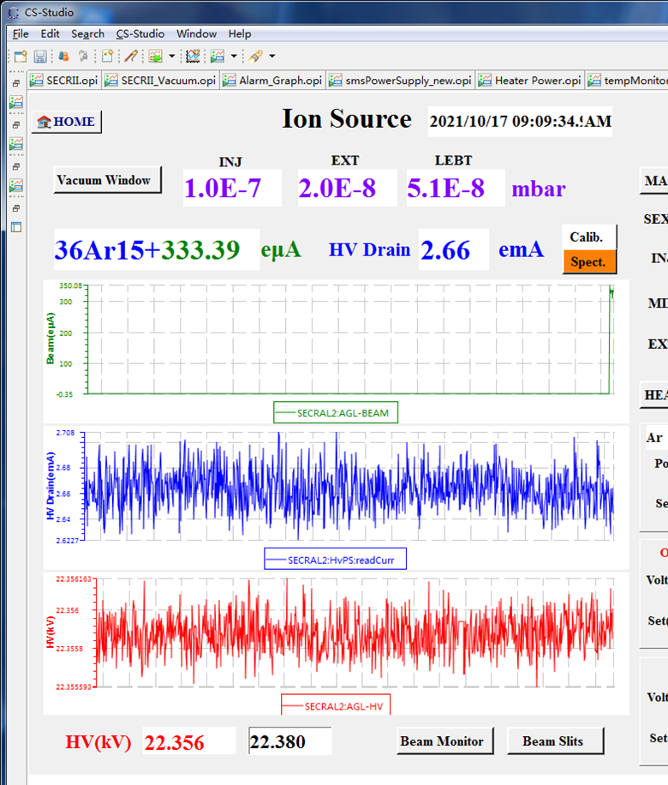
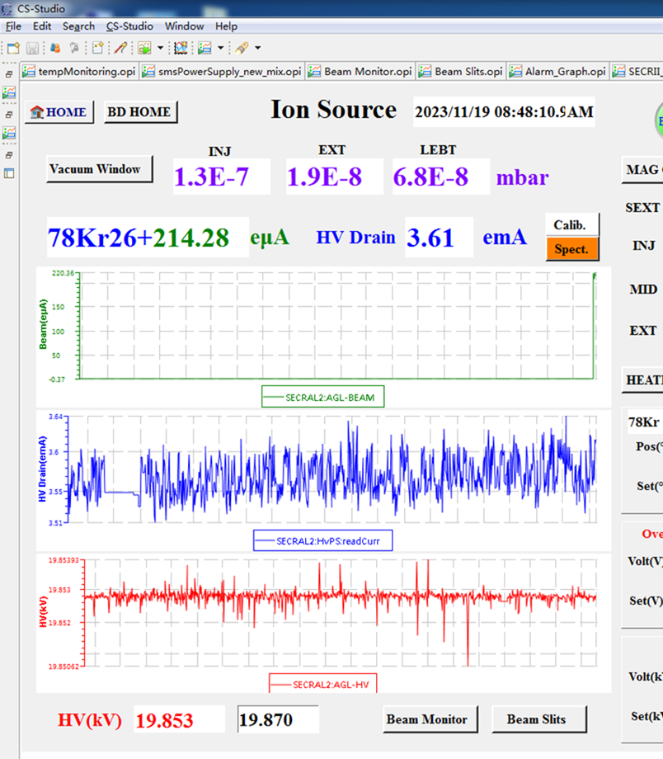
SECRAL-II examples
±1.1%
±1.1%
±0.002%
±0.003%

Slide 6
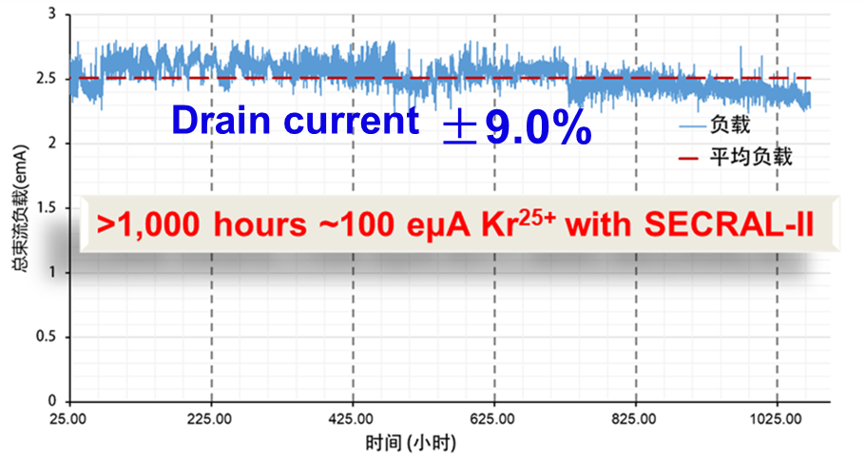
SECRAL-II examples
Time (hours)

Slide 7
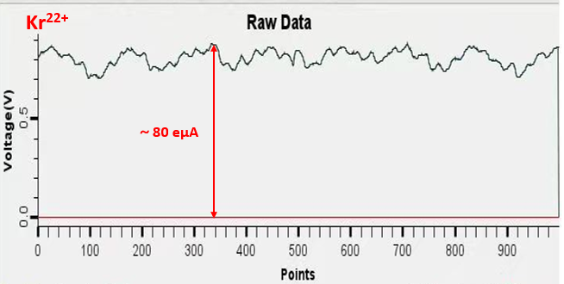
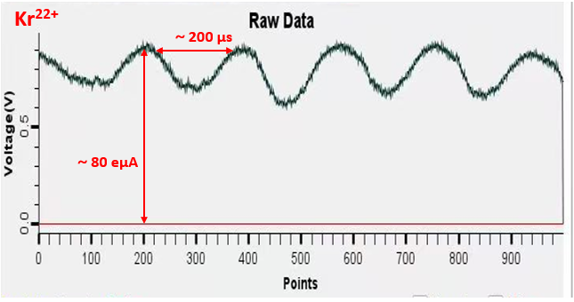
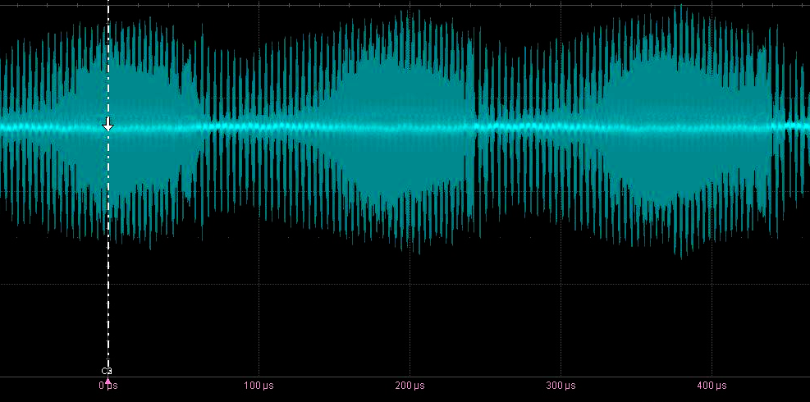
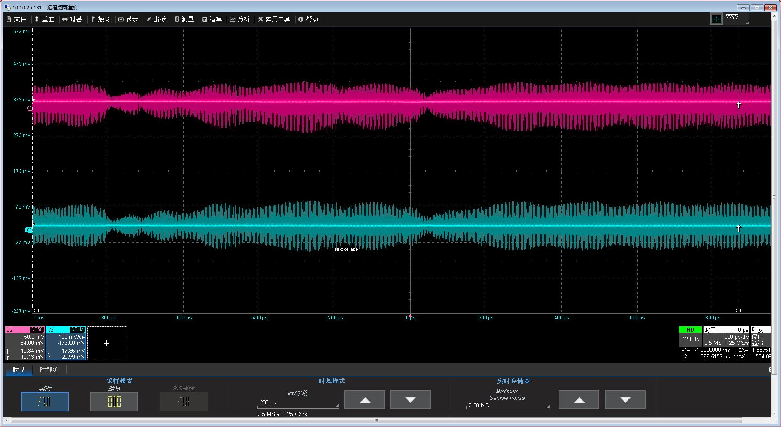
SECRAL-II examples
Faraday cup signal after analyzing magnet
Phase probe signal after SFC
Parameter optimization

Slide 8
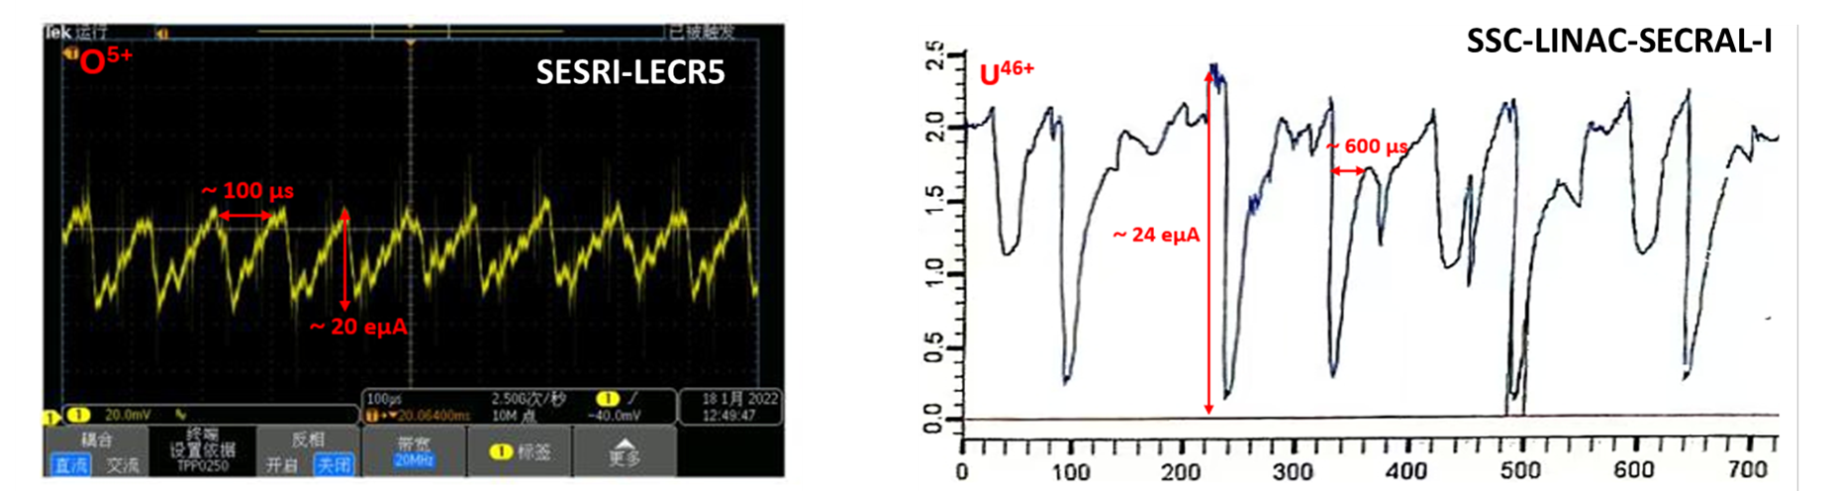
SECRAL-I and LECR5 examples

Slide 9
Discussion 3
3. Hot electrons and microwave heating including multi-frequency heating issues for HF ECRIS.
What electron energy spectrum or distribution would a HF ECRIS really need particularly for higher intensity and higher charge state beam production ?
Contributions of warm electrons ( keV-tens keV) and hot electrons (>100 keV) both are very important for HCI production. Detailed functions of the hot electrons which have been discussed many years by many of ECR colleagues, still not so clear!
The hot electrons are related to Binj/Becr, Bmin, field gradient near the resonance, RF frequency and power,….
The hot electrons are quite headache: ECR plasma instabilities, heating up to the plasma chamber and cryostat of SC magnet …..
Two or multi-frequency heating issues.
Real physics behind multi-frequency heating? Typical two frequency heating is that primary frequency is higher than auxiliary frequency (18+14, 28+18 GHz).
Can primary frequency (related to B) be much lower than auxiliary frequency for two frequency heating?
Can a 18 GHz ECRIS work with 28 GHz auxiliary frequency and higher sextupole field?
FECR 45 GHz + 28 GHz results?

Slide 10
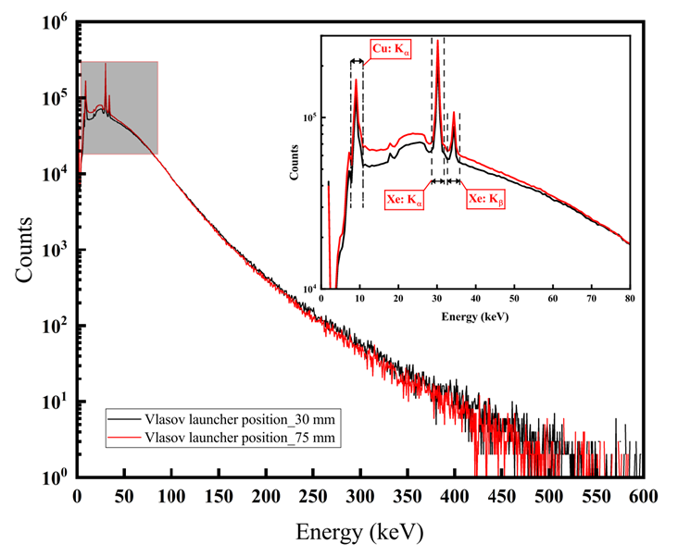
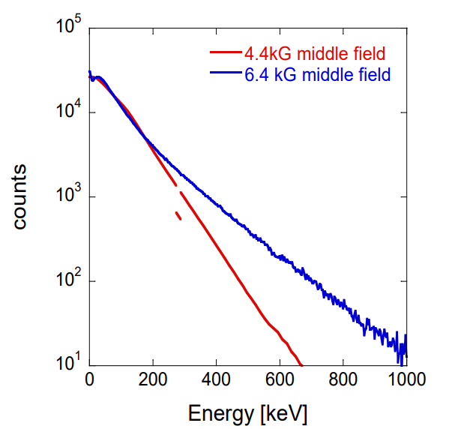
Discussion 3
© IMP, Jibo Li paper
© LBNL, Janilee Benitez paper

Slide 11
Thank you for all the speakers and questions, discussions !

Slide 12
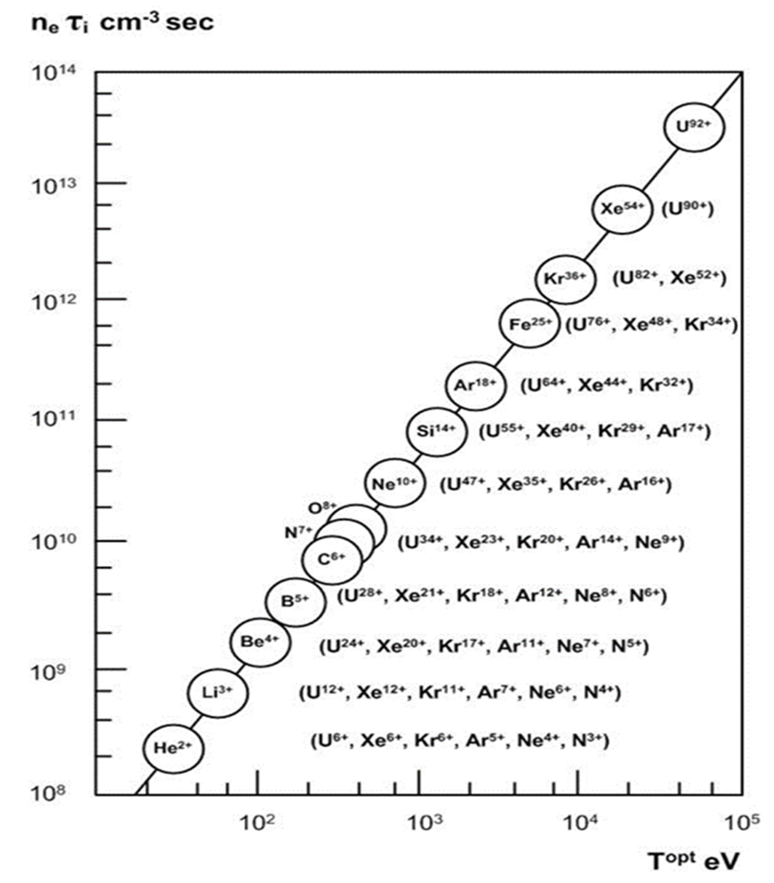
Discussions （Back-up）
4. Future HF ECRIS development issues
4th Generation 45-56 GHz, 5th Generation 74-84 GHz ? Shall we continue to go the way raising the RF frequency, the magnetic fields and the RF power?
The biggest challenges: Cost and long-time technical development
SC magnet, high power RF coupling, long-term stability at high RF power, heating to chamber and cryostat, beam emittance.
New ideas, new technologies, particularly physical path might be the only way to continue the ECRIS future development in the community !
5th G ECR
 | RF frequency | Maximum B field | RF power
4th G. ECRIS | 45-56 GHz | 12-15 T | 20 kW
5th G. ECRIS | 74-84 GHz | 20-23 T | 30 kW
4th G ECR
3rd G ECR

