Slide 1

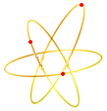
28-45 GHz ECRIS results and development at IMP
IMP
Hongwei Zhao， Liangting Sun
On behalf of IMP ECRIS team
Institute of Modern Physics, CAS, 730000, Lanzhou, China
PIBHI25 April 7-9, 2025, INFN-LNS, Catania, Italy

Slide 2
Outline
24-28 GHz SECRAL-I & SECRAL-II results and performance
45 GHz FECR results and performance
Discussion

Slide 3
Who needs high frequency ECRIS? (RF ≥ 24 GHz)
Most of cyclotrons do not need HF ECRIS (Axial injection with inflector and space-charge). Only the cyclotrons need to raise beam energy through higher charge state and also need higher beam intensity.
IMP SFC, LBNL-88 cyclotron..
Heavy ion linacs ( with RFQ) do need higher intensity with high charge state
FRIB, HIAF-iLinac, SPIRAL2, RIKEN linac-injector, IMP linac-injector…

Slide 4
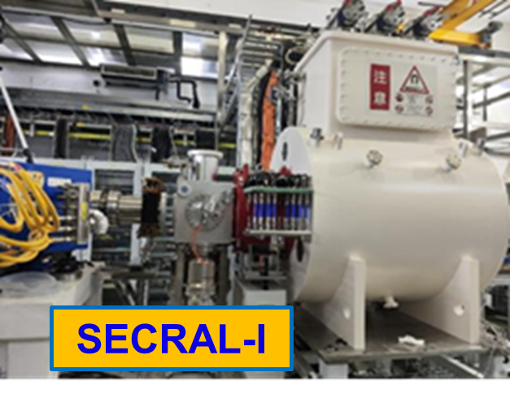
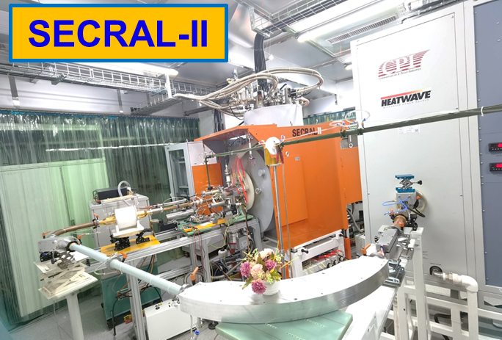
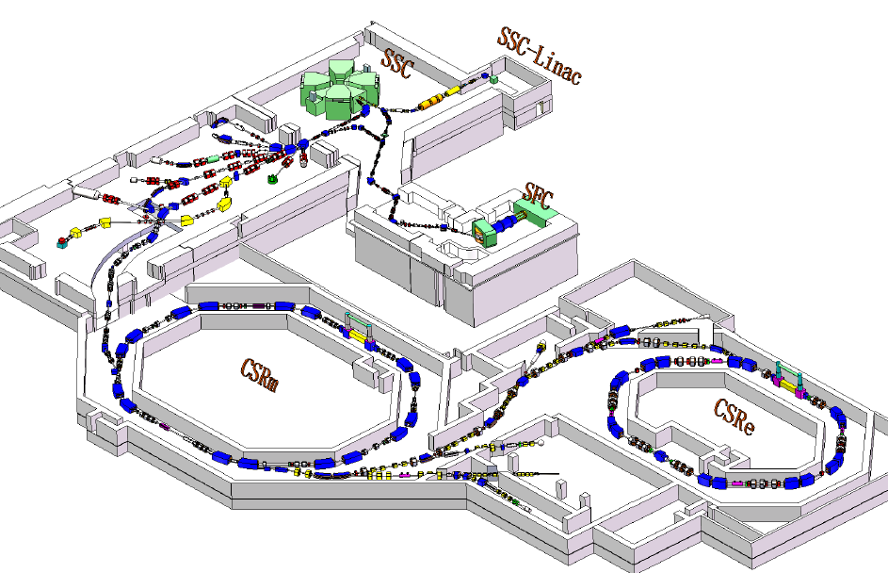
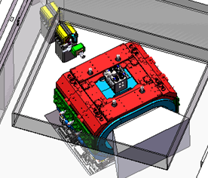
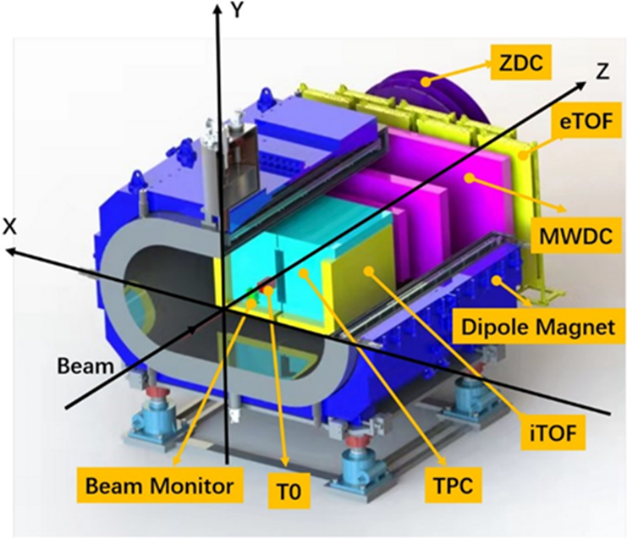
HIRFL requests high intensity HCI with SECRAL I&II
High Intensity
²³⁸U⁴⁶⁺ beam
SSC
SFC
CSRe
U⁴⁶⁺
SECRAL-I: U⁴⁶⁺
CSRm
ECR (50~100 eμA U⁴⁶⁺)→SSC-Linac→SSC→Striper→U⁷⁴⁺→CSRm→≥500 MeV/u U⁷⁴⁺
U⁷⁴⁺
Physics | Needed Ion Beam Energy (MeV/u)
Equation of state of nuclear matter at low temperature and high density Quarkonium symmetry energy | Xe: 10⁵pps E = 400 - 600
 | C: 10⁵pps E = 400 - 600
Baryon number fluctuations QCD critical point | ²³⁸U^{7x+}: 10⁴ pps E = 500－700
 | C: 10⁵ pps E = 500
HIRFL
facility layout
CEE
CSR External target Experiment
CEE

Slide 5
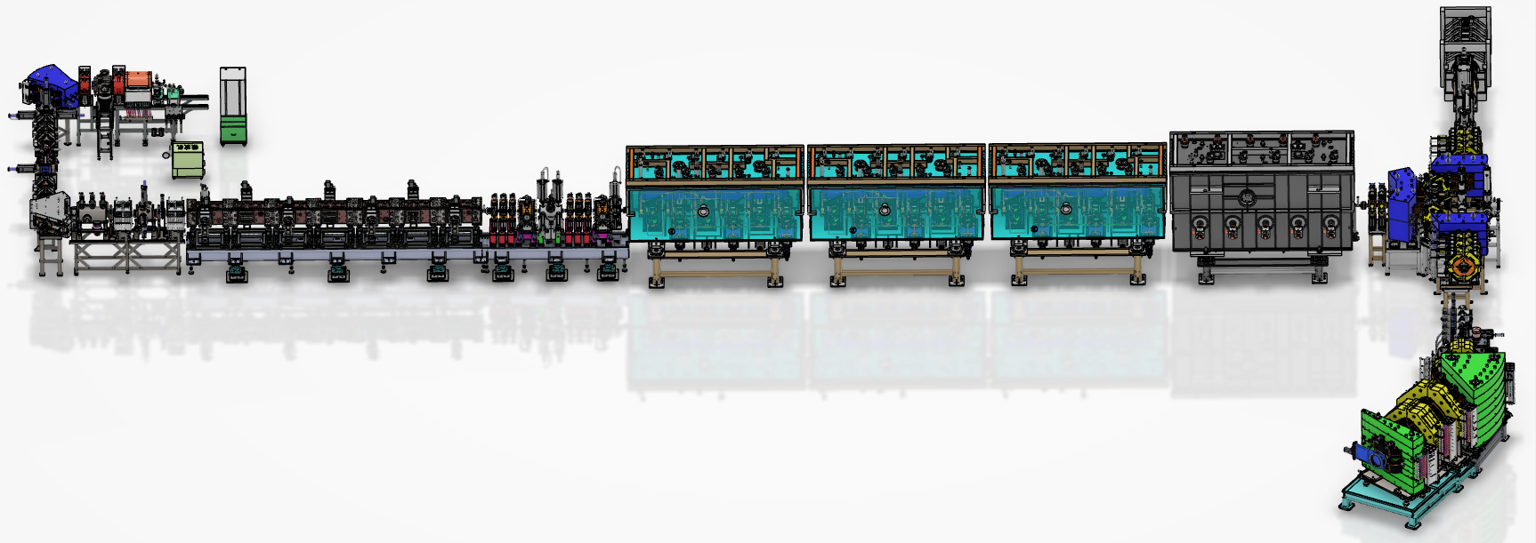
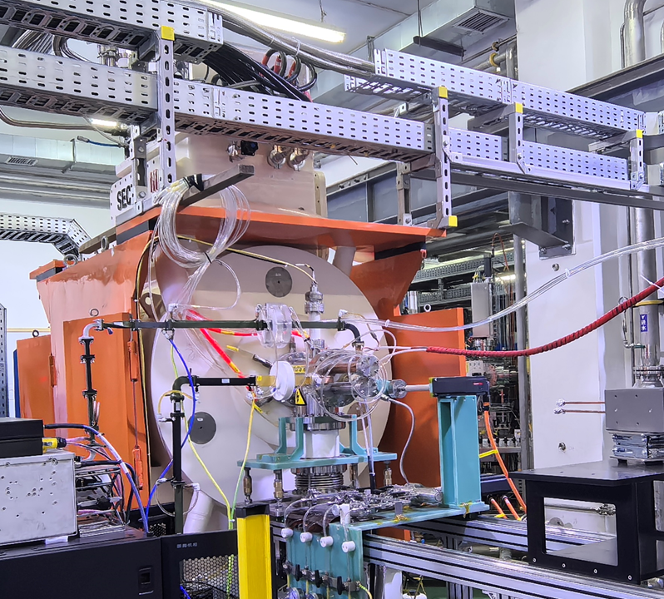
SHE Facility-CAFe 2 with SECRAL III
Upgraded the ADS SC proton linac
Demo-machine (A/Q=3)
High Intensity SC HC HI linac for Medium Mass Metallic Ion Beams dedicated to SHE (119&120)
LECR5
Ca¹³⁺ >40 eμA
by LECR5
Layout of CAFE-2
HEBT
LEBT
RFQ
MEBT
SRF-Linac
Ca¹³⁺
~28 eμA
Heavy ion Linac
SHANS-2
Parameters | Design | Unit
Particles | Ca～Zn | -
M/Q | ~1/3 | -
Energy | ~6 | MeV/u
Intensity | 3-5/10~20 | pμA
Operation Mode | CW | -
Experimental Area
New source: SECRAL-III, 28GHz
Notes:
.

Slide 6
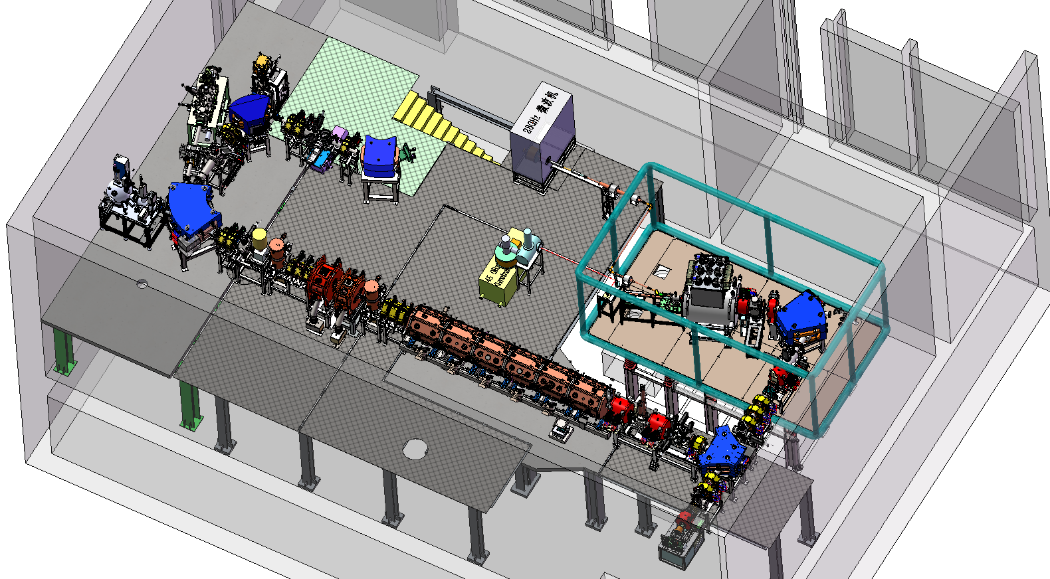
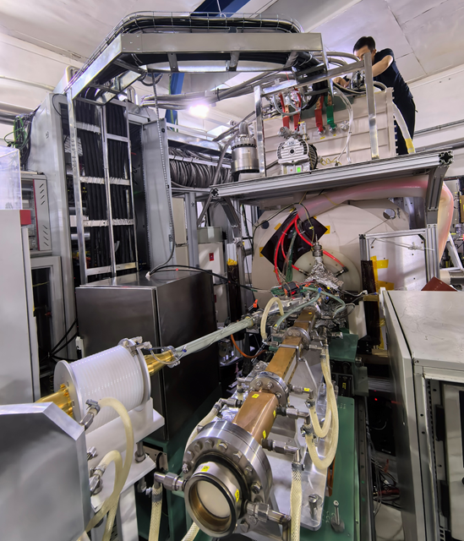
LEAF facility with FECR (prototype for HIAF)
LEAF: Low Energy high intensity highly-charged heavy ion Accelerator Facility
Layout of LEAF Platform
FC5
FECR
FC1
0.5 MeV/A
RFQ
45GHz FECR

Slide 7
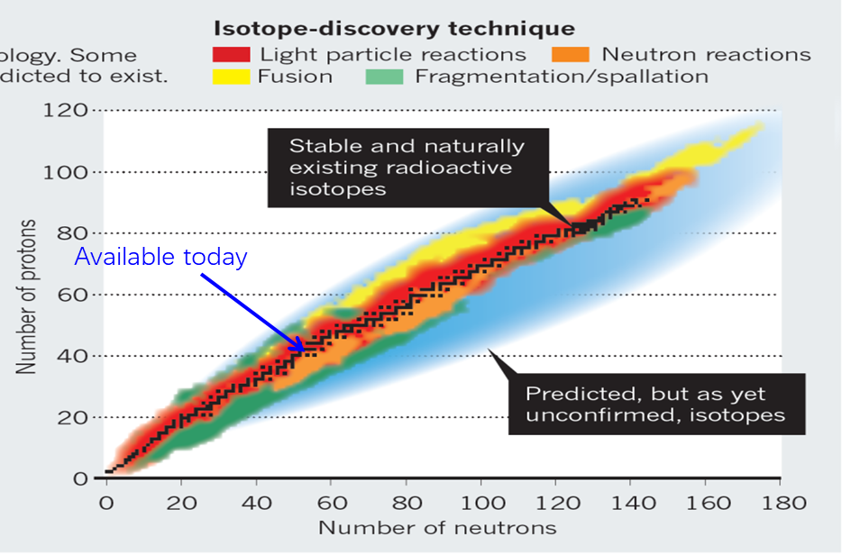
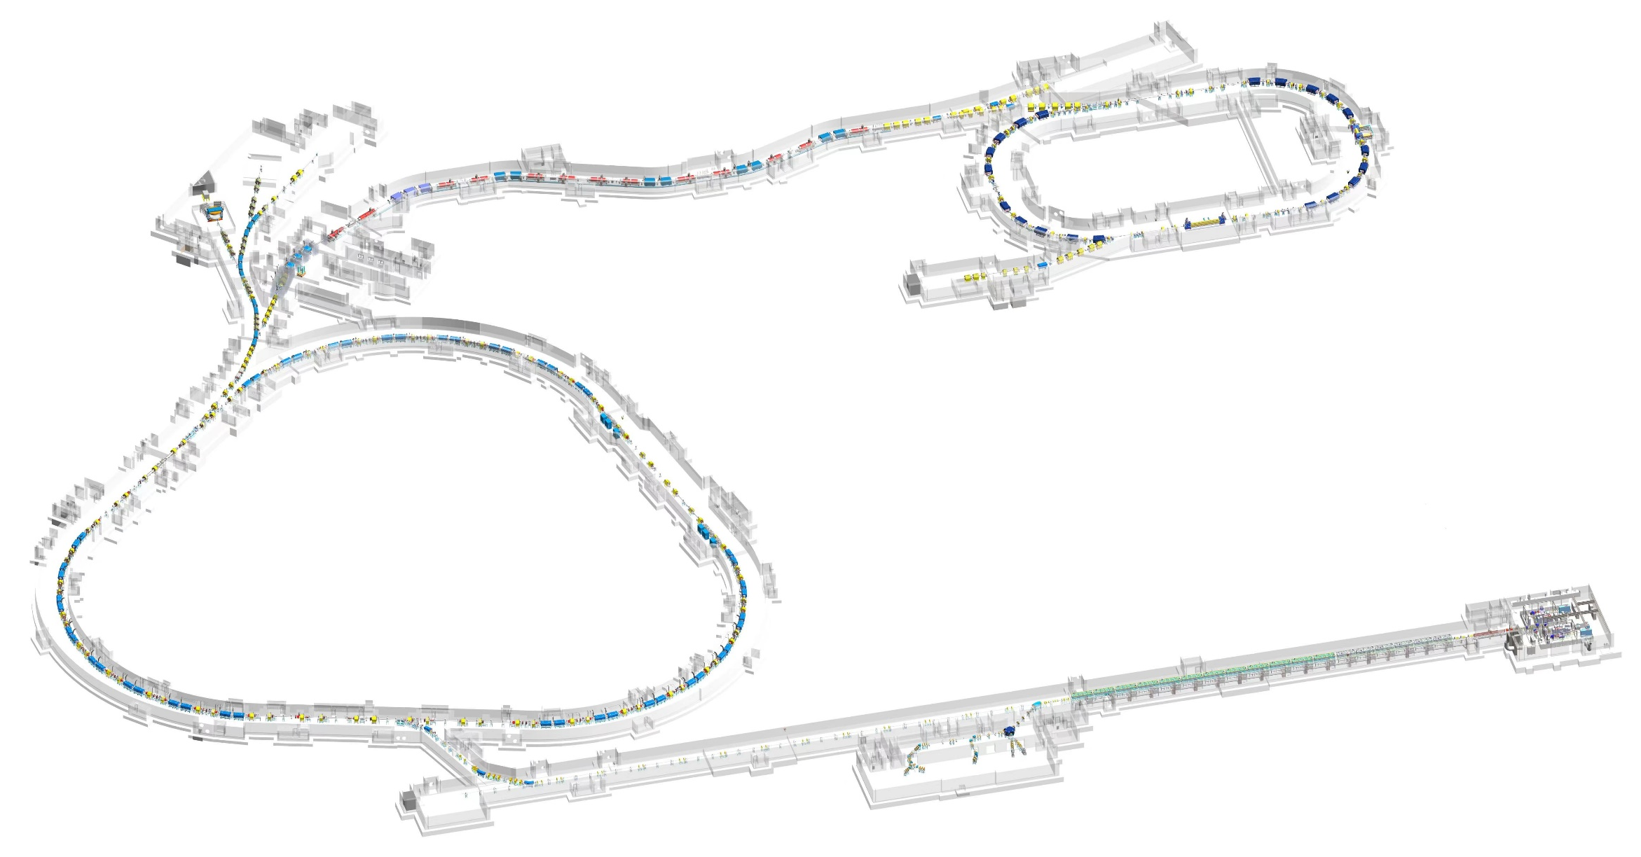
HIAF facility with SECRAL IV and HFECR
High Intensity heavy-ion Accelerator Facility (HIAF)
T5
T2
HFRS
T3
SRing
T4
SRing: Spectrometer ring
C: 278m
Bρ: 15Tm
T6
CW: >10 pμA U⁴⁶⁺
~50 pμA U³⁵⁺/ 3-5 Hz@0.5~2 ms
BRing: Booster Ring
C: 569 m
Bρ: 34 Tm
iLinac: Superconducting linac
E: 17 MeV/u( ²³⁸U³⁵⁺)
I : 1 emA
28 GHz SECRAL- IV
45 GHz HFECR
SECR
iLinac
iLinac-2 (reserved)
E: 150 MeV/u U⁴⁶⁺
T1
High Intensity CW/Pulsed Ion Beams

Slide 8
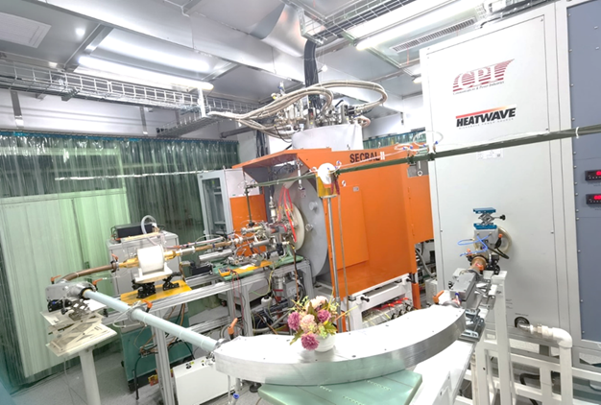
Maximum beam intensities produced by SECRAL&SECRAL-II
Ion species | Charge state | SECRAL& SECRAL-II 24~28 +18 GHz 6-10 kW [eμA]
⁴⁰Ar | 12+ | 1420
 | 16+ | 620
 | 18+ | 15
⁷⁸Kr | 18+ | 1030
 | 28+ | 145
¹²⁹Xe | 26+ | 1100
 | 30+ | 365
 | 42+ | 16
²⁰⁹Bi | 31+ | 680
 | 41+ | 100
²³⁸U | 34+ | 620
 | 35+ | 545
 | 46+ | 61
 | 55+ | 13
SECRAL-II, 24-28GHZ
This maximum beam intensities can not be delivered to the accelerator due to stability
Typically, long-term operational beam intensity:
60-80% maximum intensities for gaseous ions
50-60% maximum intensities for metallic ions

Slide 9
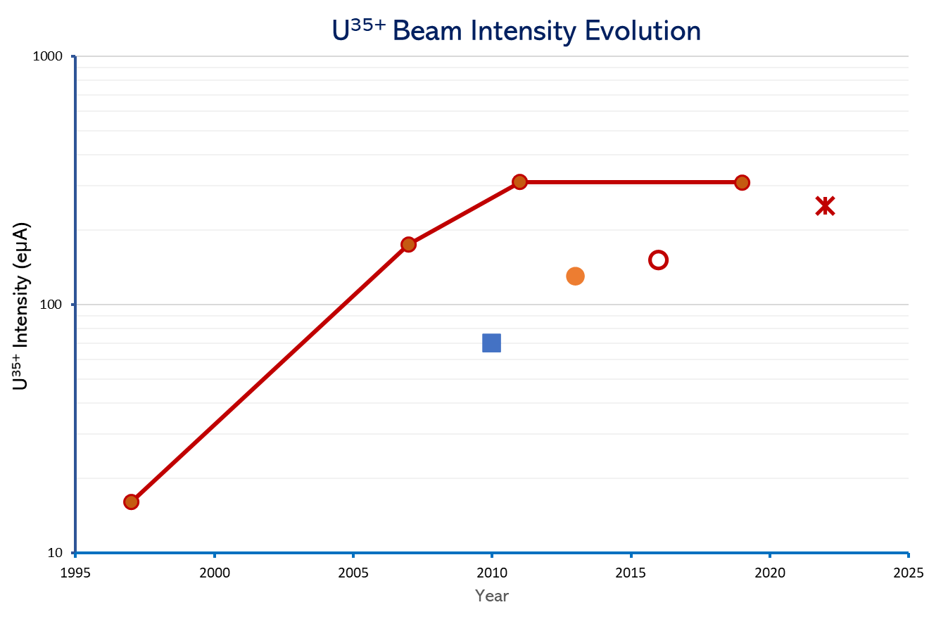
High Intensity Uranium Beam Production by 24-28 GHz ECRIS
U³⁵⁺ 545 eμA
24 GHz SECRAL-II
(IHO + UO₂)
28 GHz VENUS
(HTO + UO₂)
28 GHz SECRAL-II
(IHO + UO₂)
28 GHz SCECRIS/RIKEN
(HTO + UO₂)
28 GHz VENUS
(oven + URe₂ alloy)
28 GHz SCECRIS/RIKEN
(Sputtering)
24 GHz SECRAL
(Sputtering)
18 GHz SuSI
(Sputtering)
High Intensity U³⁵⁺
High performance ECRIS
Reliable high-T oven >2000℃
14.5 + 10 GHz AECR-U
(oven + URe₂ alloy)
HTO: High temperature resistor heating oven, IHO: Inductive heating oven
Notes:
Solutions 4: High Intensity Uranium Beam production by high performance ECRIS with reliable high temperature oven around 2000 degree C.
This graph shows the U35+ beam intensity evolution in the past 20 years produced by different ECRISs.
Berkeley AECR-U and VENUS are pioneers for high intensity U beam production,
And then following by SuSi, SECRAL, RIKEN SCECRIS, SECRAL-II with sputtering, and High temperature resistor heating oven. It was last year SECRAL-II produced U35+ 545 euA with Inductive heating oven

Slide 10
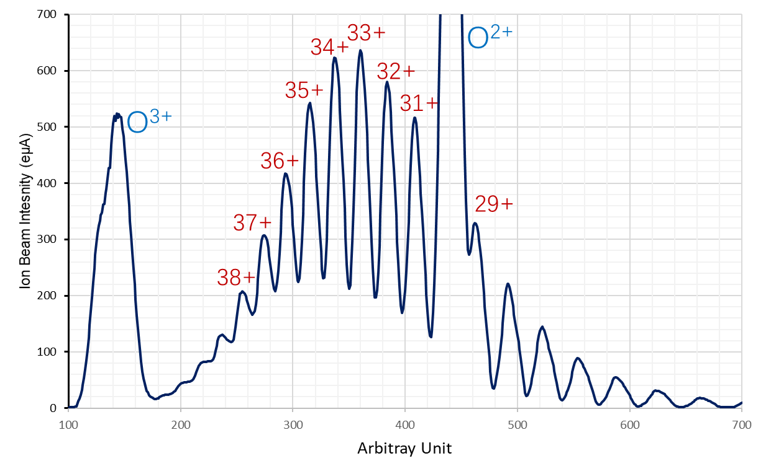
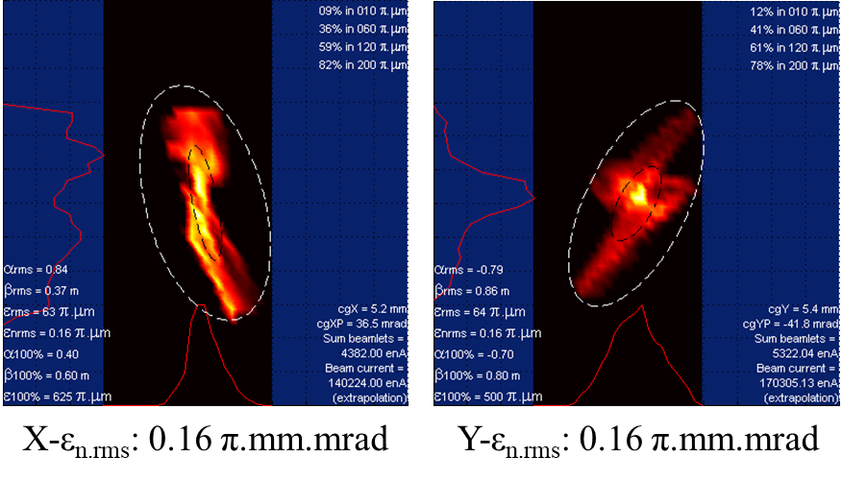
High Intensity Uranium Beams by SECRAL-II
Material: UO₂+O_{2,}IHO
Frequency: 24+18 GHz
μW power: ~7.9 kW
Total drain: ~13.2 emA
Production of 545 eμA ²³⁸U³⁵⁺ by SECRAL II

Slide 11
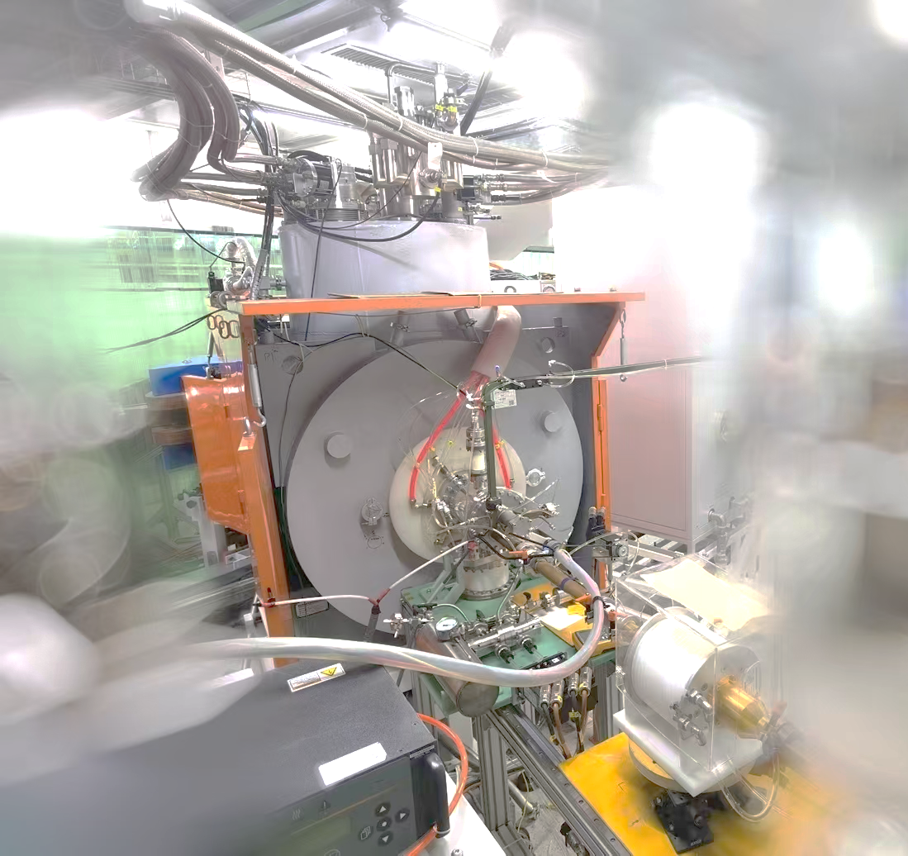
Record Intensities of Uranium Beams by SECRAL-II
Features:
High performance SECRAL-II ion source
High power: 7 kW@24 GHz + 2 kW@18 GHz
Reliable IHO oven: >2000℃
SECRAL-II
U Charge State | SECRAL-2023 (eμA) | Records as of 2022 (eμA) | Contributors as of 2022
33 | 640 | 450 | SECRAL-II/IMP¹
34 | 620 | 400 | VENUS/LBNL²
35 | 545 | 310 | VENUS/LBNL，SECRAL-II/IMP
42 | 100 | 62.6 | SCECRIS/RIKEN³
46 | 61 | 36.2 | SCECRIS/RIKEN
50 | 38 | 20.1 | SCECRIS/RIKEN
54 | 19 | 10.4 | SCECRIS/RIKEN
56 | 9.5 | 0.9 | SECRAL-II/IMP
58 | 2.7 | 0.7 | SECRAL-II/IMP
18 GHz
24 GHz
Oven
Power Supply
W. Lu et al., Rev. Sci. Instrum. 90, 113318 (2019)
J. Benitez, et al., ECRIS2012, THXO02-talk
T. Nakagawa, Cyclotron’22, invited talk

Slide 12
SECRAL-II routine operation for HIRFL in 2023
No. | Ion | V_{extr}(kV) | Date | Time (Hr) | 0FC1 (μA) | 1FC1/2 (μA) | E (Mev/u) | Accelerators and experimental setup
1 | ¹⁸¹Ta³⁵⁺ | 13.00 | 12.26-1.31 | 863.5 | 50-80 | 1.0 | 1.52→16 | SECR+SFC+SSC→ TR5
2 | ⁵⁴Fe¹⁷⁺ | 20.17/21.55 | 2.2-2.15 | 311 | 80-140 | 4.4 | 6.17→70 | SECR+SFC+SSC→ RIBLL1
3 | ³⁶Ar¹²⁺ | 20.36 | 2.15-3.1 | 318 | 120 | 4 | 6.17→70 | SECR+SFC+SSC→ RIBLL1
4 | ⁸⁶Kr¹⁷⁺ | 18.91 | 3.20-4.1 | 280.5 | 200 | 4.5 | 2.345→25 | SECR+SFC+SSC → TR6/TR5
5 | ⁵⁶Fe¹⁵⁺ | 17.71 | 4.2-4.26 | 575 | 60 | 4 | 4.3→25/120 | SECR+SFC+CSRm → CSRe
6 | ⁹⁴Zr¹⁹⁺ | 12.74 | 5.23-6.5 | 289 | 60 | 2.4 | 1.613→17 | SECR+SFC+SSC→ RIBLL1
7 | ¹²⁹Xe²⁷⁺ | 14.05 | 6.6-6.14 | 182 | 280 | 4.5 | 1.844/19.5 | SECR+SFC+SSC→ TR5
8 | ⁶⁴Ni¹⁹⁺ | 19.89 | 7.29-8.3 | 122.5 | 40 | 2.5 | 5.361→19 | SECR+SFC+SSC→ RIBLL1
9 | ⁶⁴Ni¹⁹⁺ | 20.89 | 9.13-9.28 | 346.5 | 40 | 2.2 | 5.361→19 | SECR+SFC+SSC→ RIBLL1
10 | ¹²⁹Xe³¹⁺ | 18.39 | 9.29-10.6 | 161 | 110 | 2.0 | 4 | SECR+SFC → 128-T1
11 | ⁵⁶Fe¹⁷⁺ | 22.86 | 10.21-11.8 | 430 | 30 | 1.3 | 6.3 | SECR+SFC → 128-T1
12 | ⁷⁸Kr²⁶⁺ | 19.85 | 11.17-12.31 | 1041 | 210 | 11 | 5.971 → 450 | SECR+SFC → CSRm
SECRAL-II total operation beam time in 2023: 4920 hours

Slide 13
SECRAL-II routine operation for HIRFL in 2024
No. | Ion | V_{extr}(kV) | Date | Time (Hr) | 0FC1 (μA) | 1FC1/2 (μA) | E (Mev/u) | Accelerators and experimental setup
1 | ¹²⁴Sn^{27+/30+} | 17.4/15.5 | 2.22-3.13 | 481.5 | 50/30 | 2.2 | 2.345→ 25 | SECR+SFC+SSC →RIBLL1
2 | ¹⁸¹Ta³⁵⁺ | 13.00 | 3.15-4.10 | 634 | 40 | 0.8 | 1.52→16 | SECR+SFC+SSC →TR5
3 | ⁷⁸Kr²⁶⁺ | 19.85 | 5.25-6.14 | 480 | 130 | 4 | 5.971 → 350 | SECR+SFC+BLN+CSRm+CEE
4 | ⁷⁸Kr¹⁹⁺ | 18.60 | 6.14-6.17 | 69.5 | 130 | 3 | 4 | SECR+SFC+BLN+CSRm
5 | ⁸⁶Kr²⁴⁺ | 15.82 | 6.17-6.23 | 136.5 | 120 | 3 | 4 | SECR+SFC+BLN+CSRm
6 | ³⁶Ar¹⁵⁺ | 16.29 | 6.23-7.3 | 242 | 150 | 3 | 6.17 | SECR+SFC→ 128#-T1
7 | ³⁶Ar¹²⁺ | 20.84 | 7.3-7.21 | 423 | 200 | 4.5 | 6.17 → 70 | SSECR+SFC+SSC+RIBLL1
8 | ⁸⁶Kr²⁷⁺ | 21.03 | 7.26-7.31 | 110 | 50 | 4 | 6 | SECR+SFC→ TL2
9 | ⁵⁶Fe¹⁷⁺ | 22.86 | 9.14-11.3 | 1193 | 45 | 2 | 6.3 | SECR+SFC→ TL2
SECRAL-II total operation beam time in 2024: 3769.5 hours

Slide 14
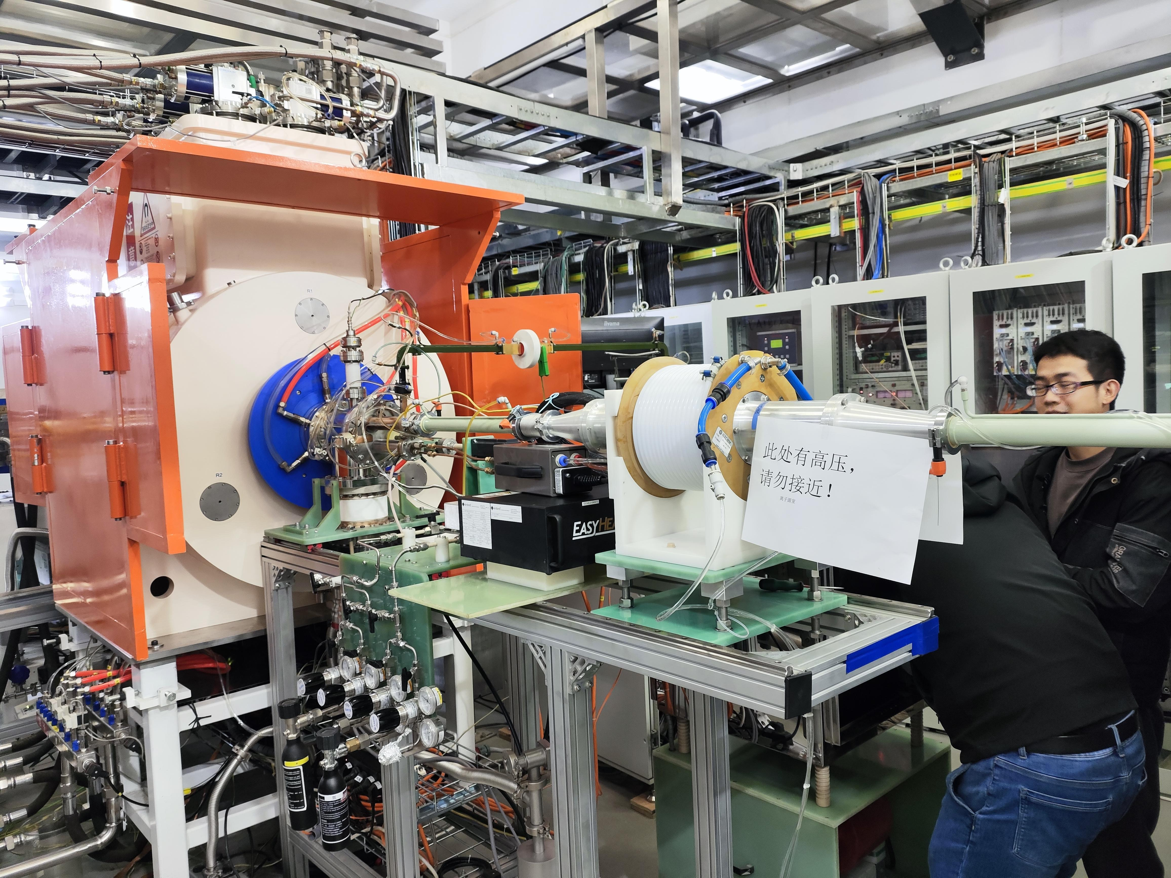
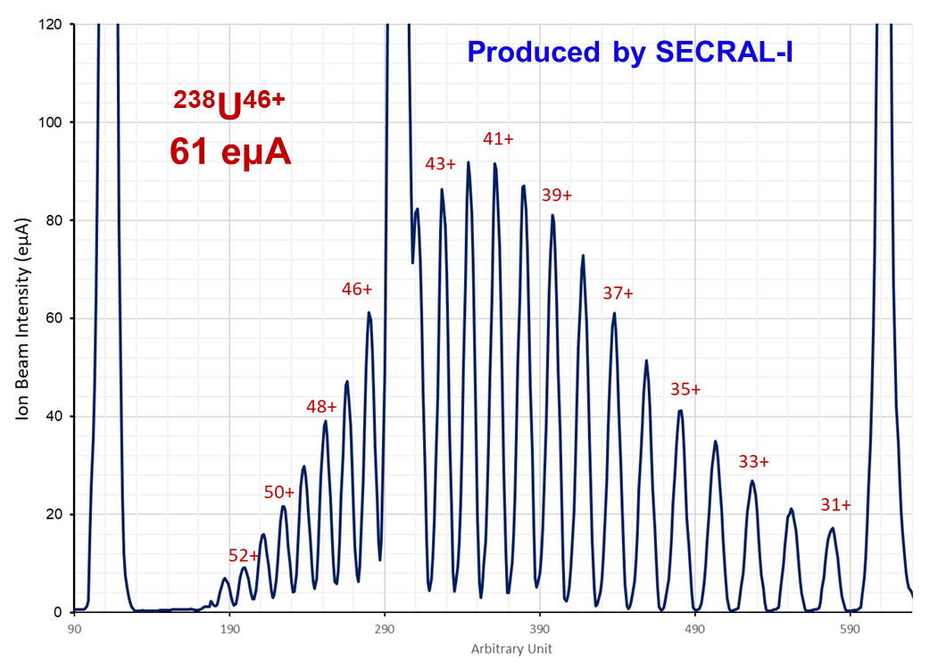
Uranium Beam Production ²³⁸U⁴⁶⁺ by SECRAL-I
SECRAL-I
SECRAL-I: 28 GHz ECR ion source
Upgraded from 24 GHz SECRAL
Ø 120 mm ID plasma chamber
10 kW max. μW power
Micro-channel cooling Al plasma chamber

Slide 15
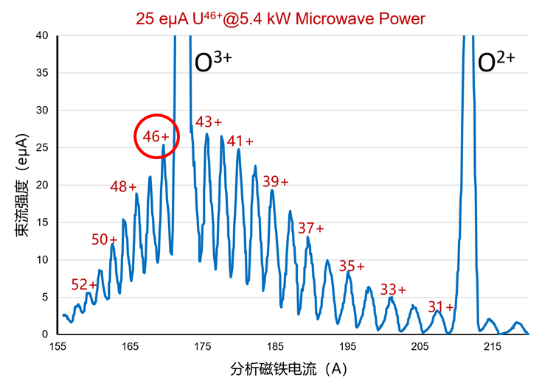
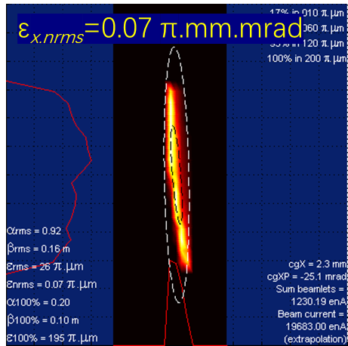
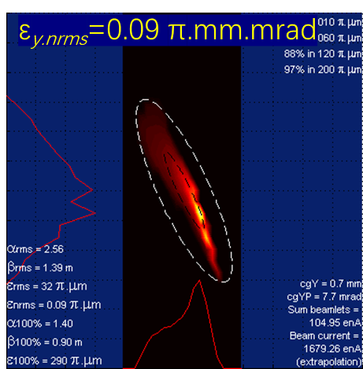
Uranium Beam Operation ²³⁸U⁴⁶⁺ for SSC-Linac by SECRAL-I
Lower emittance for higher charge state
SECRAL-I delivered ²³⁸U⁴⁶⁺ beam to SSC-Linac for 568.5 hours with intensity
25-30 eμA from 17/11/2023 to 03/01/2024.

Slide 16
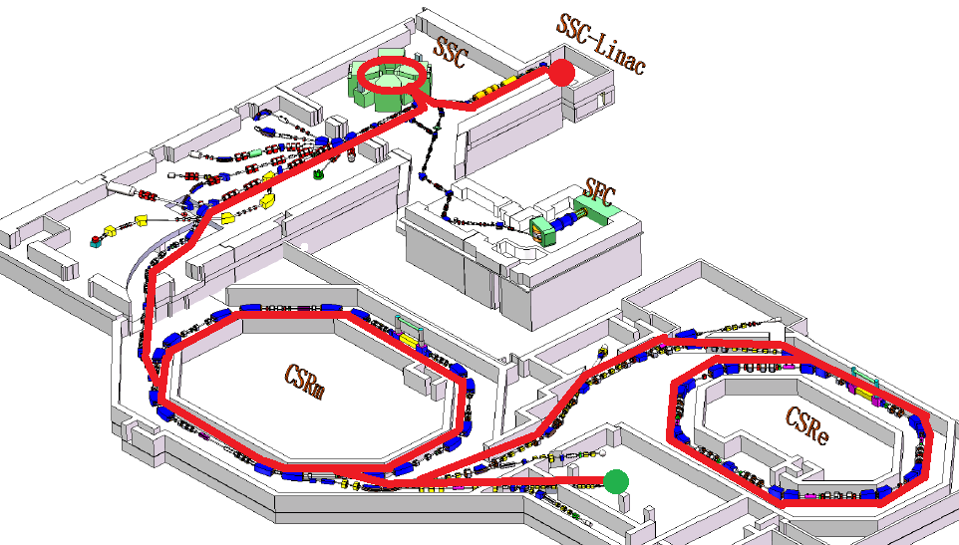
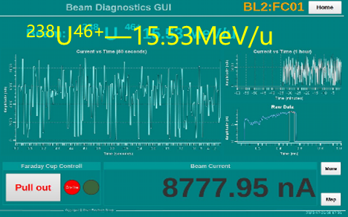
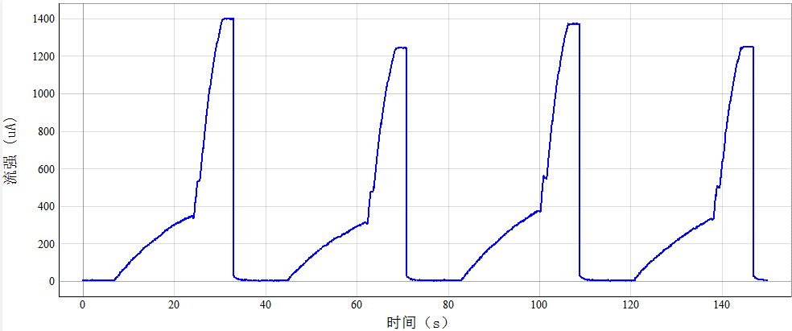
HIRFL Uranium Beam Operation with SECRAL-I
²³⁸U⁴⁶⁺—15.53MeV/u
²³⁸U⁴⁶⁺—1.48MeV/u
25~30 eμA ²³⁸U⁴⁶⁺
500MeV/u 238U74+ @1×108 ppp
Stripper： 46+ →74+
CEE
AMS
238U74+—500MeV/u
Notes:
25-30 euA U46+ from SECRAL-I was accelerated by the SSC-linac upto 1.48 MeV/A, and then re-accelerated by this big SSC cyclotron upto 15.53 MeV/A, and we got 8.7 euA U46+ beam extracted from the SSC cyclotron. After stripping to U74+ which was injected into the synchrotron CSRm, and accelerated upto 500 MeV/A, we had 10E8 ppp in the ring for physics experiments.

Slide 17
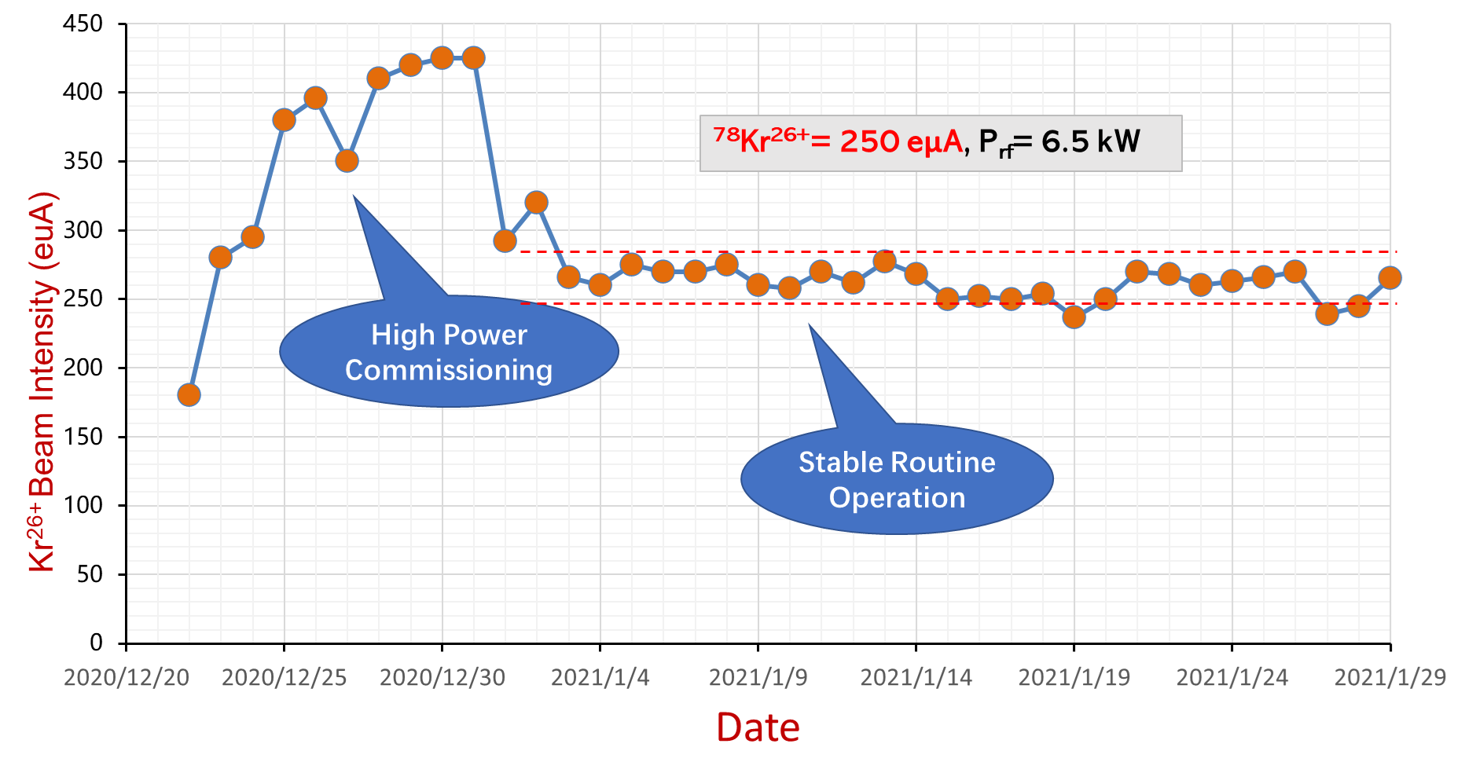
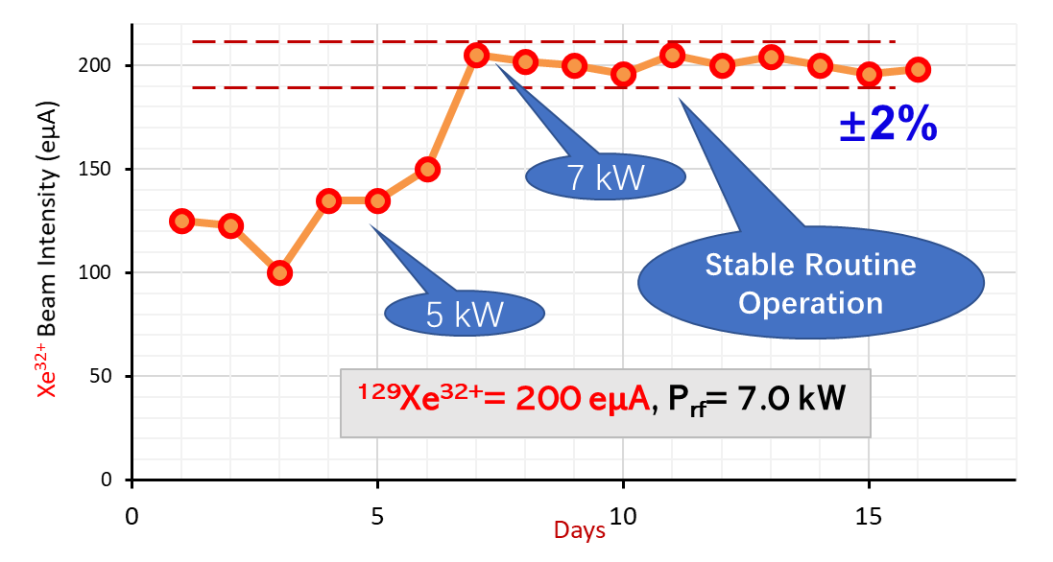
Long-term stability of high-intensity highly-charged heavy ion beams delivered by SECRAL II
High-intensity highly charged heavy ion beams produced by SECRAL II at 6-7 kW /24-28 GHz RF power were delivered to existing accelerator facility HIRFL-SFC cyclotron.
250 eμA of ⁷⁸Kr²⁶⁺ , 27 days continuously, 200 eμA of ¹²⁹Xe³²⁺ 10 days continuously
Demonstrating good long-term stability
28 GHz + 18 GHz
24 GHz + 18 GHz
±7.6%
27 days beam operation continuously for HIRFL
10 days beam operation continuously for HIRFL

Slide 18
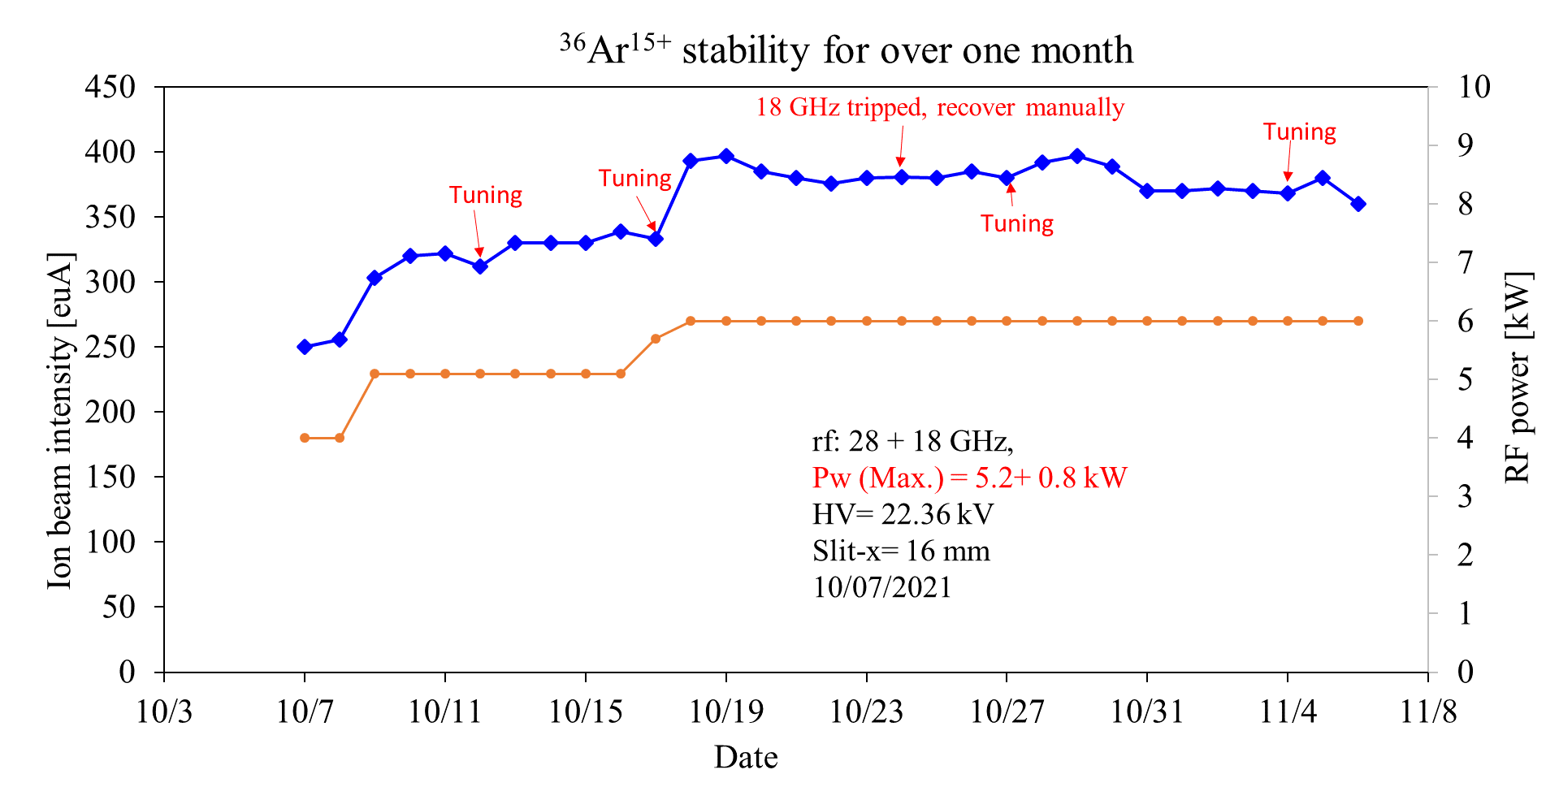
Long-term stability of high-intensity highly-charged heavy ion beams delivered by SECRAL II
2021---28+18 GHz-Ar¹⁵⁺

Slide 19
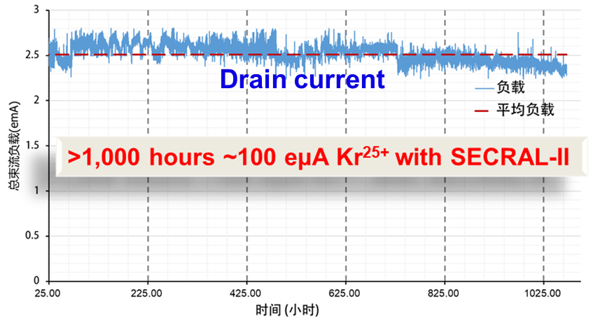
Long-term operation at high-intensities of highly-charged beams
SECRAL-II
±9.0%
Time (hours)

Slide 20
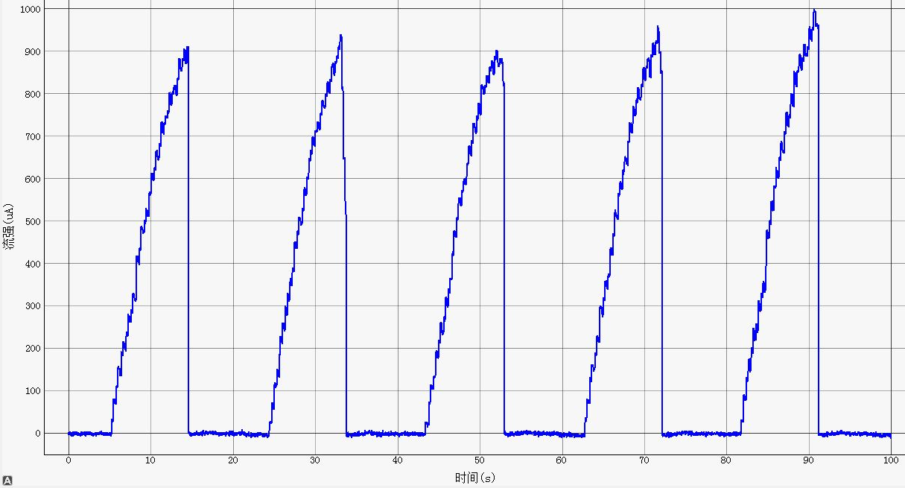
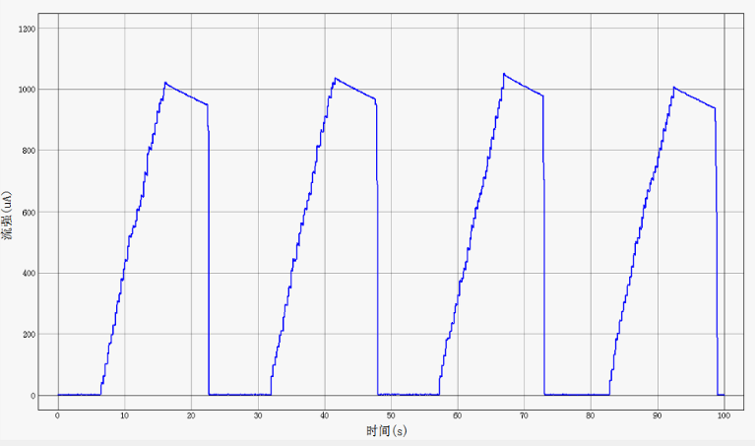
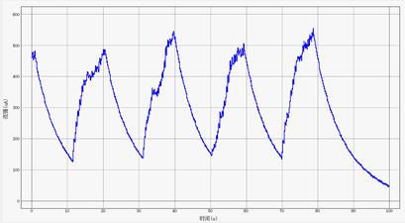
SECRAL-II operation improved performance of HIRFL-CSRm
CSRm performance enhancement together with other technical improvements
³⁶Ar¹⁵⁺
Current 1.6×10⁹ppp
SECRAL-II: ~350 eμA （~4 times historical operation current）
High current：SFC--8.5 AMeV/15 eμA
CSR_{m} Beam Current Increase by a factor of 5
⁷⁸Kr²⁶⁺
Current 1.2×10⁹ppp
SECRAL-II: ~280 eμA (not available before)
High current：SFC--6 AMeV/12 eμA
CSR_{m} Beam Current Increase by a factor of 10
¹²⁹Xe³²⁺
Current 6.3×10⁸ppp
SECRAL-II: ~200 eμA (not available before)
High current ：SFC—3.9 AMeV/8 eμA
CSR_{m} Beam Current Increase by a factor of 5

Slide 21
Outline
24-28 GHz SECRAL-I & SECRAL-II Results and Performance
45 GHz FECR Results and Performance
Discussion

Slide 22
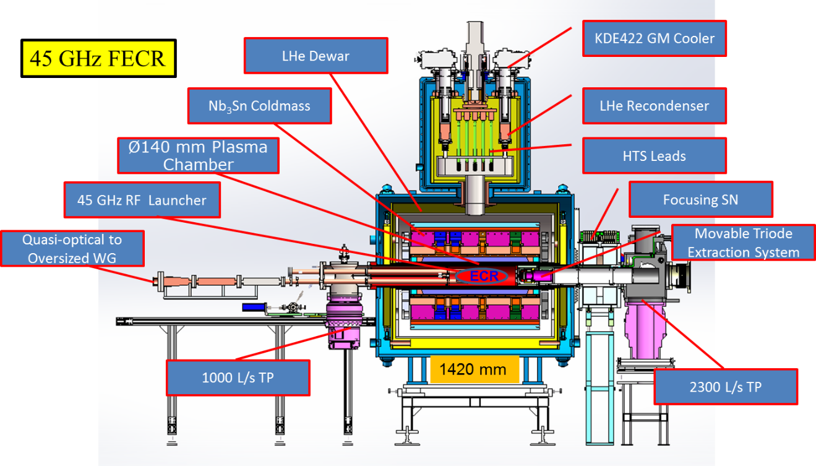
Next Generation ECRIS: 45GHz FECR
FECR (First 4th generation ECR ion source)
Specs. of FECR
Specs. | Unit | Value
Frequency | GHz | 45
RF Power | kW | 20
Chamber ID | mm | ≥Ø140
Mirror Fields | T | ≥6.4/3.2
B_{rad} | T | ≥3.2
Mirror Length | mm | ~500
B_{max} in conductor | T | ~11.8
Magnet coils | / | Nb₃Sn
Nb₃Sn | J_{c}>1500 A/mm²@12T
Cooling Capacity@4.2 K | W | >10.0
H. W. Zhao et al., Review of Scientific Instruments 89, 052301 (2018)

Slide 23
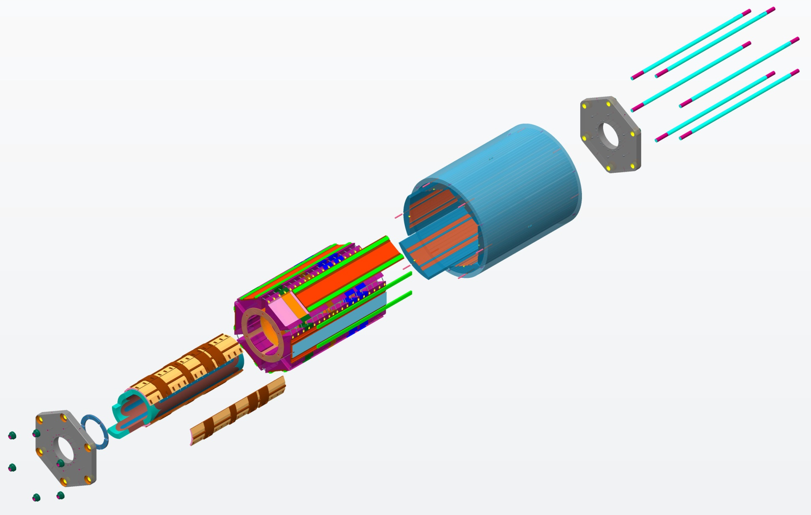
FECR : Nb₃Sn Magnet Cold-Mass Structure
In collaboration with ATAP/LBNL（2016~2017）
AXIAL RODS
(Strain Gauged)
Bladder & Keys assembly
YOKE-SHELL
ALIGNMENT PINS
MASTER-KEY PLATES
SOLENOID
STRUCTURE
SUBASSEMBLY
Detailed FECR Nb₃Sn magnet design and manufacturing will be presented by Liangting Sun in the afternoon session !
COIL-PACK
SUBASSEMBLY
AXIAL-LOAD
END PLATE
SUBASSEMBLYS
YOKES
SHELL-YOKE
SUBASSEMBLY
(Shell is strain gauged)
COIL END
BLOCKS
LOAD-KEYS
BLADDER
SUBASSEMBLY
COLLARS
M. Juchno, et al., IEEE Trans. Appl. Supercond., 28(4), 2018, Art. 4005506
SEXTUPOLE
COILS
Key technologies and tests completed in close collaboration with XSMT in China (since 2016)
Notes:
FECR Nb3Sn magnet mechanical structure was designed by collaboration with ATAP magnet group at LBNL.
This viewgraph shows the detailed and very complicated magnet structure and clamping scheme. We use Bladder and key assembly clamping.

Slide 24
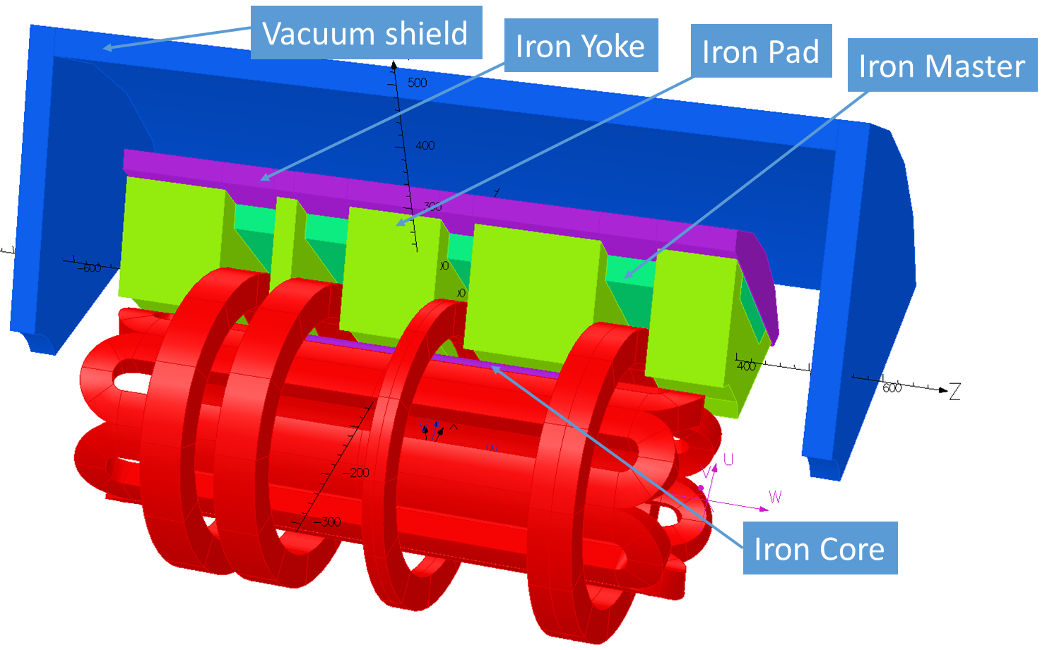
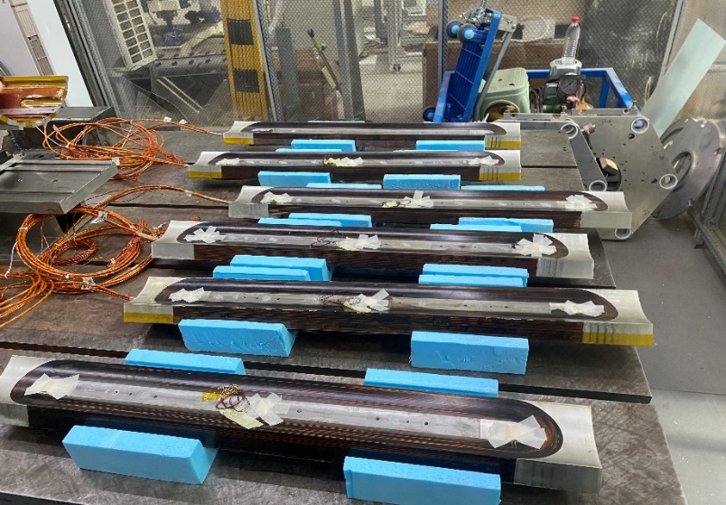
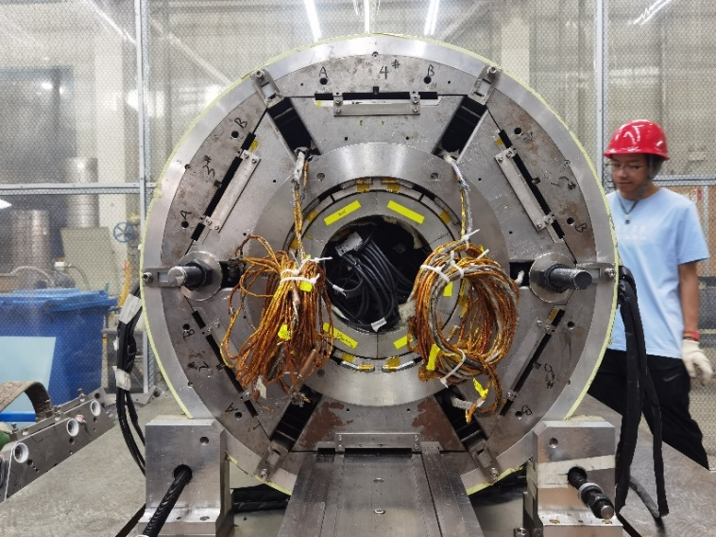
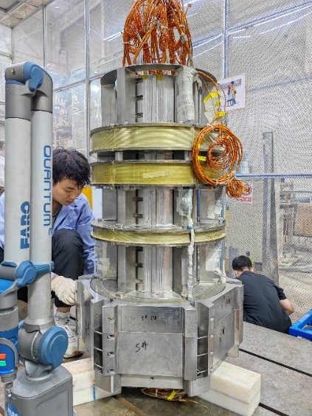
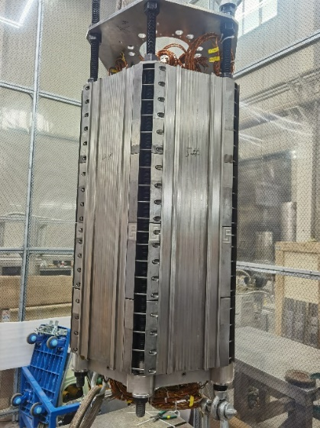
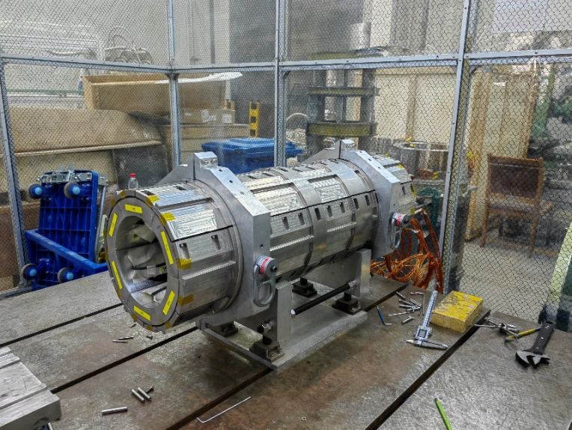
FECR : Nb₃Sn magnet Coldmass to Hybrid
NbTi Sextupole Coils
Nb₃Sn Solenoid Coils
NbTi Sextupole Coils
80% B field of the
Nb₃Sn magnet
Nb₃Sn→NbTi sextupole coils, Structure unchanged
Notes:
Already 8 years magnet development, as a project leader, I got very big pressure, I was asked to finish project as soon as possible. The magnet is not final goal, the final goal is ion source and the beams.
In such situation, we had to change our mind. The full Nb3Sn magnet Coldmass was switched to Hybrid structure, using NbTi sextupole coils replace the Nb3Sn coils, the four solenoids are still Nb3Sn conductor. All the structure and other components are same. But we can only get 80% magnetic fields of the Nb3Sn magnet.

Slide 25
FECR: Joint Test at LEAF
LEAF: Low Energy high intensity highly-charged heavy ion Accelerator Facility
Layout of LEAF Platform
FC5
FECR
FC1
0.5 MeV/A
RFQ
FECR has been used for routine operation on LEAF for 300 hours

Slide 26
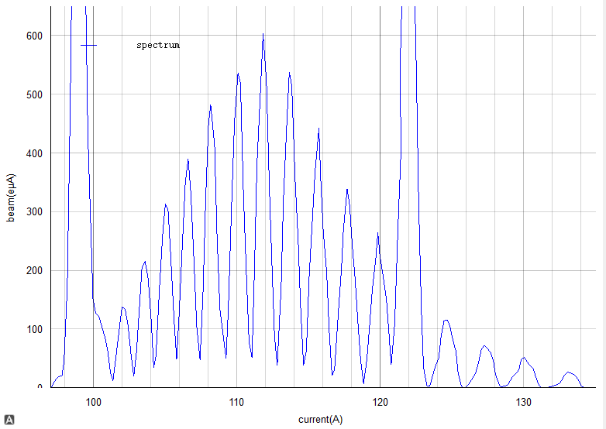
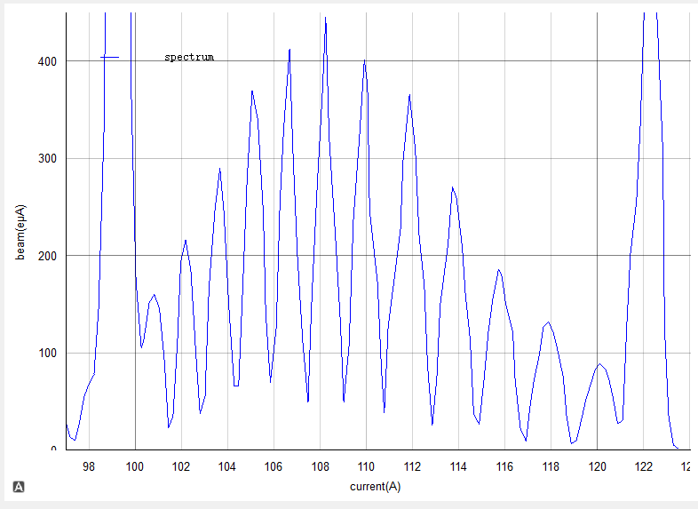
FECR beam commissioning for Bi³¹⁺ and Bi³⁵⁺
Production of 600 eμA Bi³¹⁺, 360 eμA Bi³⁵⁺
Bi³¹⁺
Bi³⁵⁺
6.5 kW@45 GHz + 4.5 kW@28 GHz (50% transmission of 9.0 kW )

Slide 27
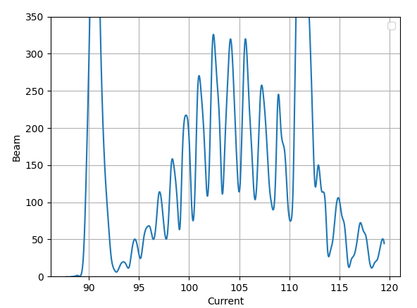
FECR beam commissioning for ²³⁸U³⁵⁺
Production of 320 eμA ²³⁸U³⁵⁺
O³⁺
U³⁵⁺
O²⁺
Preliminary results !
3 days beam commissioning.
5 kW@45 GHz + 4.5 kW@28 GHz (50% transmission of 9.0 kW )

Slide 28
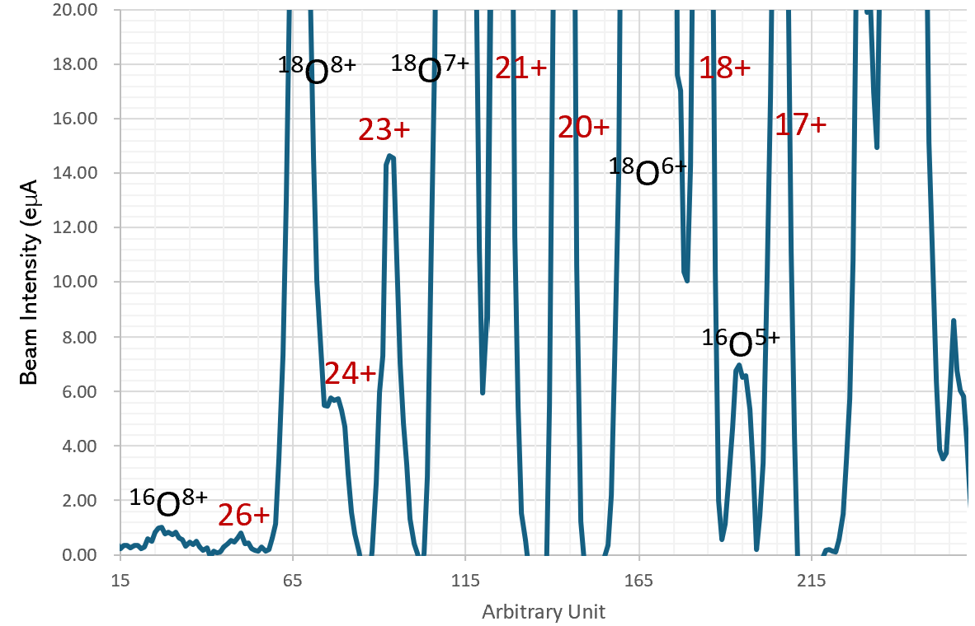
FECR beam commissioning for fully-stripped ⁵⁶Fe²⁶⁺
Production of Fully stripped iron beam ⁵⁶Fe²⁶⁺
⁵⁶Fe + ¹⁸O
Iq= 0.8 eμA
Ion validated with Si detector
Preliminary results !

Slide 29
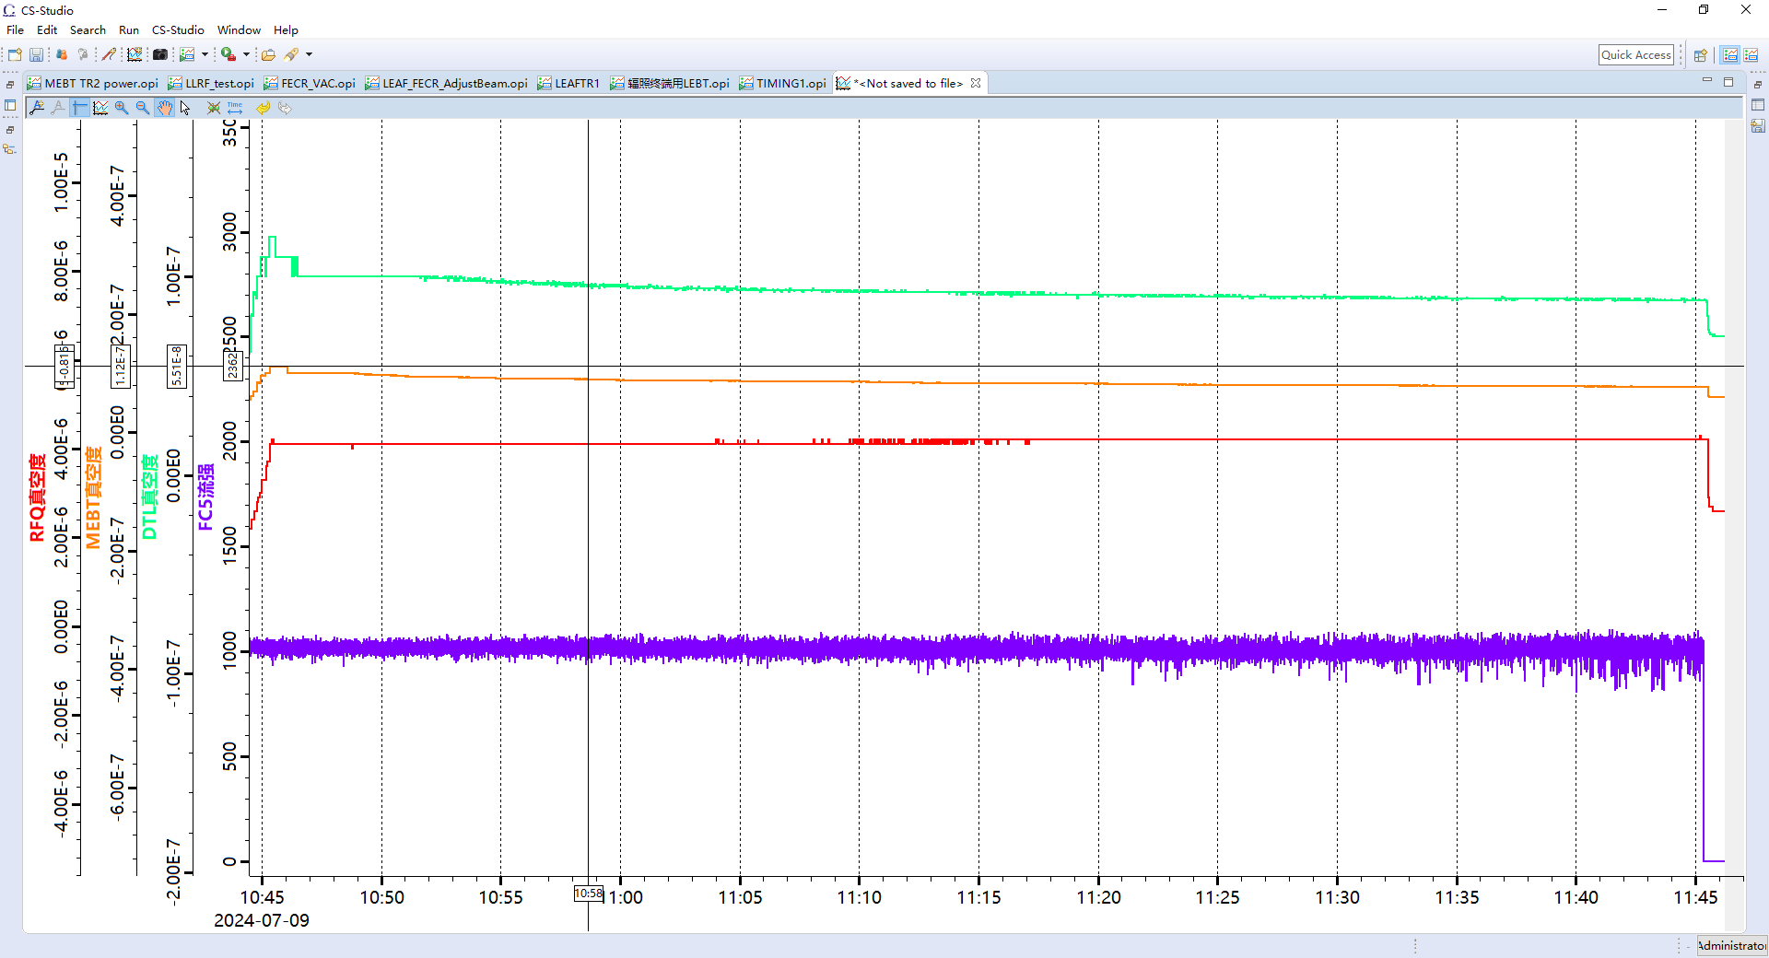
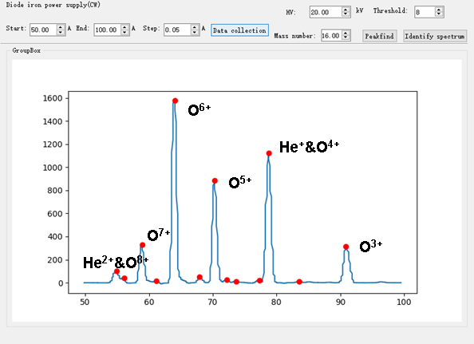
FECR: Joint Test at LEAF and the First Results
LEAF RFQ – 0.5 MeV/A
1.016 emA O⁶⁺@60 mins
FECR: 1.6 emA O⁶⁺
1 hour stability demonstration of CW 1.0 emA O⁶⁺ beam
accelerated by the LEAF-RFQ (~90% transmission)

Slide 30
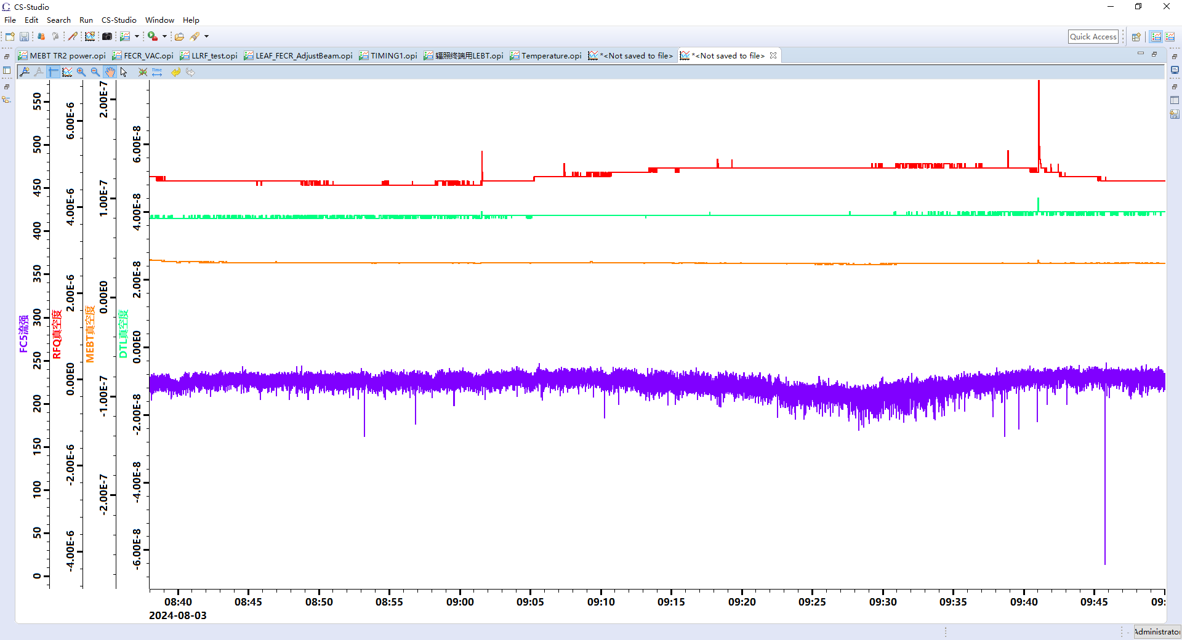
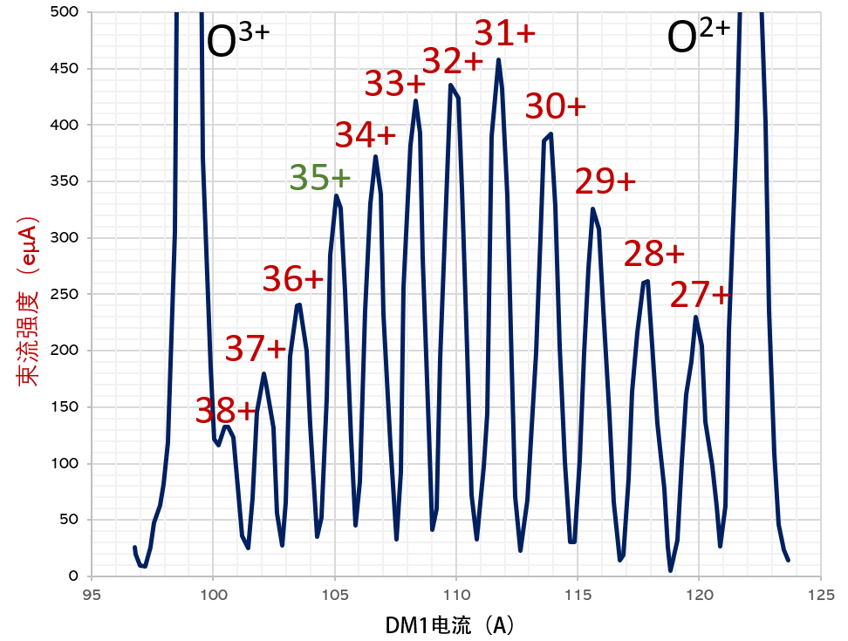
FECR: Joint Test at LEAF and the First Results
Beam Intensity (eμA)
0.23 emA Bi³⁵⁺@60 mins
DM1 Current (A)
FECR: 350 eμA ²⁰⁹Bi³⁵⁺
6.5 kW 45GHz+5.5 kW 28GHz
1 hour stability demonstration of CW 230 eμA Bi³⁵⁺ beam
accelerated by the LEAF-RFQ (~90% transmission)

Slide 31
FECR double frequency heating (1) ²⁰⁹Bi³¹⁺ and ²⁰⁹Bi³⁵⁺
Production of 600 eμA Bi³¹⁺, 360 eμA Bi³⁵⁺
Bi³¹⁺
Bi³⁵⁺
6.5 kW@45 GHz + 4.5 kW@28 GHz (50% transmission of 9.0 kW )
The magnetic field B_{z} peak 3.9 T, B_{r} at the wall 2.3 T, 28 GHz B field.
45 GHz power played an significant role for raising the beam intensity.
What is the reason or physics behind ?

Slide 32
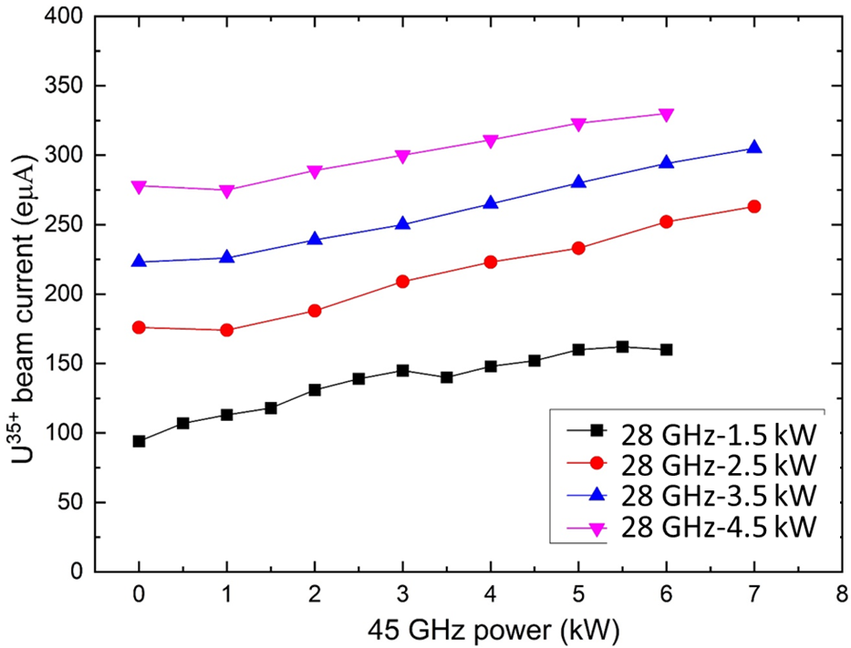
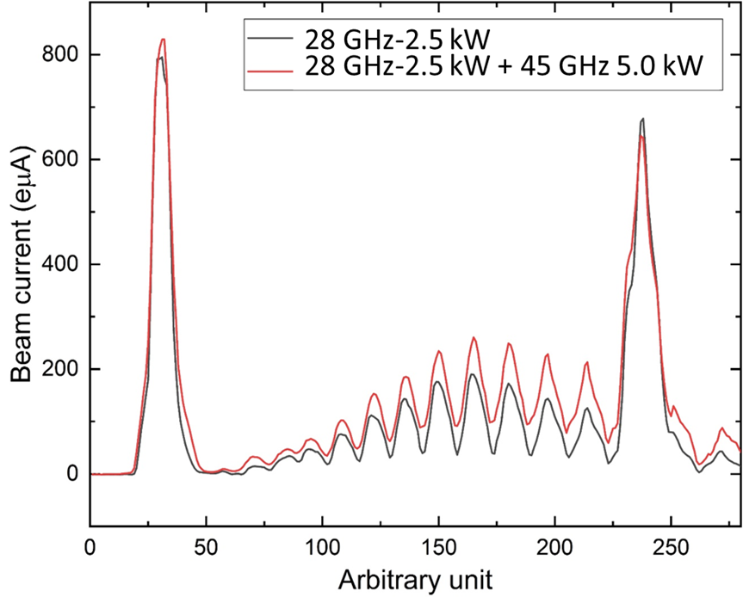
FECR double frequency heating (2) ²³⁸U³⁵⁺
Microwave frequency: 45 GHz +28 GHz. Magnetic fields (T): B_{r}-2.23, B_{inj}-3.88, B_{min}-0.58, B_{ext}-2.10
28 GHz magnetic field, higher frequency 45 GHz power could play a significant role ?

Slide 33

Discussion and comments
The big challenges for HF ECRIS:
SC magnet, high power RF coupling, long-term stability at high RF power, heating to chamber and cryostat, beam emittance…

Slide 34
Thank you for your attention !

