Slide 1
28 GHz ECRIS results and development at RIKEN
T. Nagatomo
on behalf of Ion Source Team, RIKEN Nishina Center

Slide 2
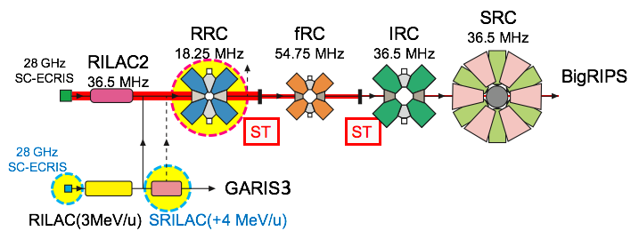
RIBF
@ RIKEN Nishina Center
RIBF
For RIBF
He, ¹⁸O, ⁴⁸Ca, ⁷⁰Zn, ⁷⁸Kr, ¹²⁴Xe, ²³⁸U
Typical beams
345 MeV/u ⁷⁰Zn 820 pnA
345 MeV/u ²³⁸U 120 pnA
R28G-S
R28G-K
Super Heavy Element Synthesis (SHE)

Slide 3
Current Performance of RIBF
345 MeV/u
²³⁸U⁸⁶⁺ 120 pnA
on Target
Charge Stripping (CS)
CS1: U34+ → U64+ 20 %
CS2: U64+ → U86+ 25 %
As a routine supply
3.2 keV/u
²³⁸U³⁵⁺ ~ 3000 pnA
from ECRIS(~110 μA)
R28G-S
+ Stable beam for ~1 month
CS1
CS2

Slide 4
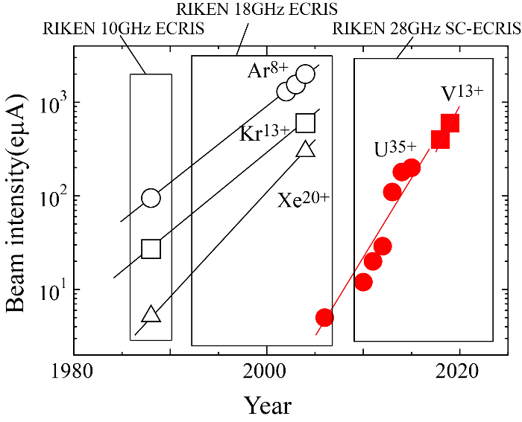
Beam intensity for Super Heavy Element Synthesis (SHE)
R28G-K
Production of intense V ion beam for SHE (Z=119)
As a routine supply
3.5 keV/u
⁵¹V¹³⁺ > 11,000 pnA
from ECRIS(~150 μA)
+ Stable beam for > 1 month

Slide 5
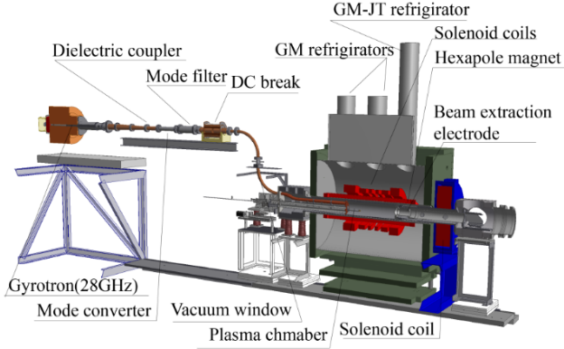
RIKEN 28-GHz ECRIS
R28G-S:
RIKEN 28GHz SC ECRIS for RILAC II (RIBF)
R28G-K:
RIKEN 28GHz SC ECRIS for RILAC (SHE)
Specsifications | Unit | R28G-S/K | SECRALII | VENUS | FECR
Frequency | GHz | 28 +18 | 28 | 28+18 | 45 + 28
RF power | kW | 10 | 10 | 10 | 20+10
Vext | kV | 22 | 25 | 25 (FRIB) | 50
Chamber ID | mm | Φ150 | Φ125 | Φ150 | >Φ140
Warmbore ID | mm | Φ172 | Φ142 |  | Φ165
Mirror fields | T | 3.8/2.3 | 3.7/2.2 | 4.0/3.0 | ≥6.4/3.2
Brad (@ r) | T, @ mm | 2 @ 75 | ∼2.0 @ 63 | 2 | 3.8 @ 75
Mirror length | mm | 525 | 420 | 500 | ∼500
Conductor material | - | NbTi | NbTi | NbTi | Nb3Sn
Cooling capacity | W @ 4.2 K | 8 | >5 | 4∼5 | >10.0
18 GHz Klystron (1.5 kW)
or TWTA (0.7 kW)
28 GHz Gyrotron ( > 8 kW @ DC break)
＋

Slide 6
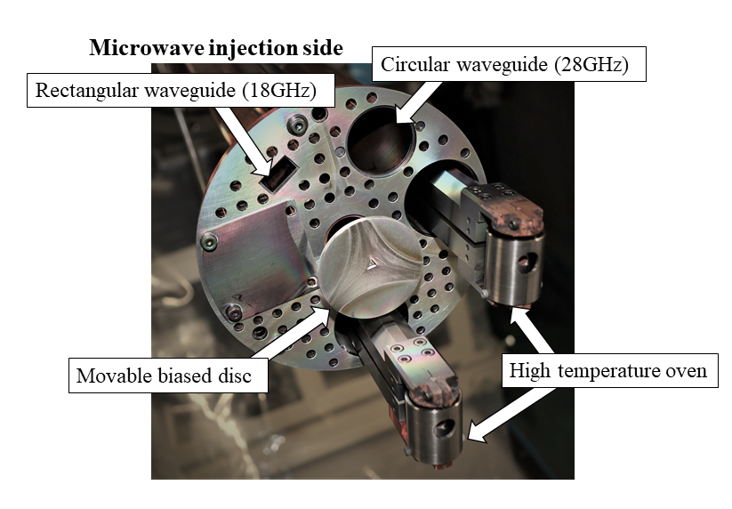
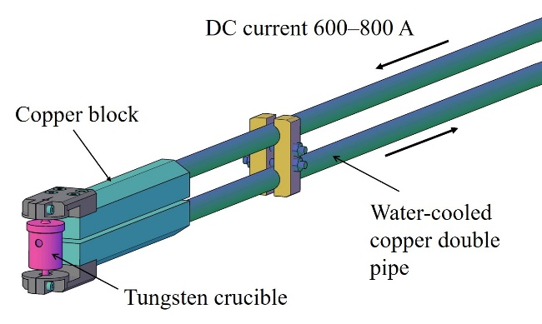
Microwave Injection and Metal Evaporation Oven
28 GHz
18 GHz
The end face (cross section) of the waveguide is the flange face of the plasma chamber.
→ No special modifications (e.g. horn shaped)

Slide 7
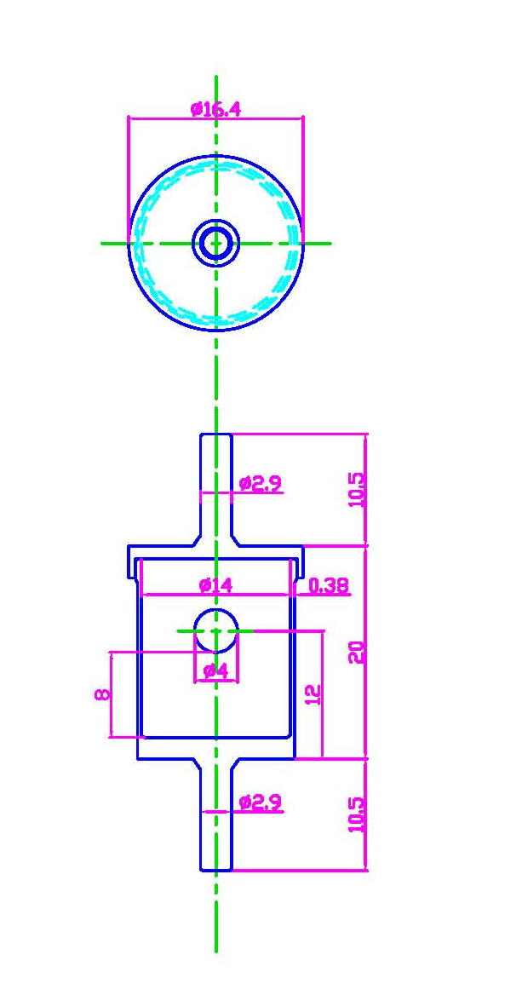
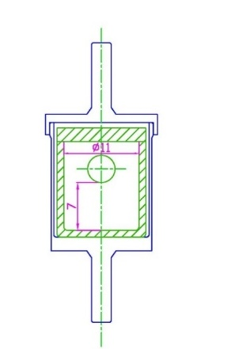
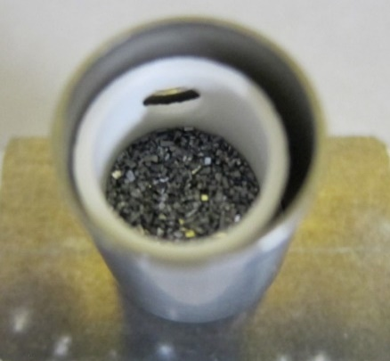
Crucible (High Temperature Oven)
W crucible
2500
2000
1500
1000
500
0
Ceramic crucible
(Y₂O₃)
Temperature (℃)
Vanadium powder
To avoid the chemical reaction between the crucible and vanadium, we used theY₂O₃ inner crucible.
Calculated (line) and Obtained temperature (triangles) of the oven using IR camera as a function of the heating power
J. Ohnishi et al, ECRIS2018

Slide 8
Consumption rate of V and Ti ( High temperature oven)
8
6
Consumption Rate (mg/h)
dM (μg/cm²/h)
4
2
0
The consumption rate increases exponentially with increasing the oven power. The consumption rate of Ti is much higher than that for V. It is due to the difference in their vapor pressure.
Melting point of Ti: ~ 1941 K
Melting point of V : ~ 2183 K
J. Ohnishi et al, ECRIS2018, Catania, Italy, WEB4

Slide 9
To provide
more Intense Metal beam …

Slide 10
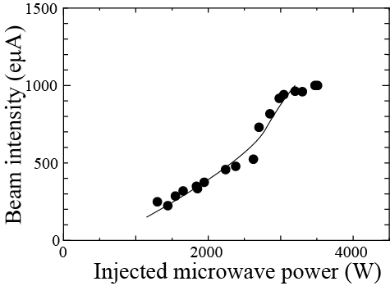
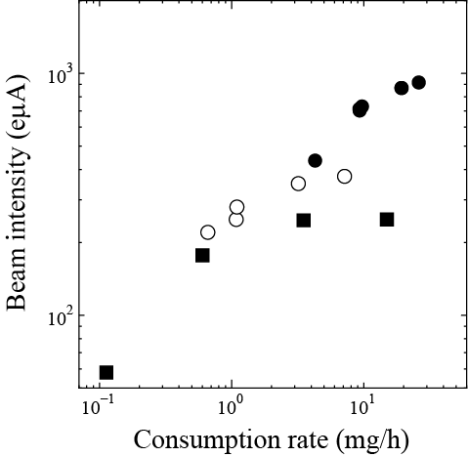
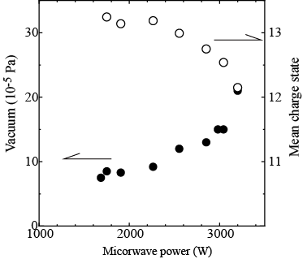
Maximized Beam intensity of V¹³⁺ as a function of microwave power and neutral gas pressure
V¹³⁺
V¹³⁺
2.95kW
1.96kW
1.28kW
V. + N₂

Slide 11
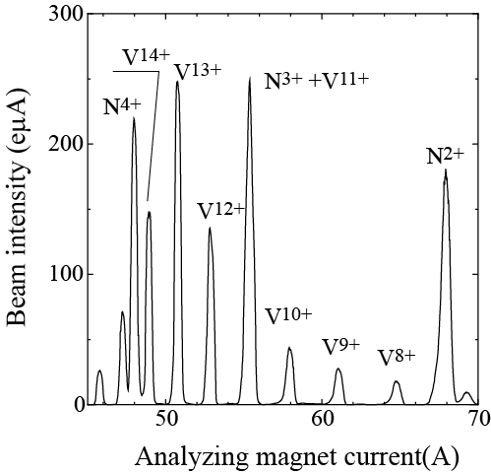
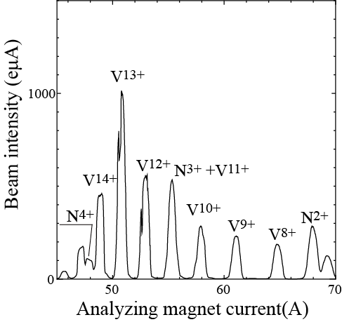
Beam intensity of V¹³⁺ as a function of microwave power
RF power =1.25 kW, 9x10⁻⁵ Pa
with consumption rate of 3.6 mg/h
RF power =3.5 kW, 15x10⁻⁵ Pa
with consumption rate of 26 mg/h
Higurashi et al., ICIS2023
Right figure shows the charge state distribution of multi-charged V ion at 3.5 kW. We observed that the beam intensity of V¹³⁺ was about 1 mA. It should be stressed that the beam intensity of multicharged N ions is remarkably lower than those of V ions compared to the charge state distributions at lower microwave power (1.25 kW, left figure), even the gas pressure at 3.5 kW was significantly higher than that for lower power.

Slide 12
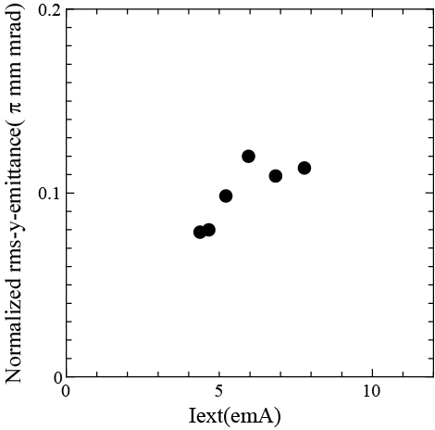
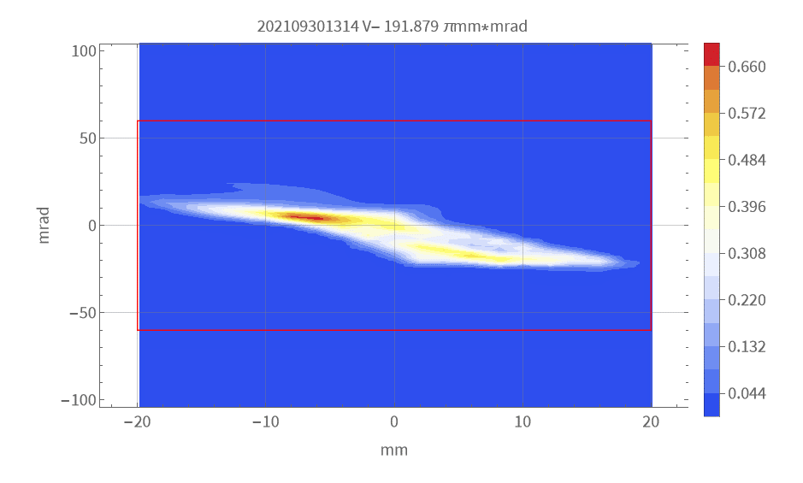
Emittance Growth of V¹³⁺ as a function of I_{ext} (I_{drain})
V¹³⁺ ~900eμA
Iext = 7.8 mA
V¹³⁺ ~100eμA
Higurashi et al., ICIS2023

Slide 13
U³⁵⁺ beam
Next Goal:
Intensity of 300 μA (“acceleratable”)
Good stability

Slide 14
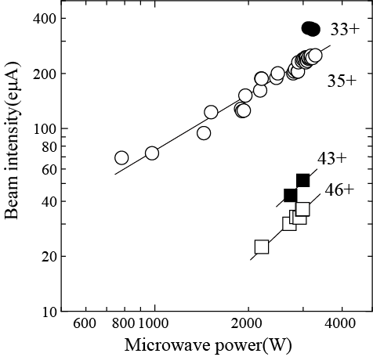
Current status of U35+ beam supply
Long period beam of 1 month was
U³⁵⁺ (110μA) with 2.4mg/h
High consumption causes unstable beam intensity.
(Absent a long-term stable supply)
250-μA U³⁵⁺ with 10.5 mg/h.
To avoid the instability,
Anti-deposition shield may be effective.
→ Morning session, tomorrow

Slide 15
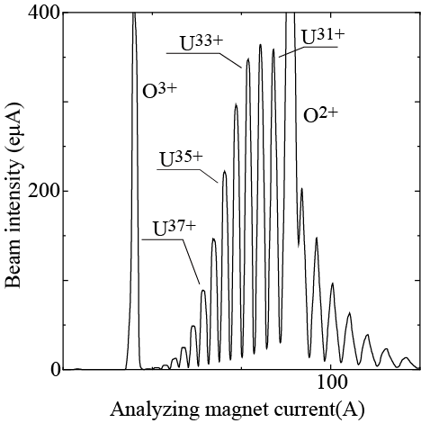
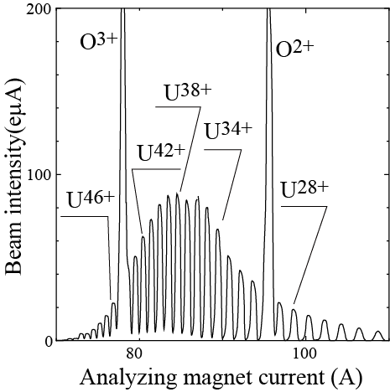
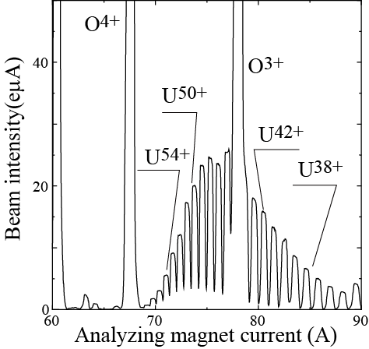
Charge state distributions of highly charged U ions. Ion source was tuned to maximize the beam intensity of 33+(a), 42+(b), and 50+(c) at the microwave power of about 3000 W.
(a)
(b)
(c)

Slide 16
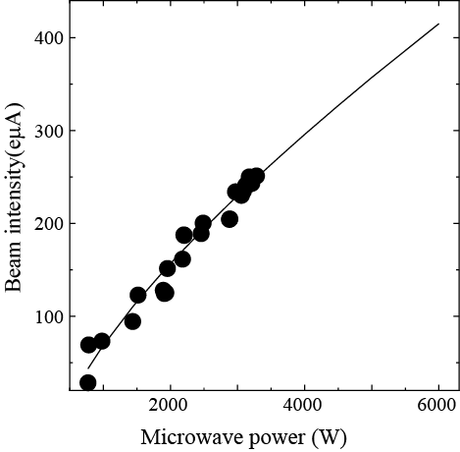
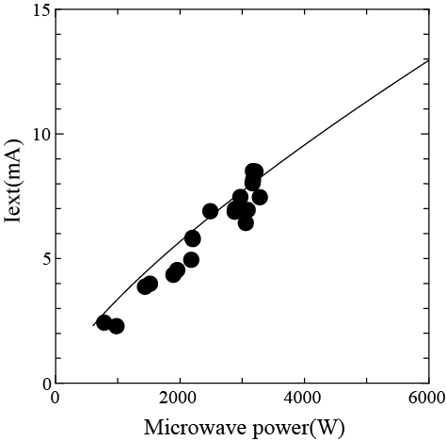
Emittance Growth (Iext) in the U³⁵⁺ case?
?
?
nrms - Beam Emittance
4000 W
Microwave power (W)

Slide 17
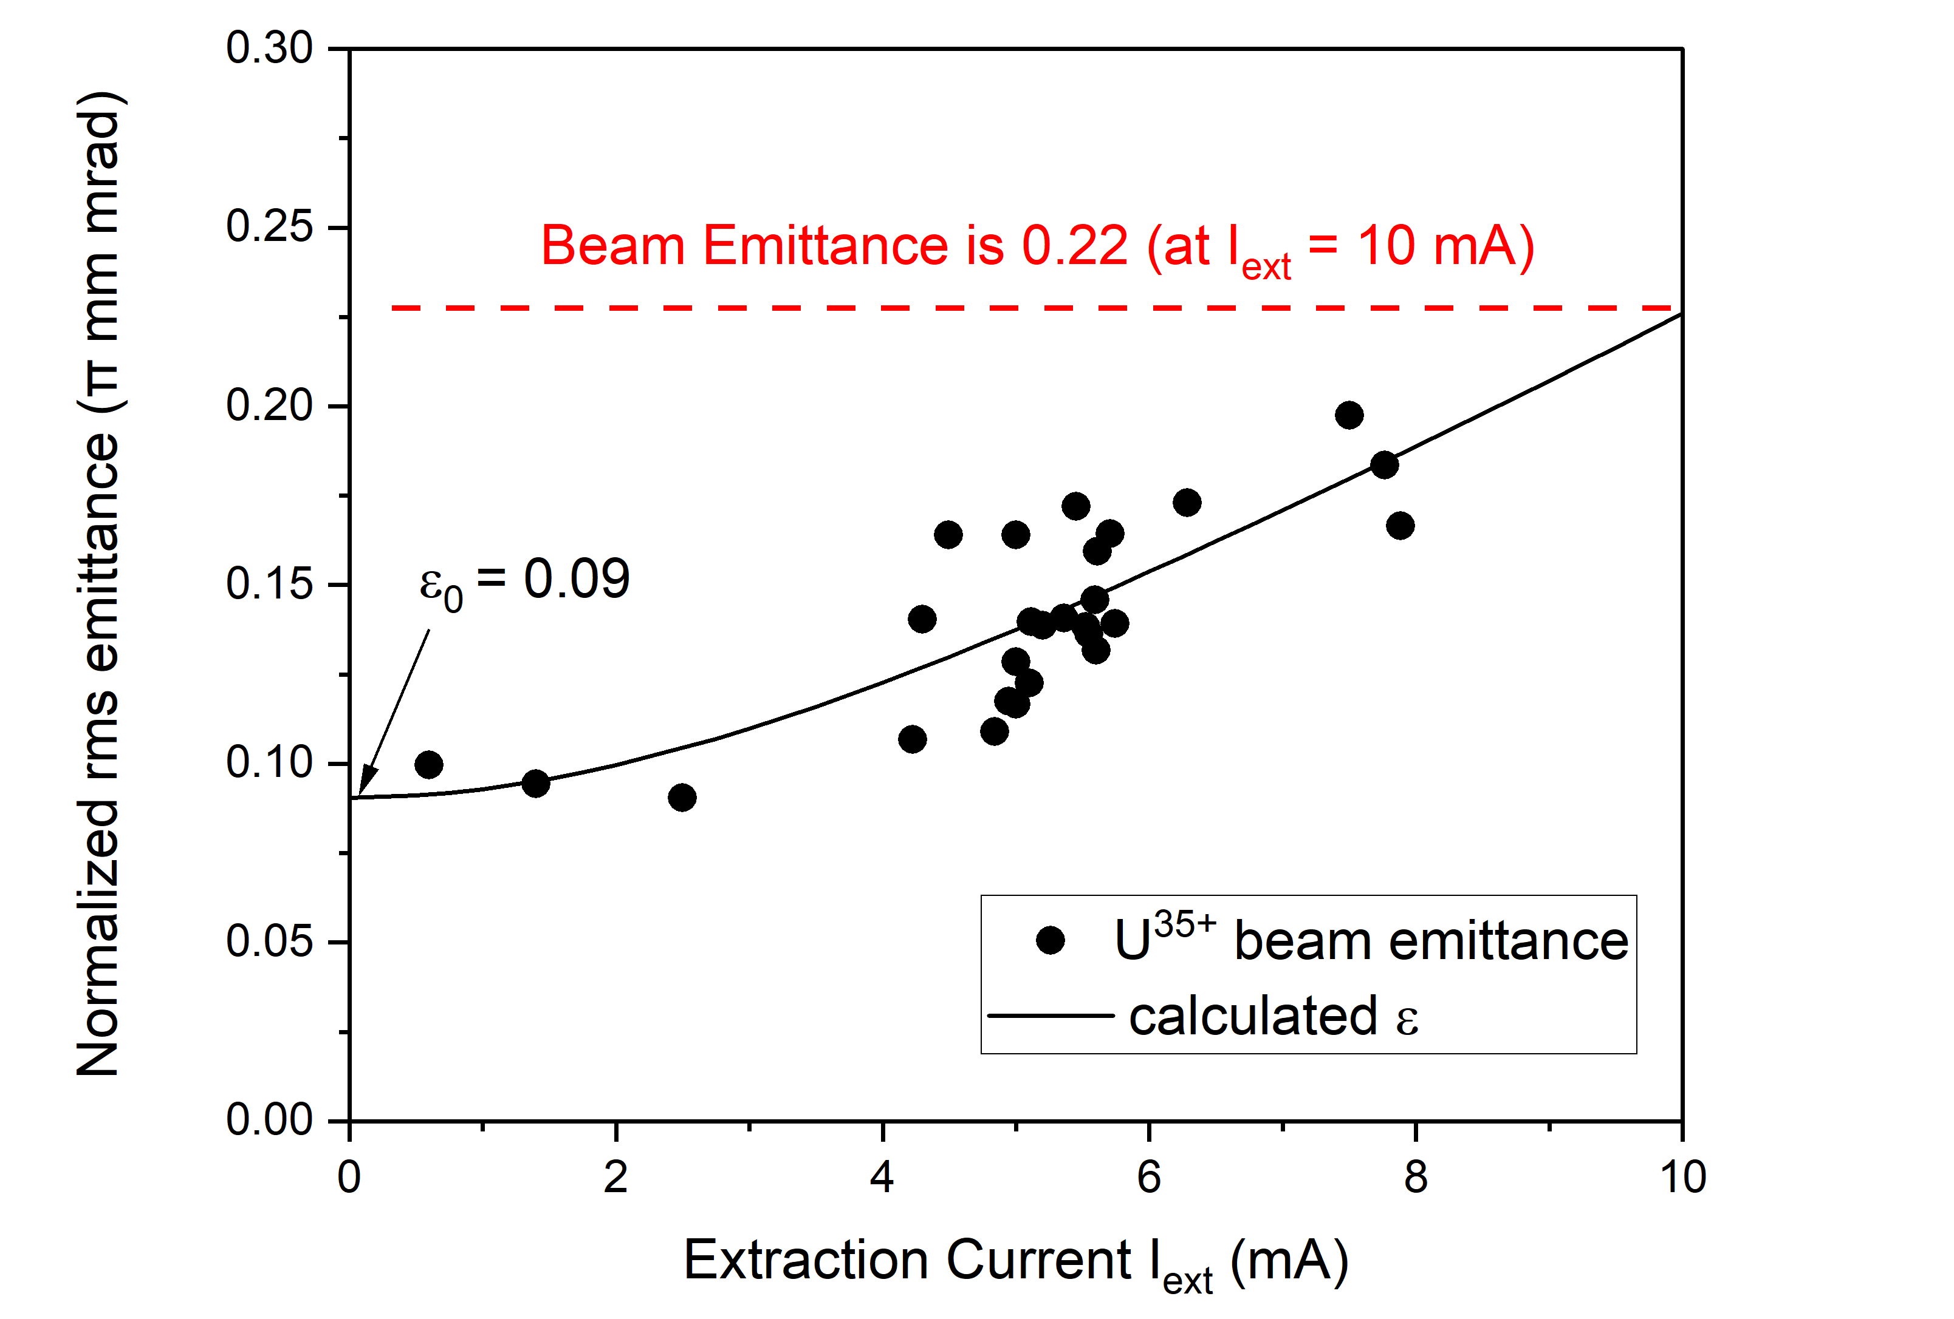
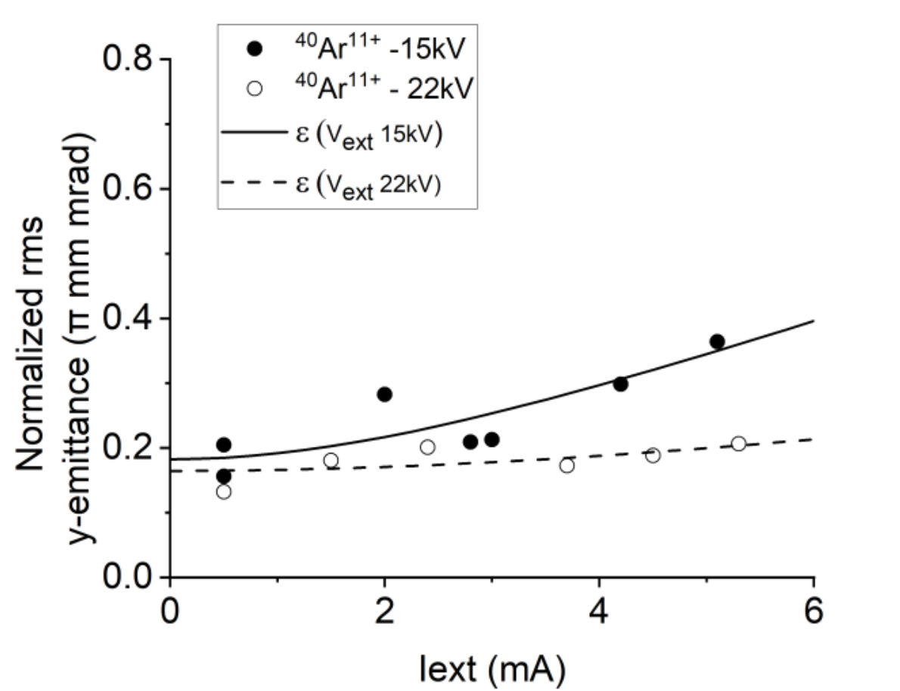
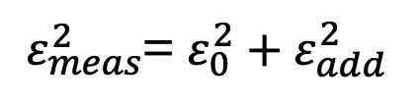
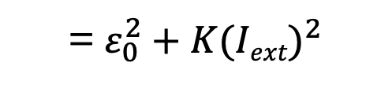
$ε_{meas}^{2}$= $ε_{0}^{2}+ε_{add}^{2}$
= $ε_{0}^{2}+K(Iext)^{2}$
Glynnis et al, ECRIS2024
Glynnis et al, ICIS2023
We should pay attention to the ε_{add}(I_{ext}) < Acceptance.

Slide 18
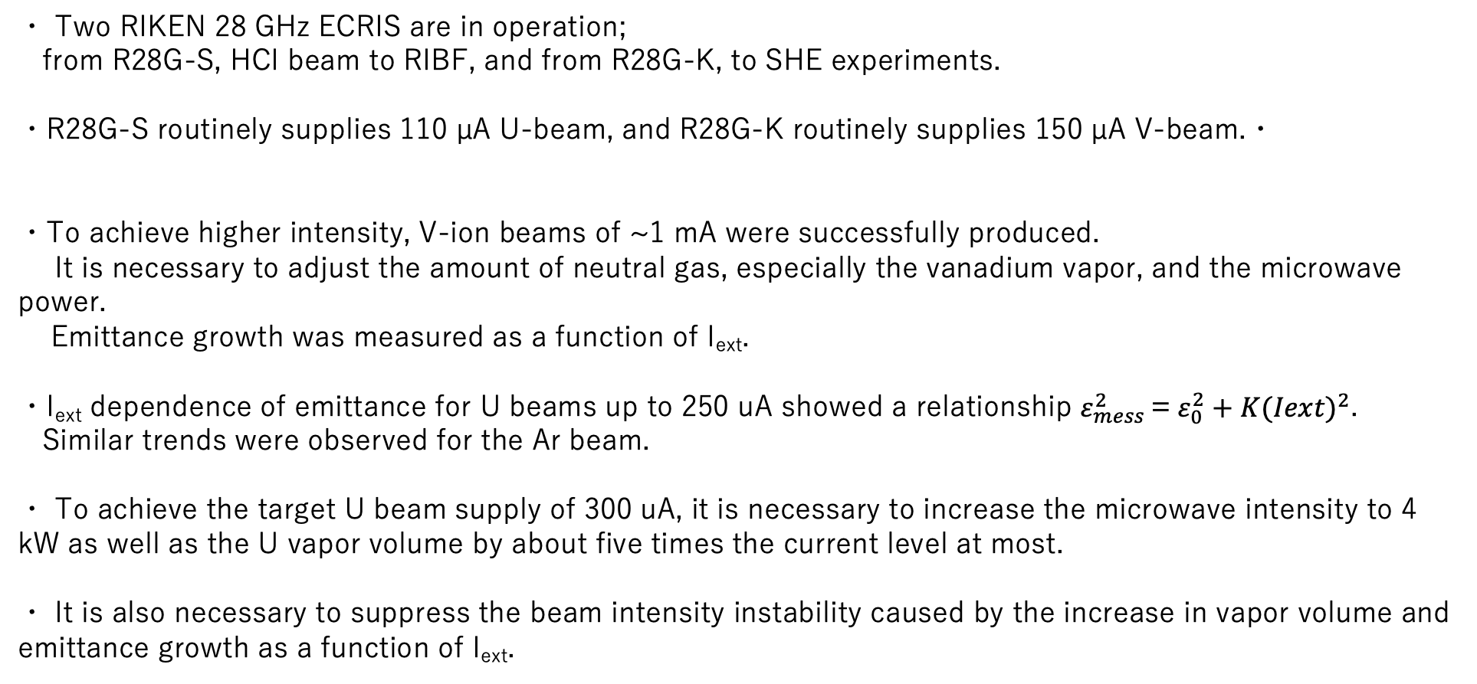
Summary
・ Two RIKEN 28 GHz ECRIS are in operation;
from R28G-S, HCI beam to RIBF, and from R28G-K, to SHE experiments.
・R28G-S routinely supplies 110 µA U-beam, and R28G-K routinely supplies 150 µA V-beam.・
・To achieve higher intensity, V-ion beams of ~1 mA were successfully produced.
It is necessary to adjust the amount of neutral gas, especially the vanadium vapor, and the microwave power.
Emittance growth was measured as a function of I_{ext}.
・I_{ext} dependence of emittance for U beams up to 250 uA showed a relationship $ε_{mess}^{2}$= $ε_{0}^{2}+K(Iext)^{2}$.
Similar trends were observed for the Ar beam.
・ To achieve the target U beam supply of 300 uA, it is necessary to increase the microwave intensity to 4 kW as well as the U vapor volume by about five times the current level at most.
・ It is also necessary to suppress the beam intensity instability caused by the increase in vapor volume and emittance growth as a function of I_{ext}.

Slide 20
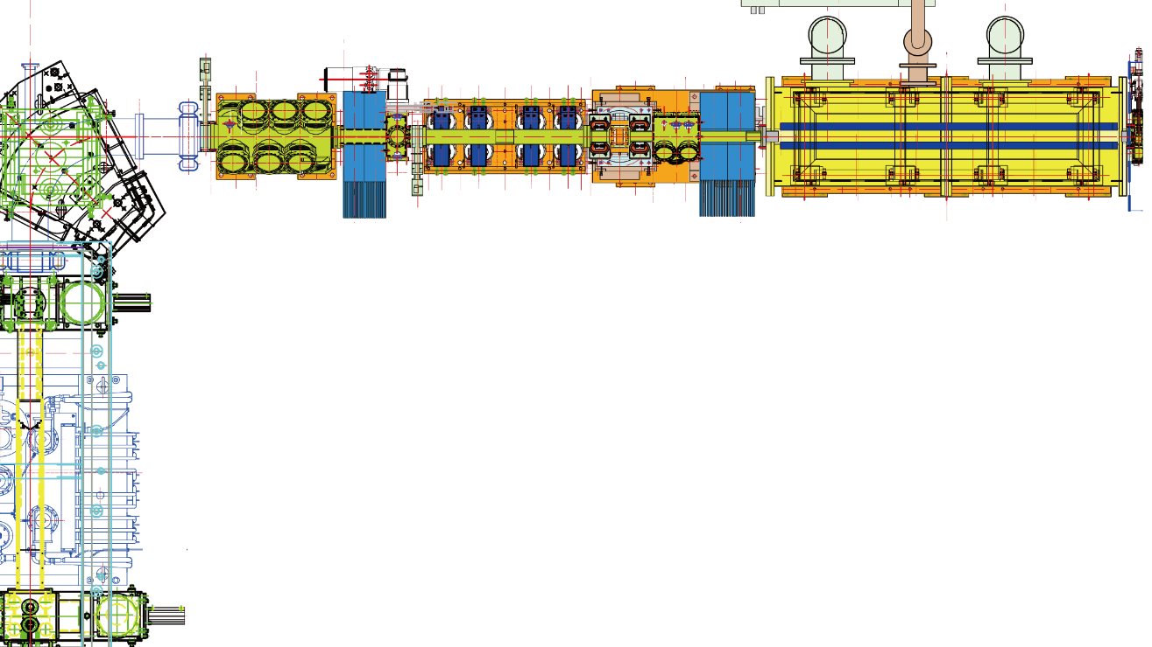
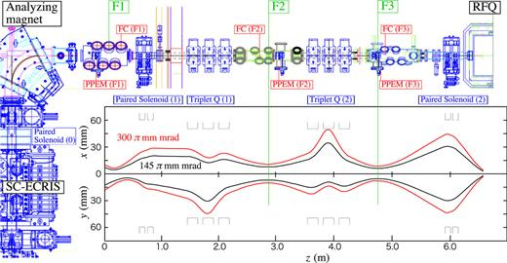
RIKEN 28-GHz ECRISs for RILAC II and RILAC
SC-ECRIS（RILAC II）and LEBT
RFQ
Q magnet
Faraday
cup
Paired Solenoid
Paired Solenoid
SC-ECRIS
Analyzing magnet
3 m
SC-ECRIS（RILAC）and LEBT

Slide 21
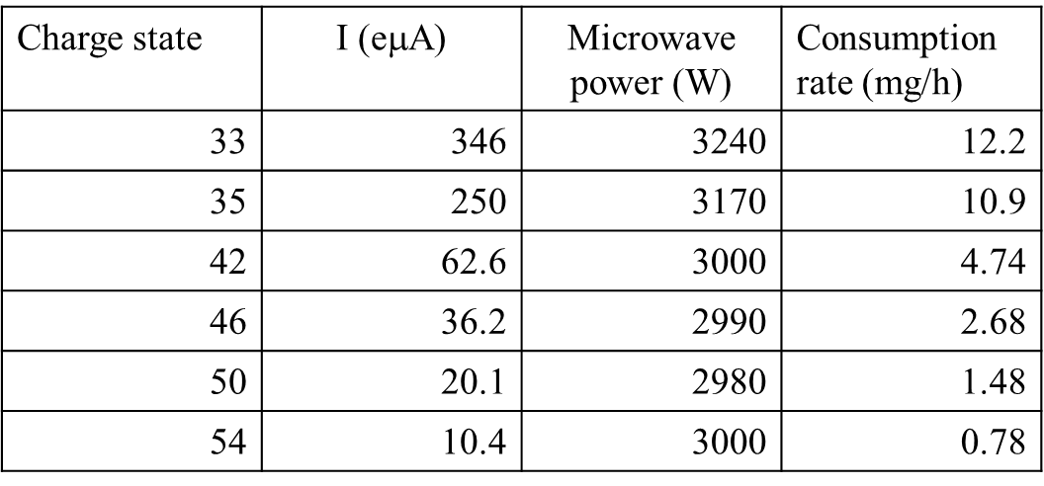
Current status of U35+ beam supply
Long period beam of 1 month was
U³⁵⁺ (110μA) with 2.4mg/h
High consumption causes unstable beam intensity.
(Absent a long-term stable supply)
250-μA U³⁵⁺ with 10.5 mg/h.
Beam intensity of highly charged U ions

Slide 22
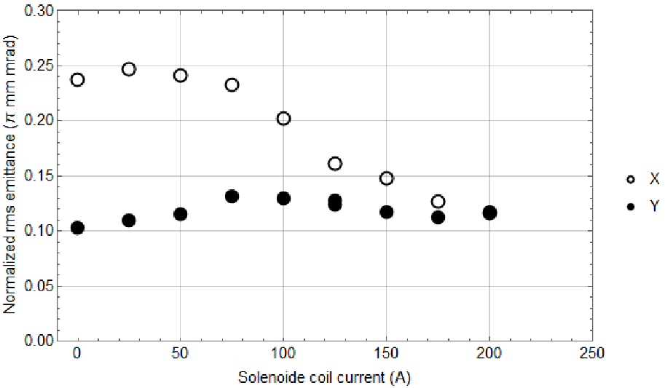
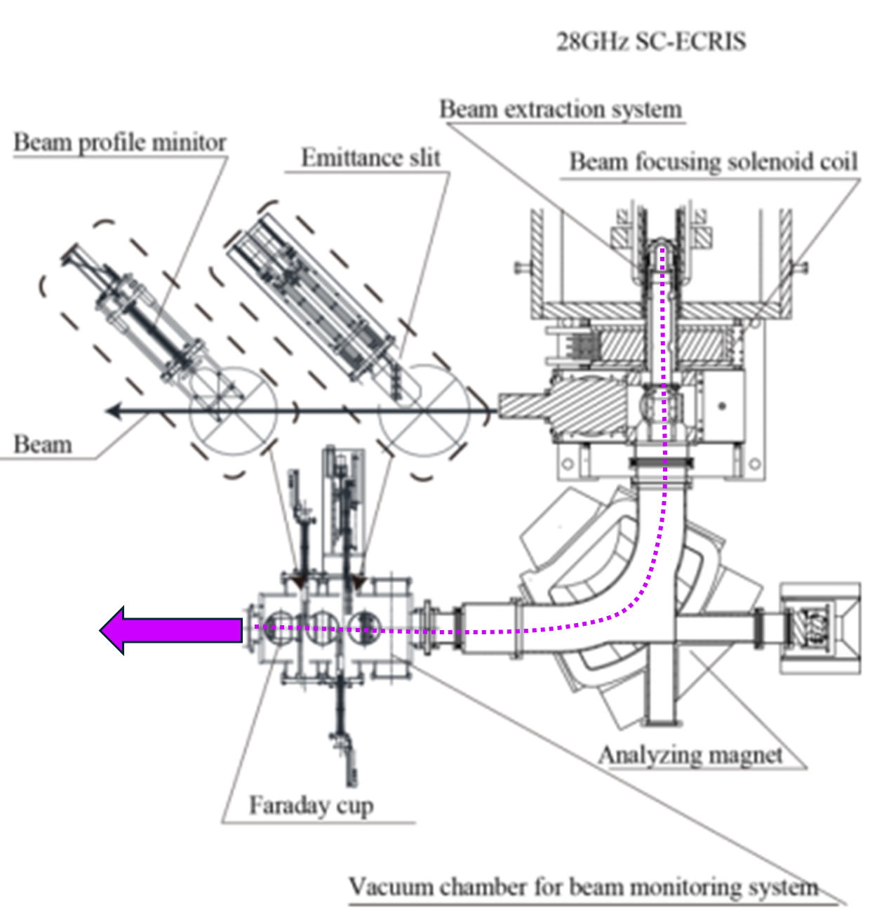

Beam Emittance of Uranium (U³⁵⁺)
Focusing lens (Solenoid Coil)
RMS Emittance and Focusing Solenoid Current
After the beam extraction, the beam is focused using a solenoid coil before passing through the dipole analyzing magnet to select the ion charge state.
In previous studies*, emittance size of the generated beam can be reduced by increasing the focusing solenoid current.
Analyzing the beam emittances, it is important to distinguish the growth factors
In this case, beam aberration along the beamline can be the cause and
the x-emittance should be carefully considered.
$ε_{meas}^{2}$ = $ε_{ECRIS}^{2}$+ $ε_{Space−Charge}^{2}$+ $ε_{other effects}^{2}$
This suggests minimal aberration for y-emittance and this can be used to deduce the ε_{ECRIS} and ε_{Space-charge}
Y. Higurashi, et. al., 2016 Proc. of ECRIS2016 (Busan) MOBO04
ECRIS SMT 26 December 2024

