Slide 1
Ion confinement in minimum-B ECRIS plasmas
Olli Tarvainen
PIBHI’25, Aci Trezza, Italy
Date: 07/04/2025

Slide 2
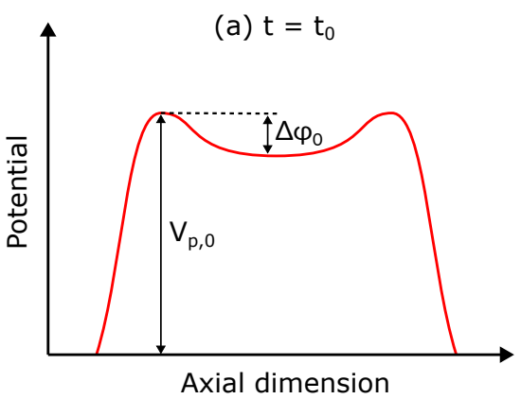
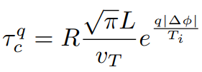
Electrostatic confinement of high charge state ions
Experimental data suggests that high charge state ions are electrostatically confined in a potential dip (magnetic confinement prevented by high collisionality).
The corresponding ion confinement time of charge state q is

Slide 3
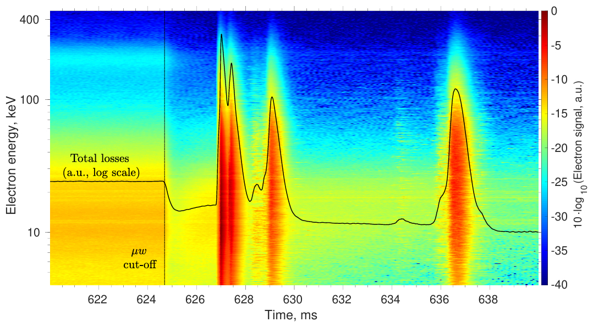
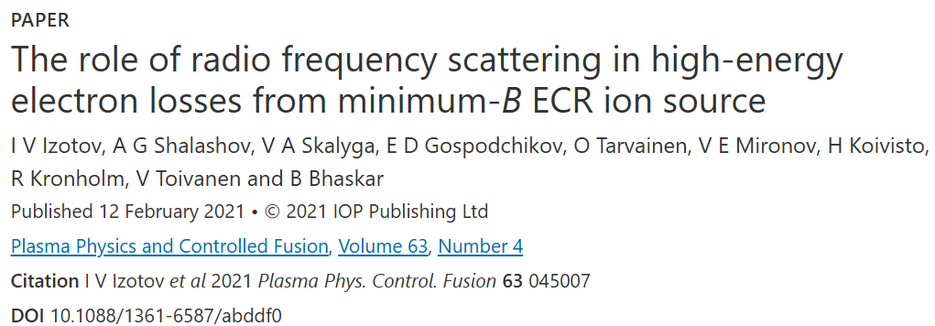
What happens when the microwave power is switched off?
Electrons:
RF scattering!

Slide 4
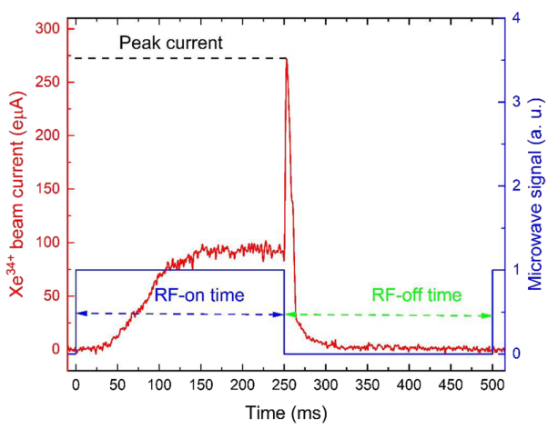
What happens when the microwave power is switched off?
Li. et al, Rev. Sci. Instrum. 96, 023303 (2025)
Ions:
Afterglow peak!

Slide 5
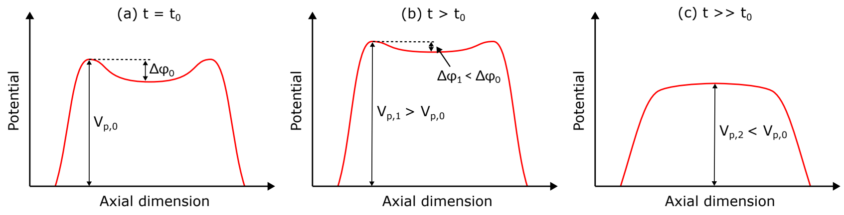
What happens when the microwave power is switched off?
The ionisation time of high charge state ions is much longer than the afterglow peak, so the peak is not increased production but instead increased ion flux of already existing ions that become deconfined. This happens when the potential dip disappears.

Slide 6
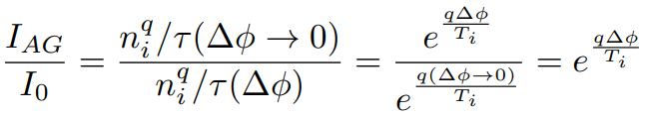
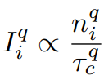
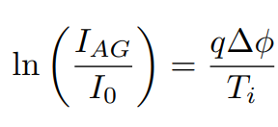
What happens when the microwave power is switched off?
The ionisation time of high charge state ions is much longer than the afterglow peak, so the peak is not increased production but instead increased ion flux of already existing ions that become deconfined. This happens when the potential dip disappears.
The same in terms of ion flux:
OR
(
)

Slide 7
What is the value of the potential dip?
Can be measured
Can be measured
Measurement of the afterglow to steady-state beam current ratio for several charge states q
and ion temperature yields the value of the potential dip Δφ
Data from the JYFL 14 GHz ECRIS to follow…

Slide 8
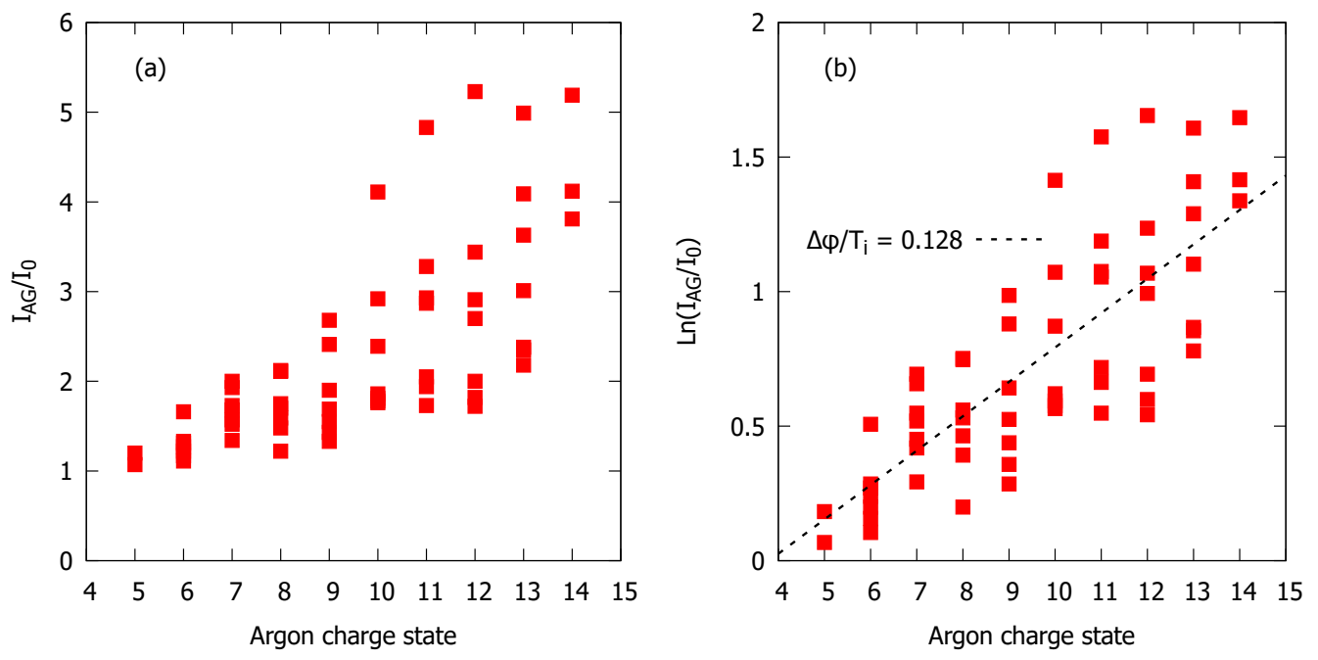
What is the value of the potential dip?

Slide 9
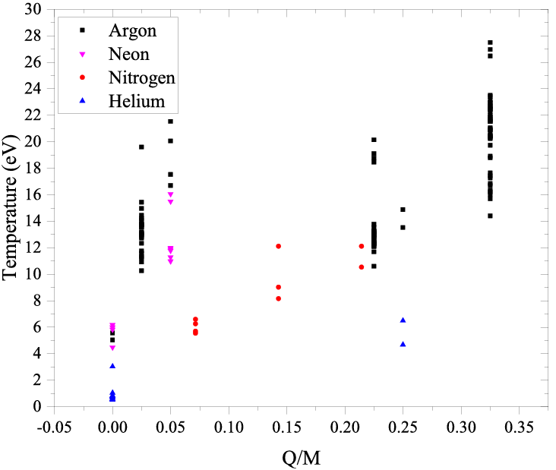

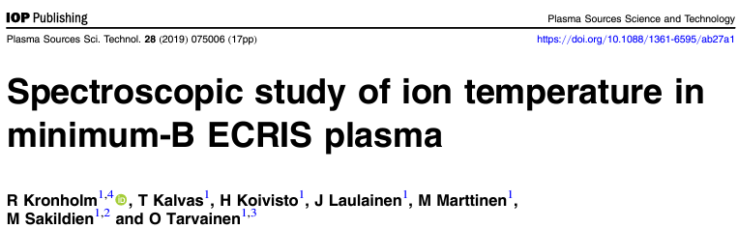
What is the value of the potential dip?
Doppler broadening due to ion temperature
Important to know the instrumental broadening
T_{i} of 10-15 eV for high charge state argon

Slide 10
What is the value of the potential dip?
Δφ of 1.3 – 1.9 V

Slide 11
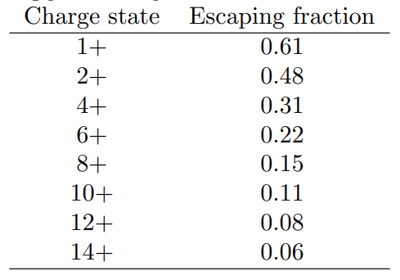
What does this mean?
Only a small fraction of the ions can escape
The charge state distribution of the extracted beam is different from that of the core plasma
Argon ions, 10-15 eV temperature, 1.3-1.9 V dip

Slide 12



Collisional ion heating
Balance equation:
All ions (q) at effective T_{i}:
Electron-ion collisions:
Reasonable assumptions…

Slide 13
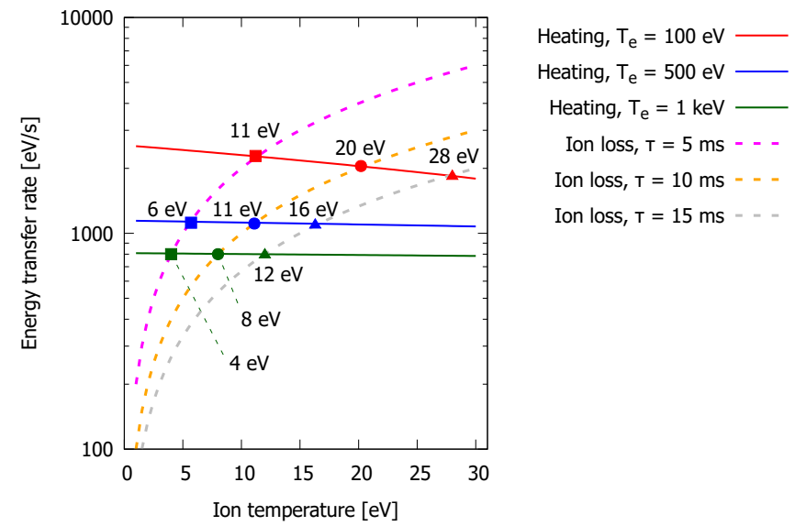
Collisional ion heating
See Luntinen et al. in Phys. Rev. E 106, 055208(2022) for ion confinement times

Slide 14
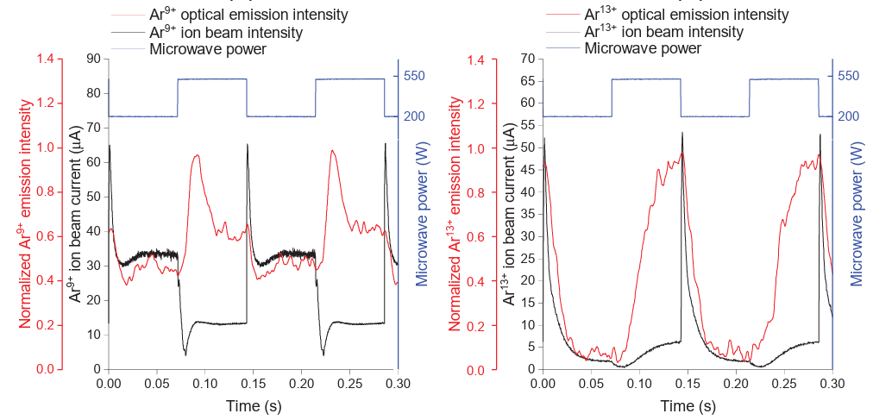
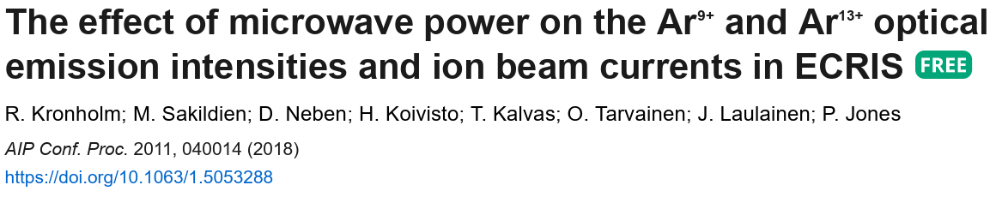
Ion heating time from amplitude modulation?
∼30 ms transient
High charge state beam currents and optical emission have the opposite response to power variation

Slide 15
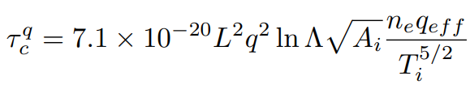
What happens when the microwave power is switched off?
When the potential dip disappears, the ion “confinement scheme” and ion confinement time change from
to
Plugging in reasonable numbers for the parameters we obtain…

Slide 16
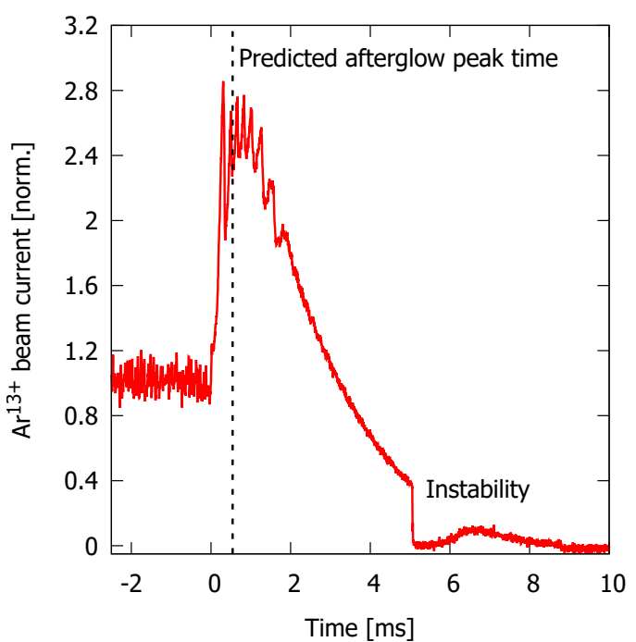
What happens when the microwave power is switched off?
Very good match…
BUT
needs further experiments on
high-frequency, large-volume ECRISs

Slide 17
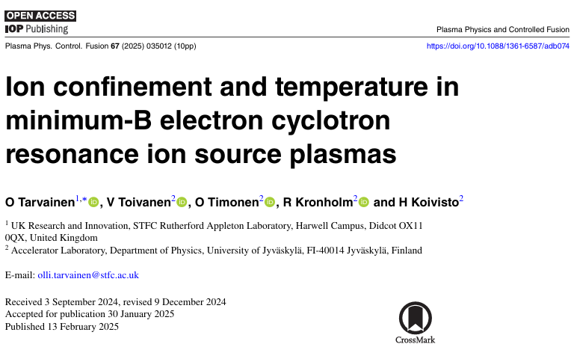
More details in

Slide 18





F
International Conference on Ion Sources, St. Catherines’s College 8-12th September 2025 https://indico.stfc.ac.uk/e/ICIS25
Abstracts due by April 30th, 2025
Images from istockphoto.com

