Slide 1


Emittances with ECRISs one major challenge to realize high intensity heavy ion beam acceleration with SRF linac
IMP
L. Sun
Institute of Modern Physics, CAS, 730000, Lanzhou, China
PIBHI’25, April. 7~9, 2025, Acitrezza, Italy

Slide 2
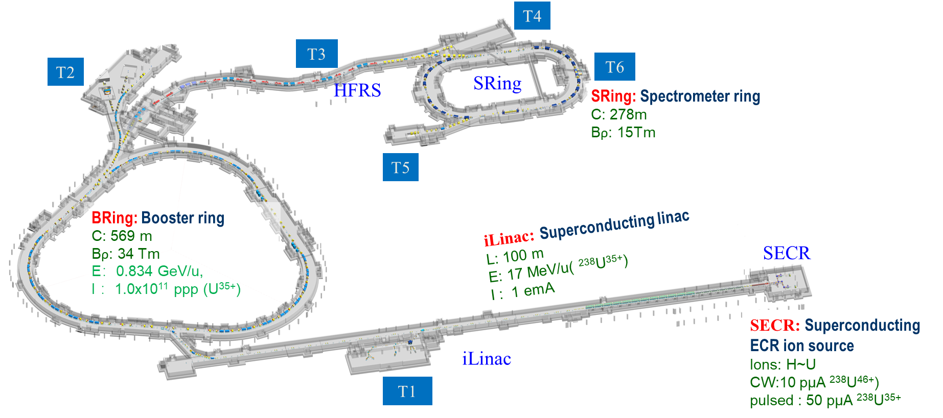
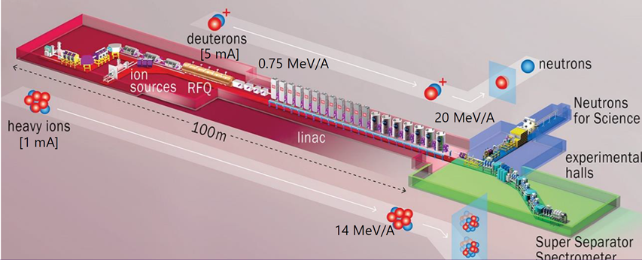
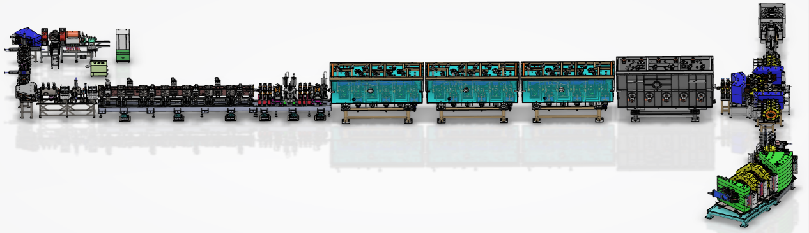
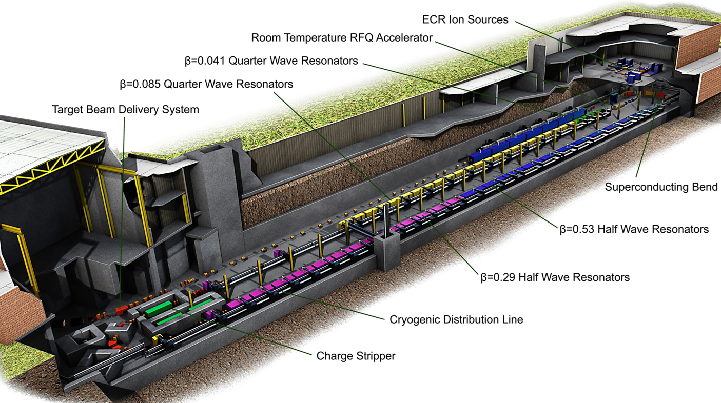
SRF Linacs for High Intensity Heavy Ion Beams
>1 emA Ar¹²⁺, CW
>340 eμA U³⁴⁺, CW
>460 eμA U⁴⁶⁺, CW
> 1 emA U³⁵⁺, pulsed
IMP HIAF（under commissioning）
GANIL SPIRAL 2（in operation）
Emittances requirements:
ε_{n.rms}= 0.20~0.25 π.mm.mrad
>450 eμA U³⁴⁺, CW
>500 eμA ⁵⁴Cr¹⁷⁺, CW
MSU FRIB（in operation）
IMP CAFE2（in operation）
Notes:
Needs: SHE, CEE, HIAF
HCI production: metallic beams with CAFe-2 (LECR5 & SECRAL 3), Uranium beam with HIRFL@SECRAL-I & SECRAL-II
New Techniques towards intense beams: HTO, Vlasov launcher, 2-frequency AG, Biased probe + AG effect
HIAF requirements in long range, FECR

Slide 3
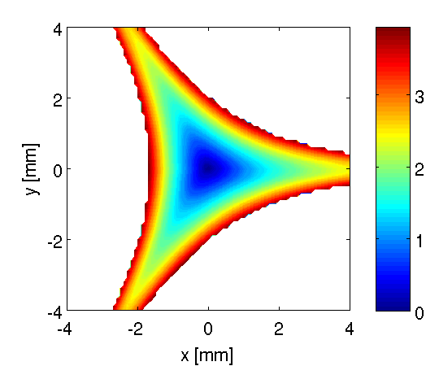
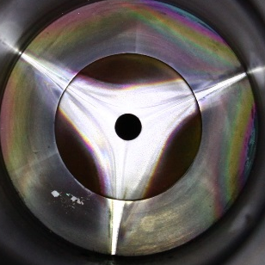
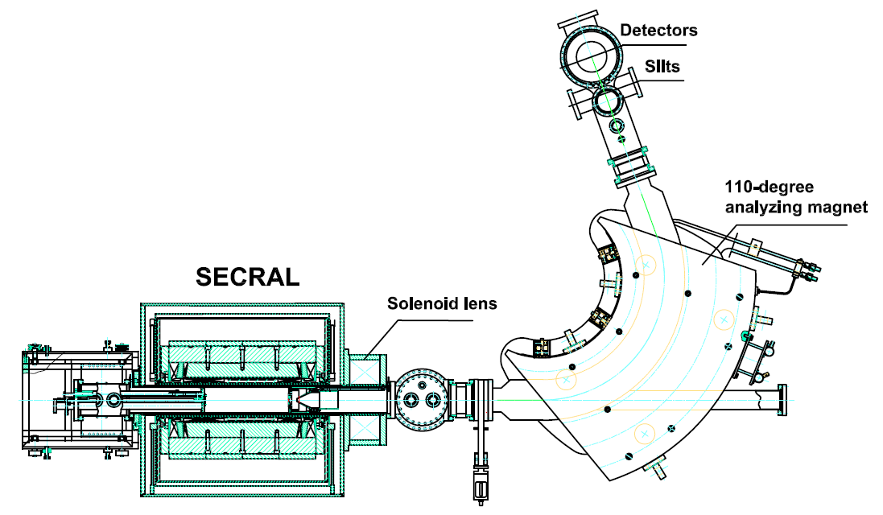
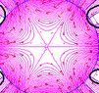
Why Ion Beam Quality from HCI ECRIS Degrades
Emittance Growth:
Asymmetric beam
Beam axis offset
High order aberrations
Strong space charge effect
Notes:
Needs: SHE, CEE, HIAF
HCI production: metallic beams with CAFe-2 (LECR5 & SECRAL 3), Uranium beam with HIRFL@SECRAL-I & SECRAL-II
New Techniques towards intense beams: HTO, Vlasov launcher, 2-frequency AG, Biased probe + AG effect
HIAF requirements in long range, FECR

Slide 4
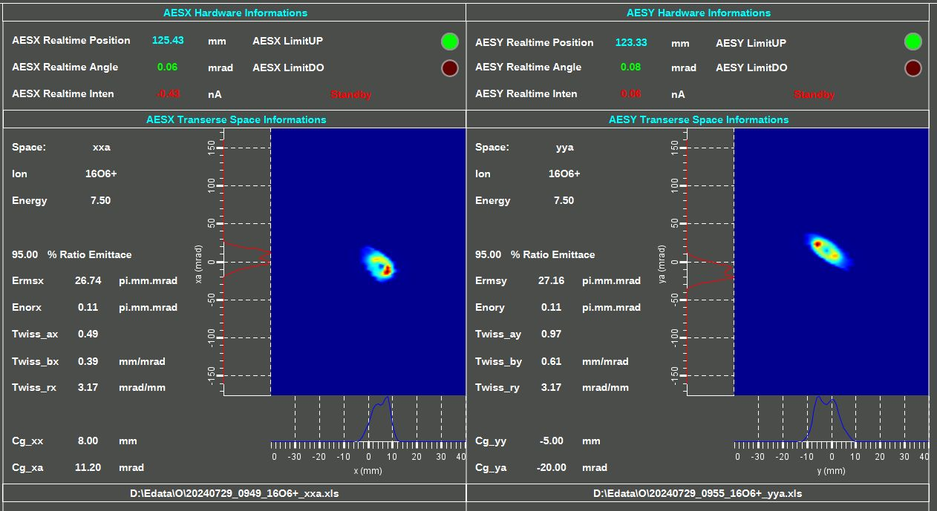
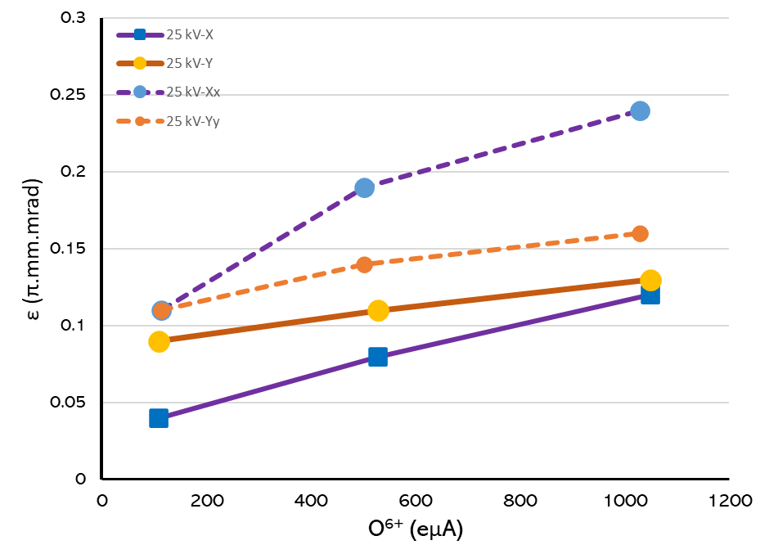
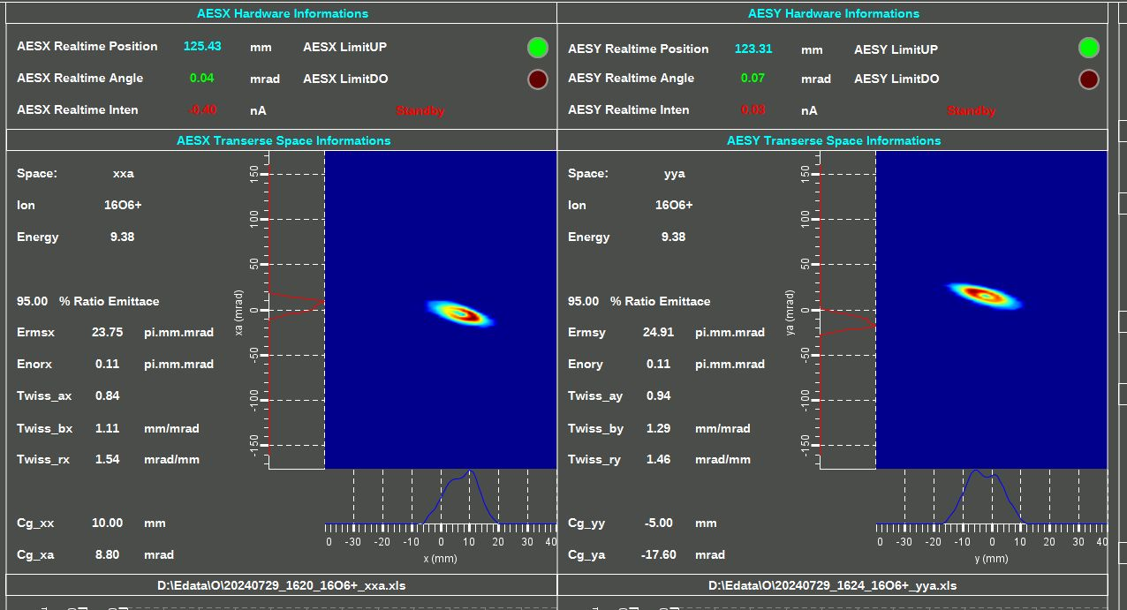
Beam Emittances of intense HCIs
Notes:
Needs: SHE, CEE, HIAF
HCI production: metallic beams with CAFe-2 (LECR5 & SECRAL 3), Uranium beam with HIRFL@SECRAL-I & SECRAL-II
New Techniques towards intense beams: HTO, Vlasov launcher, 2-frequency AG, Biased probe + AG effect
HIAF requirements in long range, FECR

Slide 5
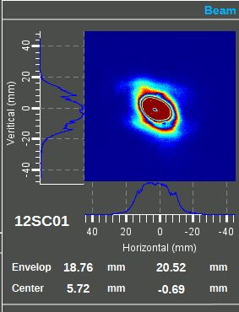
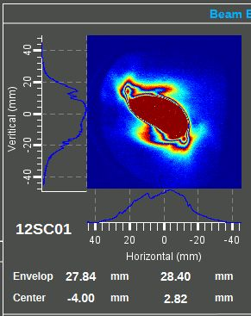
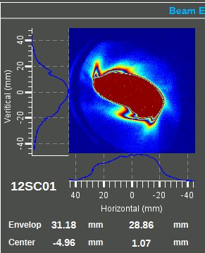
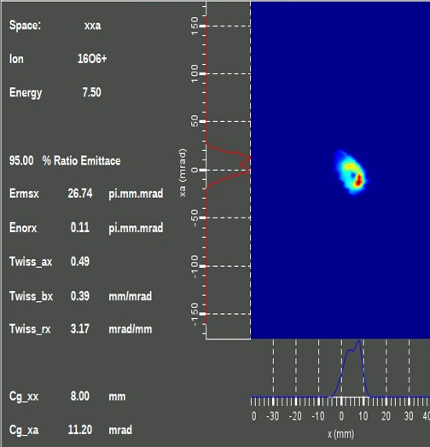
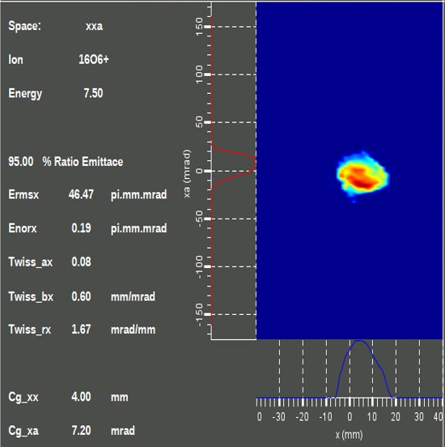

Beam Emittances of intense HCIs
X-Y
X-X’
100 eμA
500 eμA
1000 eμA
Notes:
Needs: SHE, CEE, HIAF
HCI production: metallic beams with CAFe-2 (LECR5 & SECRAL 3), Uranium beam with HIRFL@SECRAL-I & SECRAL-II
New Techniques towards intense beams: HTO, Vlasov launcher, 2-frequency AG, Biased probe + AG effect
HIAF requirements in long range, FECR

Slide 6
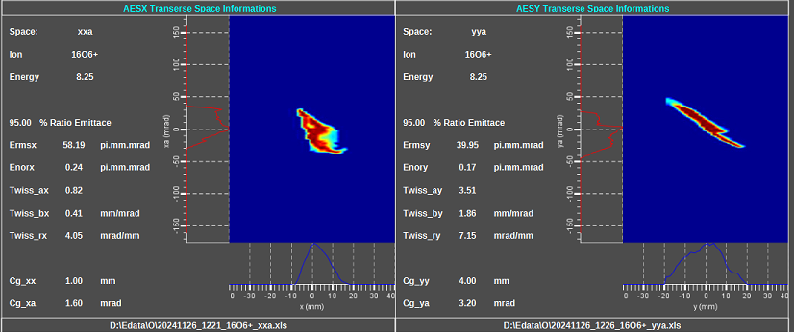
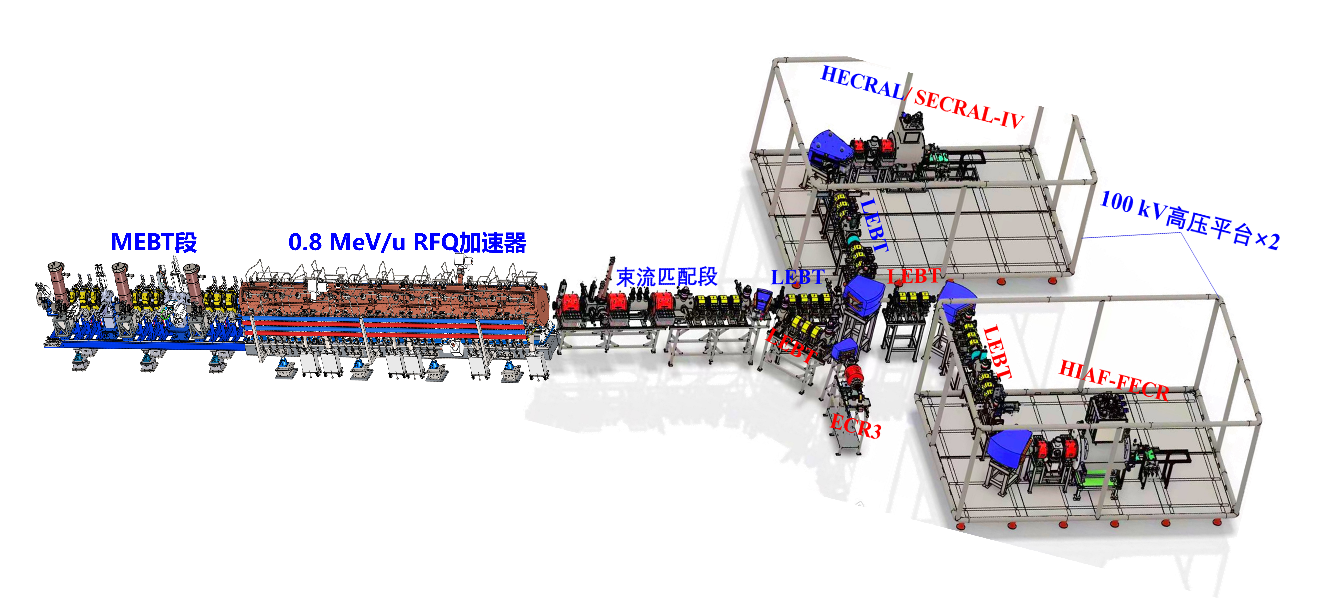
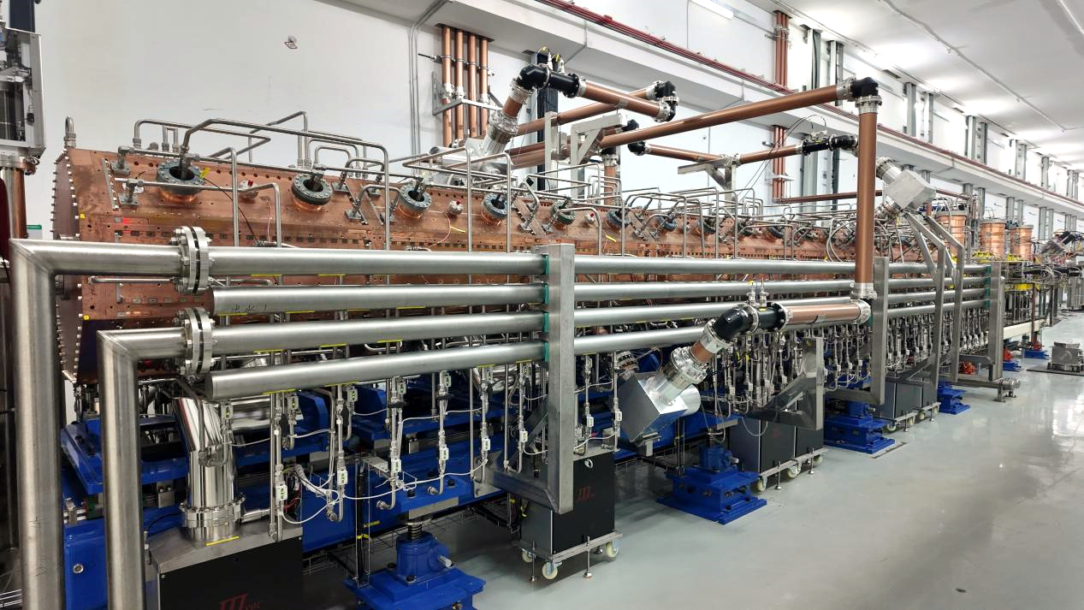
Intense beam commissioning
1.6 emA O⁶⁺
@0.24 π.mm.mrad
MEBT
0.8 MeV/u RFQ
iLinac
Collimator
Notes:
Needs: SHE, CEE, HIAF
HCI production: metallic beams with CAFe-2 (LECR5 & SECRAL 3), Uranium beam with HIRFL@SECRAL-I & SECRAL-II
New Techniques towards intense beams: HTO, Vlasov launcher, 2-frequency AG, Biased probe + AG effect
HIAF requirements in long range, FECR

Slide 7
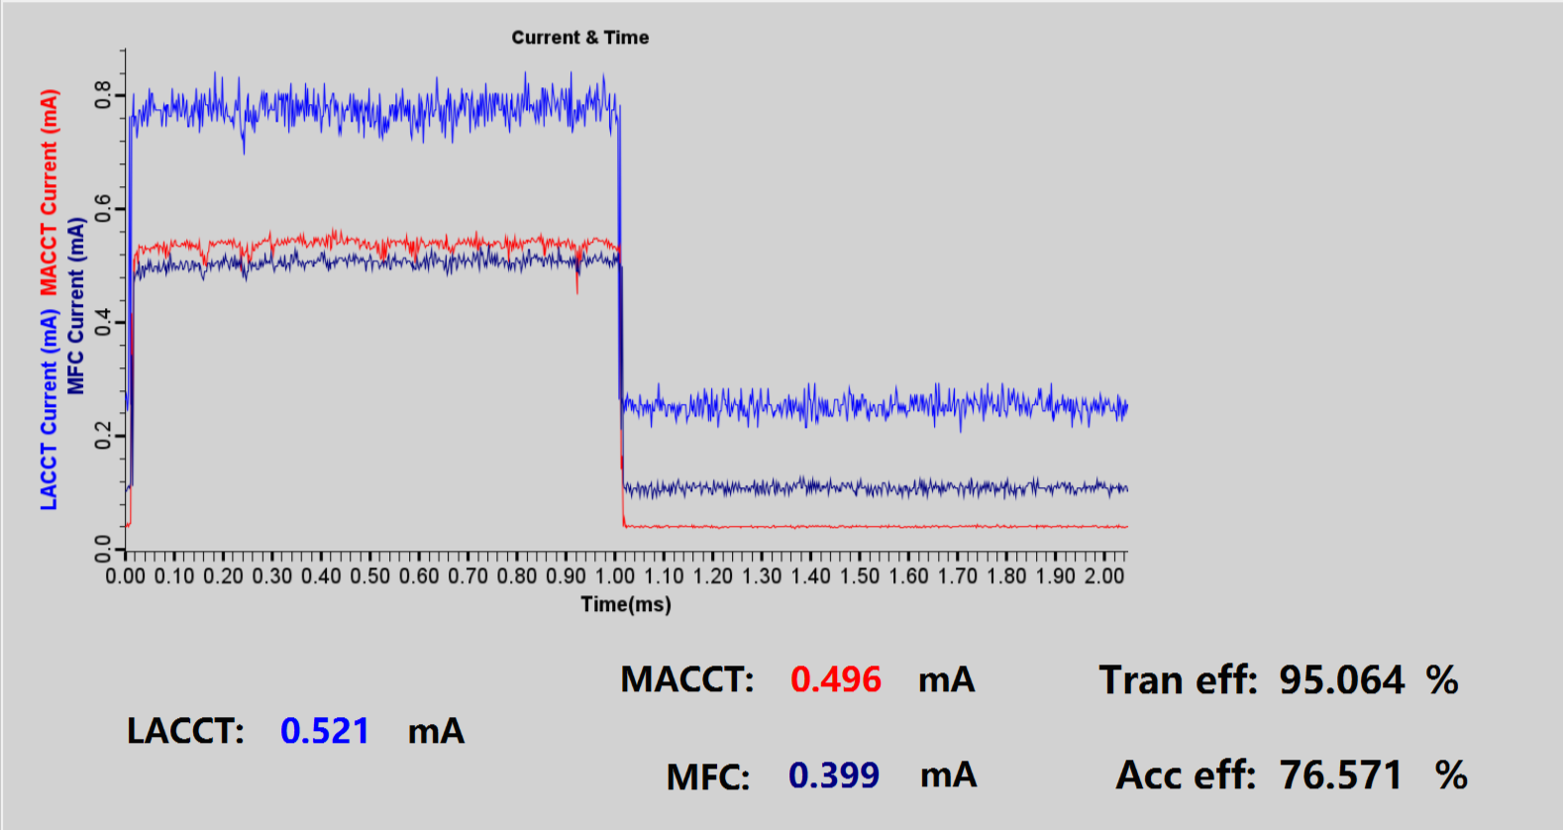
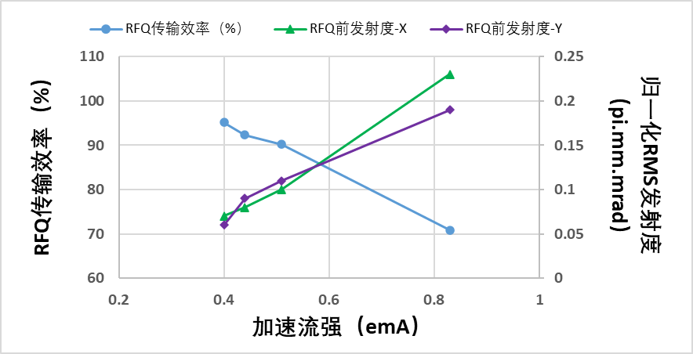
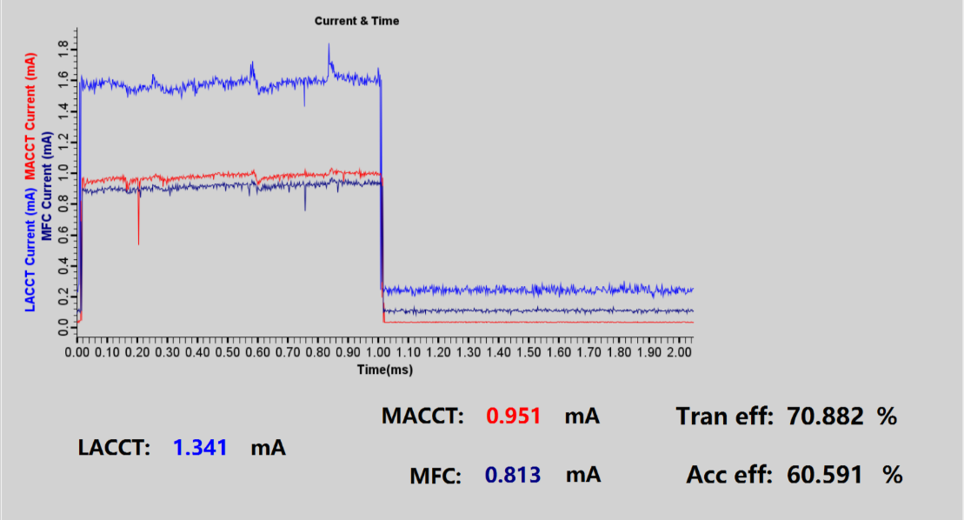
Intense heavy ion beams acceleration
400 eμA Acc.
Emittance
Transmission
Transmission efficiency (%)
Nor. RMS Emittance (π.mm.mrad)
800 eμA Acc.
Transmitted Ion Beam Current (eμA)
Notes:
Needs: SHE, CEE, HIAF
HCI production: metallic beams with CAFe-2 (LECR5 & SECRAL 3), Uranium beam with HIRFL@SECRAL-I & SECRAL-II
New Techniques towards intense beams: HTO, Vlasov launcher, 2-frequency AG, Biased probe + AG effect
HIAF requirements in long range, FECR

Slide 8
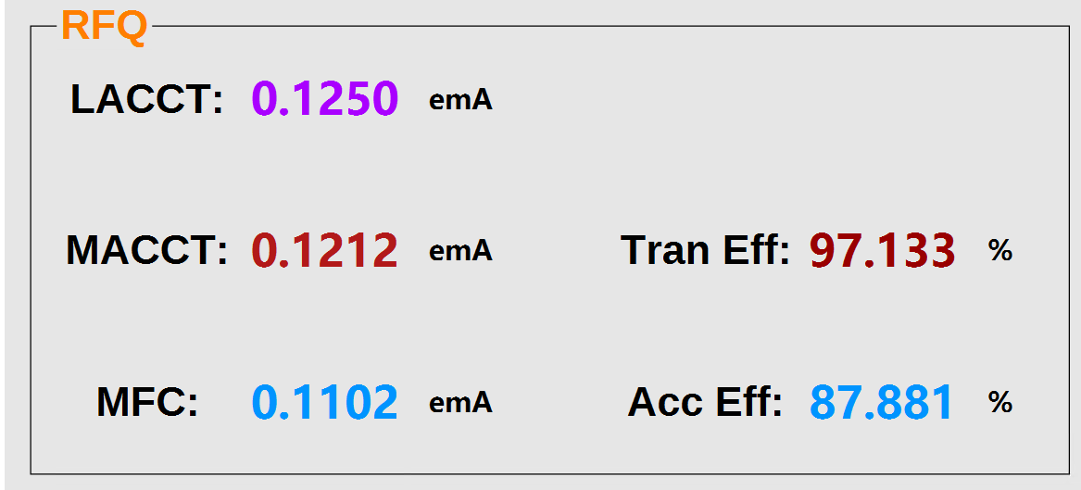
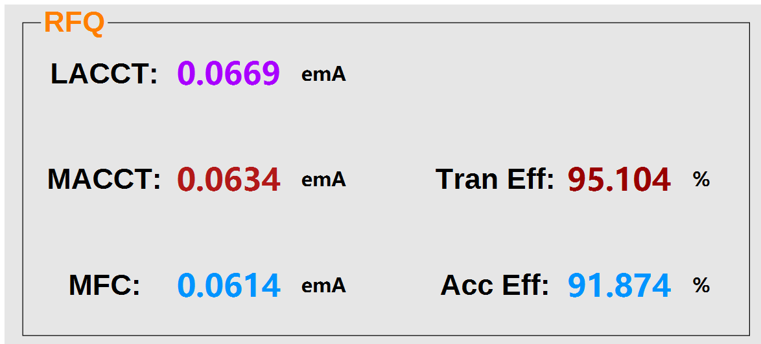
Intense heavy ion beams acceleration
120 eμA Kr¹⁹⁺
60 eμA Bi³¹⁺
Notes:
Needs: SHE, CEE, HIAF
HCI production: metallic beams with CAFe-2 (LECR5 & SECRAL 3), Uranium beam with HIRFL@SECRAL-I & SECRAL-II
New Techniques towards intense beams: HTO, Vlasov launcher, 2-frequency AG, Biased probe + AG effect
HIAF requirements in long range, FECR

Slide 9
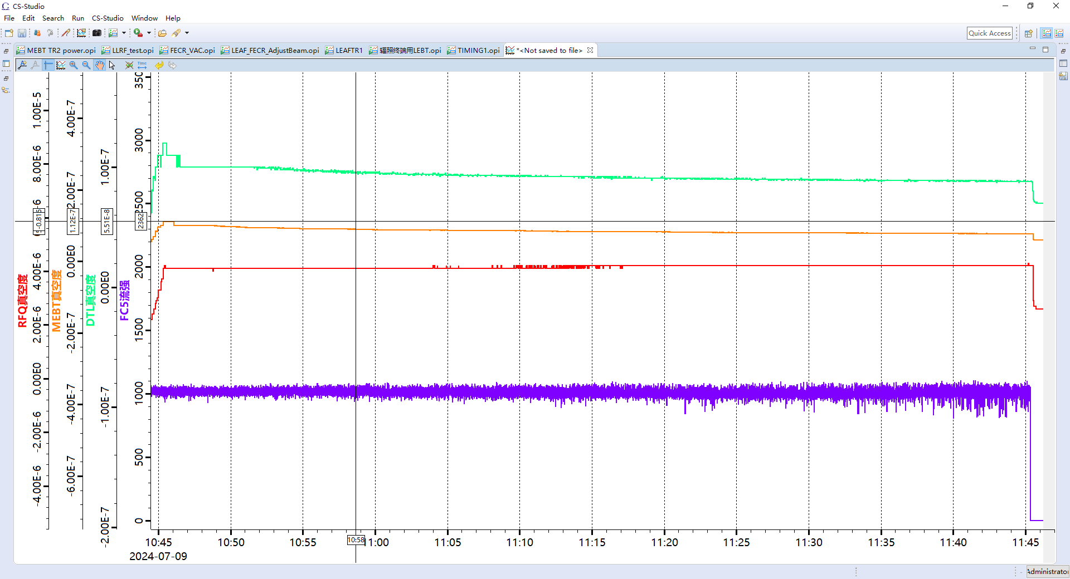
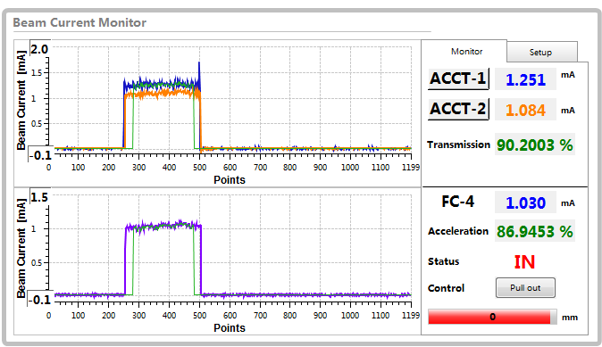
Intense heavy ion beams acceleration
1 emA O⁶⁺ Acceleration with LEAF
1emA O⁶⁺Acceleration
1.016（σ=18.83）emA O⁶⁺@60 mins
With 1.8 emA O⁶⁺ from FECR
Long-term CW operation of emA heavy ion beam is challenging
Notes:
Needs: SHE, CEE, HIAF
HCI production: metallic beams with CAFe-2 (LECR5 & SECRAL 3), Uranium beam with HIRFL@SECRAL-I & SECRAL-II
New Techniques towards intense beams: HTO, Vlasov launcher, 2-frequency AG, Biased probe + AG effect
HIAF requirements in long range, FECR

Slide 10
Summary
Beam quality of ECRIS is not good: evolving with the beam intensity
Mostly, ion Beam quality determinates with intensity increase
Realizing high quality intense heavy ion beam acceleration is challenging
Perspectives:
Minimize extracted ion beam emittances
Control beam emittance growth
Ion beam extraction and transmission needs better understanding
Don’t let collimation be the only solution to good beam matching

