Slide 1
What contributes to the emittance of an ion beam?
ISIS Low Energy Beam Physics Section
Olli Tarvainen, Erin Flannigan, Alejandro Garcia Sosa
PIBHI’25, Aci Trezza, Italy
Date: 07/04/2025

Slide 2
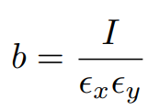
Main parameters of an ion beam
The main parameters of the ion beam extracted from an ion source are the ion species (mass and charge state), the beam energy and energy spread, the intensity (current), and the beam quality, which is often quantified using the beam brightness
Where I is the beam current, and ε_{x} and ε_{y} are the horizontal and vertical transverse (to beam propagation) emittance
Notes:
Emittance is an important beam parameter

Slide 3

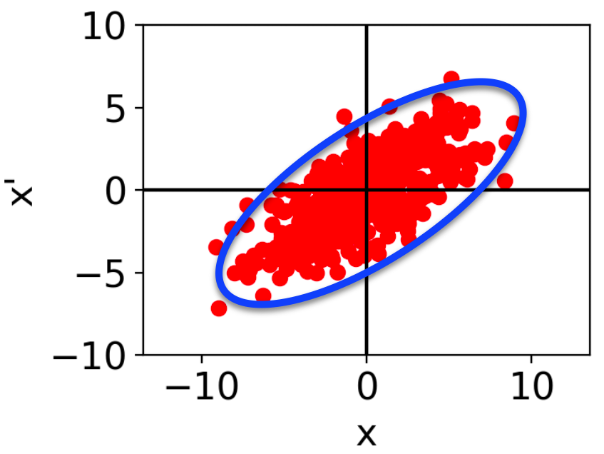






What is emittance?
The ensemble of beam particles can be described by a 6D position and momentum distribution function
where the 2D projections
describe the distributions of transverse (x,y) and longitudinal (z) positions and momenta of the particles.
Here and and
Notes:
Each particle has six phase space coordinates. Transverse emittance is a distribution of the 2D projection

Slide 4
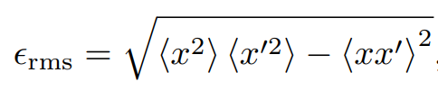
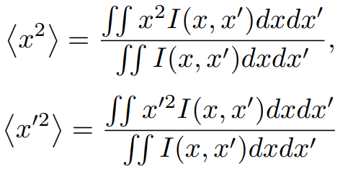
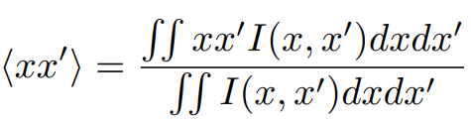
What is emittance?
The root-mean-square or rms emittance in (x,x’) phase space - only one 2D transverse projection for simplicity - is defined as
where the expectation values are integrated from the beam particle positions
and
Here I(x,x’)dxdx’ is the beam current in phase space element dxdx’.
Notes:
Definition of emittance

Slide 5
Transverse emittance of an ion beam
The transverse emittance of an ion beam is affected by
Fundamental plasma properties and ion source design principles (given)
Beam extraction and transport properties (can be changed)
These are sometimes interconnected i.e. a fundamental plasma property affects the transverse emittance due to effects induced in the beam transport
ε = + + + + …
Discussion on various contributions to the transverse (and longitudinal) emittance and their relevance for each type of ion source…

Slide 6
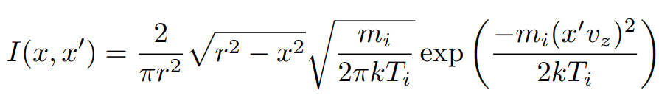
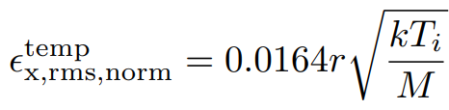
Ion temperature
Assuming a Gaussian ion temperature distribution for a spatially uniform beam extracted from a round aperture we have
which through integration results in normalised emittance (ε_{norm}=βγε) of
Here r is the radius of the extraction aperture (in mm), kT_{i} is the ion temperature (in eV) and M is the ion mass (in amu).

Slide 7
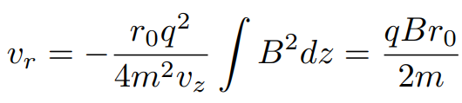

Magnetic field
The magnetic field of an ion source at the extraction is typically a solenoid field (axial), which diverges strongly in the region where the beam is extracted. The resulting radial velocity of the ions at zero field (far in the beamline) is
which for a uniform ion distributions translates to normalised emittance of
Here r is the radius of the extraction aperture (in mm), B is the magnetic field strength at the extraction aperture (in T), Q is the ion charge state (e.g. Q = 1 for protons) and M is the ion mass (in amu).

Slide 8
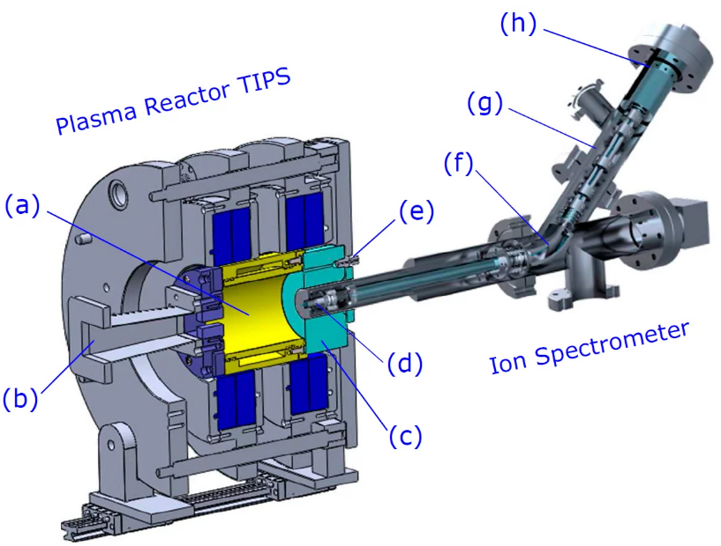
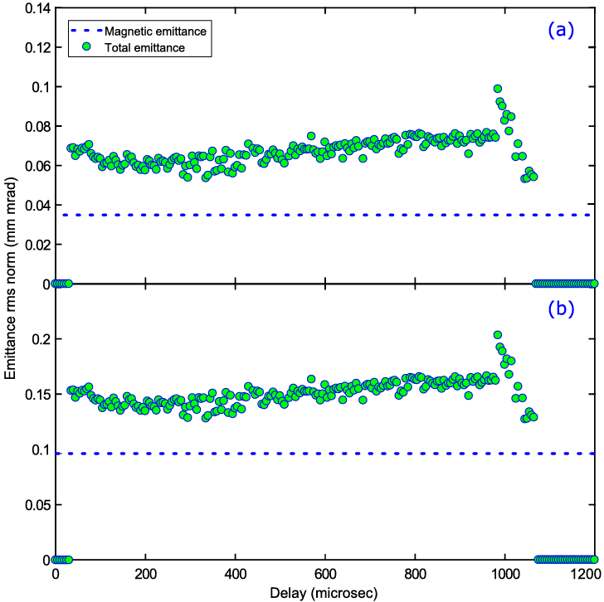
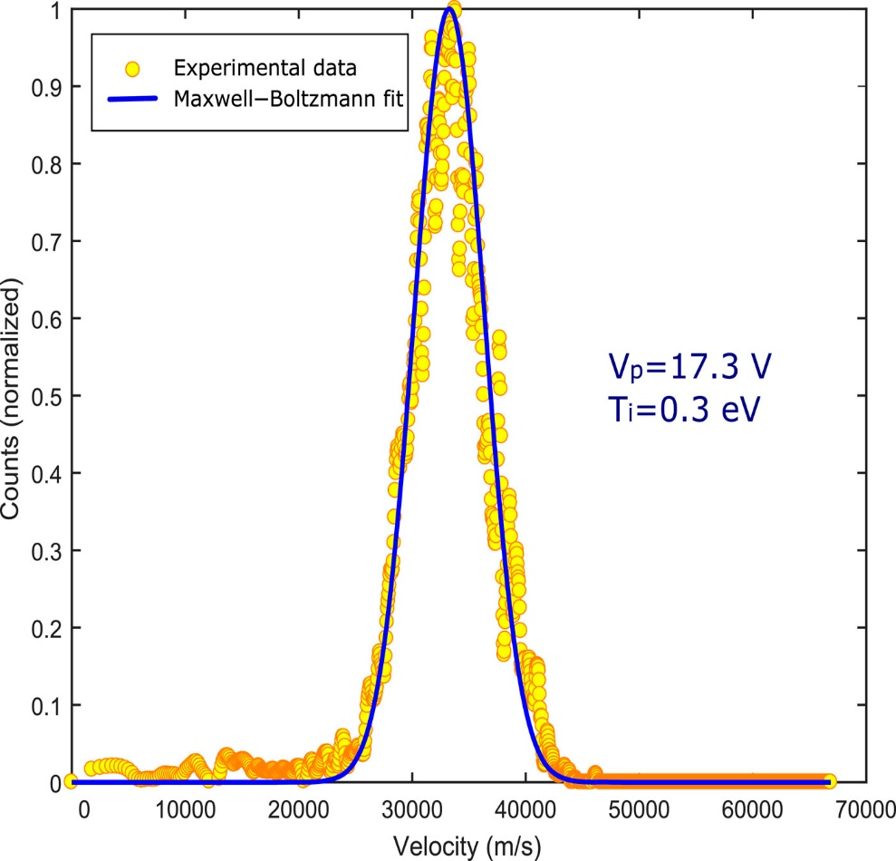
Ion temperature and magnetic field contributions on emittance
2.45 GHz microwave ion source
Megia-Macias et al. Rev Sci Instrum 92 (2021)113301
φ 6 mm
φ 10 mm
∼ 1:1 contribution from T_{i} and B
Notes:
2.45 GHz ECRIS results with a Hiden EQP mass and energy analyser. Reveals Ti which can then be compared to magnetic emittance

Slide 9
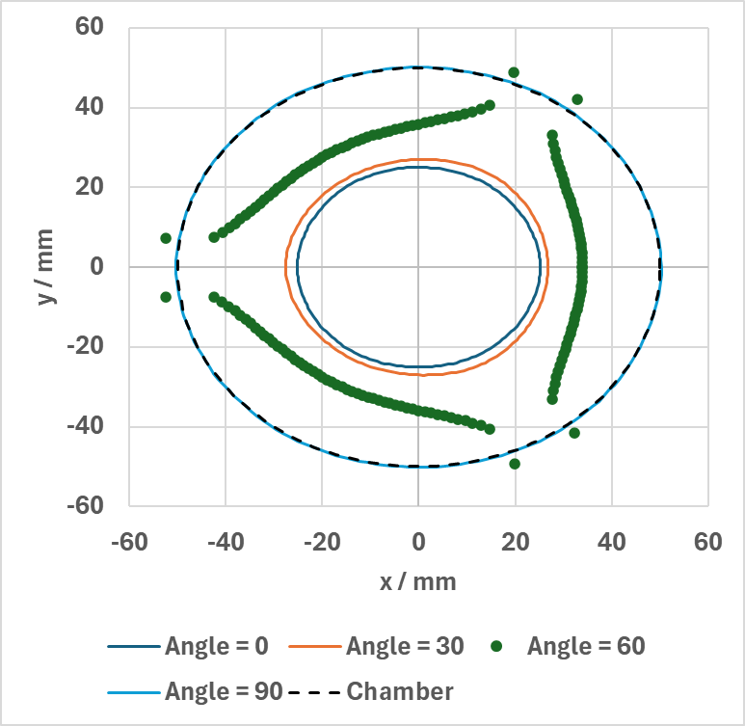
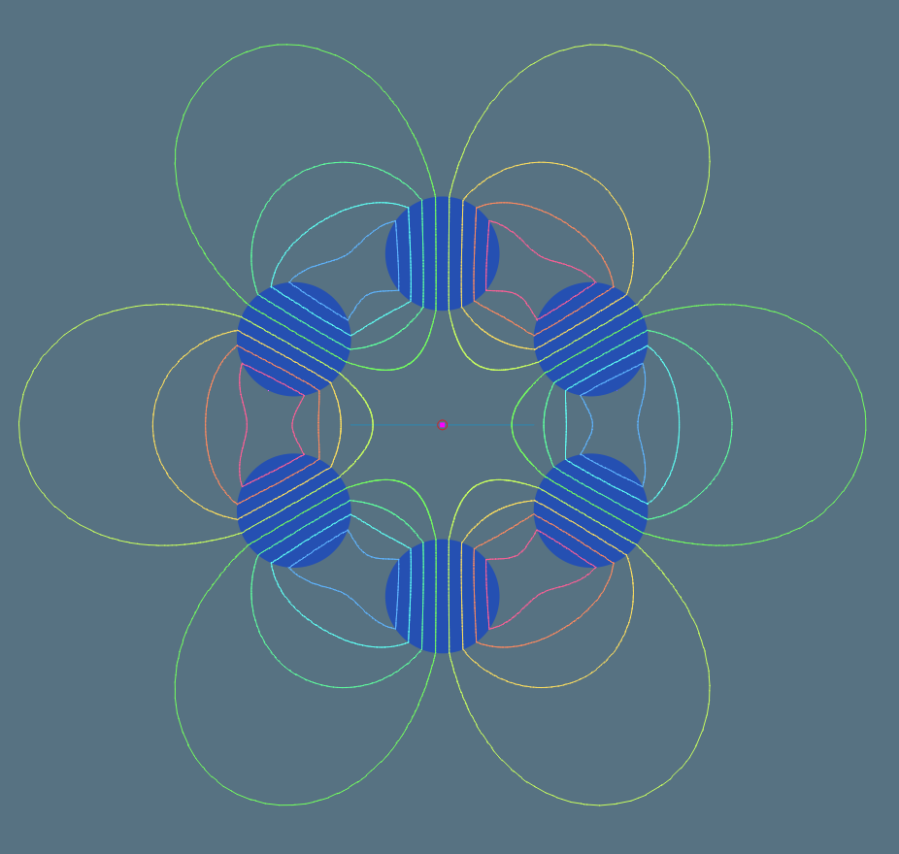
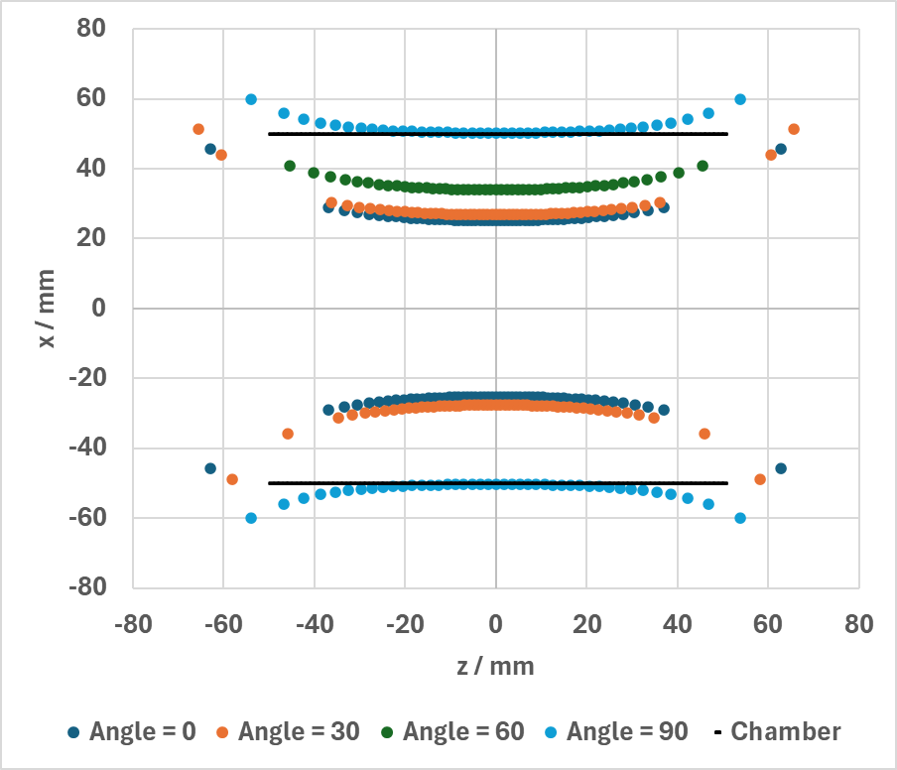
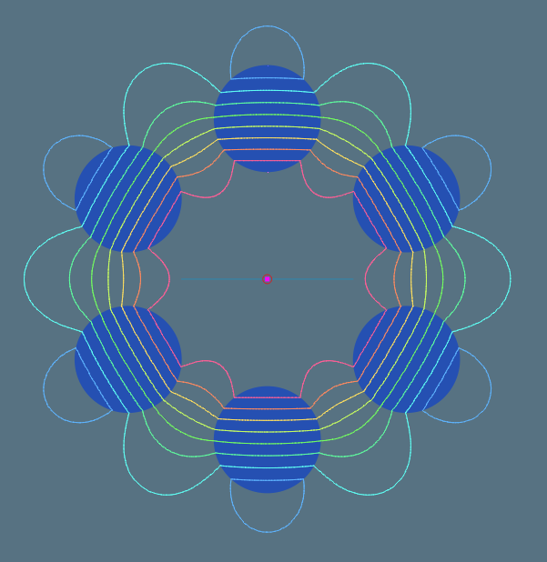
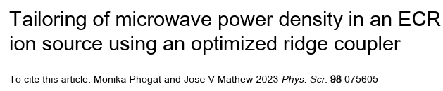
Ion temperature and magnetic field contributions on emittance
∴ In 2.45 GHz microwave ion sources it would be beneficial to minimise the on-axis magnetic field strength
High strength
(0 degrees)
This zero-field on-axis concept based on permanent magnet multipole with adjustable resonance surface is developed in collaboration between UK Science and Technology Facilities Council (STFC) and Department of Atomic Energy (DAE) India.
DAE have already demonstrated comparable plasma densities in “conventional” solenoid-field microwave plasma and a cusp-field device
Low strength
(90 degrees)
Simulations by Alex Hinton
ASTeC, STFC Daresbury Laboratory
Notes:
This concept has zero field on-axis to theoretically minimise emittance

Slide 10
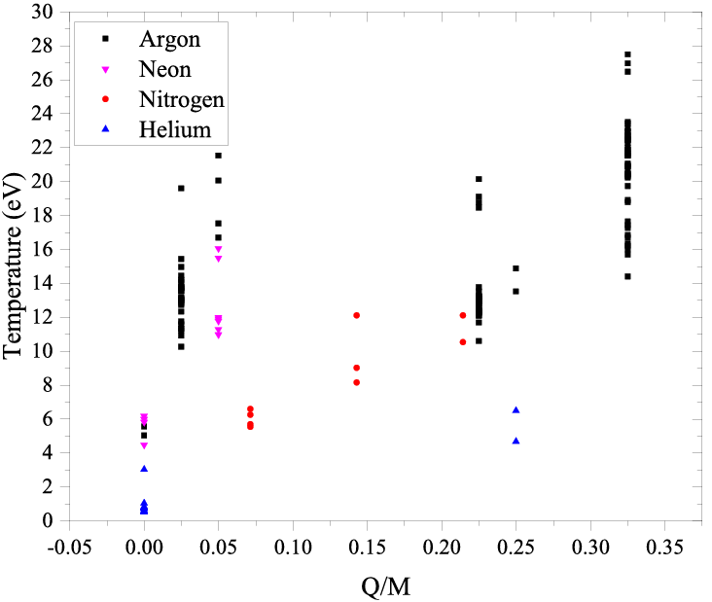

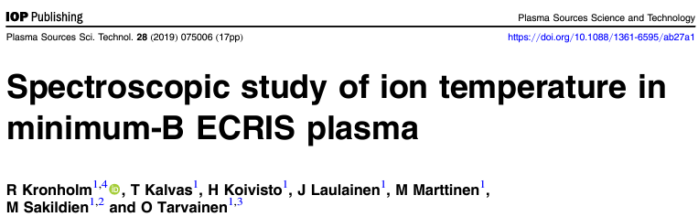
Ion temperature in minimum-B ECRIS
Doppler broadening due to ion temperature
Important to know the instrumental broadening
Higher than expected ion temperature ∼10 eV vs. 1 eV
Notes:
14 GHz ECRIS, all other broadening mechanisms taken into account. Calibrated with narrow bandwidth laser and measures low Ti for microwave source. Also: cold neutrals.

Slide 11
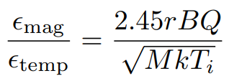
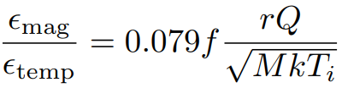
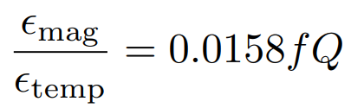
Magnetic field vs. ion temperature effect on transverse emittance
The ratio of the magnetic and ion temperature contributions is
In high-frequency minimum-B ECRIS the B-field at extraction B_{ext} is ∼0.9B_{ECR} and B_{ECR} for 28 GHz microwave frequency is 1 T. With f in GHz it follows that
To calculate an example, let’s assume typical values for high frequency ECRIS:
r = 4mm, M =40 (argon), kT_{i} = 10 eV
Notes:
Importance of magnetic vs. ion temp emittance at different gen ECRISs

Slide 12
Magnetic field vs. ion temperature effect on transverse emittance
Magnetic vs. ion temperature emittance contributions for argon (theoretical)
Frequency [GHz] | Ar⁶⁺ | Ar⁸⁺ | Ar¹⁰⁺ | Ar¹²⁺ | Ar¹⁴⁺ | Ar¹⁶⁺
6.4 | 0.61 | 0.81 | 1.01 | 1.21 | 1.42 | 1.62
10 | 0.95 | 1.26 | 1.58 | 1.90 | 2.21 | 2.53
14 | 1.33 | 1.77 | 2.21 | 2.65 | 3.10 | 3.54
18 | 1.71 | 2.28 | 2.84 | 3.41 | 3.98 | 4.55
24 | 2.28 | 3.03 | 3.79 | 4.55 | 5.31 | 6.07
28 | 2.65 | 3.54 | 4.42 | 5.31 | 6.19 | 7.08
45 | 4.27 | 5.69 | 7.11 | 8.53 | 9.95 | 11.4
56 | 5.31 | 7.08 | 8.85 | 10.6 | 12.4 | 14.2
∴Magnetic emittance dominates at relevant frequencies and charge states (even with 10 eV kT_{i})
Notes:
Magnetic emittance dominates

Slide 13
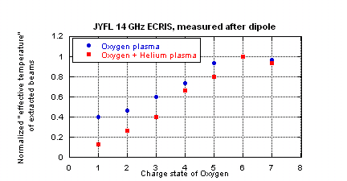
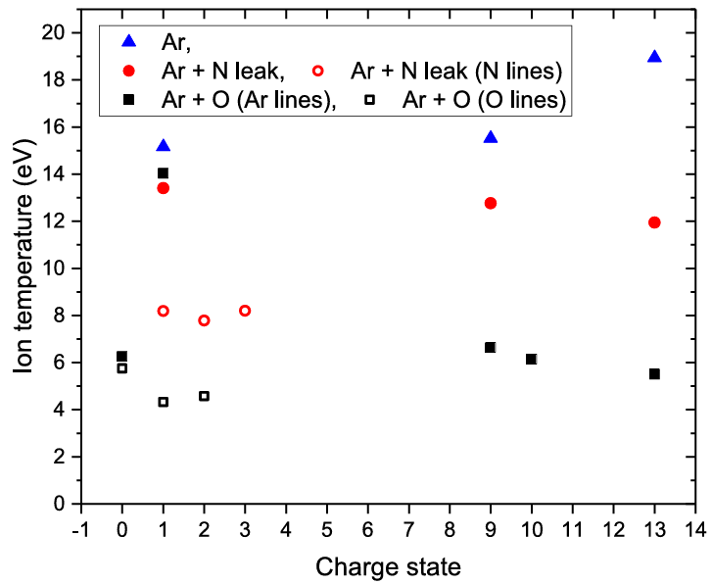
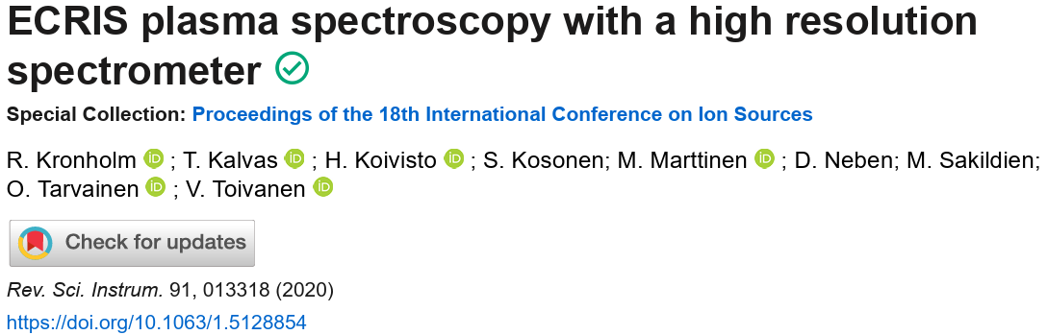
Ion temperature and magnetic field contributions on emittance
Is there experimental evidence on the ion temperature and/or magnetic field effects?
Gas mixing lowers the ion temperature of the heavier mass ions (optical emission spectroscopy and retarding field analyser)
Measured with a retarding field analyser
Notes:
Can we expect to see these effects in emittance?

Slide 14
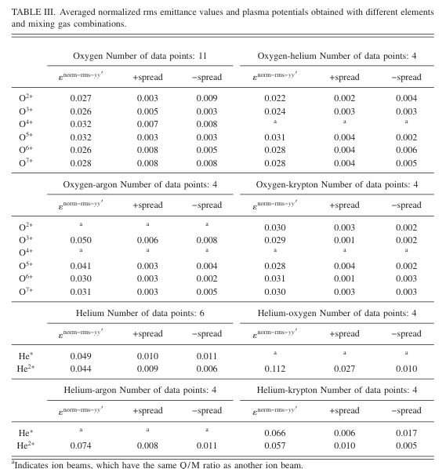
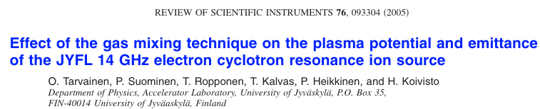
Ion temperature and magnetic field contributions on emittance
Is there experimental evidence on the ion temperature and/or magnetic field effects?
Adding lighter mixing gas (helium) lowers the transverse emittance of low charge state oxygen ions by up to 20%.
No effect on the high charge state beam emittance.
Adding heavier mixing gas (krypton) increases the transverse emittance of low charge state oxygen and helium ions by up to 20%.
No effect on the high charge state beam emittance.
This kind of makes sense but there are too many caveats to conclude that we are observing just the ion temperature effect – why no effect on the high charge states?
Notes:
Horrible table – apologies.

Slide 15

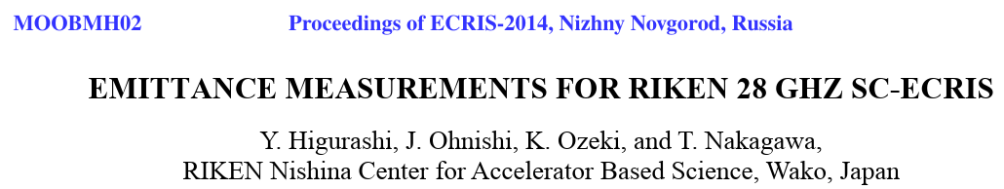
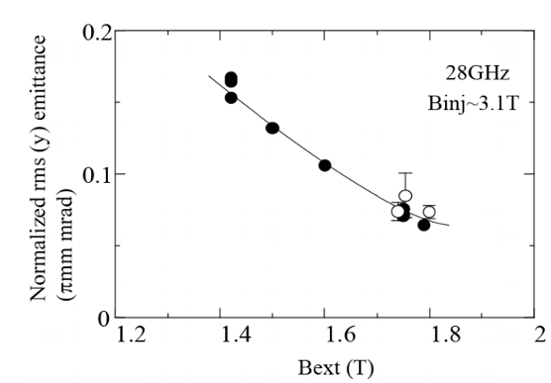
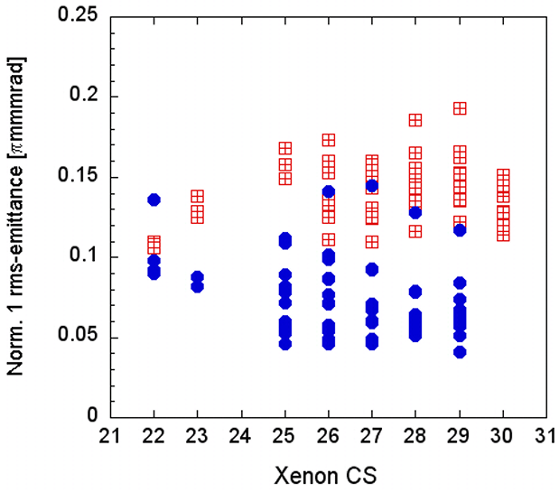


Ion temperature and magnetic field contributions on emittance
Is there experimental evidence on the ion temperature and/or magnetic field effects?
28 GHz
U³⁵⁺
18 GHz
???
Notes:
Not always straightforward…

Slide 16
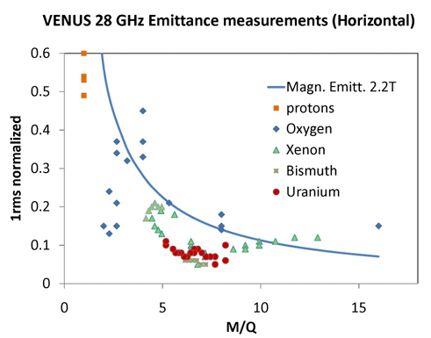
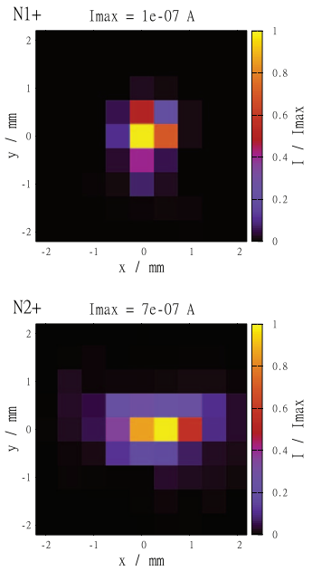
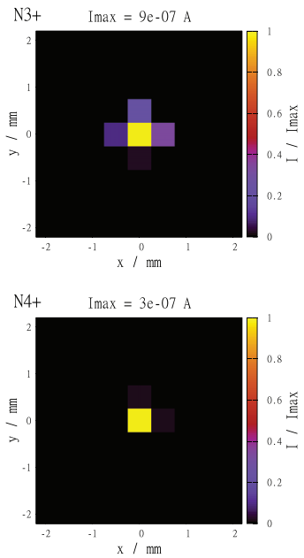
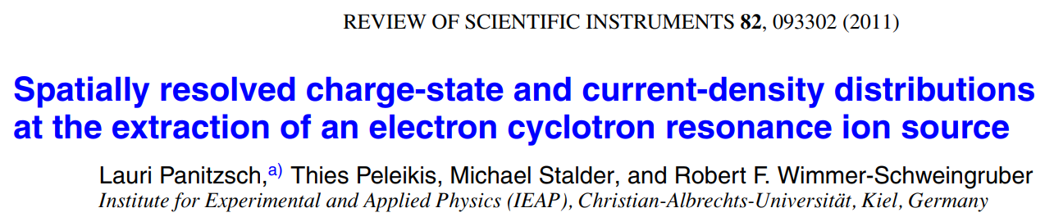
Ion temperature and magnetic field contributions on emittance
Non-uniform distribution of ions across the extraction aperture → smaller than predicted emittance for high Q/M
Puller moved in xy-plane, M/Q-analysed signal from FC
N¹⁺
N³⁺
N²⁺
N⁴⁺
Notes:
High charge states are concentrated near the axis!

Slide 17
Transverse emittance of an ion beam
The transverse emittance of an ion beam is affected by
Fundamental plasma properties and ion source design principles (given)
Beam extraction and transport properties (can be changed)
These are sometimes interconnected i.e. a fundamental plasma property affects the transverse emittance due to effects induced in the beam transport
ε = + + + + …
These are all well-known.
So, why the experiments don’t always “follow the physics”
T_{i}
B
n_{i}(r)

Slide 18
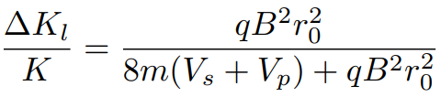
Revisiting the magnetic field effect
The magnetic field of an ion source at the extraction is typically a solenoid field (axial), which diverges strongly in the region where the beam is extracted. The resulting radial velocity of the ions at zero field (far in the beamline) is
Where did this transverse energy come from?
Because the total kinetic energy K in a static magnetic field is conserved, the transverse energy has to come from the longitudinal energy. It can be shown that
Here V_{s} is the ion source (extraction) potential and V_{p} is the plasma potential.
Notes:
Static magnetic field doesn’t change the beam energy

Slide 19
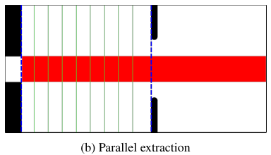
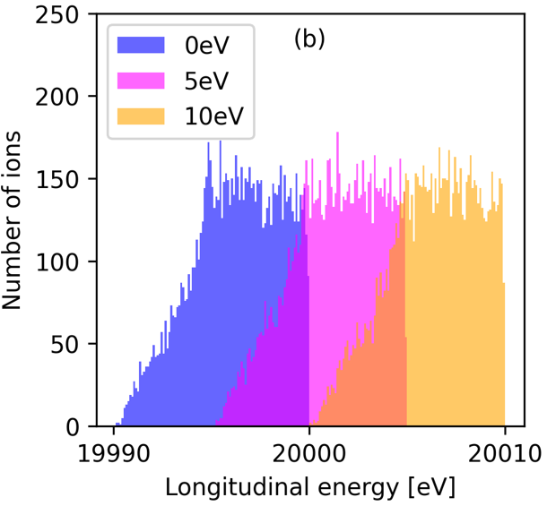
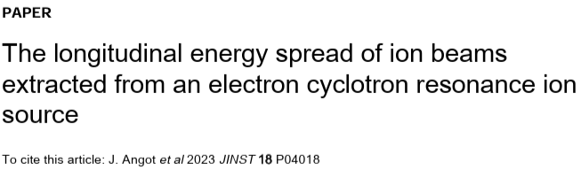
Revisiting the magnetic field effect
Monoenergetic, uniform beam at extraction has longitudinal energy spread at zero B-field
+ solenoid
“fringe” field
The effect is observed
at energies
K_{l} < q(V_{s}+V_{p})
Simulation of O⁺ beam
V_{s} = 20 kV
V_{p} = 0…10 V
Notes:
There is a longitudinal energy spread. Simulation using the LPSC charge breeder B-field. 10 eV spread at all plasma potentials

Slide 20
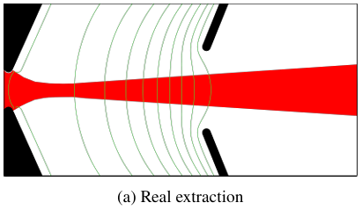
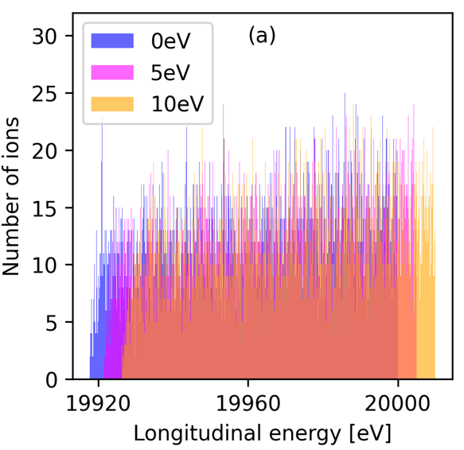
Revisiting the magnetic field effect
In “real extraction systems” the effect is pronounced i.e. longitudinal energy spread is larger
LPSC Charge
Breeder ECRIS
+ solenoid
“fringe” field
The effect is observed
at energies
K_{l} < q(V_{s}+V_{p})
Simulation of O⁺ beam
V_{s} = 20 kV
V_{p} = 0…10 V
Notes:
Real extraction geometry has much wider energy spread

Slide 21
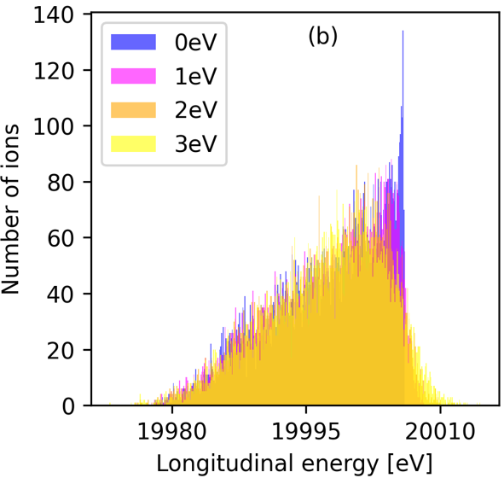
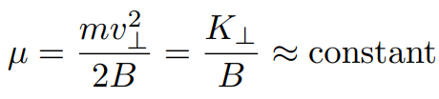
Revisiting the magnetic field effect
The longitudinal energy spread is also affected by the ion temperature (transverse energy) coupling with the magnetic field (smaller effect)
This follows from the conservation of magnetic moment
converting perpendicular energy to longitudinal energy (similar to magnetic mirroring of electrons).
The effect is observed at energies K_{l} > q(V_{s}+V_{p})
O⁺ beam,
“parallel” extraction
Notes:
Also a “temperature effect”

Slide 22
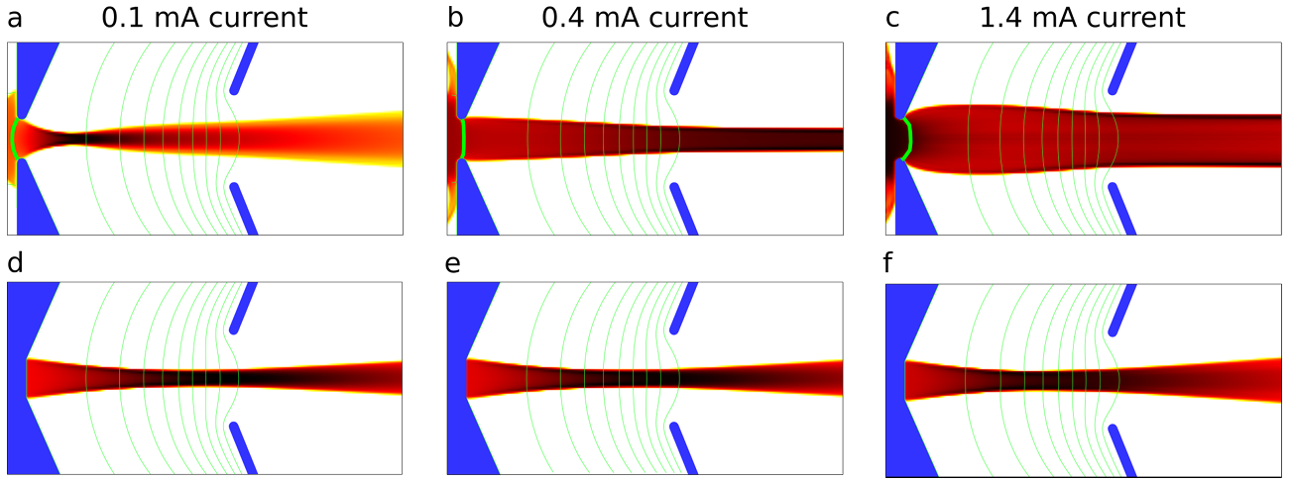
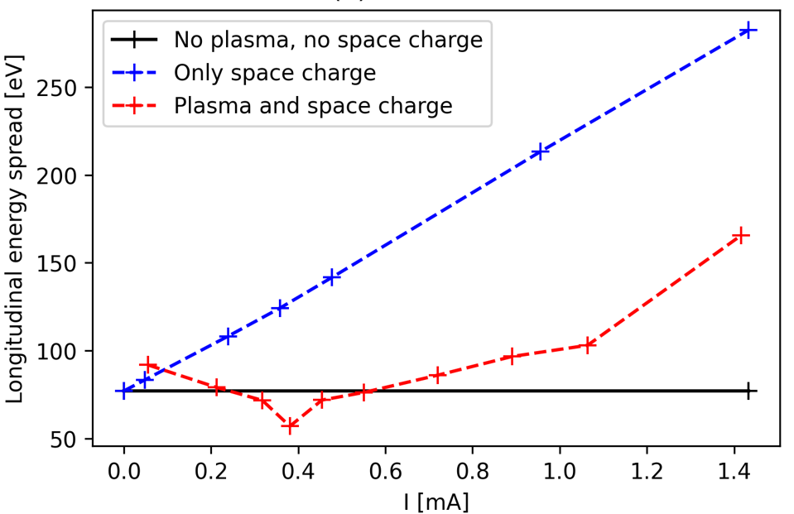
How about plasma-beam boundary effects (meniscus)?
Plasma meniscus and space charge in the extraction affect the longitudinal energy spread
Plasma and space charge
“Plasma focusing” can reduce
the energy spread
Only space charge
Notes:
Plasma-beam boundary has a large effect on the longitudinal energy spread

Slide 23
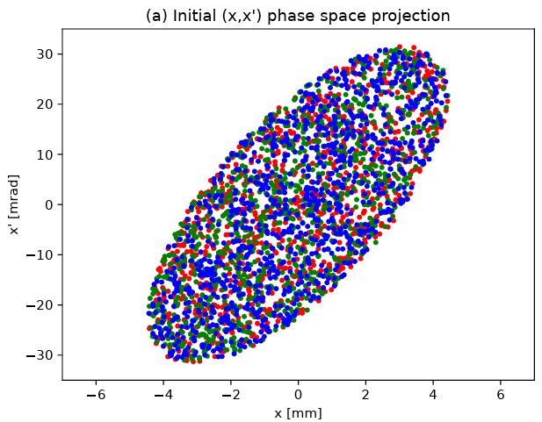
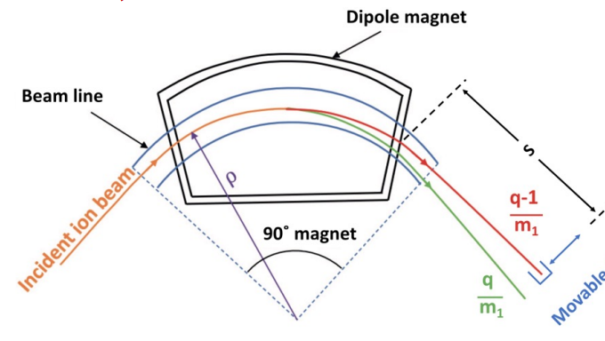
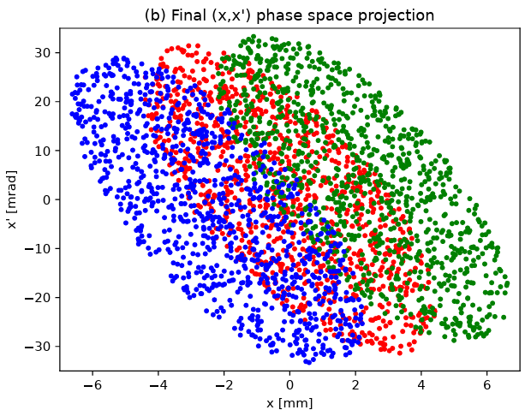
Why does the longitudinal energy spread matter for transverse emittance?
Different colours are different longitudinal energies
Energy spread of the beam and dispersive ion optics
(e.g dipole magnet) cause the transverse emittance to increase
Notes:
Effective area of the transverse phase space becomes larger

Slide 24
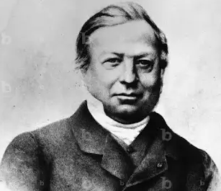
Harrumph?
As long as the beam is only subjected to conservative
forces, Liouville's theorem shows that emittance is a
conserved quantity.
BUT
The ensemble of beam particles can be described by a
6D position and momentum distribution function.
Increase in transverse emittance means that there is a
decrease of longitudinal energy spread with respect
to the reference particle
No issues here Joe… nous allons bien, merci
Joseph Liouville (1809-1882)

Slide 25
Transverse emittance of an ion beam
The transverse emittance of an ion beam is affected by
Fundamental plasma properties and ion source design principles (given)
Beam extraction and transport properties (can be changed)
These are sometimes interconnected i.e. a fundamental plasma property affects the transverse emittance due to effects induced in the beam transport
ε = + + + +
+
Starting to make sense why the experiments don’t always “follow the physics”
AND there’s more bad news…
T_{i}
B
n_{i}(r)
ΔK/K
Extraction design (E-field)
n_{e}, V_{s}

Slide 26
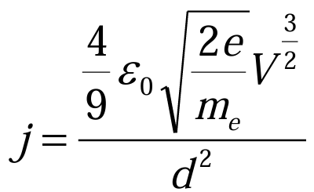
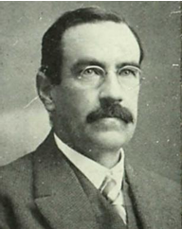
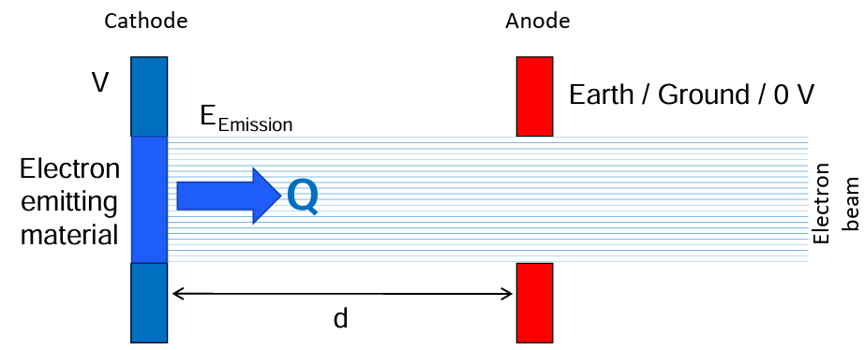
Space charge effects – Child-Langmuir law
Clement D. Child
(1868-1933)

Slide 27


Space charge effects – Child-Langmuir law
“In the space charge limited region the extracted current varies as V^{3/2}”
Accepted wisdom espoused by
… and many others
No implications on emittance!
Notes:
We already see a problem here. The curves do not overlap at low voltages.

Slide 28






Space charge effects – Child-Langmuir law?
Assumptions

Slide 29






Divergence-limited extraction
The true cause for the observed power law is “meniscus focusing” and collimation on the extraction electrode
Low extraction voltage (region 1)
High extraction voltage (region 2)

Slide 30

Divergence-limited extraction – implications on emittance
Emittance measurements are reliable and comparable only if the whole beam is measured and the plasma-beam boundary effects are minimised (“flat meniscus”) i.e. at constant divergence
The current at the “knee-point” varies as V^{3/2}
Questions the concept of normalised emittance when comparing different ion sources as the beam formation is energy dependent
Could this explain:
B_{ext} affects the plasma flux
plasma beam boundary changes?
→ less divergent beam?
Must match n_{e} for each V
No “V^{3/2}-law” for each curve

Slide 31






Divergence-limited extraction – example of “plasma meniscus matching”
SNS H⁻ ion source
Increasing the aperture size allows “plasma meniscus matching” and improved beam brightness
Notes:
Increasing the aperture size sounds like a bad idea but in reality reduces the emittance at any given current i.e. higher brightness.

Slide 32




How to overcome the space charge effects – innovative technique
With the “plasma meniscus matched” the current density can be increased by strongest electric field where to ion velocity is lowest
Notes:
Spherical extractor maximises the electric field where the beam is slowest. Different space charge limit and lower emittance

Slide 33






ECRIS afterglow emittance?
Li. et al, Rev. Sci. Instrum. 96, 023303 (2025)
RIKEN 18 GHz ECRIS
Gain factor of 4-300 for
HCI With “PUMAEX”
Emittance in afterglow measured only once(?).
Could not find a comparison to CW emittance
Longitudinal energy spread peaks during plasma breakdown and decay.
This together with the higher space charge affects the effective emittance of the M/Q-analysed beams during the afterglow.
Could this minimise emittance during afterglow?
Notes:
Some words about the afterglow…

Slide 34
Transverse emittance of an ion beam
The transverse emittance of an ion beam is affected by
Fundamental plasma properties and ion source design principles (given)
Beam extraction and transport properties (can be changed)
These are sometimes interconnected i.e. a fundamental plasma property affects the transverse emittance due to effects induced in the beam transport
ε = + + + +
+ + +
Starting to make more sense why the experiments don’t always “follow the physics”
AND there’s more bad news…
T_{i}
B
n_{i}(r)
ΔK/K
Extraction design (E-field)
V_{p}, V_{s}
Plasma-beam boundary
Divergence/ collimation

Slide 35


Space charge induced emittance growth in beam transport
The self-repulsion of the high-current ion beam exerts a non-linear force on the beam particles and causes transverse emittance growth. The space charge effect can be estimated from
where ε is the is the original emittance before the drift space, I the effective beam current with I=(1-η)I₀ where η is the space charge compensation degree and I₀ the beam current. The factor χ can be determined numerically for a given particle distribution (e.g. 0.55 for a Gaussian beam or 0.094 for Water Bag distribution). Furthermore, z is the drift length, I_{c} = 3.13×10⁷ M/Q), and β and γ the relativistic Lorentz parameters.
Note that the space charge induced emittance growth does not depend on the beam radius.
Notes:
We have to transport the beam…

Slide 36


Space charge induced emittance growth example
SCC degree | Emittance growth factor δ
0.5 | 10.4
0.6 | 6.68
0.7 | 3.76
0.8 | 1.67
0.9 | 0.41
1 | 0
1.6 m long LEBT
Waterbag distribution, ε = (1+δ)ε₀
Front End Test Stand (FETS) at RAL
Pulsed 60 mA H⁻ beam at 65 keV energy
Very poor beam transport at low SCC degree!
SCC time
Notes:
Massive emittance increase with low SCC degree. Explain the SCC process in a nutshell.

Slide 37





Space charge effects in an ECRIS beamline (JYFL 14 GHz ECRIS – old configuration)
Solenoid focusing → Hollow beams of high charge state ions (Ar⁸⁺)
Optimum brightness despite of beam losses
Old
New
Notes:
If the SCC is improved, the emittance is better. Gas injection experiments at JYFL

Slide 38
Transverse emittance of an ion beam
The transverse emittance of an ion beam is affected by
Fundamental plasma properties and ion source design principles (given)
Beam extraction and transport properties (can be changed)
These are sometimes interconnected i.e. a fundamental plasma property affects the transverse emittance due to effects induced in the beam transport
ε = + + + +
+ + + +
Starting to make even more sense why the experiments don’t always “follow the physics”
AND brace yourself for more…
T_{i}
B
n_{i}(r)
ΔK/K
Extraction design (E-field)
V_{p}, V_{s}
Plasma-beam boundary
Divergence/ collimation
Space charge

Slide 39







(fine-)Freqency tuning and double frequency heating in ECRIS
O⁷⁺
Emittance depends on
ECRIS frequency!
Helium beam
… and number of frequencies
(as does Vp)
Needs more investigations!
Non-linear beamline optics (e.g. spherical aberrations) amplify the effect of non-uniform beams!
Notes:
The beam is often far from uniform. Frequency affects the emittance

Slide 40








Instabilities of ECRIS plasmas
The effect of the instabilities affect the high charge state beam currents and the emittance measured with an Allison scanner (no quantitative data)
Helium beam
“Perfect beam” – no fluctuations
X’
ε = 1.00
X
25 % fluctuation at 860 Hz
Current and spatial (energy) fluctuation matching the experiment → 67% measured emittance increase
X’
ε = 1.67
X
Notes:
Instabilities affect the measured emittance.

Slide 41

Transverse emittance of an ion beam
The transverse emittance of an ion beam is affected by
Fundamental plasma properties and ion source design principles (given)
Beam extraction and transport properties (can be changed)
These are sometimes interconnected i.e. a fundamental plasma property affects the transverse emittance due to effects induced in the beam transport
ε = + + + +
+ + + +
+ + + + …
T_{i}
B
n_{i}(r)
ΔK/K
Extraction design (E-field)
V_{p}, V_{s}
Plasma-beam boundary
Divergence/ collimation
Space charge
Beam uniformity
Instabilities
Σ Unknown unknowns

Slide 42
Topics for discussion
The information presented here is scattered all over the literature and only some examples were presented – do we need a review?
Beam extraction effects contribute significantly – how can we ever compare ion sources?
Do we need a comparative simulation study of various extraction systems?
How to make sure a factors affecting the transverse (normalised) emittance are not masked by divergence-limited extraction and collimation further down the beamline?
Does the measurement technique affect the transverse emittance values? Is there a preferred technique?
What was missed here?
…
…

Slide 43
Contributions to this round table session (not in any particular order)
Sergey Kondrashev
  Application of pepper pot emittance probe for ECRIS beam studies
Liangting Sun
  Emittances with ECRISs: one major challenge to realize high intensity heavy ion beam acceleration with SRF linac
Thomas Thuillier
  Where does the magnetic field effect on emittance come from

Slide 44





F
International Conference on Ion Sources, St. Catherines’s College 8-12th September 2025 https://indico.stfc.ac.uk/e/ICIS25
Abstracts due by April 30th, 2025
Images from istockphoto.com

