Slide 1
Application of Pepper Pot Emittance Probe for ECRIS Beam Studies
Sergey Kondrashev
April 7, 2025
PIBHI’2025 Acitrezza, Italy

Slide 2
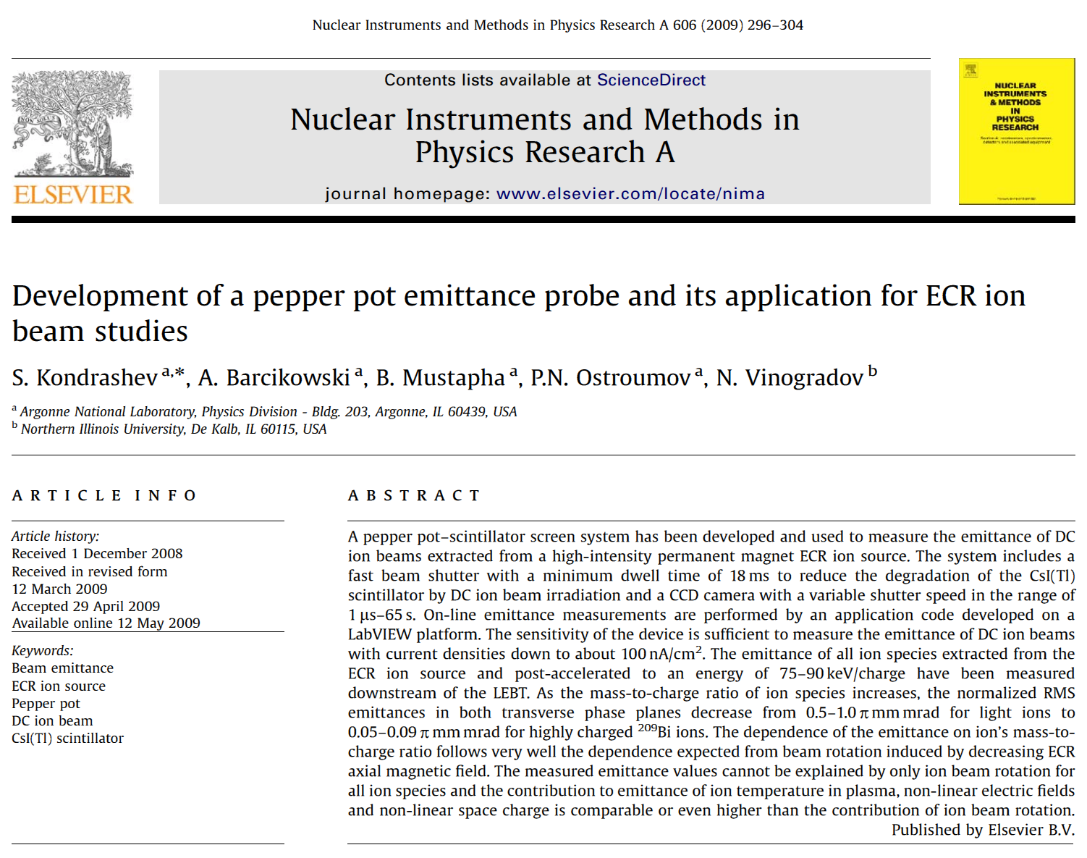
Sergey Kondrashev PIBHI’2025 (7 April 2025)

Slide 3
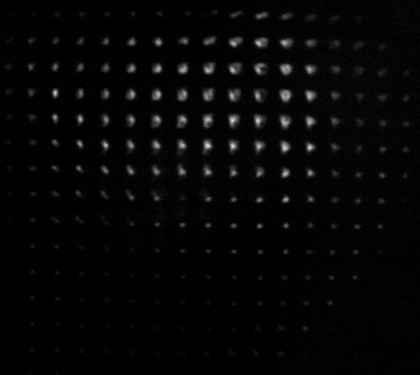
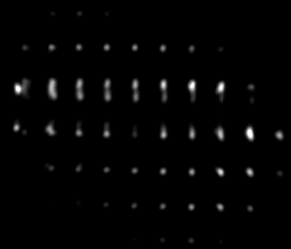
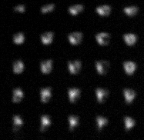
Emittance of ECR beams has complicated structure
¹⁶O⁷⁺
²⁰⁹Bi²⁰⁺
Slit and Alison type scanners can not provide full information about
such phase space distributions
Sergey Kondrashev PIBHI’2025 (7 April 2025)

Slide 4
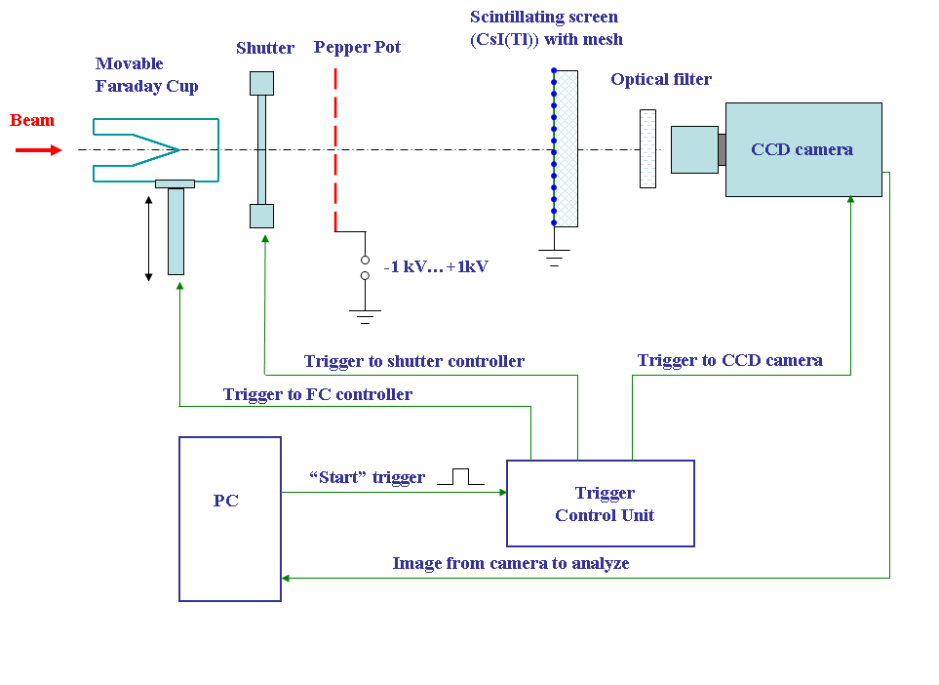
Emittance meter structure
Sergey Kondrashev PIBHI’2025 (7 April 2025)

Slide 5
Emittance meter structure (cont.)
“Slow” shutter – FC with diameter 46 mm:
- protection of “fast” shutter from damage by ion beam with power up to 10 W
- measurements of ion beam current at the entrance of emittance meter
“Fast” shutter - iris-type UNIBLITZ-CS65S with aperture 65 mm and minimum dwell time of 18 ms
- protection of scintillator from degradation by long-time ion beam irradiation
Pepper pot mask – Ta plate Ø 70 mm x 380 µm, 415 holes with diameters 100 – 104 µm and spacing 3 mm
Scintillator – CsI(Tl), Ø 80 mm x 3 mm, grounded fine Nickel mesh with transparency 88.6% and cell size 200 µm is attached to scintillator front surface to prevent charge build-up caused by ion beam
CCD camera – 2 Mpix digital IMI TECH IMB-147FT 12-bit Firewire Monochrome:
- pixel size – 4.6x4.6 µm²
⁻ shutter speed – adjustable from 1 µs to 65 s
- adjustable gain
Sergey Kondrashev PIBHI’2025 (7 April 2025)

Slide 6
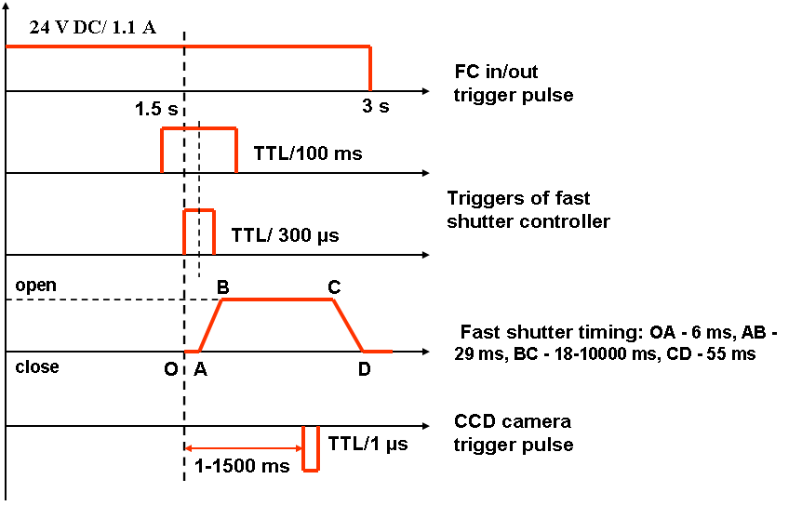
Emittance meter timing
BC = 100 ms and CCD gate = 66 ms were used for measurements
Sergey Kondrashev PIBHI’2025 (7 April 2025)

Slide 7
1 - All permanent magnet ECRIS installed on HV platform, 2 - 75-kV accelerating tube, 3 - isolation transformer, 4 - 60° bending magnet, 5 - Einzel lens, 6 - electrostatic quadruple triplet, 7 - electrostatic steers, 8 - rotating wire scanner, 9 – moveable horizontal slits, 10 – moveable Faraday cups, 11- emittance meter
Sergey Kondrashev PIBHI’2025 (7 April 2025)

Slide 8
Parameters of BIE-100 All Permanent Magnet ECR Ion Source*
Axial peak field (injection region) – 13 kG
Axial field at extraction – 6.6 kG
Axial central magnetic field – 4.2 kG
Maximum radial field (at chamber wall) – 11 kG
Aluminum plasma chamber: length – 17.5 cm, diameter – 6.4 cm
Extraction aperture – 8 mm
Heating: 2 kW/14 GHz klystron + 700 W/12.75-14.5 GHz TWT RF amplifier
Extraction potential – up to 25 kV
HV platform potential – up to 75 kV
*D. Z. Xie. Rev. Sci. Inst. v. 73 (2), 2002, pp. 531 – 533.
Sergey Kondrashev PIBHI’2025 (7 April 2025)

Slide 9
Currents of ions with different masses and charge states
²⁰⁹Bi ions were produced using oven method
Oxygen used as support gas to enhance intensity of Bi highly charged ions
Current of Bi¹⁷⁺ - Bi²³⁺ ions – 1 – 1.5 pµA
Sergey Kondrashev PIBHI’2025 (7 April 2025)

Slide 10
Transmission from source exit to emittance meter
El. | Hydrogen |  | Oxygen |  |  |  |  |  | Bismuth
Ion | 1+ | H2+ | 7+ | 6+ | 5+ | 4+ | 3+ | 2+ | 25+ | 24+ | 23+ | 22+ | 21+ | 20+ | 19+ | 18+ | 17+ | 16+ | 15+ | 14+
I, µA | 2 | 0.6 | 1.0 | 32 | 118 | 292 | 387 | 378 | 10 | 15 | 21 | 23 | 26 | 27 | 26 | 23 | 20 | 17 | 12 | 10
Total current of Oxygen ions (FC1) – 1.56 mA
Total current of Bismuth ions (FC1) – 0.23 mA
Total current of all ion species (FC1) – 1.8 mA
Total current extracted – 3.8 mA
Transmission from source exit to FC1 – 47%
Transmission from source exit to emittance meter – 40 – 47 %
Sergey Kondrashev PIBHI’2025 (7 April 2025)

Slide 11
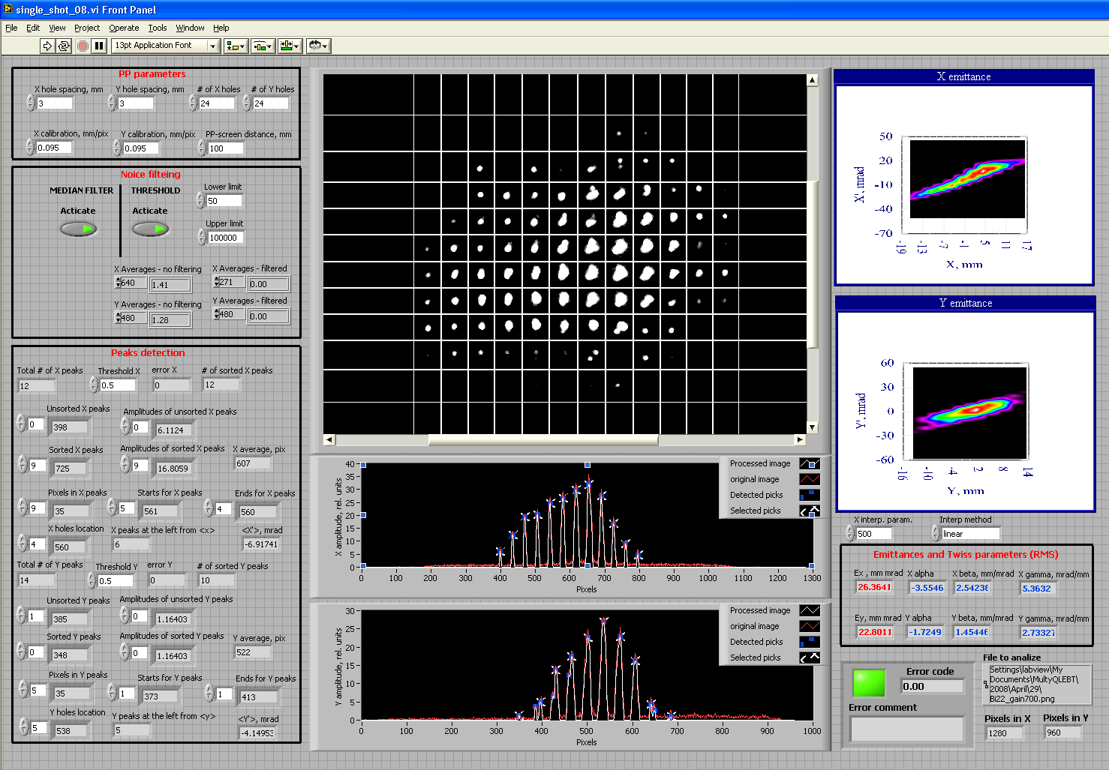
LabVIEW based software for on-line measurements
Sergey Kondrashev PIBHI’2025 (7 April 2025)

Slide 12
Choice of CCD camera parameters
Which value is “true” emittance value?
Sergey Kondrashev PIBHI’2025 (7 April 2025)

Slide 13
Choice of CCD camera parameters (cont.)
Criteria applied to all emittance measurements – number of saturated pixels between 1 and 10!
Sergey Kondrashev PIBHI’2025 (7 April 2025)

Slide 14
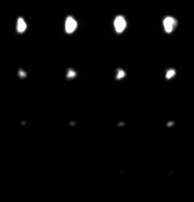
Does CsI (Tl) scintillator have linear response?
Calibration pepper pot mask was used to check CsI (Tl) linearity:
4x4 array of holes with diameters 10 µm, 20 µm to 300 µm
(20 µm step)
5 mm spacing between holes
If D_{hole}<<D_{image}, D_{image} will be defined by emittance of ion beam and should be approximately the same for all holes.
Then, if beam has homogeneous current distribution across 15x15 mm2 area, ion current at scintillator is proportional to (D_{hole})².
If scintillator has linear response, light output should follow this relation too.
The main challenge of this approach is very big spatial fluctuations of ion beam intensity – 3 – 10 times over 15x15 mm² for focused ion beams of different ion species.
It was improved to about 40 - 50% by switching off all electrostatic quads along LEBT (total ion current dropped by about factor 5).
Sergey Kondrashev PIBHI’2025 (7 April 2025)

Slide 15
Does CsI (Tl) scintillator have linear response? (cont.)
O⁶⁺ ion beam, energy – 450 keV, current density (at pepper pot plate) – 0.24 µA/cm²
Sergey Kondrashev PIBHI’2025 (7 April 2025)

Slide 16
Does CsI (Tl) scintillator have linear response? (cont.)
Bi²⁰⁺ ion beam, energy – 1.5 MeV, current density (at pepper pot plate) – 0.4 µA/cm²
CsI (Tl) scintillator dynamic range – better than 50
Sergey Kondrashev PIBHI’2025 (7 April 2025)

Slide 17
Emittance measurements for different ion species
For each ion specie beam was centered by adjusting both bending magnets
Slits were scanned for each ion specie
Horizontal slits between bending magnets were adjusted to cut single ion specie
Transmission from source exit to emittance meter – 40 – 47% for all ion species
Resolution was better for all other ion species
Sergey Kondrashev PIBHI’2025 (7 April 2025)

Slide 18
Emittance measurements for different ion species (cont.)
Sergey Kondrashev PIBHI’2025 (7 April 2025)

Slide 19
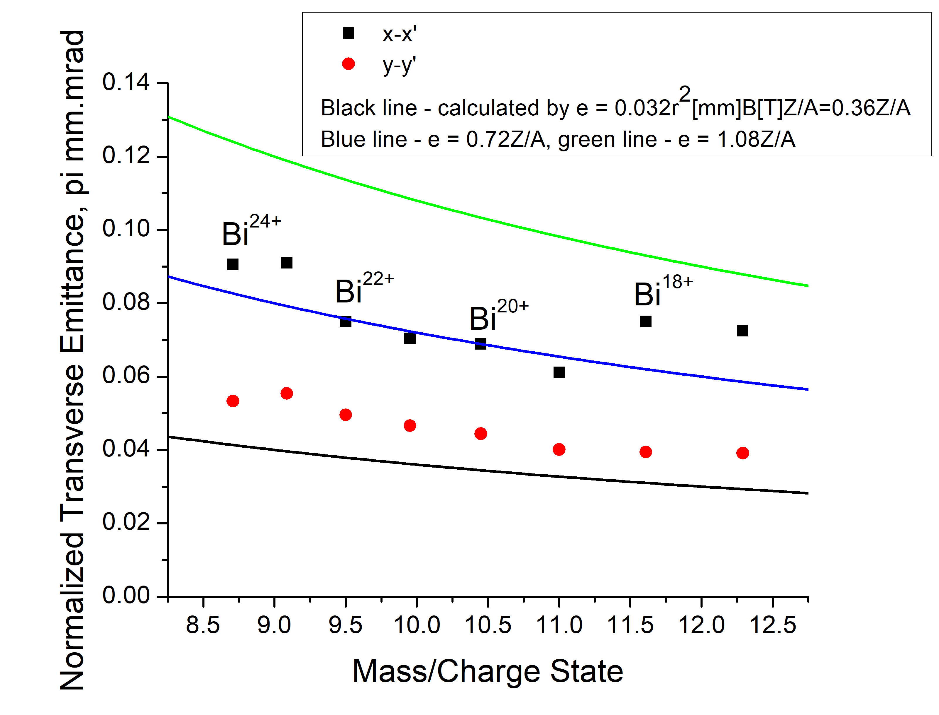
Emittance measurements for different ion species (cont.)
Sergey Kondrashev PIBHI’2025 (7 April 2025)

Slide 20
Emittance measurements for different ion species (cont.)
x-x’ emittance is higher than y-y’ emittance for all ion species, probably, due to:
- higher x-x’ acceptance of the first bending magnet
- asymmetric ion beam distribution at ECR exit
Dependence of emittance on M/Z ratio qualitatively well follows the dependence of emittance due to beam rotation induced by decreasing ECR axial magnetic field
Emittance values are 1.2 - 3.2 times higher than emittance due to beam rotation induced by decreasing ECR axial magnetic field; it means that ion temperature in plasma, non-homogeneous extraction electric field, non-linear space charge contributions to emittance are comparable or even higher than contribution of beam rotation induced by decreasing ECR axial magnetic field
Emittance increases with increasing of charge state for both oxygen and bismuth ions
Sergey Kondrashev PIBHI’2025 (7 April 2025)

Slide 21
Dependence of emittance on biased disc potential
Only plasma parameters are affected by biased disc potential
Brightness of ²⁰⁹Bi²⁰⁺ is maximal for -40 V biased disc potential (highest current and lowest emittance)
E_{x-x’}/E_{y-y’} depends on biased disc potential
Sergey Kondrashev PIBHI’2025 (7 April 2025)

Slide 22
Summary
4D pepper pot – scintillator (CsI (Tl)) on-line emittance meter was developed and used to study emittance of DC ion beams extracted from ECR ion source
A special attention was paid to linearity of registration system:
- no saturation of CsI(Tl) light output was found for ion current densities typical for ECR ion sources
- emittance measurement errors can be minimized by choosing CCD camera gain and shutter speed just at the boundary of CCD saturation
Emittance of all ion species extracted from ECRIS was measured:
- Dependence of emittance on M/Z qualitatively very well follows the dependence of emittance due to beam rotation induced by decreasing ECR axial magnetic field
- Measured emittance values can not be explained by ion beam rotation only for all ion species and contribution to emittance of ion temperature in plasma, non-linear electric fields and non-linear space charge is comparable or even higher than contribution of ion beam rotation
- Emittance increases with increasing of charge state for both oxygen and bismuth ions
- Emittance and brightness can be optimized by biased disc potential
Sergey Kondrashev PIBHI’2025 (7 April 2025)

