Slide 1



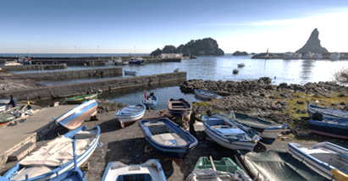
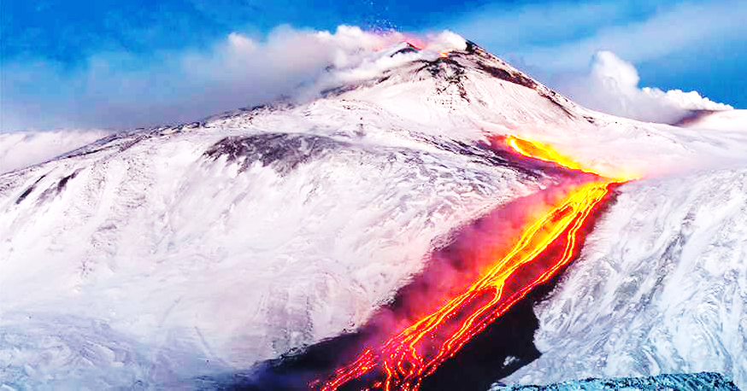
international WORKSHOP on production of intense beams and highly cHarged ions
Status and Open Challenges of the Electron Cyclotron Resonance Ion Sources
T. Thuillier, Université Grenoble Alpes, CNRS-LPSC, Grenoble INP

Slide 2
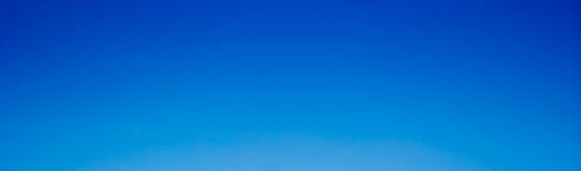

OUTLINE
A short reminder on ECR Ion Sources
ECRIS history and technology
Open challenges in ECRIS

Slide 3
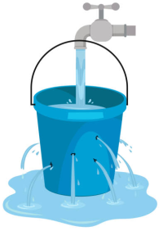
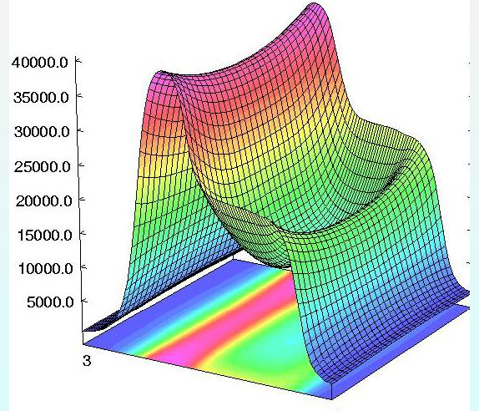
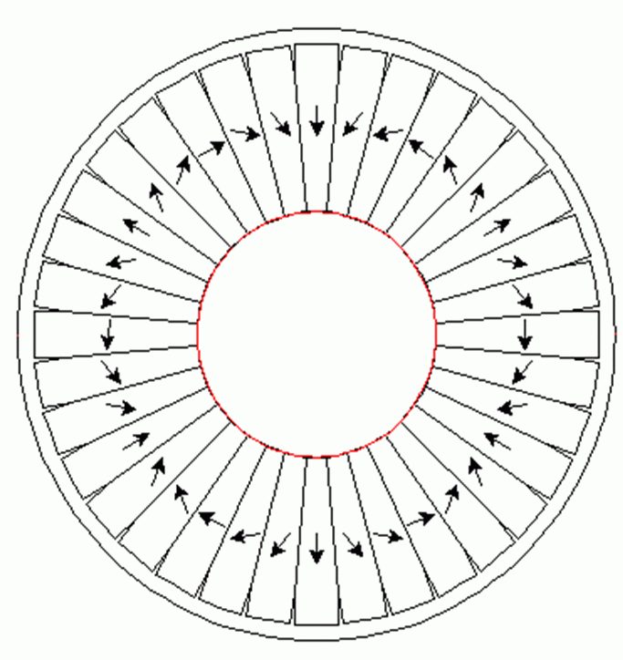
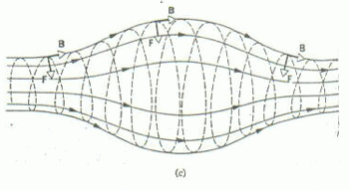
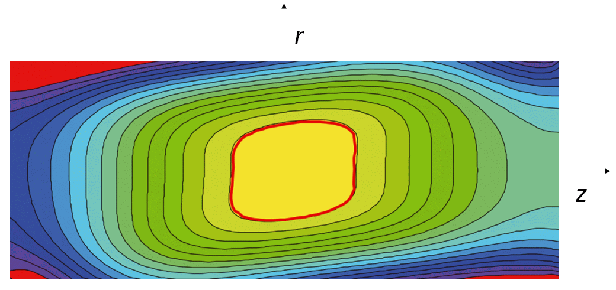







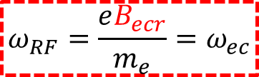

ECRIS Minimum-B confinement
ECR ION SOURCE FOR DUMMIES
MHD stable
Axial mirror
Radial mirror
B_{z}
$$\left|B_{r}\right|$$
$$B_{inj}$$
$$B_{rad}$$
$$B_{ext}$$
$$B_{r}(r)∝r^{2}$$
$$B_{ecr}$$
wall
$$B_{ecr}$$
+
r
=
$$B_{min}$$
z
$$ω_{RF}=\frac{eB_{ecr}}{m_{e}}=ω_{ec}$$
c_{inj}
c_{med}
c_{ext}
r
z

Slide 4
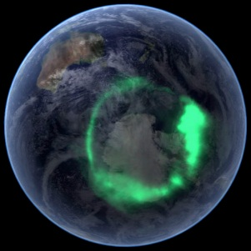
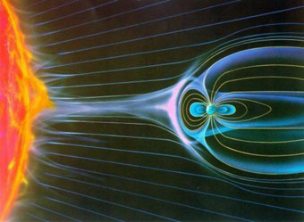
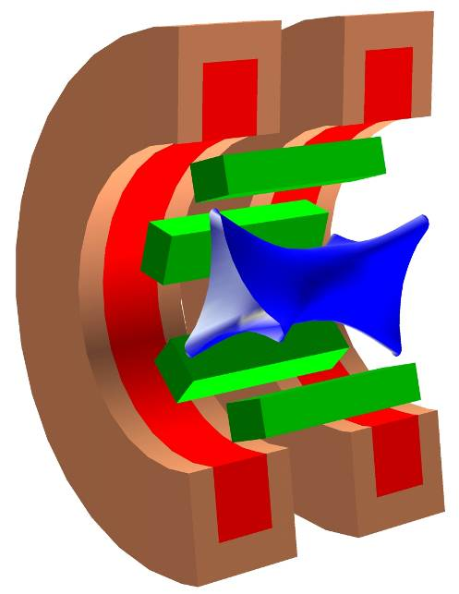
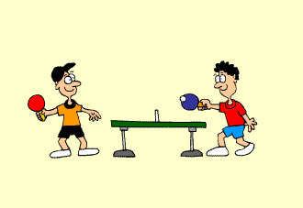


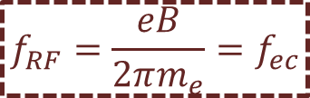


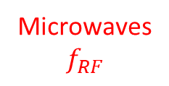


ECR Ion Source for dummies
High Voltage
Minimum-B
dense ECR
plasma
$${\vec{E}}_{RF}$$
Field lines
$$\vec{B}$$
$${\vec{E}}_{RF}\left(t\right)=\cos{ω_{RF}t}\vec{x}$$
Atom Flux
vacuum
$$\vec{E}$$
Ion Beam
$$v\left(t\right)=ρ(t)ω_{ec}$$
ECR resonance
Microwaves
$$f_{RF}$$
$$f_{RF}=\frac{eB}{2πm_{e}}=f_{ec}$$
Multi-Mode Cavity
$$λ_{RF}≪L_{cavity}$$
Magnetic Mirror effect

Slide 5

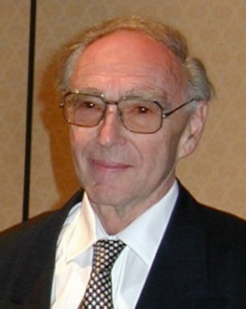


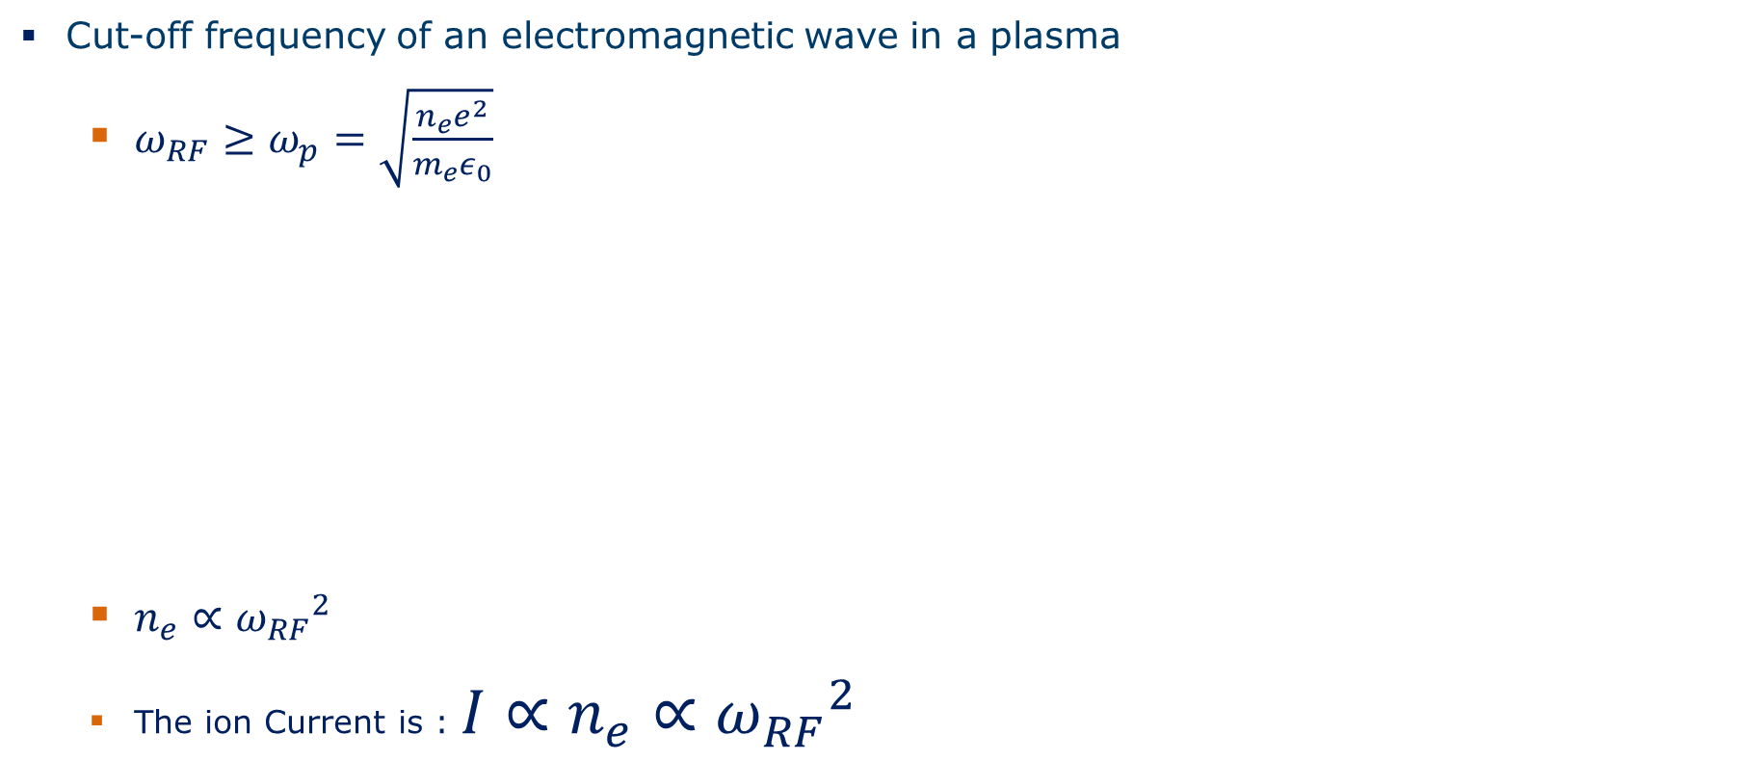
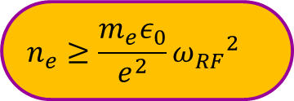
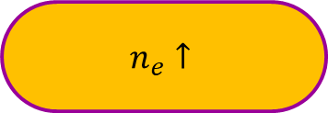
The Frequency scaling laws
Long distance com.
with the ionosphere
Cut-off frequency of an electromagnetic wave in a plasma
  $ω_{RF}≥ω_{p}=\sqrt{\frac{n_{e}e^{2}}{m_{e}ε_{0}}}$
  $n_{e}∝{{ω_{RF}}^{2}}_{}$
  The ion Current is : ${I∝n}_{e}∝{{ω_{RF}}^{2}}_{}$
Absorbed microwave
$$n_{e}↑$$
Richard Geller
Reflected microwave
$$n_{e}≥\frac{m_{e}ε_{0}}{e^{2}}{{ω_{RF}}^{2}}_{}$$
$$n_{e cut off}$$
...But it comes with a price:
$$I∝B_{ecr}^{2}$$

Slide 6
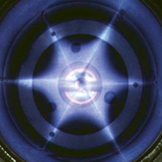
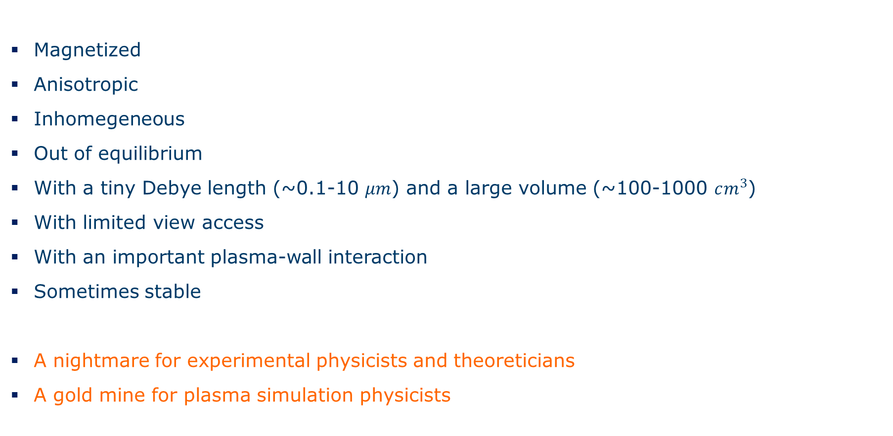
The ECRIS Plasma is complicated
Magnetized
Anisotropic
Inhomegeneous
Out of equilibrium
With a tiny Debye length (~0.1-10 $μm$) and a large volume (~100-1000 $cm^{3}$)
With limited view access
With an important plasma-wall interaction
Sometimes stable
A nightmare for experimental physicists and theoreticians
A gold mine for plasma simulation physicists

Slide 7
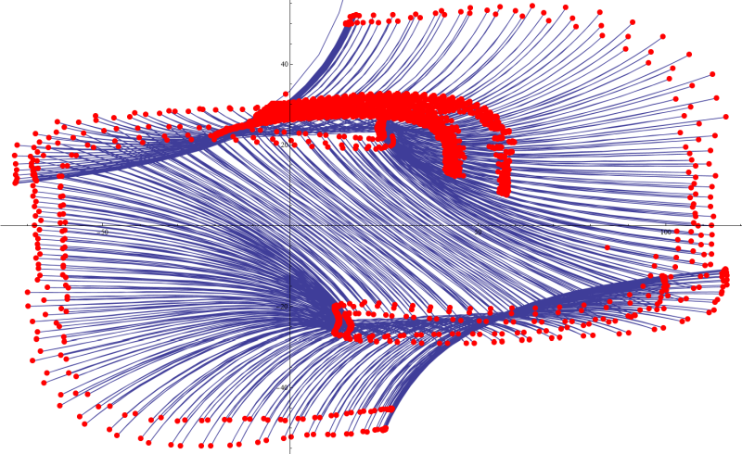
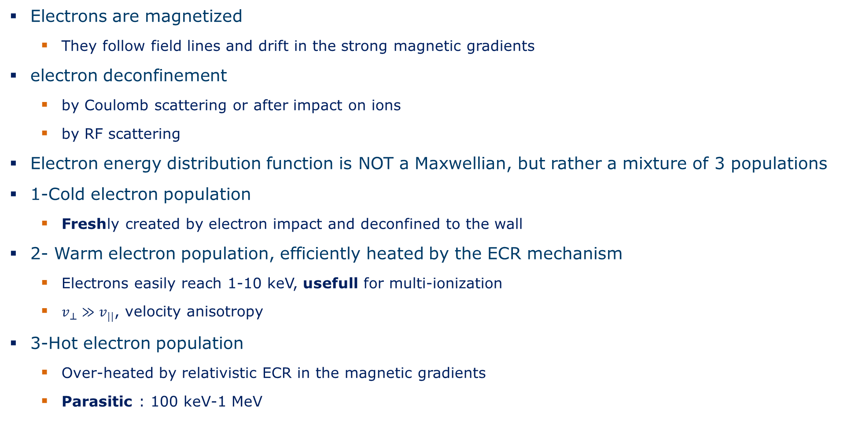
Electron Dynamics in ECRIS
Electrons are magnetized
  They follow field lines and drift in the strong magnetic gradients
electron deconfinement
  by Coulomb scattering or after impact on ions
  by RF scattering
Electron energy distribution function is NOT a Maxwellian, but rather a mixture of 3 populations
1-Cold electron population
  Freshly created by electron impact and deconfined to the wall
2- Warm electron population, efficiently heated by the ECR mechanism
  Electrons easily reach 1-10 keV, usefull for multi-ionization
  $v_{⊥}≫v_{||}$, velocity anisotropy
3-Hot electron population
  Over-heated by relativistic ECR in the magnetic gradients
  Parasitic : 100 keV-1 MeV

Slide 8
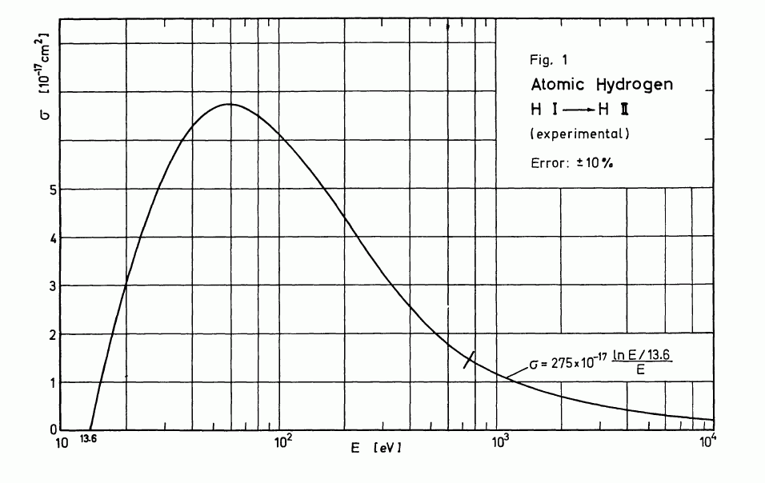
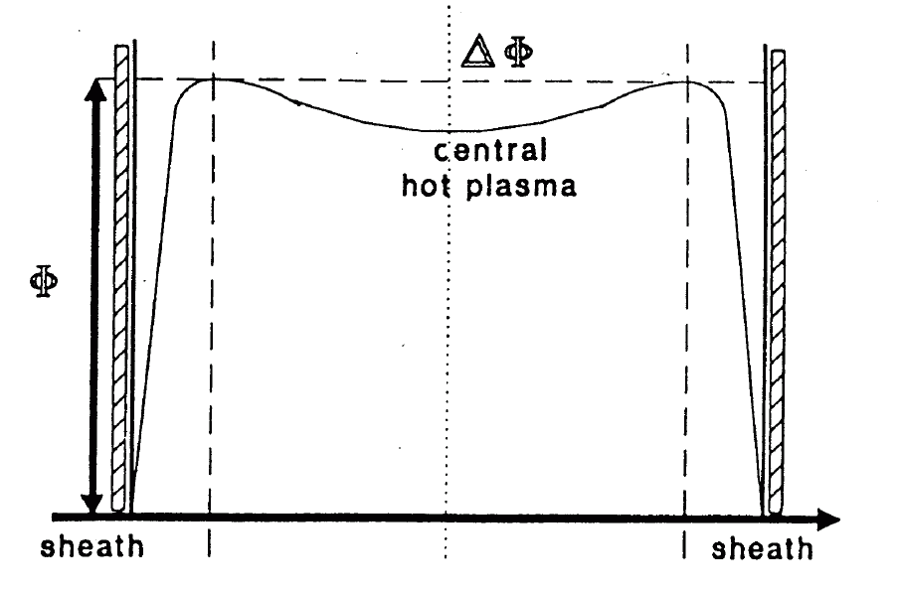
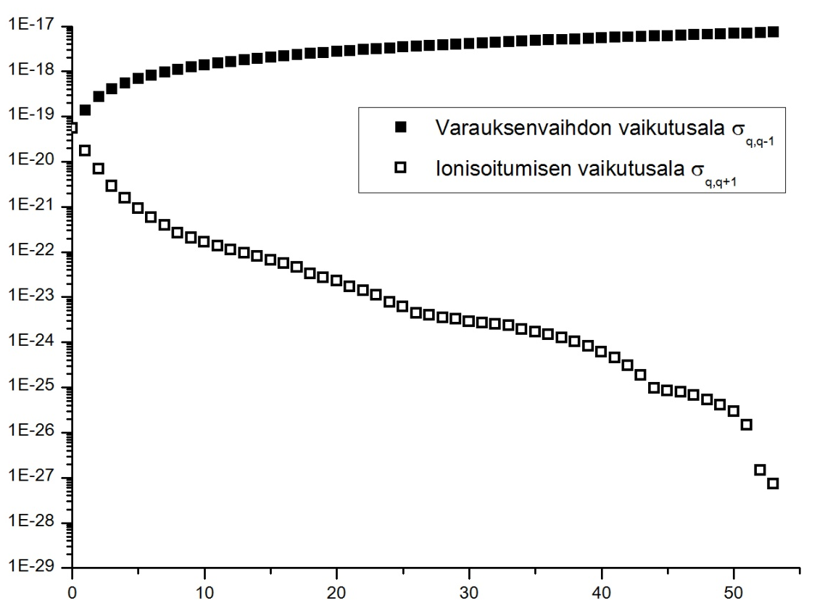


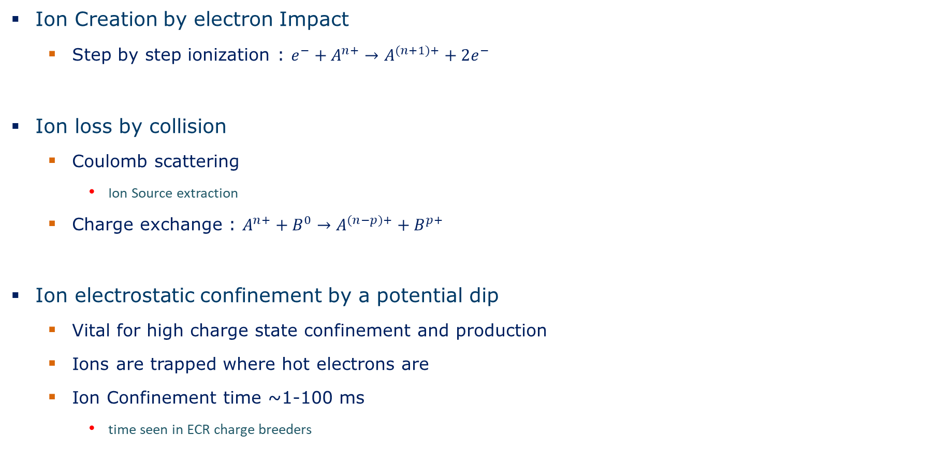
Ion Dynamics in ECRIS
Ion Creation by electron Impact
  Step by step ionization : $e^{−}+A^{n+}→A^{(n+1)+}+2e^{−}$
Ion loss by collision
  Coulomb scattering
    Ion Source extraction
  Charge exchange : $A^{n+}+B^{0}→A^{(n−p)+}+B^{p+}$
Ion electrostatic confinement by a potential dip
  Vital for high charge state confinement and production
  Ions are trapped where hot electrons are
  Ion Confinement time ~1-100 ms
    time seen in ECR charge breeders
$$I_{n}$$
Electron impact cross-section
Electric Potential dip
Charge exchange
Electron impact
$$σ(m^{2})$$
Xe
Charge state

Slide 9
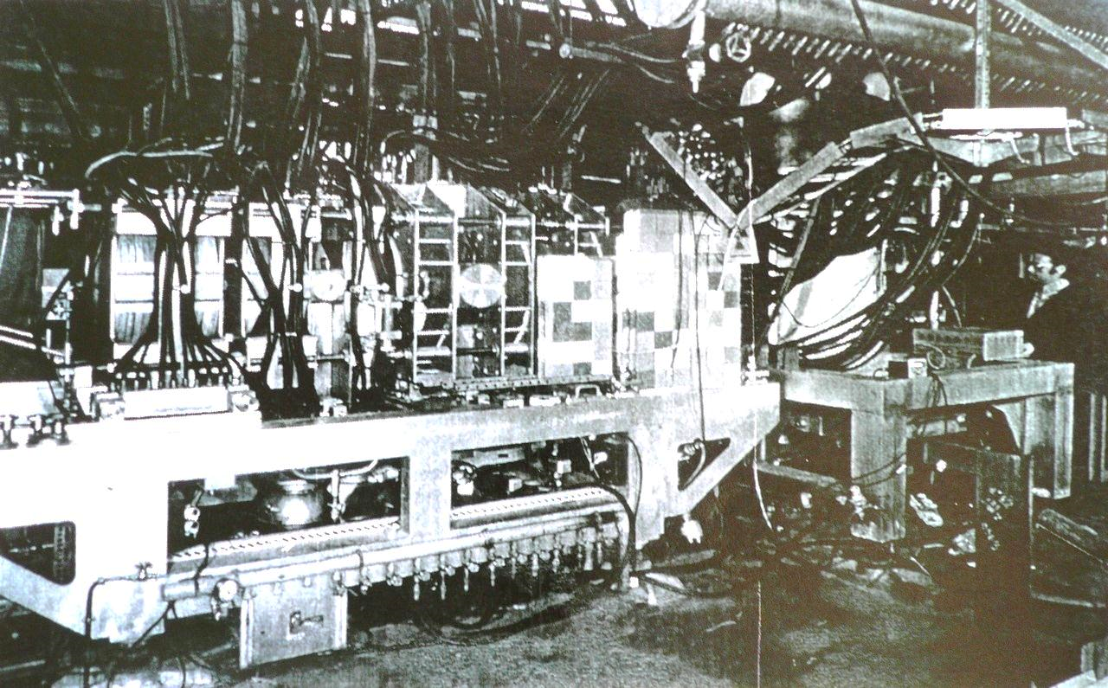
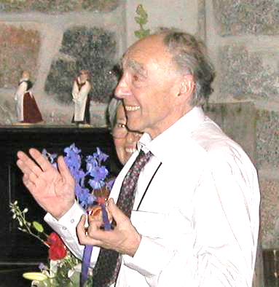
The first Multicharged Ion Source (1975)
R. Geller
SuperMafios
Bernard
Jacquot
A 3 MW linear magnetic fusion machine (CIRCE) modified to produce ion beams
  The legend says that, at first power switching, a power cut left half Grenoble city without electricity

Slide 10
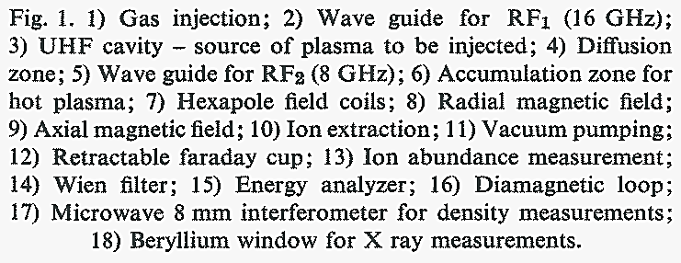
SUPERMAFIOS, the first Multicharged Ion Source
History picks of ECRIS
A Two Stage ECR Ion Source
  The first ECRIS were very long (≥ 1m) and featured a complicated two stage ECR plasma
  Stage 1: high frequency, high pressure plasma in an axi-symetric magnetic field to pre-ionize the atoms
  Plasma diffusion between stage 1 and stage 2 in a magnetic gradient
  Stage 2: main plasma heated at a lower frequency but in a large volume chamber equipped with a min-B structure
  (Iofee bar hexapole + axial coils mirror) providing good confinement time for ions.
  The ion extraction was done very far away from the last magnetic mirror peak
10 GHz
16 GHz
Lots of diag!

Slide 11
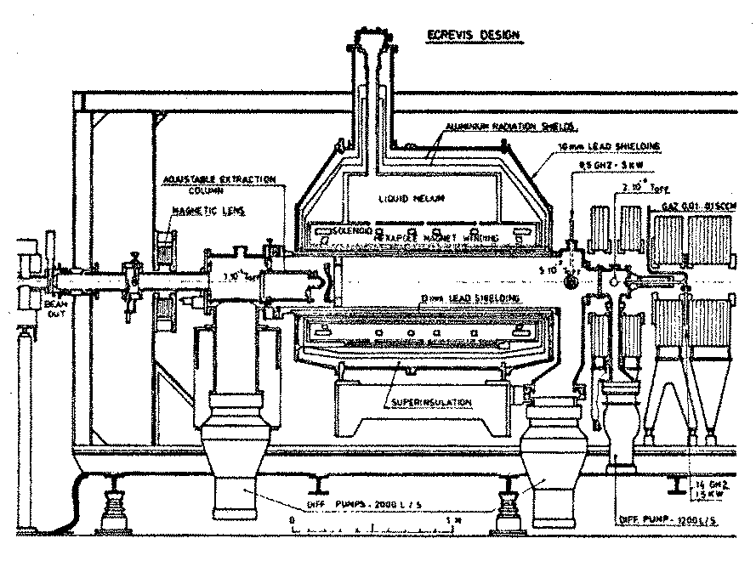
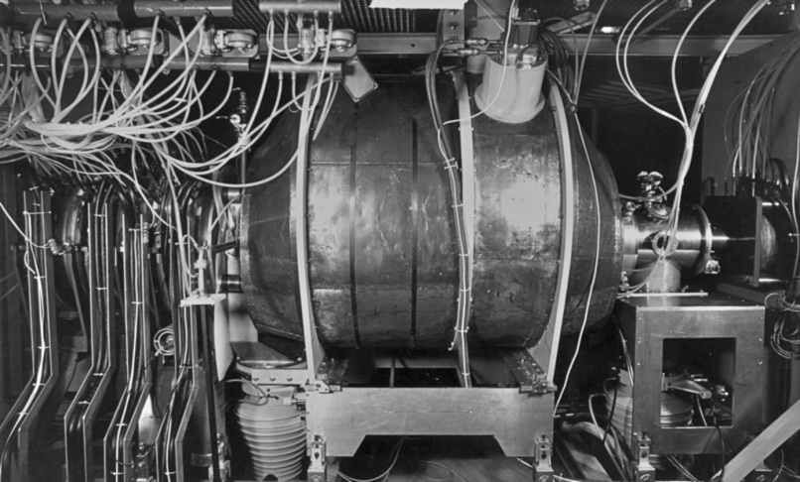
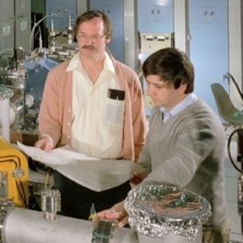
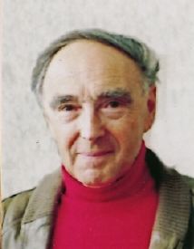
The 70’s & 80’s Pioneers
– First Generation of Ion Sources applied to cyclotrons-
History picks of ECRIS
ECREVIS
MINIMAFIOS
LBL ECR
Louvain la Neuve, Belgium
CEA Grenoble, France
Berkeley, California
1st Superconducting ECRIS !
Richard Geller
Yves Jongen
&
Claude Lyneis
Source LBNL

Slide 12
First Generation (G1) ECRIS performances
History picks of ECRIS
The international competition for results was already there
Typical beam performance of G1:
~100 µA Ar⁸⁺
~100 µA O⁶⁺

Slide 13
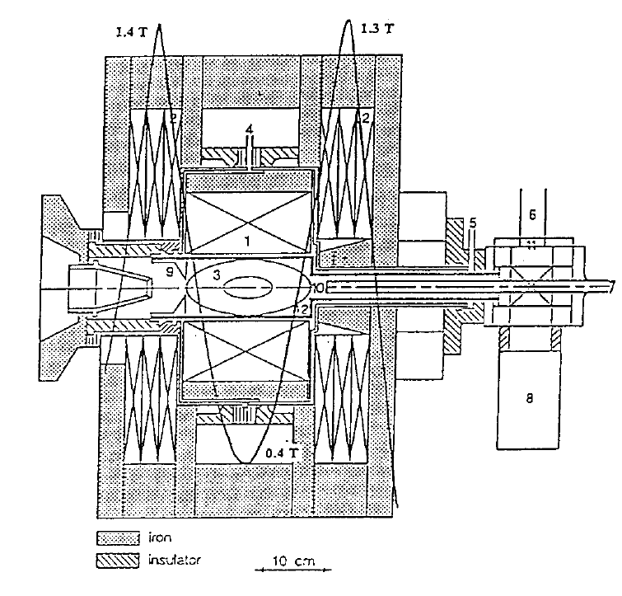
90’s ECRIS 2nd Generation (G2)
– Quartz tube tech. & coaxial coupling -
History picks of ECRIS
A much more compact first plasma stage
  RF injection in a cube equipped with a tuner
  Gas passing through a quartz tube
  direct pre-ionization of the injected atoms
  in a quartz tube by the high RF field
  Modern ion beam extraction
  Permanent magnet hexapoles
10 GHz
RF feed
Gas feed
Quartz
Tube
Pump
Caprice Ion Source – CEA Grenoble

Slide 14
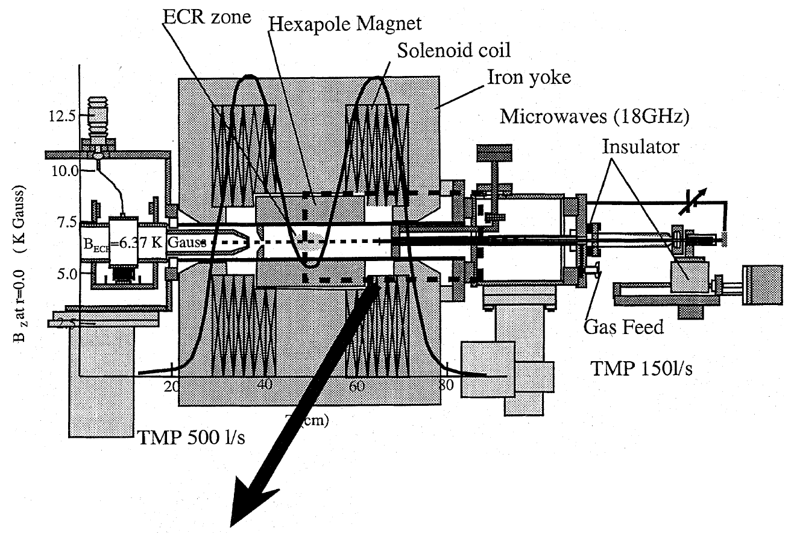
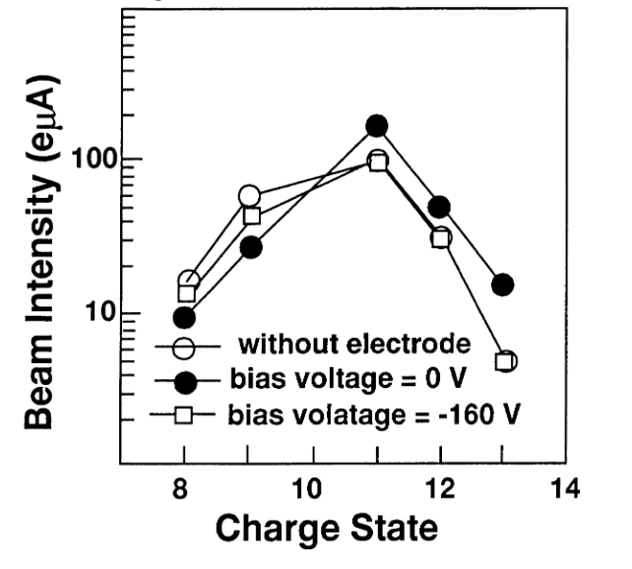
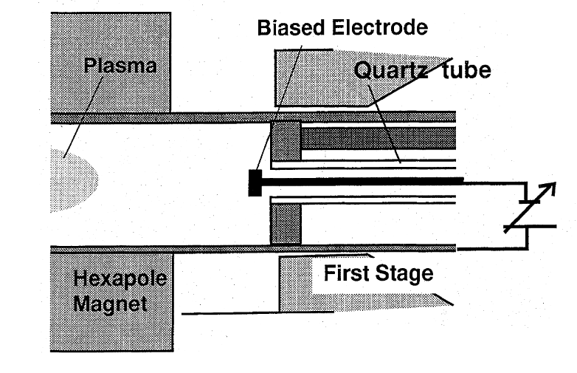
90’s ECRIS G2 progresses : the Biased Disk
Introduction of the biased disk on the injection side
  Serendipity discovery
Improvement of High charge state ion beam current
  Enhances (freshly created) cold electron confinement
  Increases the electron density => more ion current
Riken ECR, 1999, Biri et al.

Slide 15
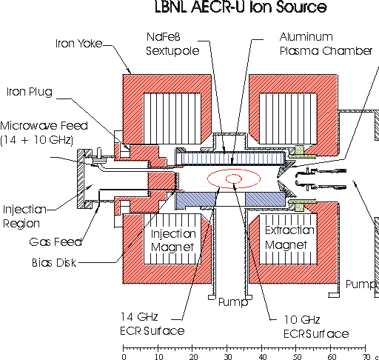
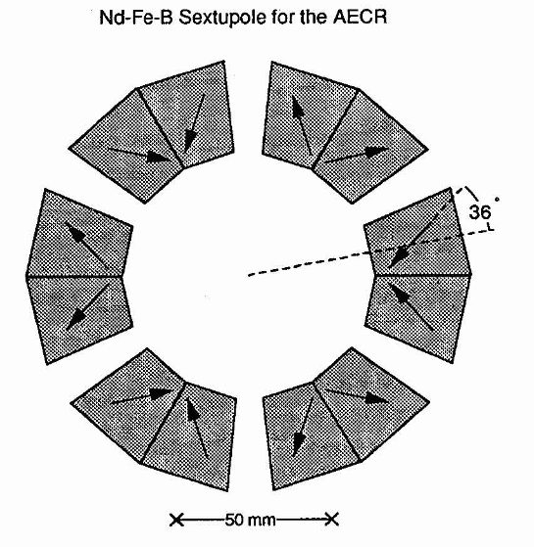

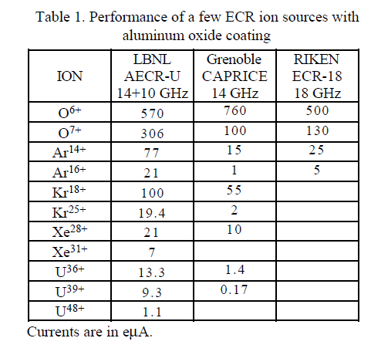
90’s ECRIS G2 progresses : direct RF injection
Set up of the Modern RF injection
  Direct injection of RF into the plasma chamber with a waveguide
  10 GHz→14 GHz →18 GHz
The AECR-U and its hollow hexapole
allowing for direct view of the plasma
Xie, 1997

Slide 16
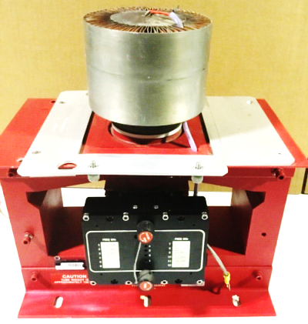
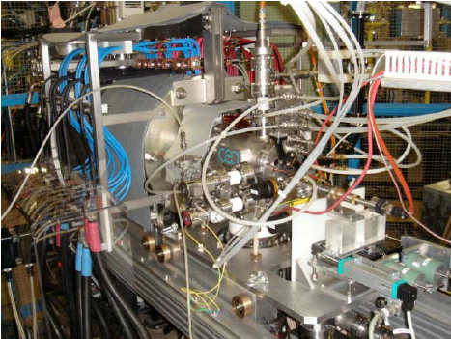
ECRIS G2 progresses
- Generalization of the 18 GHz Operation-
Thanks to the development of satellite and television technologies, High power
18 GHz klystrons are available since the 90’s
18 GHz ECRIS are easy to develop with permanent magnets and room temperature copper coils
  Cost effective
  Low project risk
  High intensity beam
  High charge states
  Reliable
  Easy to maintain
The workhorse of many accelerators in the world
18 GHz klystron
Typical beam performance of G2:
~1000 µA Ar⁸⁺
~1000 µA O⁶⁺
18 GHz GTS Source at CERN

Slide 17
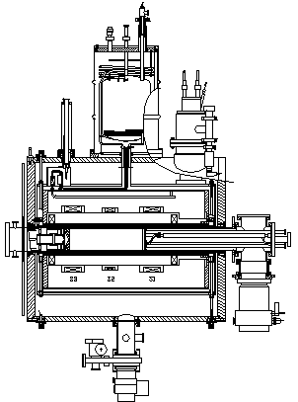
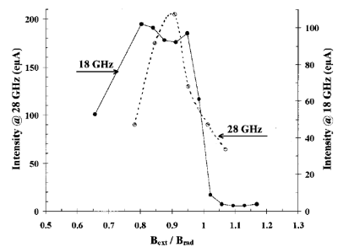
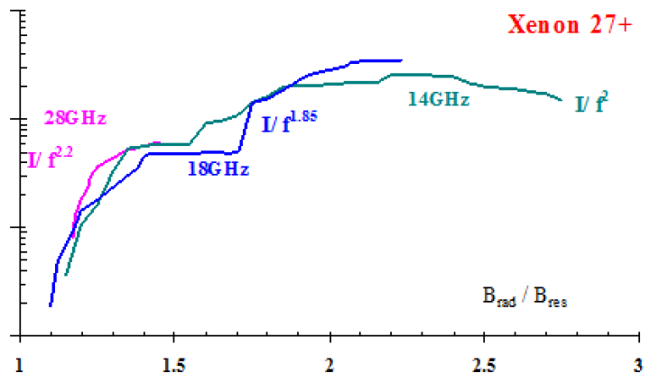
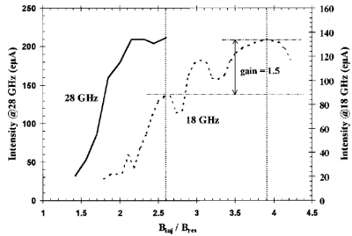
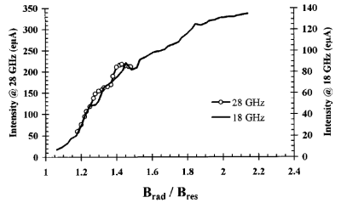
SERSE and the magnetic scaling laws
18 GHz SERSE superconducting ECRIS @ LNS
14 vs 18 vs 28 GHz results led to the ECRIS « standard »
scaling law magnetic model
f_{ecr} [GHz] | 14 | 28 | 45 | 56
B_{ecr} [T] | 0.5 | 1 | 1.6 | 2
B_{rad}~2× B_{ECR} | 1 | 2 | 3.2 | 4
B_{inj}~3-4× B_{ECR} | 2 | 3.5 | 5.6 | 7
B_{min}~0.5-0.8× B_{ECR} | 0.25 | 0.5 | 0.8 | 1
B_{ext}≤B_{rad} | 1 | 2 | 3.2 | 4
Hitz et al.,2002
B_{inj}
B_{ext}
B_{r}
B_{min}
r
z
Axial Mirror
Radial Mirror

Slide 18
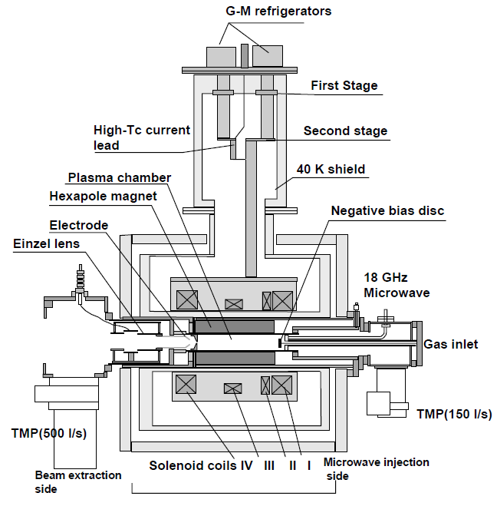
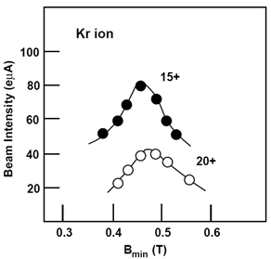


Effect of B_{min} studied at Riken (RAMSES)
Adding a middle coil brings tuning flexibility and more importantly can optimize high charge state ion production in ECRIS
  While keeping B_{ext} and B_{inj} constant
The B_{min} optimum is independent of the charge state
RAMSES 18 GHz ECRIS@RIKEN
Arai et al., 2002

Slide 19




3rd ECRIS Generation –2004 - a big Frequency boost
New Ion Sources operating in the range of 24 to 28 GHz
  Superconducting magnets required to generate high magnetic field
  Change of RF emitter technology
    Klystrons→Gyrotrons
    28 GHz waveguides larger than at 18 GHz
First operational 3G ECRIS : VENUS (LBL)
  Sextupole-in-coil technology
  NbTi in a LHe bath
  Large Plasma Chamber volume V~8 liter
    Ø~14 cm , L~50 cm
  G3 More expensive than G2
  Improvement of ion beam charge state and
  Intensity
VENUS

Slide 20





Multiplication of G3 ECRIS
SECRAL
Iron pole
SECRAL (IMP Lanzhou, 2005)
  Coil-in-sextupole technology , NbTi
  18+24 GHz RF heating
SUSI (MSU, 2007)
  Sextupole–in–coil tech. , NbTi
  6 axial coils
  18+24 GHz RF heating
  Flexible axial field and cavity length
Hexapole
SC coil in sextupole tech.
(SECRAL)
SECRAL
Extract.
Solenoid
Middle
Solenoid
Inject.
Solenoid
SUSI
SUSI

Slide 21



Before the trade war, the US/CN ion current intensity competition : VENUS vs SECRAL
ECRIS08
ECRIS10
ECRIS16

Slide 22












G3 TIMELINE
JINR @28 GHz?
VENUS-FRIB
Louvain L-N
RIKEN SC
SECRAL II
ASTERICS
SECRAL
KBSI SC
VENUS
SUSI
G3 ECRIS FIRST PLASMA
2004
2007
2022
2029
2005
2016
2010
2015

Slide 23





So far, the ECR frequency scaling law is valid
The ionic current experimentally scales with the ECR frequency to the square
A very strong motivation to keep on increasing the RF frequency => 4th Generation ECRIS 45 GHz
?
?
$$O^{6+}$$
Source: C. Lyneis, LBL

Slide 24



REX: X-ray load at 28 GHz operation
The Early return or experience of operation @28 GHz shows a high X-ray load to the SC magnet cold mass for high $B_{min}$ tuning
Up to ~1 W LHe boil-off / kW RF
Requires extra LHe cooling for the magnets cryostats
VENUS
SECRAL II
Leitner et al. (2008)
Sun et al. (2018)

Slide 25


X-ray spectral temperature and $B_{min}$
The Bremsstrahlung x-ray high energy tail spectral temperature is proportional to $B_{min}$
Whatever the ECR frequency
Whatever the usual range values of $B_{inj}$, $B_{ext}$, $B_{rad}$
Working at low $B_{min}$saves LHe boil-off in G3 ECRIS
J. Benitez et al. (2017)

Slide 26





ECRIS and ECR Volume @18 GHz
The large number of existing ECRIS @ 18 GHz allows to study the effect of the ECR volume
ECRIS following the same magnetic scaling laws
It is observed that $I(Ar^{12+})∝V_{ecr}$, provided that the power density in the source is comparable
  P~1 kW/liter here
Performance @ 18 GHz can still be improved
Motivation to make next ECRIS with a larger ECR volume and higher RF power
Ar¹²⁺ Beam intensity @ 18 GHz
$$V_{ecr}∝R_{ecr}^{2}.L_{ecr}$$
$${2R}_{ECR}$$
(Thuillier, 2023)
ECR
ZONE
$$L_{ECR}$$
Sources PHOE.V2, PHOE. V3, GTS, HIISI, SUSI

Slide 27







RF coupling test at 28 GHz- HE₁₁ Snake
The 28 GHz Gyrotrons deliver 10 kW in TE₀₂ circular mode
The initial RF mode injection in ECRIS is TE₀₁ circular ID 32.5 mm
How efficient is this coupling?
Attempt to inject HE₁₁ mode (LBL, Snake 2013)
  Following (Hitz,2006) proposal
  $TE_{01}→TE_{11}→HE_{11}$ ID 32.5 mm
  Unfortunately no big current change
  But…
Lyneis, 2014
TE₀₁
TE₁₁
HE₁₁

Slide 28




RF coupling improvement at 24 GHz- $TE_{01}$@20 mm ID
Serendipity discovery@IMP (Zhao,2017)
  A 20 mm ID version of the snake was built for SECRAL
    Because it was more compact and fitting into SECRAL hardware
    No improvement neither with th esnake, but…
  The simple tapering of $TE_{01}$@20 mm ID performs better!
    much better than standard $TE_{01}$@32.5 mm or HE₁₁@20 mm
(Zhao,2017)
$$TE_{01}Taper 32.5→20 mm$$
(Zhao,2017)

Slide 29




RF coupling - Vlasov Launcher (IMP,2024)
A movable Vlasov Launcher was tested with SECRAL II @ 24 GHz
  Large high charge state intensity improvement vs position
  Subsequent Higher x-ray count rat
_{Xe}27+
_{U}35+
_{Xe}30+
Movable
_{Xe}30+
Beam intensity I_{q} response to Vlasov launcher position
I_{q} and Bremsstrahlung counts responses to Vlasov launcher position
(X. Wang,2024)

Slide 30




Ion Source Prospects
The need for higher performance ion sources is required by the future accelerators
MSU FRIB U³⁴⁺
13 pμA/ CW
RIKEN RIBF U³⁵⁺ 15 pμA/ CW
GSI FAIR 1mA U²⁸⁺
IMP HIAF 0.5 emA U⁴⁶⁺ / U³⁵⁺ 50 pμA (400 μs)

Slide 31




4G Prospect : MARS-D (LBL, USA)
Ongoing 45 GHz ECRIS magnet construction
  Iofee-bar Sextupole, decreases the stress on the SC cable
  NbTi cable can be used to wind the sextupole
  Project risk reduction
  But increase of time to wind the coil (handmade)
ECRIS20, D.Xie
Cold mass CAD

Slide 32




4G Prospect: FECR (IMP, CN)
IMP Lanzhou : Classical Sextupole-in-coil design
  SC magnet designed by LBL using Nb₃Sn cable
Status of the magnet construction
  ½ scale mockup tested successfully
  The sextupole coil built failed (cable feed broken outside of the magnet )
A NbTi Sextupole was recently successfully built instead to start the source operation
Successfull
mockup test

Slide 33




ECRIS and plasma instabilites studies in the 10’s
Demonstration of Cyclotronic instabilities in ECRIS (JYFL)
  Intensive experimental campaigns
  Transient swift hot electrons deconfinement
  Transient HCI beam collapse
  Linked to EVDF anisotropy and EEDF shape
  Dependent on $B_{min}$ and RF power
(Tarvainen, 2014)
In the 90’s ,Tim Antaya (MSU) used to tune his ion source
by plugging the FC current signal in a speaker

Slide 34

Boom of plasma experimental investigations in the 10’s
ECR Plasma Stability monitored with scintillator, RF probe, light detector (JYFL)
Multicharged ion population studied by measuring soft x-ray and light emission (Atomki,JYFL)
Plasma density measured with microwave Faraday rotation (interfero-polarimetry) (LNL)
Escaping electron measured with micro-channel plate + photomultiplier (IAP RAS)
Ion injection in ECRIS charge breeder to probe the ECR plasma (LPSC)
Shedding new light of ECR plasma, with great prospects and yet a long way to go

Slide 35


Dramatic improvement of ECRIS plasma simulations since the 2000 ’s
NAM-ECRIS (JINR)
INFN-LNS
PIC-MCC
Ion dynamics
Gas mixing
Spatial plasma Potential distribution
Charge breeding
…
Electron dynamics
Self-consistent RF coupling to the plasma
Metallic ion dynamics
Full 2D Microwave source PIC
…
Mishra, 2021
Mironov, 2017

Slide 36

Prospect: Pandora ECR experiment @ INFN-LNS
A game changer to investigate experimentally the ECR plasma with multiple detectors
astrophysics applications
18 GHz superconducting ECRIS with Nb₃Sn coils and view ports passing through the cold mass (wow!)
Mascali, 2023

Slide 37
Open challenges: Better understand the ECR plasma
What results/insight would give
time resolved plasma
measurements?
by Experience and simulation
Are Geller frequency
scaling law still
valid @45 GHz?
Microwave mode
coupling to the plasma?
What is the Potential dip value
and its spatial distribution?
?
Actual plasma
density?
How anisotripic is the
EVDF anisotropy?
Can we predict
The plasma Meniscus shape for ion beam extraction?
How to explain the
Very long ion confinement?
How exactly is the EEDF?

Slide 38




Open Challenge: long term afterglow operation
6 months run in afterglow mode@14.5 GHz / 10 Hz, argon beam
Observation of 0.1 mm deep sputtered grooves at the radial wall along
the plasma loss lines
@45 GHz, that would make the groove depth ~0.9 mm/6 months…
Cyclotron Instability objectified at RF switching ON/OFF (Izotov, 2016)
  Transient plasma potential build up favors argon sputtering
RF
(Küchler,2016)
AFG
Pb²⁸⁺
Microwave signal
X-ray count
(Izotov, 2016)

Slide 39





Open Challenge : ECR charge breeder beam purity
As of now, The 1+ radioactive ion beam (RIB) intensities are much lower than the N+ plasma material sputtered from the plasma chamber walls
Will high purity liner solve the issue? (INFL-LNL)
Can atomic layer deposition (ALD) of Al2O3 reduce the contamination? (ANL)
Buffer gas
~${10}^{16} pps$
Gases contaminants
~$10^{9}−10^{13} pps whole spectrum$
$\sim 10^{4} pps$ within $\frac{M}{ΔM}\sim 400$
$\sim 10^{2} pps$ within $\frac{M}{ΔM}\sim 4000$
Wall sputtering
~${10}^{9}−{10}^{10} pps$ whole ion spectrum
~${10}^{4} pps$ within $\frac{M}{ΔM}\sim 400$
~${10}^{2} pps$ within $\frac{M}{ΔM}\sim 5000$
14 GHz ECR
contaminants
1+ signal
$$up to 10^{13} pps$$
Itotal~1 mA
(~${10}^{15}−{10}^{16} pps)$
N+ signal

Slide 40





Open challenge: 4G RF coupling to the plasma
High frequency gyrotron emit quasi-optical gaussian beams
The coupling to the plasma is optical
  No more waveguides, except for safety, No DC breaker
RF Mode conversion to the plasma is required
  simulations
The RF power needed for high performance ECR scales with the ECR plasma volume and the plasma density
An estimate of 25 kW per plasma liter is required for a high performance operation at 45 GHz
  This is very likely to be challenging
RF
Optical
Coupling
RF power need per plasma liter
$$P_{RF}(f_{ecr})$$
$$P_{RF}∝f_{ecr}^{2}V_{ecr}$$

Slide 41

Open challenge: B-Min magnet at high ECR frequency
NbTi cable limit is reached
Nb₃Sn magnet can make the Min-B but
  Brittle, risky, expensive
  Lab tech only
HTS could be used, but that’s very very expensive
Managing the high energy stored in the magnet coils is also challenging
  > 1 MJ, active quench protection system required
  Risk of perturbation by Source High Voltage breakdowns
  1 quench and magnet to garbage…
Copper works > 60 GHz
J. Schwartz, 2006

Slide 42




Open challenge: plasma chamber burn
Higher plasma density →Higher Power injected→Higher power to the walls
Likely degradation of the plasma chamber on a year time scale
  Excessive power density to the wall leading to a water flow boil-off
  and a too high wall temperature, leading to metal recrystalisation
  or even melting
SECRAL II chamber burn
VENUS chamber burn
SECRAL chamber burn

Slide 43





Open Challenge: Intense parasitic X-RAY flux
X-ray
Lost plasma electrons converted into photons @ wall
(Bremsstrahlung)
  Huge X-Ray flux proportional to the plasma density
Damage of the HV plastic insulator (burn)
  Mitigation (shielding) with a high Z material
without
shield
HV
Insulator
2mm Tantalum
X-ray Shield
with
shield
Axial flux
SECRAL
VENUS
Water Cooling Grooves
at the plasma Flutes
VENUS
VENUS
VENUS
VENUS

Slide 44
THANK YOU FOR YOUR ATTENTION

Slide 45

THANK YOU FOR
YOUR ATTENTION
Мариупольский театр, 2022

Slide 46




Microwave generation
RF generators
  Magnetrons
    2.45 GHz 30 kW
    35 GHz – 100W
  Klystrons
    1 GHz- 1MW
    22 GHz- 100W
  Gyrotrons
    18 GHz - 1 MW
    600 GHz- 10W
Microwave generation
is not a limit
R. Temkin, MIT
Granatstein et al. 1999
magnetron
klystron
gyrotron

Slide 47




Microwave transport and coupling
Coaxial
coupling
14 GHz
Direct injection 28 GHz
Oversized WG
Direct injection 18 GHz
WG dim.
(mm)
Optical
Coupling
80
coaxial
fundamental
waveguide
Oversized
waveguide
Optical coupling
16
2.45
14
18
$$f_{ECR}(GHz)$$
28
45
60

Slide 48

ECRIS frequency and magnet Technology
4G: Very high magnetic fields are required
  What technology is possible?
Cu@300K
mature
R&D
60
4G: Very high magnetic field is required
What technology is possible
1G & 2G ECRIS up to 18GHz
  Iron dominated geometry
  Cu coils and permanent magnets
3G ECRIS up to 28 GHz
  NbTi SC ECRIS
4G ECRIS projects up to 45 GHz
  Nb₃Sn
  Limit of NbTi
Above 45 GHz
  Nb₃Sn very risky
  High Temp Superconductors
  a safe way is paradoxically Cu technology
Nb₃Sn@4K
56
Brittle…
45
28
project
risk
NbTI@4K
24
18
mature
Cu@300K
FeNdB

Slide 49


