Slide 1
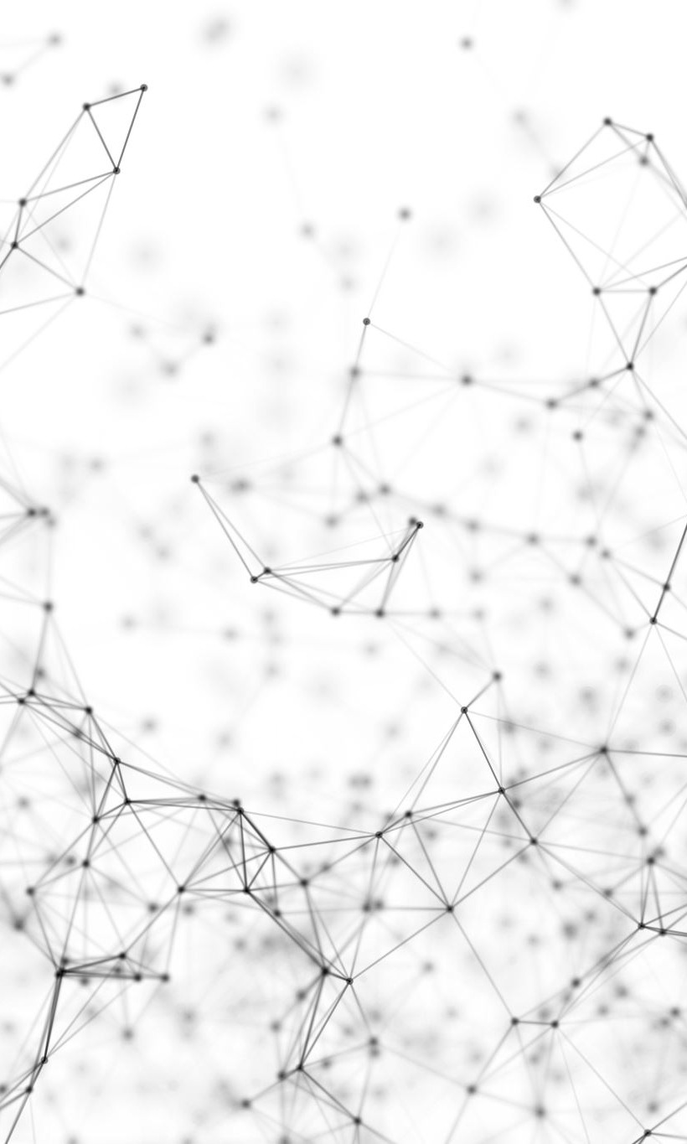

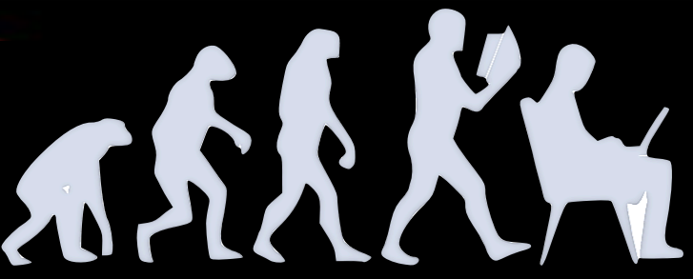
The A(i)DAPT program AI for Data Analysis and Preservation
Tommaso Vittorini
on behalf of A(i)DAPT Working Group
Tommaso Vittorini
The A(i)DAPT program

Slide 2
Data collected by NP/HEP experiments are (always) affected by the detector’s effects
Before starting physics analysis the detector’s effect unfolding is required
Traditional observables may not be adequate to extract physics in multidimensional space (multi-particles in the final state)
At High-Intensity frontiers, data sets are large and difficult to manipulate/preserve
Should AI support NP/HEP experiments to extract physics from data in more efficient way?
Develop AI – supported procedures to:
Accurately fit data in multiD space
Unfold detector effects
Compare synthetic (AI-generated) to experimental data
Quantify the uncertainty (UQ)
Collaborative effort (regular meeting)
ML experts (ODU, Jlab)
Experimentalists (Jlab Hall-B)
Theorists (JPAC, JAM)
1 - Tommaso Vittorini
The A(i)DAPT program

Slide 3
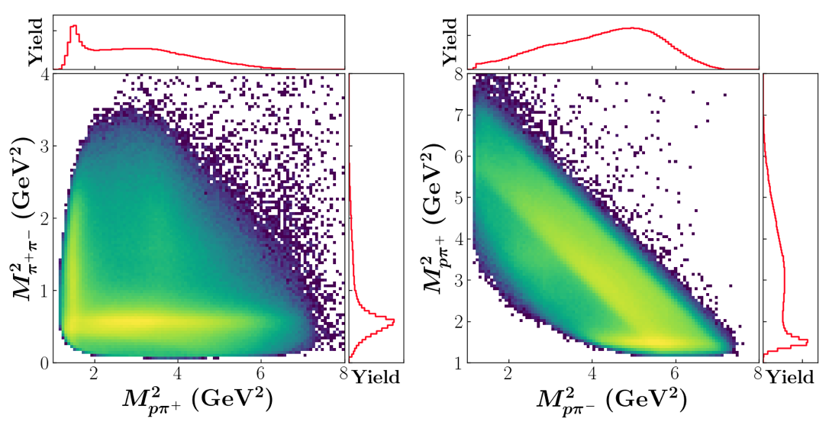

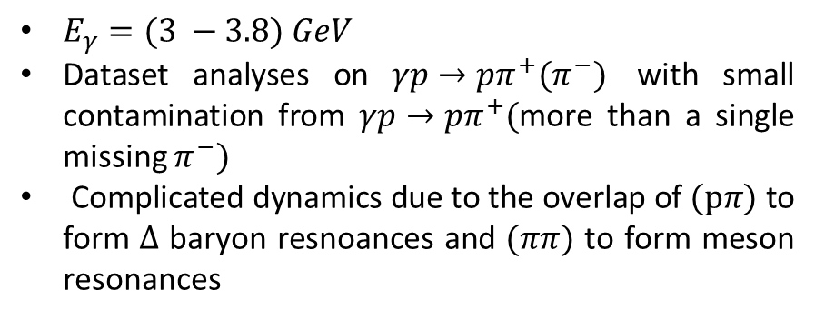

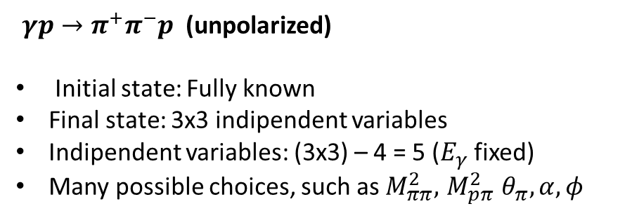
Exlusive reactions: $2→3$
$γp→π^{+}π^{−}p$ (unpolarized)
Initial state: Fully known
Final state: 3x3 indipendent variables
Indipendent variables: (3x3) – 4 = 5 ($E_{γ}$ fixed)
Many possible choices, such as $M_{ππ}^{2}, { M}_{pπ}^{2} θ_{π}, α, φ$
CLAS g11 $2π$ photoproduction
$E_{γ}=(3 −3.8) GeV$
Dataset analyses on $γp→pπ^{+}(π^{−})$ with small contamination from $γp→pπ^{+}($more than a single missing $π^{−})$
Complicated dynamics due to the overlap of $(pπ)$ to form $Δ$ baryon resnoances and $(ππ)$ to form meson resonances
AI could provide a new way to look at data and to extract observables and physics interpretation
Credit: Y.Alanazi Awadh, , P..Ambrozewicz, G. Costantini A.Hiller Blin, E. Isupov, T. Jeske, Y.Li, L.Marsicano W. Menlnitchouk, V.Mokeev, N.Sato, A.Szczepaniak, T.Viducic
2 - Tommaso Vittorini
The A(i)DAPT program

Slide 4
Detector unfolding
Detector effects make measured observables (detector-level) different from the ‘true’ observables (vertex level)
Acceptance: Any measurement can access only a limited portion of the phase space. What can we say about these unmeasured regions?
Resolution: Any measurement has an experimental resolution that may modify cover up effects that we’re looking for
Interpolation: deal with the holes in the phase space
Extrapolation: extend our coverage from the borders of measured regions
Spikes may be concealed behind the detector resolution
Measurements could be extended to unphysical regions
Mitigation strategy:
Acceptance: ‘Fiducial volumes’ to exclude unmeasured regions and extend the covered measured of the phase space
Resolution: build and validate ML-models to unfold resolution effects
3 - Tommaso Vittorini
The A(i)DAPT program

Slide 5
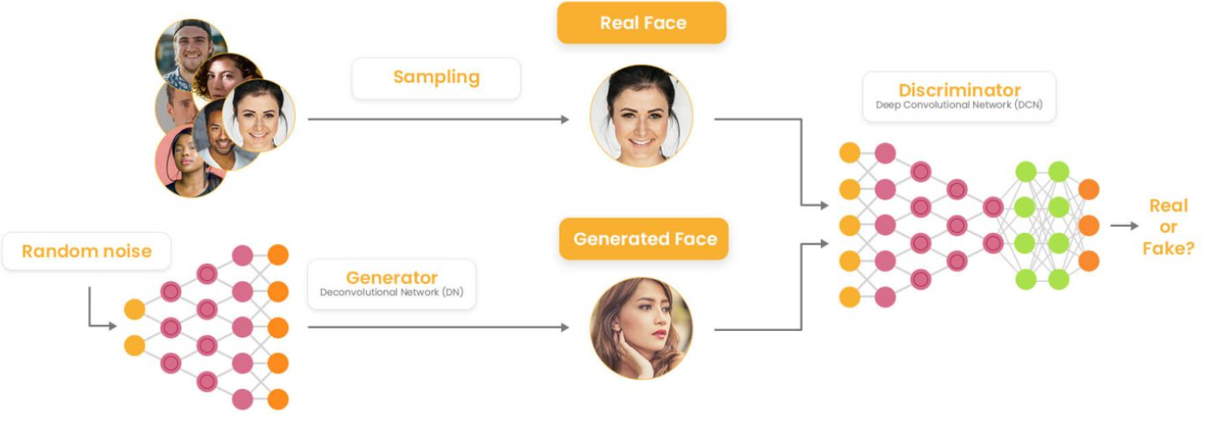
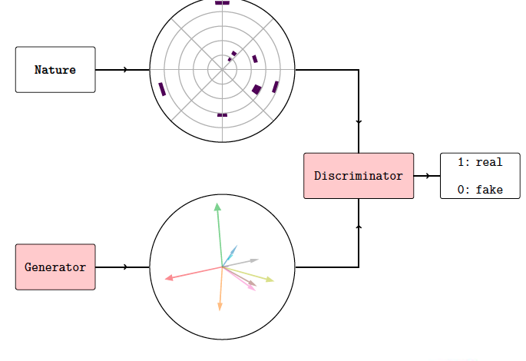
Generative Adversarial Networks (GANs)
Generative model based on the competition between two Neural Networks: Generator vs Discriminator
Generator produces synthetic data which progressively reproduce realistic data and the Discriminator has to distinguish between synthetic and realistic data
Generator be used to retain high dimensional correlations (detector proxies)
Generator can be used to provide highly realistic pseudo-data in an extremely fast way
4 - Tommaso Vittorini
The A(i)DAPT program

Slide 6
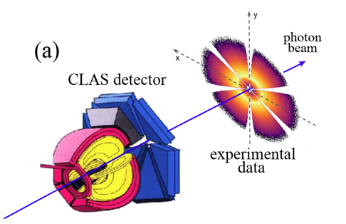
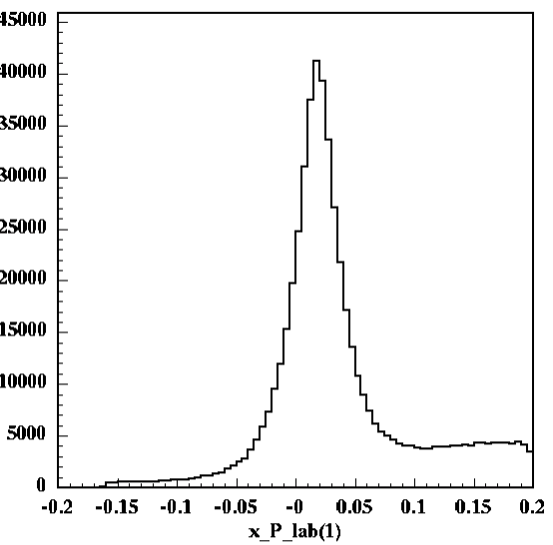
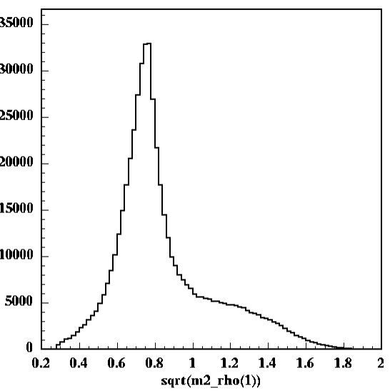
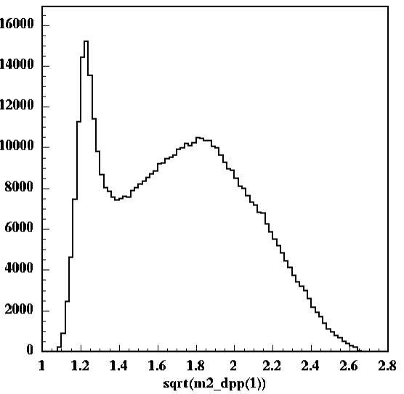
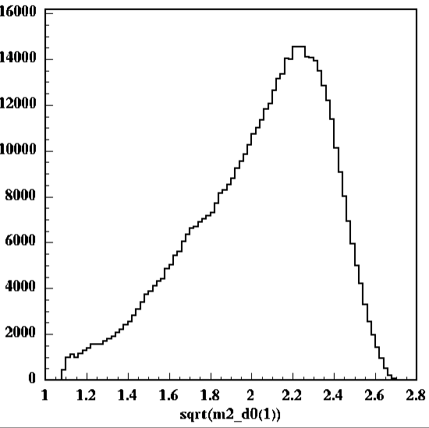
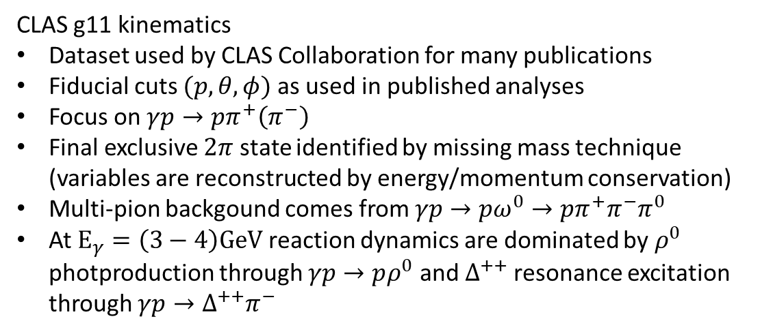
M. Battaglieri et al. (CLAS Collaboration) Phys. Rev. Lett. 102, 102001
Resolution: Multi-d cross-section: exclusive $2π$ photoproduction
M. Battaglieri et al. (CLAS Collaboration) Phys. Rev. D 80, 072005
CLAS g11 kinematics
Dataset used by CLAS Collaboration for many publications
Fiducial cuts $(p, θ, φ)$ as used in published analyses
Focus on $γp→pπ^{+}\left(π^{−}\right)$
Final exclusive $2π$ state identified by missing mass technique (variables are reconstructed by energy/momentum conservation)
Multi-pion backgound comes from $γp→pω^{0}→pπ^{+}π^{−}π^{0}$
At $E_{γ}=\left(3−4\right)GeV$ reaction dynamics are dominated by $ρ^{0}$ photproduction through $γp→pρ^{0}$ and $Δ^{++}$ resonance excitation through $γp→Δ^{++}π^{−}$
M(γ p → p π⁺ X)
M(ππ)
M(pπ⁺)
M(pπ⁻)
M(missing π)
ρ⁰(770)
Δ⁺⁺(1232)
M(missing ππ ..)
5 - Tommaso Vittorini
The A(i)DAPT program

Slide 7
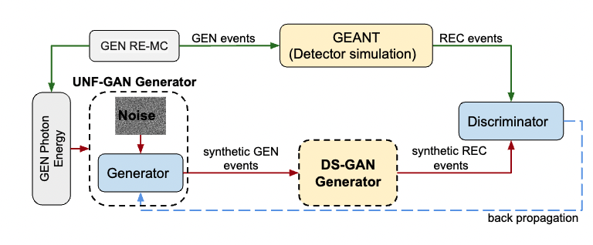
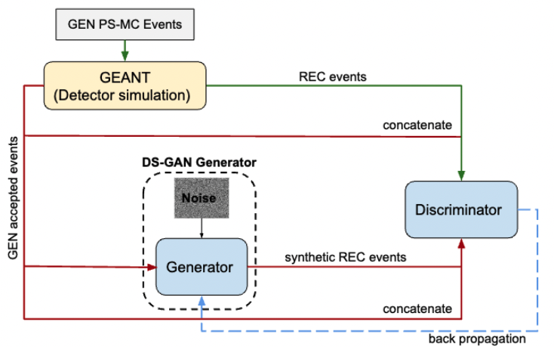

Resolution: $2π$ photoproduction closure test
CLOSURE TEST:
Demonstrate that GANs reproduce ‘true’ multi-d correlations, unfolding CLAS resolution effects, comparing vertex- level (GEN) events with GAN GEN SYNT events, trained at detector-level and unfolded with a (GAN-based) detector proxy
UNFOLDING GAN (UNF-GAN)
DETECTOR SIMULATION GAN (DS-GAN)
6 - Tommaso Vittorini
The A(i)DAPT program

Slide 8
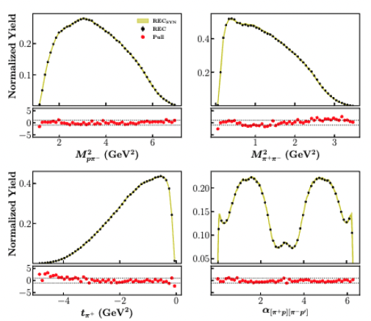
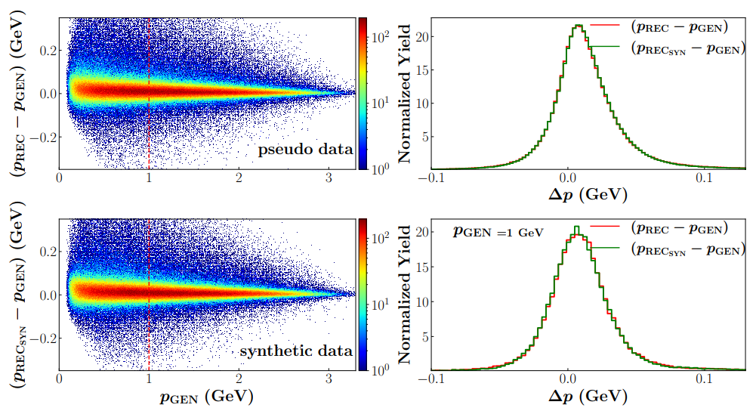
Resolution: DS-GAN results
DS-GAN used to unfold CLAS detector effects (within acceptance)
MC REC pseudodata vs. DS-GAN synthetic data
CLAS resolution
pseudodata
Uncertainty quantification via pull calculation: Bootstrap with 20 indipendently trained GANs
synthetic data
DS-GAN learned the CLAS detector effects!
7 - Tommaso Vittorini
The A(i)DAPT program

Slide 9
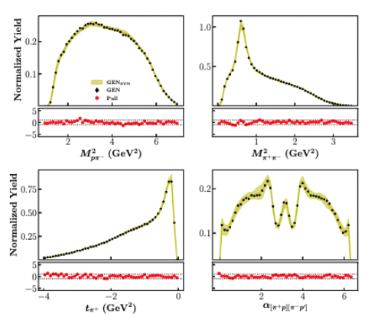
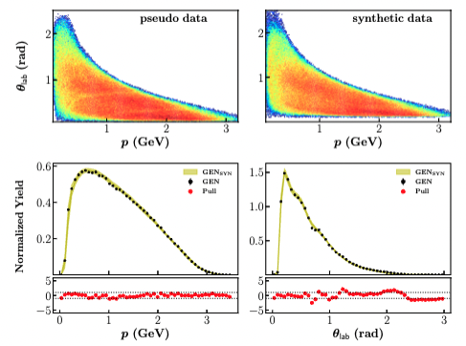
Resolution: UNF-GAN results
RE-MC GEN pseudodata vs. UNF-GAN SYN data
UNF-GAN trained with REC-MC pseudodata (experimental data proxy)
RE-MC GEN pseudodata vs. UNF-GAN SYN data
CLAS resolution
Compare UNF-GAN GEN SYNT to RE-MC GEN pseudodata
Good agreement ($±1σ$) for vertex-level training variables!
8 - Tommaso Vittorini
The A(i)DAPT program

Slide 10
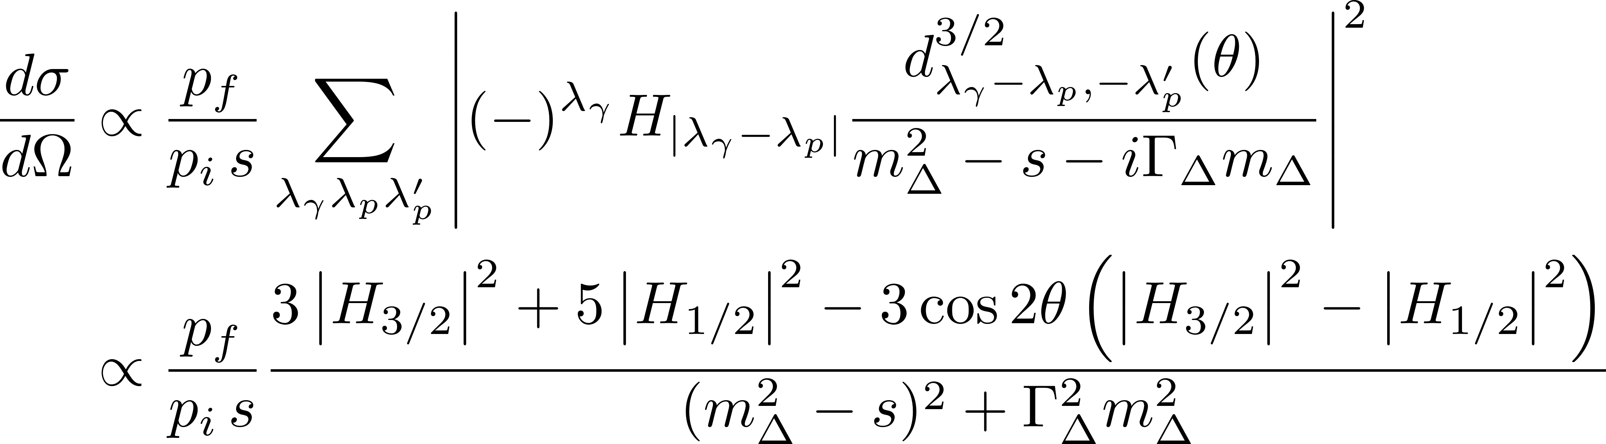
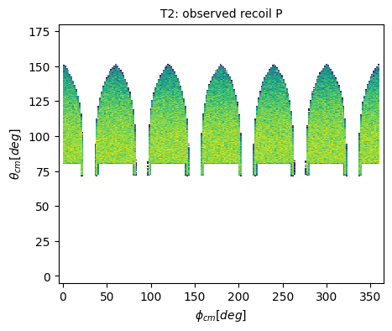
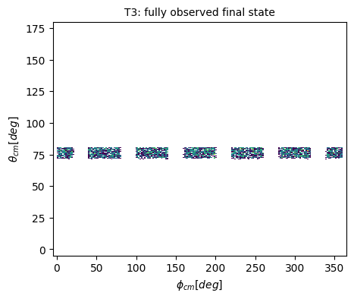
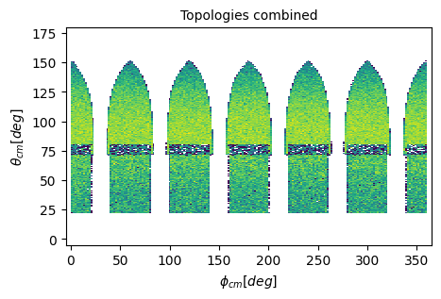
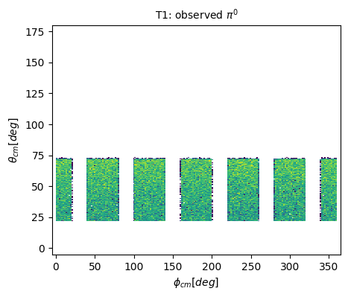

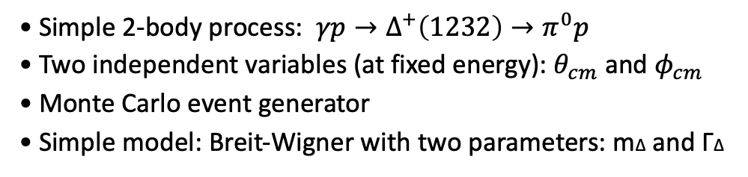
Acceptance: Single $π^{0}$photoproduction
Simple 2-body process: $γp→Δ^{+}\left(1232\right)→π^{0}p$
Two independent variables (at fixed energy): $θ_{cm}$ and $φ_{cm}$
Monte Carlo event generator
Simple model: Breit-Wigner with two parameters: mΔ and ΓΔ
Detector acceptance (CLAS) implemented via fiducial cuts (coils, minimum proton momentum and angle in the lab frame)
topology 1: γ p → (p) π⁰ (proton missing)
topology 2: γ p → p (π⁰) (π⁰ missing)
topology 3: γ p → p π⁰ (all detected)
[topology 0: unmeasured]
topology II
topology III
Build a single Network able to generate in the full phase space according to the correct distributions
topology I
Credit: T.Vittorini , T.Alghamdi,Y. Li
9 - Tommaso Vittorini
The A(i)DAPT program

Slide 11
Acceptance: Single $π^{0}$photoproduction
Differential cross-section for the different models
Test the robustness of our approach using different models:
RE-MC: Realistic model as a proxy of experimental data in the measured region
PS-MC: Phase space model as simple guess for the unmeasured region
CT-MC: Control model as an unrealistic guess for the unmeasured region
Effect of the acceptance cuts on RE-MC distribution
We built two different datasets to test our model on:
measured
D1: (PS-MC, RE-MC) D2: (CT-MC, RE-MC)
unmeasured
The acceptance cuts will always have the same effect on the portions of the phase space covered by each topology for any model and differences will arise only as density of events
Credit: T.Vittorini , T.Alghamdi,Y. Li
10 - Tommaso Vittorini
The A(i)DAPT program

Slide 12
Acceptance: Single $π^{0}$photoproduction closure test
CLOSURE TEST:
Demonstrate that GANs reproduce ‘true’ multi-d correlations, unfolding CLAS acceptance effects, comparing vertex- level (GEN) events with GAN GEN SYNT events, trained at detector-level and unfolded with a (GAN-based) detector proxy
Event: $(θ_{cm}, φ_{cm}, P_{T0}, P_{T1},P_{T2},P_{T3})$
Probabilities for an event to belong to a given topology to take care of detector inefficiencies
UNFOLDING GAN (UNF-GAN)
DETECTOR SIMULATION GAN (DS-GAN)
11 - Tommaso Vittorini
The A(i)DAPT program

Slide 13
Acceptance: DS-GAN results on D1
DS-GAN used to unfold CLAS detector effects (within acceptance) trained on PS-MC data
Detector-level pseudodata vs. DS-GAN synthetic data
Uncertainty quantification via pull calculation: Bootstrap with 20 indipendently trained GANs
DS-GAN learned to generate smeared events according to each topology !
12 - Tommaso Vittorini
The A(i)DAPT program

Slide 14
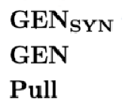
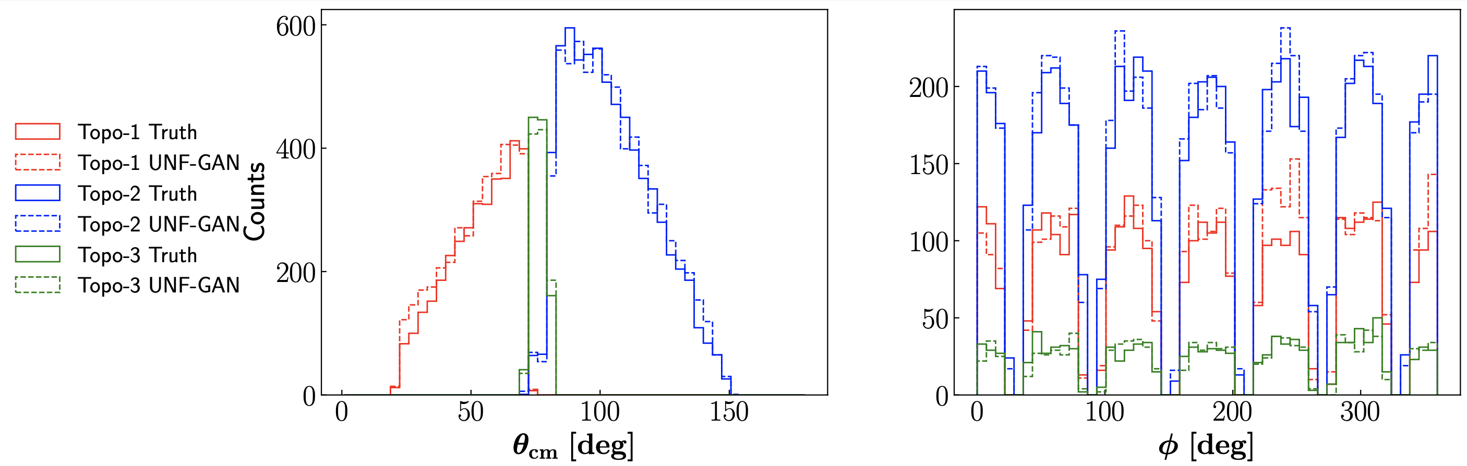
Acceptance: UNF-GAN results on D1
UNF-GAN trained with REC-MC pseudodata (experimental data proxy)
RE-MC GEN pseudodata vs. UNF-GAN SYN data
RE-MC GEN pseudodata vs. UNF-GAN SYN data for each measured topology
Compare UNF-GAN GEN SYNT to RE-MC GEN pseudodata
UNF-GAN is able to generate the correct distributions inside each topology phase space region!
Preliminary results with D2 dataset show an independence of our procedure from the model we choose to cover our unmeasured region with
13 - Tommaso Vittorini
The A(i)DAPT program

Slide 15


Thank you
Tommaso Vittorini
The A(i)DAPT program

