Slide 1
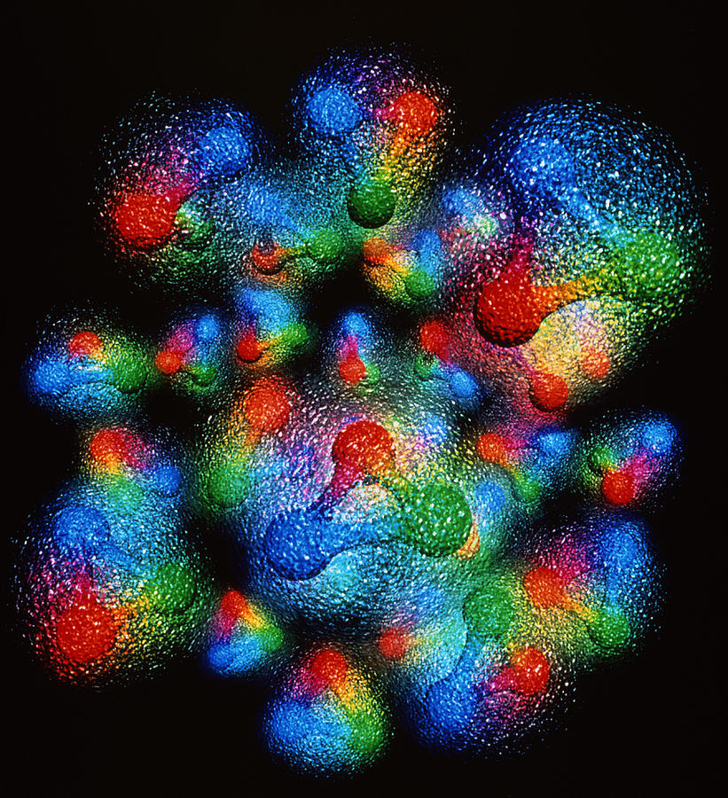




What physical information is in deeply virtual exclusive experiments and how do we take a snapshot of the proton?
Simonetta Liuti
Notes:
EIC have templates for that
UQ pointing at where to measure at EIC
Digital twins and lattice
Example: molecular dynamics, diffusion model, build the whole dynamics in ns, surrogate of very costly project. GiaWei: accuracy issue? For both stages: lattice configurations and correlators
Prasanna: when to use surrogate models, build cheaper yet accurate
Self-learning MC and non-abelian theory, like surrogate model
Kyle Cranmer P. Shanahan et al., Nature review paper,
Pseudo data + data based anaysis
Put in lattice component on digital twins at the observable level not gauge configurations, End-to-End: big survey of all GPD calculations from parameters to observables
Ensemble based analysis

Slide 2
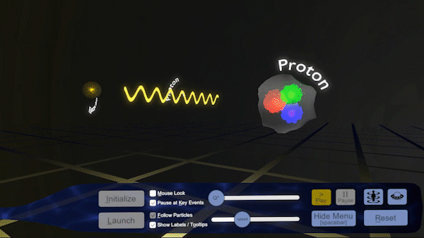
The Electron-Ion Collider (EIC) is a next-generation particle accelerator planned to be built at Brookhaven National Laboratory in the U.S., with construction expected to start in the mid-2020s and first collisions later in the decade.
“The EIC will be a particle accelerator that collides electrons with protons and nuclei to produce snapshots of those particles’ internal structure—like a CT scanner for atoms.
The electron beam will reveal the arrangement of the quarks and gluons that make up the protons and neutrons of nuclei.”
https://www.bnl.gov/eic/

Slide 3
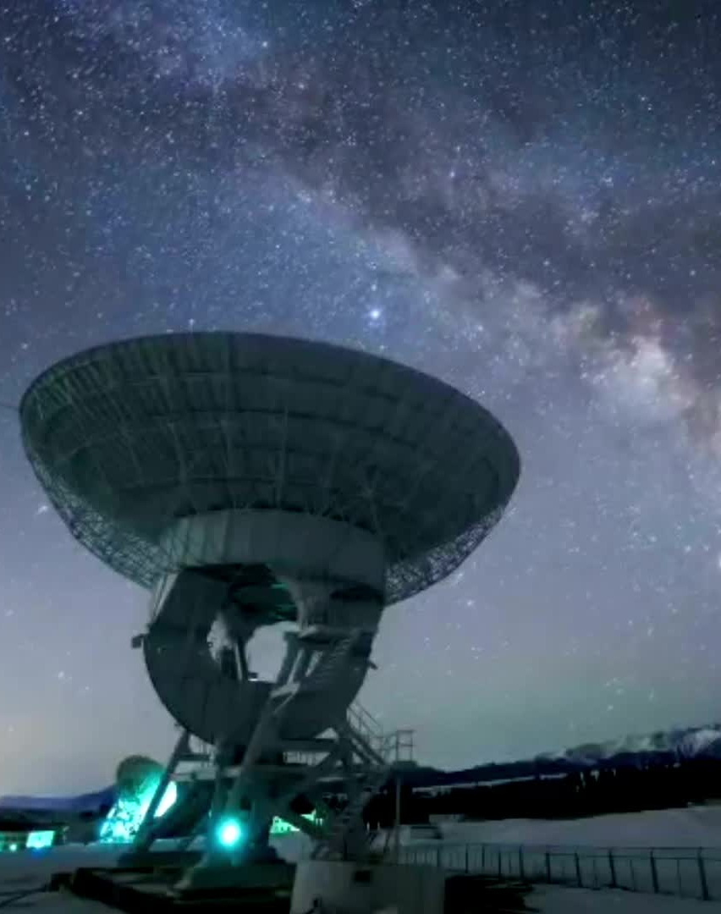
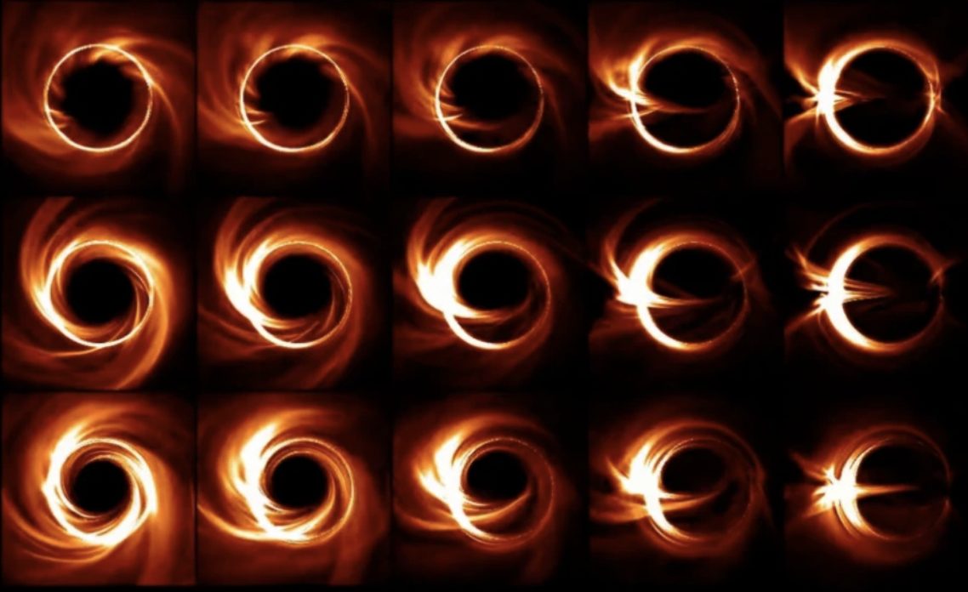
Many prominent examples of the importance of imaging One more example: Event Horizon Telescope (EHT) imaging an object 55 M light-years=5 x 10²³ m away
Very large scales
But what is the science that goes into imaging the proton, observing its spatial structure at 10⁻¹⁵ m?
(and with this the question of understanding the origin of spin)
Very small scales
SgsA* (2023)
M87* (first image, no ML, 2017)
Notes:
ay tracing, a technique that visualizes the properties of the black hole based on data collected with the radio telescope array

Slide 4

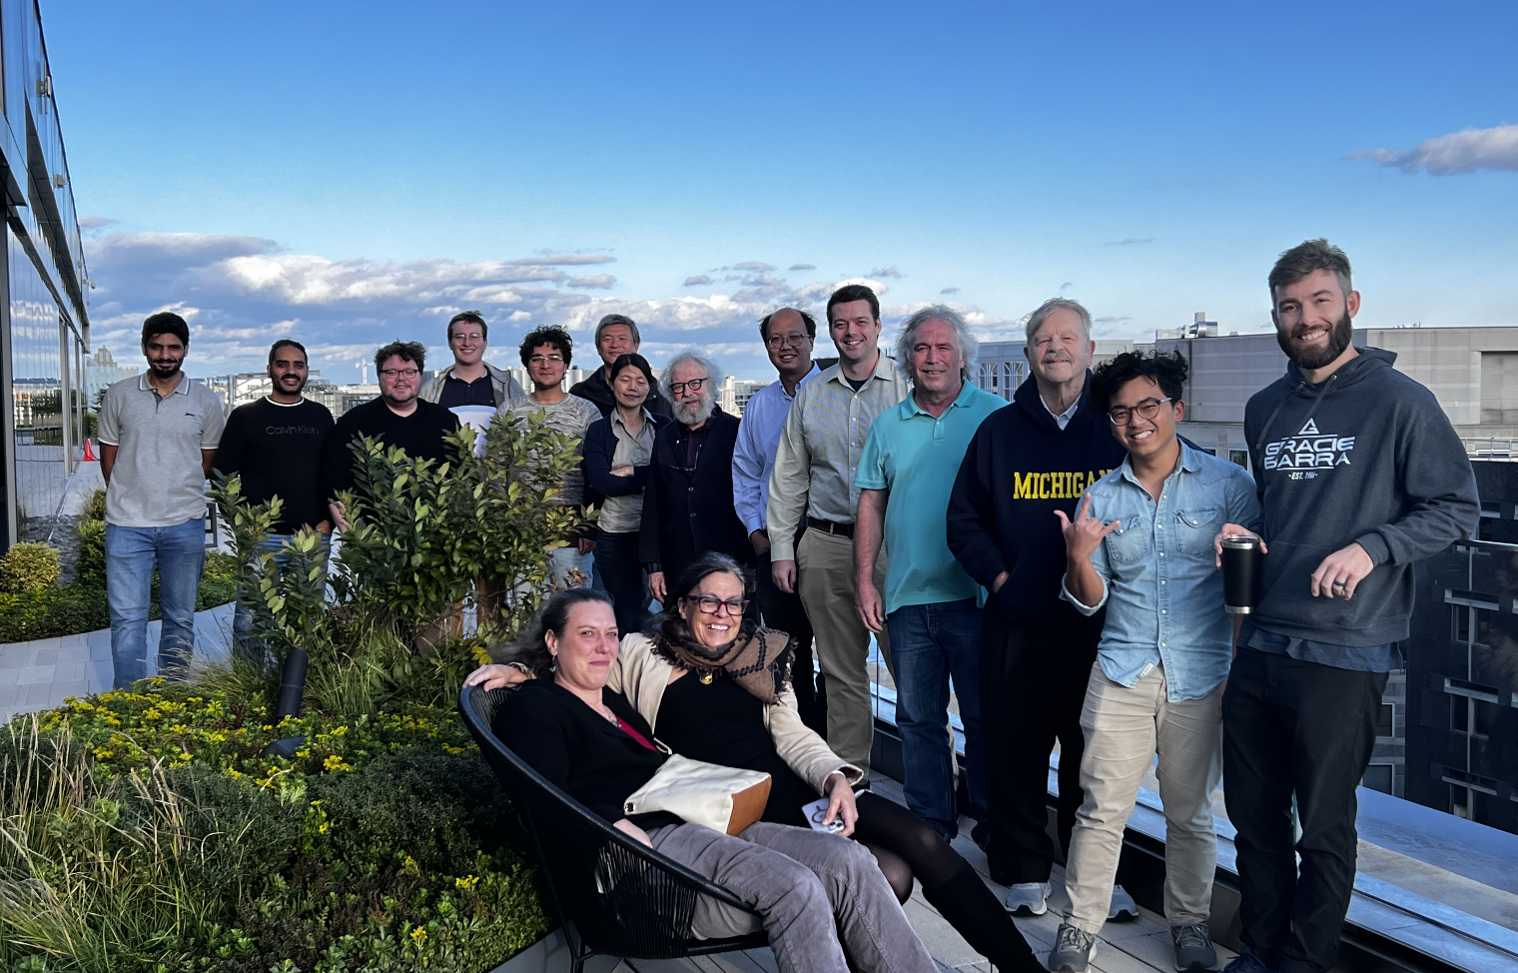
The EXCLAIM collaboration
https://exclaimcollab.github.io/web.github.io/
PIs:
CS Methods: Prasanna Balachandran, Gia-Wei Chern, Yaohang Li
Lattice QCD: Michael Engelhardt, Huey-Wen Lin
Phenomenology: Gary Goldstein, SL, Matt Sievert, (Dennis Sivers)
Experiment: Marie Boer
Currently Funded Postdocs: Douglas Adams, Liam Hockley, Saraswati Pandey, Kemal Tezgin
Graduate Students: Andrew Dotson, Jang (Jason) Ho, Adil Khawaja, Zaki Panjsheeri, Brannon Semp, Jitao Xu
Undergraduates: Will Faircloth, Lionel Strauss

Slide 5




UVA grad students/postdocs sub-group
ODU sub-group
Douglas Q. Adams
Saraswati Pandey
Jitao Xu
Zaki Panjsheeri
Jang (Jason) Ho
Adil Khawaja

Slide 6
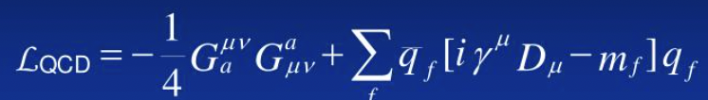
Quantum Chromodynamics: The Theory of the Strong Interaction
SU(3) non-Abelian gauge theory of quarks and gluons interacting through the color force
(self-interacting) gluon fields
quark fields

Slide 7
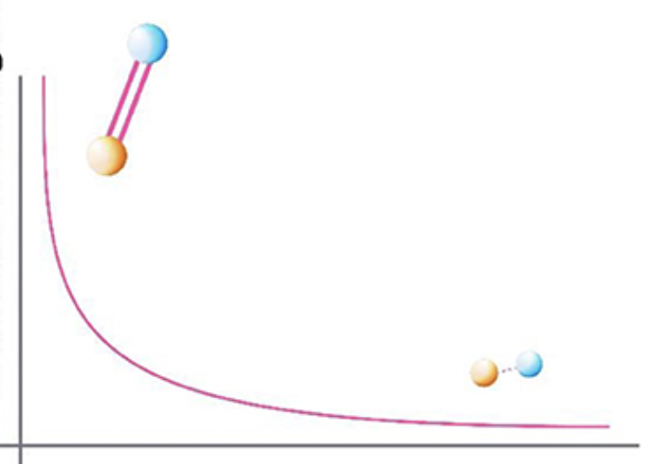
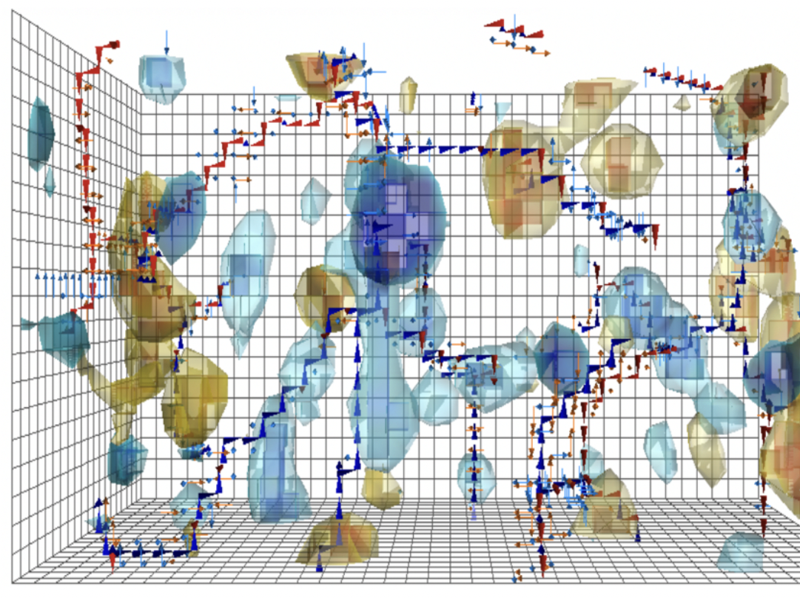
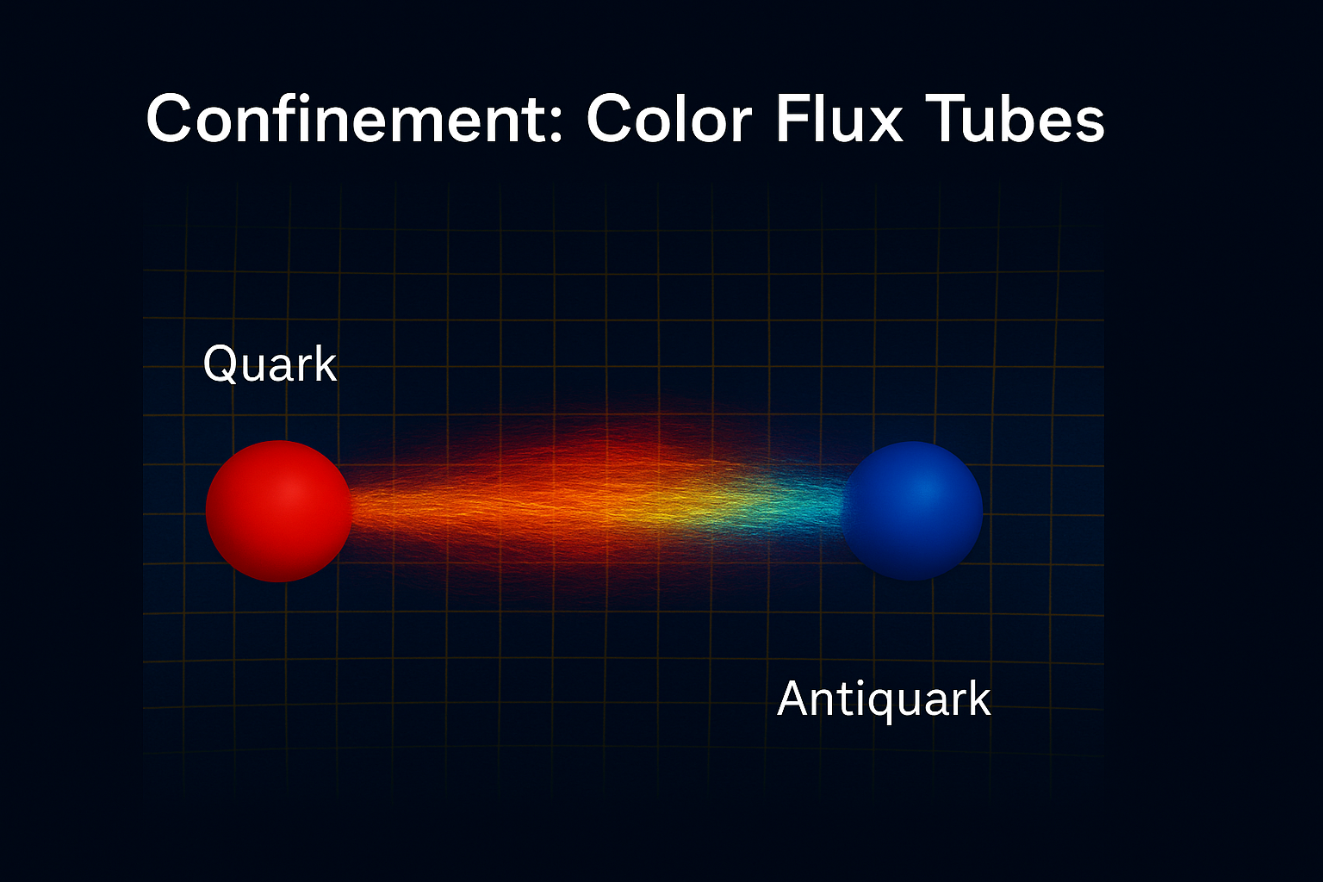
At high energy: Asymptotic freedom
At low energy: Confinement — no free quarks/gluon
Rich vacuum structure
Strength of interaction
Asymptotic freedom
Energy scale → 1/(Distance)
D. Leinweber’s visualizations
gluon and quark fluctuations/ condensates described in terms of instantons and/or color vortices
Notes:
that break chiral symmetry, confine color, and and generate most of the mass of visible matter

Slide 8
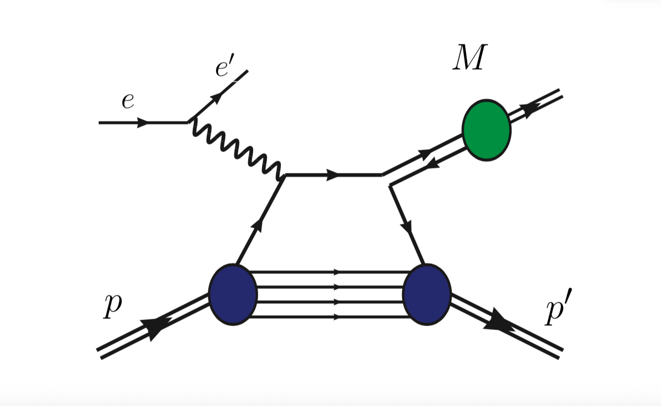
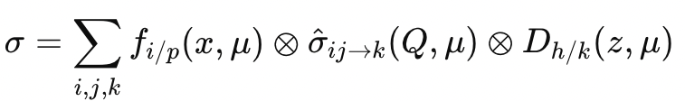
Factorization
Parton distribution function
Fragmentation function
Hard scattering process

Slide 9
To predict hadron properties from first principles/from Lagrangian
understand the factorization properties of the theory
solve QCD in the non perturbative regime
understand the non perturbative-perturbative connection

Slide 10
But…..even in a framework where factorization occurs at a given value of a hard scale
We cannot predict where the demarcation between high and low and low energy happens (value of the factorization scale)
There are many largely unknown layers that separate the observable from the dynamical and topological properties of the underlying QCD vacuum
Lattice QCD provides only partial answers to these questions
Notes:
we only know it’s larger than a typical hadronic scale${ Λ}_{QCD }$

Slide 11
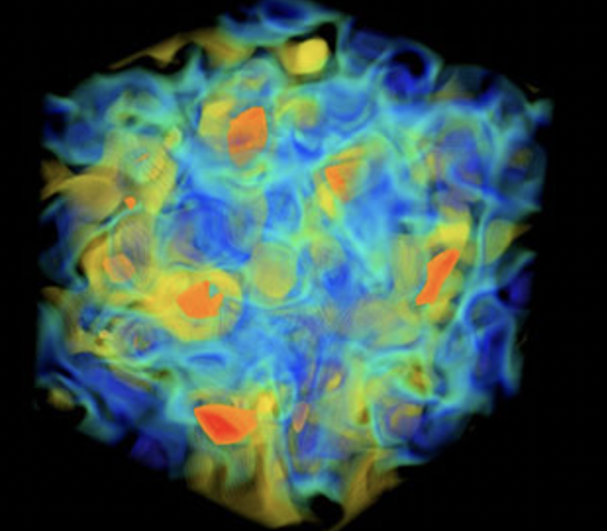
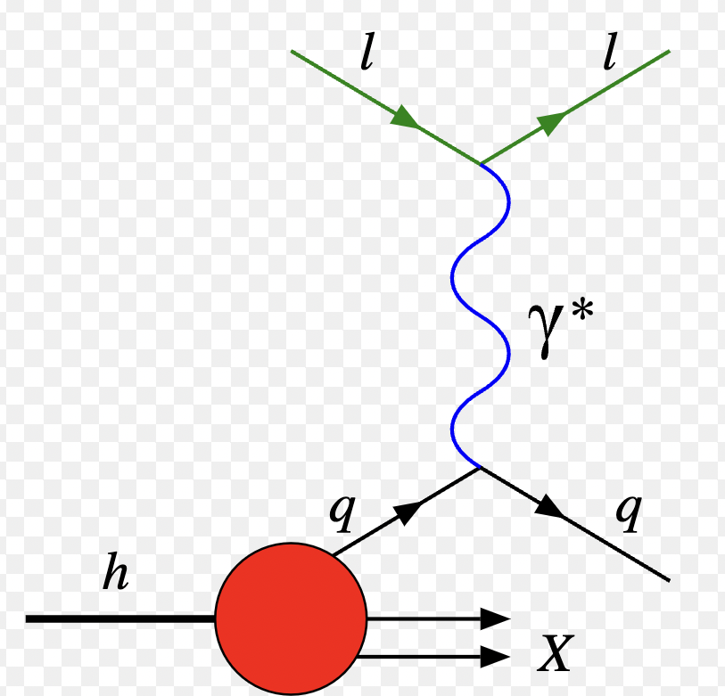
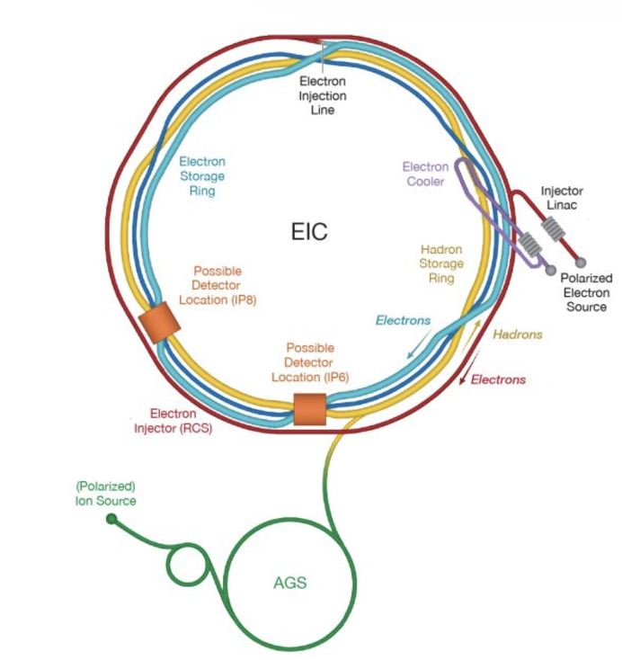
And all of this is done in reverse! Inverse Problem in QCD
Forward
QCD
quark field
gluon field
correlation functions
Observables
Form Factors
Structure Functions
Compton Form Factors
Fragmentation functions
…
Data/Measurements
Inverse
Notes:
We want to merge ML and physics to use machines to generate interpretable understandable models which humans can understand, while solving inverse problems

Slide 12

To find a solution need to address tension between computation complexity and physical existence of a solution
P=based on fast polynomial algorithm
undecidable
NP
Example: sorting data
P
NP-complete = based on slow algorithms, exponential or slower
NP-complete
NP-hard
NP-hard = the hardest problems
Example: Traveling Salesman Problem

Slide 13
Interpretability: directly enabling discovery of laws
(not just evaluating matrix elements)
Analysis of C-VAIM latent space
Explainable AI methods
Physics → “why ?”
Standard ML→ “what?”
Symbolic Regression algorithm for
data modeling with analytic expressions
Interpretable/Intelligible AI
Finding a common language!
Notes:
Not just advanced computational tools

Slide 14
Our Physics Case: Extracting information from deeply virtual exclusive scattering
Notes:
On the LHS is the Feynman diagram for the DVCS scattering process. The virtual photon q (along z in previous page) scatters off a quark coming out of the proton. The quark probability/QCD matrix element for finding a quark with given momentum and spin is represented by the “blob”.
On the RHS we integrate over the quark (loop) momentum, which by Fourier transformation corresponds to taking the two photon-quark scattering vertices at the same point in the conjugate space coordinate. This is represents the QCD matrix element for a local operator. It measures a moment in the momentum fraction x. Particularly interesting are the second moments, x \times GPD, because they coincide with the Eneregy Momentum tensor (EMT) form factors

Slide 15
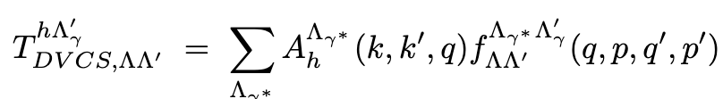
In a QCD factorized scenario:
quark and gluon spatial configurations from deeply virtual exclusive scattering
e
At least one photon is hard
q, Λ_{γ∗}
q’, Λ_{γ’}
helicity amplitude
GPD
e γ∗ -> e’
γ∗ p -> γ’ p’
p, Λ
p’, Λ’
Deeply virtual Compton scattering (DVCS)
Generalized Parton Distribution (GPDs)
Notes:
On the LHS is the Feynman diagram for the DVCS scattering process. The virtual photon q (along z in previous page) scatters off a quark coming out of the proton. The quark probability/QCD matrix element for finding a quark with given momentum and spin is represented by the “blob”.
On the RHS we integrate over the quark (loop) momentum, which by Fourier transformation corresponds to taking the two photon-quark scattering vertices at the same point in the conjugate space coordinate. This is represents the QCD matrix element for a local operator. It measures a moment in the momentum fraction x. Particularly interesting are the second moments, x \times GPD, because they coincide with the Eneregy Momentum tensor (EMT) form factors

Slide 16
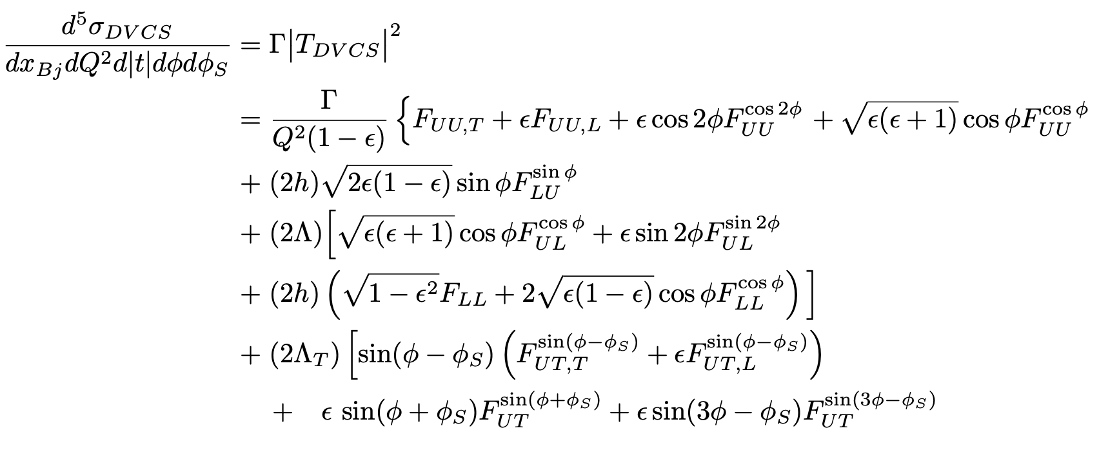
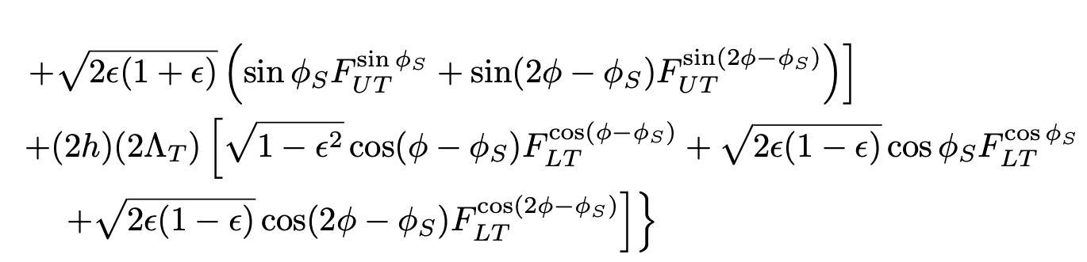
From Helicity Amplitudes to DVCS Cross Section
unpolarized
long. polarized
transv. polarized
B. Kriesten et al, Phys.Rev. D 101 (2020)
B. Kriesten and SL, Phys.Rev. D105 (2022), arXiv 2004.08890
B. Kriesten and SL, Phys. Lett. B829 (2022), arXiv:2011.04484
First inverse problem!

Slide 17

Assuming a QCD factorized scenario → CFFs → GPDs
Assume known from PQCD
Second Inverse Problem!

Slide 18
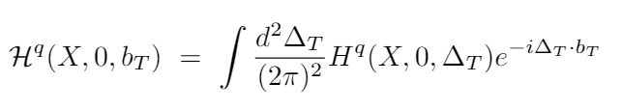
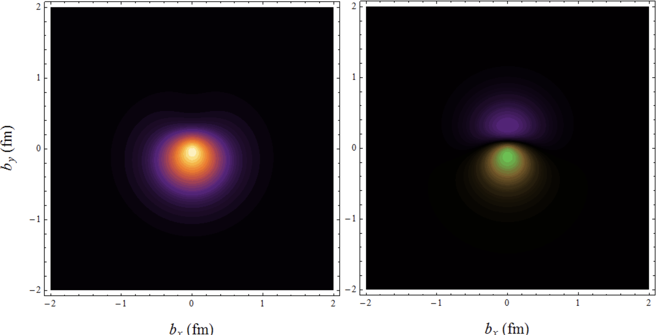
3D Coordinate Space Representation requires a Fourier transform of a GPD
Observables from DVES matrix elements can be Fourier transformed from momentum space into coordinate space, providing insight into the spatial distributions of quarks and gluons inside the proton, besides matter and charge distributions.
Wigner phase space distribution
GPD
H-W Lin,
https://web.pa.msu.edu/people/hwlin/research.html

Slide 19
Statistics
Compton form factors extraction
Cross section information
Developing ML/AI algorithms
More theoretical questions
Does QCD Factorization work at the scale of data?
1st set of inverse problem techniques
2nd inverse problem set
Notes:
interpretability directly enable discovery of la

Slide 20
Introducing Maximum Likelihood Analysis of deeply virtual exclusive scattering data
Douglas Adams et al., arXiv:2410.23469

Slide 21
From Helicity Amplitudes to DVCS Cross Section
unpolarized
long. polarized
transv. polarized
B. Kriesten et al, Phys.Rev. D 101 (2020)
B. Kriesten and SL, Phys.Rev. D105 (2022), arXiv 2004.08890
B. Kriesten and SL, Phys. Lett. B829 (2022), arXiv:2011.04484
First inverse problem!

Slide 22
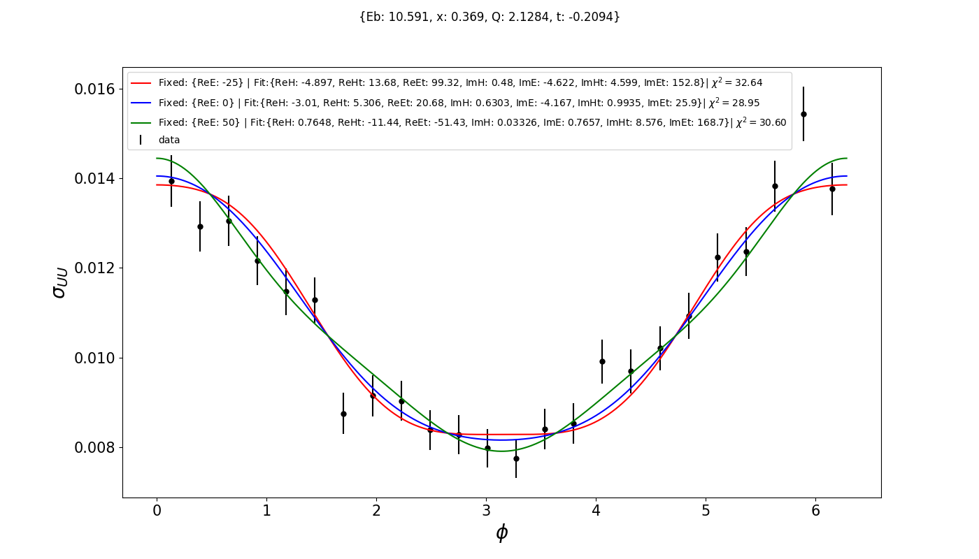
Performing CURVE FIT with “standard methods” results in degeneracy
The extracted CFFs are significantly sensitive to the way the fit is done!

Slide 23
Performing CURVE FIT with “standard methods” results in degeneracy
The extracted CFFs are significantly sensitive to the way the fit is done!

Slide 24
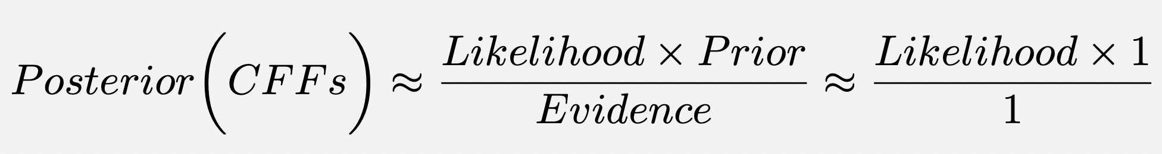
Working Framework: Bayesian statistical inference
Uninformative prior
Evaluated Likelihood with MCMC/Metropolis Hasting Algorithm

Slide 25
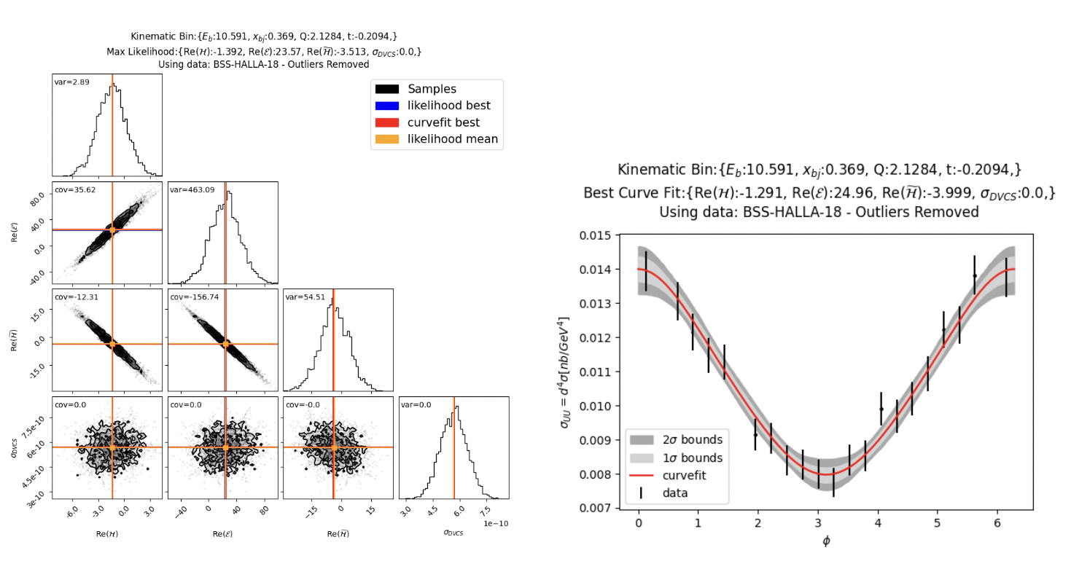
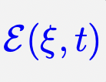
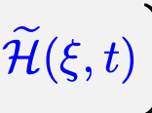
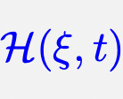
Deeply Virtual Compton Scattering Results

Slide 26
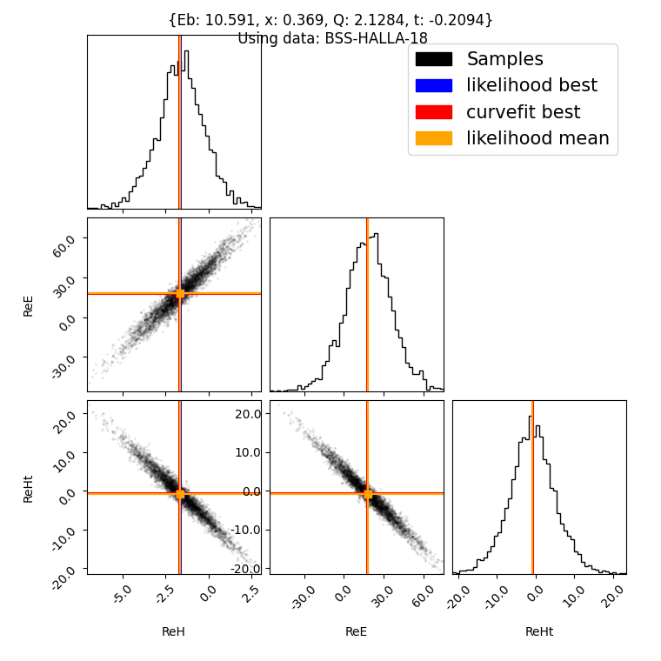
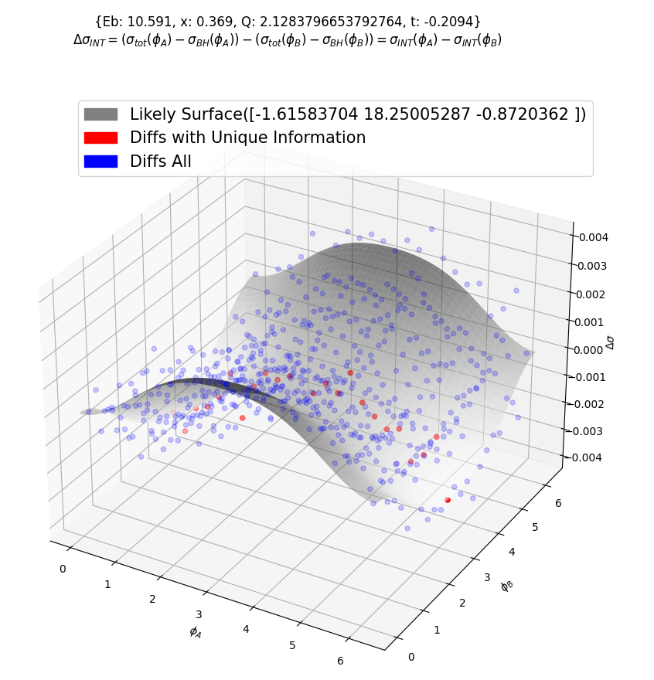
Covariance of CFF Results
Here the maximum likelihood is achieved allowing 3 CFFs to vary.
Only 23 combinations of 2 angles are used.
Notes:
Define Bayesian Likelihood

Slide 27
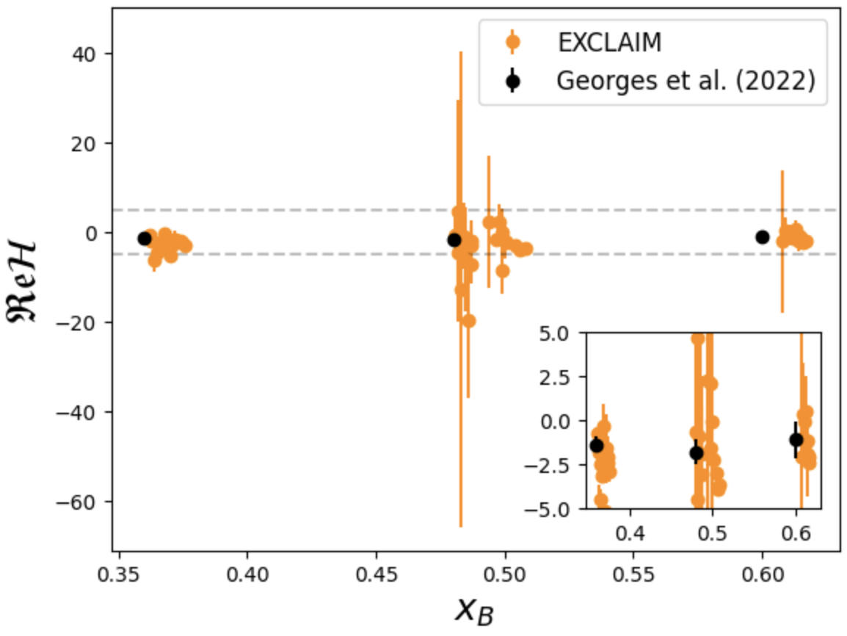
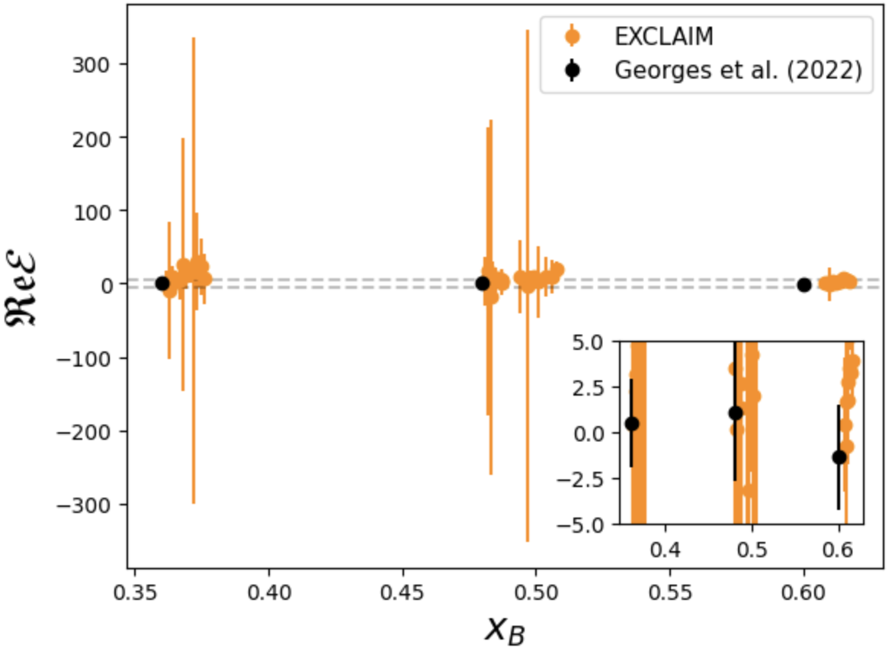
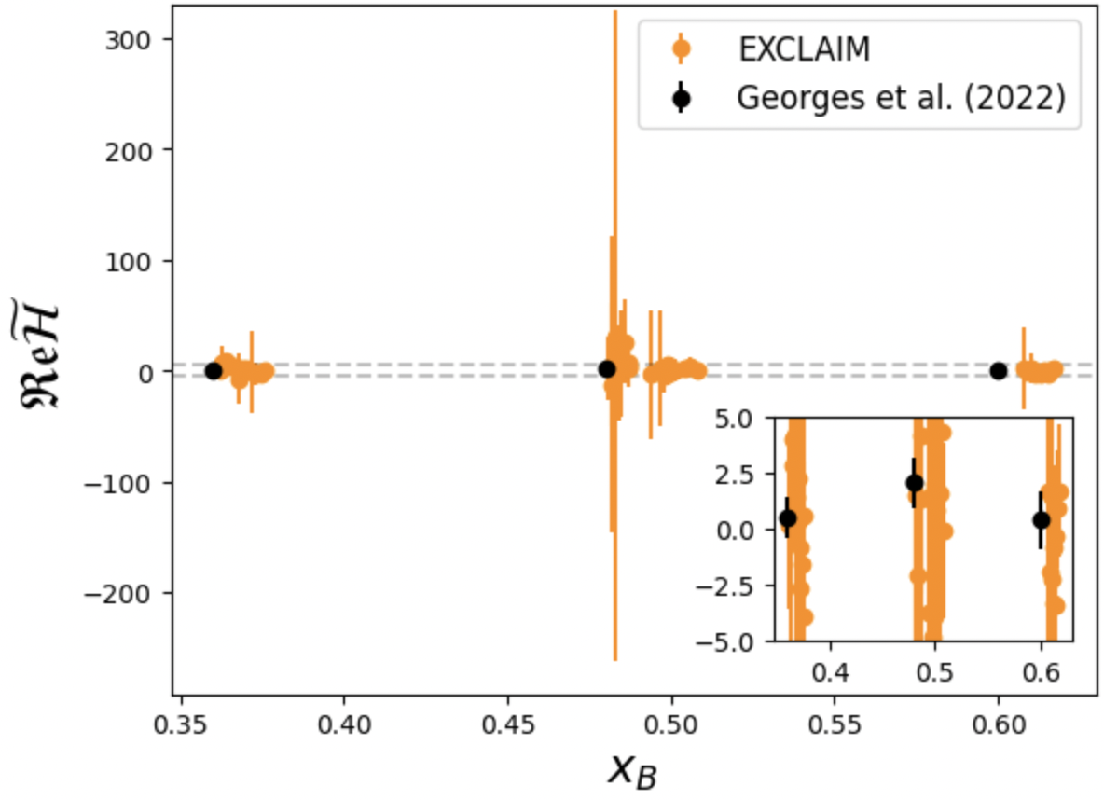
First fully quantitative/statistically sound extraction of CFFs from experiment
H
E
~
H

Slide 28
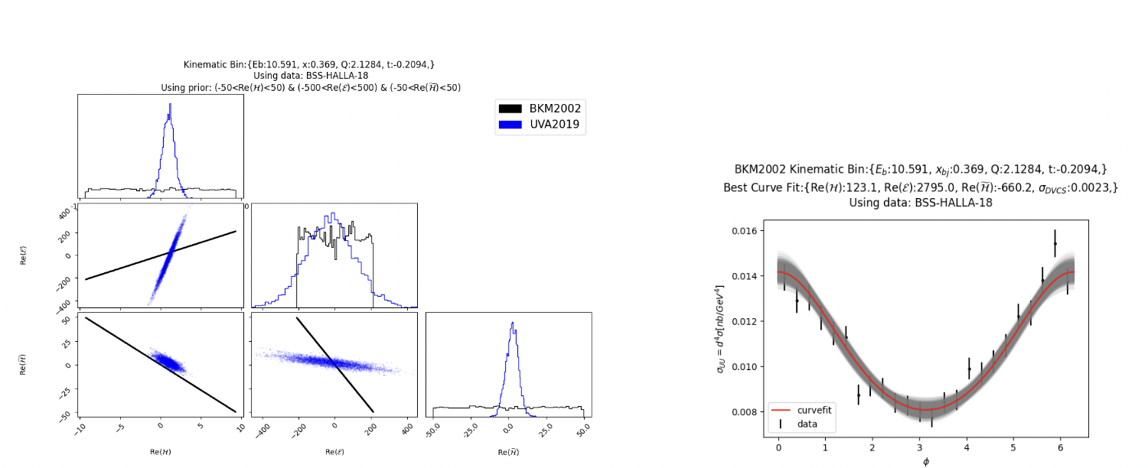
Accurate description of phase dependence of cross section is crucial: formalism of BKM, Braun et al. leads to degeneracy

Slide 29
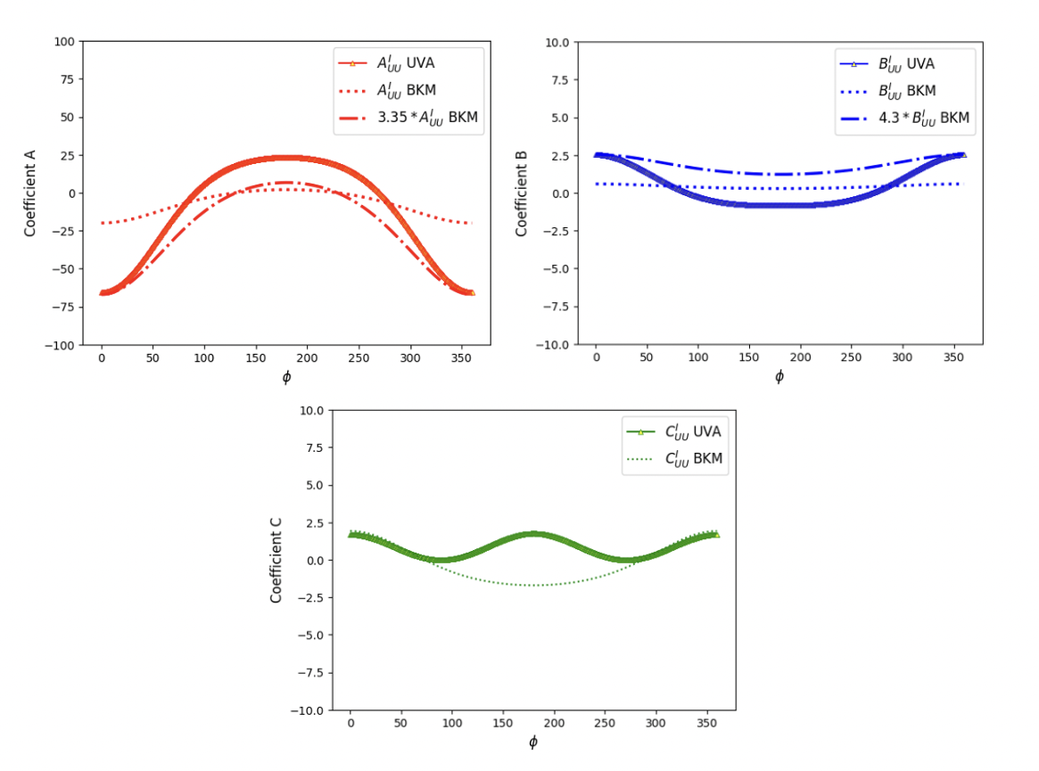
Understanding the origin of degeneracy of BKM results

Slide 30
What’s next? To reduce the error our analysis points at use of other observable keeping kinematics the same, before expanding phase space
(Polarization is a crucial handle)
LL type data: E.Seder et al. [CLAS], PRL114 (2015)

Slide 31
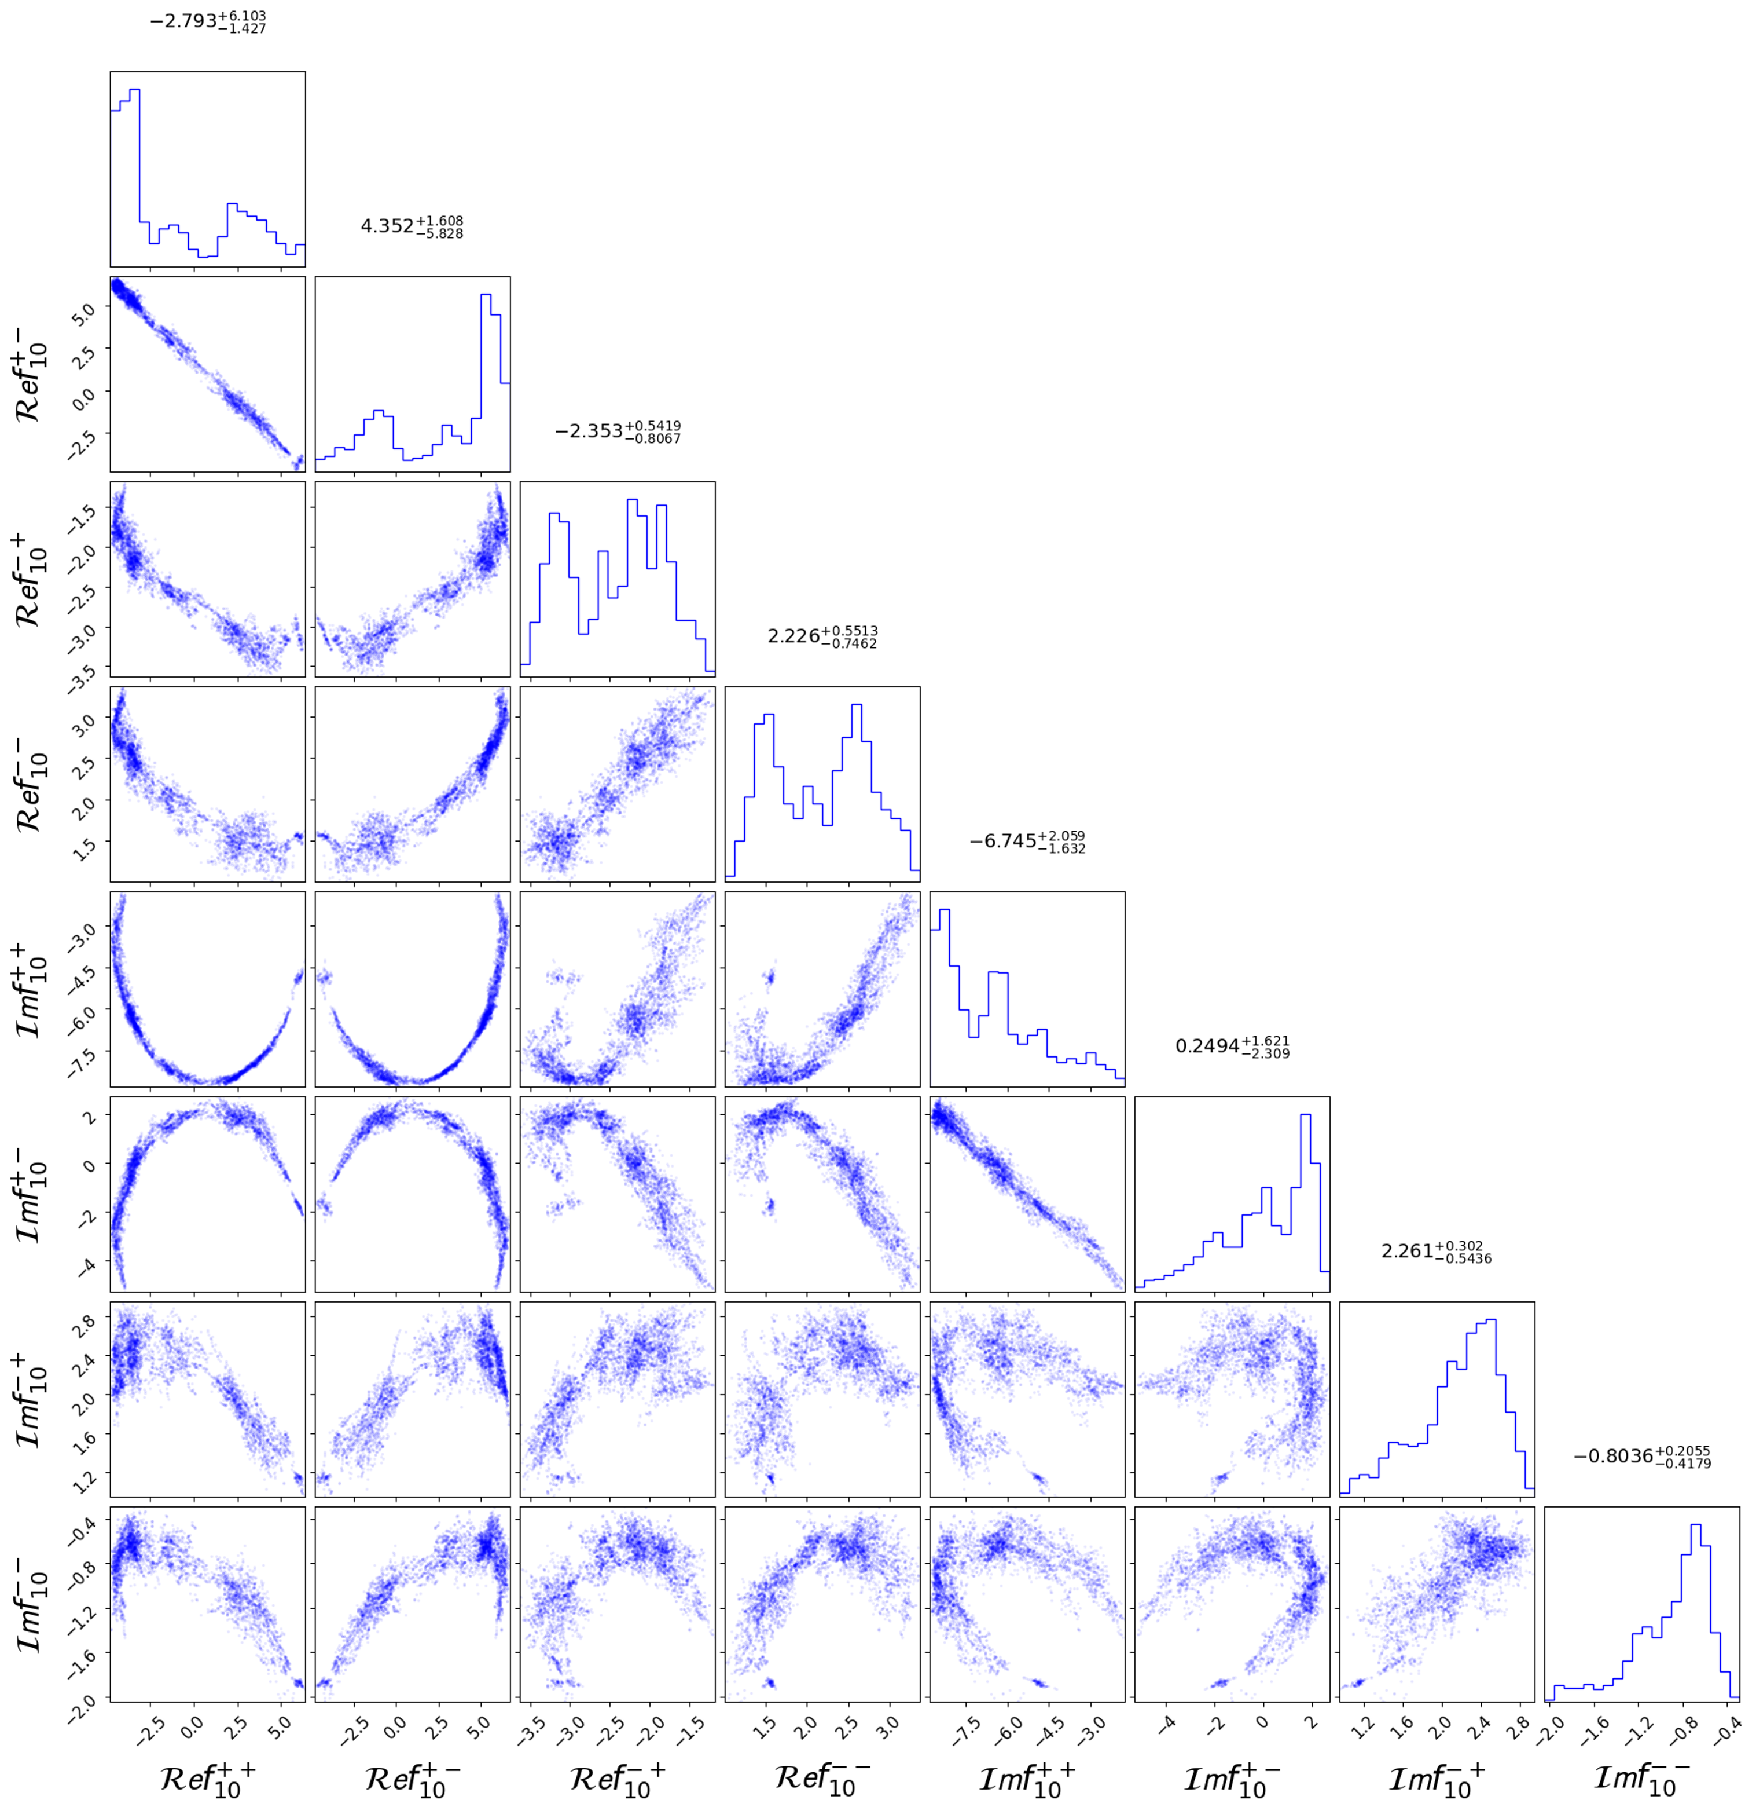
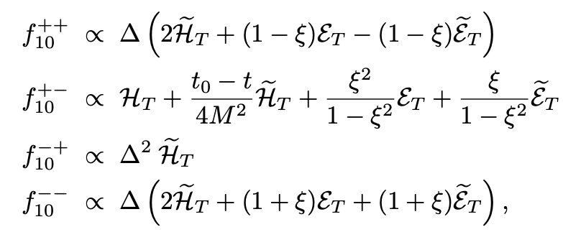




Study role of QCD factorization in π⁰ electroproduction a window on transversity GPDs
$$Re f^{+ −}$$
Saraswati Pandey
$${Im f}^{+ −}$$
using Hall A data, Dlamini et al.
$$Re f^{+ +}$$
$${Im f}^{+ + }$$

Slide 32
Statistics
Compton form factors extraction
Cross section information
Developing ML/AI algorithms
1st set of inverse problem techniques

Slide 33
2. Inverse Problem Techniques: VAIM, C-VAIM, MCMC
Approaches to find parameters statistically in an underdetermined system
Can quantify parameter uncertainty when more parameters than data
Techniques highly dependent on bounded parameter priors
These methods give us an initial way to perceive:
→ the correlation between parameters on a complicated model
→ what information is missing (latent space)

Slide 34
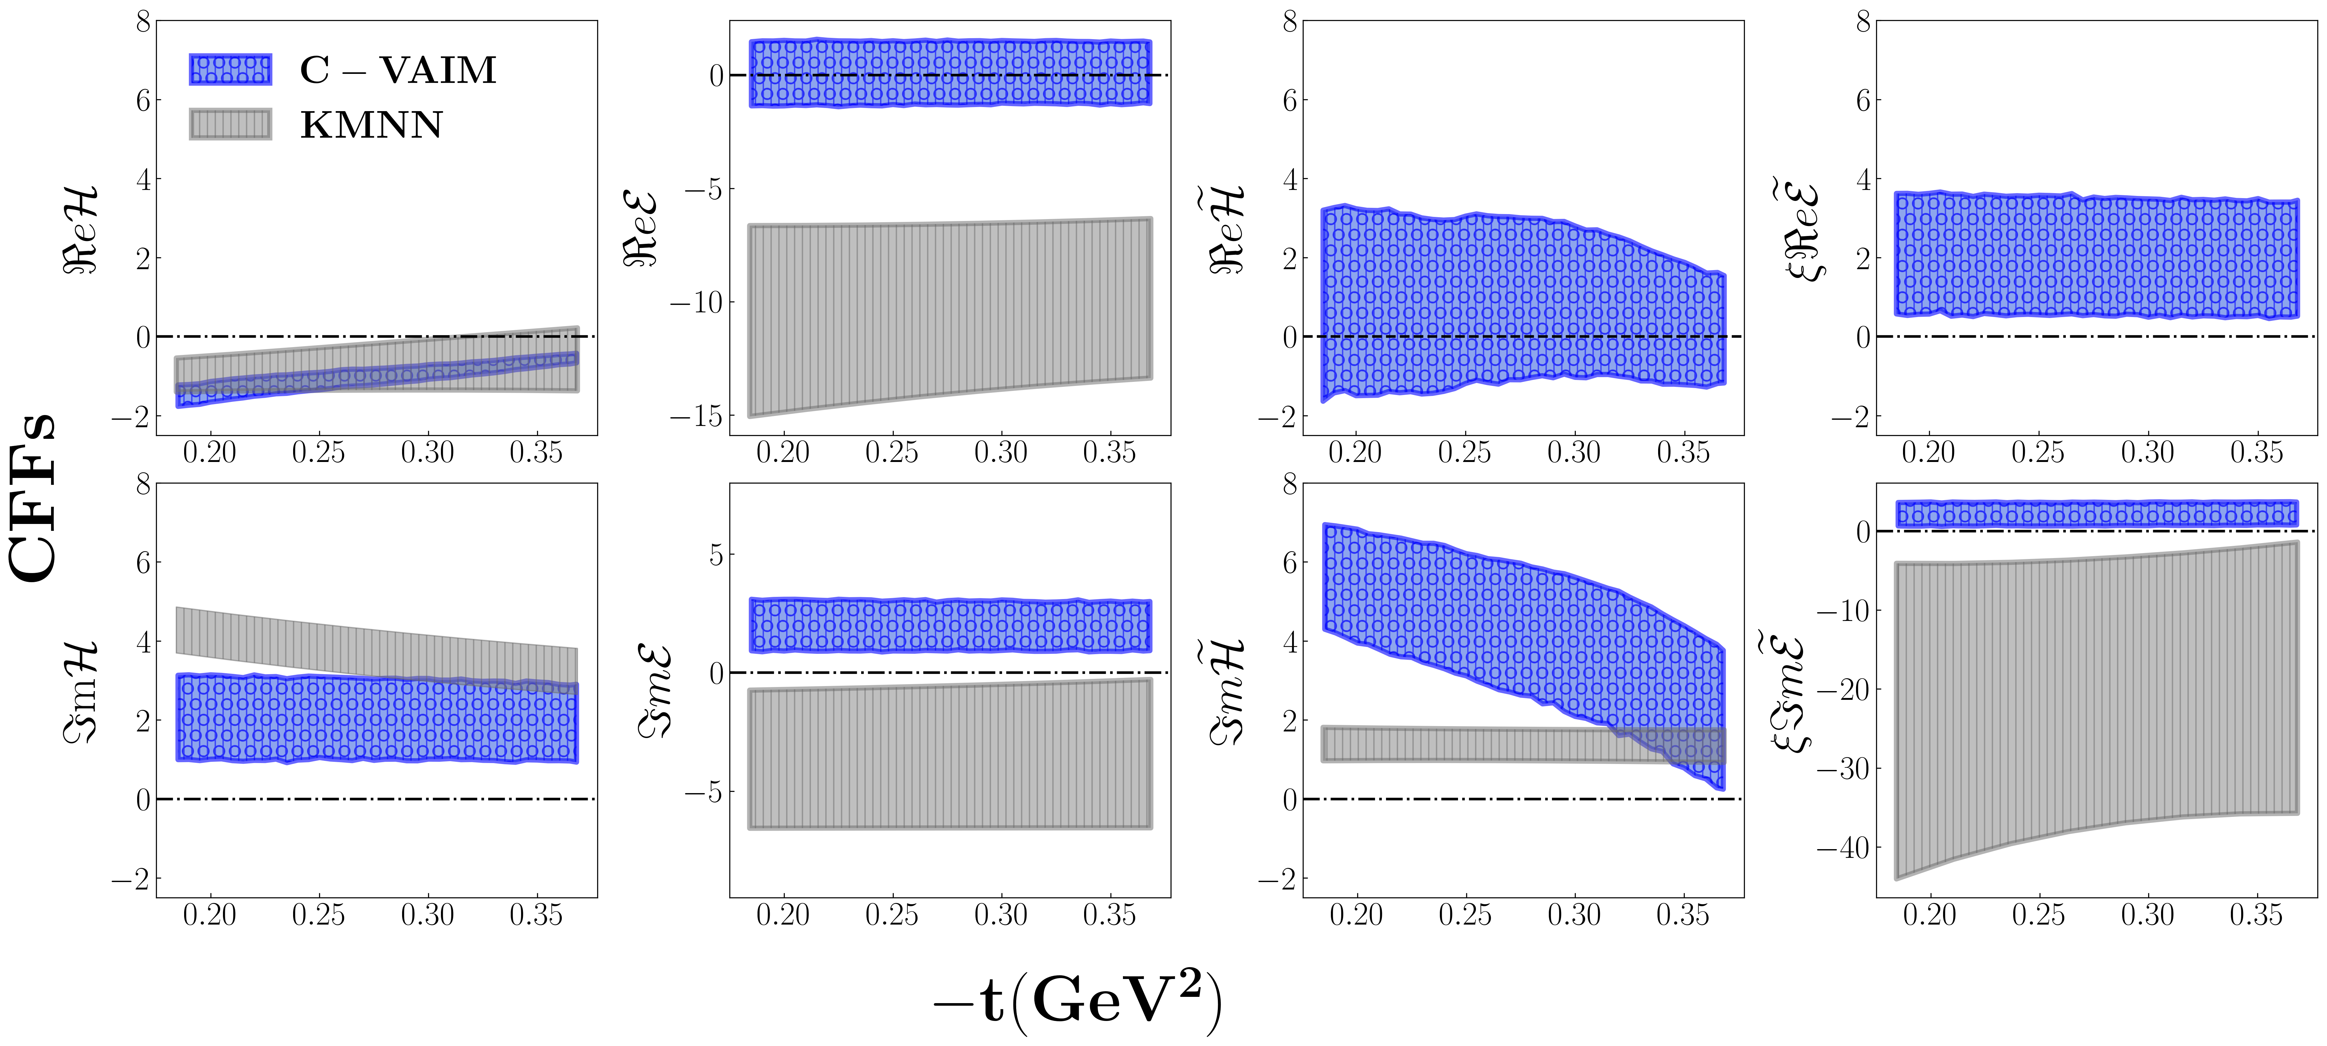
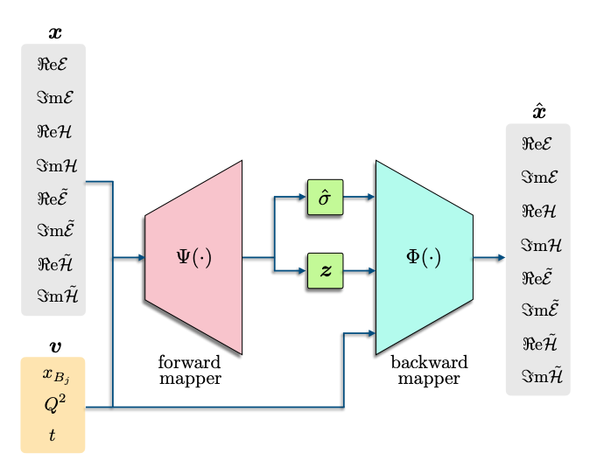
A variational autoencoder inverse mapper solution to Compton form factor extraction from deeply virtual exclusive reaction
arXiv:
2405.05826 (published in EPJC 2025)
t=0.34
Ht
Et
E
H
(2023)
KMNN, https://arxiv.org/abs/2007.00029
Notes:
The red dots on the RHS represent values from the analysis on the LHS in a similar kinematics

Slide 35
CFFs Analysis of Latent Space
H
E
Ht
Et
sign!!
periodicity/oscillation

Slide 36
3. Symbolic Regression for Parton Research
What is symbolic regression and why do we care?
Spoiler: because then humans can read the answer
What are the existing tools out there?
Eureka
Gplearn
AI Feynman
PySr
RL-SR
*Meijer-G-Function (very preliminary)
Graduate Students:
Andrew Dotson (NMSU) Anusha SingiReddy (ODU)
Zaki Panjsheeri (UVA)
Slide courtesy of Douglas Adams

Slide 37
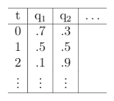

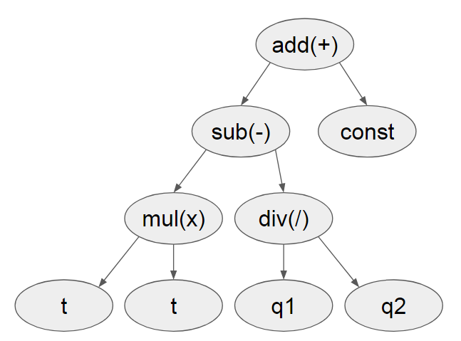

Symbolic regression (SR) in a nutshell:
Goodness
Data Table
Fitness Metric
e.g. squared error
Symbolic Modification
e.g. mutation
Form Metric
e.g. #terms
Attempt an Expression
No
Good?
Yes
Done
Slide courtesy of Douglas Adams

Slide 38
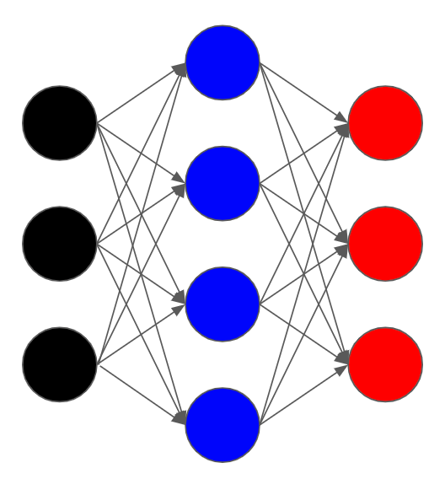

Why bother with SR when we have neural networks?
Which is easier to read? ( a.k.a interpretability of AI )
Black Box Regression
vs
Slide courtesy of Douglas Adams

Slide 39
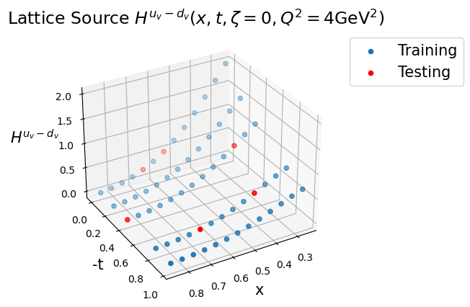
Lattice QCD can predict the x dependence of GPDs for various t:
Can SR help us find an interpretation of the numerical x dependence?
Do the x and t dependences factorize?
H.-W. Lin, Phys. Rev. Lett. 127, 182001 (2021)

Slide 40
Does x and t dependence of GPDs factorize? Why is it important to check x and t factorization?
gluon
3D Coordinate Space picture
t = -Δ_{T}²
d-quark
GPD
If x and t dependences factorize, the radius of the partonic distributions is constant throughout the proton volume!
Z. Panjsheeri

Slide 41
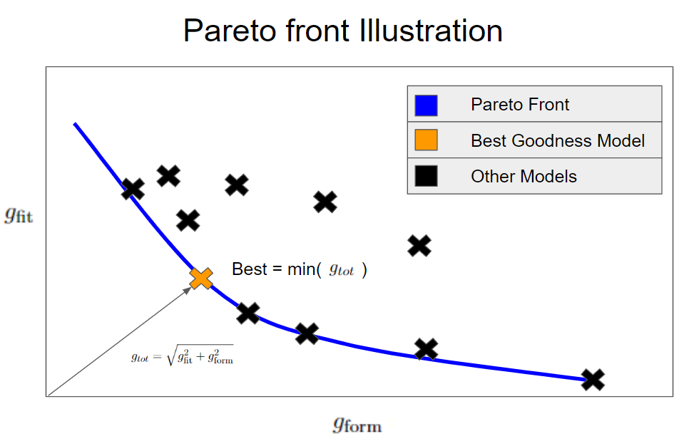
Using a pareto front to choose amongst forms
define a “metric” which balances fit vs. form to choose a best

Slide 42
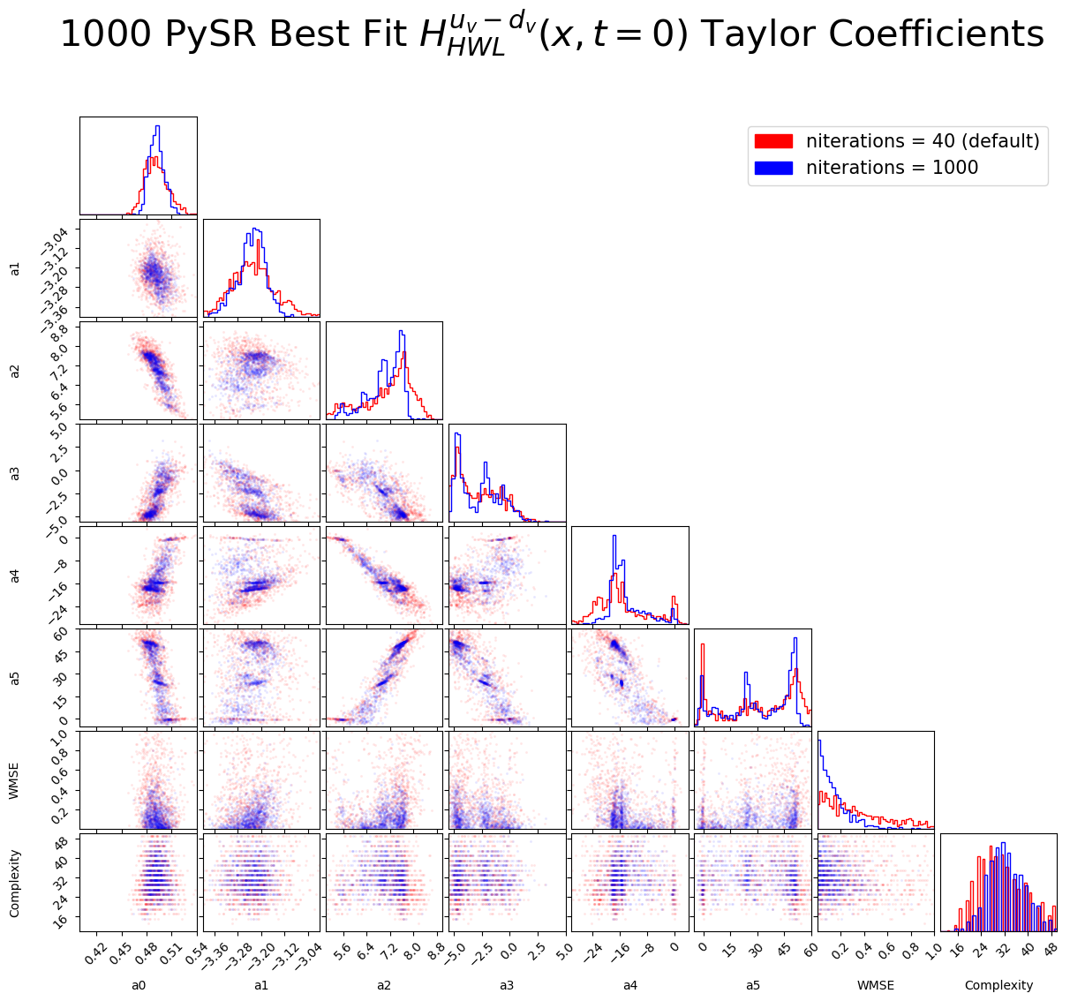
“Convergence” criterion using Taylor expansion around points in x
PySR convergence
Andrew Dotson

Slide 43
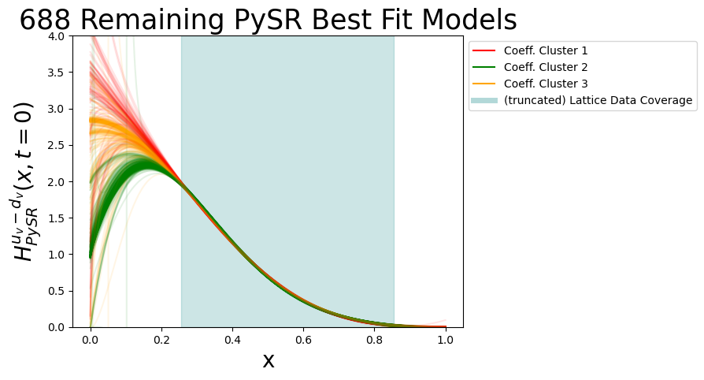
Novel SR Convergence Clustering
Extrapolation
Lattice Region

Slide 44
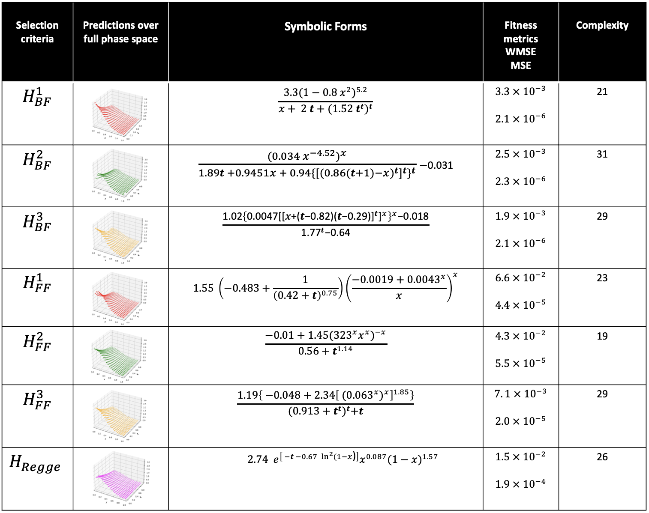

Slide 45
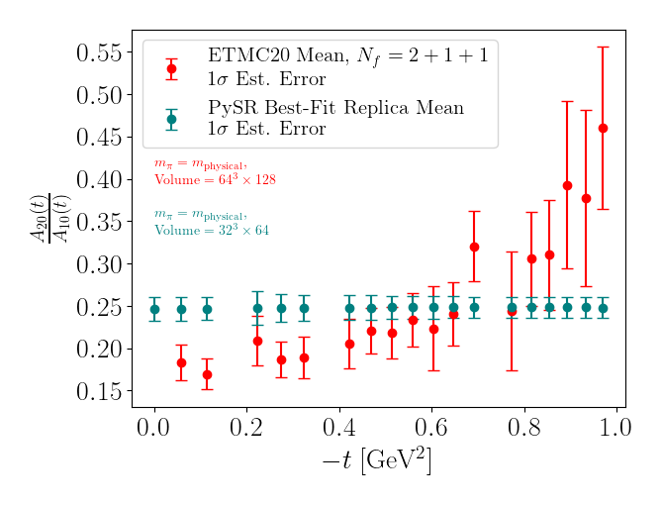
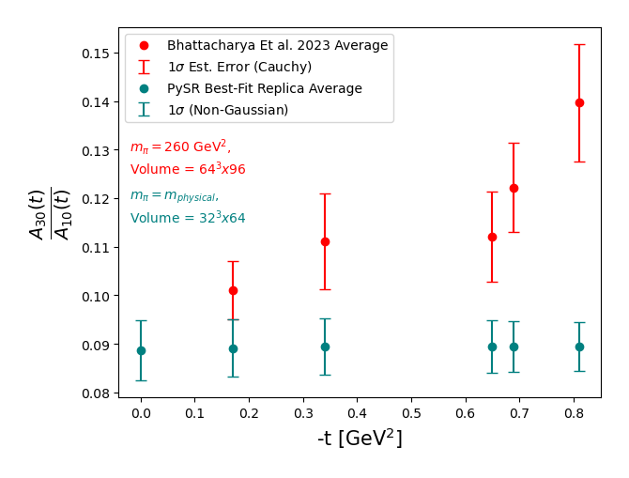
Comparison with lattice QCD Moments: testing x,t factorization

Slide 46
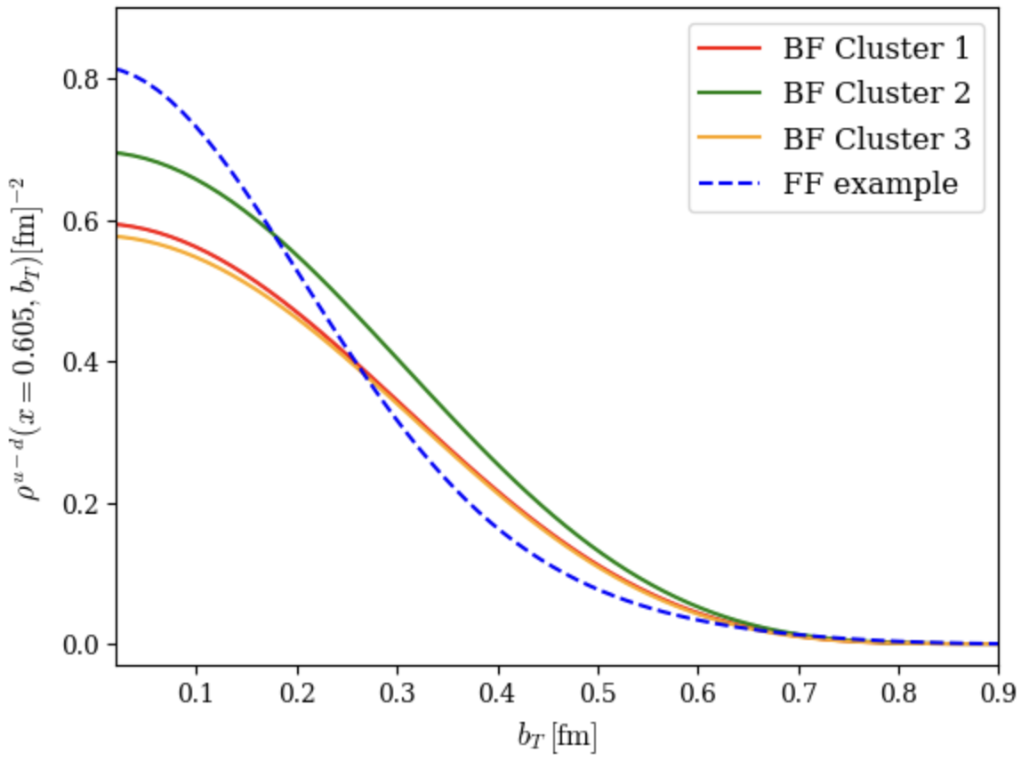
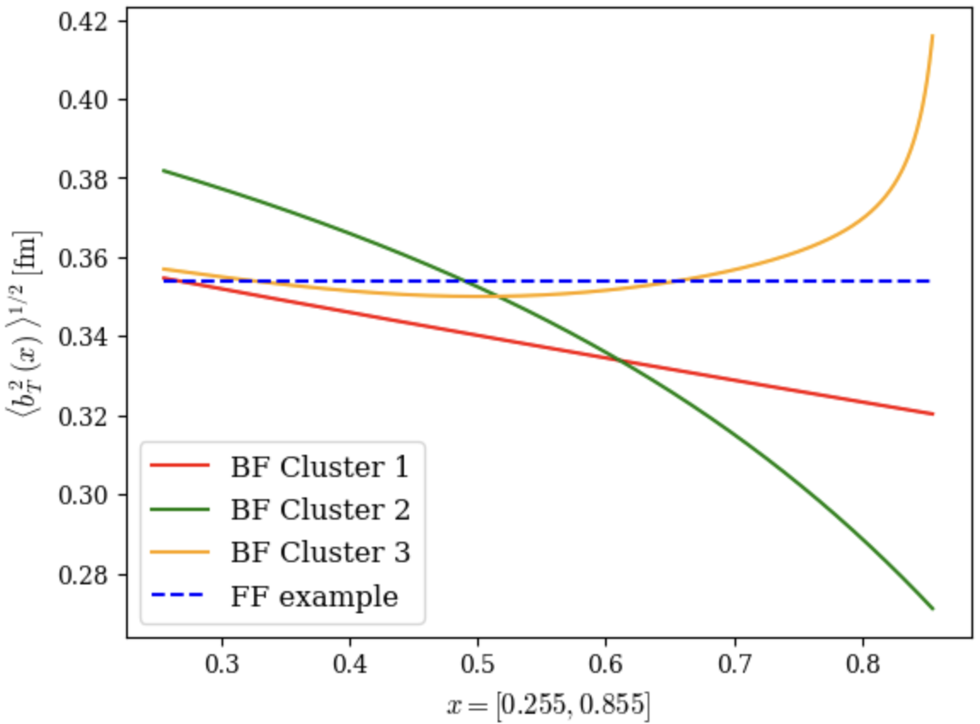
Fourier transform
Density at fixed x
rms Radius of partonic configurations vs x
x

Slide 47
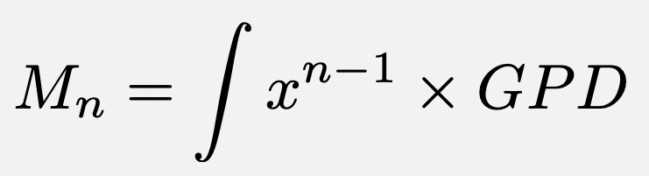
4. NNGPD and End to End problem
Gia-Wei Chern, Yaohang Li
angular momentum, calculable in lattice QCD
experimental observable
GPD
Is information on angular momentum directly extractable from data?

Slide 48
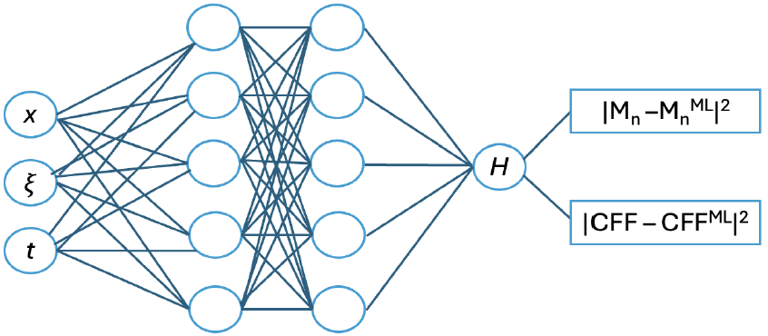

NNGPD
Standard feed forward neural network for the extraction of GPDs from data, lattice QCD and symmetries
Q² ξ, t
Preliminary results from Jason Ho (UVA)

Slide 49


:
Diffusion model
Yaohang Li
Standard noise-prediction loss without any additional prior term:
x₀​: the true MM2 value (target)
t: the diffusion time step, randomly sampled from {1,…,T} each iteration
ε: Gaussian noise sampled from N(0,I), which is directly linked to the target x₀​ because it is the exact noise we added to x₀​ in the forward process to obtain x_{t}​
x_{t}​: the noisy MM2 obtained from the forward process
ε noise predicted by the neural network, conditioned on the CFF values (ReCFF, ImCFF)
predicted
true
preliminary results from Jitao Xu

Slide 50


https://eic.ai/

Slide 51
Conclusions
Extracting QCD-based information from data
relies on our ability to understand the cross section for all the various DVES processes
requires solving multiple inverse problems
Key example: spatial structure of the proton (and all of its mechanical properties including angular momentum)
We have defined a path to extract the observables from experiment that allows us to fully take into account UNCERTAINTY QUANTIFICATION (UQ) from data using likelihood analysis and MCMC
We have detected inconsistencies leading to degeneracy in approximated formalism of deeply virtual exclusive processes
On one side: our path to AI&theoretical physics brings interpretability features in the computation and benchmarking of AI tools
On the other: diffusion models provide a reliable method to extract angular momentum from data
Notes:
UQ is a necessary and currently incomplete step in forming the 3D structure of the proton

