Slide 1
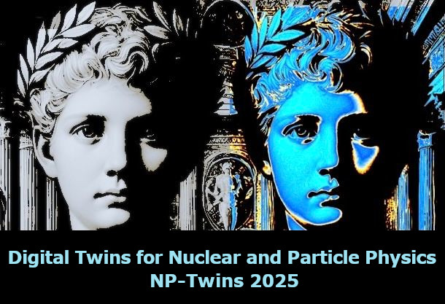
Generative AI for Inverse Problems in Nuclear and Particle Physics
Yaohang Li
Department of Computer Science
Old Dominion University
yaohang@cs.odu.edu
10/8/2025 @ Digital Twins for Nuclear and Particle Physics - NPTwins 2025

Slide 2
Agenda
The Inverse Problem
The Machine Learning Architectures
Variational Autoencoder Inverse Mapper
Diffusion Model
Applications in Nuclear and Particle Physics
Extraction of Crompton Form Factors as an Inverse Problem
Event-level Analysis

Slide 3
The Inverse Problem
The Forward Problem (Normal Problem)
Use the model parameters to calculate the observables
The Inverse Problem
Use the results of actual observables to infer the values of the parameters characterizing the system

Slide 4
The Challenges of Solving the Inverse Problem
Ill-posedness
Different values of the model parameters may be consistent with the observables
Curse of Dimensionality
Need to explore a huge, high-dimensional parameter space
Finding a needle in a haystack

Slide 5
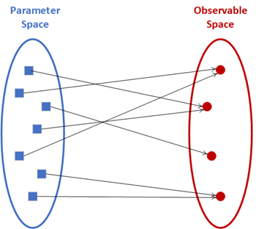
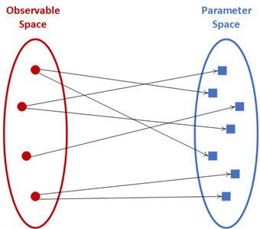



Ill-posedness of Inverse Problems
Forward Mapper
Backward Mapper
well-posed
ill-posed

Slide 6
Agenda
The Inverse Problem
The Machine Learning Architectures
Variational Autoencoder Inverse Mapper
Diffusion Model
Applications in Nuclear and Particle Physics
Extraction of Crompton Form Factors as an Inverse Problem
Event-level Analysis

Slide 7
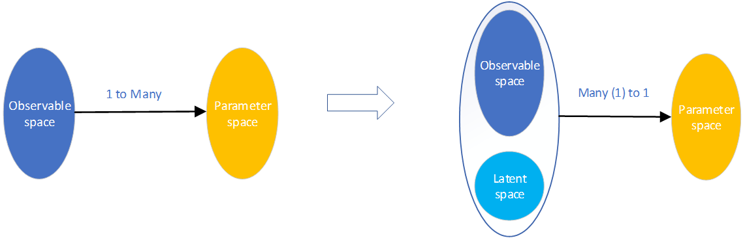
Fundamental Idea
Variational Autoencoder Inverse Mapper
Inverse Problem
VAIM
ill-posed
well-posed

Slide 8
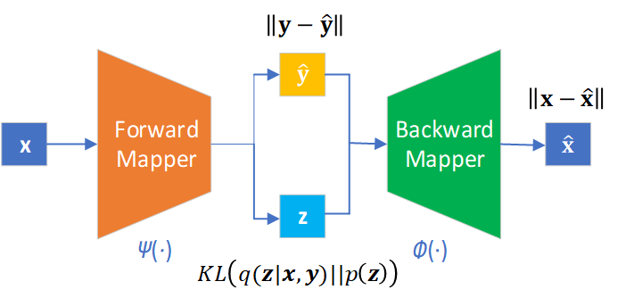
Variational Autoencoder Inverse Mapper Architecture
Variational Autoencoder Inverse Mapper
Predicted Observables
Parameters
Reconstructed Parameters
Latent Variables

Slide 9
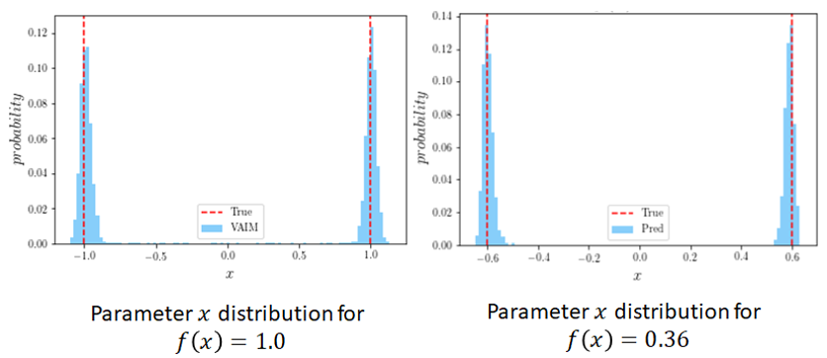
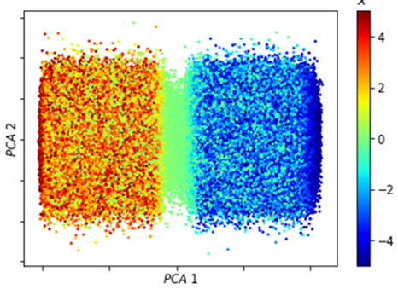
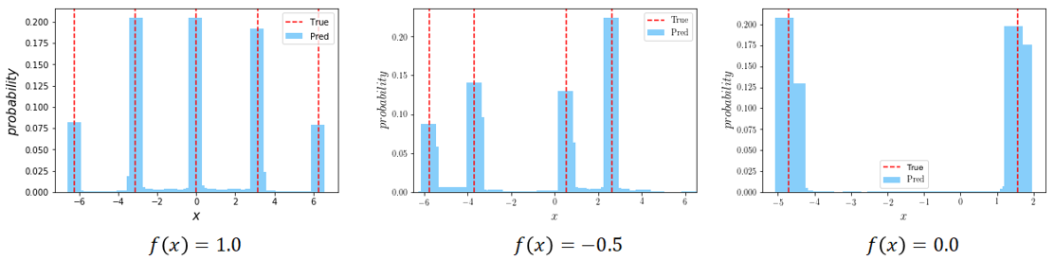
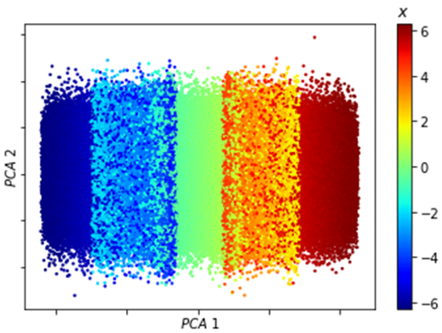
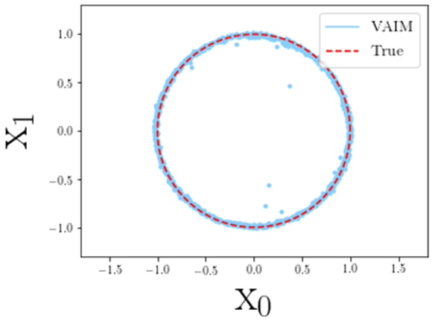
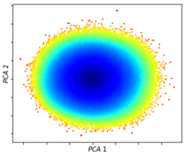
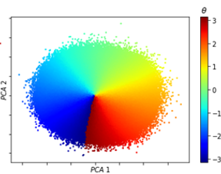
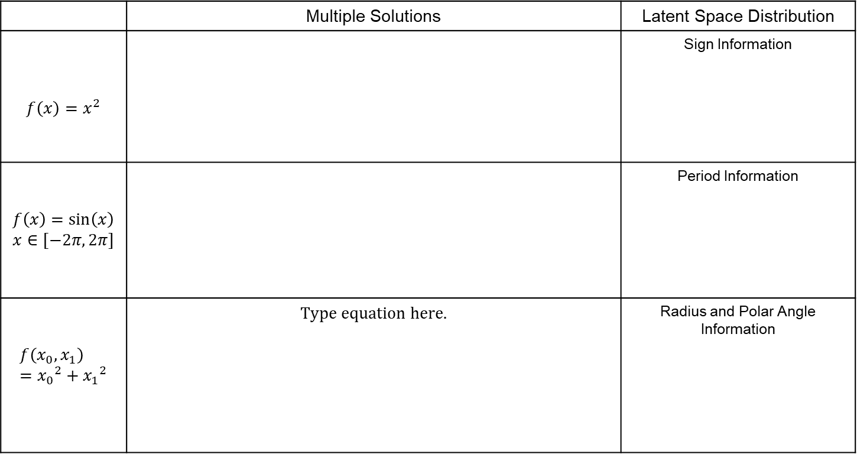

VAIM on Toy Inverse Problems
 | Multiple Solutions | Latent Space Distribution
$$f\left(x\right)=x^{2}$$ |  | Sign Information
$$f\left(x\right)=\sin\left(x\right)$$ $$x∈[−2π, 2π]$$ |  | Period Information
$$f\left(x_{0}, x_{1}\right)={x_{0}}^{2}+{x_{1}}^{2}$$ |  | Radius and Polar Angle Information
$$f\left(x_{0}, x_{1}\right)=1.0$$

Slide 10
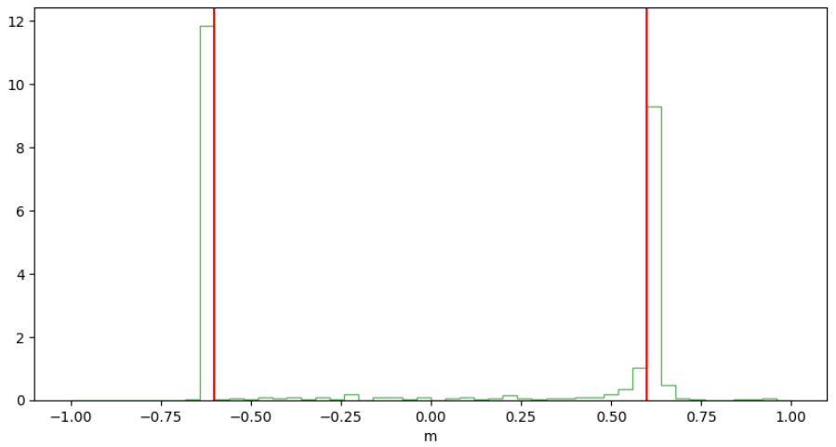
Diffusion Model for Inverse Problems
$$f\left(x\right)=x^{2}$$

Slide 11
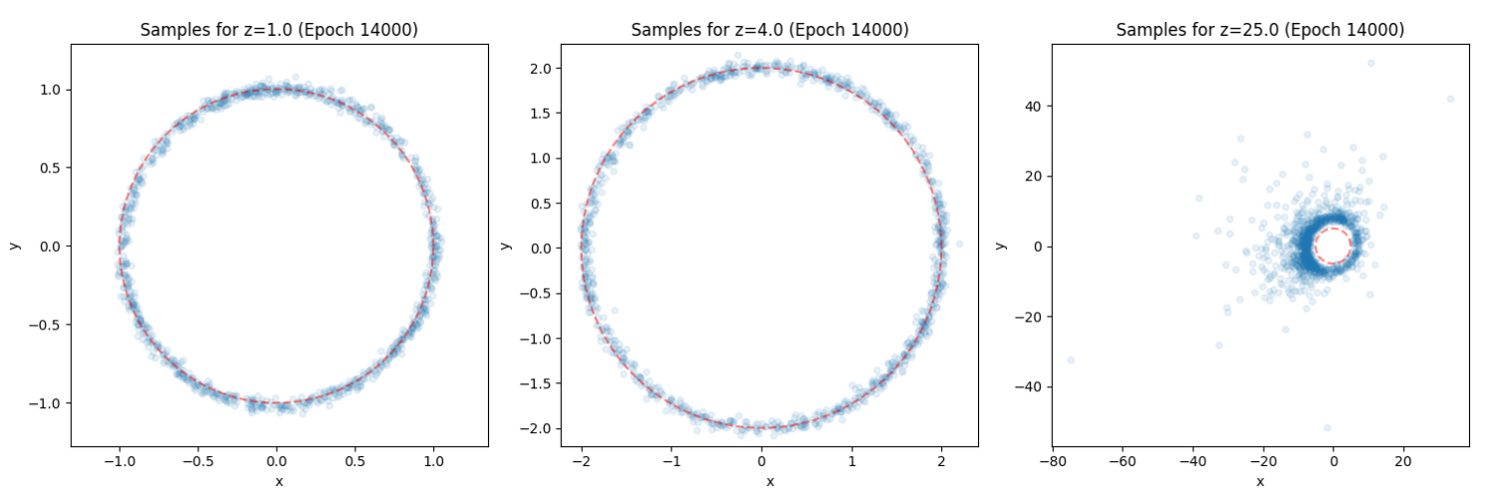

Toy Example
$x^{2}+y^{2}=z$
Training samples: $z∈[0, 4]$

Slide 12
Active Learning

Slide 13
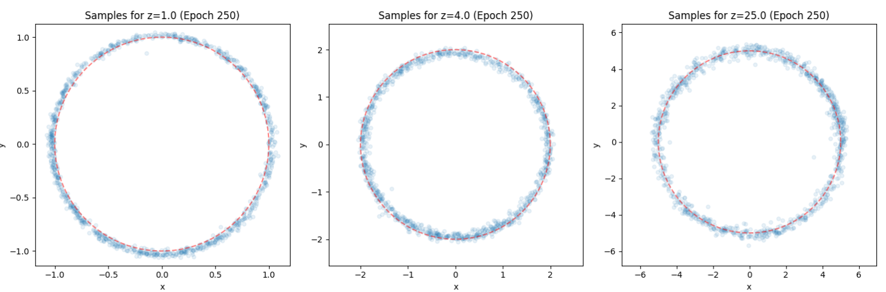
Toy Example: Active Learning

Slide 14
Agenda
The Inverse Problem
The Machine Learning Architectures
Variational Autoencoder Inverse Mapper
Diffusion Model
Applications in Nuclear and Particle Physics
Extraction of Crompton Form Factors as an Inverse Problem
Event-level Analysis

Slide 15
Extraction of Compton Form factors
Generalized Parton Distributions (GPDs)
Multi-dimensional descriptions of proton structure
Deeply virtual exclusive scattering processes
Golden channel for the extraction of information on partonic 3D dynamics in the nucleon
Compton Form Factors (CFFs)
2D Slices of GPDs
Measured in Deeply Virtual Compton Scattering (DVCS)
Contain potentially new information on hadronic structure

Slide 16
Extraction of CFFs as an Inverse Problem
Extraction of 8 CFFs from a single polarization observable
An inverse problem of extracting 8 unknowns from a single equation
Quantification of information extracted from experiments
$$Re\left(H\right),Im\left(H\right),Re\left(\tilde{H}\right),Im\left(\tilde{H}\right),Re\left(E\right),Im\left(E\right),Re\left(\tilde{E}\right),Im\left(\tilde{E}\right)$$

Slide 17
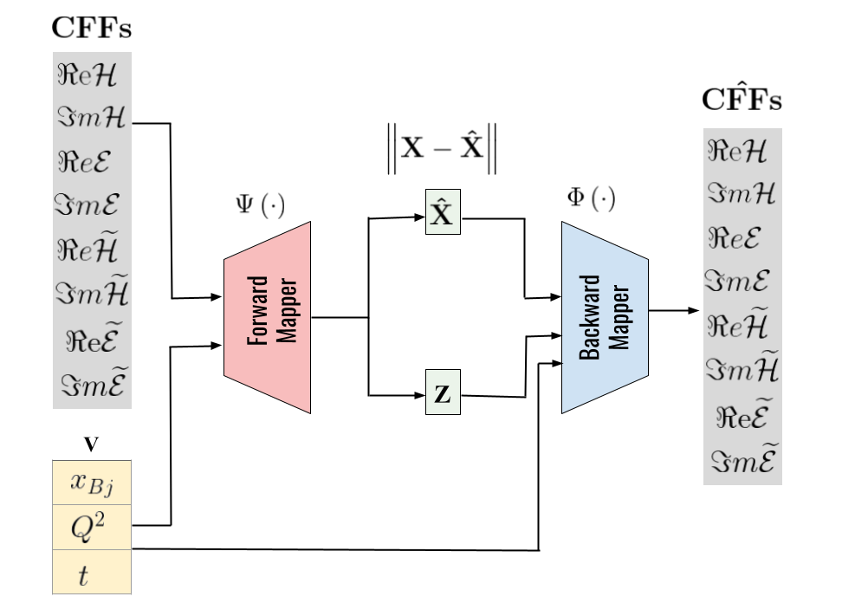
Conditional VAIM Architecture for CFF Extraction
Cross Sections

Slide 18
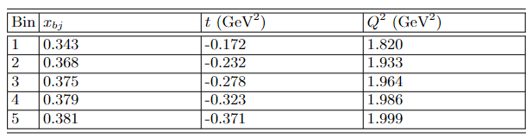
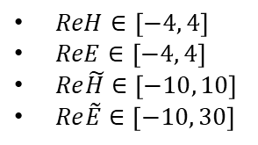
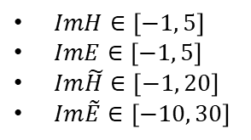
Training of Conditional VAIM
Training Data:
Kinematics values
Generate uniformly distributed CFFs
Compute cross sections
$ReH∈\left[−4, 4\right]$
$ReE∈\left[−4, 4\right]$
$Re\tilde{H}∈\left[−10, 10\right]$
$Re\tilde{E}∈\left[−10, 30\right]$
$ImH∈\left[−1, 5\right]$
$ImE∈\left[−1, 5\right]$
$Im\tilde{H}∈\left[−1, 20\right]$
$Im\tilde{E}∈\left[−10, 30\right]$

Slide 19
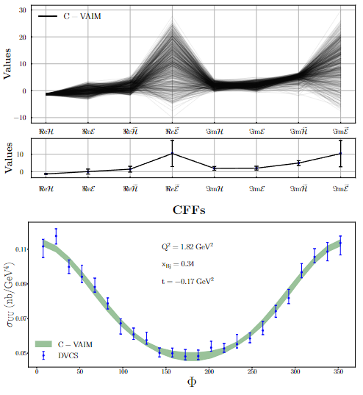
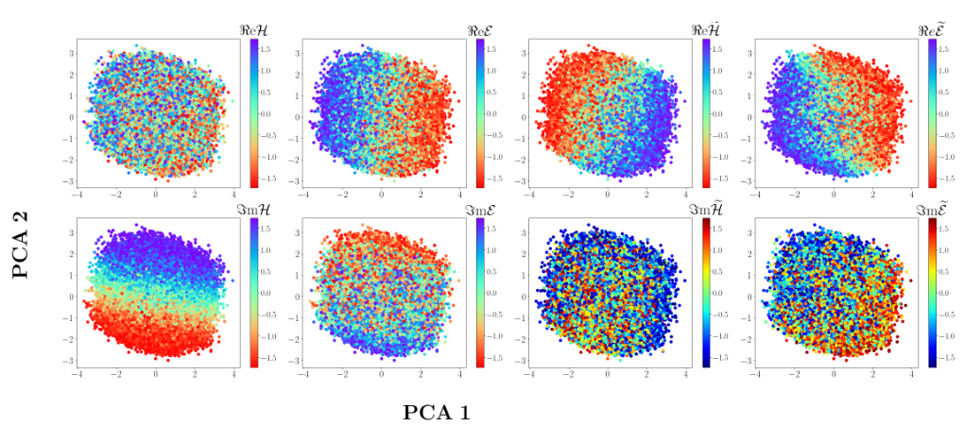
Prediction of CFFs
Predicted CFFs from VAIM-CFF
X_{Bj} = 0.343
t = -0.172 GeV²
Q² = 1.820 GeV²
Latent Space Analysis

Slide 20
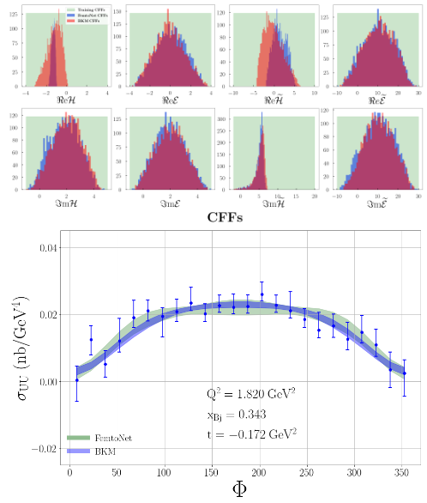
Training C-VAIM on Different Cross-section Formulations
Two Cross-section Formulations
FemtoNet (UVA)
BKM (Belitksy, Kirchner, Mueller)
Kinematics
X_{Bj} = 0.35
t = 0.172
Q² = 1.9 GeV²
Eb = 5.75 GeV

Slide 21
Agenda
The Inverse Problem
The Machine Learning Architectures
Variational Autoencoder Inverse Mapper
Diffusion Model
Applications in Nuclear and Particle Physics
Extraction of Crompton Form Factors as an Inverse Problem
Event-level Analysis

Slide 22
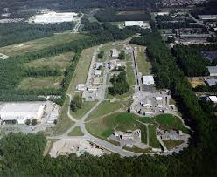
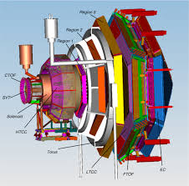
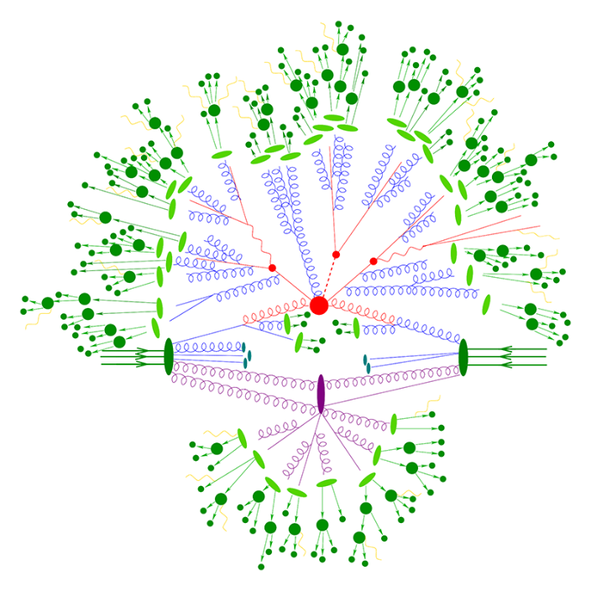
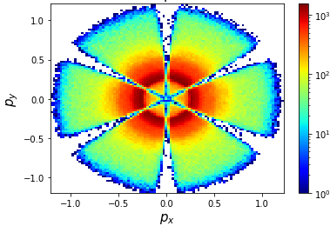
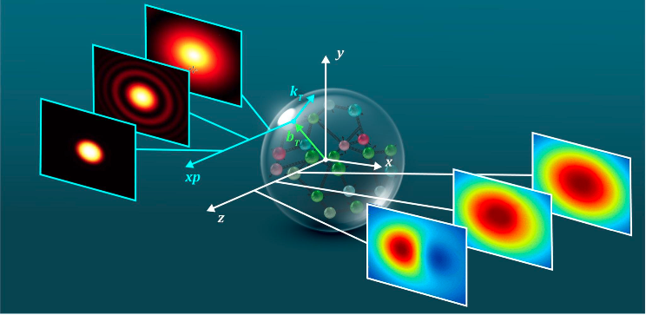
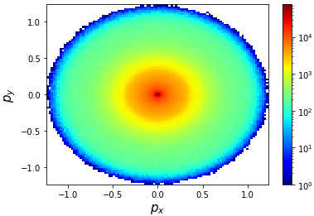
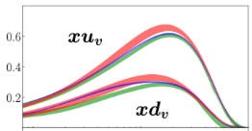
Experiment
Accelerator
Detector
Hadronic Structure
High Energy
Scattering Experiments
Observed
Events
Inverse Inference
Inverse Problem
Inverse Problem
Observed
Event
Distribution
Reconstructed
Vertex
Distribution
Theory

Slide 23
GAN-based Workflow for Event-level Analysis
Event-level Analysis

Slide 24
Sampling

Slide 25
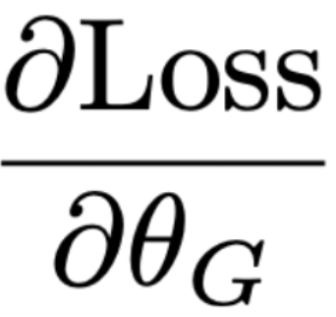
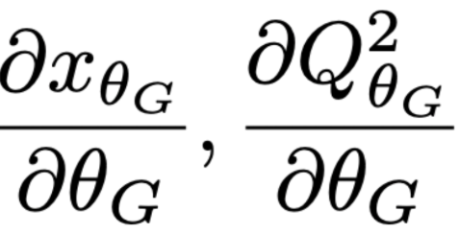
A Critical Obstacle in Backpropagation: Gradient over Sampling
Gradient?

Slide 26
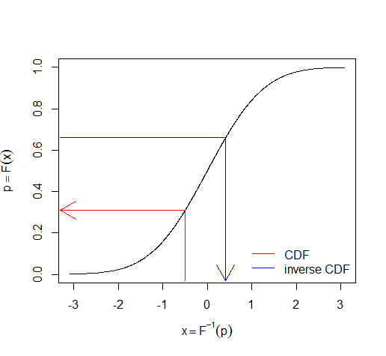
Sampling Algorithms
Inverse CDF
Can provide meaningful gradient
Only works in 1D
Markov Chain Monte Carlo (Gaussian proposal function)
Random walk
Can work in higher dimensionality
No useful gradient

Slide 27
Two Possible Solutions
Make the Sampling Method Differentiable
LOITS (see Nobuo’s Talk)
Build a Surrogate Model
Neural Network
Approximate the sampling process
Differentiable
Easy to incorporate in the event-based analysis workflow

Slide 28
Simulation-based Inference
An Inverse Problem
Extract Quantum Correlation Functions (QCFs) from experimental events
Forward Simulation Model
sample QCFs to generate events
Statistical Inference Model
compare the generated events with the target ones to determine the parameters
Surrogate Models
Approximate the forward sampler
Good fidelity of the simulation
Provide gradient for parameter inference in gradient-based optimization
Fast computation
Only neural network evaluations

Slide 29
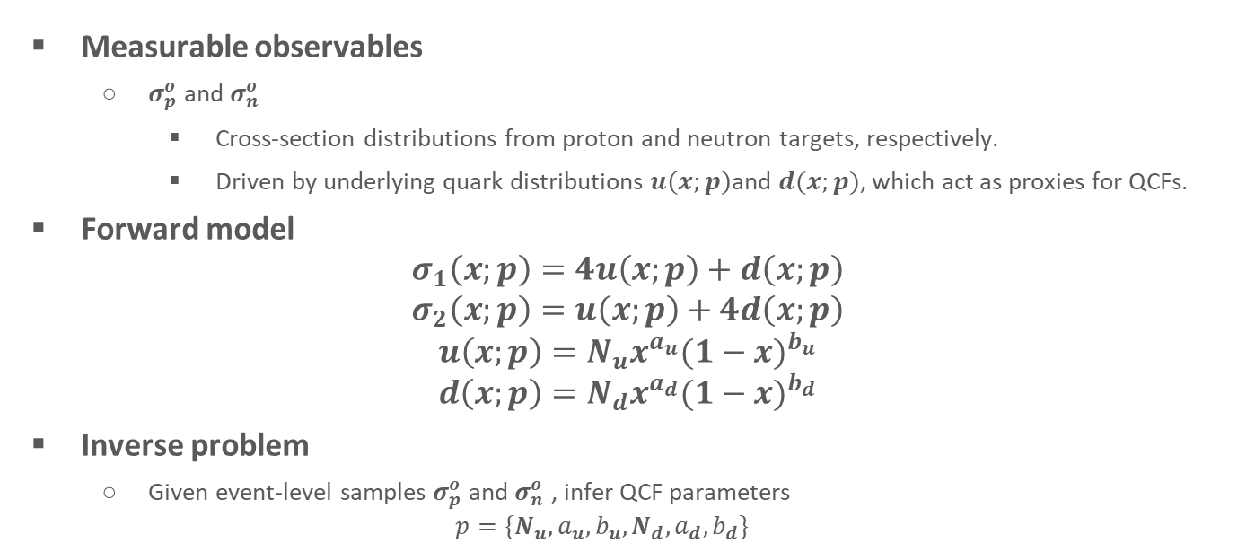
QCF Proxy Model
Measurable observables
$σ_{p}^{o}$ and $σ_{n}^{o}$
Cross-section distributions from proton and neutron targets, respectively.
Driven by underlying quark distributions $u\left(x;p\right)$and $d(x;p)$, which act as proxies for QCFs.
Forward model
$$σ_{1}\left(x;p\right)=4u\left(x;p\right)+d\left(x;p\right)$$
$$σ_{2}\left(x;p\right)=u\left(x;p\right)+4d\left(x;p\right)$$
$${u\left(x;p\right)=N}_{u}x^{a_{u}}{(1−x)}^{b_{u}}$$
$${d\left(x;p\right)=N}_{d}x^{a_{d}}{(1−x)}^{b_{d}}$$
Inverse problem
Given event-level samples $σ_{p}^{o}$ and $σ_{n}^{o}$ , infer QCF parameters
$$p=\{N_{u},a_{u},b_{u},N_{d},a_{d},b_{d}\}$$

Slide 30
Computational Experiments
1D QCF Proxy Model
We can use 1D inverse CDF as the truth
1D inverse CDF
“Perfect” sampling
Need to evaluate PDF for every sample
Generative AI-based Surrogates
Conditional GAN
Conditional Diffusion Model (DM)
Both trained on 20M parameter-event pairs

Slide 31
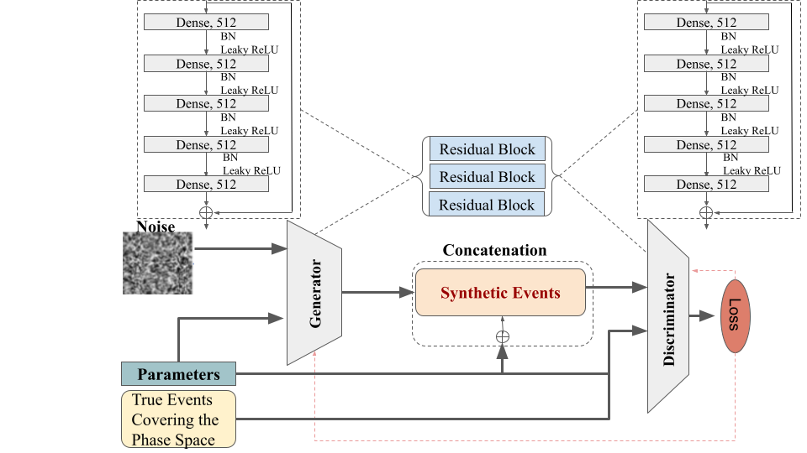
Conditional GAN as the Surrogate
Generator
Residual blocks
5 dense layers
512 neurons each
Discriminator
Similar architecture with 5% dropout
Loss
Least Squares

Slide 32
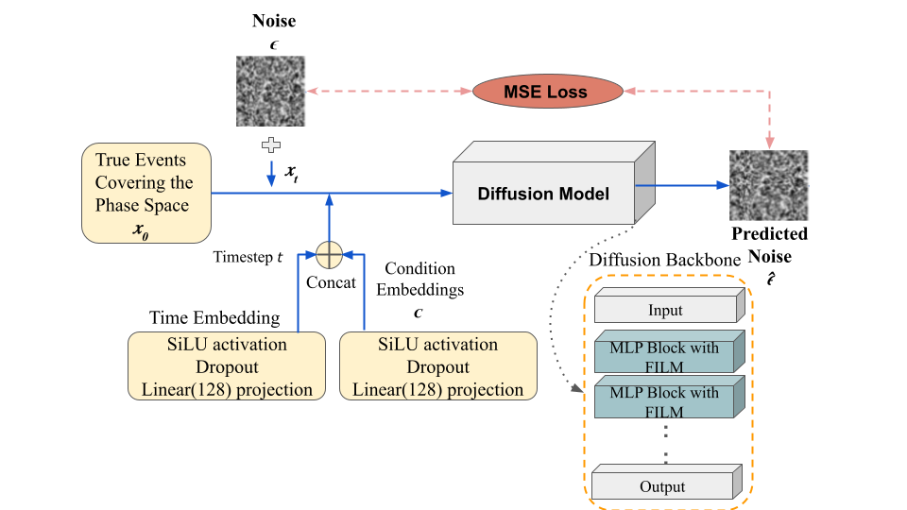
Diffusion Model as the Surrogate
Denoising Network
6 MLP blocks (256 hidden units)
FiLM (Feature-wise Linear Modulation) conditioning
Noise schedule
T = 1,000 steps
β_{min} = 10⁻⁴
β_{max} = 0.02
Training
MSE loss between predicted and true noise

Slide 33
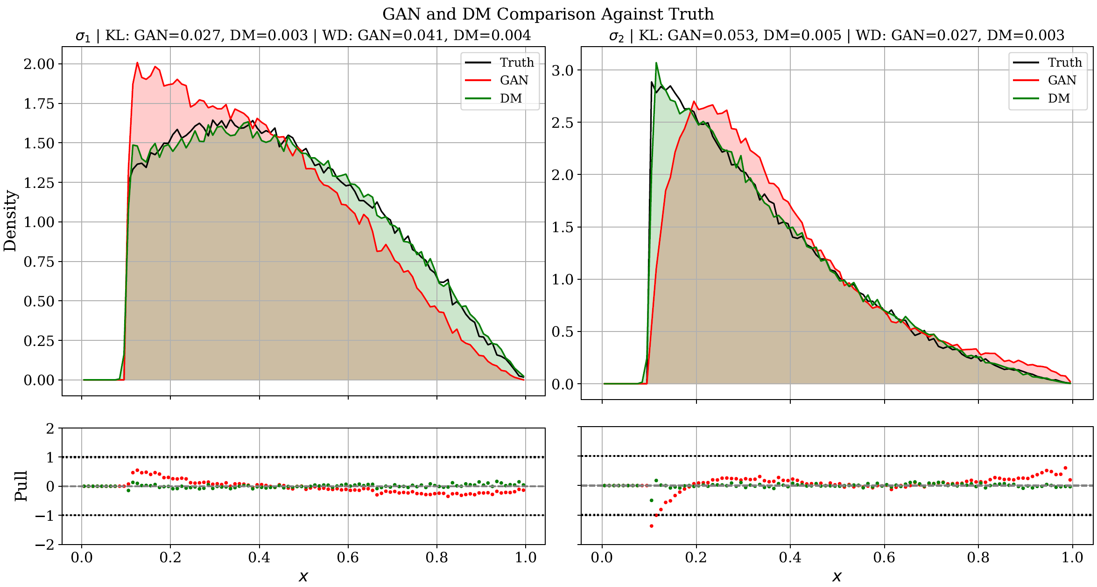
Fidelity Comparison of Generative AI Models
Diffusion Model yields better fidelity compared to GAN.

Slide 34
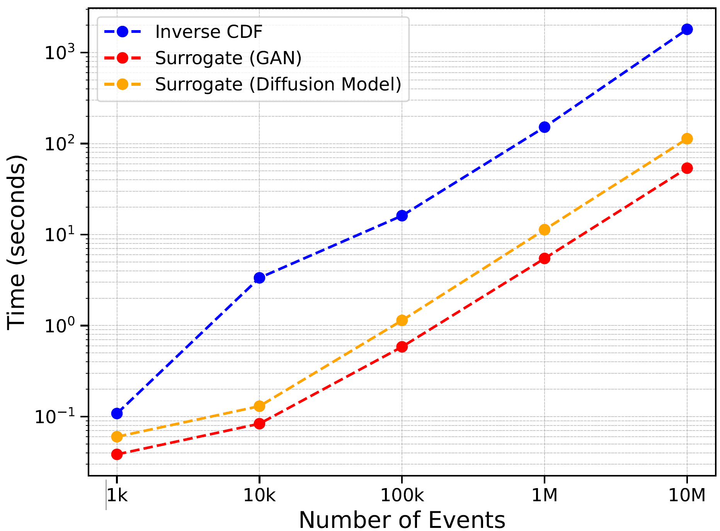
Comparison of Computational Time

Slide 35
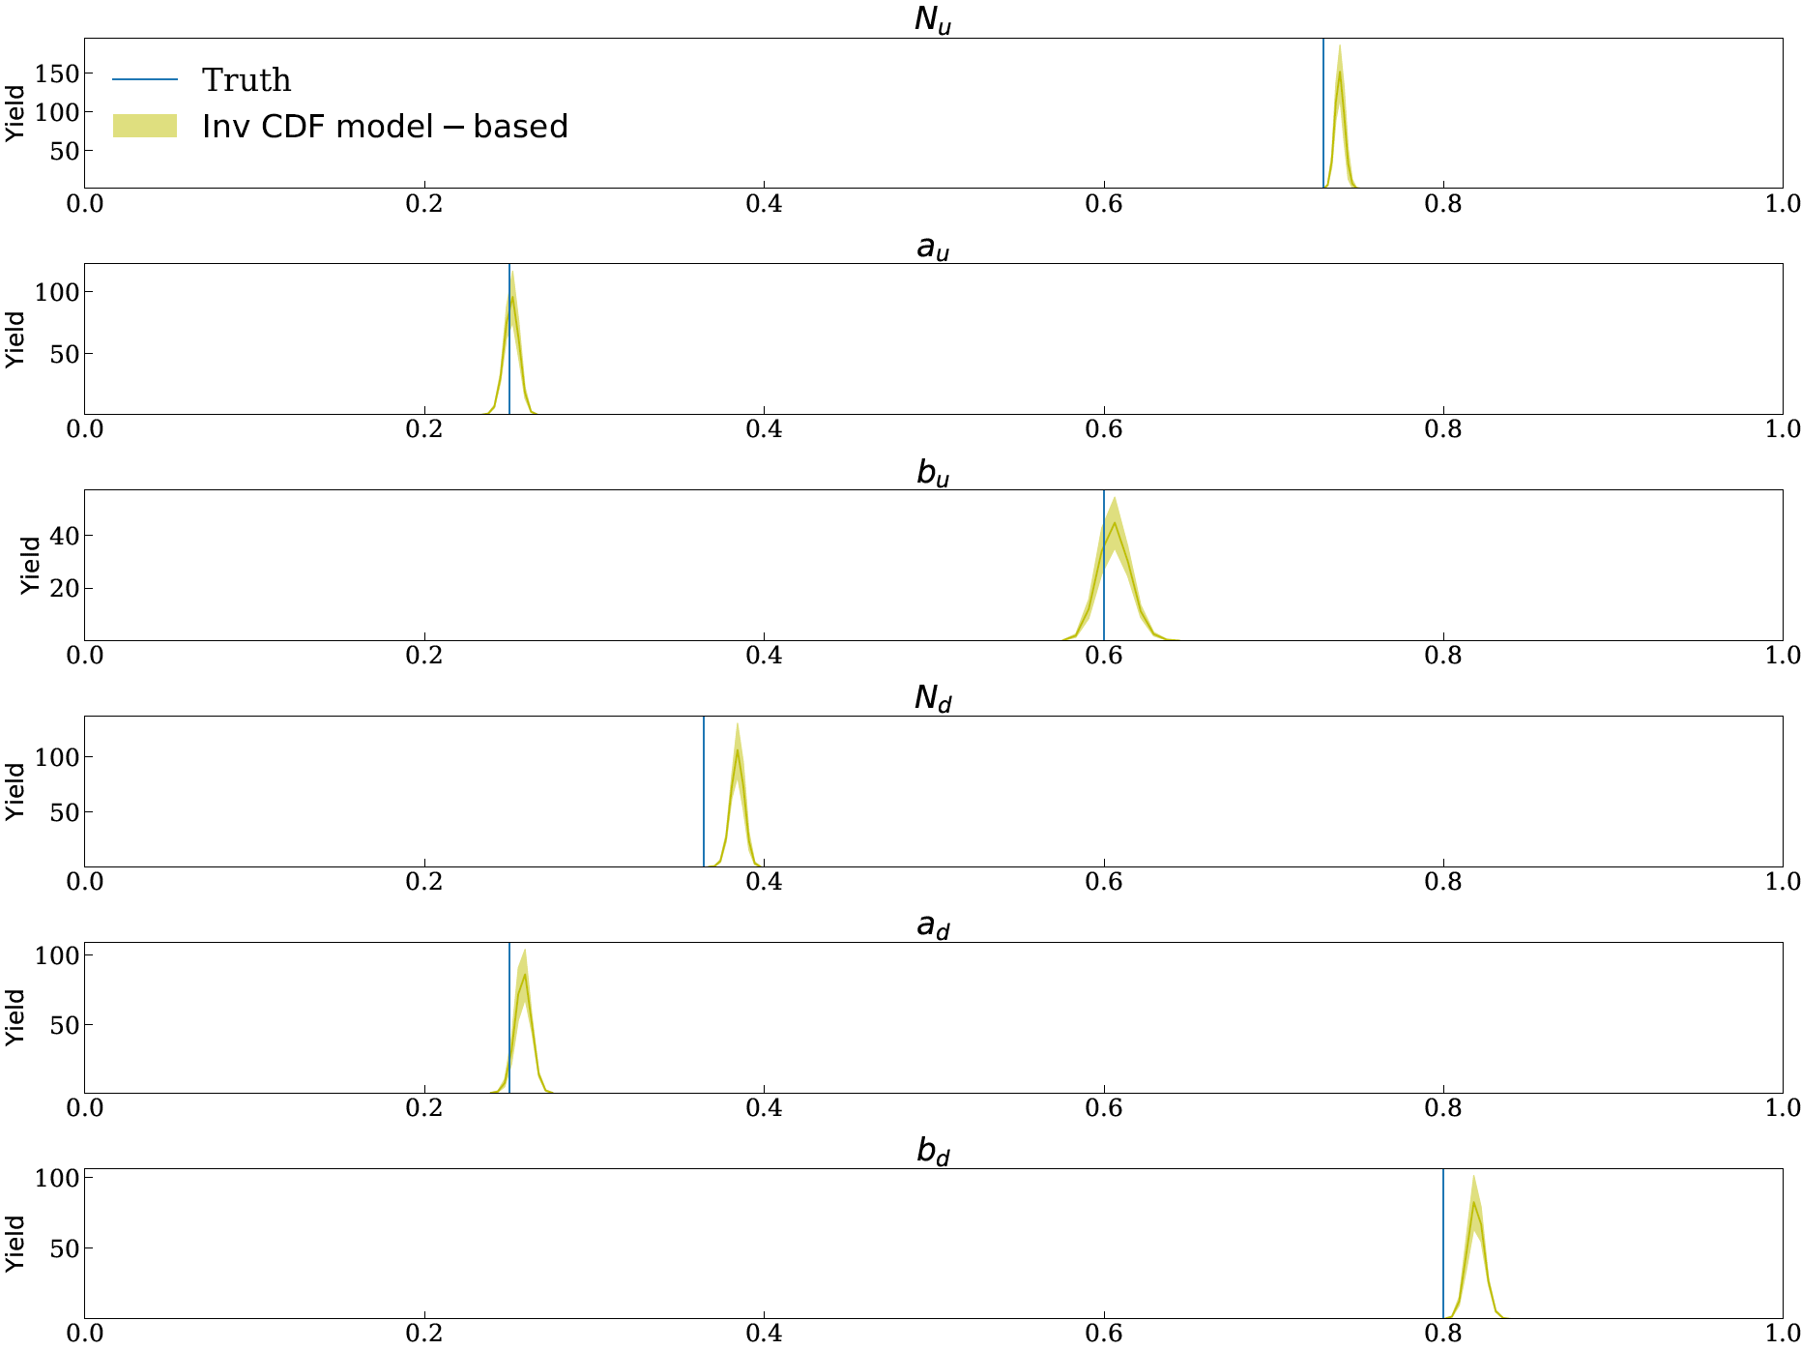
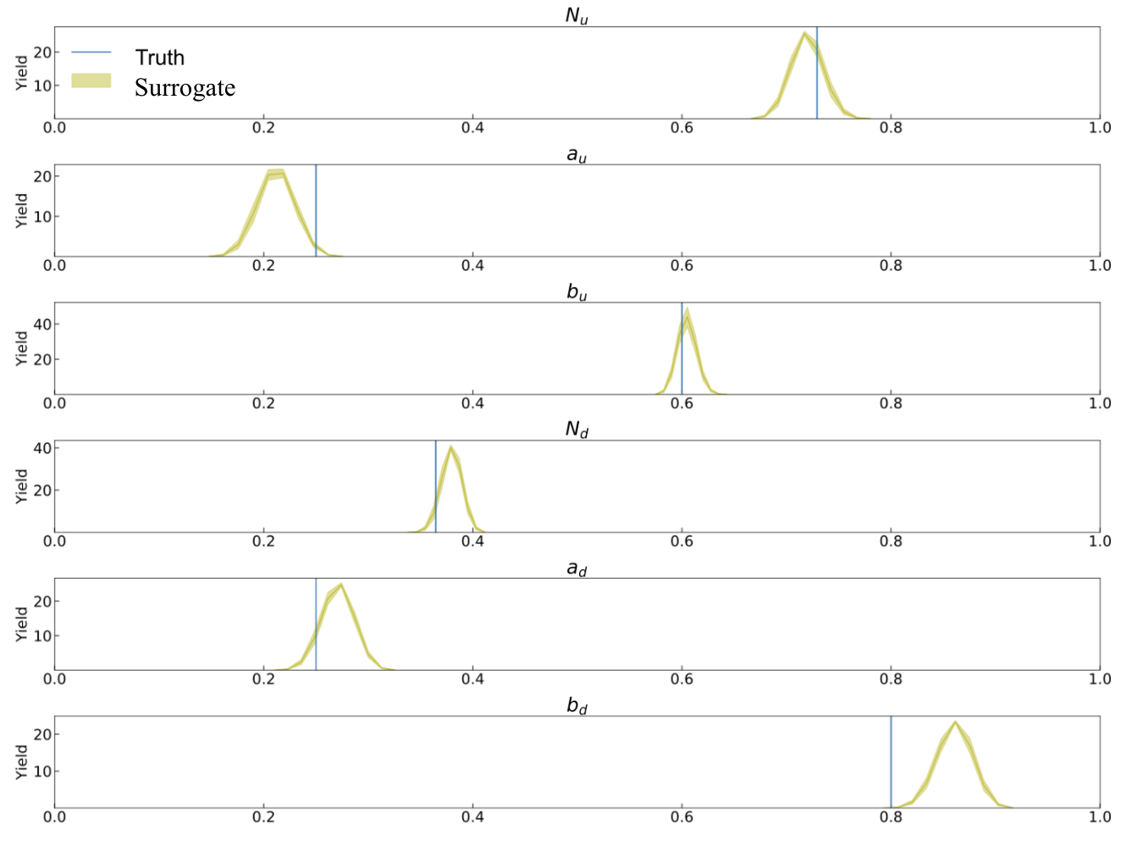
QCF Parameter Inference
Parameter distributions obtained using an inverse-CDF sampler
Parameter distributions obtained using the surrogate sampler

Slide 36
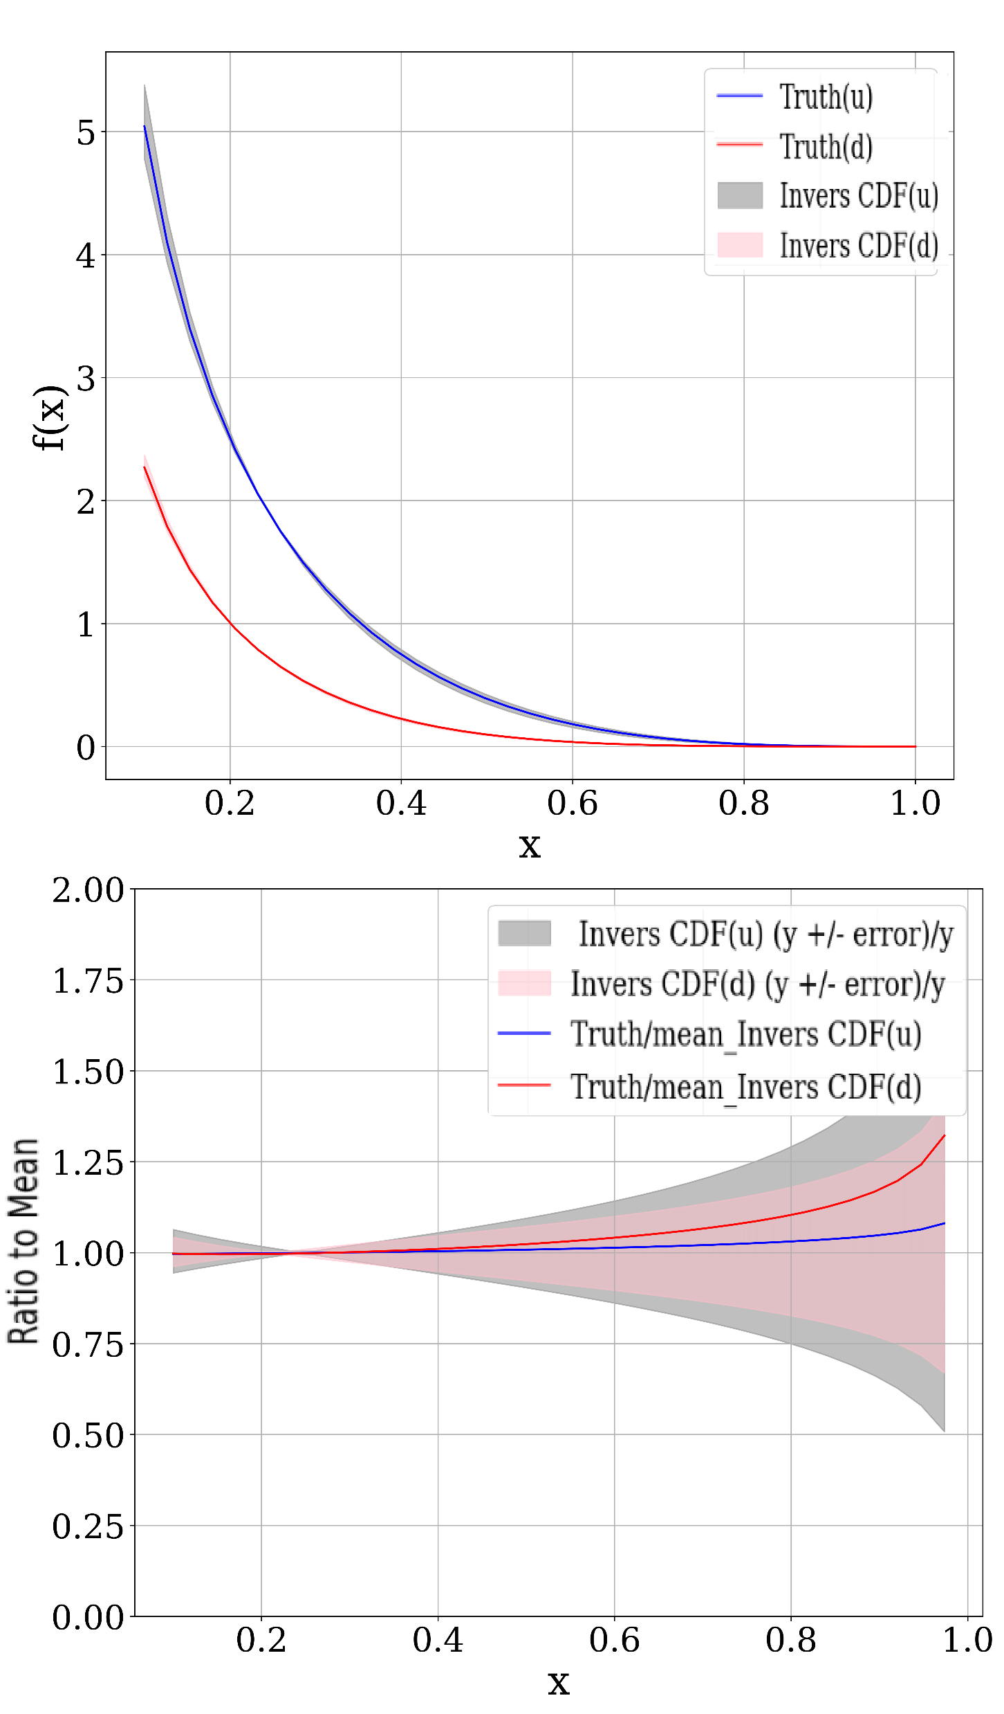
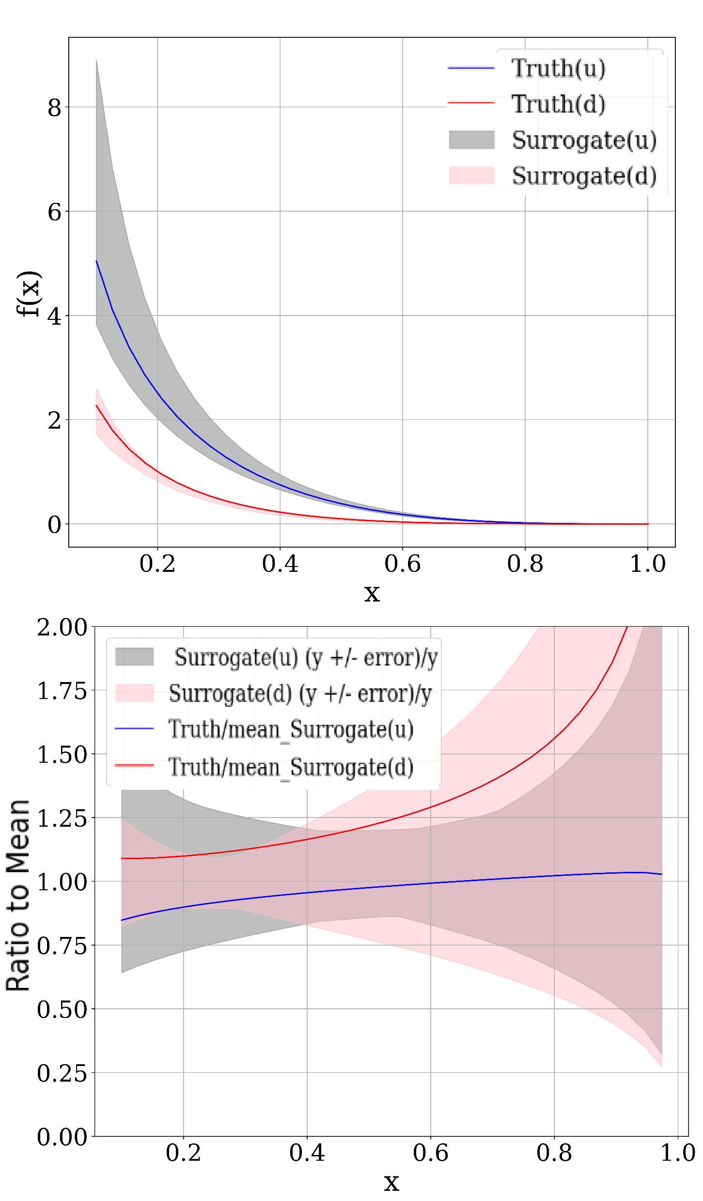
Reconstructed QCFs
Inverse CDF
Generative AI-based Surrogate

Slide 37
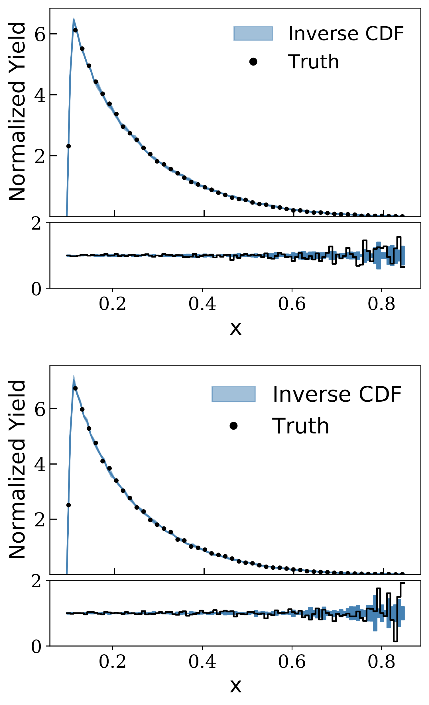
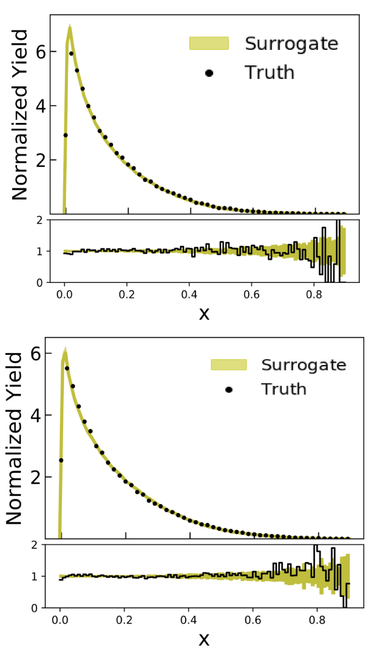


Reconstructed Cross-sections
$$σ_{1}$$
$$σ_{2}$$
Reconstructed cross sections from parameters using an inverse-CDF sampler
Reconstructed cross sections from parameters using a Surrogate

Slide 38
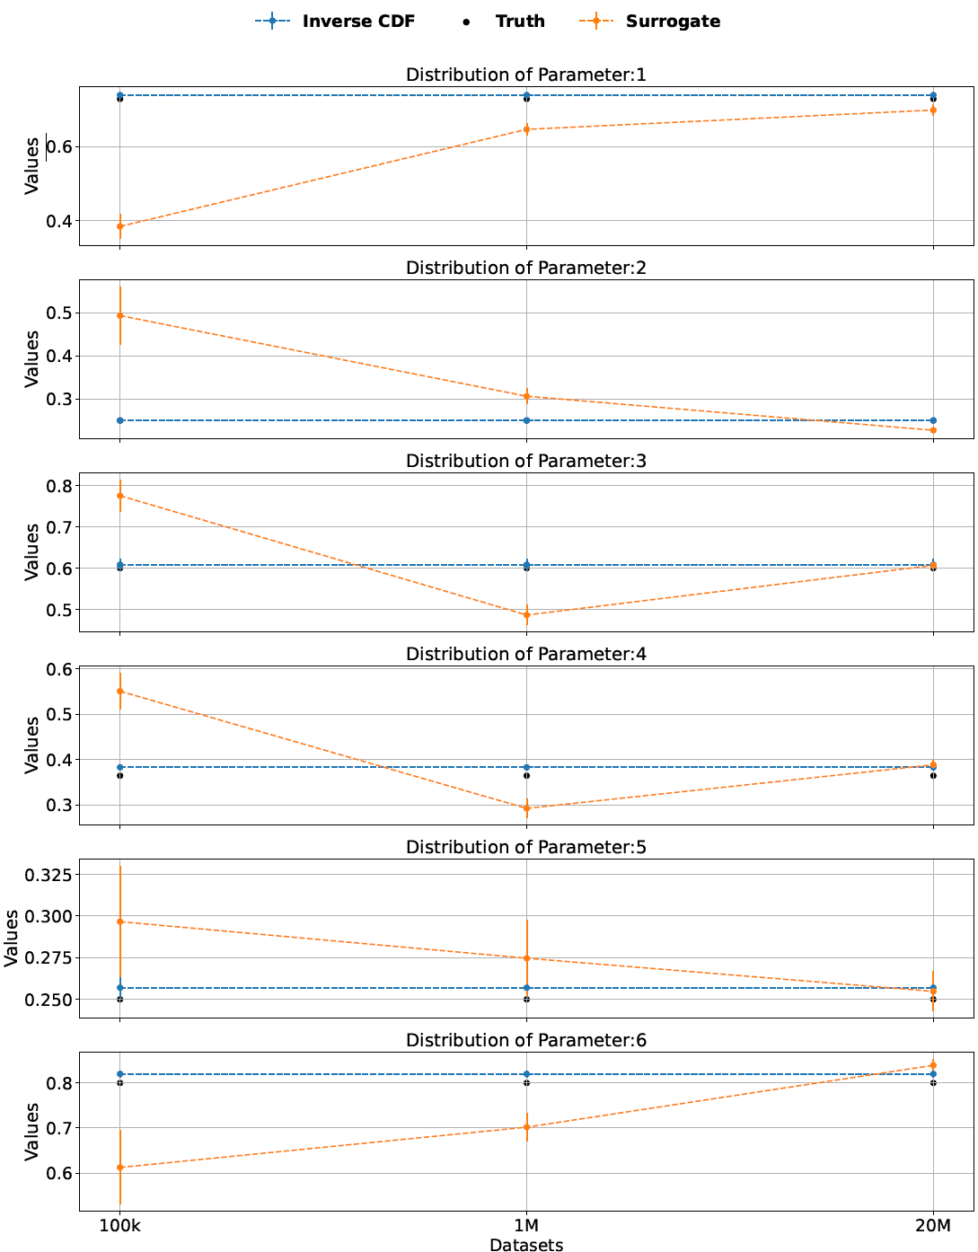
Training Samples for Surrogate Model
Comparison of parameter distributions for six parameters across datasets of different sizes using the inverse CDF, surrogate, and ground truth values. Error bars indicate the standard deviation of the predicted parameters.

Slide 39
Comparison
Differentiable Samplers
Pros
Accurate
No pre-defined range of parameters
No training needed
Cons
Computational Costly
Difficulty in implementation to ensure differentiability
Generative AI-based Surrogates
Pros
Fast (neural network evaluation)
Differentiable
Easy to incorporate into inference framework
Cons
Approximation error
Need to train with a lot of samples
Pre-defined range of parameters

Slide 40
Summary
Inverse Problem
Ill-posedness
Generative AI is natural to solving inverse problem
Generate multiple solutions
Diffusion Model yields better fidelity than GAN and Variational Autoencoder
Challenges
Stability
Robustness
Uncertainty Quantification
Programming physics into the deep learning framework
Extracting physics from inverse inferencing

Slide 41
References
M. Almaeen, Y. Alanazi, N. Sato, W. Melnitchouk, M. P. Kuchera, Y. Li., “Variational Autoencoder Inverse Mapper: An End-to-End Deep Learning Framework for Inverse Problems.” Proceedings of International Joint Conference on Neural Networks (IJCNN2021), 2021.
M. Almaeen, T. Alghamdi, B. Kriesten, D. Adams, Y. Li, H. W. Lin, S. Liuti, “VAIM - CFF: A variational autoencoder inverse mapper solution to Compton form factor extraction from deeply virtual exclusive reactions,” The European Physical Journal C, 85(5): 499, 2025.
T. Alghamdi, J. Xu, N. Ramachandra, N. Sato, Y. Li, “Towards an event-level analysis in hadronic physicsusing generative AI-based surrogates,” IEEE International Conference on Tools with Artificial Intelligence (ICTAI2025), accepted, 2025.

Slide 42



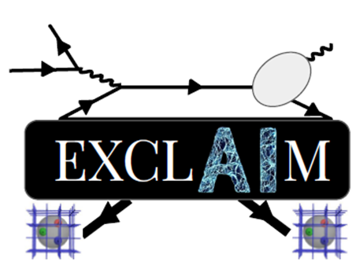


Acknowledgements
A(I)DAPT Collaboration
EXCLAIM Collaboration
QuantOm Collaboration
DOE SciDAC Program
Center for Nuclear Femtography (CNF)
ODU Data Science Seed Fundings 2023

Slide 43
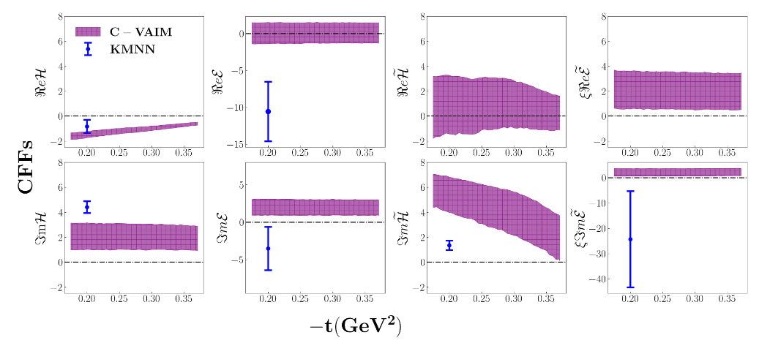
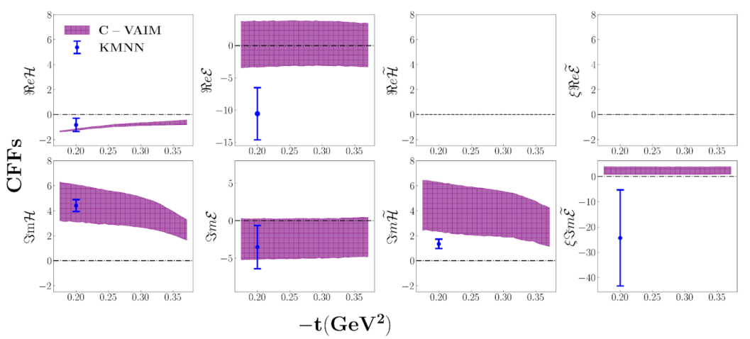

Prediction of CFFs w.r.t. t
Prediction of CFFs as a function of the Mandelstam variable t for Jlab 6GeV Kinematics
X_{Bj} = 0.35
Q² = 1.9 GeV²
All 8 CFFs
Fixing $Re\tilde{H}=0$, $Re\tilde{E}=0$

