Slide 1

Momento importante di incontro e confronto della comunità acceleratori (e non solo)
Possibilità di approfondimento di tematiche in un LN
Visione del Management (grazie Diego per il costante confronto e sostegno!)
Visione/confronto Commissioni Scientifiche
Risultati scientifici (presentati dai giovani!)
Sinergie
Prospettive di finanziamento
Reti
Formazione ed Università

Slide 2

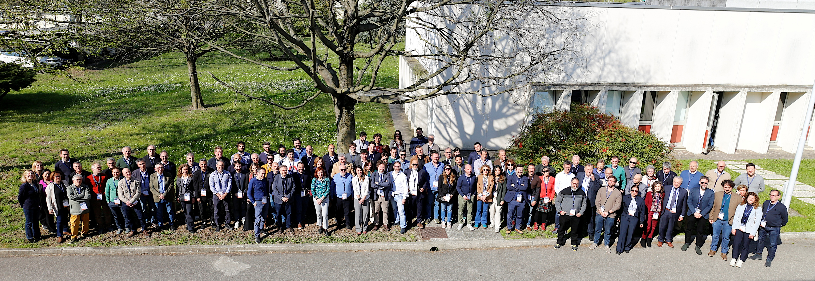
GRAZIE PER LA PARTECIPAZIONE!

Slide 3



ERICE INTERNATIONAL SCHOOL OF PARTICLE ACCELERATORS
«KJELL JOHNSEN, GUSTAV VOSS AND EDMUND WILSON»
School directors: Lucio Rossi, Thomas Taylor
Place : ERICE
Title of the 5th Course: Higgs factories for the post-HiLumi era
Dates : 26 Nov- 1 Dec 2025
Course Directors : Massimo Ferrario, INFN-LNF, Lucio Rossi, Università di Milan and INFN-MI-LASA,
F. Zimmermann, CERN
Scientific Secretary: Stefano Sorti, University of Milano and INFN-MI-LASA

Slide 4
Join the INFN Accelerator School – Shaping the Future of Particle Physics!
Particle physics is at an exciting crossroads! As the Large Hadron Collider (LHC) nears the end of its standard configuration run, it is preparing to transition into the High-Luminosity LHC (HiLumi LHC), boosting its luminosity tenfold in the quest for new physics beyond the Standard Model.
At the same time, the global particle physics community is engaged in defining the future of accelerators, with the Update of the European Strategy for Particle Physics taking place throughout 2025 and into spring 2026. The big question: What comes after the HiLumi LHC?
Several groundbreaking options are on the table:
🔹 A next-generation circular hadron collider with cutting-edge high-temperature superconductor (HTS) magnets? Either following the FCC-ee Higgs/electroweak/top factory, as envisaged by present CERN plan, or as direct bold step into the future.
🔹 A linear lepton collider leveraging plasma acceleration for a revolutionary compact design?
🔹 The resurgence of the Muon Collider, re-emerging as a bold alternative?
With so many competing concepts, how can we compare their beam dynamics, technological challenges, and scientific potential? How do cost, feasibility, and physics priorities shape the decision-making process?

Slide 5
💡 This Accelerator School is your opportunity to explore these questions firsthand! Designed for students, young researchers, and even experienced scientists, the school offers a comprehensive, comparative perspective on the next frontier of accelerator physics.
📌 What to Expect?
✅ Top-tier lecturers – leading scientists, chief technologists, and project directors
✅ A deep dive into all major accelerator proposals, with decision-makers
✅ Fact-based insights to help you form your own informed opinion
🚀 Don't miss this chance to be at the heart of the debate on the future of high-energy physics!
Student fee: 1000 Euro. It includes registration, full board and transportation from Palermo and Trapani airports top Erice and back.
This slot we are alone, and students can be in single room! This favors also the “senior” students.

Slide 6
Preliminary!!!!

Slide 7
Preliminary!!!!

