Slide 1
INFaN
Irradiation National Facility Network
Giada Petringa (Laboratori Nazionali del Sud)
Luca Foggetta (Laboratori Nazionali di Frascati)

Slide 2
Irradiation National Facility Network: the main goal
3
The proposal is initiated in INFN-A environment to establish an internal INFN network connecting
IRRADIATION facilities that are dedicated to external users.
This proposal is founded on a shared request for abstraction and synergy among the numerous scientific, technological, and technical management experiences of irradiation facilities across the national territory and under
the management of INFN.
Single and independent way of working
Collaborative win-win approach
AIMS
INTERNAL NETWORK: Establish an internal network within INFN for scientific, technological, technical, and infrastructure exchange between irrad facilities for mutual operational benefit.
GENERALIZED INFRASTRUCTURE with NATIONAL SERVICEs: Utilize a generalized infrastructure based on national services that includes information, beam time calls, and access procedures to INFN irrad facilities for scientific and third-mission purposes, while respecting the usage norms and local customs of the facilities, which will integrate into an abstract IT infrastructure.
COMMON FUNDING: the collection of funds to implement innovative and experimental operational solutions (e.g., detectors, hardware and software infrastructure) of shared ownership and common use, as well as to support and implement the network itself.

Slide 3
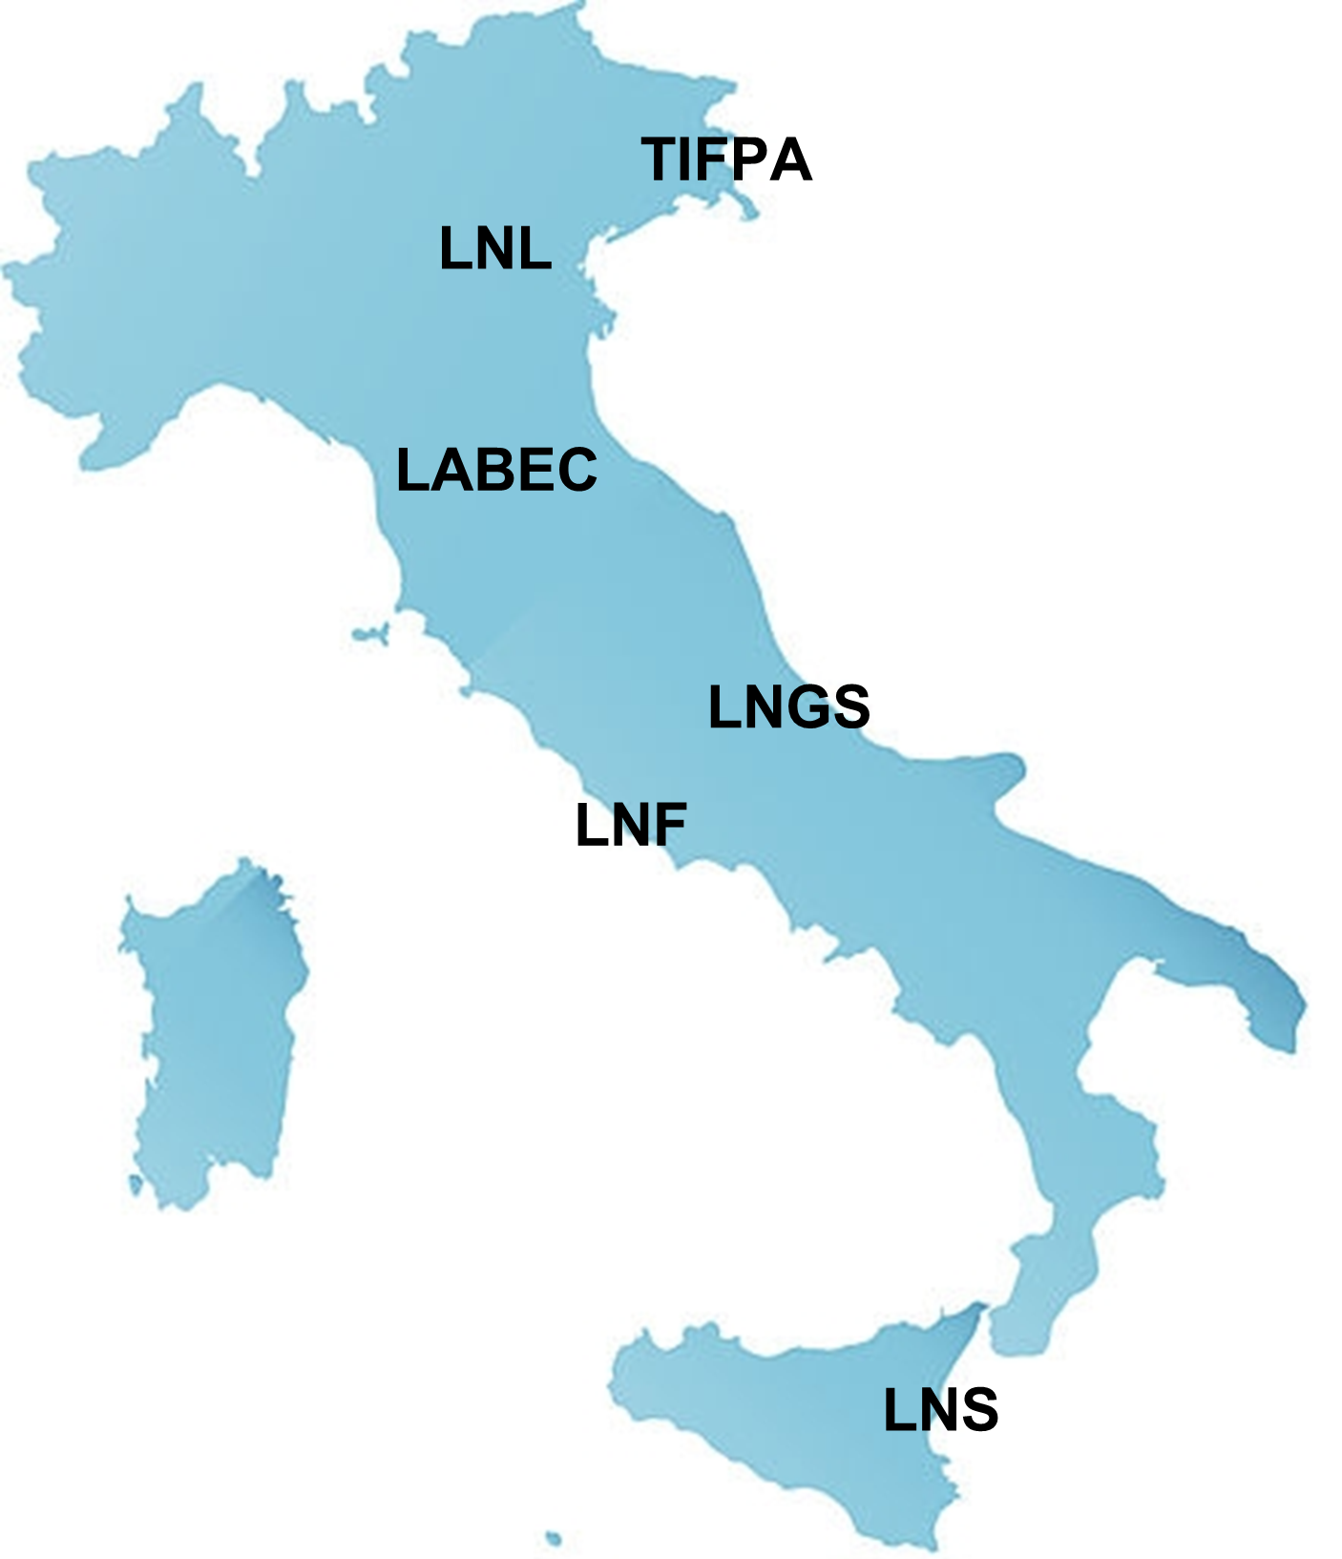
Irradiation National Facility Network: the involved facilities
3
We are open to new collaborations and the addition of new members to the network.
INFN
Sez. Torino
Key contacts
INFN-LNF | Luca Foggetta
INFN-LNS | Giada Petringa
INFN-LNL | Luca Bellan
INFN-LNGS | Matthias Junker
INFN-FI | Mirko Massi & Massimo Chiari
INFN-TIFPA | Francesco Tommasino & Enrico Verroi
INFN-TO | Simona Giordanengo
Contacted facilities
(up to now only charged one)

Slide 4
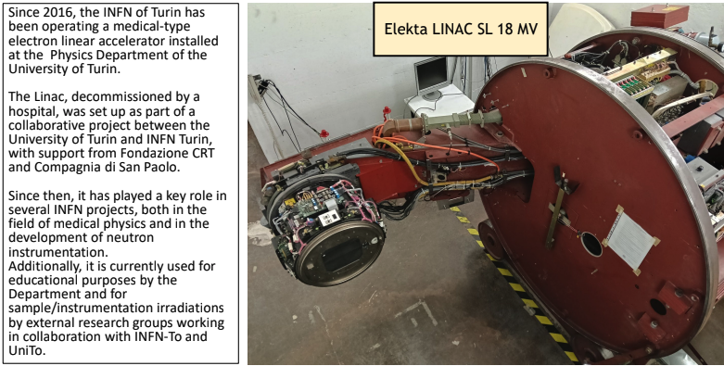
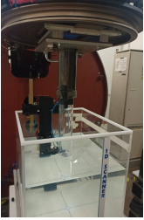
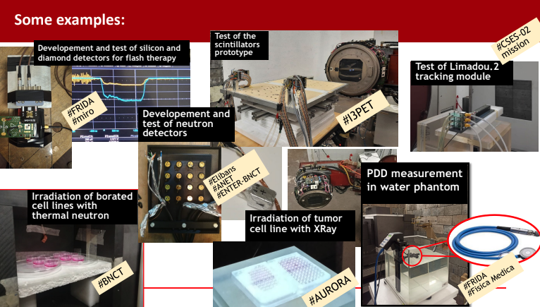
Irradiation National Facility Network: the involved facilities
3
INFN
Sez. Torino
Contacted facilities
(up to now only charged one)

Slide 5
Generalized common infrastructure
National Level
Local Level (Customizable)
INFN main site
National services
fully mantained
more reliable
wiki.infn.it
@lists.*.it
GODIVA
AAII
Userportal
Booking
DB
Backup
Territorial access
Facility web site
Light web DB facility
Wiki.infn
Calls Newsletter (now performed by hand replies)
Mailing list
Local level object linking
Booking app
Guided path to best beam needed
Own call DB
Dissemination
Repository Software
Data Logging

Slide 6
Generalized common infrastructure
National Level
Local Level (Customizable)
INFN main site
National services
fully mantained
more reliable
wiki.infn.it
@lists.*.it
GODIVA
AAII
Userportal
Booking
DB
Backup
Territorial access
Facility web site
Light web DB facility
Wiki.infn
Calls Newsletter (now performed by hand replies)
Mailing list
Local level object linking
Booking app
Guided path to best beam needed
Own call DB
Dissemination
Repository Software
Data Logging

Slide 7
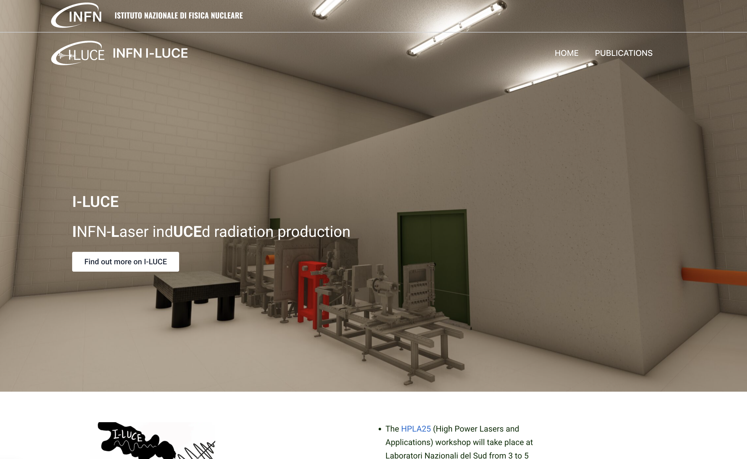
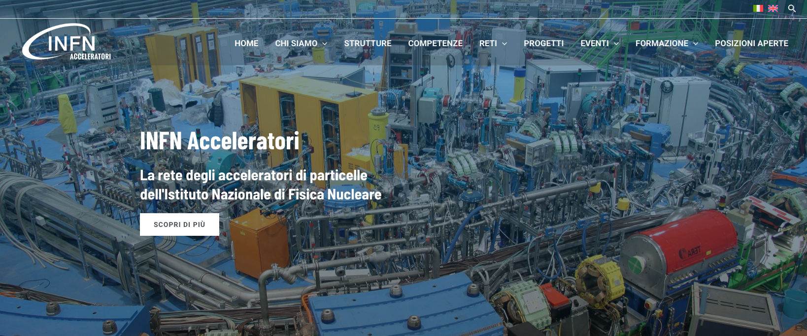
Local website
A direct link to the INFN-A web site
I-LUCE website underconstruction
New INFN-A website
Wiki.infn
Booking app
Data Logging

Slide 8
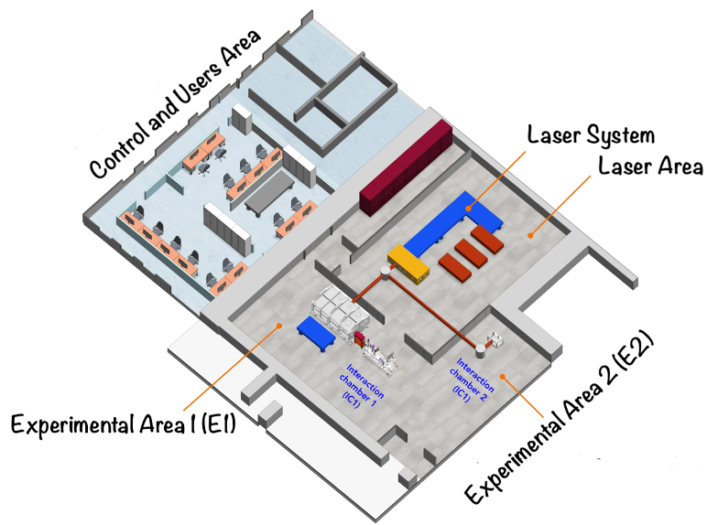
Local website
Protons
Energy [MeV] | up to 40
Number of particles per pulse | 1E11 -1E12
Beam divergence | ± 20°
I-LUCE is a complex facility featuring a multi-radiation source and serving a diverse type of external users
Three different types of lasers
Two irradiation areas
More than two beamlines
Electrons
Energy | 100 MeV - 3 GeV
Beam Charge | 30 - 400 pC
Number of particles per pulse | 1E08 - 1E09
Beam divergence [mrad] | from ± 2 up to ± 20
Multi-radiation facility
Neutrons
Energy [MeV] | up to 40
Number of particles per pulse | 1E+05
Beam divergence | ± 20°
E1
production of
protons
ions
electrons
photons
neutrons
E2
warm dense matter
nuclear physics
beam-plasma interaction
stopping power
Photons
Energy [MeV] | up to 10 MeV
Number of particles per pulse | 1E09 - 1E010

Slide 9
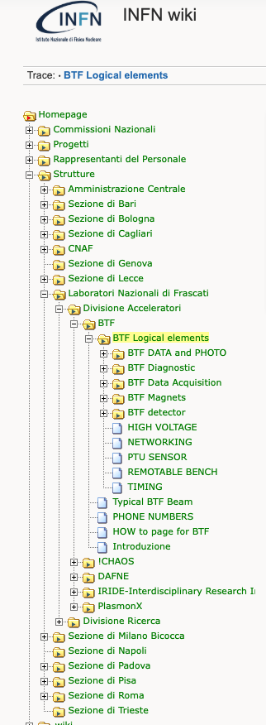
Local website
Protons
Energy [MeV] | up to 40
Number of particles per pulse | 1E11 -1E12
Beam divergence | ± 20°
I-LUCE is a complex facility featuring a multi-radiation source and serving a diverse type of external users
Three different types of lasers
Two irradiation areas
More than two beamlines
ESS
SEM
DGIC
FC
E1
production of
protons
ions
electrons
photons
neutrons
E2
warm dense matter
nuclear physics
beam-plasma interaction
stopping power

Slide 10
Facility in productions and future developments of booking
Booking status
CURRENT ONLINE Version
Discussed Development
Beam Test Facility(LNF)
More than three years of continuous developing
Almost Two years of continuous operation with users
Around 200 managed users per year, from proposal to territorial access​
DAɸNE-L Facility(LNF)
Software released one year ago
Final release for “Call” and “on demand” types
PLC/UTA remote control(LNF)
For Conference room booking related automation control
Developed for LNF Techical Division
INFN-LABEC developing(FI)
Released one year month ago, 48 slots managed
Collaboration born on INFN-A
FISMEL (LNF)
Reservation for radioactive sources
Final test reached, in production next two weeks
CHNET(Cultural Heritage Network)
Use booking software for booking facilities and resource for CHNET
Proposal under evaluation
ASIF-2
Needs BTF like or extended version
SPARCLAB-EUPRAXIA(LNF)
Needs BTF like or extended version
ILUCE— Facility (LNS)
Many beam type
External and internal users
Internal PAC approval
Typical developing time ~3 person-month
(full customization, design-devel-test-debug)​
Definitely simple to use, as reported by users​
IT infrastructure seems reliable
Tech note
https://www.openaccessrepository.it/record/143679
Notes:
Aggiunt

Slide 11
Booking software version
Facility Booking Software version | User Type | Booking type | Workflow type | Auth Management workflow | Calendar management | User Management | Reports and Documents Management | Booking period
BTF | External, internal, (GODIVA LoA2) | External user Call On demand | BTF like | Secretariat Management | Users' selection, management allocation | Secretariat explicit approval (automatic role creation for new no-INFN users, dynamic) | In the call proposals | Weekly
DAFNE Light | External, internal, (GODIVA LoA1 LoA2) | External user Call, On demand, Sample mailing (no team) | BTF like extended | Management Beamline scientist PAC | Management allocation | Implicit (no automatic role creation, user already associated) | At experiment ends | Daily/Weekly
LABEC | Internal (GODIVA LoA2) | Internal Management | Linear | Management | Management allocation | None | At experiment ends | Daily
FISMEL | Internal (GODIVA LoA2) | Internal User | Linear | Management | Users’ selection | Internal (GODIVA LoA2) | At experiment ends | Open up to 30 days
Notes:
Internal ossia del laboratorio, LoA1-2 sono utenti certificati AAII, workflow type sono le tipologie di disegno del workflow (linear che ha un tubo di esecuzione unico, le altre che si possono tornare negli step precedenti per tunare la dommanda),
Booking type sample mailing vuol dire che inviano i pezzi da metteere sotto fascio, on demand, external user che c’è un team di persone esterno, internal user vuol dire che sono user che vengono dal laboratorio, internla management che vuol dire che le settimane se le divide il management senza nessuna call

Slide 12
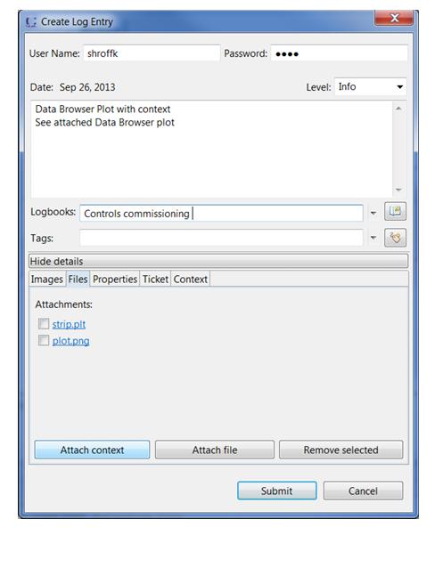
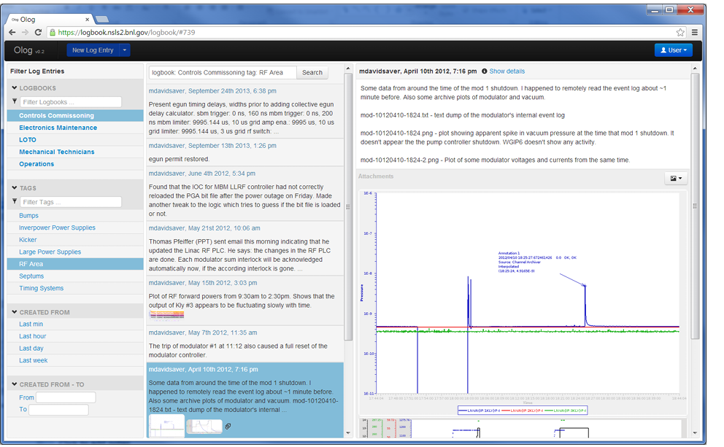
Future Control Service releases
EPICS development EPIK8S
INFN-LNF Fork from EPICS
-> See A. Michelotti presentation
OLOG - Logging
LOG entry tool integrated in EPICS/CS-Studio/Phoebus, pyOlog and Standalone Webclient
Natively integrated in EPICS, direct logging with PV entries
A. Michelotti, L. Napoleoni, G. Papalino and BTF Development
Entries type: Time • Owner • Text • Attachments • Logbooks • Tags • Properties
Currently in test at BTF-LNF
At facility user disposable with BOOKING linking
ADDED
LOG templates
AAII secure logging both for Phoebus and Webclient
Fetching PV snapshots (saving machine status directly in the logbook)
TODO
Linking for
Developing for INFN national service opened to all the INFN facilities and LoA2 users
Integration in existing ticketing-asset management service (Jira/Confluence)

Slide 13
What is the next?
Possibility to dedicate one week per year of each facility's machine time to INFaN activities (detector tests, hardware tests, and control).
AIMS
INTERNAL NETWORK: Establish an internal network within INFN for scientific, technological, technical, and infrastructure exchange between irrad facilities for mutual operational benefit.
GENERALIZED INFRASTRUCTURE with NATIONAL SERVICEs: Utilize a generalized infrastructure based on national services that includes information, beam time calls, and access procedures to INFN irrad facilities for scientific and third-mission purposes, while respecting the usage norms and local customs of the facilities, which will integrate into an abstract IT infrastructure.
COMMON FUNDING: the collection of funds to implement innovative and experimental operational solutions (e.g., detectors, hardware and software infrastructure) of shared ownership and common use, as well as to support and implement the network itself.
We are working to establish all aspects of the infrastructure and apply it to the facilities participating in INFaN

Slide 14
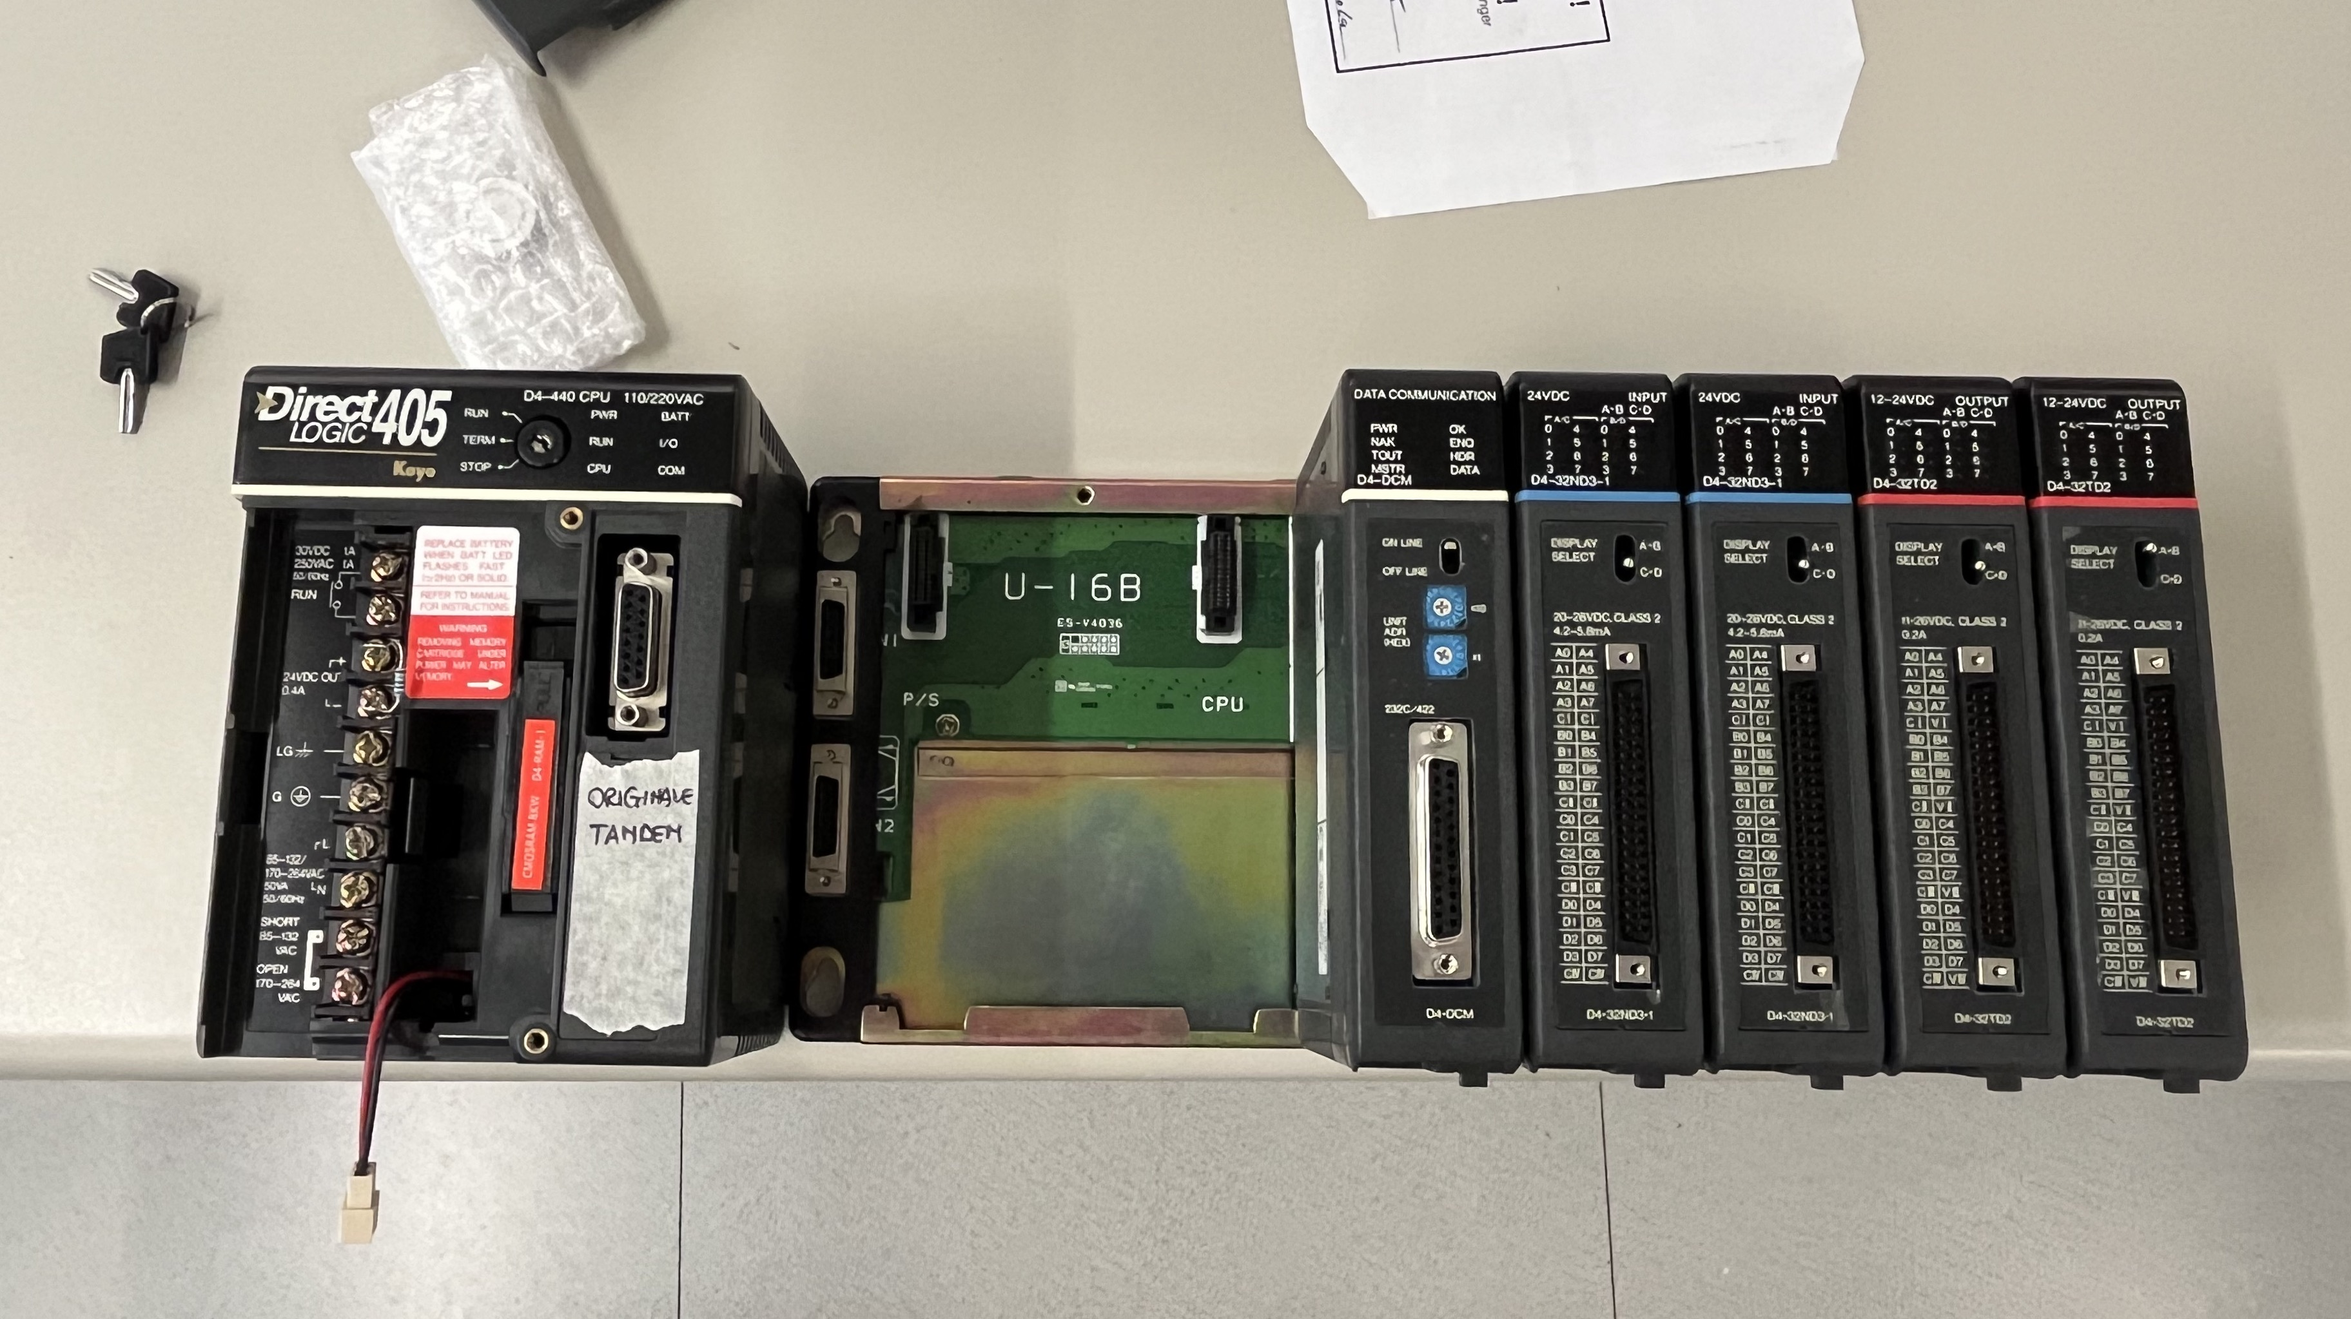
Irradiation National Facility Network: the involved facilities
3
An example: LABEC-LNF Collaboration
A major fault in the cabinet mains led to burned components on the LABEC Control PLC during the 2024 summer. No way to recover from producer.
LNF-LINAC Technicians (G. Piermarini and M. Ceccarelli) identified the problem and refurbished some parts of discontinued products.
In less than two weeks, the components was repaired and installed with teams from both labs.
The INFaN network facilitated contact between different lab personnel and expertise to solve the problem.
INFN
Sez. Torino
Contacted facilities
(up to now only charged one)

Slide 15
Thanks for your attention

