Slide 1



INFN Convegno Nazionale: Quarta Giornata Acceleratori
Applications of C and X band extremely high gradient RF structures at LNF
F. Cardelli, INFN-LNF
INFN Laboratori Nazionali di Legnaro, Italia
Apr 3 – 4, 2025

Slide 2
Outline
X-band high gradient Activities
  Eupraxia@SPARC_LAB Linac and X-band module layout
  X-band high gradient accelerating structure
    design and prototyping activity
    Low and high power test
  TEX facility description and Upgrade
C-band high gradient and high repetition rate RF Photo-Gun
  Design and technology
  Realization
  Low and high power RF test
Conclusion and Perspectives

Slide 3
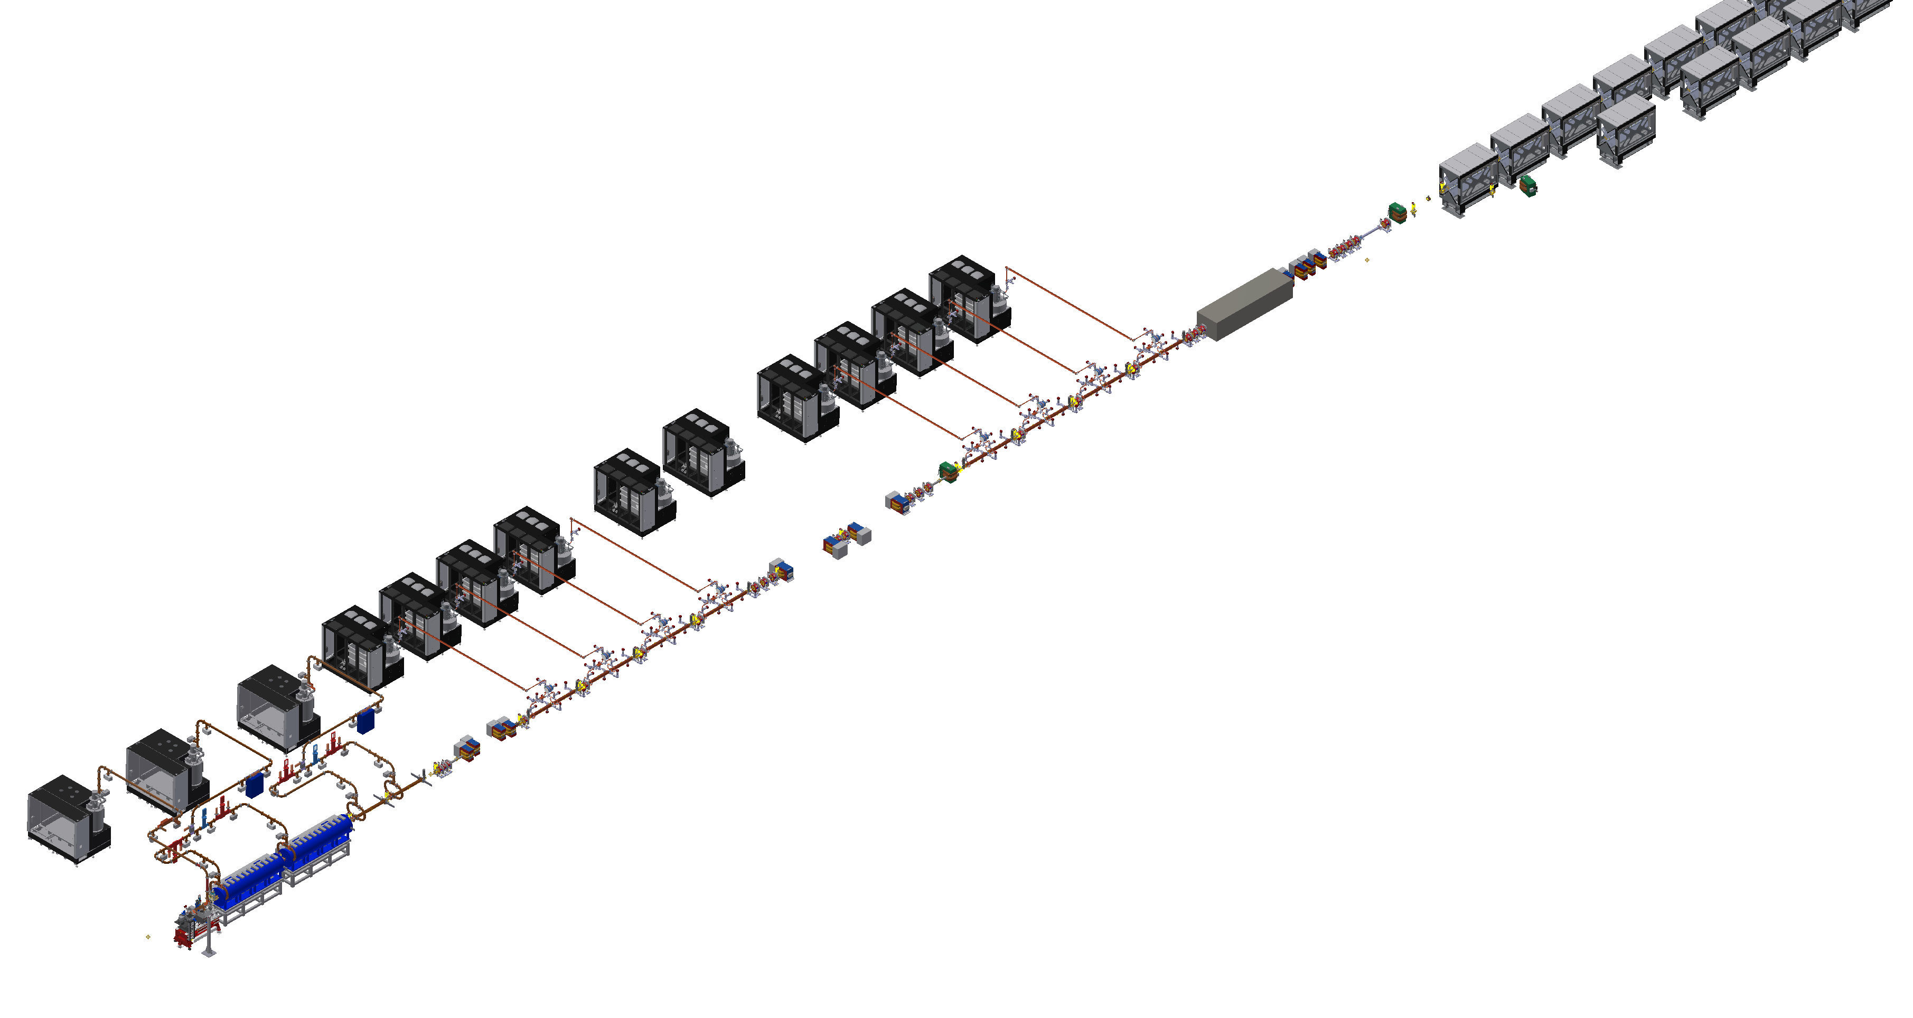
Layout of the EuPRAXIA RF Linac
FEL radiation source (two FEL lines λ_{FEL}=4 nm and 50-180nm) combining: 1GeV RF Linac with a Plasma module for PWFA. The Linac uses an S-band (2.998 GHz) injector followed by an X-band (11.998 GHz) booster to produce a high brightness electron beam up to an energy of 1 GeV at a repetition rate of 100Hz.
A new building, now under executive design phase, will host the new Facility at LNF, the construction will start in September 2026.
Undulators (Aria, Aqua)
PARAMETER | Unit | Values
Electron Energy | GeV | 1-1.2
Bunch charge | pC | 30-500
RMS Energy spread | % | <1
RMS Bunch Length | µm | 3-20
RMS Norm. Emitt. | µm | ≤1
Slice Energy spread | % | ≤0.05
Slice Norm. Emitt. | mm∙mrad | 0.5
8+2 X-band RF Sources
Plasma module
High energy X-band booster
3 S-band RF Sources
Bunch compressor
Low energy X-band booster
S-band RF Photo-Injector

Slide 4
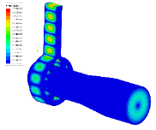
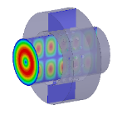
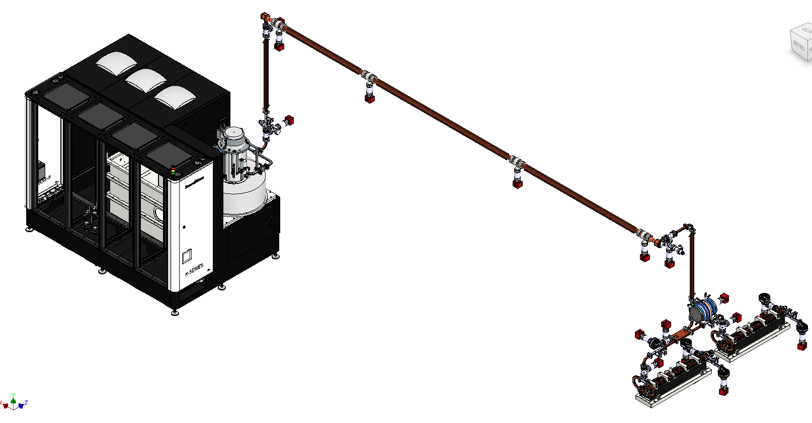
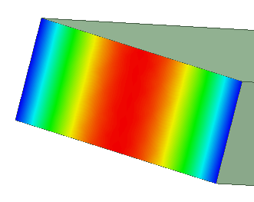
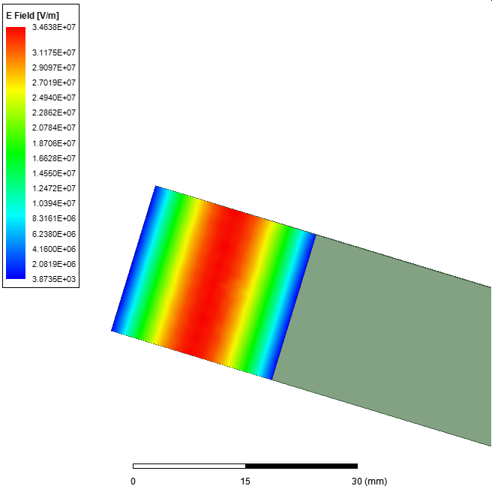
X-band module layout
25 MW
1.5 us
100 Hz
PARAMETER | Value
Frequency [GHz] | 11.9942
Average acc. gradient [MV/m] | 60
Structures per module | 2
Peak input power per structure [MW] | 70
Input power averaged over the pulse [MW] | 51
Filling time [ns] | 130
Required Kly power per module [MW] | 22.5
Kly RF pulse length [µs] | 1.5
Repetition Rate [Hz] | 100
Mode conv.
Transport line:
Low loss Circular waveguide
WR90
DHWR90
Pulse Compressor
140-70 MW
6 m
130 ns
100 Hz
∼33 MV/m
∼23 MV/m
(comparable with C band @ 300 MW)
70-35 MW
130 ns
100 Hz
Power Source:
Solid State Modulator + Klystron
Accelerating module
2.3 m

Slide 5
X-band Structure
The EM design of the structure is completed: 1.05 m long structures with 3.5 mm average iris radius design to work with an average acceleration gradient of 60 MV/m. The single cell and RF structure optimization has been completed developing a semi-analytical code to consider also the power gain from the BOC pulse compressor: done
Thermo-mechanical simulations to demonstrate the correct sizing of the cooling system (at 100 Hz and 400 Hz): done
Dark current simulations (CST Particle in cell) have been performed to evaluate the background radiation together with vacuum calculation to verify the pression distribution along the structure: done
The final mechanical design of the final X-band structure has been under constant review, related to the result of the pre-prototyping activity: brazing test, cell to cell alignment, etc: done
PARAMETER | Value
 | Quasi-Constant Gradient | Constant Impedance
Frequency [GHz] | 11.9942
Average acc. gradient [MV/m] | 60
Structures per module | 2
Iris radius a [mm] | 3.85 - 3.15 | 3.5
Tapering angle [deg] | 0.04 | 0
Struct. length L_{s} act. Length [m] | 1.05
No. of cells | 113
Shunt impedance R [MΩ/m] | 93-107 | 100
Peak input power per structure [MW] | 70
Input power aver. over the pulse [MW] | 51
Average dissipated power [kW] | 1
P_{out}/P_{in} [%] | 25
Filling time [ns] | 130
Peak Modified Poynting Vector [W/μm²] | 3.6 | 4.3
Peak surface electric field [MV/m] | 160 | 190
Required Kly power per module [MW] | 22.5
Kly RF pulse length [µs] | 1.5
Repetition Rate [Hz] | 100
1.05 m
5
M. Diomede et al. NIM A 909 (2018) 243–246

Slide 6
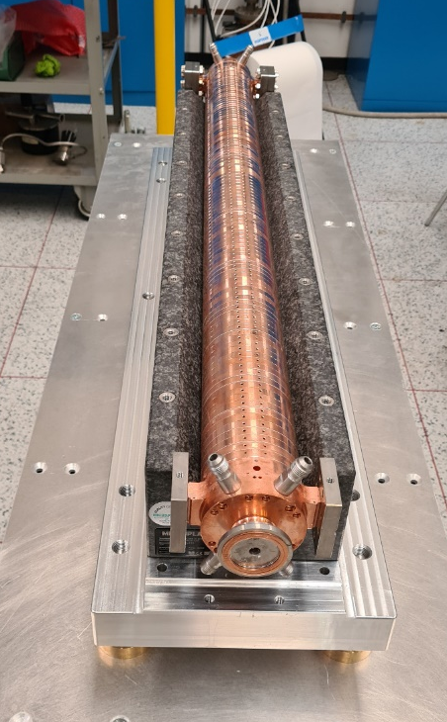
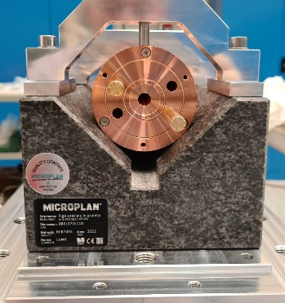
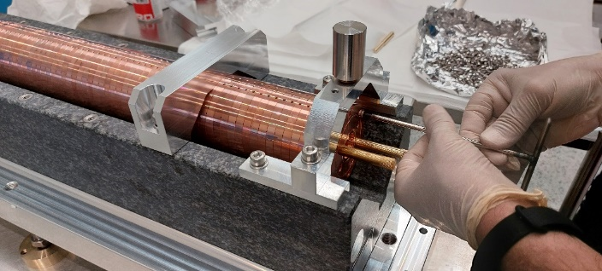
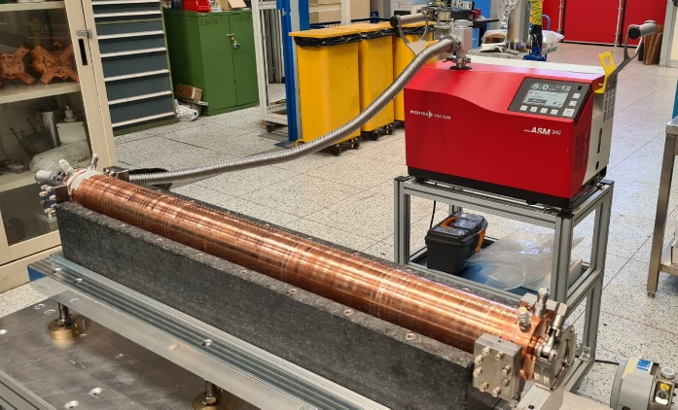
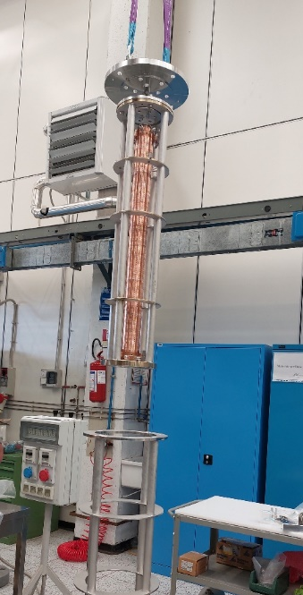
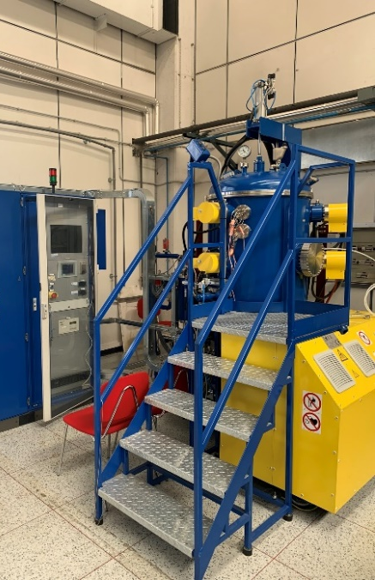
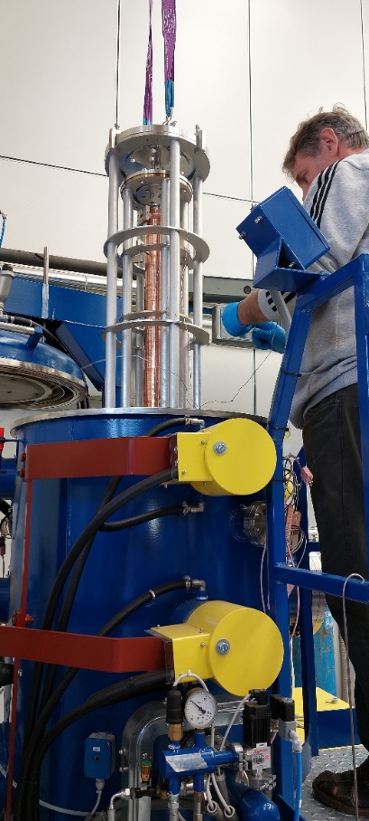
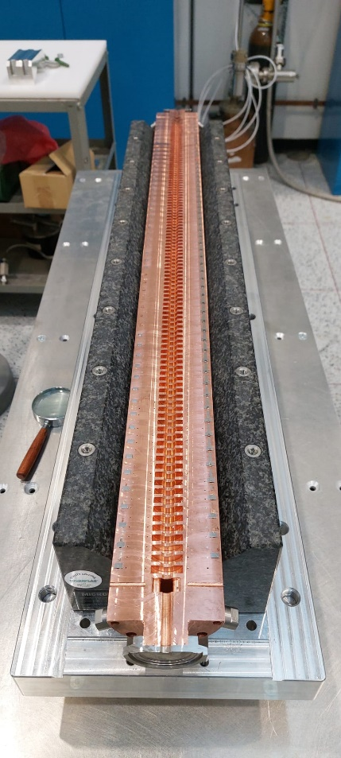
X-band mechanical prototypes
2x Full scale mechanical prototype for brazing optimization and test
To maintain the alignment and cell to cell straightness during and after the brazing process, each cell is fixed to the next one by means of screws and mounted on a very precise granite support. This ease also the cells assembly
Results on the brazed structure
Vacuum test OK (except one coupler for a miss-positioning of the brazing alloy)
Straightness <±15 μm obtained after brazing on both the prototypes (±30 μm required by BD)
6
6

Slide 7
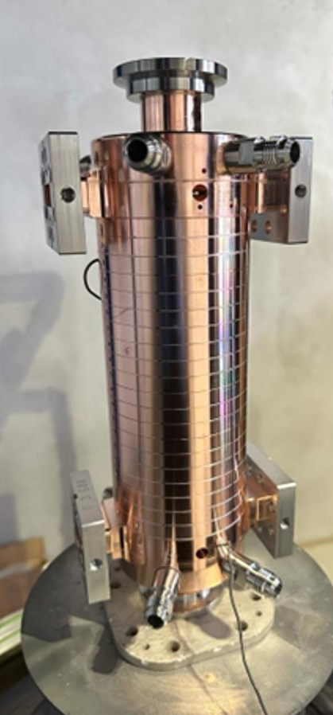
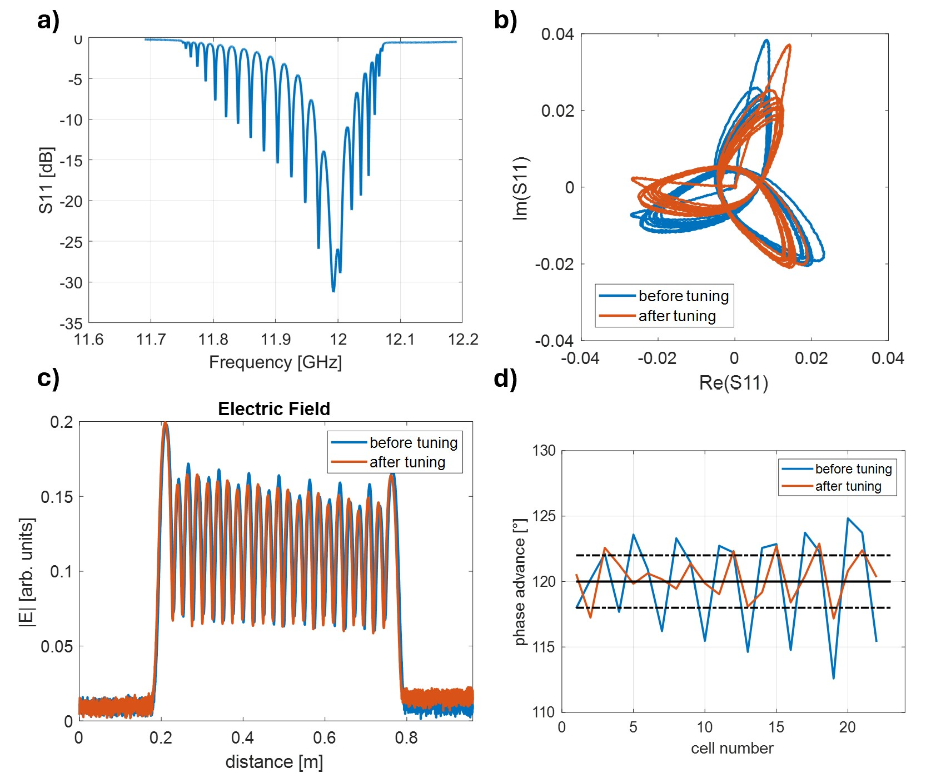
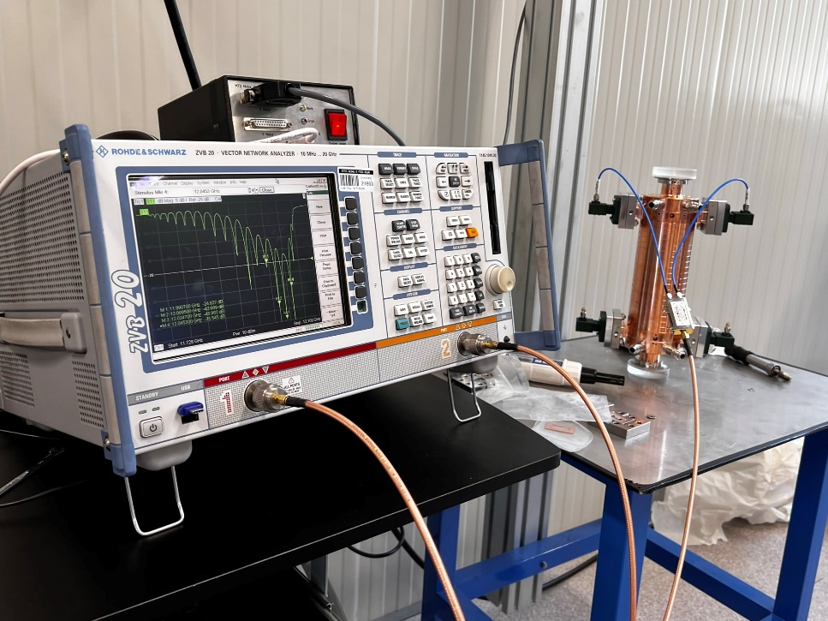
21 cells RF prototype measurements
X-band, 21 (+2) cells, CI, travelling wave structure prototype
It has been realized without tuners on the cells, we just have a couple of tuners on the two couplers
We perform low power measurements before cells brazing (thank to the screws), after the brazing and then aftert the tuning of the couplers.
During the measurements and the tuning procedures the structure has been continuosly fluxed with nitrogen.
All the cells seems to be smaller to obtain the best response from the cells we have to increase the working temperature → T_{cav} = 35 °C

Slide 8
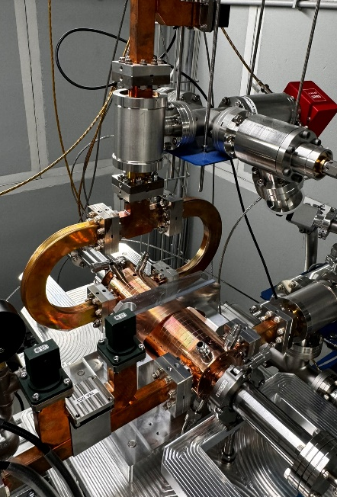
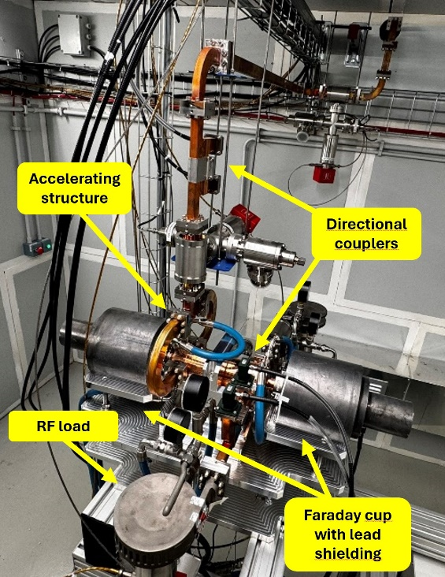
21 cells RF prototype preliminar high power test
In spring 2024 we started the high-power test of the first EuPRAXIA@SPARC_LAB X-band structure prototype.
21 cells, constant impedance, RF prototype (the real structure will be 1 m long).
In nearly 12 days we reach an input pulse of 35 MW, 100 ns length at 50 Hz repetition rate, that correspond to an average gradient along the structure equal to 74 MV/m and a peak gradient at the structure input of 80 MV/m with a BDR/m nearly 5e-4.
The test will continue after the end of the TEX upgrade in May 25, with the BOC pulse compressor (PSI) installed on the line.
DESIGN PARAMETER | Value
Frequency [GHz] | 11.9942
Average acc. gradient [MV/m] | 60
Structures per module | 2
Iris radius a [mm] | 3.5
Struct. length L_{s} act. Length [m] | 0.2
No. of cells | 20
Shunt impedance R [MΩ/m] | 100
Filling time [ns] | 30
Repetition Rate [Hz] | 100
8

Slide 9
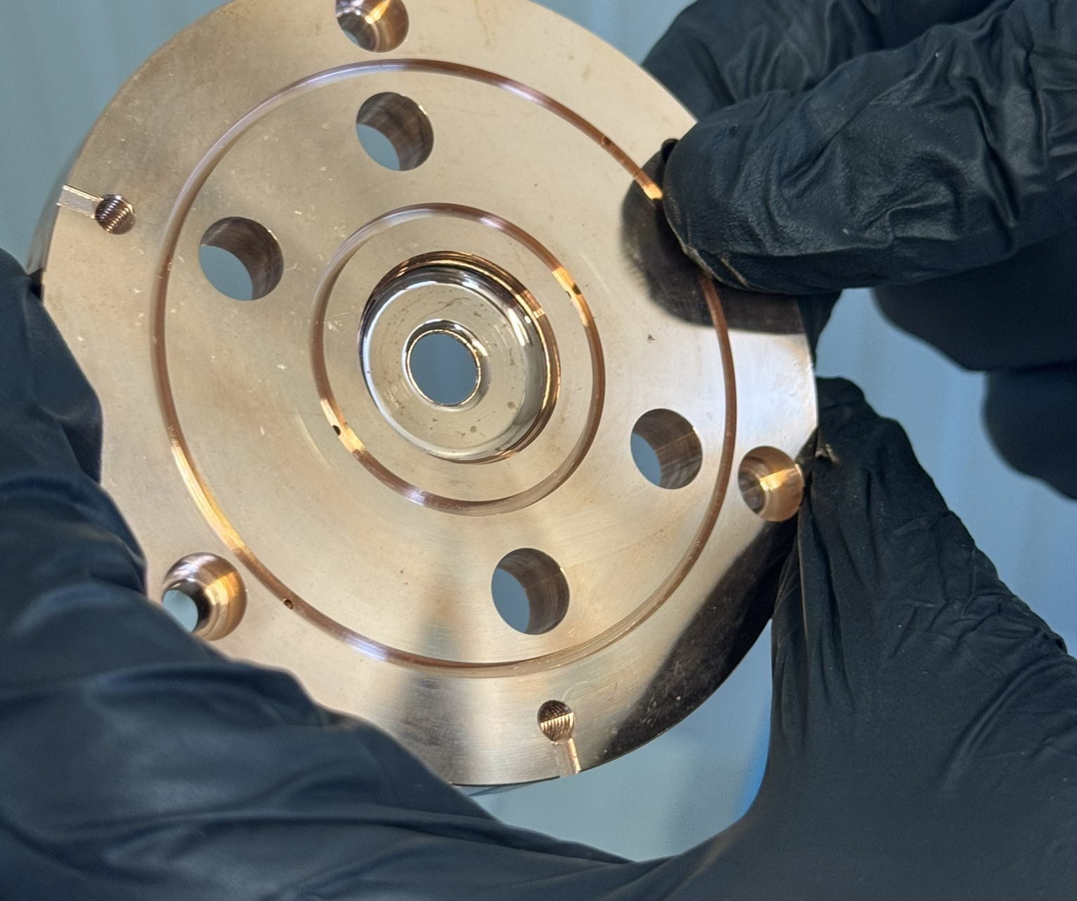
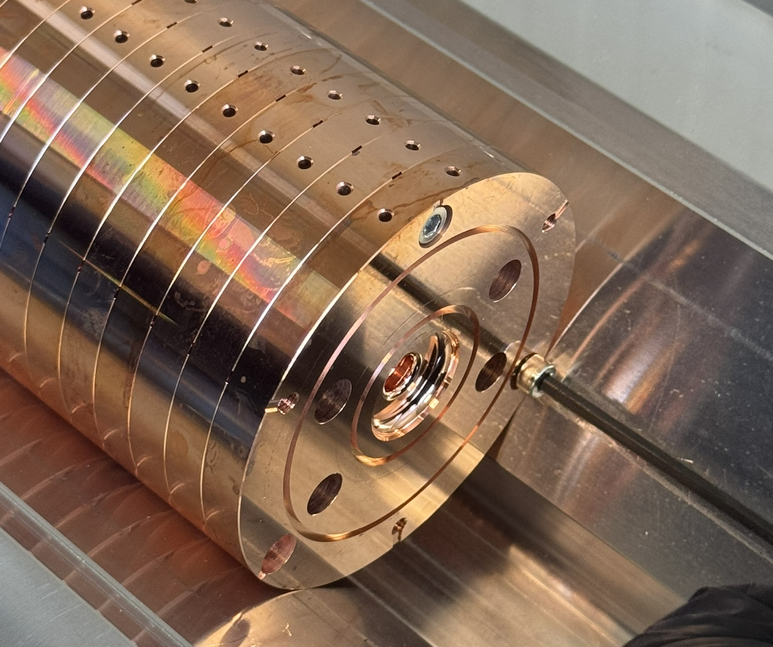
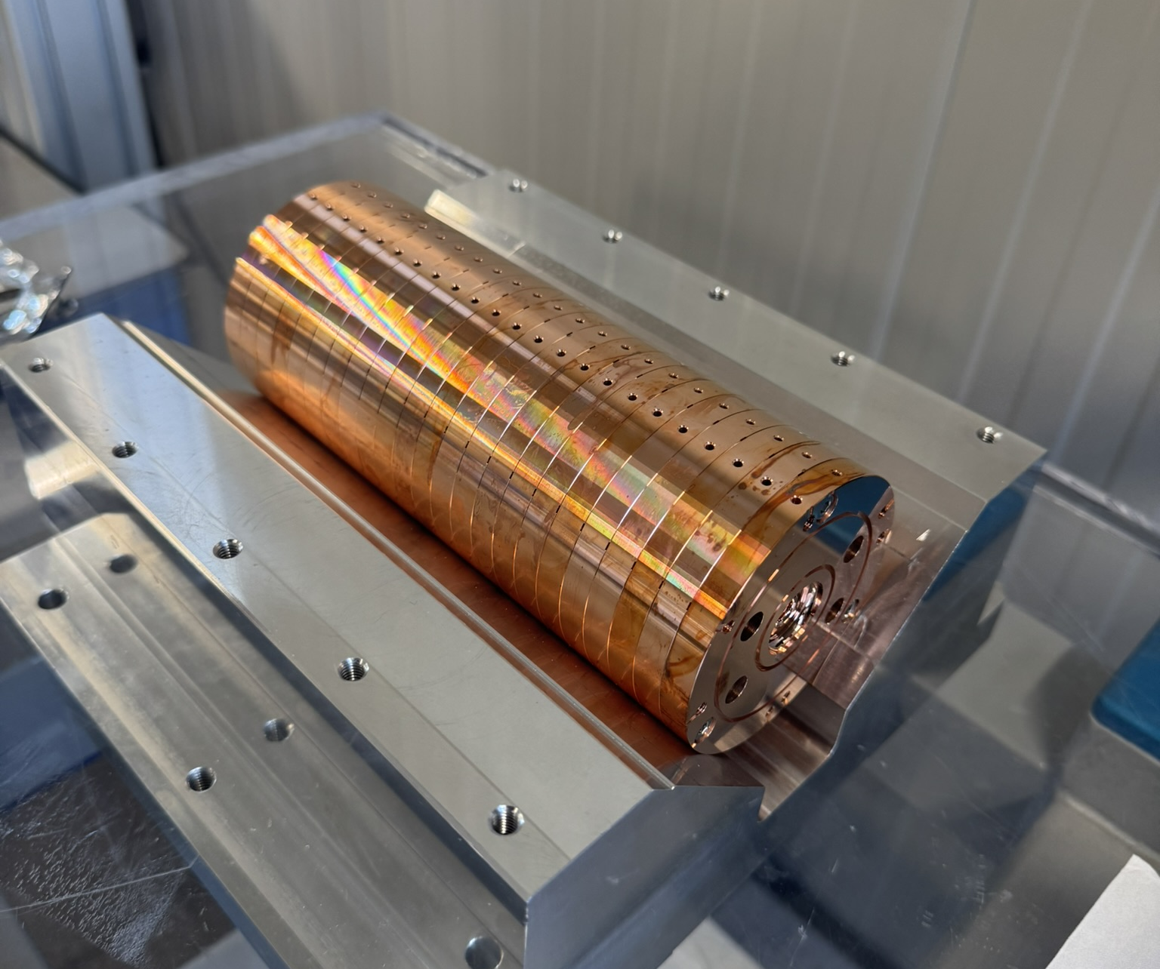
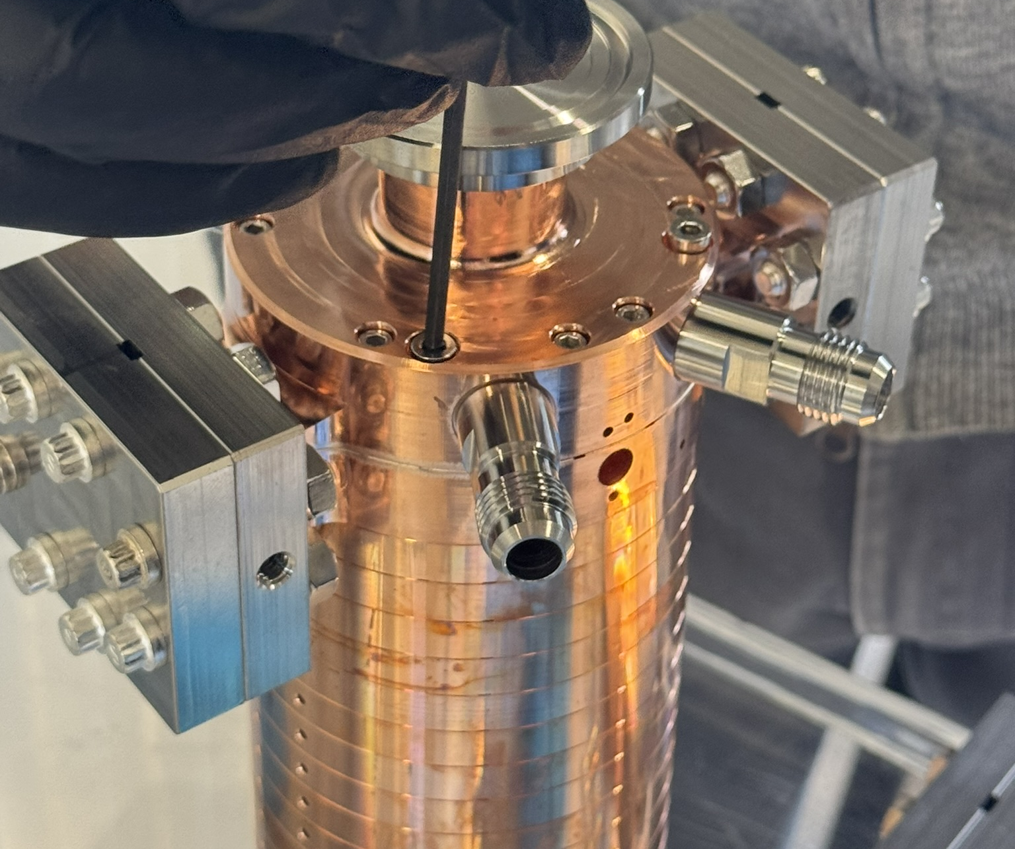
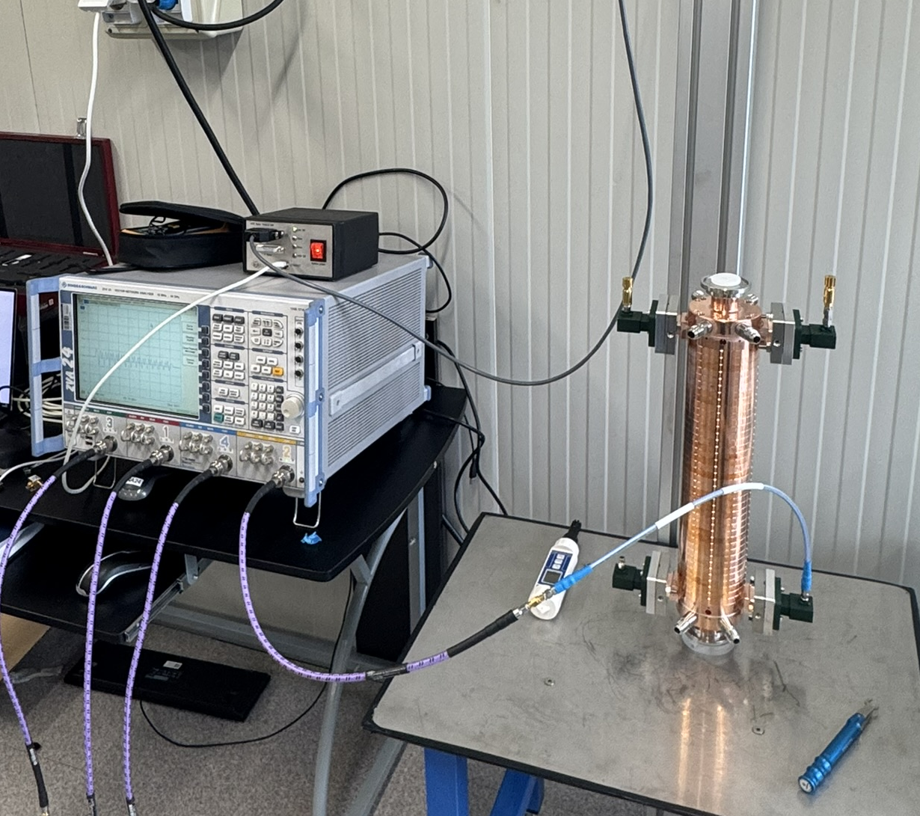
Full scale RF prototype measurements
The two couplers have been realized and brazed, and all the cells have been machined.
To verify that the cells were properly machined, we divided them into three groups (39, 39 and 44 cells) and measured them with the bead pull technique, simply assembling them with screws and using the two brazed couplers.
We didn't find any faulty cells, but they all seem slightly larger, requiring a lowering of the operating temperature of nearly 5 degree. T_{cav} = 20 °C
Results of the 3rd group:

Slide 10
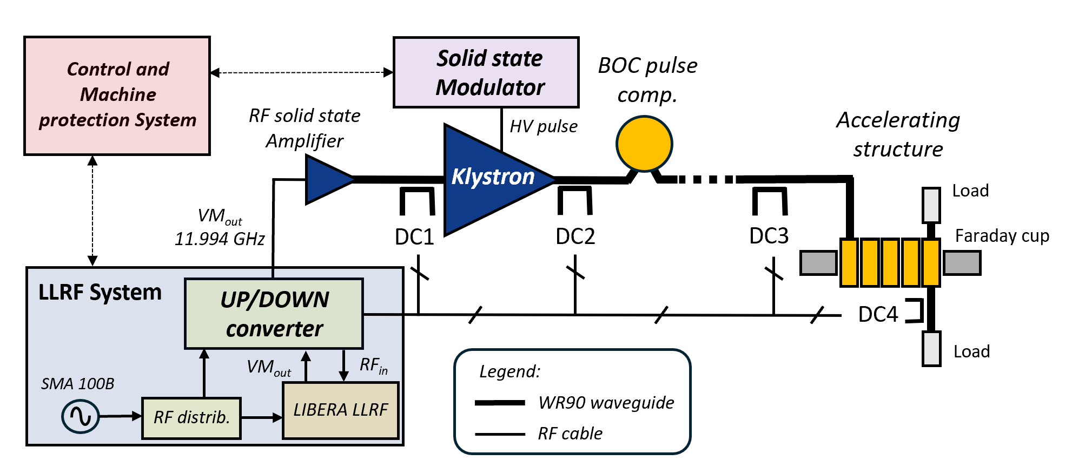

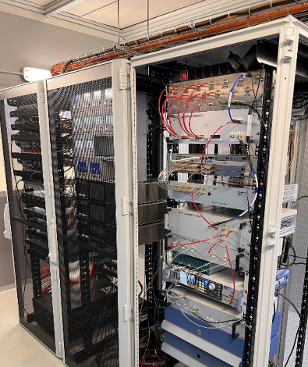
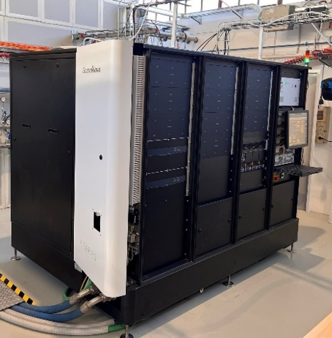
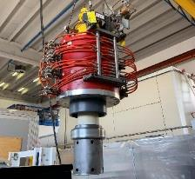
TEX Facility
The TEst-stand for X-band (TEX) is conceived for R&D and test on high gradient X-band accelerating structures, RF components, LLRF systems, Vacuum system and Control System
It has been co-funded by Lazio region in the framework of the LATINO project (Laboratory in Advanced Technologies for INnOvation). The setup has been done in collaboration with CERN and it will be also used to test CLIC structures
The installation and commissioning of the whole system (Source and RF network, LLRF, vacuum and EPICS control system) have been completed by the end of 2022 [3,4,5].
Then started the testing activity:
Cathode peak voltage | 427 kV
Peak RF output power | 50 MW
Pulse length | 100 ns - 1.5 us
Repetition Rate | 50 Hz
RF output amplitude stability | < 0.09 %
RF output phase stability | 20.9 fs
Period | Device tested at high power
Jan. - Feb. 2023 | 3D printed Spiral RF loads and wg system
May - Oct. 2023 | X-band T24 CLIC structure
Nov. - Dec. 2023 | X-band Mode converter and circular wg
Jan. - Feb. 2024 | X-band RF waterload design at PSI
March 2024 | 21 cells first EuPRAXIA RF prototype
April 2024 - Now | Upgrade of the facility
LLRF system
50 MW RF Source
VKX8311A Klystron
F. Cardelli et al., 13th Int. Particle Accelerator Conf. IPAC22, Bangkok, Thailand, Jun. 2022, paper TUPOPT061
L. Piersanti et al. “RF power station stabilization techniques and measurements at LNF” In Proc. IPAC24 - TUPR01.
L. Piersanti et al. “Design and test of a klystron intra-pulse phase feedback system for electron linear accelerators” Photonics 2024, 11(5), 413.
F. Cardelli et al., in Proc. IPAC'24, Nashville, TN (2024) paper TUPR02
10

Slide 11
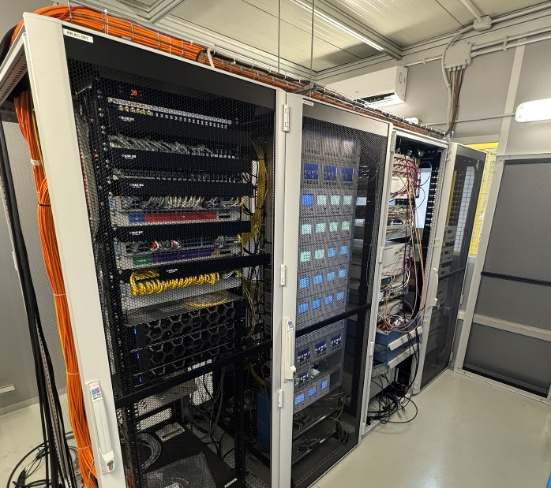
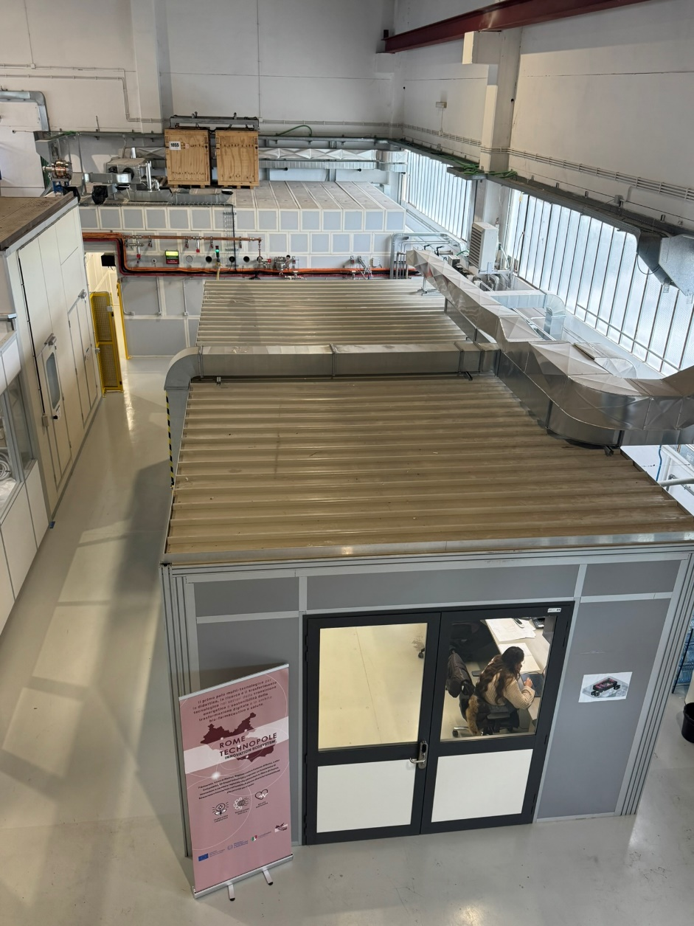
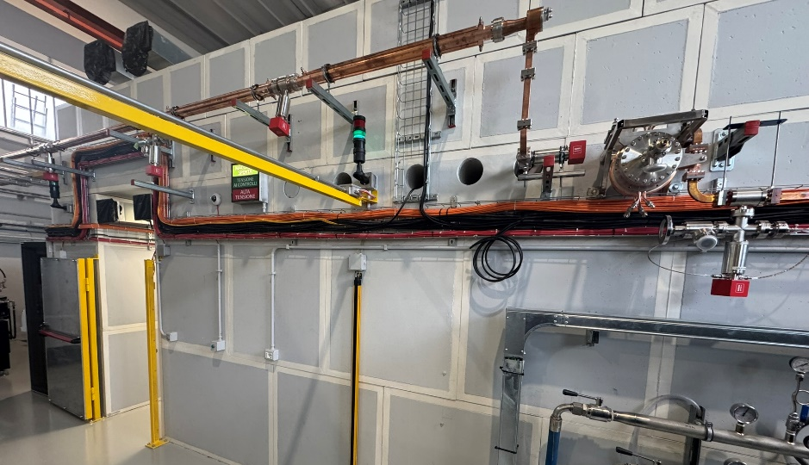
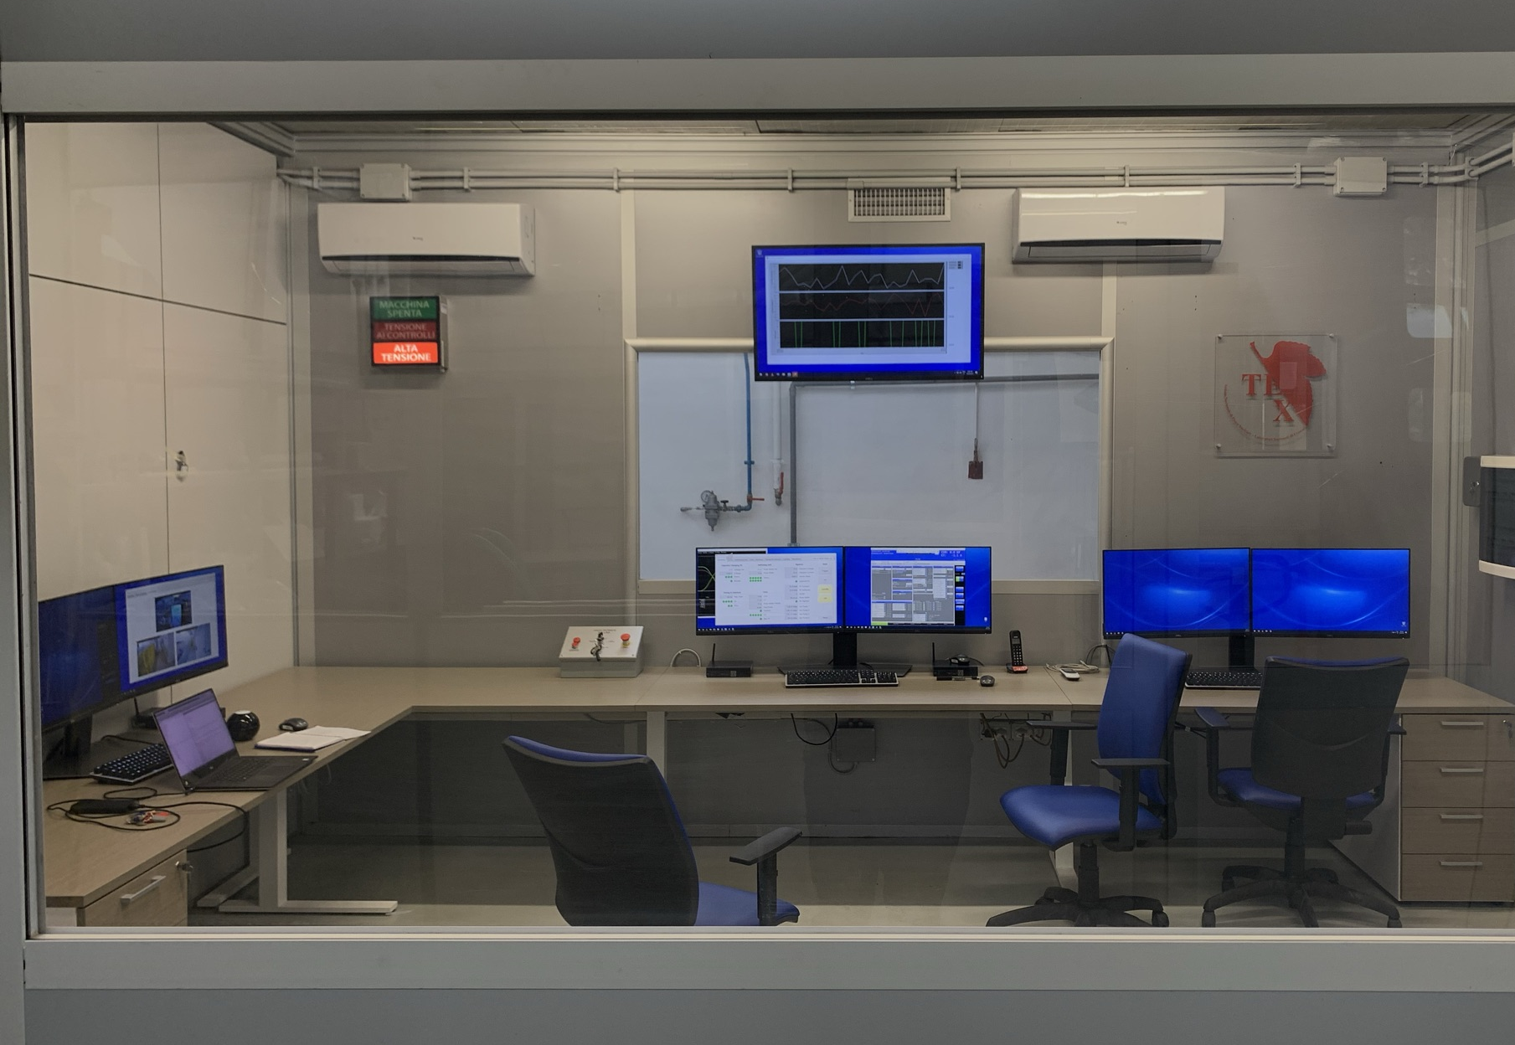
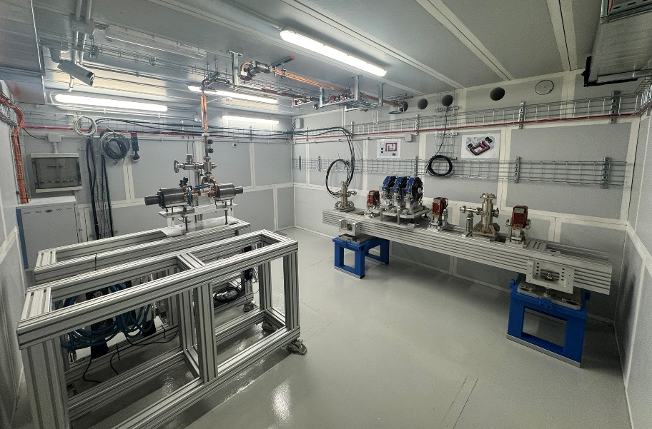
TEX Facility (II)
TEX is located at the building 7 of INFN-LNF that has been completely refurbished to host this facility.
Rack Room
Bunker
Experimental hall
Control Room

Slide 12
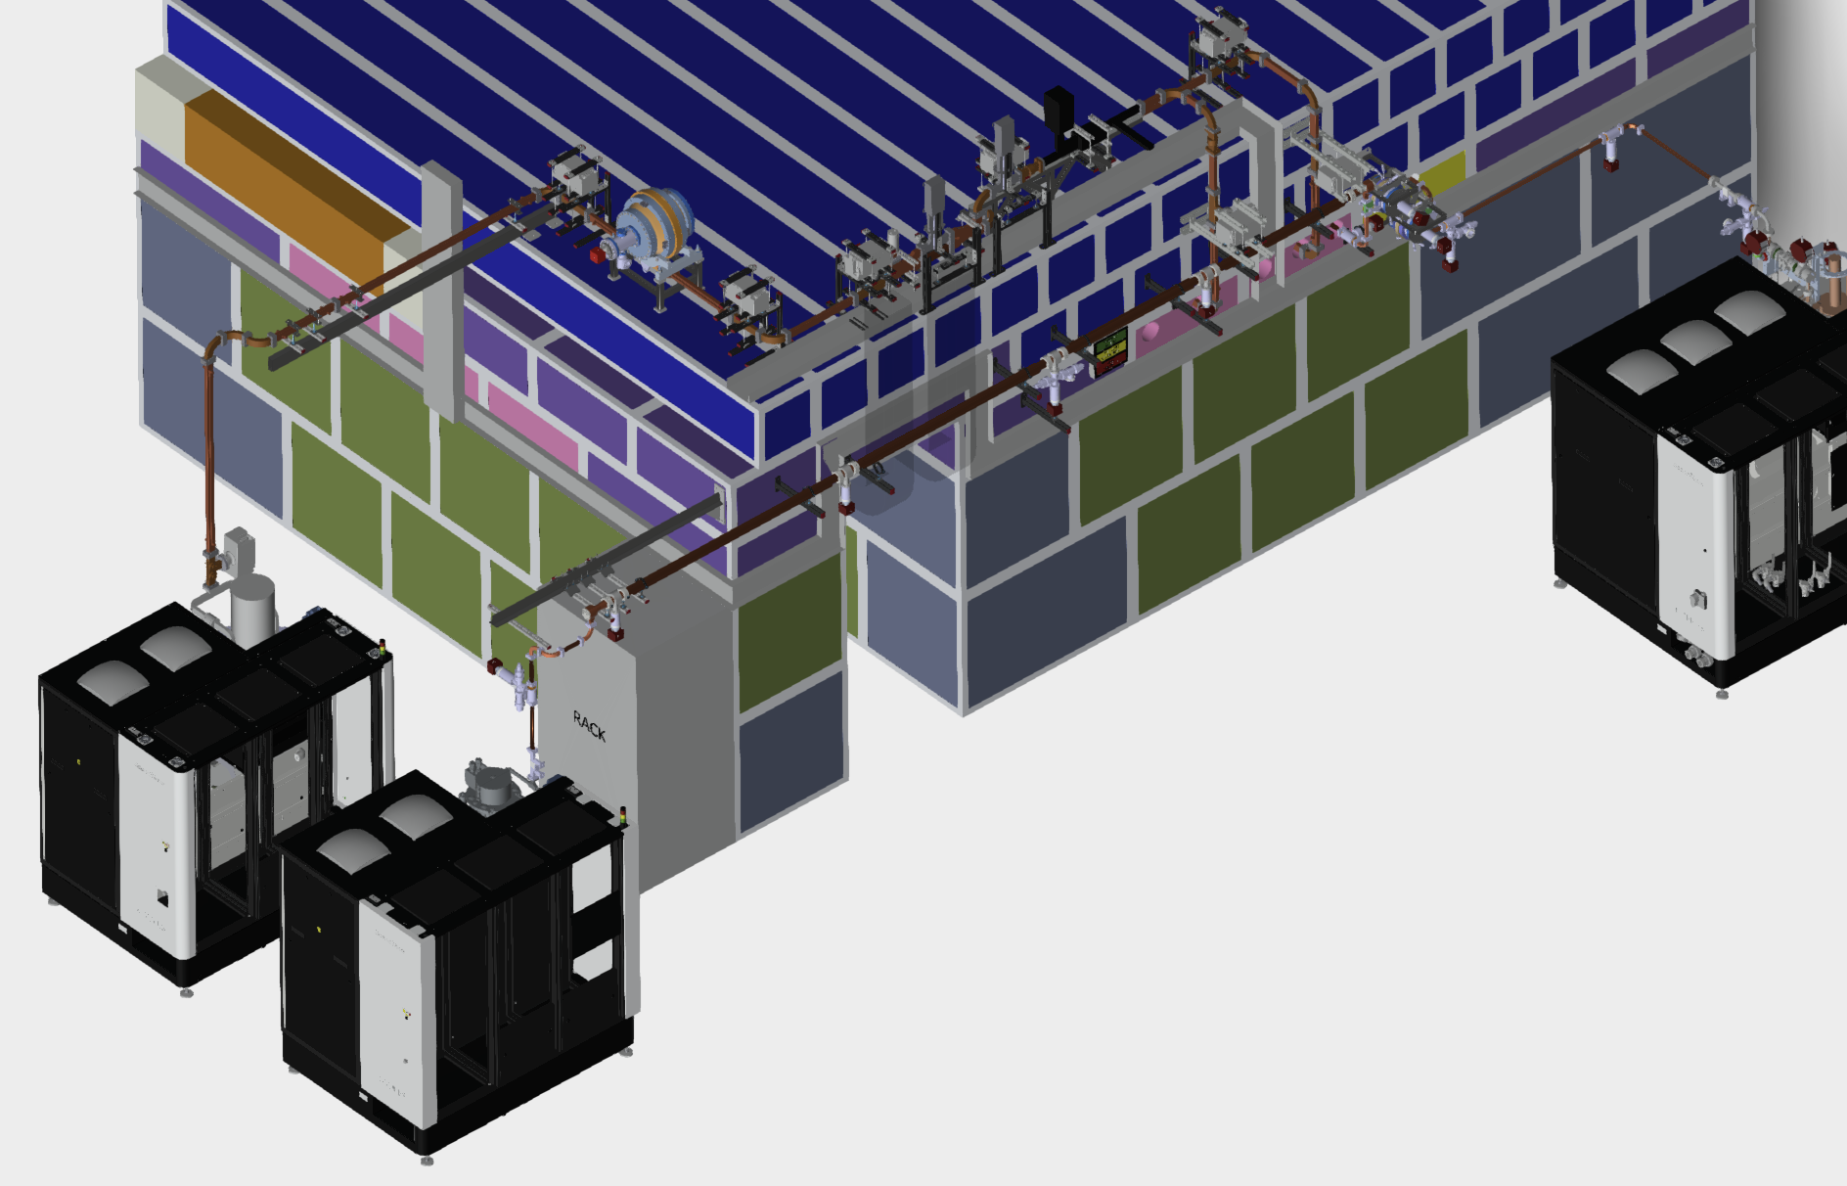

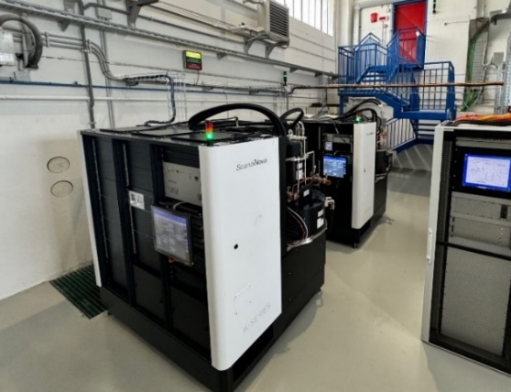
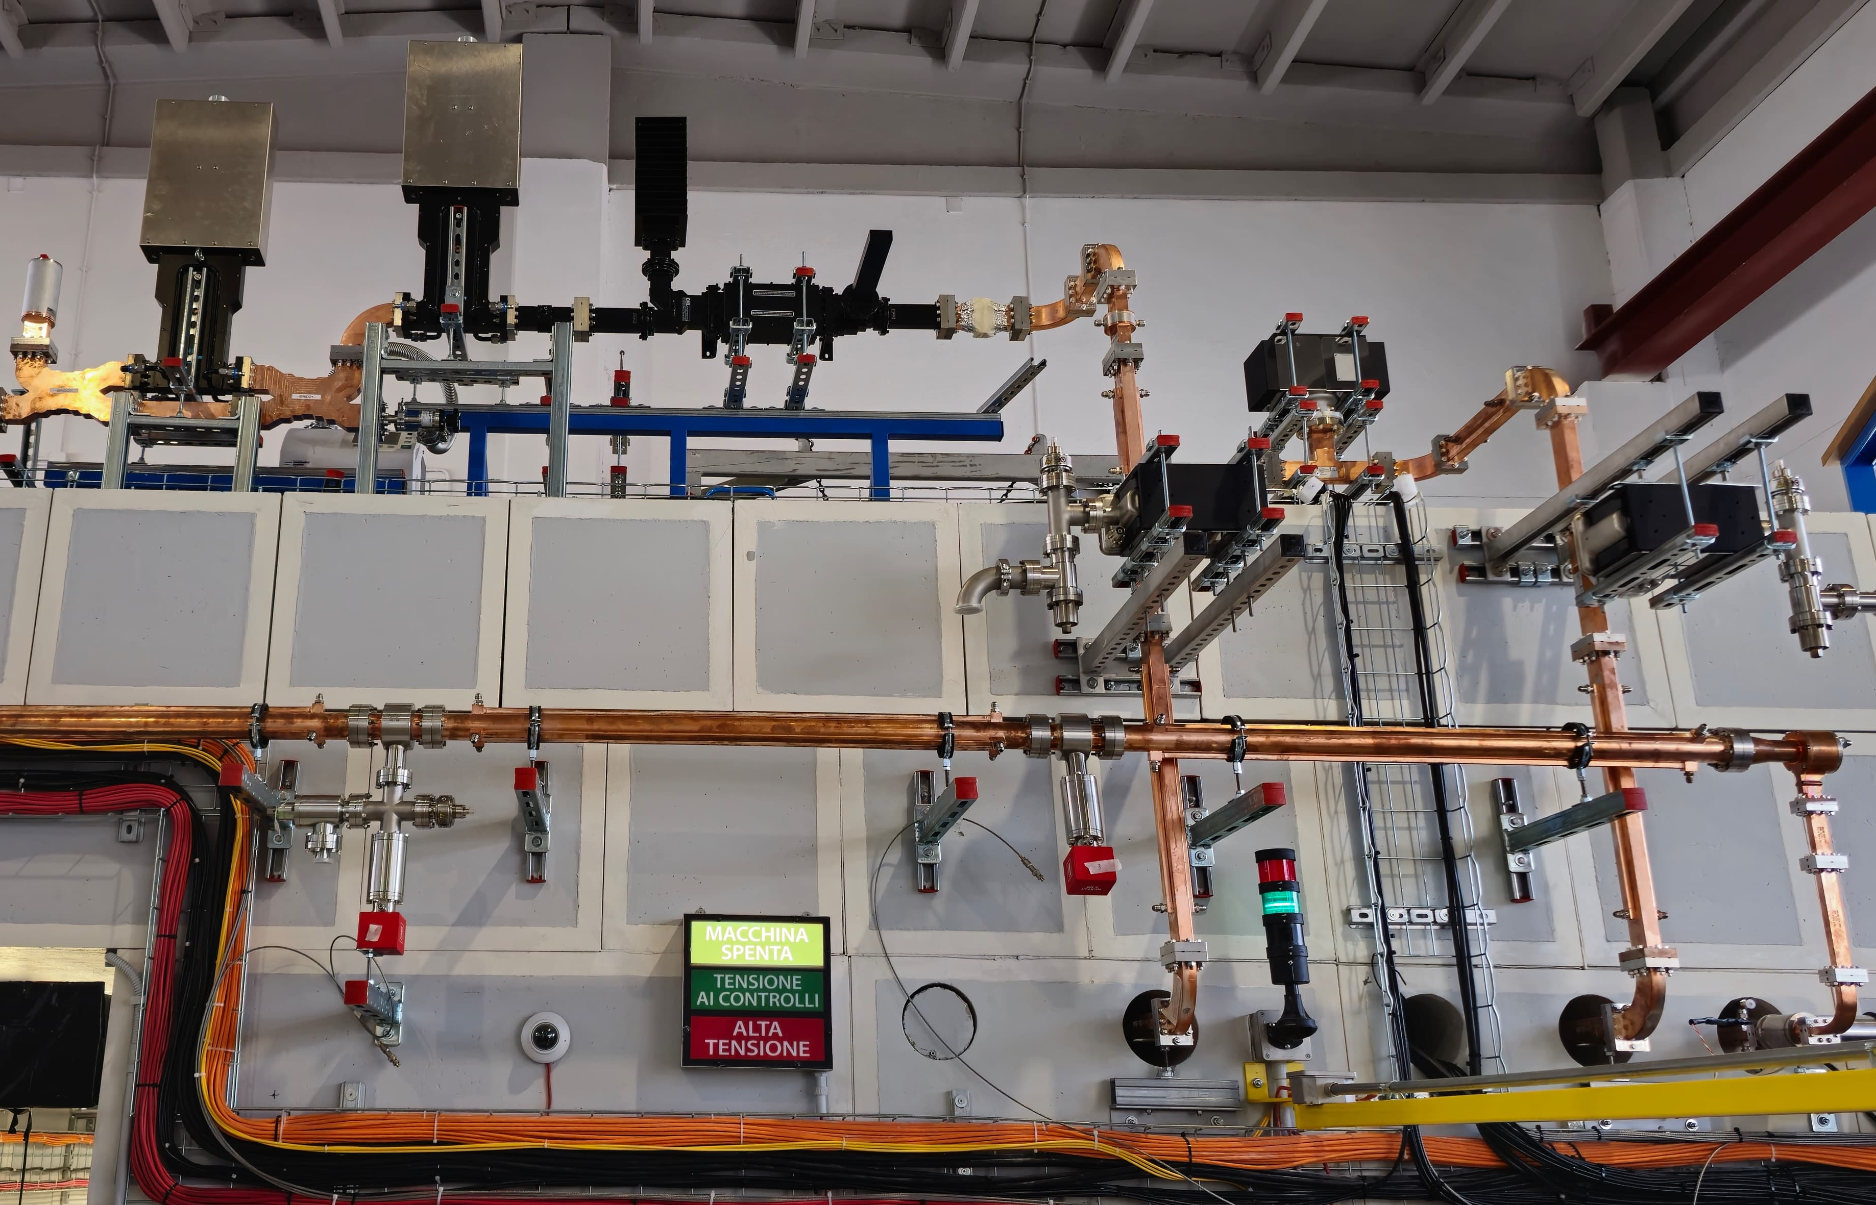
TEX Upgrade
Since April 2024, thanks to EuPRAXIA project and PNRR Rome Technopole project, started the upgrade of the TEX facility.
Procurement, installation and test of two new RF sources, waveguide systems, with a new cooling plant and new LLRF system:
C-band BOC
X-band BOC
400Hz 20MW C-band klystron
  X-band (11994 MHz) 25MW, 400Hz Power Source: will double the X-band testing capabilities of the facility at high average power.
  C-band (5712 MHz) 20MW, 400Hz Power Source: will allow testing of C-band components and structures.
Dry cooler installation by the end of April 2025.
  SAT with Scandinova and Canon is scheduled in May 2025.
  Operation restart in May 2025.
50Hz 50MW X-band klystron
400Hz 25MW X-band klystron
Parameter | Unit | CPI VKX8311 | Canon E37119 | Canon E37217
Frequency | MHz | 11994 | 11994 | 5712
Vk beam voltage | kV | 420 | 312 | 254
Ik cathode current | A | 320 | 199 | 196
Peak RF output Power | MW | 50 | 25 | 20
Average RF output power | kW | 7.5 | 15 | 21
Modulator Average power | kW | 48 | 80 | 80
RF pulse length | μs | 1.5 | 1.5 | 2.5
Repetition Rate | Hz | 100 | 400 | 400
Gain | dB | 47 | 47 | 50
Efficiency | % | 38 | 40 | 40
12

Slide 13
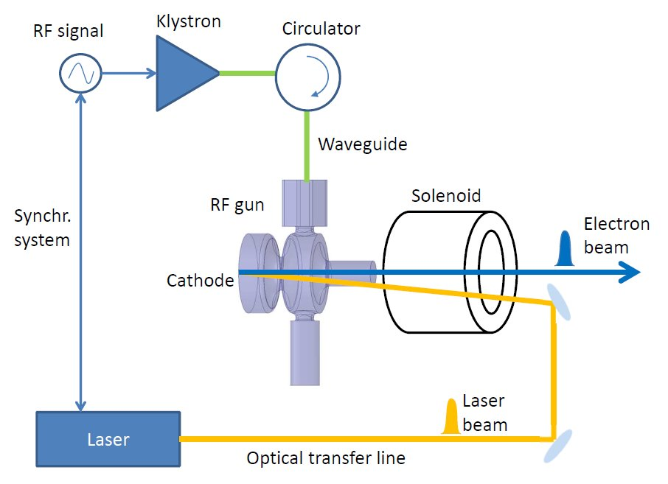


C-band RF Photo-Gun Introduction
RF Photo-injectors are widely used in FEL, as very low-emittance and high-brightness electron sources.
A laser pulse hits a cathode, and the electrons are immediately accelerated by an intense RF Electric field (60-120 MV/m).
RF technology mostly used is the L or S-band (f=1.3 or 3 GHz).
The higher the peak electric field on the cathode, the better the quality of the electron beam.
An R&D program has been funded by the I.FAST (Horizon 2020) and TUAREG (INFN commission V) projects
The frequency step-up from L/S-band to C-band can provide:
Higher achievable cathode peak field as high as 160-180 MV/m.
Higher efficiency, so it is suitable for application requiring repetition rates in the 200 Hz÷1 kHz range.
The availability of a new state-of-the-art, electron injector would bring benefits to a large accelerator user community, (FEL radiation sources, Thomson/Compton photon sources and plasma based accelerators)

Slide 14
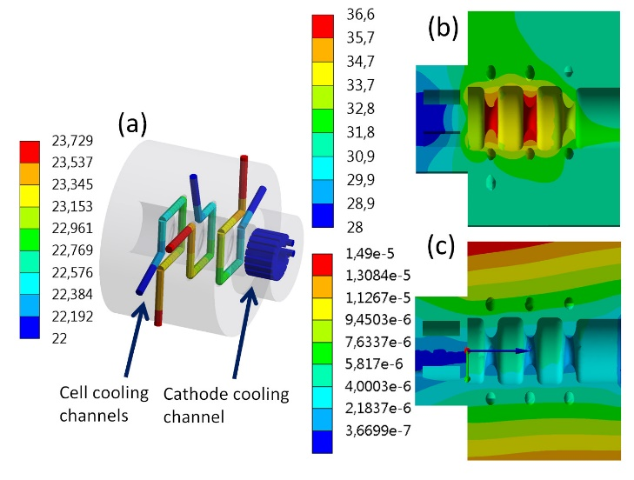
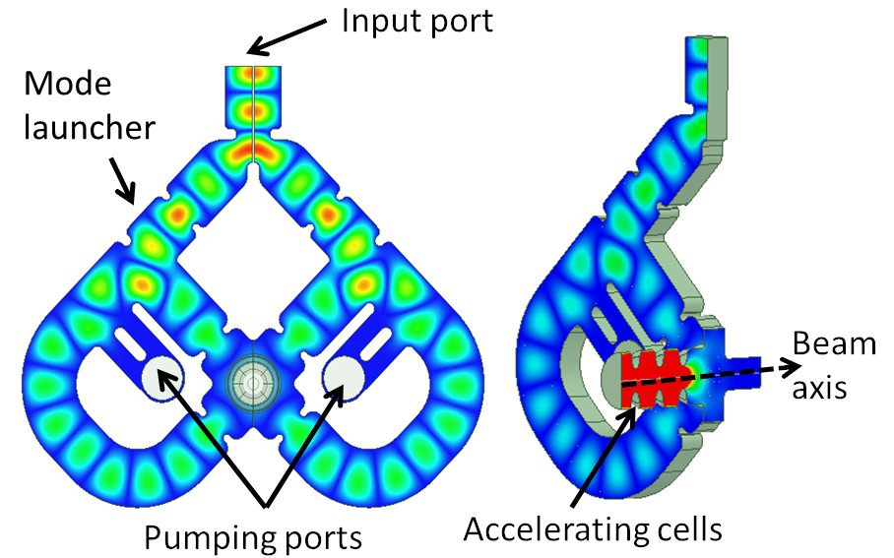
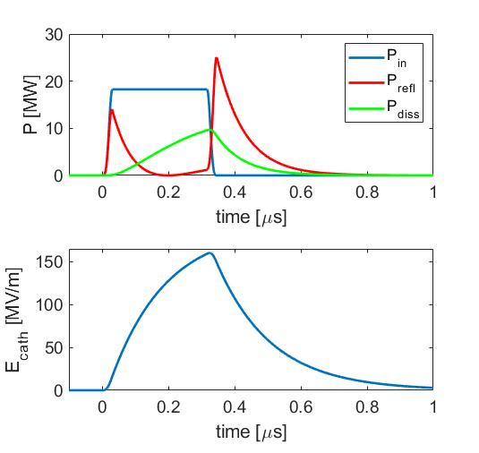
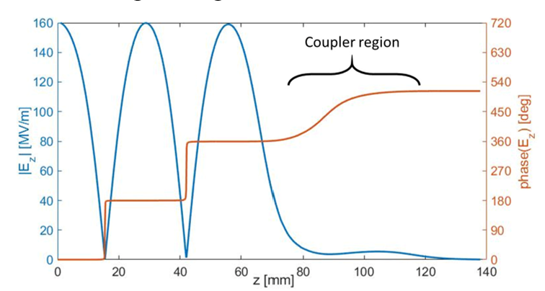
C-band RF Photo-Gun Design
The new C-Band RF gun is a 2.5 cell standing wave cavity with:
four-port mode launcher for electric field coupling (low pulsed heating) and no multipole components induced by the coupler
coupling factor β=3 to operate with short rf pulses (300 ns)
Elliptical shape of the irises to reduce the surface electric field and modified Poynting vector
Large irises apertures to increase the pumping speed and increase the mode separation
A dedicate cooling system in each cell (possible with the on axis coupler) that allow to operate at high rep. rate (up to 1 kHz)
Parameter | Value
Resonant frequency | 5.712 (5.712)
E_{cath}/√P_{diss} [MV/(m⋅MW^{0.5})] | 51.4
rf input power [MW] | 18
Cathode peak field [MV/m] | 160
Rep. rate [Hz] | 100-400
Quality factor | 11900 (11900)
Filling time [ns] | 166 (147)
Coupling coefficient | 3 (3.5)
rf pulse length [ns] | 300
Mode sep. π-π/2 [MHz] | 47 (48.3)
E_{surf}/E_{cath} | 0.96
Mod. Poy. vector [W/μm²] | 2.5
Pulsed heating [ºC] | 16
Average diss. Power [W] | 250-1000
D. Alesini et al., MOPOMS021, IPAC2022, Bangkok, Thailand, p. 679, 2022
D. Alesini et al., TUPA009, IPAC2023, Venezia, Italy, p. 1356, 2023
F. Cardelli et al., MOPOMS020, IPAC2022, Bangkok, Thailand, p. 675, 2022
A. Giribono et al., PRAB 26, 083402, 2023
F. Cardelli, Nuovo Cimento issue 5 (2024)
14

Slide 15
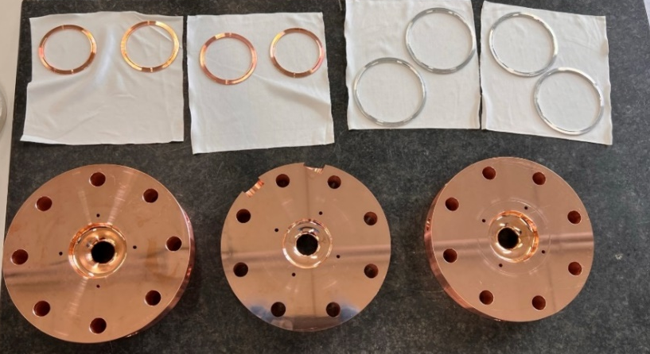
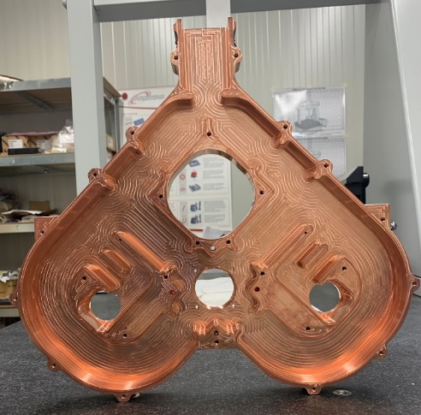
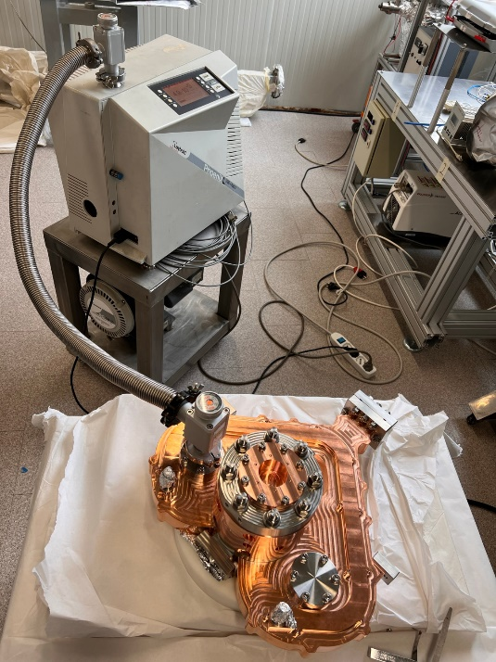
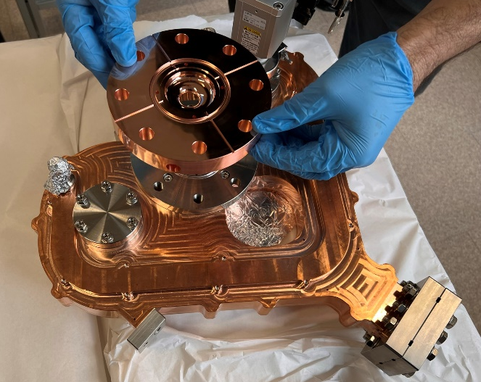
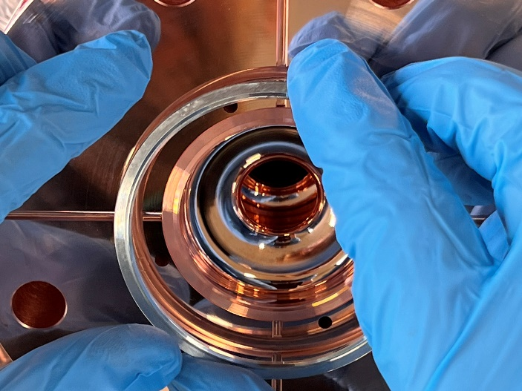
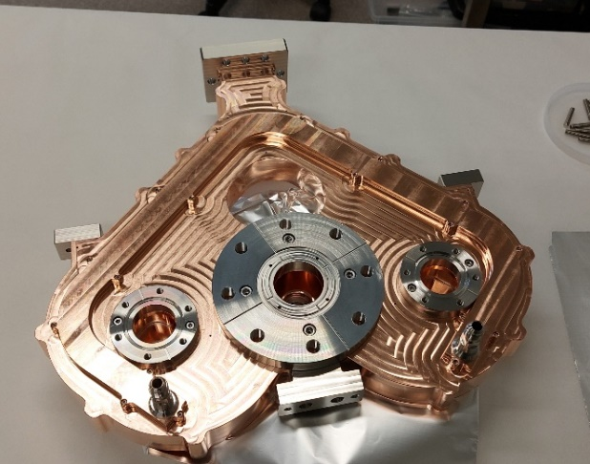
C-band RF Gun Realization and Assembly
The Gun has been realized with an innovative technique developed at INFN (Frascati), which uses special RF-vacuum gaskets made from the same copper material as the gun. These gaskets ensure both a vacuum seal and excellent RF contact when the structure is clamped.
    simplify the fabrication
    reduce the cost and the risk of failure
    reach in principle higher accelerating field with lower BDR and lower conditioning time.
Clamping
Brazing
Vacuum Leak test
15
D. Alesini et al., Phys. Rev. ST Accel. Beams 18, 092001 (2015)

Slide 16
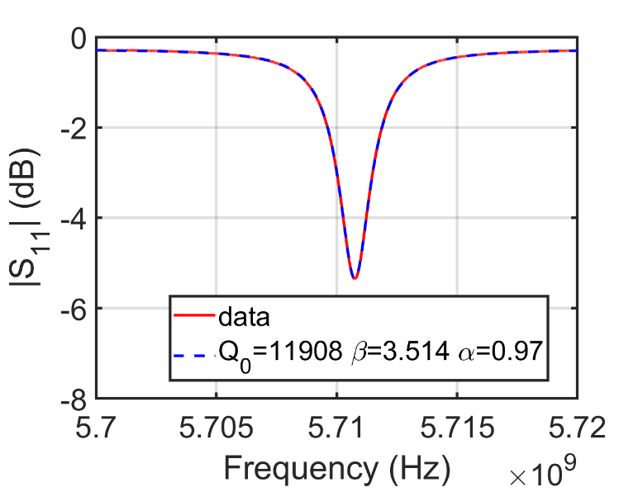
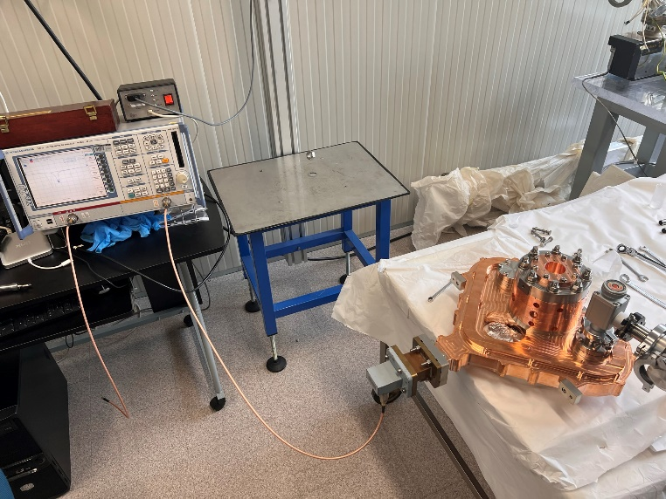
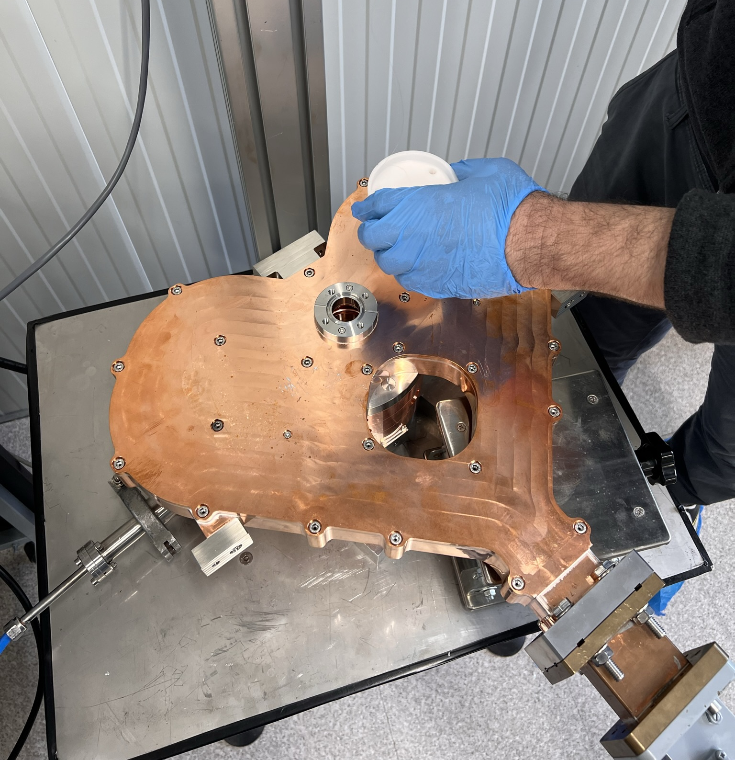


Low Power RF Measurements
The assembled gun has been RF tested. The three modes are clearly visible in the plot. The frequency and quality factor of the working mode are the nominal ones while the coupling coefficient is slightly larger. The gun is without tuners
Parameter | Unit | Design Value | Measured Value
Resonant frequency | GHz | 5.712 | 5.712
Quality factor |  | 11900 | 11900
Filling time | ns | 166 | 147
Coupling coefficient |  | 3 | 3.5
Mode sep. π-π/2 | MHz | 47 | 48.3
Bead-drop mesurement
π/2 mode
π mode
0 mode
16

Slide 17






C-band Gun final Assembly
The gun, after the final assembly and vacuum test has been assembled in its final configuration with the solenoid and vacuum chambers.
The whole system has then been transported to PSI and installed in the High Power Test Stand [T. Lucas, IPAC 24, WEPC69]
Final Assembly
Shipment and Installation at PSI
Solenoid
RF Power Source of the Valhalla facility
Photo-Gun

Slide 18



High power test schematic layout
In the setup there are eight NEG-ion pumps and four directional couplers. The vacuum is also monitored through four vacuum gauges; one in the laser injection chamber, two near the BOC and one near the klystron window. These have been used to monitor the local vacuum in the regions expected to suffer the most from high power operation.
DC 1
Bunker
Concrete wall
RF Load 1
50 MW
C-band Klystron
DC 3
DC 4
Waveguide line
From klystron
Klystron gallery
Laser Injection chamber
RF Load 2
9:1 Power divider
Faraday cup
Solenoid
BOC
Pulse compressor
Solenoid
NEG/ion pumps
DC 2
Gun
Pulse compressor (BOC)
ion pumps
18
Vacuum Gauge
GUN

Slide 19




High power test results
RF conditioning began in February 2024. The conditioning was done in a semi-automatic way, monitoring the vacuum at the different vacuum pumps and the reflected power to the klystron and progressively increasing the power from the klystron and pulse length keeping the repetition rate at 100 Hz
Conditioning dominated by the vacuum activity in the waveguide
final maximum input power limited by a vacuum activity in the ceramic of the klystron probably due to the reflected power
we reached so far a cathode peak field is 160 MV/m
no limitation due to the gun.
BOC detuned
BOC tuned
BOC detuned
BOC tuned
19

Slide 20





Future installation at TEX
RF wg layout
The C band photo-gun will be installed in the TEX facility
It can be integrated with a TW structure to form a compact photoinjector and used for high beam quality generation and experiments,
A first test facility for a full C-band injector, BD studies performed [A. Giribono et al., PRAB 26 (2023)
Possible upgrade for the EuPRAXIA@SPARC_LAB project.
Photoinjector Preliminary Layout
C-band RF Gun
Solenoid
C- band
TW structure
Dump dipole
20
< 5 m
Courtesy of D. Alesini, E. Di Pasquale, S. Pioli, A. Giribono, G. Costa and L. Spallino.

Slide 21


Conclusions and future work
  X-band structures: An intensive prototyping activity is ongoing exploiting the new vacuum furnace at LNF.
    Two full-scale mechanical prototypes has been realized and tested.
    The first 21 cells RF prototype has been realized, low power RF measurements performed and preliminar high power test (will continue after the TEX upgrade).
    All the cells and coupler for a full-scale 1m RF prototype have been realize and pre tested at low power, in the next months we will assembly the full structure and braze it. Then it will be tested at TEX.
  TEX Facility: The facility is currently being upgraded, with completion expected by the end of April 25. In early May, the commissioning of the new sources will take place, and testing of the first EuPRAXIA prototype will resume.
  C-band Photo-Gun
    We developed a new C band RF photo-gun with the brazing free technology that represents the frontier of this type of electron sources in term of cathode peak field (>160 MV/m) and repetition rate (up to kHz).
    The gun, solenoid and vacuum components have been designed, built, assembled at INFN and tested at PSI reaching 160MV/m cathode peak field.
    The test of the C-band photo-gun line will continue at TEX.
Thank you for your attention!
Aknowledgements:
INFN: D. Alesini, B. Buonomo, S. Cantarella, G. Catuscelli, P. Chimenti, M. Cianfrini, R. Clementi, G. Costa, L. Faillace, A. Gallo, A. Giribono, C. Di Giulio, E. Di Pasquale, G. Di Raddo, G. Latini, S. Lauciani, A. Liedl, V. Lollo, R. Mascio, L. Piersanti, S. Pioli, L. Sabatini, B. Serenellini, L. Spallino, A. Vannozzi, on behalf of the INFN-LNF Accelerator Division and Technical Division.
CERN: N. Catalan Lasheras, A. Grudiev, G. McMonagle, P. M. Sanchez, I. Syratchev.
PSI: C. Beard, P. Craievich, L.J.F. Hol, T.G. Lucas, F. Marcellini, R. Zennaro.
Sapienza University: L. Giuliano, S. Farina
SLAC: V. Dolgashev
This project has received funding from the European Union’s Horizon 2020 Research and Innovation programme under GA No101004730 and by INFN Commission n. V

