Slide 1






Status of the Sapienza FLASH Project
Convegno Nazionale: Quarta Giornata Acceleratori
3 – 4 Aprile 2025 INFN - Laboratori Nazionali di Legnaro
L. Giuliano, E. Chiadroni, M. Coppola, A. Curcio, A. De Gregorio, C. Di Carlo, S. Farina, G. Franciosini, M. Magi, A. Mostacci, M. Migliorati, V. Patera, R. Remetti, A. Sarti, L. Palumbo Sapienza University of Rome
L. Ficcadenti, E. Lalli INFN – Rome
D. Alesini, F. Cardelli, R. Di Raddo, L. Faillace, G. Franzini, A. Gallo, L. Piesanti, S. Pioli, B. Spataro, A. Vannozzi INFN-LNF
G. Cuttone, G.S. Mauro, G. Sorbello, G. Torrisi INFN-LNS
Convegno Nazionale: Quarta Giornata Acceleratori
3 – 4 Aprile 2025 INFN - Laboratori Nazionali di Legnaro
Lucia Giuliano et al.
High Gradient Technology for VHEE Linac in FLASH Radiotherapy
HG2025, Mérida, Yucatán, México

Slide 2
OUTLINE
FLASH therapy in a nutshell
SAFEST project and 24 MeV prototype FLASH linac@Sapienza
Phase 1 – SW structure (2025)
  Mechanical drawing and realization
  Triode gun optimization
Phase 2: TW structure (2026)
  First prototype for low power test and tuning
  Second prototype for high power test
Future perspectives and conclusion
Convegno Nazionale: Quarta Giornata Acceleratori
3 – 4 Aprile 2025 INFN - Laboratori Nazionali di Legnaro
Lucia Giuliano et al.
High Gradient Technology for VHEE Linac in FLASH Radiotherapy
HG2025, Mérida, Yucatán, México

Slide 3
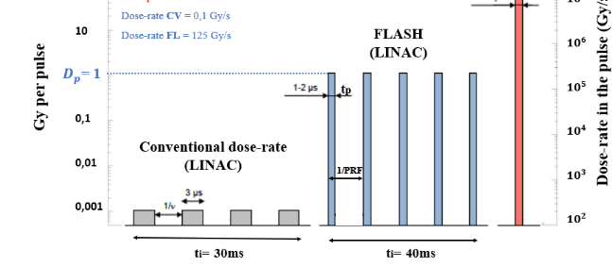
FLASH Therapy IN A NUTSHELL
FLASH irradiation protects healthy tissues from damage and remains as efficient as conventional irradiation in the repression of tumor growth.
Courtesy of V. Faudon
FLASH THERAPY
Dose rate =125 Gy/s
It is a new way to deliver the dose:
- high dose per pulse (>1 Gy) in “very short time” of irradiation (< 100 ms )
- high mean dose rate (>40-100Gy/s)
Dose rate =0,1 Gy/s
Control 17 Gy CONV 17 Gy FLASH
Favaudon et al., Science Translational Medicine 6, 2014
 | Conventional | FLASH
Dose (Gy) | 17 | 17
Mean Dose rate (Gy/s) | 0,03 | 60
Healthy Fibrosis Healthy
Convegno Nazionale: Quarta Giornata Acceleratori
3 – 4 Aprile 2025 INFN - Laboratori Nazionali di Legnaro
Lucia Giuliano et al.
High Gradient Technology for VHEE Linac in FLASH Radiotherapy
HG2025, Mérida, Yucatán, México

Slide 4
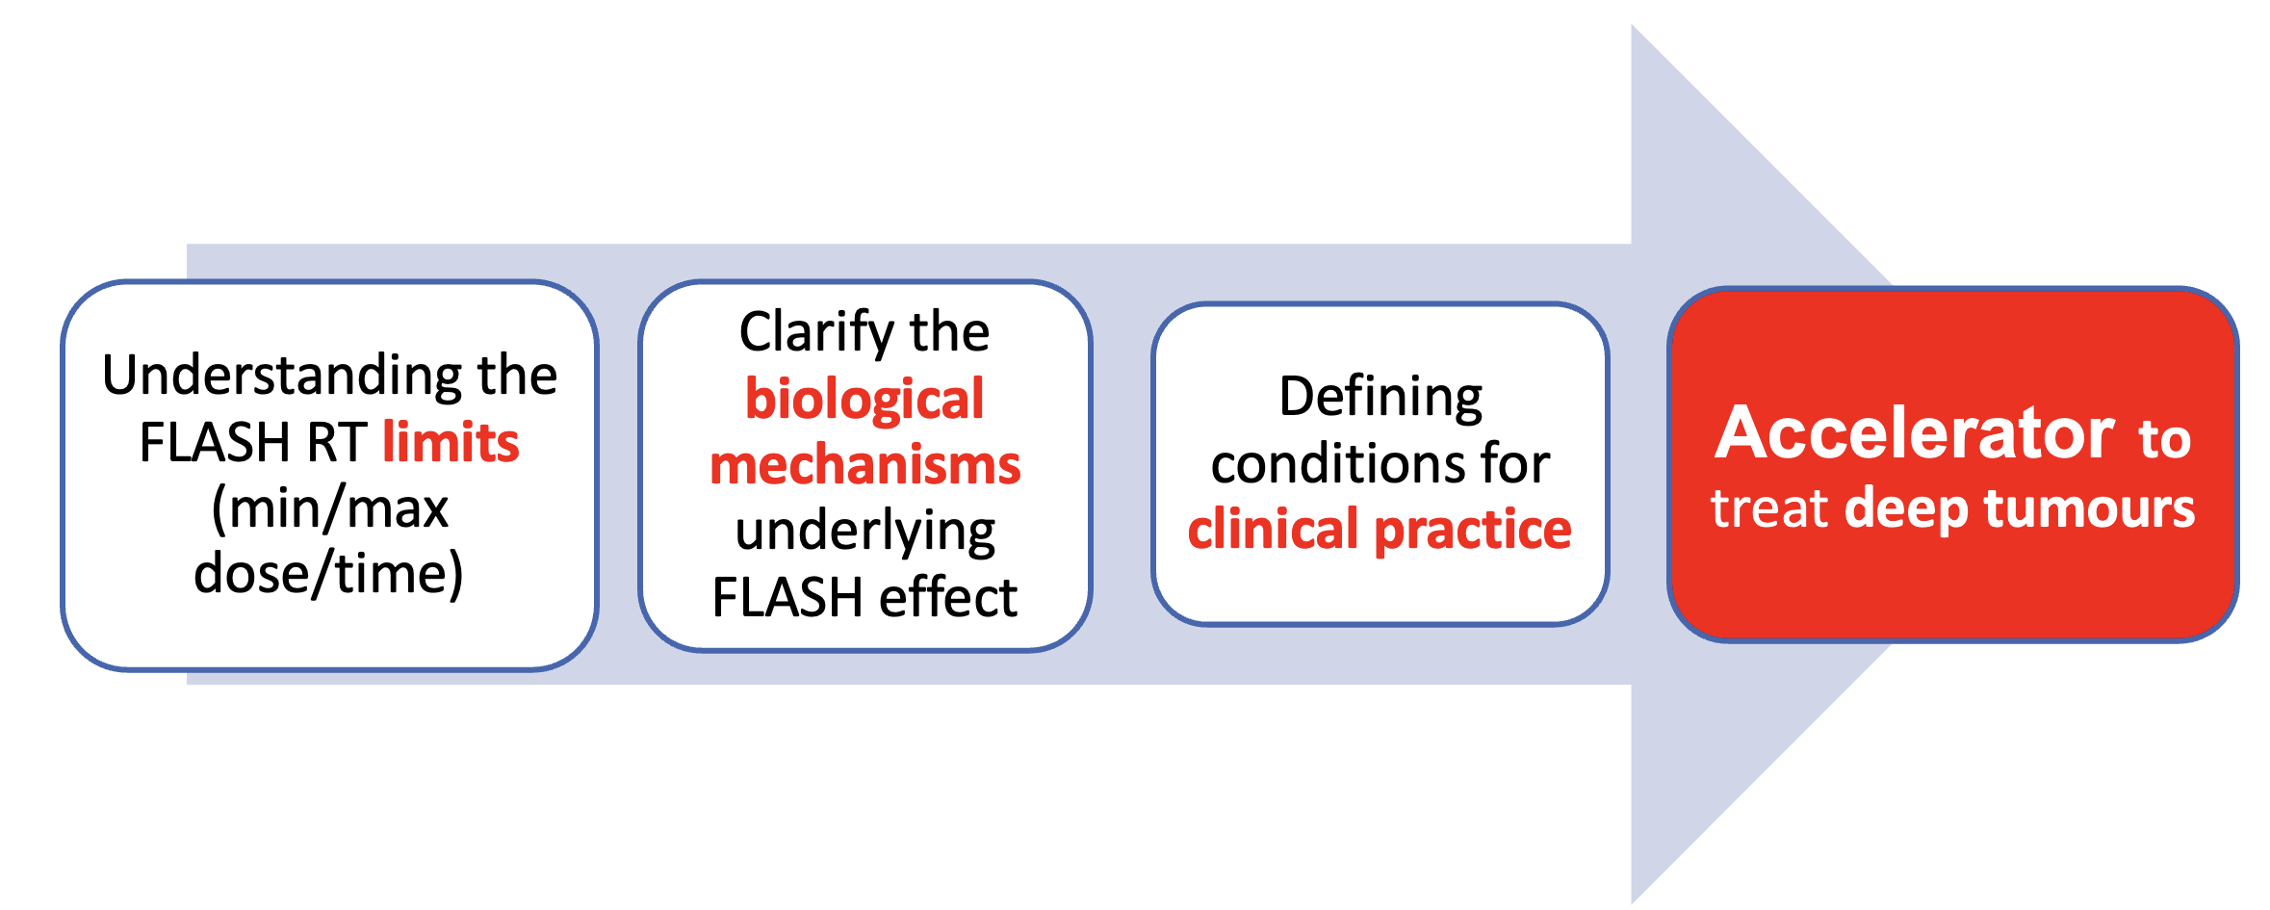
SAFEST PROJECT
VHEEs
Very High Energy Electrons
>100MeV
The choice of operation in C-Band (5.712GHz), by using a compact and modular layout, is an optimal compromise for working with high-charge electron bunches, and still for having more compact accelerating structures
Emerging Research Trends
SAFEST Parameters | Value
Frequency | 5.712 GHz
RF pulse length | 5 μs
RF source Power | 45 MW
LINAC length | ~ 3 m
Nominal beam energy | 100 MeV
Beam pulse current | 100 mA
L. Faillace et al., Perspectives in linear accelerator for FLASH VHEE: Study of a compact C-band system, Phisca Medica, November 2022
Convegno Nazionale: Quarta Giornata Acceleratori
3 – 4 Aprile 2025 INFN - Laboratori Nazionali di Legnaro
Lucia Giuliano et al.
High Gradient Technology for VHEE Linac in FLASH Radiotherapy
HG2025, Mérida, Yucatán, México
Notes:
TRL 5 – Technology Validated in Relevant Environment: The prototype or system is tested in an environment similar to the intended application.

Slide 5
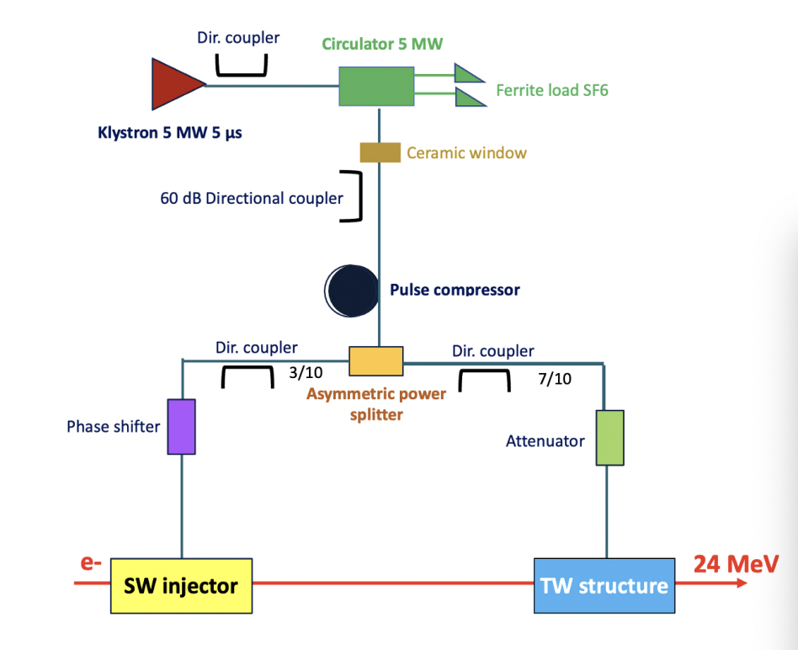
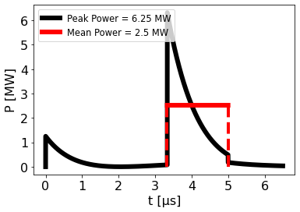
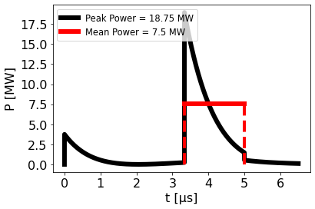
24 Mev Flash linac: pnrr funding
A prototype was funded by the PNRR with a budget of 1.6 M€
Parameters | Value
Frequency | 5.712 GHz
RF pulse length | 5 μs
Klystron Power | 5 MW
Peak power with pulse compressor | 24.4 MW (β = 3)
Linac length | ~ 1.5 m
Nominal beam energy | 24 MeV
Beam pulse current | 100 mA
1/4
3/4
Asymmetric power splitter
Scalable to VHEE machines
Convegno Nazionale: Quarta Giornata Acceleratori
3 – 4 Aprile 2025 INFN - Laboratori Nazionali di Legnaro
Lucia Giuliano et al.
High Gradient Technology for VHEE Linac in FLASH Radiotherapy
HG2025, Mérida, Yucatán, México

Slide 6
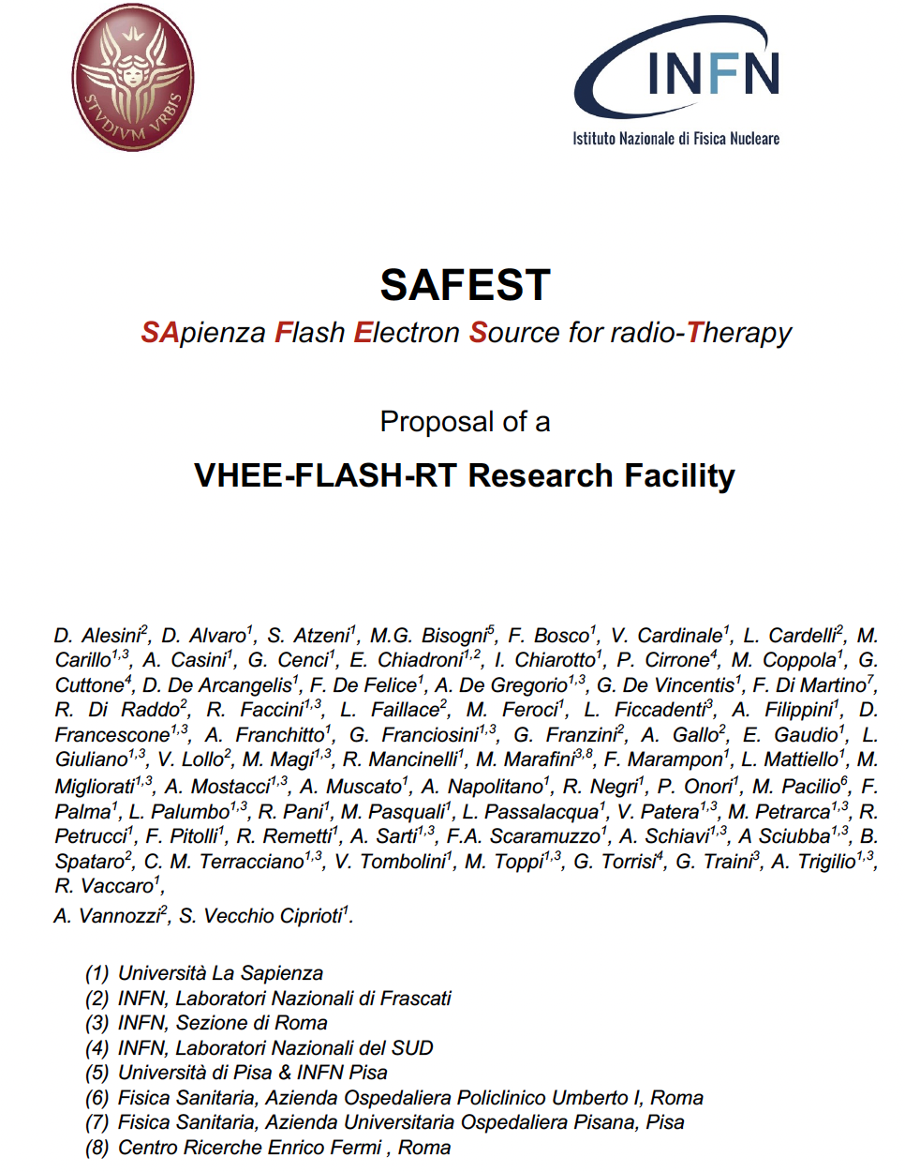
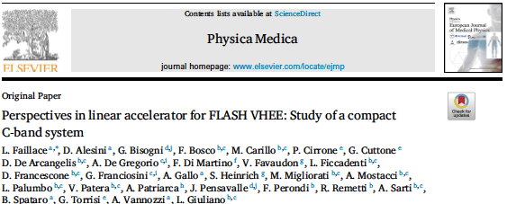
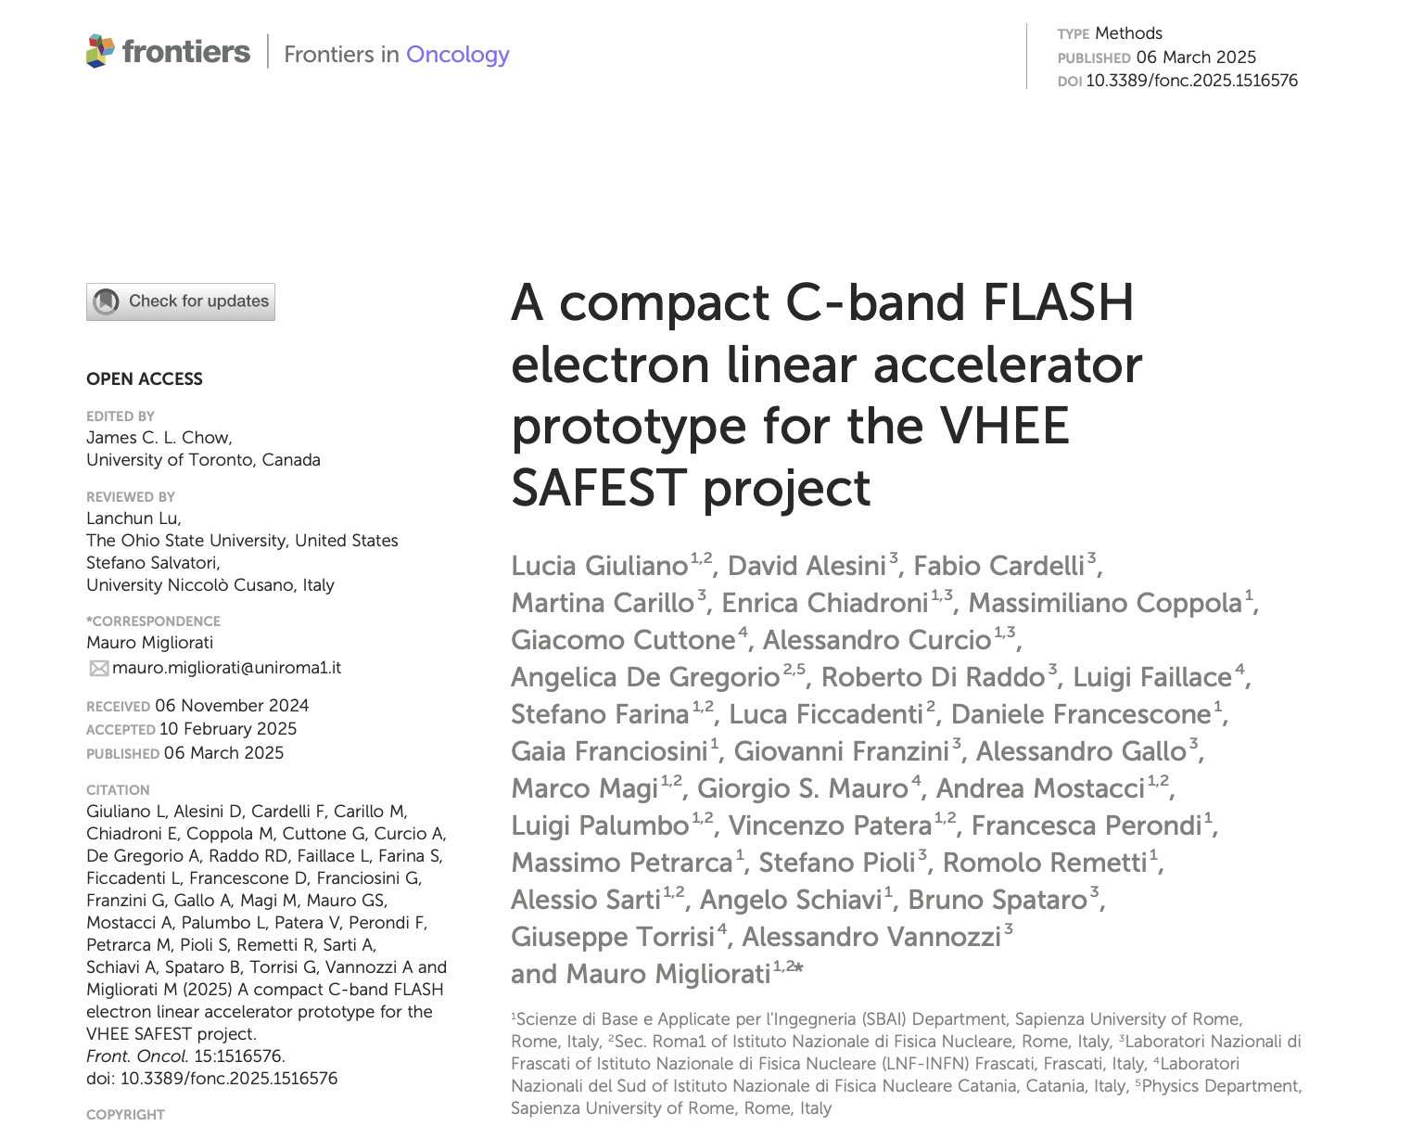
Joint study group Sapienza - infn
2022
2021
Studio di fattibilità
2025
Convegno Nazionale: Quarta Giornata Acceleratori
3 – 4 Aprile 2025 INFN - Laboratori Nazionali di Legnaro

Slide 7
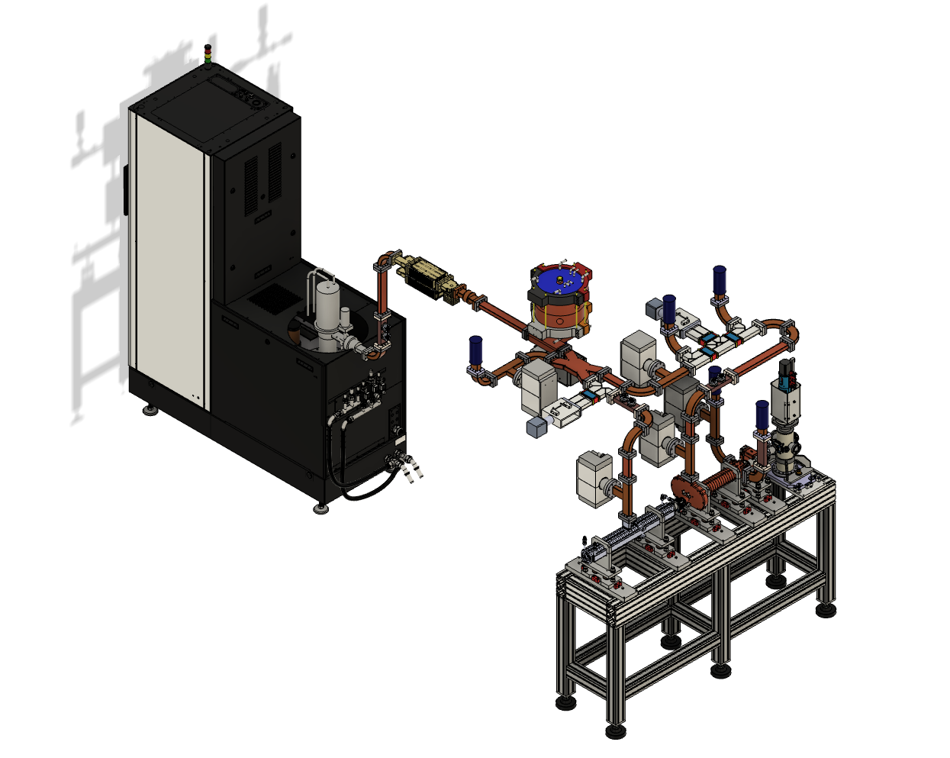
Cad technical design
Modulator
Scandinova k100
Working frequency 5.712GHz (C-band)
RF load
Repetion frequency 200Hz
Klystron
Canon (5MW 200 Hz)
Pulse compressor
(LNS-INFN design)
RF power
distribution network
Electron
beam to users
Vacuum pump
Flash Electron
Accelerator
Convegno Nazionale: Quarta Giornata Acceleratori
3 – 4 Aprile 2025 INFN - Laboratori Nazionali di Legnaro
Lucia Giuliano et al.
High Gradient Technology for VHEE Linac in FLASH Radiotherapy
HG2025, Mérida, Yucatán, México

Slide 8
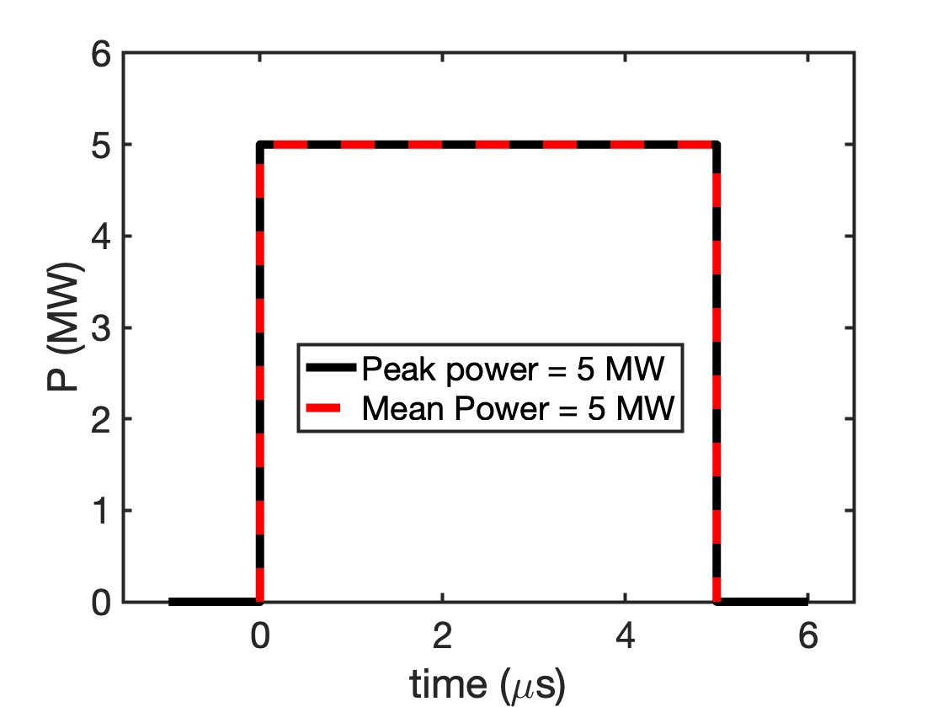
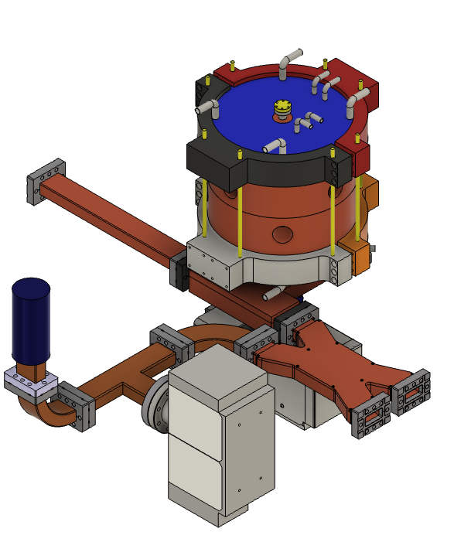
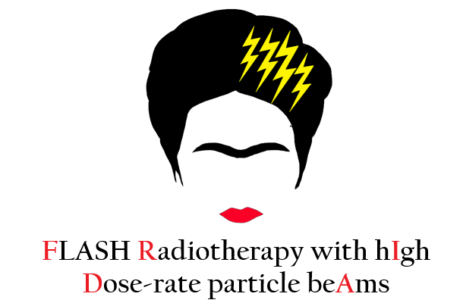
PULSE COMPRESSOR – lns design
G. Torrisi, G.S. Mauro, G. Sorbello
from the klystron
towards the TW section
towards the
standing wave section
A. Curcio, S. Farina, A. Mostacci,
L. Giluiano et al., A compact C-band FLASH electron linear accelerator protoype for the VHEE SAFEST project, Frontiers, 2025
Lucia Giuliano et al.
Convegno Nazionale: Quarta Giornata Acceleratori
3 – 4 Aprile 2025 INFN - Laboratori Nazionali di Legnaro

Slide 9
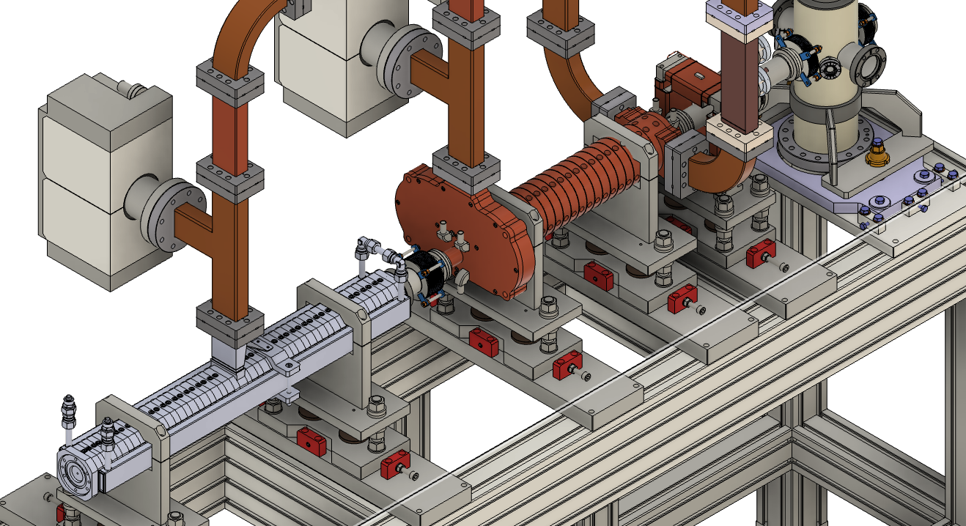
FLASH ELECTRON ACCELERATOR
RF power to loads
Electron
beam
Vacuum pump
RF power
Beam diagnostics
Traveling wave structure
RF power
Standing wave structure
Electron source
L. Giuliano et al., A compact C-band FLASH electron linear accelerator protoype for the VHEE SAFEST project, Frontiers, March 2025
Convegno Nazionale: Quarta Giornata Acceleratori
3 – 4 Aprile 2025 INFN - Laboratori Nazionali di Legnaro
Lucia Giuliano et al.
High Gradient Technology for VHEE Linac in FLASH Radiotherapy
HG2025, Mérida, Yucatán, México

Slide 10
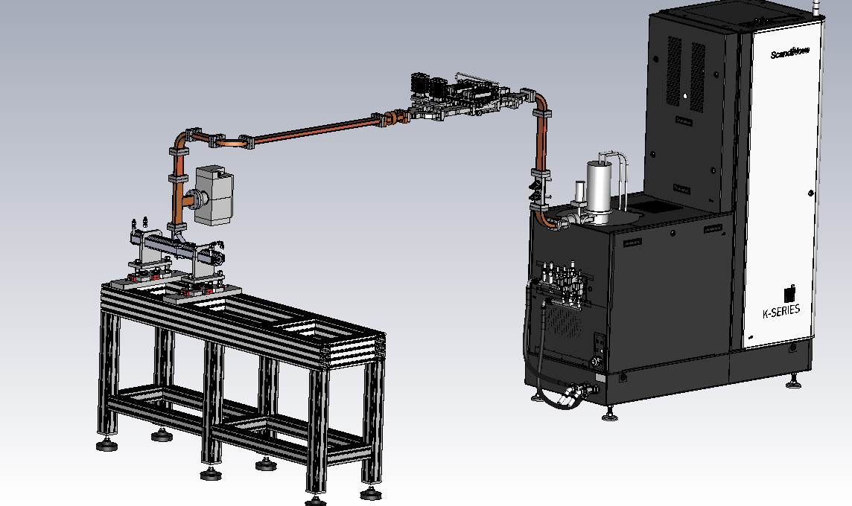
Phase 1 – December 2025
Circulator
Modulator
Scandinova K100
Klystron
Canon (5MW 200 Hz)
SW structure
Electron beam
Convegno Nazionale: Quarta Giornata Acceleratori
3 – 4 Aprile 2025 INFN - Laboratori Nazionali di Legnaro
Lucia Giuliano et al.
High Gradient Technology for VHEE Linac in FLASH Radiotherapy
HG2025, Mérida, Yucatán, México

Slide 11
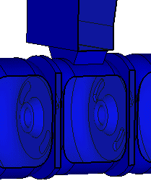
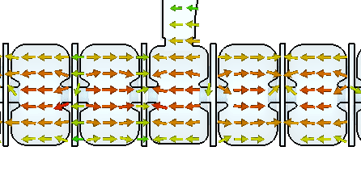
Standing wave structure
beam
Feeding power waveguide
Main cotributors: L. Giuliano, L. Faillace
RF power
Input coupler window
Parameters | Value
Mode of operation | Bi-periodic ; π/2
N of cells | 27
Shunt Impedance | 103 MΩ/m
Quality factor | 10178
Coupling coefficient | 1.58
Beam capture | 35%
Filling Time | 0.220 μs
Average gradient | 17 MV/m
Peak Electric field | 50 MV/m
Beam output energy | 10 MeV
Beam pulse current | 100 mA
Off axis magnetic coupling
Input power
Magnetic field
Electric field
L. Giuliano et al., RF Design and Measurements of a C-Band Prototype Structure for an Ultra-High Dose-Rate Medical Linac, Instruments, February 2024
Convegno Nazionale: Quarta Giornata Acceleratori
3 – 4 Aprile 2025 INFN - Laboratori Nazionali di Legnaro
Lucia Giuliano et al.
High Gradient Technology for VHEE Linac in FLASH Radiotherapy
HG2025, Mérida, Yucatán, México

Slide 12
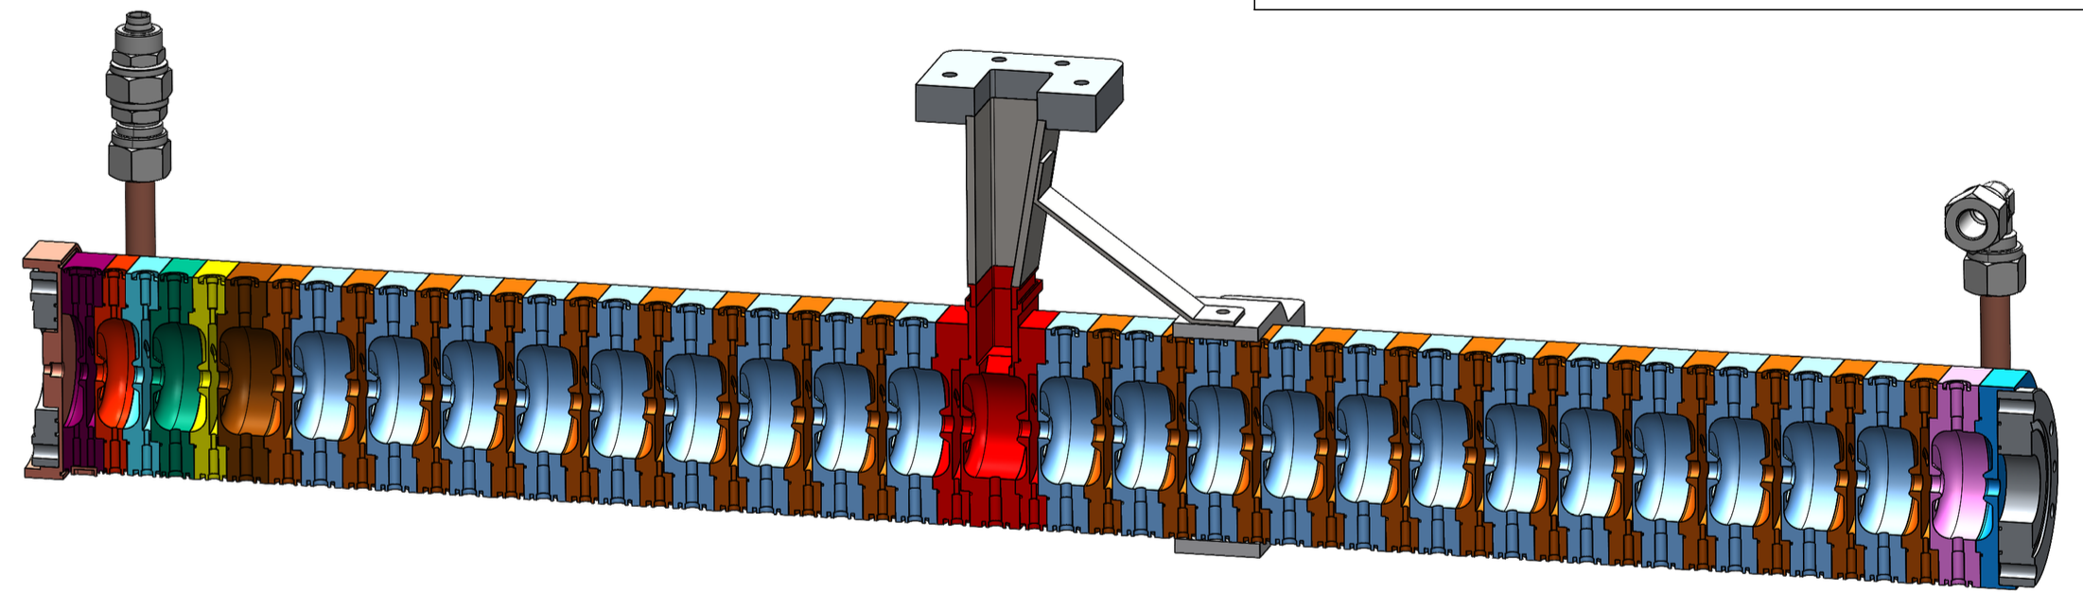
SW mechanical drawing
Water cooling
RF power
Bunching section
69 cm
The final realization will be completed by the end of June 2025
Convegno Nazionale: Quarta Giornata Acceleratori
3 – 4 Aprile 2025 INFN - Laboratori Nazionali di Legnaro
Lucia Giuliano et al.
High Gradient Technology for VHEE Linac in FLASH Radiotherapy
HG2025, Mérida, Yucatán, México

Slide 13

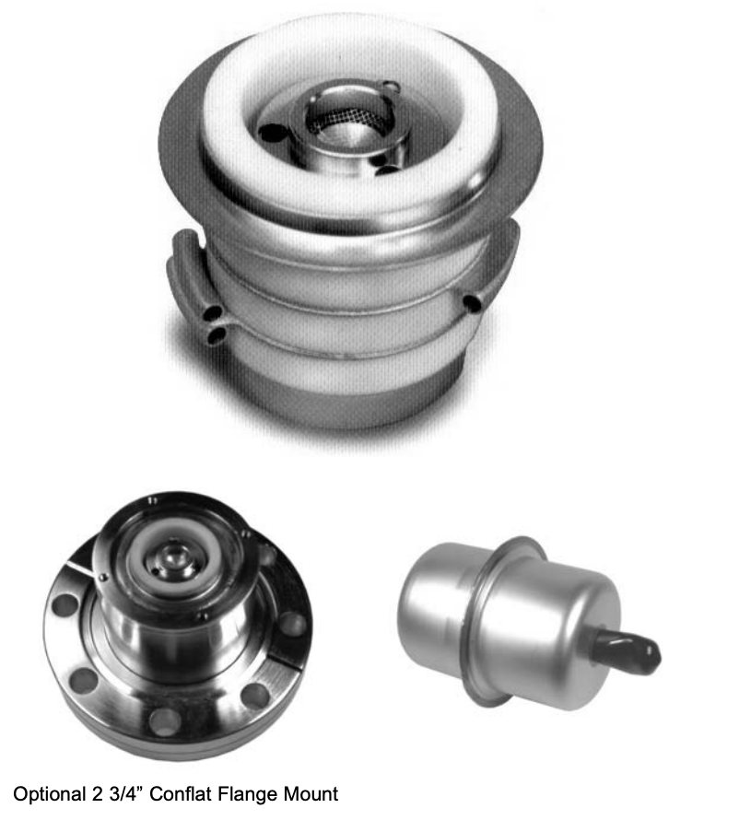
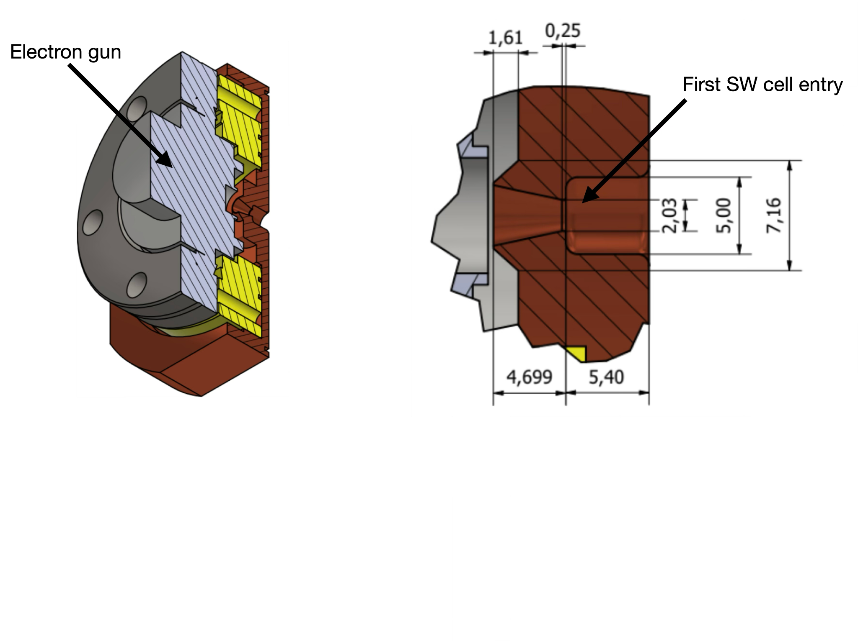
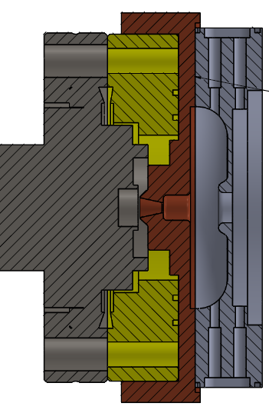
Electron source: thermionic triode gun
Custom flange
First accelerating cell
Electron gun
Cathode
Custom
Anode
Optimized distance
Courtesy of S. Farina
Convegno Nazionale: Quarta Giornata Acceleratori
3 – 4 Aprile 2025 INFN - Laboratori Nazionali di Legnaro
Lucia Giuliano et al.
High Gradient Technology for VHEE Linac in FLASH Radiotherapy
HG2025, Mérida, Yucatán, México

Slide 14
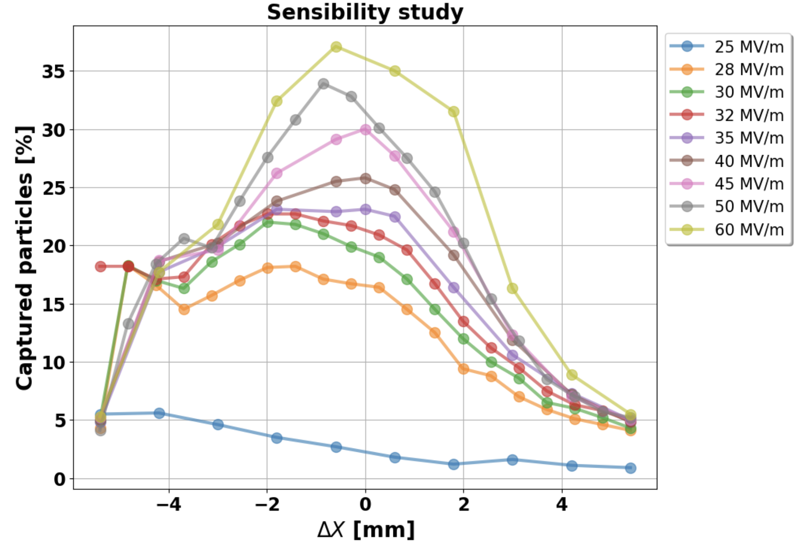
Electron source: thermionic triode gun
Cathode
ASTRA
The first segment of SW replicates the anode industrial configuration
The second part was design by us to maximize the electrons capture
Custom flange designed to maintain the required distance for beam capture optimization
Optimized distance
Courtesy of S. Farina
Convegno Nazionale: Quarta Giornata Acceleratori
3 – 4 Aprile 2025 INFN - Laboratori Nazionali di Legnaro
Lucia Giuliano et al.
High Gradient Technology for VHEE Linac in FLASH Radiotherapy
HG2025, Mérida, Yucatán, México

Slide 15
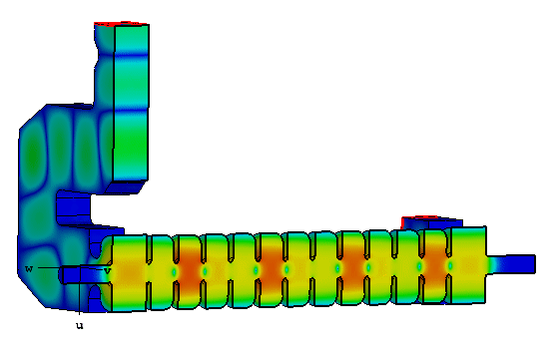
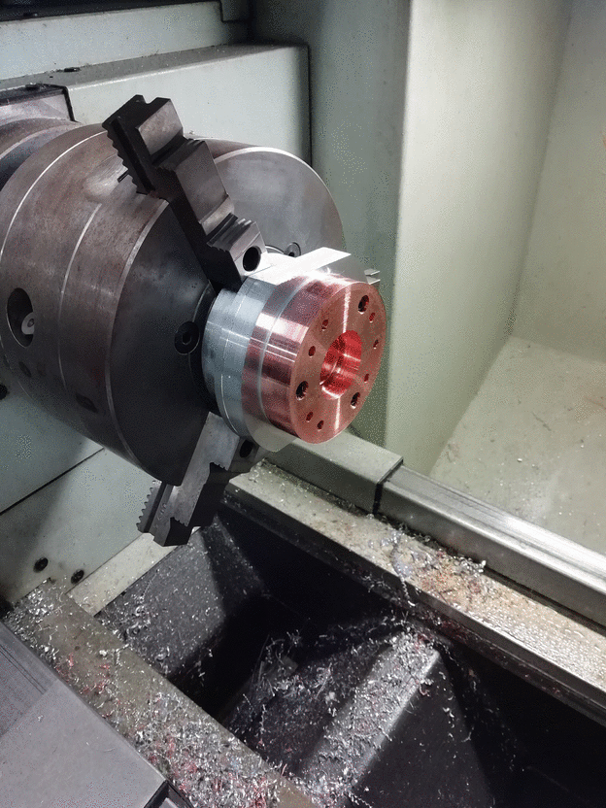
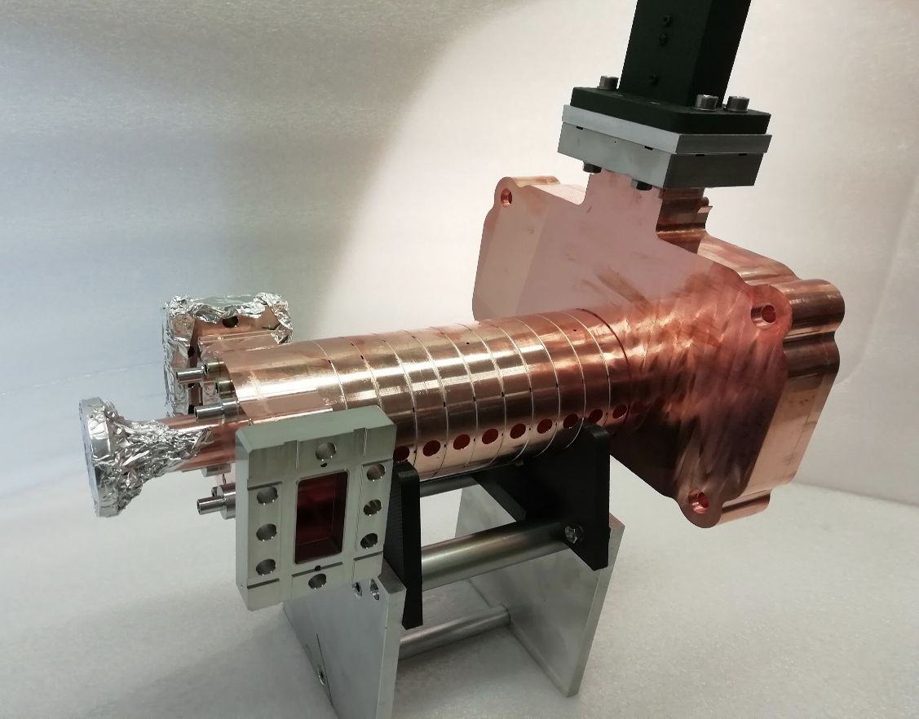
Phase 2: Traveling wave structure (2026)
RF power IN
RF power OUT
beam
Parameters | Value
Structure type | Constant Impedance
Shunt impedance | 107 MΩ/m
Quality factor | 10127
Filling time | 0.143 μs
Group velocity | 0.01c
Mode of operation | 2/3π
Final beam energy | 24 MeV
Beam pulse current | 100 mA
Main contributors D. Alesini, F. Cardelli, A. Curcio, L. Faillace, L. Ficcadenti, L. Giuliano, M. Magi, M. Migliorati
Convegno Nazionale: Quarta Giornata Acceleratori
3 – 4 Aprile 2025 INFN - Laboratori Nazionali di Legnaro
Lucia Giuliano et al.
High Gradient Technology for VHEE Linac in FLASH Radiotherapy
HG2025, Mérida, Yucatán, México

Slide 16
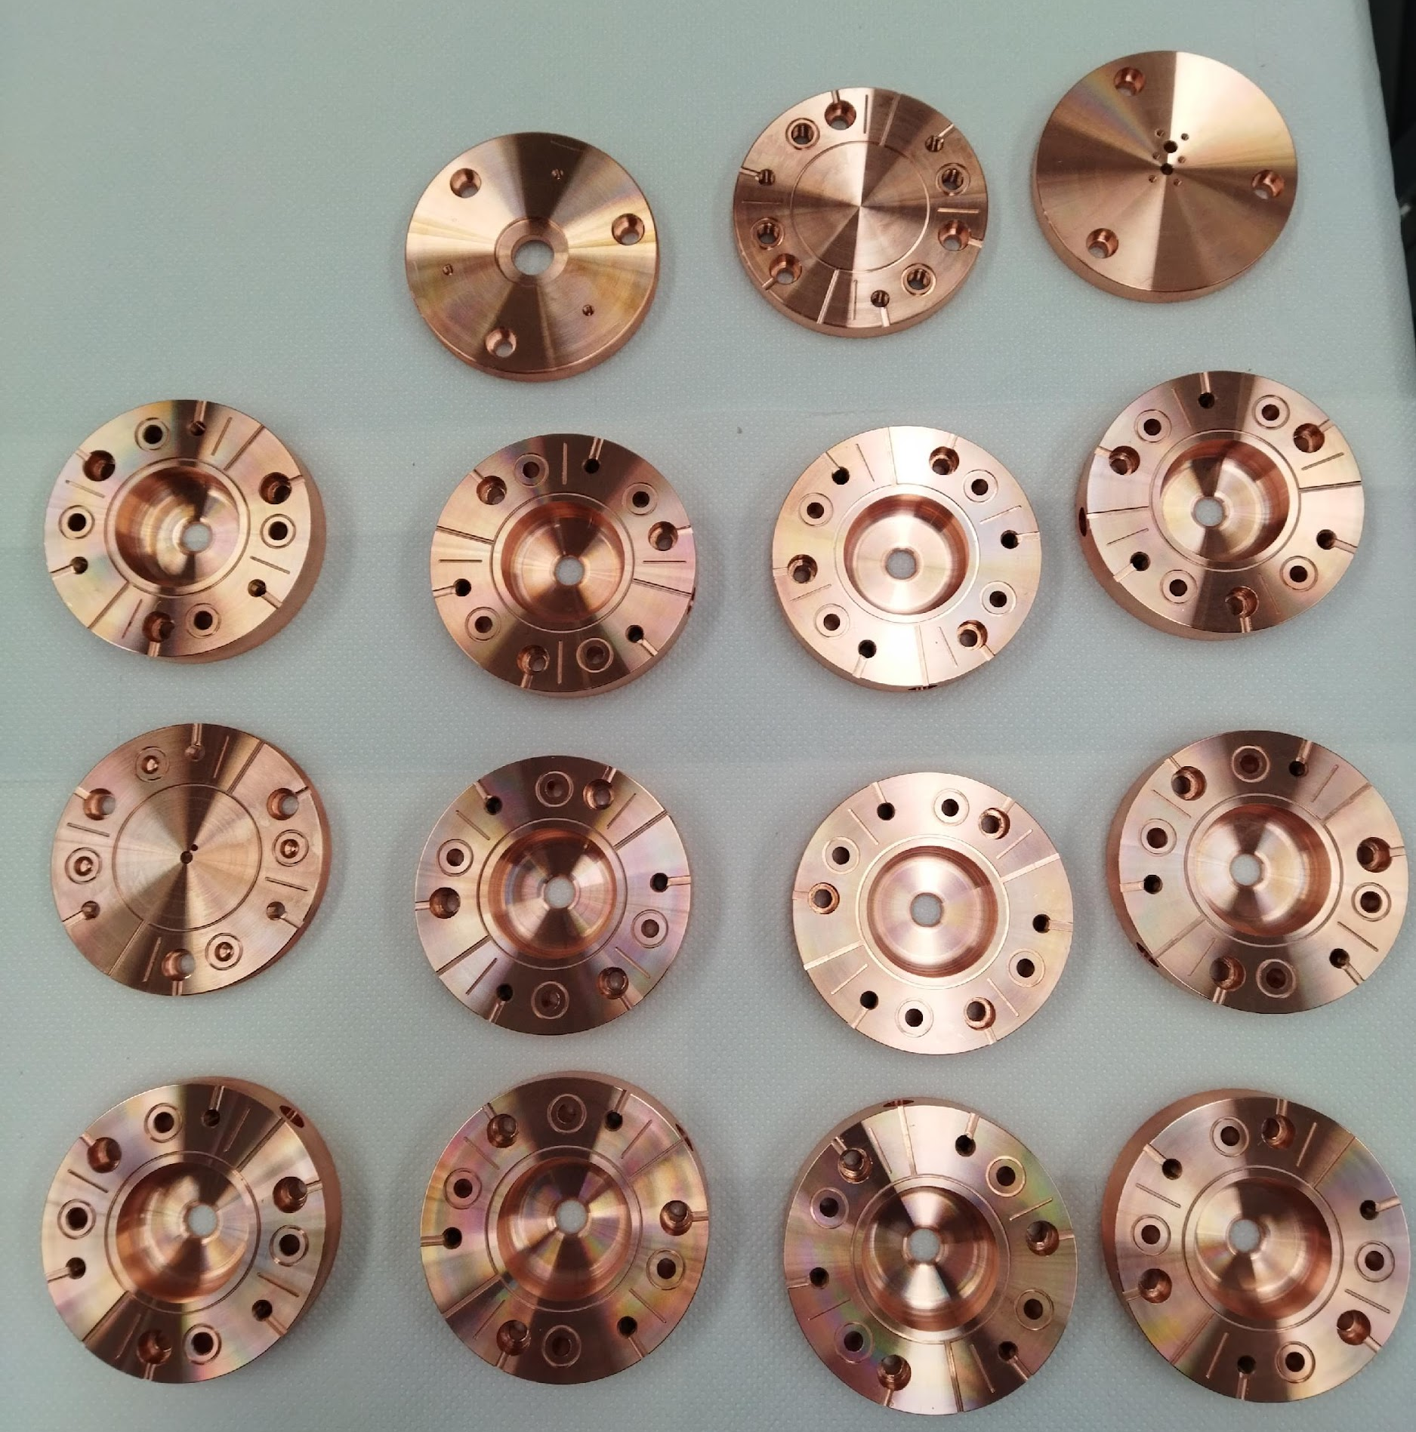
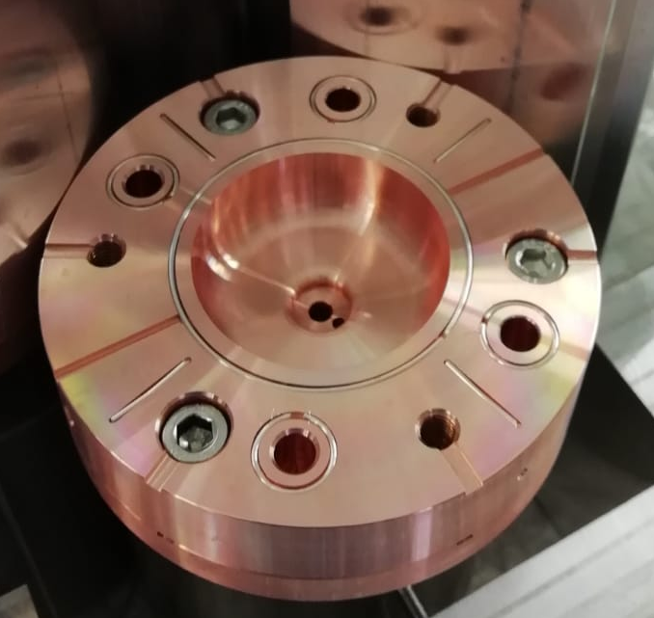


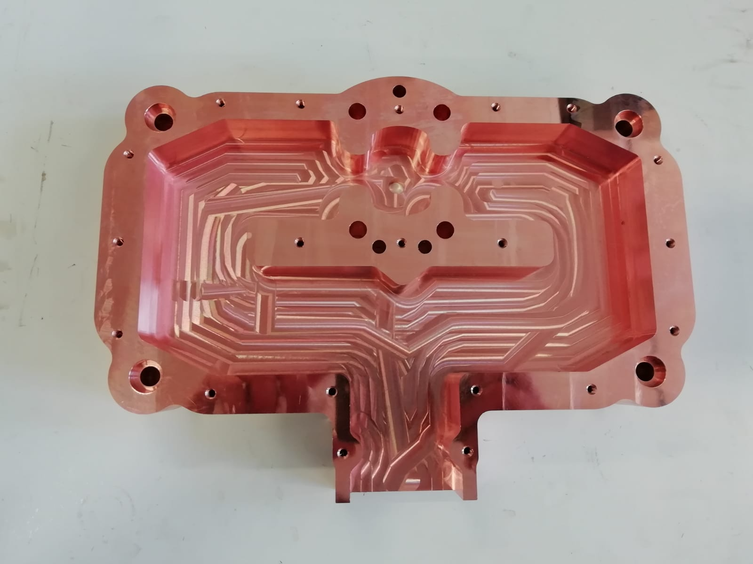
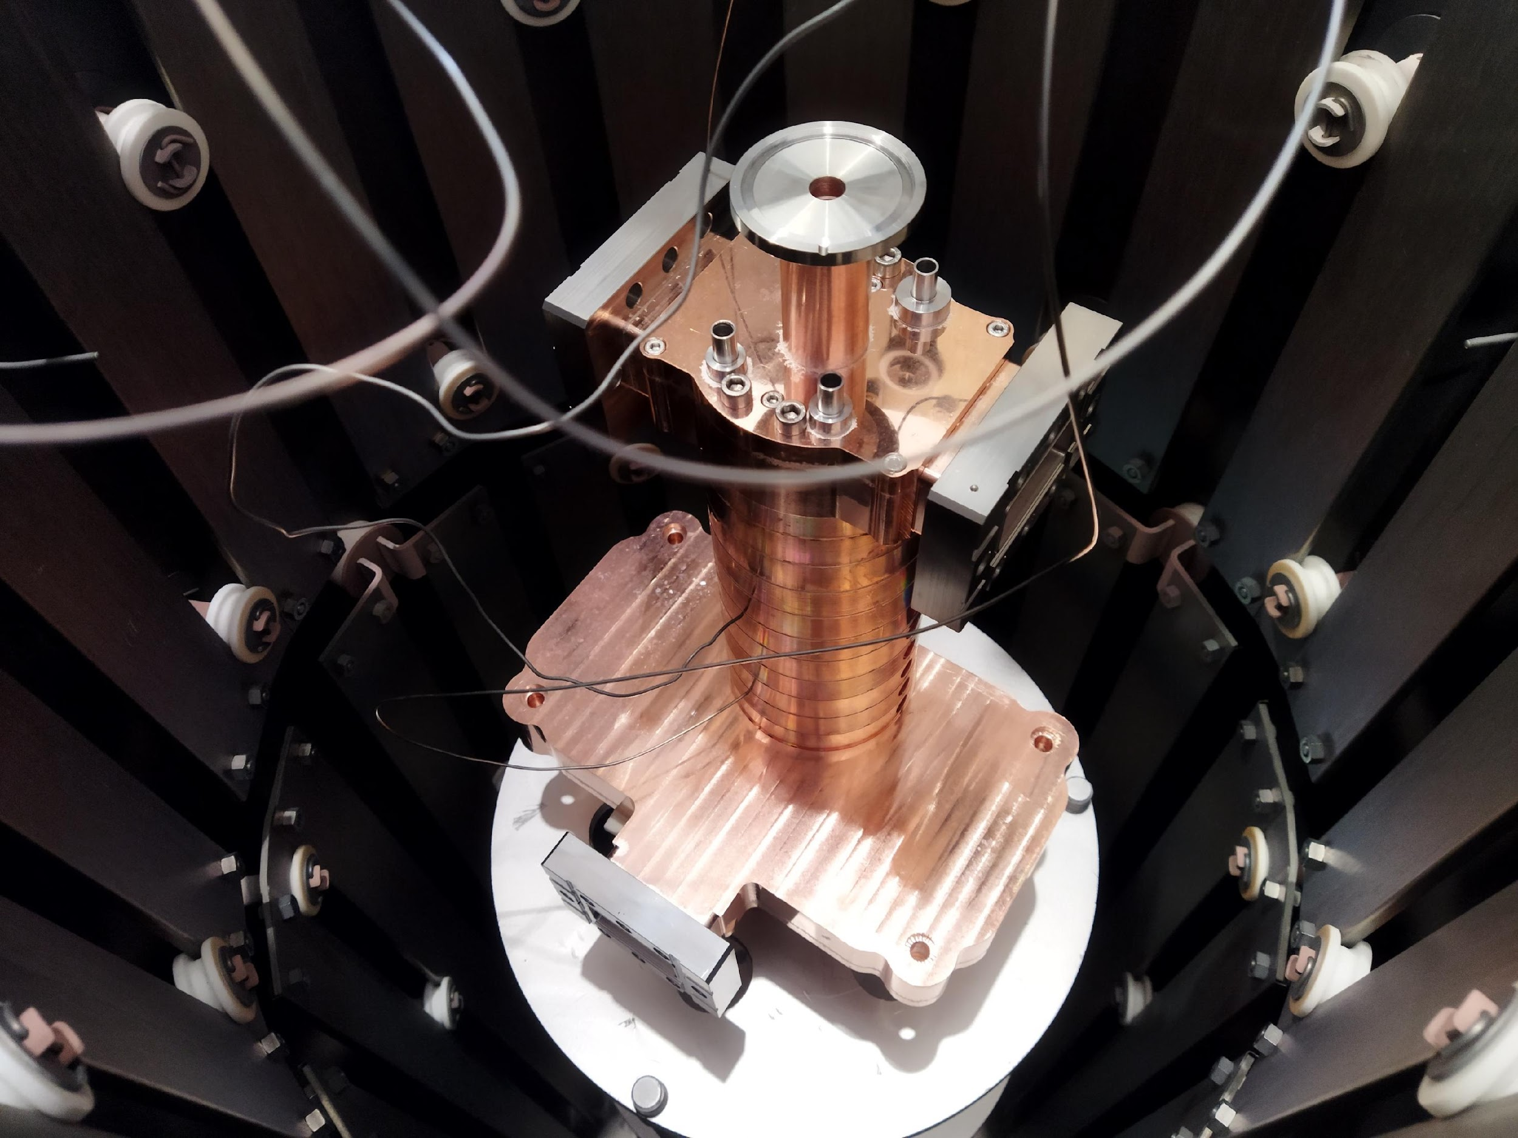
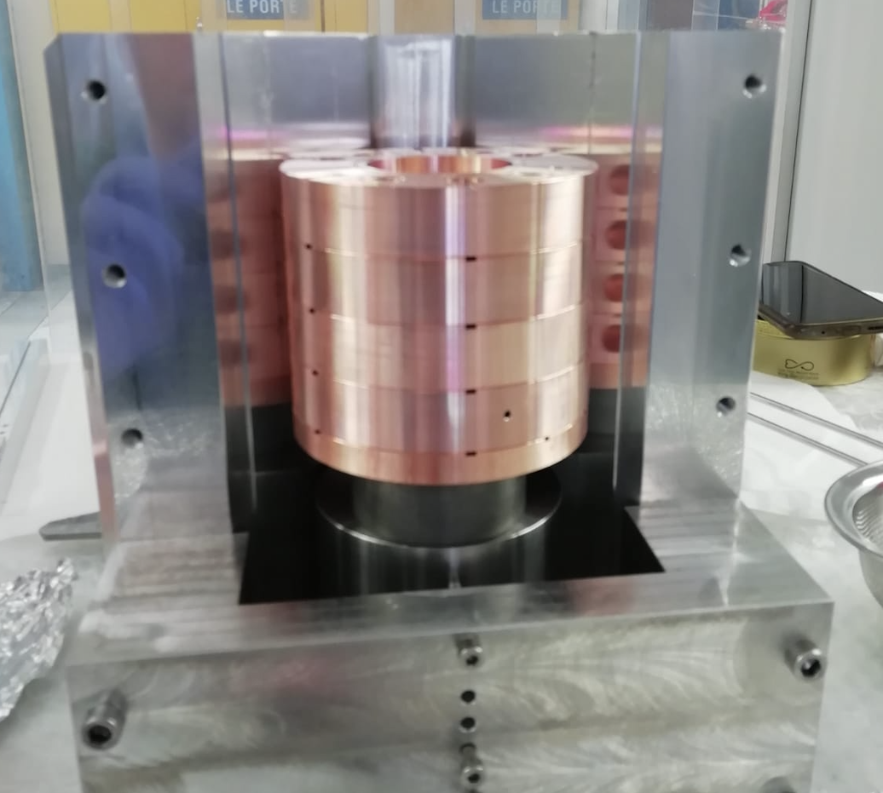
Building the TW structure @ Sapienza
Brazing alloy
Screws: prevent external clamping and ensure alignment and more reliable assembly
Screws to join the cells
In house building of the accelerating structure
Water cooling hole
RF power
Main contributors: D. Alesini, R. Di Raddo, L. Faillace, L. Giuliano, M. Magi, M. Migliorati
Convegno Nazionale: Quarta Giornata Acceleratori
3 – 4 Aprile 2025 INFN - Laboratori Nazionali di Legnaro
Lucia Giuliano et al.
High Gradient Technology for VHEE Linac in FLASH Radiotherapy
HG2025, Mérida, Yucatán, México

Slide 17
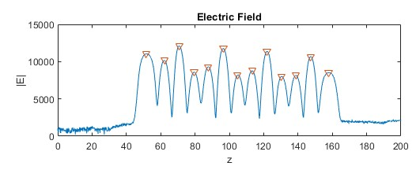
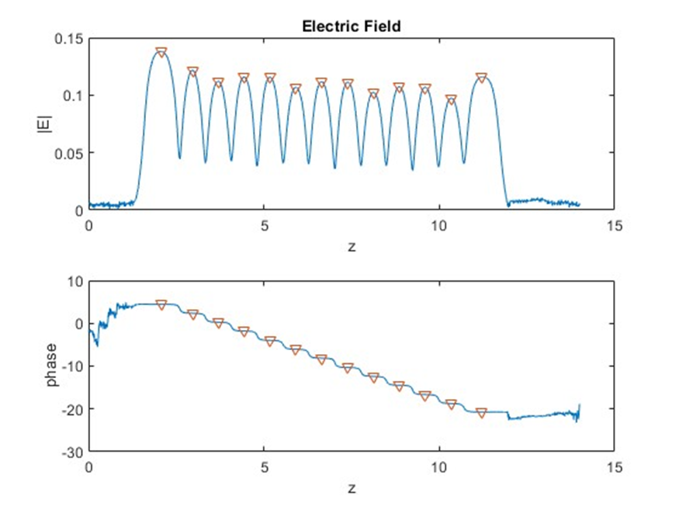
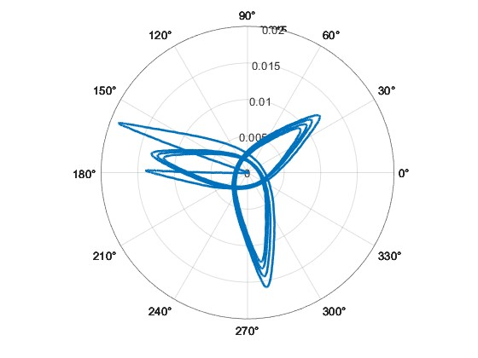
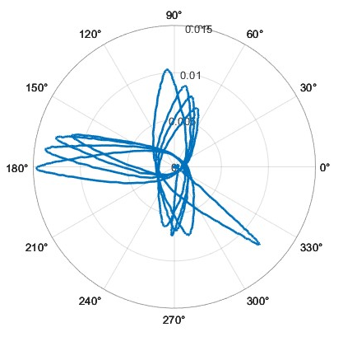
FINAL Tuning of TW section at sapienza-LAB
Electric field before tuning
Electric field after tuning
Phase shift after tuning
Phase shift before tuning
Main cotributors: L. Ficcadenti, L. Giuliano
Convegno Nazionale: Quarta Giornata Acceleratori
3 – 4 Aprile 2025 INFN - Laboratori Nazionali di Legnaro
Lucia Giuliano et al.
High Gradient Technology for VHEE Linac in FLASH Radiotherapy
HG2025, Mérida, Yucatán, México

Slide 18
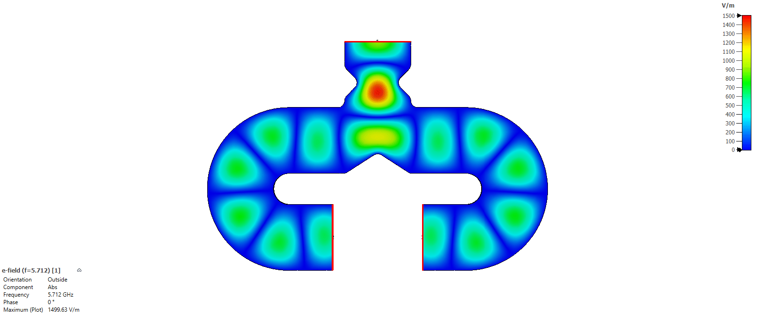
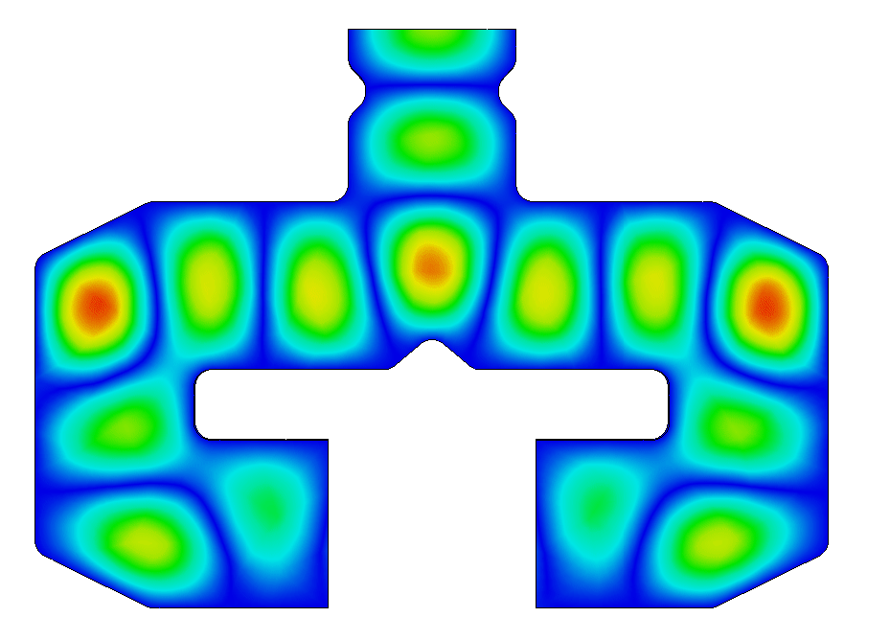
Power splitter optimization
The electric field in the power splitter
before optimization
The electric field in the power splitter
after optimization
High fields at the curves
1 Watt
1 Watt
Constriction that caused higher-order mode excitation
Rounding not suitable for mechanical processing
TE010 mode
Main cotributors: L. Ficcadenti, L. Giuliano
Convegno Nazionale: Quarta Giornata Acceleratori
3 – 4 Aprile 2025 INFN - Laboratori Nazionali di Legnaro
Lucia Giuliano et al.
High Gradient Technology for VHEE Linac in FLASH Radiotherapy
HG2025, Mérida, Yucatán, México

Slide 19
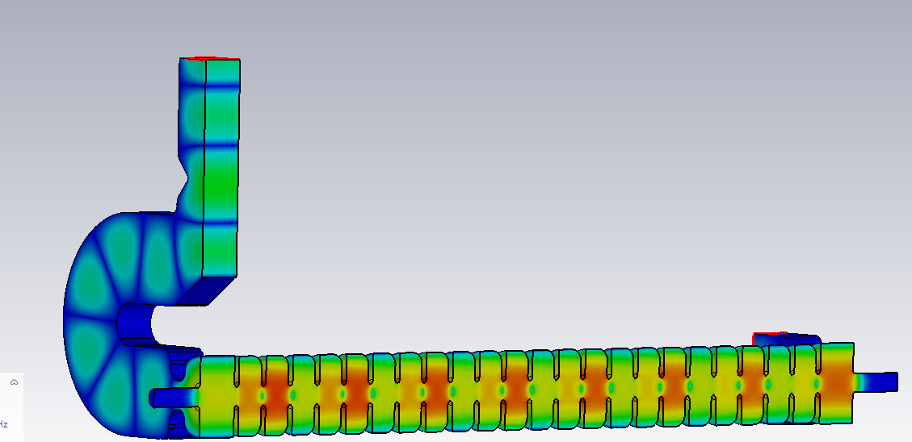
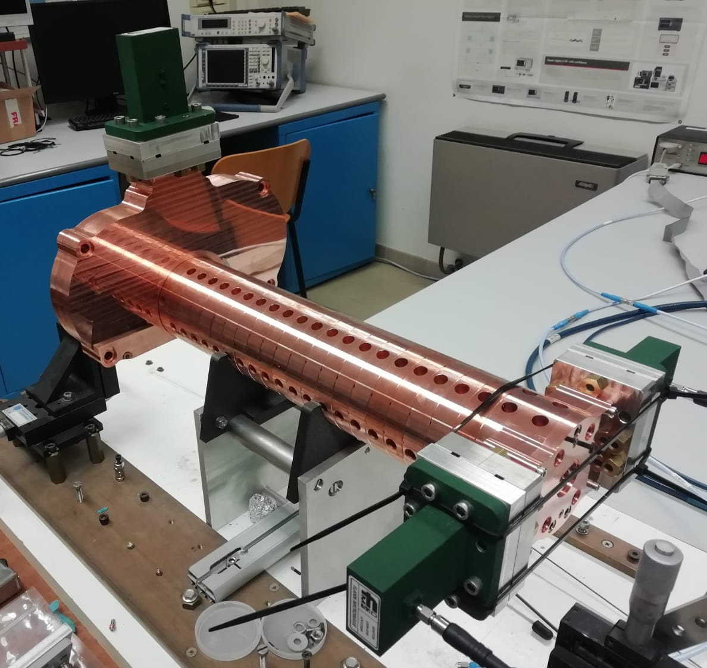
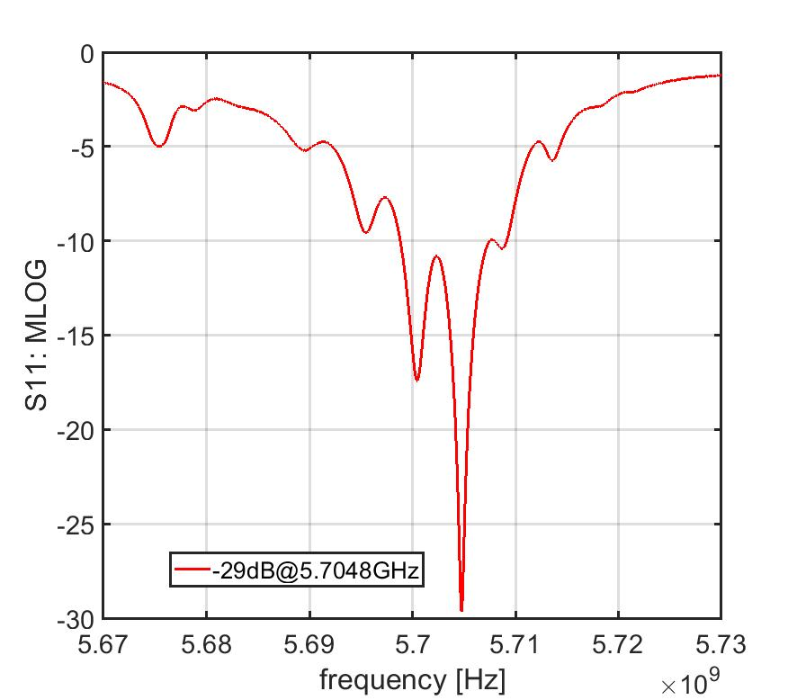
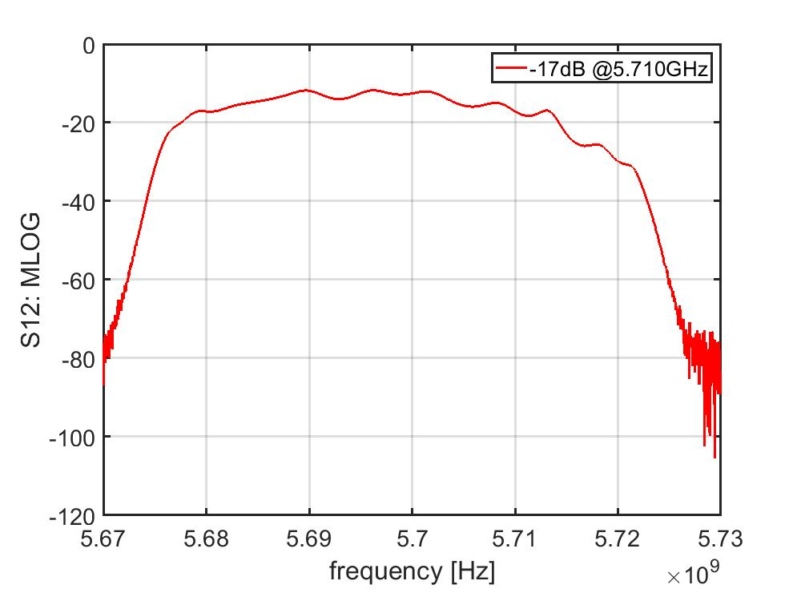
TW realization and low power test
Sim[GHz] | Meas [GHz]
5,7232 | - ?
5,7202 | 5,7217
5,7193 | 5,7197
5,7178 | 5,7178
5,7157 | 5,7149
5,7132 | 5,7120
5,7106 | - NO
5,7075 | 5,7080
5,7044 | 5,7050
5,7013 | 5,7013
5,6977 | 5,6977
5,6941 | 5,6940
5,6908 | 5,6907
5,6874 | 5,6870
5,6842 | 5,6842
5,6816 | 5,6811
5,6789 | 5,6786
5,6773 | - NO
5,6758 | 5,6756
43.23 cm
Measurements without Couplers SW-like:
Peaks match CST simulations ✅
Likely issue: Couplers, not cells
New couplers machinery is ongoing
Main cotributors: D. Alesini, F. Cardelli, A. Curcio, S. Farina, L. Giuliano, M. Magi
Convegno Nazionale: Quarta Giornata Acceleratori
3 – 4 Aprile 2025 INFN - Laboratori Nazionali di Legnaro
Lucia Giuliano et al.
High Gradient Technology for VHEE Linac in FLASH Radiotherapy
HG2025, Mérida, Yucatán, México

Slide 20

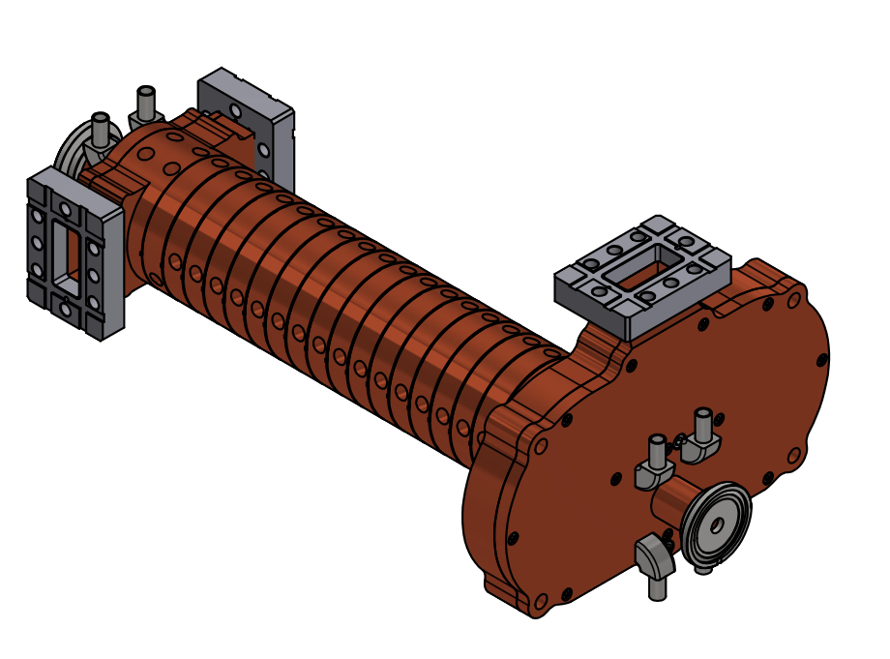
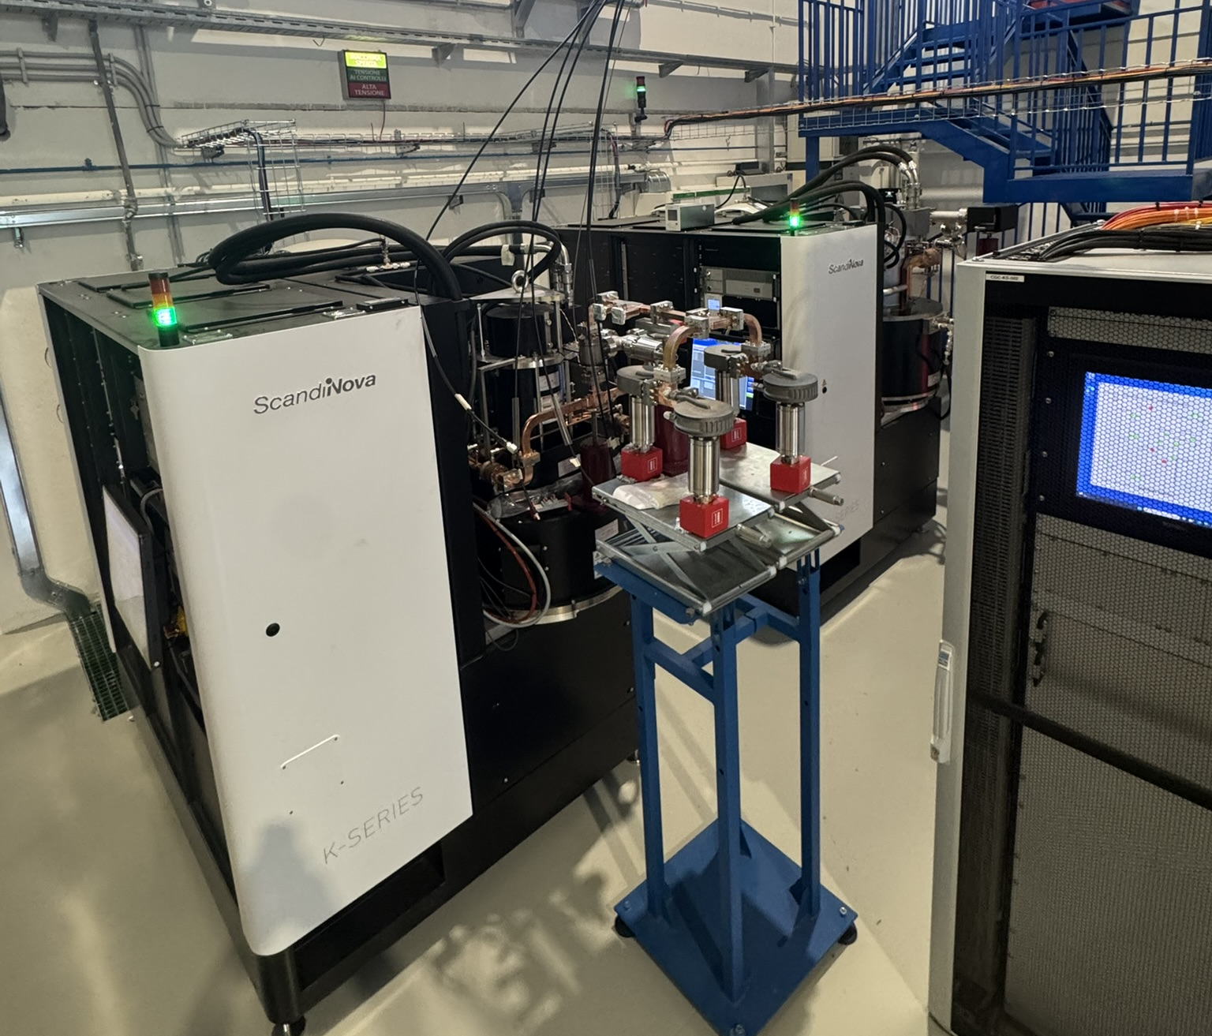
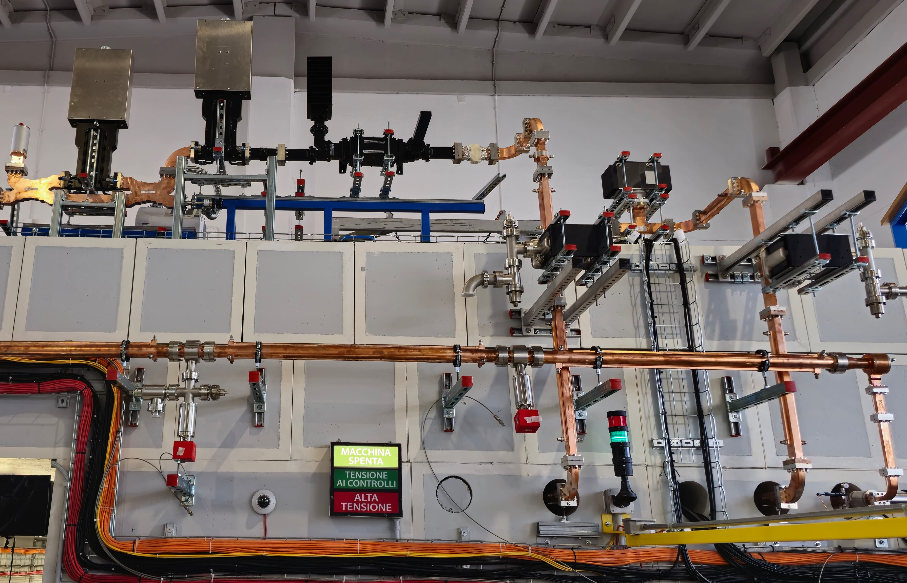
PLANNED high POWER TEST AT LNF
50 cm TW structure
Joint-lab medical accelerator
C-band Klystron
High Power Test scheduled in autumn 2025
Imagines courtesy of F. Cardelli and S. Pioli
Lucia Giuliano et al.
Convegno Nazionale: Quarta Giornata Acceleratori
3 – 4 Aprile 2025 INFN - Laboratori Nazionali di Legnaro

Slide 21
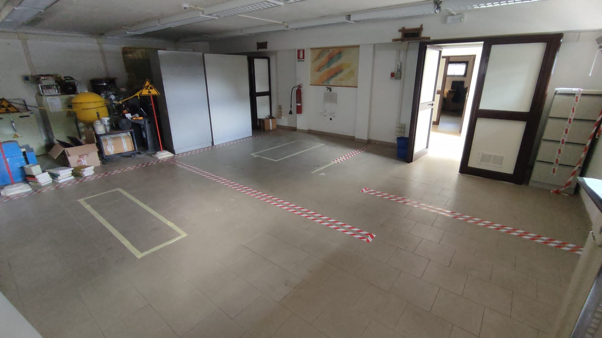
Bunker @ Sapienza University
Modulator & Klystron
Room Service
LINAC
e-
The works of the bunker will be completed in October 2025
Convegno Nazionale: Quarta Giornata Acceleratori
3 – 4 Aprile 2025 INFN - Laboratori Nazionali di Legnaro
Lucia Giuliano et al.
High Gradient Technology for VHEE Linac in FLASH Radiotherapy
HG2025, Mérida, Yucatán, México

Slide 22
Future perspectives:
beam delivery and pre-clinical studies
Convegno Nazionale: Quarta Giornata Acceleratori
3 – 4 Aprile 2025 INFN - Laboratori Nazionali di Legnaro

Slide 23
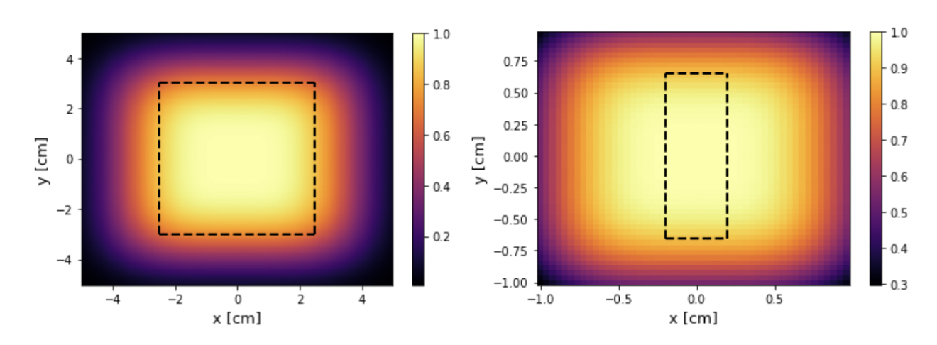
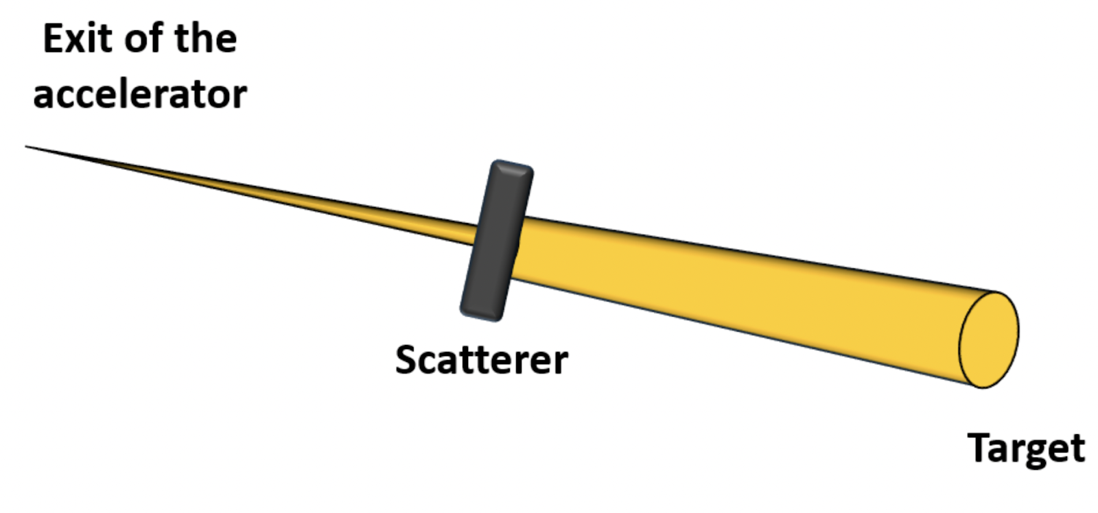
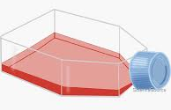
Beam delivery: flat beAM
Irradiation 4 X 4 cm
Cell flask
Main contribution A. Curcio, L. Giuliano
Convegno Nazionale: Quarta Giornata Acceleratori
3 – 4 Aprile 2025 INFN - Laboratori Nazionali di Legnaro
Lucia Giuliano et al.
High Gradient Technology for VHEE Linac in FLASH Radiotherapy
HG2025, Mérida, Yucatán, México

Slide 24
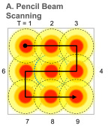
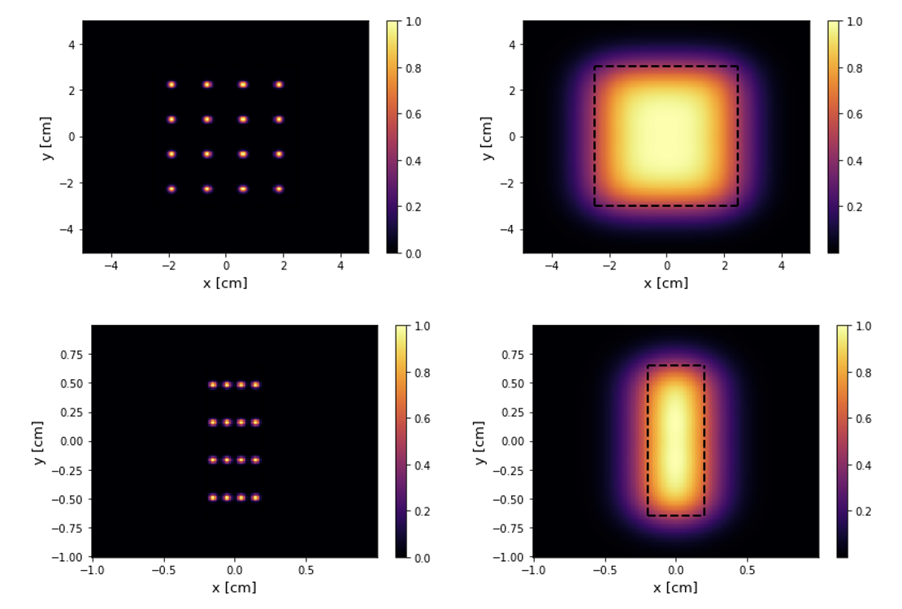
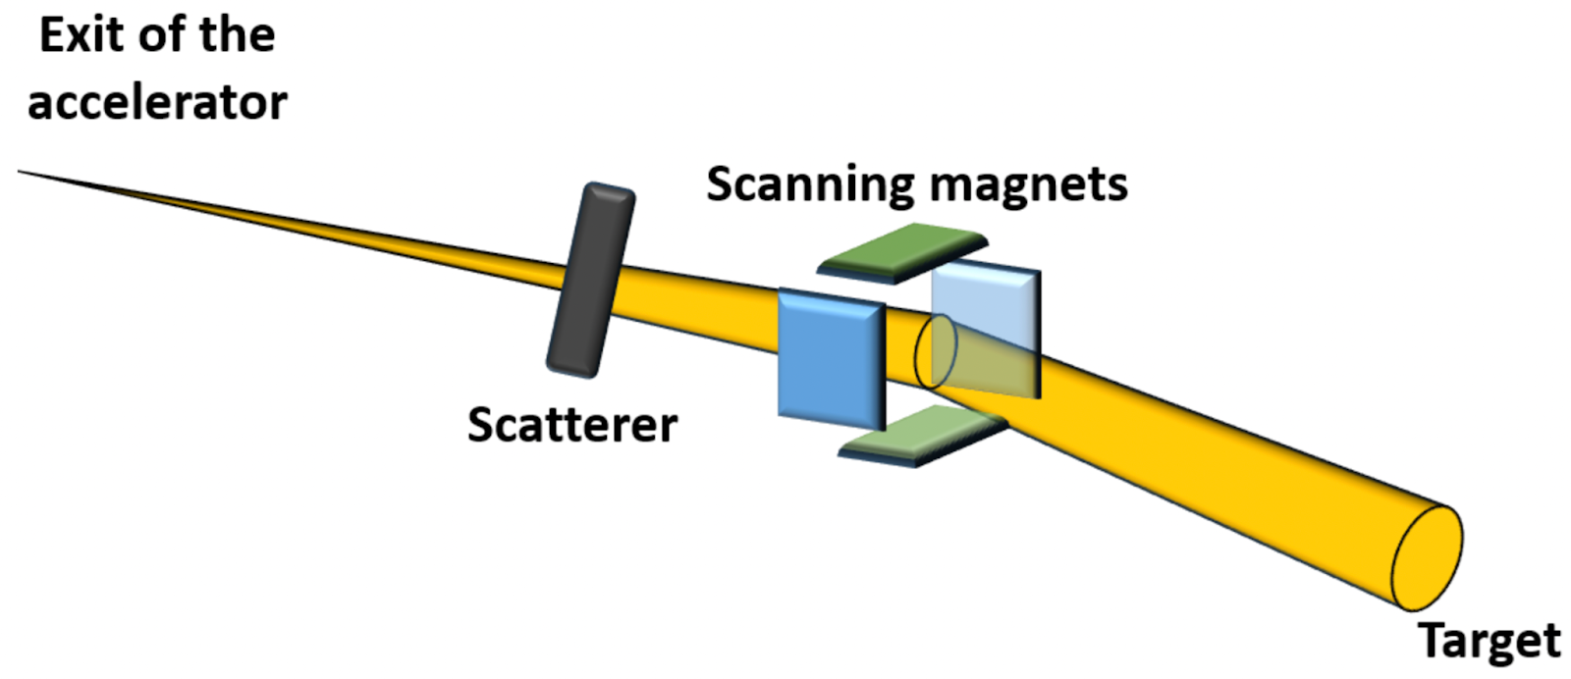
Beam delivery: pencil beam scanning
Irradiation 4 X 4 cm
Irradiation 13 mm X 8 mm
Main contribution A. Curcio, L. Giuliano
Convegno Nazionale: Quarta Giornata Acceleratori
3 – 4 Aprile 2025 INFN - Laboratori Nazionali di Legnaro
Lucia Giuliano et al.
High Gradient Technology for VHEE Linac in FLASH Radiotherapy
HG2025, Mérida, Yucatán, México

Slide 25
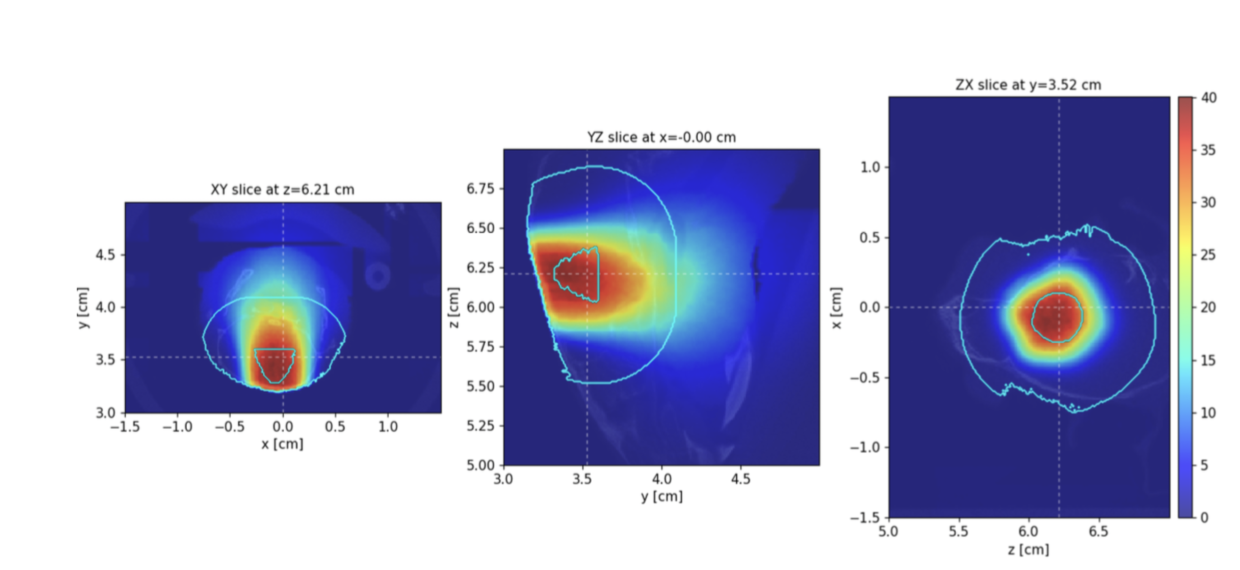

Pre-clinical applications: GBM in mice
Dipartimento di Fisiologia e Farmacologia “Vittorio Erspamer”
Dipartimento di Scienze di Base Applicate per l’Ingegneria
In PBS and FLAT, the dose absorbed by the organ at risk (green) surrounding the Tumor Volume (red) remains significantly low, staying below a reasonable hypothetical constraint.
Main contribution A. Curcio, A. De Gregorio, G. Franciosini, L. Giuliano, G. D’Alessandro, C. Limatola, A. Sarti, E. Teseo
Lucia Giuliano et al.
Convegno Nazionale: Quarta Giornata Acceleratori
3 – 4 Aprile 2025 INFN - Laboratori Nazionali di Legnaro

Slide 26
CONCLUSION
  24 MeV FLASH Linac is under costruction @Sapienza University
  The procurement of all components is on schedule
  Phase 1: featuring SW 10 MeV, will be completed by the end of 2025
    The SW and gun design has been completed.
    SW structure will be realized by the end of June 2025
  Phase 2: featuring SW and TW 24 MeV, will be completed by the end of 2026
    The TW 50 cm development is in progress
    The high-power test expected to be conducted at Frascati INFN - TEX Laboratory in autumn 2025
  Future perspectives: Beam Delivery and applications
Convegno Nazionale: Quarta Giornata Acceleratori
3 – 4 Aprile 2025 INFN - Laboratori Nazionali di Legnaro
Lucia Giuliano et al.
High Gradient Technology for VHEE Linac in FLASH Radiotherapy
HG2025, Mérida, Yucatán, México

Slide 27





Thank you!!!
Convegno Nazionale: Quarta Giornata Acceleratori
3 – 4 Aprile 2025 INFN - Laboratori Nazionali di Legnaro
Lucia Giuliano et al.
High Gradient Technology for VHEE Linac in FLASH Radiotherapy
HG2025, Mérida, Yucatán, México

Slide 28

FLASH Therapy IN A NUTSHELL
FLASH irradiation protects healthy tissues from damage and remains as efficient as conventional irradiation in the repression of tumor growth.
Courtesy of V. Faudon
FLASH THERAPY
Dose rate =125 Gy/s
It is a new way to deliver the dose:
- high dose per pulse (>1 Gy) in “very short time” of irradiation (< 100 ms )
- high mean dose rate (>40-100Gy/s)
Dose rate =0,1 Gy/s
Control 17 Gy CONV 17 Gy FLASH
Favaudon et al., Science Translational Medicine 6, 2014
 | Conventional | FLASH
Dose (Gy) | 17 | 17
Mean Dose rate (Gy/s) | 0,03 | 60
Healthy Fibrosis Healthy
Convegno Nazionale: Quarta Giornata Acceleratori
3 – 4 Aprile 2025 INFN - Laboratori Nazionali di Legnaro
Lucia Giuliano et al.
High Gradient Technology for VHEE Linac in FLASH Radiotherapy
HG2025, Mérida, Yucatán, México

