Slide 1
Nano-Imaging Trackers: A Novel Approach for High-Resolution Particle Detection
Andrey Alexandrov, Takashi Asada, Vincenzo Boccia, Nicola D'Ambrosio, Giovanni De Lellis, Giuliana Galati, Adele Lauria, Simone Masci, Maria Cristina Montesi, Tatsuhiro Naka, Valeri Tioukov
Sestri Levante, 19/03/2025
IFD 2025 - INFN Workshop on Future Detectors

Slide 3
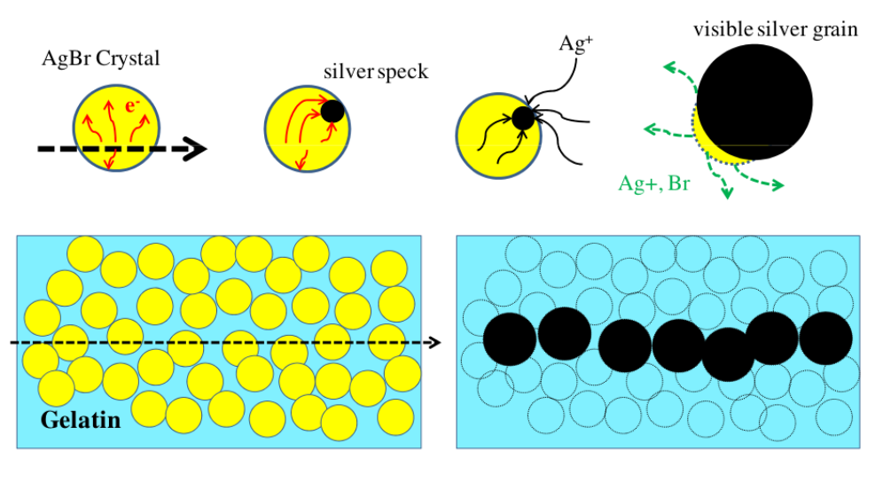
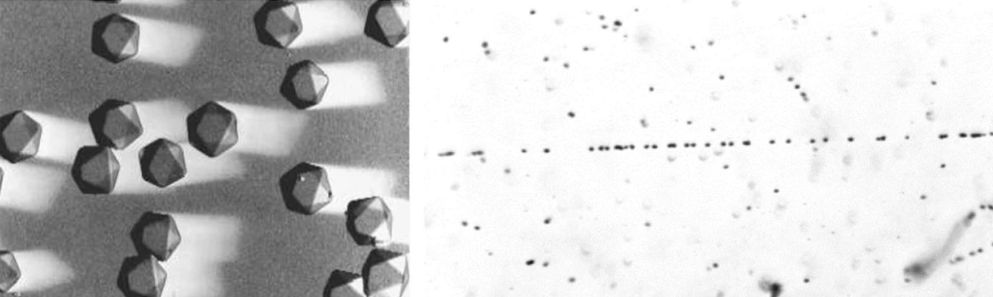
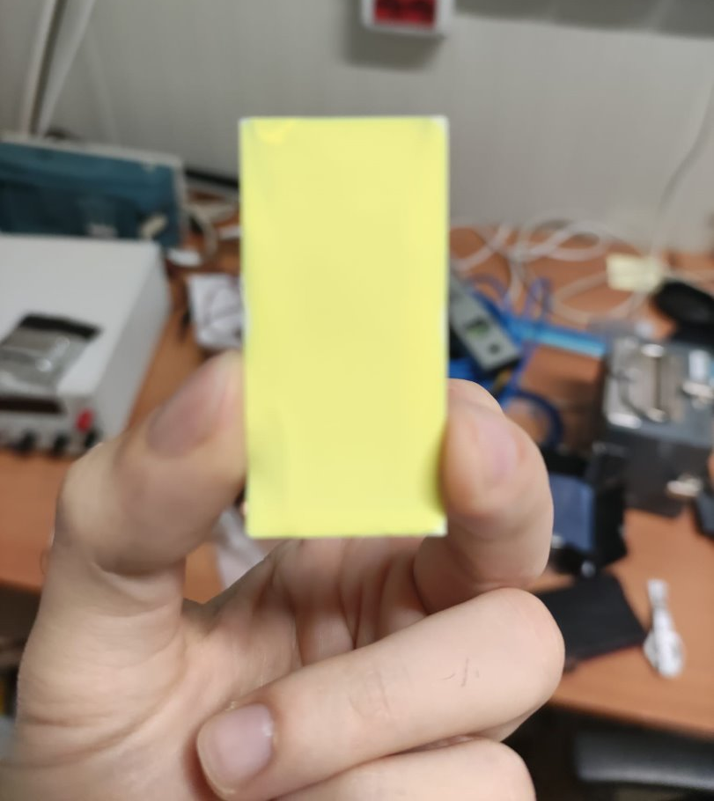
Nano Imaging Tracker (NIT)
Example of a track in a nuclear emulsion
Nano Imaging Trackers (NIT) are a novel kind of nanometric nuclear emulsion films that were designed to achieve a directional direct detection of WIMP-induced nuclear recoils
Large number of silver halide crystals (AgBr) dispersed in an organic gelatine binder
Passage of charged particle produces latent image
Signal amplification after chemical development
From: Asada T. et al. Prog. Theor. Exp. Phys. 2015
From: G. De Lellis et al., Journal of Instrumentation
New production method: finer AgBr crystals (tunable from 20 nm to 80 nm)
More than 350 sensitive elements per $1μm^{3}$
Undeveloped NIT sample
heavy nuclei
light nuclei
Notes:
Signal amplification = Ag grains become visible

Slide 4
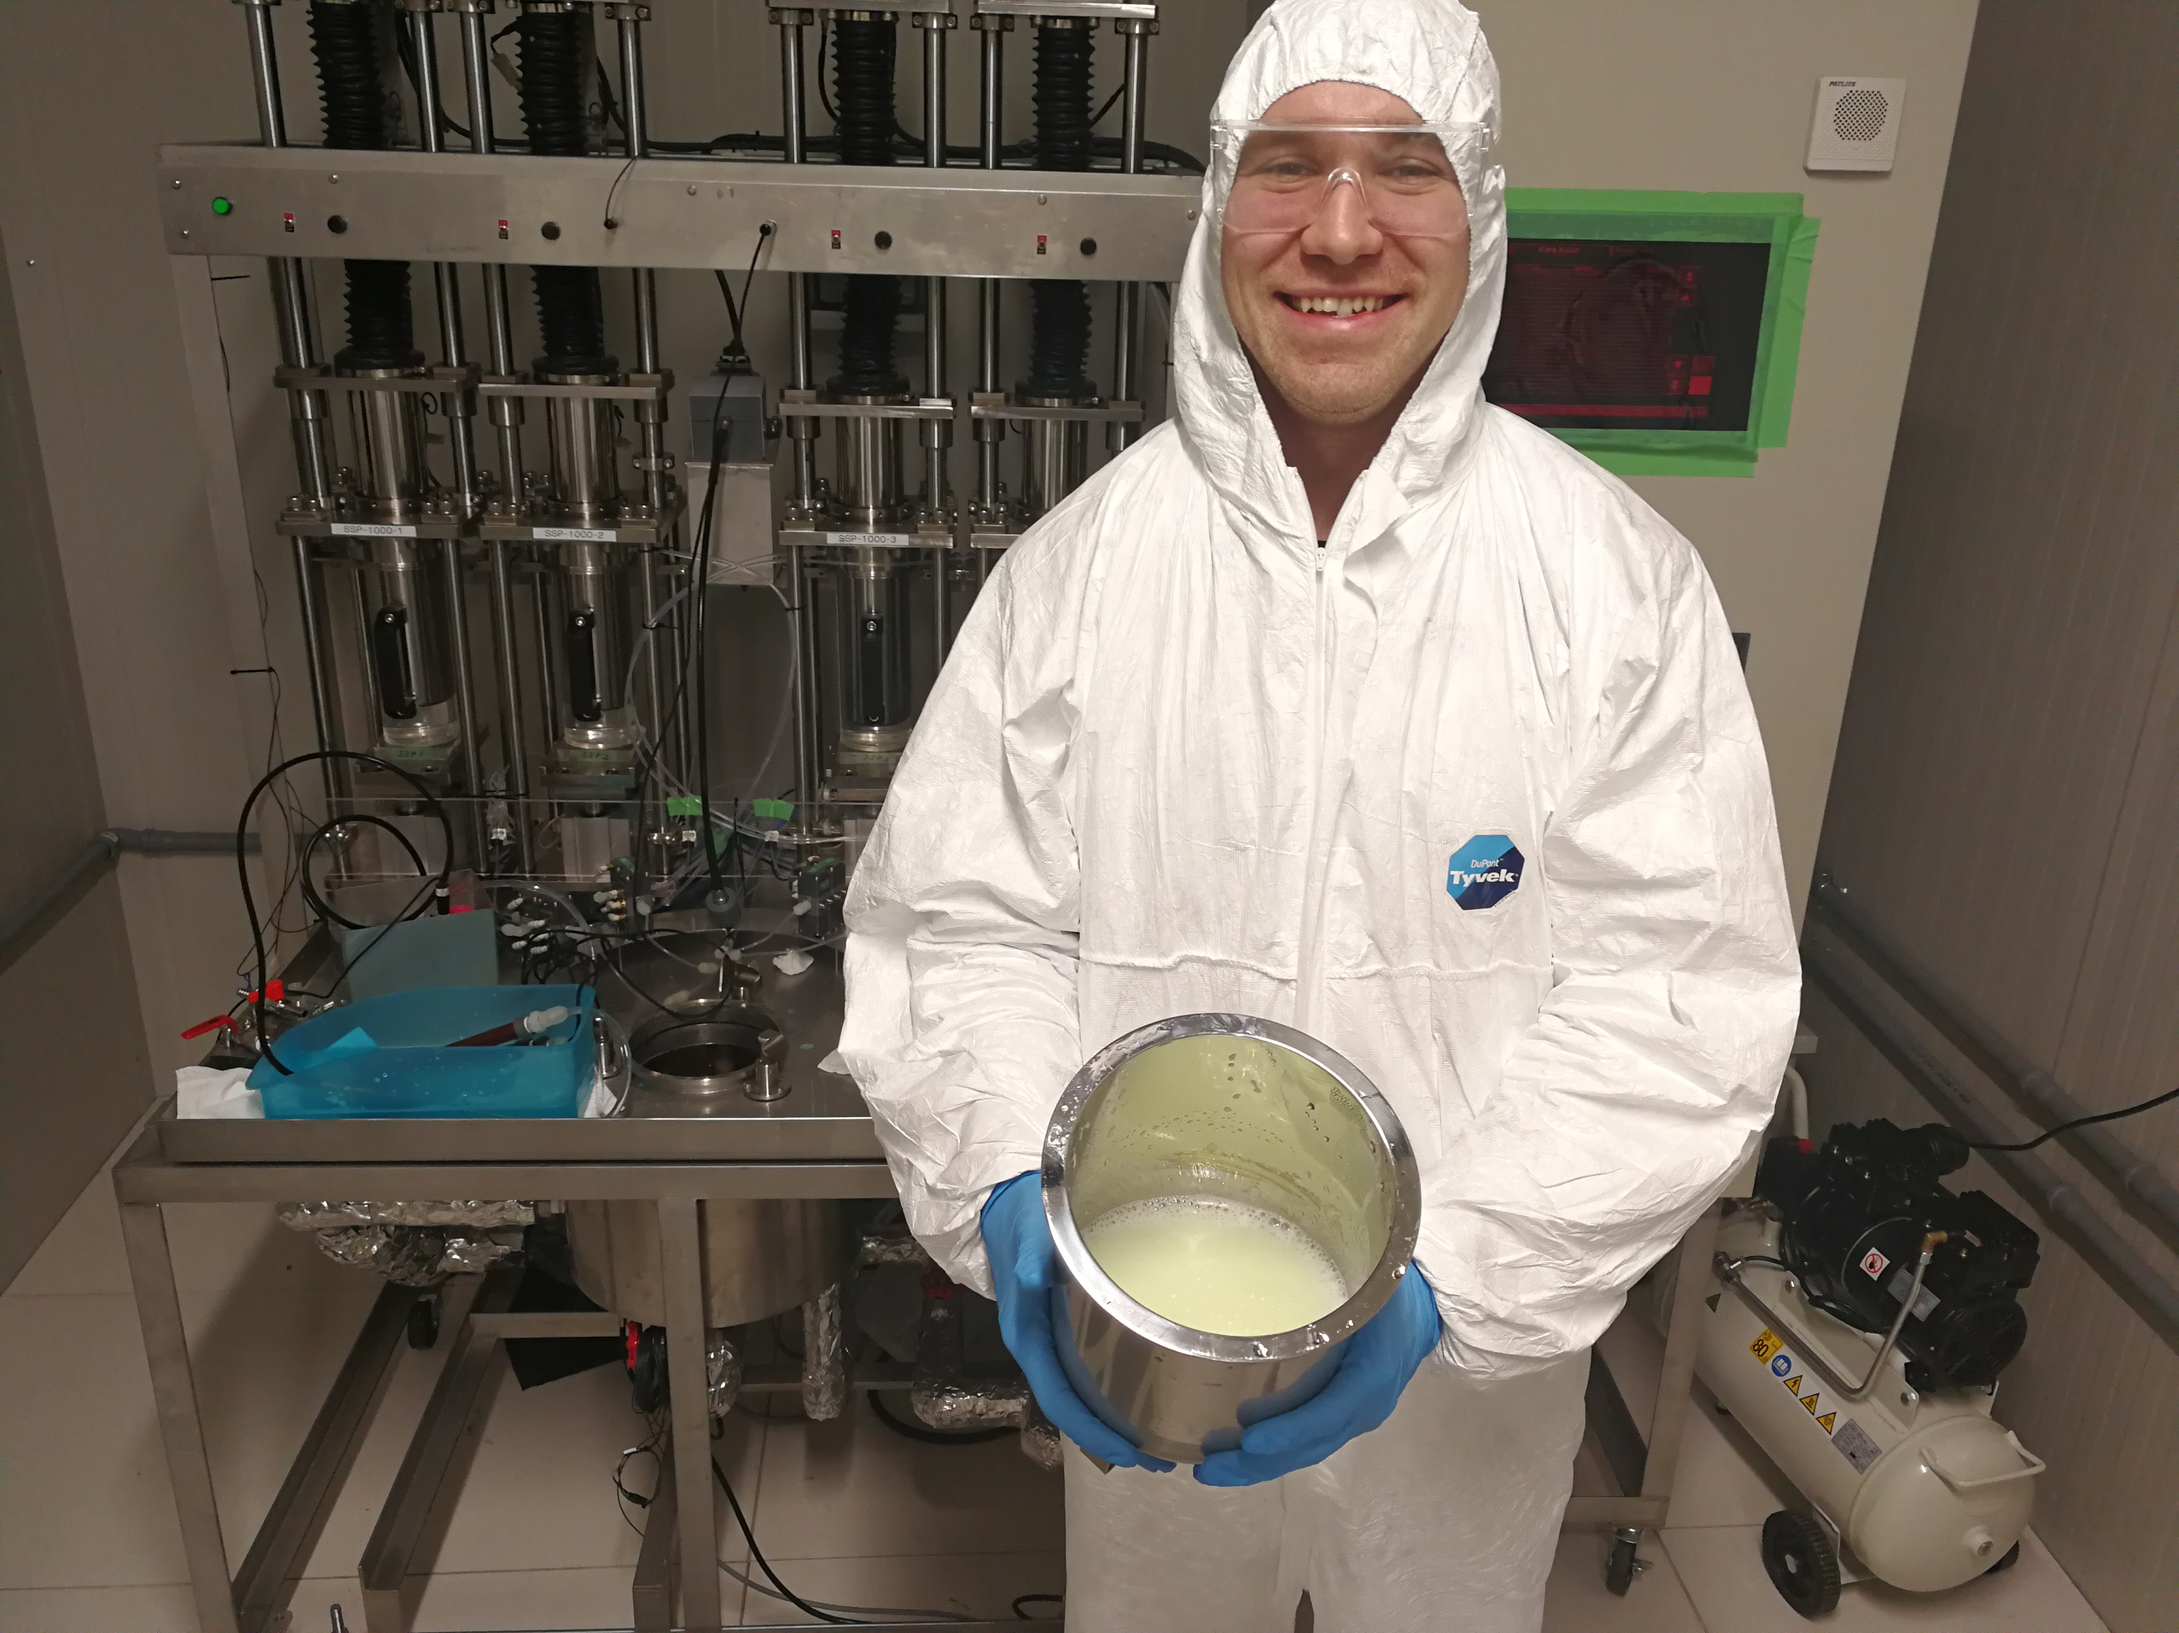
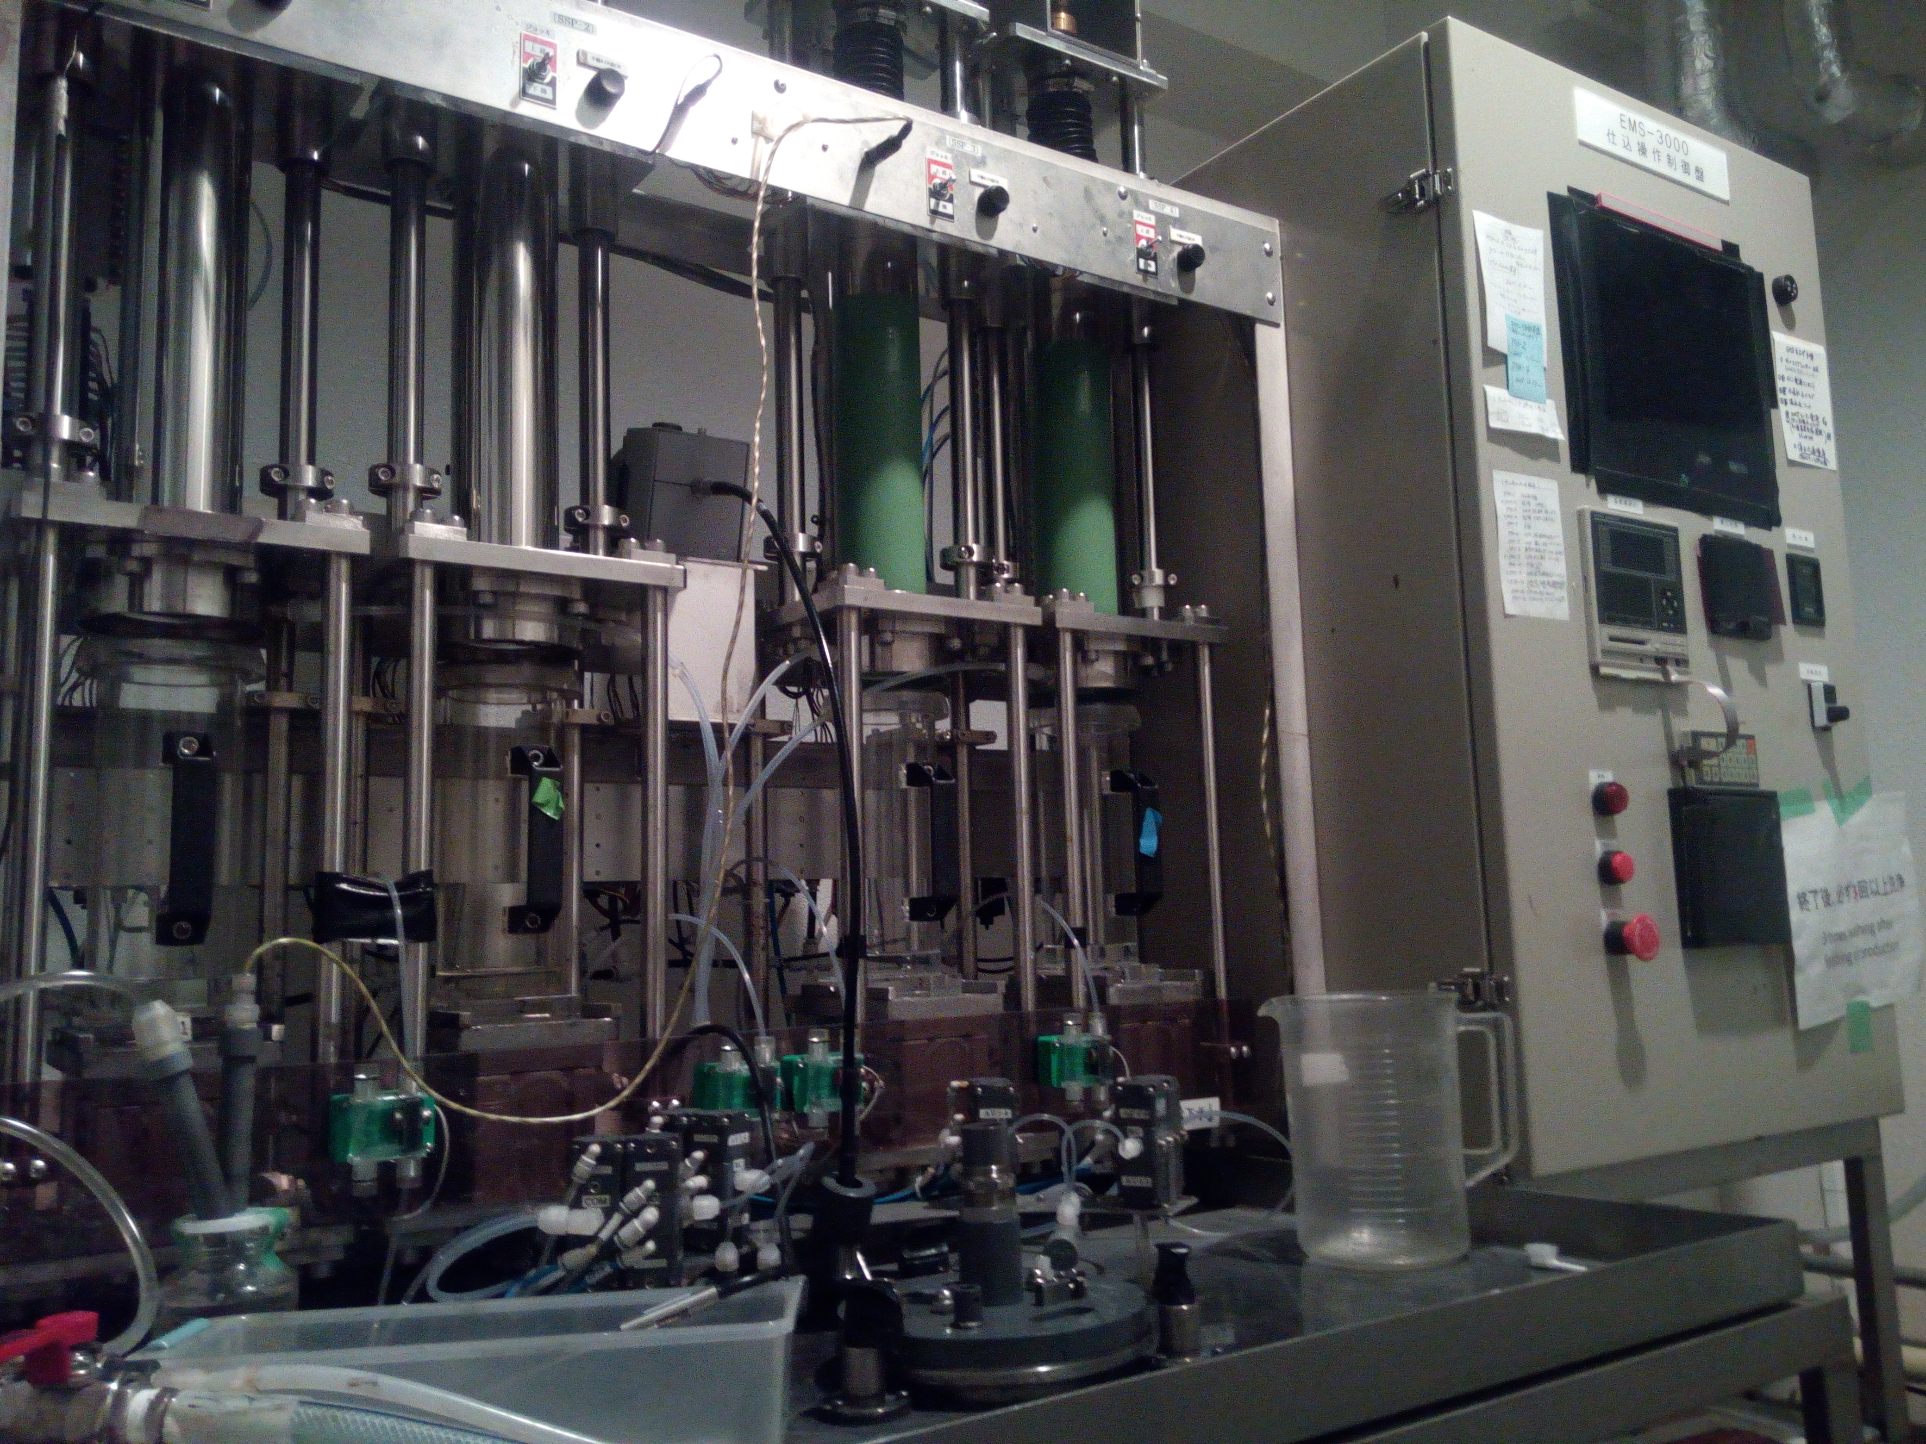
Self-production of nuclear emulsion device
LNGS Site
Nagoya Site

Slide 5
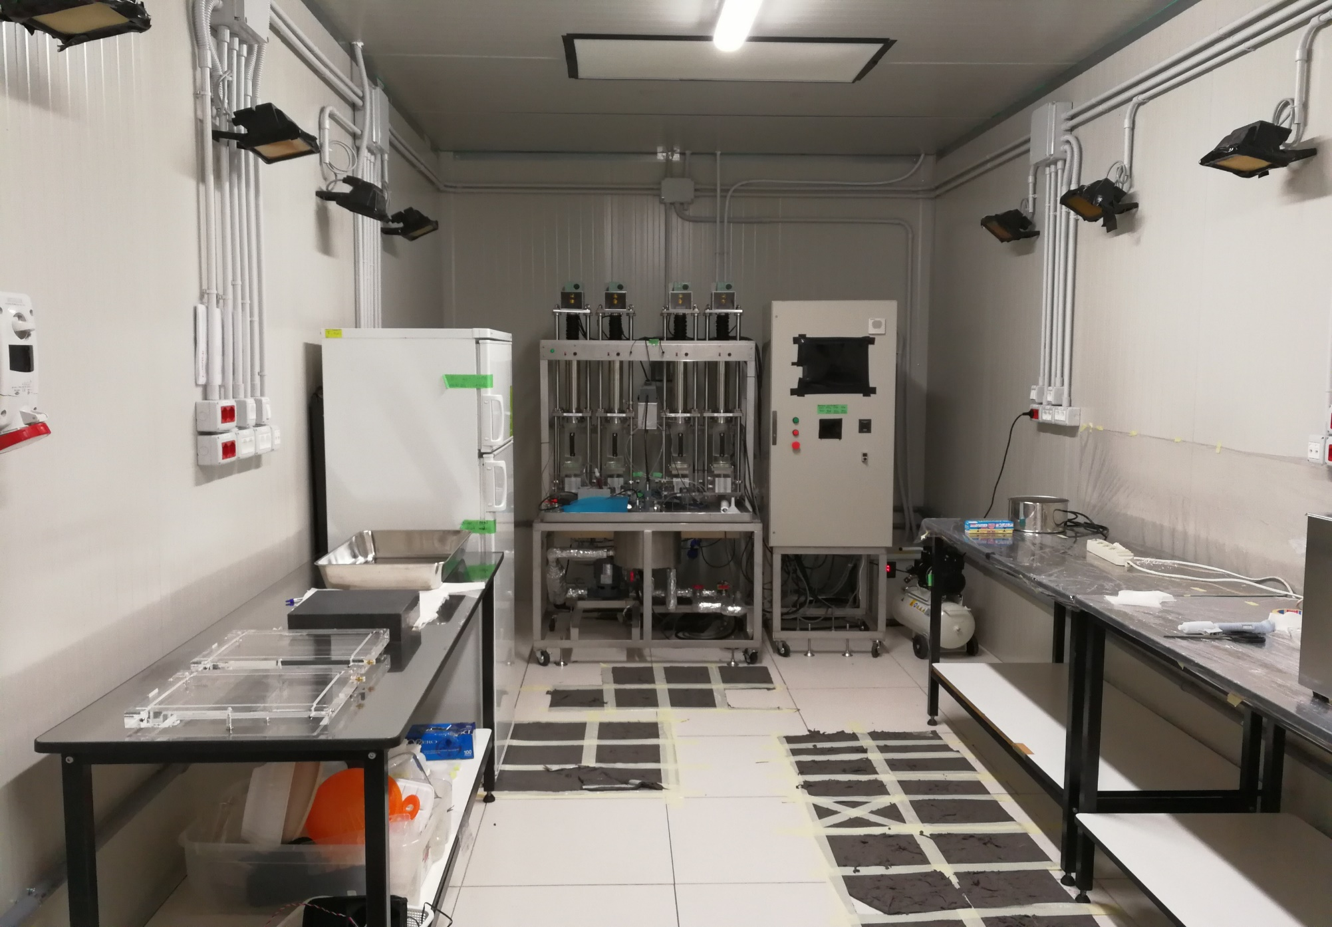
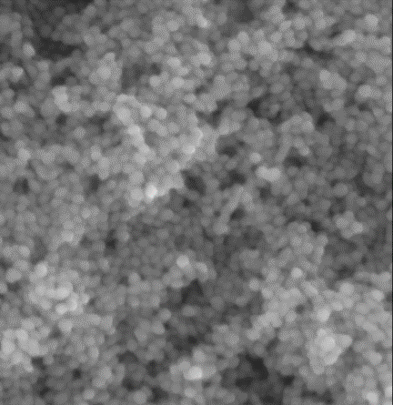
Self-production of nuclear emulsion
AgNO₃ solution
KBr
solution
Commercial technology → Academia (2008~ )
Production machine
AgNO₃+KBr→AgBr↓+KNO₃
Controlled AgBr crystal
Chemical preparation desk
Pouring stages
500nm
500nm
500nm
T. Naka et al., Nucl. Inst. Meth. A 718 (2013) 519-521

Slide 6
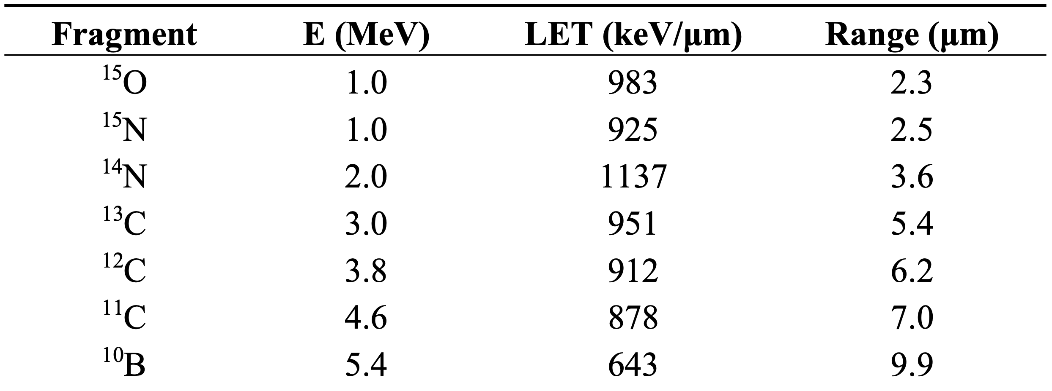
The idea
The main experimental difficulty for a direct measurement of target fragmentation induced by a proton beam is the short range of produced fragments
Fragments so short do not exit the target: target and the tracking device should coincide
Very high resolution: novel kind of nuclear emulsion, called Nano Imaging Tracker (NIT), with grains at the nanometric scale allows to detect path lengths shorter than 100 nm
p (180 MeV) on H2O: range of fragments
References:
Asada, T. et al. The development of a super-fine-grained nuclear emulsion. Prog. Theor. Exp. Phys. 6, (2017)
Alexandrov, A. et al. Super-resolution high-speed optical microscopy for fully automated readout of metallic nanoparticles. Sci. Reports 10, 18773 (2020)
Tomasino, Durante, Cancers - 2015 https://pubmed.ncbi.nlm.nih.gov/25686476/
Notes:
The experimental measurements of LET (and consequently of RBE) of fragments is difficult and there is a lack of data for the production of fragments after proton irradiation in the energy range of interest, up to 250 MeV. The main experimental difficulty is due to the short range of produced fragments (≤100 μm). The inverse kinematic approach has been adopted in all experiments so far to overcome the problem, at the price of increased systematic errors. To study these fragments is crucial because they have very high LET and RBE
NIT have been developed to search for dark matter candidates in the frame of the NEWSdm experiment, a very innovative approach for a high sensitivity experiment aiming at the directional detection of WIMPs (Weakly Interacting Massive Particles), which are are one of the most appealing Dark Matter candidates.

Slide 7
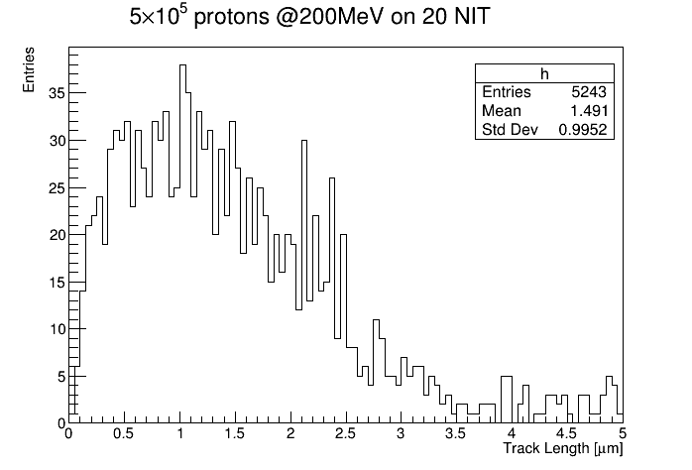
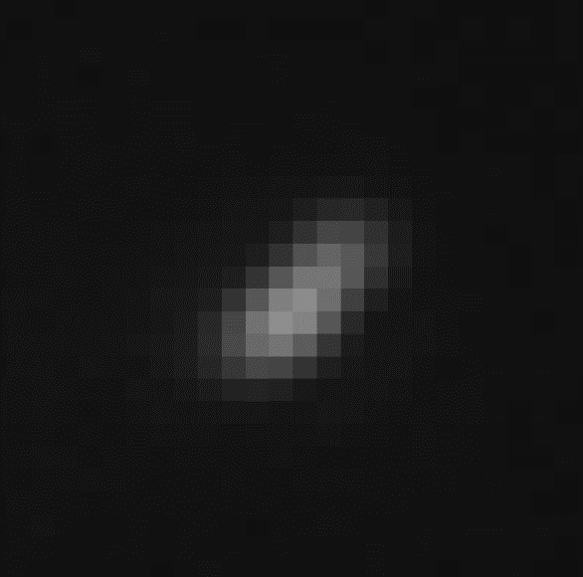
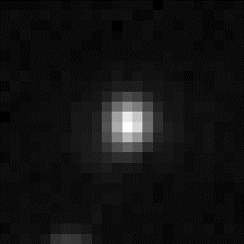
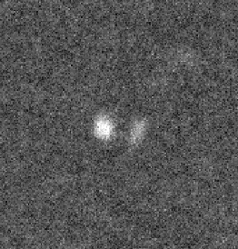
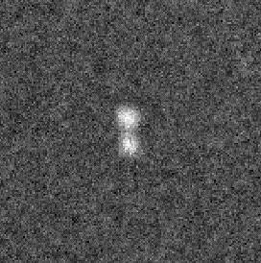
NIT Read out
Tracks shorter than ～200 nm can not be resolved due to the optical diffraction limit
X-ray or Scanning Electron Microscope (SEM) cannot be employed on a large scale because of their limited speed → new approach employing an optical super-resolution microscope
400 keV Kr ion in NIT
Optical
Optical
Optical
X-ray
X-ray
X-ray
L = 380 nm
L = 265 nm
L = 160 nm
Notes:
Thanks to NIT emulsions and to high resolution microscopes, it is possible to reconstruct also trajectories with path lengths shorter than 100 nm.
The read-out system has to be fast and completely automated, in order to analyze a large emulsion volume, and must have a spatial resolution of a few tens of nanometers, in order to ensure high efficiency and purity in the selection of signal candidates.
About 10% of proton induced target fragments (200 MeV) are expected to have track lenghts in NIT

Slide 8
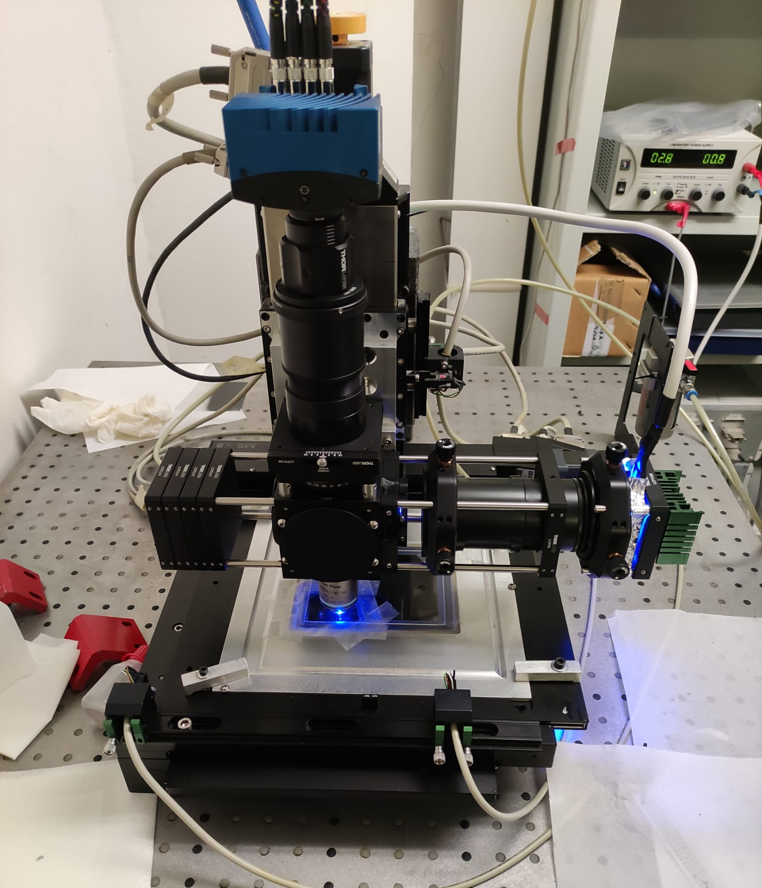
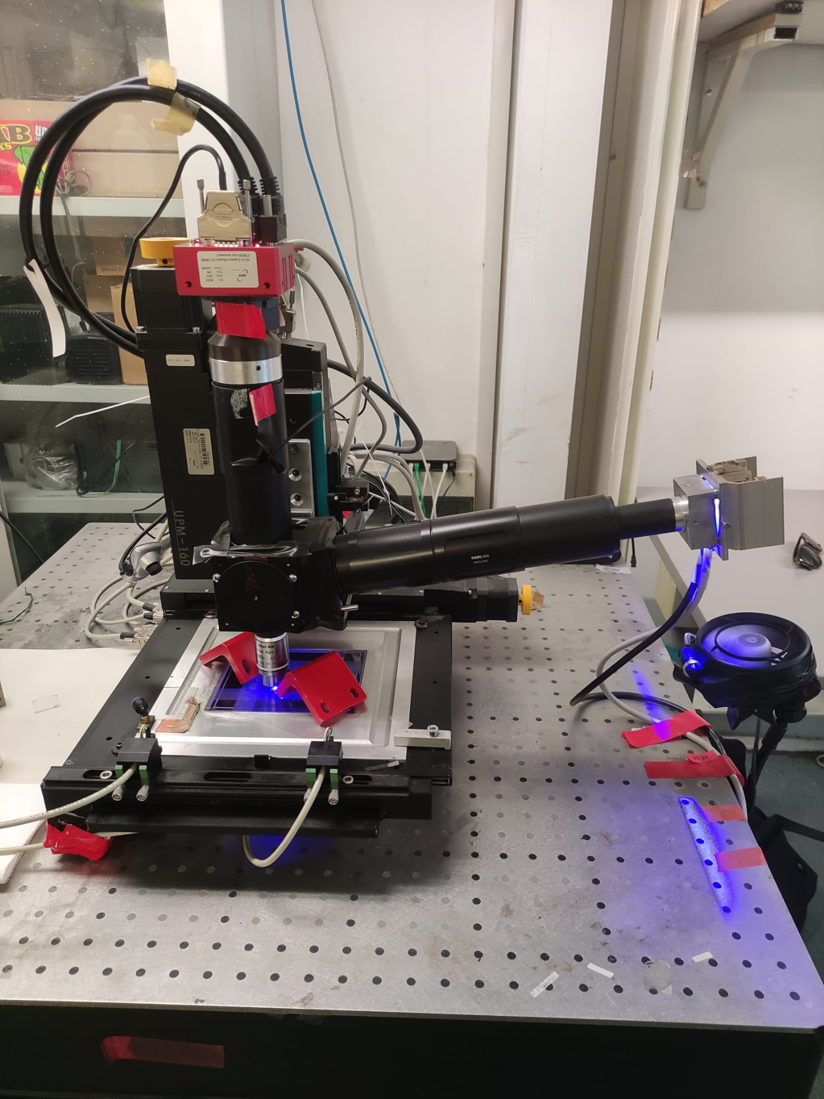
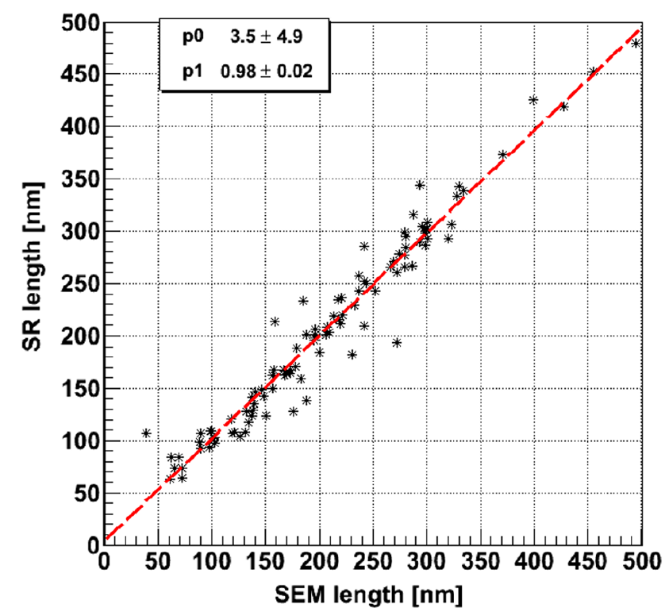
NIT Read out
Optical microscopes
Challenge: detect tracks with lengths comparable/shorter than optical resolution
STEP 1: CANDIDATE IDENTIFICATION
Pros: Fast scanning profiting of the improvements driven by the OPERA experiment
Limit: Resolution: ∼200 nm (Optical diffraction limit)
STEP 2: CANDIDATE VALIDATION (Resonant light scattering)
Pros: Super resolution: ∼50 nm
Camera
(40nm NIT)
Liquid Crystal Polarizer
Optical
Super Res.
SEM
From: Alexandrov et al. Scientific Reports volume 13, Article number: 22813 (2023)
LED
Notes:
Thanks to NIT emulsions and to high resolution microscopes, it is possible to reconstruct also trajectories with path lengths shorter than 100 nm.
The read-out system has to be fast and completely automated, in order to analyze a large emulsion volume, and must have a spatial resolution of a few tens of nanometers, in order to ensure high efficiency and purity in the selection of signal candidates.

Slide 9
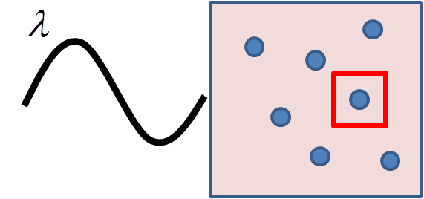
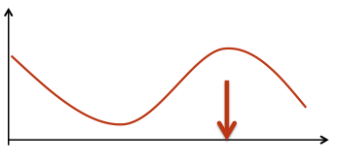
Step 2: Localized Surface Plasmon Resonance
Occurring when the light is scattering off a nanometric metallic (silver) grain dispersed in a dielectric medium (Applied Phys Letters 80 (2002) 1826)
Sensitive to the shape of nanometric grains: when silver grains are not spherical, the resonant response depends on the polarization of the incident light.
Each grain is emphasized at different polarization values
Taking multiple measurements over the whole polarization range produces a displacement of the barycenter of the cluster
Measure the displacement of cluster barycentre as a function of polarization angle (dx, dy)
TEM image of Carbon track after development
λ_{l}
polarization direction
Oscillation of e-cloud
Scattering intensity
polarization direction of incident light
polarization direction
Scattering intensity
polarization direction of incident light
Notes:
To overcome the diffraction limit, a new type of optical microscope has been developed, based on localized surface plasmon resonance (LSPR). LSPR occurs when there are metallic objects, in particular gold or silver, smaller than about 100 nm, immersed in a dielectric, and this is precisely the case of NIT, where we have nanometric Ag grains immersed in an organic gelatin. LSPR is given by the collective oscillation of free electrons induced by an external electric field. The free electrons in metal nanoparticles have a natural frequency due to the binding strength which depends on the displacement induced by the electrostatic attraction in an external electric field. NIT grains go into a resonant condition in visible light. The grains are not spherical objects, but filaments approximating to ellipsoids. The resonant wavelength depends on the size of the object and, if this is ellipsoidal and not spherical, also on its polarization. The random orientation of the grains causes them to “light up” one at a time as the polarization varies, creating a shift in the center of gravity of the cluster visible under the microscope along the direction of the track.

Slide 10
Step 2: Localized Surface Plasmon Resonance
Occurring when the light is scattering off a nanometric metallic (silver) grain dispersed in a dielectric medium (Applied Phys Letters 80 (2002) 1826)
Sensitive to the shape of nanometric grains: when silver grains are not spherical, the resonant response depends on the polarization of the incident light.
Each grain is emphasized at different polarization values
Taking multiple measurements over the whole polarization range produces a displacement of the barycenter of the cluster
Measure the displacement of cluster barycentre as a function of polarization angle (dx, dy)
TEM image of Carbon track after development
λ_{l}
polarization direction
Oscillation of e-cloud
Scattering intensity
polarization direction of incident light
polarization direction
Scattering intensity
polarization direction of incident light
Notes:
To overcome the diffraction limit, a new type of optical microscope has been developed, based on localized surface plasmon resonance (LSPR). LSPR occurs when there are metallic objects, in particular gold or silver, smaller than about 100 nm, immersed in a dielectric, and this is precisely the case of NIT, where we have nanometric Ag grains immersed in an organic gelatin. LSPR is given by the collective oscillation of free electrons induced by an external electric field. The free electrons in metal nanoparticles have a natural frequency due to the binding strength which depends on the displacement induced by the electrostatic attraction in an external electric field. NIT grains go into a resonant condition in visible light. The grains are not spherical objects, but filaments approximating to ellipsoids. The resonant wavelength depends on the size of the object and, if this is ellipsoidal and not spherical, also on its polarization. The random orientation of the grains causes them to “light up” one at a time as the polarization varies, creating a shift in the center of gravity of the cluster visible under the microscope along the direction of the track.

Slide 11
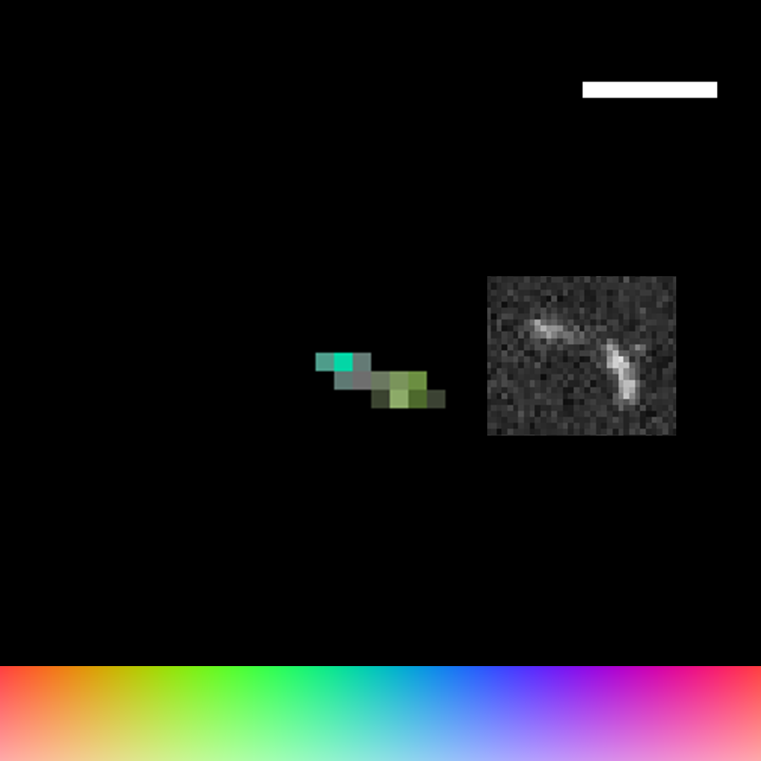
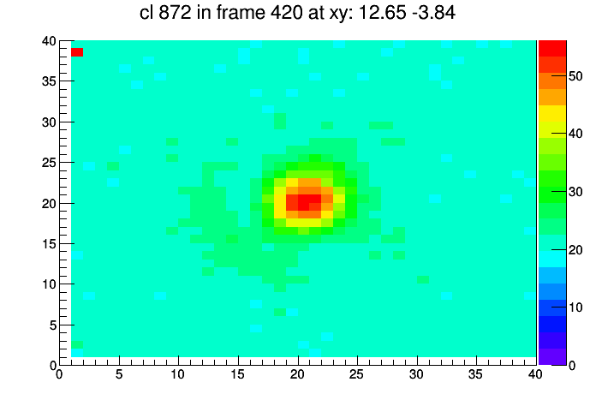
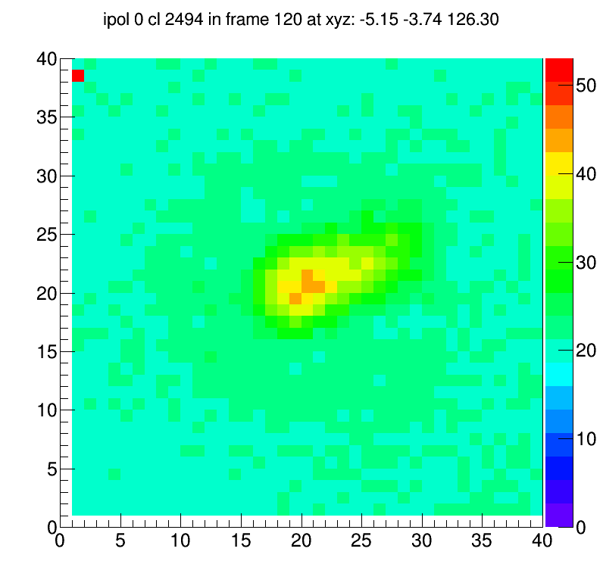
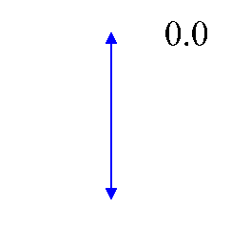
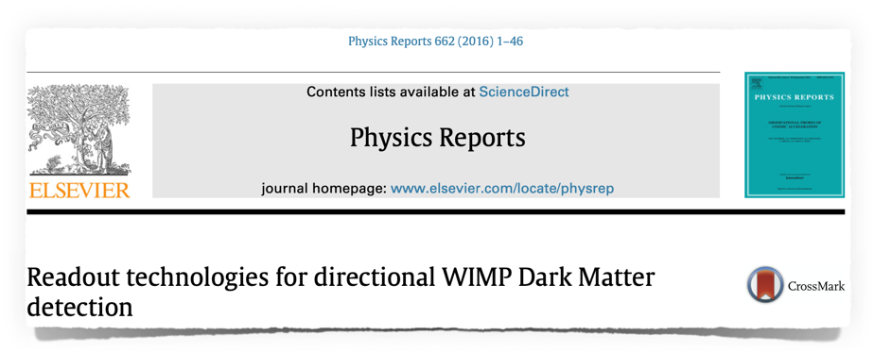
Step 2: Localized Surface Plasmon Resonance
Signal-like events (100keV C ion)
Optical microscope
486nm
486nm
X-ray microscope
Background grain
236nm
Barycenter of the cluster
Max barshift
236nm
Reconstructed image
200 nm
Optical microscope
X-ray microscope
330nm
Polarization angle
330nm
600nm
SEM image
No barycenter shift
600nm
Polarization Angle

Slide 12
On-going R&D to improve sensitivity
R&D on-going in collaboration with Toho University to enhance sensitive to protons@200MeV
Characterization of the detector's response as a function of proton energy (particle ID, energy measurement)
Tests on gel sensitization, chemical development, support material
NIT (70 nm)
Proton Beam
TEA (2.5%) REVERSAL
End of range
$$\sim 26MeV$$
$$\sim 68MeV$$
$$\sim 96MeV$$
$$\sim 126MeV$$
$$\sim 179MeV$$
Proton Energy

Slide 13
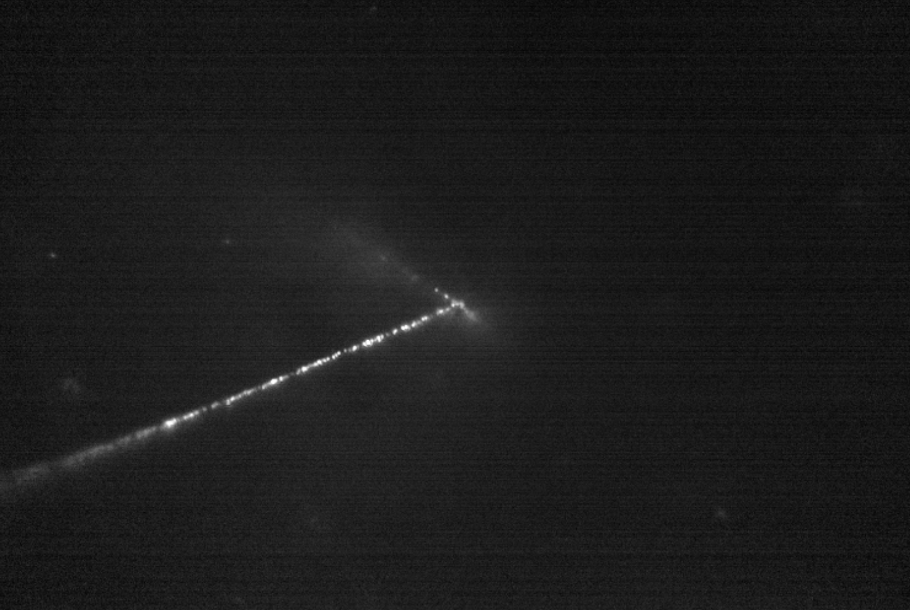
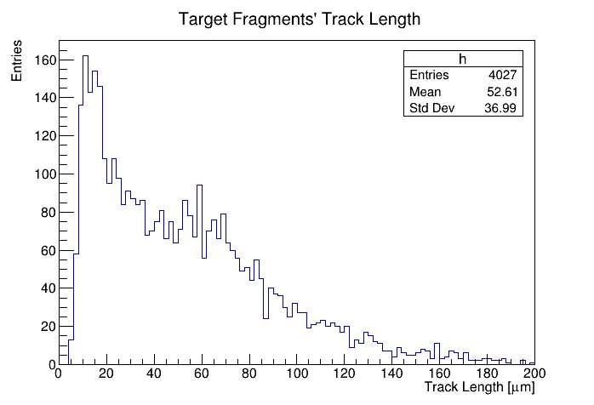
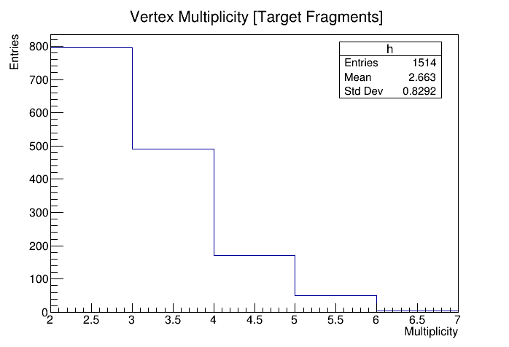
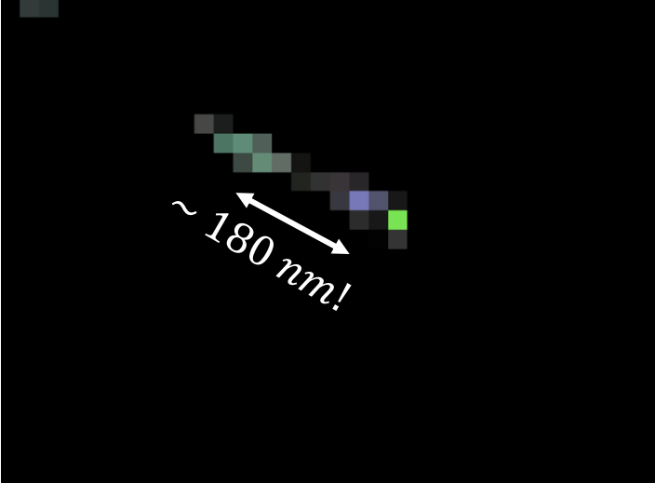
Example of vertices reconstruction from pilot test with proton@211 MeV
Scanning with high speed optical microscopes (reflection mode) and analysis of 18 NIT films: reconstruction of about 1500 events
Application of super resolution imaging to fully characterize these interactions (on-going)
Target Fragments’ Track Length
Polarization Angle = 112.5°
Polarization Angle = 180°
Vertex Multiplicity
doi.org/10.1016/j.nima.2024.170006
SuperResolution analysis
Notes:
8 polarizzazioni

Slide 14
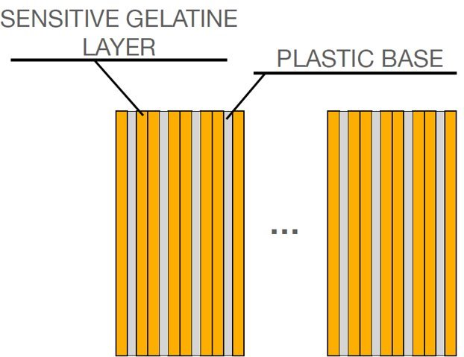
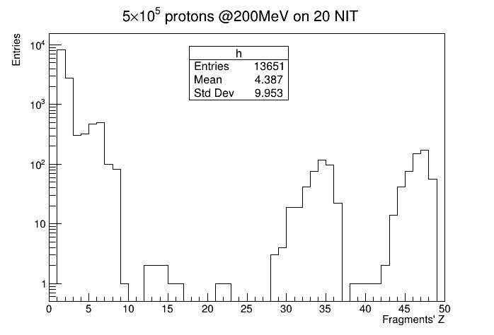
DAMON: A new approach to Target Fragmentation
The DAMON (Direct meAsureMent of target fragmentation) project (PRIN 2022) aims at measuring for the first time proton-induced target fragmentation in direct kinematics ​
Direct detection of short fragments made possible by NIT acting both as target and tracking devices
The estimated interaction probability for 200 MeV protons in a detector with 20 NIT is $\sim 1\%$
Among all interactions (Geant4 Simulation):
~38 % occur in the emulsion gel ($C,O,H,N,Ag,Br$)
~62% occur in the plastic support (Polystirene, ${\left(C_{8}H_{8}\right)}_{n}$)
Less than 10% of interactions on $Ag,Br$
Typical energies of fragments, of the order of MeV, make them travel at least 300 nm $→$ detectable!
Proton Beam
$$Br$$
$$Ag$$
16th Pisa Meeting on Advanced Detectors – Vincenzo Boccia

Slide 15
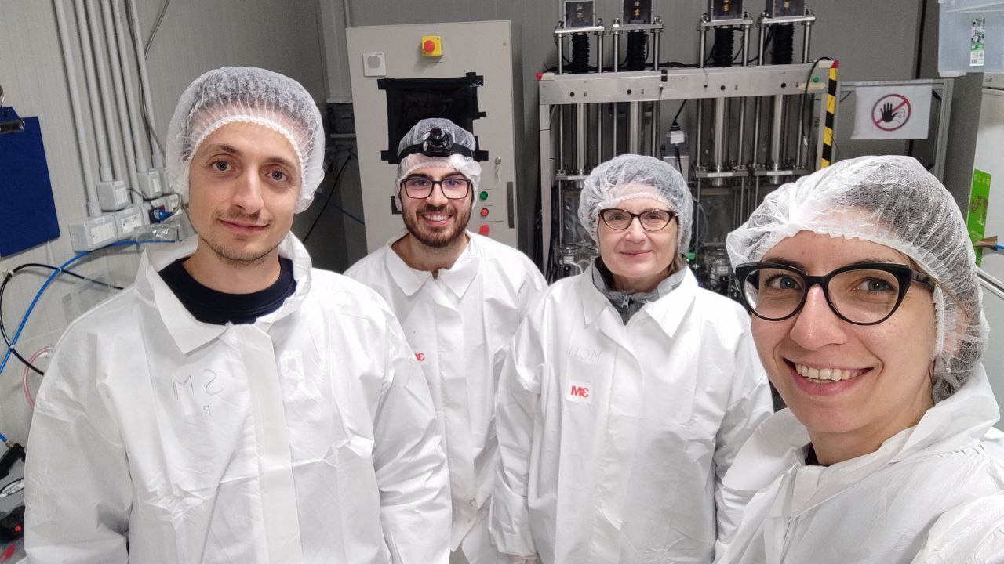
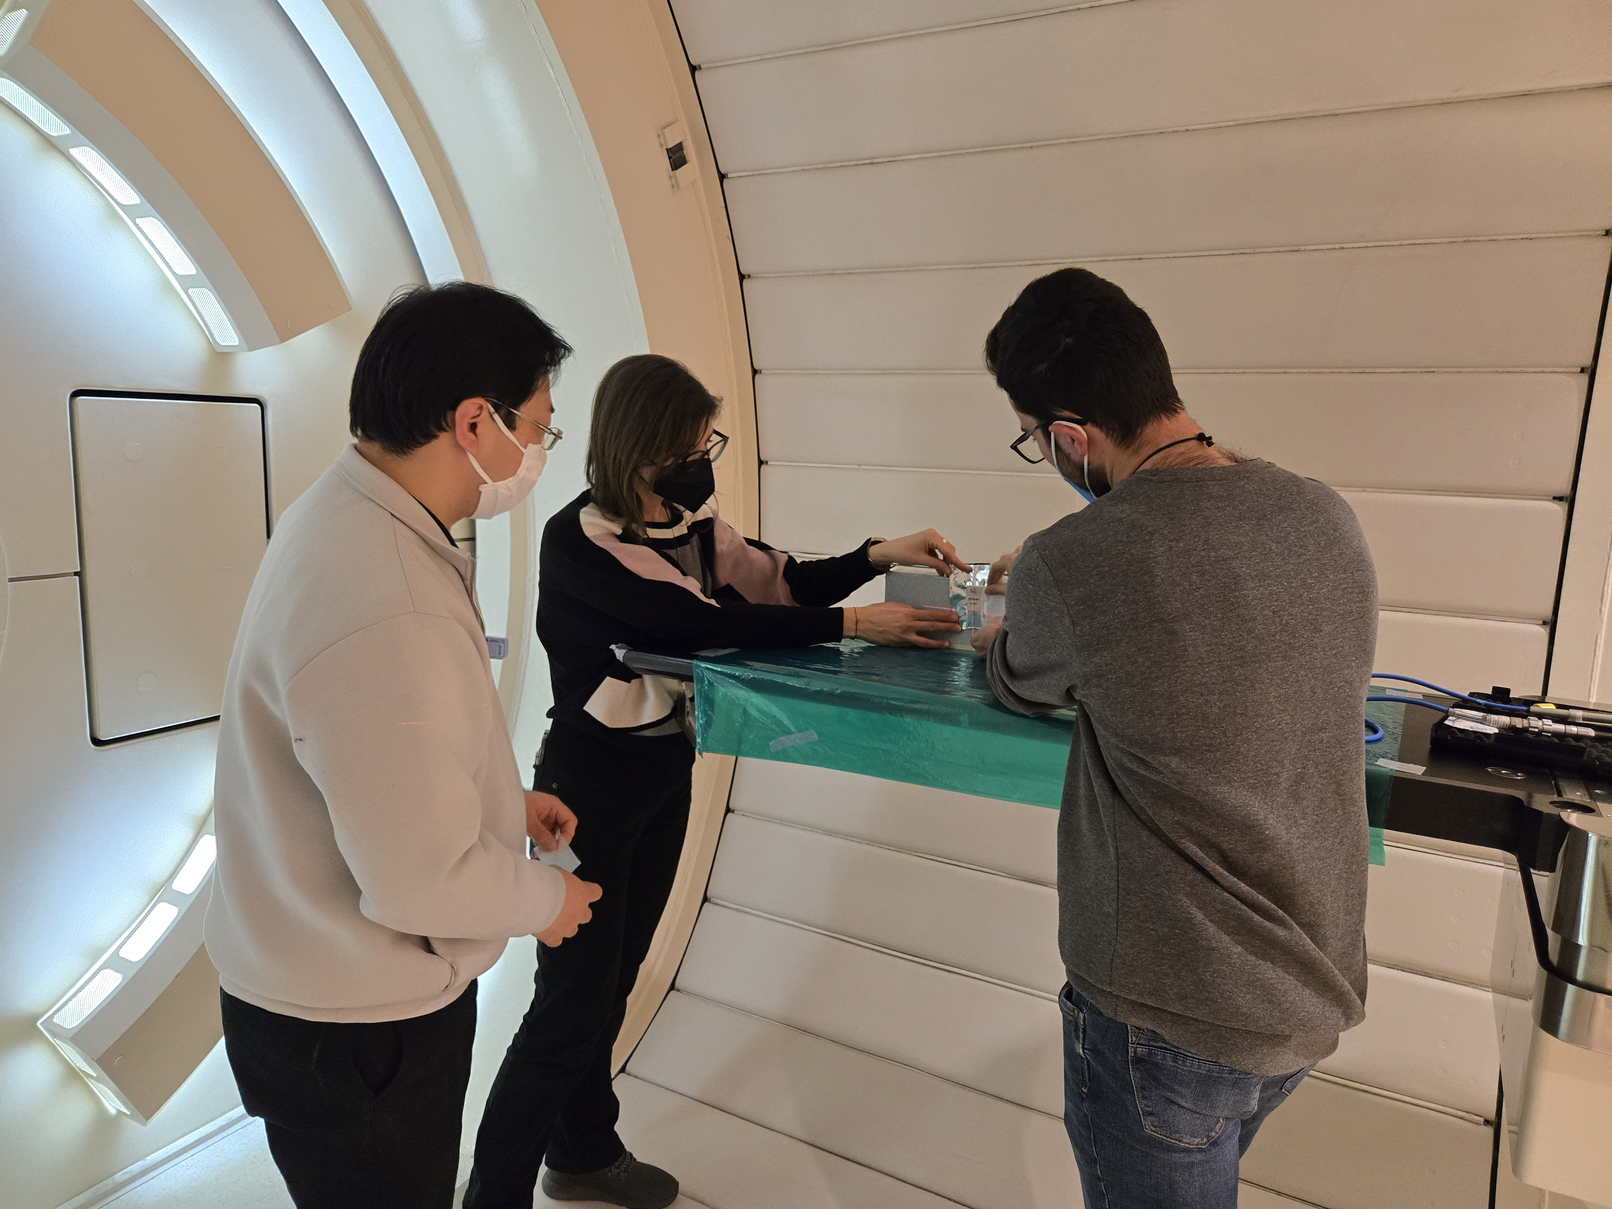
Conclusions on Nano Imaging Trackers (NIT)
3D Tracking with solid detector: resolution = ∼50 nm
Energy information inferred from grain density
No Power supply
PRESENT APPLICATION:
DAMON (Direct meAsureMent of target fragmentatiON) project: measuring for the first time proton-induced target fragmentation in direct kinematics:
direct detection of short fragments made possible by NIT acting both as target and tracking devices
Laboratori Nazionali del Gran Sasso INFN
+
Nagoya Proton Therapy Center

Slide 16
Examples of interactions seen in NIT
Interaction of proton @
165 μm
Notes:
400x300 micron

