Slide 1
Precision measurements of (anti)neutrino with SAND detector
Giulia Lupi
IFD – INFN Workshop on Future Detectors
17-19 March 2025

Slide 2
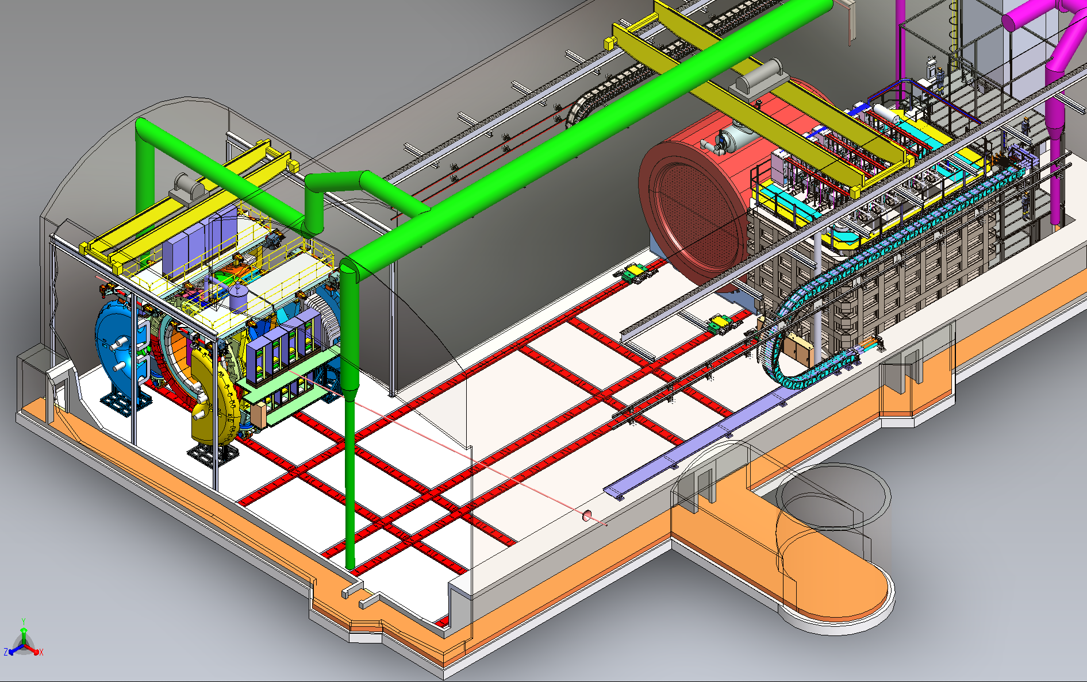
DUNE neutrino oscillation experiment
1.2 – 2.4 MW
Far Detector Complex
Four LArTPC modules $∼17$ kton each
1.5 km underground
Near Detector Complex
574 m from $ν$-source
Three detectors: SAND – NDLAr - TMS
SAND
System for on-axis Neutrino Detection to monitor beam stability and study nuclear effects
NDLar
Liquid Argon TPC for high statistics on $ν$-Ar interactions
TMS Magnetized steel range stack for measuring muon momentum and sign
SAND
TMS
ND-LAr
$$ν$$

Slide 3
The Near Detector
Beam measurements near the production point, limit systematic and nuclear effects to optimize oscillation analysis at the Far Detector (FD)
Initial neutrino flux
Interaction cross-section
Detector response
The ND will provide high-statistics to measure:
$Φ\left(E_{ν}\right)$ With a low-density detector to provide high resolution and precise energy scales.
$σ_{x}\left(E_{ν}\right)⋅R_{det}$ Using the same Argon target as at FD.
$R_{phys}$ By constraining nuclear effect on both Ar and lighter targets.

Slide 4
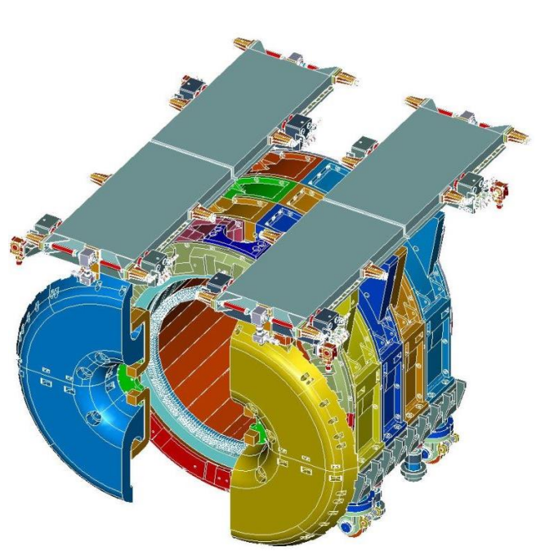
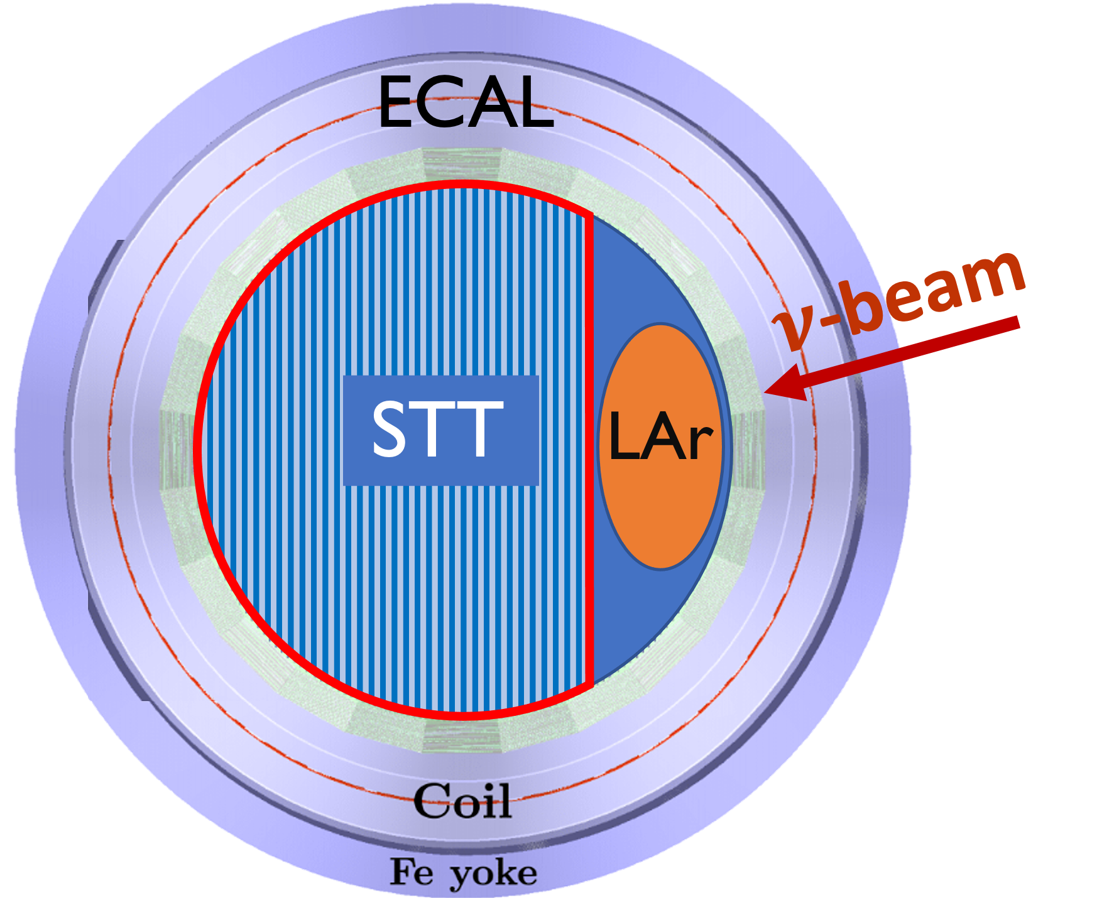
SAND System for On-Axis Neutrino Detection
Multipurpose detector featuring:
0.6 T superconducting solenoid magnet from KLOE
Electromagnetic Calorimeter (ECAL) made of lead and scintillating fibers $15 X_{0}$ (see Denise Casazza talk)
Inner low-density CH2, C target and tracker (STT/Drift) $<0. 2 g/cm^{3}$
GRAIN Liquid Argon active target $∼1 t$
Scientific Program
On-axis spectrum Monitoring : Most deviations detectable on a weekly basis, with a sensitivity of $\sqrt{Δχ^{2}}>3$
Independent measurements of $ν_{μ,e}/{\overline{ν}}_{μ,e}$ fluxes and energy spectra
Reduction of Systematic Uncertainties : Inner target tracker with multiple nuclei targets to study nuclear effects
Extended ND Program : EW physics,$\sin{θ_{W}}$, isospin tests, QCD and form factors

Slide 5
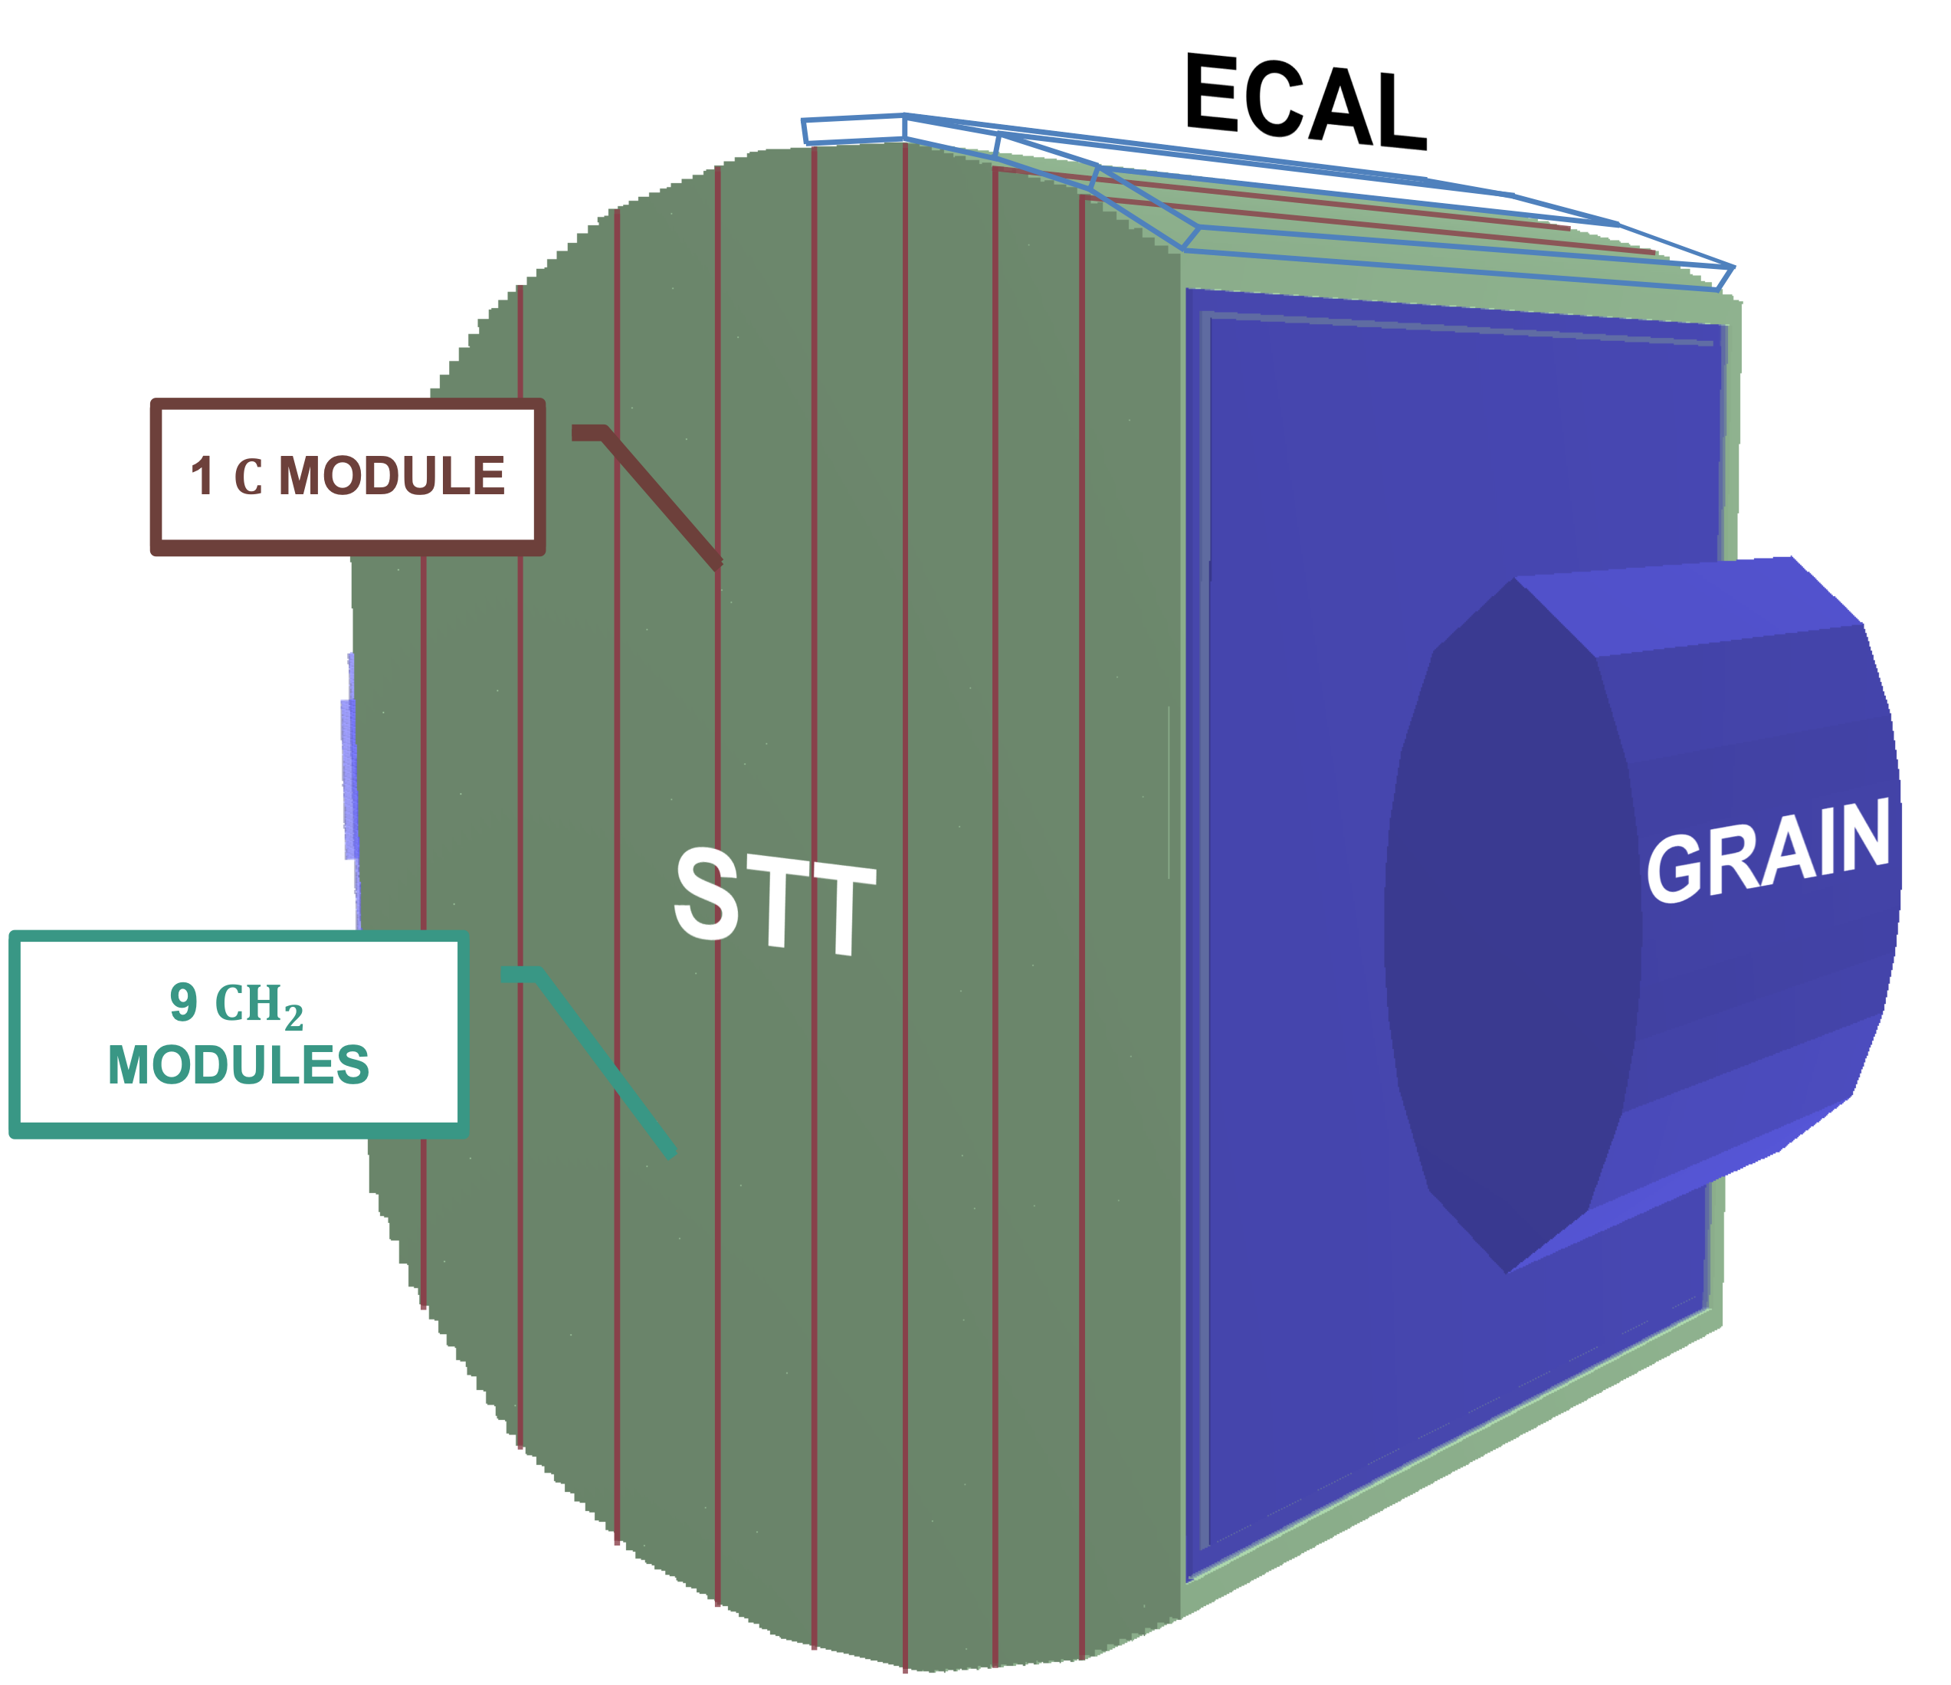
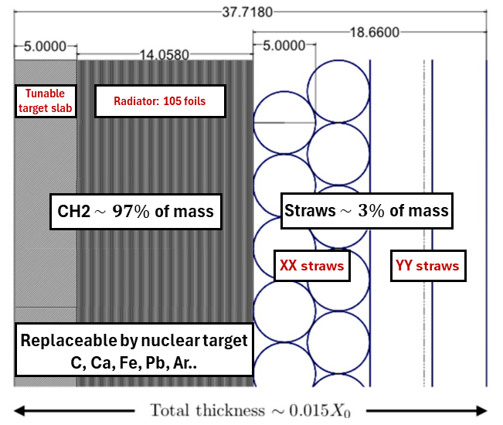
SAND The Inner Tracker
TRACKING MODULE
The full geometry comprises 84 modules each containing
Target slabs (1 C every 9 CH₂ )
Radiator 105 polypropylene foils alternated with air gaps
Four Tracker layers 5 mm diameter straws tubes filled with Xe/${\text{CO}}_{2}$ gas at 1.9 atm arranged in XXYY
y
z
4m
x
5 t fiducial mass to measure $ν_{μ}$ spectrum in one week
$<1X_{0}$ to minimize secondary hadronic interactions
Accurate reconstruction of transverse plane kinematics
$δp/p≤3$% $δθ/θ≤1.5$%
Separation of $ν$ and $\overline{ν}$ events for optimal charge ID
Isolation of a $ν$-H enriched sample

Slide 6
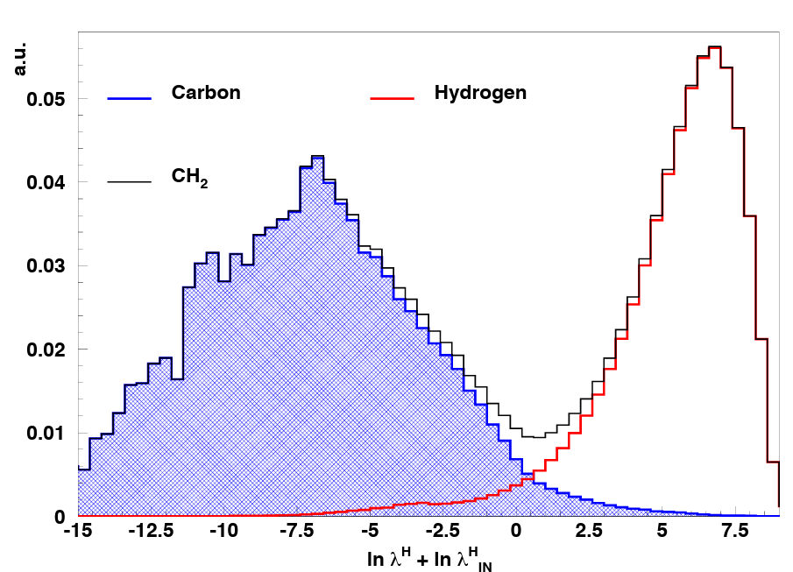
Measurements of $ν(\overline{ν})$ hydrogen Interactions
Subtracting measurements on carbon targets from CH₂ allows a clean selection of hydrogen interactions:
$ν_{μ}p→μ^{−}pπ^{−}$, $\overline{ν_{μ}}p→μ^{+}pπ^{+}$, $\overline{ν_{μ}}p→μ^{+}n$
Why it’s important:
1. $Φ(E_{ν})$measurements $→$ interactions on H are free from typical problems arising from nuclear smearing
2. Constrain models on nuclear effects: H + Ar target in the SAND detector offers valuable information to reduce systematics:
constrain the product $σ_{X}$ , $R_{phys}$ on Ar from a direct comparison between Ar and H interactions within the same detector.

Slide 7
Thanks for your attention!

