Slide 1
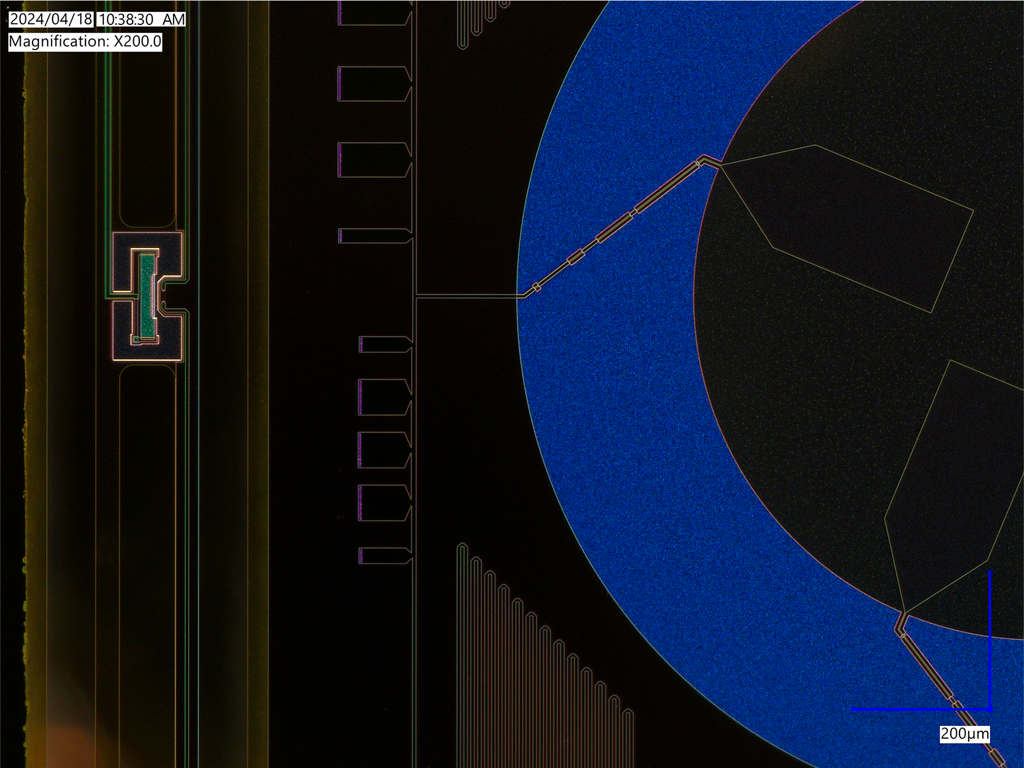
Cryogenic Detectors
For For Frontier Physics
Mario De Lucia
Università di Pisa – Dipartimento di Fisica ‘E. Fermi’
INFN – Sezione di Pisa
INFN Workshop on Future Detectors 2025
17 Marzo 2025 – Sestri Levante

Slide 2
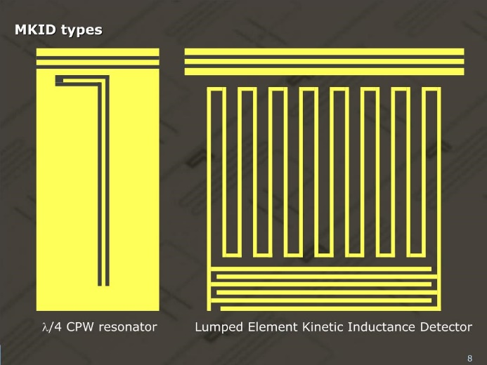
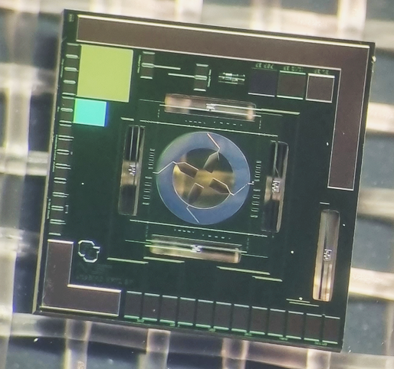
Superconducting Detectors
Kinetic Inductance Detectors
Bolometers and calorimeters E < eV
Photons, Phonons and Particles
Transition Edge Sensors
Bolometers and calorimeters E < eV
THz, CMB and visible radiation

Slide 3
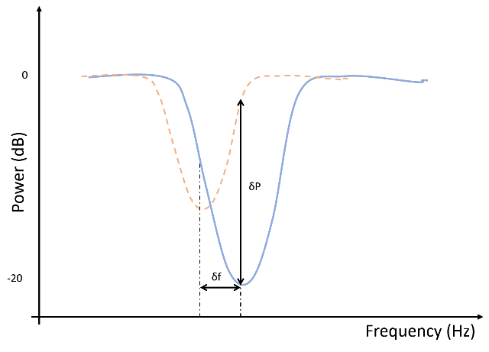
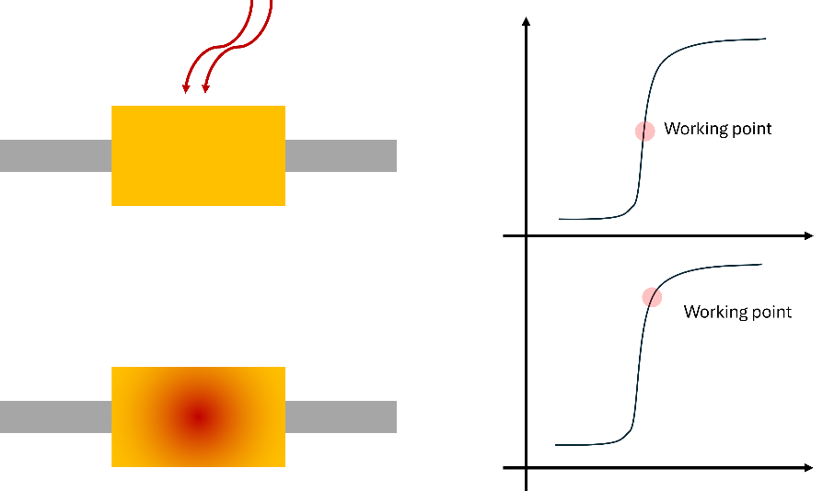
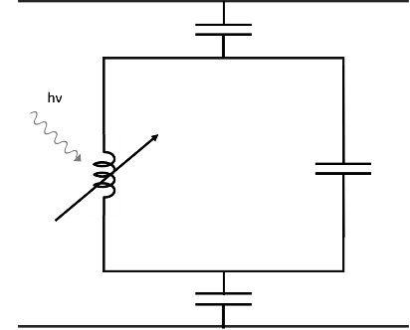
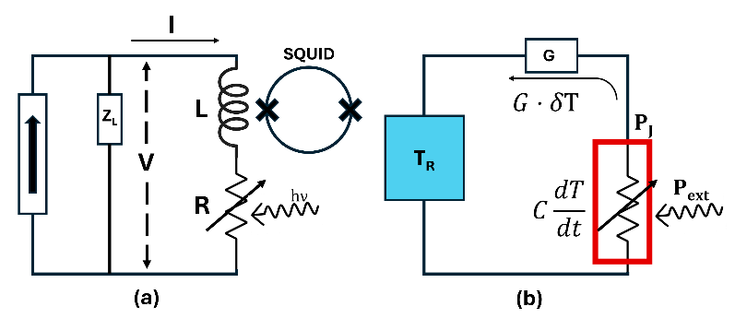
Superconducting Detectors
Kinetic Inductance Detectors
Transition Edge Sensors

Slide 4
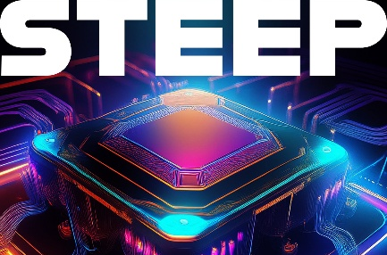
Some experiments in Pisa:
CSN2
Local PI: D. Nicolò
KIDs for Dark Matter Detection
CSN5
Local PI: G. Lamanna
Qubits for Dark Matter Detection
- -
PI: F. Paolucci
Novel Detectors for eV radiation
CSN2
Local PI: G. Signorelli
TESs for CMB Radiation
CSN2
Local PI: A. Tartari
TESs for CMB Radiation
CSN5
PI: F. Paolucci
TESs for THz and eV radiation

Slide 5
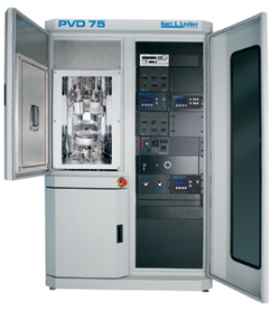
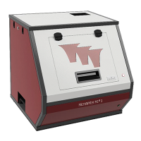
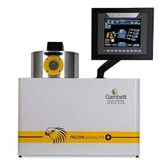
Fab Facilities – Clean Room
~50 m² ISO7 (class 10000) Clean Room
attualmente attrezzata per micro-fabbricazione
Wet bench with fume hood: spin-coater, hot plate and ultra-sonicator
Optical Lithography: mask aligner and laser writer
Thermal evaporator
Reactive ion etching (just installed last week)
E-beam evaporator + Magnetron sputtering (upcoming)

Slide 6
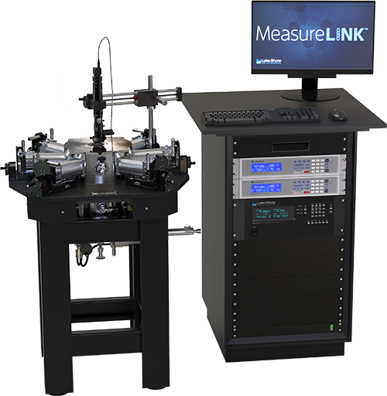
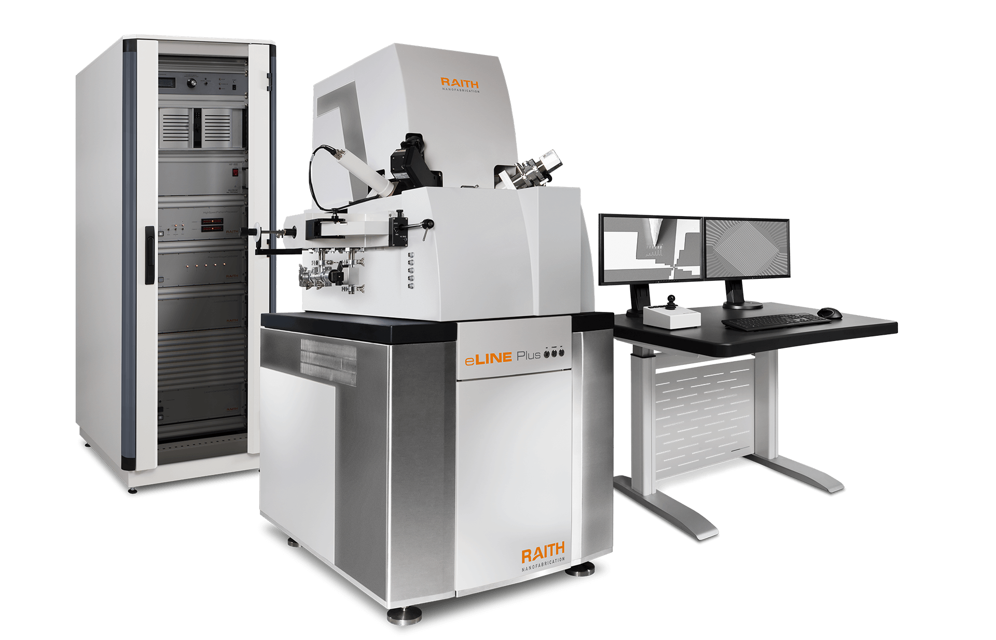
Fab facilities – outside the CR
Raith e-beam lithography
Resolution < 5 nm
4’’ Wafer
SEM + nanofab
Cryogenic probestation
T < 2.5 K
Magnetic Field up to 4 T
DC and RF lines up to 60 GHz

Slide 7
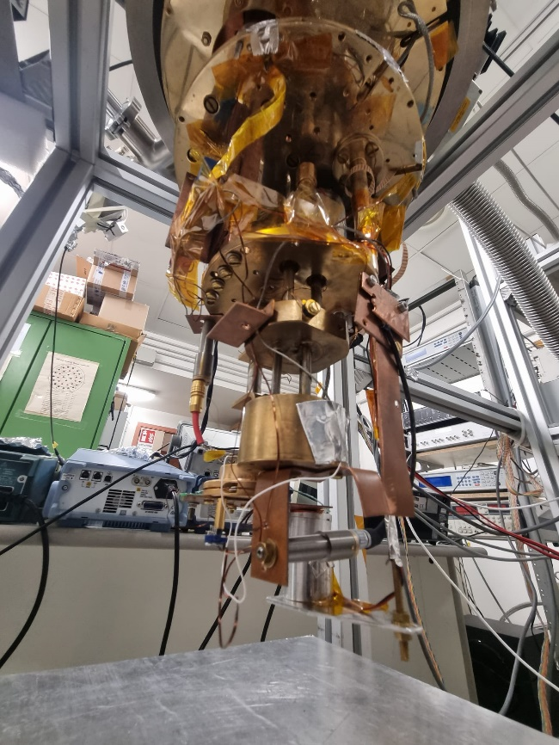
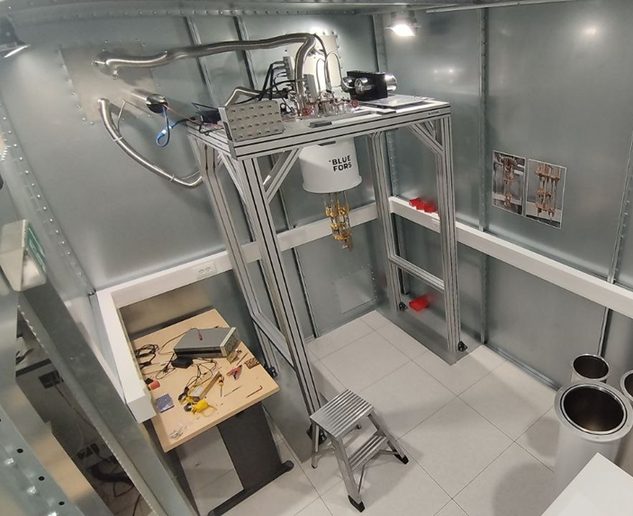
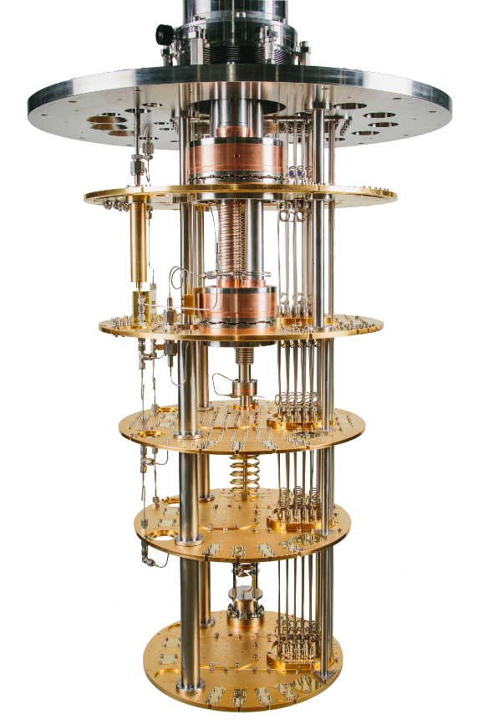
Cryolab @ INFN - PI
Delivery expected for June
He³ / He⁴ Cryostat
T < 300 mK
DC measurements
TES characterisation
Bluefors Dilution Refrigerator
T < 30 mK
EMI – EMC chamber
DC + RF lines up to 18 GHz
Oxford Dilution Refrigerator
T < 10 mK
DC + RF lines up to 18 GHz
6-1-1 T Magnet

Slide 8
Thanks for listening!
If you have any questions, please come talk to me at the reception

