Slide 1

Design of next-generation LGADs with TCAD tools
A. Fondacci, A. R. Altamura, R. Arcidiacono, A. Bisht, M. Boscardin, N. Cartiglia, M. Centis Vignali, T. Croci, M. Ferrero, L. Lanteri, L. Menzio, A. Morozzi, F. Moscatelli, D. Passeri, G. Paternoster, F. Siviero, V. Sola, R. S. White
Fourth INFN Workshop on Future Detectors, Sestri Levante, Italy

Slide 2
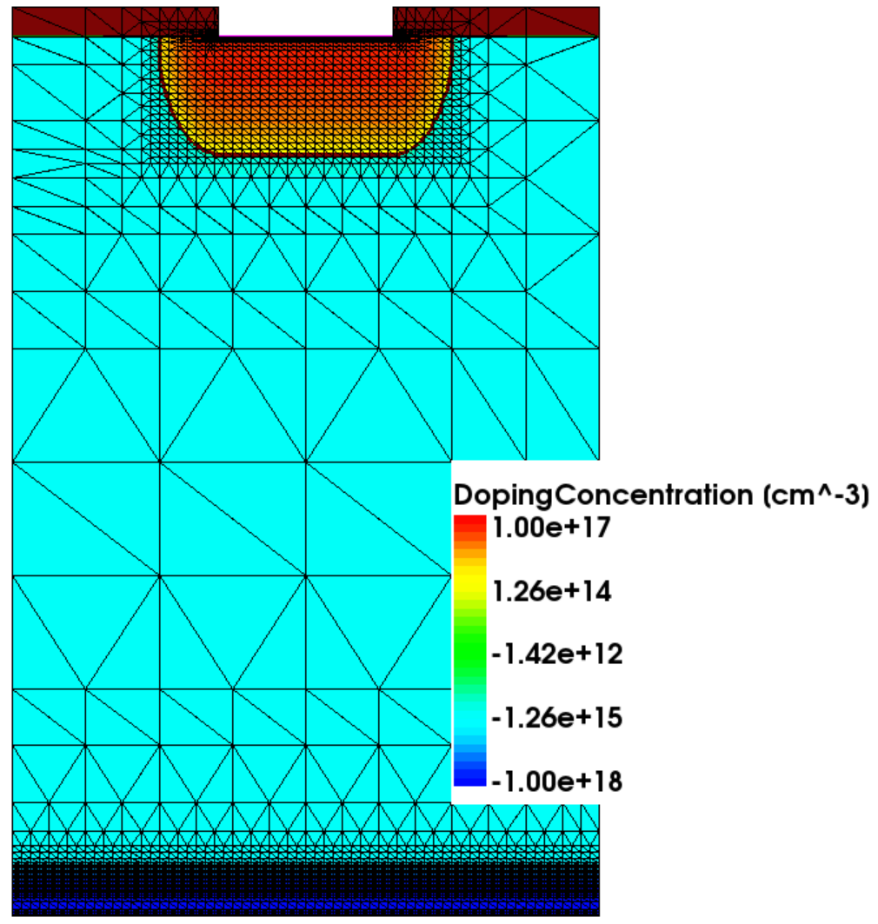
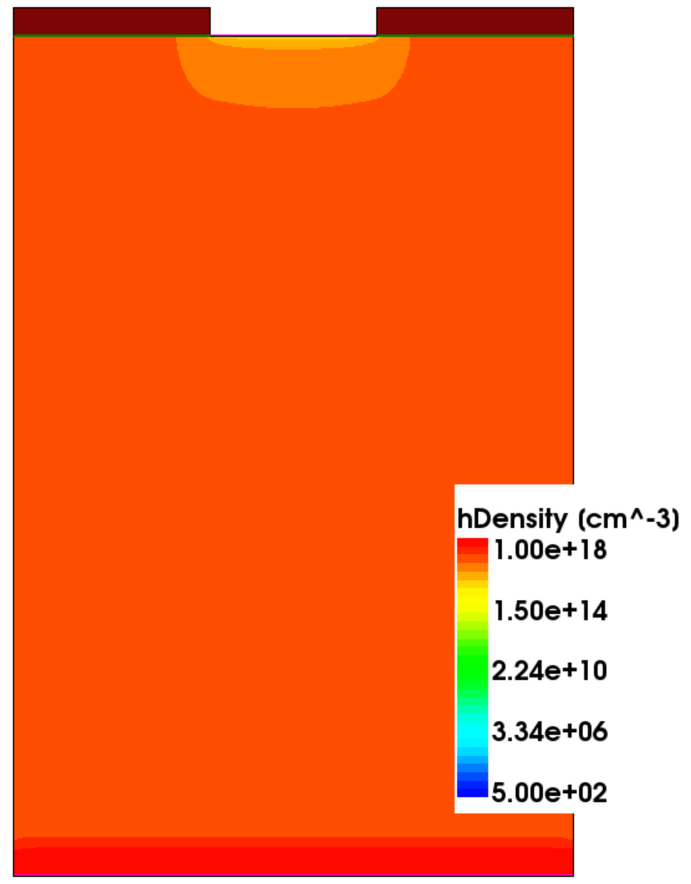
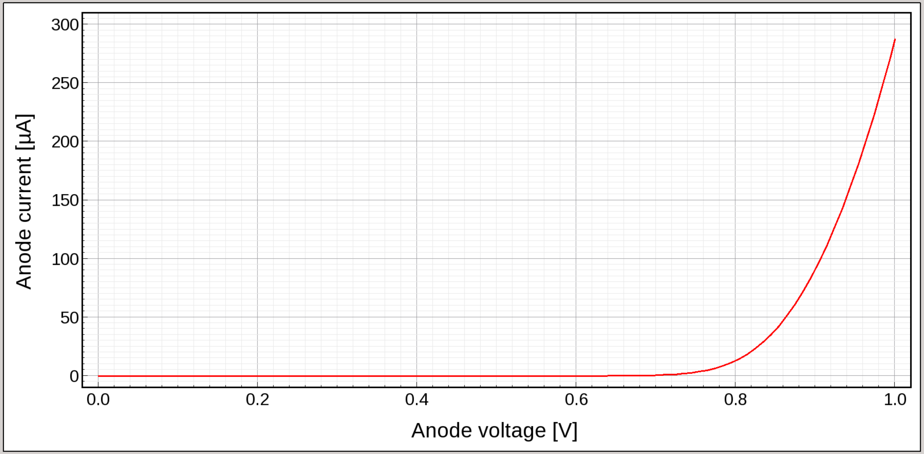
Technology Computer Aided Design (TCAD)
1
DEVICE
SIMULATION
Design of next-generation LGADs with TCAD tools
&
Geometry definition
Microscopic information (carrier density, electric field,…)
Macroscopic information (current, capacitance,…)
IFD 2025
A. Fondacci et al.

Slide 3
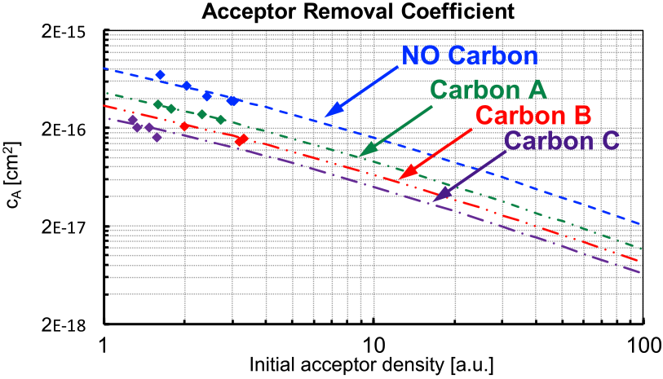

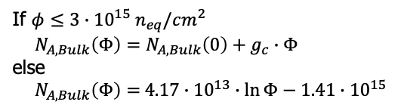
Technology Computer Aided Design (TCAD)
1
DEVICE
SIMULATION
Design of next-generation LGADs with TCAD tools
&
Geometry definition
Microscopic information (carrier density, electric field,…)
Macroscopic information (current, capacitance,…)
NEW UNIVERSITY OF PERUGIA RADIATION DAMAGE MODEL
IFD 2025
Acceptor Removal
$$N_{A,GL}\left(Φ\right)=N_{A,GL}\left(0\right)∙e^{−c_{A}∙φ}$$
Acceptor Creation
M. Ferrero et al., CRC Press (2021)
A. Morozzi et al., PoS Vertex2019 (2020) 050
If $φ≤3∙{10}^{15} n_{eq}/cm^{2}$
$$N_{A,Bulk}\left(Φ\right)=N_{A,Bulk}\left(0\right)+g_{c}∙Φ$$
else
$N_{A,Bulk}\left(Φ\right)=$ $4.17∙{10}^{13}∙\ln{Φ}−1.41∙{10}^{15}$
A. Fondacci et al.

Slide 4
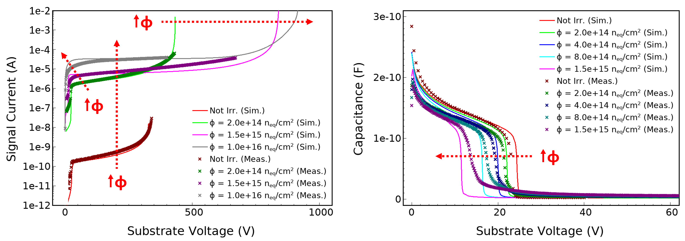
Technology Computer Aided Design (TCAD)
1
DEVICE
SIMULATION
Design of next-generation LGADs with TCAD tools
&
Geometry definition
Microscopic information (carrier density, electric field,…)
Macroscopic information (current, capacitance,…)
NEW UNIVERSITY OF PERUGIA RADIATION DAMAGE MODEL
IFD 2025
Acceptor Removal
$$N_{A,GL}\left(Φ\right)=N_{A,GL}\left(0\right)∙e^{−c_{A}∙φ}$$
Acceptor Creation
M. Ferrero et al., CRC Press (2021)
A. Morozzi et al., PoS Vertex2019 (2020) 050
If $φ≤3∙{10}^{15} n_{eq}/cm^{2}$
$$N_{A,Bulk}\left(Φ\right)=N_{A,Bulk}\left(0\right)+g_{c}∙Φ$$
else
$N_{A,Bulk}\left(Φ\right)=$ $4.17∙{10}^{13}∙\ln{Φ}−1.41∙{10}^{15}$
A. Fondacci et al.

Slide 5
Technology Computer Aided Design (TCAD)
1
DEVICE
SIMULATION
Design of next-generation LGADs with TCAD tools
&
Geometry definition
Microscopic information (carrier density, electric field,…)
Macroscopic information (current, capacitance,…)
NEW UNIVERSITY OF PERUGIA RADIATION DAMAGE MODEL
IFD 2025
Acceptor Removal
$$N_{A,GL}\left(Φ\right)=N_{A,GL}\left(0\right)∙e^{−c_{A}∙φ}$$
Acceptor Creation
M. Ferrero et al., CRC Press (2021)
A. Morozzi et al., PoS Vertex2019 (2020) 050
If $φ≤3∙{10}^{15} n_{eq}/cm^{2}$
$$N_{A,Bulk}\left(Φ\right)=N_{A,Bulk}\left(0\right)+g_{c}∙Φ$$
else
$N_{A,Bulk}\left(Φ\right)=$ $4.17∙{10}^{13}∙\ln{Φ}−1.41∙{10}^{15}$
A. Fondacci et al.

Slide 6
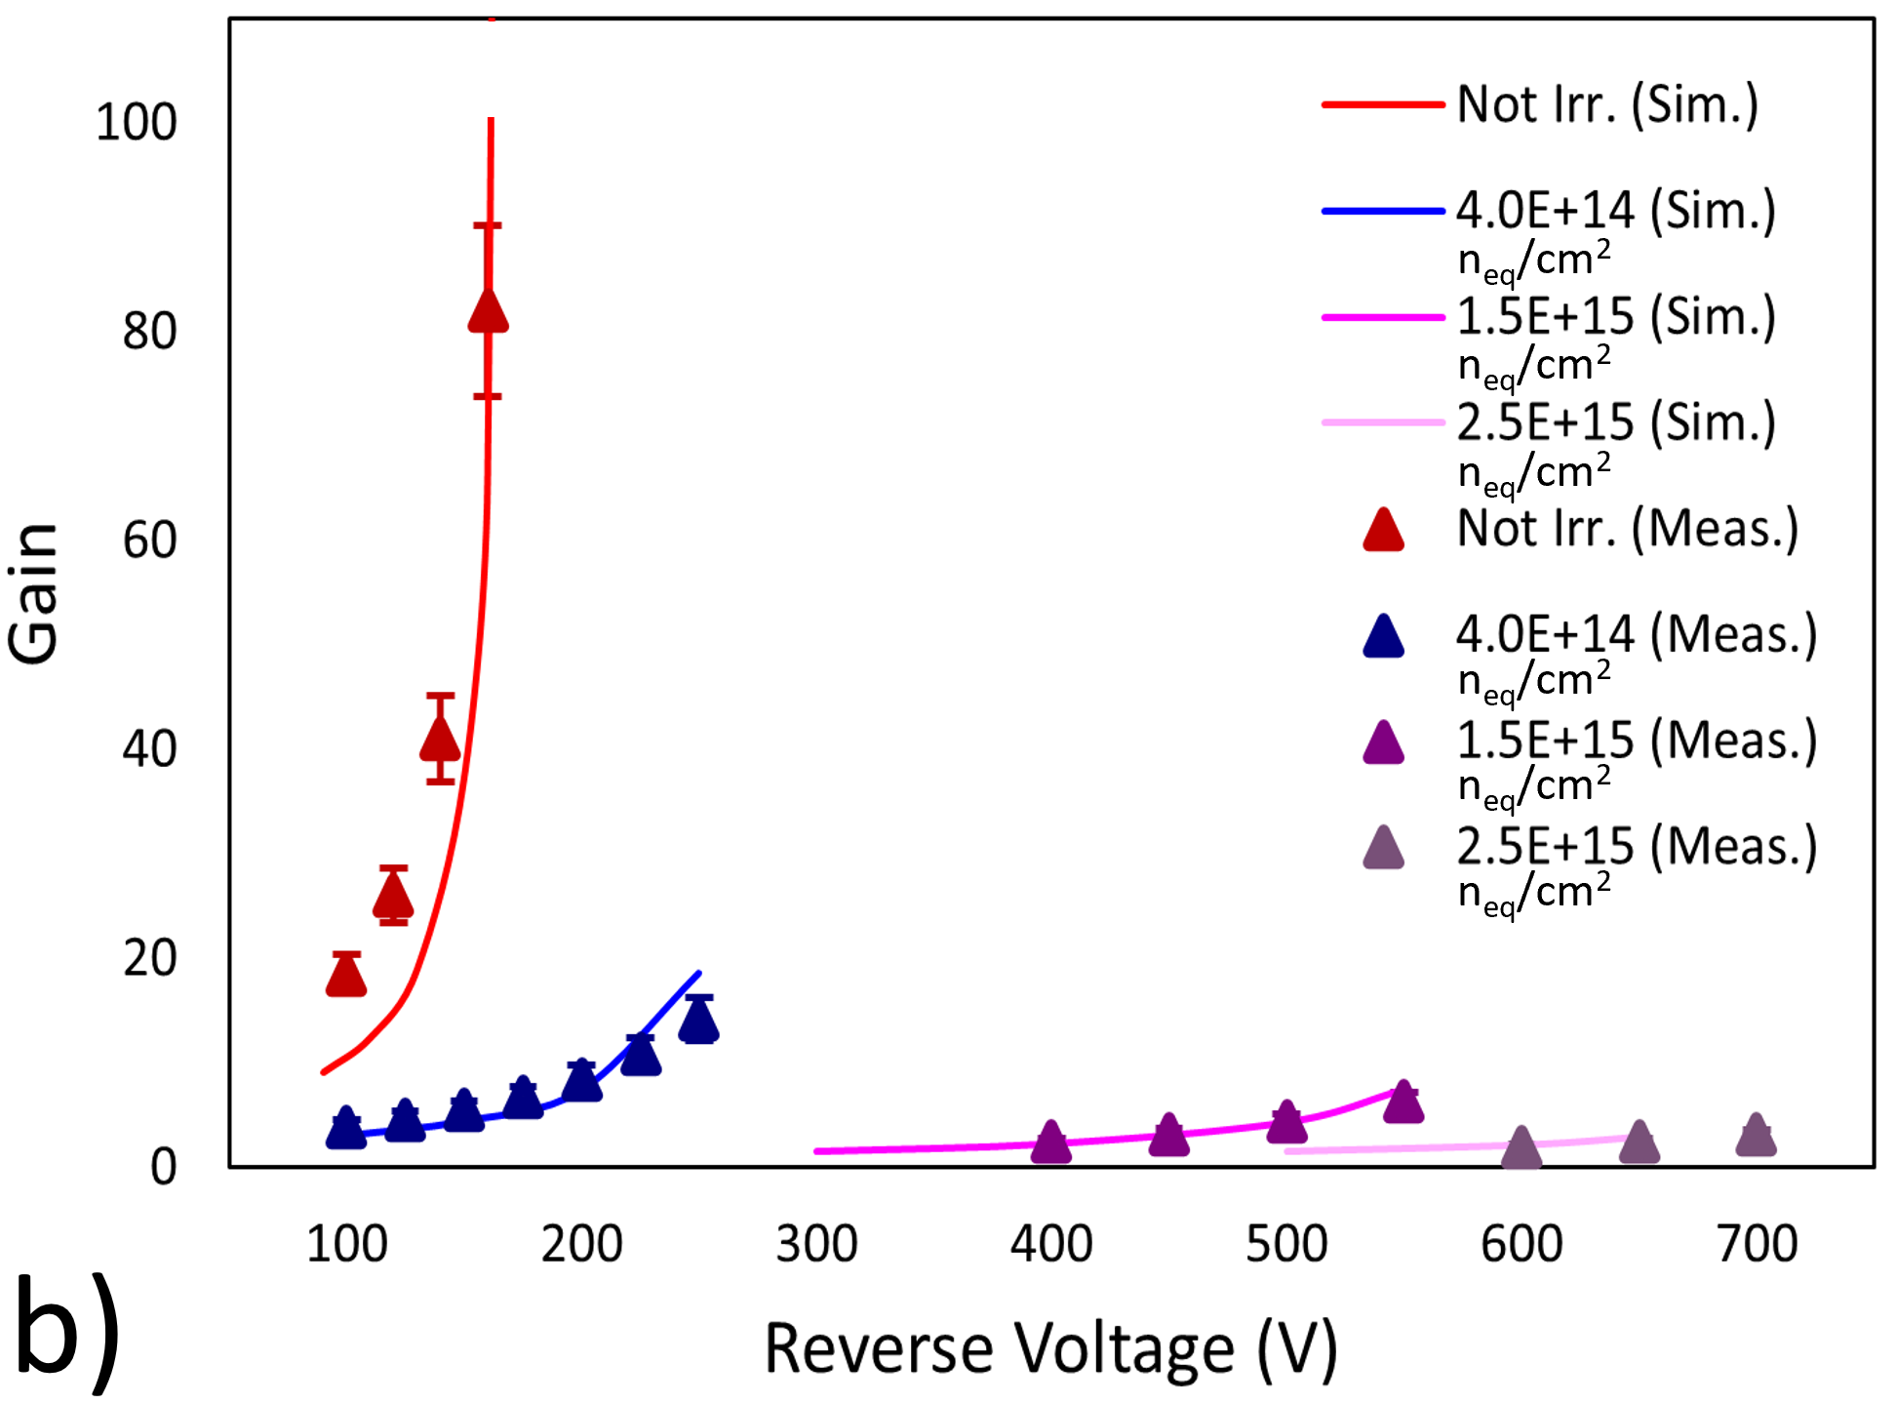
Technology Computer Aided Design (TCAD)
1
DEVICE
SIMULATION
Design of next-generation LGADs with TCAD tools
&
Geometry definition
Microscopic information (carrier density, electric field,…)
Macroscopic information (current, capacitance,…)
NEW UNIVERSITY OF PERUGIA RADIATION DAMAGE MODEL
IFD 2025
Acceptor Removal
$$N_{A,GL}\left(Φ\right)=N_{A,GL}\left(0\right)∙e^{−c_{A}∙φ}$$
Acceptor Creation
M. Ferrero et al., CRC Press (2021)
A. Morozzi et al., PoS Vertex2019 (2020) 050
If $φ≤3∙{10}^{15} n_{eq}/cm^{2}$
$$N_{A,Bulk}\left(Φ\right)=N_{A,Bulk}\left(0\right)+g_{c}∙Φ$$
else
$N_{A,Bulk}\left(Φ\right)=$ $4.17∙{10}^{13}∙\ln{Φ}−1.41∙{10}^{15}$
A. Fondacci et al.

Slide 7
DC-coupled Resistive Silicon Detectors (DC-RSD)
2
Design of next-generation LGADs with TCAD tools
IFD 2025
A. Fondacci et al.

Slide 8
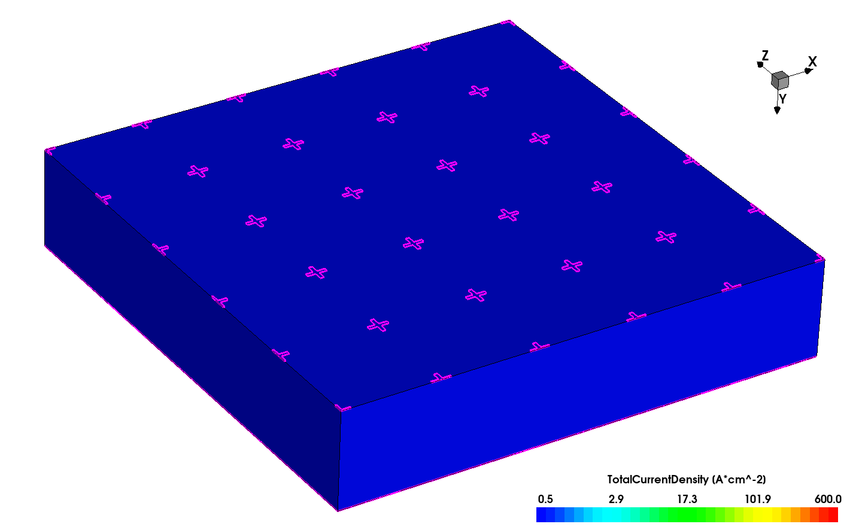
DC-coupled Resistive Silicon Detectors (DC-RSD)
2
IMPORTANCE OF THE CONTACT RESISTANCE
Design of next-generation LGADs with TCAD tools
MIP
IFD 2025
A. Fondacci et al.

Slide 9
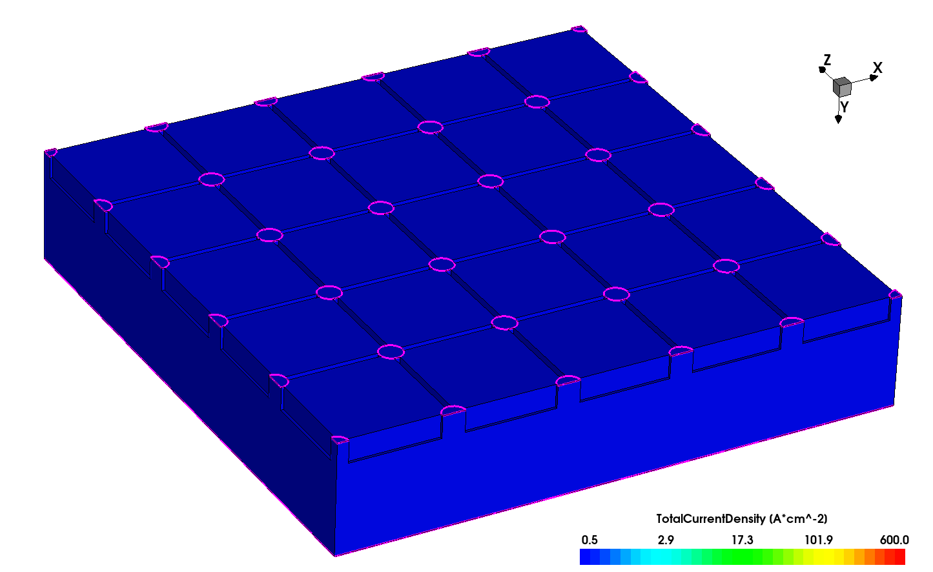
DC-coupled Resistive Silicon Detectors (DC-RSD)
2
IMPORTANCE OF THE CONTACT RESISTANCE
CONFINEMENT WITH SiO₂ TRENCHES
Design of next-generation LGADs with TCAD tools
MIP
MIP
IFD 2025
A. Fondacci et al.

Slide 10
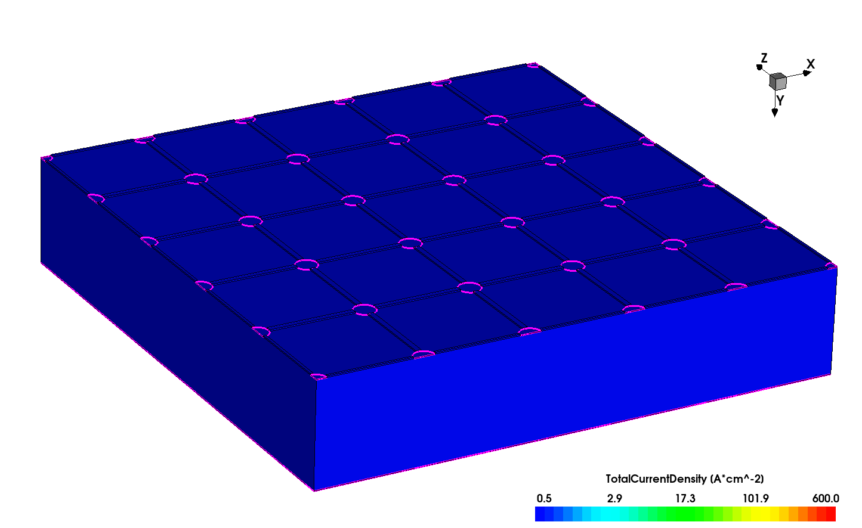
DC-coupled Resistive Silicon Detectors (DC-RSD)
2
IMPORTANCE OF THE CONTACT RESISTANCE
CONFINEMENT WITH SiO₂ TRENCHES
CONFINEMENT WITH RESISTIVE STRIPS
Design of next-generation LGADs with TCAD tools
MIP
MIP
MIP
IFD 2025
A. Fondacci et al.

Slide 11
DC-coupled Resistive Silicon Detectors (DC-RSD)
2
IMPORTANCE OF THE CONTACT RESISTANCE
CONFINEMENT WITH SiO₂ TRENCHES
CONFINEMENT WITH RESISTIVE STRIPS
Simulations guided the design of FBK's first DC-RSD batch, released in late 2024
Design of next-generation LGADs with TCAD tools
MIP
MIP
MIP
IFD 2025
A. Fondacci et al.

Slide 12
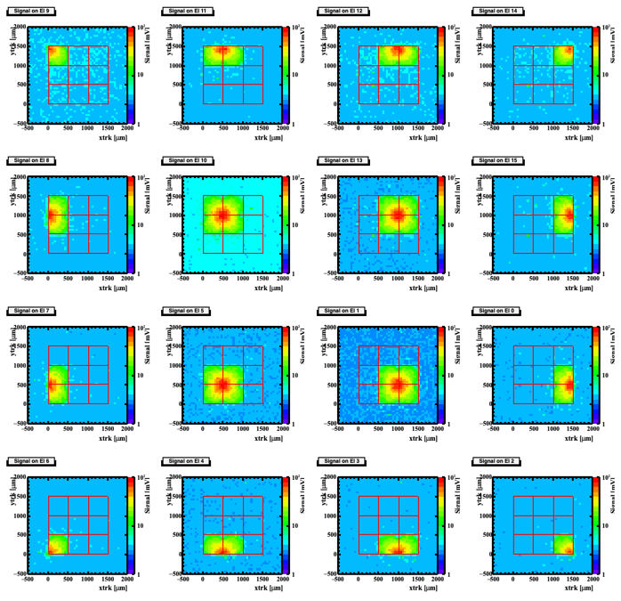
DC-coupled Resistive Silicon Detectors (DC-RSD)
2
Design of next-generation LGADs with TCAD tools
IFD 2025
A. Fondacci et al.

Slide 13
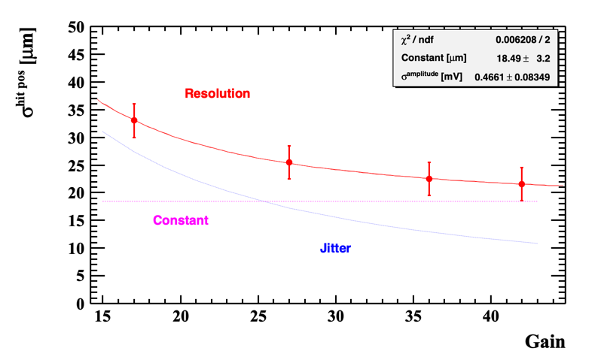
DC-coupled Resistive Silicon Detectors (DC-RSD)
2
Design of next-generation LGADs with TCAD tools
IFD 2025
A. Fondacci et al.

Slide 14
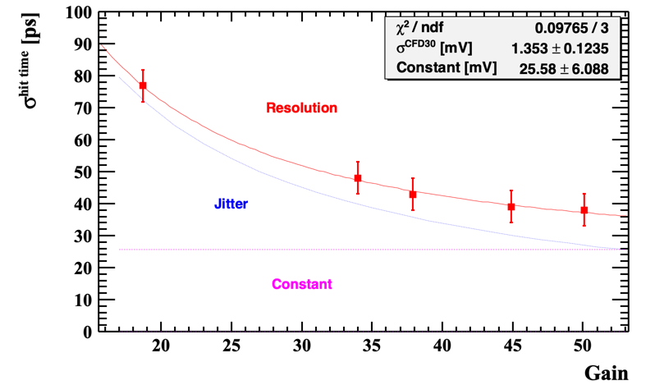
DC-coupled Resistive Silicon Detectors (DC-RSD)
2
Design of next-generation LGADs with TCAD tools
IFD 2025
A. Fondacci et al.

Slide 15

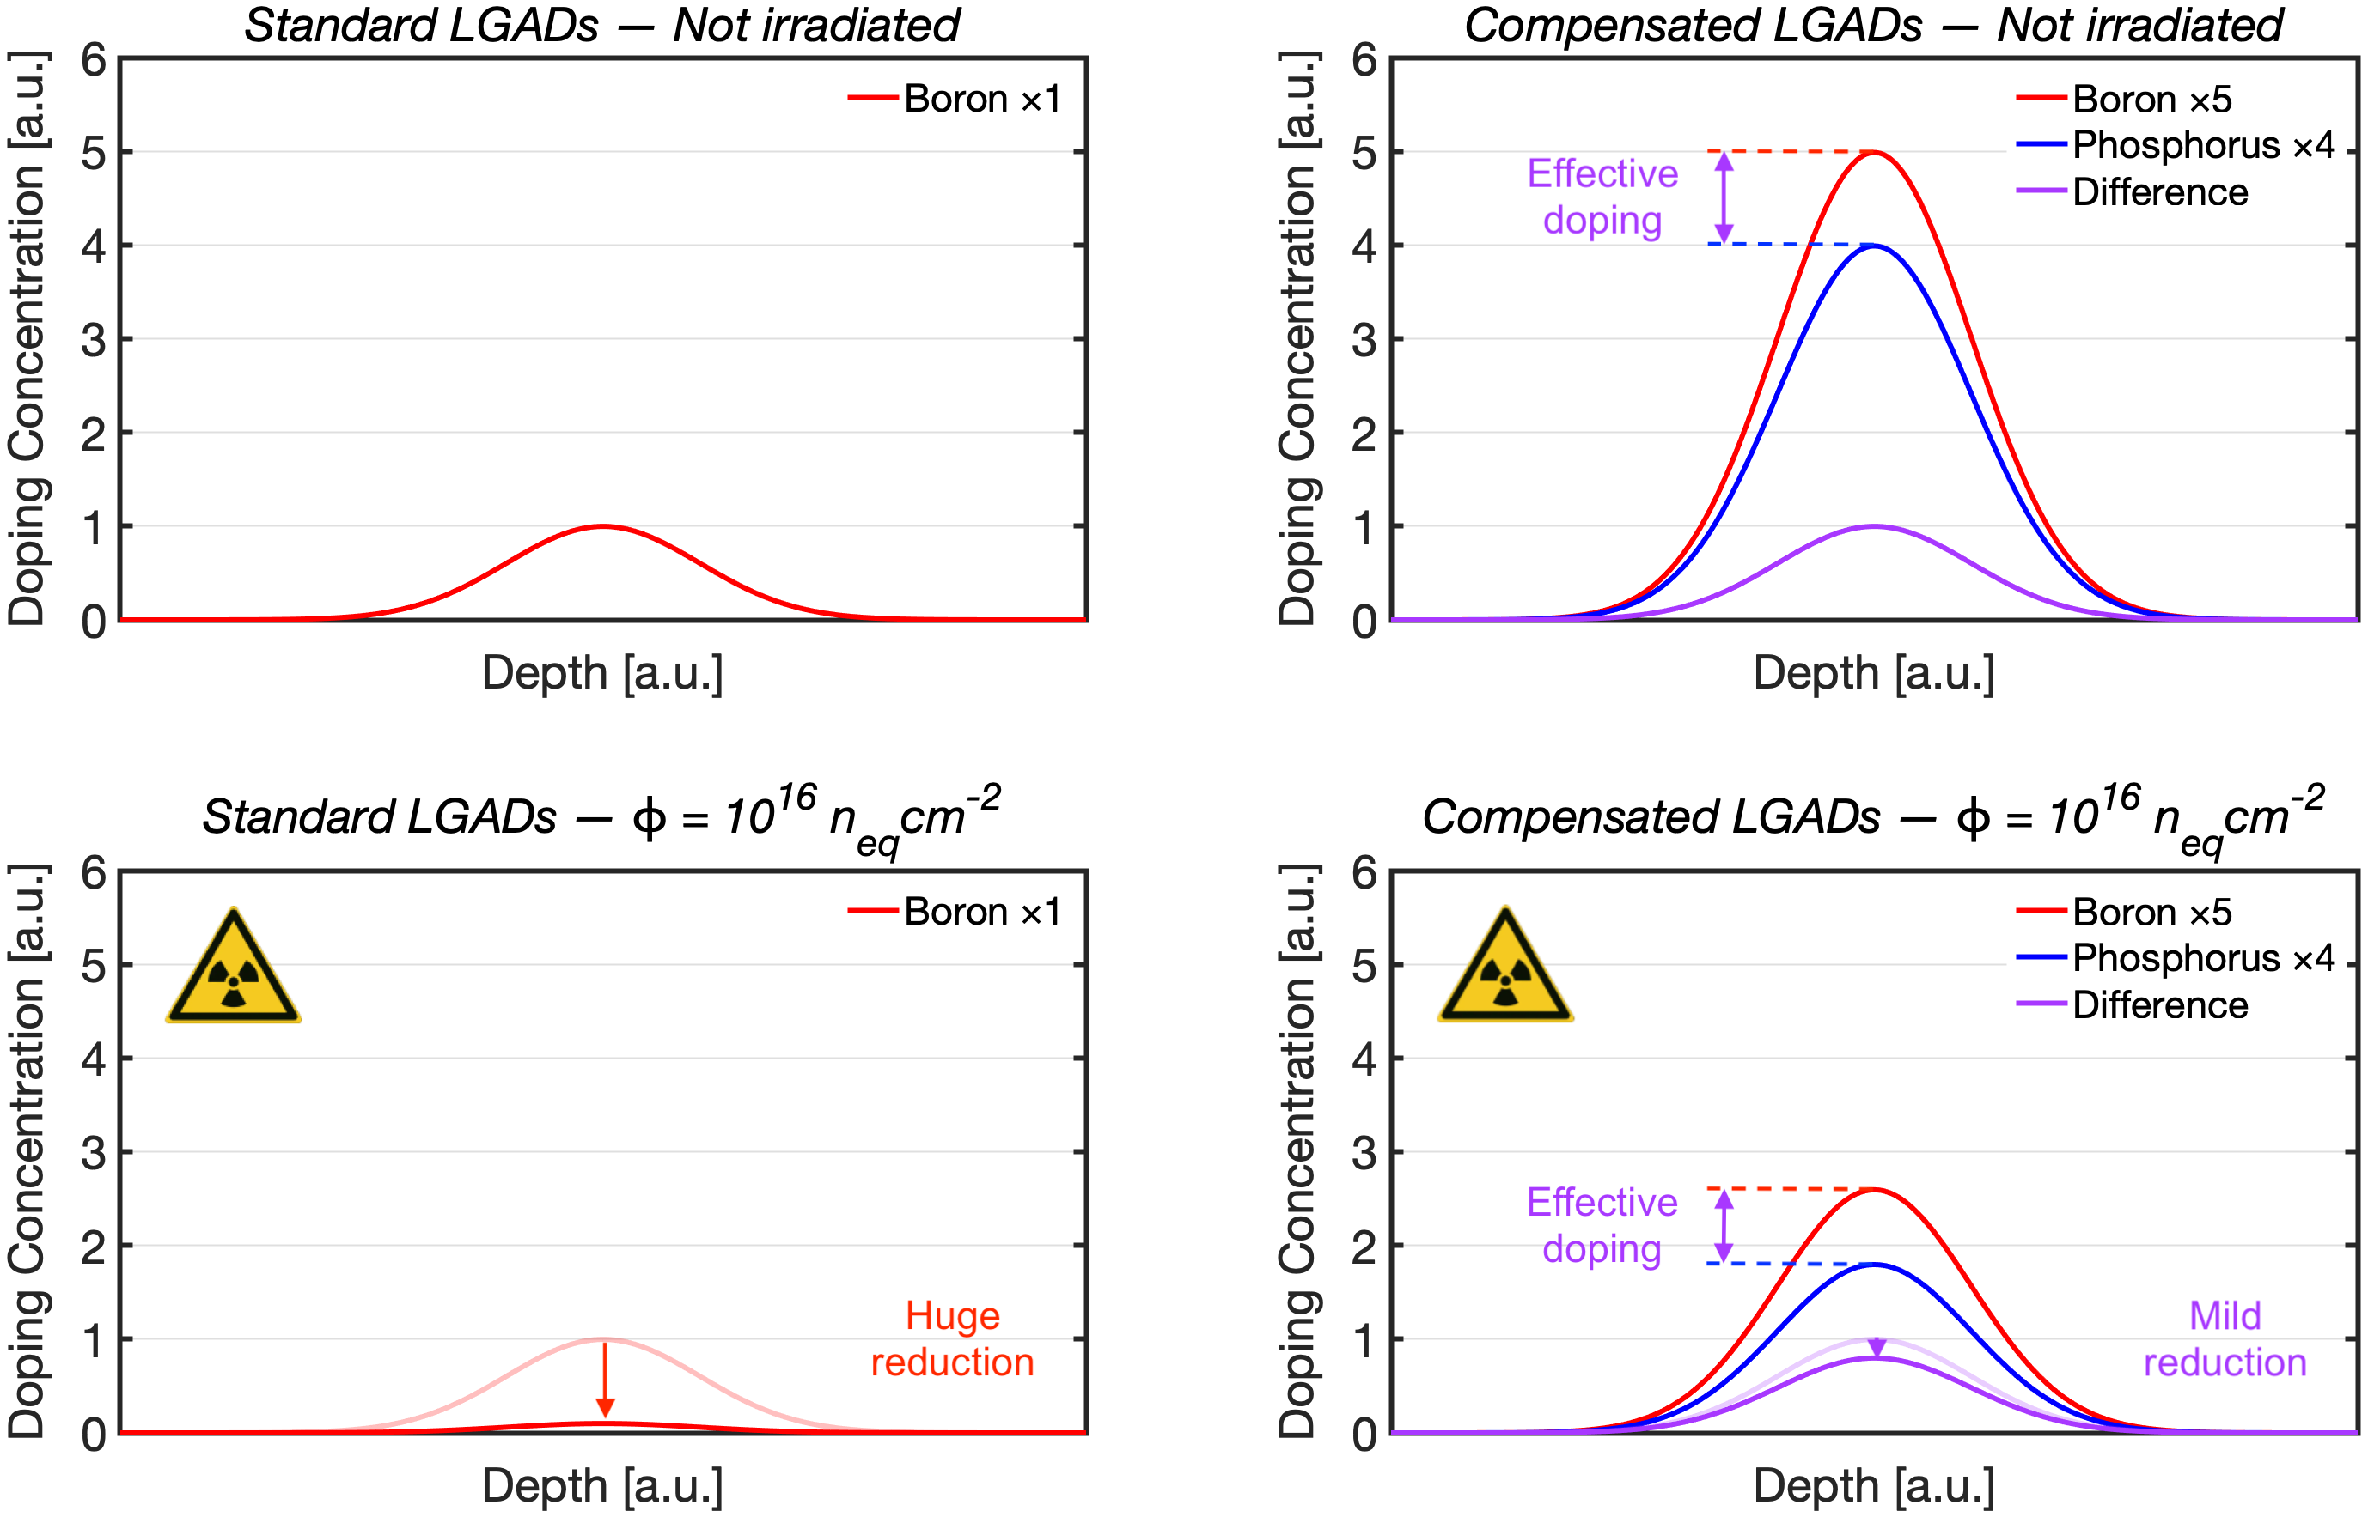
Compensated LGADs
3
Design of next-generation LGADs with TCAD tools
IFD 2025
A. Fondacci et al.

Slide 16
Compensated LGADs
3
Design of next-generation LGADs with TCAD tools
IFD 2025
A. Fondacci et al.

Slide 17
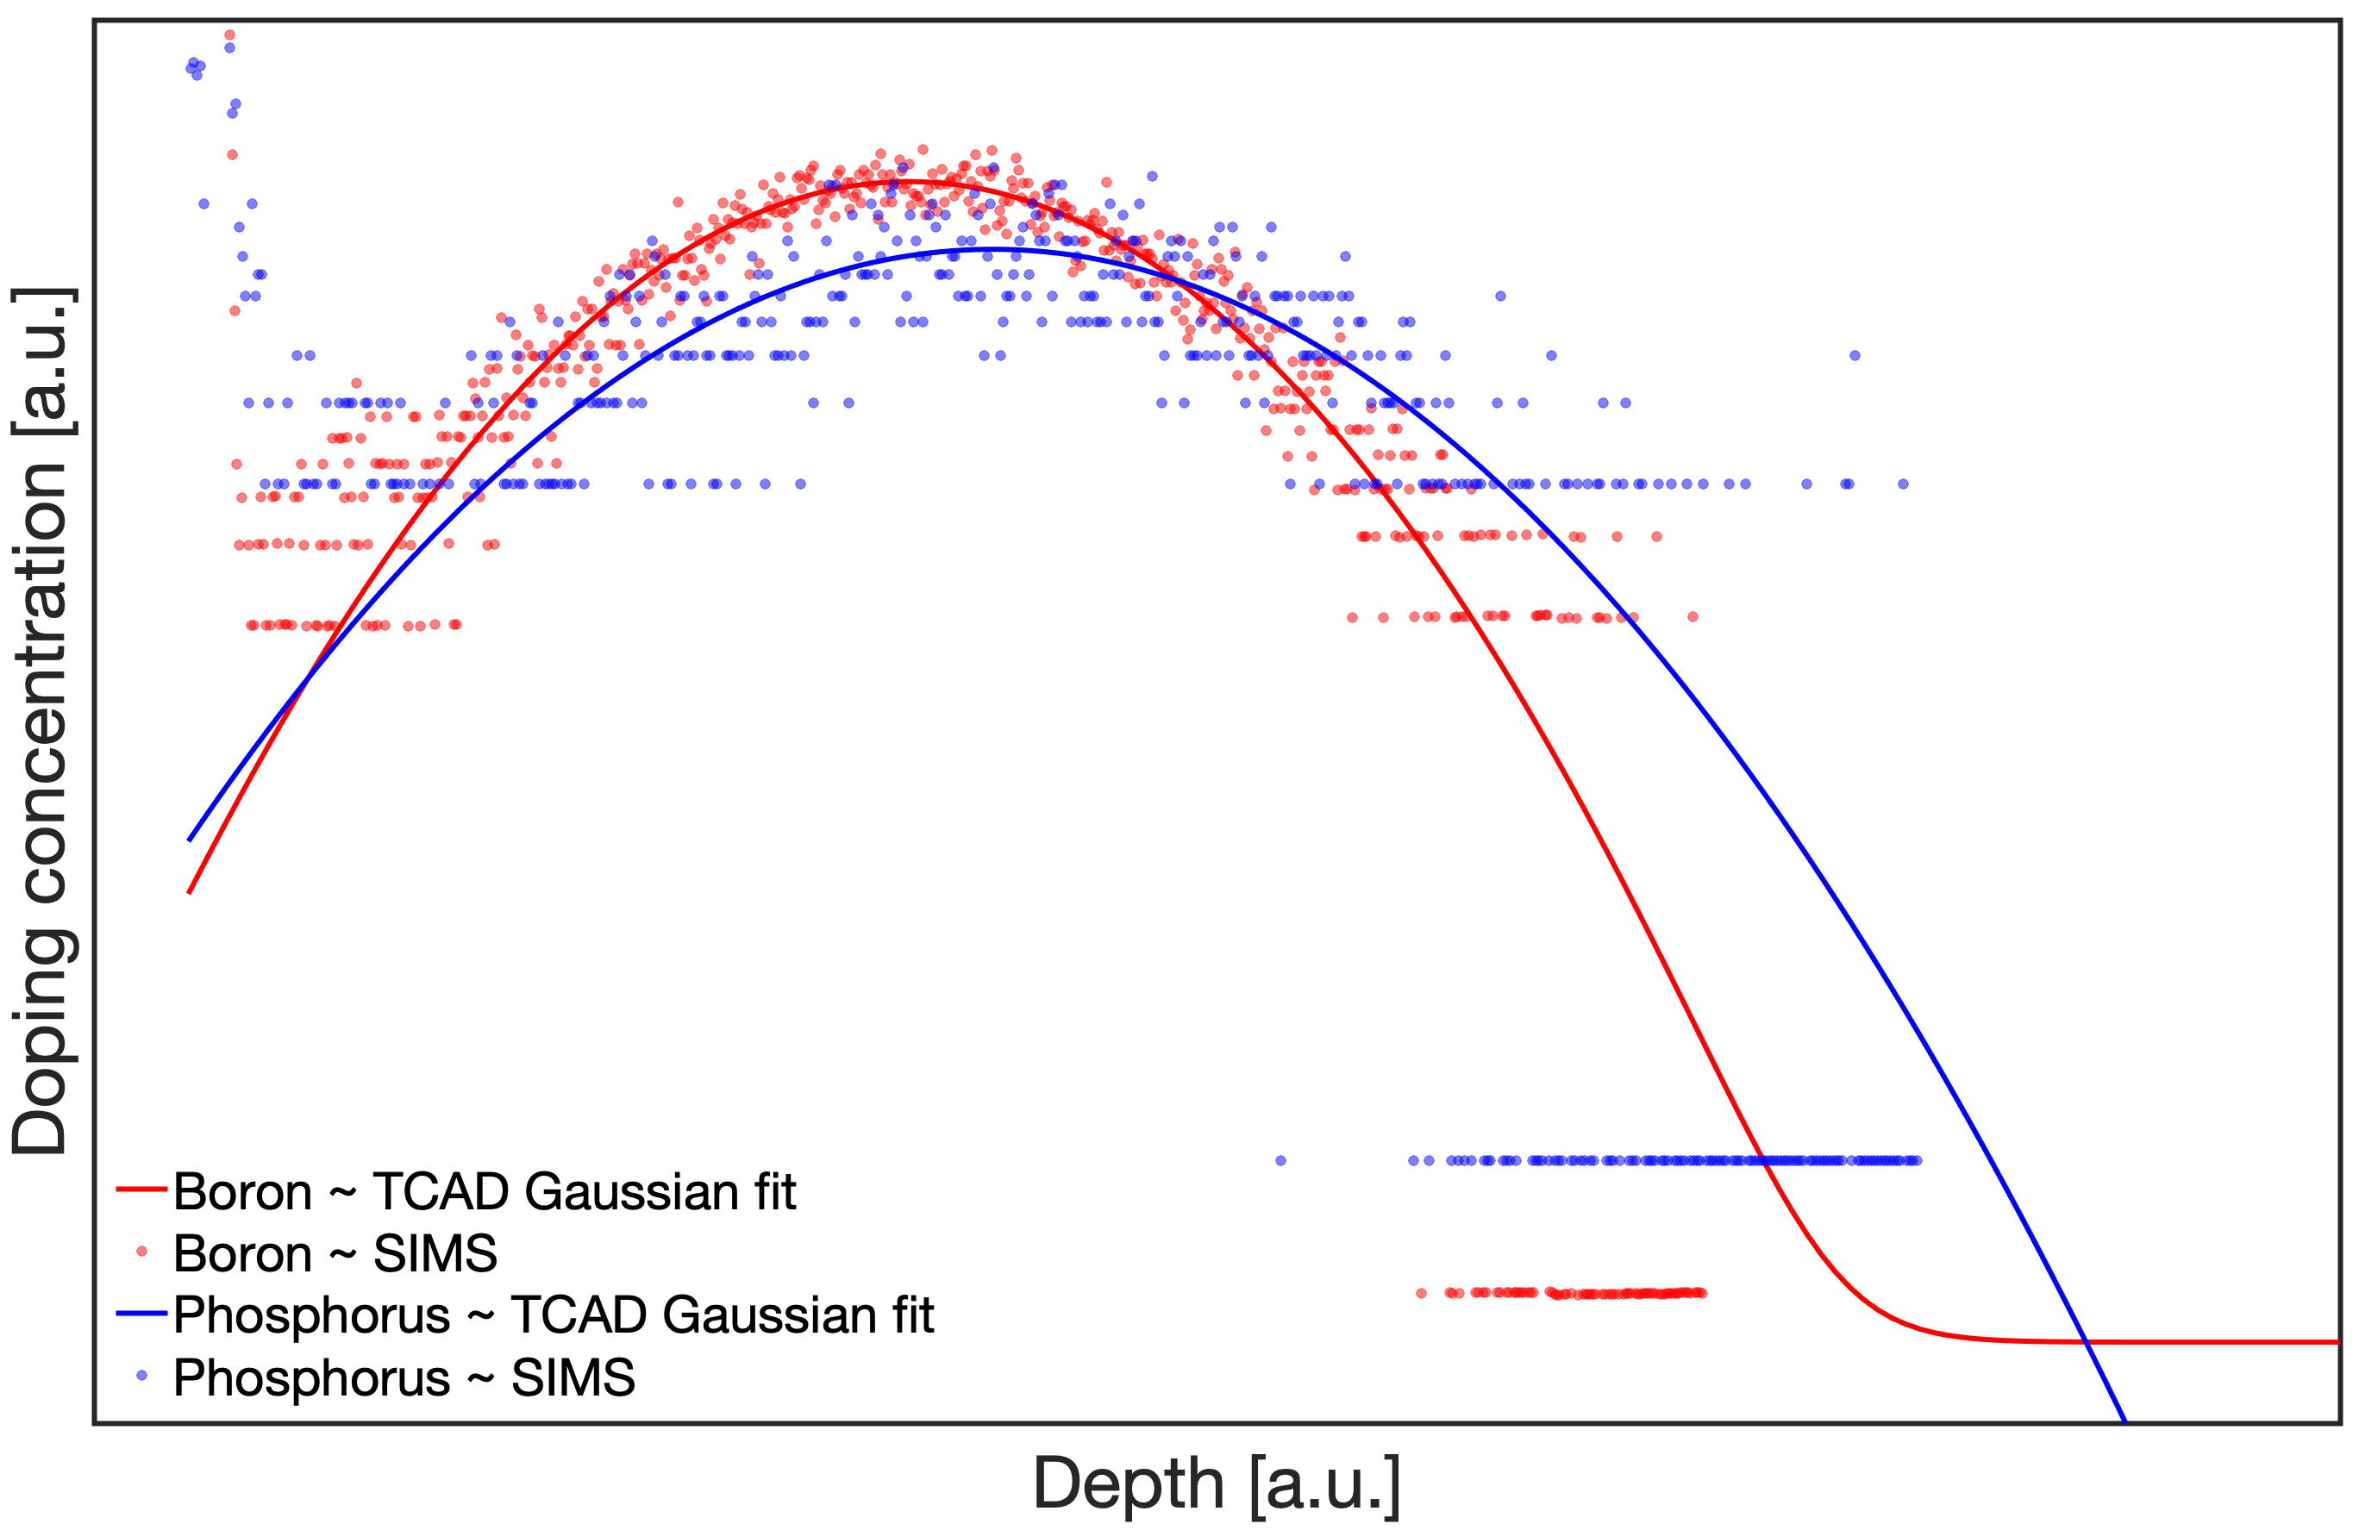
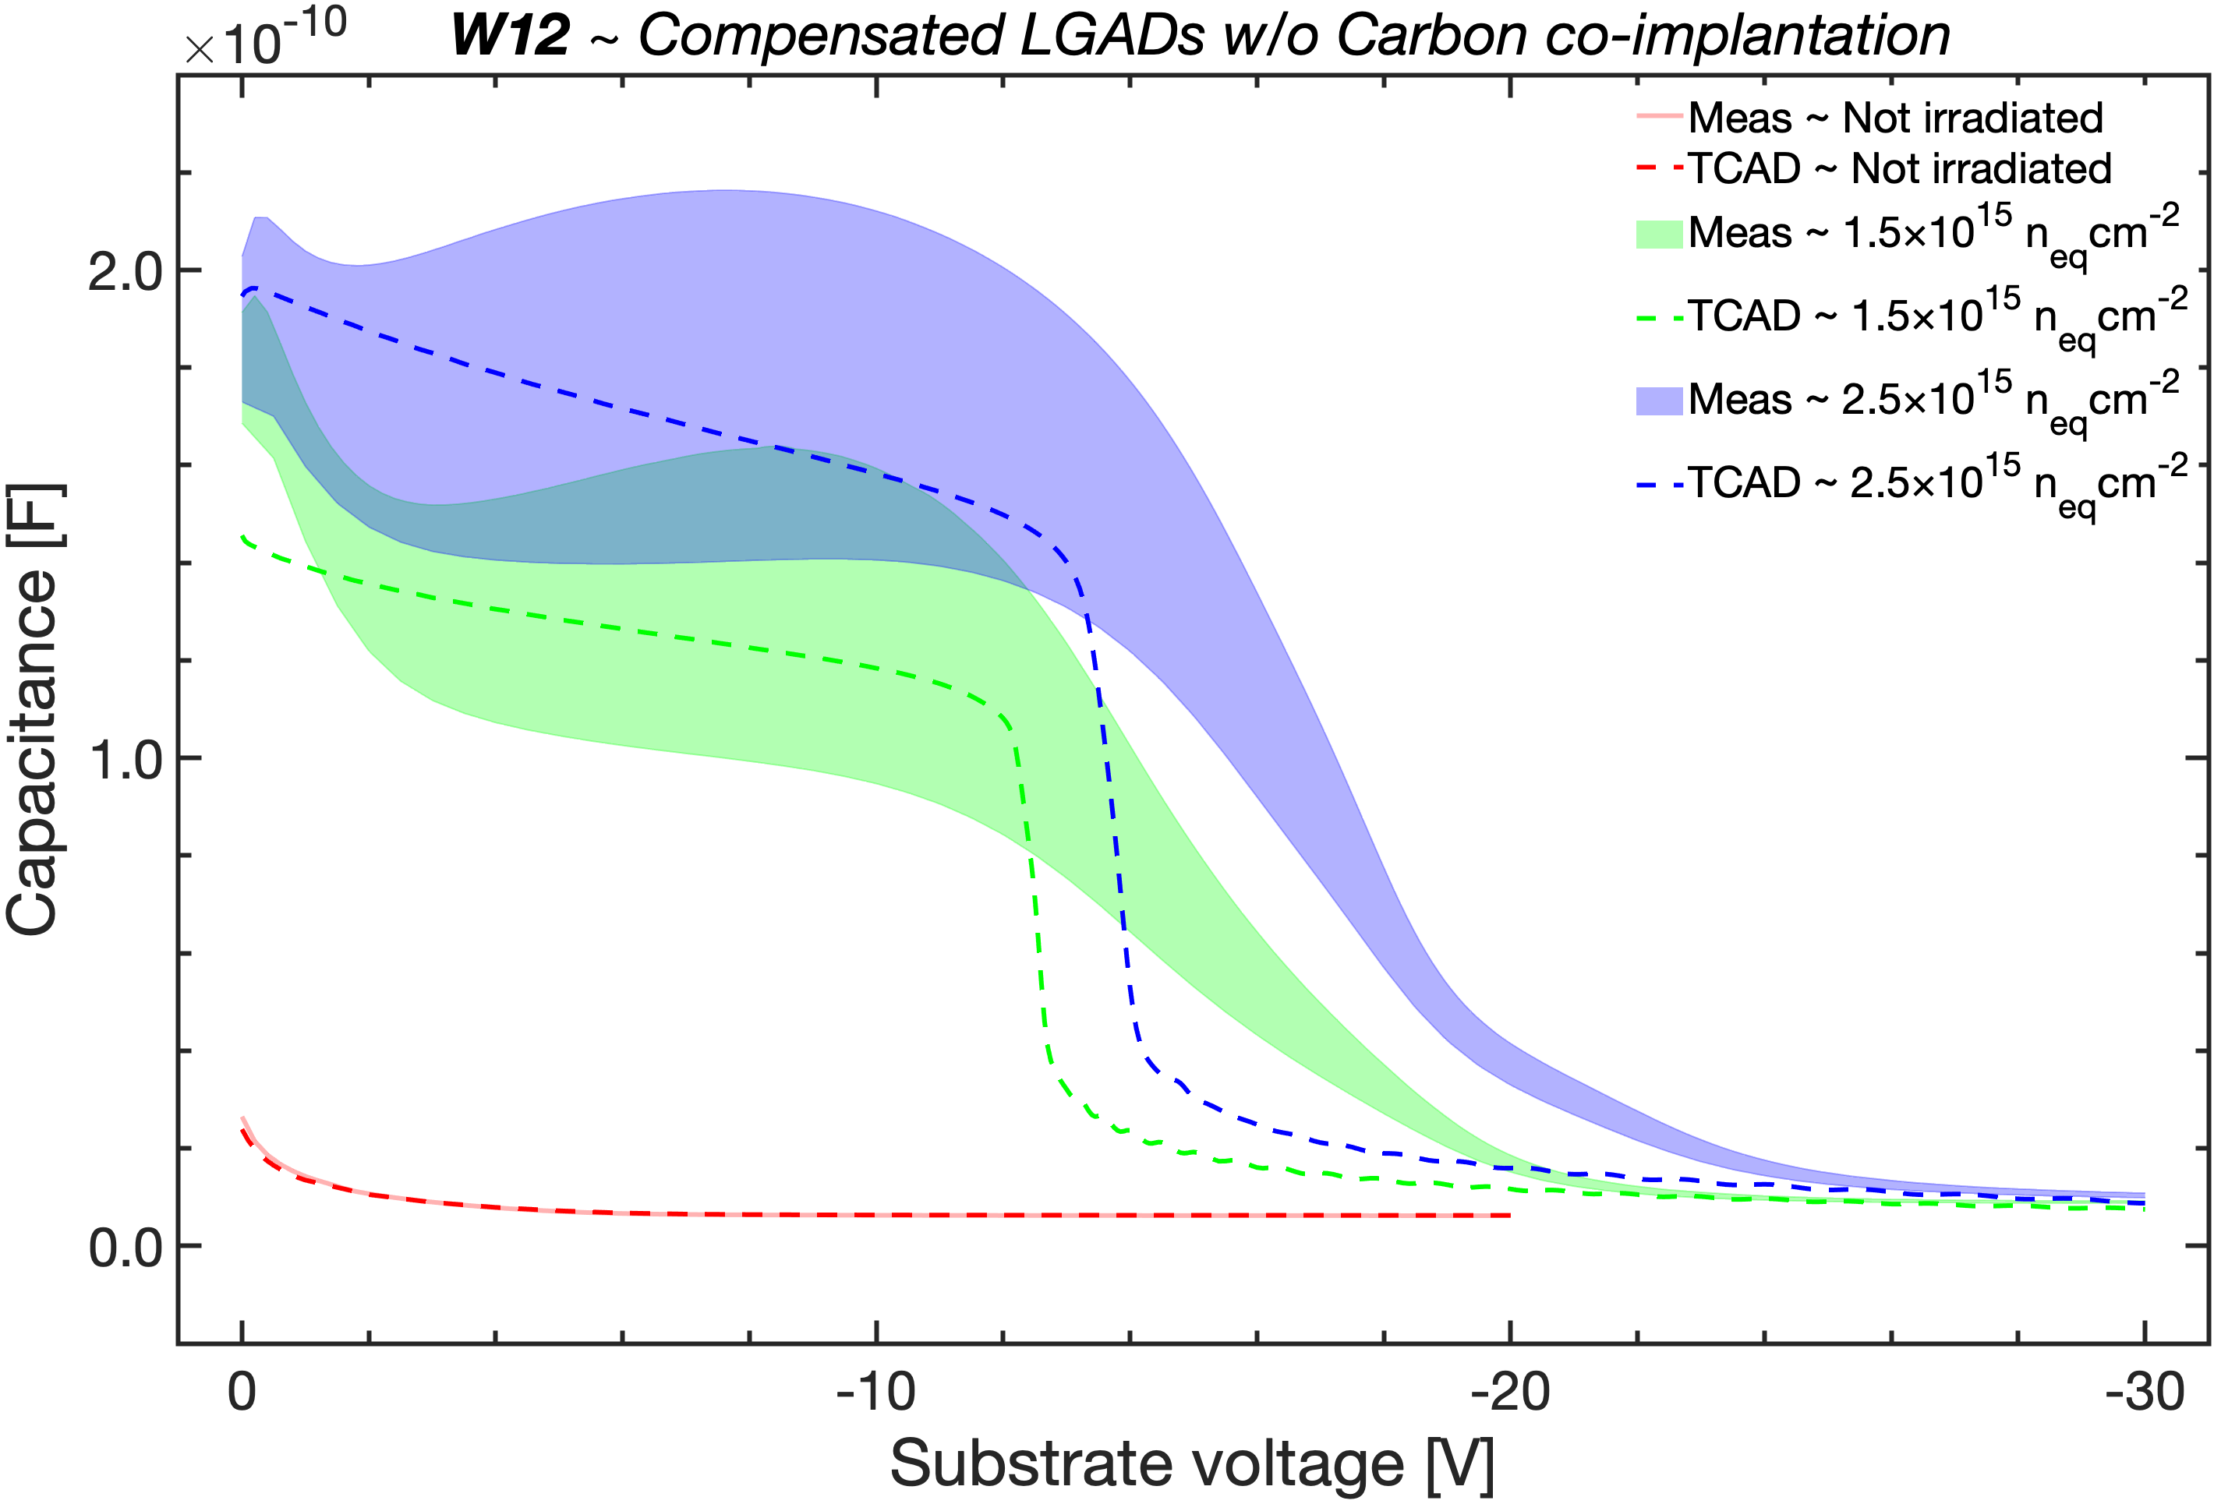
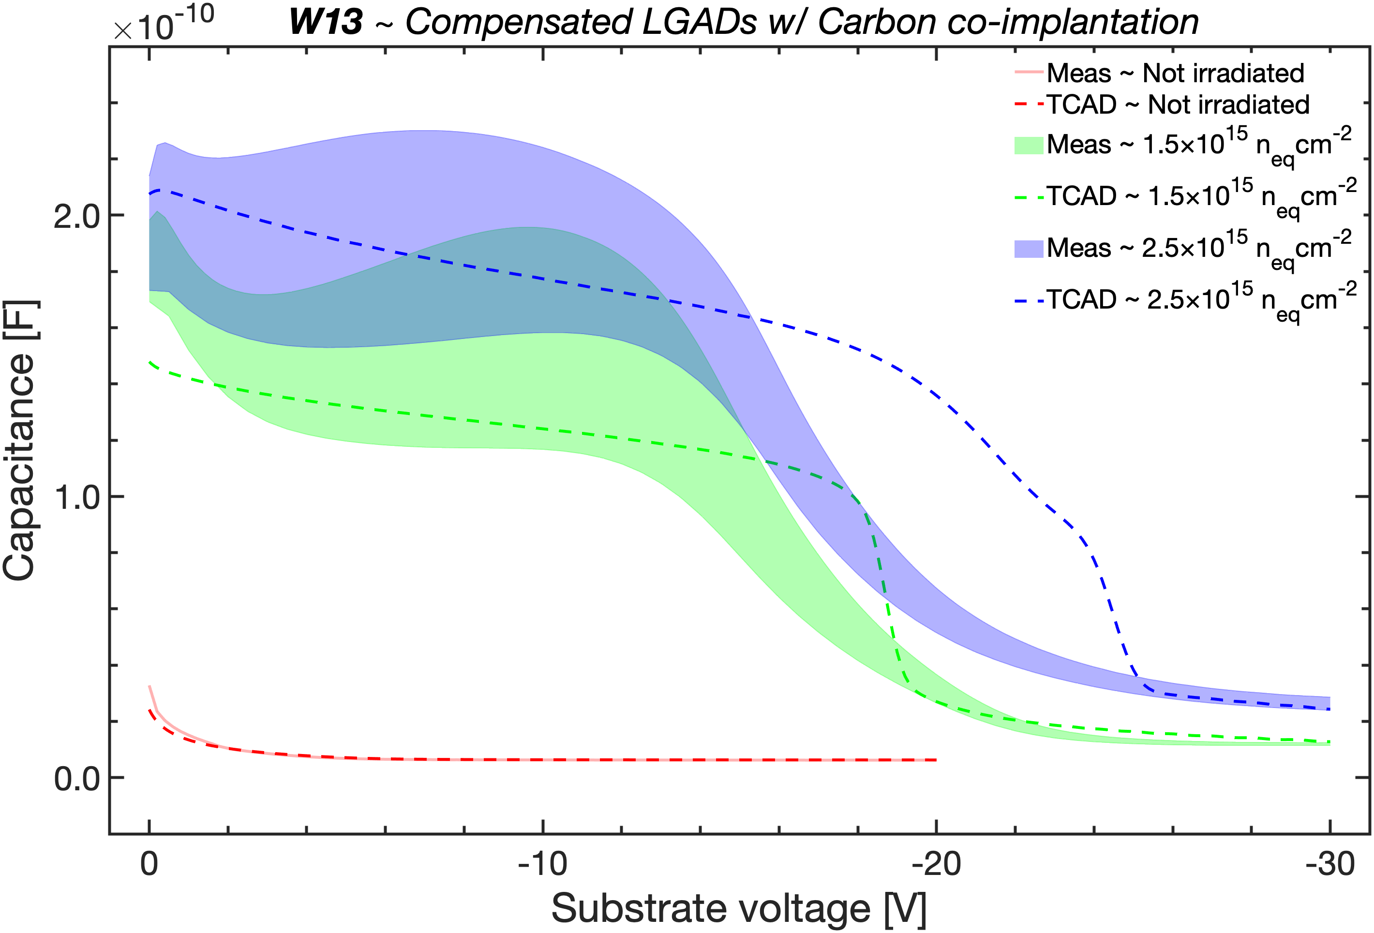
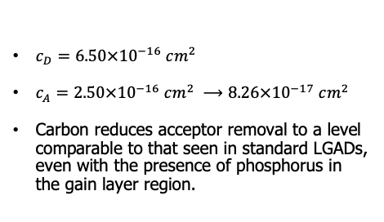
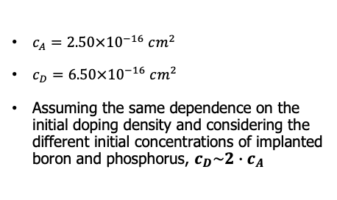
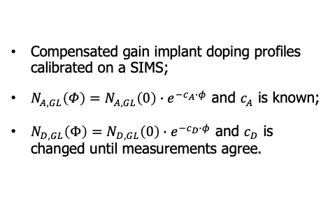
Compensated LGADs
3
C-V CHARACTERISTICS
Compensated gain implant doping profiles calibrated on a SIMS;
$N_{A,GL}\left(Φ\right)=N_{A,GL}\left(0\right)∙e^{−c_{A}∙φ}$ and $c_{A}$ is known;
$N_{D,GL}\left(Φ\right)=N_{D,GL}\left(0\right)∙e^{−c_{D}∙φ}$ and $c_{D}$ is changed until measurements agree.
Design of next-generation LGADs with TCAD tools
$c_{A}=2.50×{10}^{−16} cm^{2}$
$c_{D}=6.50×{10}^{−16} cm^{2}$
Assuming the same dependence on the initial doping density and considering the different initial concentrations of implanted boron and phosphorus, $c_{D}\sim 2∙c_{A}$
IFD 2025
$c_{D}=6.50×{10}^{−16} cm^{2}$
$c_{A}=2.50×{10}^{−16} cm^{2} ⟶8.26×{10}^{−17} cm^{2}$
Carbon reduces acceptor removal to a level comparable to that seen in standard LGADs, even with the presence of phosphorus in the gain layer region.
A. Fondacci et al.

Slide 18
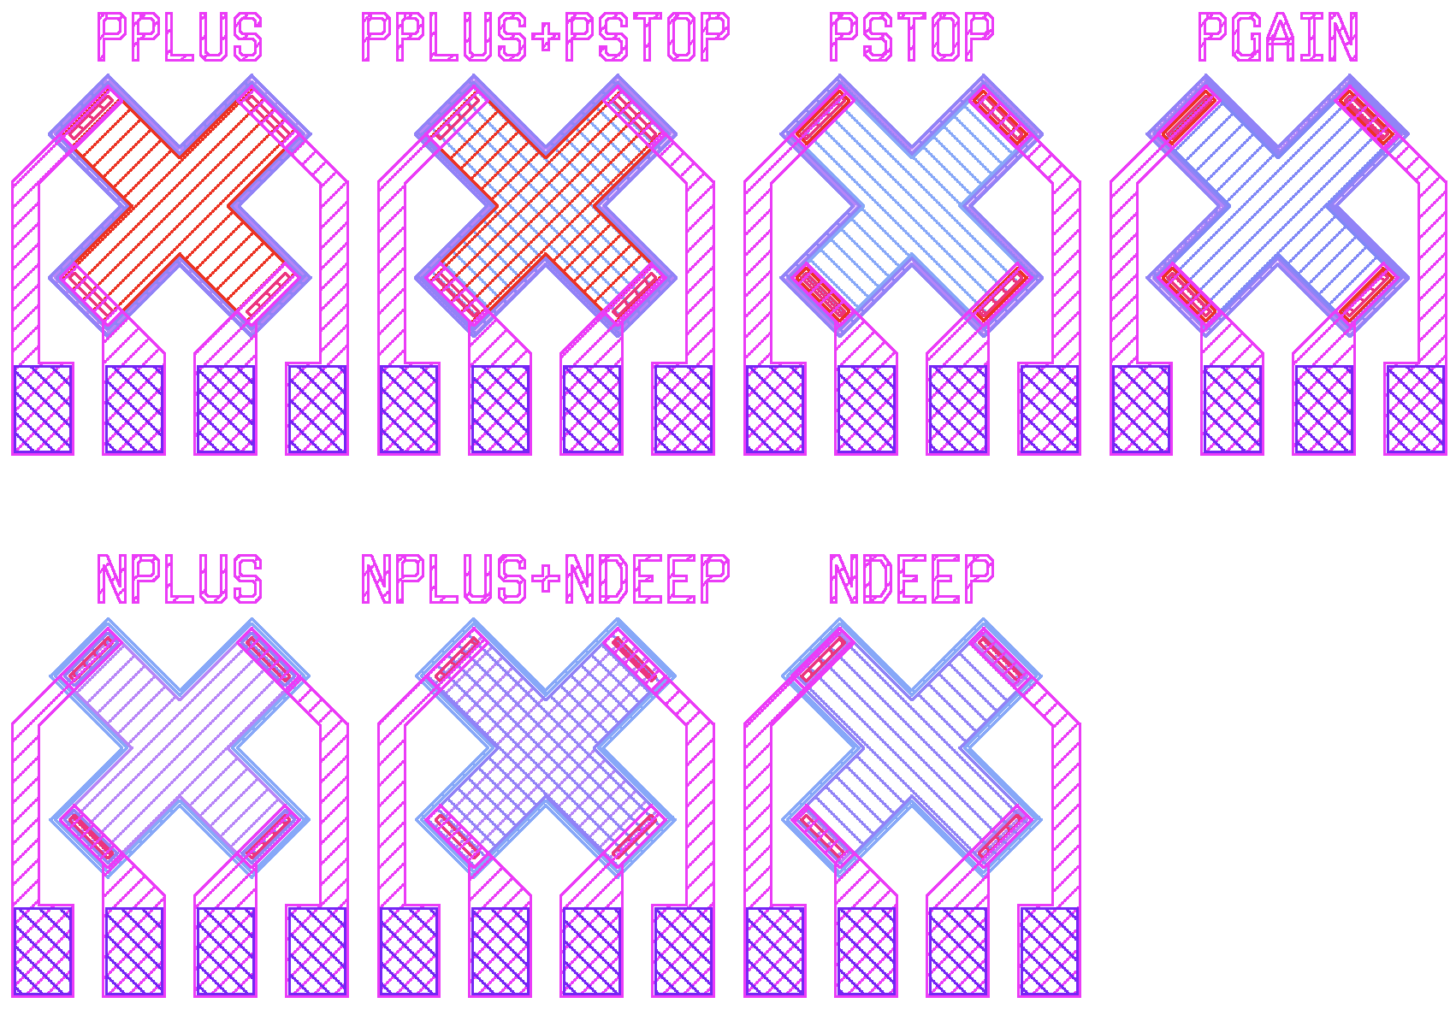
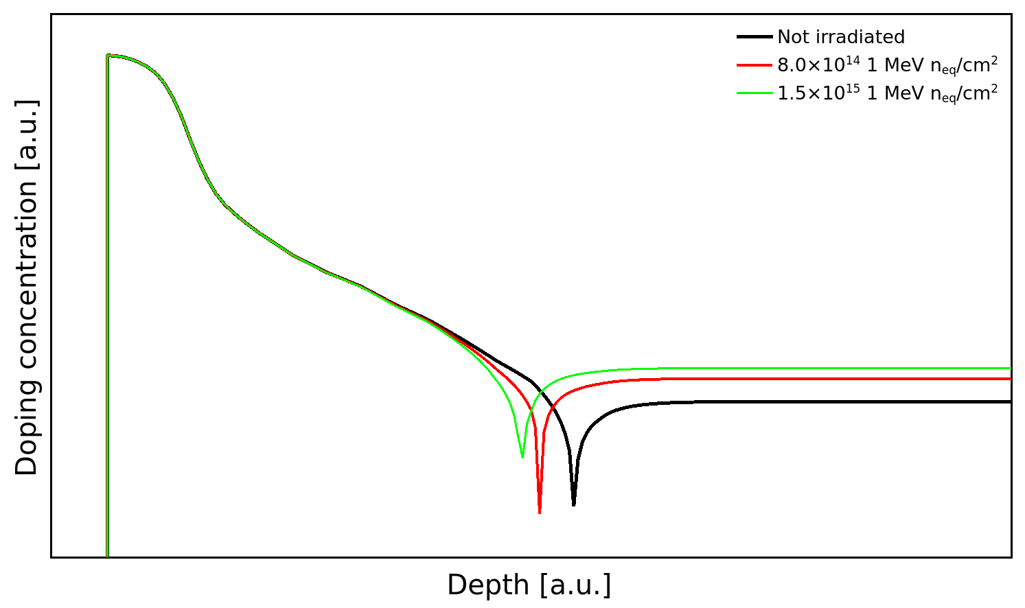
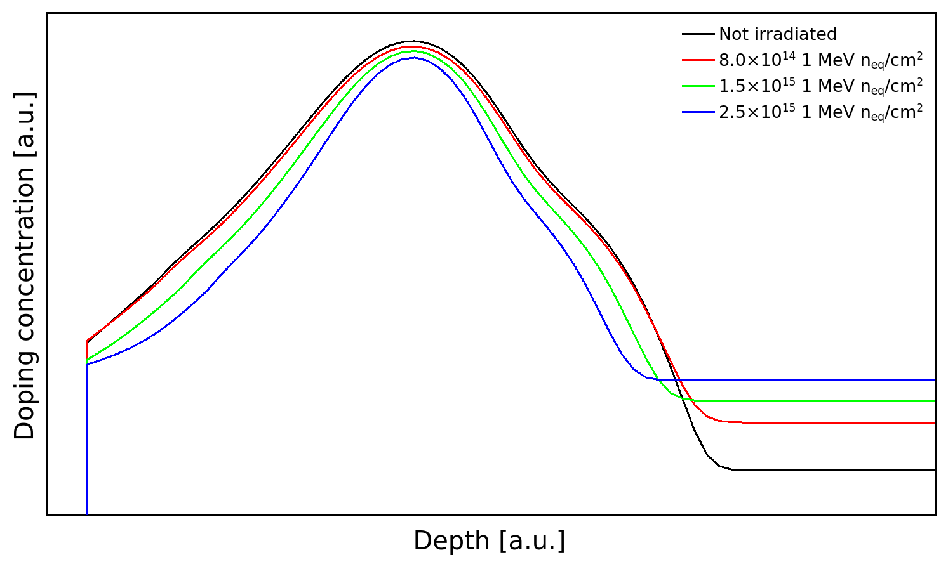
Compensated LGADs
3
C-V CHARACTERISTICS
SHEET RESISTANCE (van der Pauw)
Compensated gain implant doping profiles calibrated on a SIMS;
$N_{A,GL}\left(Φ\right)=N_{A,GL}\left(0\right)∙e^{−c_{A}∙φ}$ and $c_{A}$ is known;
$N_{D,GL}\left(Φ\right)=N_{D,GL}\left(0\right)∙e^{−c_{D}∙φ}$ and $c_{D}$ is changed until measurements agree.
Design of next-generation LGADs with TCAD tools
$c_{A}=2.50×{10}^{−16} cm^{2}$
$c_{D}=6.50×{10}^{−16} cm^{2}$
Assuming the same dependence on the initial doping density and considering the different initial concentrations of implanted boron and phosphorus, $c_{D}\sim 2∙c_{A}$
NPLUS
IFD 2025
$c_{D}=6.50×{10}^{−16} cm^{2}$
$c_{A}=2.50×{10}^{−16} cm^{2} ⟶8.26×{10}^{−17} cm^{2}$
Carbon reduces acceptor removal to a level comparable to that seen in standard LGADs, even with the presence of phosphorus in the gain layer region.
PGAIN W5
A. Fondacci et al.

Slide 19
Compensated LGADs
3
C-V CHARACTERISTICS
SHEET RESISTANCE (van der Pauw)
Compensated gain implant doping profiles calibrated on a SIMS;
$N_{A,GL}\left(Φ\right)=N_{A,GL}\left(0\right)∙e^{−c_{A}∙φ}$ and $c_{A}$ is known;
$N_{D,GL}\left(Φ\right)=N_{D,GL}\left(0\right)∙e^{−c_{D}∙φ}$ and $c_{D}$ is changed until measurements agree.
Valuable information for designing the next Compensated LGAD batch
Design of next-generation LGADs with TCAD tools
$c_{A}=2.50×{10}^{−16} cm^{2}$
$c_{D}=6.50×{10}^{−16} cm^{2}$
Assuming the same dependence on the initial doping density and considering the different initial concentrations of implanted boron and phosphorus, $c_{D}\sim 2∙c_{A}$
NPLUS
IFD 2025
$c_{D}=6.50×{10}^{−16} cm^{2}$
$c_{A}=2.50×{10}^{−16} cm^{2} ⟶8.26×{10}^{−17} cm^{2}$
Carbon reduces acceptor removal to a level comparable to that seen in standard LGADs, even with the presence of phosphorus in the gain layer region.
PGAIN W5
A. Fondacci et al.

Slide 20
Thank you for your attention
A. Fondacci, A. R. Altamura, R. Arcidiacono, A. Bisht, M. Boscardin, N. Cartiglia, M. Centis Vignali, T. Croci, M. Ferrero, L. Lanteri, L. Menzio, A. Morozzi, F. Moscatelli, D. Passeri, G. Paternoster, F. Siviero, V. Sola, R. S. White
Fourth INFN Workshop on Future Detectors, Sestri Levante, Italy

