Slide 1
Characterization of IXPE Gas Pixel Detectors with the X-ray Calibration Facility
Stefano Tugliani
Simone Maldera, Andrea Frassà, Raffaella Bonino, Nicolò Cibrario, Luca Latronico, Alessio Gorgi
18/03/2025

Slide 2
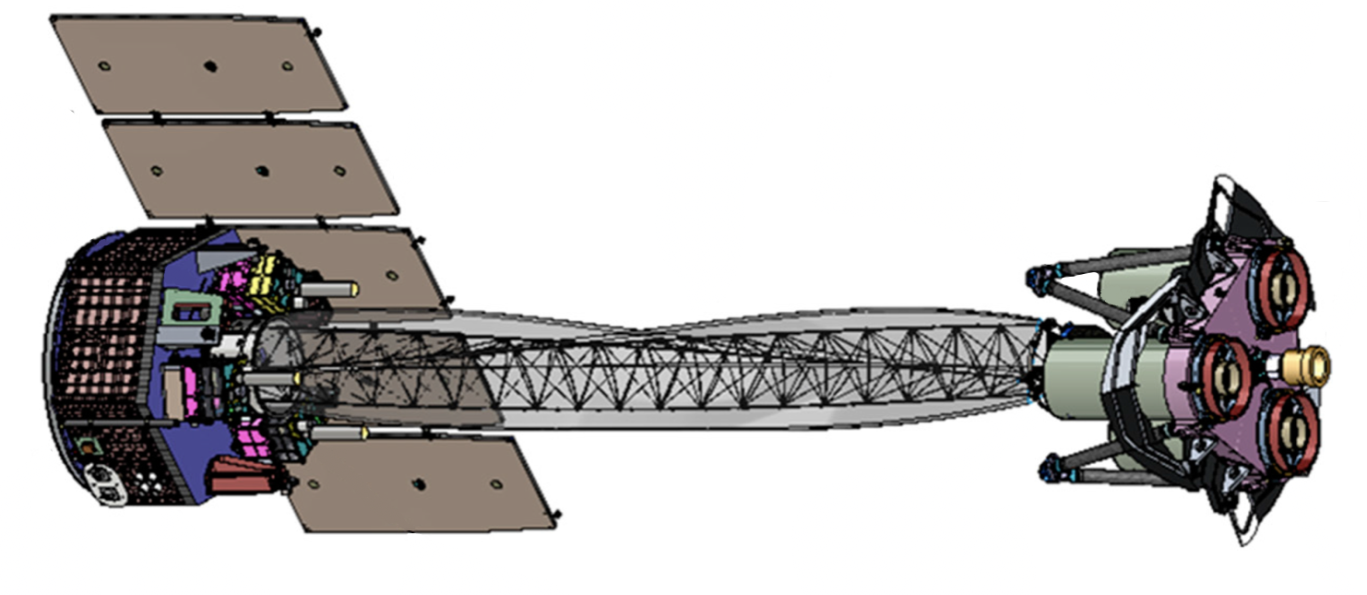
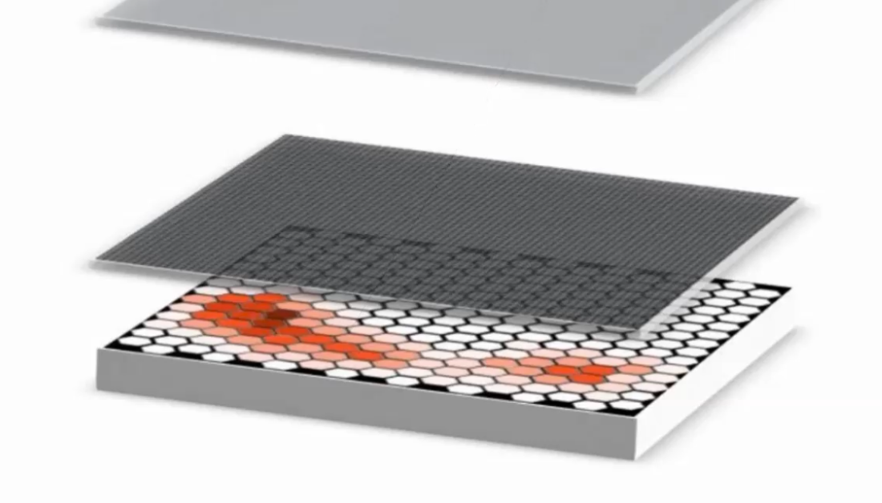
The Gas Pixel Detector GPD
DRIFT PLANE
Final absorption
point
V drift = -2800 V
Interaction point
$Φ$: angle of emission of the photoelectron wrt the polarization direction
IXPE
Barycenter
Interaction point
Final absorption
point
$$\vec{E}$$
Dymethyl-ether
DME ${(CH_{3})}_{2}O$
Photoelectron
emission direction
V top = -840 V
$$Φ$$
10
mm
Emission direction
Detector
Unit
GEM
V bottom = -400 V
0.7
mm
ASIC
V ASIC = 0 V
ADC
Final absorption
point
Ref. [2]
Interaction point
APPENDIX A
Characterization of IXPE Gas Pixel Detectors with the X-ray Calibration Facility
18/03/2025
2

Slide 3
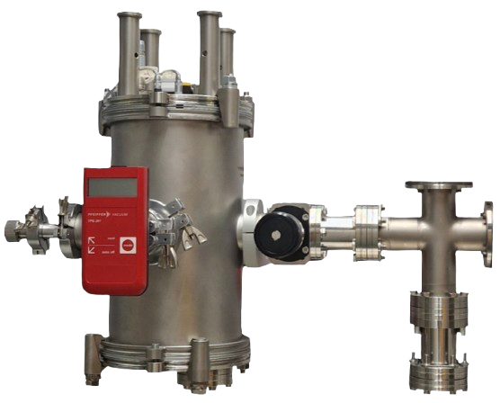
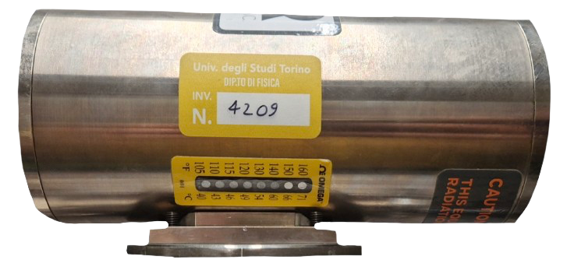
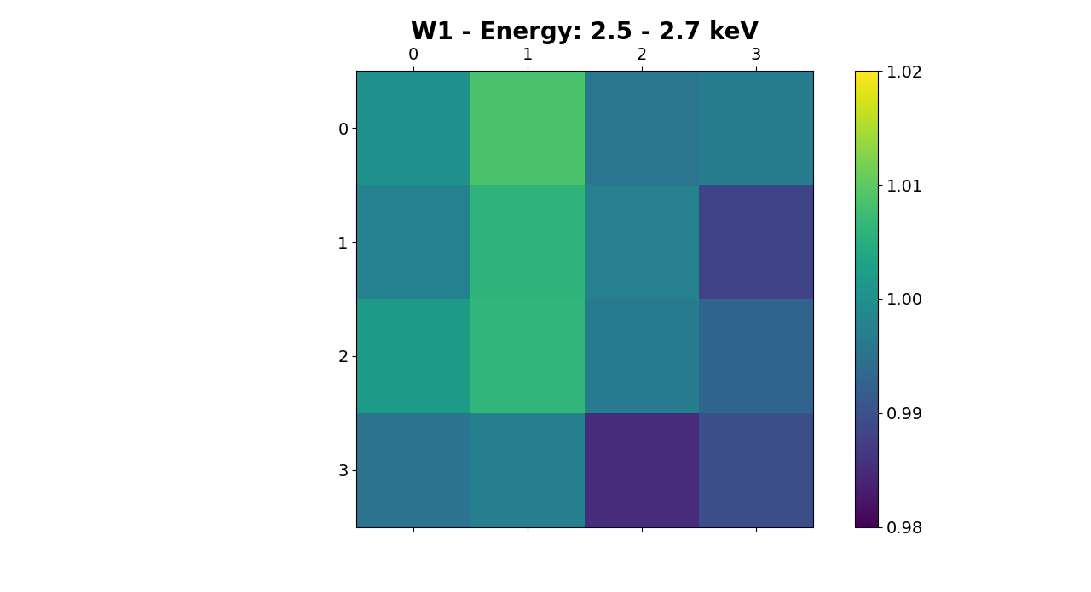
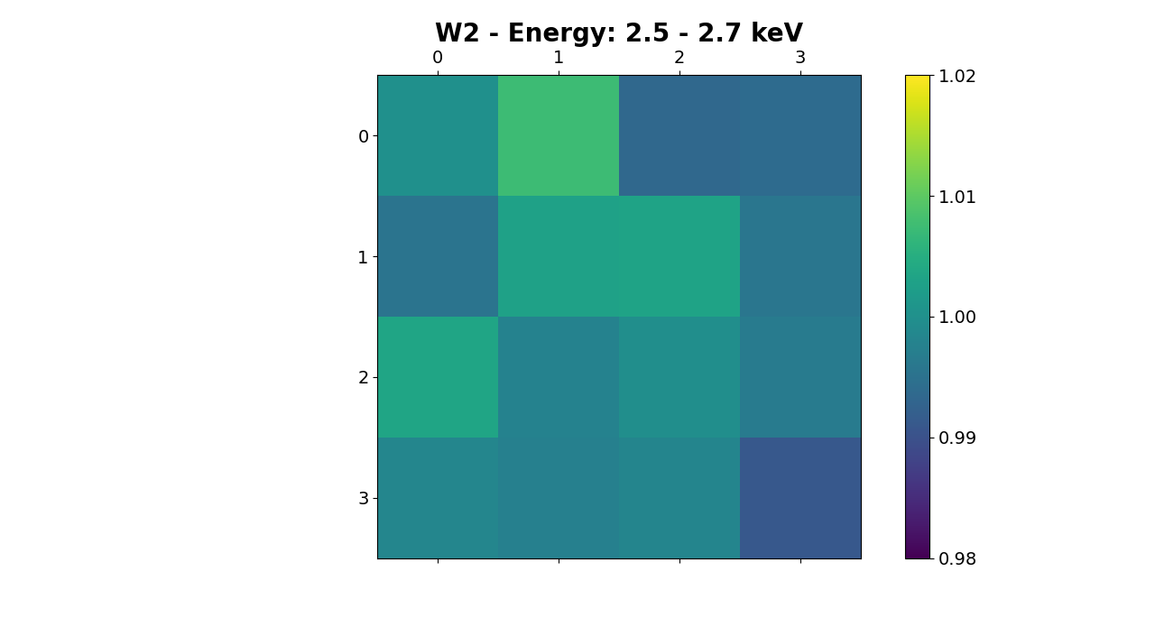
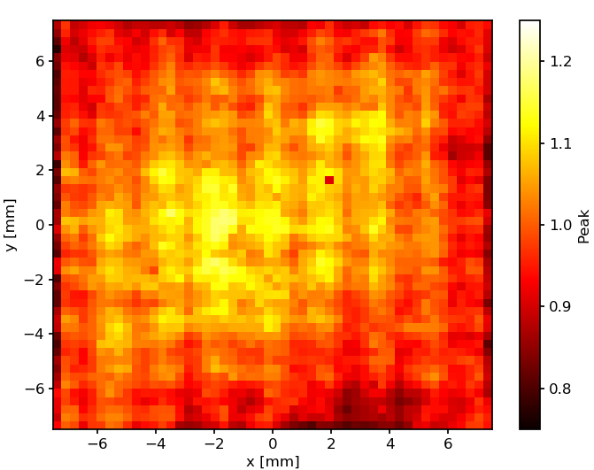
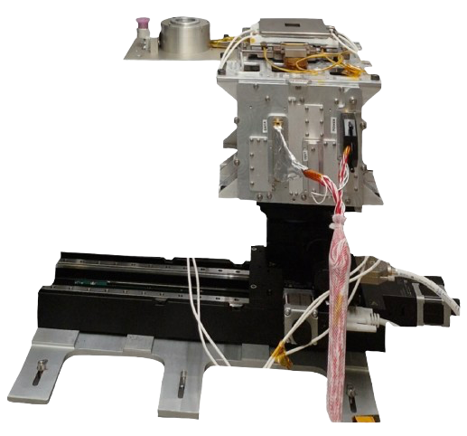
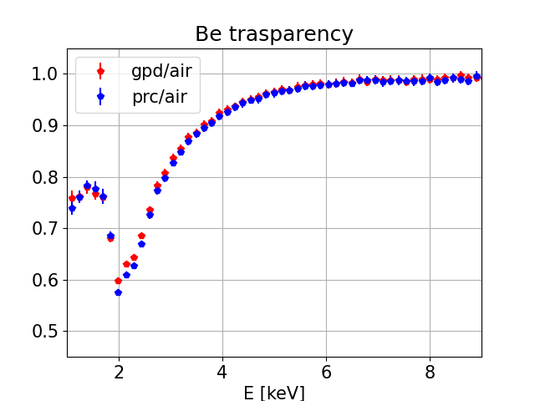
The X-ray Calibration Facility
X-ray tube: radiation source
Beryllium windows transparency measurements for future X-ray detectors
Ref. [2],[5],[6]
Gas Pixel Detectors:
study of systematic effects that take place in the detector
Unpolarized beam line
GPD gain map
w1/air
SDD
w2/air
GPD
CMOS camera
Handling system
APPENDIX A
Characterization of IXPE Gas Pixel Detectors with the X-ray Calibration Facility
18/03/2025
3

Slide 4
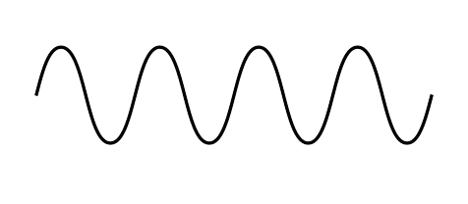
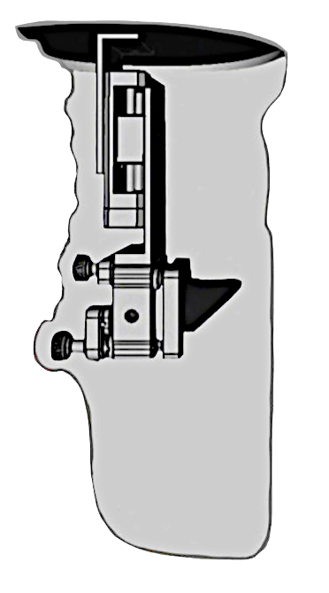
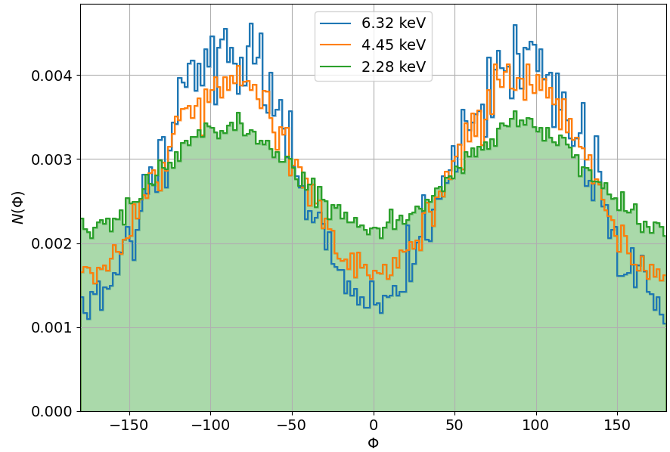
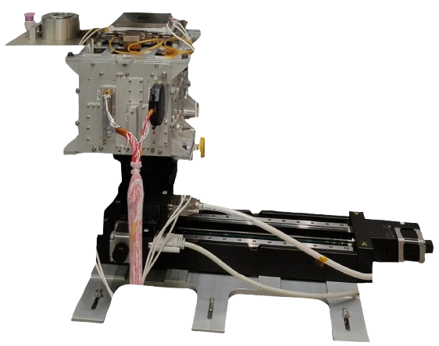
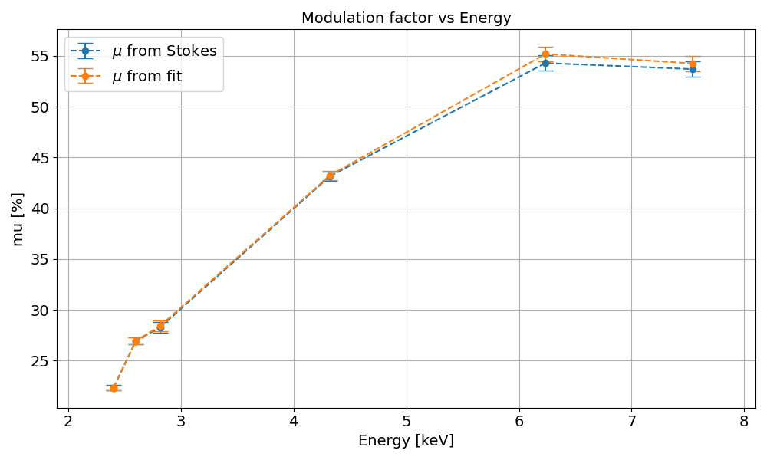
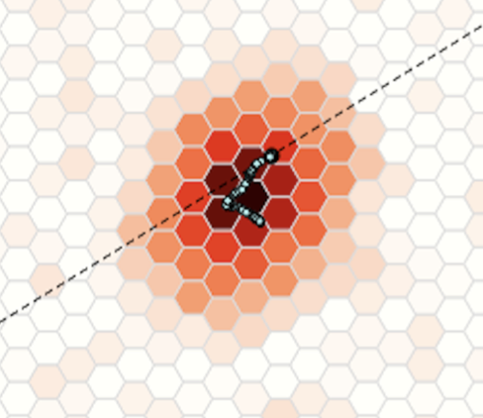
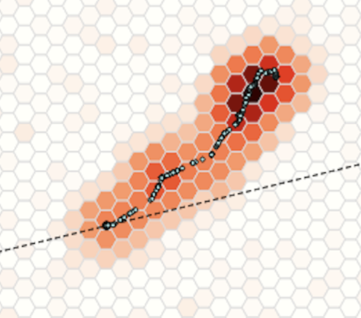
The X-ray Calibration Facility
Polarizing crystal
X-ray tube: radiation source
GPD response to the polarization:
Modulation factor (response to 100% linearly polarized radiation) vs Energy.
$$∥$$
$$θ=45°$$
$$⊥$$
Unpolarized incident radiation
$$⊥$$
B
Diffracted polarized radiation
Plane of incidence
A
$$N\left(φ\right)=A+B\cos^{2}(φ−φ_{0})$$
Polarized beam line
SDD
GPD
CMOS camera
Handling system
Ref. [2],[3],[5],[6]
APPENDIX A
Characterization of IXPE Gas Pixel Detectors with the X-ray Calibration Facility
18/03/2025
4

Slide 5
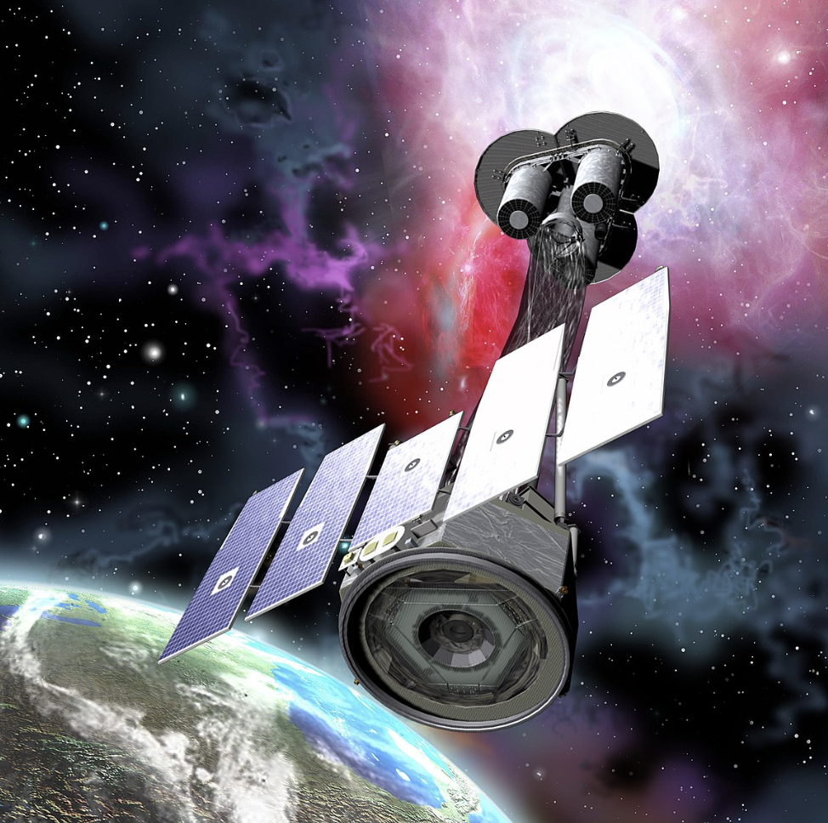
THANK YOU FOR YOUR ATTENTION
18/03/2025
Astrophysical X-ray Polarimetry with IXPE
5

Slide 6
Bibliography
[1] Weisskopf et al. The Imaging X-Ray Polarimetry Explorer (IXPE): Pre-Launch. 2021. doi: 10.48550/ARXIV.2112.01269. url: https://arxiv.org/abs/2112.01269.
[2] L. Baldini et al. “Design, construction, and test of the Gas Pixel Detectors for the IXPE mission”. In: Astroparticle Physics 133 (2021), p. 102628. issn: 0927-6505. doi: https:// doi.org/10.1016/j.astropartphys.2021.102628. url: https://www.sciencedirect. com/science/article/pii/S0927650521000670.
[3] Fabio Muleri Sergio Fabiani. Astronomical X-ray Polarimetry. Aracne, 2014.
[4] Fabio Muleri. “ON THE OPERATION OF X-RAY POLARIMETERS WITH A LARGE FIELD OF VIEW”. In: The Astrophysical Journal 782.1 (Jan. 2014), p. 28. doi: 10.1088/ 0004-637x/782/1/28. url: https://doi.org/10.1088%2F0004-637x%2F782%2F1%2F28.
[5] S. Tugliani et al. “IXPE Gas Pixel Detectors characterization using the X-ray Calibration Facility”. In: Nuovo Cim. C 47.3 (2024), p. 141. doi: 10.1393/ncc/i2024-24141-9.
[6] S. Tugliani et al. “IXPE Gas Pixel Detector characterization with the X-ray calibration facility”. In: Nuclear Instruments and Methods in Physics Research Section A: Accelerators, Spec- trometers, Detectors and Associated Equipment 1069 (2024), p. 169800. issn: 0168-9002. doi: https://doi.org/10.1016/j.nima.2024.169800.
[7] F. Kislat et al. “Analyzing the data from X-ray polarimeters with Stokes parameters”. In: Astroparticle Physics 68 (Aug. 2015), pp. 45–51. doi: 10.1016/j.astropartphys.2015. 02.007. url: https://doi.org/10.1016%2Fj.astropartphys.2015.02.007.
[8] C. Tomaiuolo et al. " Time-dependent instrumental effects in IXPE: Pressure variation and GEM charging inside GPDs ". In: Nuclear Instruments and Methods in Physics Research Section A: Accelerators, Spectrometers, Detectors and Associated Equipment, 1069 (2024), p. 169881. issn: 0168-9002. doi: https://doi.org/10.1016/j.nima.2024.169881.
16/10/24
Astrophysical X-ray Polarimetry with IXPE
APPENDIX A
6

Slide 7
IXPE: Imaging X-ray Polarimetry Explorer
Mirror Module Assembly (x3) (Wolter I)
Boom w/ thermal Sock deployed
Detector Unit (x3)
Forward star tracker
X-ray Shields (x3) deployed
Solar array
Ref. [1]
APPENDIX A
Astrophysical X-ray Polarimetry with IXPE
18/03/2025
7

Slide 8
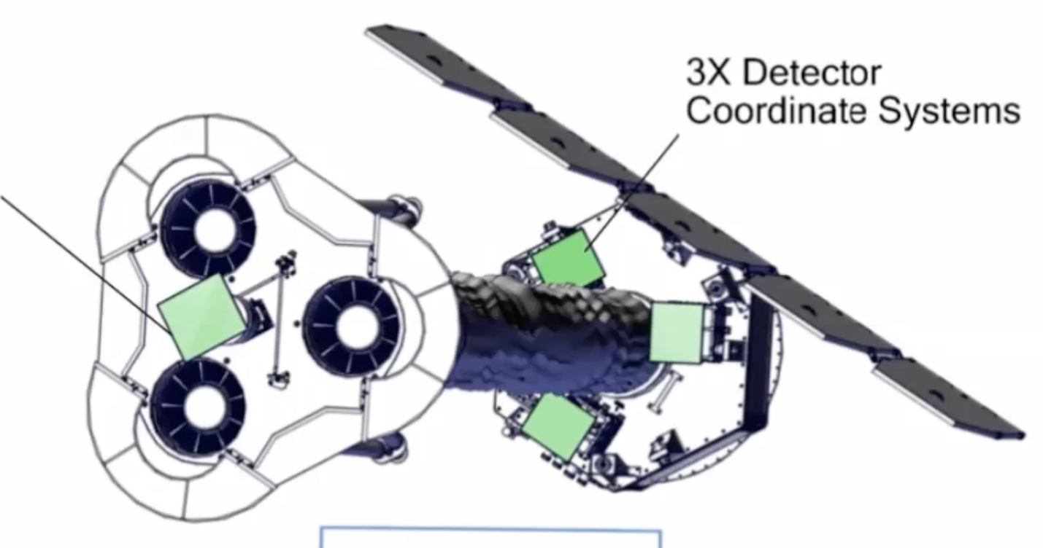
IXPE data processing 1
3 Detector
Units
Star Tracker:
Celestial
Coordinates system
Detector Coordinates
Level 1 data:
Event reconstruction
in detector coordinates
Level 2 data:
Data in sky coordinates
DU1
DU2
Celestial Coordinates
DU3
12/10/24
Astrophysical X-ray Polarimetry with IXPE
APPENDIX A
8

Slide 9
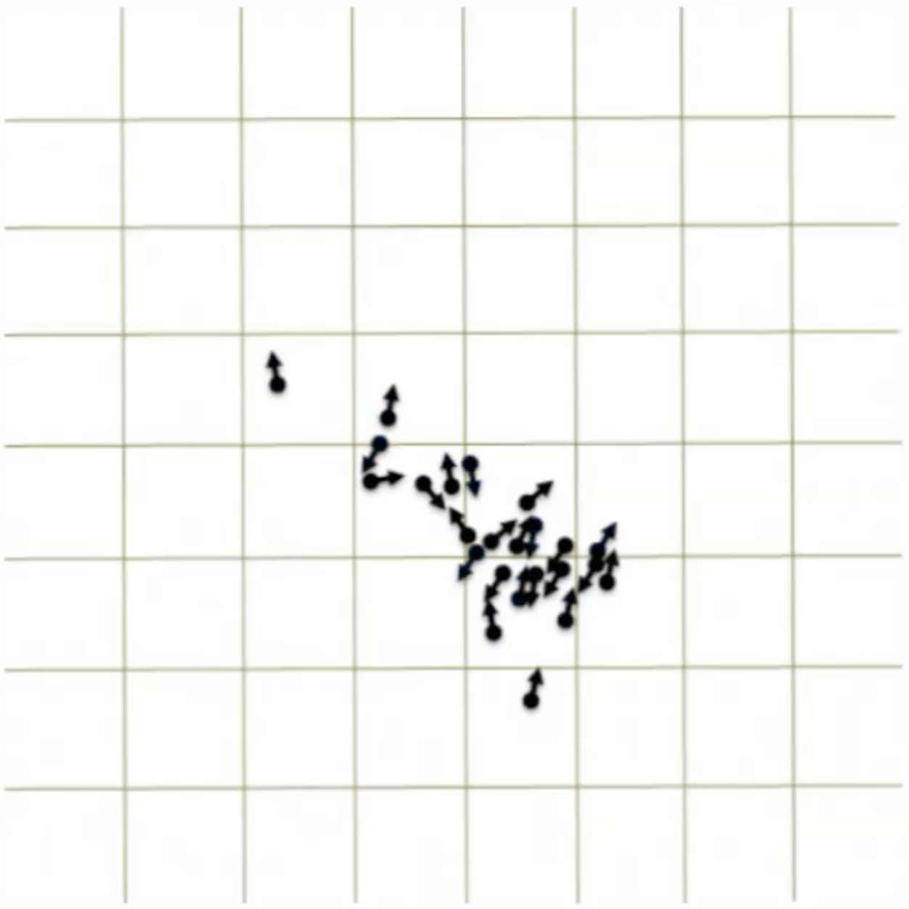
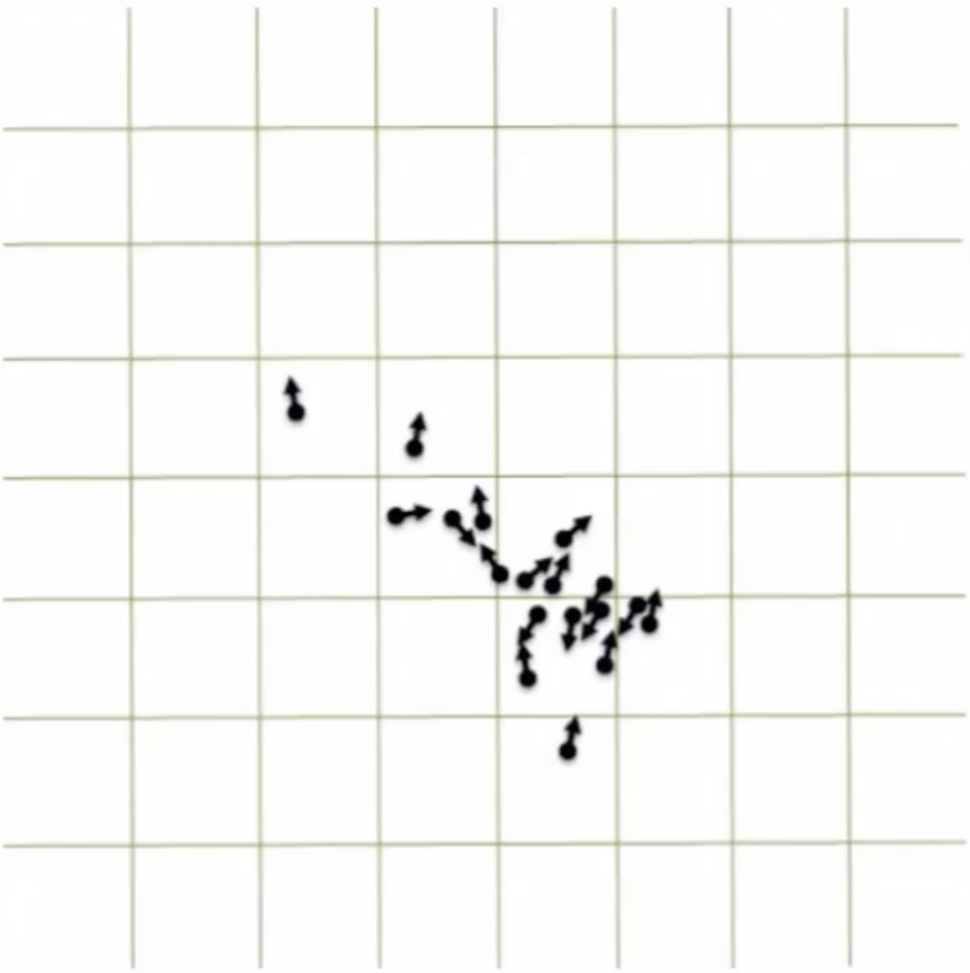
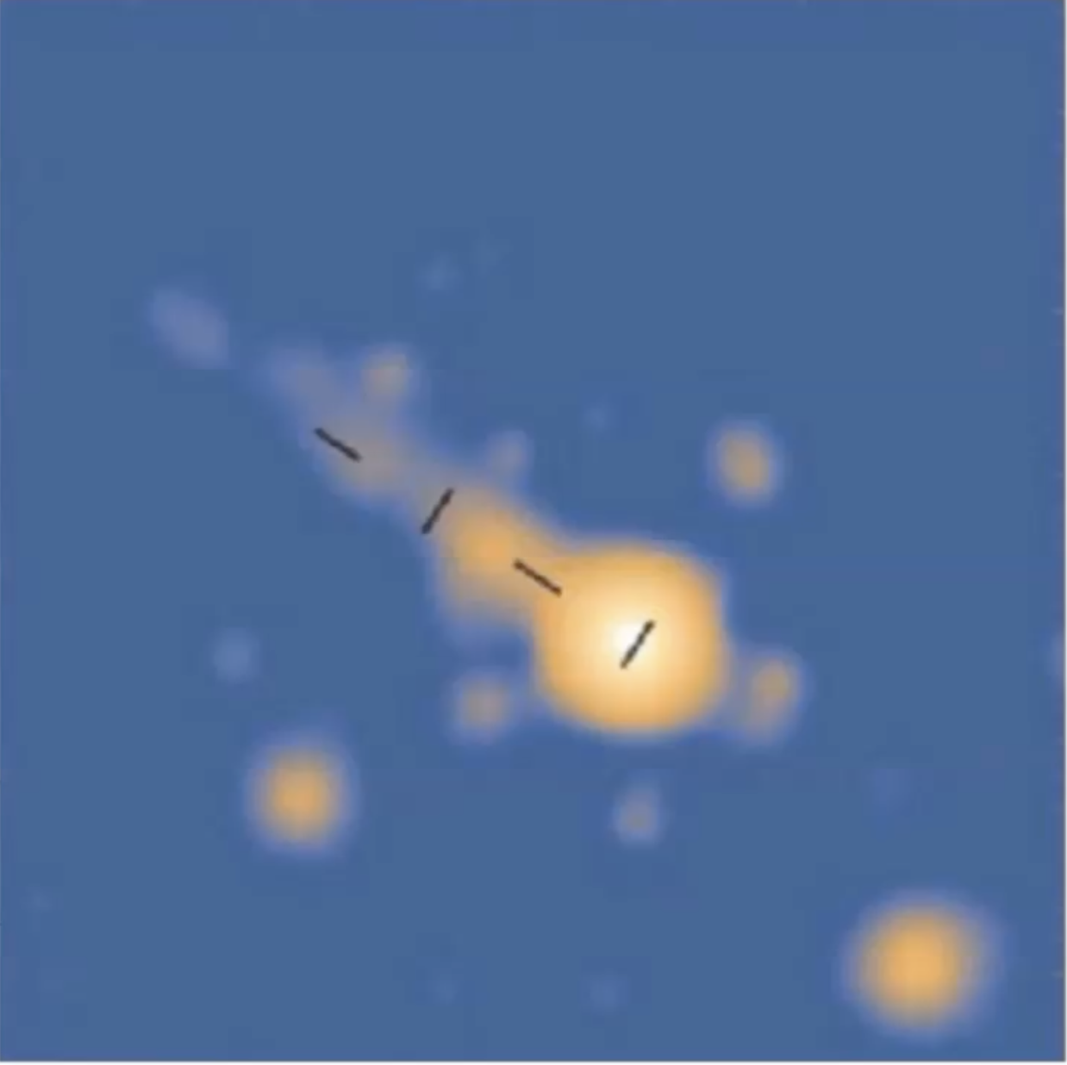
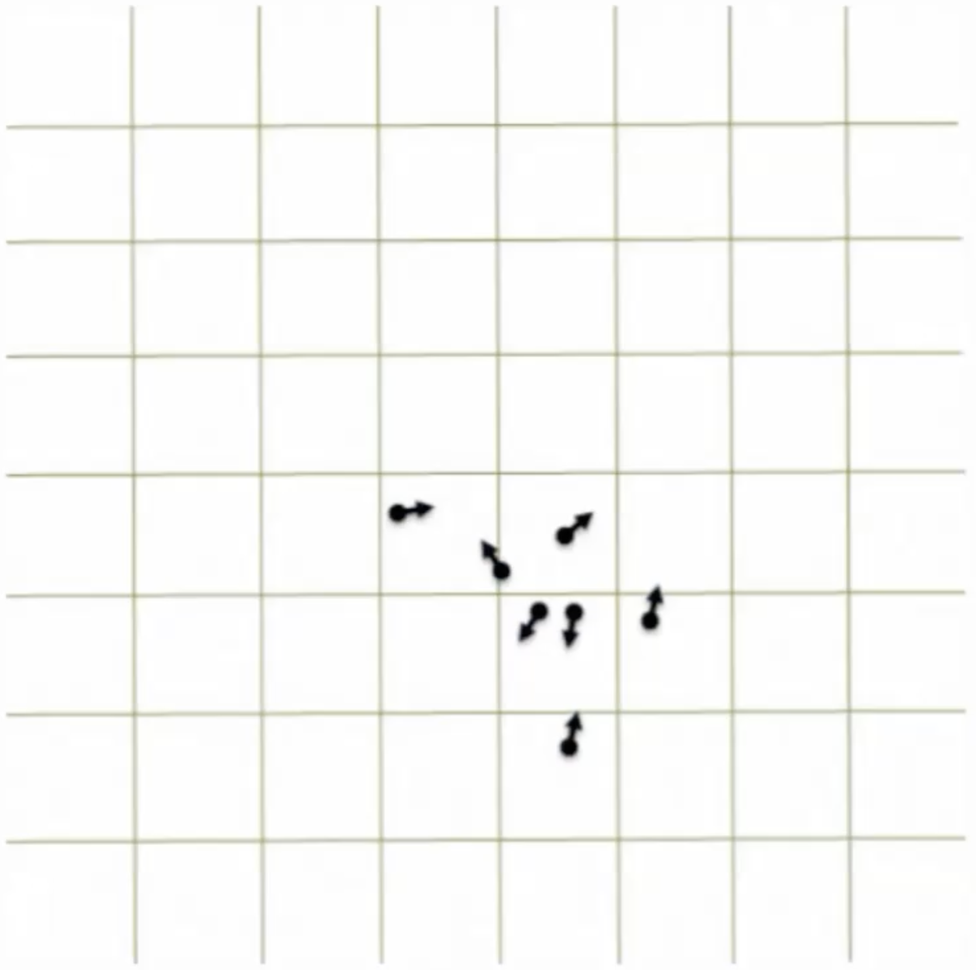
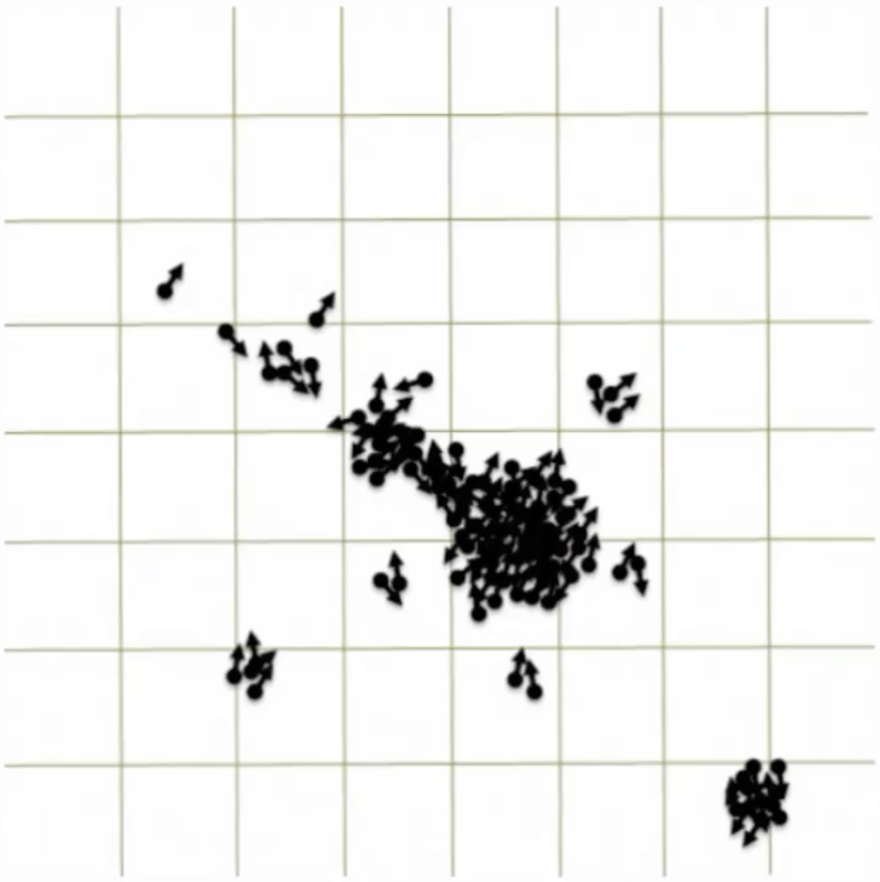
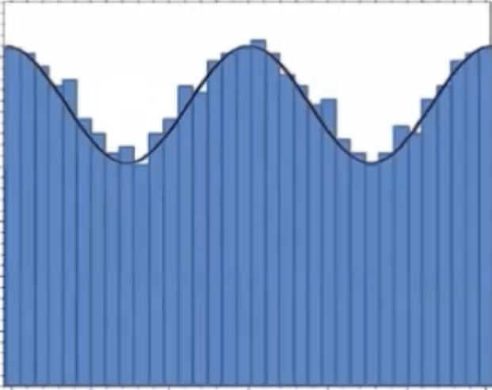
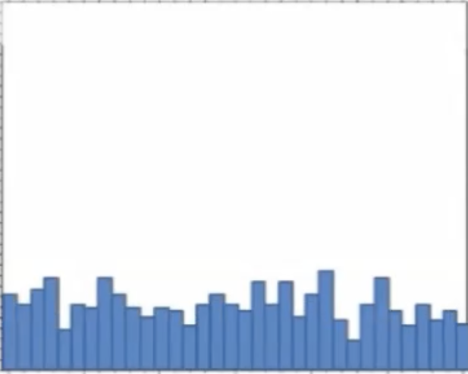
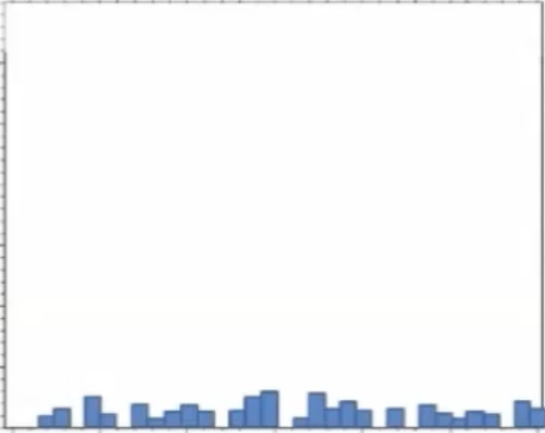
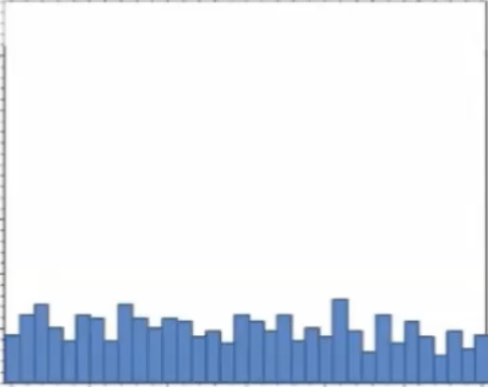
IXPE data processing 2
Event in Celestial Coordinates
Event in Detector Coordinates
Polarization information: recovered on a statistical basis from the azimuthal distribution of the photoelectron directions of emission.
Photoelectric differential cross section:
$\frac{dσ}{dΩ}=r_{0}^{2}α^{4}Z^{5}{\left(\frac{m_{e}c^{2}}{E}\right)}^{\frac{7}{2}}\frac{4\sqrt{2}\sin^{2}θ\cos^{2}φ}{{\left(1−βcosθ\right)}^{4}}$
The total counts are modulated as:
Ref. [3], [4], [7]
Azimuthal angle $φ$: photelectron emission direction.
Polarization angle: $φ_{0}$
Polarization Degree: derived from the Stokes parameters and from
$μ=\frac{N_{max}−N_{min}}{N_{max}+N_{min}}=\frac{B}{2A+B}⟹$
$$N\left(ϕ\right)=A+B\cos^{2}(ϕ−ϕ_{0})$$
$$p_{0}=\frac{1}{μ}\sqrt{𝒬^{2}+𝒰^{2}}$$
12/10/24
Astrophysical X-ray Polarimetry with IXPE
APPENDIX A
9

Slide 10
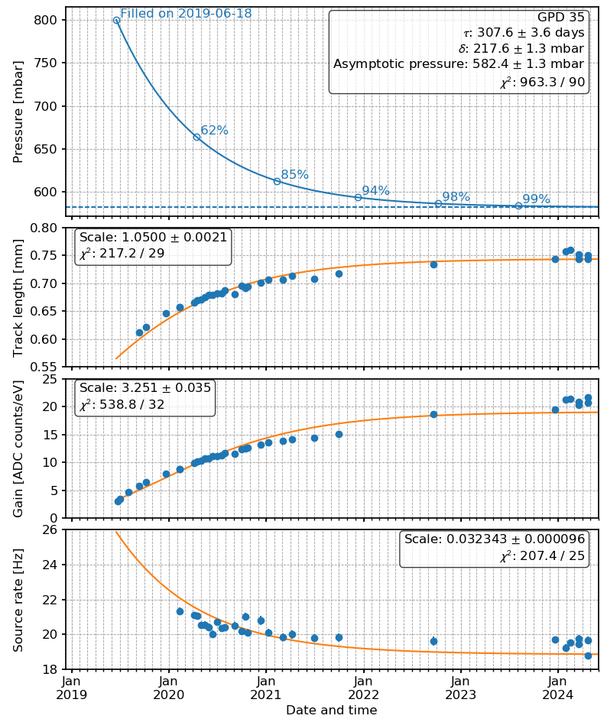
GPD long term studies
GPD long term studies: secular pressure decrease
Secular decrease of the pressure in the sealed gas cell, due to internal adsorption of DME with a time scale of months.
$$p\left(t;τ,Δ_{p}\right)=p_{0}−Δ_{p}(1−e^{−\left(t−t_{0}\right)/τ})$$
The pressure decrease can be retrieved analyzing:
Increase of track
length
Increase of gain
Decrease of rate
$$L\left(t;τ,Δ_{p}\right)=L_{0}{\left(\frac{p\left(t\right)}{p_{0}}\right)}^{−α_{L}}$$
$$G\left(t;τ,Δ_{p}\right)=G_{0}exp\left\{−\frac{p\left(t\right)−p_{0}}{p_{scale}}\right\}$$
$$R\left(t;τ,Δ_{p}\right)∝p(t)$$
Ref. [8]
16/10/24
Astrophysical X-ray Polarimetry with IXPE
10

