Slide 1
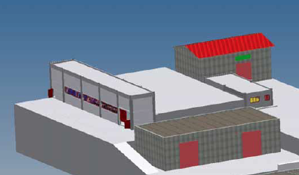
SPARC_LAB
(Sources for Plasma Accelerators and Radiation Compton
Lasers And Beams

Slide 4
SPARC_LAB Mission
Mission of SPARC_LAB is primarily to integrate and harmonize all the existing activities at the test-facility, coordinate commissioning, operation and upgrade of the experiments, stimulate research and development and submissions of proposals for experiments to be performed at the SPARC_LAB test-facility.

Slide 5
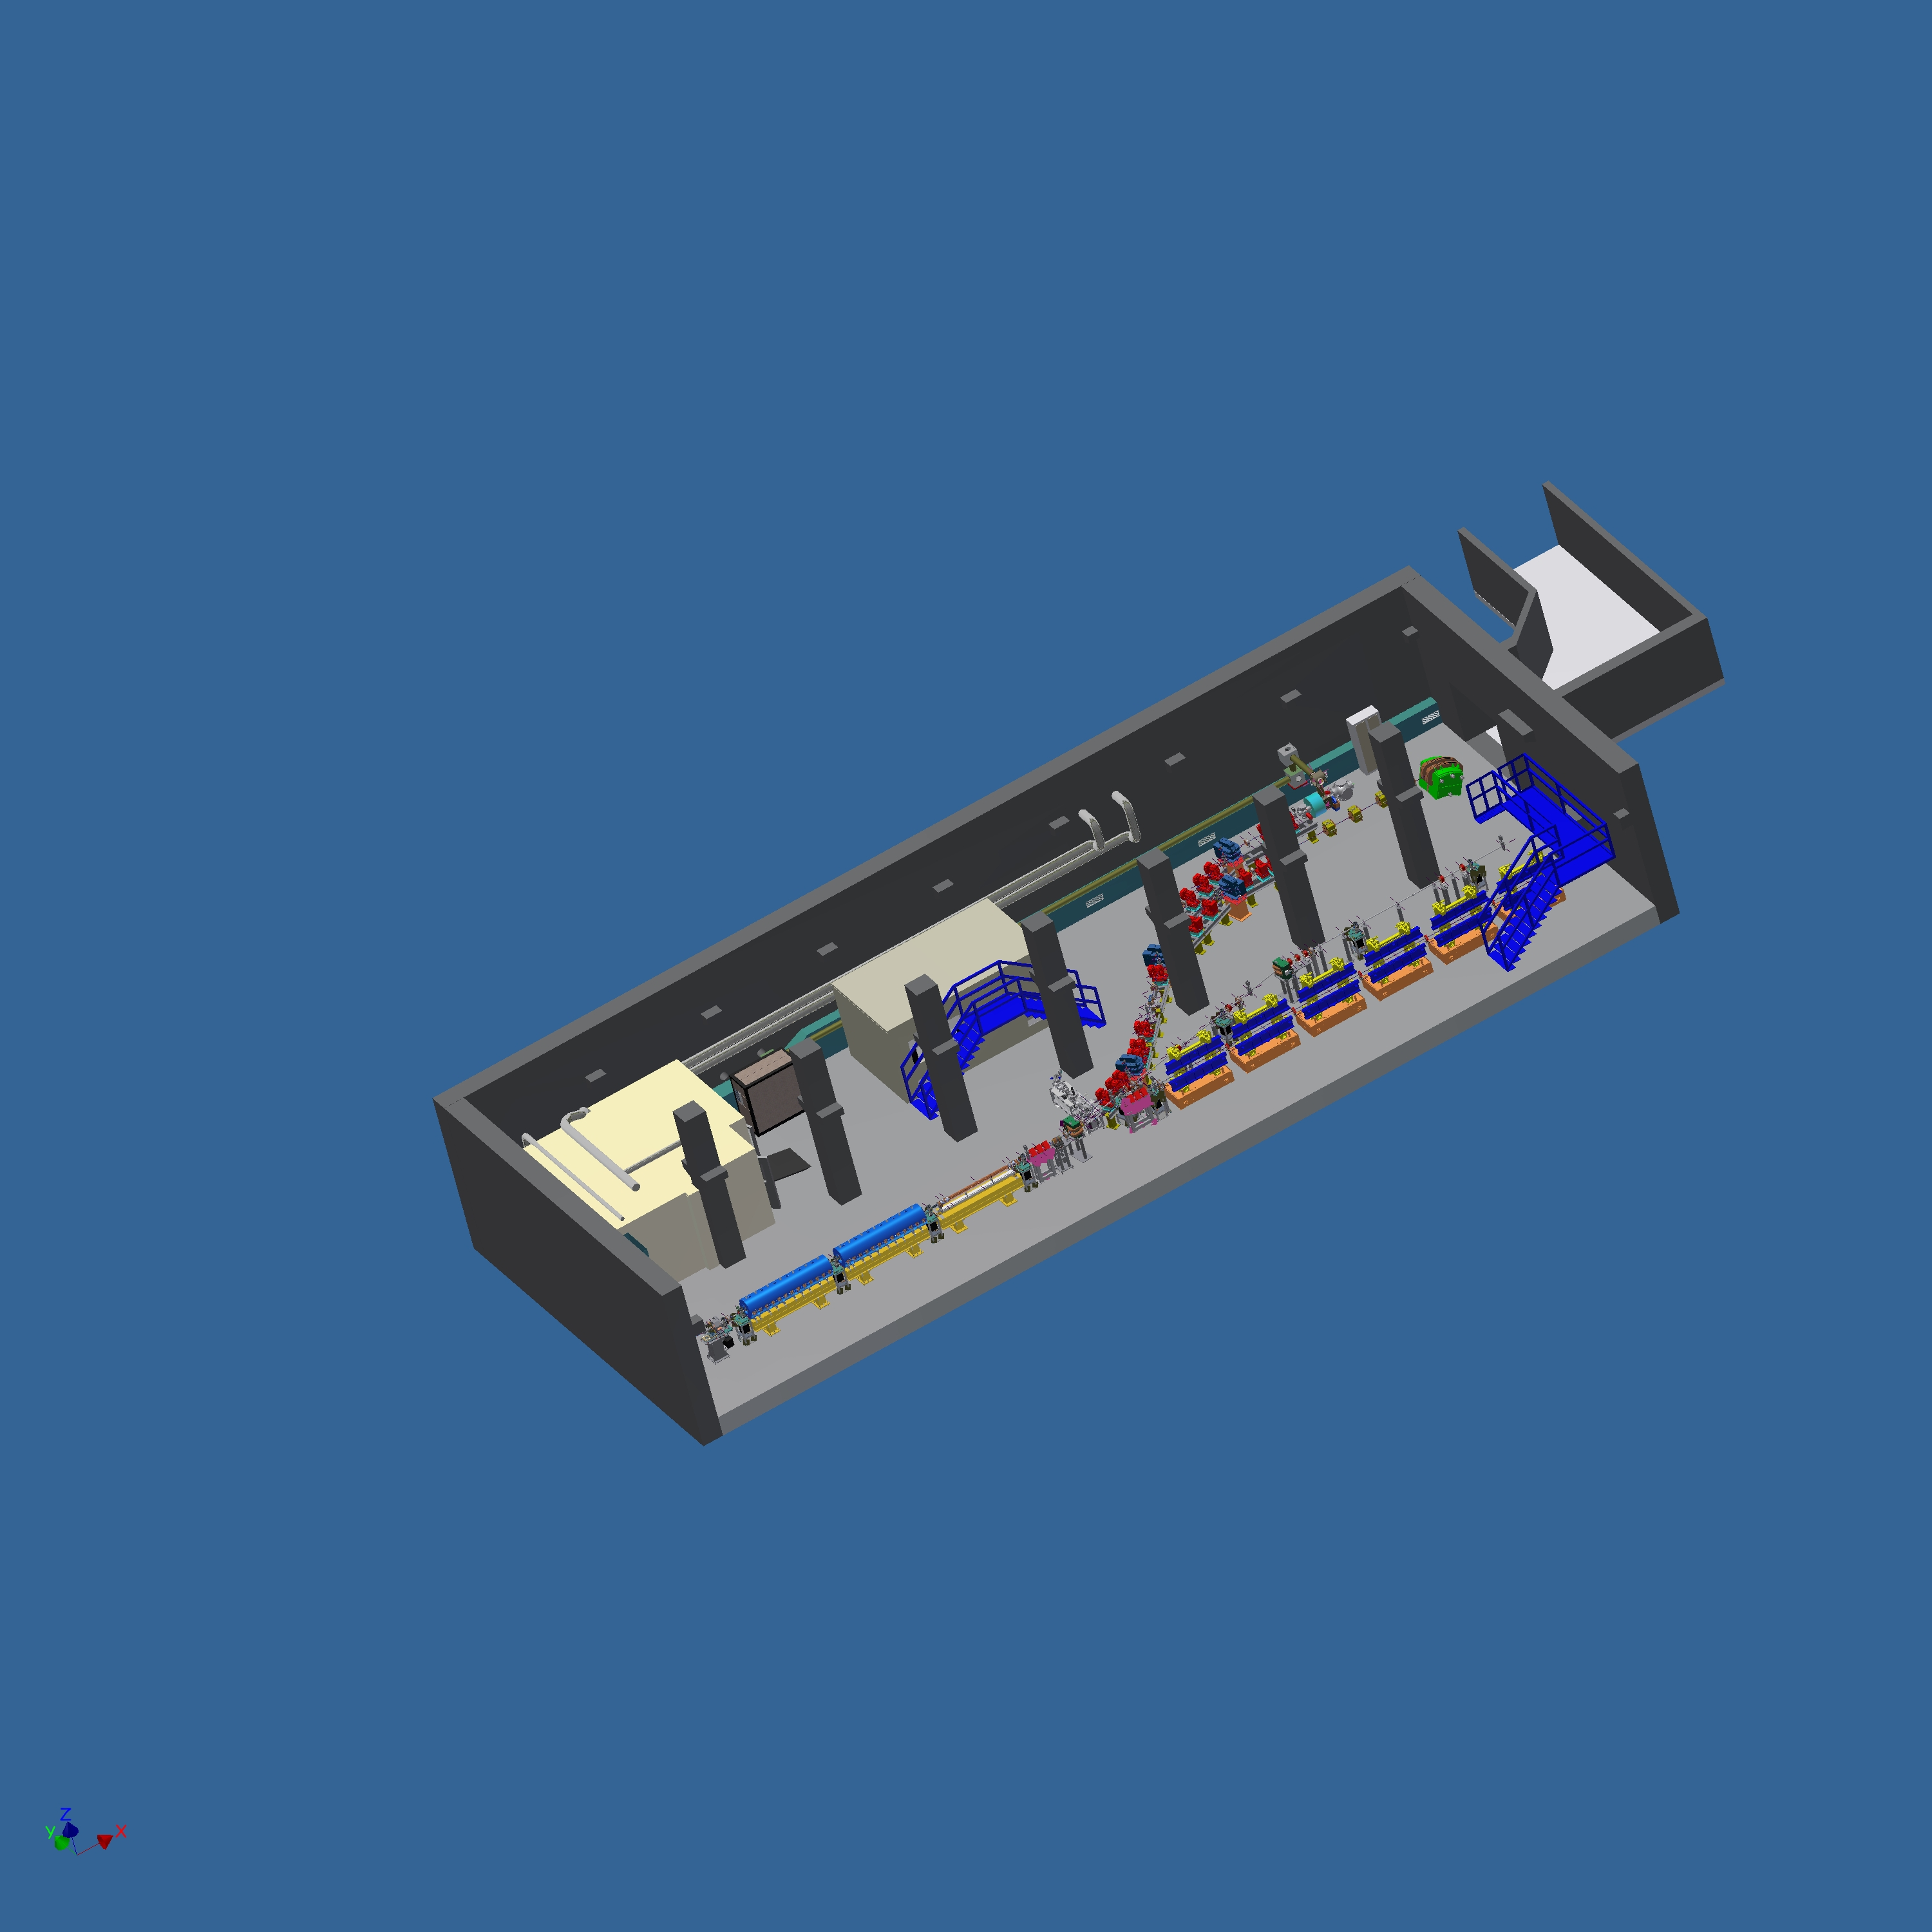


Slide 6
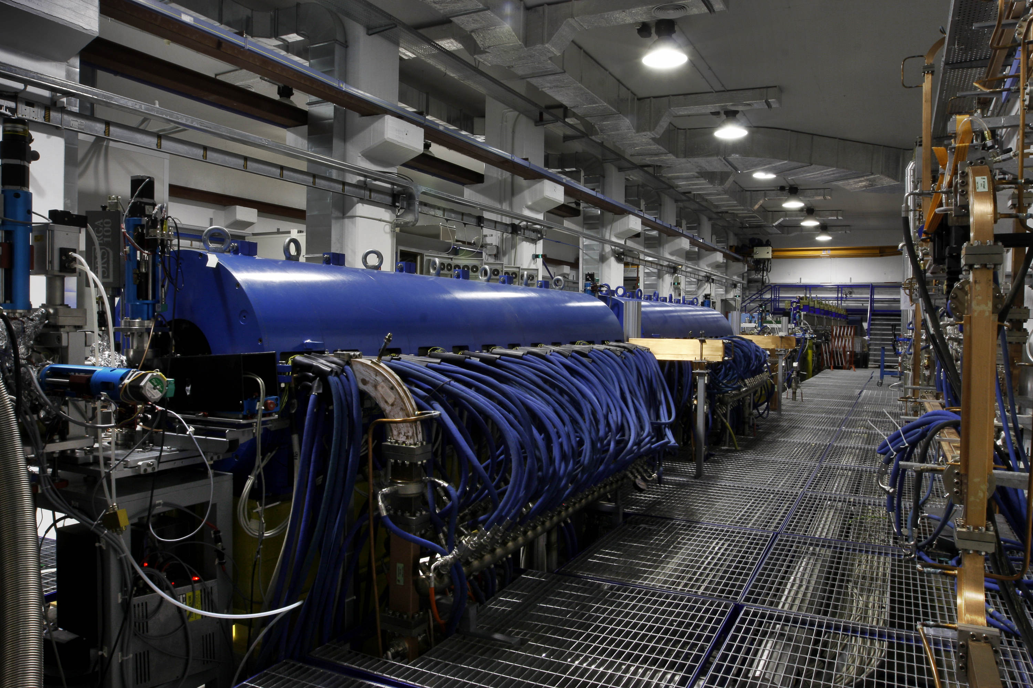
Notes:
6

Slide 7
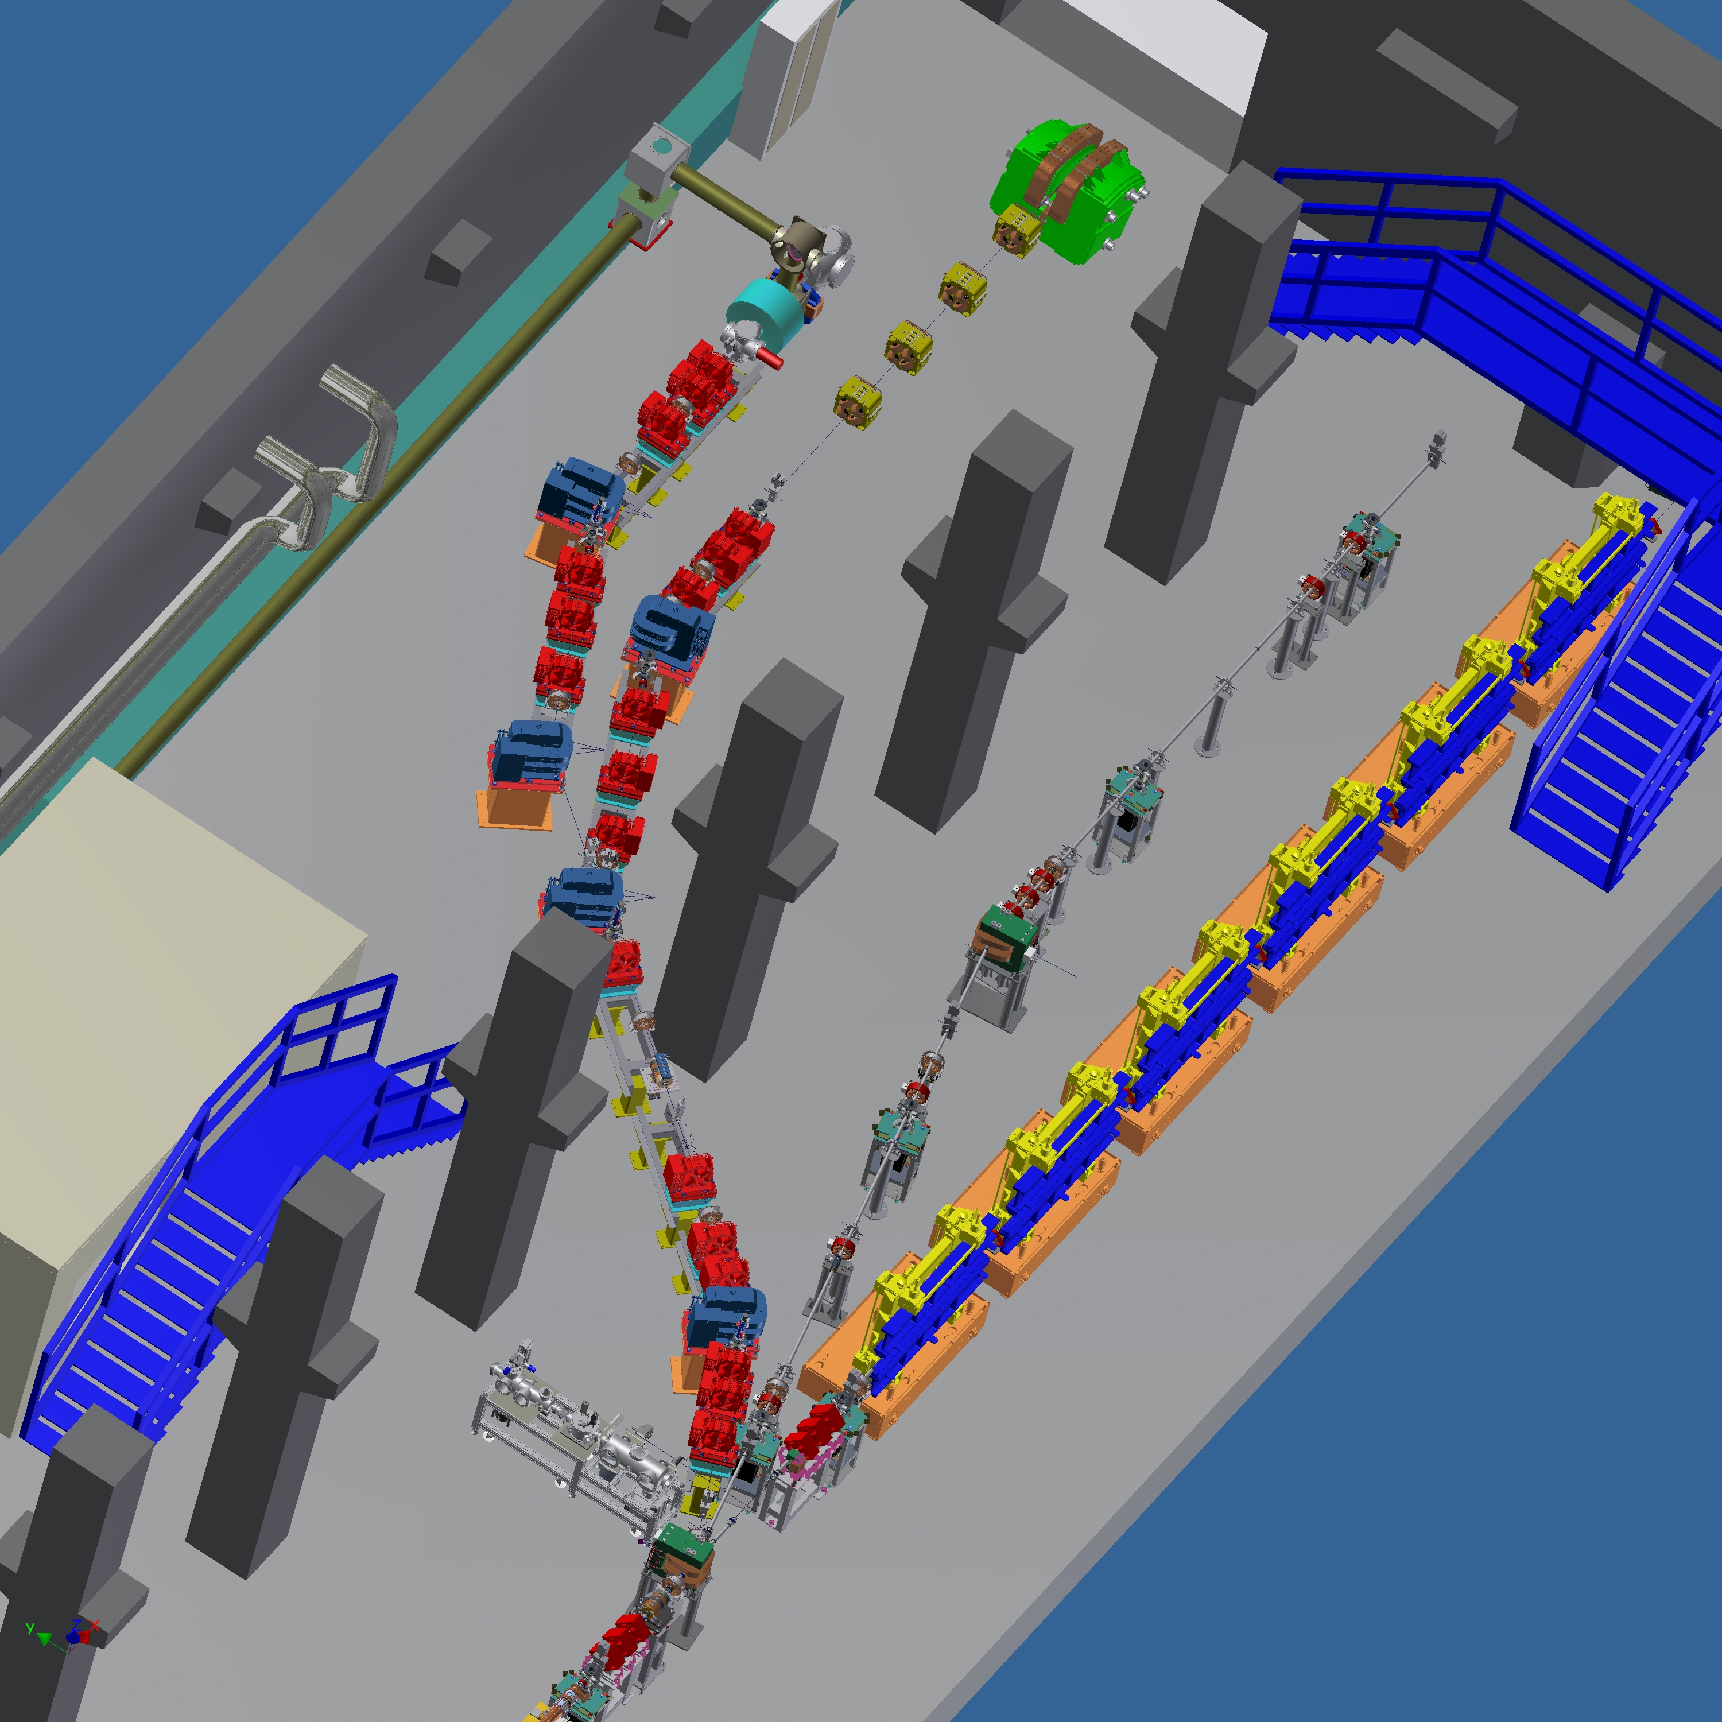
New installations

Slide 8
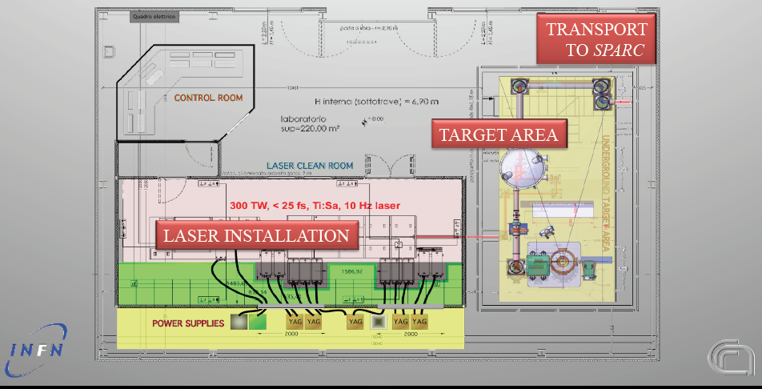
FLAME Laser

Slide 9
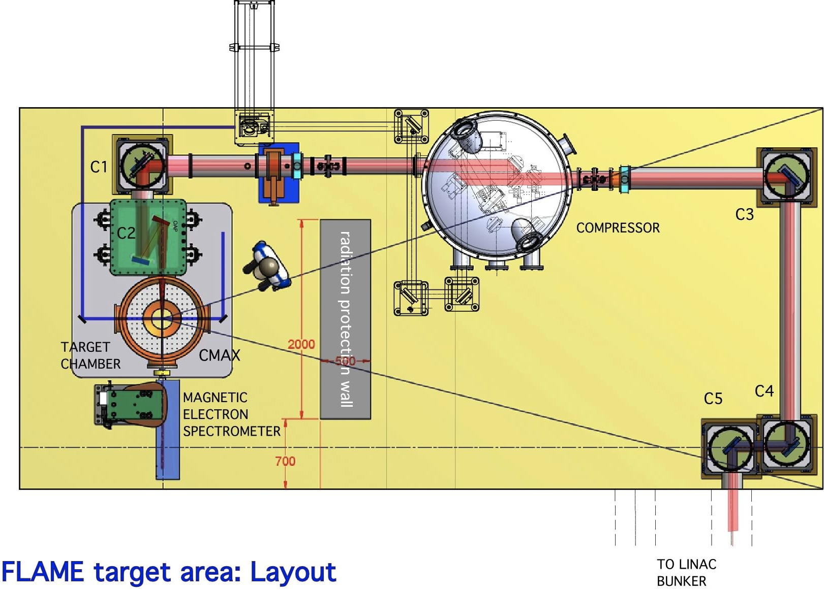
Target Area

Slide 10
SPARC_LAB Activities
High gradient acceleration (COMB, PLASMONX, SITE)
FEL physics and applications (SPARC, SASE, SEEDING, HHG, COMB)
Advanced radiation sources and applications (PLASMONX, BEATS2, TERASPARC, γ-RESIST, ELI_NP)
Advanced beam physics and accelerator technology (SPARC, COMB, ELI_NP)
Fundamental physics (γ-RESIST)
Positron source (POSSO)
Laser/Plasma physics (γ-RESIST, PLASMONX)
Promote Spin-off of previous activities (SPARC, ELI_NP)
Laser/Plasma based ion sources (LILIA)

Slide 11
JRA-ANAC2 Assessment of Novel Accelerator Concepts
Task 1. ANAC Coordination and Communication.
Coordination and scheduling of the WP tasks
Monitoring the work, informing the project management and participants within the JRA
WP budget follow-up
Task 2. Achievement of high brightness electron beam with laser plasma accelerators
Feasibility study of external injection done at INFN and HZDR
Optical injection done at LOA and LLC
Two stage laser plasma accelerator done at STRATH

Slide 12
EuroNNAc
A seguito di un incontro preliminare tenutosi lo scorso Maggio al CERN tra gli istituti europei interessati, si sta formando un Network di ricerca sulle nuove frontiere degli acceleratori di particelle mediante plasmi, denominato EuroNNAc, potenzialmente finanziabile nell’ambito del programma Europeo EuCARD2 (FP7, richiesta entro Novembre 2011).
Scopo del network sara’ quello di valutare la possibilita’ di utilizzare le nuove tecniche di accelerazione per facilities dedicate alla luce di sincrotrone (FEL), alle applicazioni biomediche ed alla ricerca di base.
Contemporaneamente si intende preparare una proposta, da presentare al prossimo programma Europeo FP8 (2013), per finanziare un’intensa attivita’ di R&D attraverso la formazione di una “Distributed Open Test Facility” di cui SPARC_LAB potrebbe fare parte a pieno titolo.
L’integrazione finale con TIARA e’ uno degli obiettivi auspicabili

Slide 13
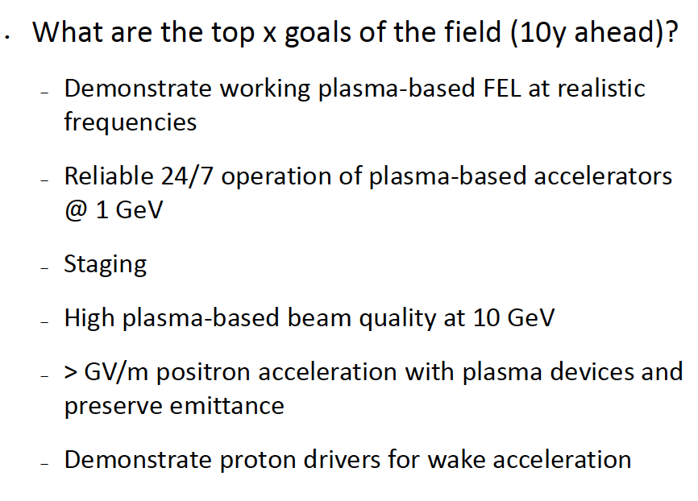
EuroNNAc

Slide 14
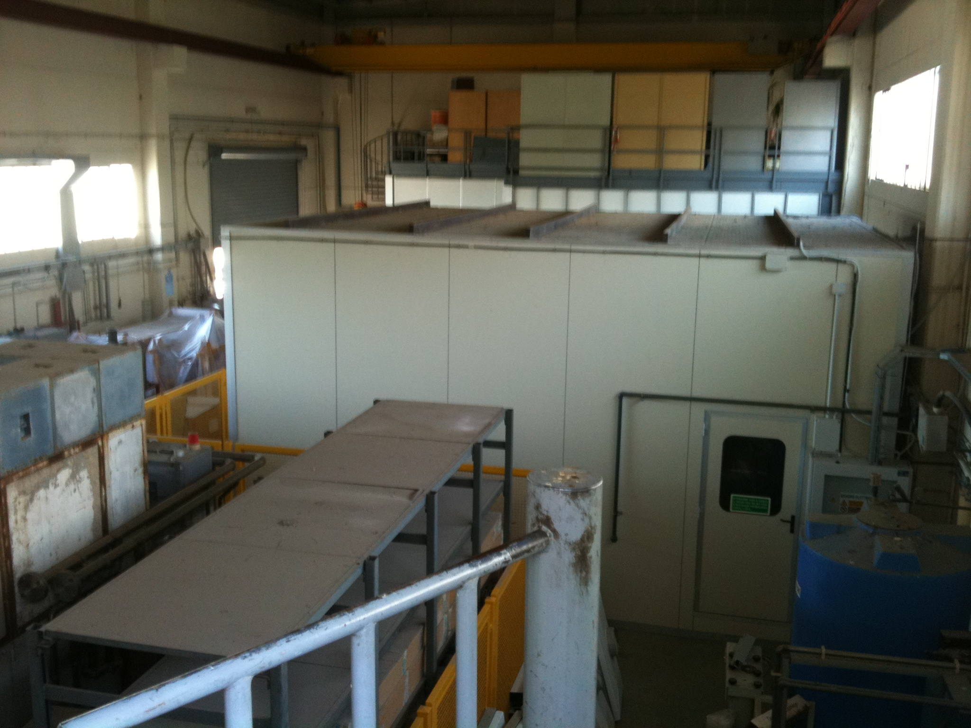
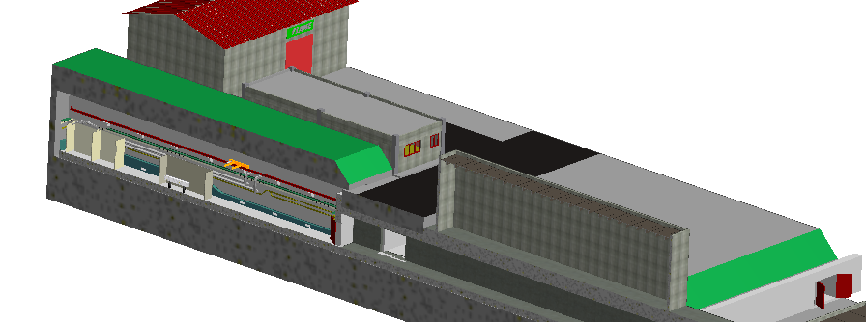
SPARC_LAB Extensions?

Slide 15
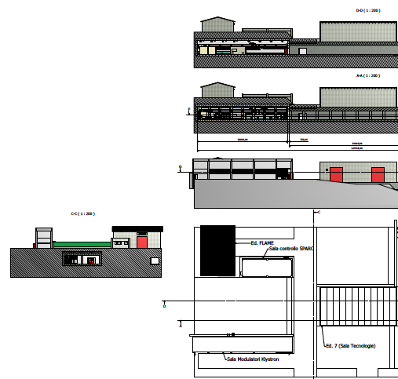

Slide 16
A FEL driven by Plasma Accelerator at LNF?

Slide 17
Summary of the COMB mini-workshop
Massimo Ferrario
4-pulses-time-structure
4-bands-energy-spectrum
longitudinal phase space
time
vertical dim
time
orizontal dim
energy
energy
LNF - October 4, 2011

Slide 18
Resonant plasma Oscillations by Multiple electron Bunches
Weak blowout regime with resonant amplification of plasma wave by a train of high Brightness electron bunches produced by Laser Comb technique ==> 5 GV/m with a train of 3 bunches, 100 pC/bunch, 50 μm long, 20 μm spot size, in a plasma of density 10²² e⁻/m³ at λ_{p}=300 μm ?
Ramped bunch train configuration to enhance tranformer ratio?
High quality bunch preservation during acceleration and transport?
Strong blowout regime with pC/fs bunches ==> TV/m regime ?

Slide 19
Laser Comb technique

Slide 20
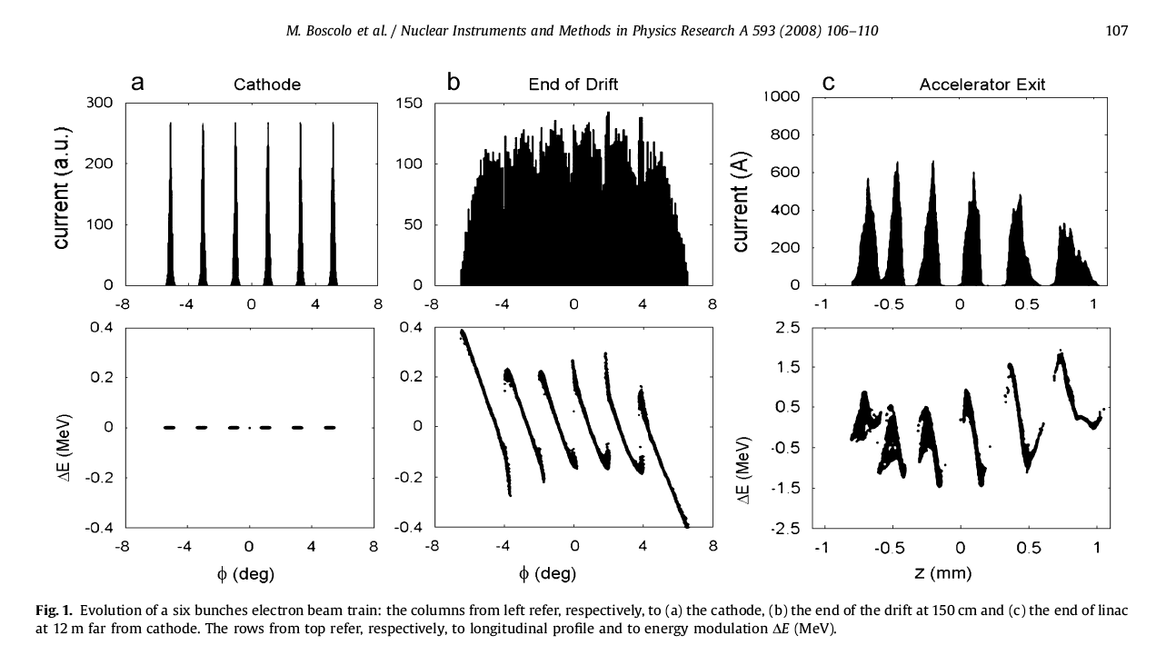
Laser Comb: beam echo generation of a train bunches
    - P.O.Shea et al., Proc. of 2001 IEEE PAC, Chicago, USA (2001) p.704.
    - M. Ferrario. M. Boscolo et al., Int. J. of Mod. Phys. B, 2006 (Taipei 05 Workshop)
Notes:
20

Slide 21
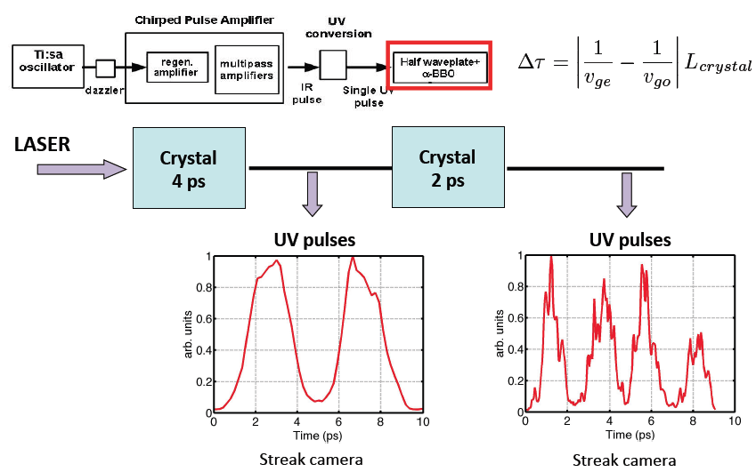
Laser pulse train generation by birefringent cristals

Slide 22
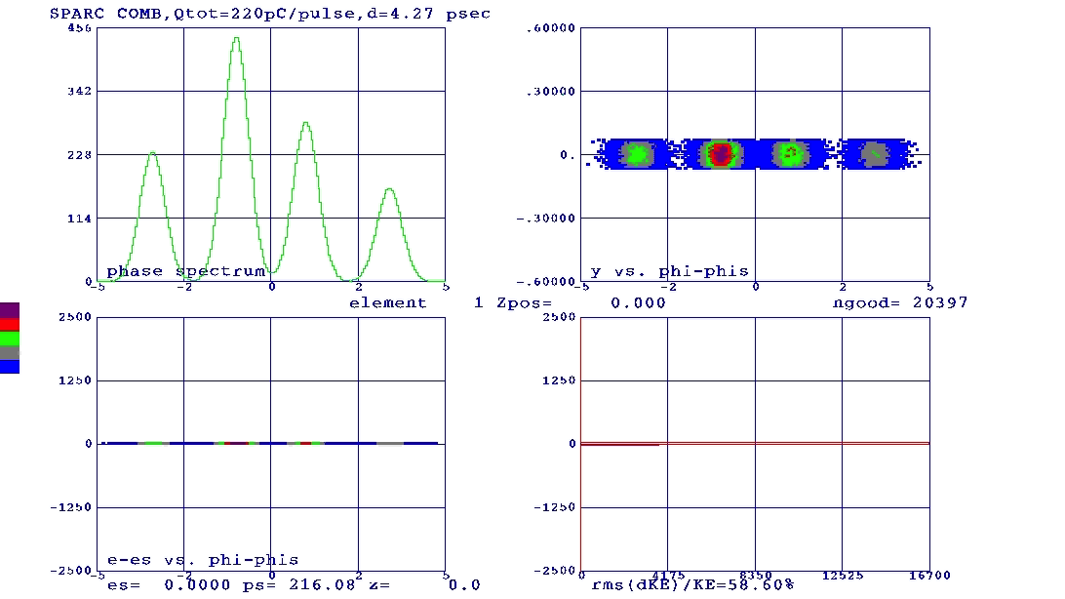
Overcompression

Slide 23
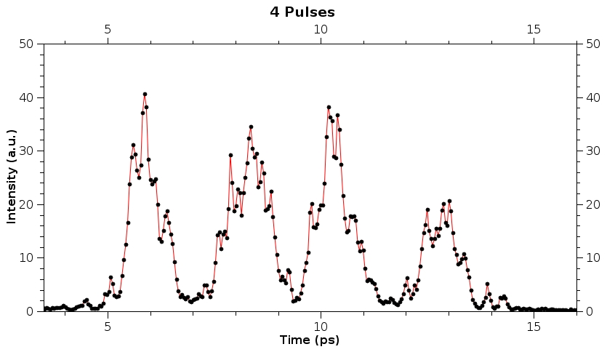
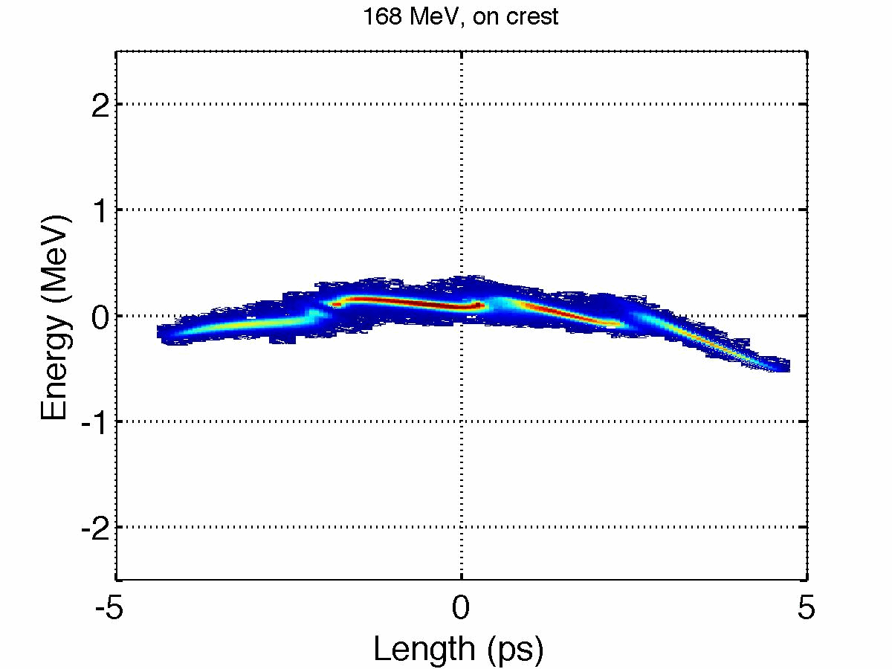
4-pulses-time-structure
4-levels-energy-spectrum
longitudinal phase space
time
vertical dim
time
orizontal dim
energy
energy

Slide 24
Total projected emittance: 5.68 μm ( 4.09 μm )

Slide 25
Double FEL pulse
Notes:
25

Slide 26
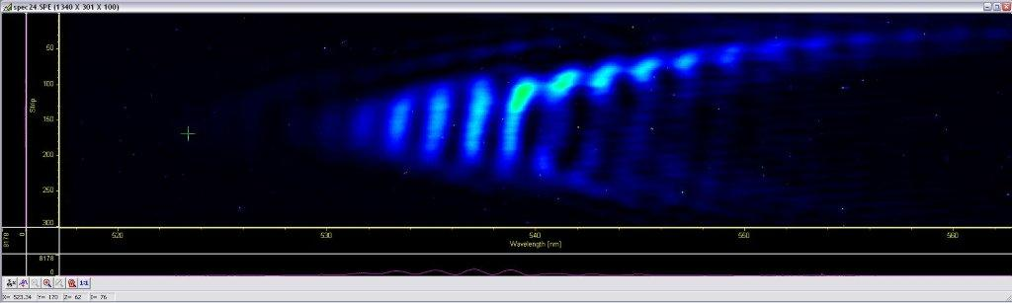

Slide 27
Narrow band THz radiation

Slide 28
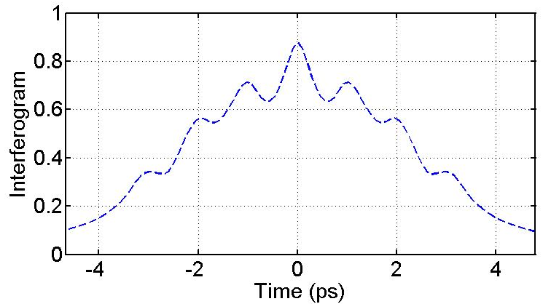
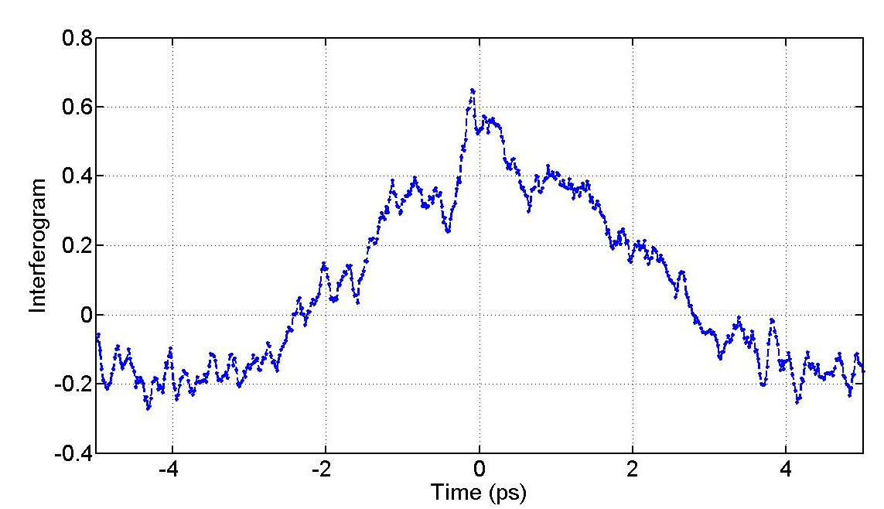
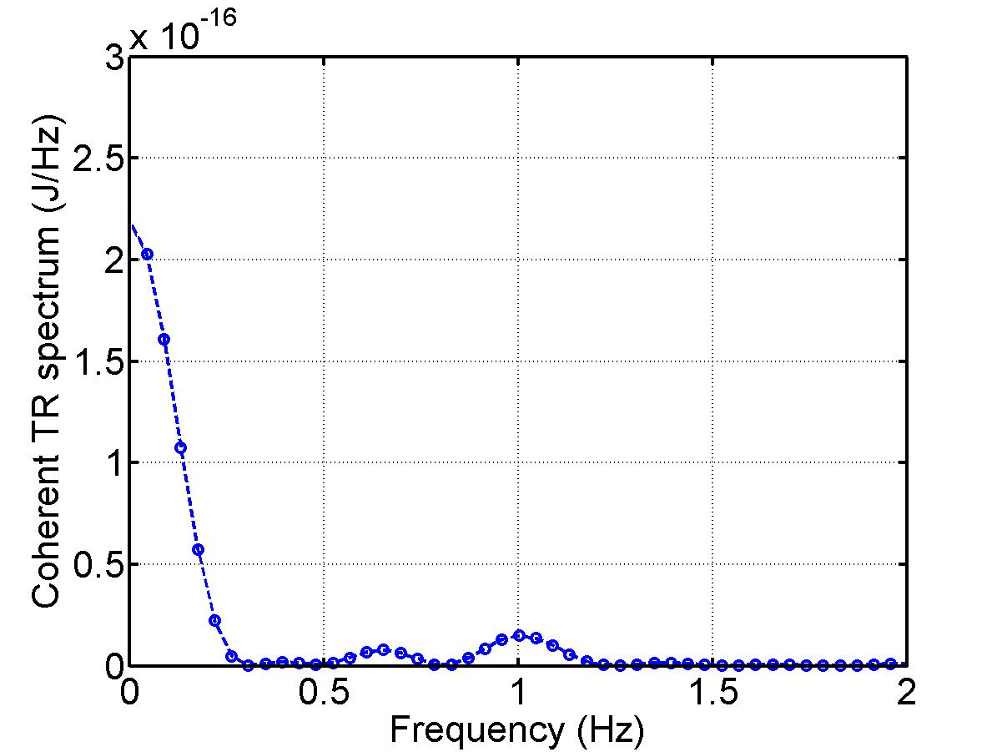
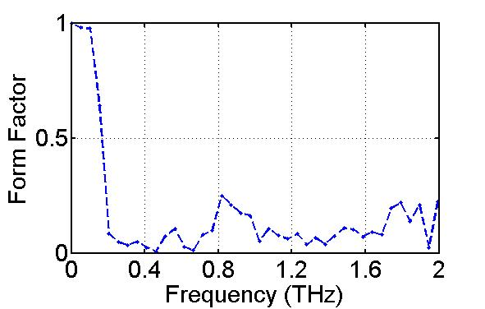
Expected
Measured
Interferogram
Spectrum
e. chiadroni

Slide 29
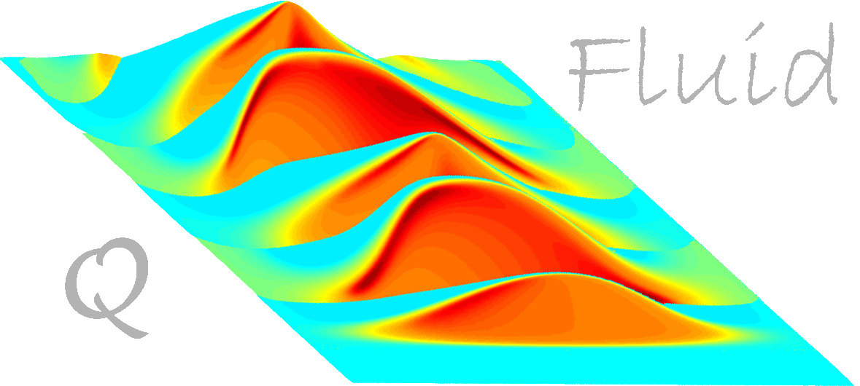
QFLUID2
A Quick code for Fluid plasma acceleration (Paolo Tomassini)

Slide 30
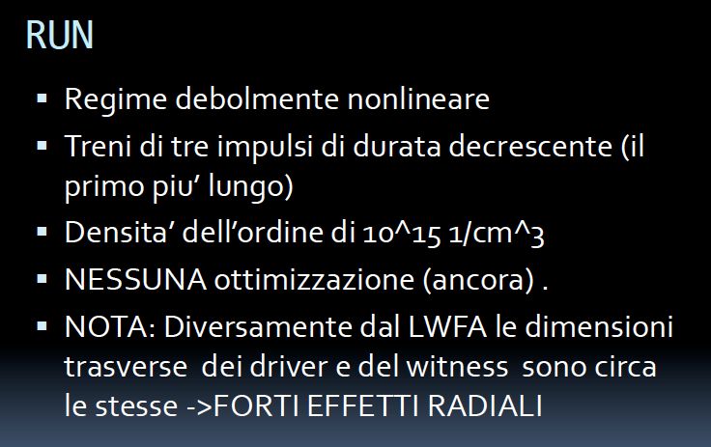

Slide 31
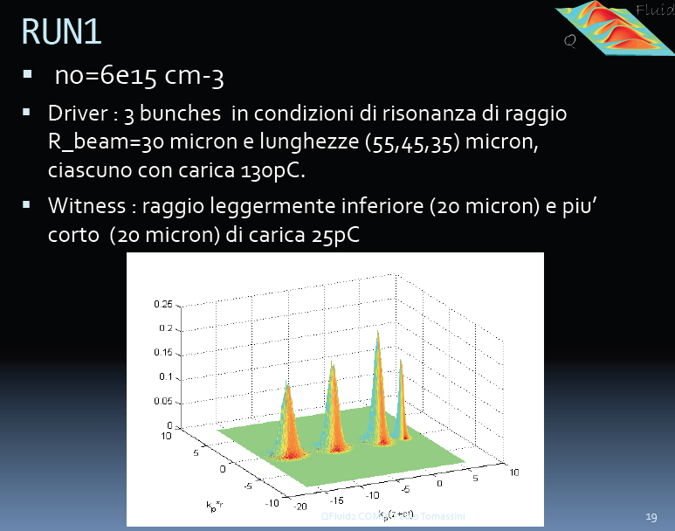

Slide 32
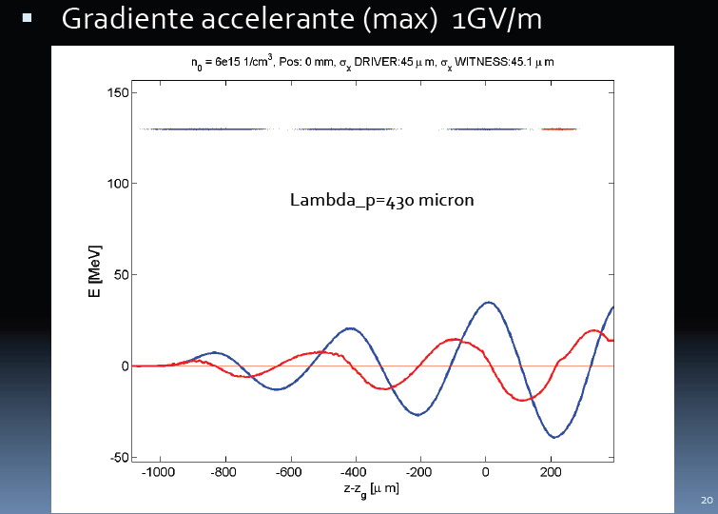

Slide 33
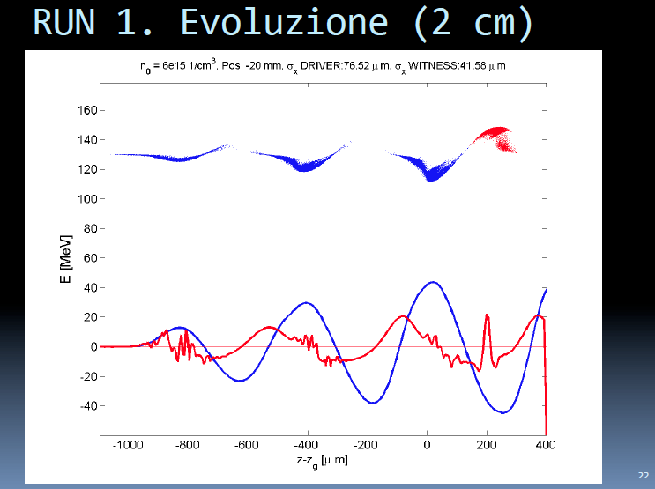
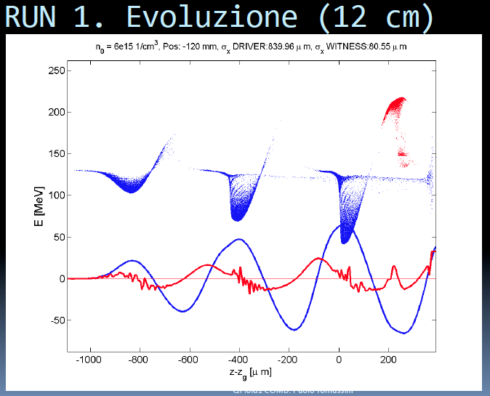
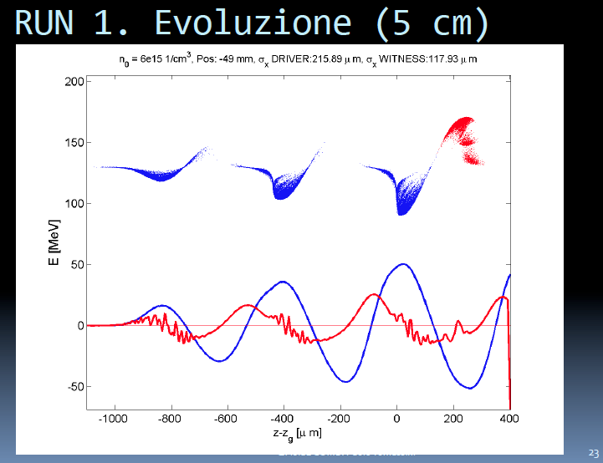

Slide 34
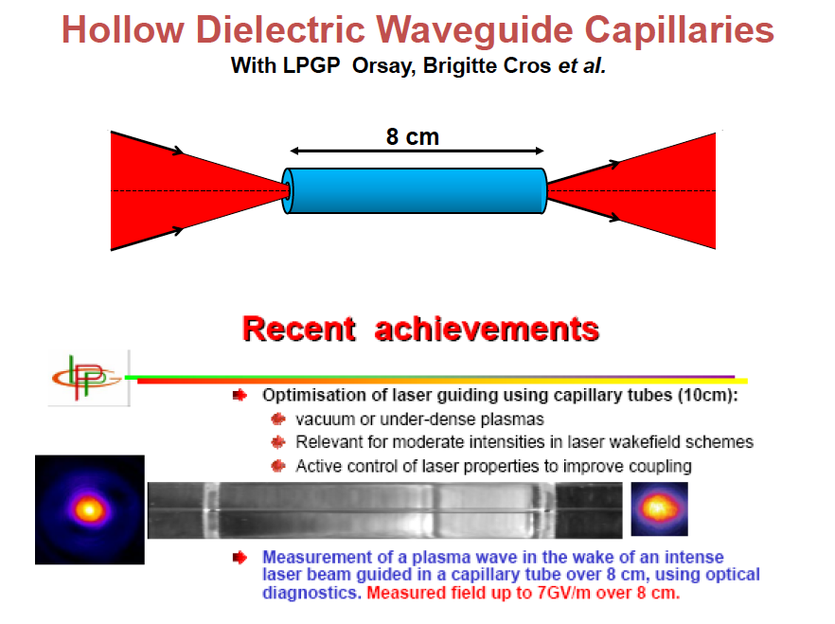

Slide 35
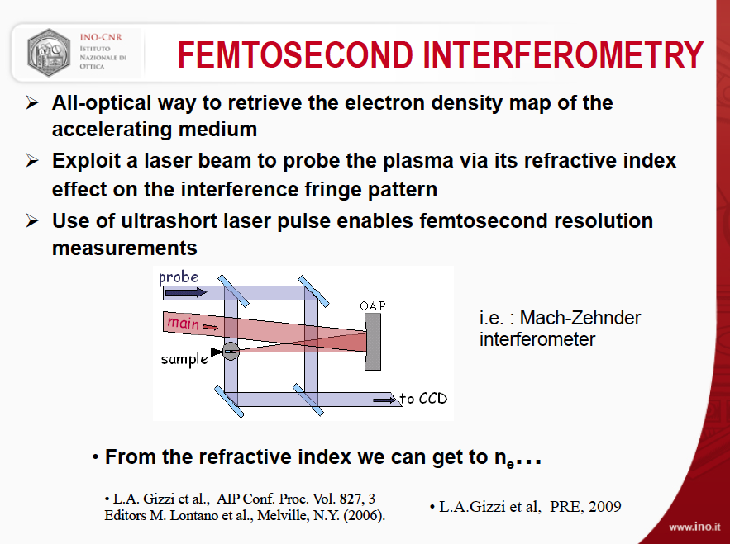

Slide 36
New RF deflector
Notes:
36

Slide 37
Input energy spectrum
4-bands-energy-spectrum
vertical dim
energy

Slide 38
No RF deflector
With RF deflector
4-bands-energy-spectrum
longitudinal phase space
vertical dim
time
energy
energy
4-bands-energy-spectrum
longitudinal phase space
vertical dim
time
energy
energy

Slide 39
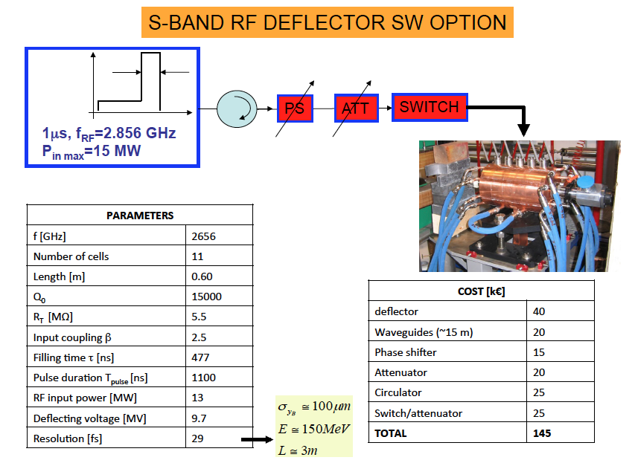

Slide 40
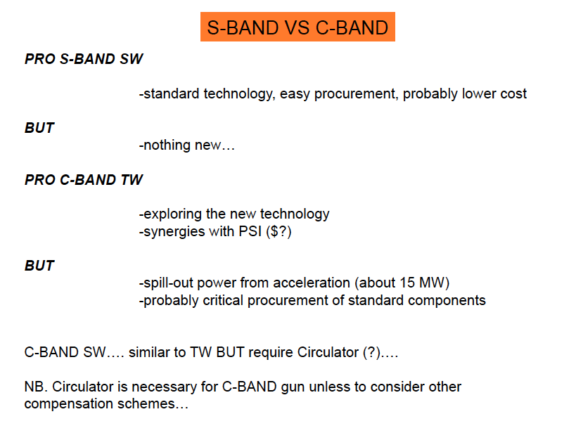

Slide 41
Electro Optical Sampling

Slide 42
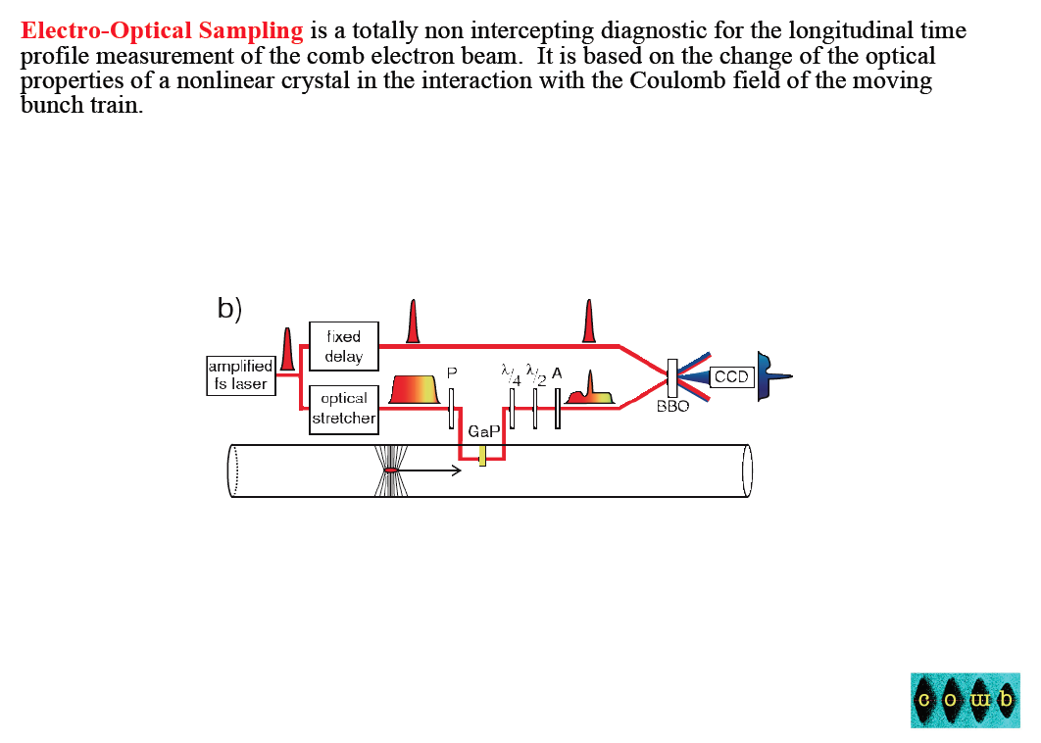
<100 fs relosultion

Slide 43
Electro Optical Sampling (EOS)
Misura delle caratteristiche longitudinali dei pacchetti COMB non intercettante
Basata sul cambio delle proprietà ottiche in un cristallo non lineare nell’interazione con un campo relativistico Coulombiano delle cariche in moto.
Campi elettrici dell’ordine delle decine di MV/m ➔ cambia la polarizzazione
Misura Q(t) e non solo |Q(ω)|
Misura singolo colpo
Rivelatori a temperatura ambiente (CCD intensificata)
Notes:
Cristalli:
GaP (preferito perche’ si raggiungono risoluzioni maggiori, i.e. 60 fs; vibrazioni reticolari a 11 THz, quindi l’estensione in frequenza e’ fino a questo valore; spessore 100-200 um) o ZnTe
Il limite alla risoluzione e’ dato dalle proprieta’ reticolari del cristallo

Slide 44
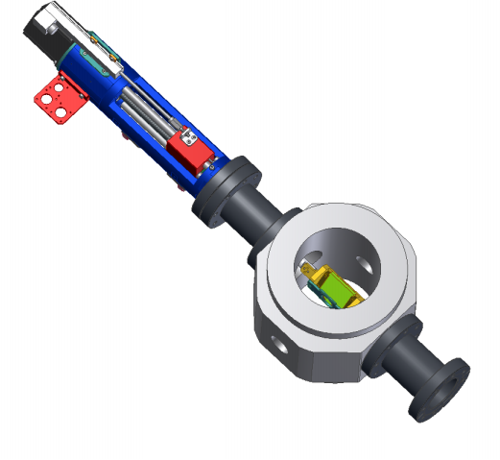
Camera in lavorazione
laser
beam
Notes:
Laser-beam 30 deg
3 cristalli: 2 GaP e 1 ZnTe
1 YAG
1 OTR

Slide 45
Tuesday 4
14:30 P. Tomassini " Preliminary results with QFluidCOMB code", via SKYPE
15:00 P. Londrillo "Modelling plasma waves driven by an electron bunch: a preliminary investigation using the Aladyn-PIC code"
15:30 F. Tanjia, R. Fedele "Self-consistent transverse beam dynamics description in the Plasma Wake Field excitation”
16:00 L. Serafini "Considerations about beams/plasma matching conditions suitable for interaction chamber design”
-Define a set of reference parameters
-Code validation (Tomassini, Londrillo, renato, cgatti,,arossi,abacci,titti,vittoria)
-condizioni di matching
16:30 C. Ronsivalle "Parmela simulations up to THz station"
17:00 C. Vaccarezza "COMB transport up to the plasma chamber: problems?
17:30 B. Marchetti, "Comb shaping with X band cavity”
-Investigate and exploit chromatic effects in transport lines, sextupoles?
-diagnostics available
-stability

Slide 46
Wednesday 5
09:30 G. Gatti, "Flexibility of the sparc laser system for COMB configurations and possible upgrades”
-charge distribution, time structure, diagnostics, laser room
10:00 M. Bellaveglia "Status of SPARC synchronisation system and possible upgrades”
10:30 L. Gizzi "Plasma diagnostics relevant for COMB”
-Investigate diagnostics suitable for capillary , ionization
11:00 D. Alesini "C band RF deflector for post interaction longitudinal phase space optimization”
-Investigate and design Deflector+Bending (Faccini?) system for long. Phase space

Slide 47
14:30 Discussions, possible topics:
- interaction chamber design
- beams stability (measurement and control)
- capillary versus gas jet performances
- gas ionization
- simulations
- plasma diagnostics
- electron beam diagnostics.
Friday 21 morning 9:00-11:00
Round table about possible collaboration: definition of proposed topics, workplan and schedule
Friday 21 11:00-16:00
Discussion about COMB codes development

