Slide 1
4comb_tracking@PlasmonX

Slide 2
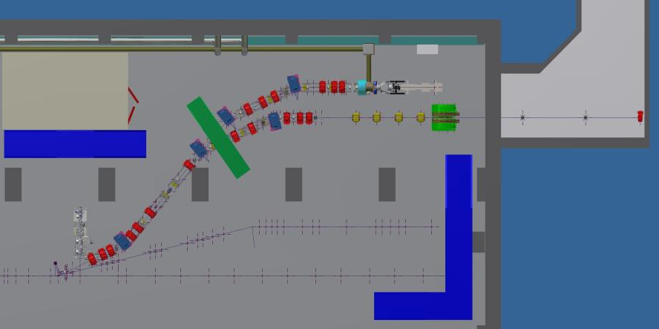
Thomson & Plasma Acceleration beamlines
THOMSON
Plasmaccel

Slide 3
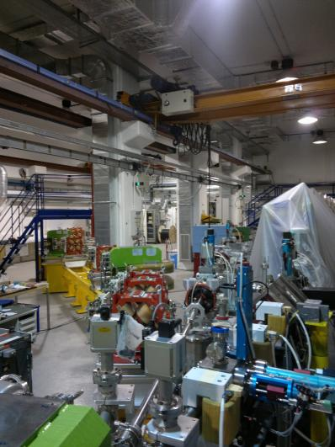
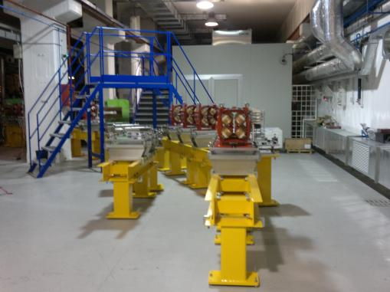

Slide 4
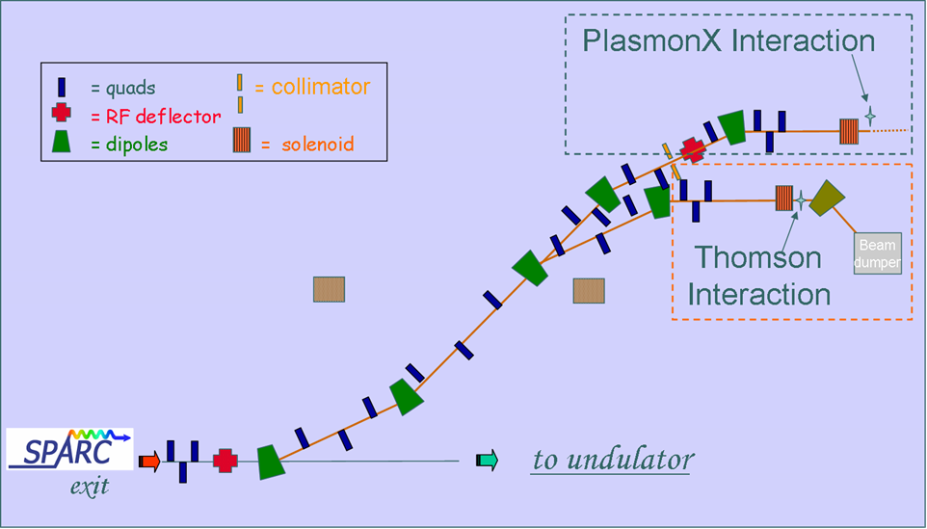
Schematic layout
Thomson Interaction
PlasmonX
interaction

Slide 5
From Photoinjector (C. Ronsivalle)

Slide 6
From Photoinjector (C. Ronsivalle

Slide 7
Twiss parameters
R56= -22 mm

Slide 8
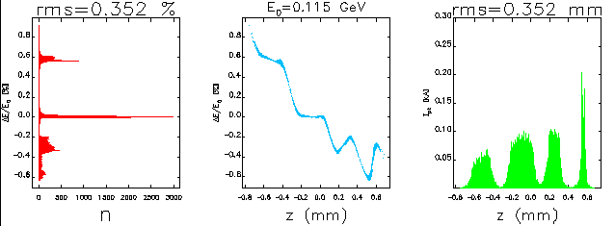
From Elegant w CSR ON
from photoinjector
R56=-22 mm
at IP

Slide 9
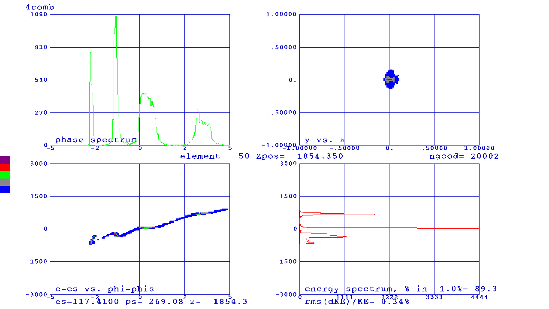
From Elegant & Parmela
from ELEGANT
at IP
R56=-22 mm
T566=2.148
Q5666=24.5
From Parmela at IP
No Spc

Slide 10
In the transverse space:

Slide 11
In the transverse space:

Slide 12
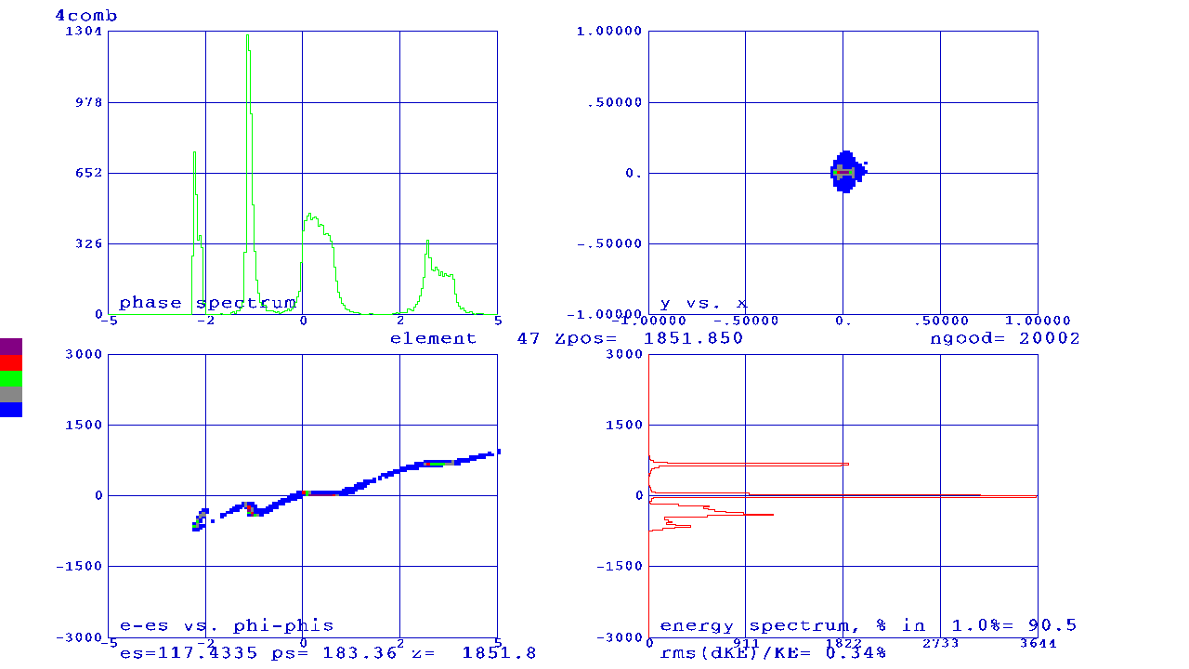
w & wo spc at IP
OFF
ON

Slide 13
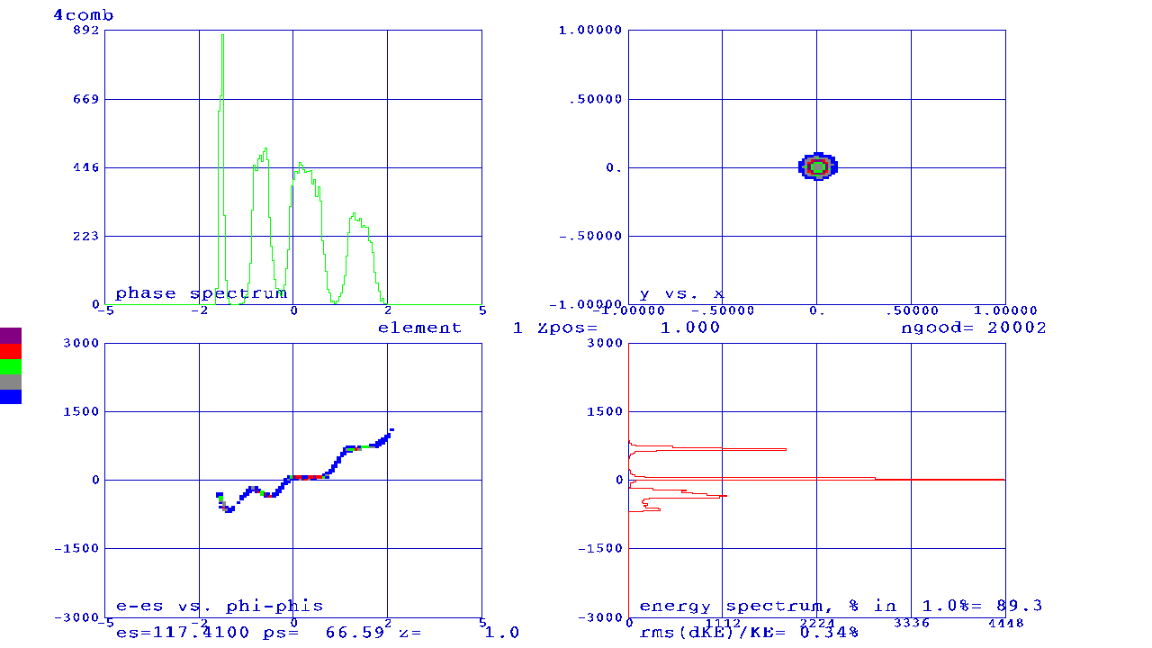
From start to IP (SPC ON)
Z=0
Z=18.53 m

Slide 14
From start to IP (SPC ON)
Z=0
Z=18.53 m

Slide 15
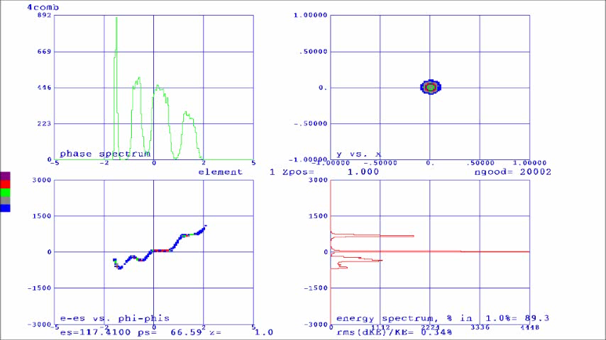
Along the dogleg w Parmela step 1.5 deg SPC ON

Slide 16
Conclusions
The SPC doesn’t seem to be the main aspect
The non linear terms play a relevant role
The alignment between the codes is in progress.
Nevertheless the double dogleg provides some chance to manipulate the beam phase space.
 | Elegant | Parmela
σ_{x} (µ) | 91 | 390
σ_{y} (µ) | 380 | 390

