Slide 1
LWFA experience
on the ALPHA-X project
@ Strathclyde
Group Leader: Prof. Dino Jaroszynski
Post-docs and lecturers: E. Brunetti, B. Ersfeld, R. Islam, A. Noble, G. Raj, G. Vieux, R. Issac, G.W. Welsh, S.M. Wiggins
PhDs: M. P. Anania, S. Abuazoum, C. Aniculaesei, S. Chen, S. Cipiccia, J. Farmer, D. Grant, Y. Kravets, G. Manahan, R.P. Shanks, A. Subiel, X. Yang
Technicians: D. Clark, T. McCanny
Supported by the U.K. EPSRC, the European Community Laserlab-Europe and ELI projects.

Slide 2
Outline
Why LWFA is interesting? Motivations
Introduction to the LWFA theory
Resonant betatron oscillations in a plasma wake
Experiments:
Example of an electron beam out from a LWFA (stability)
Quality of the electron bunch measured on ALPHA-X
Gamma-rays from harmonically resonant betatron oscillations in a plasma wake
Conclusions

Slide 3
Motivations
PROS:
Cost of the facility: going from accelerators of the kilometer scale length to accelerator in the millimeter scale length.
Compactness: possibility to have accelerators in University and, why not, in hospitals.
In general: key word TABLE TOP !
CONS:
Shot to shot Instability of the electron beam – fundamental in some type of experiments (ex. FELs)! → necessity to develop control schemes of the beams!

Slide 4
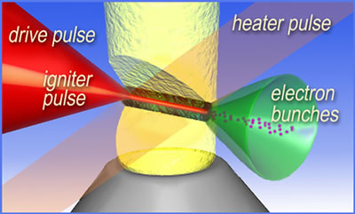
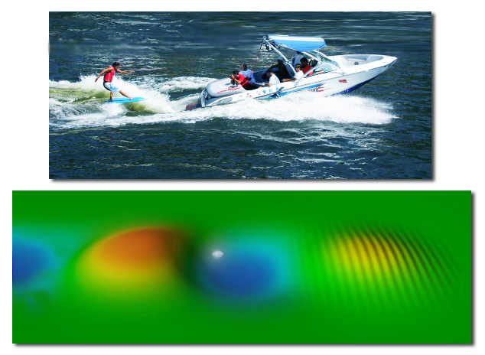
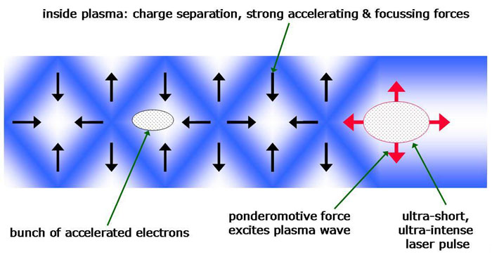
LWFA theory
An ultrashort and intense beam is focalized into a plasma. When the laser beam passes trough the gas, generate plasma waves, like a boat on the water surface.
The plasma electrons, can surf on the plasma waves like a surfer in the sea, and be accelerated.

Slide 5
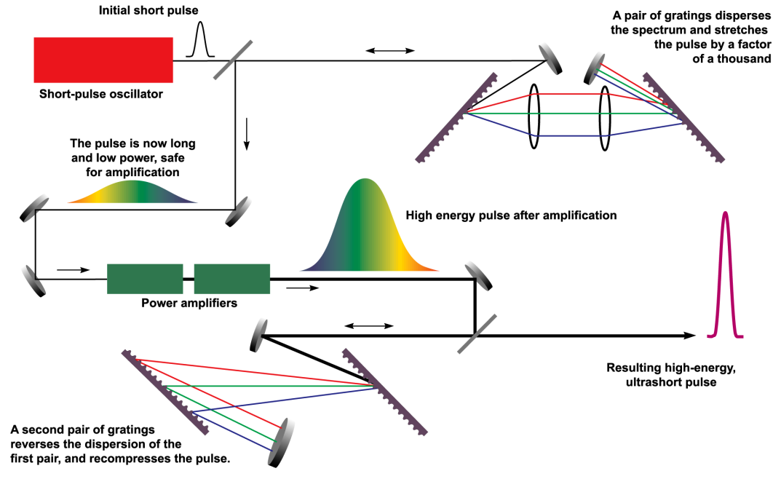
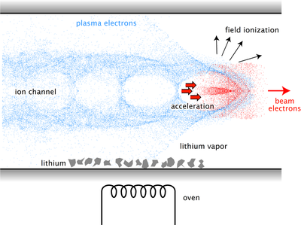
LWFA theory
CPA: a simple way to avoid the breakdown that occurs on the walls of the structure.
Based on the idea of reversible manipulation of the temporal characteristics of the laser pulses.
Once that the laser beam is amplified, it’s focused on a few micron spot on a flowing gas (usually He or H).
As the pulse travels through the plasma, the electric field of the light separates the electrons and nucleons (ionization). Since electrons are much lighter than nucleons, they move much further, leading to a charge separation.

Slide 6
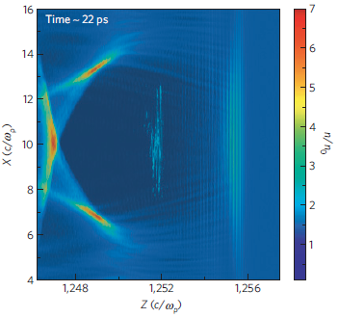
LWFA theory
As the laser pulse pass trough, the electrons are pulled back toward the centre by the ions that did not move. As they "fall" into this positive area they pick up speed, so when they reach the centre they "pile up" briefly before losing this energy in collisions and eventually flattening out into a more even distribution.
Bubble: simulations from OSIRIS code.
The bubble: region cleared of electrons (positively charged), followed by the region where the electrons fall back into the centre (negatively charged).
In this period particles are not moving very quickly, but macroscopically it appears that a "bubble" of charge is moving through the plasma with v~c. It is this "wakefield" that is used for particle acceleration. A particle injected into the plasma near the high-density area will experience an acceleration toward it, an acceleration that continues as the wakefield travels through the column, until the particle eventually reaches the speed of the wakefield.

Slide 7
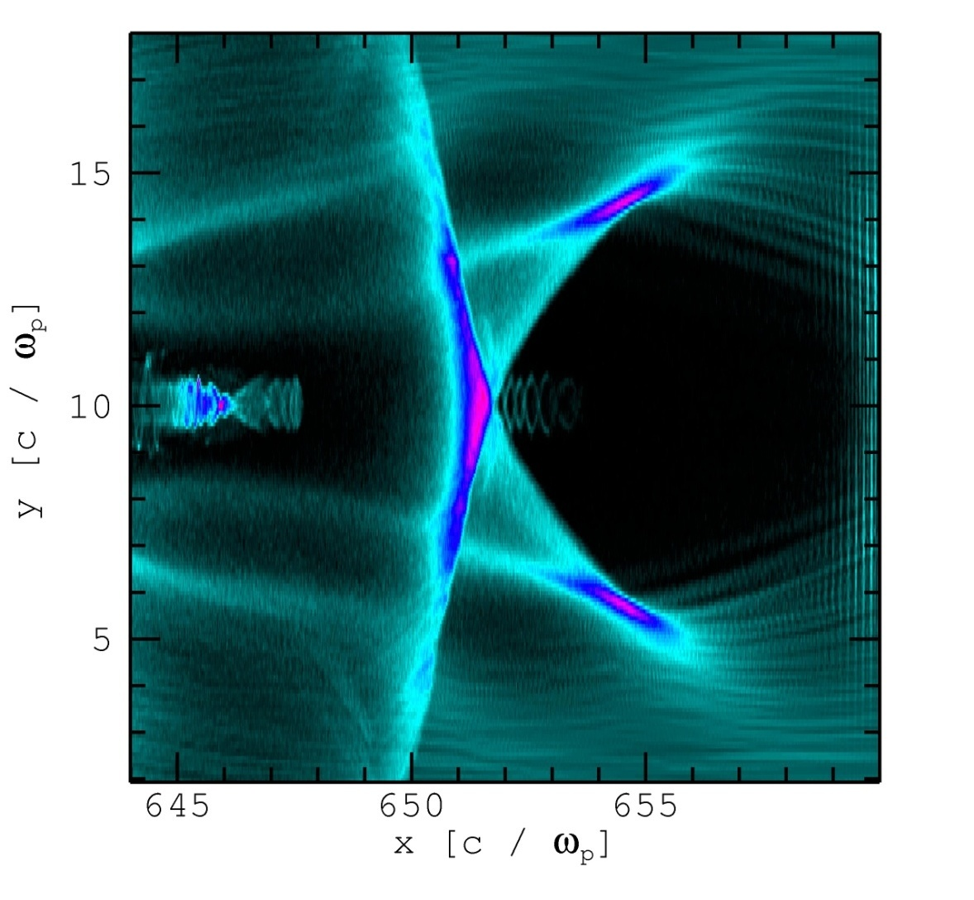
Resonant betatron oscillations
Bubble structure – relativistic regime
laser
self-injected electron bunch undergoing betatron oscillations
ion bubble
ion bubble radius

Slide 8
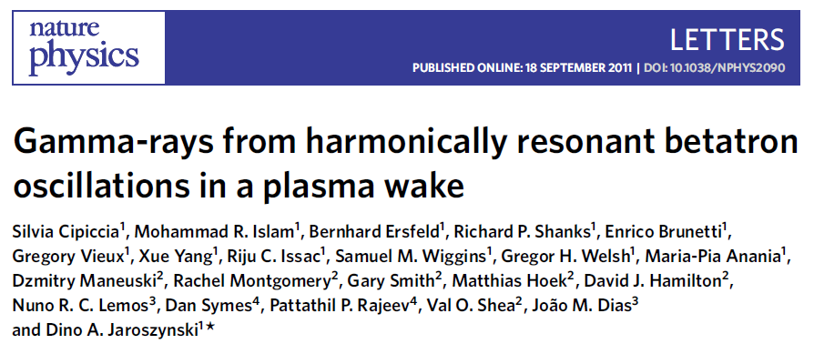
Resonant betatron oscillations
Transverse betatron motion in the plasma wake results in X-ray photons with an energy that depends on the electron energy, oscillation amplitude and frequency of the betatron motion. Paper shows that the betatron amplitude is resonantly enhanced when electrons interact with the rear of the laser pulse. At high electron energy, resonance occurs when the laser frequency is a harmonic of the betatron frequency, leading to a significant increase in the photon energy.

Slide 9
Examples:
Electron beam from LWFA @ Strathclyde.
Quality of the electron beam measured @ Strathclyde.
Resonant betatron oscillations @ RAL.

Slide 10
Examples:
Electron beam from LWFA @ Strathclyde.
Quality of the electron beam measured @ Strathclyde.
Resonant betatron oscillations @ RAL.

Slide 11
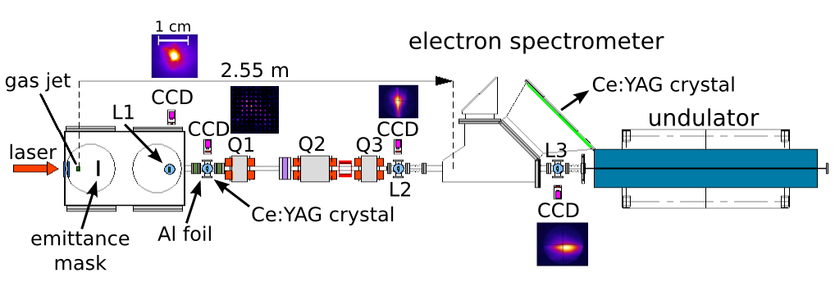
Strathclyde experiments: set-up
Here we limit our attention to the interaction chamber only.
We have used a 2 mm gas-jet “home made”. Using it, we have accelerated electrons up to 230 MeV!

Slide 12
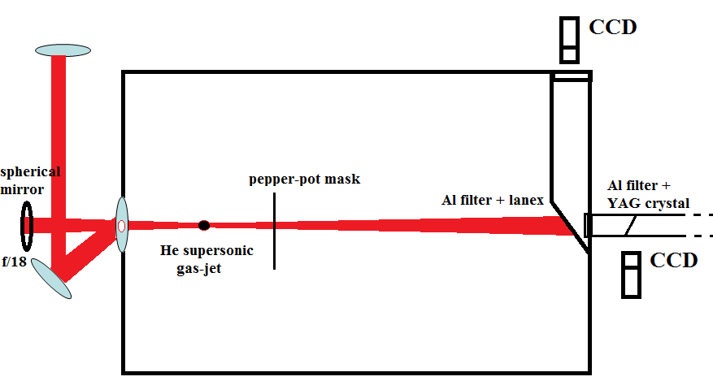
Strathclyde experiments: set-up
Gas-jet choice is fundamental. Sharp gas profile is required.
Detection: one camera looking at the gas jet from the top of the camera (to check the plasma channel), one looking at the first lanex screen (Al filter + lanex) and one for the pepper pot emittance measurement (placed just after the interaction camera). The transition radiation detector is placed in the some place of emittance.

Slide 13
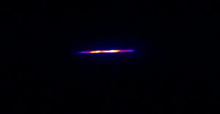
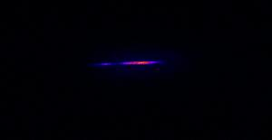
Strathclyde experiments: gas-jet
The image here shows the laser scattering at the interaction. Using this image, we can understand the quality of the interaction. A long channel is usually related to high energy, high quality electron bunches.
2 mm
In this case the interaction is not good. In fact the channel is very short and the intensity of the scattering is very low. In this case we expect that the bunch is not bunched or the quality of the beam is poor. A bad quality of the channel can be due to laser shot to shot variation or a wrong position of the gas-jet respect to the laser axis.
2 mm

Slide 14
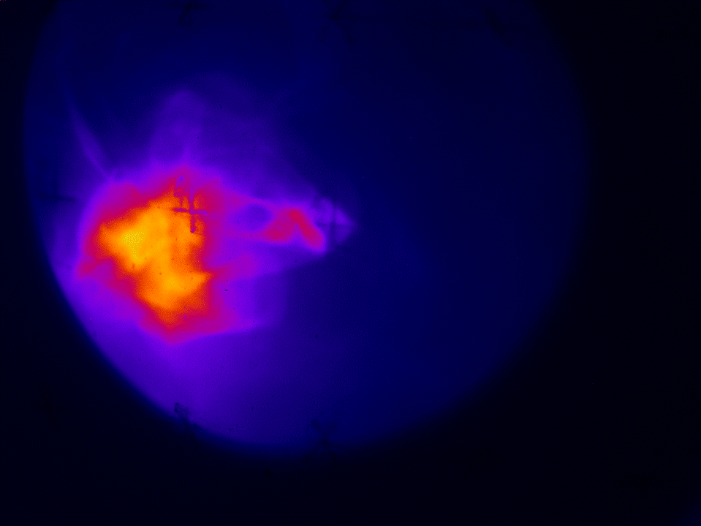
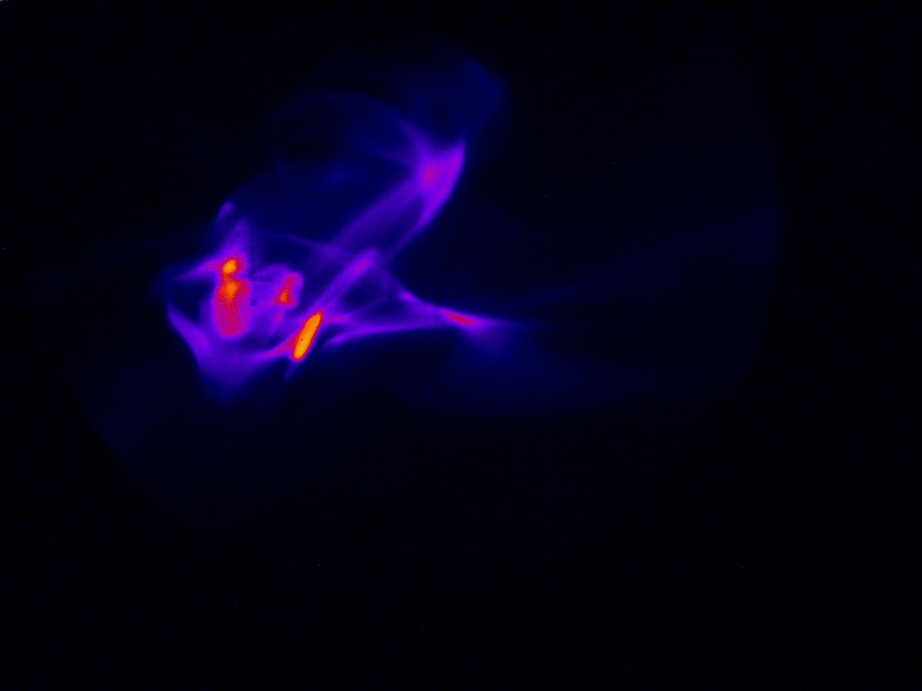
1: electron beam from LWFA
Those are 100 consecutive optimised shots measured at the exit of the accelerator on a lanex screen without using any focusing resource.
Divergence:
1 cm
Those are 100 consecutive shots measured at the exit of the accelerator on a lanex screen using a very compact triplet of quadrupoles, designed to reduce the divergence of the beam and to improve the pointing stability.
1 cm

Slide 15
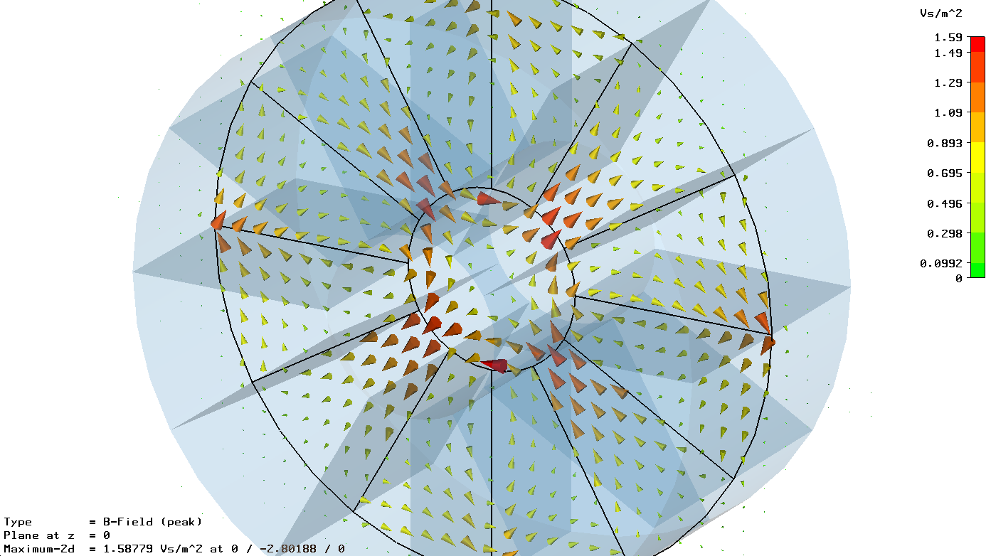
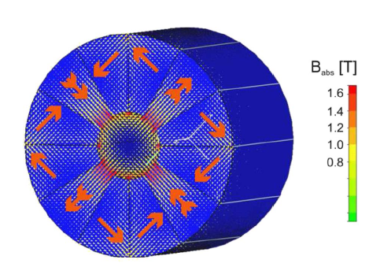
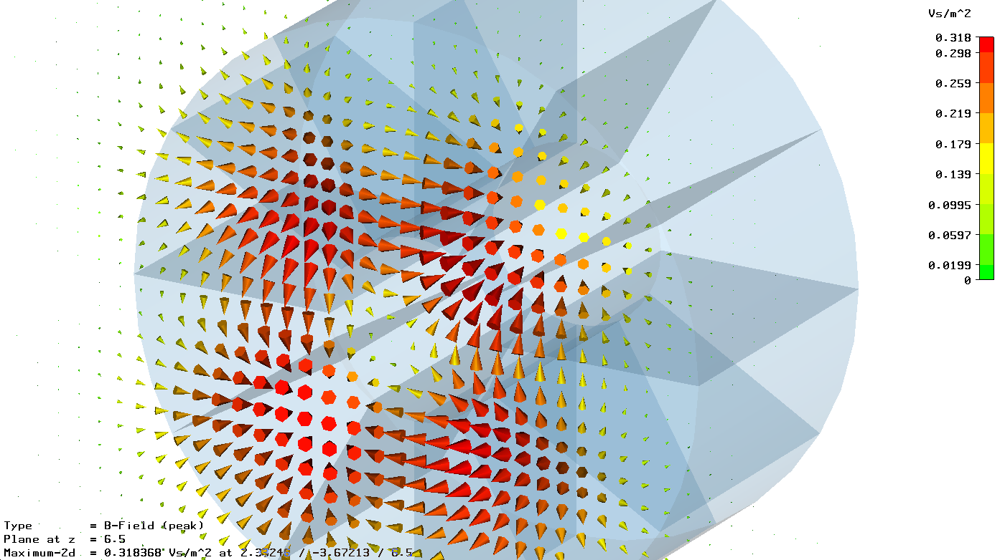
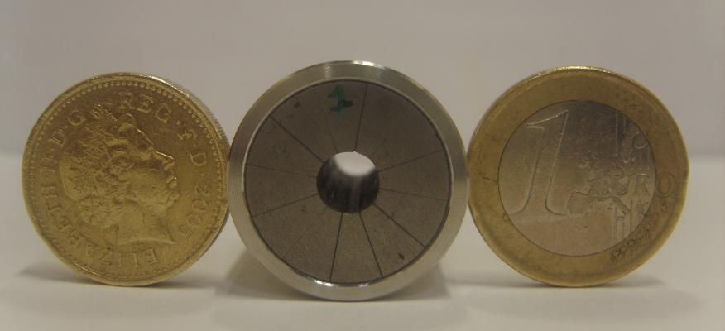
Permanent magnet triplet design
Magnetic field inside
the magnets
Magnetic field out of the magnets –
“fringe field”
Collaboration with PD Dr. Ulrich Schramm , FZ Dresden-Rossendorf (FZD), FWT

Slide 16
Examples:
Electron beam from LWFA @ Strathclyde.
Quality of the electron beam measured @ Strathclyde.
Resonant betatron oscillations @ RAL.

Slide 17
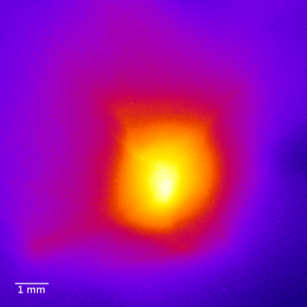
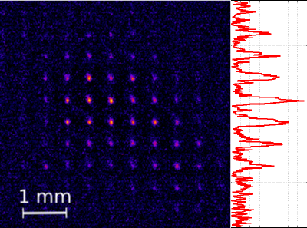
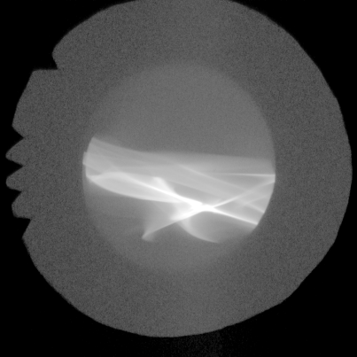
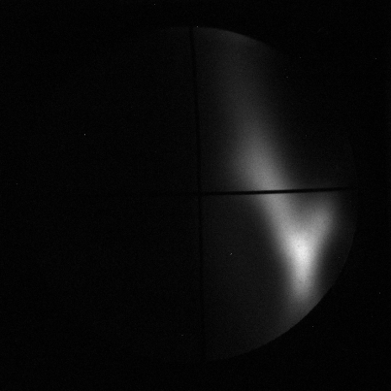
2: Quality of the electron bunches from LWFA
Emittance measurement using a pepper-pot mask: measured emittance at 60 cm from the source down to 1.1 π mm mrad.
False colour image of an electron beam with and without the pepper-pot mask.
Charge measurement using a calibrated image plate: measured charge at 1.5 m from the accelerator up to 20 pC.
image plate
Lanex 2

Slide 18
2: Quality of the electron bunches from LWFA
Example of the best energy spread measured on our system: only 0.4%, which is the resolution limit of the electron spectrometer.
Transition radiation technique used to measure the bunch length measured at 1 m from the source.
The curve that better fits the experimental data is the one of the 2 fs duration.

Slide 19
Examples:
Electron beam from LWFA @ Strathclyde.
Quality of the electron beam measured @ Strathclyde.
Resonant betatron oscillations @ RAL.

Slide 20
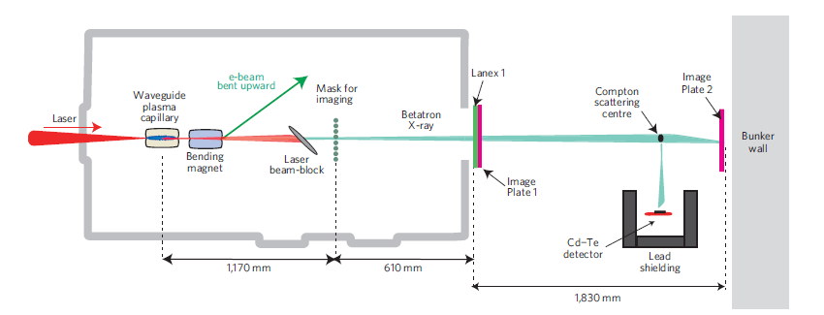
RAL experiment: the set-up
In this experiment, the bending magnet is placed just after the accelerator in order to avoid undesired Bremsstrahlung radiation on the Cd-Te detector placed downstream, shielded with 20 cm of lead.

Slide 21
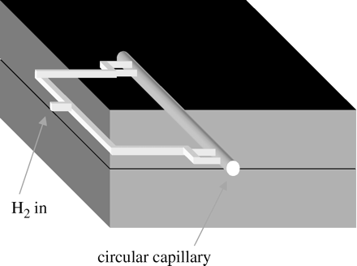
RAL experiment: the set-up
Accelerator: 4 cm waveguide – capillary.
Laser: ASTRA-GEMINI @ RAL.
Parameters: 5 J, 55±5 fs duration, preformed plasma waveguide with n_{p}~2x10¹⁸ cm⁻³
Initial vector potential a₀~ 2.

Slide 22
RAL experiment: the set-up
Two different X-ray detectors have been used in the experiments.
Single-shot X-ray spectra have been measured using a single-photon multi-pixel CdTe detector, originally developed at CERN. As the detector was not suitable for directly measuring the entire photon spectrum, ranging from 10 keV to more than a MeV, especially towards the higher end, it was necessary to use an indirect method to determine the spectrum.
The X-ray spectra, in the weakly and strongly resonant regimes, have been measured in a single shot using a semiconductor detector to detect 90° Compton side-scattered betatron radiation from a 12mm diameter aluminium rod. Compton scattering downshifts the X-ray spectrum such that spectra in the MeV range can be detected with adequate resolution using only the 1mm thick semiconductor detector, which has a range from 20 keV to 600 keV.

Slide 23
3. Resonant betatron oscillations
NON-RESONANT CASE: Betatron X-rays limited to spectra peaking between 1 and 10 keV.
RESONANT CASE: 10⁸ gamma ray photons, with spectra peaking between 20 and 150 keV, and a peak brilliance > 10²³ photons ⁻¹ mrad⁻²mm⁻² per 0.1% bandwidth, are measured for 700MeV beams, with 10⁷ photons emitted between 1 and 7MeV.
a) X-ray image as transmitted through calibrated metallic cut-off filters (0.3mm (top left) and 1mm (bottom left) tungsten foils, 0.5mm (top right) and 1mm (bottom right) copper foils). The calibrated cut-off filters give a spectral peak at 20 keV.
b) X-ray beam profile used to deduce a divergence of 14 mrad, measured simultaneously with the 700 MeV electron beam shown in c.

Slide 24
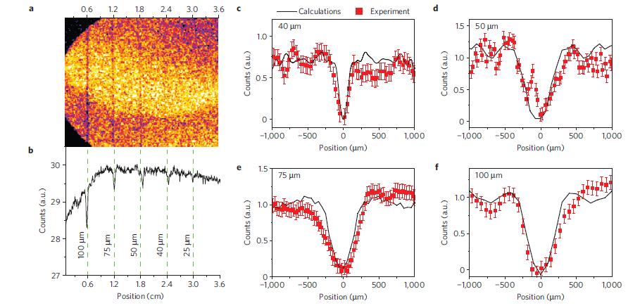
3. Resonant betatron oscillations
Phase contrast experiment carried out to find out the x-ray source size.
a) Phase contrast on an image plate, showing images of 4 copper wires of 100, 75, 50 and 40 µm thickness, respectively from left to right.
b) Profiles where a faint shadow of a 25 µm thick wire is visible at position 3 mm.
c–f) Shadows cast by the wires compared with simulated data; consistent with a 15 µm diameter X-ray source size. Simulations assume a X-ray spectrum ranging from 10 to 100 keV. Error bars calculated from the standard deviation of the signal variation from pixel to pixel.

Slide 25
Conclusions
Described the LWFA process.
Introduced the resonant betatron radiation and summarized the conditions nedeed to be in resonance with the laser beam.
Shown 3 different experiments, two performed at Strathclyde and one in RAL.
Exp.1: possibility to optimize the laser parameters and the plasma density? conditions to get stable electron beams.
Exp. 2: complete characterization f the electron beam for quality purposes: measured emittance (down to 1.1 π mm mrad), charge (up to 20 pC), energy spread (down to 0.4%) and bunch length (down to 2 fs).
Exp. 3: Measurements of resonant betatron radiation: higher peak brilliance ever measured in a lab! X-ray images to measure spectral peak, phase contrast to find the x-ray source size of 15 µm.

Slide 26
Thank you!!!

