Slide 1



Statistical insights in time resolution of Resistive Plate Chambers
Marcello Abbrescia
University of Bari and INFN
DeSyT 2025
LNS Feb. 24-26 2025

Slide 2
Signals in Resistive Plate Chambers
Generally the growth of ONE avalanche in a Resistive Plate Chamber is schetched like in the following, containing a part of exponential growth and one of saturation because of space charge effects:
x_{sat}
Exponential growth
Saturation
“Drift”
The induced charge on a planar readout electrode is usually written as:
Exponential growth
Drift
Of course the second term depens on how the saturation effects are modelled.

Slide 3
Signals in Resistive Plate Chambers
If one considers all clusters, in number n_{cl} , each containing n₀^{j} electrons, generated by the passage of one ionizing particle through the gas gap, of width g, the induced current i_{ind}(t) can be usefully expressed as:
Here, we neglect saturation effects (correct if we consider the initial stages of the avalanches), and:
  v_{d} is the electron drift velocity (assumed constant with time);
  E_{w} is the weighting field (assumed uniform in space);
  η is the first effective Townsend coefficient
  M_{j} is the avalanche fluctuation coefficient
  t is the time elapsed since the passage of the ionizing particle

Slide 4
Signal fluctuations in RPC
ALL quantities in the red boxes are stochastic variables, namely they change from event to event; in particular:
n_{cl} follows a Poisson distribution
n⁰_{j} depends strongly on the gas used, generally a 1/n² distribution for small n is used, followed by a long tail toward large n-values.
M_{j} is described by different distributions depending on the approach used: usually, for small avalanches, a Furry’s law is used, for larger avalanches generally a Polya distribution with a suitable value of the parameter is chosen.
The fact that the induced current contains stochastic variables has the consequence that it changes from event to event.
→ These fluctuations cannot be eliminated.

Slide 5
Signal fluctuations in RPC
Note that the number of clusters n_{cl}(t) in the gas at a certain time t, is monotonically decreasing with time, due to the fact that, with time, more and more avalanches arrive onto the anode and stop.
Due to the fact that their initial positions are, themselves, stochastic variables, this adds up a «hidden» cause for fluctuations.
In the initial phases of the avalanches, ALL clusters are drifting (and avalanching).
Note that, at a certain time t, ALL clusters contribute at the same way to the induced current.
Vice versa, the induced charge, which is another quantity typically measured, depends mainly on the cluster closest to the cathode:
≈ 0.02 is the average ratio between the charge induce by two consecutive clusters

Slide 6
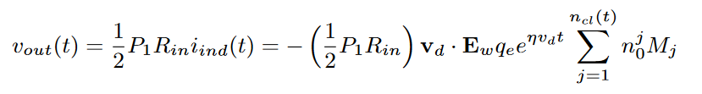
Signals after readout electronics
Considering the electronics, the output of a perfect voltage amplifier can be usefully written like:
where:
P₁ is the amplification factor
R_{in} is the input impendance
½ takes into account that usually strips are used.
In the case of charge sensitive amplifiers:
where:
P₂ is the amplifiers charge sensitivity.

Slide 7
Origin of timing
Generally we are interested to the time t_{thr} when v_{out}(t) becomes larger than a certain electronics threshold V_{thr}. The most logical thing to do would be invert the expression:
This is not possible because of the dependance of n_{cl}(t) over t.
On the average, however:
where λ is the primary cluster density (# cluster/mm).
Also:
M_{j} has average 1 (by definition)
n⁰_{j} average depends on the gas

Slide 8
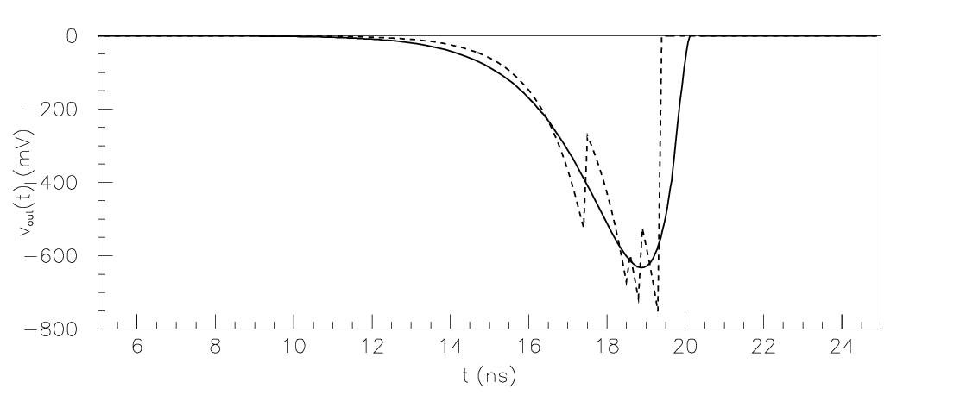
The «average» signal
Therefore, we can re-write the previous formula for the «average» signal as:
where:
B is the average value of n⁰_{j}M_{j} (M_{j} has average value 1).
Comparison between «average» and «exact» formula (one instance)
Initial phase, typical zone of interest

Slide 9
Inverting the «average» signal
Not even this simplified expression can be directly inverted, because of the contemporary presence of the exponential and linear terms in t:
However, we can take the logarithm of both terms, and expand the logarithm at the right of the equal sign (stopping at the second power):
where R = ½ P₁ R_{in}
This is equivalent to approximate, in the initial stages of the avalanche as:

Slide 10
Inverting the «average» signal 2
THIS expression can be easily inverted, to obtain, for v(t)=v_{thr}:
in the linear approximation, and, for the quadratic approximation:
The time t_{thr} at which the signal overcomes the threshold is inversely proportional to v_{d}, inversely proportional to η – 1/g, and only logarithmically dependant on λ, g and v_{thr} (and R, A and B).

Slide 11
Timing fluctuations in RPCs
Moreover, from the expression (modified exploiting the fact that «n_{cl}»=λg):
one can compute the partial derivatives with respect to M_{j} , n⁰_{j} (included in B) and n_{cl}, which are the stochastic variables contained therein.
These are, within the approximations done, the contributions to the fluctuations of t_{thr}:
Since they appear in the same term, the numerical factors in front of the relative fluctuations on n_{cl}, M_{j} and n⁰_{j} are the same, which simplifies the conclusions to be drawn.

Slide 12
Time resolution of RPC
An estimation of the RPC resolution is therefore:
Time resolution is inversely proportional to v_{d} (hence the need for gas mixtures characterized by a large drift velocity), and inversely proportional to η – 1/g.
Note that, keeping the same electronics, the η g product, which is related to the gain, is roughly constant in «narrow» or «wide» gap RPCs
→ Narrow gap RPCs are characterized by a good time resolution simply because η is larger in this case.
Of course, there are other sources of signal fluctuations (electronics, diffusion), but these above derive directly from the statistics of electron-ion pairs formation and avalanche growth: they cannot be eliminated.
In this sense, they represent a lower limit of the time resolution for an RPC (within the hypothesys done).

Slide 13
Time resolution of RPC
To quantify the time resolution using the previous formula, the various terms need to be quantified, at least approximately.
easy, denser gases provide better time resolution
Actually depends on the preferred model for avalanche fluctuations; this is an approximate value for a Polya distribution with θ = 1.5
Strongly depends on the gas (mixture) used
For a 2 mm RPC, η = 9 mm⁻¹, v_{d} = 120 μm/ns
σ_{t}≈ 1 ns
For a 300 μm RPC, η = 110 mm⁻¹, v_{d} = 200 μm/ns
σ_{t}≈ 50 ps
Both in the right ballpark.

Slide 14

Time resolution of RPC
Following a different approach, and other simplifying assumptions
one cluster only
exponentially distribution of the amplitudes
Riegler, Lippman and Veenhof found out a similar expression:
$$σ_{t}≈ \frac{1.28}{ηv_{d}}$$
W. Riegler et al., Nuclear Instruments and Methods in Physics Research A 500 (2003) 144–162, doi:10.1016/S0168-9002(03)00337-1
Comparison between the above formula (line) and a full Monte Carlo simulation (dots), for a timing (300 μm) RPC
Weak dependance of time resolution on v_{thr}, predicted by both approaches, confirmed by Monte Carlo.

Slide 15
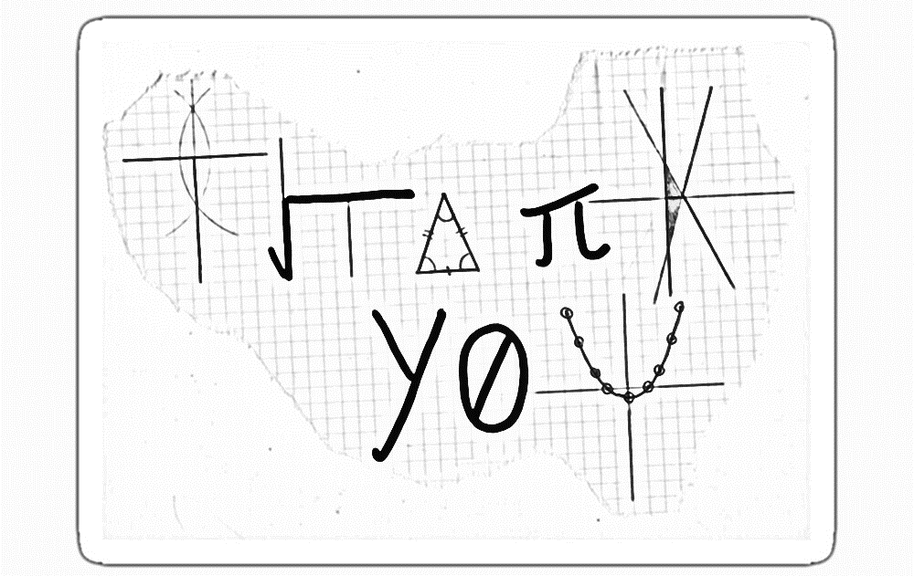
Conclusions
In some communities of gaseous detectors, there are discussions about timing properties of RPCs; this presentation stemmed from one of them.
→ «narrow» gap RPCs are characterized by a better time resolution with respect to «wide» gap RPCs because of the larger values of η and v_{d}.
Statistical considerations can help a lot in understanding the physical reasons of signal fluctuations and derive approximate expressions for time resolution.
Even if approximate, these expressions give results in the right ballpark and, above all, provide limits beyond which is hard (impossible?) to go.

