Slide 1
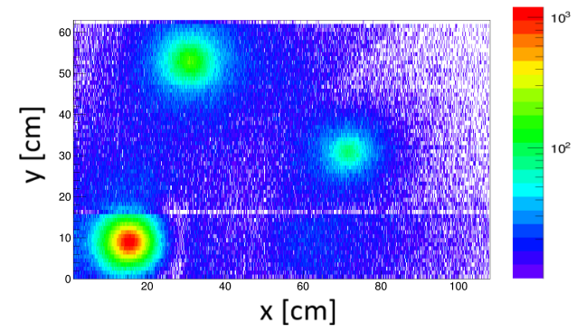
PI3SO
Radwaste reconditioning:
a new approach through a gamma
scanner/imaging system
Chiara Rita Failla
Dipartimento di Fisica e Astronomia Università di Catania
INFN Laboratori Nazionali del Sud

Slide 2

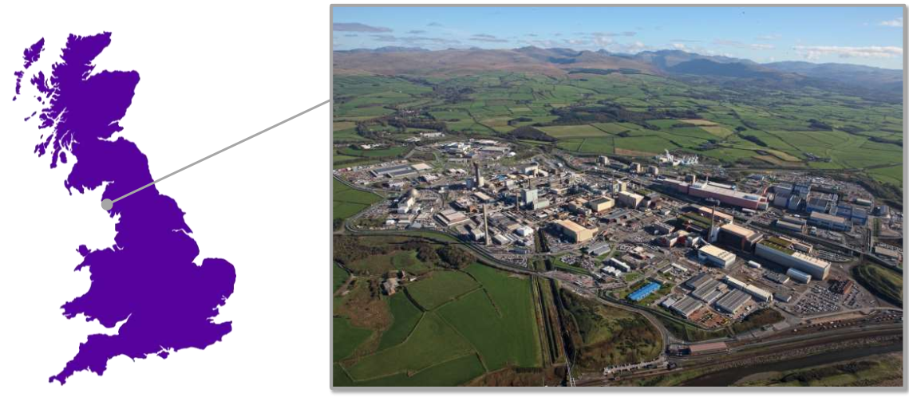
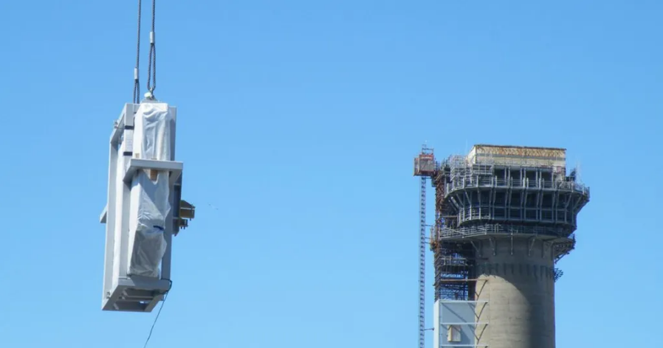
Radioactive waste
‘’At various steps in the predisposal management of radioactive waste, the radioactive waste shall be characterized and classified in accordance with requirements established or approved by the regulatory body ‘’.
Sellafield
22 concrete silos
Nuclear waste silo opened (BBC)
~11.000 m³ of radwaste.

Slide 3
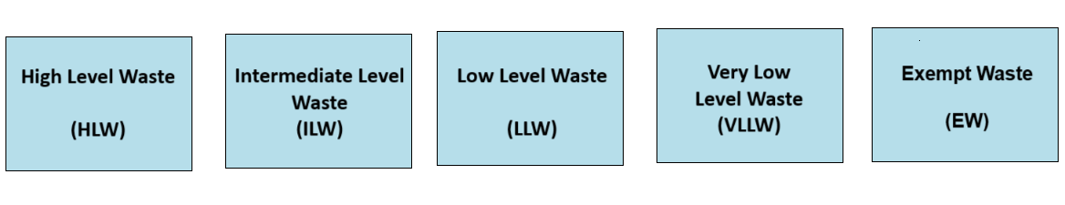
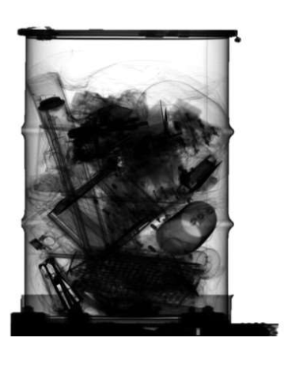
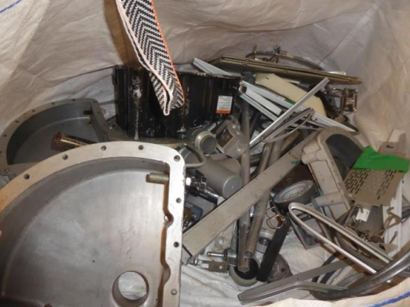
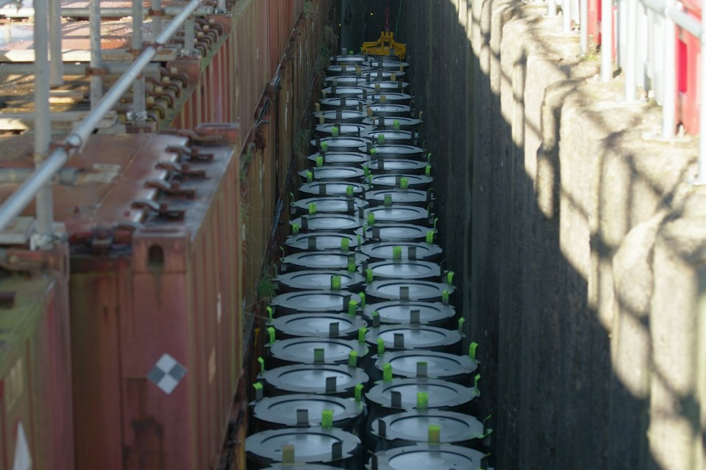

Radioactive waste
‘’At various steps in the predisposal management of radioactive waste, the radioactive waste shall be characterized and classified in accordance with requirements established or approved by the regulatory body ‘’.
>2kW/m³
<2kW/m³
<4 GBq/t for α
<12GBq/t for β, γ
Not harmful
LLW Repository site (NDA)

Slide 4

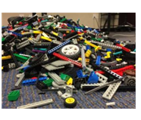
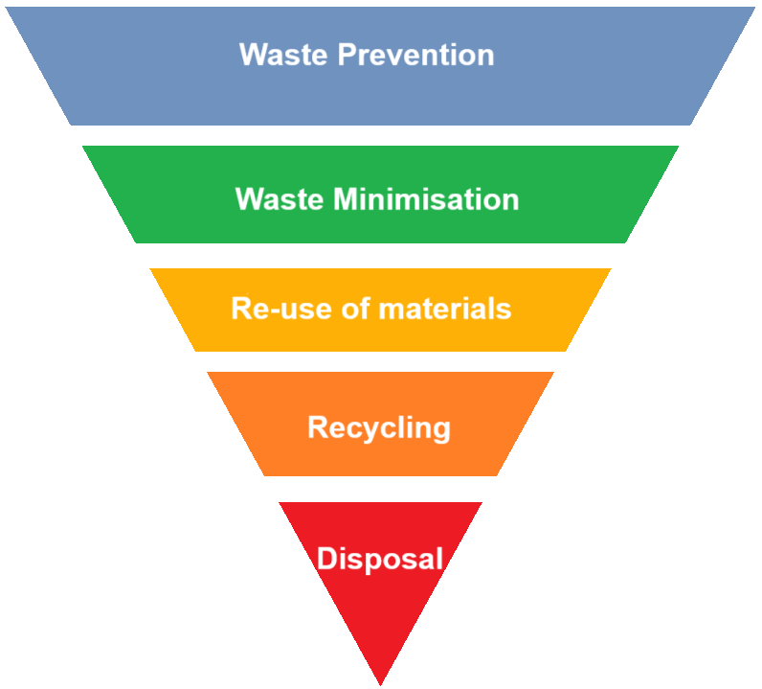
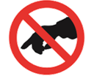
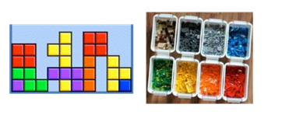


Nuclear waste decommissioning
Sort & Segregate
ILW
LLW
VLLW
how to sort and segregate the waste?
γ-Rays
PI3SO
How do we integrate it together?

Slide 5
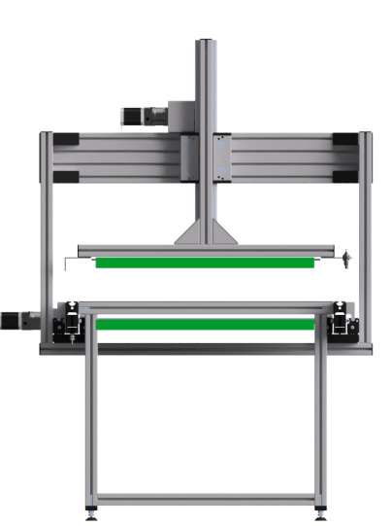
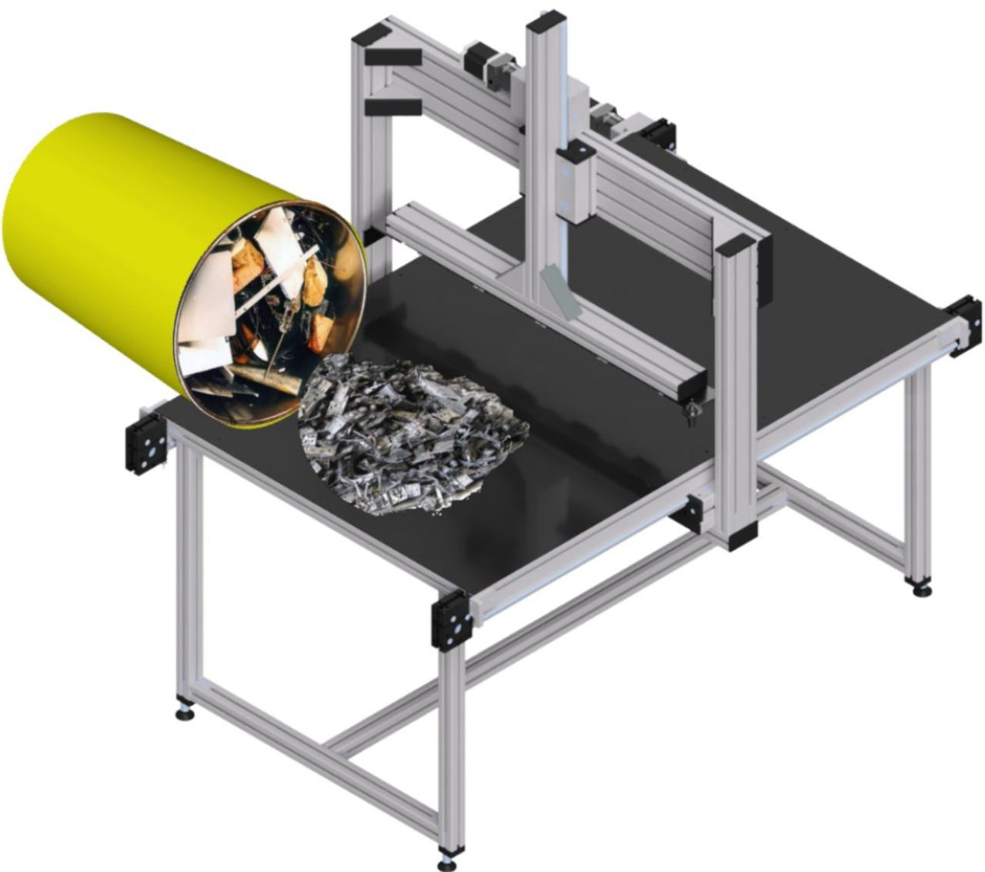
γ counter
Proximity imaging system
PI3SO
Spectroscopic detectors
P = Proximity
I = Imaging
3S = System for
Sort and
Segregate
O = Operations
Funded by INFN-Energy

Slide 6
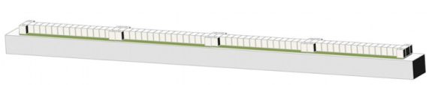
The Mechanical Scanning system
• 120 × 80 cm² surface
• 108 × 64 cm² scanning area
• top and bottom γ-detectors:
- 2×64 linear detector arrays
- 1 cm³ crystals & 36 mm² SiPMs
• anticollision system (LED)
• two motion engines:
- horizontal (both detectors)
- vertical (top)
• 2 mm Carbon fiber tabletop
• software: motion & DAQ

Slide 7
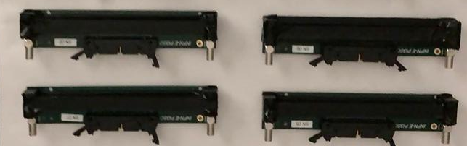
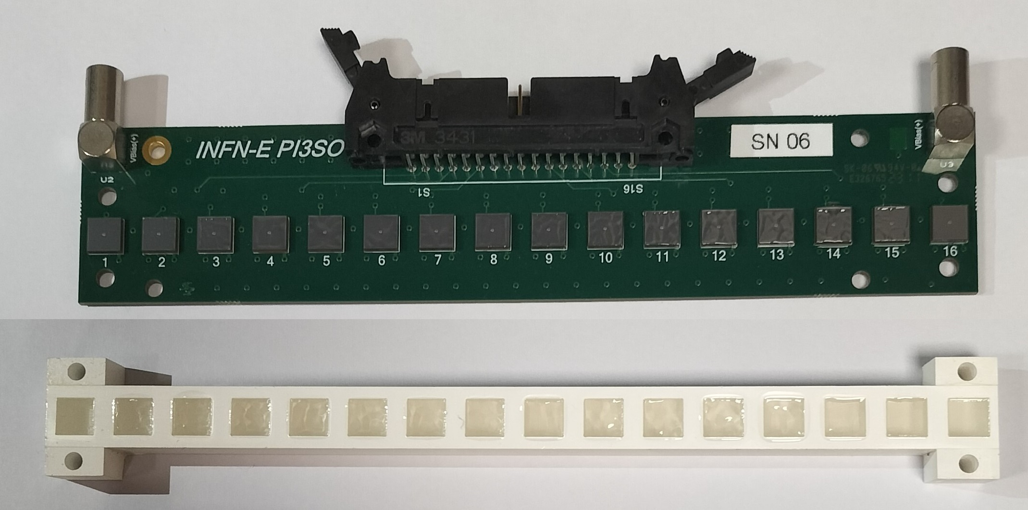
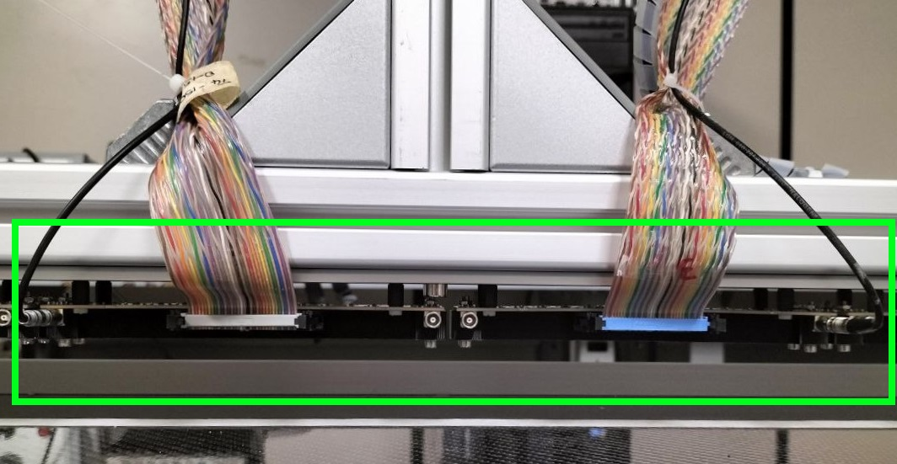
Focus on the detectors setup

Slide 8
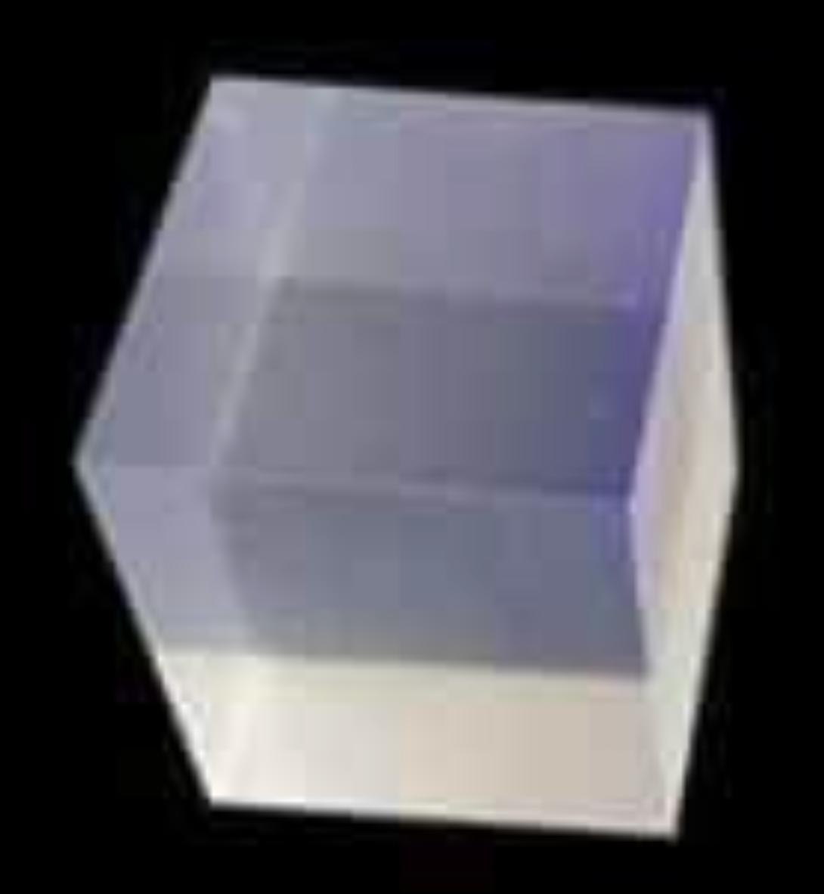
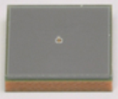
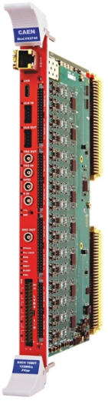
Detectors and Data Acquisition
1 cm³ CsI(Tl) crystal
6x6 mm² SiPM
2 CAEN VX2745 digitizers
• light yield 6x10⁴ photons/MeV
• spectral emission around 550 nm
• density: 4.51 g/cm³ →
good intrinsic detection efficiency
• MPPC Hamamatsu
S14161-6050HS
• 2x64 channels, 16 bit
125 MS/s (8 ns/sample)

Slide 9
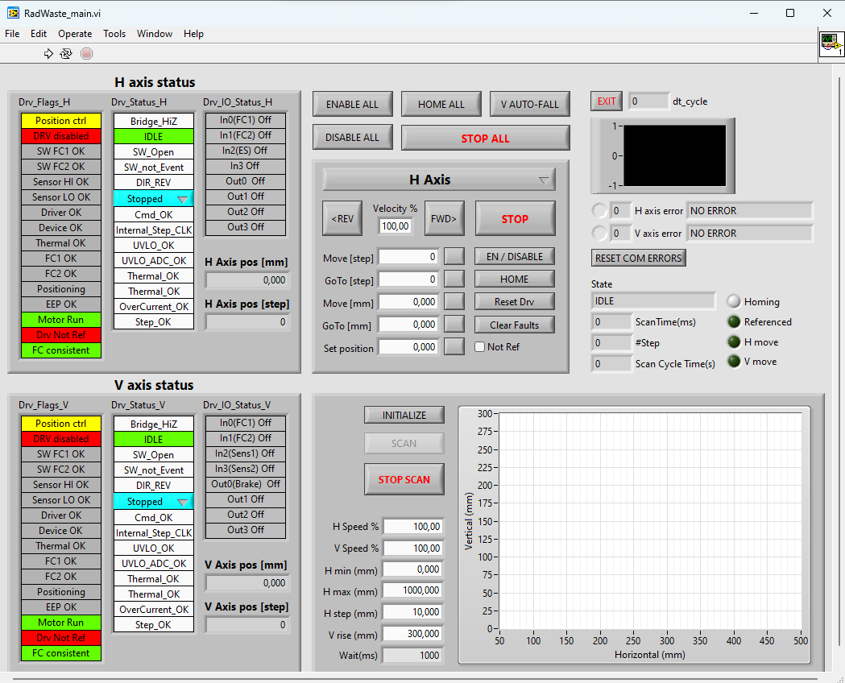
The Mechanical Scanning system
Motion software

Slide 10
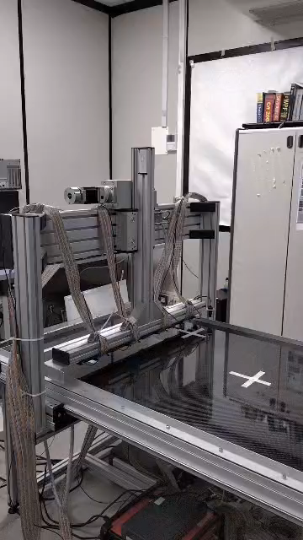
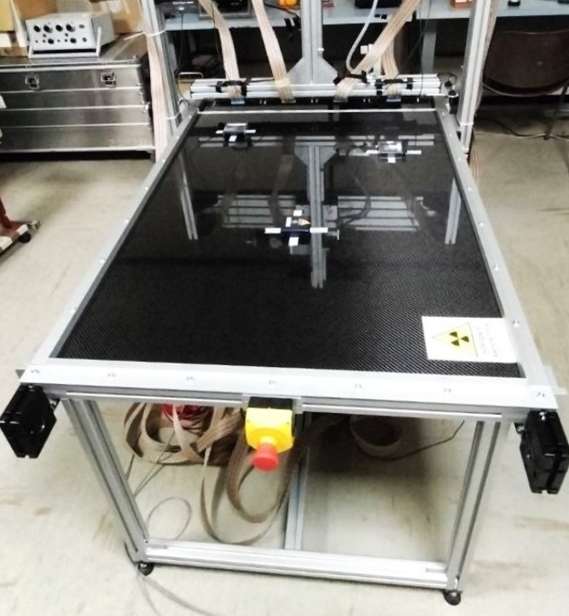
The Mechanical Scanning system

Slide 11
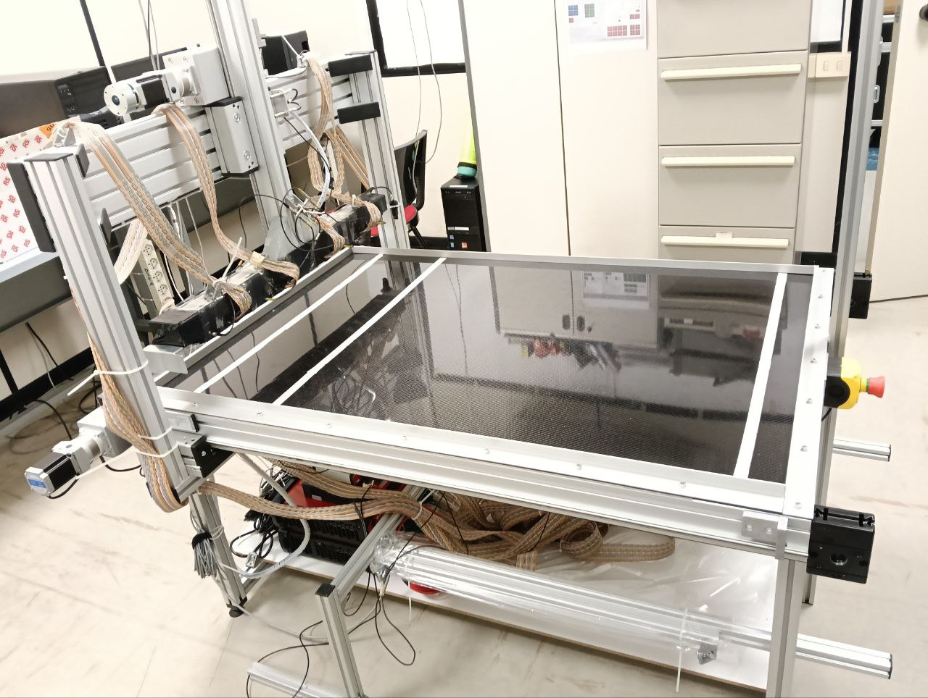
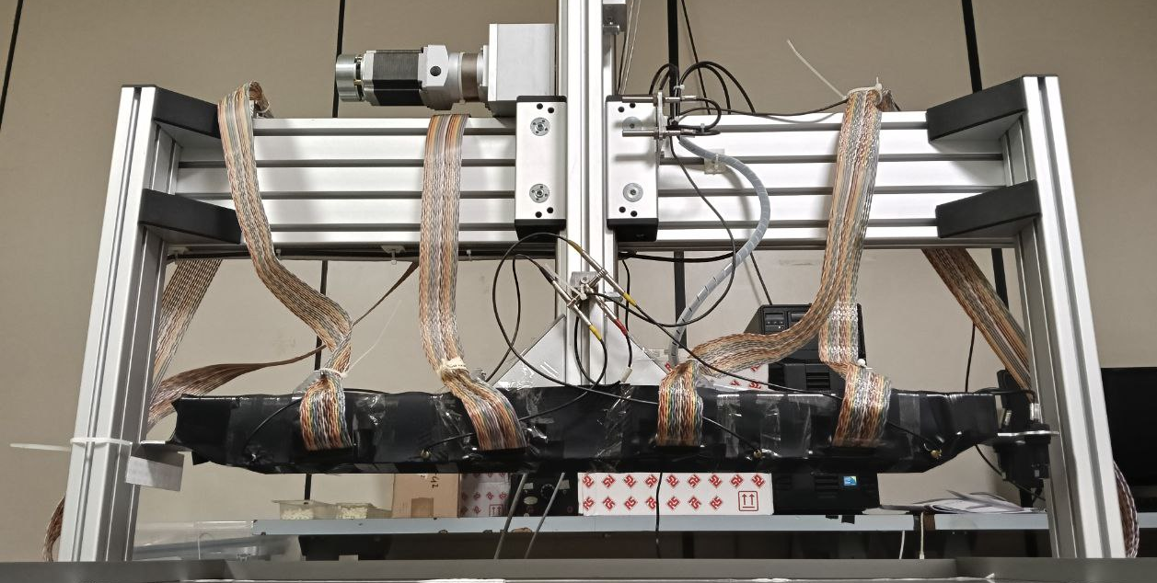
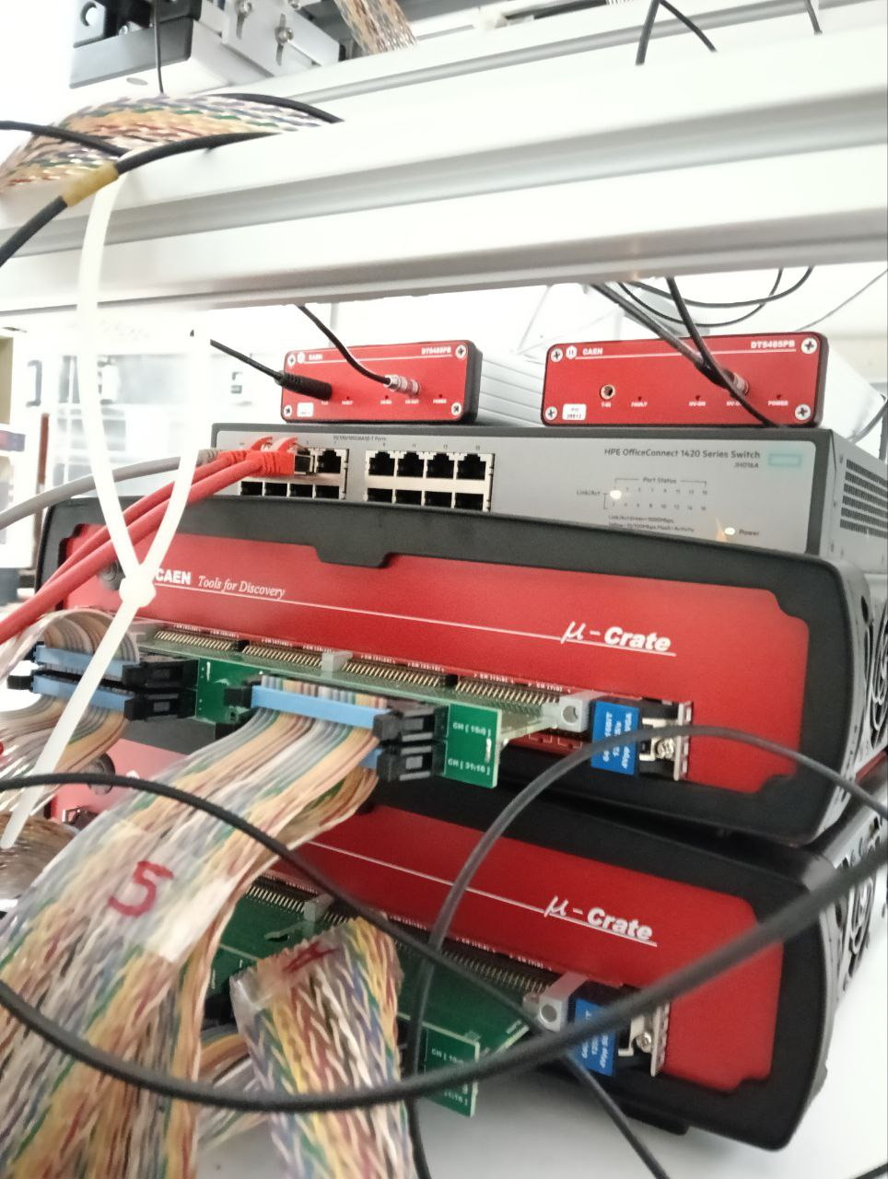
PI3SO
Scanner Tests
2 linear scanner arrays:
Top: (4 modules – 4x16 detectors)
Bottom(4 modules – 4x16 detectors)
• complete table with detectors
• 8 modules at once
• unique bias supply
• 8 flat cables from boards to
digitizers
• 3 scan tests:
Simulation of waste with radioactive sources.
¹³⁷Cs source in a beamline cross.
Investigation of decommissioned parts of a cyclotron electrostatic deflector.
2 digitizers (one serves 4 modules)
SiPM power supply
• hot spots finding
• Spectroscopic measurement

Slide 12
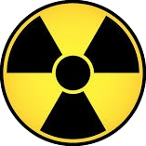
PI3SO
Characterization of the 128 detectors
Source | Peak Energy [keV] | Activity [MBq]
¹³⁷Cs | 662 | 1.4000
²²Na | 511, 1274 | 0.0154
⁶⁰Co | 1173, 1331 | 0.0560
• peaks finding
• energy calibration
• FWHM Energy Resolution
Sample spectrum
Det. n. 79 – Tab n. 5
Calibration

Slide 13
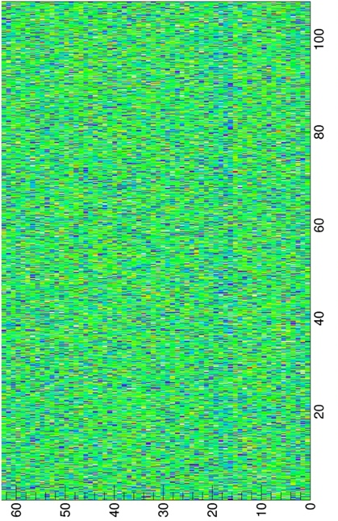
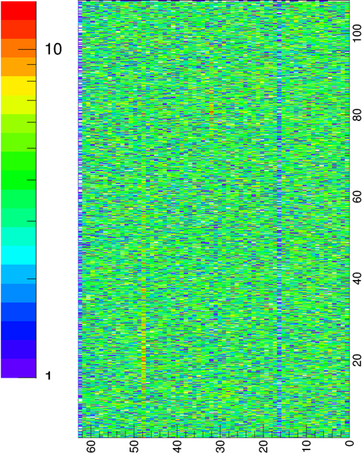
PI3SO
Background scan
Bakcground scan
NO sources on the table

Slide 14
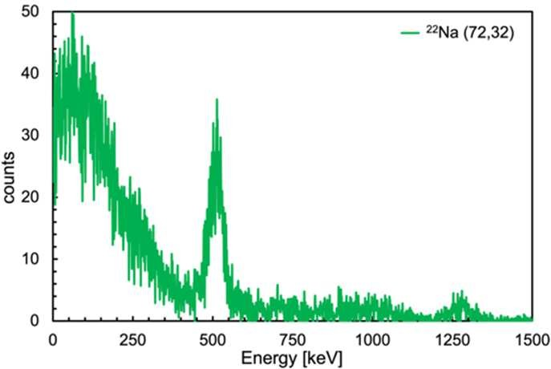
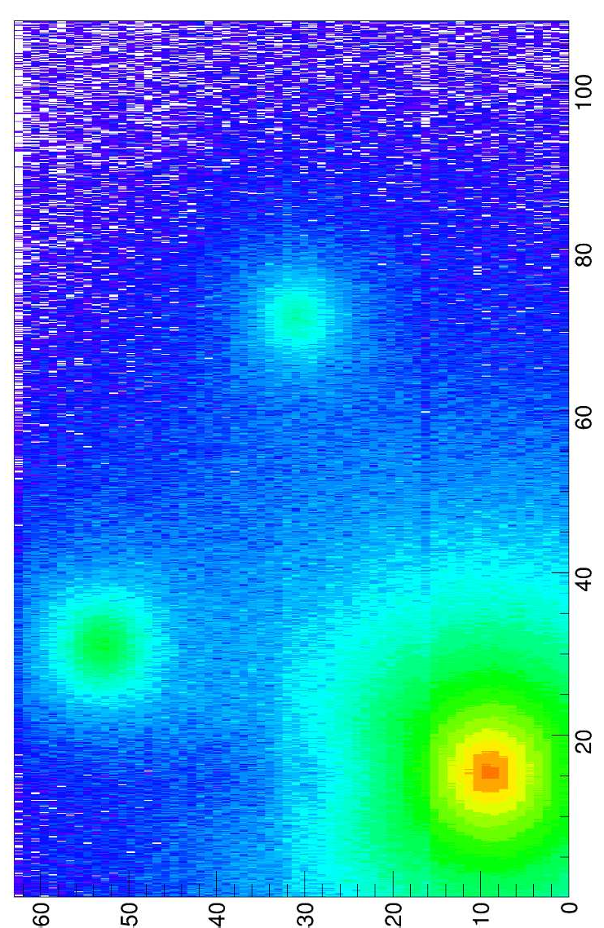
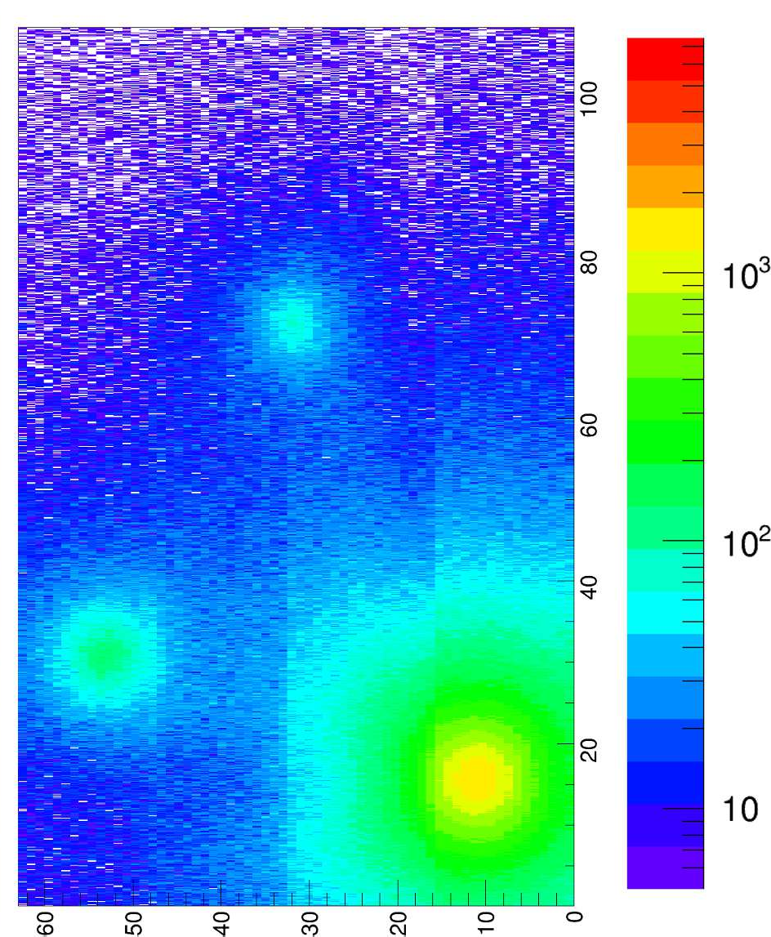
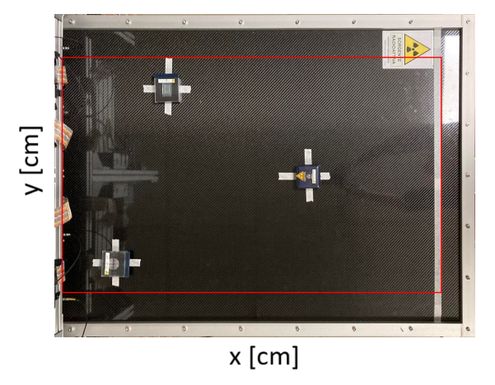
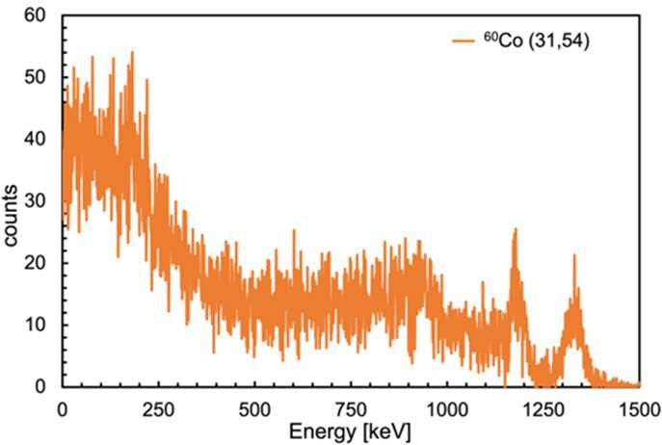
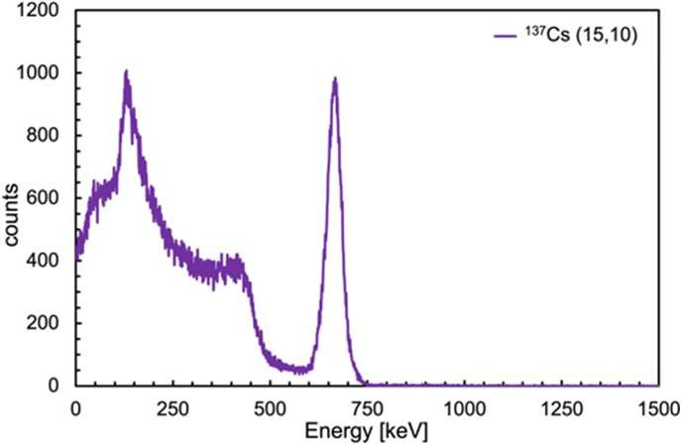
PI3SO
Scan with 3 sources:
⁶⁰Co, ²²Na, ¹³⁷Cs
²²Na
Top
Bottom
⁶⁰Co
¹³⁷Cs

Slide 15
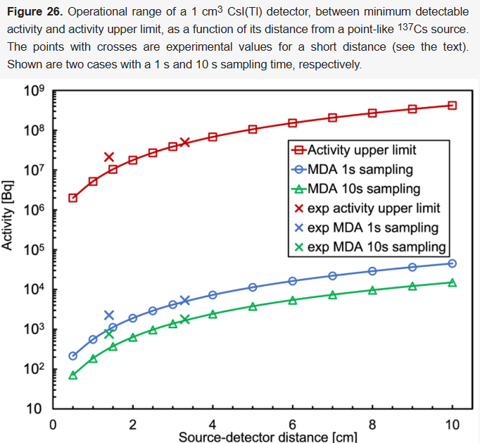
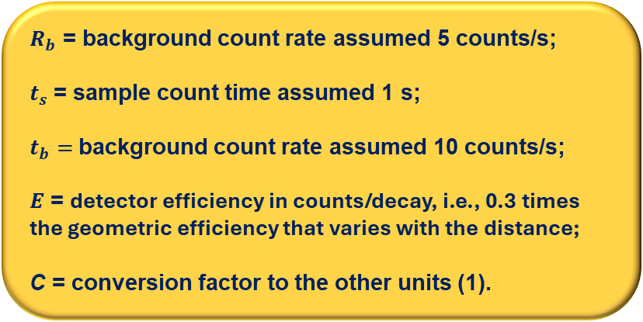
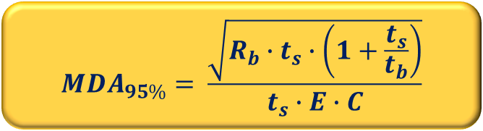
$${MDA}_{95\%}= \frac{\sqrt{R_{b}∙t_{s}∙\left(1+\frac{t_{s}}{t_{b}}\right)}}{t_{s}∙E∙C}$$
$R_{b}$ = background count rate assumed 5 counts/s;
$t_{s}$= sample count time assumed 1 s;
$t_{b}=$background count rate assumed 10 counts/s;
$E$ = detector efficiency in counts/decay, i.e., 0.3 times the geometric efficiency that varies with the distance;
C = conversion factor to the other units (1).

Slide 16
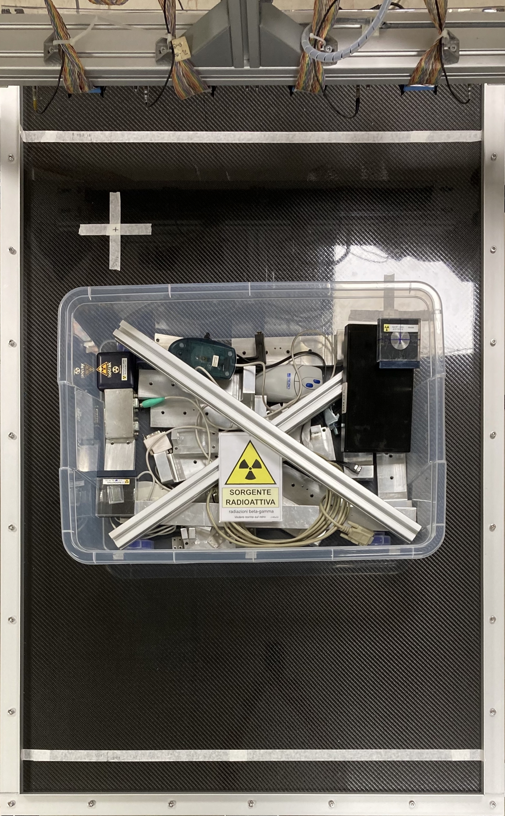
PI3SO
Simulation of waste containing radioactive sources
1.4MBq ¹³⁷Cs source on top of shielding objects in the “drum”
12,6kBq ²²Na source in the “drum” – nothing in between
50,0kBq ⁶⁰Co source in the “drum” – nothing in between

Slide 17
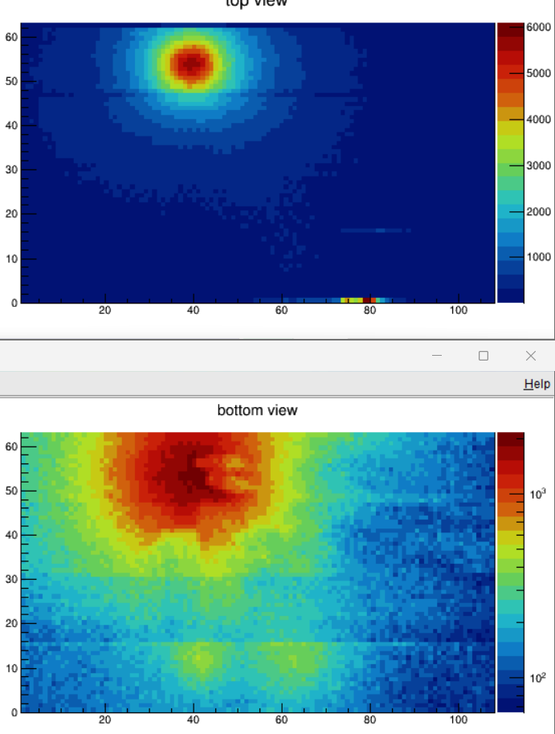
PI3SO
Top - Linear Z
Bottom - Log Z

Slide 18
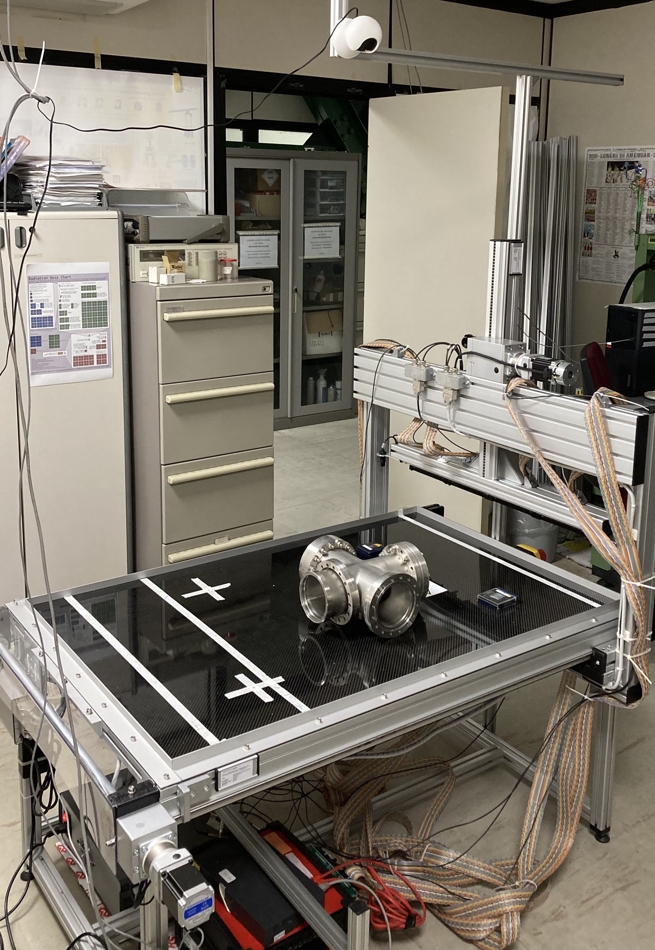
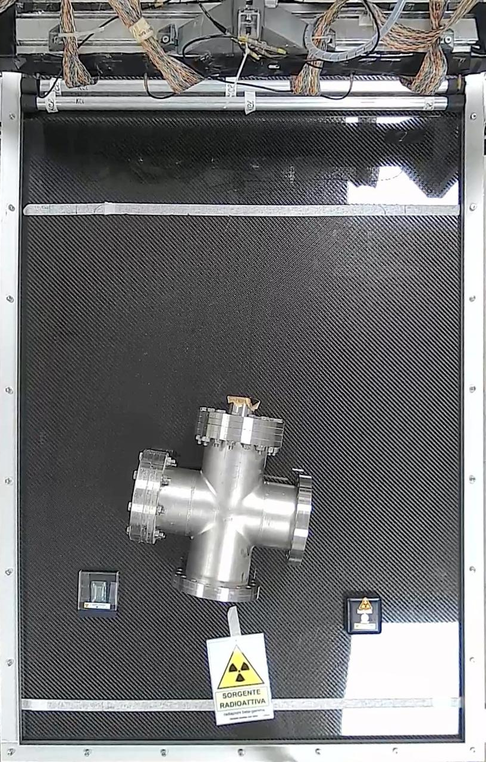

PI3SO
¹³⁷Cs source in steel cross pipe.
1.4MBq ¹³⁷Cs source on top of the table inside a steel cross pipe
12,6kBq ²²Na source on top of the table
50,0kBq ⁶⁰Co source on top of the table

Slide 19
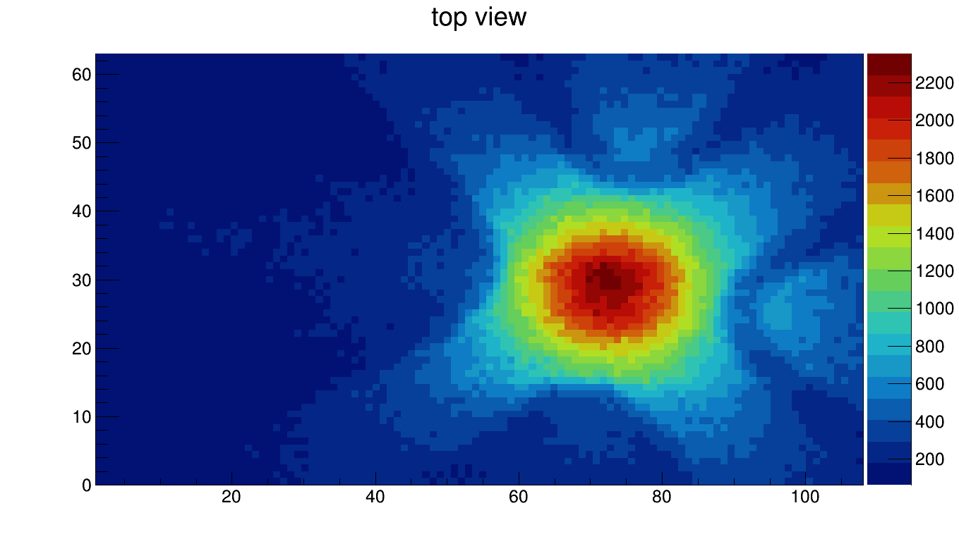
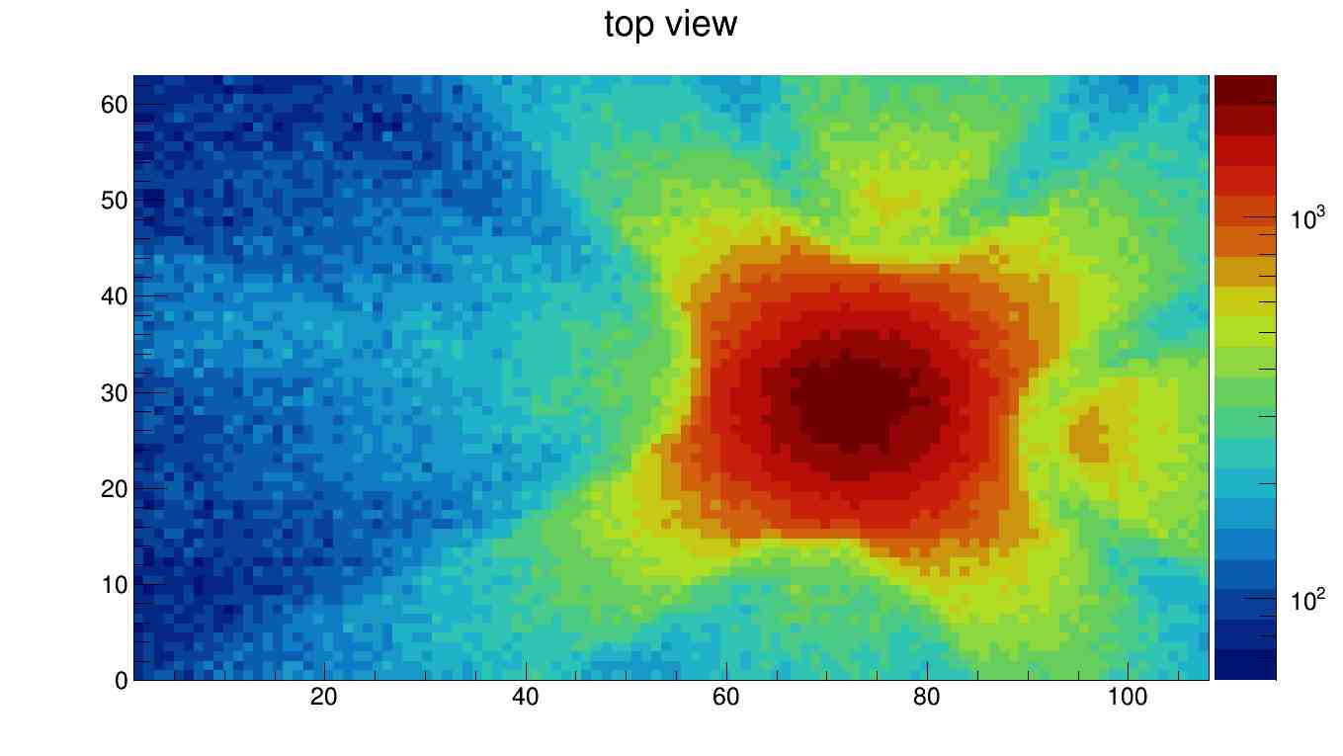
PI3SO
Top - Linear Z
Top - Log Z

Slide 20
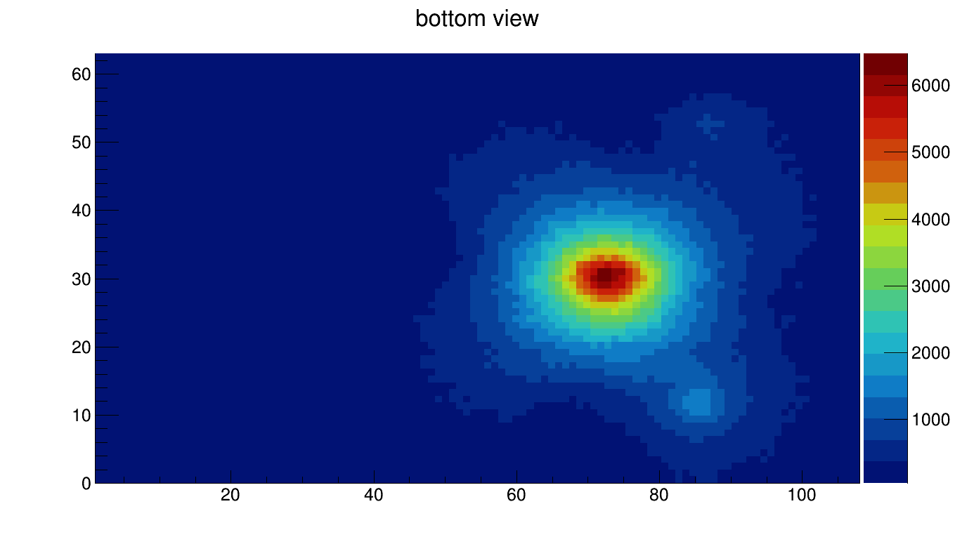
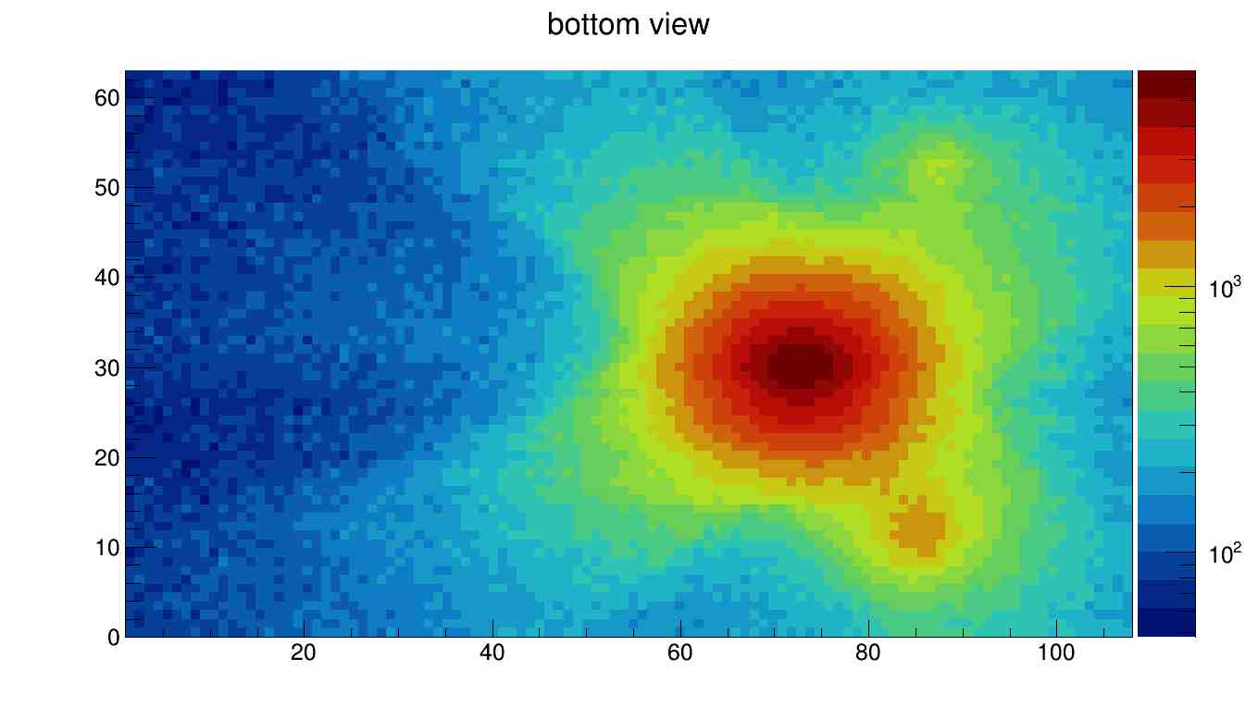
PI3SO
Bottom - Linear Z
Bottom - Log Z

Slide 21
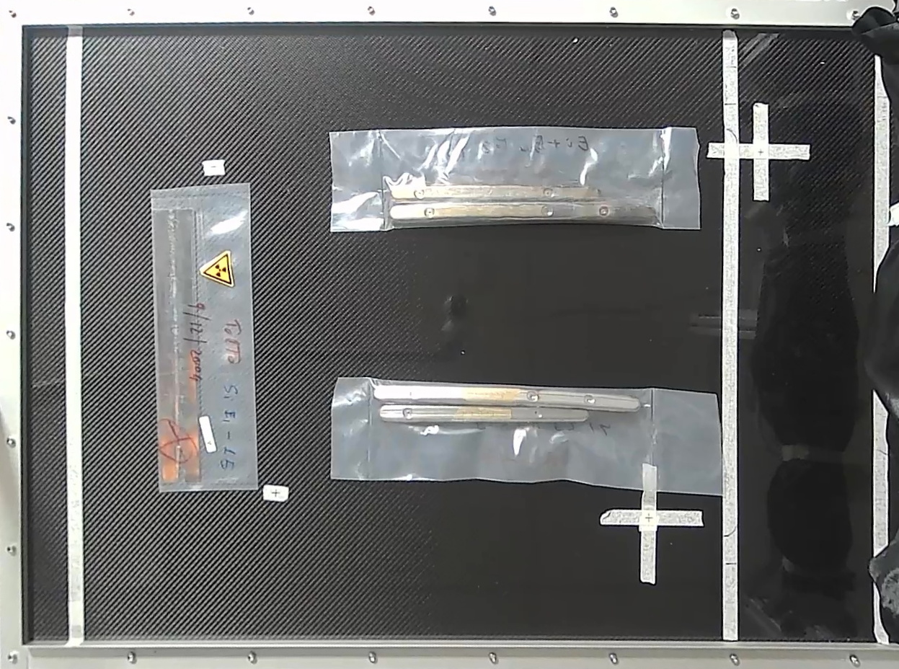
PI3SO
Investigation on decommissioned (2012) parts of a cyclotron deflector
?

Slide 22
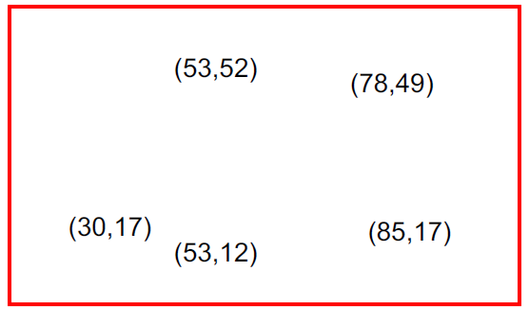
PI3SO
Electrode E2 - 15
Lamina E1 - 15
Electrode E2 - 14
hot-spots coordinates

Slide 23
PI3SO
Foil E1 - 15
spectroscopy example

Slide 24

PI3SO
foil E1 - 15
(30, 17) PI3SO (lin, 15 min)
(30, 17) germanium detector (lin, 30 min)
¹³³Ba 10.5 y
(302, 356, 383 keV)
⁶⁰Co 5.27 y
(1173, 1330 keV)
spectroscopy example

Slide 25
PI3SO
Electrode E2 - 15
spectroscopy example

Slide 26
PI3SO
Electrode E2 - 15
(78, 49) PI3SO (lin, 15 min)
[(78, 49); (53, 52)] germanium detector (log, 30 min)
⁴⁴Ti 59.1 y
(67.9, 78.3 kEv)
⁴⁴Sc, ²²Na β+
(511 keV)
⁴⁴Sc 3.96 h
(1157 keV)
²²Na 2.6 y
(1274 keV)
(53, 52) PI3SO (lin, 15 min)
spectroscopy example

Slide 27
PI3SO
Conclusions
The system
Measurement results
Low cost, compact, robust, commercial components
Fast scan, results in line with expectations
Reliable, repeatable, safe operations
Digital data storage, full scan history
Fast and accurate scan: optimal search for hot–spots
Gamma-ray images
Spectroscopic investigation with each of the 128 detectors

Slide 28
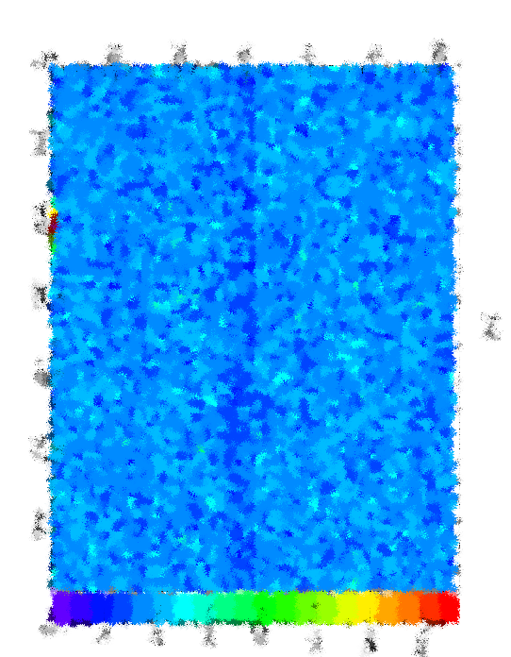
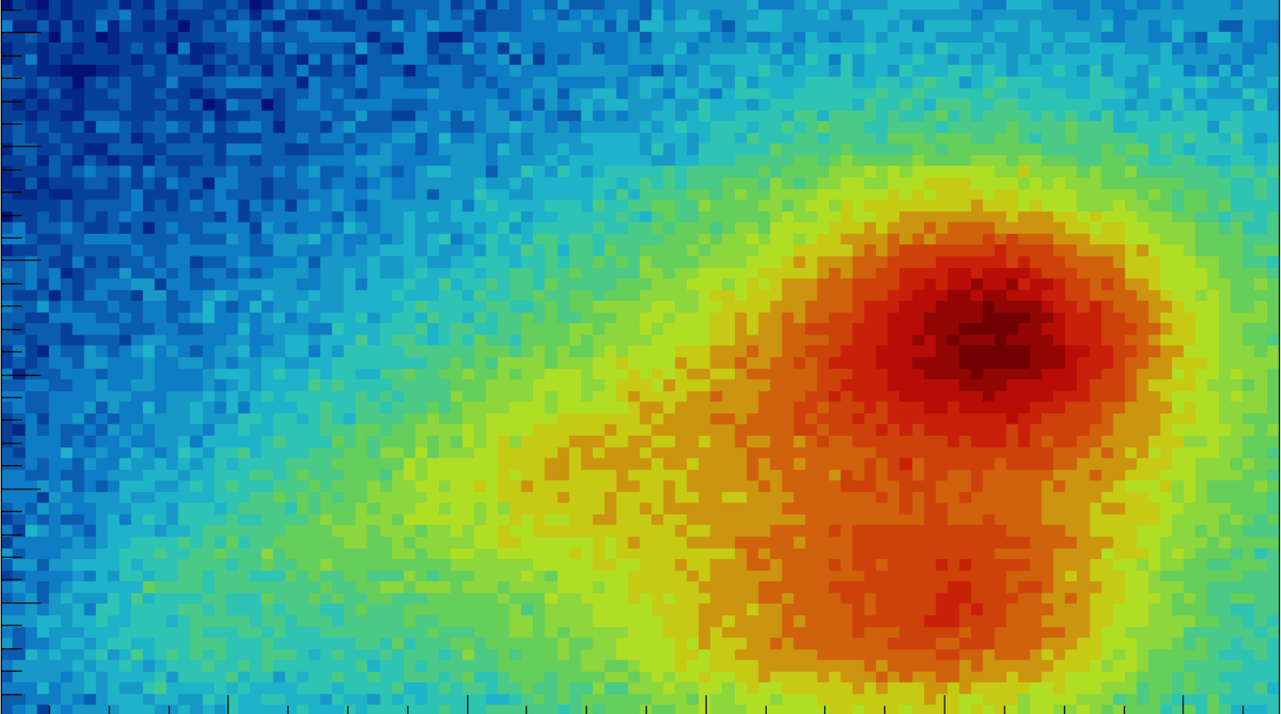
Thank you
for
your attention

Slide 29
backup

Slide 30


PI3SO
Final operational tests:
hot spots findings
Top
Bottom
Background scan:
- 15 mins scan;
- 8.3 s/cm speed;
- 5 counts/sec;
- Background subcracted.

Slide 31

Final operational tests:
hot spots findings
Top
Bottom
Sources free scan:
- 15 mins scan;
- 8.3 s/cm speed;
- 2.5 cm min distance from top detectors
- 2.1 cm min distance from bottom detectors
- Background subcracted.

Slide 32
Final operational tests:
hot spots findings
Top
Bottom
1 min data acquisition on the three detected hot-spots:
¹³⁷Cs, ⁶⁰Co, ²²Na

Slide 33

Final operational tests:
hot spots findings
Top
Bottom
Sources lead scan:
- 15 mins scan;
- 8.3 s/cm speed;
- 2.5 cm min distance from top detectors
- 2.1 cm min distance from bottom detectors
- 1 cm thick lead plate on top of ¹³⁷Cs source;
- Background subcracted.

Slide 34


PI3SO
Cesio in crociera
Final operational tests:
hot spots findings
Top
Bottom

Slide 35




PI3SO
Final operational tests:
hot spots finding
Lead
presence
on top of the
¹³⁷Cs source

Slide 36
PI3SO
Final operational tests:
hot spots findings
Source | X ± σ X [cm] | Y ± σ Y [cm]
¹³⁷Cs top | 15.1 ± 3.2 | 9.6 ± 2.7
¹³⁷Cs bottom | 15.4 ± 3.8 | 11.6 ± 3.2
⁶⁰Co top | 30.8 ± 3.2 | 54.2 ± 2.8
⁶⁰Co bottom | 30.7 ± 3.6 | 54.3 ± 3.0
²²Na top | 71.7 ± 3.2 | 31.8 ± 2.8
²²Na bottom | 71.7 ± 3.7 | 32.8 ± 3.3
¹³⁷Cs lead top | 15.0 ± 2.5 | 9.6 ± 2.1
¹³⁷Cs lead bottom | 15.4 ± 3.7 | 11.6 ± 3.1
⁶⁰Co lead top | 30.8 ± 2.9 | 54.2 ± 2.8
⁶⁰Co lead bottom | 30.8 ± 3.7 | 54.3 ± 3.2
²²Na lead top | 71.9 ± 3.1 | 31.8 ± 2.7
²²Na lead bottom | 71.9 ± 3.6 | 32.7 ± 3.2

Slide 37




PI3SO
Final operational tests:
ROI drawing & (S – B)/B
Sources free scan
¹³⁷Cs lead shielded
Background scan

Slide 38




PI3SO
Sources position on table
Preliminary results
Background scan.
Sources on top of the table
Shielded ¹³⁷Cs source.
Sources free scan
¹³⁷Cs lead shielded
Background scan
Y (64 cm)
Y (64 cm)
NO sources on the table
X 108 cm
X 108 cm

Slide 39






PI3SO
Final operational tests:
Spectroscopic measurements
Top
Top
Top
Bottom
Bottom
Bottom

Slide 40


Slide 41



Slide 42

VIRERO (VIrtual REmote RObotics for Radiometric Sorting), is currently being developed in Germany by AiNT GmbH, Friedrich-Alexander-Universität Erlangen-Nürnberg, and Framatome GmbH, funded by the Bundes Ministerium für Bildung und Forsch-ung (BMBF)

Slide 43

CLEANDEM The Gamma and Neutron Sensor System for Rapid Dose Rate Mapping in the CLEANDEM Project

Slide 44


Slide 45


Slide 46








As in real applications the speed can be a relevant requirement, we also tested the data quality at a ten times faster scanning speed, i.e., with a total duration of 1.5 min. In this case, in order to improve the statistics, the plots were also binned at 1 cm along the X (sliding direction). We obtained basically the same images with worse statistics, but the hot-spots are still recognized.
Lead
Top
Lead
Bottom

Slide 47


Slide 48
PI3SO
Conclusions
Detectors: low cost, compact, robust, commercial components
Fast scan, results in line with expectations
Reliable, repeatable, safe operations
Digital data storage, full scan history available
Precision measurements; no need of operator

