Slide 1
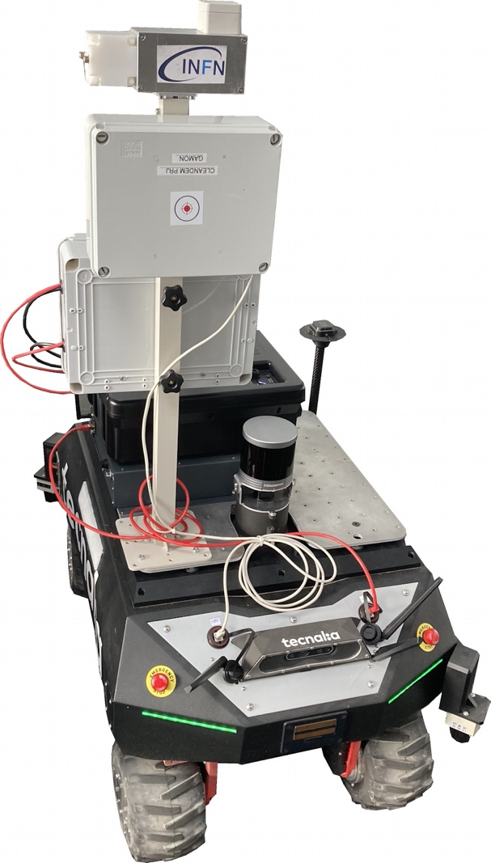
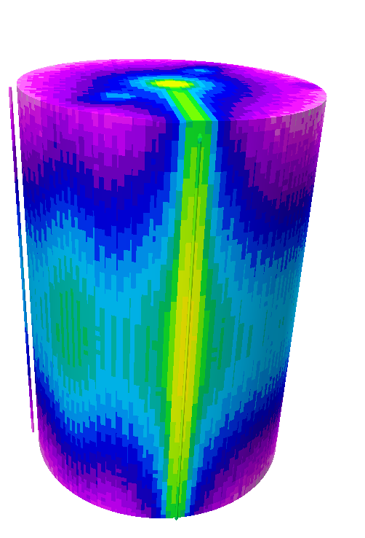
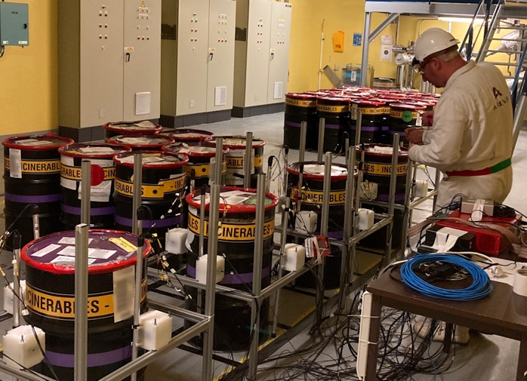
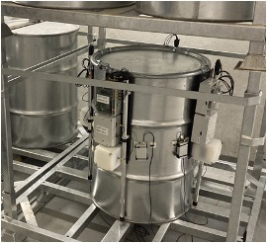

DeSyT-2025
2nd International Workshop on Detection Systems and Techniques for Fundamental and Applied Physics, Catania (Italy), Feb 24-26, 2025
Sensor systems for radwaste monitoring and nuclear decommissioning:
experience from the Euratom projects MICADO, PREDIS, CLEANDEM
Paolo Finocchiaro
Istituto Nazionale di Fisica Nucleare
Laboratori Nazionali del Sud, Catania, Italy
MICADO, PREDIS, CLEANDEM projects have received funding from the European Union’s Horizon 2020 research and innovation programme under grant agreements No 847641, No 945335, No 945098.

Slide 2




INFN-Energy committee
supports energy-related initiatives
EU
EU projects
SME

Slide 3

our R&D activity in the radwaste
monitoring field started in 2008
Ansaldo Nucleare funded
5 fellowships on the subject
2008
INFN-E DMNR
contract between INFN and Sogin 2013-2014
INFN-E HELNEM
INFN-E RADSIEVE
2019-2023: Euratom H2020 MICADO
2020-2024: Euratom H2020 PREDIS
2021-2024: Euratom H2020 CLEANDEM
2025
INFN-E PI3SO

Slide 4





triggered participation to H2020 Euratom projects
and the development of new applications
Type | Name | Takes part in | Period | #Partners | Note
 |  | WP7 (leader) | 2019-2023 concluded | 9
 | SmarTent |  |  |  | Detectors derived from MICADO
 | Portal |  |  |  | Detectors derived from MICADO
 |  | WP7 | 2020-2024 concluded | 47 | Pending new spinoff activities
 |  | WP3, WP4 | 2021-2024 concluded | 11
 |  |  |  |  | Detectors derived from CLEANDEM
EU
EU
EU
PI3SO

Slide 5


Slide 6

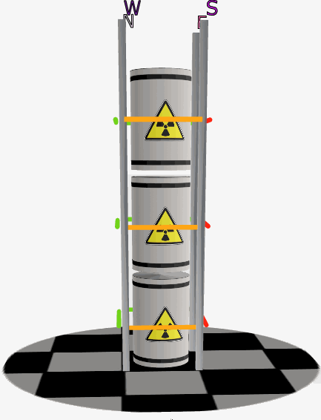
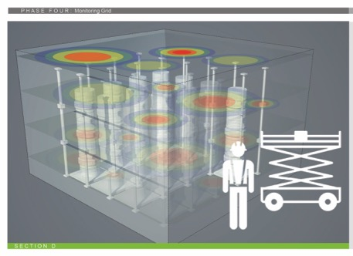
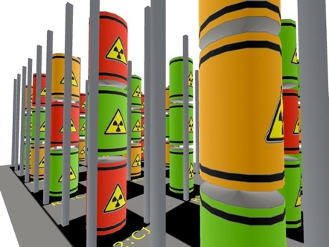
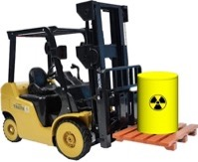
Partner | Country
CAEN | IT
ORANO | FR
CEA | FR
XIE | GE
CTU | CZ
ENEA | IT
INFN | IT
SCK•CEN | BE
SOGIN | IT
EU
Euratom call NFRP-2018-10
Measurement and Instrumentation for Cleaning And Decommissioning Operations
Radwaste characterization, classification, monitoring and data archiving
Flexibility, Transportability, Digitization, Quantification, Traceability
This project has received funding from the European Union’s Horizon 2020 innovation action programme under grant agreement No 847641.
This text reflects only the author’s views and the Commission is not liable for any use that may be made of the information contained therein.

Slide 7





Radwaste radiological monitoring
beta particles are mostly stopped inside the material and in air
what comes out?
alpha particles are immediately stopped inside the material
fission fragments are immediately stopped inside the material
neutrons, from fission or (α,n) reactions, come out very easily typically at low dose-rates; in some cases there can be many
gamma rays are ubiquitous, penetrating, and come out easily and abundantly
basic radioactivity coming out is gamma rays and neutrons
they carry information from inside and are worth monitoring
easier external monitoring

Slide 8

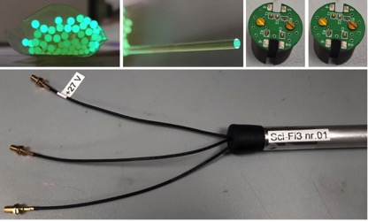
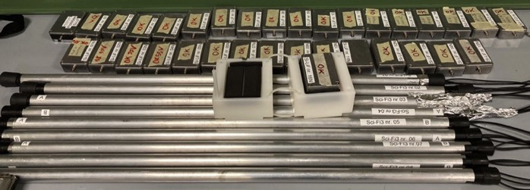
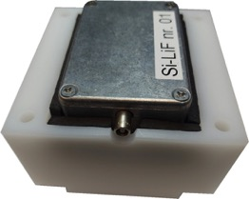
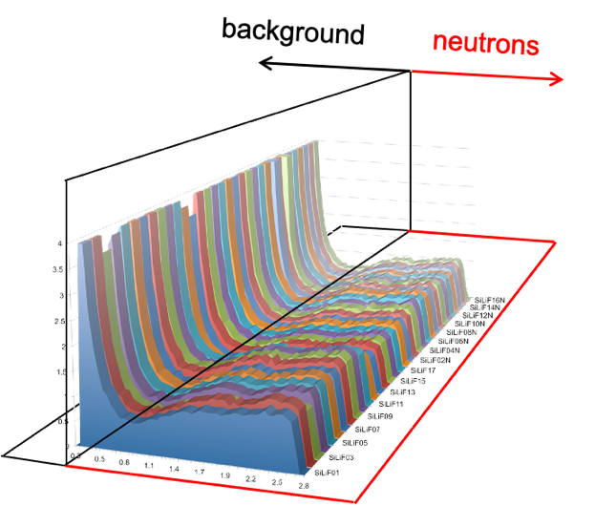
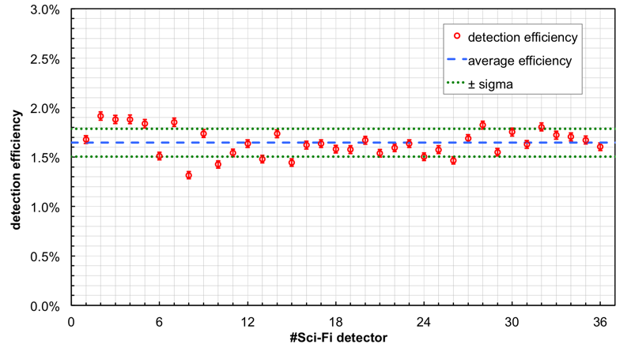
Sensors developed by INFN
SciFi SiLiF
gamma and neutron detectors for long term radwaste monitoring
SciFi (gamma)
SiLiF (neutron)
γ/n rejection
≈ 10⁻⁹
same threshold
no V bias fine-tuning
Details later in Gaetano Elio Poma's talk

Slide 9
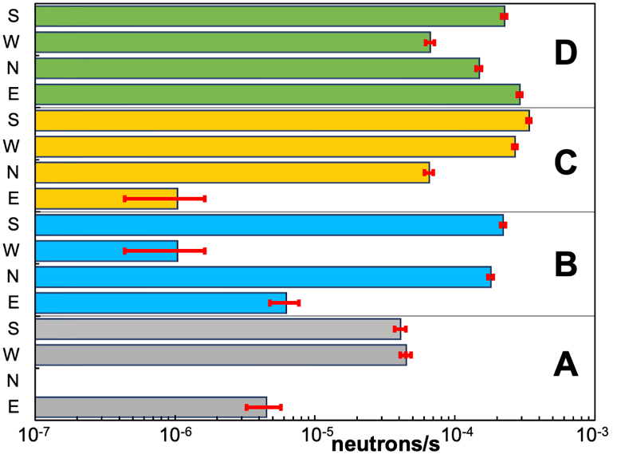
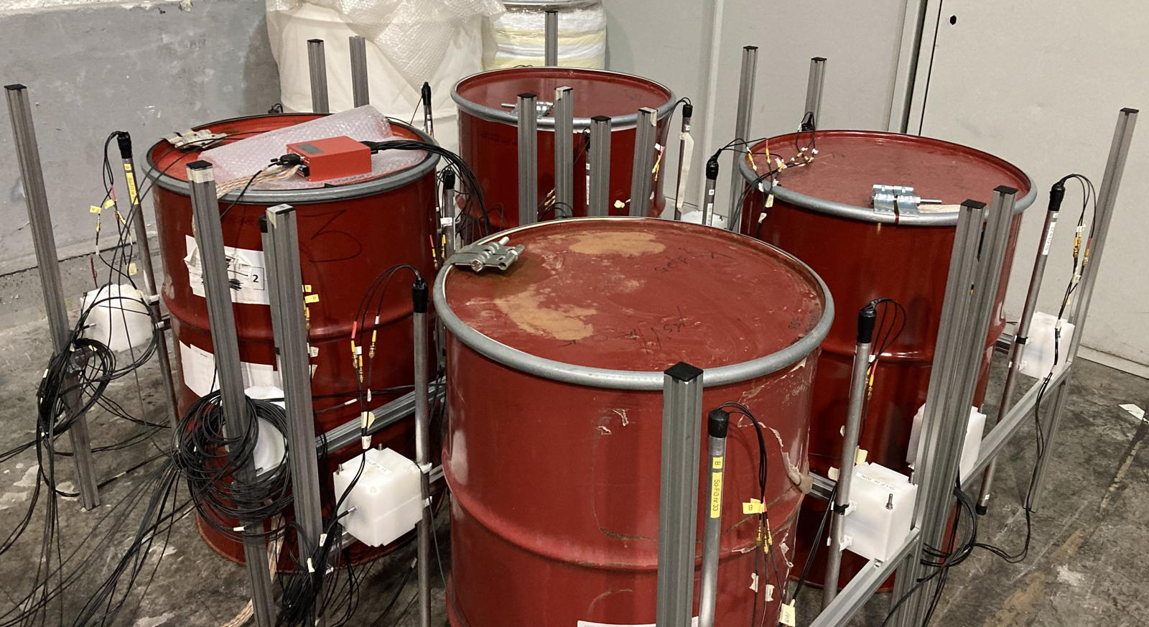
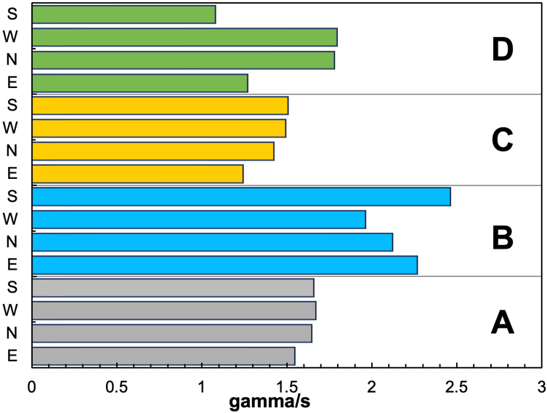
tested with low level waste (LLW)
Nucleco (Casaccia, Rome) 2023
1-month data taking
10⁻⁵ to 10⁻⁴ n/s
1.5 to 2 𝛄/s
bg ≈ 0.5 𝛄/s

Slide 10
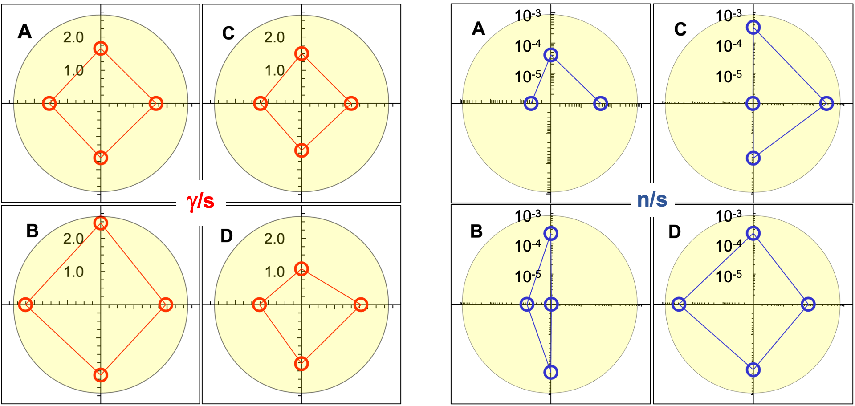
tested with low level waste (LLW)
Nucleco (Casaccia, Rome) 2023
gammas
neutrons

Slide 11
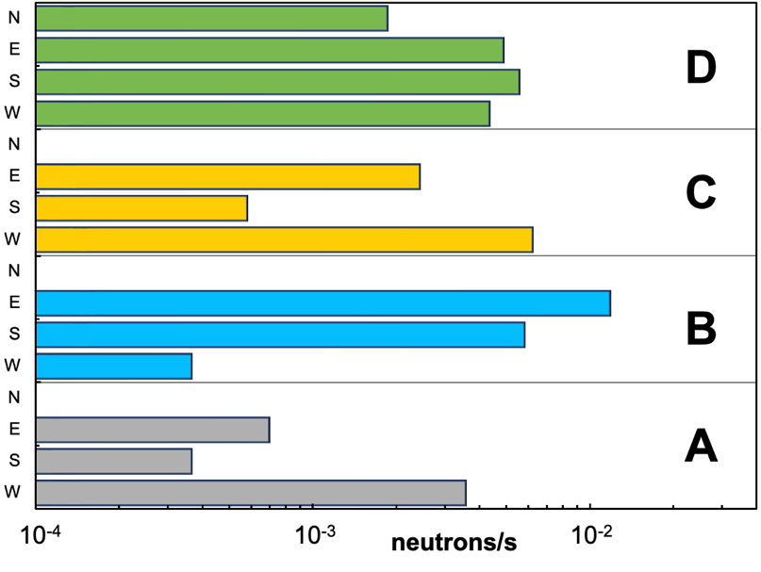
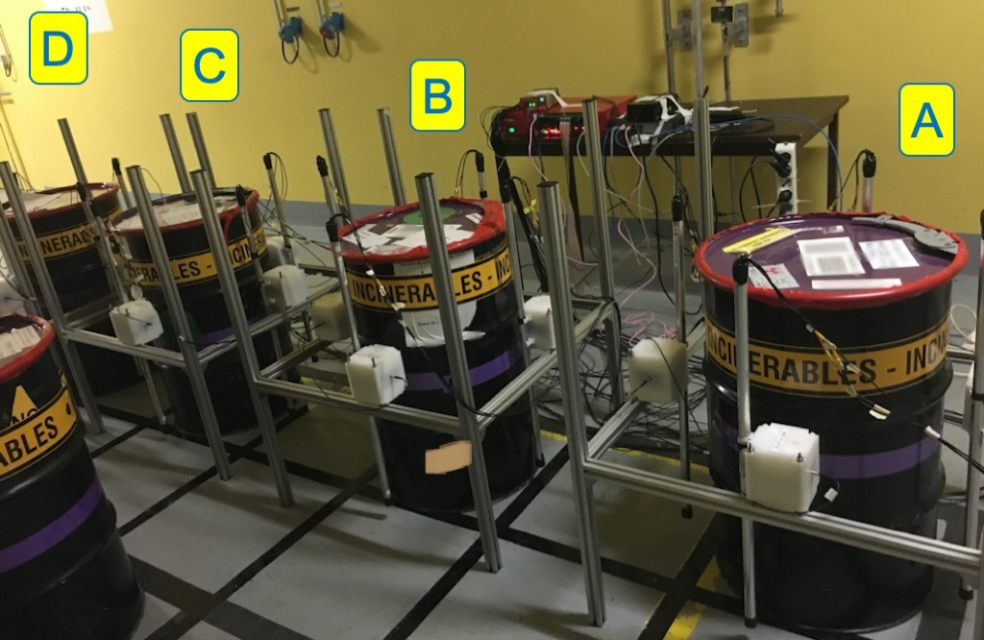
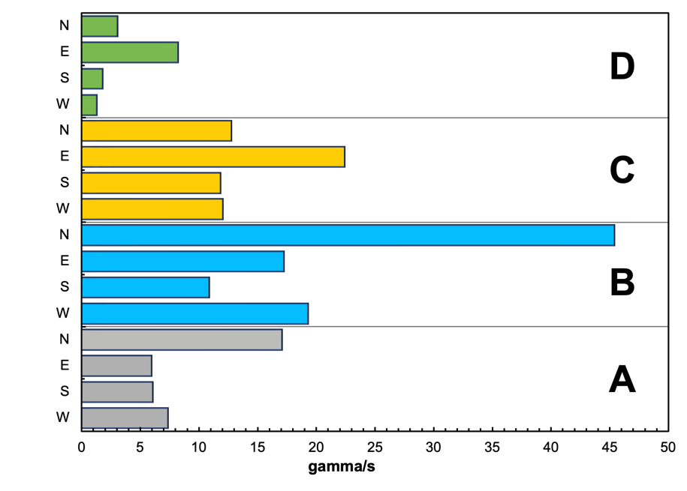
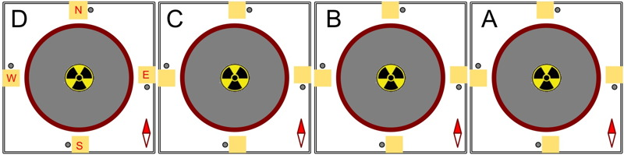
tested with intermediate level waste (ILW with Plutonium)
Orano (La Hague, France) 2022
2-day data taking
10⁻³ to 10⁻² n/s
5 to 45 𝛄/s
bg ≈ 0.5 𝛄/s

Slide 12
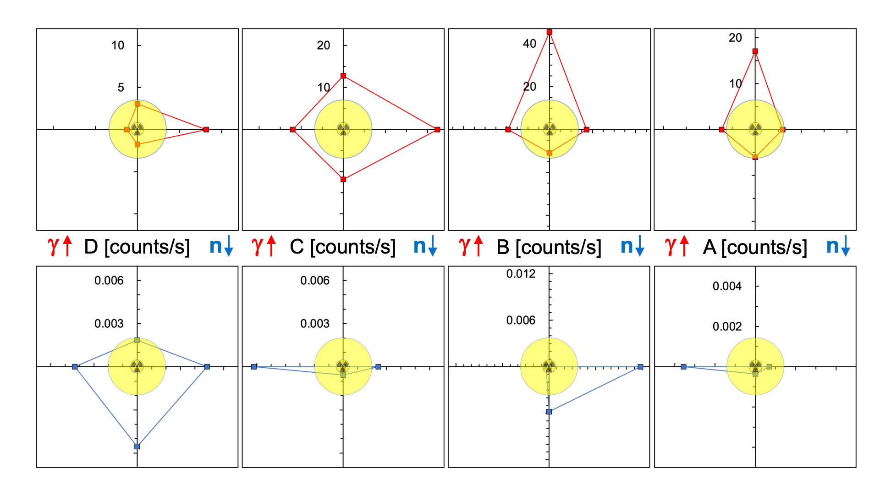
tested with intermediate level waste (ILW with Plutonium)
Orano (La Hague, France) 2022
gammas
neutrons

Slide 13
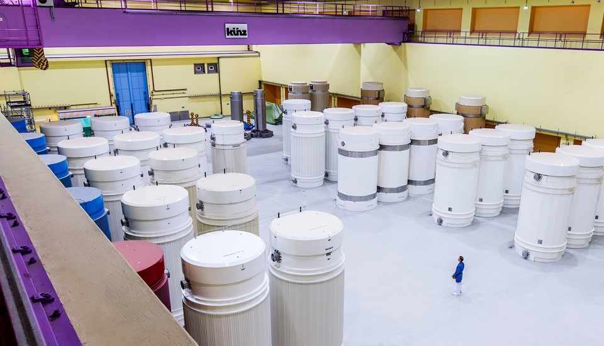
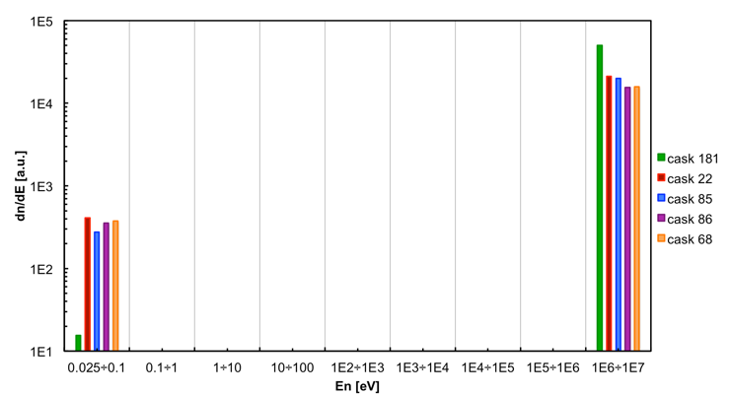
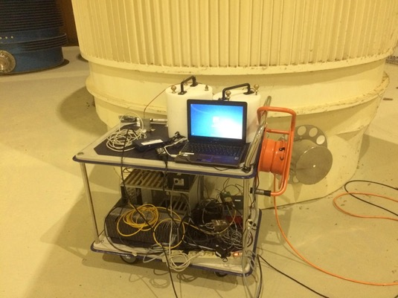
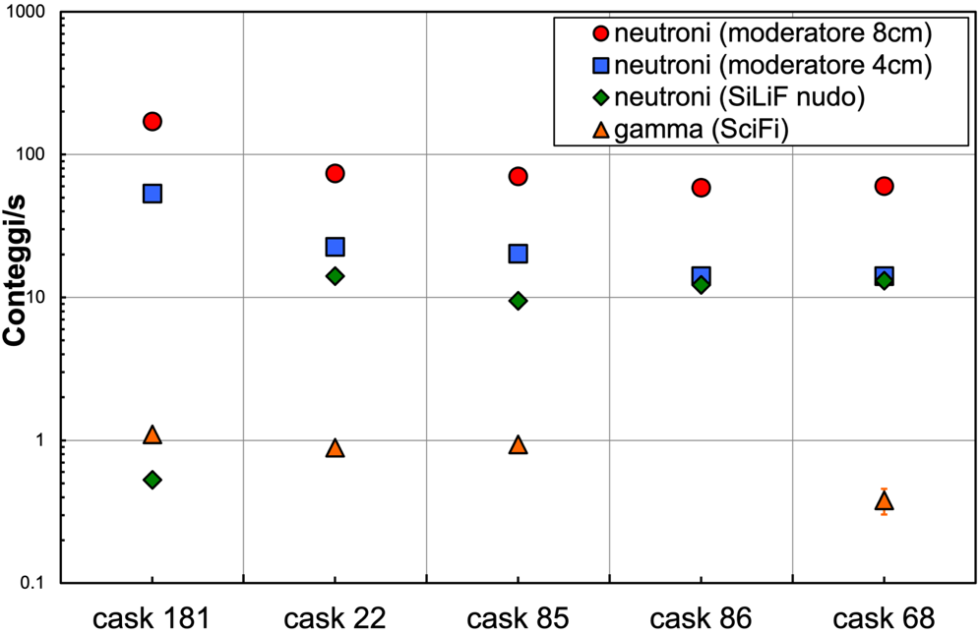
SiLiF & SciFi tested with spent fuel (2 days)
Zwilag (Würenlingen, Switzerland) 2018
!!!
neutron spectra
(5 casks)
cask 181
vitrified waste
non-moderated
!!!

Slide 14
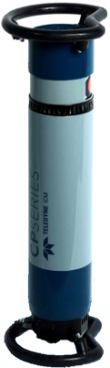
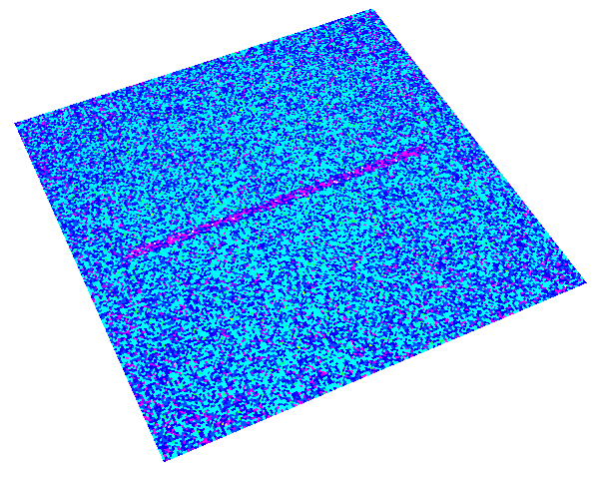
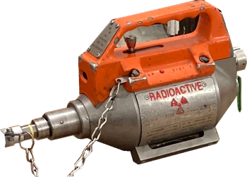
huge X-ray flux & dose monitoring
SciFi tested with high intensity X-ray machine
SciFi tested with 1 TBq gamma sources
further developments & collaborations in progress (NDA's)

Slide 15
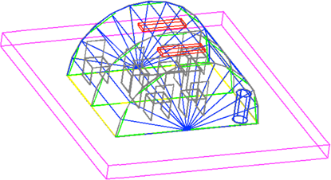
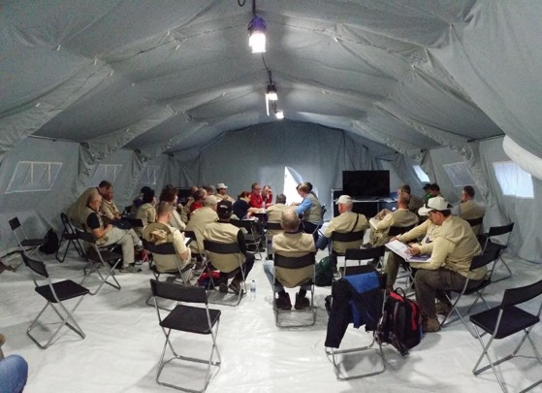
SmarTent
Side development from MICADO gamma counters:
SmarTent
Safeguards inspections:
equip a tent or a room with γ counters
further developments & collaborations in progress (ENEA)

Slide 16
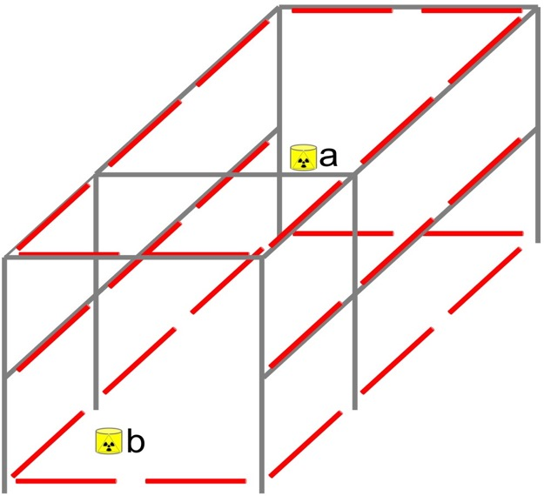
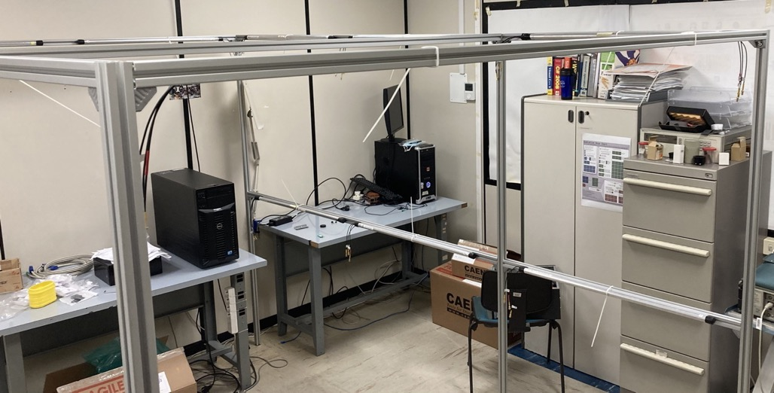
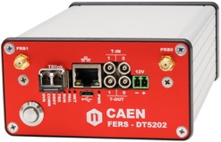
SmarTent
demonstrator with 26 SciFi detectors
2m
3m
2m
signals
provides the bias to SiPMs (low voltage)
directly accepts the SiPM output
handles 64 SiPMs i.e. up to 32 SciFi

Slide 17

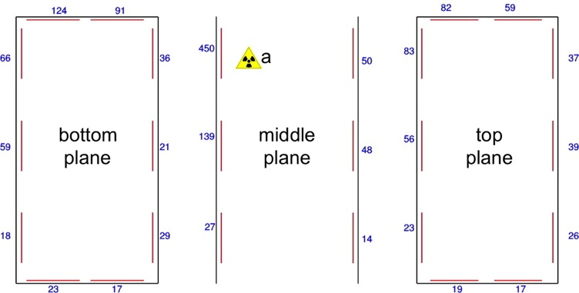
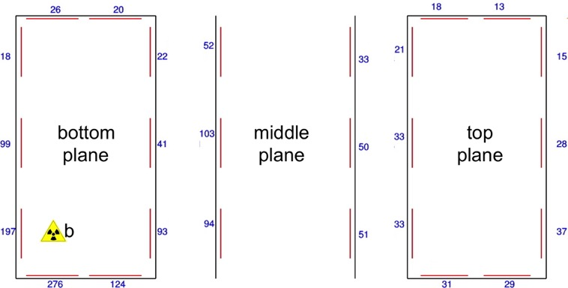
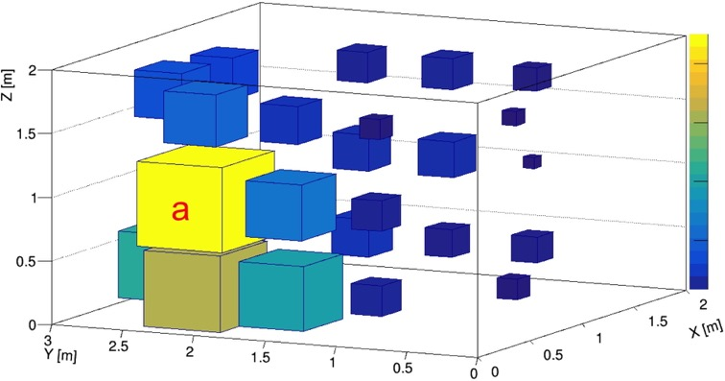
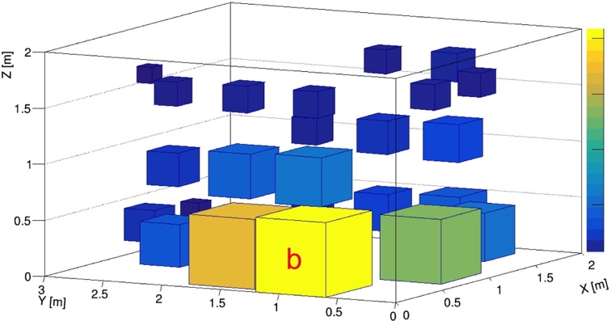
SmarTent
test with ¹³⁷Cs gamma source - 1.4 MBq
30s collection time

Slide 18
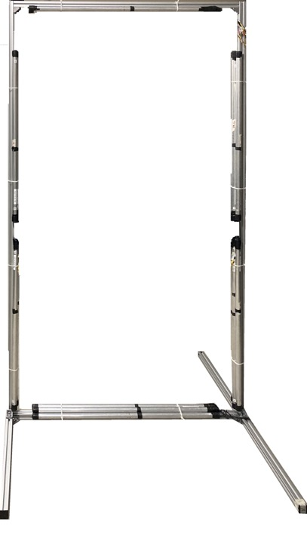
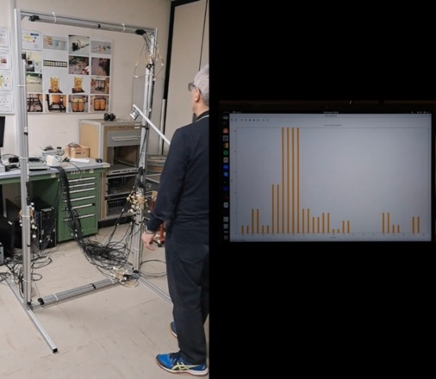
Portal
Side development from MICADO gamma counters:
gamma portal
natural background: ≈ 1 cps
with 1MBq ¹³⁷Cs source: ≈ 30 cps
further developments & collaborations in progress (NDA's)

Slide 19



Slide 20

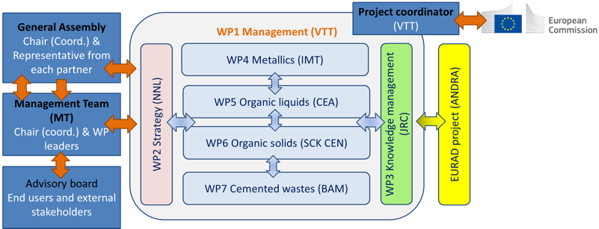
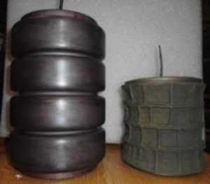
VTT | FI
NNL | UK
JRC | BE
IMTA | FR
CEA | FR
SCK•CEN | BE
BAM | DE
MAGICS | BE
TUS | BG
CTU | CZ
CVRez | CZ
SÚRO | CZ
UJV | CZ
UniHel | FI
CNRS | FR
ECL | FR
IRSN | FR
ORANO | FR
DMT | DE
FZJ | DE
KIT | DE
NCSRD | EL
ISOT | HU
SORC | HU
TSE | HU
ANN | IT
ENEA | IT
INFN | IT
NUC | IT
POLIMI | IT
SOGIN | IT
UNIPI | IT
FTMC | LT
NRG | NL
IFE | NO
RATEN | RO
A21 | ES
CIEMAT | ES
CSIC | ES
ENRESA | ES
UAM | ES
PSI | CH
GSL | UK
MCM | UK
UoM | UK
USFD | UK
KIPT | UA
SIIEG | UA
EU
Euratom call NFRP-2019-10
7 Work Packages
PRE-DISPOSAL MANAGEMENT OF RADIOACTIVE WASTE
development and implementation of innovative technologies for
pre-disposal of radwaste streams other than nuclear fuel and HLW
radwaste treatment, safety, radionuclides, nuclear science and technology, package monitoring, material science
metallic materials (WP4)
liquid organic waste (WP5)
solid organic waste (WP6)
innovations in cemented waste handling and pre-disposal storage (WP7)
47 partners
17 countries
25 End User Group members
This project has received funding from the European Union’s Horizon 2020 innovation action programme under grant agreement No 945098.
This text reflects only the author’s views and the Commission is not liable for any use that may be made of the information contained therein.

Slide 21
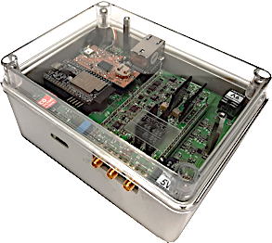
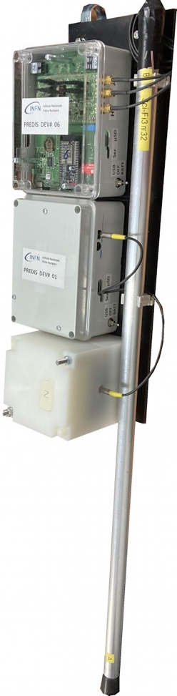
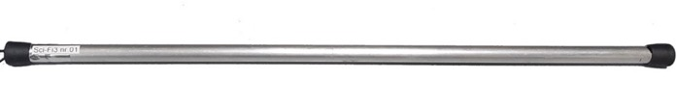
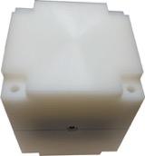
pre-disposal storage: monitoring of cemented waste (WP7.3)
SciFi front-end electronics, DAQ
& wireless data transmission
Same sensors as
in MICADO...
SiLiF front-end electronics, DAQ
& wireless data transmission
+
+
SiLiF neutron sensor
...with newly developed Electronics &
Wireless Data Acquisition
SciFi gamma sensor

Slide 22

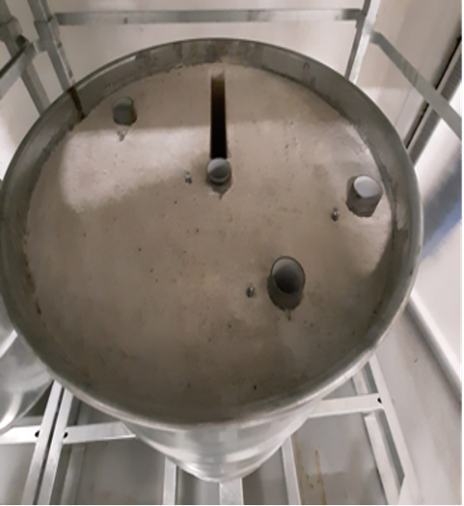

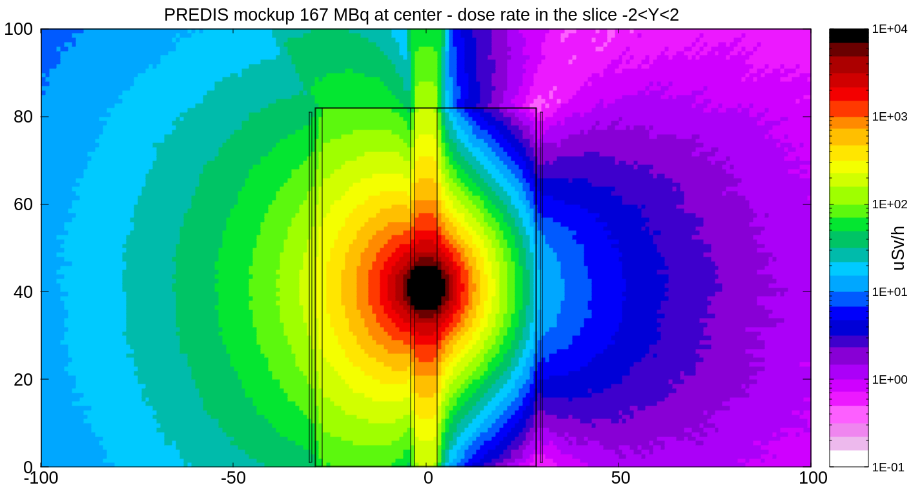
pre-disposal storage: monitoring of ILW cemented waste (WP7.3)
final demonstration UJV-REZ (Prague, Czech Republic) 2024
167 MBq ¹³⁷Cs
SciFi sensors
4 SciFi sensors
cemented mockup drum
simulation of expected dose rate

Slide 23
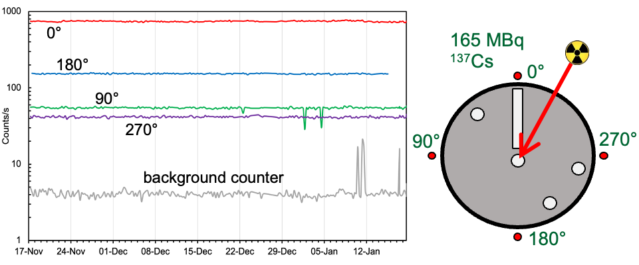
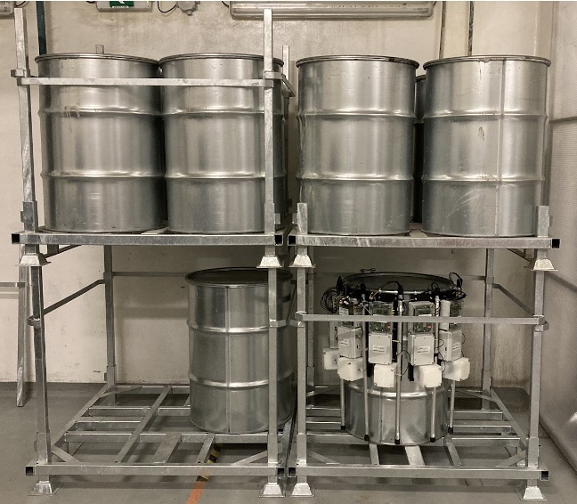
pre-disposal storage: monitoring of ILW cemented waste (WP7.3)
final demonstration UJV-REZ (Prague, Czech Republic) 2024
2-month data taking

Slide 24








installed around single drums
hooked on single drums
installed on stillages
Database

Slide 25



Slide 26


Partner | Country
CEA | FR
ORANO | FR
CAEN | IT
ENEA | IT
INFN | IT
ARTTIC | FR
SOGIN | IT
ANSALDO | IT
RINA-CSM | IT
AINT | DE
TECNALIA | ES
EU
Euratom call NFRP-2019/20-09
10 Work Packages
Cyber physicaL Equipment for unmAnned Nuclear DEcommissioning Measurements
development of a small Unmanned Ground Vehicle (UGV) equipped with sensors
Dismantling and Decommissioning of nuclear facilities and installations
This project has received funding from the European Union’s Horizon 2020 innovation action programme under grant agreement No 945335.
This text reflects only the author’s views and the Commission is not liable for any use that may be made of the information contained therein.

Slide 27



Unmanned Ground Vehicle for decommissioning & accident remediation
demo mission with 4 sources and neutron generator
AiNT (Aachen, Germany) 2024
n-generator

Slide 28



PI3SO
Side development from CLEANDEM miniradmeter:
PI3SO - Proximity Imaging System for Sort and Segregate Operations
64 × 1cm³ scintillators
test spectra with ¹³⁷Cs gamma source
64 × 1cm³ scintillators
Details in Chiara Rita Failla's talk

Slide 29


PI3SO
²²Na
15.4 kBq
⁶⁰Co
56 kBq
Proximity Imaging for Spectroscopic
Sort & Segregate Operations
¹³⁷Cs
1.4 MBq
Top view
Bottom view
Details in Chiara Rita Failla's talk

Slide 30
Summary and prospects
reliable gamma and neutron detectors have been developed at INFN
flexible: radwaste, ambient monitoring, scanners, dosimeters, ...
safety & security: airrports, buildings, nuclear material transports,...
successfully tested from very low to very high dose rates
discussions under way with companies
😀
solutions in search of problems?

Slide 31
M. Ripani et al., Field Test of the MiniRadMeter Gamma and Neutron Detector for the EU Project CLEANDEM, Sensors 2024, 24, 5905. https://doi.org/10.3390/s24185905
G.E. Poma et al., PI3SO: A Spectroscopic γ-Ray Scanner Table for Sort and Segregate Radwaste Analysis, Inventions 2024, 9, 85. https://doi.org/10.3390/inventions9040085
M. Romoli et al., A Wireless Gamma-Ray Monitoring System for Cemented Radwaste Drums, Sensors 2024, 24, 2332. https://doi.org/10.3390/s24072332
L. Cosentino et al., SiLiF Neutron Counters to Monitor Nuclear Materials in the MICADO Project, Sensors 2021, 21, 2630. https://doi.org/10.3390/s21082630
L. Cosentino et al., Gamma-Ray Counters to Monitor Radioactive Waste Packages in the MICADO Project, Instruments 2021, 5, 19. https://doi.org/10.3390/instruments5020019
P. Finocchiaro, From nuclear physics to applications: detectors for beam handling, medical diagnostics and radioactive waste monitoring, Eur. Phys. J. Plus (2020) 135:345. https://doi.org/10.1140/epjp/s13360-020-00352-5
Fabio Longhitano et al., A Scintillator Array Table with Spectroscopic Features, Sensors 2022, 22, 4754. https://doi.org/10.3390/s22134754
A.P. Caricato et al., Thermal neutron conversion by high purity ¹⁰B-enriched layers: PLD-growth, thickness-dependence and neutron-detection performances, Eur. Phys. J. Plus (2022) 137:431. https://doi.org/10.1140/epjp/s13360-022-02523-y
A. Massara et al., ⁶LiF Converters for Neutron Detection: Production Procedures and Detector Tests, Instruments 2023, 7, 1. https://doi.org/10.3390/instruments7010001
F. Rossi et al., The Gamma and Neutron Sensor System for Rapid Dose Rate Mapping in the CLEANDEM Project, Sensors 2023, 23, 4210. https://doi.org/10.3390/s23094210
P. Finocchiaro et al., New technologies for radioactive waste monitoring: Results and perspectives from recent experience, IL NUOVO CIMENTO 46 C (2023) 34. https://doi.org/10.1393/ncc/i2023-23034-9
C. Provenzano et al., Development of a High-Efficiency Device for Thermal Neutron Detection Using a Sandwich of Two High-Purity ¹⁰B Enriched Layers, Sensors 2023, 23, 9831. https://doi.org/10.3390/s23249831
M. Morichi et al., The MICADO project and its possible upgrades, IL NUOVO CIMENTO 46 C (2023) 46. https://doi.org/10.1393/ncc/i2023-23046-5
overall scientific production since 2008:
> 100 contributions
≈ 30 students (diploma, master, PhD)
last 4 years:
13 articles in peer reviewed journals

Slide 32

Thank you for your attention
...and thanks to all these people for their contributions and support
Gianni, Ricco, Emilio Migneco, Marcello Lattuada, Marco Ripani, Eugenio Nappi, Luigi Cosentino, Alfio Pappalardo, Gianfranco Vecchio, Sergio Scirè, Massimo Barbagallo, Giuseppe Greco, Carlotta Scirè, Carmela Greco, Stefania Grillo, Martina Giuffrida, Carmelo Marchetta, Antonio Massara, Pietro Litrico, Giuseppe Passaro, Fabio Longhitano, Gaetano Elio Poma, Simone Amaducci, Gabriel Frei, Stefano Caruso, Federica Pancotti, Monica Sisti, Nadia Cherubini, Giuseppe Marzo, Luigi Lepore, Giada Gandolfo, Nicolò Ratto, Sergio Lo Meo, Antonietta Rizzo, Matias Simonetto, Quentin Ducasse, Mauro Romoli, Michele Di Giovanni, Paolo Di Meo, Antonio Pandalone, Claudio Principe, Ernst Niederleithinger, Sabah Ben Lagha, Karel Prchal, Jakub Zaruba, Coralie Chapuzet, Thibaut Hemedinger, Lionel Tondut, Christopher Helbert, Eric Breuil, Maugan Michel, Camille Theroine, Anna Paola Caricato, Gianluca Quarta, Marcella Marra, Chiara Provenzano, Chiara Failla
...apologies to those I could have (surely!) forgotten

