Slide 1
The new FPD of MAGNEX: first results
Antonino Pitronaci
Preliminary concepts
The gas tracker prototype
Electric characterization
First coupling: gas tracker and SiC-detector
IRRAD4 @IFUSP
Conclusions
First characterization of the gas tracker of the new focal plane detector of the MAGNEX spectrometer for the NUMEN project
Antonino Pitronaci
February 24th - 26th, 2025
UniCT DFA ”E. Majorana” INFN - Laboratori Nazionali del Sud
Tutor: Chiar.mo Prof. F. Cappuzzello
Co-Tutors: Dr. M. Cavallaro
Dr. D. Carbone
DeSyT2025 - Feb. 24-26, 2025
DeSyT2025 - Feb. 24-26, 2025

Slide 2
NUMEN: NUclear Matrix Elements for Neutrinoless double-beta decay
The new FPD of MAGNEX: first results
Antonino Pitronaci
Preliminary concepts
Objectives: getting data-driven information on neutrinoless double-beta (0νββ) Nuclear Matrix Elements (NMEs);
Methods: measurements of Heavy-Ion induced Double Charge Exchange reaction cross-section;
Experimental setup @INFN-LNS:
K800 Superconducting Cyclotron (CS);
MAGNEX large acceptance magnetic spectrometer;
The gas tracker prototype
Electric characterization
First coupling: gas tracker and SiC-detector
IRRAD4 @IFUSP
Conclusions
International Project Network:
NUMEN Collaboration: 34 International Research Institutes - 105 Researchers
DeSyT2025 - Feb. 24-26, 2025 1/15

Slide 3
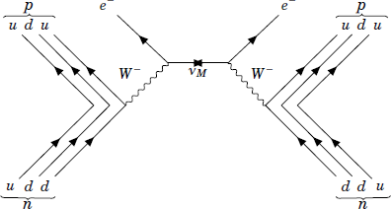
The key role of Heavy-Ion induced Double Charge Exchange reactions
The new FPD of MAGNEX: first results
Antonino Pitronaci
Neutrinoless double-beta decay
Double Charge Exchange reaction
Preliminary concepts
The gas tracker prototype
Electric characterization
First coupling: gas tracker and SiC-detector
IRRAD4 @IFUSP
Conclusions
$${}_{Z}^{A}{X_{N}}→{}_{Z+2}^{A}{Y_{N−2}}+2e^{−}$$
$${}_{Z^{′}}^{A^{′}}{a_{N}}+{}_{Z}^{A}{X_{N}}→{}_{Z^{′}−2}^{A^{′}}{b_{N+2}}+{}_{Z+2}^{A}{Y_{N−2}}$$
$${\left[T_{1/2}\right]}^{−1}=G_{0ν}{\left|M_{0ν}\right|}^{2}\left|f(m_{i},U_{ei},ξ_{i})\right|$$
Common properties:
same mother/daughter nuclei;
short-range Fermi, Gamow-Teller and rank-2 tensor operators;
DCE-reactions advantages:
No Q_{value} dependence;
higher yield due to the nuclear interaction;
Details on HI-DCE reactions: - F. Cappuzzello et al. PPNP 128 (2023), 103999
DeSyT2025 - Feb. 24-26, 2025 2/15

Slide 4
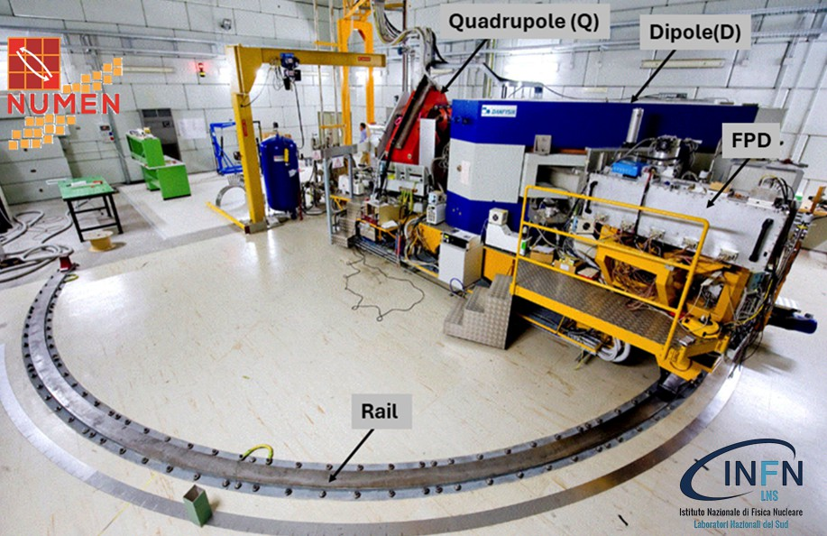
MAGNEX: a large acceptance magnetic spectrometer
The new FPD of MAGNEX: first results
Antonino Pitronaci
Technological challenges
Preliminary concepts
high tracking performances:
$Δx_{foc}=Δy_{foc}≤0. 6mm$ (FWHM)
$Δθ_{foc}≤0.3°$(FWHM) $− Δφ_{foc}≤0.5°$(FWHM)
The gas tracker prototype
Electric characterization
First coupling: gas tracker and SiC-detector
IRRAD4 @IFUSP
Conclusions
high identification power:
$\frac{ΔZ}{Z}=\frac{1}{48} − \frac{ΔA}{A}=\frac{1}{300}$
Bearing unprecedented high-intensity beams (10¹³ pps at the target);
Radiation hardness;
How to handle with aberrations?
$\left(\begin{matrix}x_{f} \\ θ_{φ} \\ y_{f} \\ φ_{f}\end{matrix}\right)=\hat{G}$ $\left(\begin{matrix}θ_{i} \\ y_{i} \\ φ_{i} \\ δ\end{matrix}\right), δ=\frac{p−p_{0}}{p_{0}}$
Magnetic field mapping: MAGNEX peculiarity;
COSY infinity: algebraic methods-based software, allowing to solve the equation of the motion at high order to obtain the energy(ies) and angles at the target point
Technological challenges: - F. Cappuzzello et al. IJMPA 36(2130018) 2021
- D. Torresi et al. NIMA 989 (164918), 2021

Slide 5
MAGNEX: a large acceptance magnetic spectrometer
The new FPD of MAGNEX: first results
Antonino Pitronaci
Technological challenges
Preliminary concepts
high tracking performances:
$Δx_{foc}=Δy_{foc}≤0. 6mm$ (FWHM)
$Δθ_{foc}≤0.3°$(FWHM) $− Δφ_{foc}≤0.5°$(FWHM)
The gas tracker prototype
Electric characterization
First coupling: gas tracker and SiC-detector
IRRAD4 @IFUSP
Conclusions
high identification power:
$\frac{ΔZ}{Z}=\frac{1}{48} − \frac{ΔA}{A}=\frac{1}{300}$
Bearing unprecedented high-intensity beams (10¹³ pps at the target);
Radiation hardness;
How to handle with aberrations?
${\hat{G}}^{−1}\left(\begin{matrix}x_{f} \\ θ_{φ} \\ y_{f} \\ φ_{f}\end{matrix}\right)=$ $\left(\begin{matrix}θ_{i} \\ y_{i} \\ φ_{i} \\ δ\end{matrix}\right), δ=\frac{p−p_{0}}{p_{0}}$
Magnetic field mapping: MAGNEX peculiarity;
COSY infinity: algebraic methods-based software, allowing to solve the equation of the motion at high order to obtain the energy(ies) and angles at the target point
Technological challenges: - F. Cappuzzello et al. IJMPA 36(2130018) 2021
- D. Torresi et al. NIMA 989 (164918), 2021

Slide 6
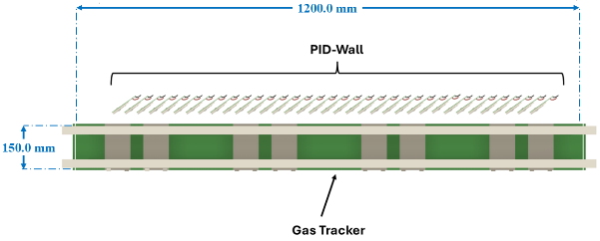
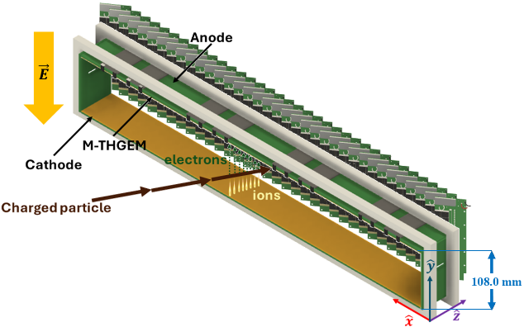
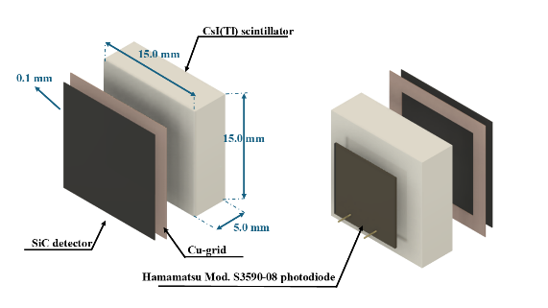
The new focal Plane Detector
The new FPD of MAGNEX: first results
Antonino Pitronaci
Track-reconstruction & PID
Preliminary concepts
Gas tracker:
gas at low pressure: (10-30) mbar;
based on M-THGEM;
high tracking resolution & rate robustness;
PID-Wall (details: Dr. C. Lombardo talk)
∆E-stage: SiC detector;
E-stage: CsI(Tl) scintillator;
high radiation hardness to bear 10¹³ions/cm²
The gas tracker prototype
Electric characterization
First coupling: gas tracker and SiC-detector
IRRAD4 @IFUSP
Conclusions
New FPD details: - F. Cappuzzello et al. IJMPA 36(2130018) 2021
DeSyT2025 - Feb. 24-26, 2025 4//15

Slide 7
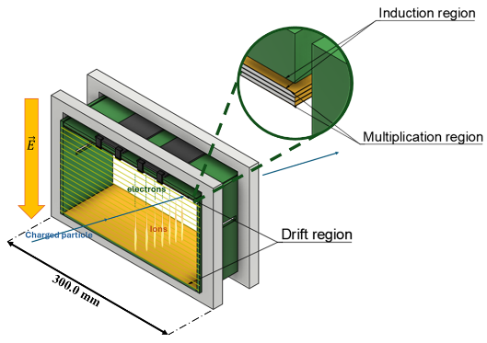
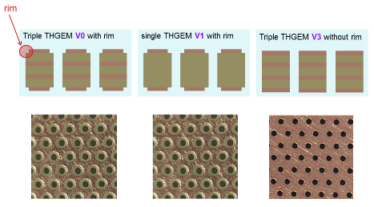
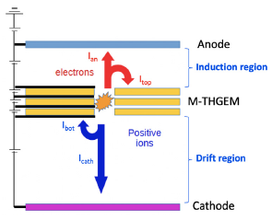
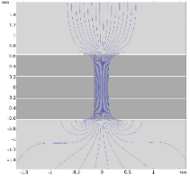
The gas tracker prototype
The new FPD of MAGNEX: first results
Antonino Pitronaci
Preliminary concepts
The gas tracker prototype
M-THGEM advantages:
High achievable gain, stability, robustness, ideal for heavy-ions detection;
Electric characterization
First coupling: gas tracker and SiC-detector
IRRAD4 @IFUSP
Conclusions
Vertical section of the tracker & electric field lines within a 3-THGEM obtained with COMSOL.
M-THGEMs details: - I. Ciraldo et al. NIMA 1048 (167893), 2023
DeSyT2025 - Feb. 24-26, 2025 5/15

Slide 8
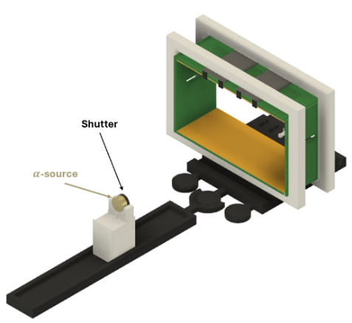
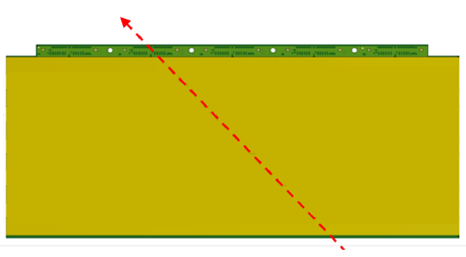
The experimental setup and methods for the electric characterization
The new FPD of MAGNEX: first results
Antonino Pitronaci
Experimental setup
Experimental methods
Preliminary concepts
The gas tracker prototype
Probe: α by ²⁴¹Am radioactive α-source;
Working regime: i-C₄H₁₀ @ [10-30] mbar;
Tool: pico® by INFN-Sez. Napoli
Measurements of currents:
- Shutter closed: dark currents;
- Shutter open: charge carriers;
Electric characterization
First coupling: gas tracker and SiC-detector
IRRAD4 @IFUSP
Conclusions
$α$ track
DeSyT2025 - feb. 24-25, 2025 8/13
DeSyT2025 - Feb. 24-26, 2025 6/15

Slide 9
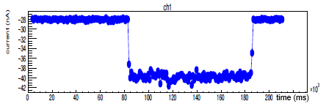
The experimental setup and methods for the electric characterization
The new FPD of MAGNEX: first results
Antonino Pitronaci
Experimental setup
Experimental methods
Preliminary concepts
The gas tracker prototype
Probe: α by ²⁴¹Am radioactive α-source;
Working regime: i-C₄H₁₀ @ [10-30] mbar;
Tool: pico® by INFN-Sez. Napoli
Measurements of currents:
- Shutter closed: dark currents;
- Shutter open: charge carriers;
Electric characterization
First coupling: gas tracker and SiC-detector
IRRAD4 @IFUSP
Conclusions
Anodic dark current(s)
electron current
DeSyT2025 - feb. 24-25, 2025 9/13
DeSyT2025 - Feb. 24-26, 2025 7/15

Slide 10
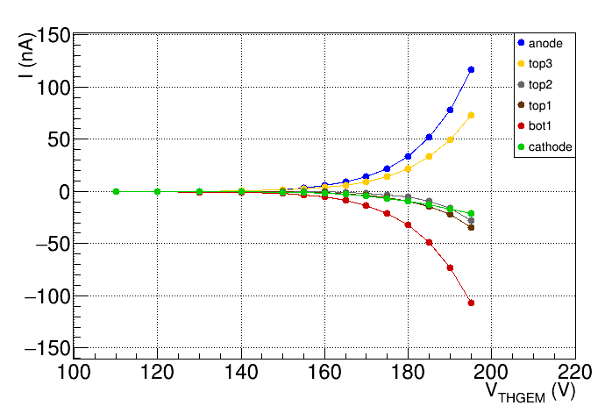
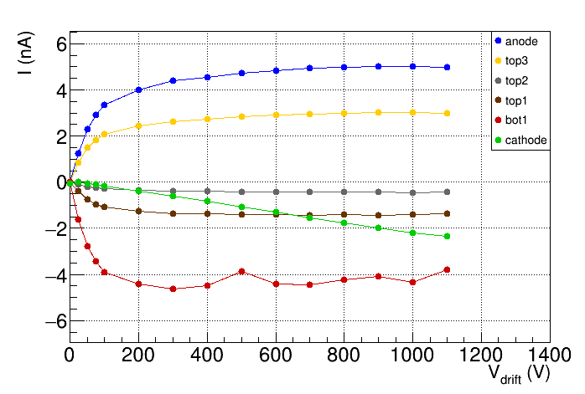
I-V characterizations
The new FPD of MAGNEX: first results
Antonino Pitronaci
Experimental methods
Preliminary concepts
The gas tracker prototype
Measurements performed varying:
- $V_{THGEM}$;
- $V_{drift}$;
Observations:
- $I(V_{THGEM})$ follows an exponential trend;
- saturation of $I\left(V_{drift}\right)$ up to 800 V;
Electric characterization
First coupling: gas tracker and SiC-detector
IRRAD4 @IFUSP
Conclusions
DeSyT2025 - Feb. 24-26, 2025 8/15

Slide 11
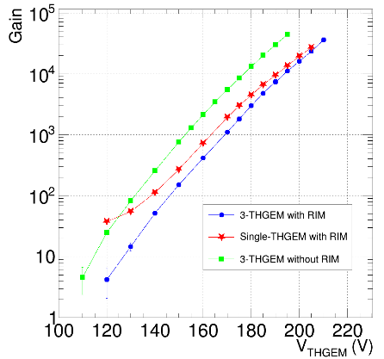
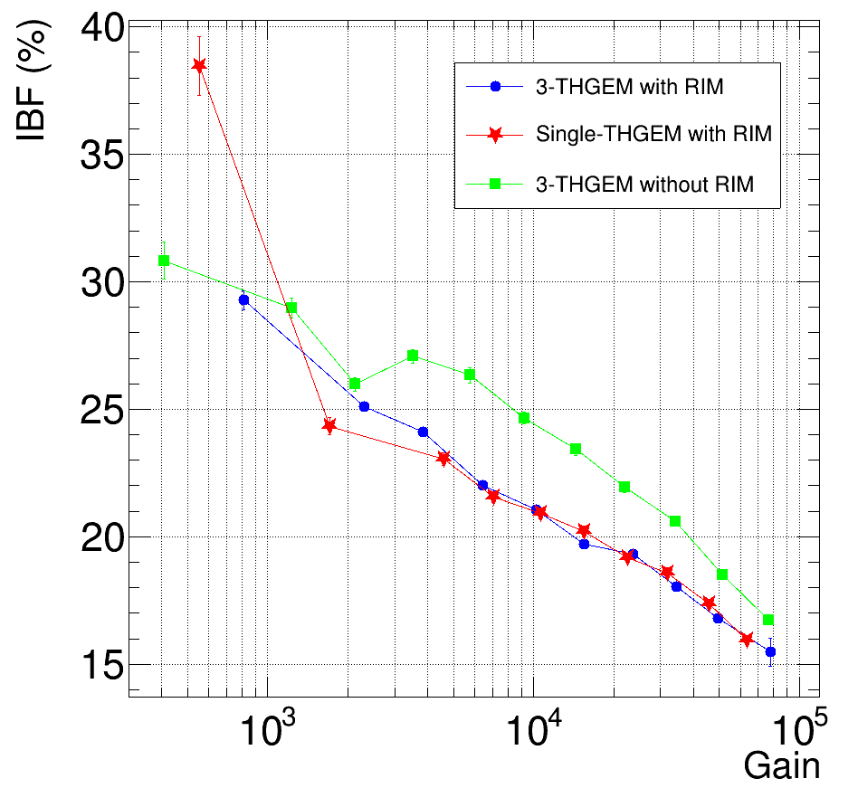
On the gas tracker properties: the Gain and the Ion Backflow
The new FPD of MAGNEX: first results
Antonino Pitronaci
Preliminary concepts
The gas tracker prototype
Electric characterization
First coupling: gas tracker and SiC-detector
IRRAD4 @IFUSP
Conclusions
Consistent with NUMEN requirements!
Gain: electron-amplification factor
IBF: fraction of the produced ions reaching the cathode
$$G=\frac{I_{an}+I_{top}}{I_{prim}}$$
$$IBF=\frac{I_{cath}}{I_{an}+I_{top}}$$
Antonino Pitronaci
DeSyT2025 - Feb. 24-26, 2025 9/15

Slide 12
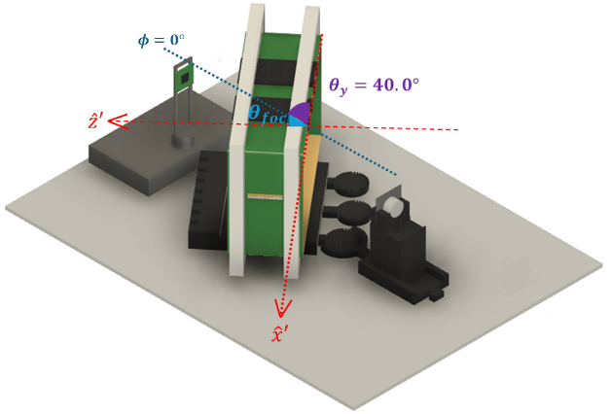
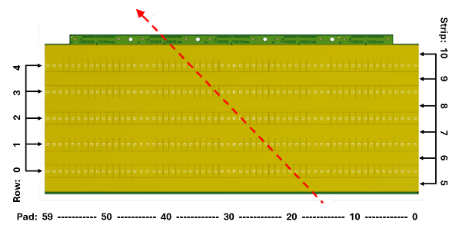
First coupling of the gas tracker prototype and a SiC-detector
The new FPD of MAGNEX: first results
Antonino Pitronaci
Experimental setup
Experimental methods
Preliminary concepts
The gas tracker prototype
Electric characterization
Probe: collimated α by ²⁴¹Am α-source;
Working regime: i-C₄H₁₀ @ [10-30] mbar;
Track measurements in correlation:
$θ_{foc}$ distribution;
$φ_{foc}$ distribution;
Track measurements in coincidence with SiC;
First coupling: gas tracker and SiC-detector
IRRAD4 @IFUSP
Conclusions
$α$ track
Antonino Pitronaci
DeSyT2025 - Feb. 24-26, 2025 10/15

Slide 13
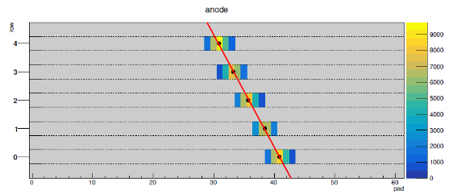
First coupling of the gas tracker prototype and a SiC-detector
The new FPD of MAGNEX: first results
Antonino Pitronaci
Experimental setup
Experimental methods
Preliminary concepts
The gas tracker prototype
Electric characterization
Probe: collimated α by ²⁴¹Am α-source;
Working regime: i-C₄H₁₀ @ [10-30] mbar;
Track measurements in correlation:
$θ_{foc}$ distribution;
$φ_{foc}$ distribution;
Track measurements in coincidence with SiC;
First coupling: gas tracker and SiC-detector
IRRAD4 @IFUSP
Conclusions
Centre of gravity algorithm:
$$x_{j}=\frac{\sum_{i=0}^{N Pads}{x_{i}w_{j}^{i}}}{\sum_{i=0}^{N}{w_{j}^{i} }}$$
Antonino Pitronaci
DeSyT2025 - Feb. 24-26, 2025 11/15

Slide 14
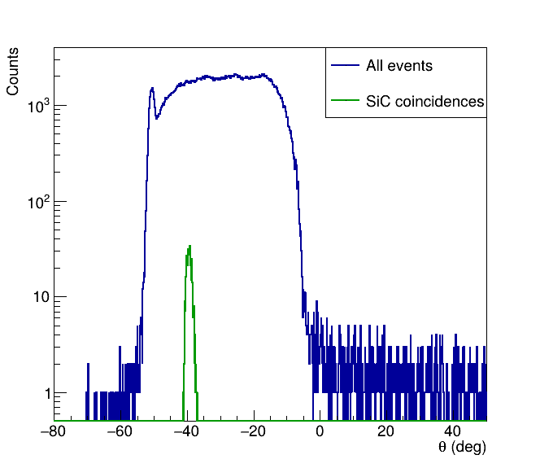
First coupling of the gas tracker prototype and a SiC-detector
The new FPD of MAGNEX: first results
Antonino Pitronaci
Experimental setup
Experimental methods
Preliminary concepts
The gas tracker prototype
Electric characterization
Probe: collimated α by ²⁴¹Am α-source;
Working regime: i-C₄H₁₀ @ [10-30] mbar;
Track measurements in correlation:
$θ_{foc}$ distribution;
$φ_{foc}$ distribution;
Track measurements in coincidence with SiC:
Goals: measurements of $θ$;
First coupling: gas tracker and SiC-detector
IRRAD4 @IFUSP
Conclusions
Antonino Pitronaci
DeSyT2025 - Feb. 24-26, 2025 12/15

Slide 15
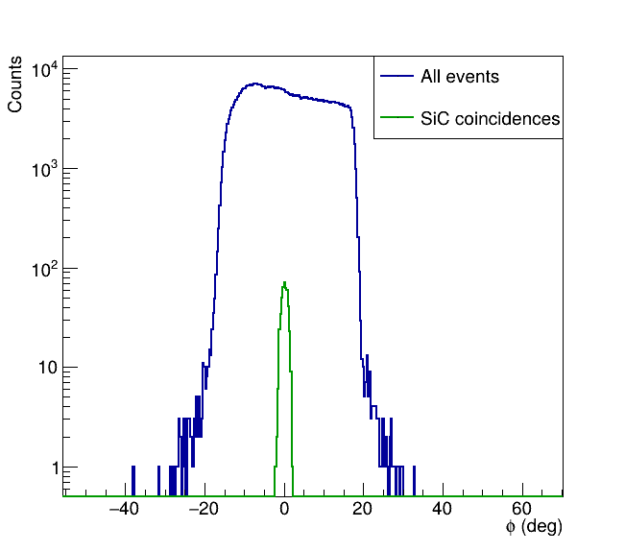
First coupling of the gas tracker prototype and a SiC-detector
The new FPD of MAGNEX: first results
Antonino Pitronaci
Experimental setup
Experimental methods
Preliminary concepts
The gas tracker prototype
Electric characterization
Probe: collimated α by ²⁴¹Am α-source;
Working regime: i-C₄H₁₀ @ [10-30] mbar;
Track measurements in correlation:
$θ_{foc}$ distribution;
$φ_{foc}$ distribution;
Track measurements in coincidence with SiC:
Goals: measurements of $φ$;
First coupling: gas tracker and SiC-detector
IRRAD4 @IFUSP
Conclusions
Antonino Pitronaci
DeSyT2025 - Feb. 24-26, 2025 13/15

Slide 16
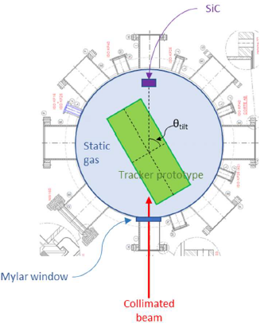
The experiment IRRAD4 @IFUSP – University of São Paulo (BR)
The new FPD of MAGNEX: first results
Antonino Pitronaci
Preliminary concepts
The gas tracker prototype
Electric characterization
First coupling: gas tracker and SiC-detector
Analysis ongoing!
In-beam characterization of the tracker:
IRRAD4 @IFUSP
Position and angular resolutions;
Tracker performances as a function of the angle wrt incident ion beam;
Tracker response to the beam rate;
Conclusions
Experimental setup:
Pelletron beams:
${}_{}^{7}Li,{}_{}^{12}C$ and ${}_{}^{16}O$;
Safiira setup:
Beam spot: 300 $μ$m;
Angular divergency: 0.2° FWHM

Slide 17
Conclusions
The new FPD of MAGNEX: first results
Antonino Pitronaci
Preliminary concepts
The gas tracker prototype
Electric characterization
First coupling: gas tracker and SiC-detector
I-V characterizations with $α$ particles:
exponential trend of $I\left(V_{THGEM}\right)$;
saturation of $I(V_{drift})$;
IRRAD4 @IFUSP
Conclusions

Slide 18
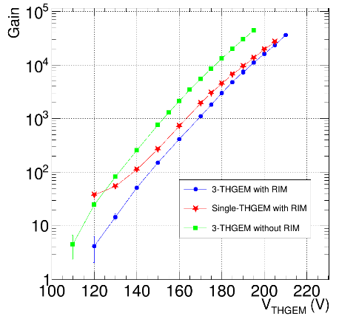
Conclusions
The new FPD of MAGNEX: first results
Antonino Pitronaci
Preliminary concepts
The gas tracker prototype
Electric characterization
First coupling: gas tracker and SiC-detector
I-V characterizations with $α$ particles:
exponential trend of $I\left(V_{THGEM}\right)$;
saturation of $I(V_{drift})$;
Gain and IBF;
IRRAD4 @IFUSP
Conclusions

Slide 19
Conclusions
The new FPD of MAGNEX: first results
Antonino Pitronaci
Consistent with NUMEN requirements!
Preliminary concepts
The gas tracker prototype
Electric characterization
First coupling: gas tracker and SiC-detector
I-V characterizations with $α$ particles:
exponential trend of $I\left(V_{THGEM}\right)$;
saturation of $I(V_{drift})$;
Gain and IBF;
IRRAD4 @IFUSP
Conclusions

Slide 20
Conclusions
The new FPD of MAGNEX: first results
Antonino Pitronaci
Preliminary concepts
The gas tracker prototype
Electric characterization
First coupling: gas tracker and SiC-detector
I-V characterizations with $α$ particles:
exponential trend of $I\left(V_{THGEM}\right)$;
saturation of $I(V_{drift})$;
Gain and IBF;
First coupling gas tracker prototype and SiC-detector:
Tracking performances:
Goals: measurements of $θ,φ$;
Angles compatible with setup geometry;
IRRAD4 @IFUSP
Conclusions

Slide 21
Conclusions
The new FPD of MAGNEX: first results
Antonino Pitronaci
Analysis ongoing!
Preliminary concepts
The gas tracker prototype
Electric characterization
First coupling: gas tracker and SiC-detector
I-V characterizations with $α$ particles:
exponential trend of $I\left(V_{THGEM}\right)\text{;}$
saturation of $I(V_{drift})$;
Gain and IBF;
First coupling gas tracker prototype and SiC-detector:
Tracking performances:
Goals: measurements of $θ,φ$;
Angles compatible with setup geometry;
First in-beam test: IRRAD4 @IFUSP:
Position and angular resolutions;
Tracker performances as a function of the angle wrt incident ion beam;
Tracker response to the beam rate;
IRRAD4 @IFUSP
Conclusions

Slide 22
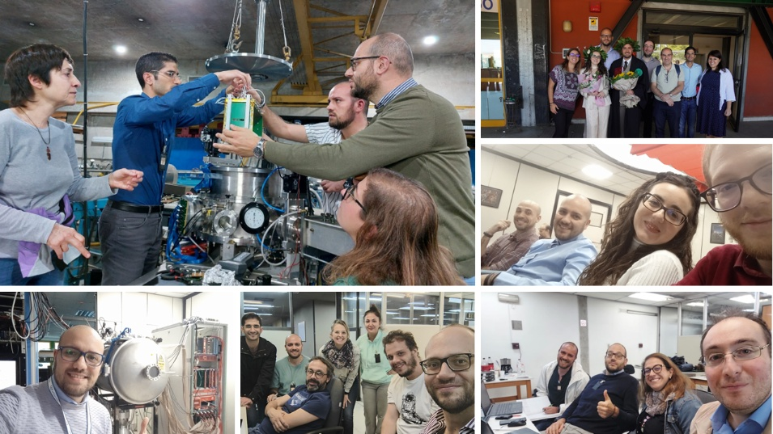
The new FPD of MAGNEX: first results
Antonino Pitronaci
Preliminary concepts
The gas tracker prototype
Electric characterization
First coupling: gas tracker and SiC-detector
IRRAD4 @IFUSP
Conclusions
Thanks for your kind attention!

Slide 23
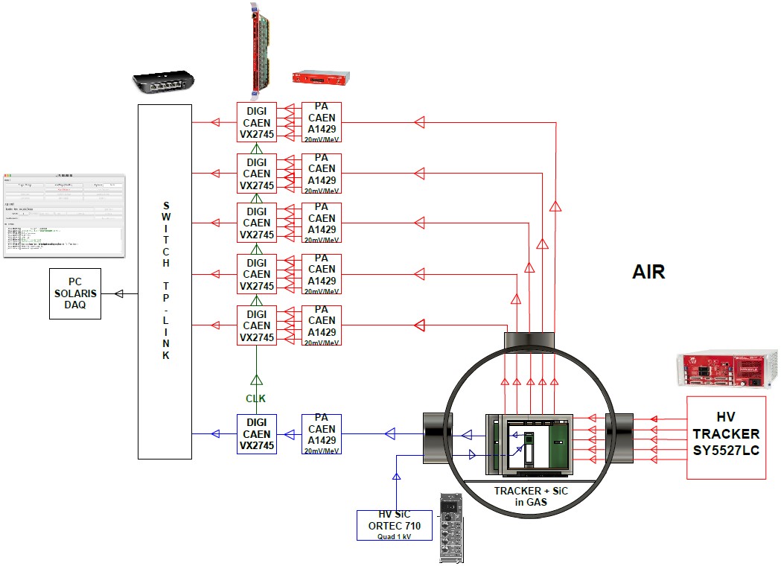
Backup slide: scheme of connesctions for the tracker and SiC coupling
The new FPD of MAGNEX: first results
Antonino Pitronaci
Preliminary concepts
The gas tracker prototype
Electric characterization
First coupling: gas tracker and SiC-detector
IRRAD4 @IFUSP
Conclusions

