Slide 1
$$Neutral particles discrimination with BGO \\ in the BGOOD experiment$$
Alessia Fantini
University of Rome Tor Vergata-INFN(Roma Tor Vergata)
In collaboration with R. Di Salvo INFN & P. Levisandri INFN & on behalf of BGOOD collaboration
$2^{ND}$International Workshop on Detection Systems and Techniques For Foundamental and Applied Physics
Catania (Italy), February 24 -26, 2025

Slide 2
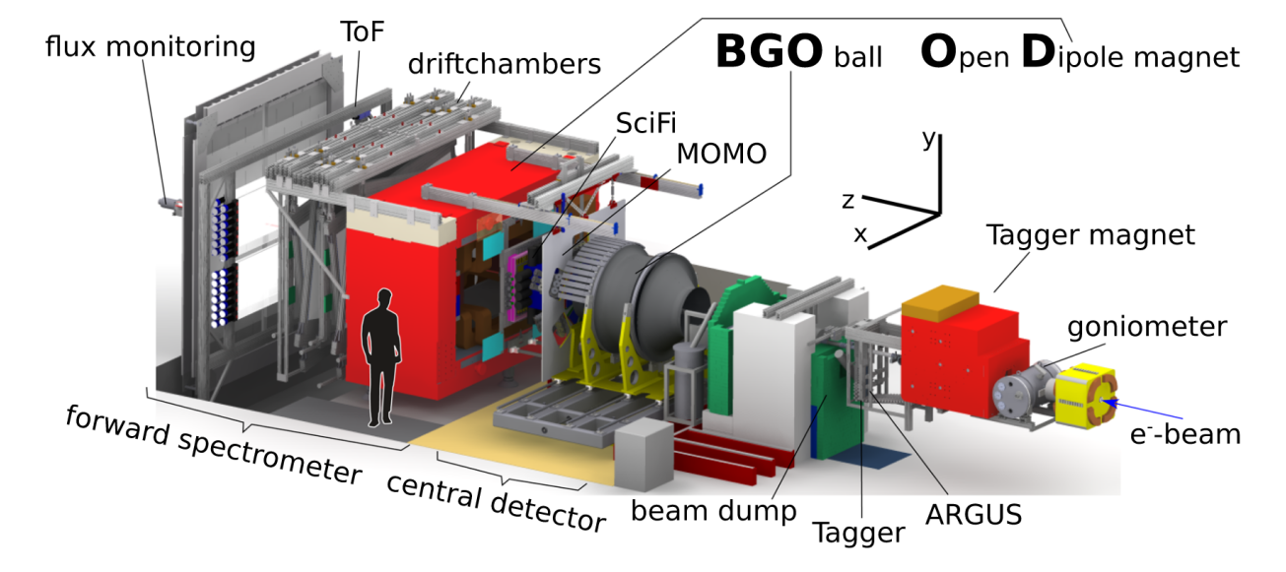
Meson photoproduction off Nucleons
The understanding of the dynamics underlying the bound state of the nucleon and its excited spectrum still remain a crucial task since in this energy range QCD cannot be treated in perturbative mode.
Many models, based on different degrees of freedom descriptions, have been developed in order to describe the spectrum of excitation states and their features
Meson photoproduction studies represent a strong tool for probing nucleon resonances:
Access to resonance states coupled to photons which only weakly coupling to the $πN$processes (Missing Resonances problem)
Access to Polarization Observables => Separation of overlapping resonances and characterization in terms of Spin and Parity, Constrains for unambiguous PWA
BGOOD EXPERIMENT
ELSA
Accelerator
$$E_{e_{MAX}^{−}}=3.2 GeV$$
Notes:
This permit to identify the resonances associated to multipoles not dominant in Cross Section and bring a valuable constraints on partial-wave analyses

Slide 3
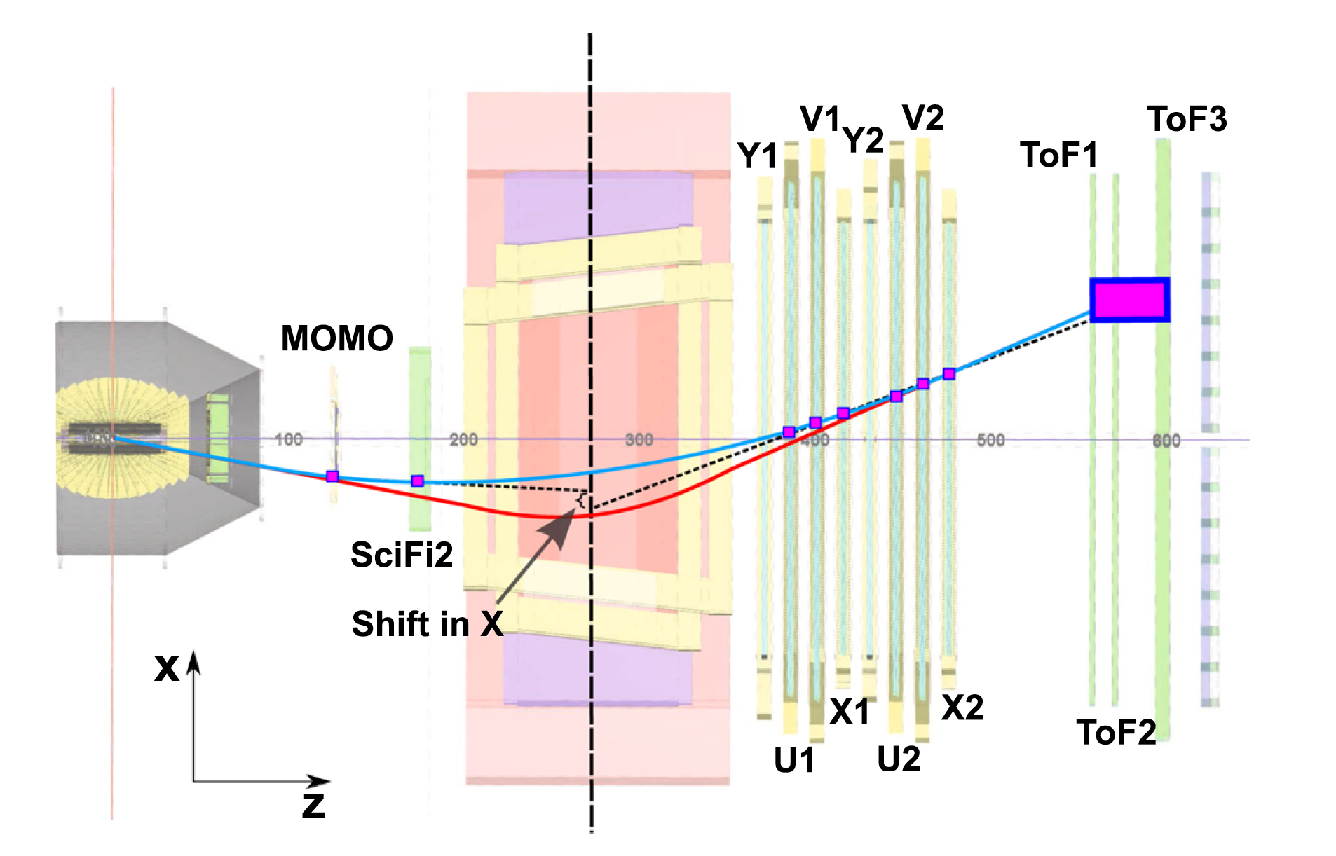
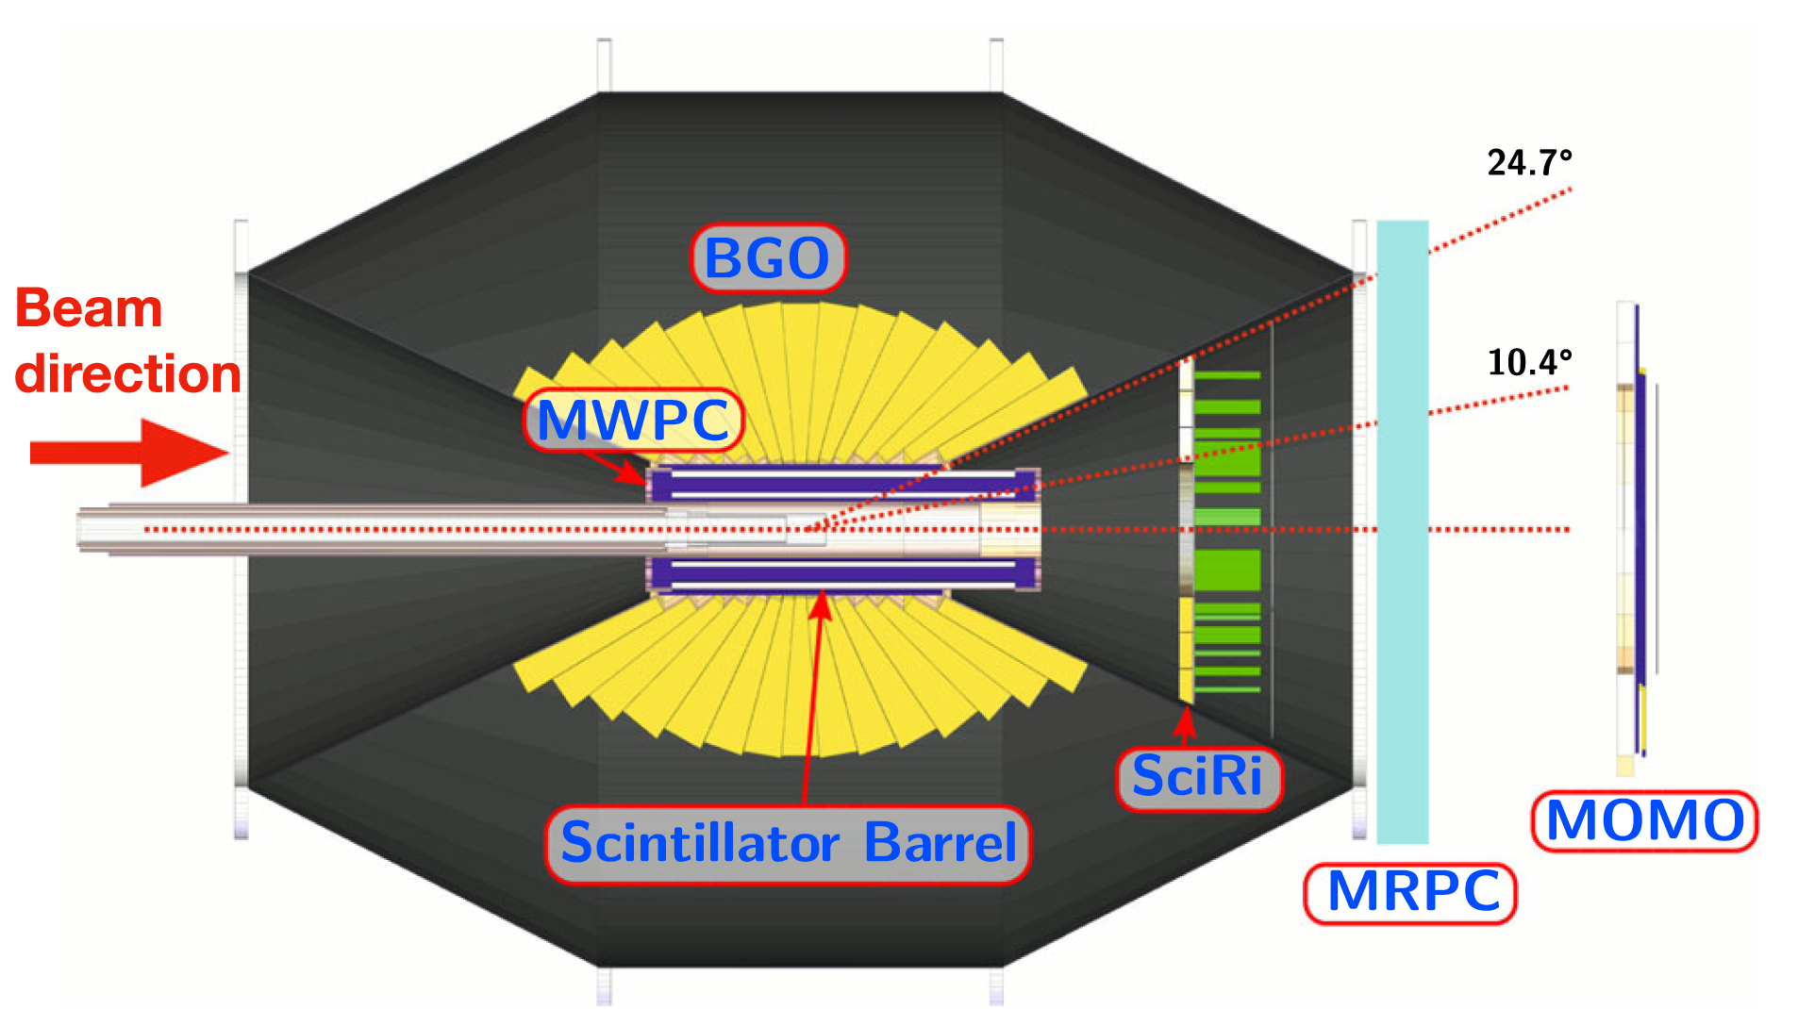
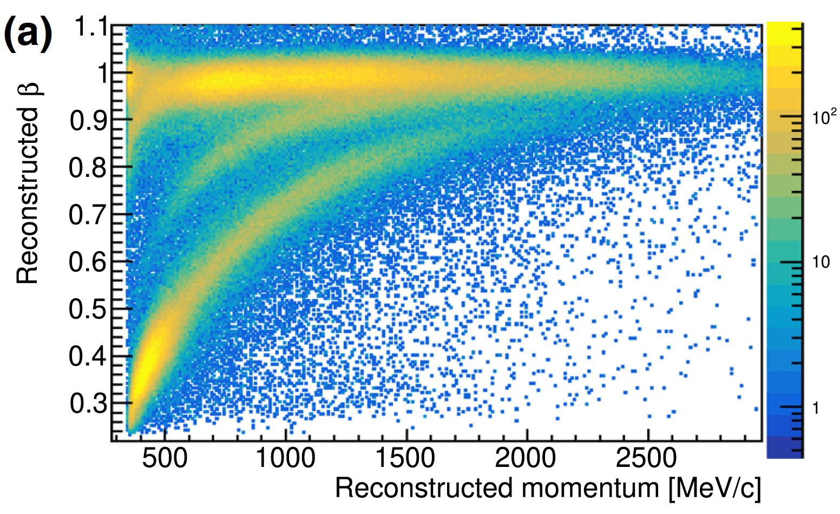
BGOOD Forward Region
BGOOD Central Region
large solid angle calorimeter:
excellent energy resolution for photons
good detection efficiency for neutrons
charged particle tracking and identification
neutron/photon discrimination
Target system
LH₂ LD₂
High momentum resolution forward tracking
β vs Momentum in Forw Spectrometer

Slide 4
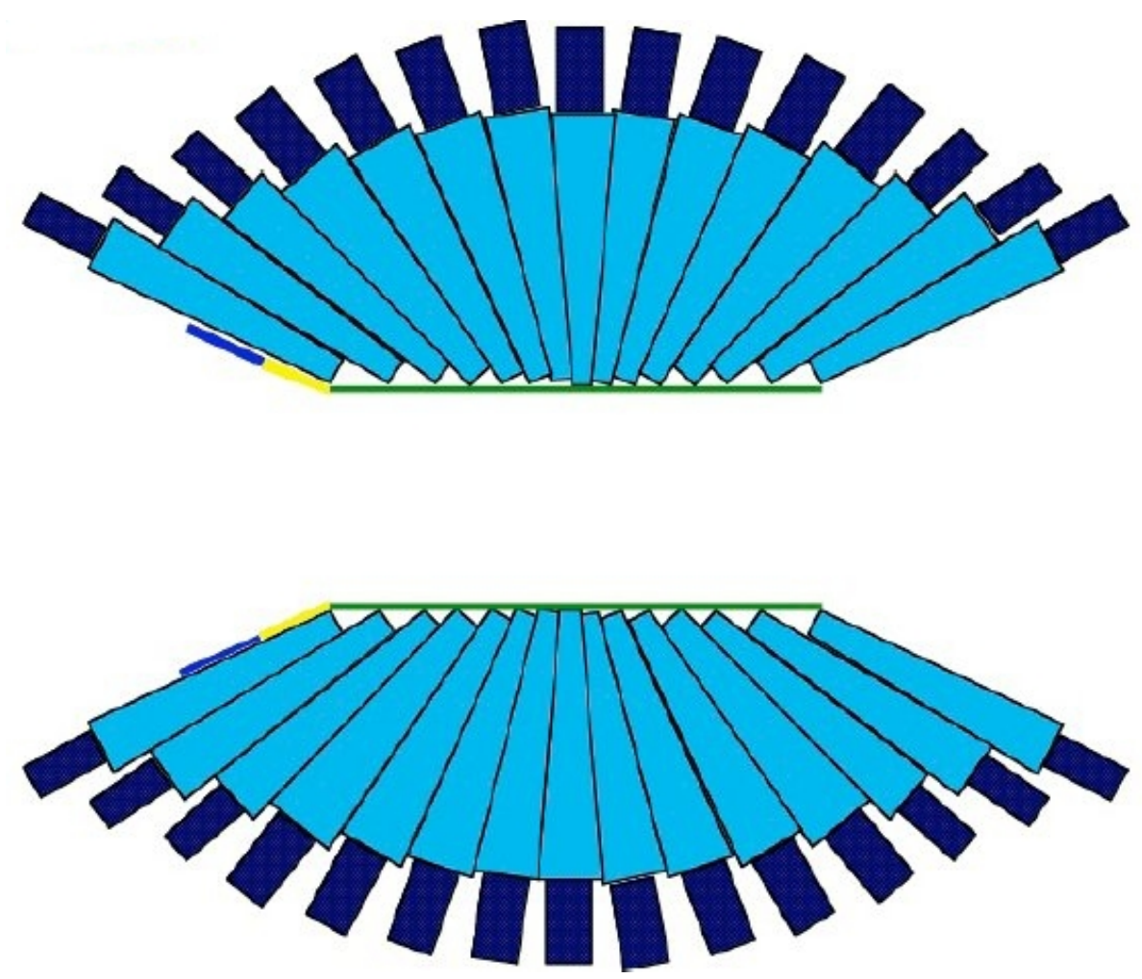
BGO Rugby Ball E.M. Calorimeter:
480 BGO crystals of 24 cm depth $⇒$ 21 radiation lengths thickness
15 x 32 sectors (polar and azimuthal angles) => 15 Crowns
Each crown covers $Δθ$= 6 ° (FWHM) in polar angle
Polar angular range θ = (25° $÷$ 155°)
Full Azimuthal range

Slide 5
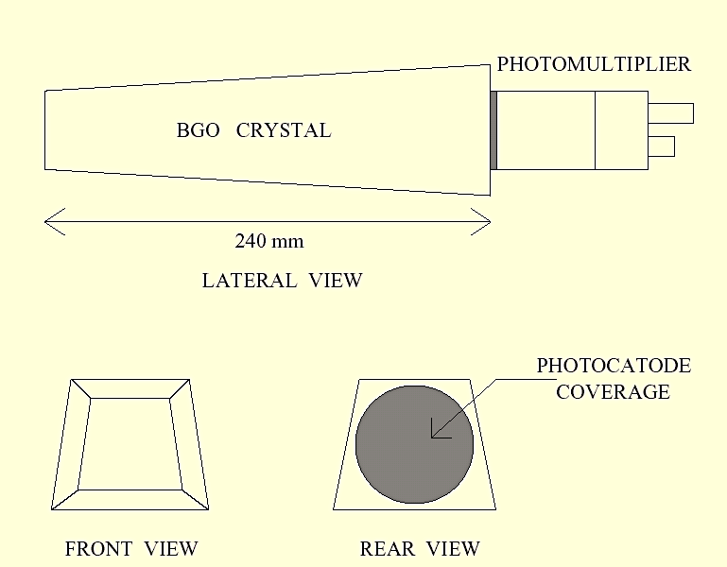
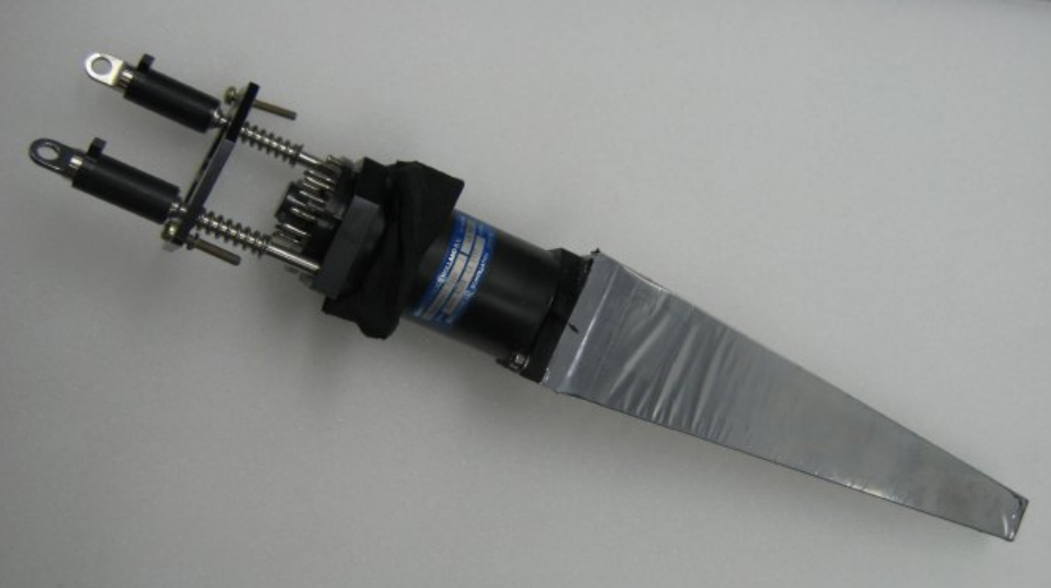
BGO Rugby Ball E.M. Calorimeter:
480 BGO crystals of 24 cm depth $⇒$ 21 radiation lengths thickness
15 x 32 sectors (polar and azimuthal angles) => 15 Crowns
Each crown covers $Δθ$= 6 ° (FWHM) in polar angle
Polar angular range θ = (25° $÷$ 155°)
Full Azimuthal range
Crystals shaped as pyramidal sectors with trapezoidal basis
8 different dimensions.
Coupling with a HamamatsuR580 or R329-2 PMT
Signals read by WIENER AVM16 sampling ADCs
Energy (Signal Integral) and Time (Signal Start Time) Information
Rate160MHz (t sample 6,25 ns) $⇒Time Resolution δt≅2÷3 \text{ns}$
Angular resolution for single crystal
Δ θ = 6 ° (FWHM)
Δ φ = 11.25° (FWHM)

Slide 6
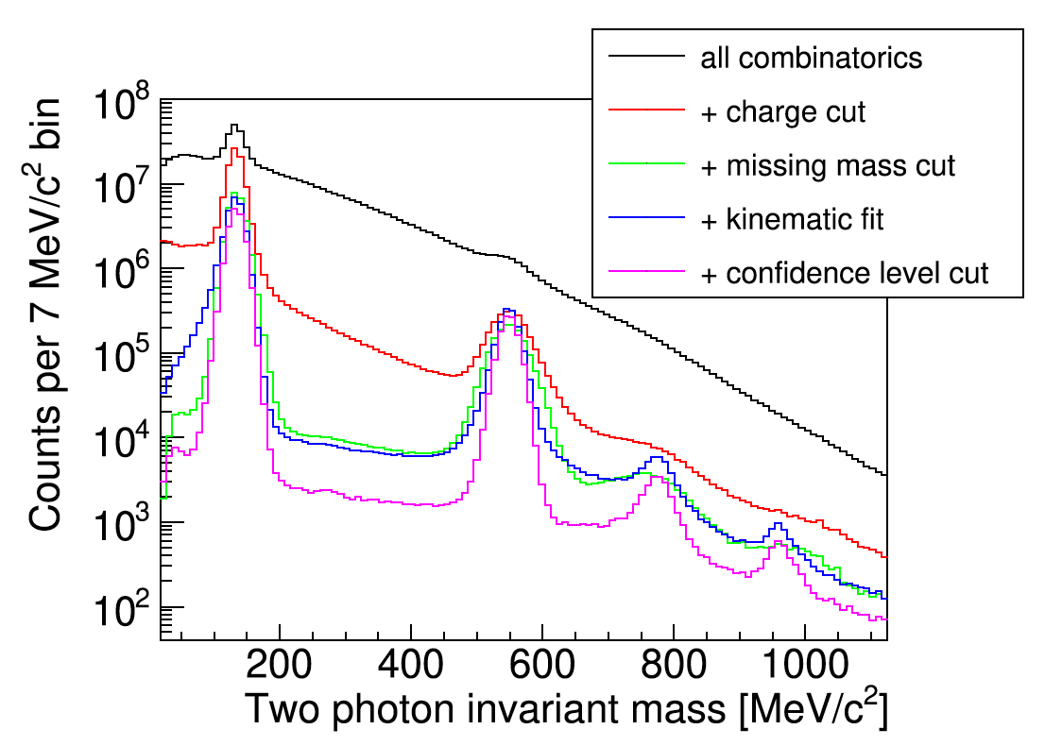
BGO Rugby Ball E.M. Calorimeter:
480 BGO crystals of 24 cm depth $⇒$ 21 radiation lengths thickness
15 x 32 sectors (polar and azimuthal angles) => 15 Crowns
Each crown covers $Δθ$= 6 ° (FWHM) in polar angle
Polar angular range θ = (25° $÷$ 155°)
Full Azimuthal range
Photons in BGO Ball
Crystals shaped as pyramidal sectors with trapezoidal basis
8 different dimensions.
Each crystal wrapped in a 30μm aluminised Mylar foil
Coupling with a HamamatsuR580 or R329-2 PMT
Signals read by W-IE-NE-R AVM16 sampling ADCs
Energy (Signal Integral) and Time (Signal Start Time) Information
Rate160MHz (t sample 6,25 ns) $⇒Time Resolution δt≅2÷3$ ns
Energy Resolution (1GeV photons)
$$Γ\left(FWHM\right)=\sqrt{a^{2}+{\left(\frac{b}{E_{γ}}\right)}^{2}+{\left(\frac{c}{{\sqrt{E}}_{γ}}\right)}^{2}}≈3\%$$

Slide 7
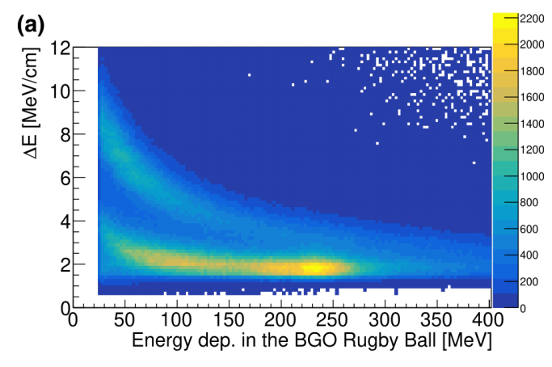
BGO Rugby Ball E.M. Calorimeter:
Charged Particles:
Signals in geometrical coincidence BGO-Barrel-MWPCs.
Charged particle Identification ( p,$π^{±}$) by mean 2-dim $\frac{dE}{dx}\%E$
Neutral Particles (Photons/Neutrons):
Signals in the BGO not associated with hits in any other detector
We define:
BGO Cluster: Group of contiguous crystals associated with the interaction of the same particle within the detector
Cluster multiplicity: Number of crystals composing the cluster.
Proton
$$π^{±}$$

Slide 8
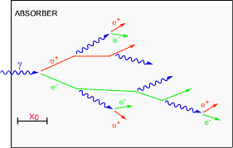
Neutron/Photon Discrimination: Method
PROBLEM => Impossible to unambiguously distinguish neutron/photon signals in BGO Calorimeter
BUT => We know that neutrons and photons interact with BGO by mean different physics processes
Neutrons
(Energy Range $10÷300 MeV$)
elastic scattering
inelastic scattering
induced fission, capture ..
on BGO components (Oxygen, Germanium,Bismuth).
A fraction of the neutron energy
is released in the detector
Photons
(Energy Range $20÷1000 MeV$)
Electromagnetic shower
The photon energy is totally released in the BGO
Study the features of clusters produced by Neutrons and Photons
Find differences (due to different physics processes underlying their detection).
Find selection criteria based on these differences

Slide 9
Neutron/Photon Discrimination: Method (Continue)
”Clean” Selection (very low residual background) of a reaction with neutron and photons in the Final State
q-free photoproduction
$γ+n→π^{0}+n$ $→2γ+n$
Proton in the Deuteron
acting as spectator
Selected with pure Two Body Process kinematical criteria
Negligible
Fermi Momentum
Analysis of the features of the selected clusters in terms of:
$M_{n,γ}=$ Cluster Multiplicity
${E_{tot}}_{n,γ}=$Total Energy released in the cluster
$E_{{Max}_{n,γ}}=$Max Energy released in a Crystal (of the cluster)
$E_{mean}$= ${E_{tot}}_{n,γ}/M_{n,γ}$
$R= E_{{Max}_{n,γ}}/{E_{tot}}_{n,γ}$
$t_{n,γ}$ = Cluster start time (ToF $of the particle)$
Definition of a posteriori cuts to be used in the selection from the beginning
Fantini Alessia - February 24-26, 2025, Catania (Italy)

Slide 10
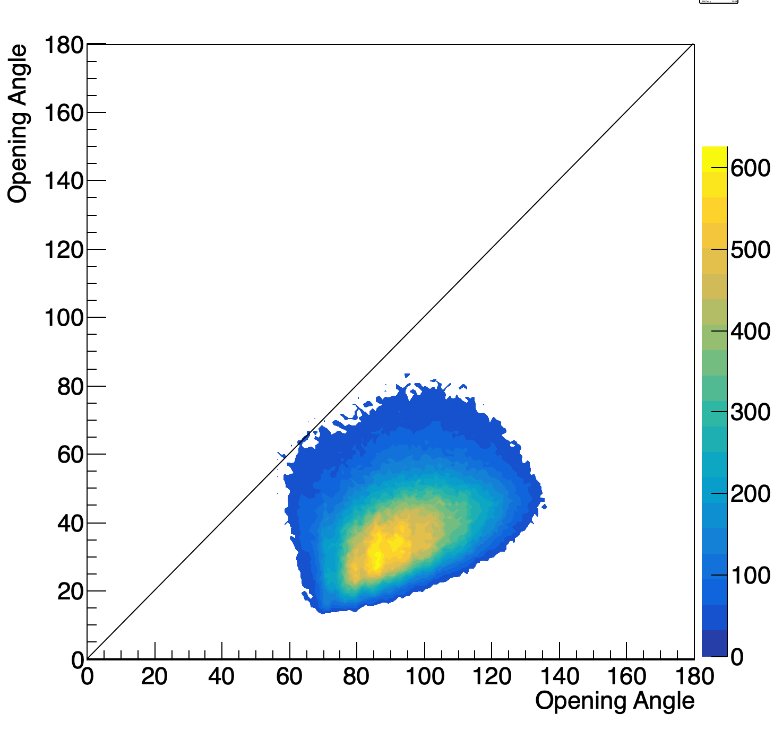
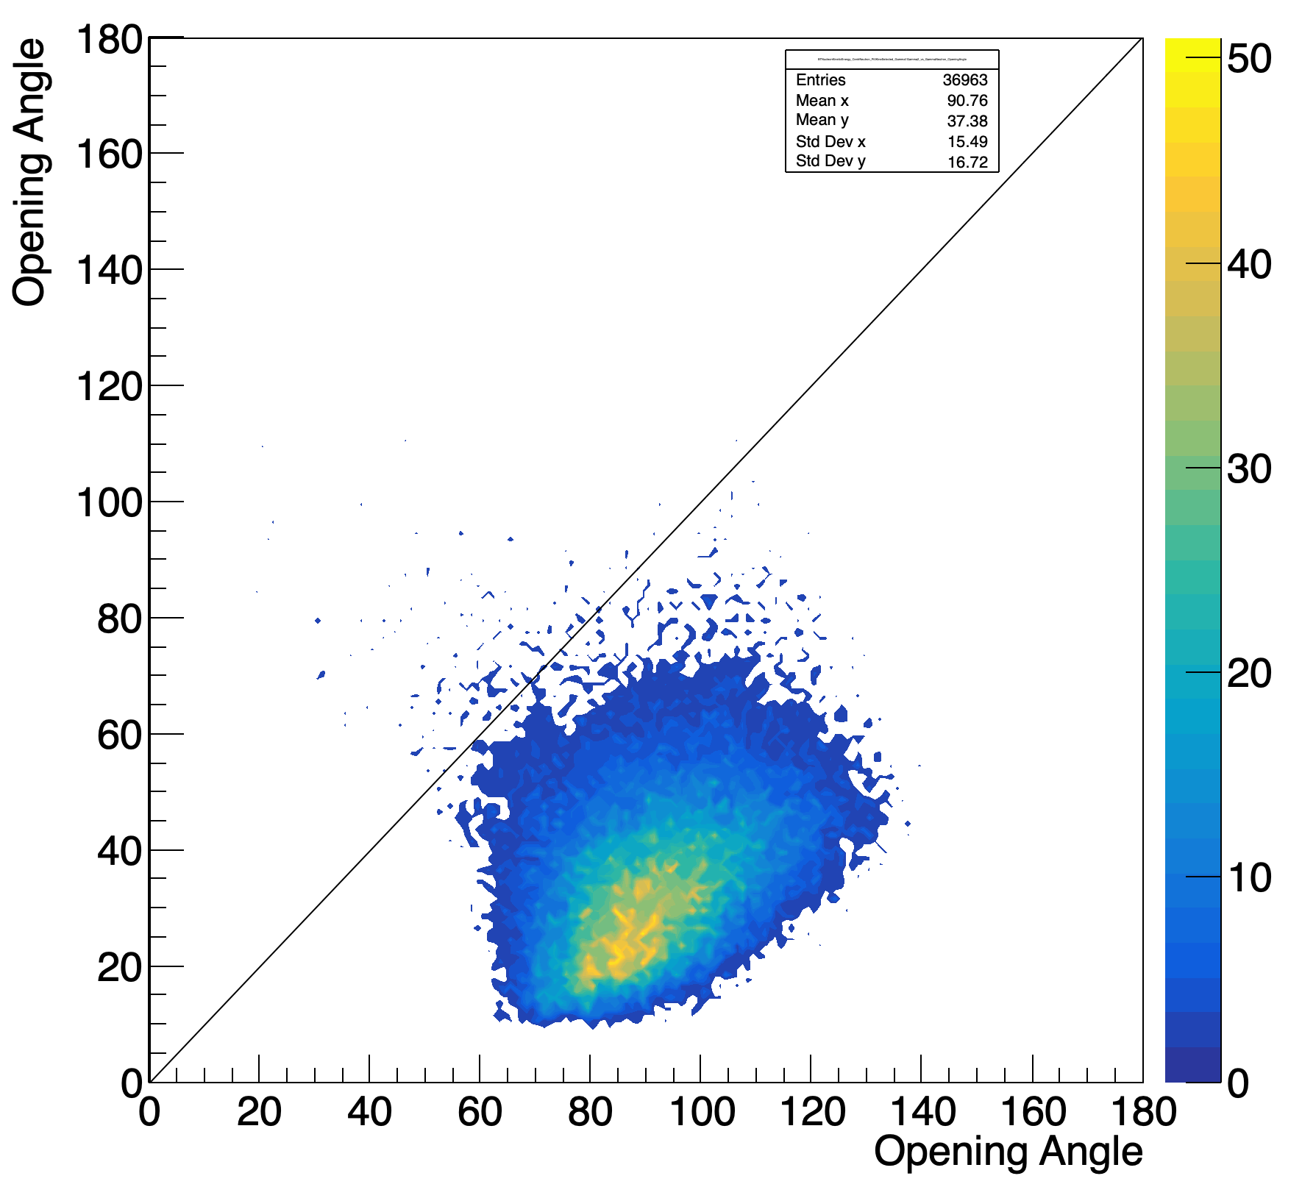
$$Event Preselection for:$$
$γ+n→π^{0}+n→2γ+n$
Starting point for the data selection: 200 Runs with LD2 target
No charged signal in the whole apparatus
3 Neutral signals in BGO
Event Preselection:
We have to use a selection criterion in order to assign an identity to the
three neutral clusters
Opening Angle Preselection Criterion =>
In $π^{0}Nucleon photoproduction the angle between γ_{1} \& γ_{2} is the smallest one$
neutron/photons discrimination based on a pure Kinematical assumption
verified by mean Simulation and
2) The Missing nucleon from $π^{0}$ has to be inside the BGO =>
=> N. of Starting events: 6.1 Millions
$γ+p→π^{0}+p$
Simulation
$\hat{γ_{1}γ_{2}}$ < $\hat{n γ_{2} }$ & $\hat{γ_{1}γ_{2}}$ < $\hat{n γ_{1} }$
$\hat{γ_{1}γ_{2}}$
$\hat{γ_{1}γ_{2}}$
comparison with twin process on proton
$γ+p→π^{0}+p$
$θ_{miss N }^{calc}>$20°
$$\hat{ n γ_{1/2} }$$
$$\hat{ p γ_{1/2} }$$
NB: $γ_{1}$Highest energy $π^{0}$decay photon
$γ_{2}$ Lowest energy $π^{0}$decay photon
Fantini Alessia - February 24-26, 2025, Catania (Italy)

Slide 11
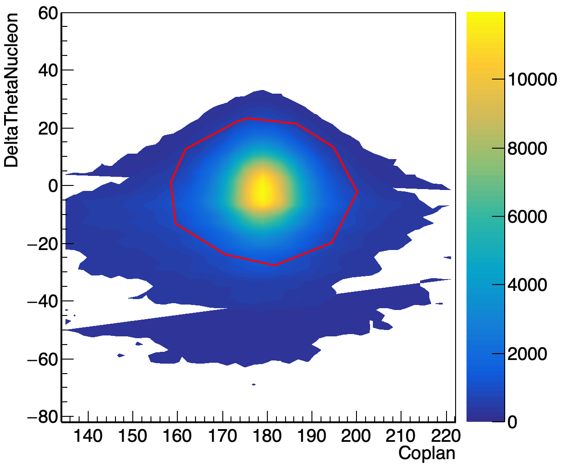
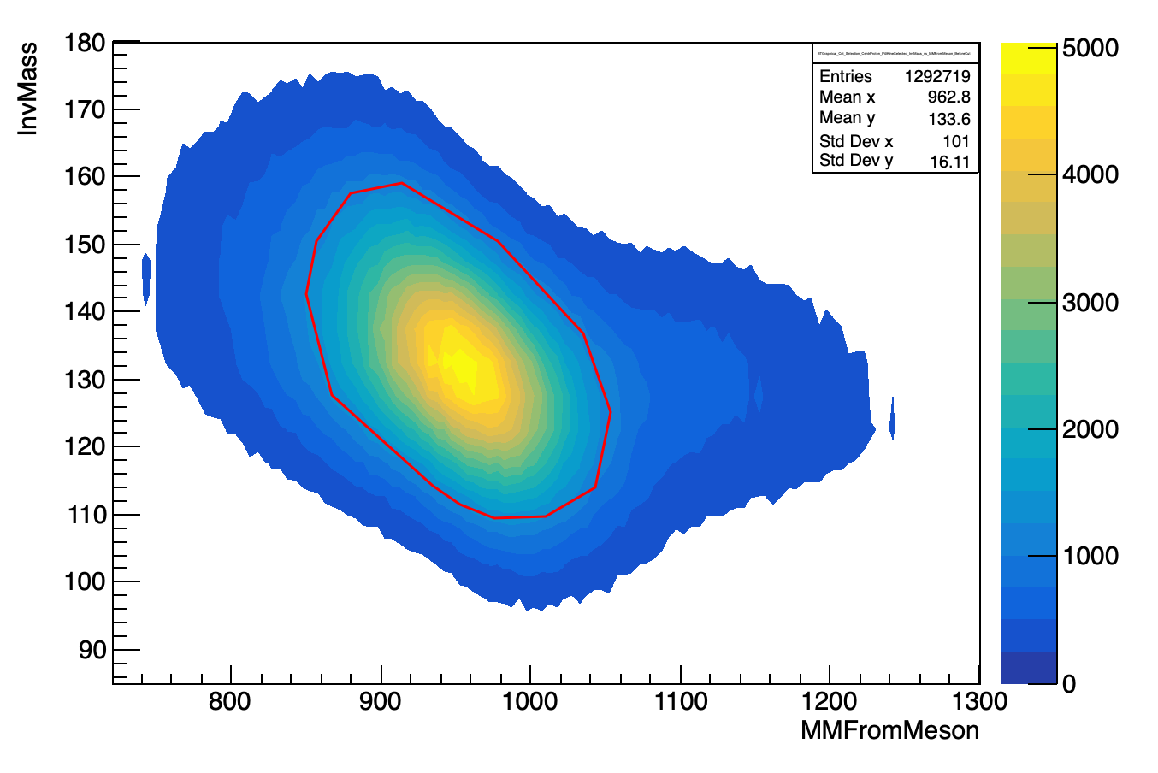
$$Event Selection for:$$
$γ+n→π^{0}+n→2γ+n$
Stringent kinematical standard cuts to select 2-body final state reactions:
$${{3) θ}_{miss N}^{calc}−θ}_{n}^{meas} \% Coplanarity$$
4) $π^{0} InvMass \% MissMass from π^{0}$
graphical 2D cuts
$$Δθ_{n}\% Coplanarity$$
$$Inv Mass π^{0} \% MissMass from π^{0}$$
$Δθ_{Nucleon}$
$$Inv Mass π^{0}$$
Miss $Mass from π^{0}(MeV)$
$$Coplanarity$$
Fantini Alessia - February 24-26, 2025, Catania (Italy)

Slide 12
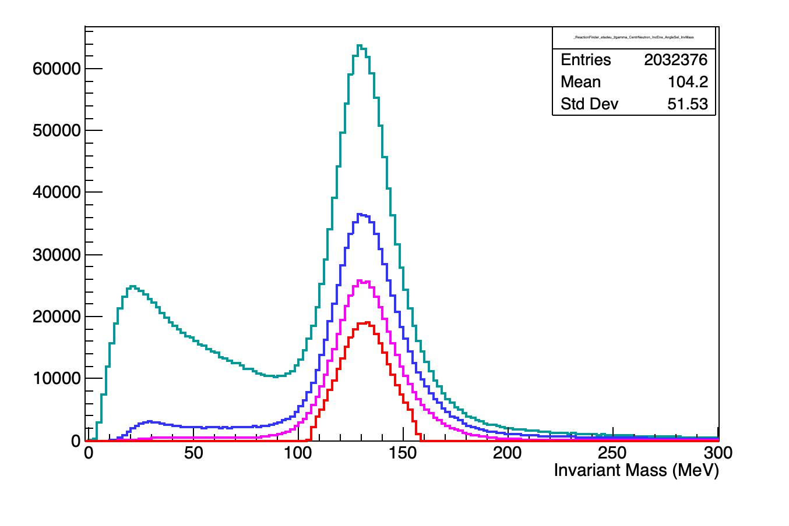
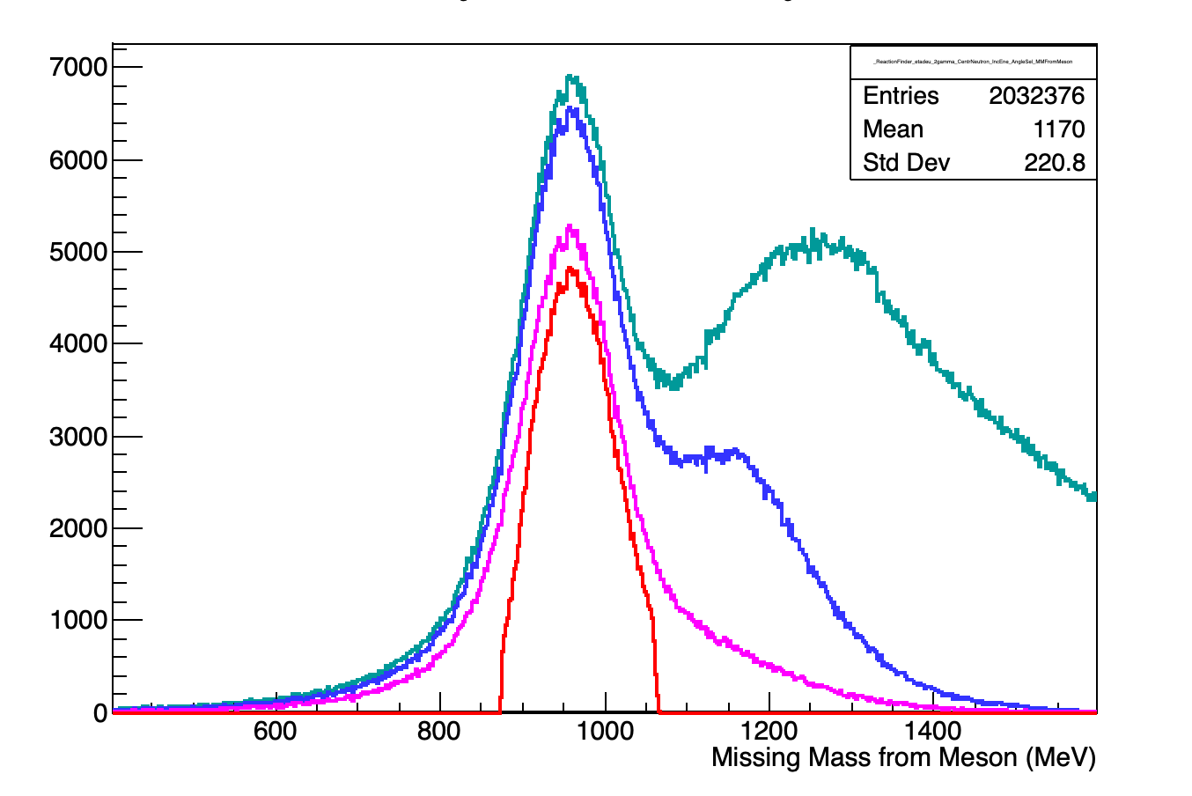
$$Kinematical Cuts:$$
$γ+n→π^{0}+n→2γ+n$
2-body reaction completely defined by the meson reconstructed from the 2 $γ$’s in BGO and the neutron detected in BGO => Clean Event Selection by means of 2D Graphical Cuts $=> 2.9·{10}^{5}$selected events
$π^{0}$Invariant Mass
$${Missing mass from π}^{0}$$
Angle Presel
${ +θ}_{miss N }^{calc}>$20°
$$+Δθ \% Coplanarity$$
+$M_{π^{0} }\% MissM_{π^{0}}$
Angle Presel
${ +θ}_{miss N }^{calc}>$20°
$$+Δθ \% Coplanarity$$
+$M_{π^{0} }\% MissM_{π^{0}}$
Fantini Alessia - February 24-26, 2025, Catania (Italy)

Slide 13
Neutron/Photon Discrimination Criteria
Starting from the Clean Data $of γ+n→π^{0}+n→2γ+n$, we analyzed the π⁰ decay photons ($γ_{1}$, $γ_{2}$) and neutron clusters in order to find other properties which could be peculiar of these particles and which could be used as discrimination criteria from the very beginning.
We identified three PID criteria
Mean Energy per Crystal $\frac{{E_{tot}}_{n,γ}}{M_{n,γ}}$
2) Energy concentration in the crystal with the highest released energy ${E_{MAX}}_{n,γ}/E_{tot_{n,γ} }$
3) Photons Time of Flight (ToF) vs. neutron ToF.
Fantini Alessia - February 24-26, 2025, Catania (Italy)

Slide 14
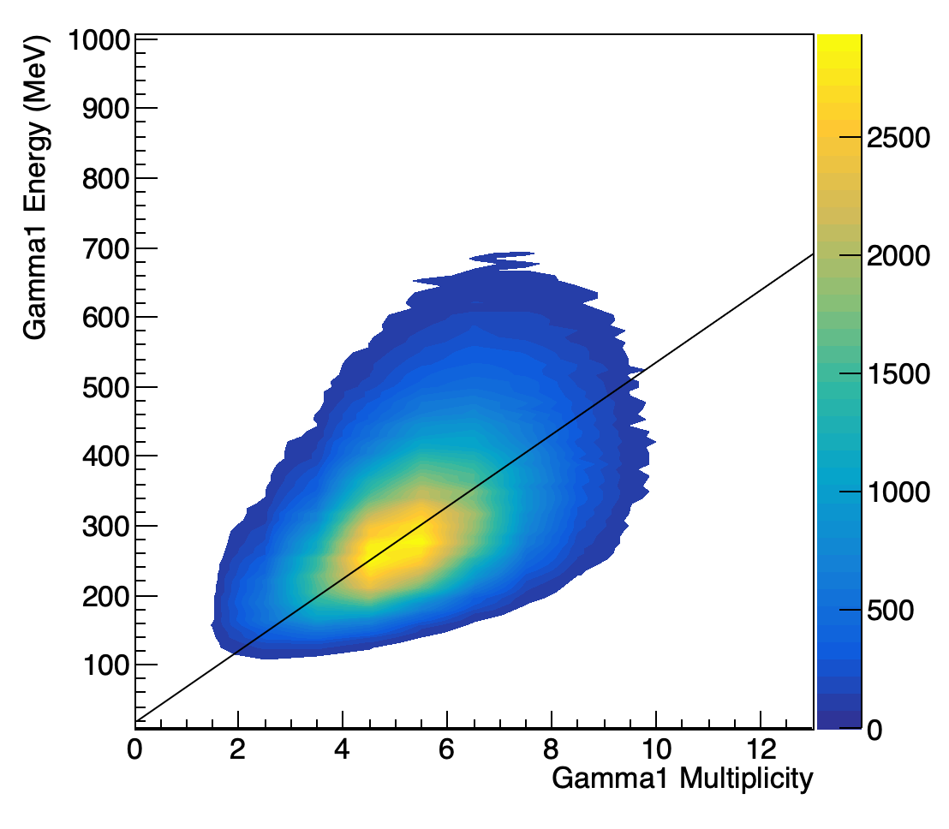
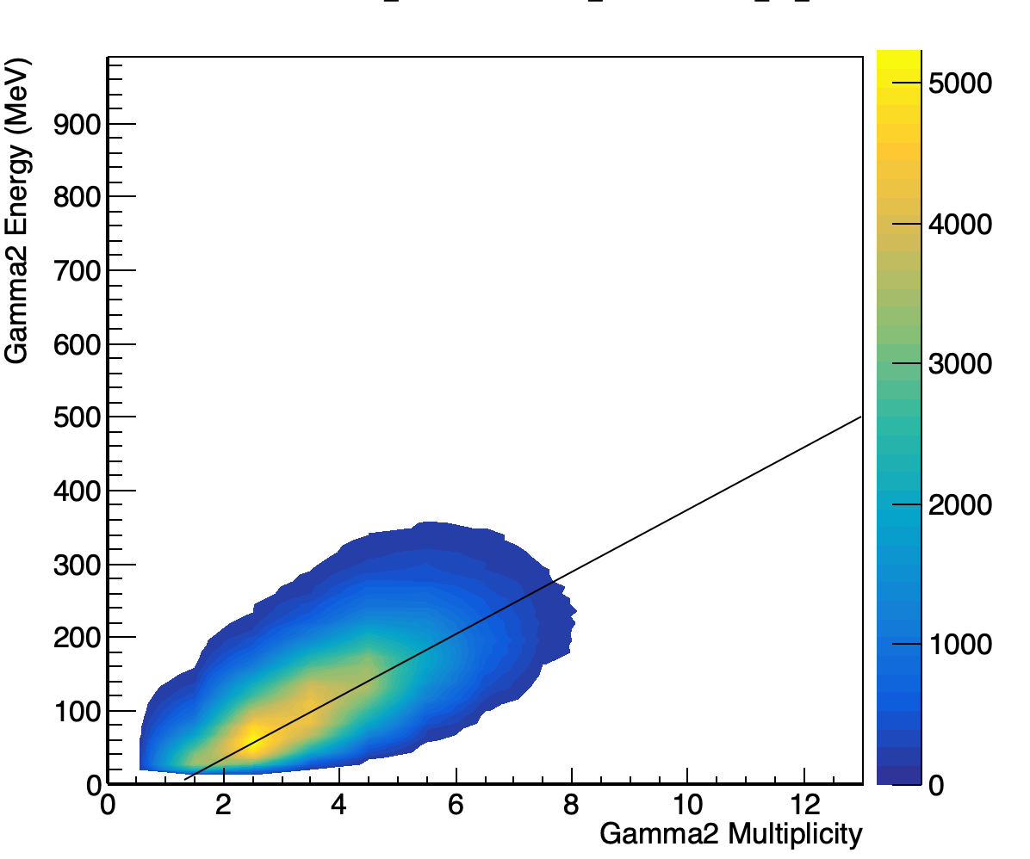
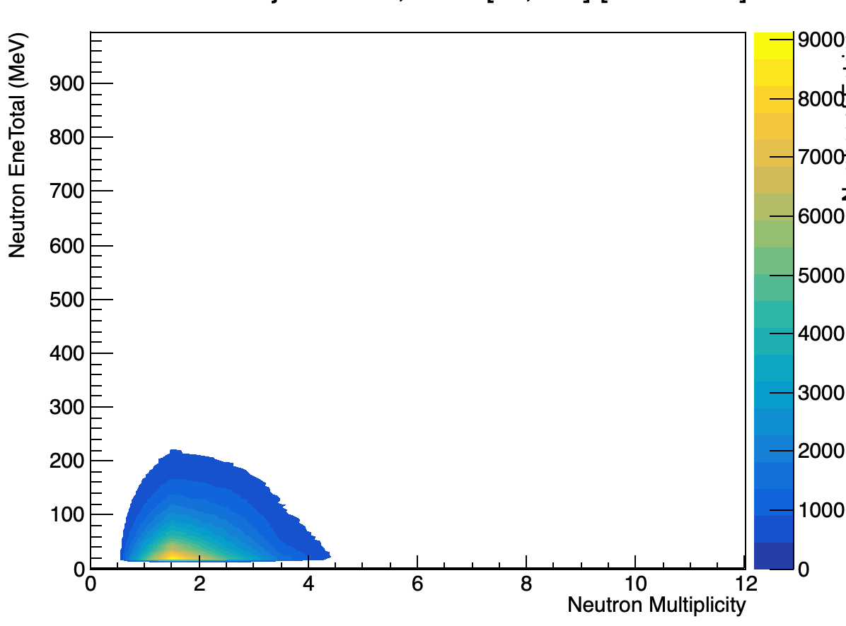
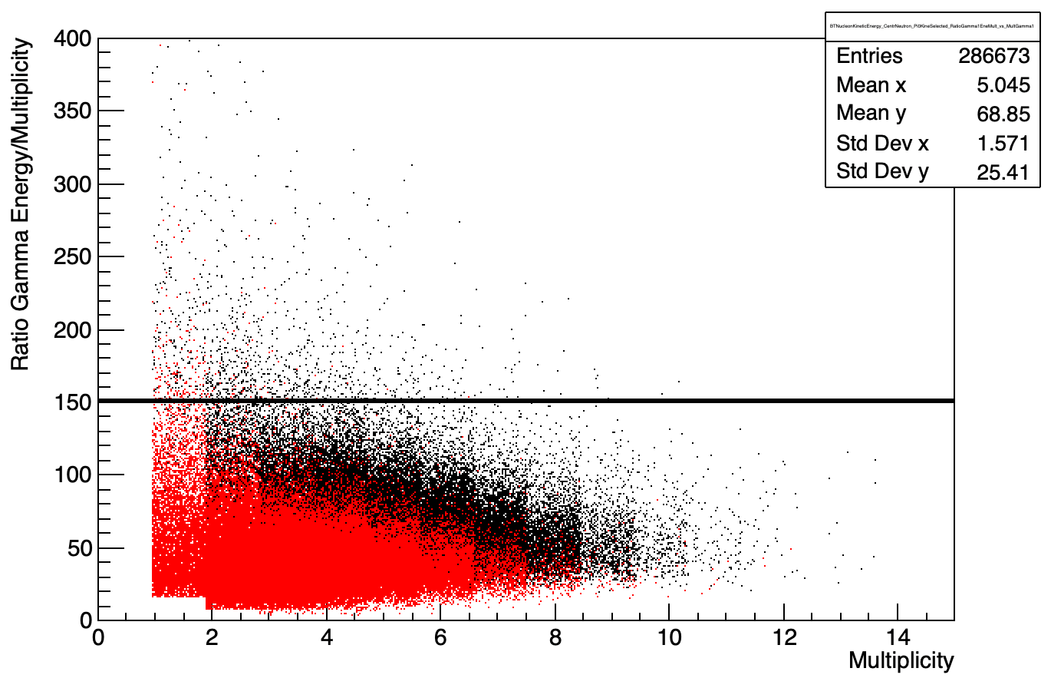
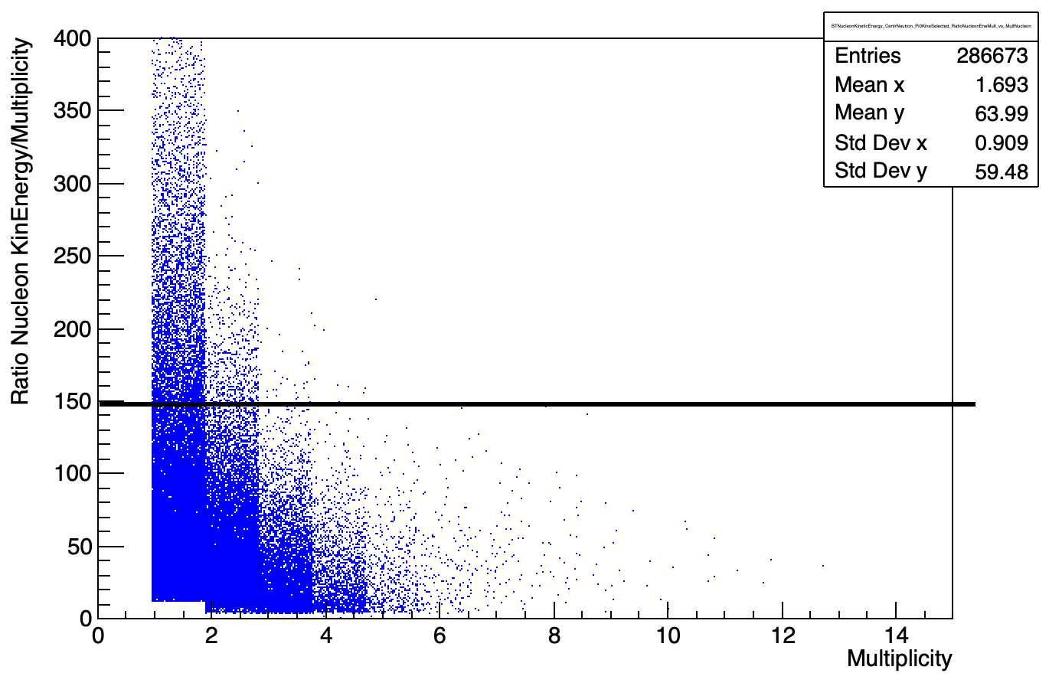
1° PID Criterion: Mean Energy per Crystal ${E_{tot}}_{n,γ}/M_{n,γ}$
Cluster multiplicity $M$ :
$M_{γ}$roughly proportional to the energy $E_{γ}$ for photon clusters;
$M_{n}$ small (<5) and independent on the energy $E_{n}$ for neutron clusters
1) Mean Energy per Crystal ${E_{tot}}_{n,γ}/M_{n,γ}$ :
$$M_{γ_{1}}\%E_{γ_{1}}$$
$$M_{γ_{2}}\%E_{γ_{2}}$$
$$M_{n}\%E_{n}$$
$\frac{{E_{tot}}_{γ}}{M_{γ}}\% M_{γ}$
$${ ∙γ}_{1}$$
$${ ∙γ}_{2}$$
for photons $⇒E_{mean}=\frac{{E_{tot}}_{γ}}{M_{γ}}$ $<150\frac{MeV}{crystal}$
for neutron $⇒$large amounts of energy per crystal are allowed
$\frac{{E_{tot}}_{n}}{M_{n}}\% M_{n}$
$\frac{{E_{tot}}_{γ}}{M_{γ}}$ $<150\frac{MeV}{crystal}⇒$ cut selection for photons
Fantini Alessia - February 24-26, 2025, Catania (Italy)

Slide 15
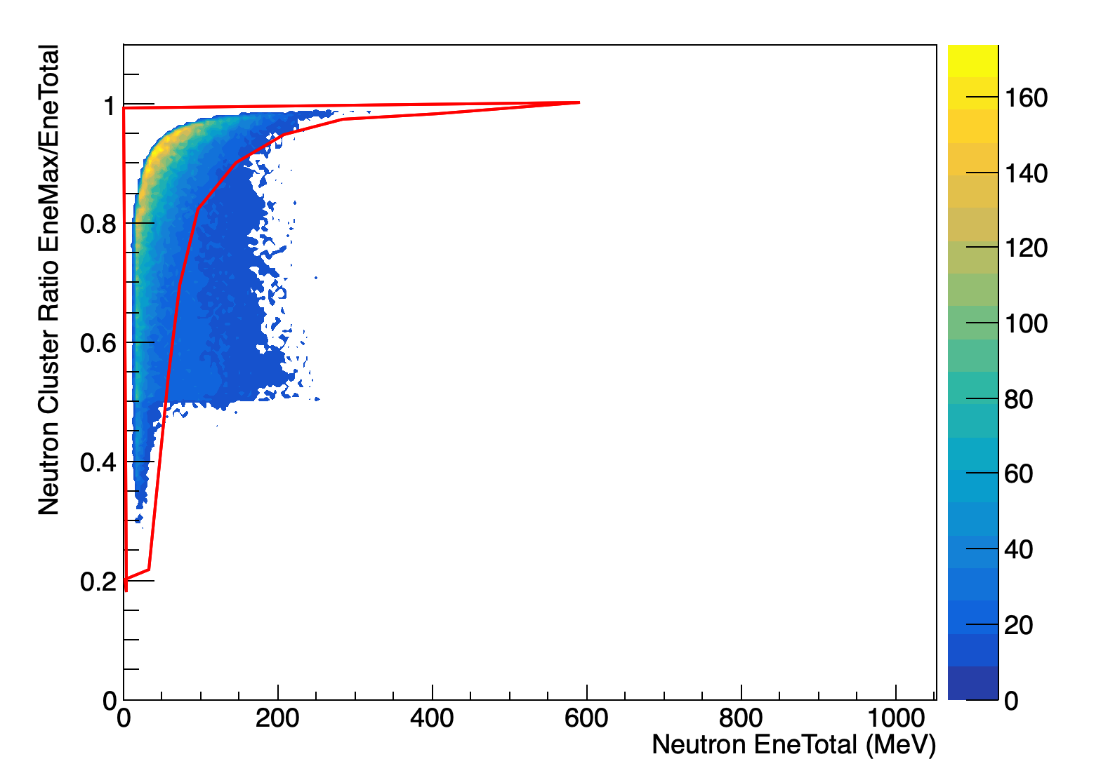
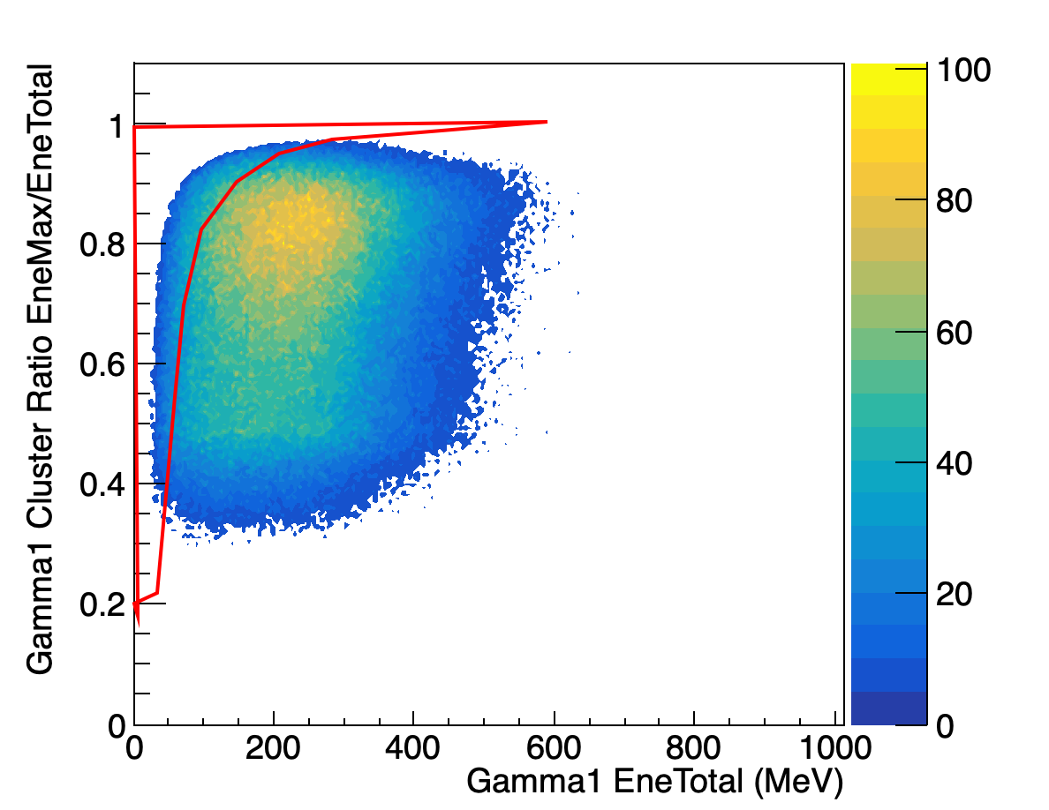
2° PID Criterion:${ E}_{Max_{n,γ}}/{E_{tot}}_{n,γ}{\% E_{tot}}_{n,γ }$
$2)$Energy concentration$\frac{{ E}_{{Max}_{n,γ}}}{{E_{tot}}_{n,γ}} \%$Cluster Energy${ E_{tot}}_{n,γ }$
$$Neutron$$
$where E_{Max}=$Max Energy released in a crystal of the cluster
$${ E}_{Max_{n}}/E_{n}$$
This distribution has different behavior for neutrons and photons for:
clusters with multiplicity>2
$$M_{n}>2$$
$${ E_{tot}}_{n }(MeV)$$
2D Graphical Cut on$\frac{{ E}_{Max_{n}}}{{E_{tot}}_{n}}{\% E_{tot}}_{n }$=> To select neutron signals
$${ E}_{Max_{γ}}/E_{γ}$$
$${ γ}_{1}+γ_{2}$$
Data with Mult =1 not included since in this case ${\left(\frac{{ E}_{Max}}{E_{tot}}\right)}_{M=1}≡1$
$$M_{γ}>2$$
$${ E_{tot}}_{γ }(MeV)$$
Fantini Alessia - February 24-26, 2025, Catania (Italy)

Slide 16
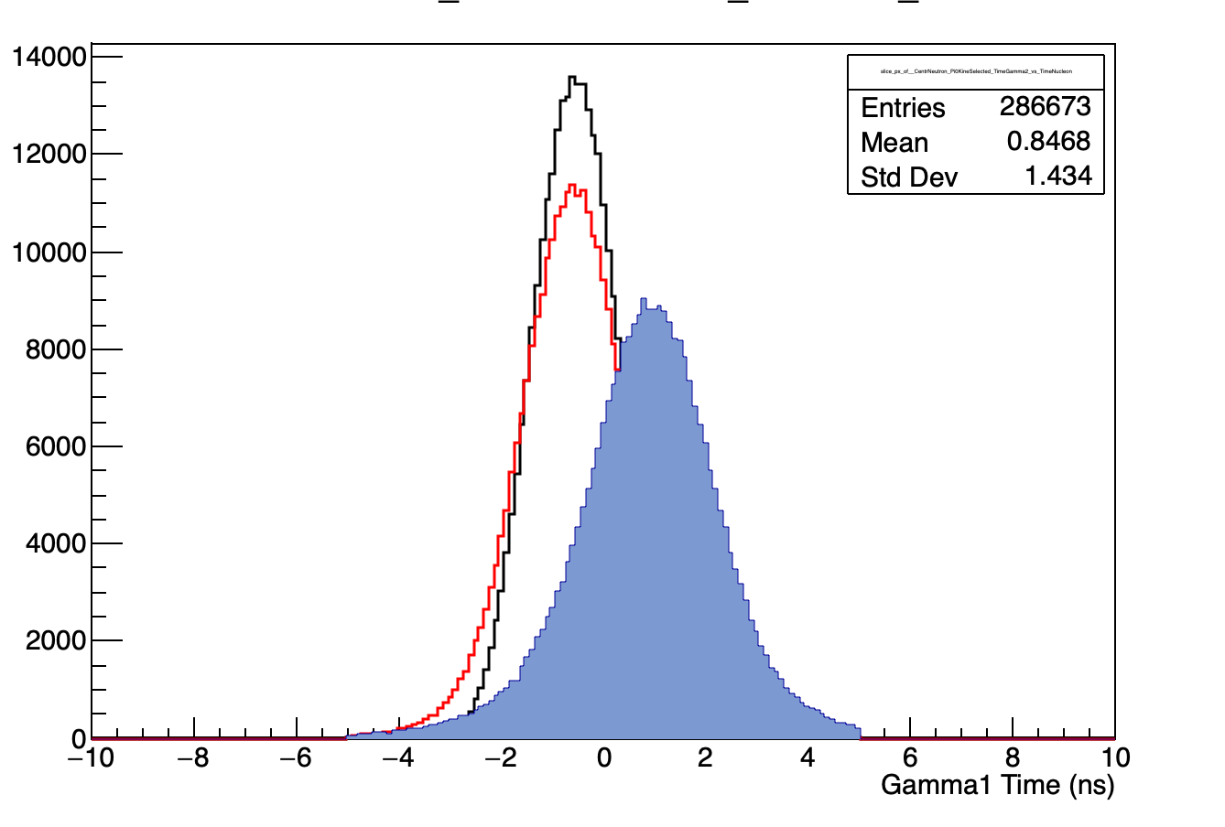
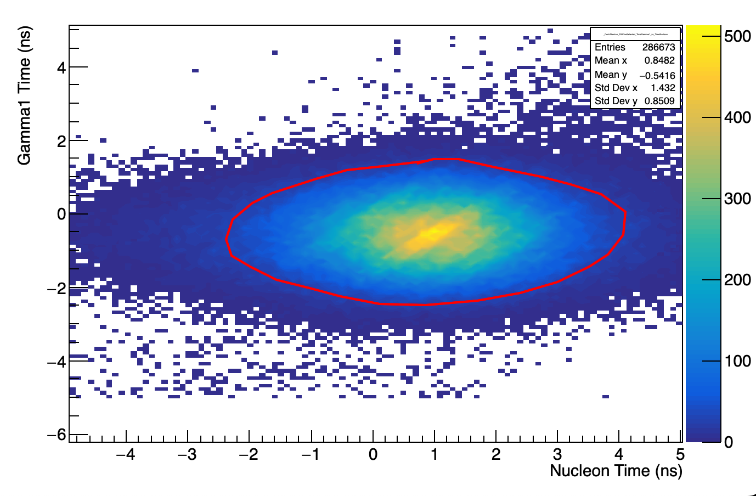
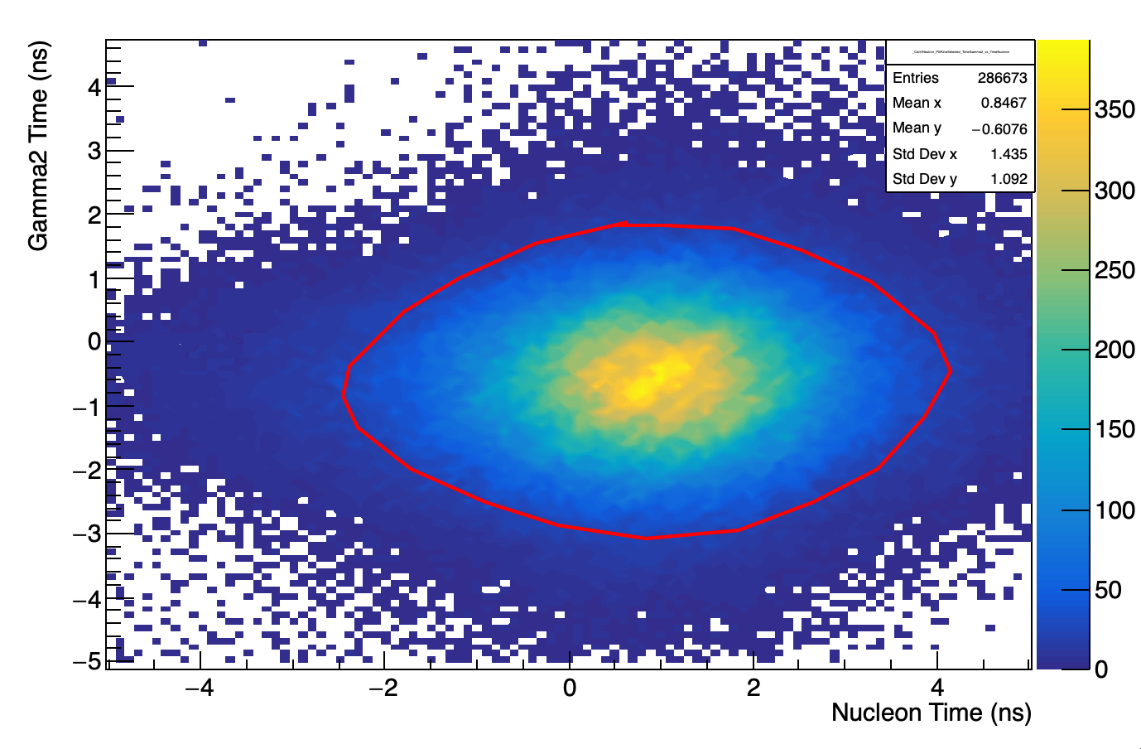
3° PID Criterion: Particles ToF
3$) ToF_{γ}\%ToF_{n}$
The ToF measured in BGO is in average higher for neutrons $(\sim 1.5ns)$than for photons $(\sim 0 ns).$
This time difference is inside the time resolution of the detector $(\sim 2÷3 ns).$
=> ToF cannot be used to univocally discriminate neutron by photon
But….
If both particles (photons and neutrons) are required in a specific analysis, it is possible to apply an ellipsoidal graphical cut on the 2D-plot ${ToF}_{γ}\%ToF_{n}$ for the suppression of the background due to low-energy photons and out-of-time events.
${ −γ}_{1}$
${−γ}_{2}$ Neutron
$ToF$(ns)
$$ToF_{γ_{1}}\%{ToF}_{n}$$
$${ToF}_{γ_{2}}\%{ToF}_{n}$$
$$ToF_{γ_{1}}(ns)$$
$ToF_{γ_{1}}$(ns)
2D Graphical Cut on ${ToF}_{γ}\%{ToF}_{n}$
For Background Suppression
${ToF}_{n}$(ns)
$${ToF}_{n}(ns)$$
Fantini Alessia - February 24-26, 2025, Catania (Italy)

Slide 17
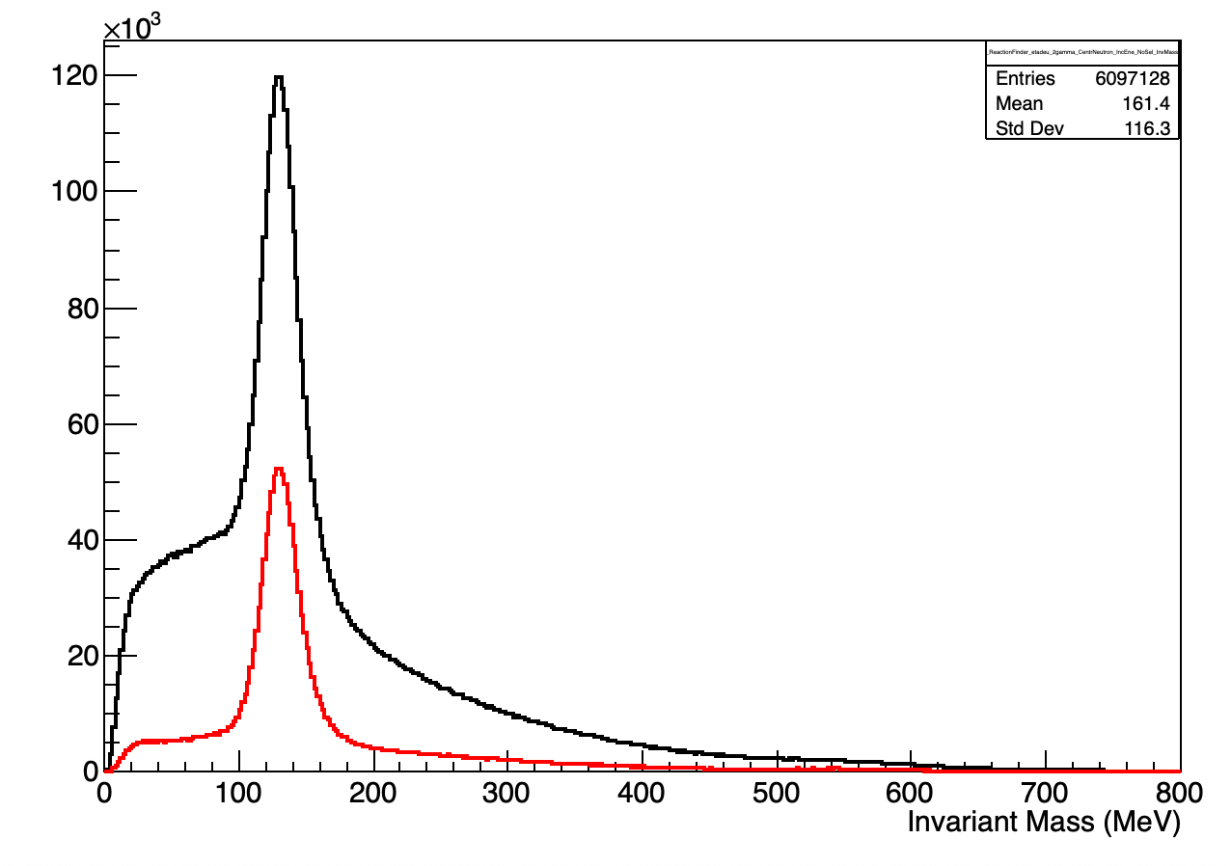
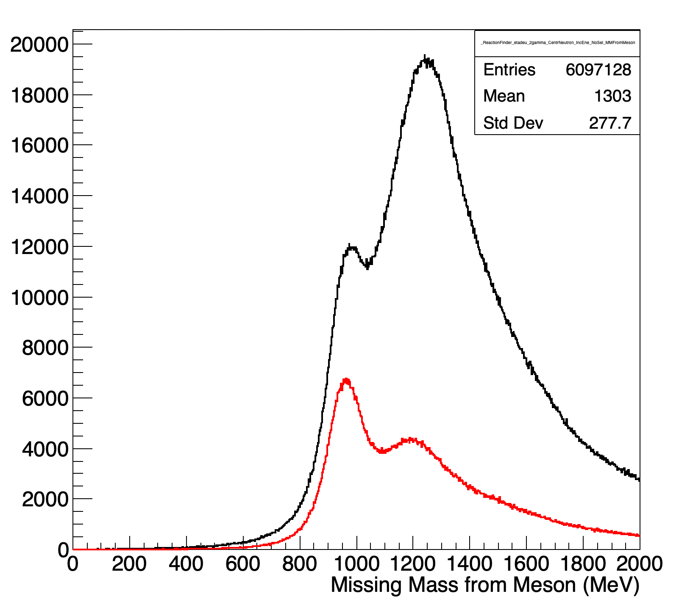
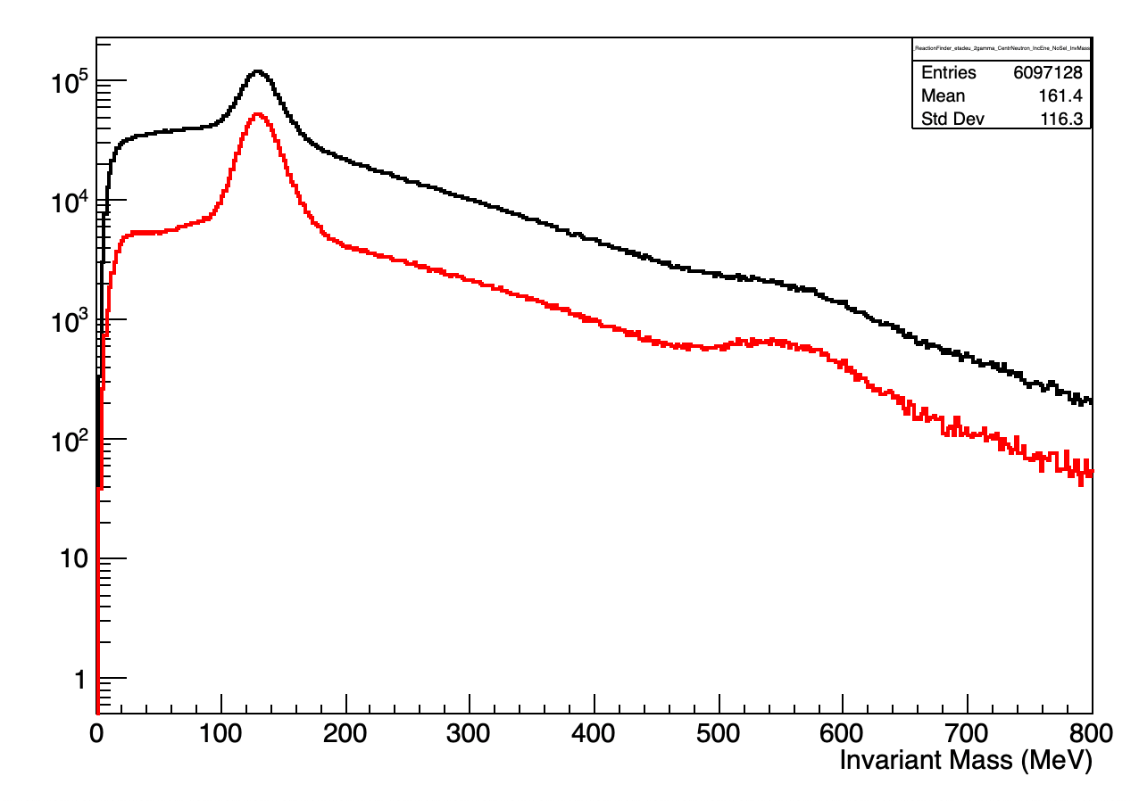
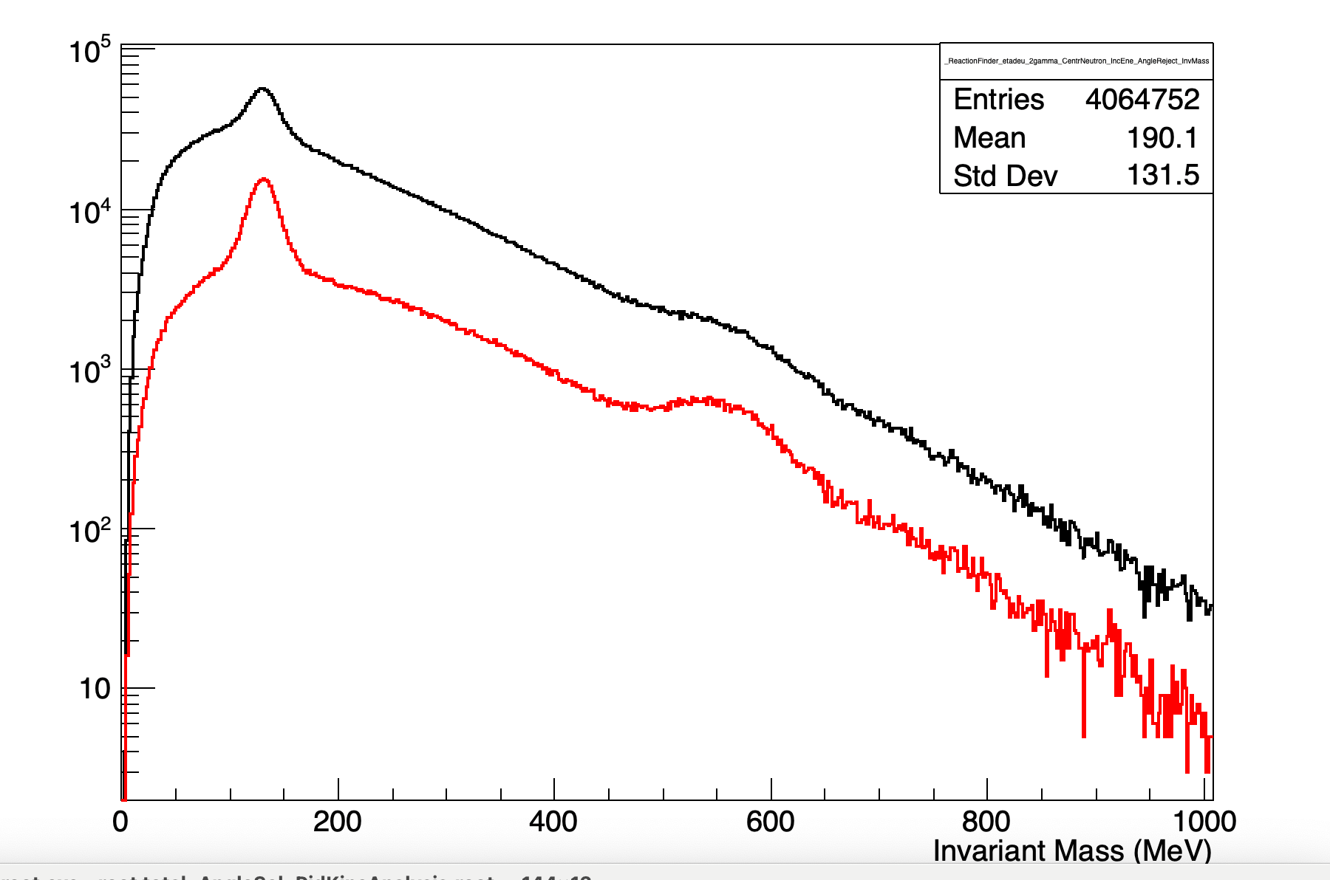
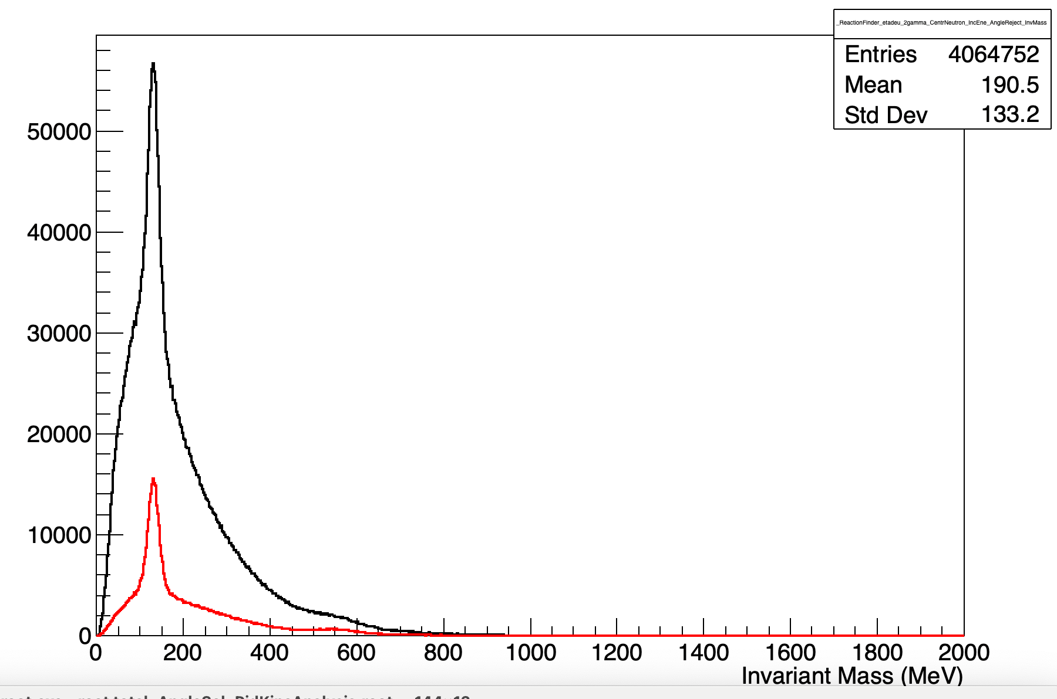
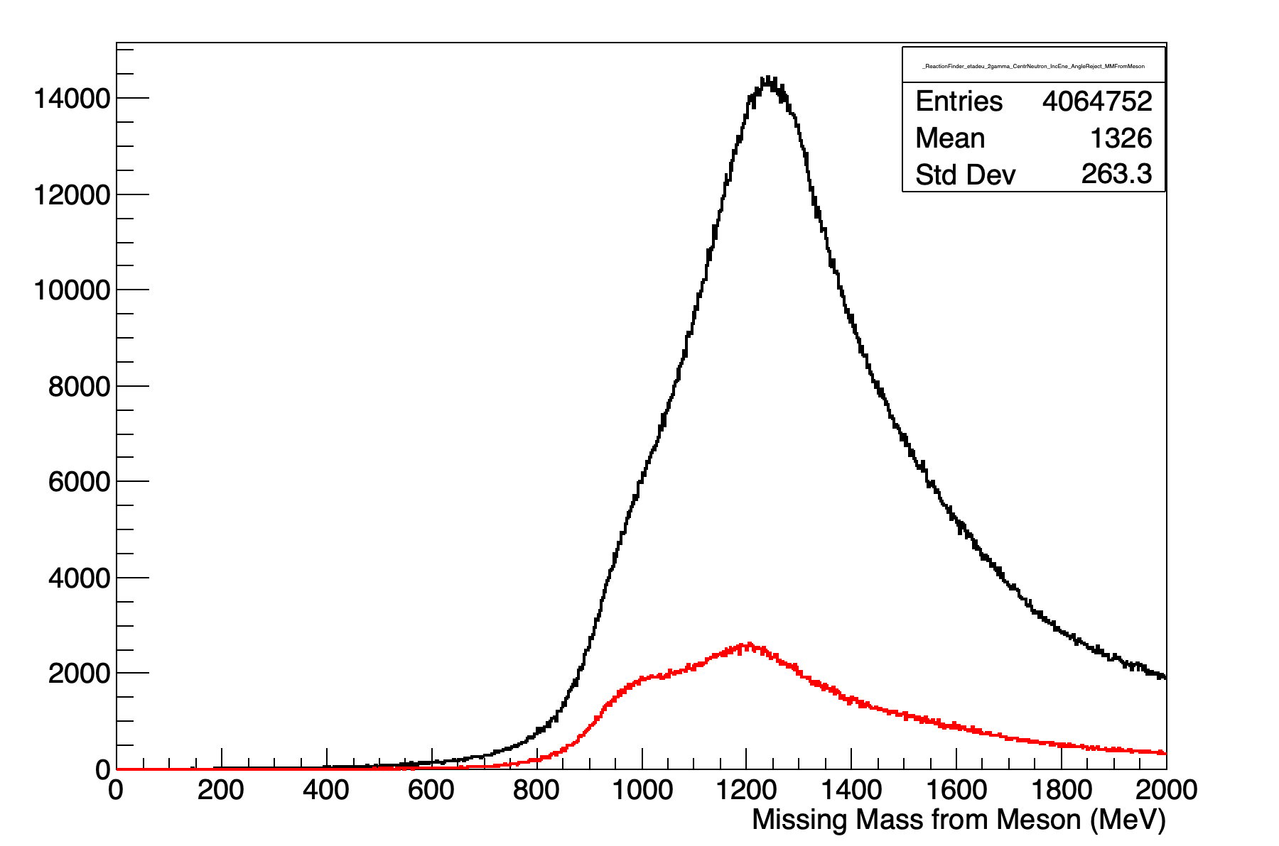
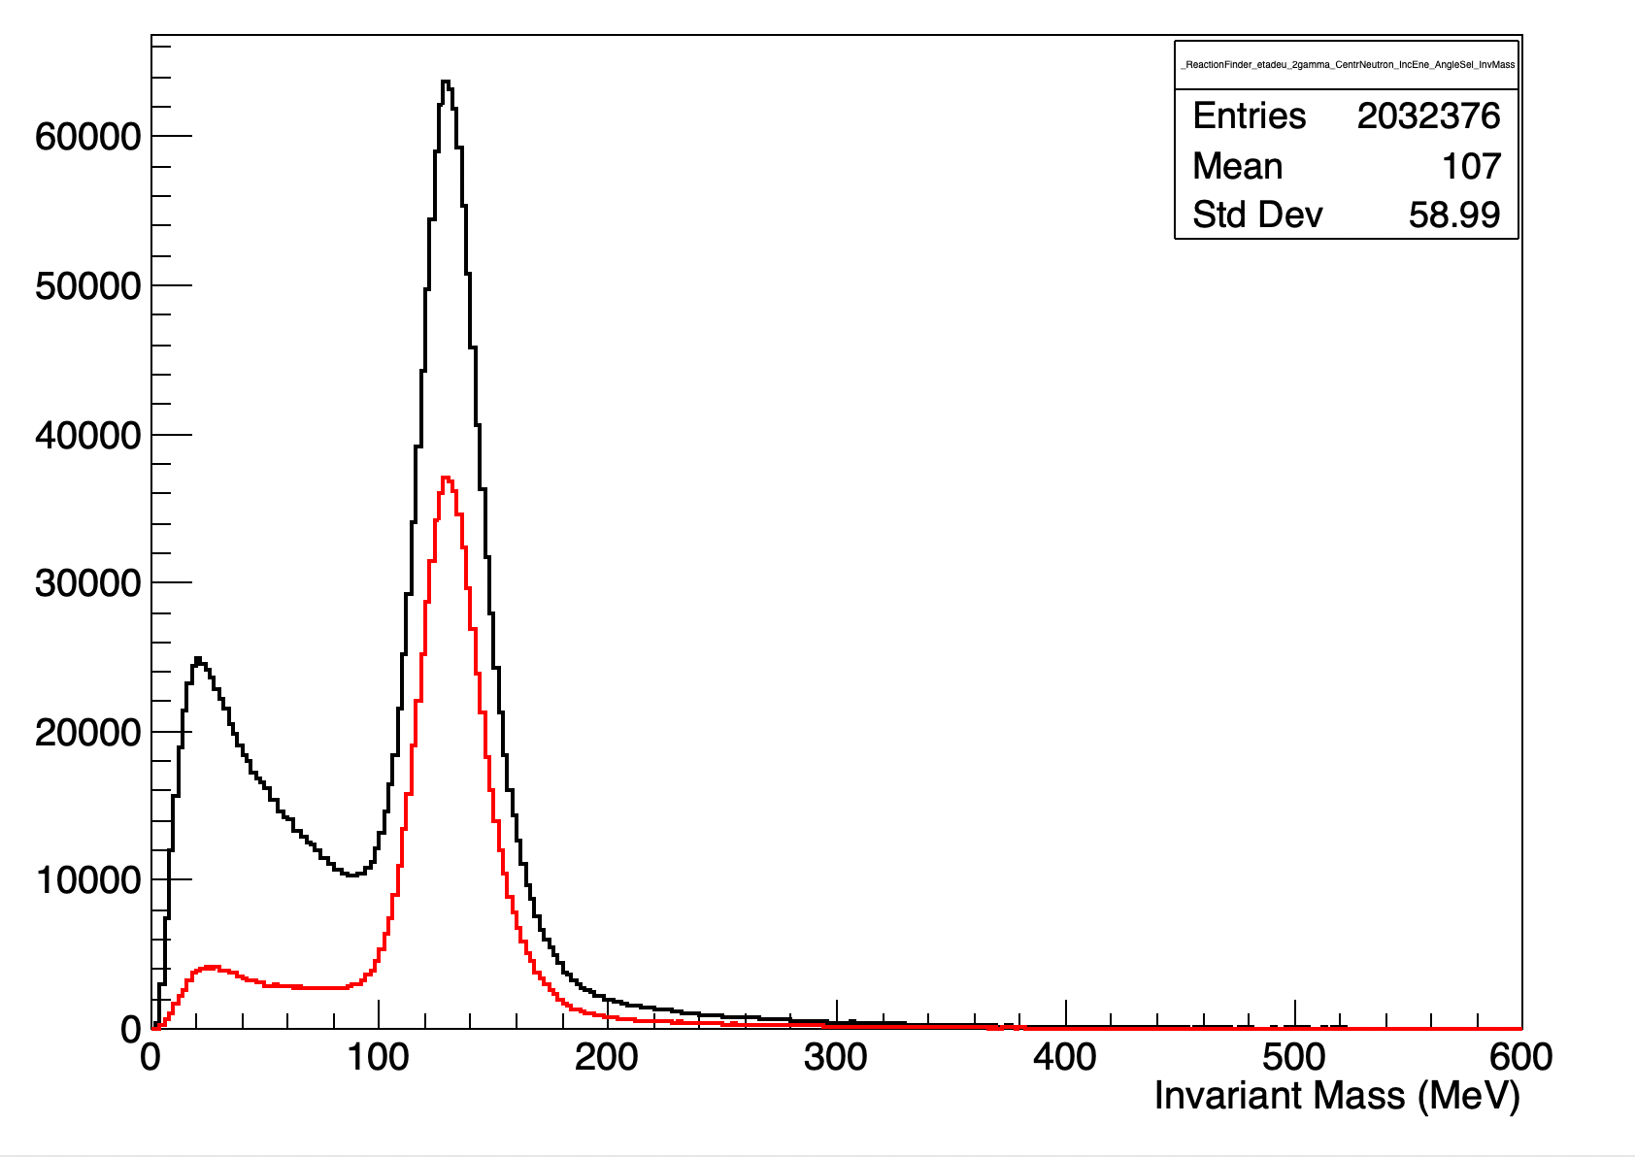
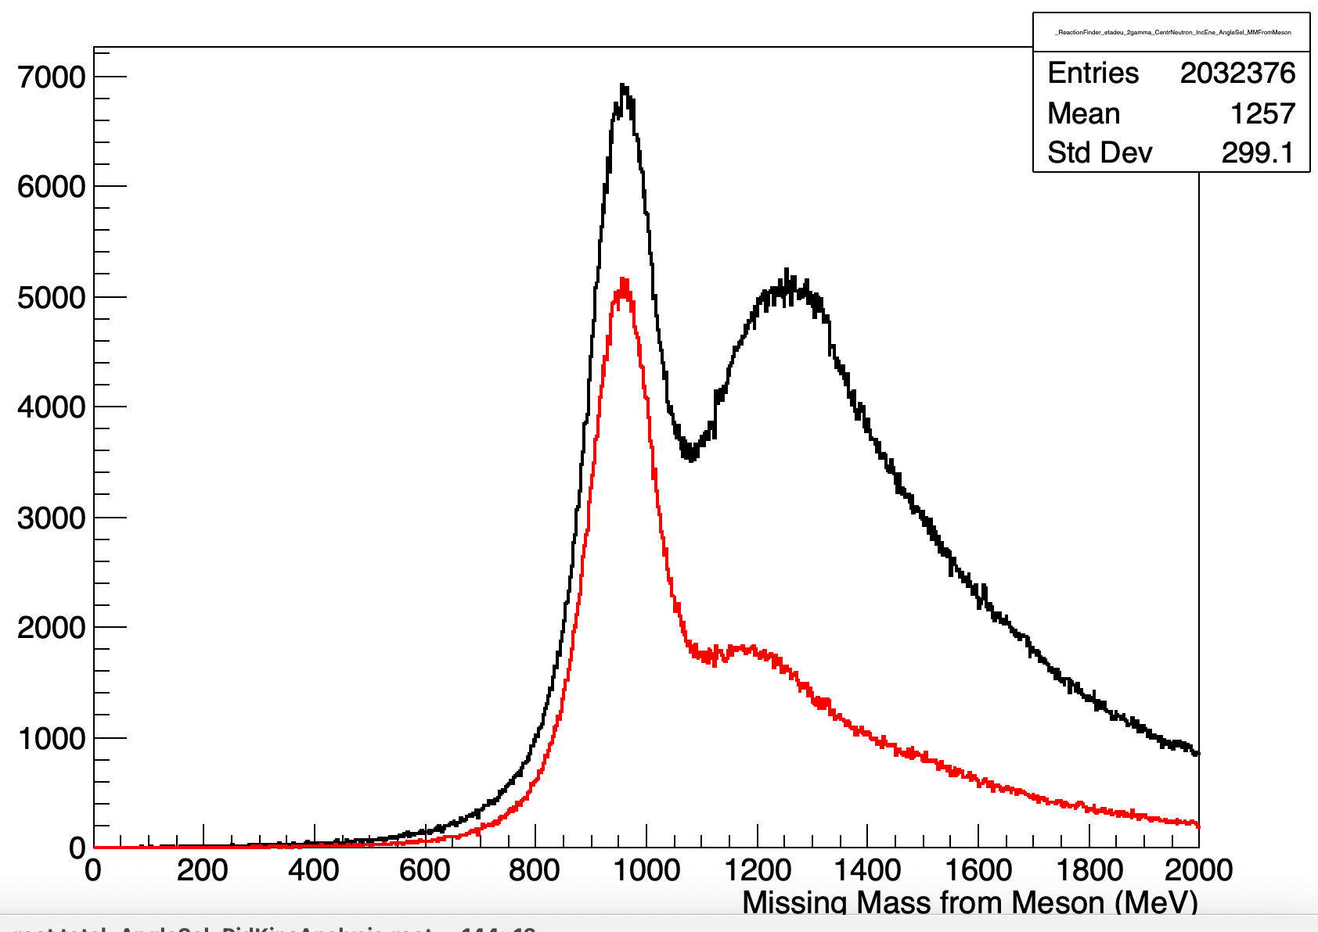
Test of Criteria: Application of PID Criteria on:
original set of data (NO preselection - NO kinematical cut)
Data Rejected by AnglePreselection (No Kinematical Cut )
$$π^{0} mass$$
$${MissM}_{2γ}$$
$${InvMass}_{2γ}$$
$${InvMass}_{2γ}$$
$${InvMass}_{2γ}$$
$$η mass$$
PID SEL
NO SEL
$$η mass$$
NO SEL
$$n mass$$
Reject.
Reject.
$$π^{0} mass$$
PID SEL
$${InvMass}_{2γ}$$
PID SEL
Reject.+PID SEL
$$π^{0} mass$$
NO SEL
Reject.+PID SEL
opening angle preselected data (NO kinematical cut selection)
$${InvMass}_{2γ}$$
$${MissM}_{2γ}$$
PreSel
$${MissM}_{2γ}$$
$$π^{0} mass$$
Reject.
PreSel
$$n mass$$
PreSel+PID SEL
Rejected+PID SEL
PreSel+PID SEL
$$n mass$$
Fantini Alessia - February 24-26, 2025, Catania (Italy)

Slide 18
Test of Criteria
 | KINE SELECTED # EVENTS | KINE SELECTED (%) |  | PID-KINE SELECTED #EVENTS | PID-KINE SELECTED (%)
TOTAL | $$6.1·10^{6}$$ |  |  | $$6.1·10^{6}$$
ANGLE SEL | $$2.0·{10}^{6}$$ | 33.3 |  | $$2.0·{10}^{6}$$ | $$\text{3}\text{3.3}$$
PID SEL |  |  |  | $8.5·{10}^{5}$ | 14.0
$$KINEMATICAL SEL$$ | $$2.9·{10}^{5}$$ | 4.7 |  | $$2.2·10^{5}$$ | $$\text{3}\text{.}\text{7}$$
PreSel
Applying the PID Criteria before the Kinematical Selection to the sample of preselected events we found a clear particle identification and a background reduction, due to incorrect assignment of particle identities, of about 50%
$${MissM}_{2γ}$$
PreSel+PID SEL
Fantini Alessia - February 24-26, 2025, Catania (Italy)

Slide 19
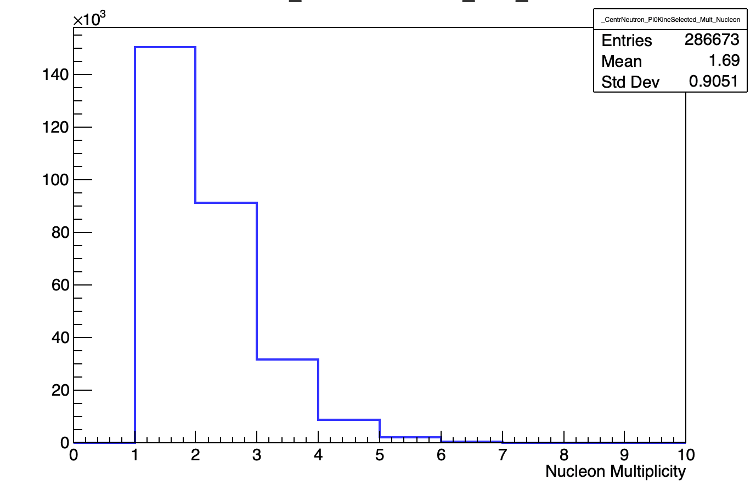
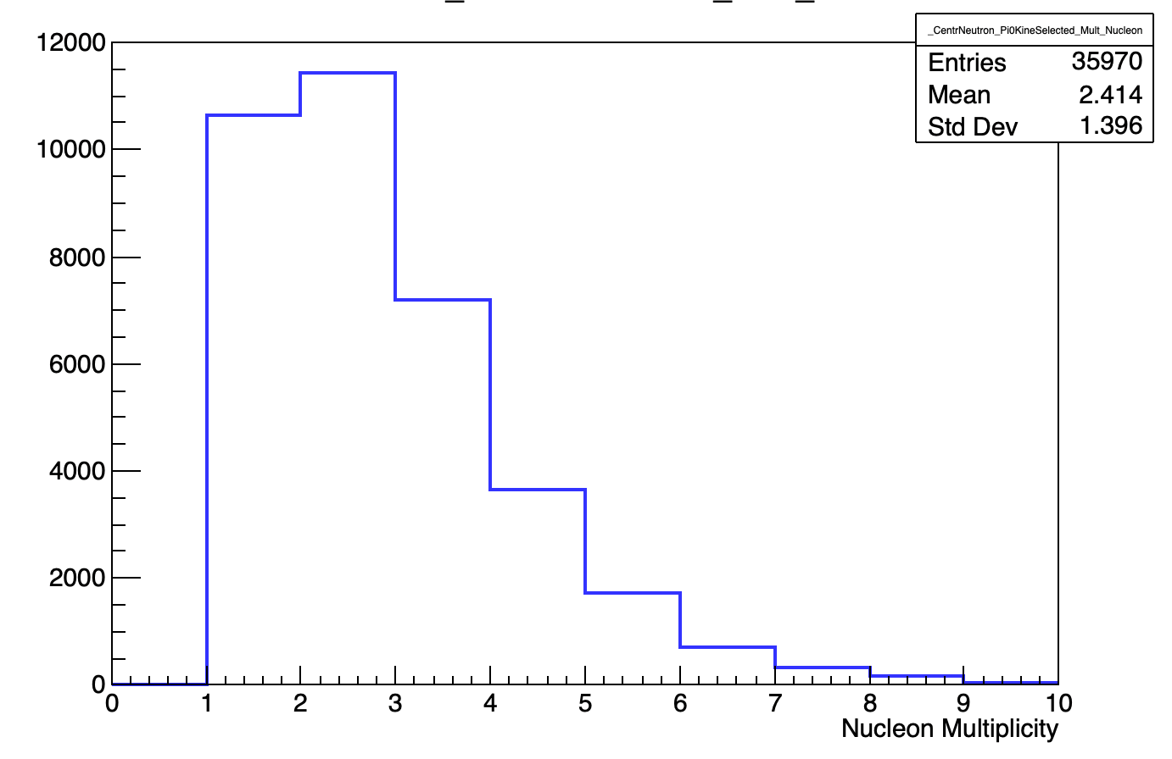
Comparison with Geant4 Simulation (QSGP-BIC-HP):
Starting from ${10}^{6}$ events for $π^{0}$ photoproduction on the neutron we applied the opening angle pre-selection criteria and the same analysis with kinematical cuts as in data, in order to select π⁰ photoproduction events => We obtained a set of $2.{5·10}^{4}$ selected events
Analyzing the cluster features of the selected events of $π^{0}$ photoproduction on the neutron, we found some crucial differences for the neutron respect to what found for data:
Neutron multiplicity in BGO => In Simul Neutron multiplicity is not well reproduced:
DATA: Most probable multiplicity = 1 & No Multiplicity > 5;
SIMUL: Most probable multiplicity = 2 & YES Multiplicity > 5;
$$M_{n}$$
$$\text{ (}\text{Data}\text{)}$$
$$M_{n}$$
(Sim)
Fantini Alessia - February 24-26, 2025, Catania (Italy)

Slide 20
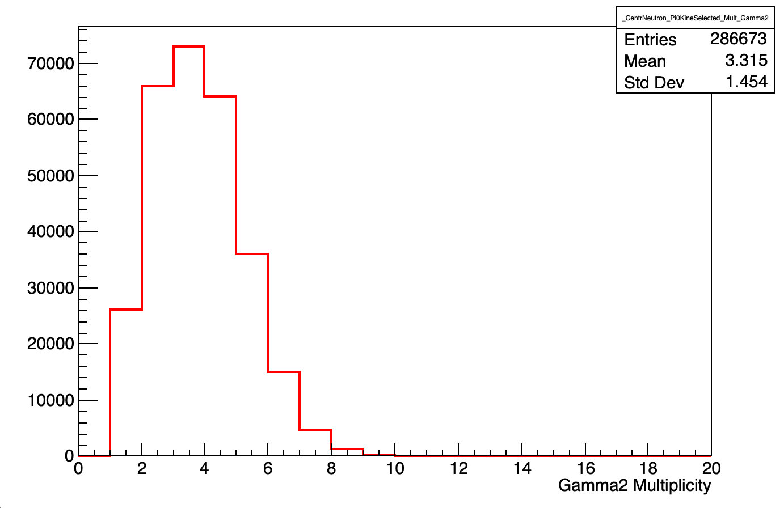
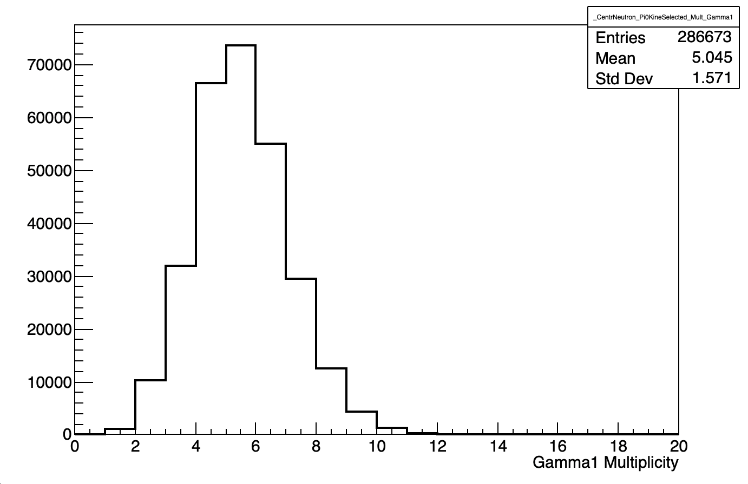
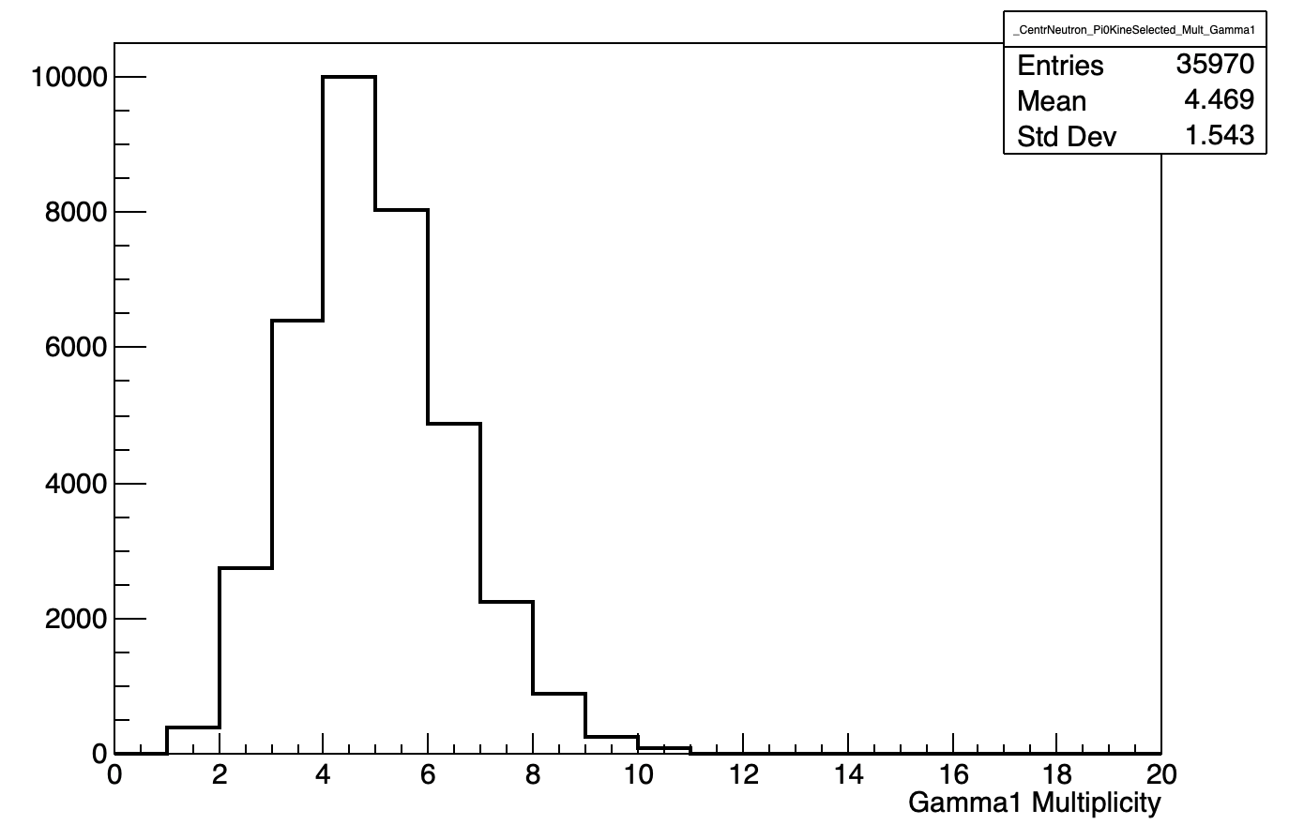
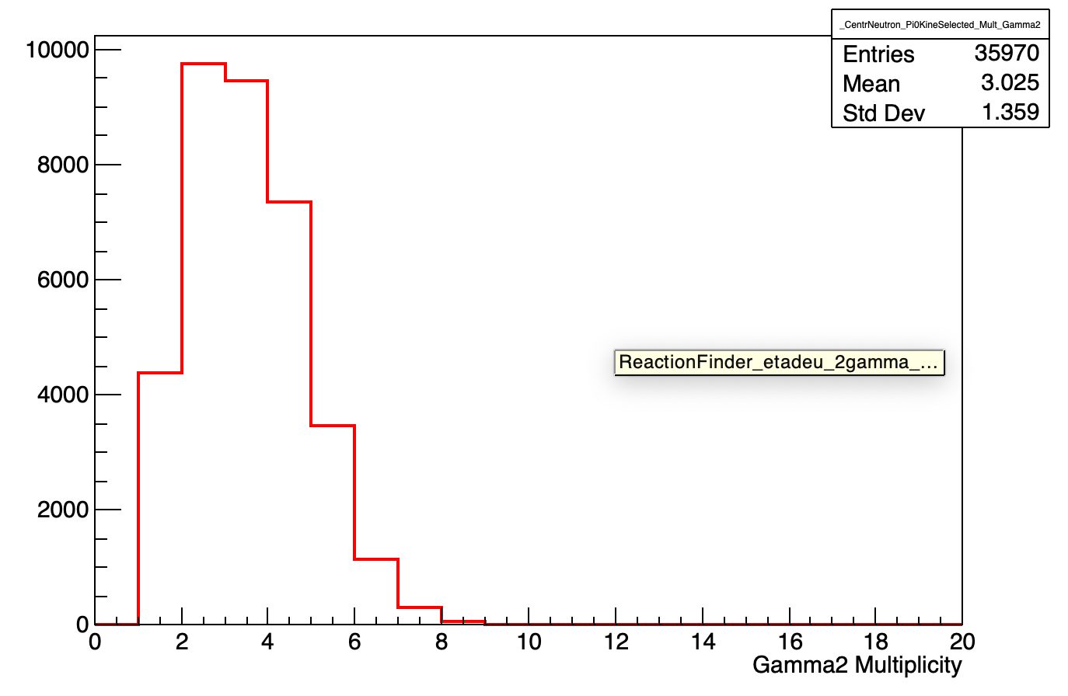
Comparison with Simulation: Cluster multiplicity
Data
Data
Data
$$M_{γ_{2}}$$
(Data)
$$M_{γ_{1}}$$
$$\text{ (}\text{Data}\text{)}$$
$$M_{n}$$
$$\text{ (}\text{Data}\text{)}$$
Simulation
Simulation
Simulation
$$M_{γ_{2}}$$
(Sim)
$$M_{γ_{1}}$$
$$\text{ (}\text{Sim}\text{)}$$
$$M_{n}$$
$$\text{ (}\text{Sim}\text{)}$$
Fantini Alessia - February 24-26, 2025, Catania (Italy)

Slide 21
Comparison with Simulation: (Neutron Energy Released in BGO)
Starting from ${10}^{6}$ events for $π^{0}$ photoproduction on the neutron we applied the opening angle pre-selection criteria and the same analysis with kinematical cuts as in data, in order to select π⁰ photoproduction events => We obtained a set of $2.{5·10}^{4}$ selected events
Analyzing the cluster features of the selected events of $π^{0}$ photoproduction on the neutron, we found some crucial differences for the neutron respect to what found for data:
Neutron multiplicity in BGO => In Simul Neutron multiplicity is not well reproduced:
DATA: Most probable multiplicity = 1 & No Multiplicity > 5;
SIMUL: Most probable multiplicity = 2 & YES Multiplicity > 5;
Neutron Energy Released in BGO => In Simul Neutrons release a greater fraction of energy than what observed in the data.
Fantini Alessia - February 24-26, 2025, Catania (Italy)

Slide 22
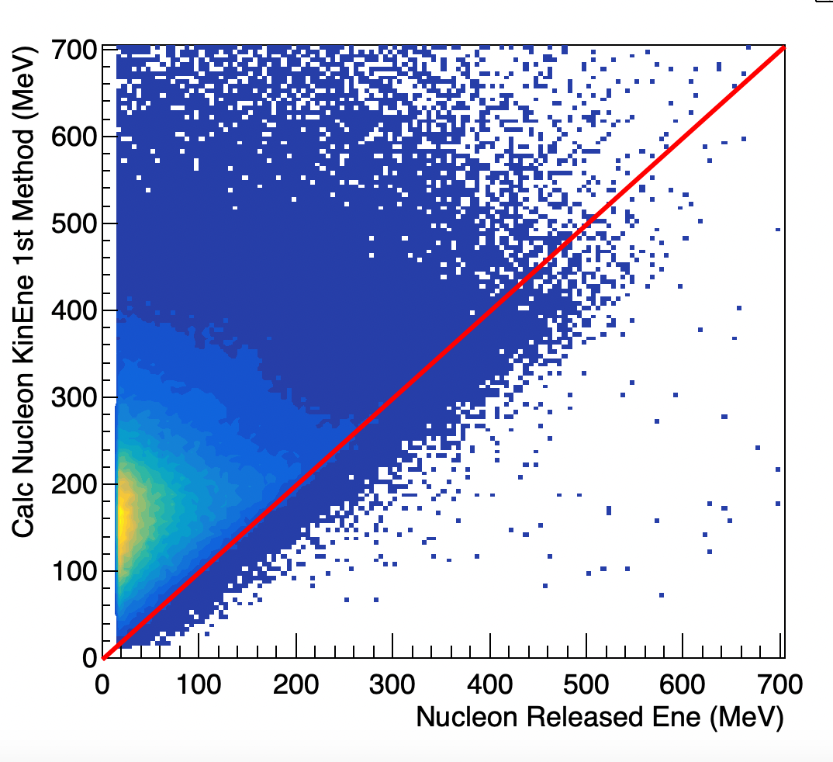
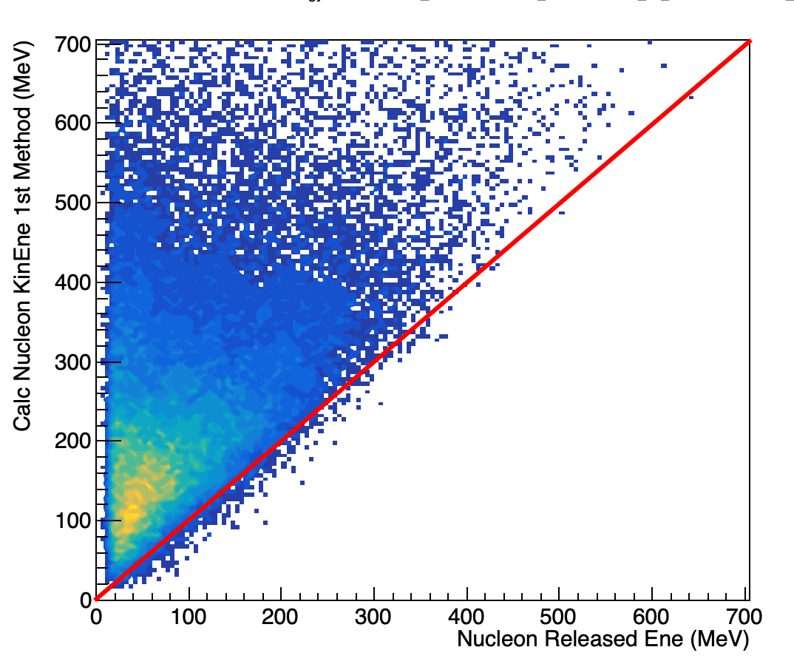
Comparison with Simulation: (Neutron Energy Released in BGO)
Data
Simulation
Calc Neutron Kinetic Energy
Calc Neutron Kinetic Energy (MeV)
Neutron Released Energy (MeV)
Neutron Released Energy (MeV)
Fantini Alessia - February 24-26, 2025, Catania (Italy)

Slide 23
Summary & Conclusions
Starting from a clean set of $π^{0}$ photoproduction on the neutron events, we have studied the features of clusters produced by Neutrons and Photons and established three selection criteria based on the differences of these features for the two particles.
The Criteria allows to preselect neutron and photons with a relevant background reduction due to incorrect assignment of particle identities
These study has also put in evidence a criticism in the GEANT4 simulation that can’t well reproduce the neutron cluster features in term of released energy in the BGO and energy distribution in clusters
Fantini Alessia - February 24-26, 2025, Catania (Italy)

Slide 24
Thank You !!!!
Fantini Alessia - February 24-26, 2025, Catania (Italy)

Slide 25
Backup

Slide 26
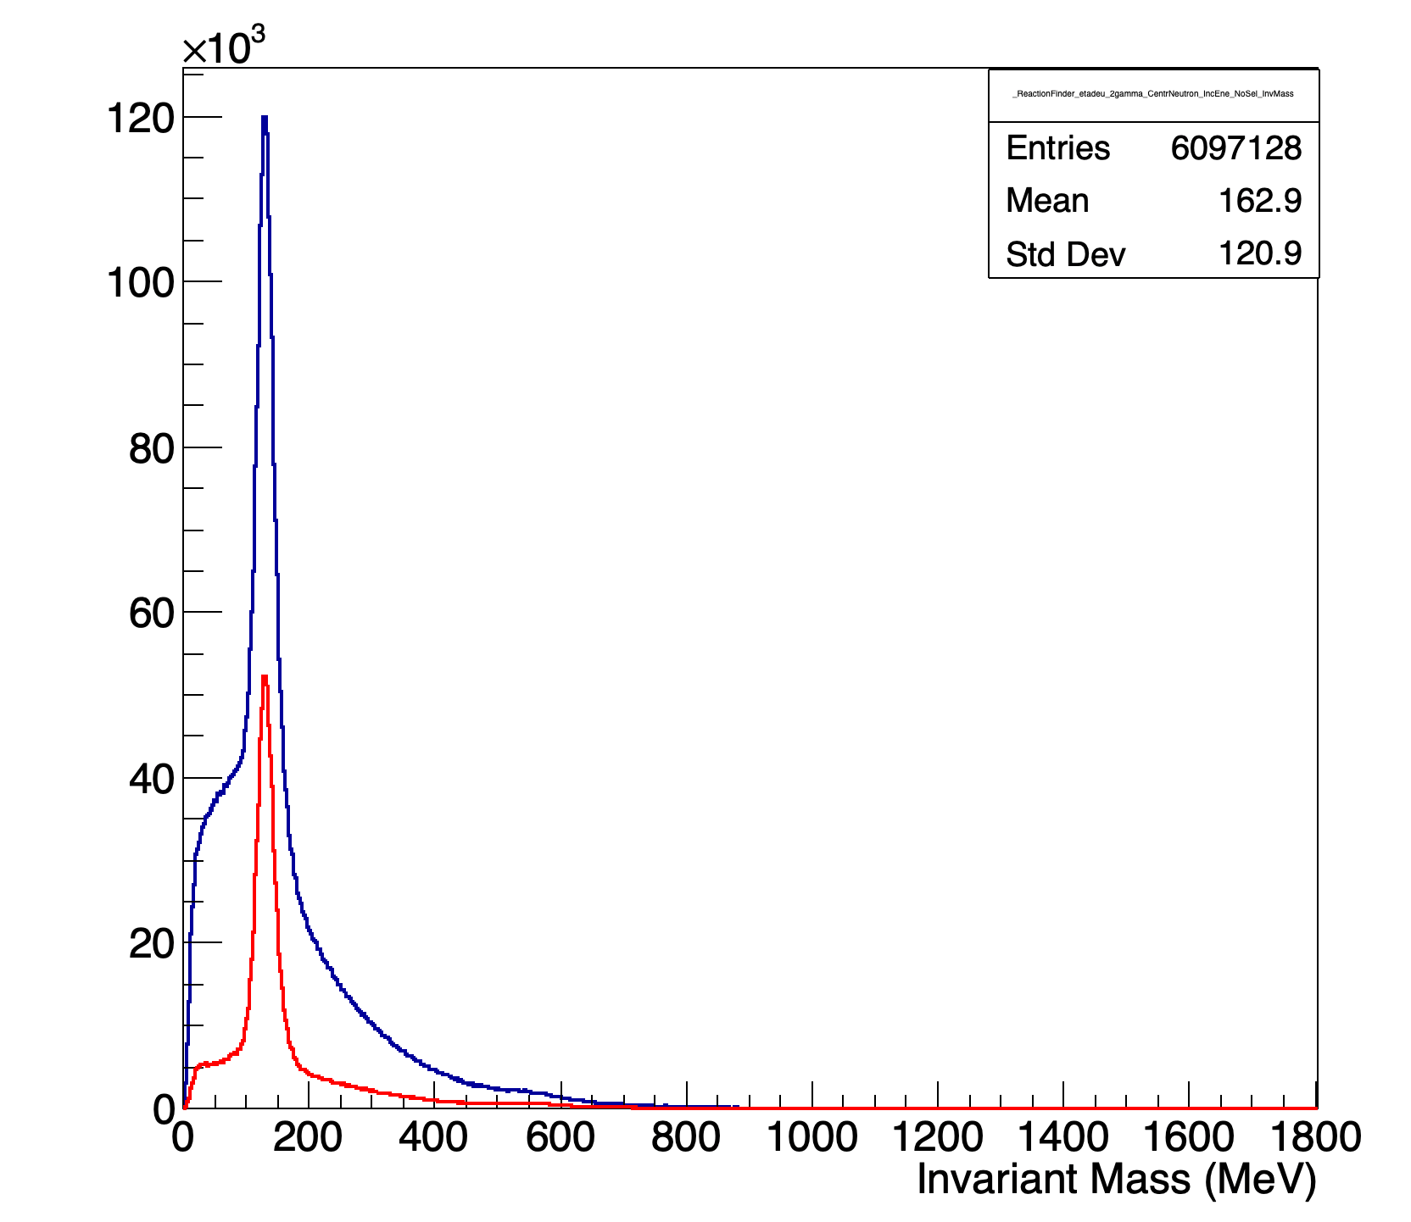
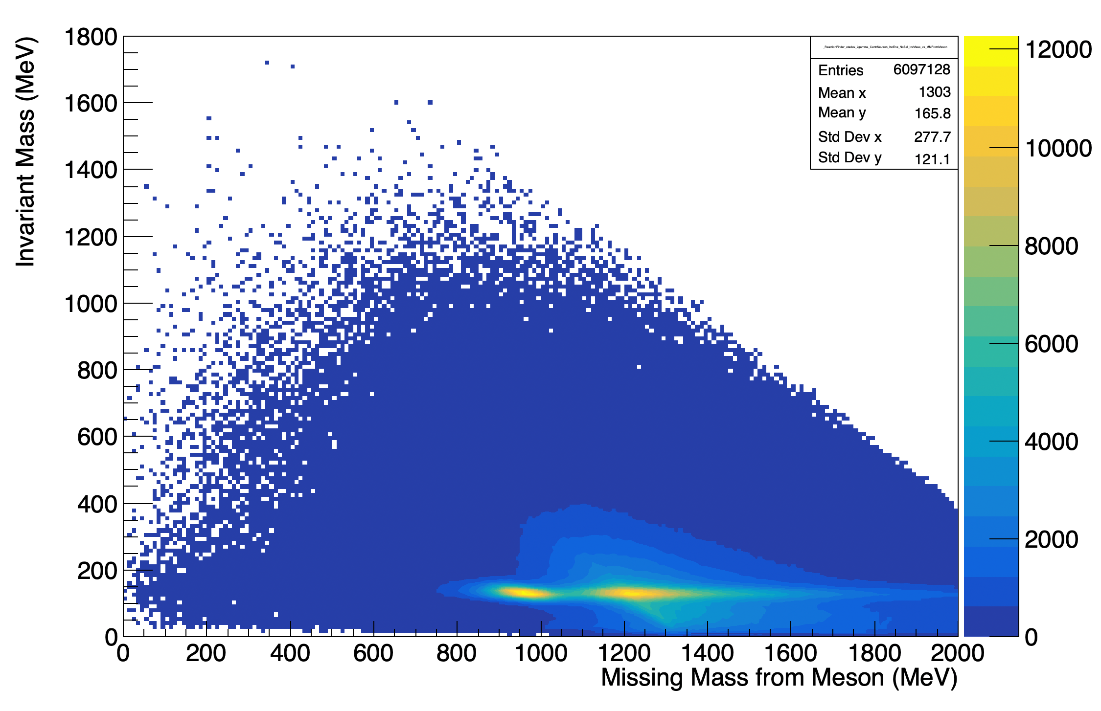
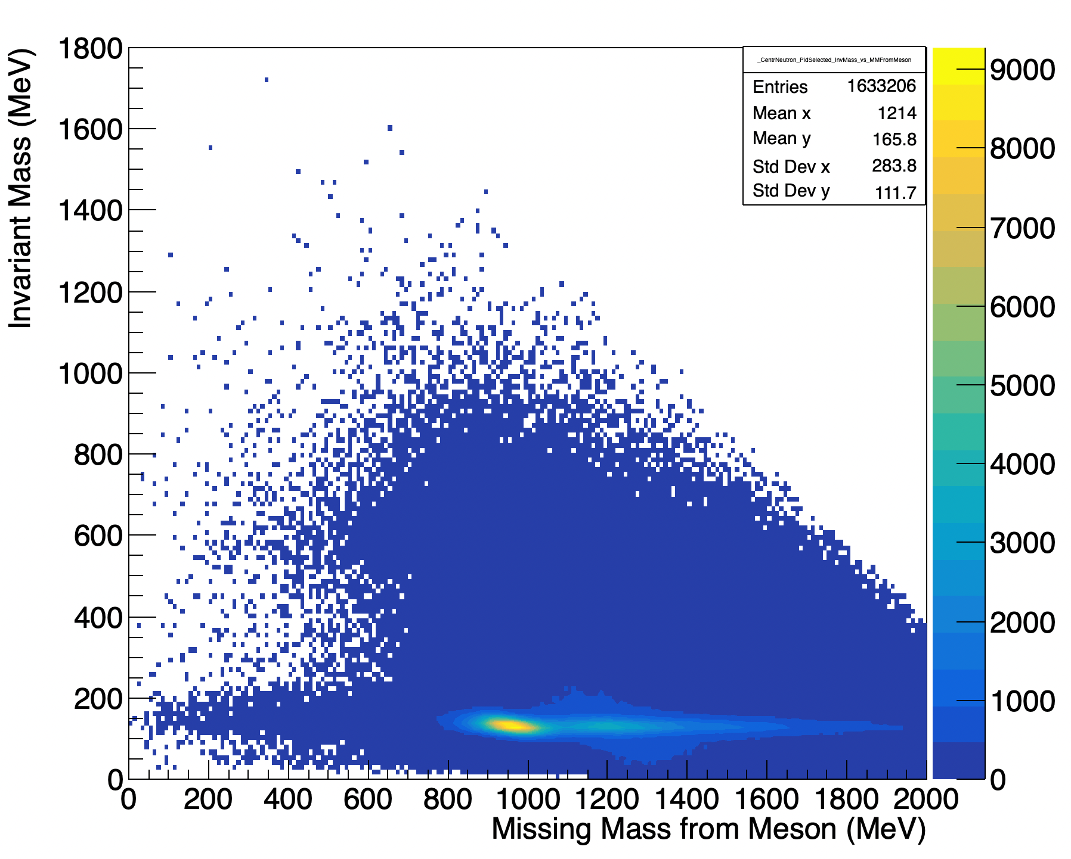
$$M_{π^{0} }\%{MissM}_{π^{0}}$$
$$M_{π^{0} }\%{MissM}_{π^{0}}$$
$$M_{π^{0} }$$
NO SEL
PID SEL
PID SEL
NO SEL
$${MissM}_{π^{0}}$$
NO SEL
PID SEL

Slide 27
Test of Criteria
the original set of data (without any preselection or kinematical cut)
the opening angle preselected data (before kinematical cut selection)
the opening angle rejected data
compared the results in terms of number of events before and after Kinematical Selection we found a clear particle identification and a background reduction, due to incorrect assignment of particle identities in the sample of preselected events, of about 50%
Fantini Alessia - February 24-26, 2025, Catania (Italy)

Slide 28
Test of Criteria
 | KINE SELECTED # EVENTS | KINE SELECTED (%) |  | PID-KINE SELECTED #EVENTS | PID-KINE SELECTED (%) |  | NO PRESEL #EVENTS | NO PRESEL (%) |  | REJECTED #EVENTS | REJECTED (%)
TOTAL | 6097128 |  |  | 6097128 |  |  | 6097128 |  |  | 6097128
ANGLE SEL | 2032376 | 33,3 |  | 2032376 | 33,33 |  | 6097128 |  |  | 4064752 | 66,7
$$\frac{{ E}_{Max_{n}}}{{E_{tot}}_{n}}{\% E_{tot}}_{n }$$ |  |  |  | 1266512 | 20,77 |  | 2878272 | 47,2 |  | 1609760 | 26,4
$$tof_{γ_{1}}\%tof_{n}$$ |  |  |  | 1002477 | 16,44 |  | 2123435 | 34,8 |  | 1120958 | 18,4
$$tof_{γ_{2}}\%tof_{n}$$ |  |  |  | 886212 | 14,53 |  | 1718461 | 28,2 |  | 832249 | 13,65
$${E_{mean}}_{γ_{1},γ_{2}}<150\frac{MeV}{Crystal}$$ |  |  |  | 854921 | 14,02 |  | 1633206 | 26,8 |  | 778285 | 12,8
PID SEL |  |  |  | 854921 | 14,02 |  | 1633206 | 26,8 |  | 778285 | 12,8
$θ_{miss N }^{calc}>20^{0}$ | 866167 | 14,21 |  | 535418 | 8,78 |  | 748052 | 12,3 |  | 212634 | 3,5
$$Δθ_{n}\% Coplan$$ | 506116 | 8,3 |  | 370951 | 6,08 |  | 399626 | 6,55 |  | 28675 | 0,5
$$M_{π^{0}}\%MissM_{π^{0}}$$ | 286673 | 4,7 |  | 224293 | 3,7 |  | 233182 | 3,8 |  | 8889 | 0,15
Fantini Alessia - February 24-26, 2025, Catania (Italy),

