Slide 1
Picosecond resolution time resolved photoelectron emission detection system
S. Zhamkochyan
(Yerevan Physics Institute)

Slide 2
OUTLINE
Precise Timing Instrumentation: state of the art
Radio-Frequency Timer
RF Timer based photo-electron emission detection system
Preliminary experimental results with nanostructures
Monte-Carlo Simulations
RF Timer applications

Slide 3
Precise time measurements
 | Time Resolution | Counting Rate | Readout
PMT, APD, HPD | >25 ps | Few MHz | Fast
SNPD | 10 ps | Few MHz | Fast
Streak Camera | 1 ps | Few 10 KHz | Slow
RF Timer | 1 ps | Few MHz | Fast
The RF Timer is a sensitive photo-detector, capable of registering single photons: optical photons produce electrons on a photo cathode, which are accelerated to keV energies, multiplied and detected.
The time information is converted into a spatial domain: the keV electrons are scanned by means of helical RF deflector.
The RF Timer provides fast signal output as with regular PMTs
and Picosecond level timing resolution as with streak cameras
The new RF Timer combines the advantages of regular and the RF timing techniques, resulting in high resolution, high rate and high stability for single particle detection.

Slide 4
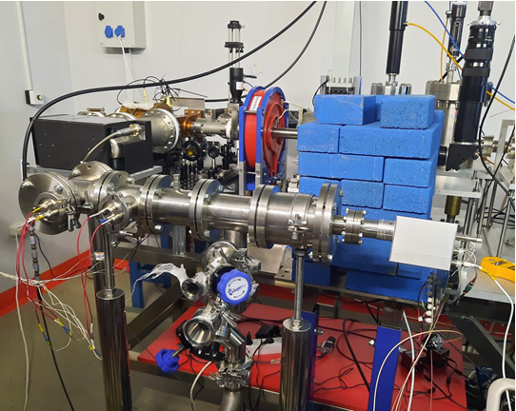
The RF Timer
Schematic of the RF Timer: (1) mirror, (2) quartz-glass window, (3) incident photons, (4) permanent magnet, (5) collimator, (6) photoelectron, (7) electron transparent electrode, (8) photocathode, (9) electrostatic lens, (10) RF deflector, (11) MCP detector, (12) position sensitive anode.
The RF Timer at CANDLE facility in Yerevan: first test studies with femtosecond synchronized laser

Slide 5
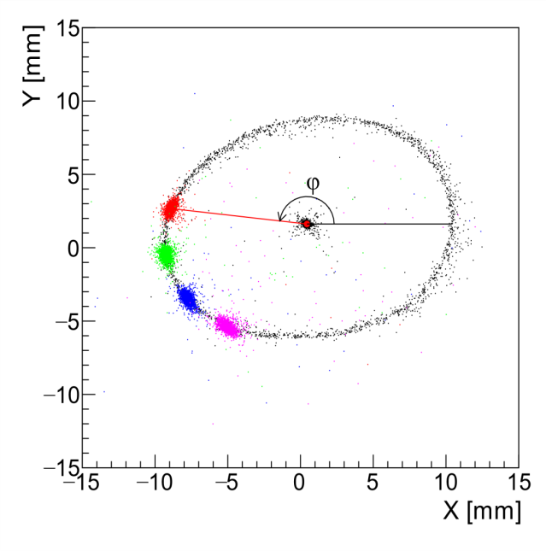
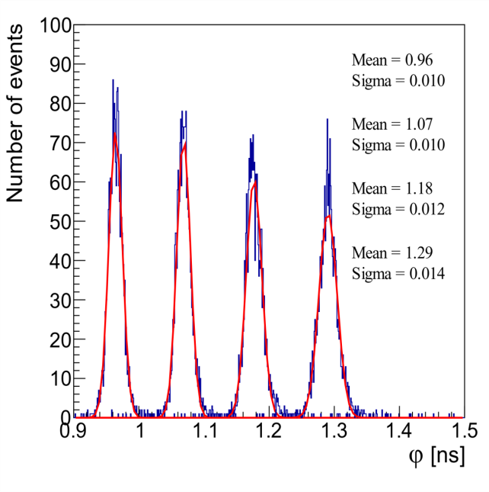
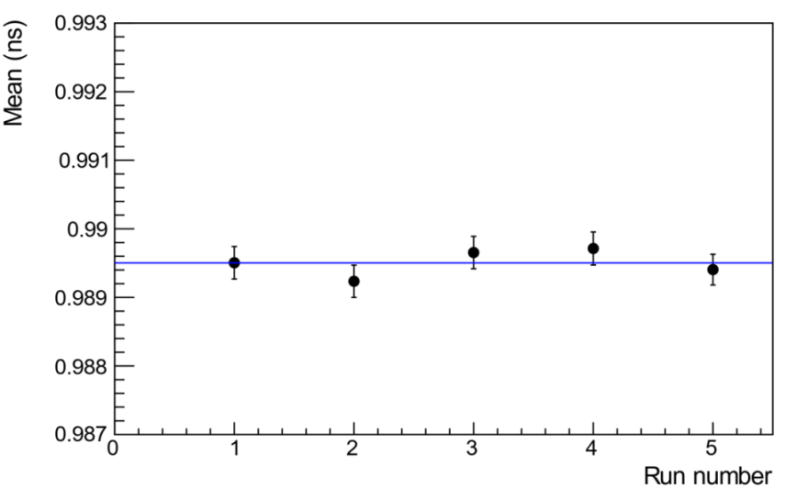
Studies with synchronized femtosecond pulsed laser at CANDLE
Left: 2D image of anode hit positions. The point in the center of the circle is the image of electrons with RF turned OFF. The circle is an image of the scanned electrons when the 500 MHz RF is ON, but not synchronized with the laser. The color spots on the circle correspond to phase distributions of the scanned, RF-synchronized photo-electrons for four different fixed phases.
Middle: Distribution of phases (φ), converted into ns, of the scanned electrons in the case of RF synchronized laser.
Right: The mean values of sequentially measured time distributions in a one hour period.
A. Margaryan et al., Nucl. Instr. & Meth. A 1038, 166926 (2022)
S. Zhamkochyan et al., JINST 19 C02014 (2024)

Slide 6
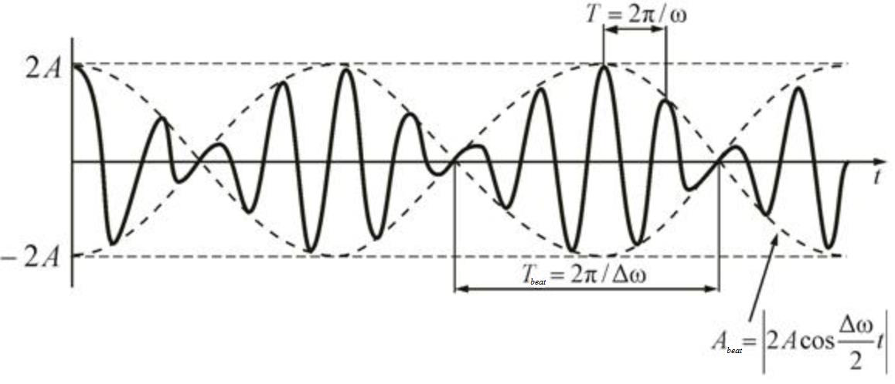
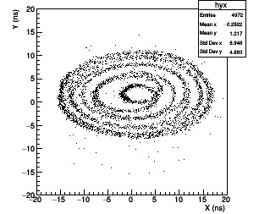
Spiral scanning studies
Using two circular scanning RF deflectors with slightly different frequencies results in spiral scanning due to “amplitude beating” effect.
Acosωt + Acos(ω+ Δω)t = (2Acos(Δω𝑡/2))cosωt
Spiral scanning allows increasing the dynamic range of the RF Timer by an order of magnitude
Preliminary studies were done using thermo-electrons

Slide 7
Time resolution of the RF Timer
Physical time resolution of the photocathode or secondary electron source
The time spread of the photoelectrons at the surface of the photocathode or SE source.
Physical and technical time resolution of the electron tube
Transit time spread and of the photoelectrons and electron beam spot size at the PSD.
Technical time resolution of the RF deflector
Δτ_{d} = d/v
d - convolution of the size of the electron beam spot and the position resolution of the electron detector, v = 2πR/T.

Slide 8
Lifetime of hot carriers
The lifetime of hot carriers is a critical parameter in various materials, such as graphene. The ability to harness hot carriers efficiently for technological applications, such as in photodetectors, solar cells, and ultrafast electronics, depends largely on their lifetime.
Theoretically, the lifetime of hot carriers in graphene should be quite long (hundreds of picoseconds to a few nanoseconds)
R. Bistritzer, A. H. MacDonald, Phys. Rev. Lett. 2009, 102, 206410.
However, numerous experimental measurements in the past decade employing various pump-probe methods have always measured a few ps decay time. This is probably caused by high exciting light intensities used in such measurements
M. Breusing, et al., Phys. Rev. B 2011, 83, 153410; X.-Q. Yan, et al., Phys. Rev. B 2014, 90, 134308; I. Gierz, et al., Nat. Mater. 2013, 12, 1119-1124; U. Soren, et al., J. Phy. Condens. Matter 2015, 27, 164206; and many others…
Longer lifetime of hot carriers was observed for the first time implementing time resolved ARPES method with low intensity light source. The measurement precision was > 64ps
Lin Fan et al., Phys Chem. Lett., 9(7), 2018
The RF Timer based system allows photoemission time measurements under low light intensities with the precision better than 10 ps

Slide 9
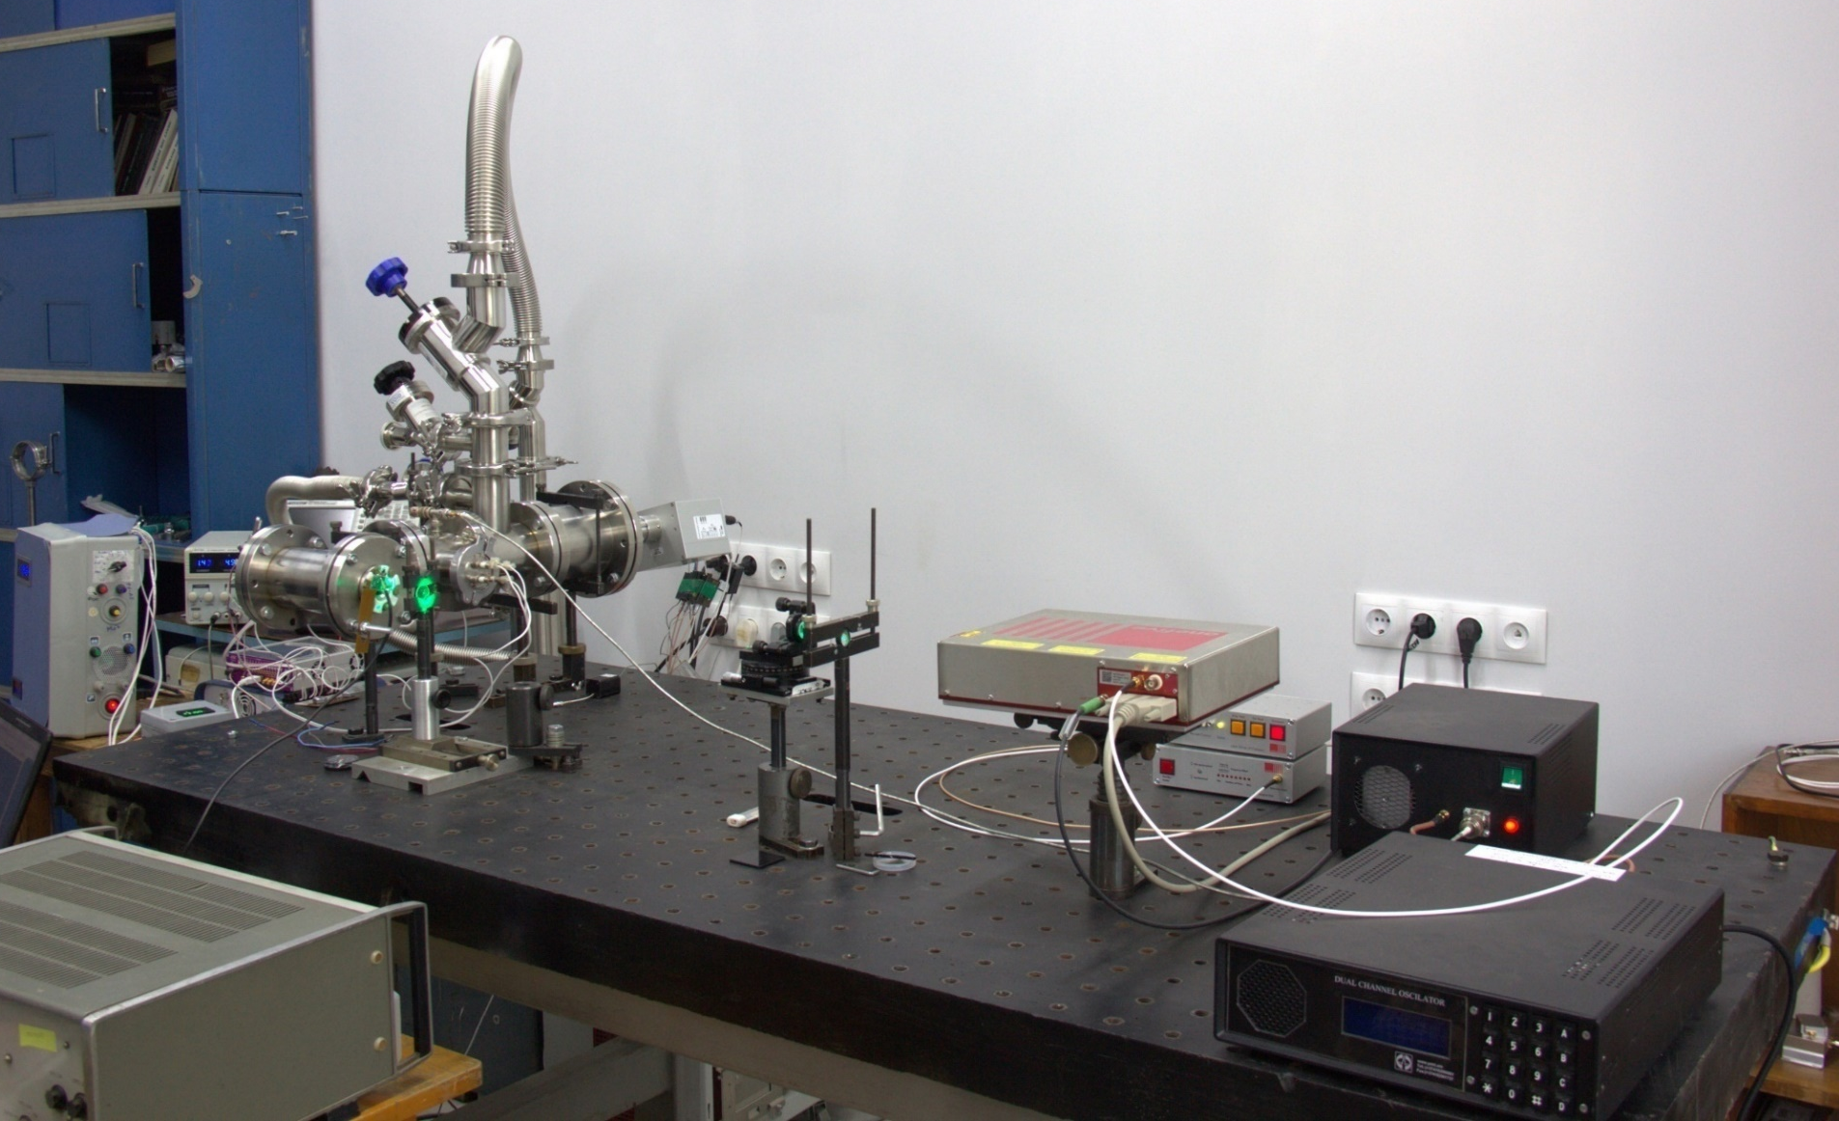
Test Setup at Yerevan Physics Institute: Time Resolved Photo-Electron Detection System
General View
RF Timer
RF amplifier
RF generator
fs Laser

Slide 10
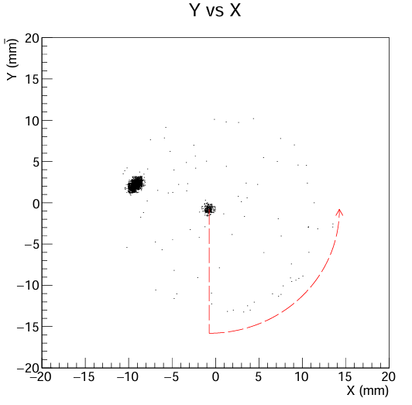
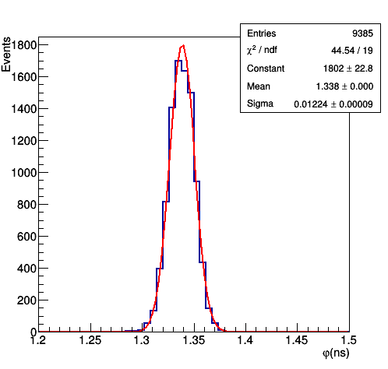
Photoemission time measurements
0.6 μm gold layer
For gold, tantalum and other non- 2D materials the measured photoemission time is on par with the system’s time resolution

Slide 11
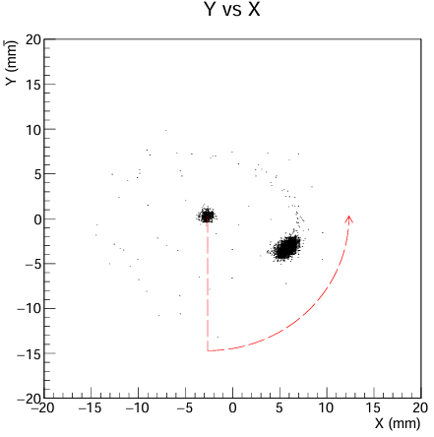
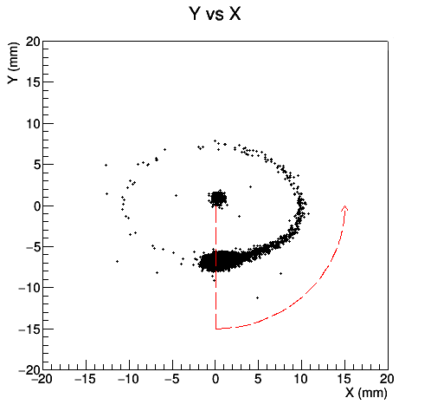
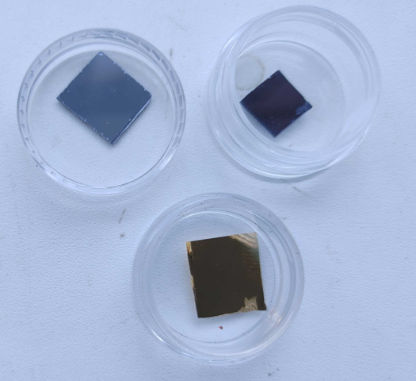
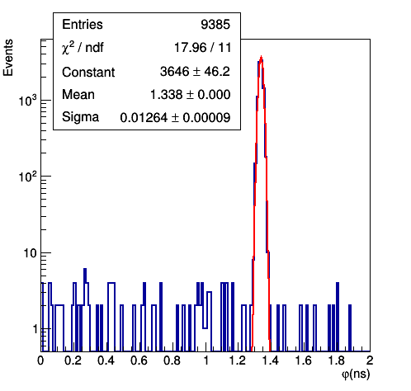
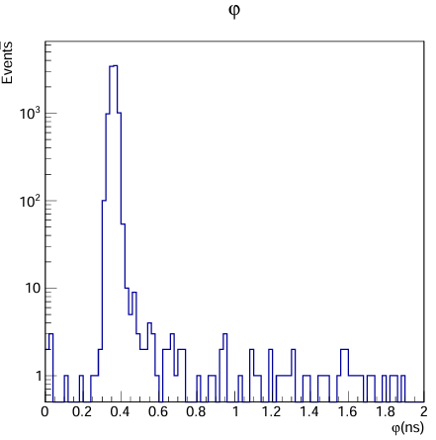
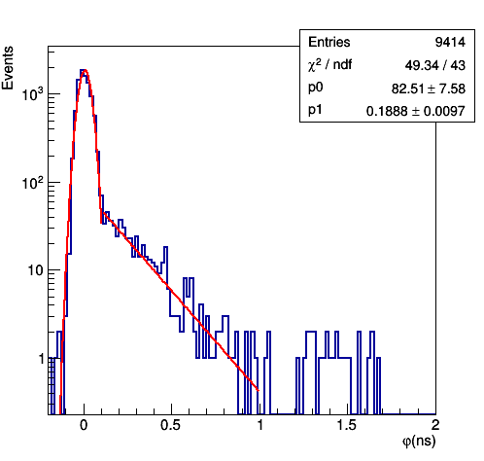
Nanostructures’ photoemission time
Preliminary results
Graphene
MoS2
Gold
Differences in photoemission timing properties for different materials are clearly seen. In particular, nanosecond scale emission time is observed for graphene
gold (for comparison)
MoS2
Graphene

Slide 12
Monte-Carlo Simulations
The SIMION 8 based model was developed to replicate the experiment.
The simulations take into account the detector’s precise geometry, applied voltages, electrons’ initial direction and energy spreads.
Predicted transit time spread: ~8ps
Predicted spot size: ~0.2mm, which corresponds to ~6.5ps technical resolution.
In quadrature they amount to 10.3 ps total detector time resolution, whish is in good agreement with the experimental results
The simulations are used to design the optimized detector components. It is shown that the time resolution can be improved further, to ~1 ps range

Slide 13
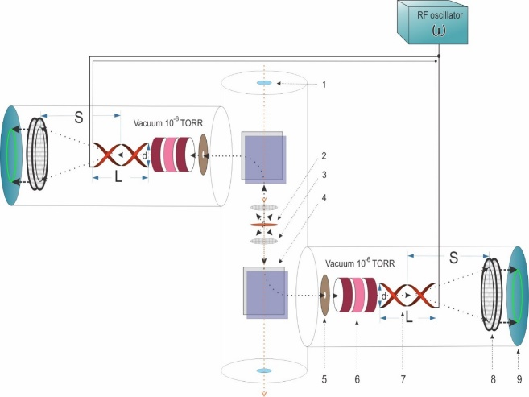
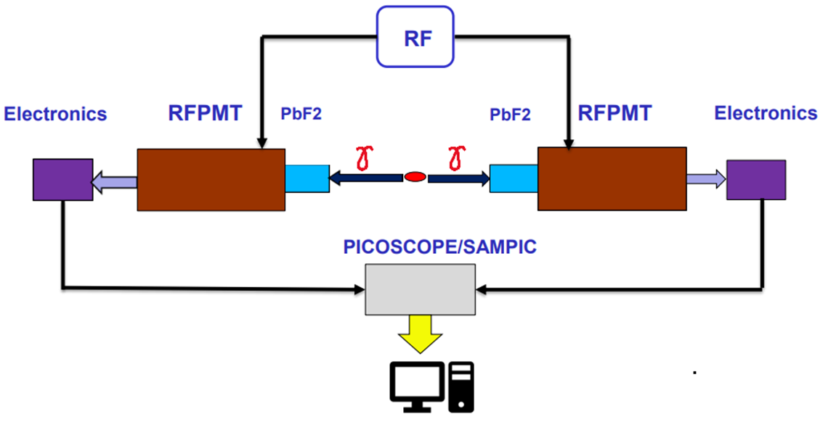
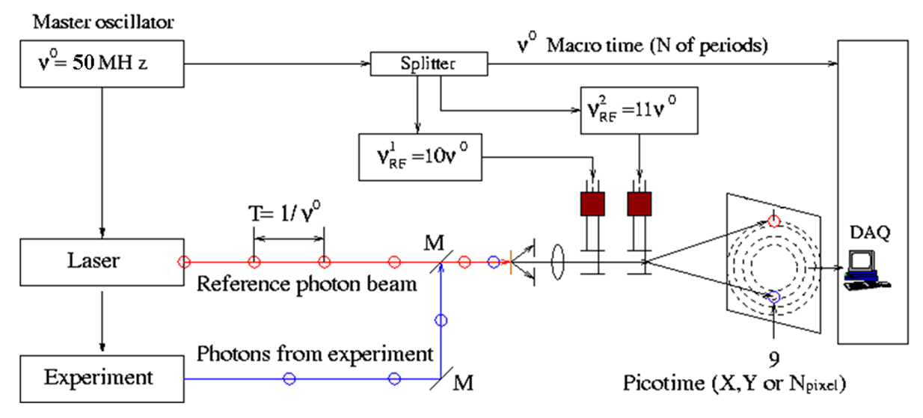
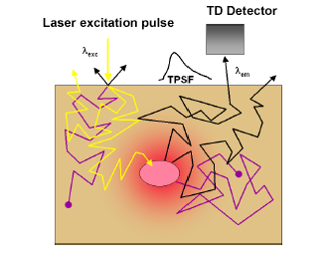
Other applications of the RF Timer
Heavy Ion Detector
Positron Emission Tomography (PET)
Time-Correlated Single Photon Counting (TCSPC)
Diffuse Optical Tomography (DOT)

Slide 14
Summary
New ultra-high precision timer, based on RF circular scanning (RF Timer), is developed and tested.
The RF Timer provides:
≤ 10 ps time resolution
MHz counting rate
≤ 0.5 ps/h (FWHM) stability
After optimization we expect to achieve ~1 ps time resolution.
The time-resolved photo-electron emission detection system is built in our lab, studies of the lifetimes of quantum states are in progress.
Long lifetimes of hot carriers in graphene were observed (preliminary results)

Slide 15
RF Timer Collaboration
A.I. Alikhanyan National Science Laboratory (Yerevan Physics Institute), Yerevan, Armenia
S. Zhamkochyan, V. Kakoyan, S. Abrahamyan, H. Elbakyan, H. Rostomyan, A. Ghalumyan, A. Margaryan et el.
School of Physics & Astronomy, University of Glasgow, Scotland, UK
J. Annand, K. Livingston, R. Montgomery
Jefferson Laboratory, Newport News, USA P. Achenbach
Institut für Kernphysik, Johannes Gutenberg-Universität Mainz, Germany
J. Pochodzalla
Extreme Light Infrastructure- Nuclear Physics (ELI-NP), Bucharest-Magurele, Romania D. L. Balabanski
Department of Physics, Graduate School of Science, the University of Tokyo, Japan
S. N. Nakamura
Department of Physics and Astronomy, University of Notre Dame, USA
A. Aprahamian, M. Brodeur, Kh. Manukyan
Département de Physique des Particules Centre de Saclay, France D. Yvon, V. Sharyy

Slide 16
Thank you for your attention!

