Slide 1
In preparation for the
Cluster Counting Article*
F: Grancagnolo
*In addition to comments to Walaa ICHEP Proceeding contribution

Slide 2
Main issues 1
Schematics of test set up with indication of trigger scintillators and beam angle relative to tube direction.
Schematics of data acquisition set up with a list of main features of the DRS (and of the oscilloscope): bandwidth, gain, timing, …
Integrate Figure 3 on gas gain with something like
Change paragraph 3.2 to «Analysis strategy» .
List both DERIV and RTA algorithms, but perform the whole analysis with RTA only (details of RTA) for consistency, except where differently indicated explicitly.
Show pulse template and comparison of different choice of parameters. Add consistency of RTA and DERIV to Figure 4.
Pointing to Figure 4, expected electrons and expected cluster should be defined.

Slide 3
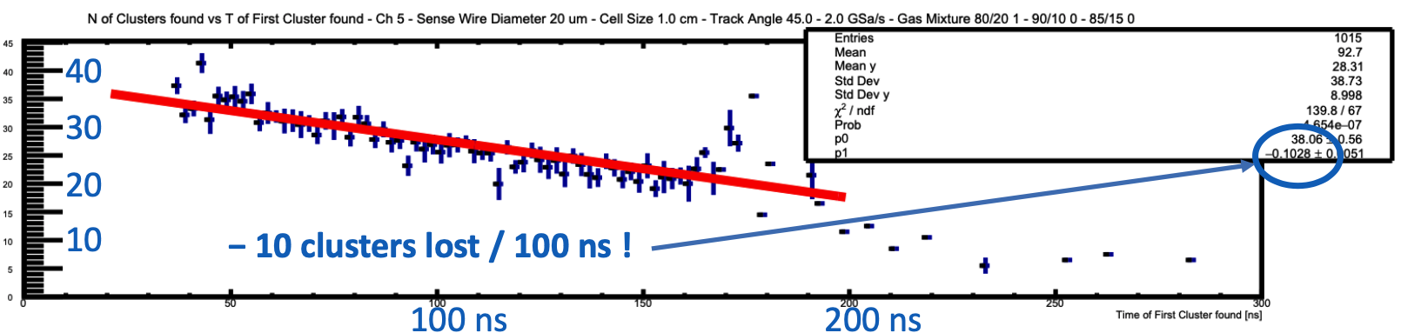
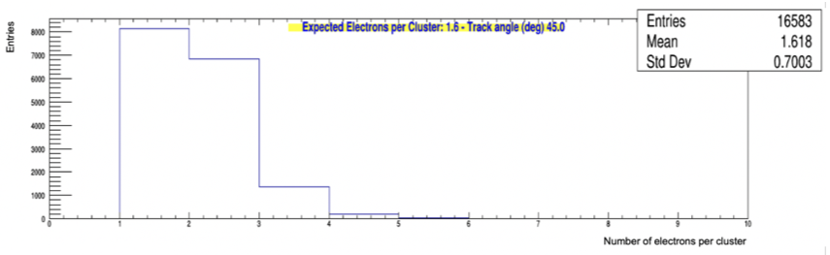
Main issues 2
More work is needed on the clusterization algorithm since the Number of electrons per cluster is wrong!
Spread due to diffusion should be quantified as a function of sqrt(drift time).
Figure 5 should be in linear scale, not in logarithmic scale (too much emphasis on tails of distribution).
Clusterization is a key concept: it needs more details.
The clear evidence of recombination and attachment effect must be shown here. Since we are loosing electrons at larger drift times, because of these effects, when we find 100% cluster finding efficiency, it means that we are overcounting the number of electrons at short drift times. This may be responsible of the fact that the distribution of the number of electrons per cluster is wrong.

Slide 4
Main issues 3
Divide paragraph «3.4 Performance scans» → «3.4 Cluster Counting Consistency checks» in different subparagraphs with clear indications of content:
  3.4.1 Cluster counting versus gas gain (right plot of figure 6) – point out that the slight increase of the counting rate with the gas gain is reflecting the fact that the RTA algorithms used was optimized for the nominal gas gain for both gas mixtures. A proper correction of the algorith parameters will fix the trend.
  3.4.2 Cluster counting versus ionization density (left plot of figure 6) – the three gas mixtures shown have been operated at the same gas gain (which one?)
  3.4.3 Cluster counting versus ionization length (center plot of figure 6) – the different ionization length is obtained by orienting the drift tubes at an angle with respect to the beam direction. as a function of beam angle. The observed cluster deficit at normal incidence for the 80/20 gas mixture is likely due to space charge effects, while at 60°, the much higher ionization electron density affects the cluster counting efficiency. Here, we should include also results from 1.5 cm tubes.
Paragraph «3.5 Resolution studies» → «3.5 dE/dx and dN/dx Resolutions» - specify what we mean by a track: a track is constructed by grouping together a sequence of hit tubes with a given ionization length. With this artifice one can construct tracks of different lengths and with different number of hits. Identical tracks are then analyzed with dE/dx and dN/dx algorithms and results are compared. However, the dE/dx analysis is incorrect!

Slide 5
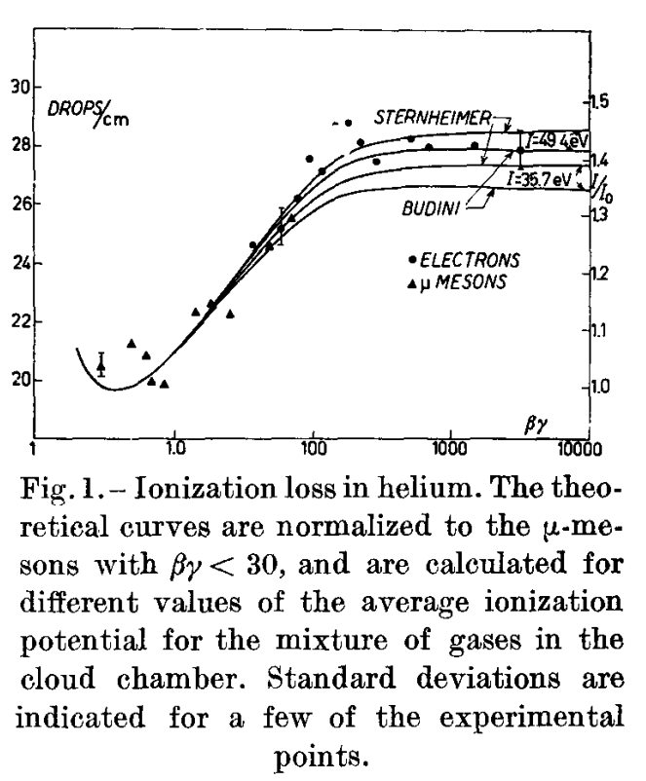
Add reference on relativistic rise in He
On the Fermi plateau (βγ > 200), the shown experimental value of the energy loss in Helium is about 1.4 times the value at the ionization minimum (βγ = 4).
We have conservatively used the value of 1.3, since different parameterizations of the Bethe-Block function predict different values in the range 1.25 – 1.45.
R. G. KEPLER, C. A. D'ANDLAU, W. B. FRETTER and L. F. HANSEN
Relativistic Increase of Energy Loss by Ionization in Gases
IL NUOVO CIMENT0 VOL. VII, N. 1 - 1 Gennaio 1958

Slide 6
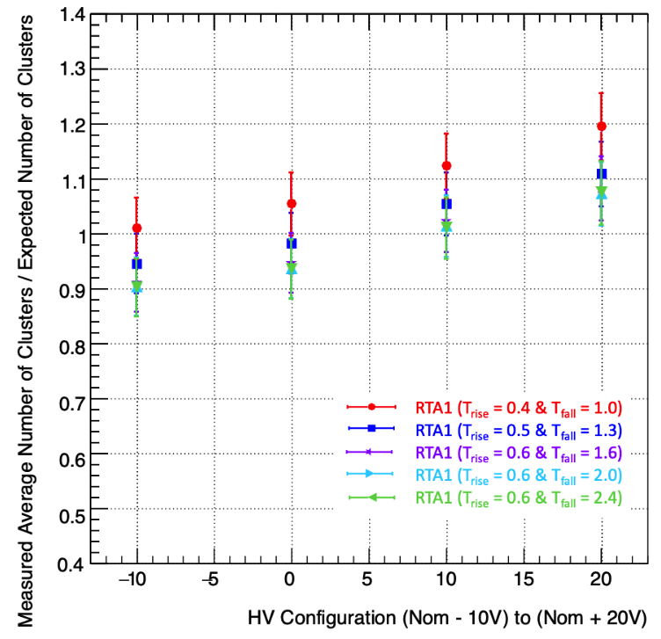
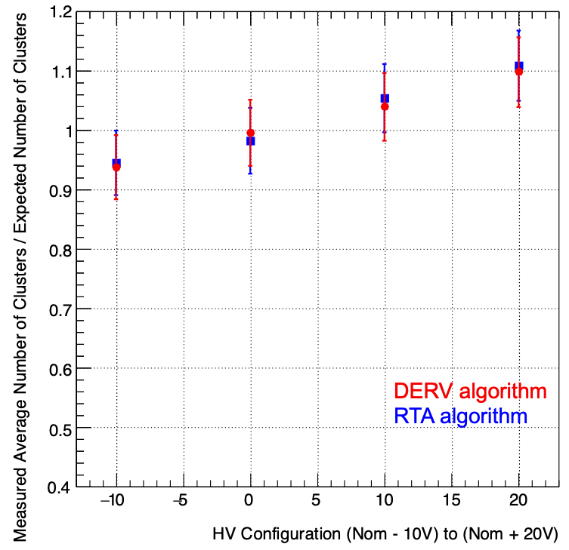
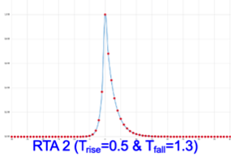
RTA algorithm

Slide 7
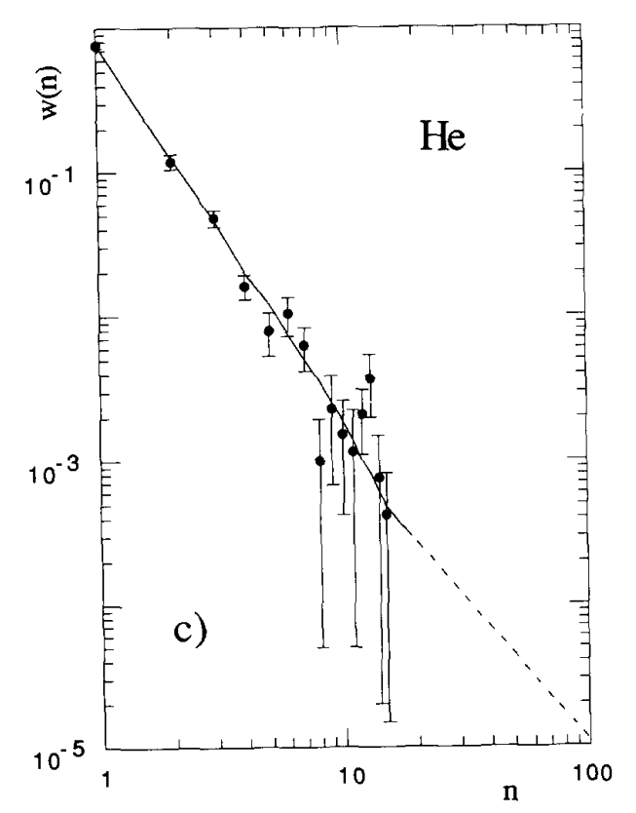
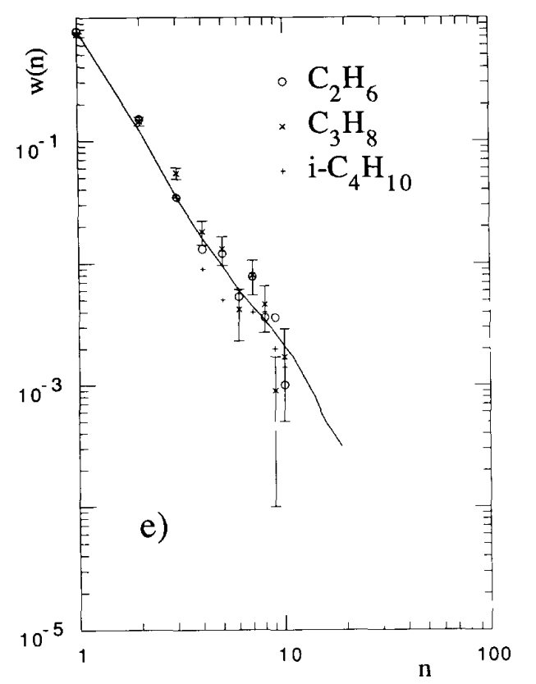
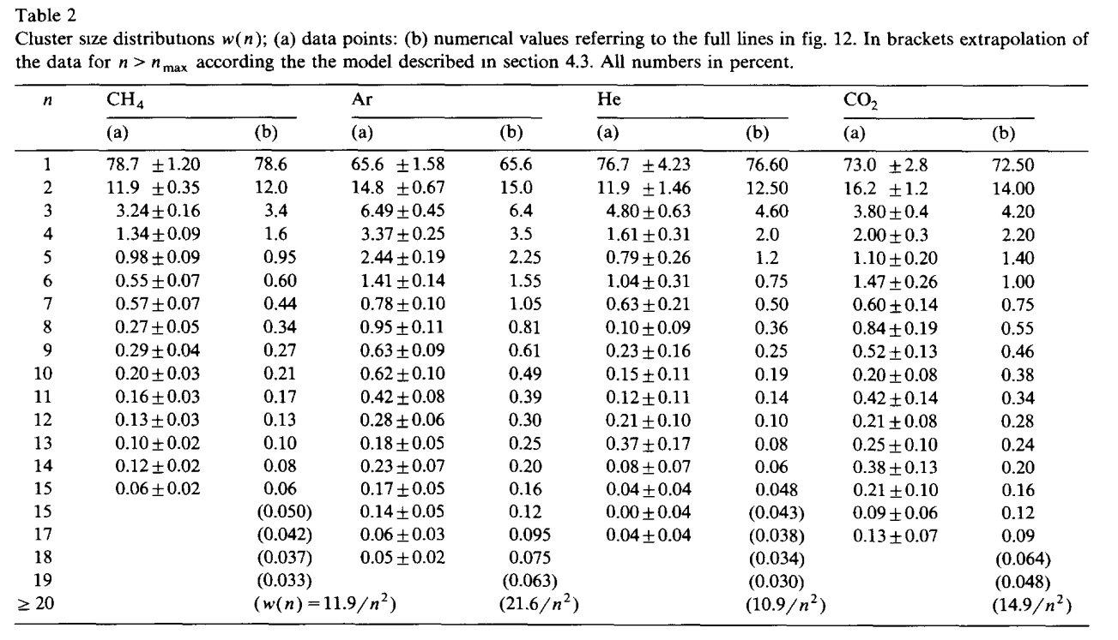
Add reference on cluster size distribution
H. Fischle , J. Heintze and B. Schmidt
Experimental determination of ionization cluster size distributions in counting gases
Nuclear Instruments and Methods in Physics Research A301 (1991) 202-214

Slide 8
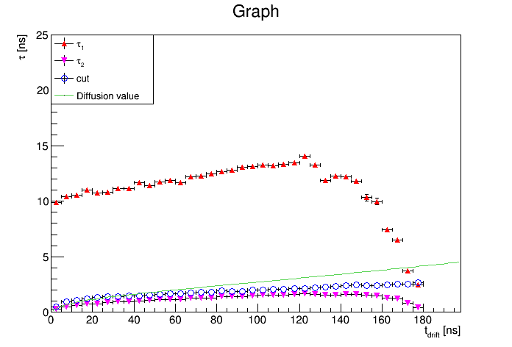
Clusterization details
e- belonging to
different
clusters
Longitudinal Diffusion
values used for
MC smearing
time cut corresponding
to Cls_{MC} = Cls_{reco}
e- belonging to
same cluster

Slide 9
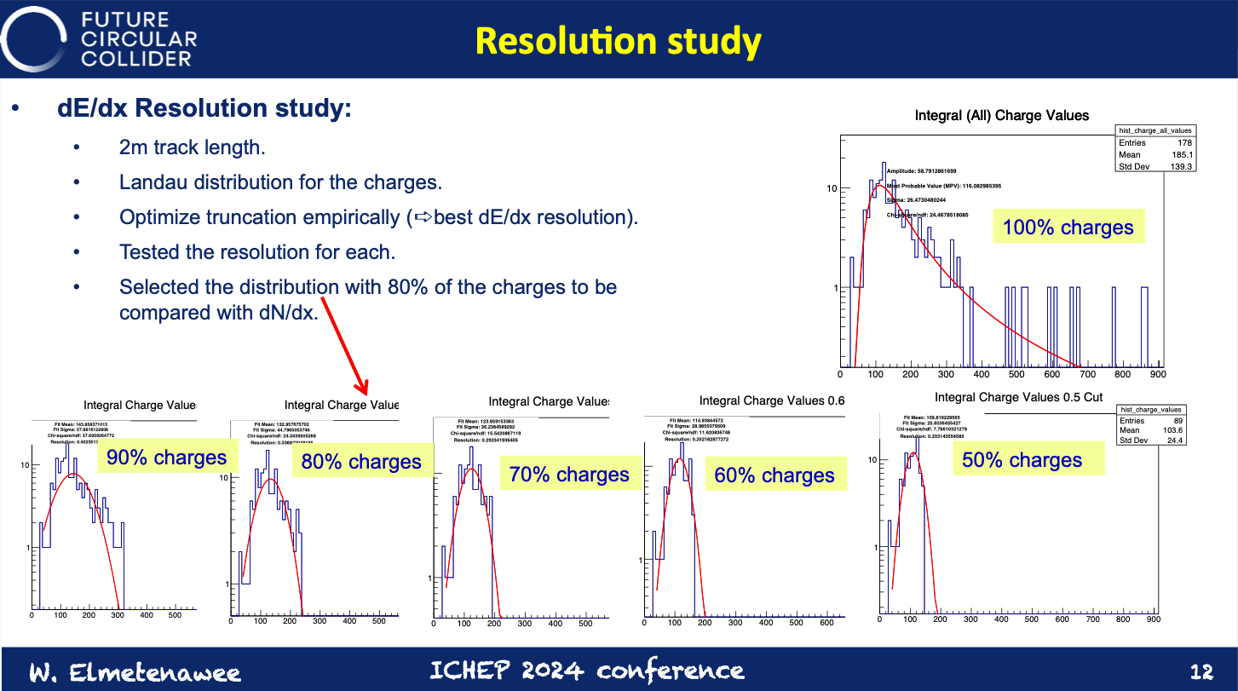
dE/dx studies
It is clear that study has been made by removing the tracks exceding the cut and not by removing, within each track, the hits with charge exceding the cut.
This is testified by the fact that the number of tracks left corresponds to the fraction determined by the cut, while it should remain constant (178).
Besides the study of dE/dx versus track length one should do also the study versus the number of hits on a track.
160
142
125
107
89
By the way, use linear scale and a larger bin size

