Slide 1
Vertex updates
23-10-2024
Luana Testa, Marco Toppi, Christian Finck, Giuseppe Battistoni e Silvia Muraro

Slide 2
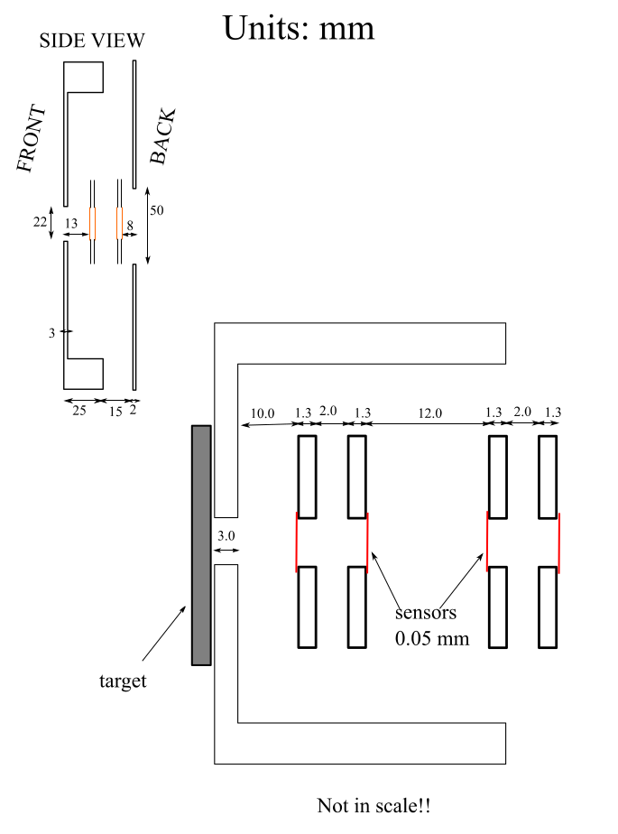
New geometry
According to the new measurements, the relative positions of the layers have been adjusted:
TAVTdetector.geo
Plane1 : PosZ: -0.92->-1.0625
Plane2 : PosZ: -0.6 -> -0.5975
Plane3 : PosZ: 0.6 -> 0.5975
Plane4 : PosZ: 0.92 ->1.0625
[cm]

Slide 3
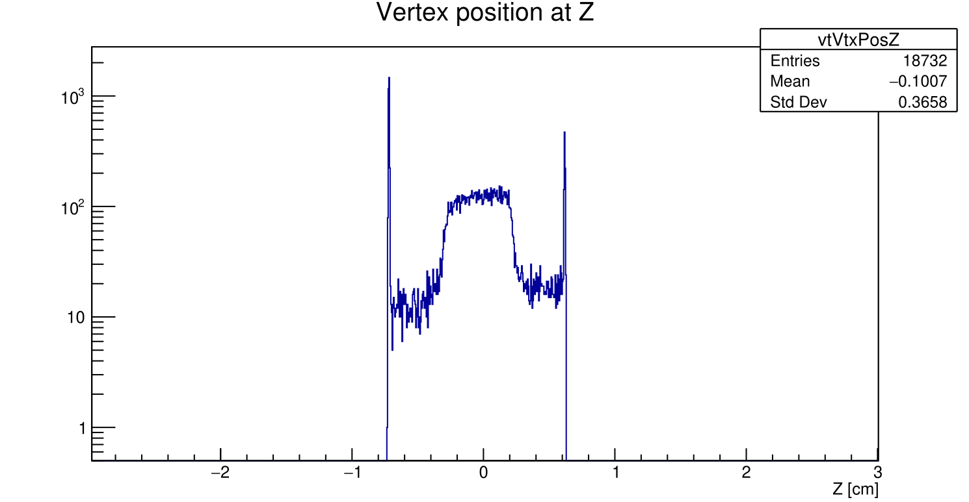
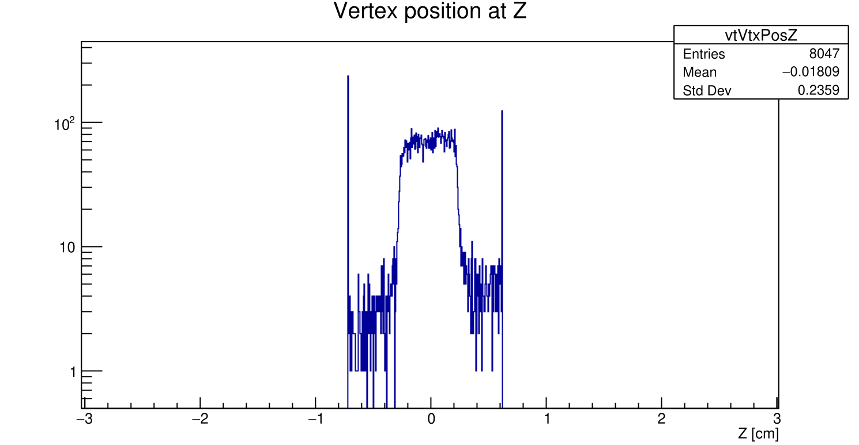
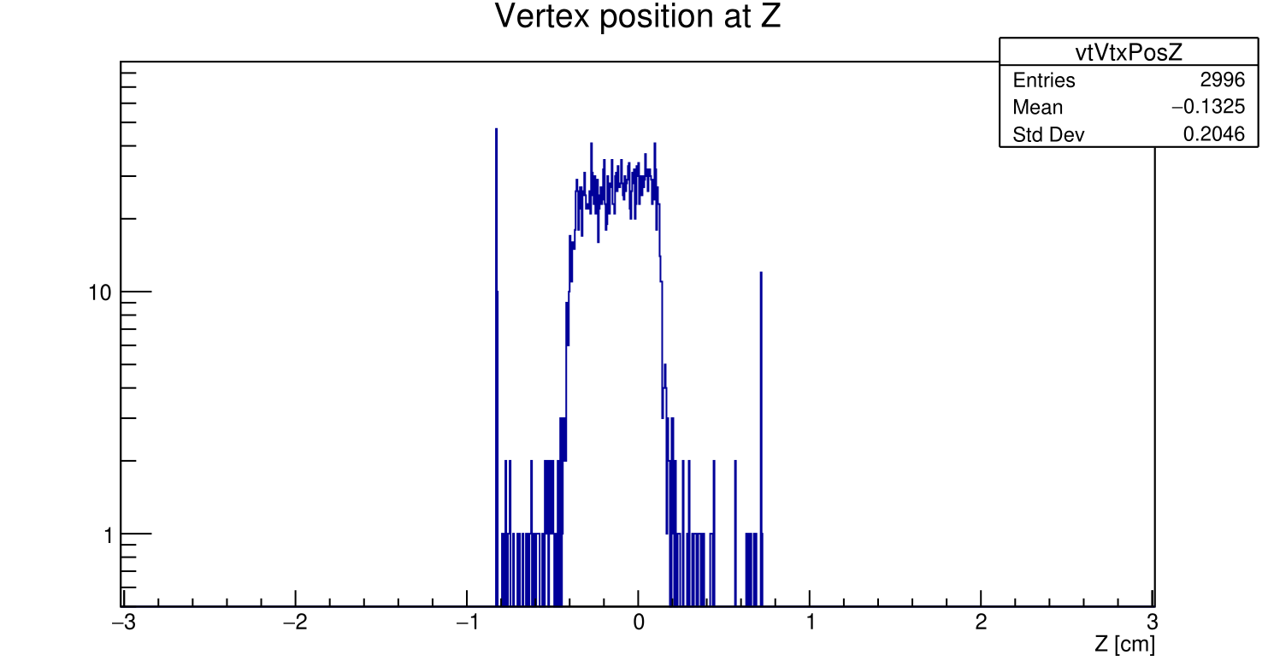
Position of the vtx
In agreement with the measurements, the Z position of the vertex in the global reference system (where the origin corresponds to the center of the target), will be:
CNAO2022 and GSI2021: VertexPosZ: 2.09 cm
CNAO2023: VertexPosZ: 2.61 cm
Shift 〜 1.2 mm in the z of the
reconstructed vertexes wrt the
target position
GSI2021
CNAO2022
Modified all the FOOT.geo files accordingly in data and MC.

Slide 4
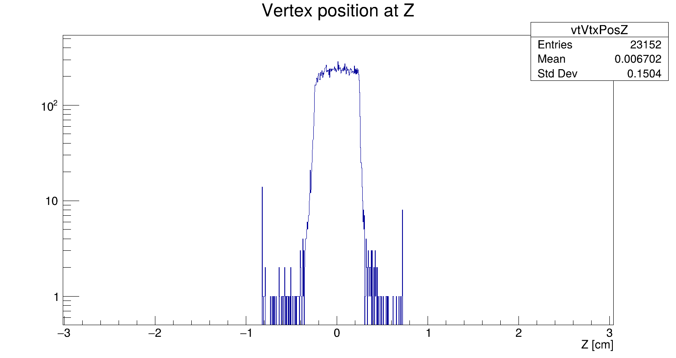
New MC (CNAO23_PS)
A new MC production with updates on:
vtx geometry
beam
No shift in reconstructed z of the vertexes! To be further investigated

Slide 5
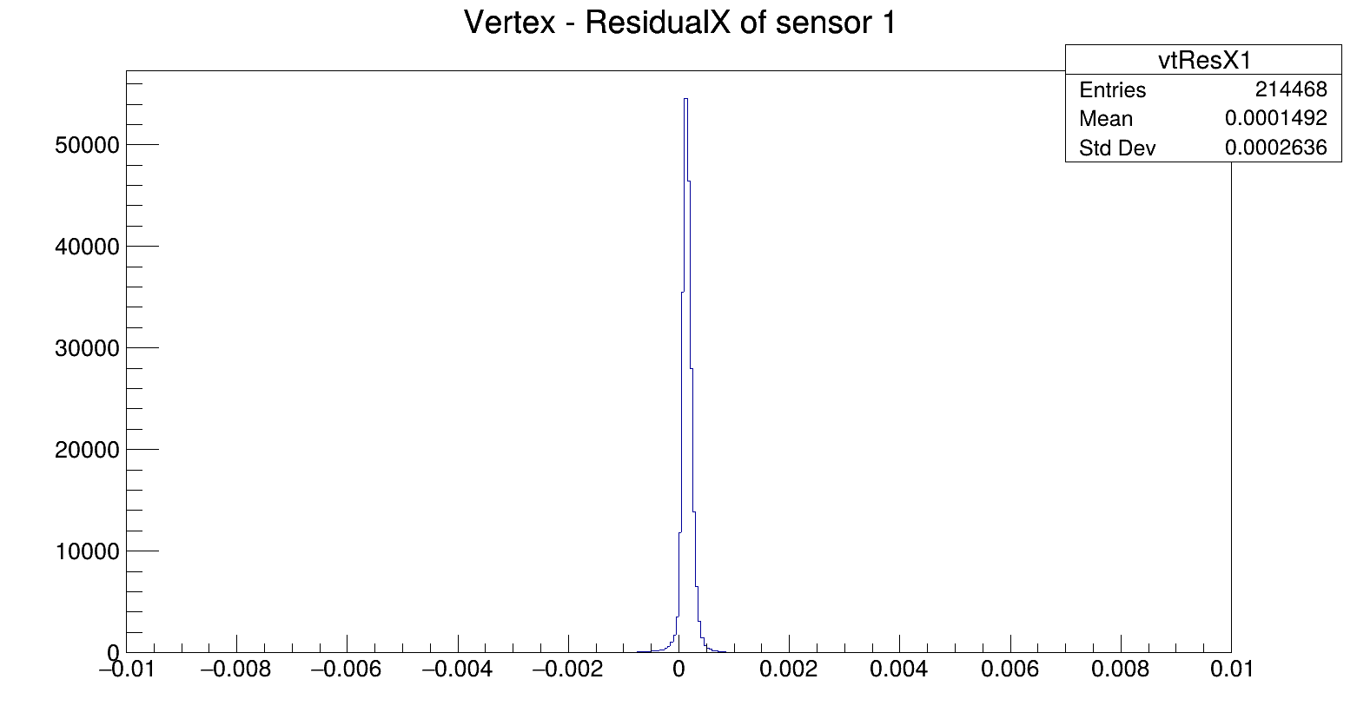
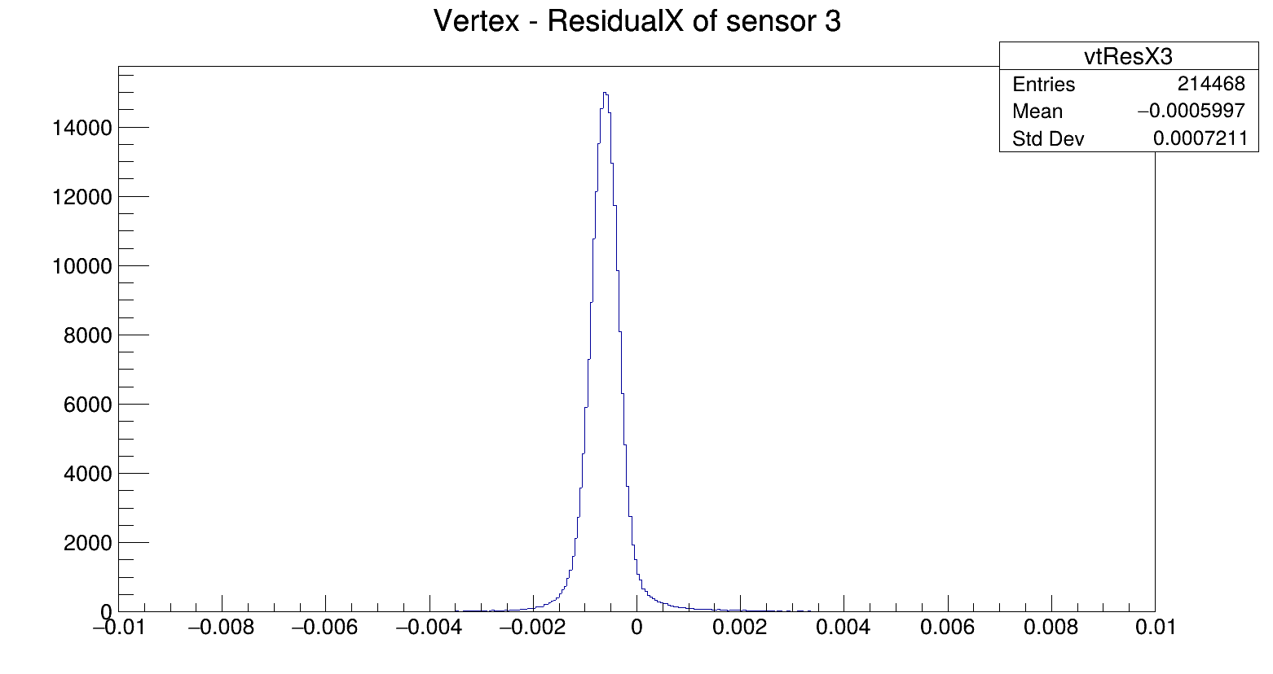
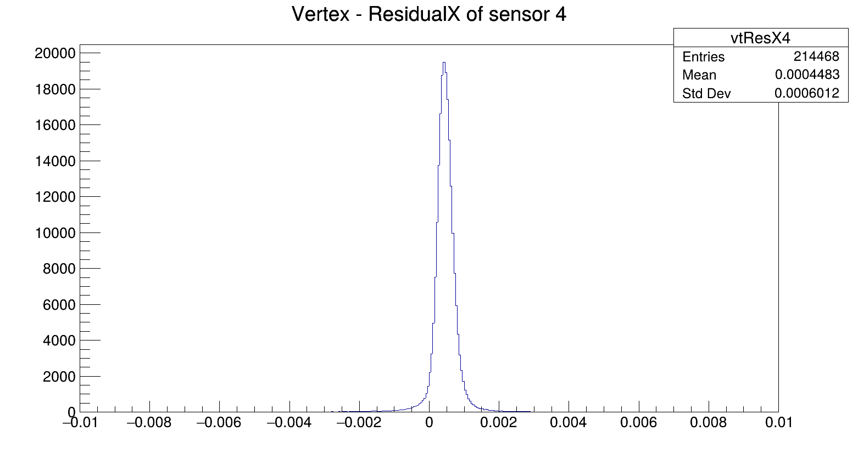
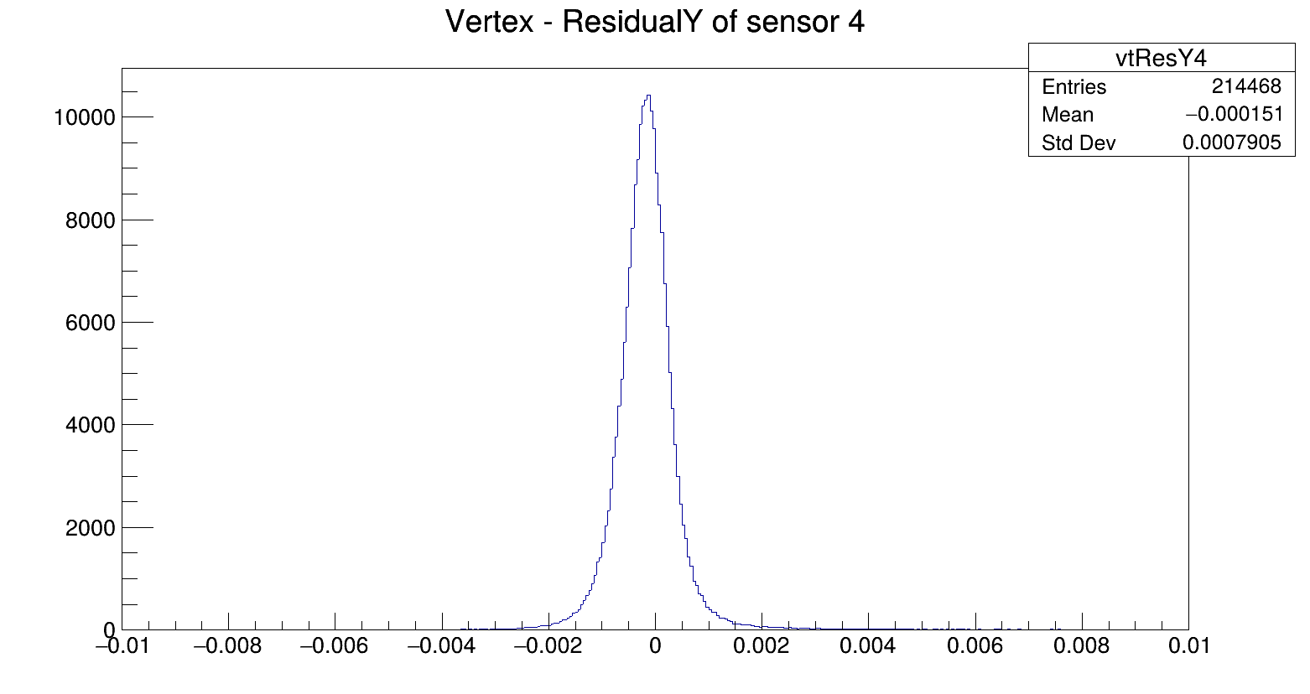
A new alignment is needed
Chris will take care to realign VTX in all the campaigns. Then a global aligment by Yun will be needed again

Slide 6
With the new geometry we have recovered ~25% of vertexes
The result is achieved using for track a search hit distance of 0.06 cm, whereas in the previous geometry it was necessary to use a value of 0.1cm: also the tracks quality is improved
A further improvement is expected after the alignment of the VTX
It will be necessary to re-optimize the parameters (shd, algorithm,..) for each campaign, considering the differing conditions of the VTX in each instance ( number of layers, thresholds, pile-up, and the VTX orientation)

Slide 7
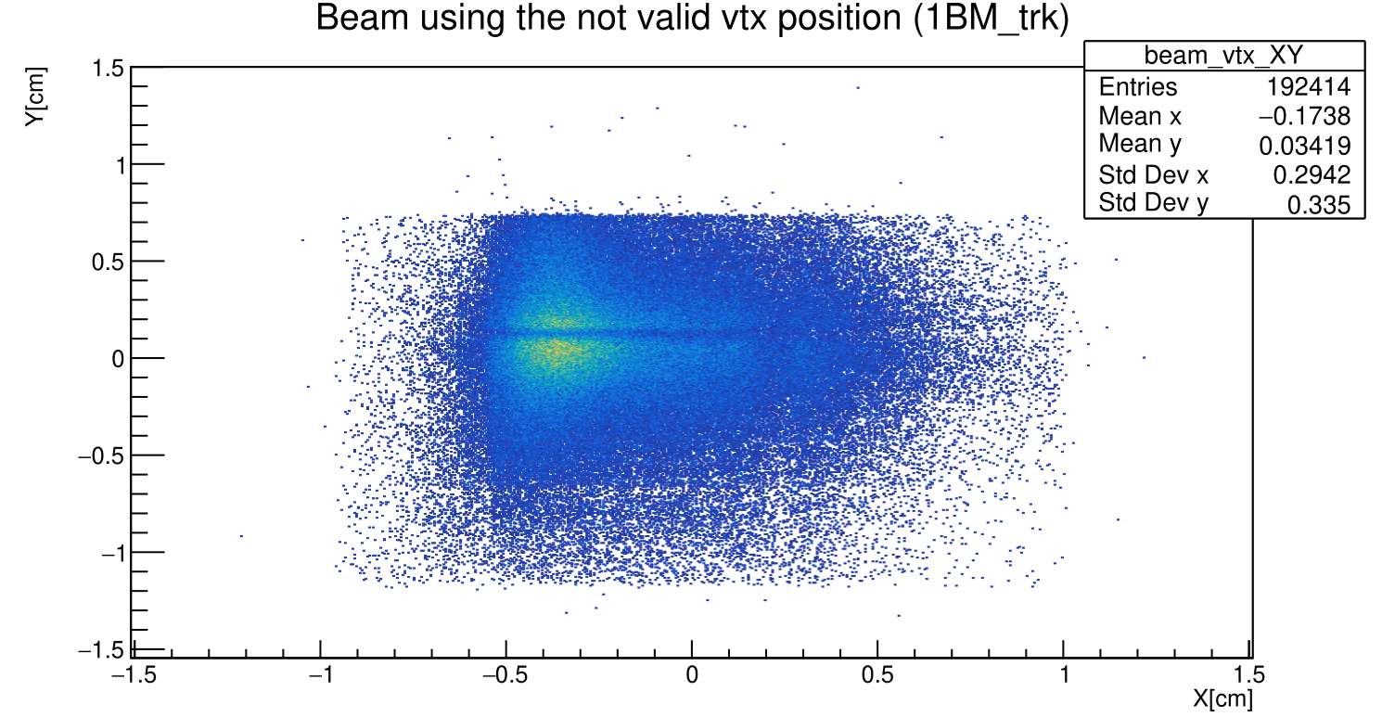
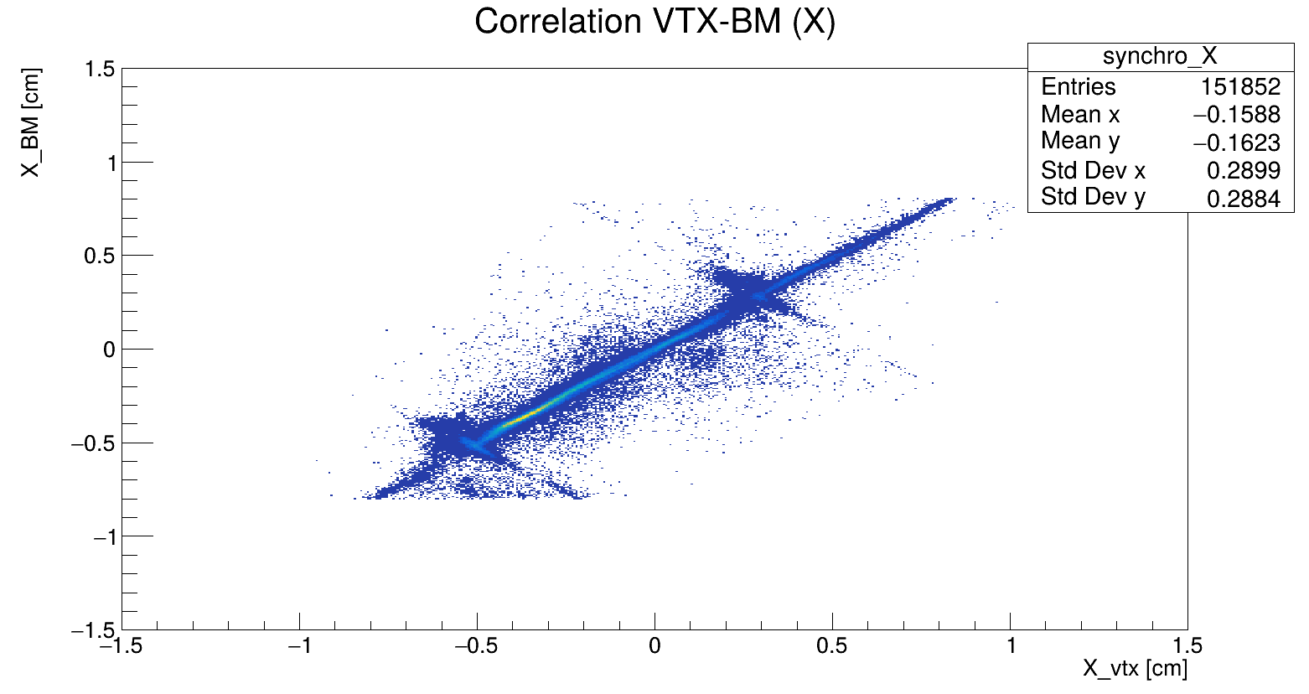
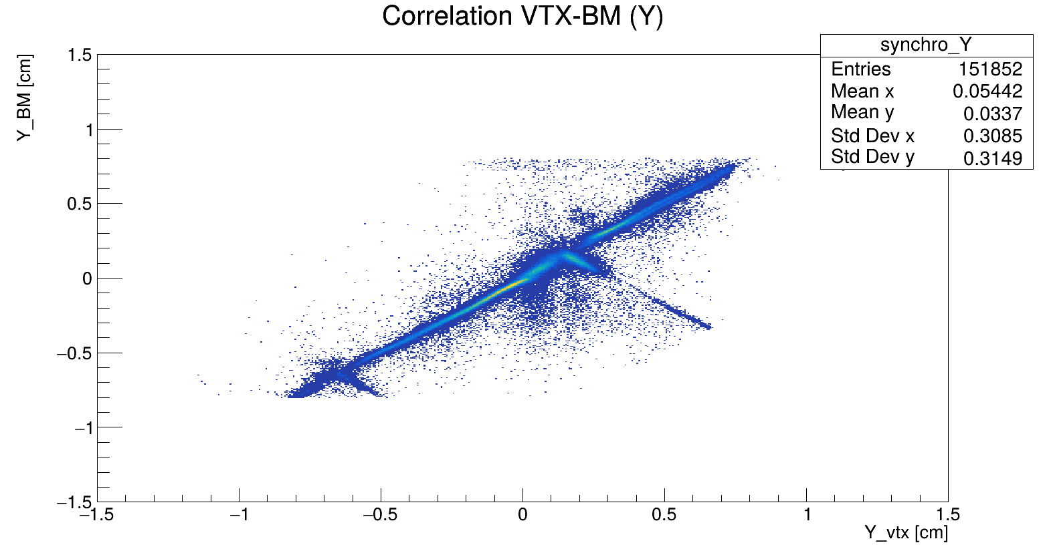
Beam
Data: 6136
Is important to have a well collimated and centered beam making attention on the BM-wires.
The beam in CNAO2024 need to be centered within the (small) surface of the Vertex detector.
The BM wires could be moved off the beam: why not to move the BM of ~3mm along (positive) y and ~1-2 mm along (positive) x ?
Correlation VTX_BM ➡ Anticorrelation in the position of the wires
Data: 6136

Slide 8
Thank you for your attention!

Slide 9
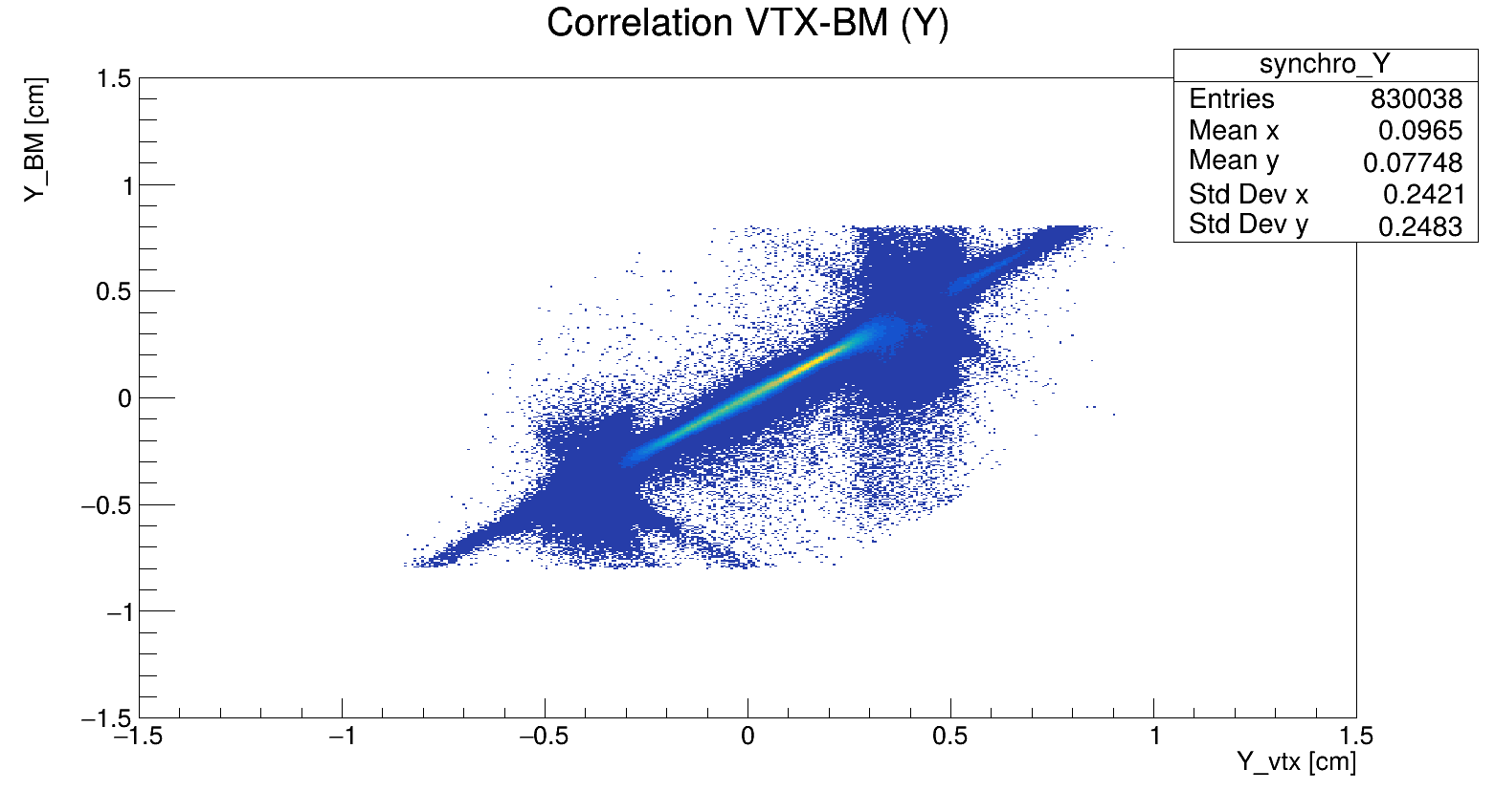
Correlation VTX-BM
Anticorrelation in the position of the wires
MC

