Slide 1

SSRIP
(Scalable System for Radio Isotopes Production)
David Alesini

Slide 2
OUTLINE
ELI-NP gamma beam system: Brief History
ELI-NP gamma beam system ⇒ SSRIP radioactive beam facility
Details of the new contract between INFN and IFIN-HH
SSRIP:
    Organization chart
    Parameters and layout
    Workplan and Timeschedule
    Activities (2023-2024) & First half of 2025
    Installation Status
    Workplan for end 2024 & First half of 2025
D. Alesini, SSRIP, 68 Sci. Com., Frascati, 20-11-2024

Slide 3

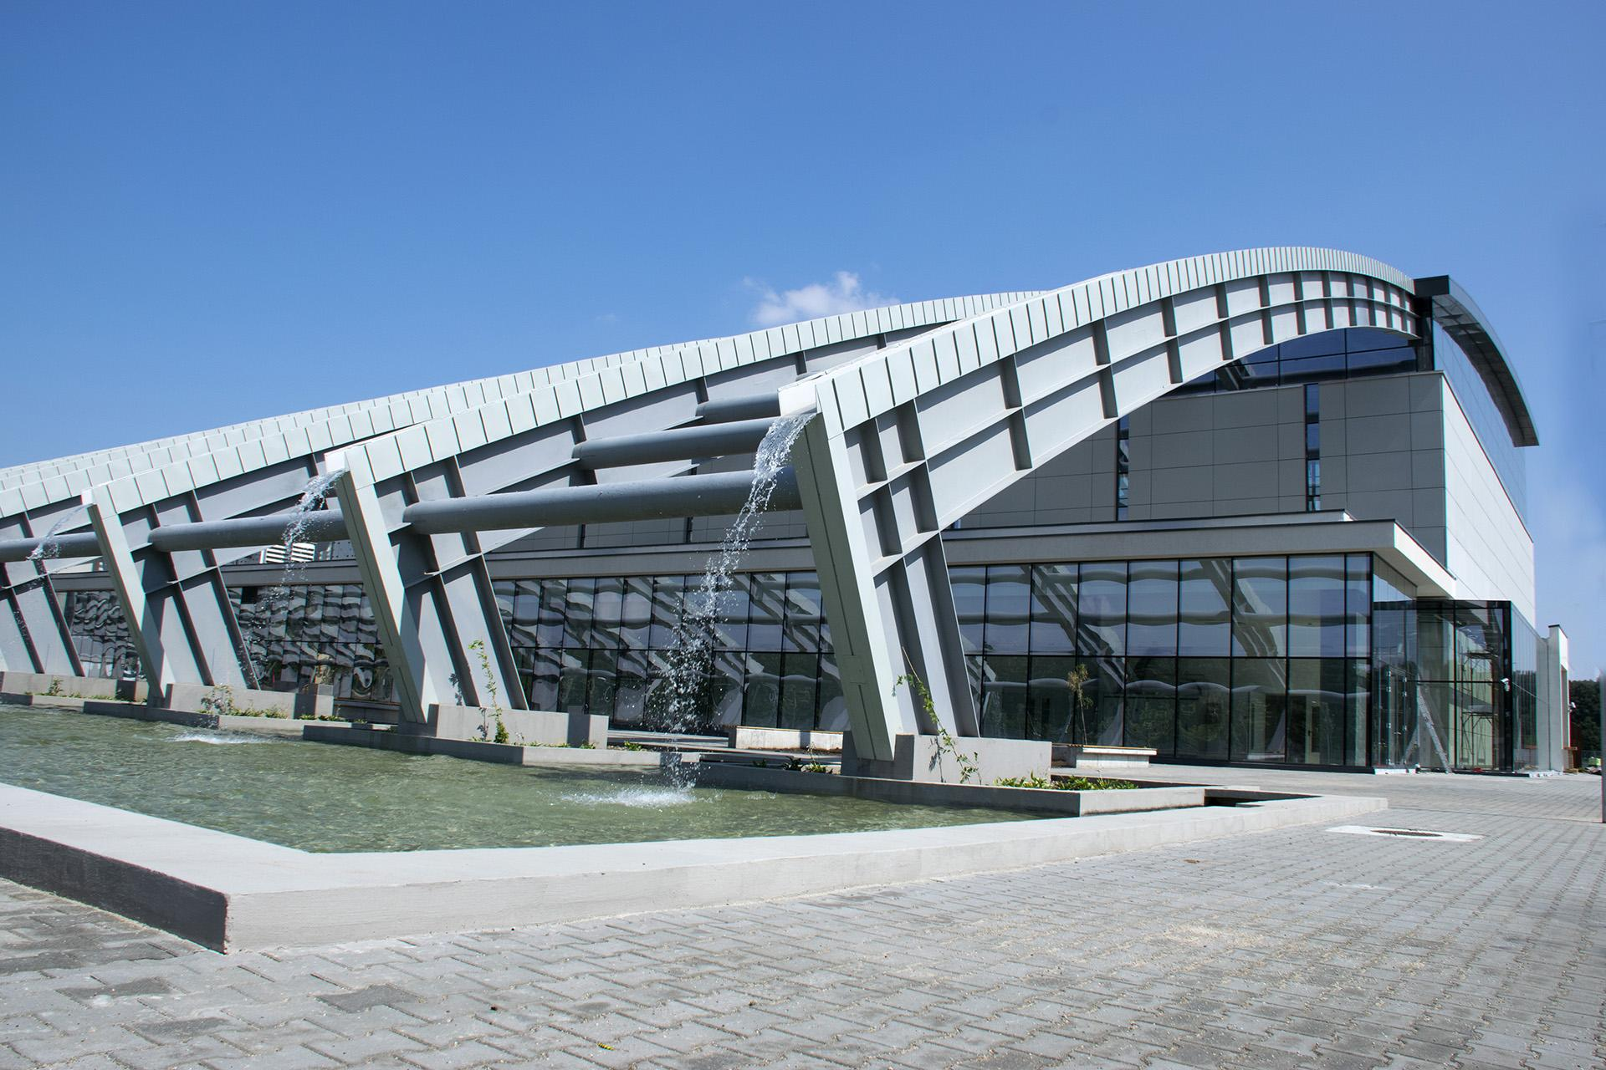





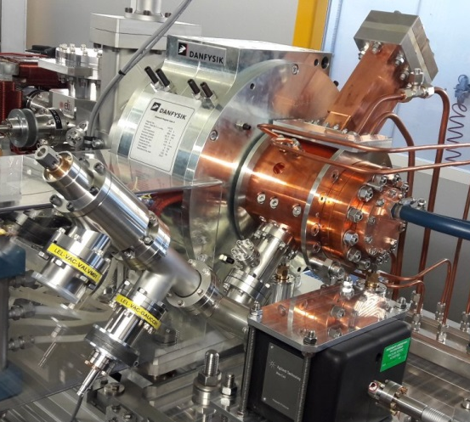
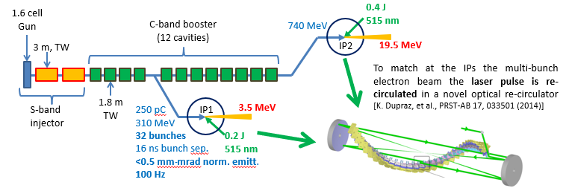
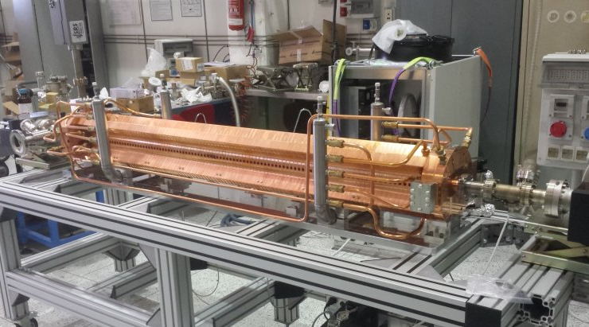
ELI-NP GAMMA BEAM SYSTEM: BRIEF HISTORY
2014: Original contract signed by the "EuroGammaS" Association and IFIN-HH, for the implementation of an advanced source of Gamma-ray photons in Magurele (Bucharest, Romania) in the context of the ELI-NP Research Infrastructure:
"Association leader"
Alsyom S.A.S.
Stage I components delivered and payed (2016)
2019: Unilateral termination of the contract and START of the Legal Dispute
D. Alesini, SSRIP, 68 Sci. Com., Frascati, 20-11-2024

Slide 4
ELI-NP GAMMA SOURCE ⇒ SSRIP radioactive beam facility
August 2023: legal dispute has been solved with an agreement approved by the Romanian Court: the agreement concluded the previous contract with the refunding of all the penalties and stamp tax (∼10 MEuro) to the EUROGAMMAS Association.
March 2024: a new “Research Contract” between Public Institutions INFN and IFIN-HH only has been signed for the implementation of a radioactive beam facility (project SSRIP-Scalable System for Radio Isotopes Production) that will integrate all the component already delivered for ELI-NP stage I with some modifications (waveguide configuration, laser clean room, control system,…):
    the new machine has to be installed in the original ELI-NP building but in a different position also for the technical rooms;
    the machine is a demonstrator (single bunch instead of multi bunch, 10 Hz instead of 100 Hz,…) and the beam commissioning with a proof of principle experiment has to be concluded by February 2026;
D. Alesini, SSRIP, 68 Sci. Com., Frascati, 20-11-2024

Slide 5
DETAILS OF THE NEW CONTRACT
    INFN-LNF is responsible for the implementation of this machine;
    The research contract is only between Public Institutions, INFN will coordinate the work of the two industrial partners, Amplitude and Scandinova
    IFIN-HH pay INFN-LNF to cover the costs of personnel, equipment, missions, implementations of modulator, klystrons and laser systems;
    Contract value ∼3 MEuro according to 4 deliverables:
          Requirements of linac auxiliary systems, building interfaces, data network, laser clean room and cables
          Linac module installation and vacuum tests
          RF power sources tests and Target station design
          Linac commissioning and electron bunch measurements and first experiment with scalable system for radioisotopes production
    End of the project February 2026
    There are activities under IFIN-HH Responsibilities (strongly correlated with INFN activities): auxiliary systems such as electrical power and cooling plants, cables (Contract with external Company), laser transport line implementation (IFIN-HH-CNRS contract), safety.
 | Deliverable 1 | Deliverable 2 | Deliverable 3 | Deliverable 4 | Total
Due Date | 30 June 2024 | 31 December 2024 | 30 June 2025 | 28 February 2026
Value (Euro) | 206000 | 1020000 | 1285000 | 475000 | 2986000
OK
OK: Report writing
D. Alesini, SSRIP, 68 Sci. Com., Frascati, 20-11-2024

Slide 6
SSRIP: ORGANIZATION CHART
PROJECT COORDINATOR
D. Alesini (LNF)
G. Franzini (Deputy)
LASER
F.Falcoz (AMPLITUDE)
MAGNETS & POWER SUPPLIES
A.Vannozzi
(LNF)
RF SOURCES &RF DISTRIBUTION F.Cardelli
(LNF)
DIAGNOSTICS & TIMING
G. Franzini
(LNF)
CONTROLS
A. Michelotti
(LNF)
RF & SYNCRO L.Piersanti
(LNF)
VACUUM
A. Liedl
(LNF)
OPTICAL LINES F.Zomer, K. Dupraz
(CNRS)
LAYOUT & ALIGNMENT
E.Di Pasquale
(LNF)
BEAM DYNAMICS
L. Faillace
(LNF)
SAFETY
S. Vescovi
(LNF)
MACHINE PROTECTION SYSTEM
S.Pioli
(LNF)
SYSTEM AND NETWORK MANAGEMENT
R. Gargana
(LNF)
PMO
T. Grimaldi
(INFN-MI)
RF SOURCES M.Lindholm
(SCANDINOVA)
ELECTRICAL PLANTS AND PLC
G. Catuscelli, R.Ricci
(LNF)
COOLING AND VENTILATION
P. Tuscano, U. Rotundo
(LNF)
STAFF IN SUPPORT OF THE PROJECT
A. Stecchi, A. D’Uffizi, S. Cantarella
D. Alesini, SSRIP, 68 Sci. Com., Frascati, 20-11-2024

Slide 7
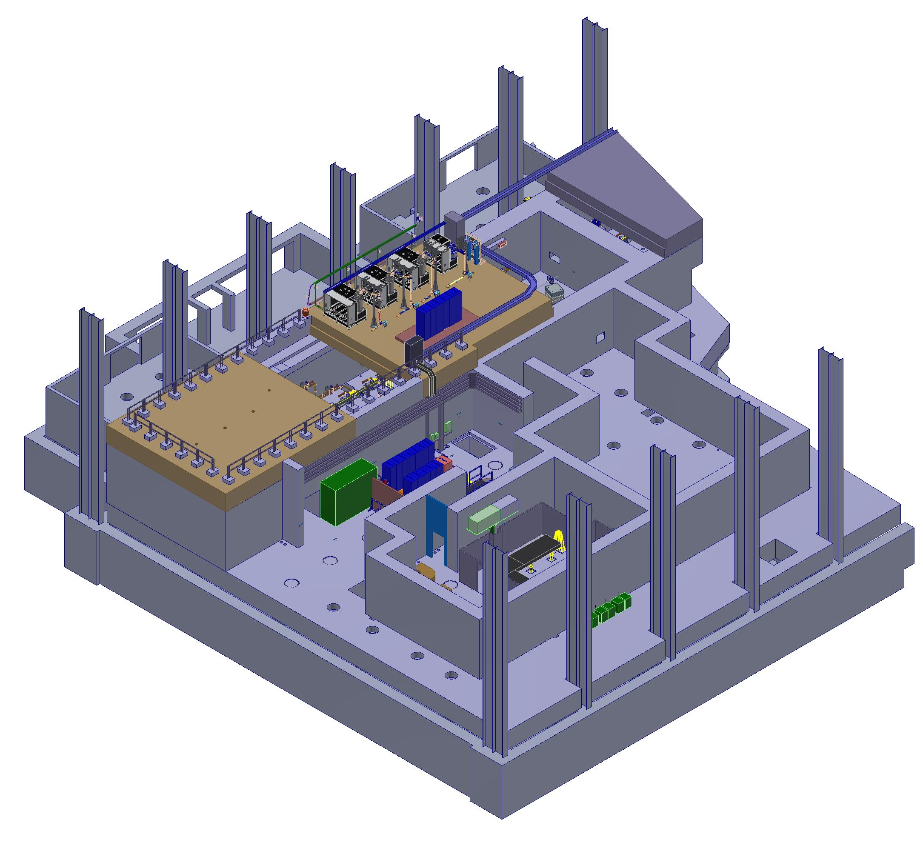
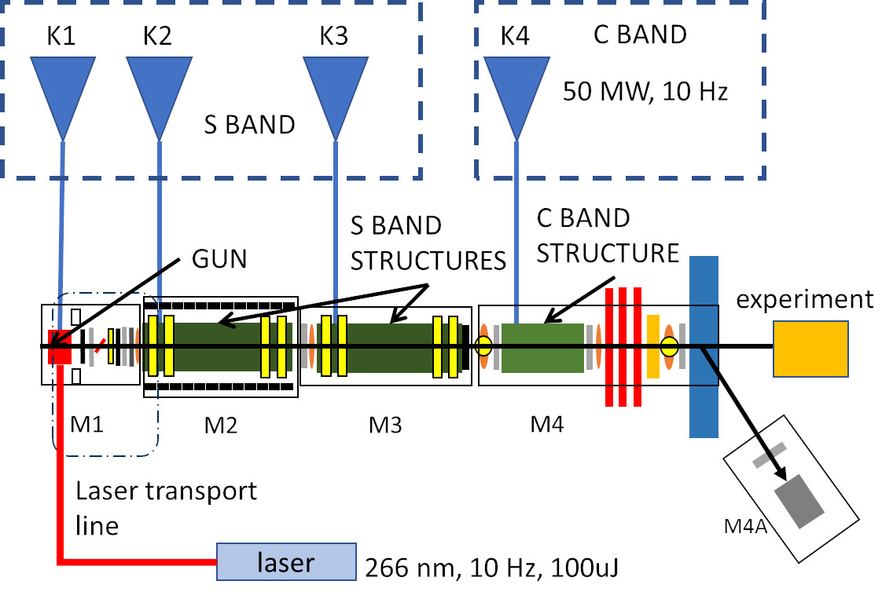
SSRIP FACILITY: PARAMETERS AND SCHEMATIC LAYOUT
The new facility will be implemented in 4 areas inside the main ELI-NP building:
  AB1 experimental hall: LINAC
  Roof: modulators, klystrons and RF racks
  ANNEX: laser and control room
  Corridor: racks
Accelerator basic parameters
Parameter | Value
S band/C band RF frequency | 2.856 / 5.712 GHz
S band accelerating gradient | 20 MV/m
C Band accelerating gradient | 25 MV/m
Gun Gradient | >=80MV/m
N Bunch/pulse | 1
Repetition frequency | 10 Hz
Charge per bunch | 100 pC
Max beam energy | ≥100 MeV
D. Alesini, SSRIP, 68 Sci. Com., Frascati, 20-11-2024

Slide 8
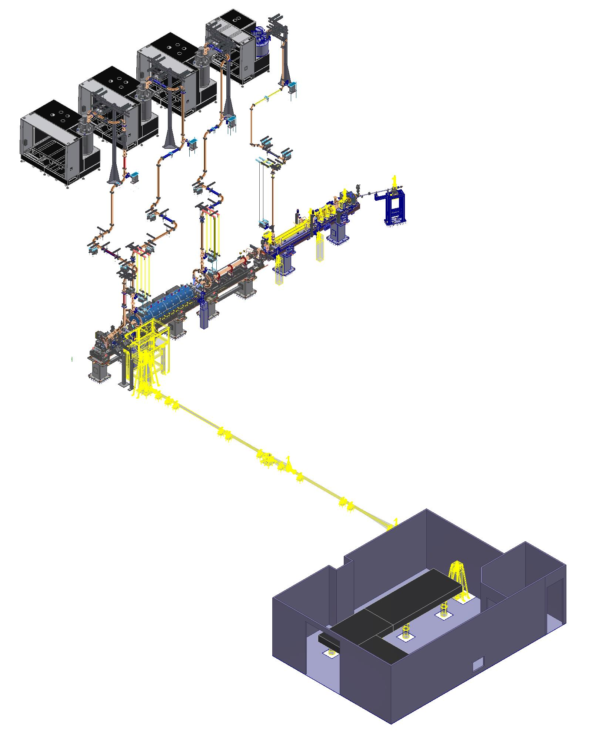
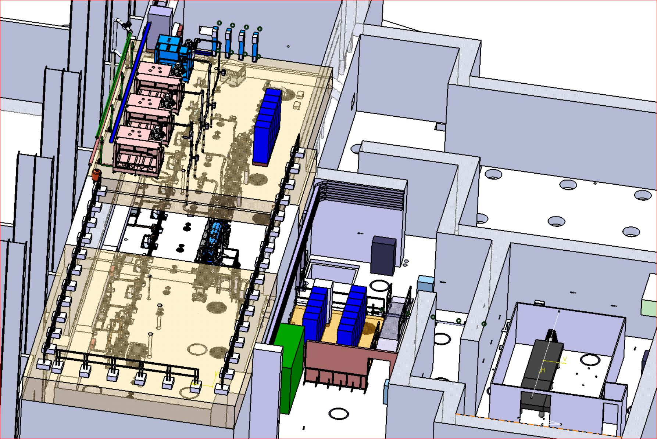
SSRIP FACILITY: LAYOUT
MODULATORS AND KLYSTRONS
WAVEGUIDES
LINAC
LASER TRANSPORT LINE
LASER
CLEAN ROOM
CONTROL ROOM
RACKS
D. Alesini, SSRIP, 68 Sci. Com., Frascati, 20-11-2024

Slide 9
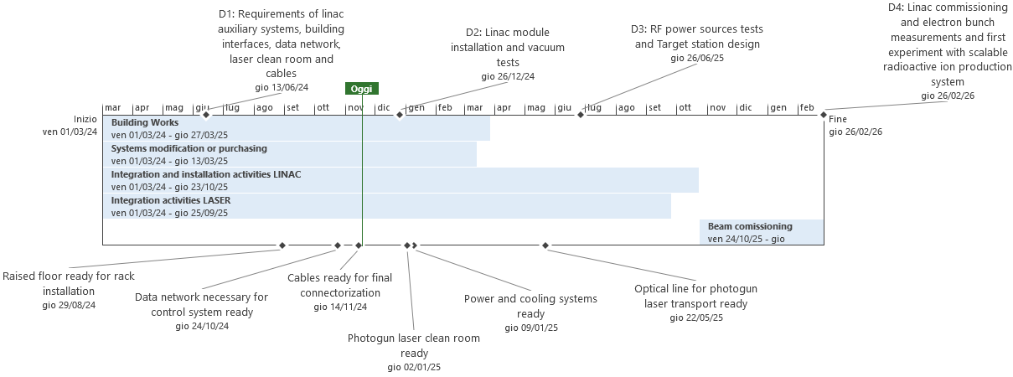
WORKPLAN AND TIMESCHEDULE
The INFN activities are strongly intercorrelated with the IFIN-HH activities (milestones) and a constant monitoring of the workplan and planning is necessary
D. Alesini, SSRIP, 68 Sci. Com., Frascati, 20-11-2024

Slide 10
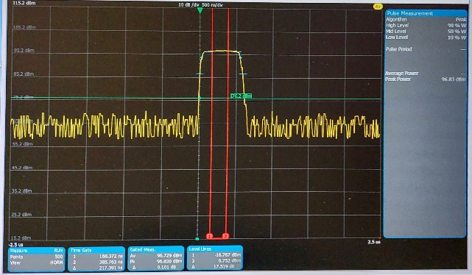
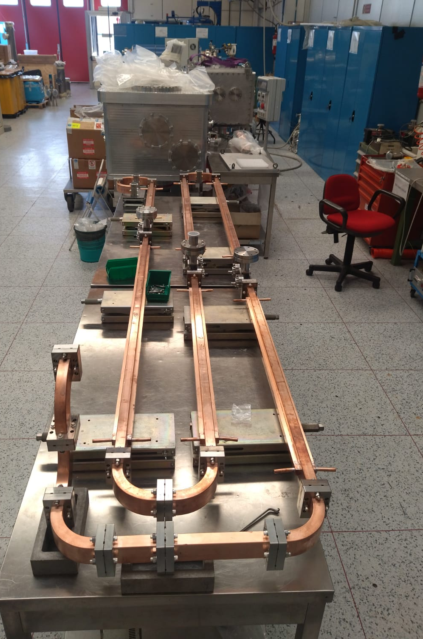
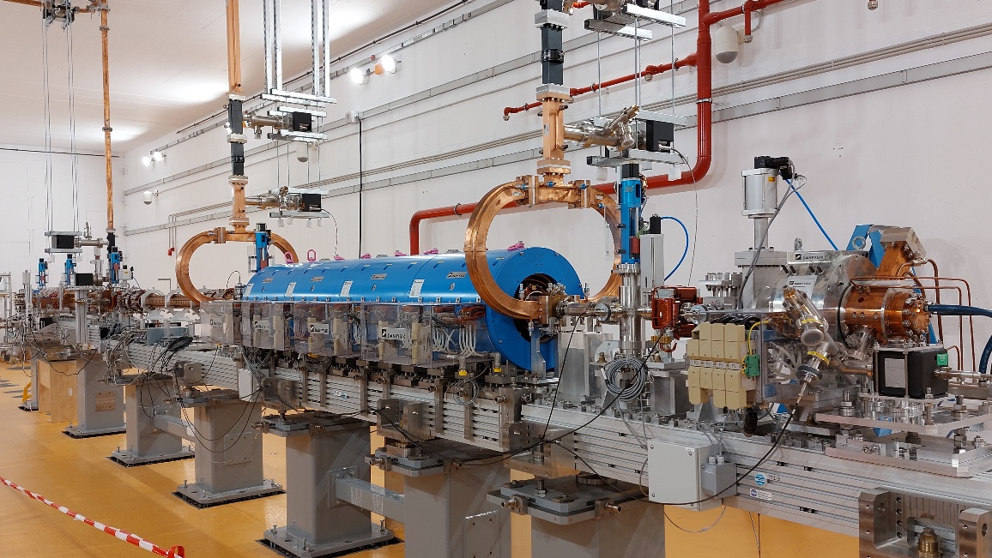
PERFOMED ACTIVITIES (2023-2024)
TECHNICAL SPECIFICATIONS OF SYSTEMS AND COMPONENTS (DELIVERABLE 1)
    electric power, cooling
    network of reference points for laser tracker
    cables
    data network
    TEST OF EXISTING EQUIPMENTS (STAGE I)
        Modulators and klystron: 1 klystron damaged
        Magnet power supplies
        Control system
        Waveguide components
ACQUISITION (ORDERS) OF NEW COMPONENTS
    Waveguides (jolly)
    control system components
    diagnostics (camera support)
    PLC
    AMPLITUDE laser installation
    INSTALLATION ON SITE
    Linac modules (connection/alignment/vacuum)
    Waveguides connections up to the roof
    Modulator and klystrons
    Racks
D. Alesini, SSRIP, 68 Sci. Com., Frascati, 20-11-2024

Slide 11
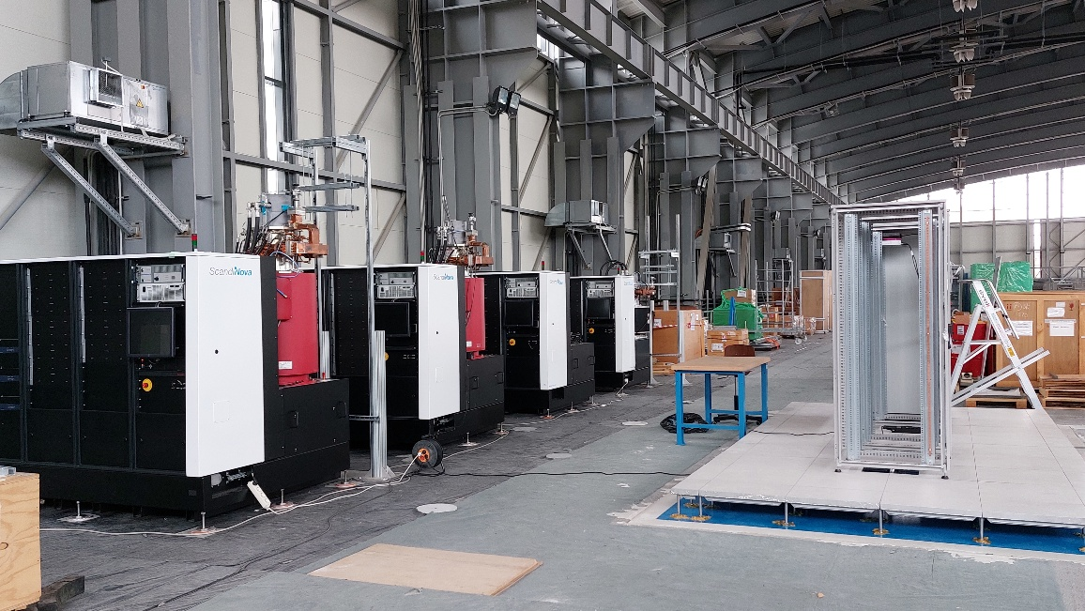
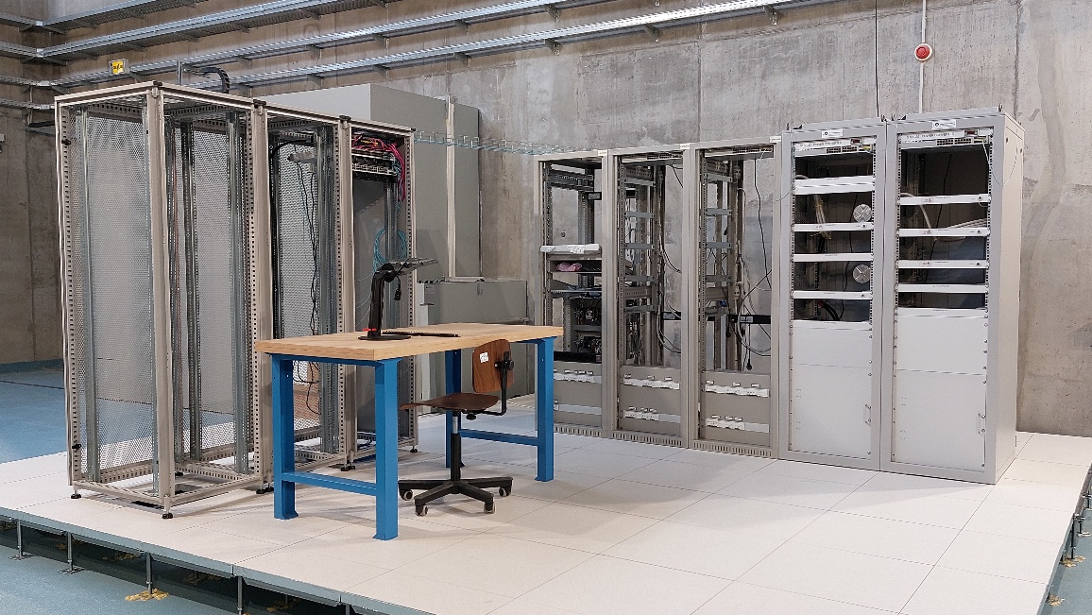
SSRIP: INSTALLATION STATUS
    Linac modules installed in AB1, aligned, connected and under vacuum (ion pumps, Deliverable 2)
    Waveguides: 3 over 4 lines connected up to the roof of AB1 (5 m height)
    Modulator and klystrons in place, tested at very low power, 1 klystron under substitution (re ordered by Scandinova)
    Racks installed in corridor and roof
D. Alesini, SSRIP, 68 Sci. Com., Frascati, 20-11-2024

Slide 12
WORKPLAN FOR END 2024 AND FIRST HALF OF 2025
One week activities on site, in parenthesis the involved WP and the FTE.
Nov-Dec 24:
    Precise position meas. of modulators on the roof to prepare the waveguides installation (LAYOUT & ALIGNMENT (3))
    Magnet power supplies installation on racks (MAGNETS & POWER SUPPLIES (3))
    Control system and data network test (CONTROLS (2), SYSTEM AND NETW. (1))
Jan 25:
    Waveguides support installation on the roof (LAYOUT & ALIGNMENT (2), EXT. COMPANY (2))
    Diagnostics controllers installation on racks and local test (DIAGNOSTICS & TIMING (3))
    Tests on synchronization system and devices installation in racks (RF & SYNCRO (3))
Feb 25:
    Waveguides gun line installation up to the roof (VACUUM (2))
    Waveguide installation on the roof (VACUUM (2))
    Control system pre-test (CONTROLS (2), SYSTEM AND NETW. (1))
    Tests on LLRF systems and devices installation in racks (RF & SYNCRO (3))
Mar 25:
    Test diagnostics and timing (DIAGNOSTICS & TIMING (3))
    Diagnostics stations tests (DIAGNOSTICS & TIMING (3))
    Order to SCANDINOVA (PMO)
May 25:
    Control system test (CONTROLS (2), SYSTEM AND NETW. (1))
    New klystron installation and test (VACUUM (2), RF SOURCES &RF DISTRIBUTION (1))⇒Deliverable 2
NB:
There are delays from IFIN-HH in the order for cables supply and pulling, power and cooling systems and clean room. This delay is at least 6 months.
A renegotiation of the next deliverables and final deadline (February 2026) will be done at the beginning of 2025.
D. Alesini, SSRIP, 68 Sci. Com., Frascati, 20-11-2024

Slide 13
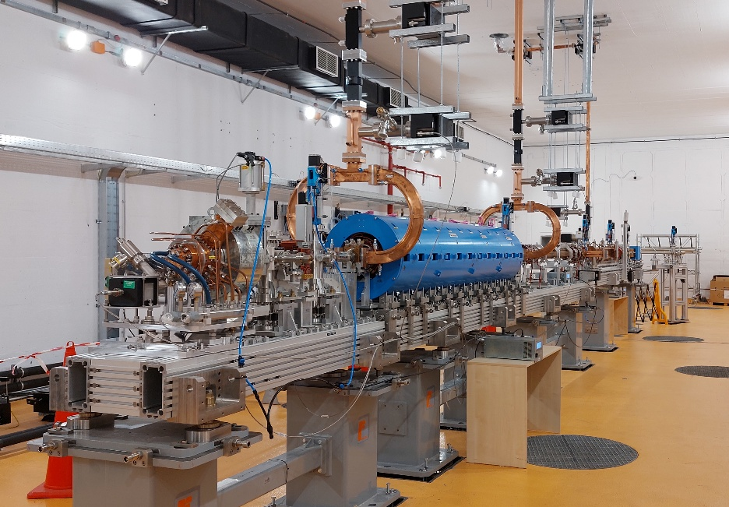
CONCLUSIONS
SSRIP is the project, in charge of INFN-LNF, related to a new Research Contract signed between INFN and IFIN-HH (Romania) on March 2024 (3 MEuro);
It is a radioisotope source facility based on a 100 MeV photoinjetor LINAC, that uses all the components delivered and paid by IFIN-HH on Stage I of the ELI-NP gamma beam system contract
Last deliverable (end of the project) February 2026, to be renegotiated because of some delays in the Milestones in charge of IFIN-HH (renegotiation expected beginning of 2025)
Implementation activities on going: 1st Deliverable concluded, 2nd under report writing
THANK YOU FOR YOUR ATTENTION
I would like to acknowledge all WP leaders, colleagues and technicians that are contributing to this “complicated” enterprise
D. Alesini, SSRIP, 68 Sci. Com., Frascati, 20-11-2024

