Slide 1
Fireball at LNF
Presentation to the scientific board of LNF – 20/11/24
Principle Investigators: E. E. Los, R. Bingham, G. Gregori
This work is supported in parts by UKRI under grants no. EP/Y035038/1 (converted from ERC Advanced Grant), ST/W000903/1 and MR/W006723/1."

Slide 2
Collaboration
E. E. Los, G. Gregori, F. Miniati, S. Sarkar, B. T. Huffman, A. A. Schekochihin, A. F. A. Bott, S. Iaquinta, A. Dyson, H. Ramm, B.K. Tan, S. Zhang, D. A. Uzdensky, N. Charitonidis, P. Simon, A.M. Goillot, I. Efthymiopoulos, V. Stergiou, S. Burger, J. W. D. Halliday, R. Bingham (also University of Strathclyde), A. R. Bell, R. M. G. M. Trines, T. Davenne, A. Phelps, K. Ronald, D. Speirs, T. Hodge, C. P. Ridgers, C. Arran, P. Bilbao, F. Cruz, L. O. Silva, N. Lopes, M. P. Anania, M. Bazzi, B. Buonomo, S. Cantarella, F. Cardelli, F. Chiarelli, A. Clozza, C. Curceanu, E. Diociaiuti, R. Donghia, L. G. Foggetta, D. Di Giovenale, C. Di Giulio, E. Di Pasquale, A. Ghigo, A. Liedl, S. Manti, F. Napolitano, A. Scordo, F. Sgaramella, F. Sirghi, C. Taruggi, A. Trigilio, A. Vannozzi, C. D. Arrowsmith, D. Haberberger, D. H. Froula, P. Simon, A. G. R. Thomas, L. Willingdale, H. Chen, R. A. Simpson, T. Ma, R.A.C. Cairns, B. Reville, T. Vieu, J. T. Gudmundsson, E. D. O. Wilhelmi, L. Serafini, V. Petrillo, R.A.C. Cairns

Slide 3
Motivation: Laboratory Astrophysics
Validate astrophysical models;
Observations: limited resolution
Simulation: computationally expensive to resolve length scales orders of magnitude apart
Laboratory experiments; use scale invariance to map lab observations to astrophysical contexts

Slide 4
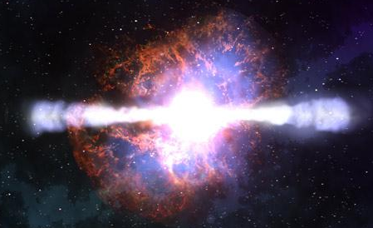
Motivation: Gamma-ray bursts (GRBs) and fast radio bursts (FRBs)
GRBs; most luminous radiation source in the universe, gamma & X-rays
FRBs: high luminosity radio bursts
Short (typically <1 minute) duration
How are GRBs and FRBs produced?
Does high brightness suggest coherent mechanism?
How are cosmic rays accelerated up to 10²⁰eV energies?

Slide 5
Overview of planned experiments
E1
Investigate different models of GRBs pair beam instabilities and inverse Compton scattering
E2
Maser emission
E3
Particle acceleration by relativistic collisionless shocks

Slide 6
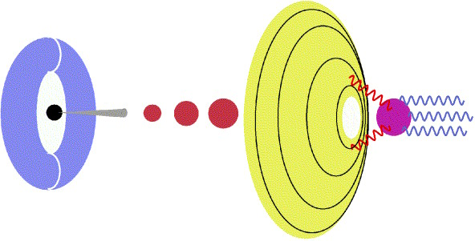
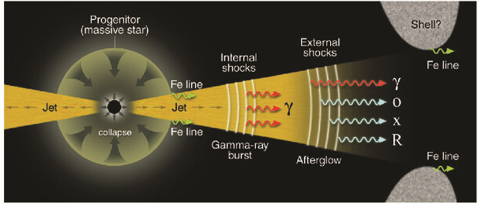
E1: Gamma-ray burst models
Fireball: relativistic e-e+ jets ejected by black holes, pulsars & quasars (BW process)
Cannonball: relativistic plasma jets (ordinary matter from accretion disk) ejected from after supernova.
Synchrotron emission
Plasma instabilities
Pairs
B field
Plasma blobs
ICS from supernova photons
Particle acceleration
P. Mészáros, Science (2001)
A. Dar, Chin. J. Astron. Astrophys. (2005)

Slide 7
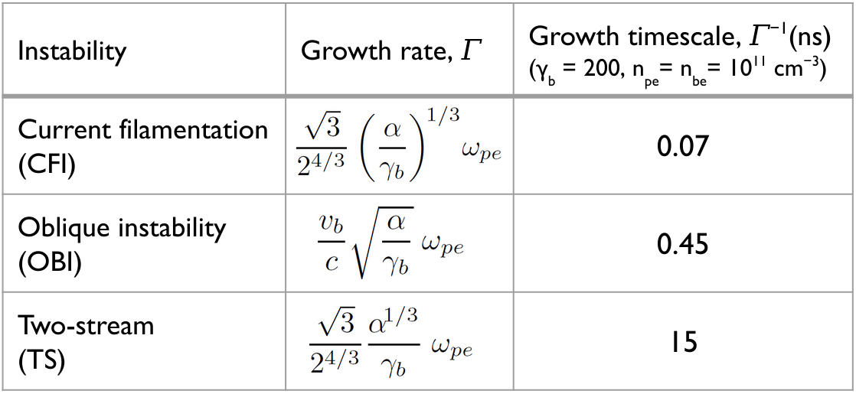
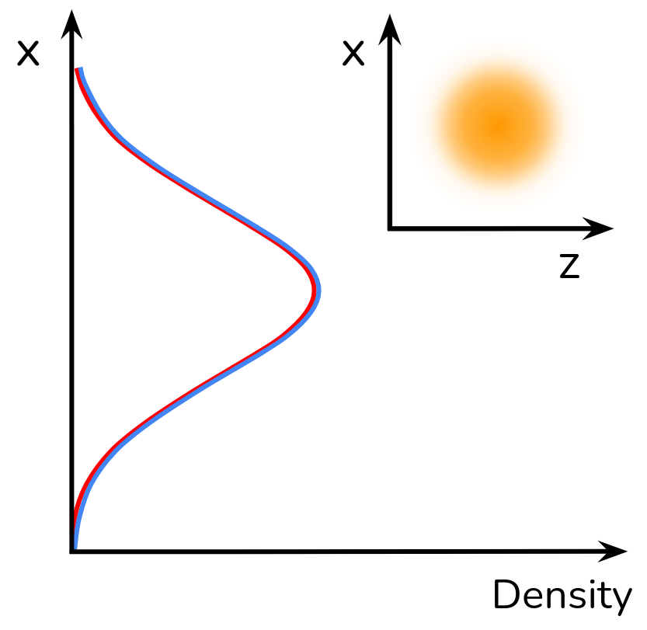
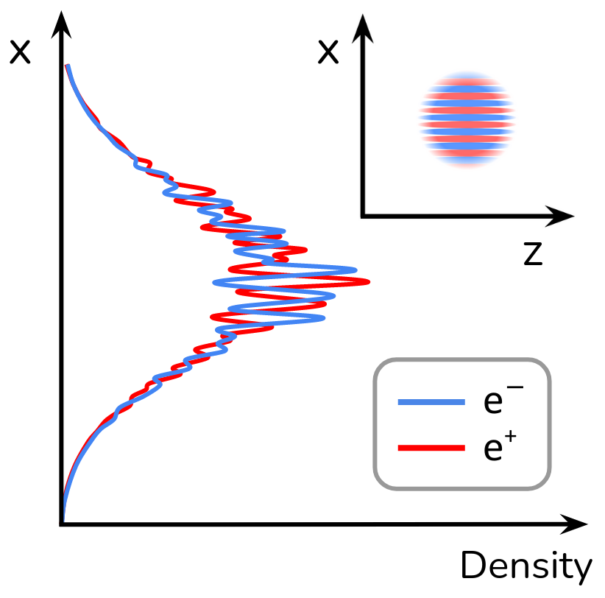
E1: Pair beam instabilities
Quasi-neutral beam propagating through ambient plasma:
Small fluctuations of magnetic field induce separation of currents in an initially homogeneous, neutral beam.
Induced currents further amplify magnetic field.
2d OSIRIS Particle-in-cell simulation
(Nitin Shukla, IST)
Initial state:
Evolved state:
x
-B_{y}
+B_{y}
Fastest growing modulations are comparable to the skin depth of the plasma:
z

Slide 8
E1: Relativistic Inverse Compton Scattering
$E_{s}=\frac{4}{3}γ^{2}ℏω$
$N_{s}=2ρ_{p}σct_{int}$
$\frac{N_{s}}{N_{i}N_{e}}=\frac{3r_{e}^{2}}{πr^{2}γℏω }$
or positron

Slide 9
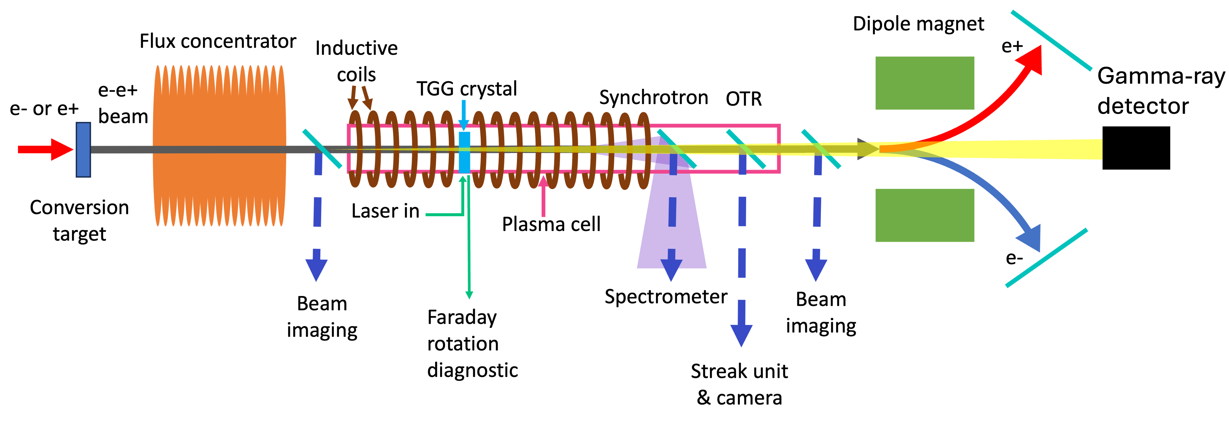
E1: experimental setup
Fireball: beam-plasma instabilities
Pair beam density modulations; transverse (profile screen) & longitudinal (OTR)
B fields (Faraday rotation)
Synchrotron emission (gated camera)
Cannonball: Inverse Compton Scattering
Scattered optical plasma photons; X-ray & gamma ray spectrometer/calorimeter
X-ray/gamma detection lead by LNF

Slide 10
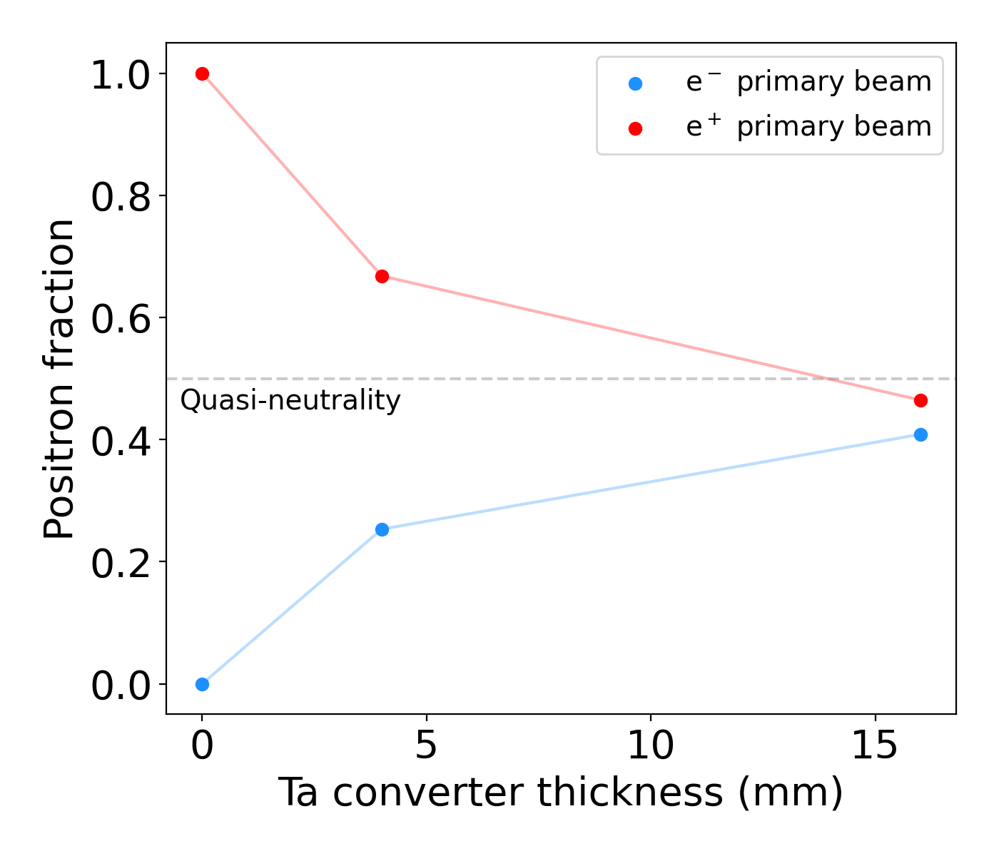
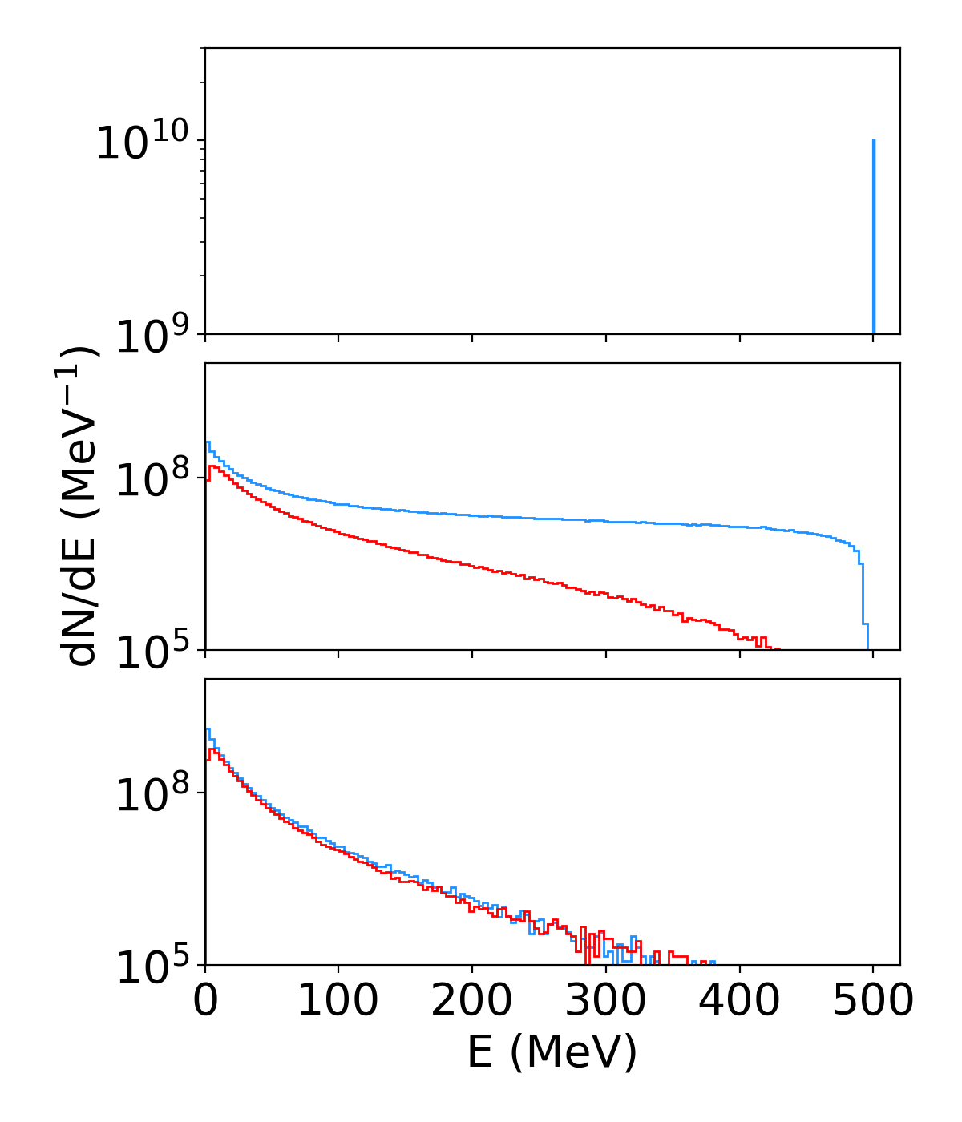
E1: Pair beam generation: FLUKA simulations
Simulated incident electron beam: ${10}^{10}$ particles, 0.1-0.6GeV energy, 1.5ns duration.
Approximate beam densities = 10⁸−10⁹ cm⁻³ (assuming 1 cm² beam size and 1.5 ns pulse).

Slide 11
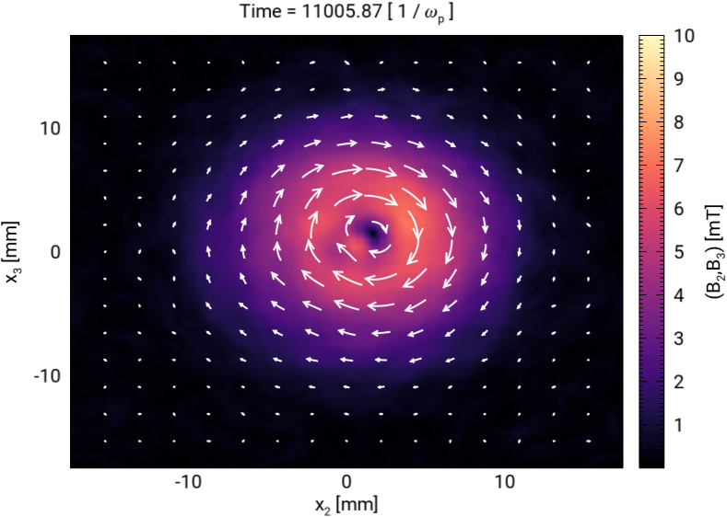
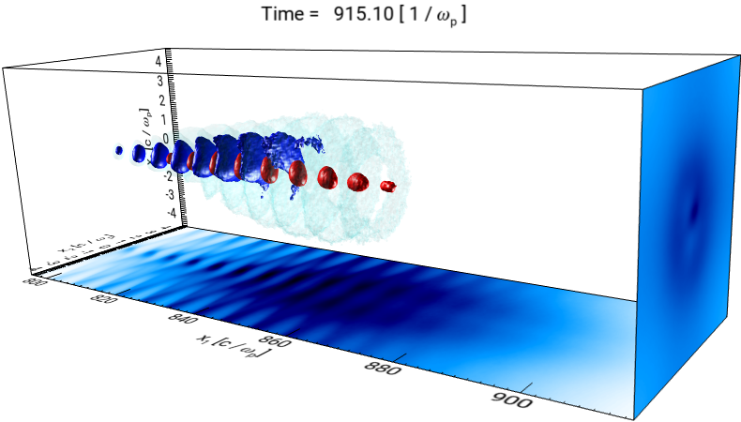
E1: OSIRIS Simulations (density modulations & B-field)
Magnetic field
Beam density profile
3m plasma cell, uniform plasma, density $2×{10}^{12}$cm⁻³
Pair beam $8×{10}^{12}$cm⁻³ density, 2% divergence, 275ps duration.
10mT self-generated magnetic fields
Primarily linear growth regime
Plasma density modulations ~skin depth (10ps)
R. A. Fonseca et al., LNCS 2331, 342-351 (2002)

Slide 12
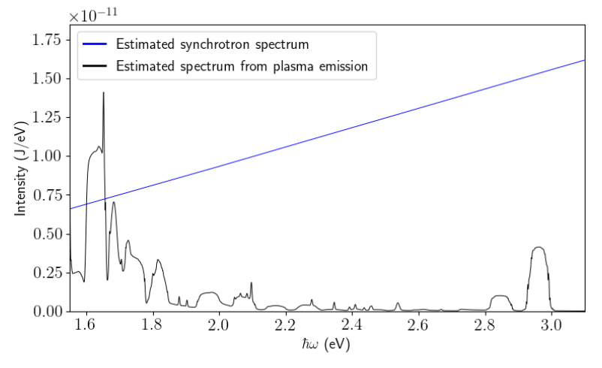
E1: predictions: synchrotron emission & ICS
Inverse Compton scattering
Synchrotron emission
Expect scattered photons to have 50keV energies + high harmonics
$\frac{N_{s}}{N_{i}N_{e}}={10}^{8}$
R. A. Fonseca et al., LNCS 2331, 342-351 (2002)

Slide 13
Overview of planned experiments
E1
Investigate different models of GRBs pair beam instabilities and inverse Compton scattering
E2
Maser emission
E3
Particle acceleration by relativistic collisionless shocks

Slide 14
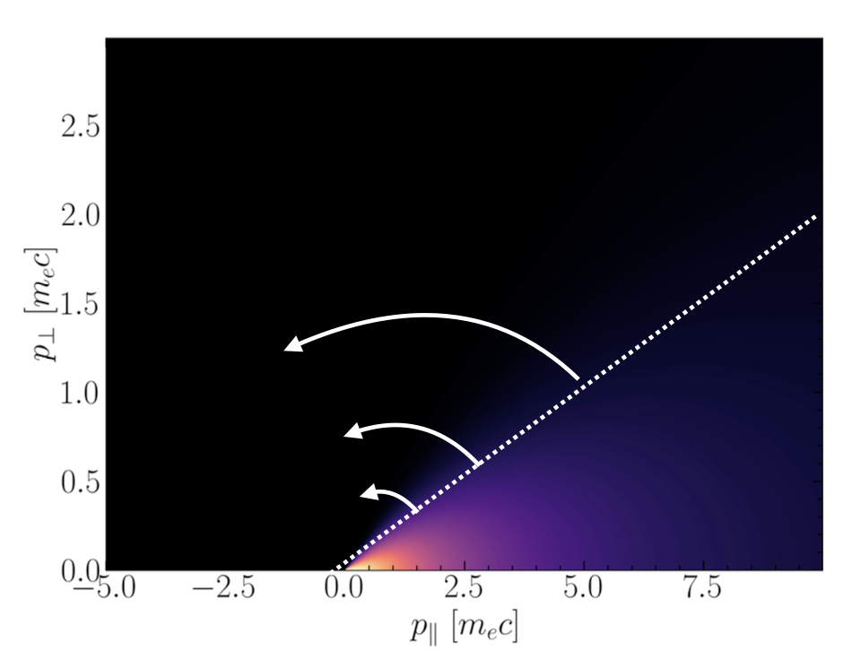
E2: Maser emission
$$\frac{∂μ}{∂t}=0 , \frac{∂E}{∂t}=0$$
$μB\left(z\right)=E_{⊥}\left(z\right)$
Electron moves into a magnetic mirror, ${\overline{p}}_{z}→{\overline{p}}_{⊥}$
population inverse in ${\overline{p}}_{⊥}$; “horseshoe distribution”
Coherent maser radiation due to stimulated synchrotron emission.
Observed only for non-relativistic electrons (S L McConville 2008, K. Ronald 2008)

Slide 15
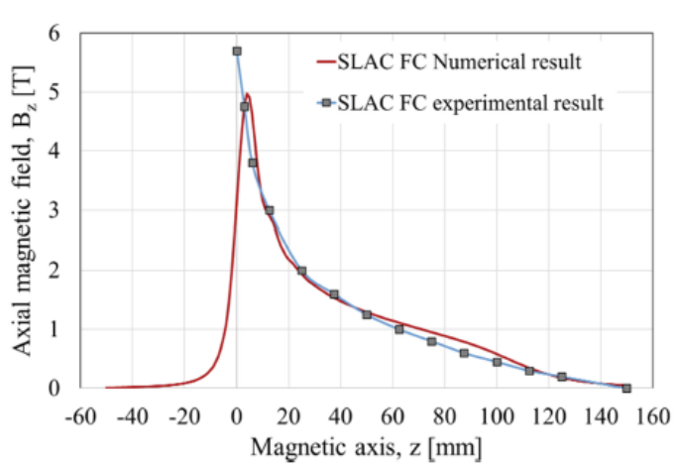
E2: Experimental setup
Maser emission
Heterodyne detector: spectrum, power and polarisation of radiation, OR THz antenna
LNF, Oxford & STFC have expertise in THz detection, further work needed to finalize design

Slide 16
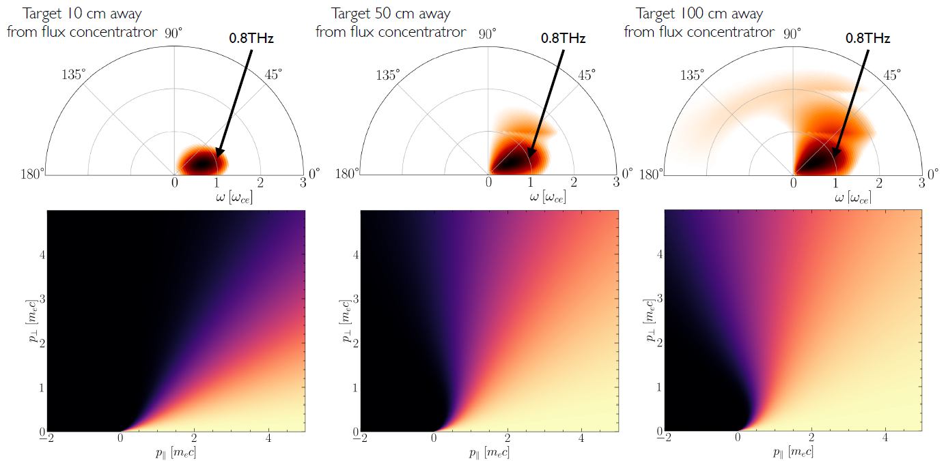
E2: OSIRIS Maser emission simulations
Maser emission at 0.8 THz (& harmonics), polarization dependence
Dependence on distance between Ta target & flux concentrator.
R. A. Fonseca et al., LNCS 2331, 342-351 (2002)

Slide 17
Overview of planned experiments
E1
Investigate different models of GRBs pair beam instabilities and inverse Compton scattering
E2
Maser emission
E3
Particle acceleration by relativistic collisionless shocks

Slide 18
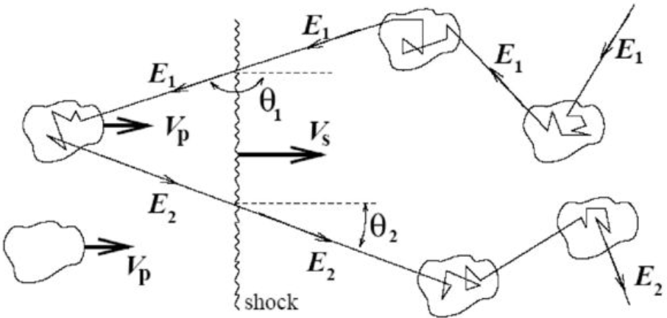
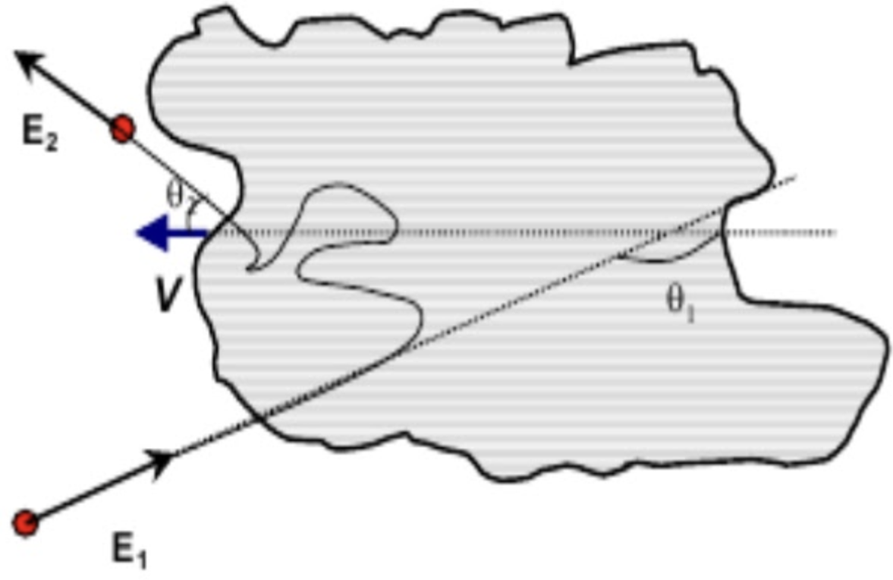
E3: Particle acceleration
Acceleration mechanisms for energetic cosmic rays:
1st order fermi acceleration:
Particles accelerated by $Γ_{sh}^{2}$, (shock Lorentz factor) on first crossing shock boundary
Particle acceleration by relativistic shocks not yet measured experimentally.
2nd order fermi acceleration:
Particles colliding with counter-propagating magnetized plasma are reflected & accelerated.

Slide 19
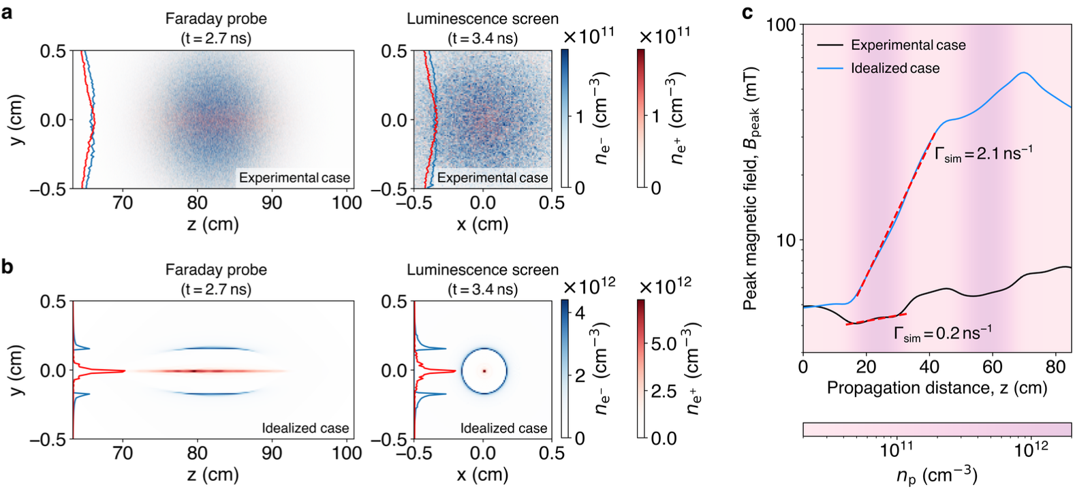
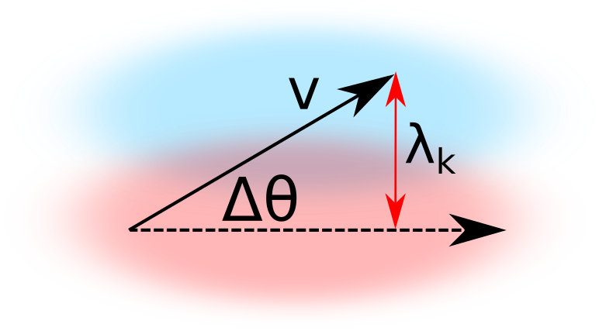
E1: Transverse momentum suppression of pair beam instabilities
Red: electron, Blue: positron
Oblique kinetic (OBIK): diverging beam
~$\frac{1}{Δθ^{2}}\left(\frac{n_{b}}{γ_{b}n_{p}}\right)ω_{p}$
Finite transverse
thermal spread
Filament scale (on the order of the plasma skin depth)

Slide 20
E3: experimental setup
Flux concentrator
Collimate pair beam -> access higher densities (up to ${10}^{14}cm^{−3}$)
Laser-solid target interaction
Increase plasma density to ${10}^{18}cm^{−3}$ over 10mm-> generate turbulence -> amplify B-field
Nd:Yag laser provided by LNF, 4J @ 1064nm, 6.8ns
Signatures of particle acceleration
First-order: expect bump in pair spectrum at high energies, indicating upshift in Lorentz factor
Second-order; expect reduction in number of low-energy pairs due to reflection by counterpropagating magnetic fields

Slide 21
E3: particle acceleration simulations
Analytic predictions
7mrad pair beam, OBI grows for > 22 e-folding lengths
B-field $\sim 10mT$
Expect particle acceleration by $≤$30MeV
C. Demidem et al., The Astrophysical Journal Letters (2023)

Slide 22
Scheduling & Costs
Estimated construction cost of 3 campaigns; 1.12 million EUR
Estimated cost of facility upgrades; 2-3 million EUR (including LINAC/BTF operation).

Slide 23
Thank you for listening!

