Slide 1
Wafer Dicing
Andrea Mazzolari 16/01/2025

Slide 2
PROCESS
Wafers coating with silicon nitride (@ Rogue Valley Microdevices)
Grooving using dicing blade
Surface interferometric characterization and IR interferometry
Chemical etching to remove lattice damage induced by dicing
Surface interferometric characterization and IR interferometry
Removal of silicon nitride
Rinsing
To lithography… ( @ CNRS Institut Néel)

Slide 3
PROCESS
Wafers coating with silicon nitride (@ Rogue Valley Microdevices)
Silicon nitride acts as masking agent against chemical etching, preserving the surfaces of the wafer later used for deposition of thin films

Slide 4
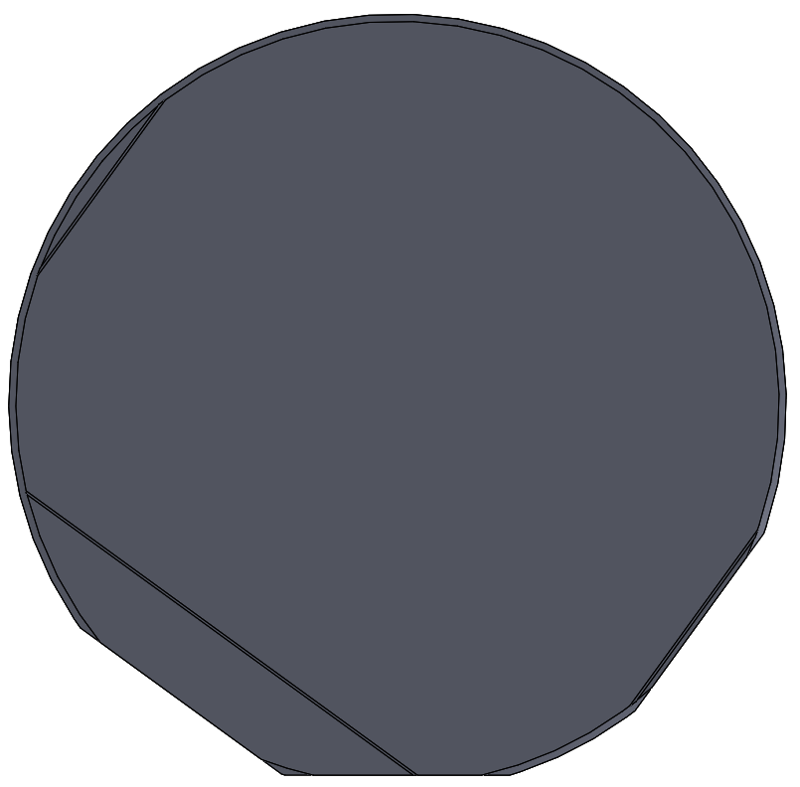
FLATS MACHINING
Starting wafer
Additional flats are machined to avoid cleave planes.

Slide 5
FLATS MACHINING
Starting wafer
Additional flats are machined to avoid cleave planes.
Markers for photolitography

Slide 6
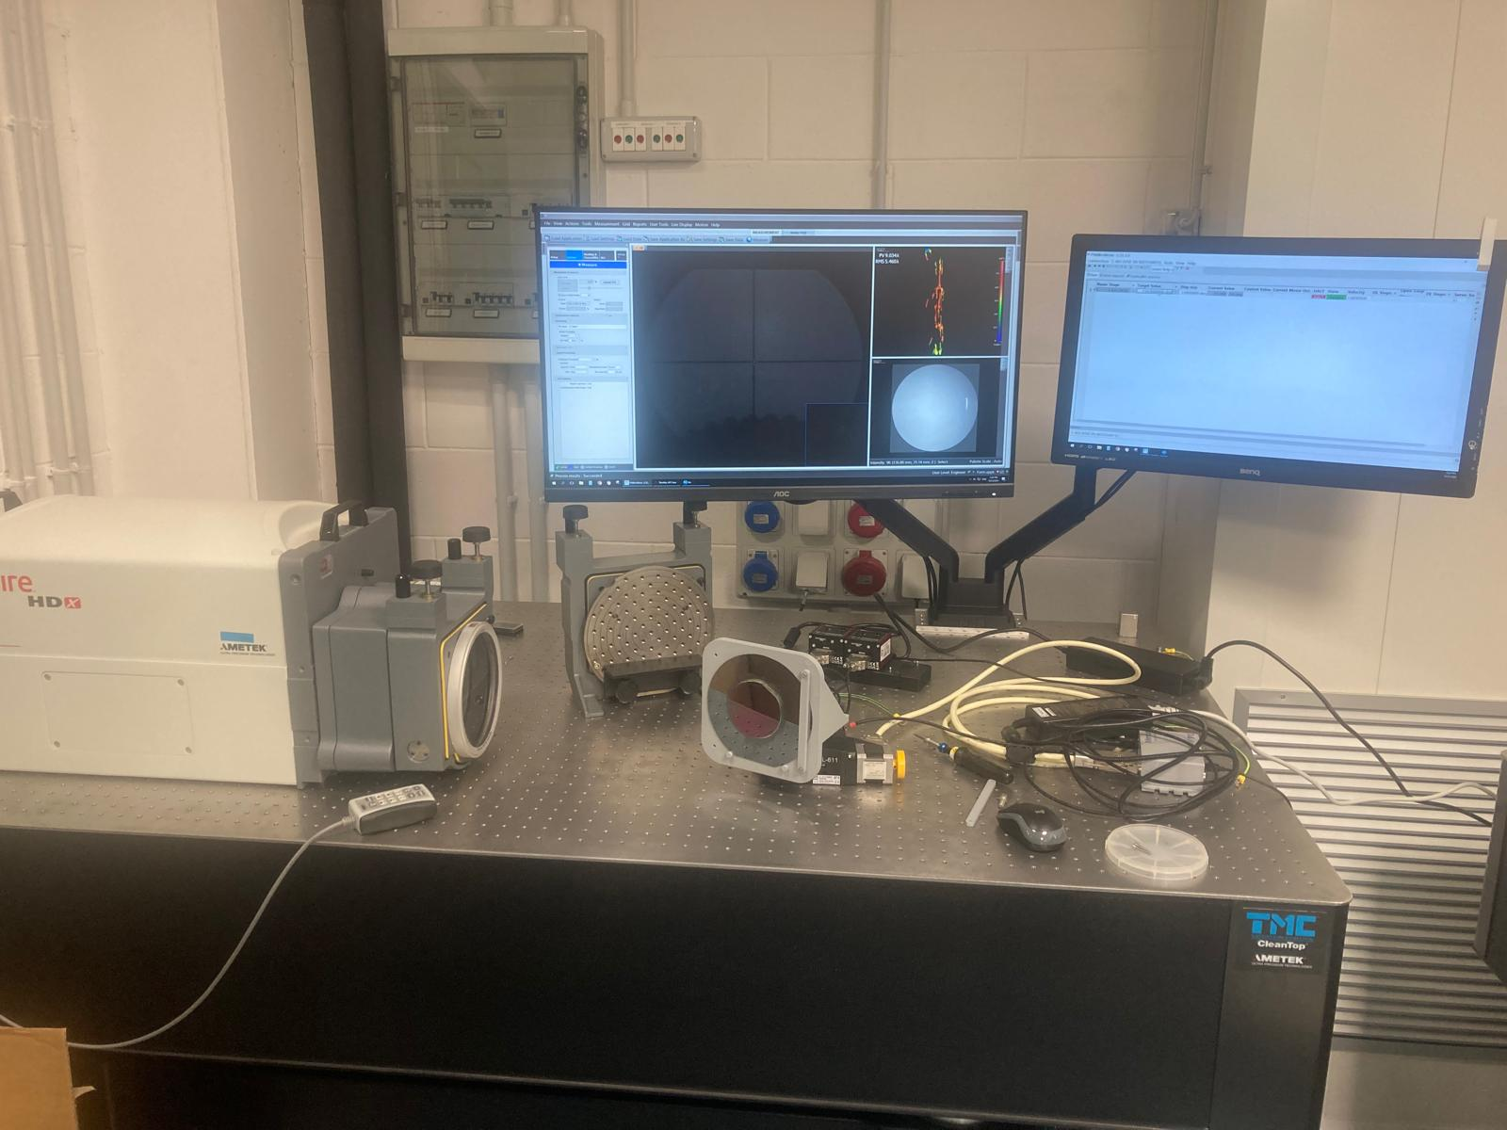
Accuracy verification
Wafer is mounted on a high-resolution rotary stage.
Perpendicularity between flat surface and wafer’s surface is assesed through laser interferometry
Wafer ready for grooving
Flats used as reference for alignment operations

Slide 7
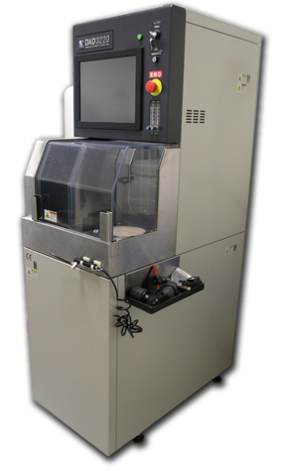
Dicing of crystals
BULLKIDs are diced from a commercially available wafer using a fine-grit blade to minimize the mechanical damage during the cut.
Cut centre positioning precision: ±0.01 mm
Cut direction precision: ±0.01°
Cut depth precision: ±0.005 mm
Minimal cut width: 0.08 mm
Maximum cut width: 1 mm
Maximum cut depth: 5 mm
Materials: Semiconductors (Si, Ge, SiC, GaAS..) and crystals in general, glass, ceramics
Dicing machine

Slide 8
Dicing of crystals
BULLKIDs are diced from a commercially available wafer using a fine-grit blade to minimize the mechanical damage during the cut.
Dicing machine

Slide 9
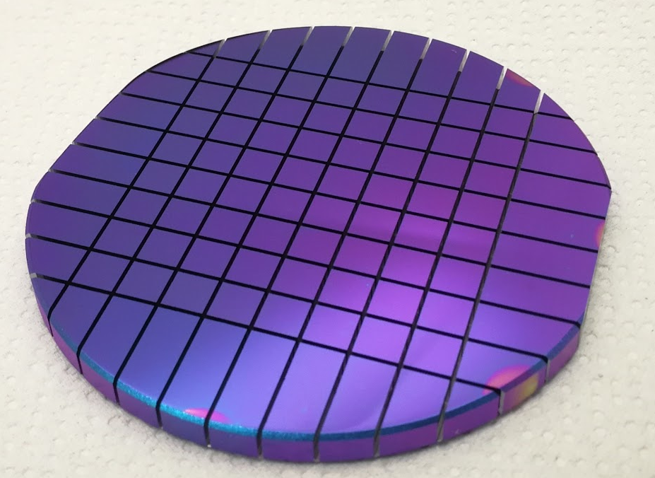
Dicing of crystals
BULLKIDs are diced from a commercially available wafer using a fine-grit blade to minimize the mechanical damage during the cut.
damage is generated at surface, which can obstruct the final performance of the BULLKIDs
Dicing machine

Slide 10
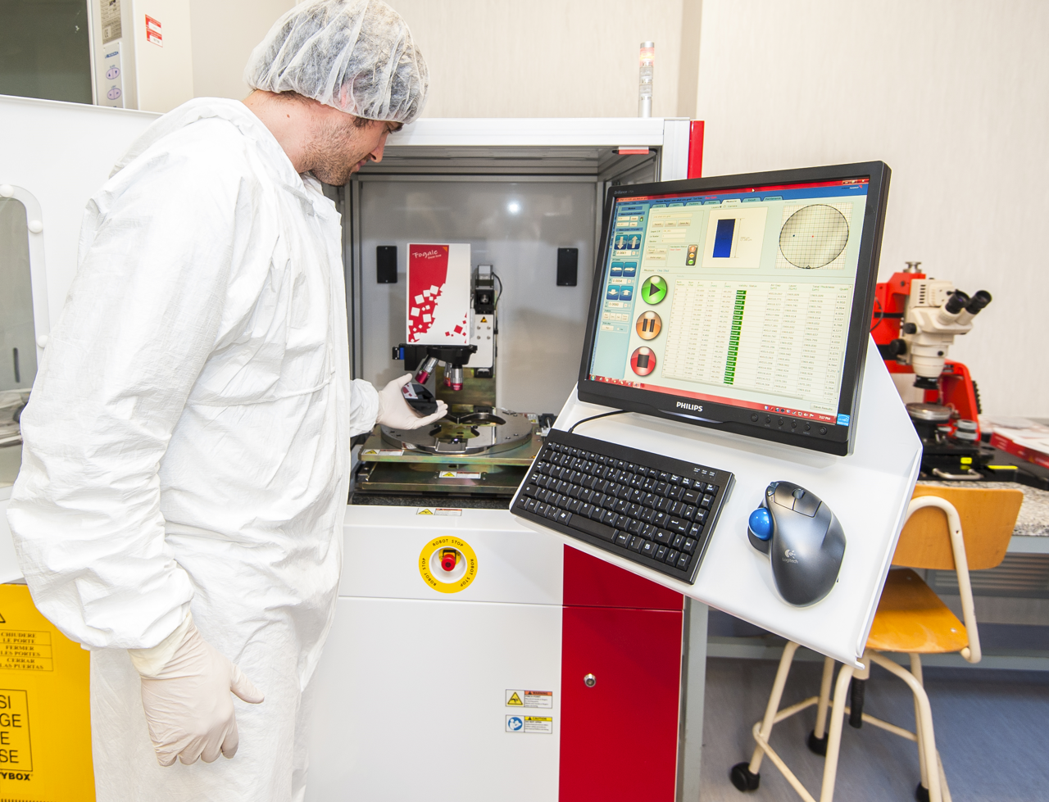
IR interferometry
IR interferometry used to measure thickness of common frame. Exploit Si transparence to IR
Measurement is carried before and after chemical etching to assure proper removal of silicon.
Precision can reach sub-micrometer resolution on thin samples (<1mm) and ≈1μm in thick samples

Slide 11
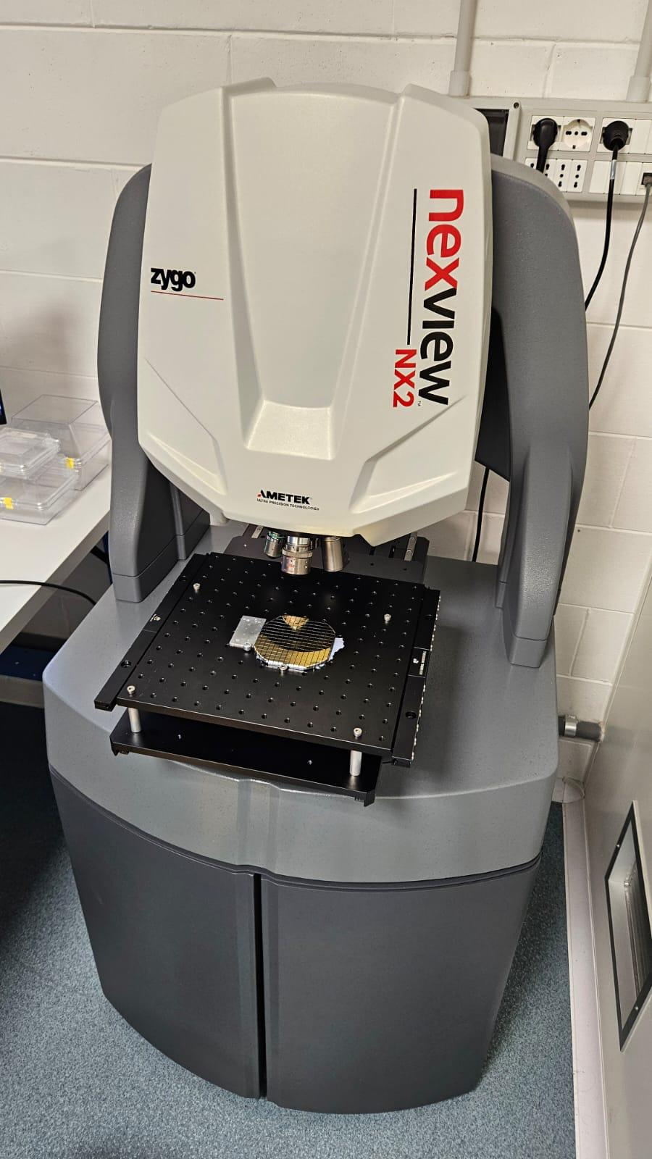
White light interferometry
White light interferometry is used to asses depth and width of the grooves before and after chemical etching
Recently acquired an automated software for faster acquisitions

Slide 12
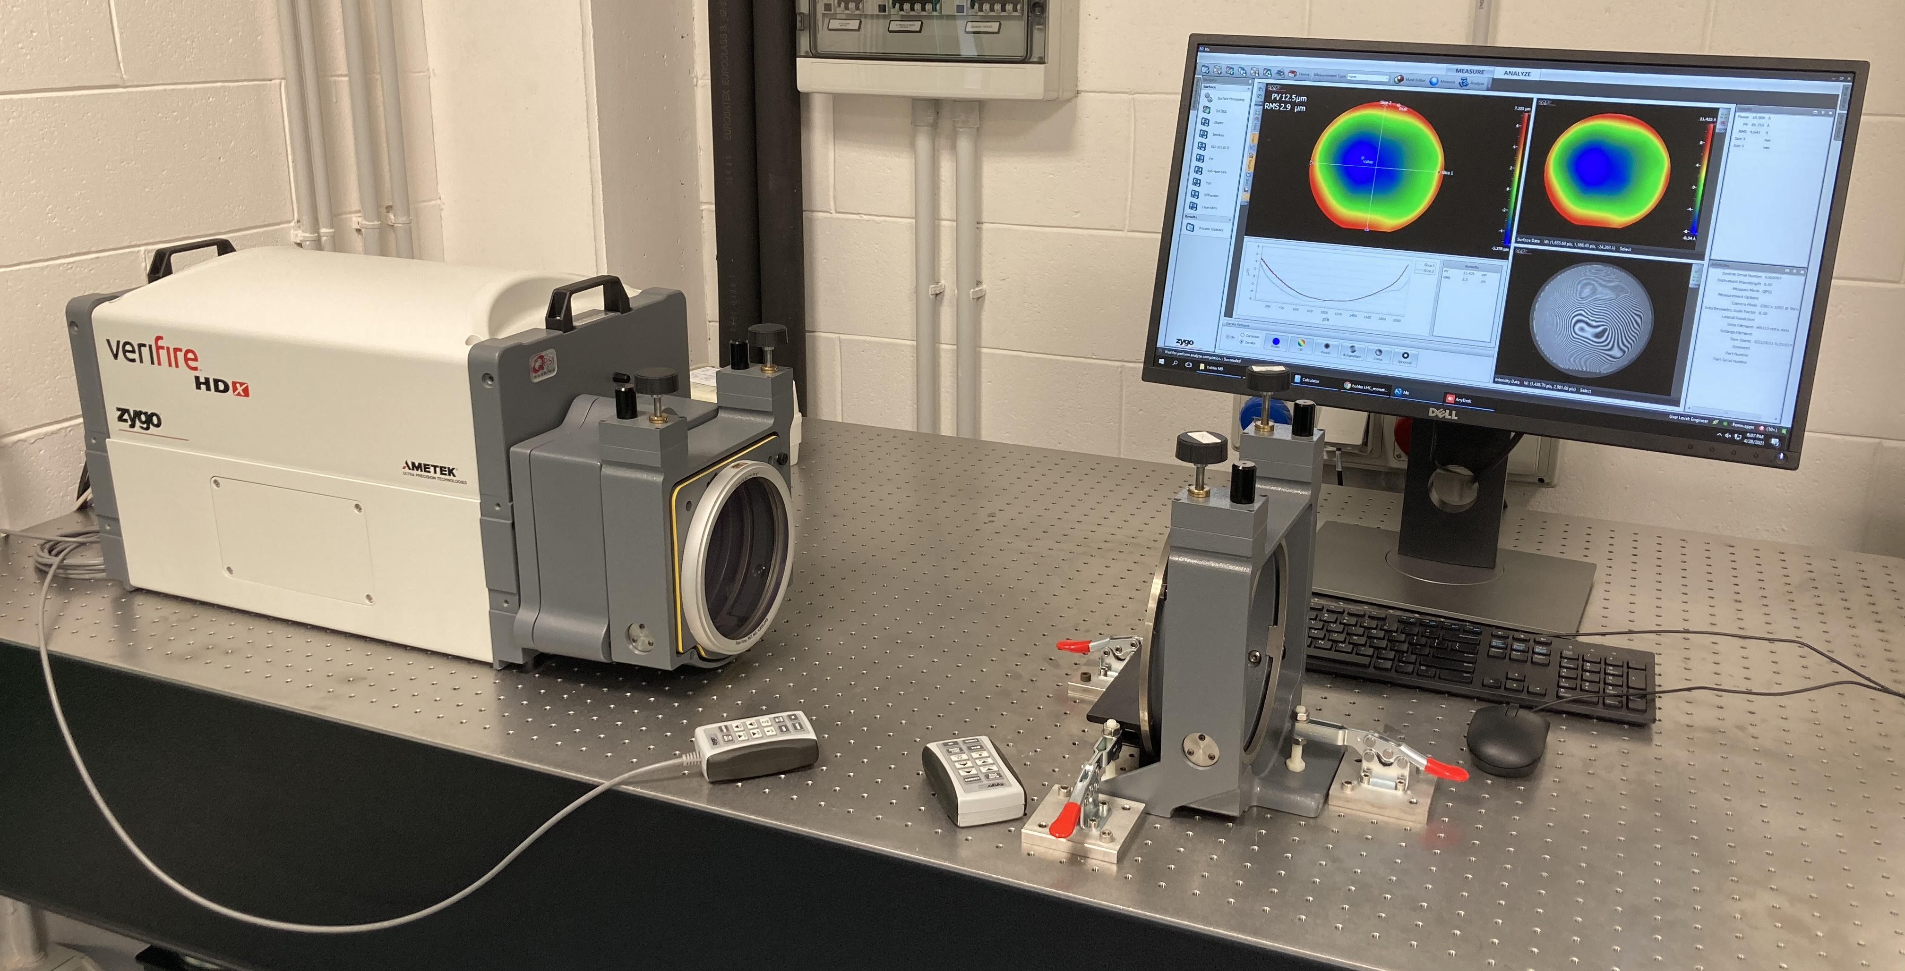
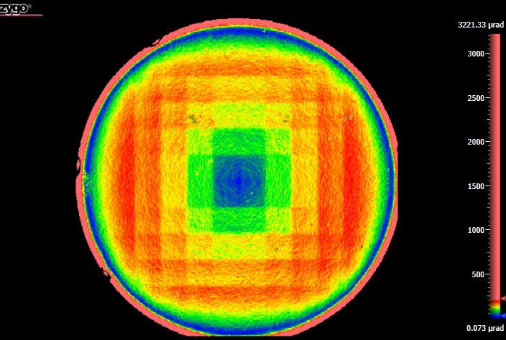
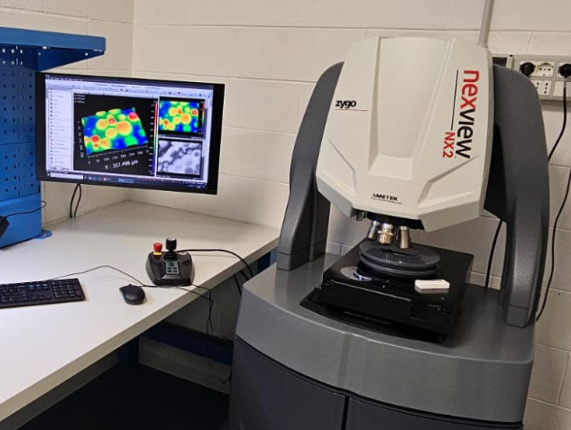
Laser interferomety
Optical interferometry is a well-assesed method to characterize flatness of reflective surfaces.
Used to characherize stress state before and after the chemical etching.
Characterization performed before and after chemical etching to assure complete removal of the stressed and damaged regions.

Slide 13
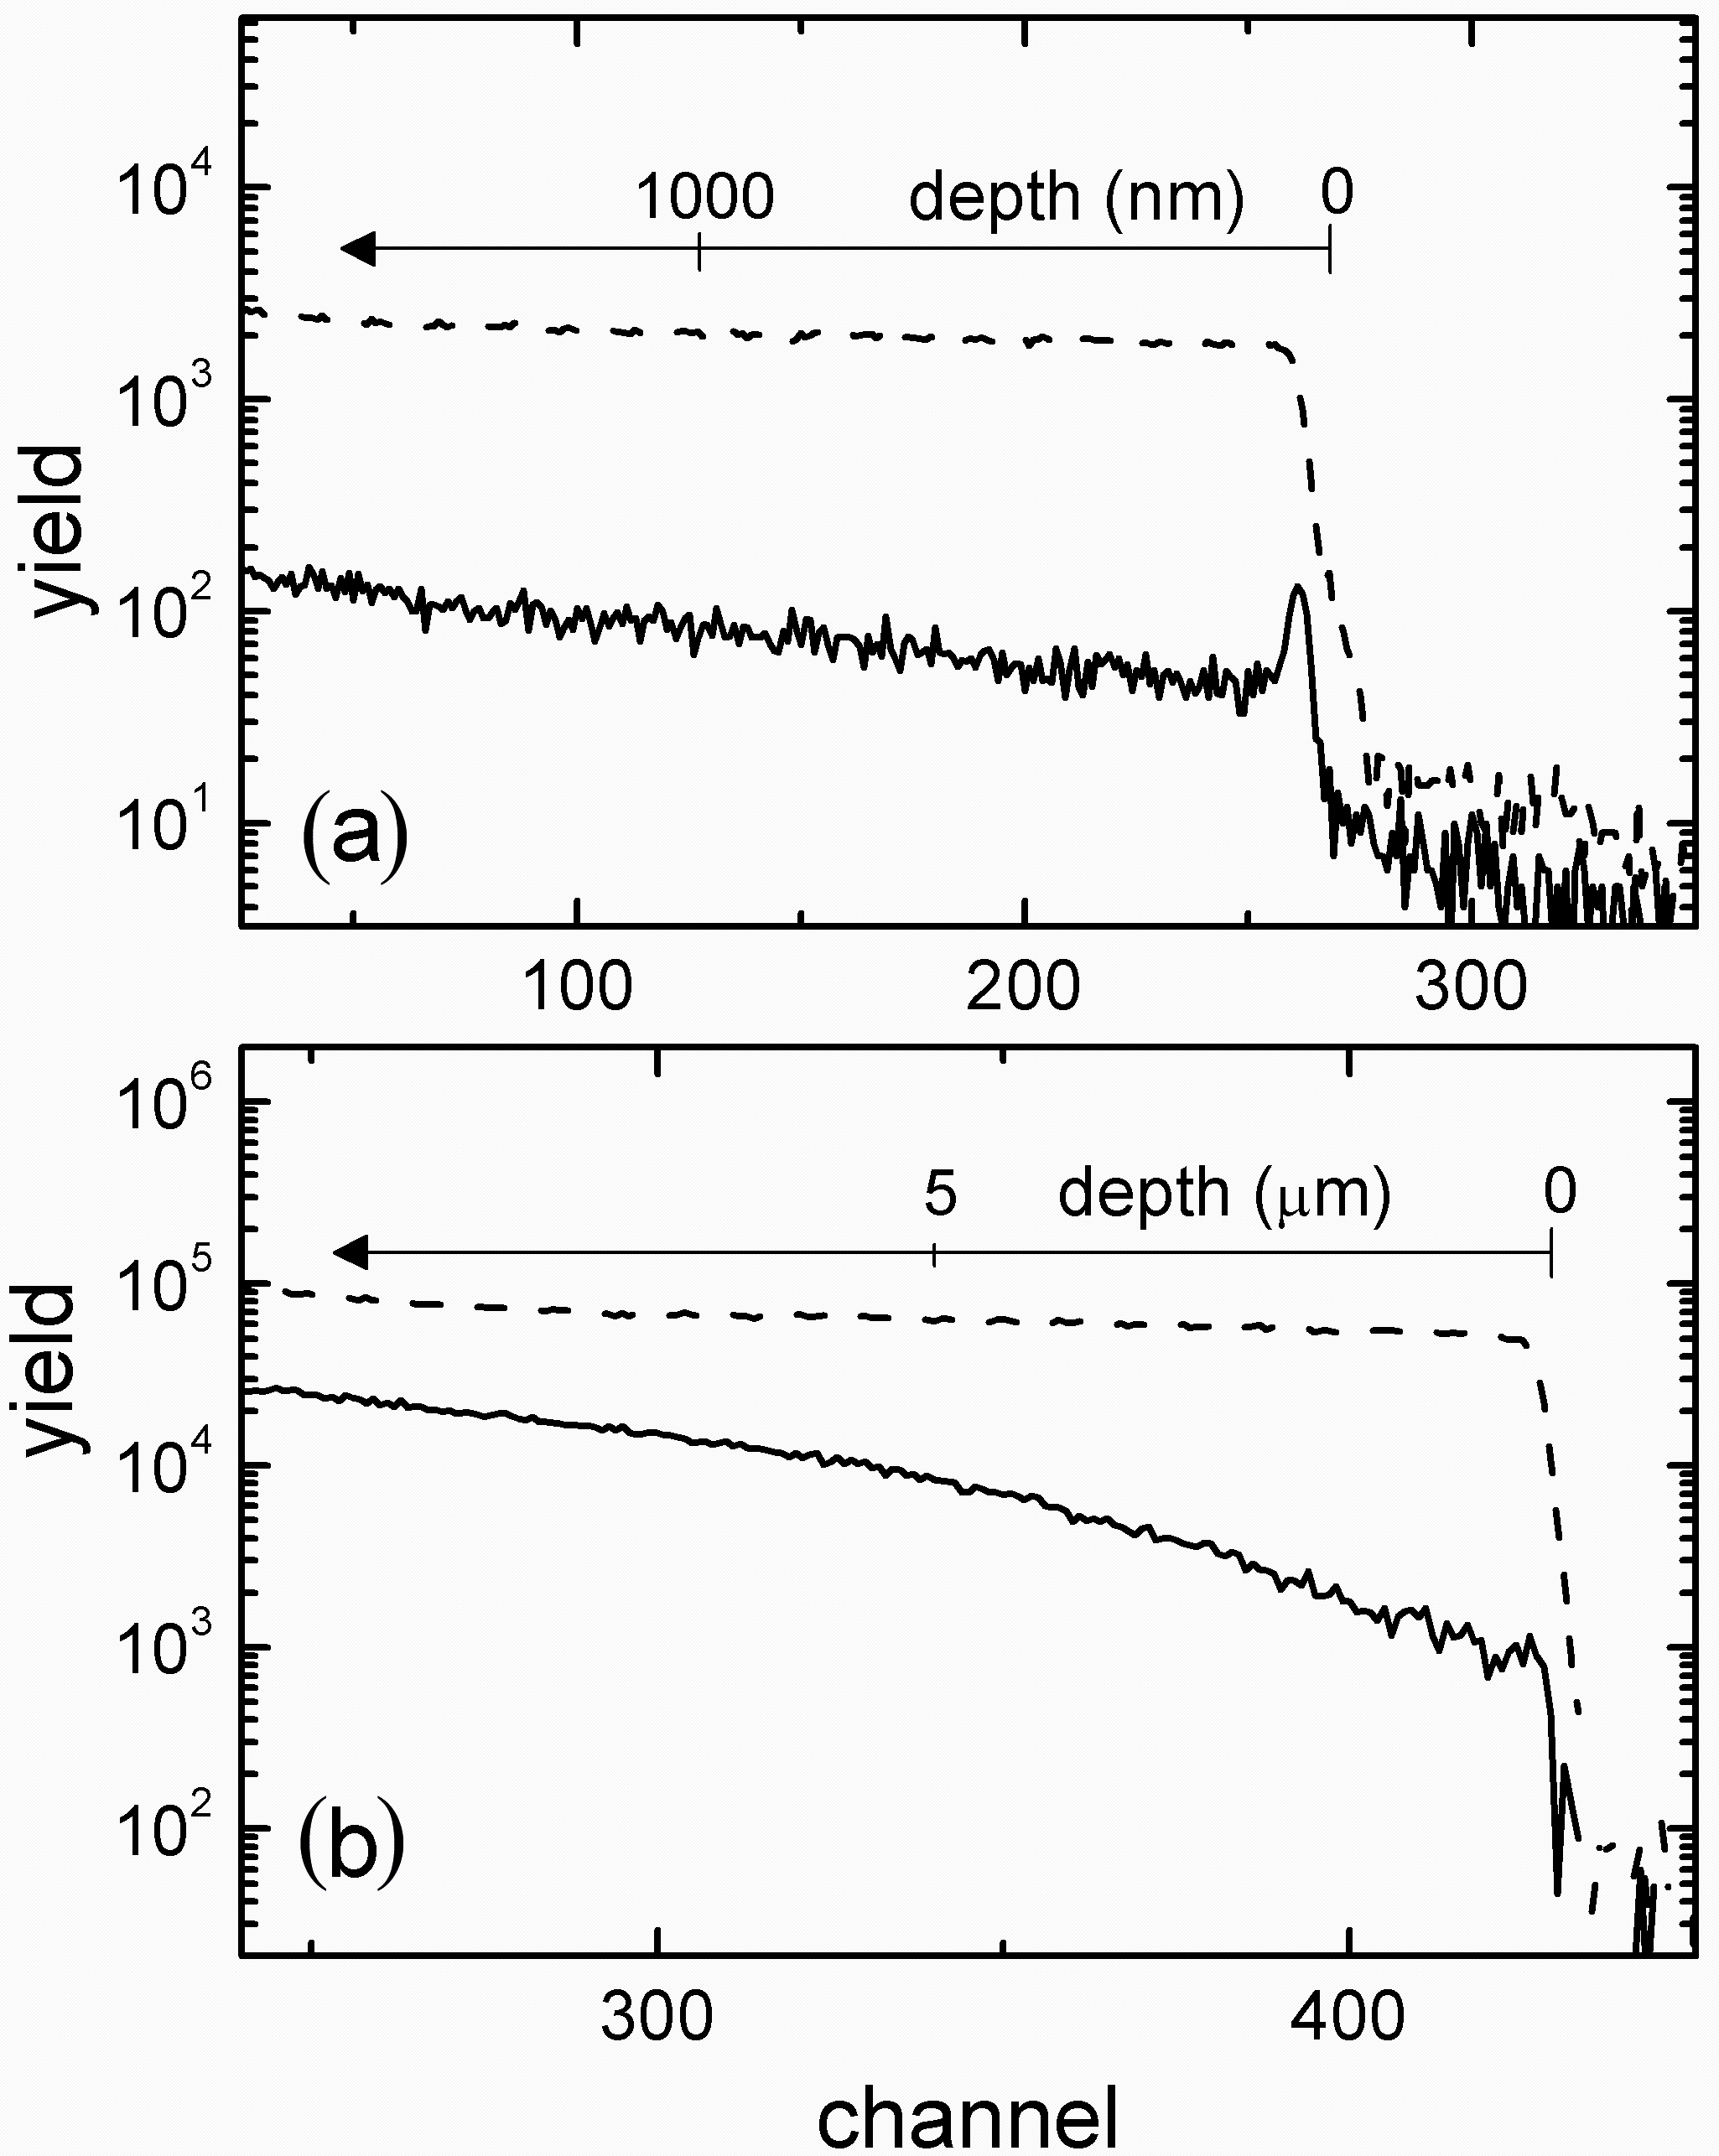
CHEMICAL ETCHING
⁴He⁺
Chemical etching is used to remove lattice damaged regions.
p⁺
Low signal of backscattered particles means good crystalline quality
S. Baricordi et al., APL 91 (2007) 061908

Slide 14
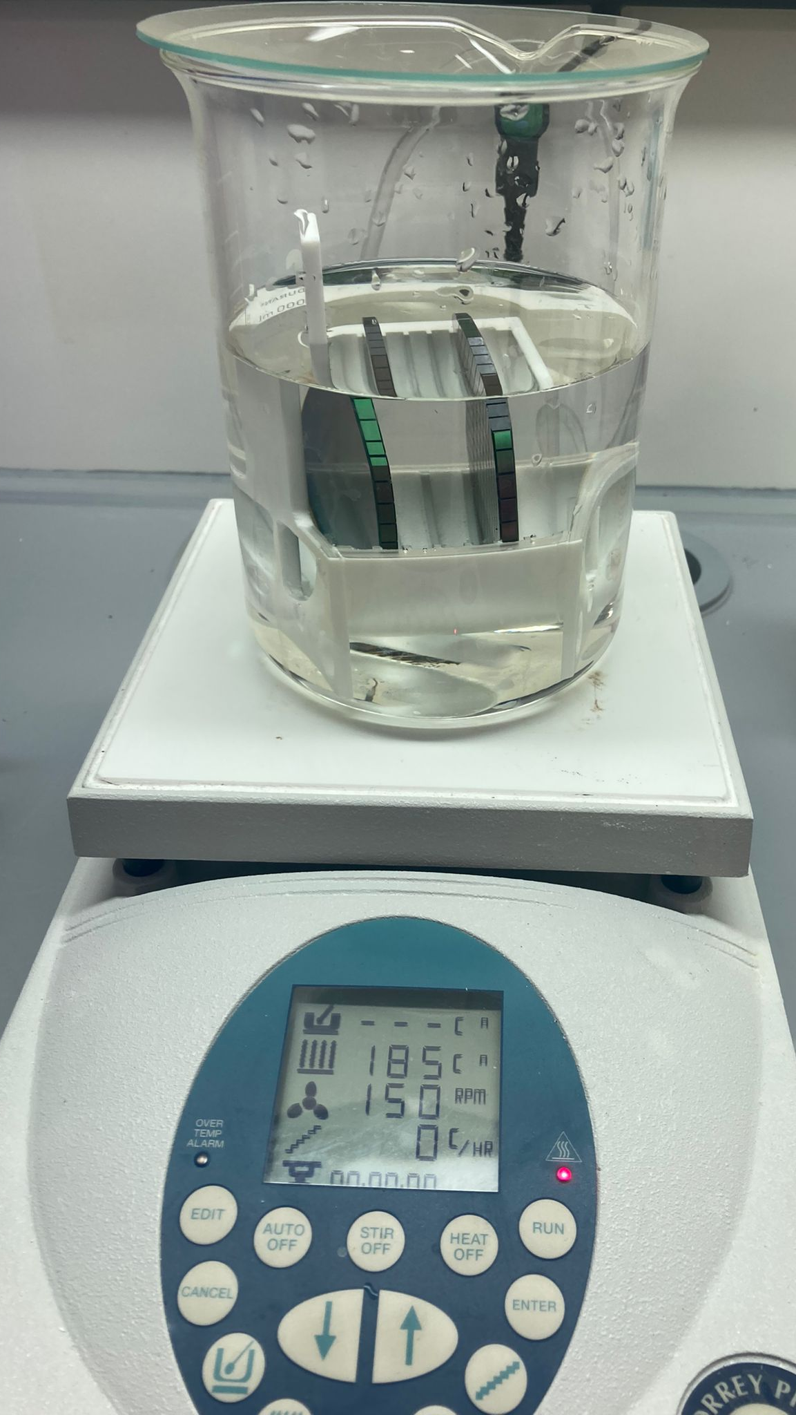
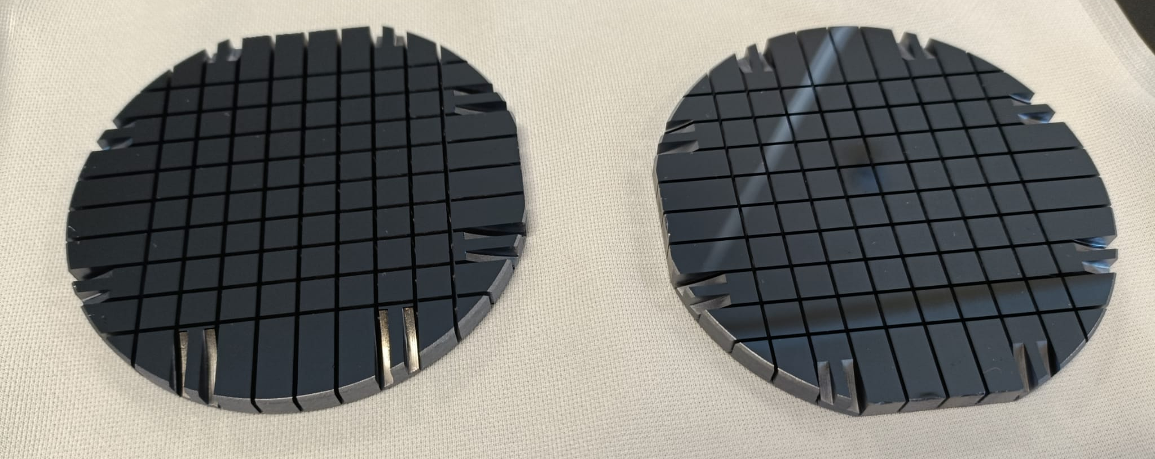
DANAE
Silicon nitride is removed in hot H₃PO₄, leaving final BULLKID2 wafers

Slide 15
DANAE
4 wafers are going to be processed in Ferrara
We are going to coat 25 more wafers of diameter 3’’

Slide 16
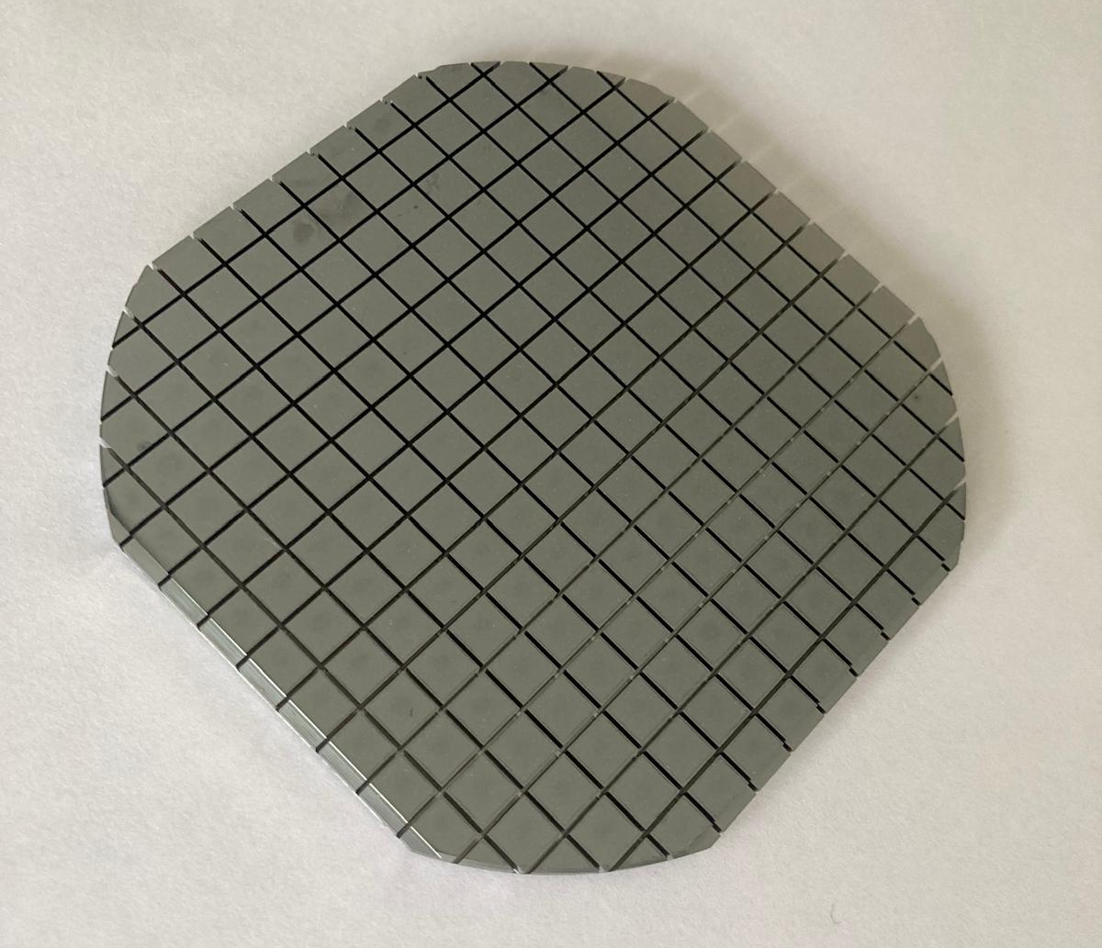
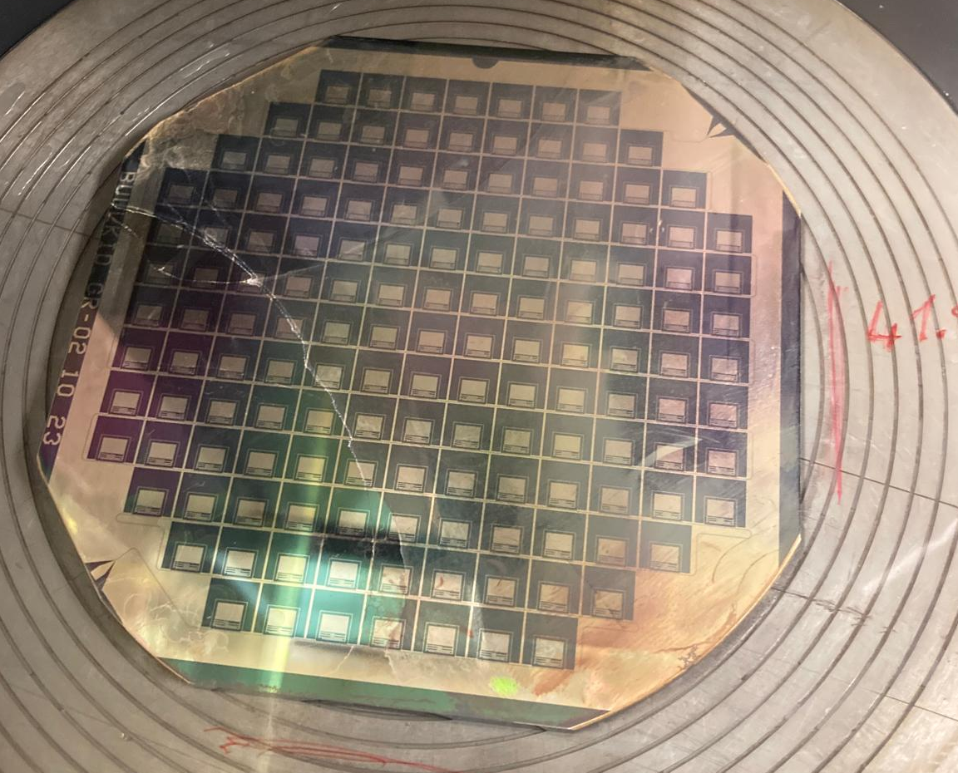
Moving toward 4’’ wafers
First tests of dicing of 4’’ Si wafers are successful
We now have 10 wafers already coated and ready for processing

Slide 17
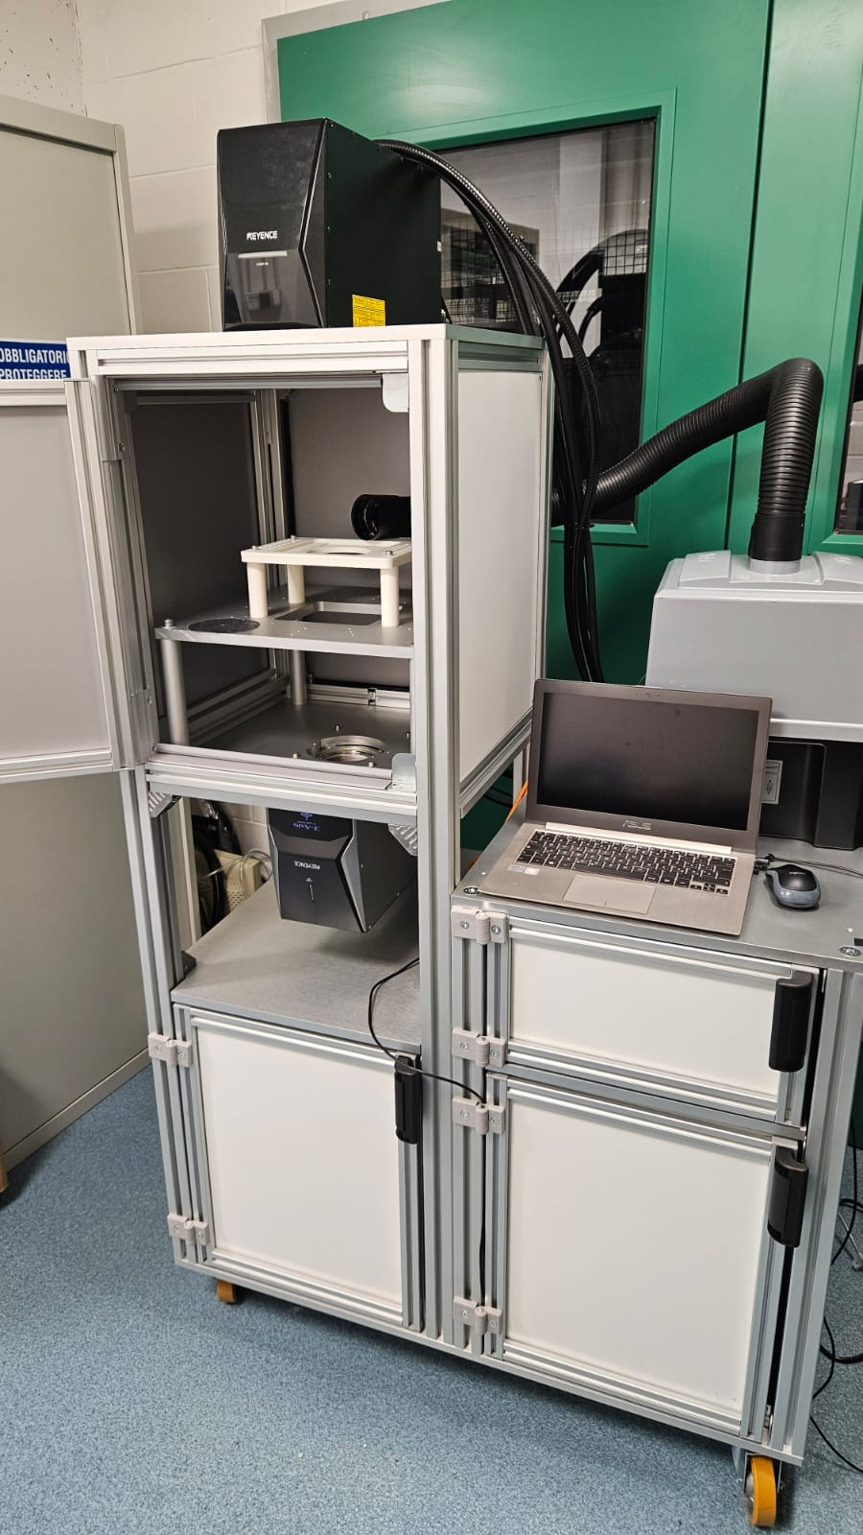
Dual laser system
Dual laser engraving system will soon aid manufacturing of references on opposite wafers surfaces.
Aim is to lowering wafer processing time.
Pre-aligment of the lasers accomplished
Fine allignment will be carried on test-wafers

