Slide 1
Results of 100 mm thin BULLKID detectors
15/01/2025
Giovanni Luca Pesce

Slide 2
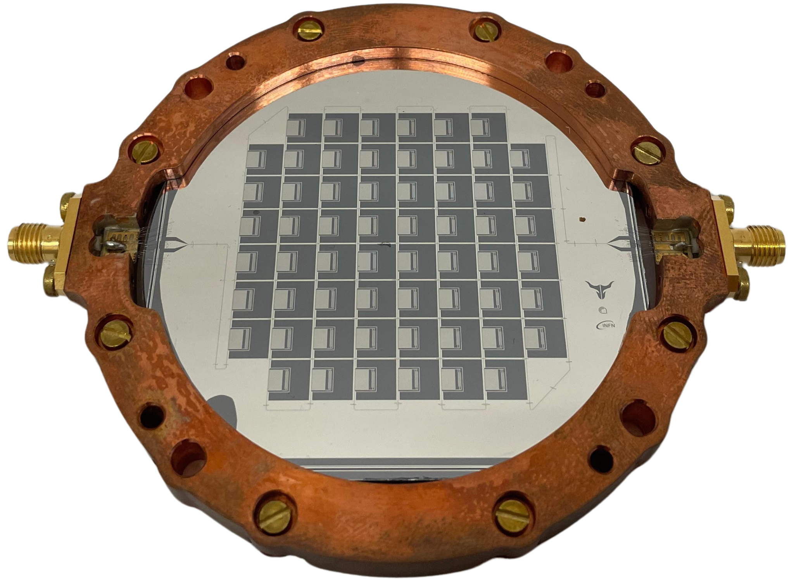
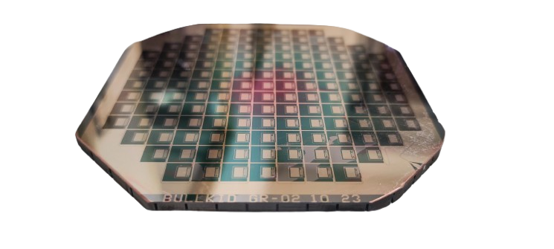
Scale-Up
5 mm Si Thickness
72,6 mm Diameter
60 Pixels
20 g of active mass
5 mm Si Thickness
100 mm Diameter
145 Pixels
50 g of active mass

Slide 3
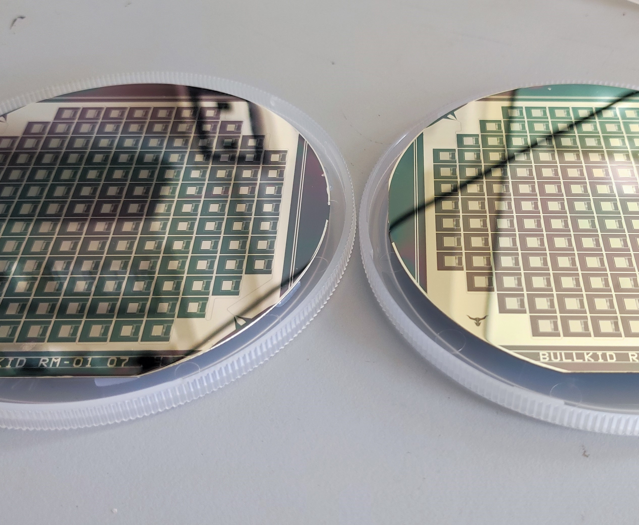
100 mm thin detectors
Features:
100 mm diameter
300 $μm$ thick
Why use them?
For electrical tests to evaluate the performance of newly lithographed KID designs
Industrial Production
Easy to obtain and test

Slide 4
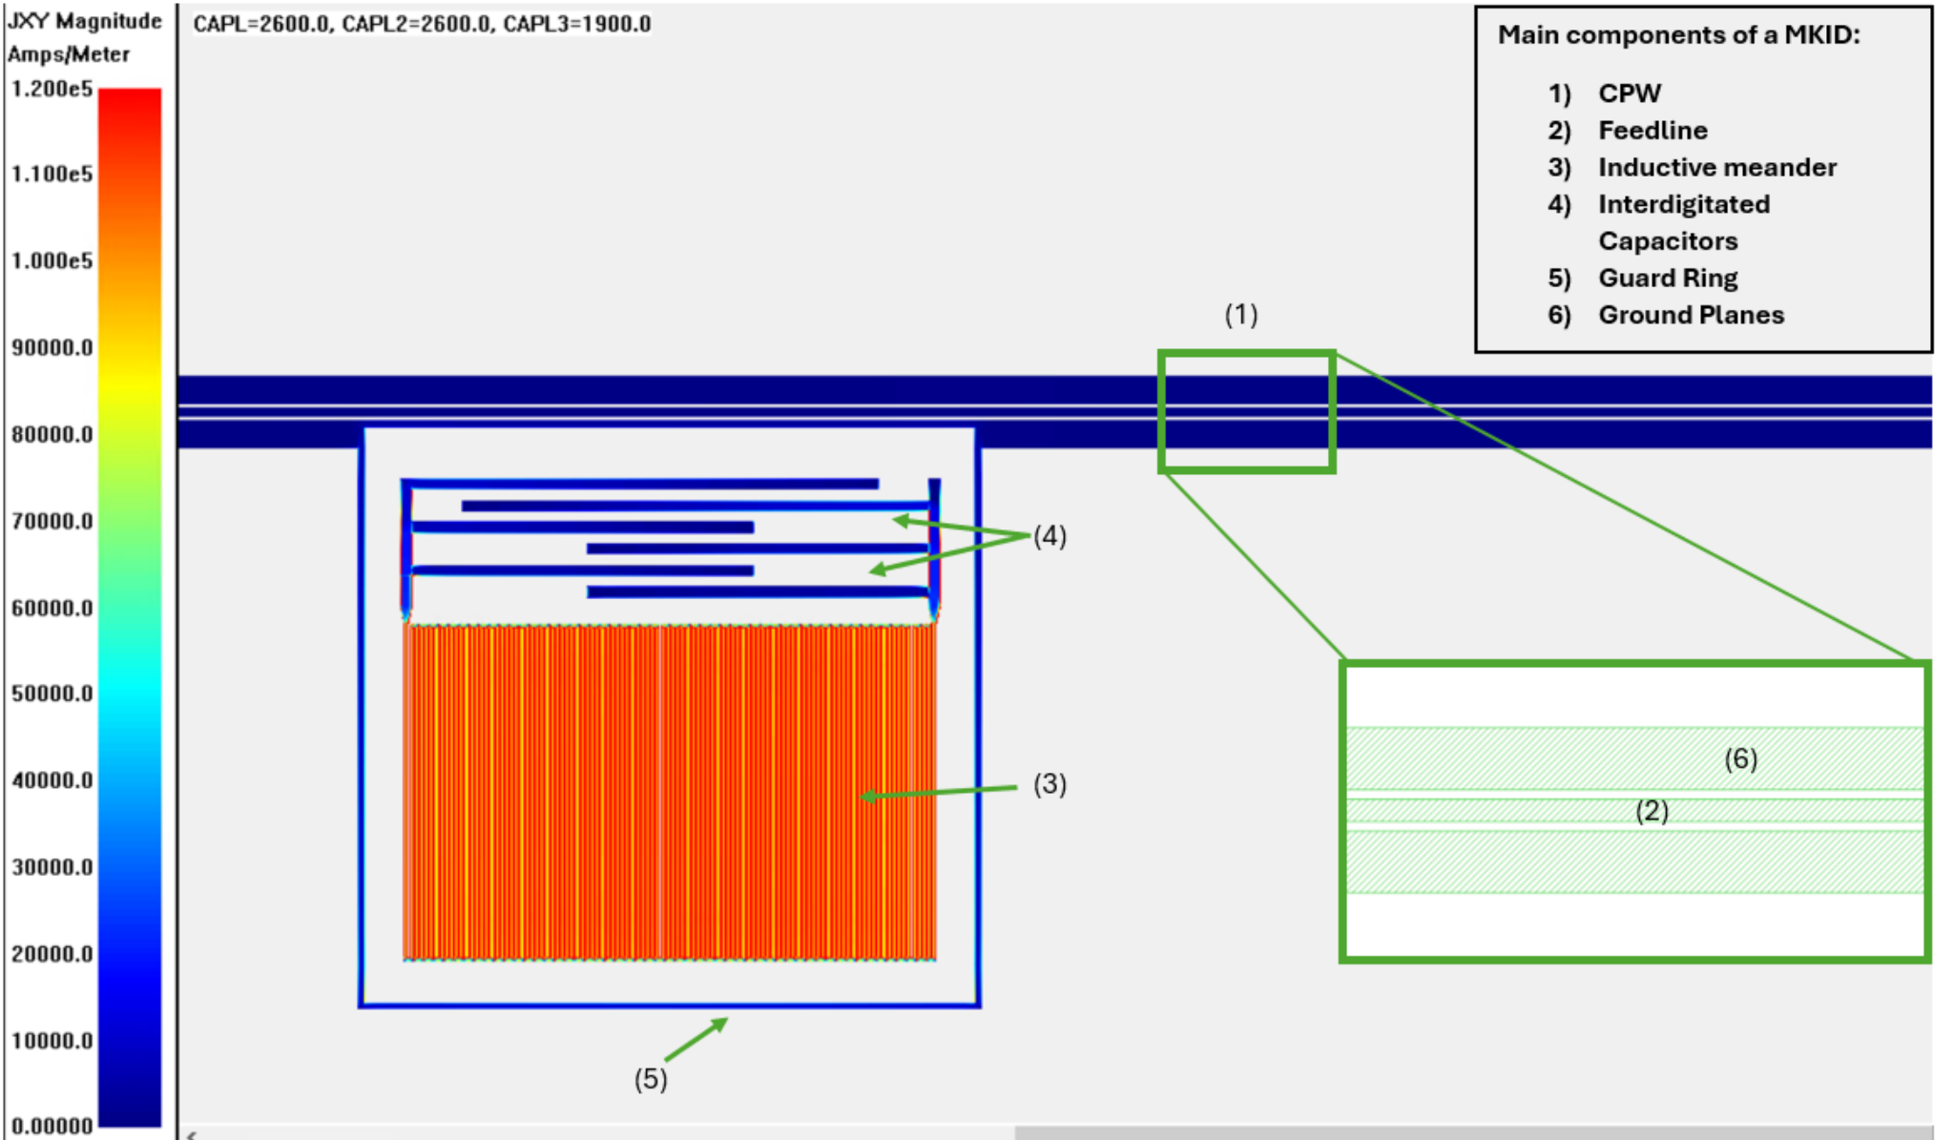
MKID Components
CoPlanar Waveguide (CPW)
Interdigitated Capacitors
Ground Plane
Inductive Meander
Feedline
Guard Ring

Slide 5
Single Pixel Design Edits

Slide 6
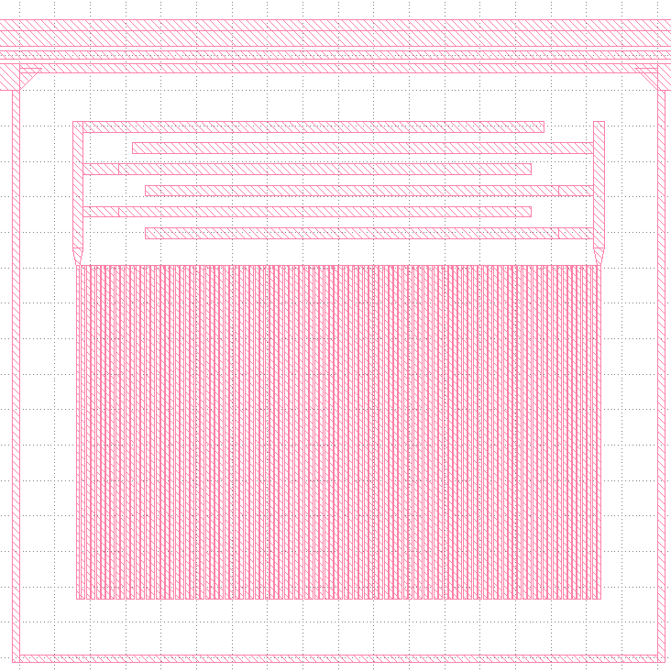
New Design
Current Design
1) Larger Feedline ($44 →52 μm)$: lower risk of interruptions
3) Thinner guard ring ($36 → 20 μm):$reduction of passive metal
2) No narrowing of the CPW: avoid impedance mismatch
More sensitive area ( $4 →4,8 mm^{2})$: improve phonon collection

Slide 7
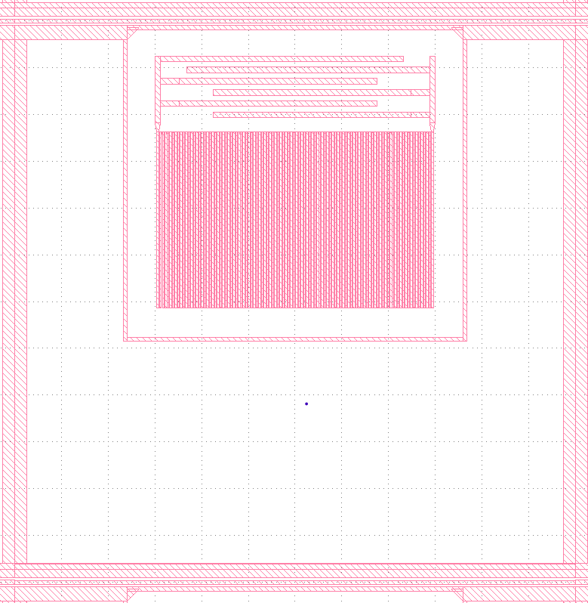
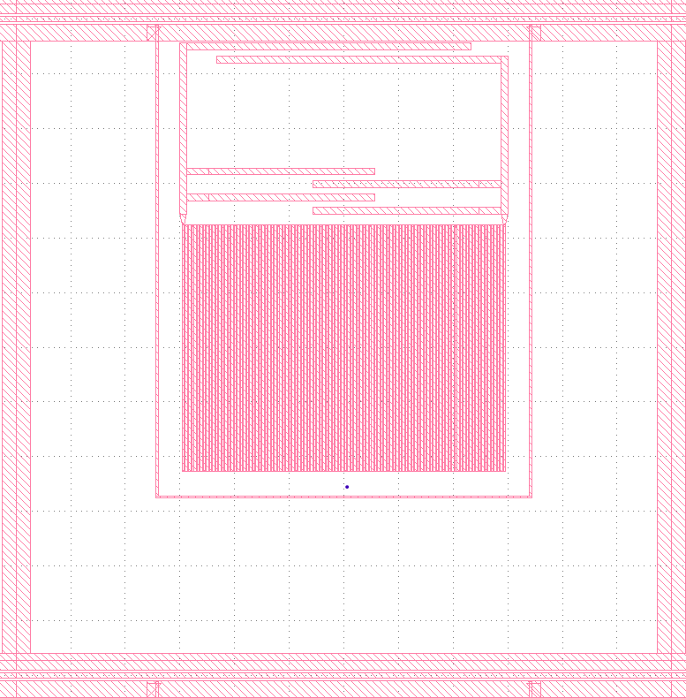
Current Design
New Design
5) Centering in the voxel: remove position effects

Slide 8
Matrix-level Edits

Slide 9
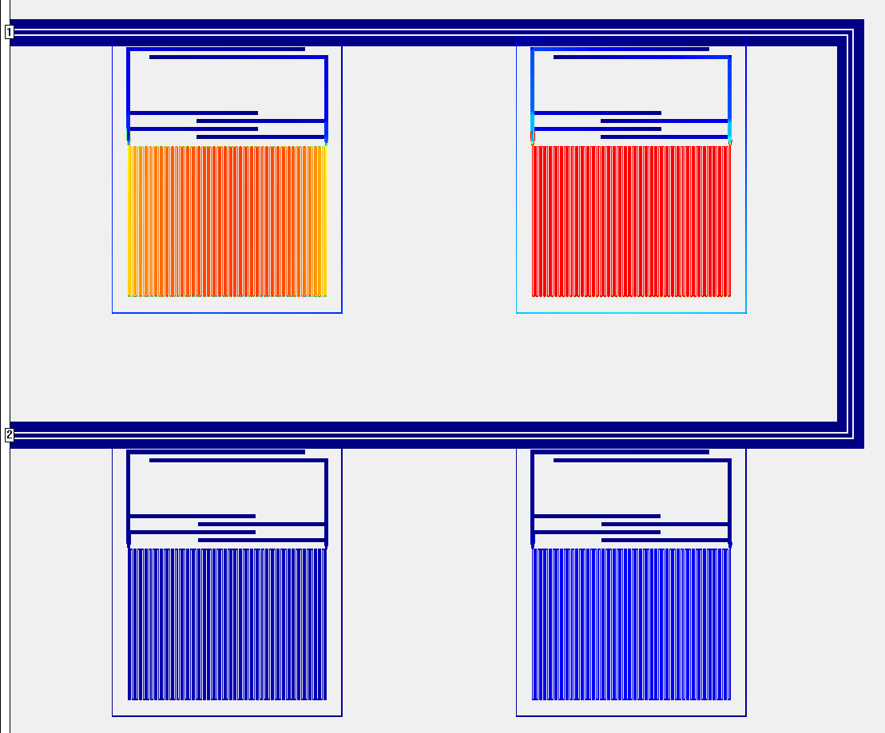
EM Cross-Talk
Definition
Crosstalk refers to the unintended electromagnetic interaction between nearby KIDs, where the excitation of one resonator affects the response of another.
Causes
Physical and frequency proximity among resonators
Consequences
Signal interference in the readout
KID 1
KID 2
KID 4
KID 3

Slide 10
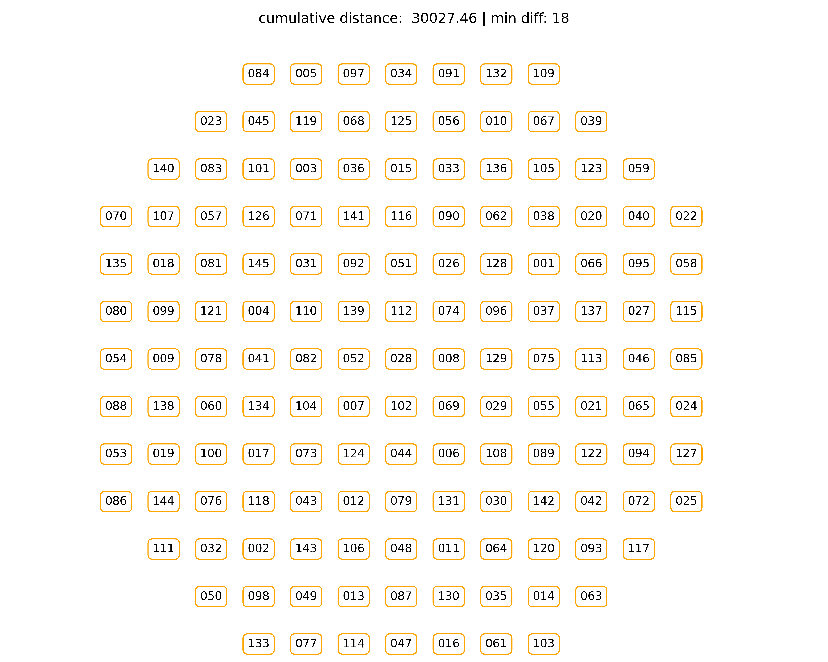
Pixel Randomization Algorithm
Trying to mitigate this phenomenon an algorithm has been developed
Goal:
Maximize the pysical distance between frequency adjacent pixels within the array
With a base frequency step of 1,5 MHz between consecutive resonances, this configuration ensures a minimum spacing of 27 MHz between adjacent KIDs
10

Slide 11
Experimental Results on Fabricated Devices

Slide 12
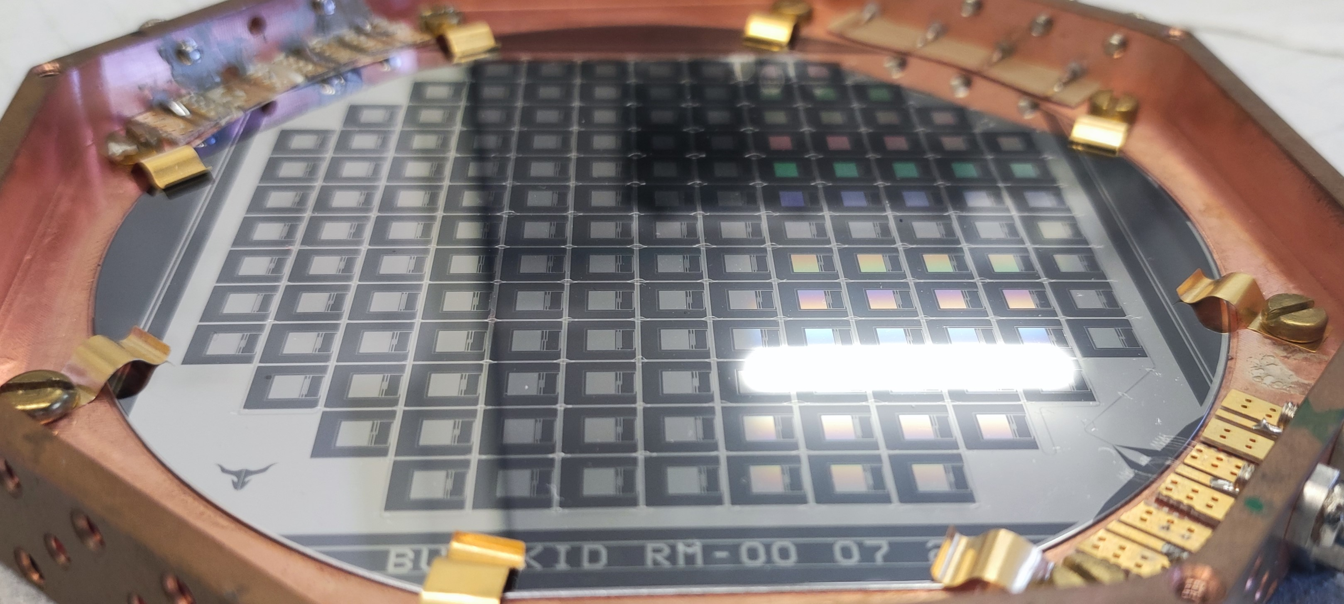
BULLKID RM-00 07 24
Features:
All detectors implement the new design
Pixel distribution follows the randomization scheme
Goals:
To evaluate Quality Factors distributions
To perform temperature and power scans
12

Slide 13
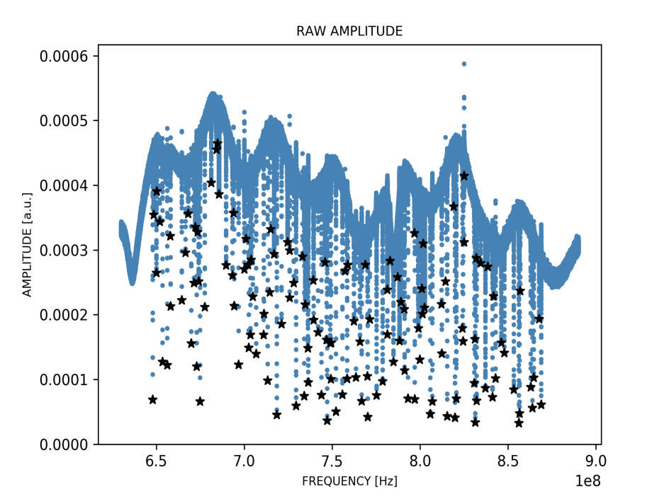
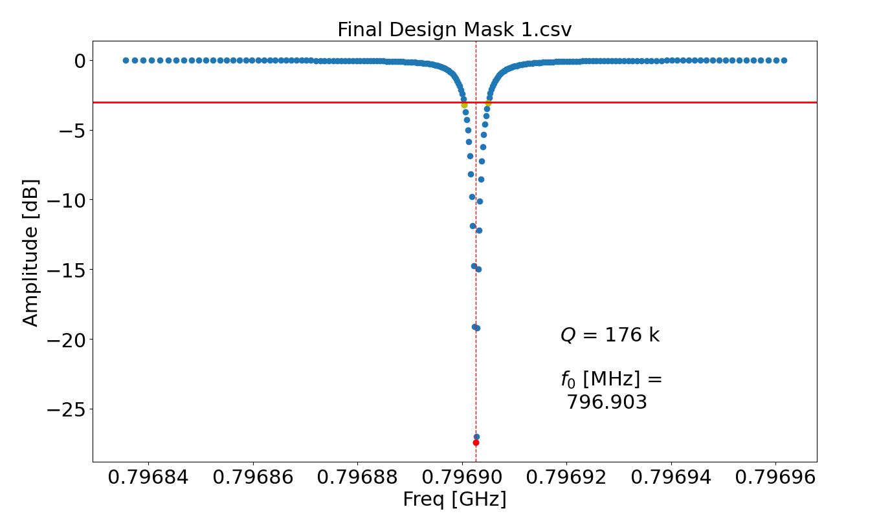
Simulation
$$Q_{c}=176k$$
$$f_{0}=796.9 MHz$$
Internal losses
Coupling losses
 | $$Q$$ | $$Q_{i}$$ | $$Q_{c}$$
Median | 7.2e+05 | 2.5e+06 | 1.3e+06
133 out of 145 resonances detected
Issue: Quality Factors higher than expected
Notes:
Aggiungere nota sul Qc

Slide 14
Simulation granularity not precise enough to properly simulate a distance of just $12 μm$
$$12 μm$$
New Goal
Data collected from 11 pixels:
All at their Optimum Power (to minimize noise from amplifiers)
$Q$ranging from 300k to 1M
Evaluate the signal-to-noise ratio (SNR) across KIDs with different quality factors

Slide 15
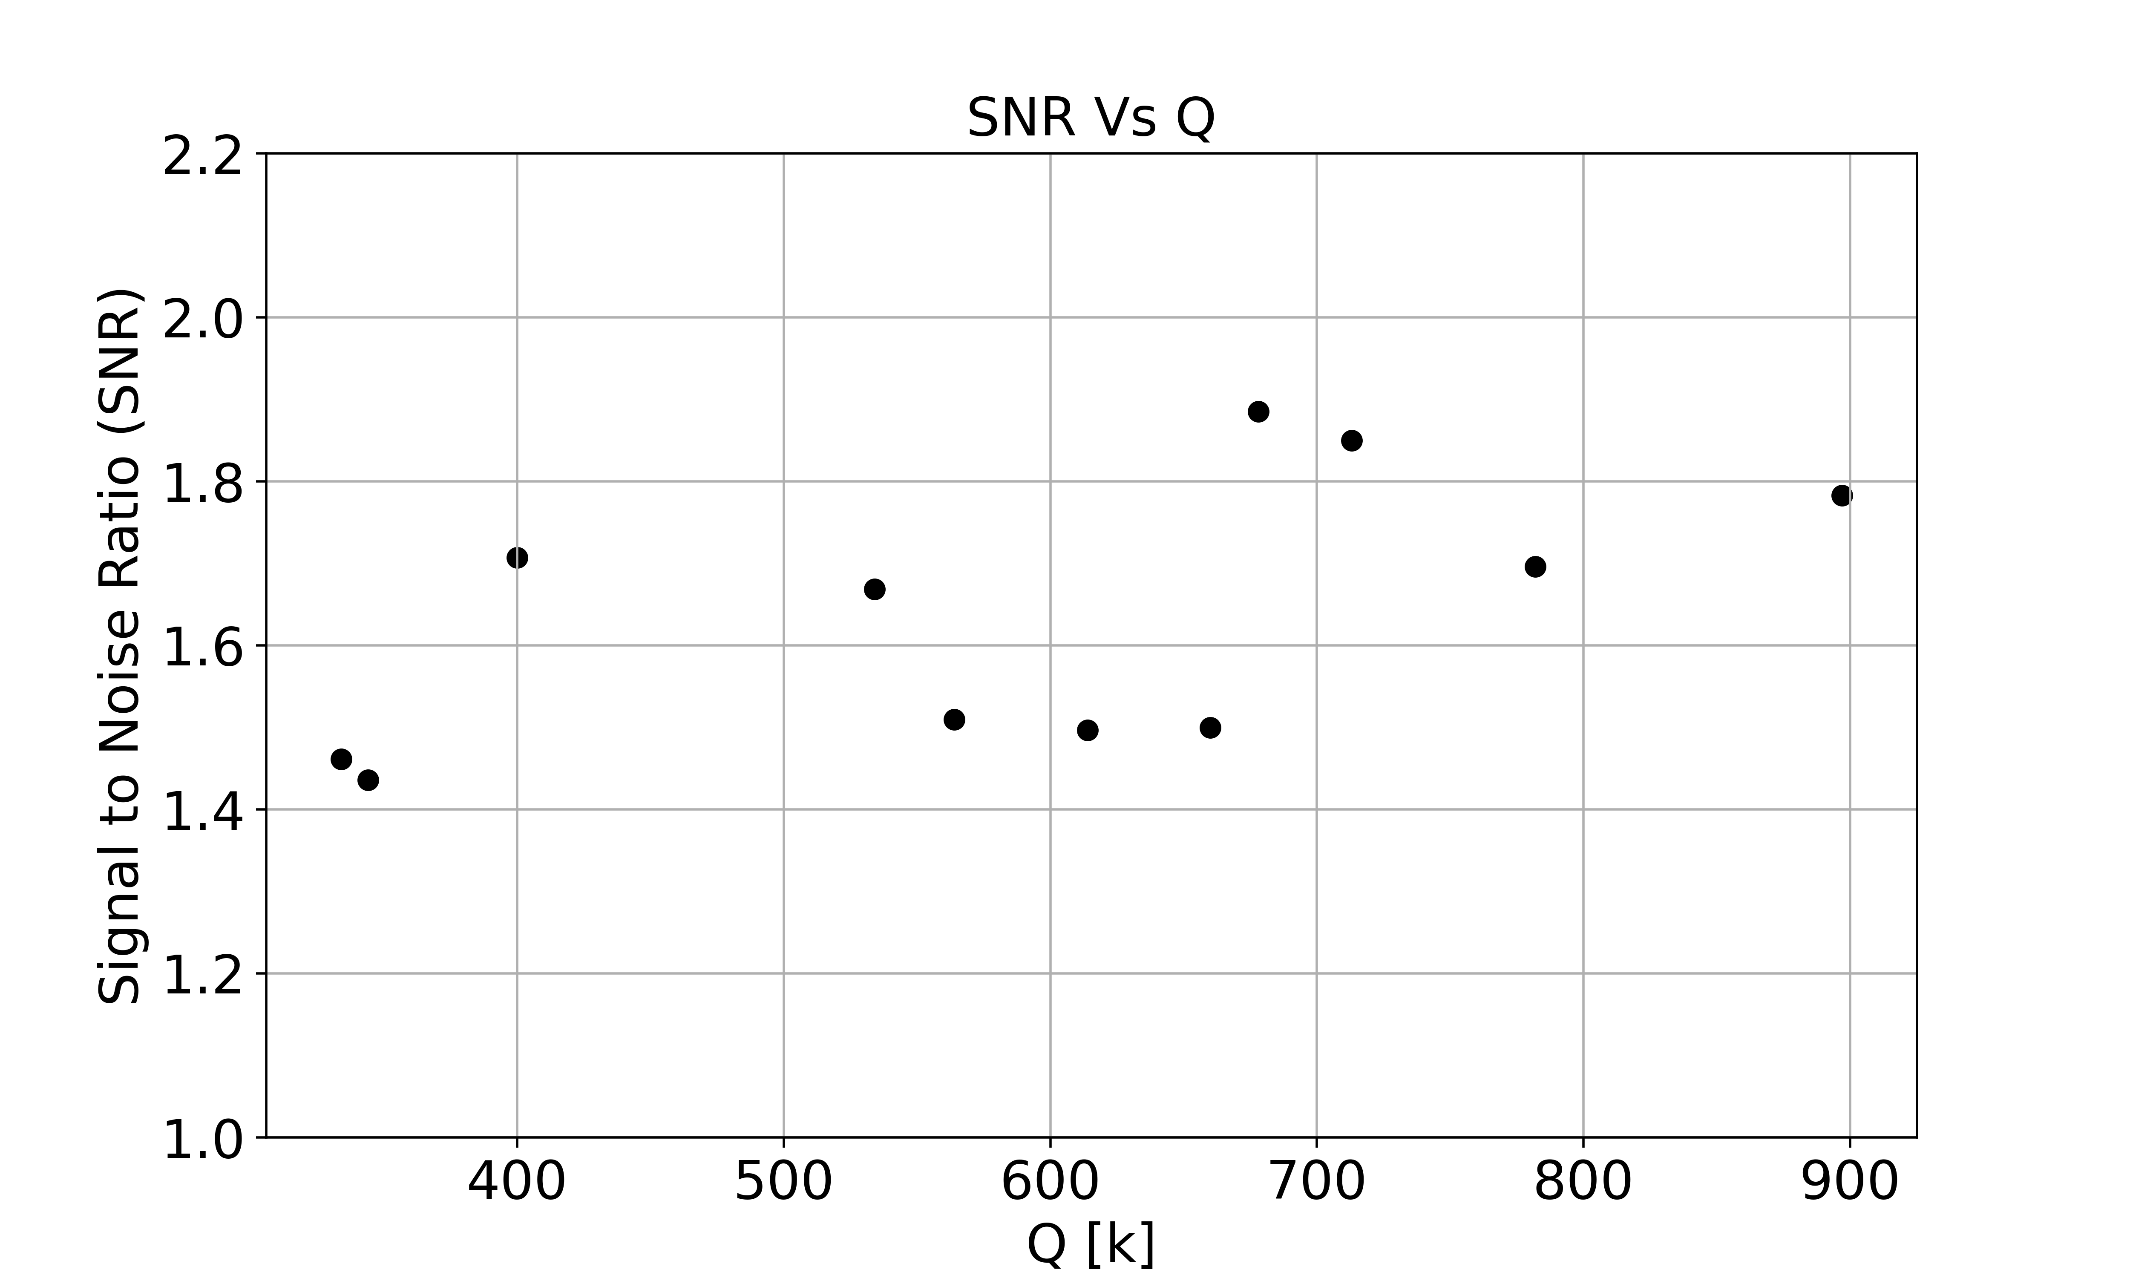
SNR Vs Q
SNR remains constant : no significant improvements but also no noticeable degradation
Quality Factor’s target can be slightly shifted above the current 150k benchmark value
Higher Q $→$ Less Drive Power

Slide 16
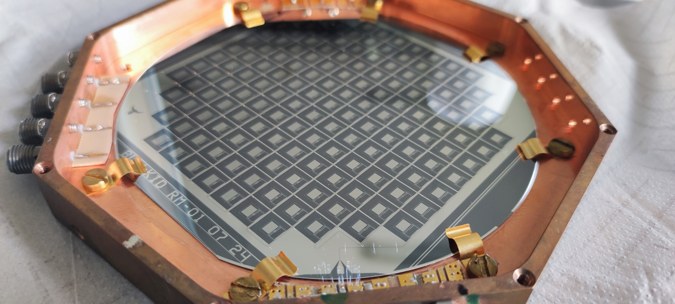
BULLKID RM-01 07 24
Features:
Three variants of the new design implemented within the same array
Goals:
Temperature scan to evaluate $α=\frac{L_{k}}{L_{k}+L_{g}}$ across the 3 variants
Temperature scan to evaluate 𝛼=𝐿_𝑘/(𝐿_𝑘+𝐿_𝑔 ) across the 3 variants
Analyze noise features across the 3 variants

Slide 17
Differences on the 3 variants
20/12
20/8
20/4
$$12 μm$$
8$μm$
4$μm$
$$20 μm$$
$$20 μm$$
$$20 μm$$

Slide 18
Expectations
20/12
20/8
20/4
$$α=\frac{L_{k}}{L_{k}+L_{g}}$$
$α:$ more compact meanders reduce $L_{g}$ -> increase of $α$
Noise: ?

Slide 19
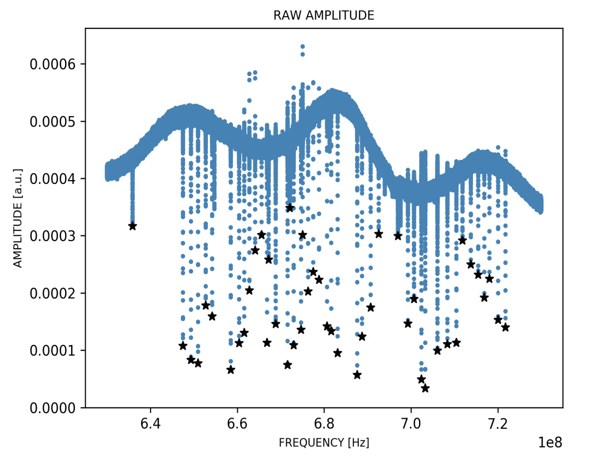
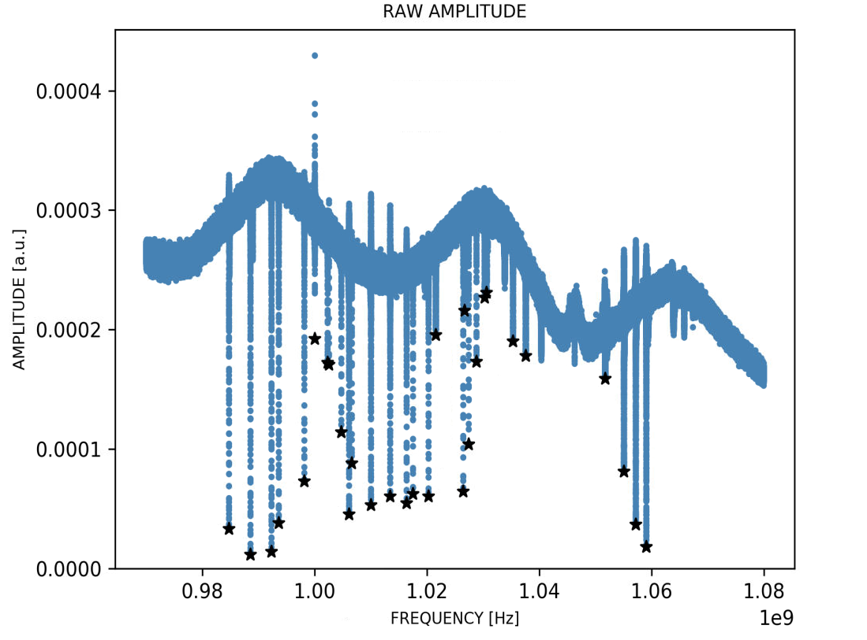
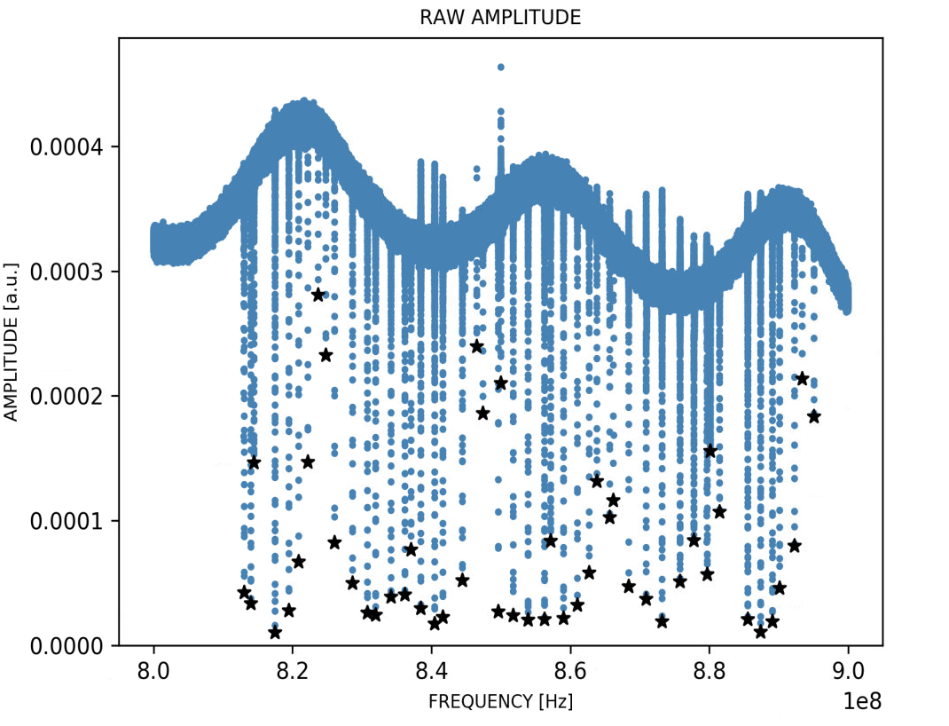
20/12
45 out of 50
20/4
29 out of 45
20/8
49 out of 50

Slide 20
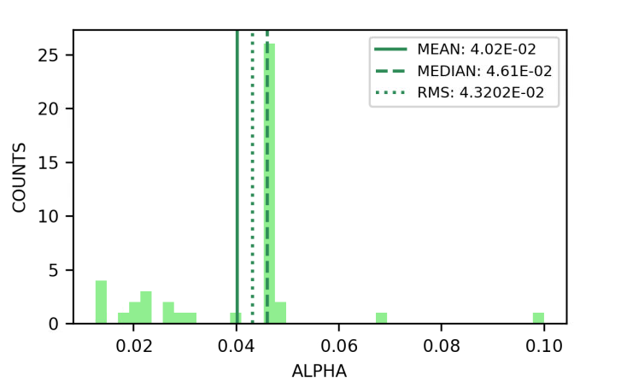
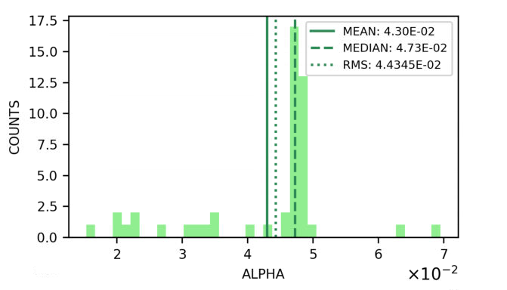
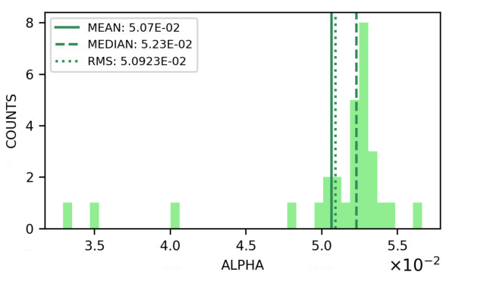
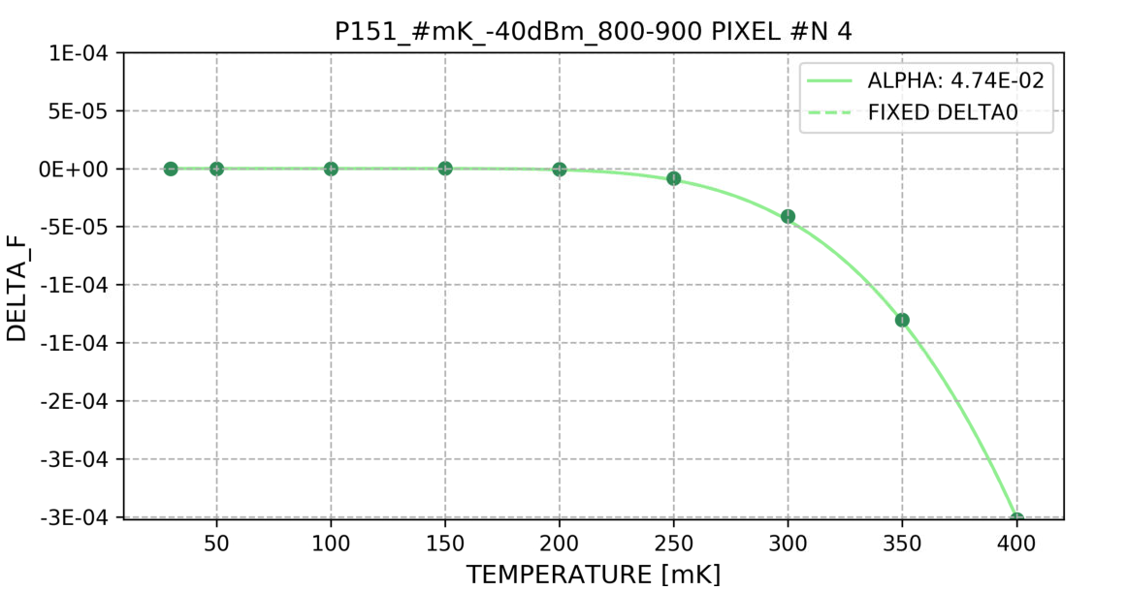
$α$ Evaluation
20/12
20/8
20/4
Increment T step by step, perform VNA acquisition and calculate $\frac{Δf}{f}$
Fit the scatter plot with the equation shown in the plot to extract $α$
$$α$$ | 20/12 | 20/8 | 20/4
Median | 0,0461 | 0,0473 | 0,0523
$$\frac{Δf}{f}=−\frac{α}{2} S_{2}\left(ω,T\right)\frac{δn_{qp}}{2N_{0}Δ\left(T\right)}$$
(Mattis-Bardeen)

Slide 21
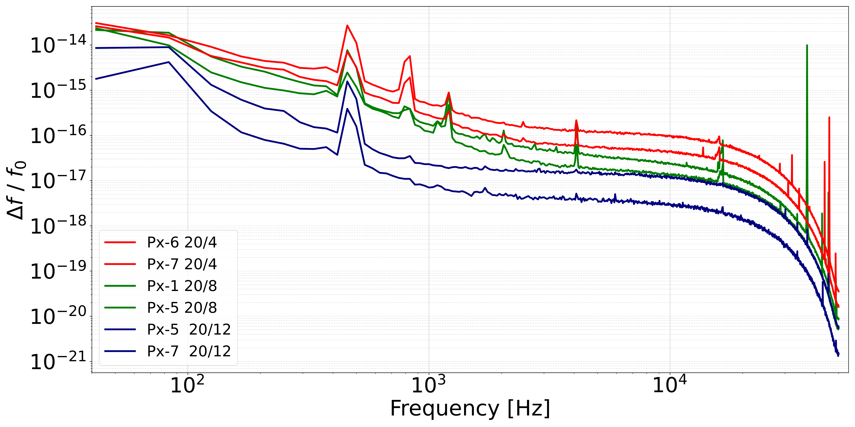
Noise Features Analysis
The Noise Power Spectrum (NPS) was analyzed across pixels from the 3 subsets at their Optimum Power
NPS in terms of frequency shift variable:
Remove Q dependency
The more compact is the meander, the higher is the noise level exhibited
Main source: TLS
$$\frac{Δf}{ΔE} α f_{0}$$
Notes:
The advantage of using the frequency shift is that it uniforms the responsivity of the KIDs, meaning that comparing the NPSDs is the same as comparing the noise to signal ratio.
Cambia legenda levando da run a pow e cambia la k con px e metti in grassett 4/8/12 (ovunque).

Slide 22
Next KID’s generation
Current configuration
$$α$$ | 20/12 | 20/8 | 20/4
Median | 0,0461 | 0,0473 | 0,0523
Wider meanders in future KIDs could reduce noise
20/12 configuration seems to be promising with respect to the current 20/8 (minimal impact on $α$ reduction; less noise)
Further works could validate these results and exploring new design optimization
Notes:
Segna configurazione attuale

Slide 23
Thanks for your attention
Giovanni Luca Pesce, MSc
Università di Roma la Sapienza
INFN-Roma1

Slide 24
Backup

Slide 25
Quality Factors
$$Q=\frac{1}{R_{s}}\sqrt{\frac{L}{C} }=2πf_{0}×\frac{energy stored}{power loss}$$
$Q_{i}$: Combination between losses due to quasi-particles $(Q_{i,qp})$ and other internal mechanism losses $(Q_{i,max})$ ( metal film quality, substrate losses, radiation ecc. )
$Q_{i}={\left(\frac{1}{Q_{i,qp}}+\frac{1}{Q_{i,max}}\right)}^{−1}$
$Q_{c}$: energy loss due to coupling mechanisms. It measures the efficiency of energy transfer to or from the resonator
Higher values indicating a weaker coupling and lower energy loss through external connections
$$Q={\left(\frac{1}{Q_{i}}+\frac{1}{Q_{c}}\right)}^{−1}$$

Slide 26
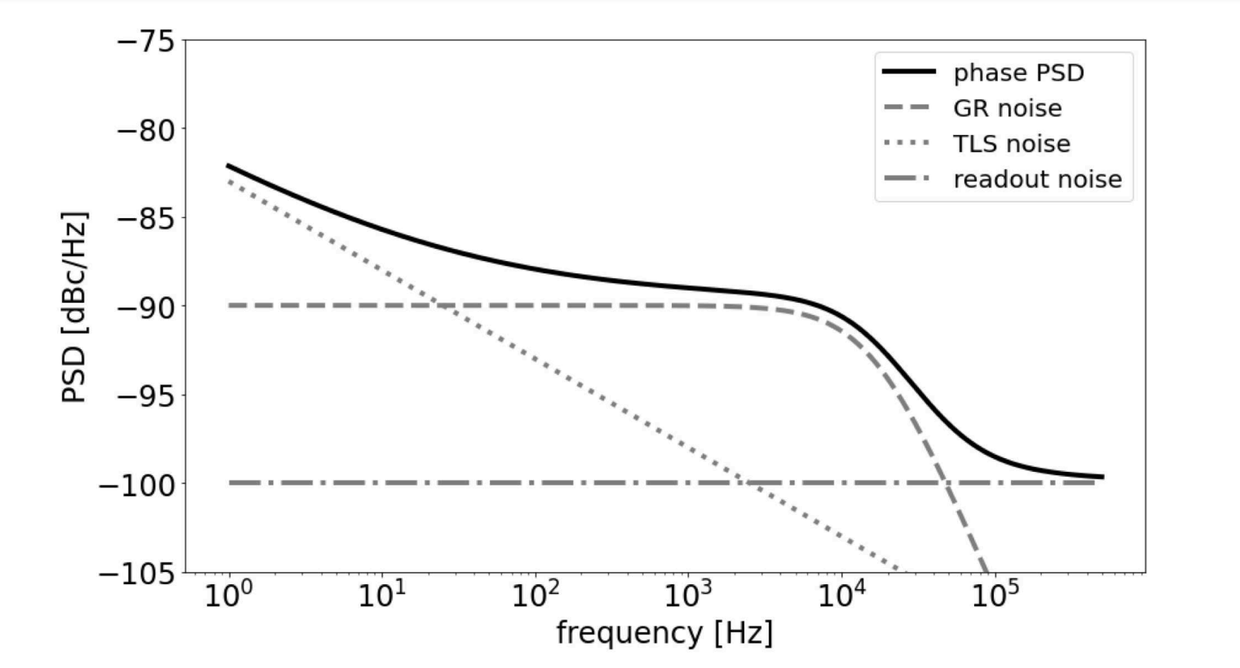
Noise Sources in MKIDs
3 main noise sources:
Generation-Recombination Noise
Two Level System Noise
Readout Noise

Slide 27
TLS Noise
Electrical fluctuations between the ground and an excited state at the surface of the substrate.
These fluctuations cause instabilities in the dielectric constant of the substrate material

Slide 28
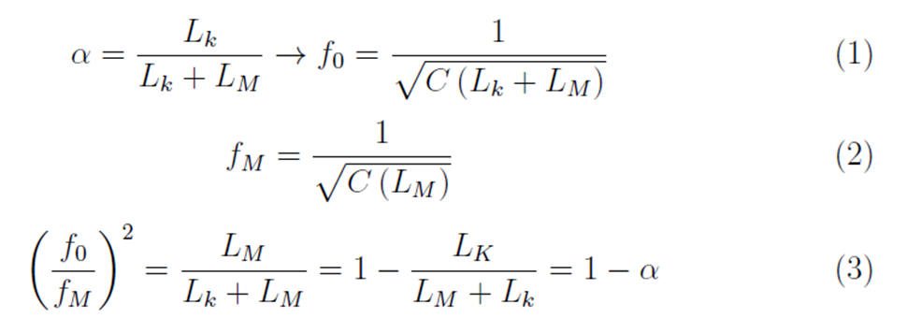
Alpha
In the simulation context is possible to estimate $α$ extracting the resonant frequency in the condition of $L_{k}=0$
$$d ↓ → L_{e} ↓ → α ↑$$

Slide 29
Phase Response Vs Frequency Response
$$\frac{dφ}{dE}=\frac{η α S_{2}\left(ω, T\right) Q}{N_{0} V Δ_{0}^{2}}$$
A direct measurable quantity from deposited energy
Non-linear behavior with respect to energy
Q dependent
$η:$ energy conversion efficiency
$α$: Kinetic/Total inductance
$S_{2}$: Complex response (releated to ${ σ}_{2}$)
$Q$: Quality factor
$N_{0}$: Density of states at Fermi level
$V$: Inductor volume
$Δ_{0}$: Superconductive gap
$$\frac{df}{dE}=\frac{η α S_{2}\left(ω, T\right) f_{0}}{4 N_{0} V Δ_{0}^{2}}$$
Reconstructed indirectly from variations in the magnitude and phase of the resonator’s complex response
Q independent

Slide 30
SNR Evaluation
Data collected from 11 pixels at their Optimum Power with a $Q_{F}$ ranging from 300k to 1M, covering the main dispersion band
From the fit of each resonance onto IQ plane it’s possible to estimate the proportianal constant between $Δf$ and $Δφ$ (WP)
WP represents the point of maximum responsivity of the KID
$$ΔE →Δf α Δφ$$
$$\frac{dφ}{dE}= \frac{df}{dE} \frac{dφ}{df}$$
Dependent on detector’s parameters
Constant term

Slide 31
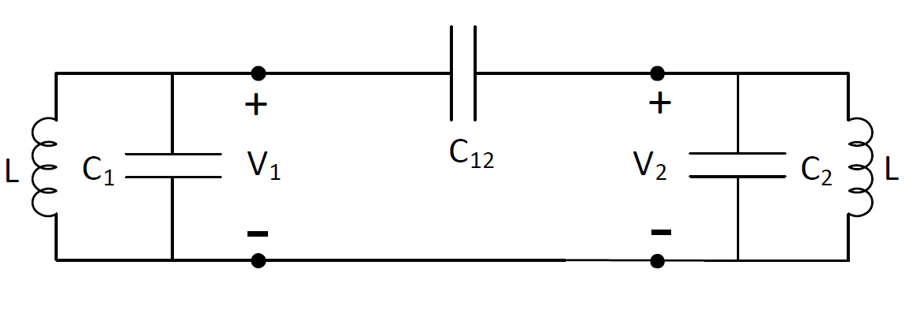
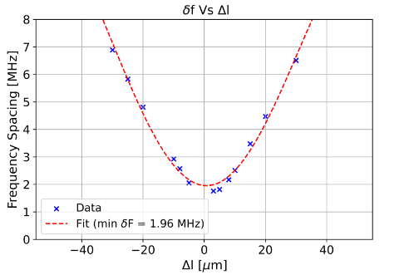
Cross-Talk Simulation Analysis
A repetead simulation analysis has been performed with 2 KIDs spaced 6 mm apart (BULLKID config.)
At each simulation step the capacitance of one KID was varied by varying the lenght of one of the finger capacitors; instead the other one was left always unchanged

Slide 32
SNR of BULLKID RM-01 07 24
Average Pulse Fitted:
$$\left[Ae^{−\frac{t−t_{0}}{τ_{d}}} −Be^{−\frac{t−t_{0}}{τ_{r}}}+Ce^{−\frac{t−t_{0}}{τ_{r}}}\right]∗F$$
Worst cases:

Slide 33
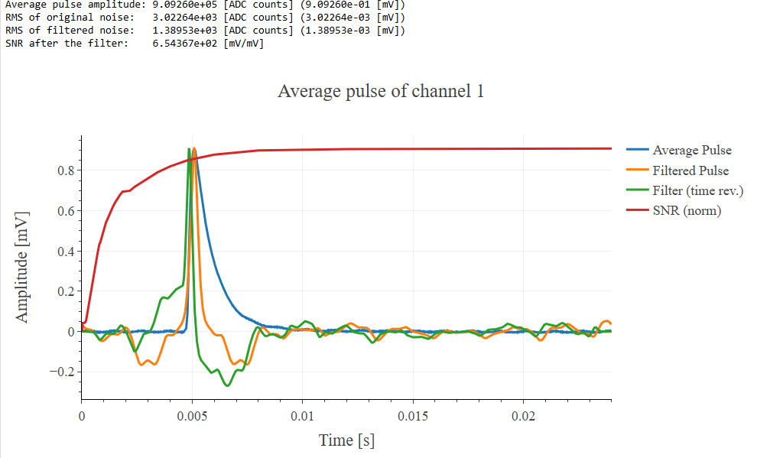
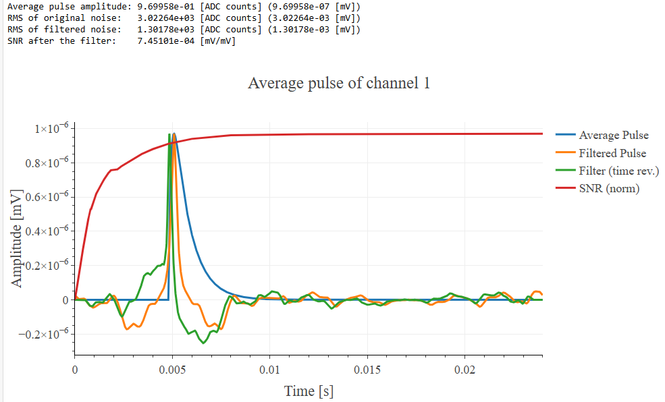
Original Average Pulse
Fitted Average Pulse
RMS of original noise: 3.02 mrad
RMS of filtered noise: 1,38 mrad
RMS of original noise: 3.02 mrad
RMS of filtered noise: 1,30 mrad
6 %

Slide 34
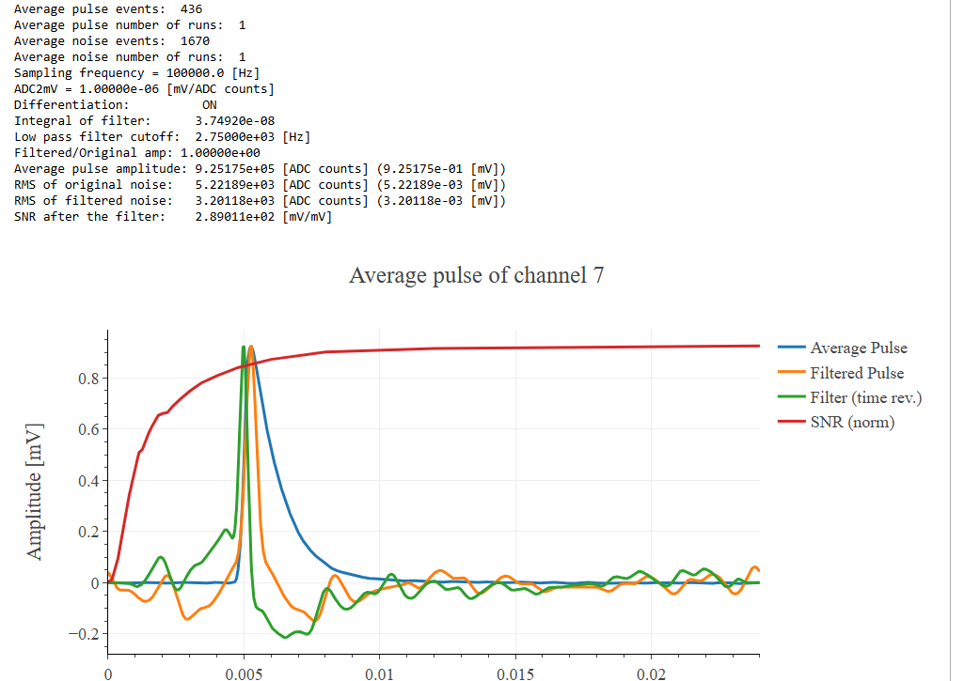
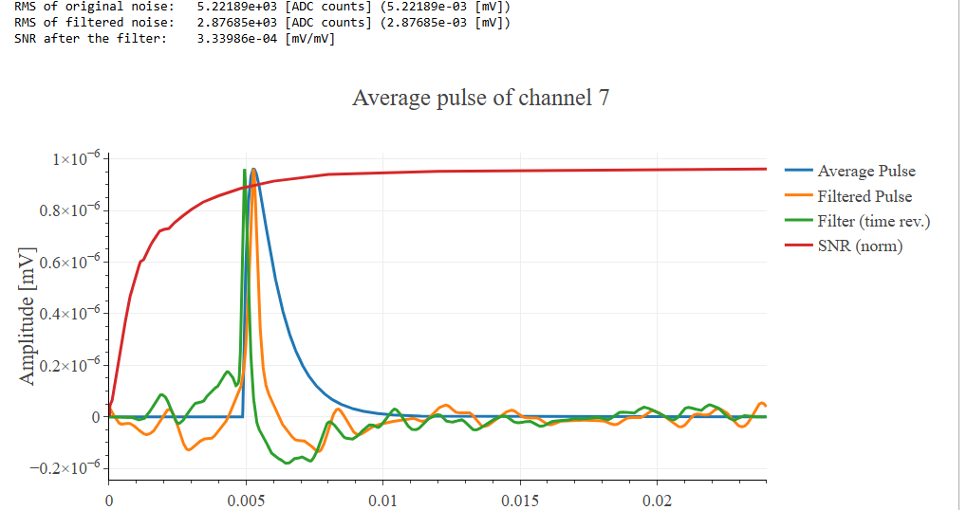
Original Average Pulse
Fitted Average Pulse
RMS of original noise: 5.22 mrad
RMS of filtered noise: 3,20 mrad
RMS of original noise: 5.22 mrad
RMS of filtered noise: 2.87 mrad
11 %

Slide 35
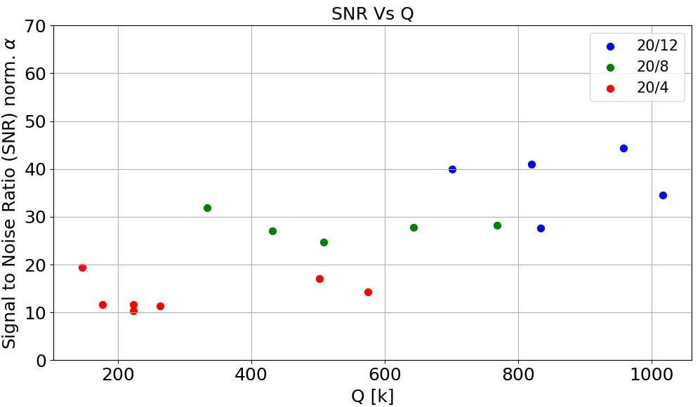
SNR of BULLKID RM-01 07 24
Data normalized wrt $α$ of each variant of KIDs

Slide 36
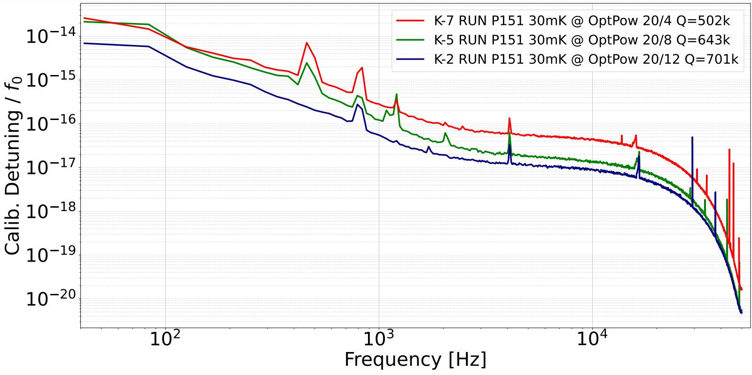
NPS similar Q

