Slide 1
Pisa testing facilities: Cryolab and RF electronics
Mario De Lucia
Università di Pisa | INFN – Sezione di Pisa
mario.delucia@unipi.it

Slide 2
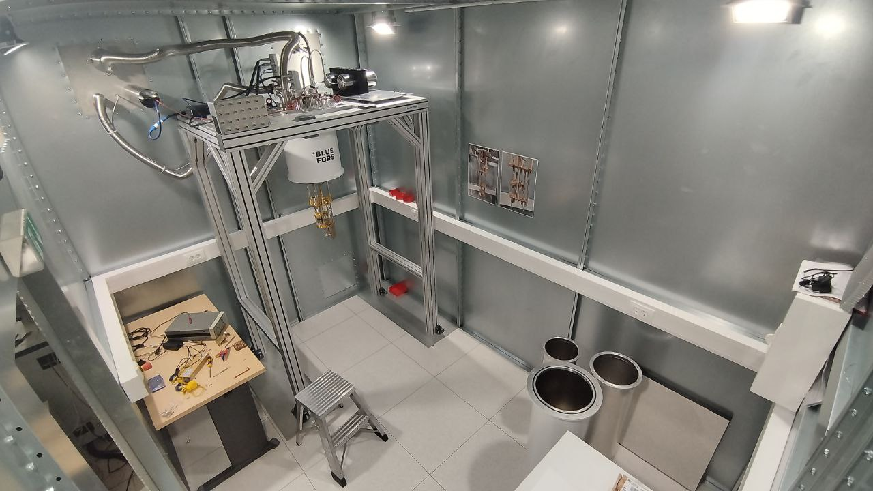
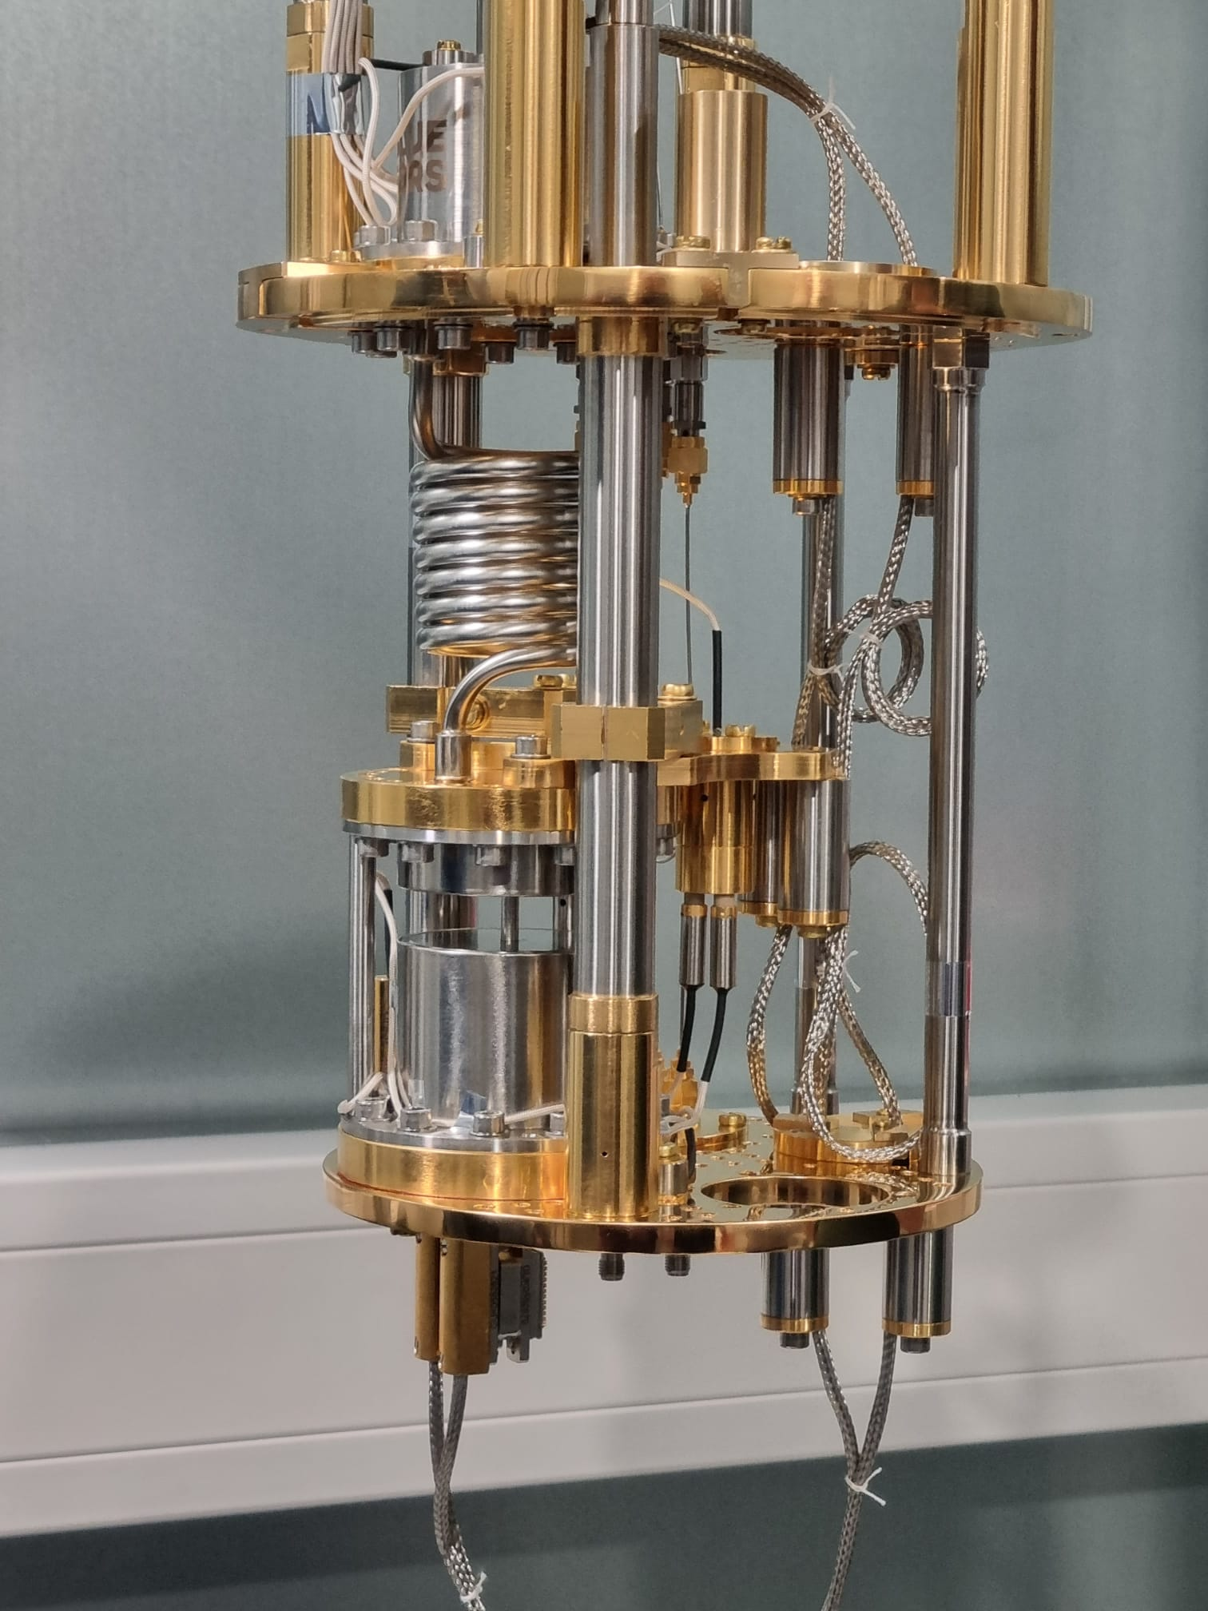
L
PISA ab: facilities
EMC Chamber BLUEFORS SD: T_{B} = 20 mK Used for: LiteBIRD readout chain module
TES MKIDs
Mario De Lucia
BULLKID DM – Jan 2025 Meeting – Pisa, Italy

Slide 3
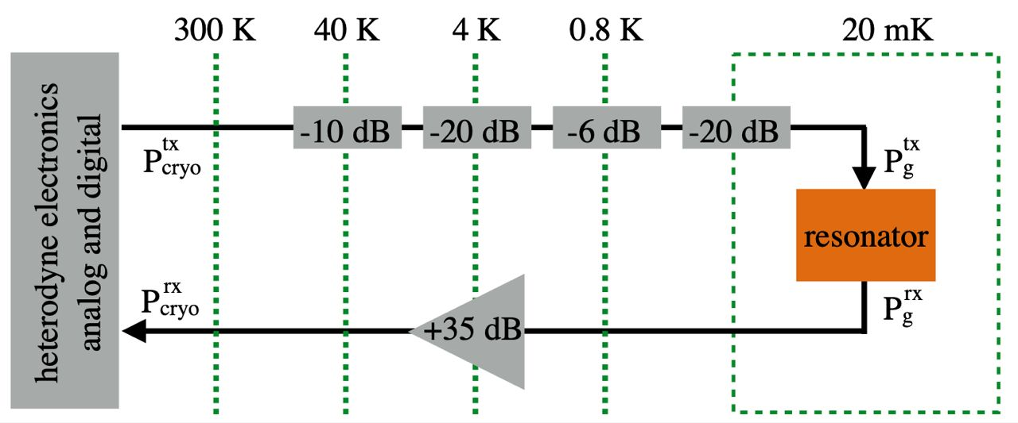
L
PISA ab: facilities
BLUEFORS SD:
Mario De Lucia
BULLKID DM – Jan 2025 Meeting – Pisa, Italy

Slide 4
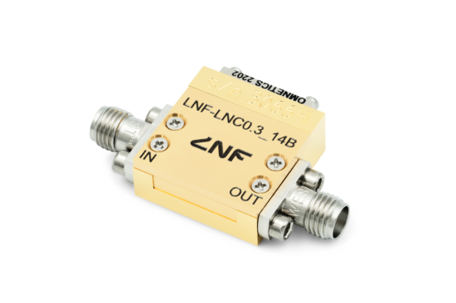
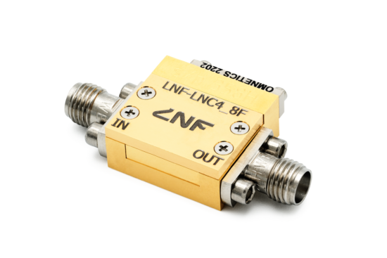
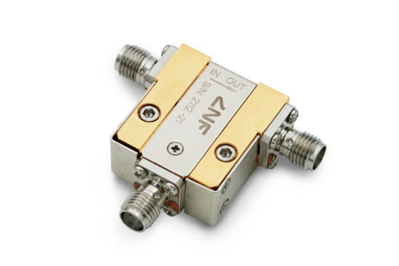
L
PISA ab: facilities
BLUEFORS SD:
LNF-LNC0.3_14B
LNF-LNC4_8F
2x 4-8 GHz Single Junction Isolator/Circulator
Mario De Lucia
BULLKID DM – Jan 2025 Meeting – Pisa, Italy

Slide 5
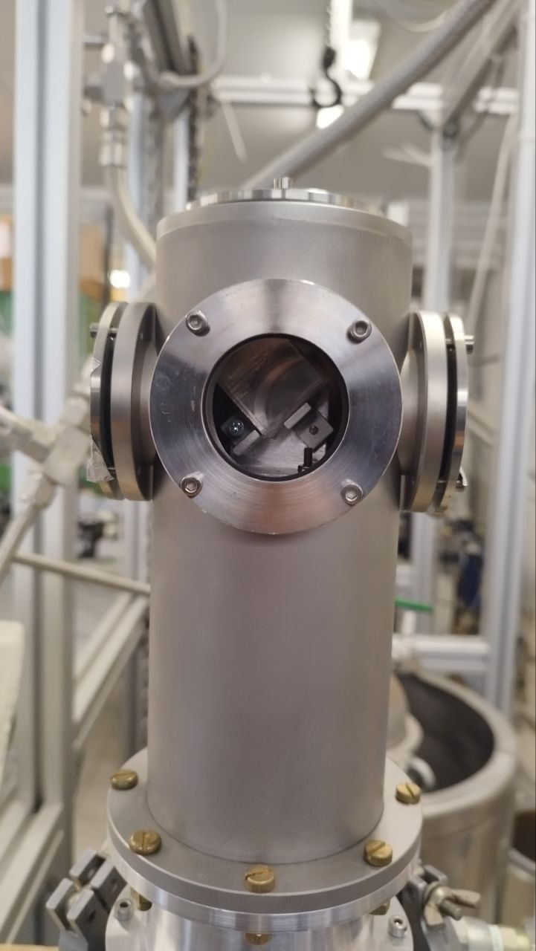
L
PISA ab: facilities
Oxford ProteoxMx expected by June ’25 T_{B} < 10 mK
T. Lari, ‘Crystal Updates’,
h. 15.00
Gilford-McMahon: T_{B} = 22 K
‘Coldfinger’ Used for: Optical characterisations
Mario De Lucia
BULLKID DM – Jan 2025 Meeting – Pisa, Italy

Slide 6
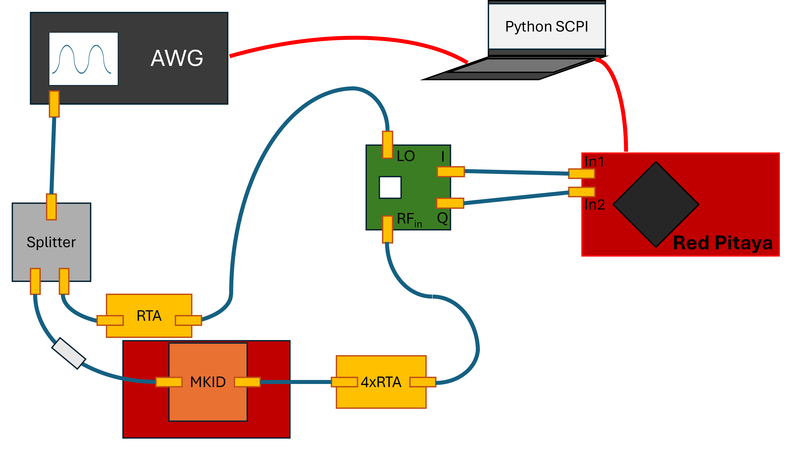
MKIDs Readout
Mario De Lucia
BULLKID DM – Jan 2025 Meeting – Pisa, Italy

Slide 7
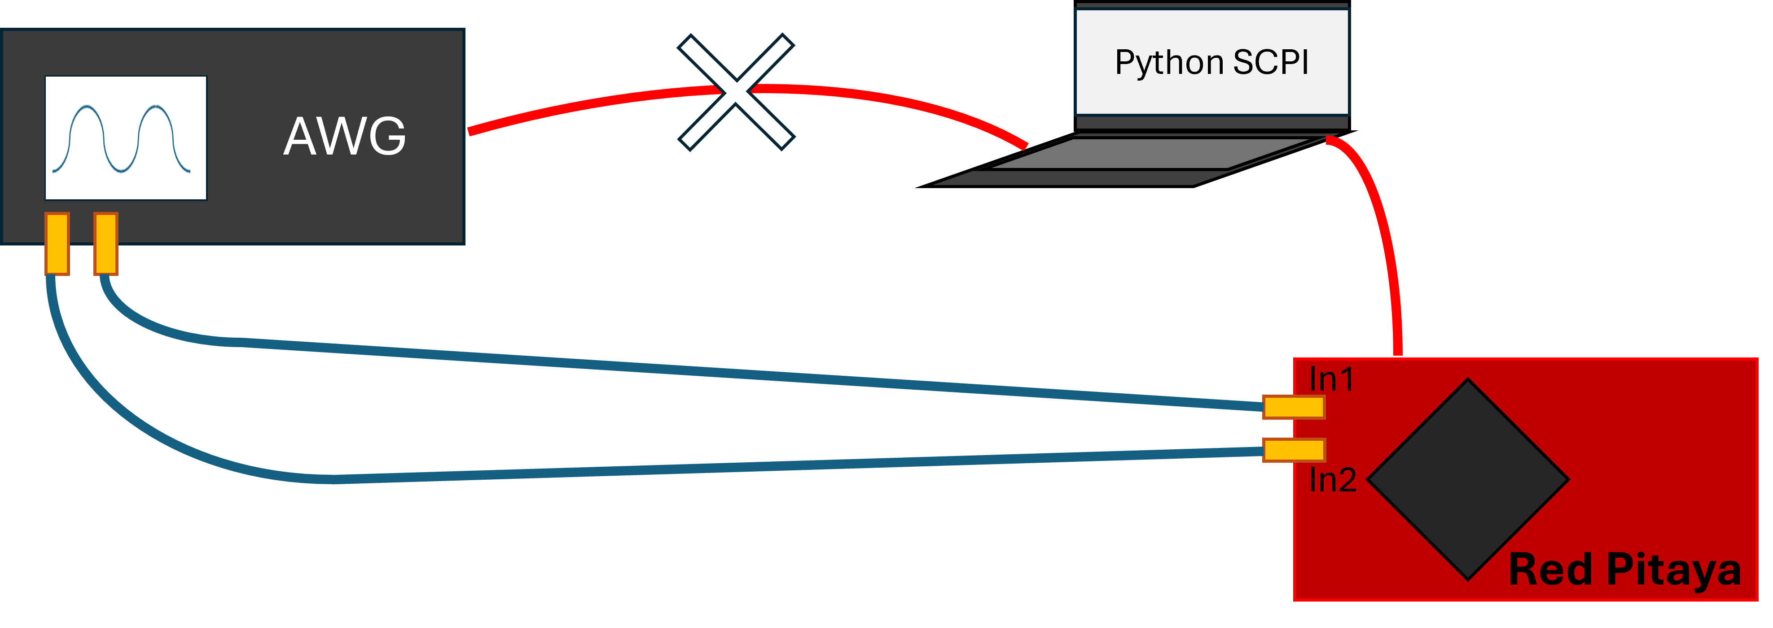
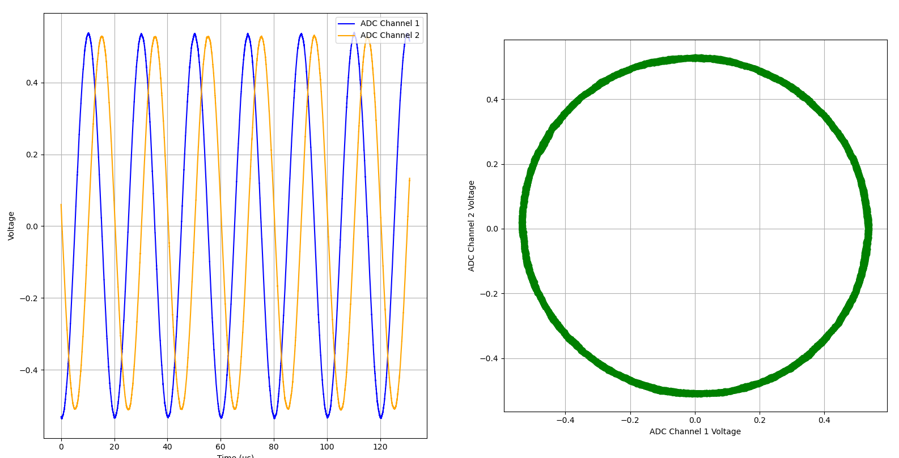
MKIDs Readout
$$f=50kHz$$
Q
Loopback test: OK
Mario De Lucia
BULLKID DM – Jan 2025 Meeting – Pisa, Italy

Slide 8
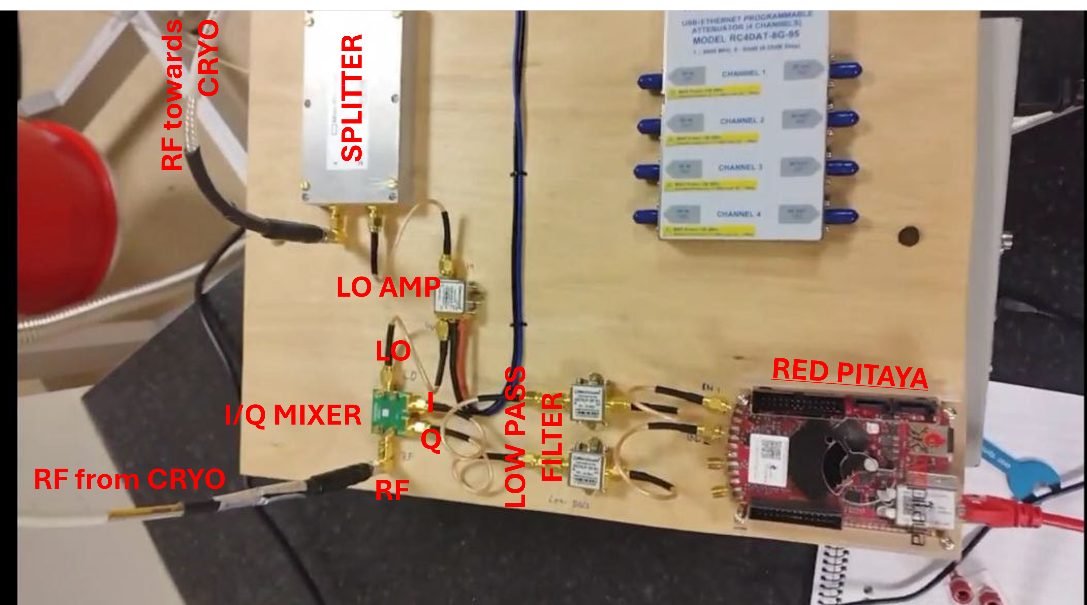
MKIDs Readout
Mario De Lucia
BULLKID DM – Jan 2025 Meeting – Pisa, Italy

Slide 9
MKIDs Readout
IQ mixer optimisation test:
LO Power (dBm) | RF Power (dBm) | Vout (mV) *
17 | 14 | 600
17 | 3 | 10
3 | 3 | 10
3 | 14 | 90
LO
RF_{in}
I
Q
Bandwidth: namely 2.5 GHz – 8,5 GHz Typical LO power: 18 dBm
$${∗ V}_{out}=\sqrt{I^{2}[mV]+Q^{2}[mV]}$$
Mario De Lucia
BULLKID DM – Jan 2025 Meeting – Pisa, Italy

Slide 10
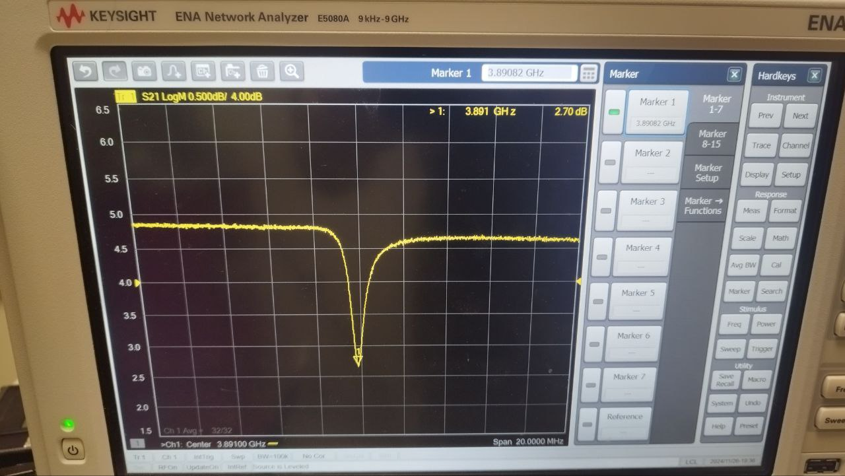
MKIDs Readout
3890,82 MHz
Really bad resonator: only 2 dB deep
Quality factor below 1000
High losses, high driving power, small responsivity
OK for prototyping the readout!
Mario De Lucia
BULLKID DM – Jan 2025 Meeting – Pisa, Italy

Slide 11
MKIDs Readout
1st Amplifier was very noisy
Multiple iterations on same span
Barely visible in Re{S21} and Im{S21}
LOOP ok
20 MHz band – cable delay loop
Freq: 3891 MHz
Number of buffers to read: 28
Mario De Lucia
BULLKID DM – Jan 2025 Meeting – Pisa, Italy

Slide 12
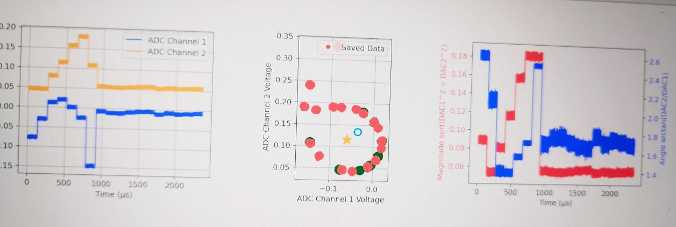
MKIDs Readout
Resonator Loop – Saved Data for future reference
4 MHz band – resonator loop
Freq: 3891 MHz
Resonator Loop – Last scan
Resonator Centre – needed to calculate angles
Number of buffers to read: 18
Time: Real 31s | active 2.3 ms
Mario De Lucia
BULLKID DM – Jan 2025 Meeting – Pisa, Italy

Slide 13
MKIDs Readout
Resonator Loop – Saved Data for future reference
Resonator Centre – needed to calculate angles
Single Frequency point – driving the MKID
SAVE centre position to temp file $I_{centre}$ & $Q_{centre}$
SAVE loop data to temp file $$Loop Data$$
Number of buffers to read: 1
Mario De Lucia
BULLKID DM – Jan 2025 Meeting – Pisa, Italy

Slide 14
MKIDs Readout
$$θ= (\frac{Q−Q_{centre}}{I −I_{centre}})$$
$Arctan θ$
Arctan2
Returns the angle in radians
REAL TIME DATA after loop translation – no rotation
Number of buffers to read: 10
Mario De Lucia
BULLKID DM – Jan 2025 Meeting – Pisa, Italy

Slide 15
MKIDs Readout
Test triggering with a working MKID
Full characterisation of the different electronic components
Estimate max resolving power
Reduce dead time: a. improve code for speed b. RT data decimation
Post-acquistion data decimation in plotting
Open a new plot for every triggered pulse
Mario De Lucia
BULLKID DM – Jan 2025 Meeting – Pisa, Italy

Slide 16
MKIDs Readout
Purchase 3-5 more RT Amps
Find a number of RF attenuators | A programmable attenuator
Source a number of RF I interconnections MM/FF
RF source currently out of working range [0-2]GHz vs [2.5-8.5]GHz
New IQ Mixer in [0-2]?
Mario De Lucia
BULLKID DM – Jan 2025 Meeting – Pisa, Italy

