Slide 1
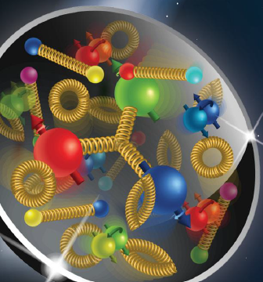


The ePIC The ePIC detector at the EIC
Alessandro Pilloni
WIFAI, November 12th, 2025

Slide 2
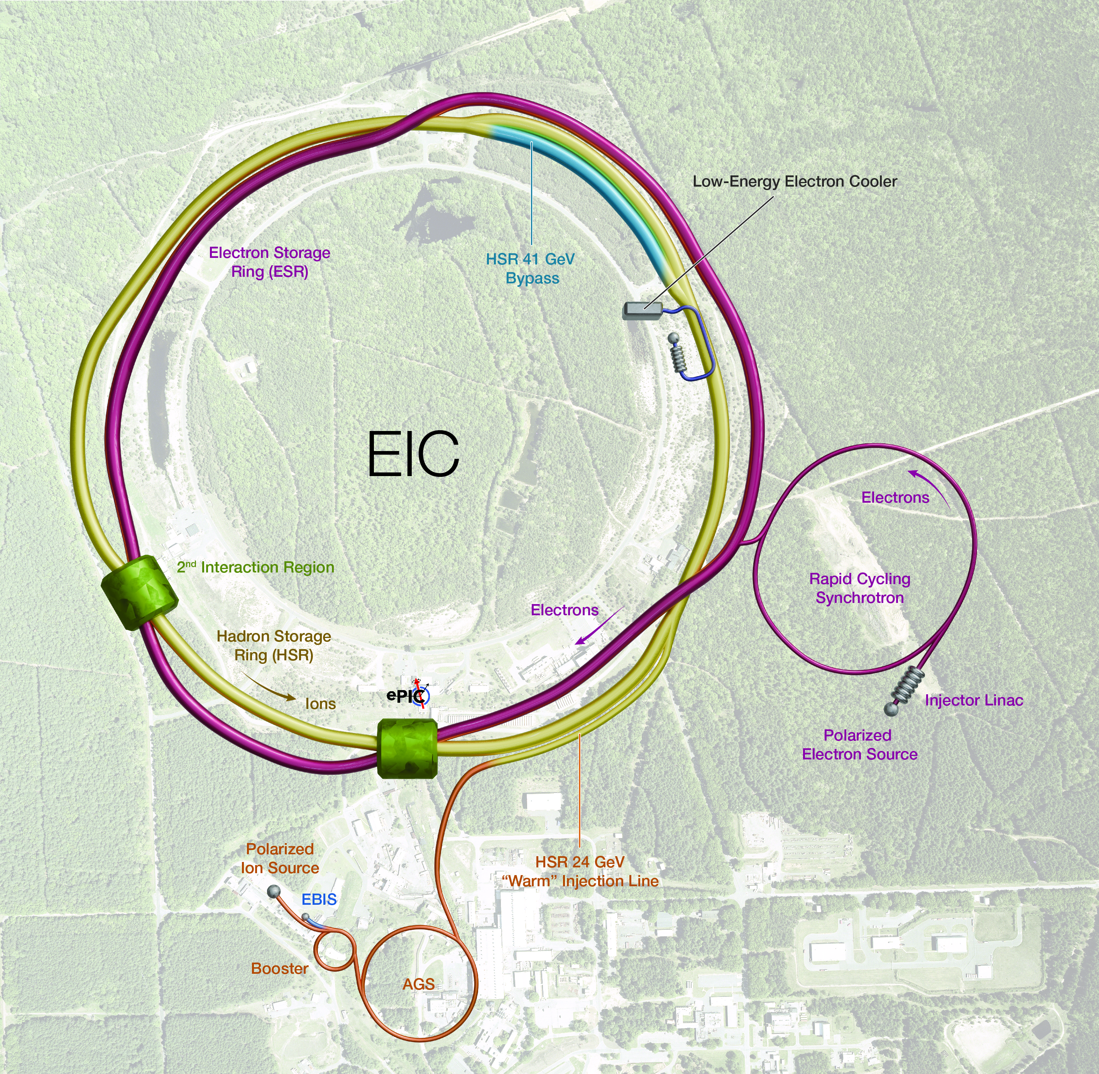
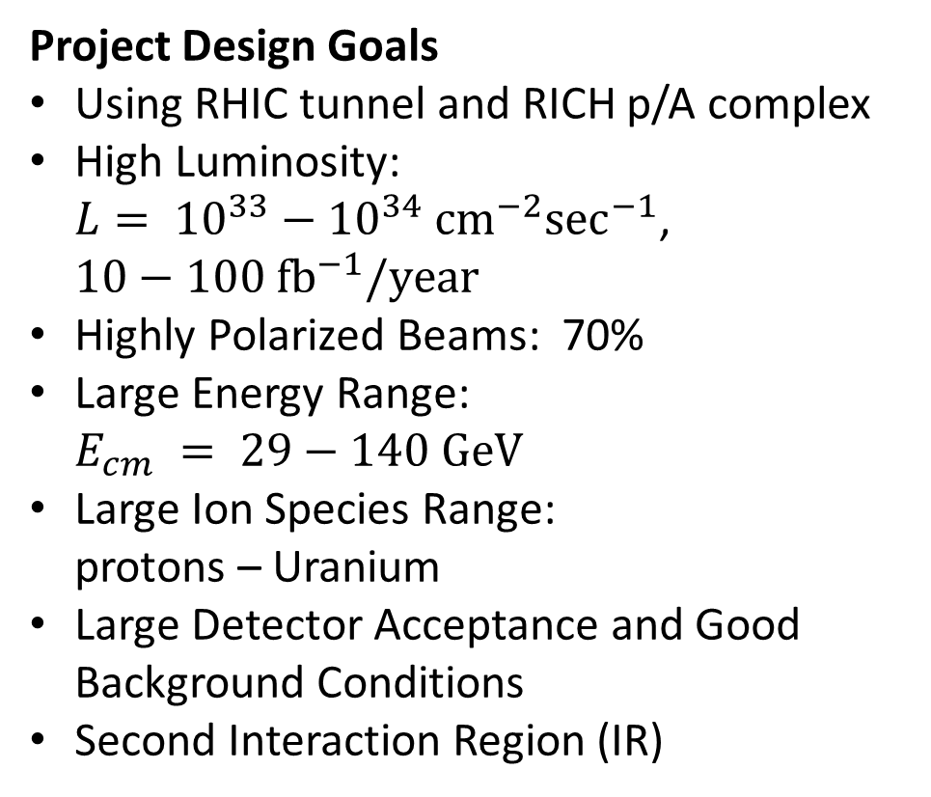
An Electron Ion Collider at BNL
Project Design Goals
Using RHIC tunnel and RICH p/A complex
High Luminosity: $L= {10}^{33}−{10}^{34} {\text{c}\text{m}}^{−2}\sec^{−1}$, $10−100 {\text{f}\text{b}}^{−1}/\text{year}$
Highly Polarized Beams: 70%
Large Energy Range: $E_{cm} = 29−140 \text{GeV}$
Large Ion Species Range: protons – Uranium
Large Detector Acceptance and Good Background Conditions
Second Interaction Region (IR)
A. Pilloni – The ePIC The ePIC detector at the EIC
Notes:
2 slides su Zc, a Bes e a Belle
2 slide su tetraquark model: dall’hamiltoniana di Jaffe al calcolo delle masse
1 slide su molecular models, dove sono i carichi? (non in Tornqvist, si in Hanhart, vedere Braaten, citare Nefediev)
2 slides su decay channels, dove si dovrebbe vedere, e a seconda del modello, vedere qualche plot
1 slide su Y(4260), tetraquark? C’è lo strano (si vede la f0)
1 slide su Zc a cleo (anche il neutro)

Slide 3
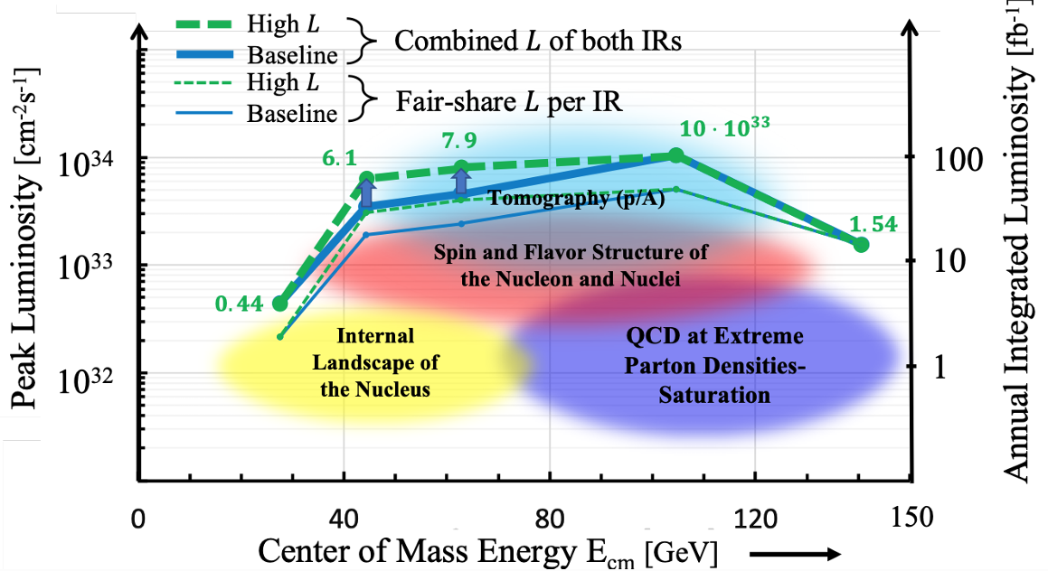
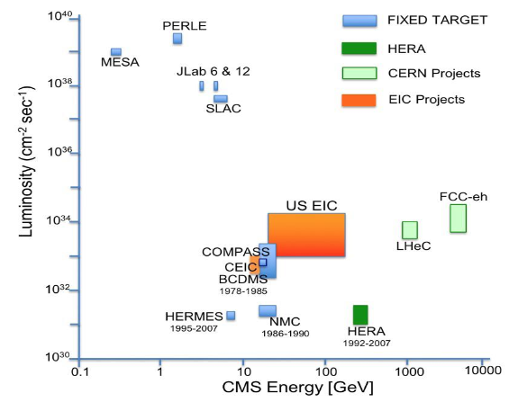

Energy & Luminosity
CEBAF@JLAB: energy vs intensity frontiers
A. Pilloni – The ePIC The ePIC detector at the EIC
Notes:
2 slides su Zc, a Bes e a Belle
2 slide su tetraquark model: dall’hamiltoniana di Jaffe al calcolo delle masse
1 slide su molecular models, dove sono i carichi? (non in Tornqvist, si in Hanhart, vedere Braaten, citare Nefediev)
2 slides su decay channels, dove si dovrebbe vedere, e a seconda del modello, vedere qualche plot
1 slide su Y(4260), tetraquark? C’è lo strano (si vede la f0)
1 slide su Zc a cleo (anche il neutro)

Slide 4

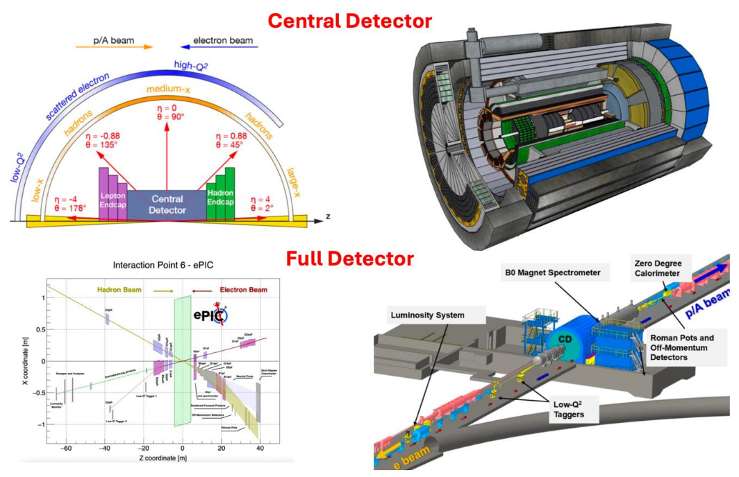
The ePIC detector
Central detector follows familiar HEP detector layout: tracking, PID, EM and hadron calorimetry
Asymmetric from forward to backward rapidity reflecting different beam energies
Extensive forward and backward instrumentation: lumi, polarimetry, Roman Pots, ZDC...
Highly integrated with IR and machine lattice -> full detector is 90m
Highest scientific flexibility, fully streaming readout electronics DAQ
A. Pilloni – The ePIC The ePIC detector at the EIC
Notes:
2 slides su Zc, a Bes e a Belle
2 slide su tetraquark model: dall’hamiltoniana di Jaffe al calcolo delle masse
1 slide su molecular models, dove sono i carichi? (non in Tornqvist, si in Hanhart, vedere Braaten, citare Nefediev)
2 slides su decay channels, dove si dovrebbe vedere, e a seconda del modello, vedere qualche plot
1 slide su Y(4260), tetraquark? C’è lo strano (si vede la f0)
1 slide su Zc a cleo (anche il neutro)

Slide 5
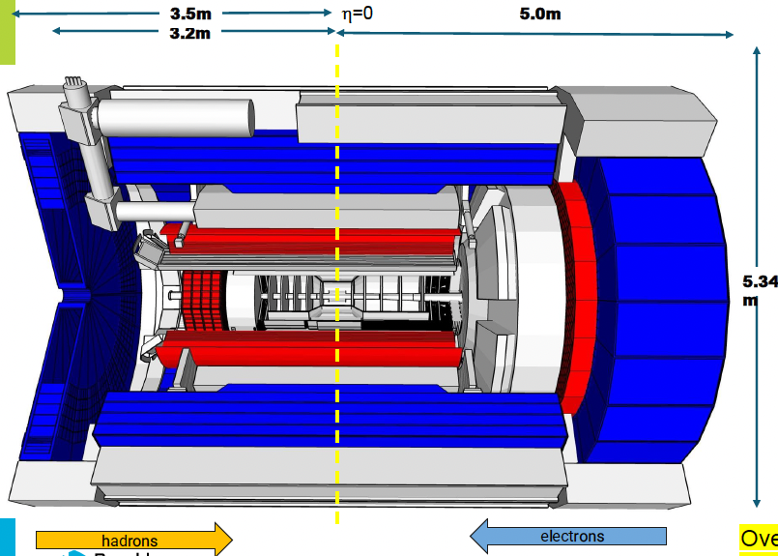
The ePIC detector
Tracking:
New 1.7T solenoid
Very thin Si Monolithic Activ Pixel Sensors (MAPS) Tracker – barrel and disks
Gaseous tracker: Micropattern gaseous detectors (MPGDs) (μRWELL/μMegas)
PID:
High Performance DIRC
Proximity focussing RICH - forward
Dual RICH (aerogel + gas) - backward
AC-LGAD (~30ps TOF) – barrel+forward
EM Calorimetry:
Imaging Si+PbW - Barrel
PbWO₄ crystals - backward
Finely segmented EMCal – forward
Hadron calorimetry:
FeSc – barrel (sPHENIX re-use)
Steel/Scint – W/Scint backward/forward (tail-catcher)
A. Pilloni – The ePIC The ePIC detector at the EIC
Notes:
2 slides su Zc, a Bes e a Belle
2 slide su tetraquark model: dall’hamiltoniana di Jaffe al calcolo delle masse
1 slide su molecular models, dove sono i carichi? (non in Tornqvist, si in Hanhart, vedere Braaten, citare Nefediev)
2 slides su decay channels, dove si dovrebbe vedere, e a seconda del modello, vedere qualche plot
1 slide su Y(4260), tetraquark? C’è lo strano (si vede la f0)
1 slide su Zc a cleo (anche il neutro)

Slide 6
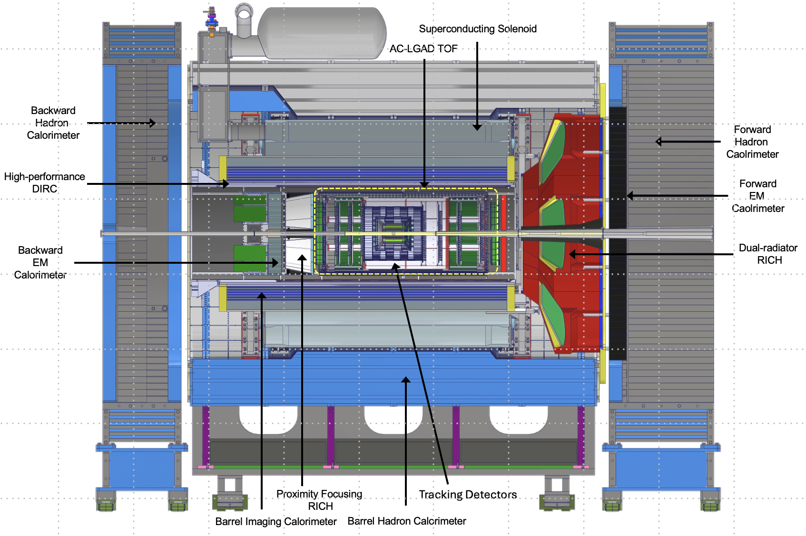
The ePIC detector
Tracking:
New 1.7T solenoid
Very thin Si Monolithic Activ Pixel Sensors (MAPS) Tracker – barrel and disks
Gaseous tracker: Micropattern gaseous detectors (MPGDs) (μRWELL/μMegas)
PID:
High Performance DIRC
Proximity focussing RICH - forward
Dual RICH (aerogel + gas) - backward
AC-LGAD (~30ps TOF) – barrel+forward
EM Calorimetry:
Imaging Si+PbW - Barrel
PbWO₄ crystals - backward
Finely segmented EMCal – forward
Hadron calorimetry:
FeSc – barrel (sPHENIX re-use)
Steel/Scint – W/Scint backward/forward (tail-catcher)
A. Pilloni – The ePIC The ePIC detector at the EIC
Notes:
2 slides su Zc, a Bes e a Belle
2 slide su tetraquark model: dall’hamiltoniana di Jaffe al calcolo delle masse
1 slide su molecular models, dove sono i carichi? (non in Tornqvist, si in Hanhart, vedere Braaten, citare Nefediev)
2 slides su decay channels, dove si dovrebbe vedere, e a seconda del modello, vedere qualche plot
1 slide su Y(4260), tetraquark? C’è lo strano (si vede la f0)
1 slide su Zc a cleo (anche il neutro)

Slide 7

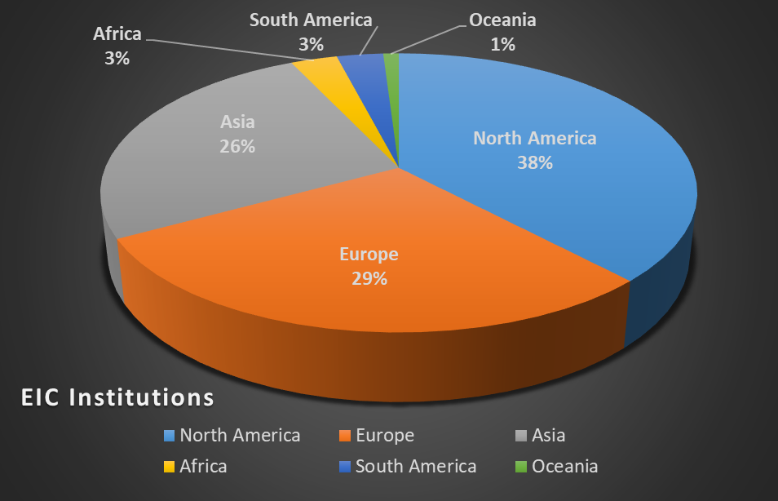
The collaboration
EIC US Partners (performing work and/or providing materials)
Eight DOE Labs
22 universities
EIC Collaborators (developing experiments, contributing expertise)
EIC User Group: 1,558 members -- and growing
907 institutions worldwide (41 countries)
80+ U.S. universities
A. Pilloni – The ePIC The ePIC detector at the EIC
Notes:
2 slides su Zc, a Bes e a Belle
2 slide su tetraquark model: dall’hamiltoniana di Jaffe al calcolo delle masse
1 slide su molecular models, dove sono i carichi? (non in Tornqvist, si in Hanhart, vedere Braaten, citare Nefediev)
2 slides su decay channels, dove si dovrebbe vedere, e a seconda del modello, vedere qualche plot
1 slide su Y(4260), tetraquark? C’è lo strano (si vede la f0)
1 slide su Zc a cleo (anche il neutro)

Slide 8
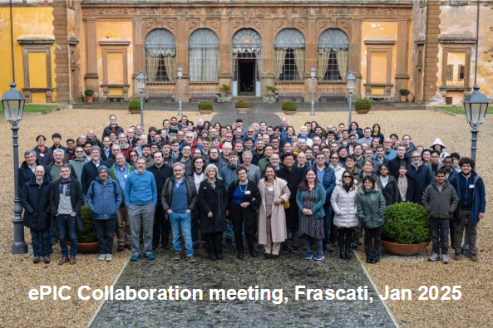
The collaboration
ePIC Spokesperson: John Lajoie (ORNL)
ePIC Deputy Spokesperson & Interim Technical Director: Silvia Dalla Torre (INFN Trieste)
A. Pilloni – The ePIC The ePIC detector at the EIC
Notes:
2 slides su Zc, a Bes e a Belle
2 slide su tetraquark model: dall’hamiltoniana di Jaffe al calcolo delle masse
1 slide su molecular models, dove sono i carichi? (non in Tornqvist, si in Hanhart, vedere Braaten, citare Nefediev)
2 slides su decay channels, dove si dovrebbe vedere, e a seconda del modello, vedere qualche plot
1 slide su Y(4260), tetraquark? C’è lo strano (si vede la f0)
1 slide su Zc a cleo (anche il neutro)

Slide 9
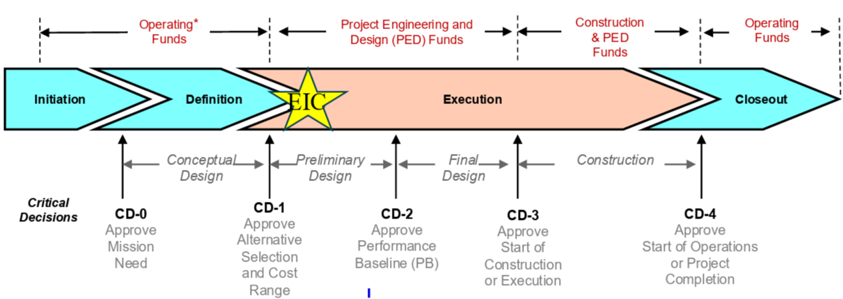
The collaboration
The timeline
A. Pilloni – The ePIC The ePIC detector at the EIC
Notes:
2 slides su Zc, a Bes e a Belle
2 slide su tetraquark model: dall’hamiltoniana di Jaffe al calcolo delle masse
1 slide su molecular models, dove sono i carichi? (non in Tornqvist, si in Hanhart, vedere Braaten, citare Nefediev)
2 slides su decay channels, dove si dovrebbe vedere, e a seconda del modello, vedere qualche plot
1 slide su Y(4260), tetraquark? C’è lo strano (si vede la f0)
1 slide su Zc a cleo (anche il neutro)

Slide 10
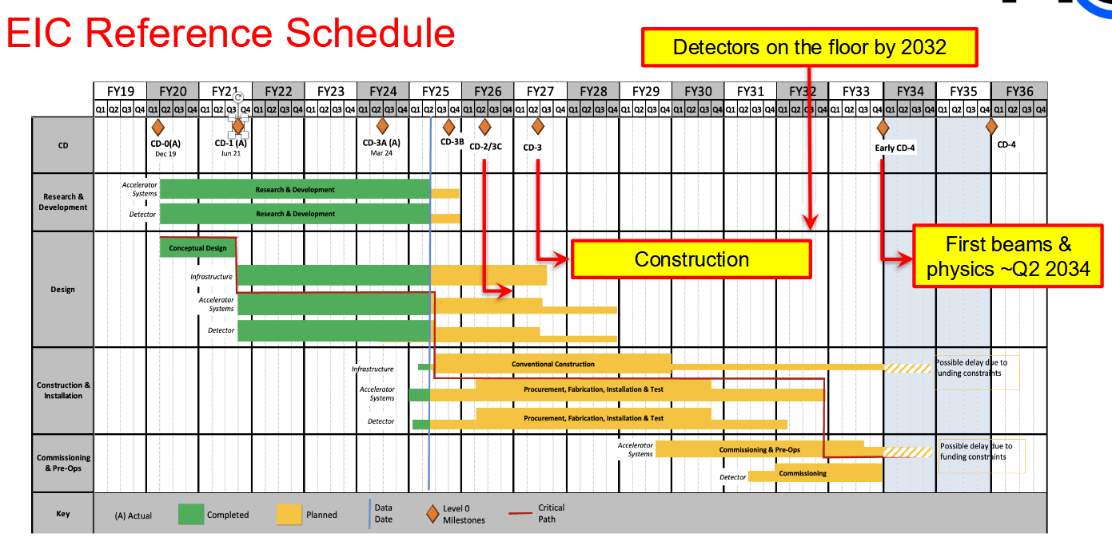
The collaboration
The timeline
A. Pilloni – The ePIC The ePIC detector at the EIC
Notes:
2 slides su Zc, a Bes e a Belle
2 slide su tetraquark model: dall’hamiltoniana di Jaffe al calcolo delle masse
1 slide su molecular models, dove sono i carichi? (non in Tornqvist, si in Hanhart, vedere Braaten, citare Nefediev)
2 slides su decay channels, dove si dovrebbe vedere, e a seconda del modello, vedere qualche plot
1 slide su Y(4260), tetraquark? C’è lo strano (si vede la f0)
1 slide su Zc a cleo (anche il neutro)

Slide 11


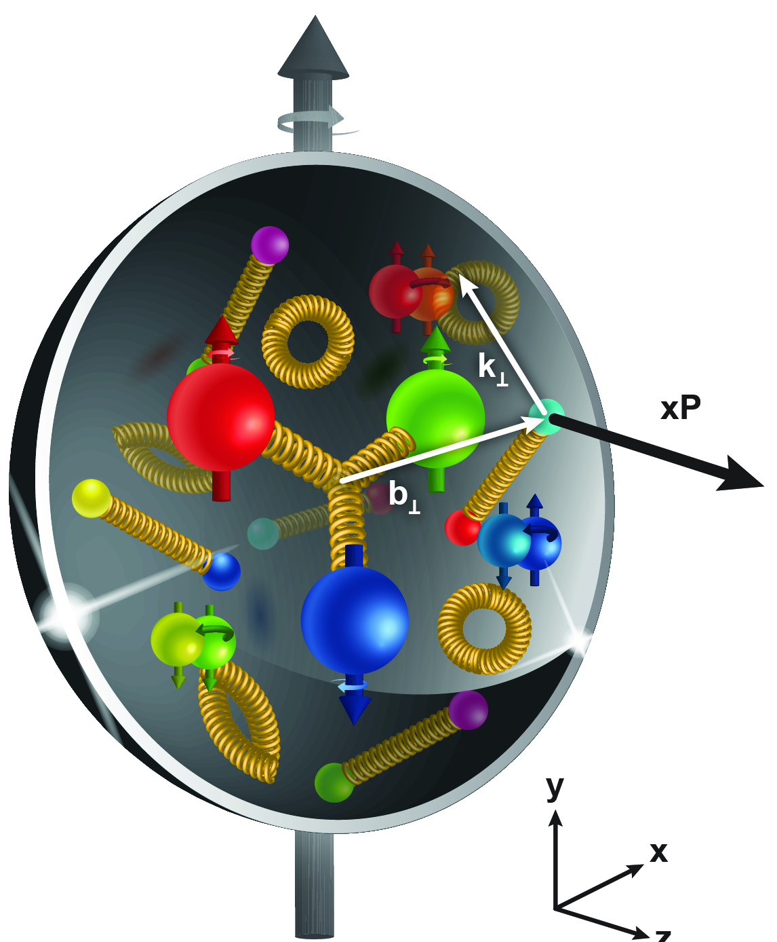
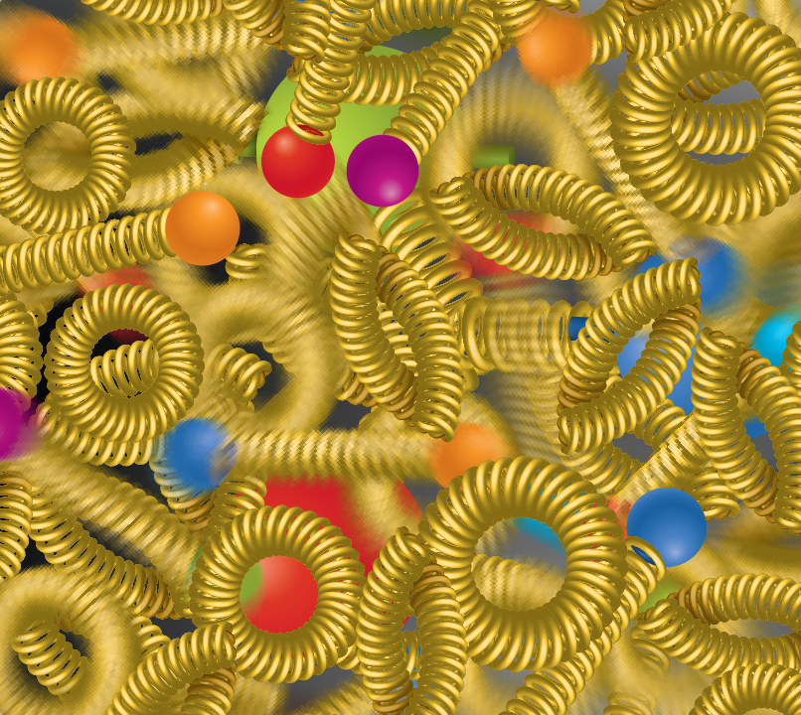
The EIC physics
Spin is one of the fundamental properties of matter.
The EIC will unravel the different contribution from the quarks, gluons and orbital angular momentum
Does the mass of visible matter emerge from quark-gluon interactions?
For the proton the EIC will determine an important term contributing to the proton mass, the so-called “QCD trace anomaly
How are the quarks and gluon distributed in space and momentum inside the nucleon & nuclei?
How can we understand their dynamical origin in QCD?
How do the confined hadronic states emerge from quarks and gluons?
How do quarks and gluons, interact with a nuclear medium?
How do the quark-gluon interactions create nuclear binding?
What happens to the gluon density in nuclei? Does it saturate at high energy?
How many gluons can fit in a proton?
How does a dense nuclear environment affect the quarks and gluons, their correlations, and their interactions?
A. Pilloni – The ePIC The ePIC detector at the EIC

Slide 12
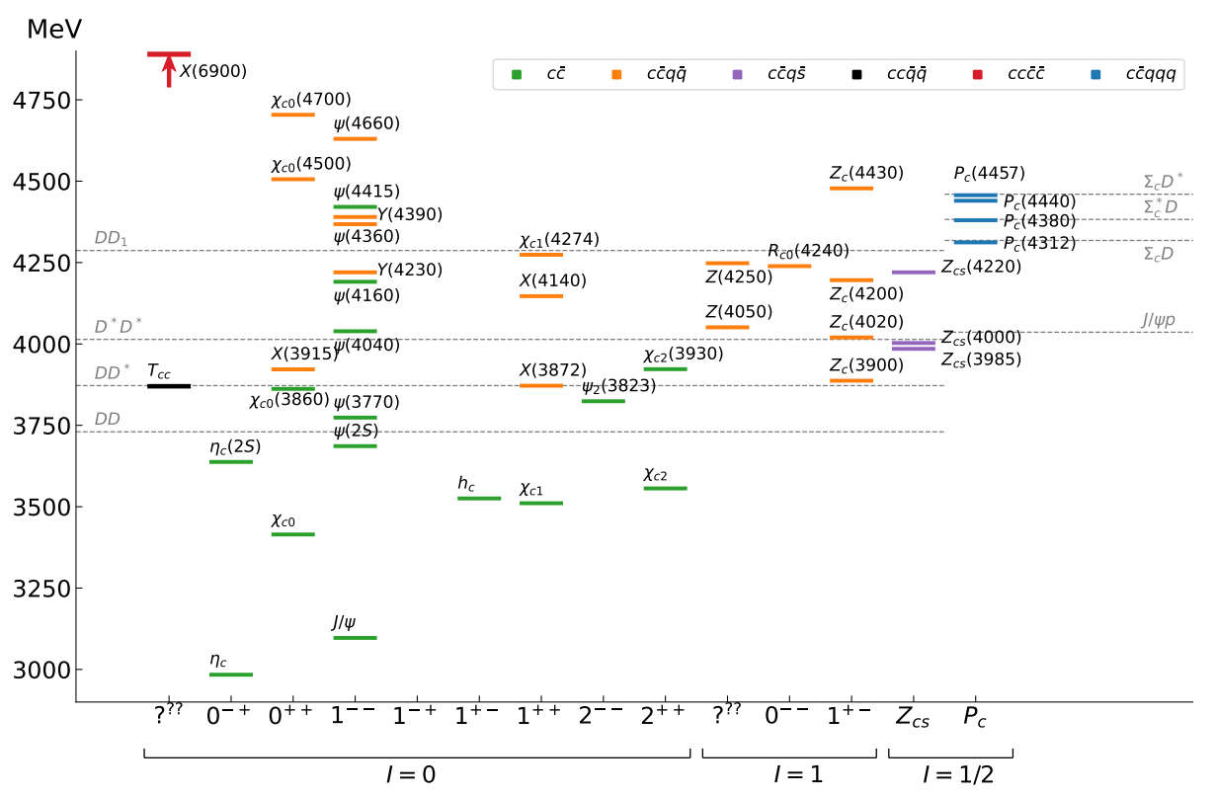

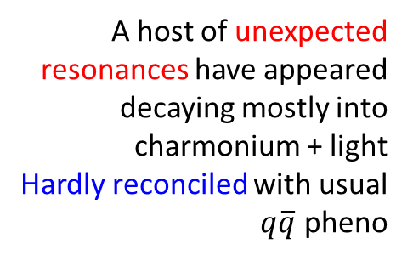
Exotic landscape in $c\overline{c}$
Esposito, AP, Polosa, Phys.Rept. 668
JPAC, PPNP
A host of unexpected resonances have appeared
decaying mostly into charmonium + light Hardly reconciled with usual $q\overline{q}$ pheno
A. Pilloni – The ePIC The ePIC detector at the EIC
Notes:
2 slides su Zc, a Bes e a Belle
2 slide su tetraquark model: dall’hamiltoniana di Jaffe al calcolo delle masse
1 slide su molecular models, dove sono i carichi? (non in Tornqvist, si in Hanhart, vedere Braaten, citare Nefediev)
2 slides su decay channels, dove si dovrebbe vedere, e a seconda del modello, vedere qualche plot
1 slide su Y(4260), tetraquark? C’è lo strano (si vede la f0)
1 slide su Zc a cleo (anche il neutro)

Slide 13
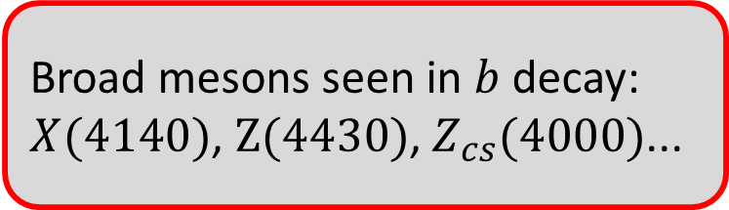
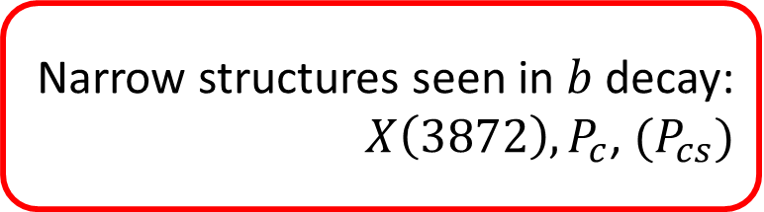
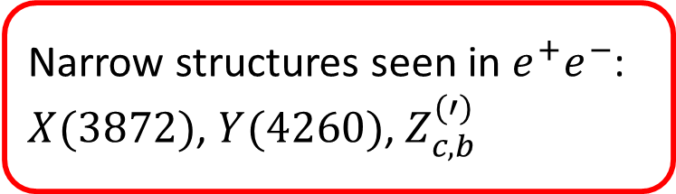
Exotic landscape
Broad mesons seen in $b$ decay:
$X(4140)$, $Z(4430)$, $Z_{cs}(4000)$...
Narrow structures seen in $b$ decay:
$X\left(3872\right), P_{c}$, $(P_{cs})$
Scarce consistency between various production mechanisms
Narrow structures seen in $e^{+}e^{−}$:
$X(3872)$, $Y(4260)$, $Z_{c,b}^{(′)}$
A. Pilloni – The ePIC The ePIC detector at the EIC

Slide 14
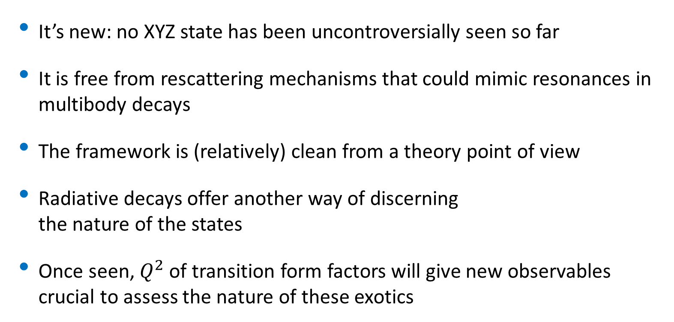
Why photoproduction?
It’s new: no XYZ state has been uncontroversially seen so far
It is free from rescattering mechanisms that could mimic resonances in multibody decays
The framework is (relatively) clean from a theory point of view
Radiative decays offer another way of discerning the nature of the states
Once seen, $Q^{2}$ of transition form factors will give new observables crucial to assess the nature of these exotics
A. Pilloni – The ePIC The ePIC detector at the EIC

Slide 15

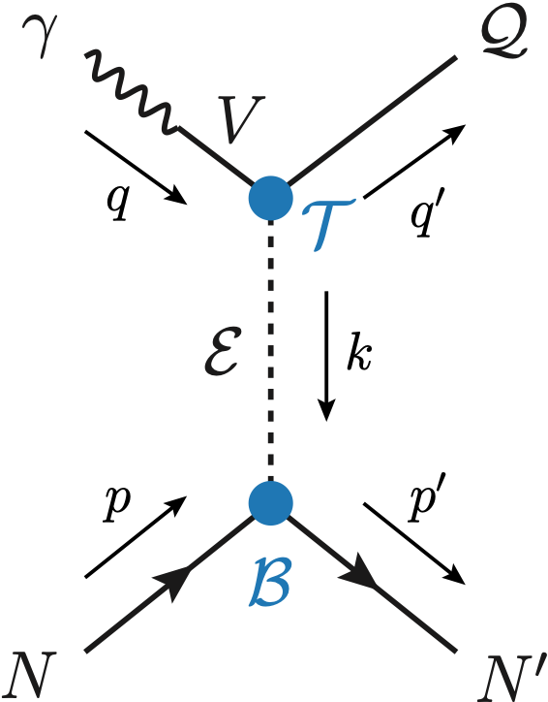
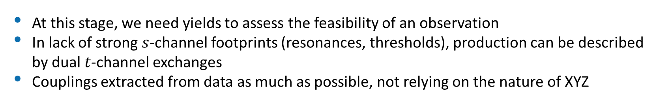

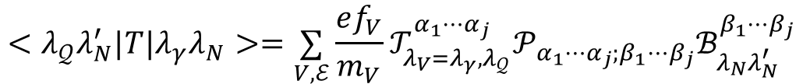
Exclusive (quasi-real) photoproduction
At this stage, we need yields to assess the feasibility of an observation
In lack of strong $s$-channel footprints (resonances, thresholds), production can be described by dual $t$-channel exchanges
Couplings extracted from data as much as possible, not relying on the nature of XYZ
Albaladejo et al., PRD 102, 114010
Winney et al., PRD 106, 094009
Winney et al., PRD 109, 114035
$$<λ_{𝒬}λ_{N}^{′}|T|λ_{γ}λ_{N}>=\underset{V,ℰ}{∑}\frac{ef_{V}}{m_{V}}𝒯_{λ_{V}=λ_{γ},λ_{𝒬}}^{α_{1}⋯α_{j}}𝒫_{α_{1}⋯α_{j};β_{1}⋯β_{j}}ℬ_{λ_{N}λ_{N}^{′}}^{β_{1}⋯β_{j}}$$
Bottom vertex from standard photoproduction pheno, exponential form factors to further suppress large t
Top vertex from measured $𝒬→Vℰ$ decay width
VMD is used to couple the incoming photon to a vector quarkonium V
A. Pilloni – The ePIC The ePIC detector at the EIC

Slide 16
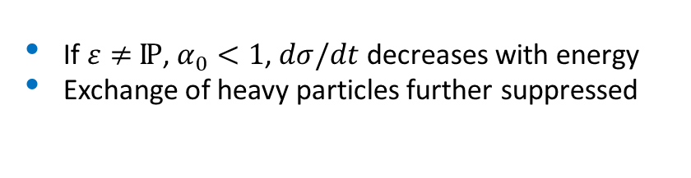
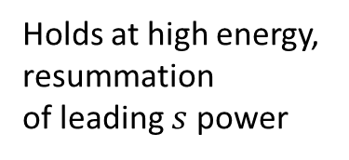

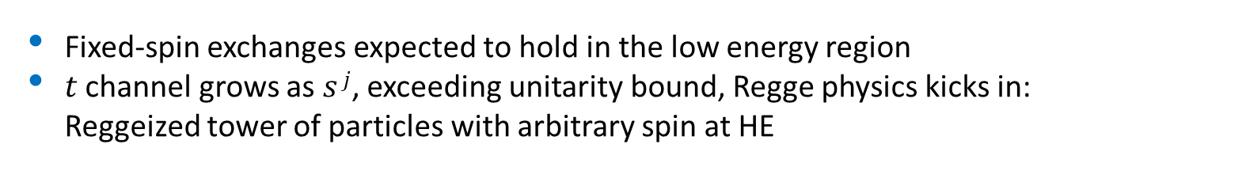
Threshold vs. high energy
Fixed-spin exchanges expected to hold in the low energy region
$t$ channel grows as $s j$, exceeding unitarity bound, Regge physics kicks in: Reggeized tower of particles with arbitrary spin at HE
$$s^{j}⟶s^{α_{0}+α^{′}t }$$
Holds at low energy, fixed spin
Holds at high energy, resummation of leading $s$ power
If $ε≠$IP, $α_{0}<1$, $dσ/dt$ decreases with energy
Exchange of heavy particles further suppressed
A. Pilloni – The ePIC The ePIC detector at the EIC

Slide 17
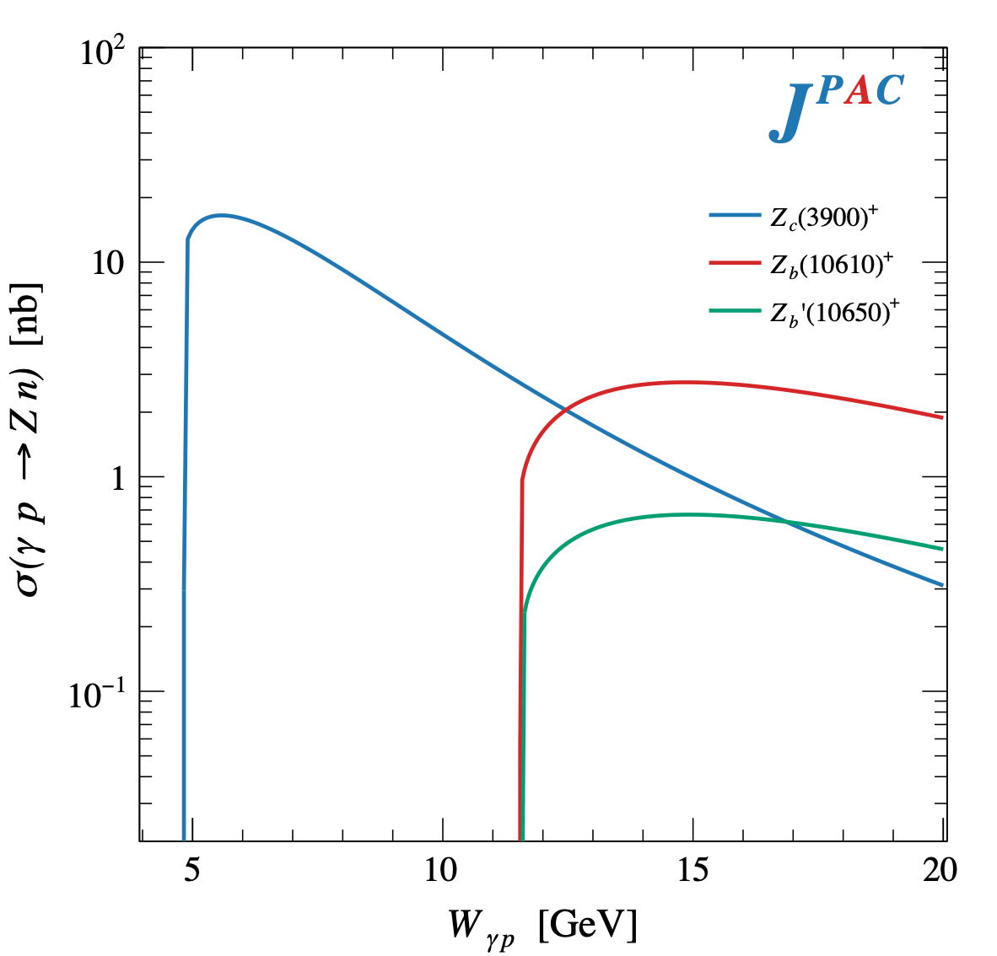
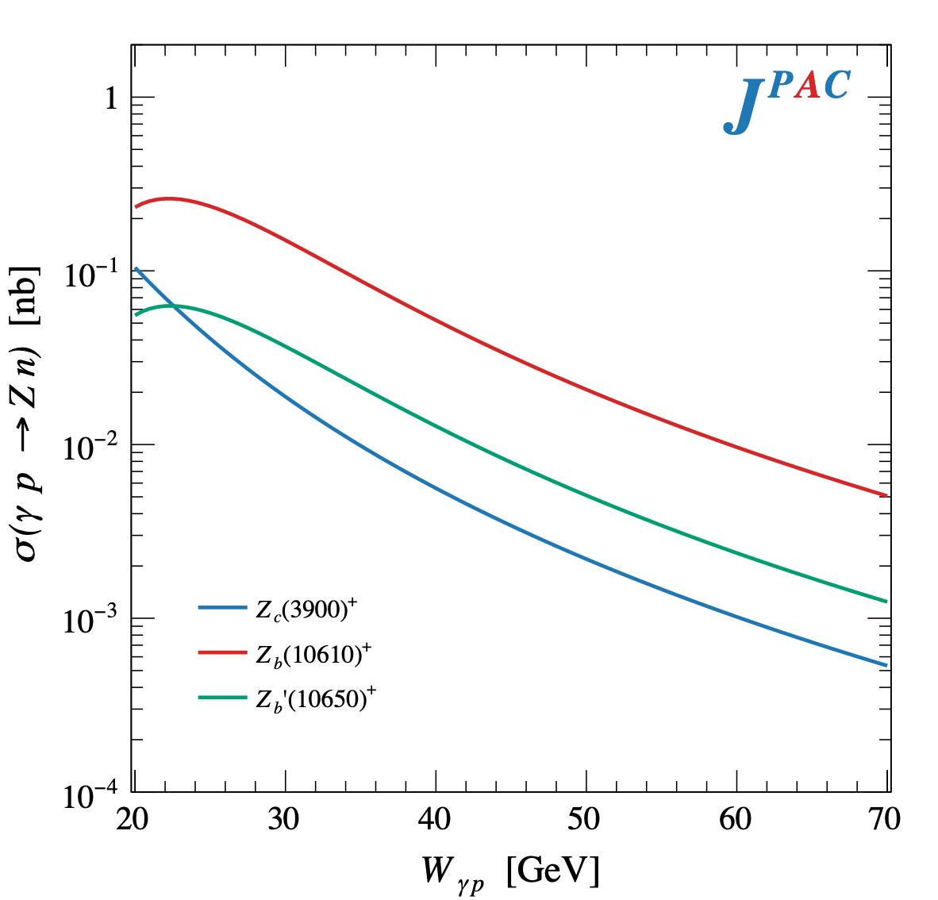

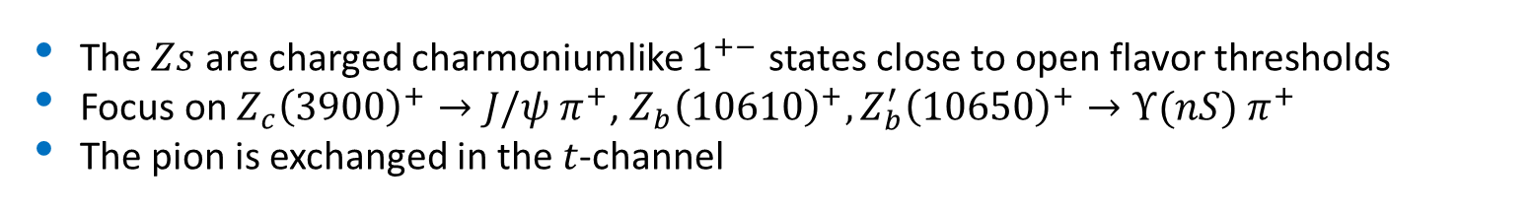
$Z$ photoproduction
The $Zs$ are charged charmoniumlike $1^{+−}$ states close to open flavor thresholds
Focus on $Z_{c}{\left(3900\right)}^{+}→J/ψ π^{+}$, $Z_{b}{\left(10610\right)}^{+},Z_{b}^{′}{\left(10650\right)}^{+}→Υ(nS) π^{+}$
The pion is exchanged in the $t$-channel
A. Pilloni – The ePIC The ePIC detector at the EIC

Slide 18
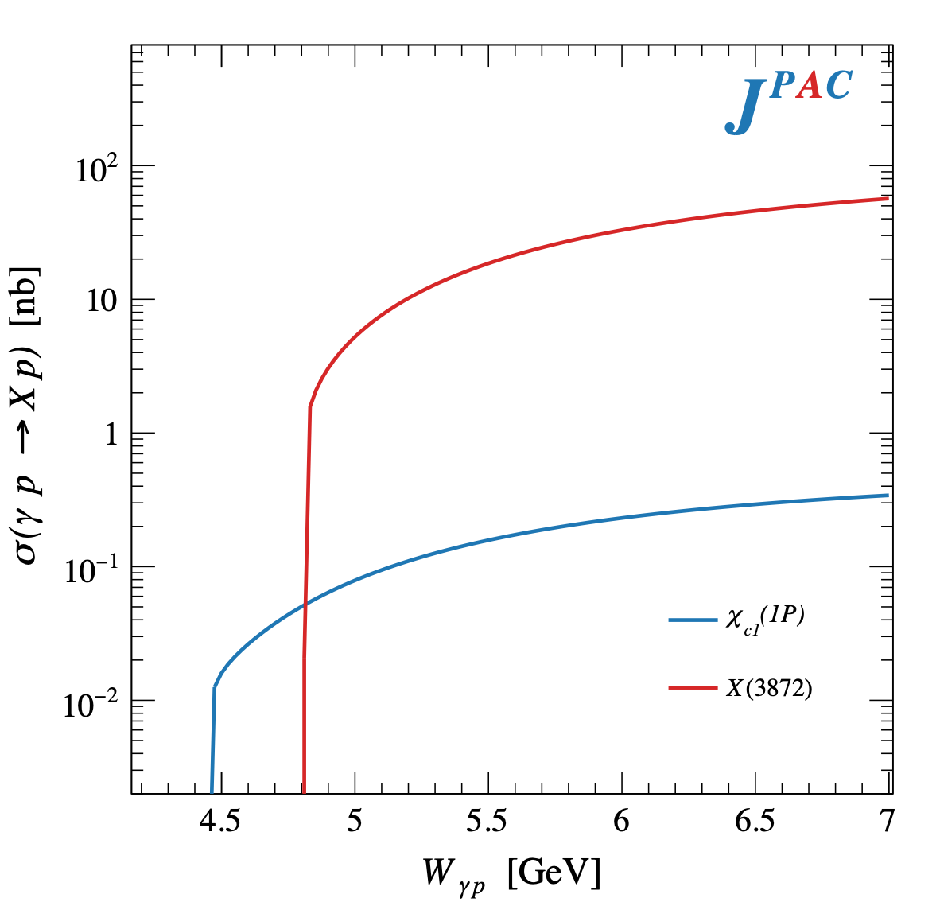
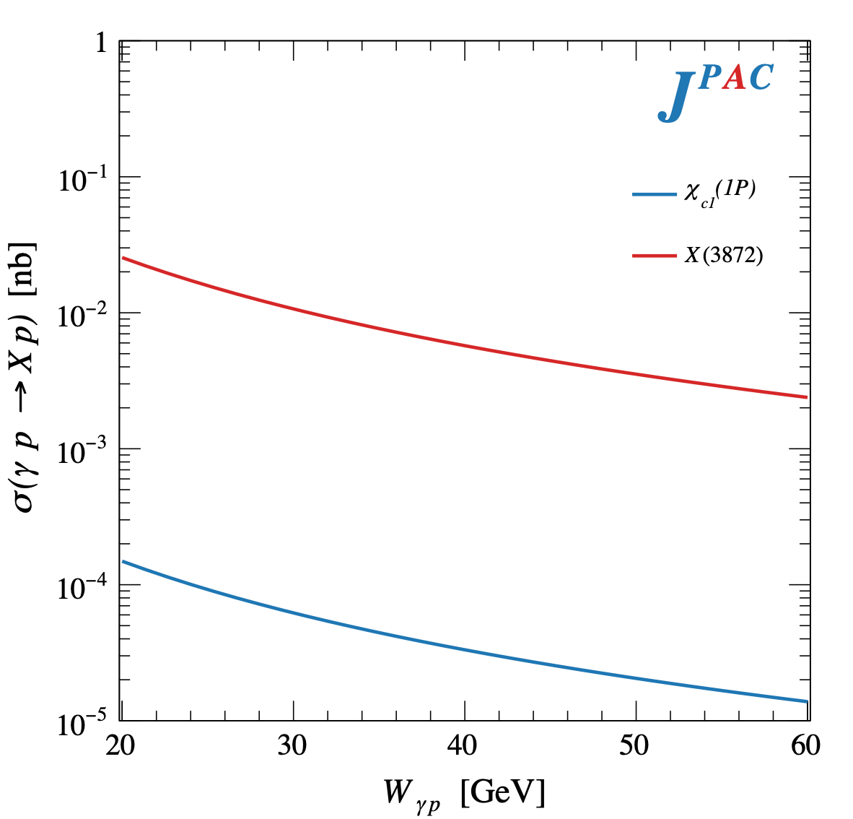
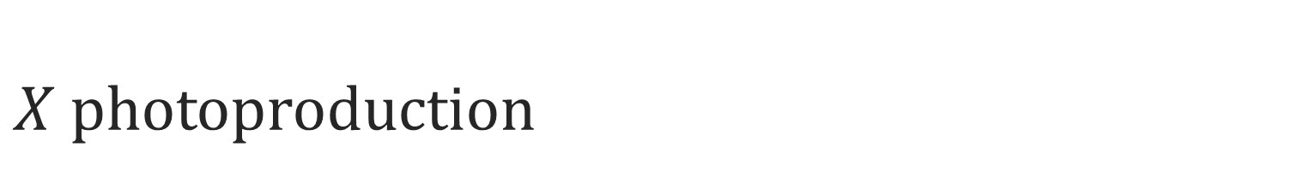
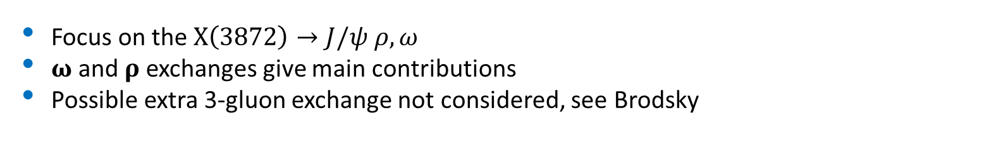
$X$ photoproduction
Focus on the $X\left(3872\right)→J/ψ ρ,ω$
𝛚 and 𝛒 exchanges give main contributions
Possible extra 3-gluon exchange not considered, see Brodsky
Large theory uncertainty in the intermediate region
A. Pilloni – The ePIC The ePIC detector at the EIC

Slide 19
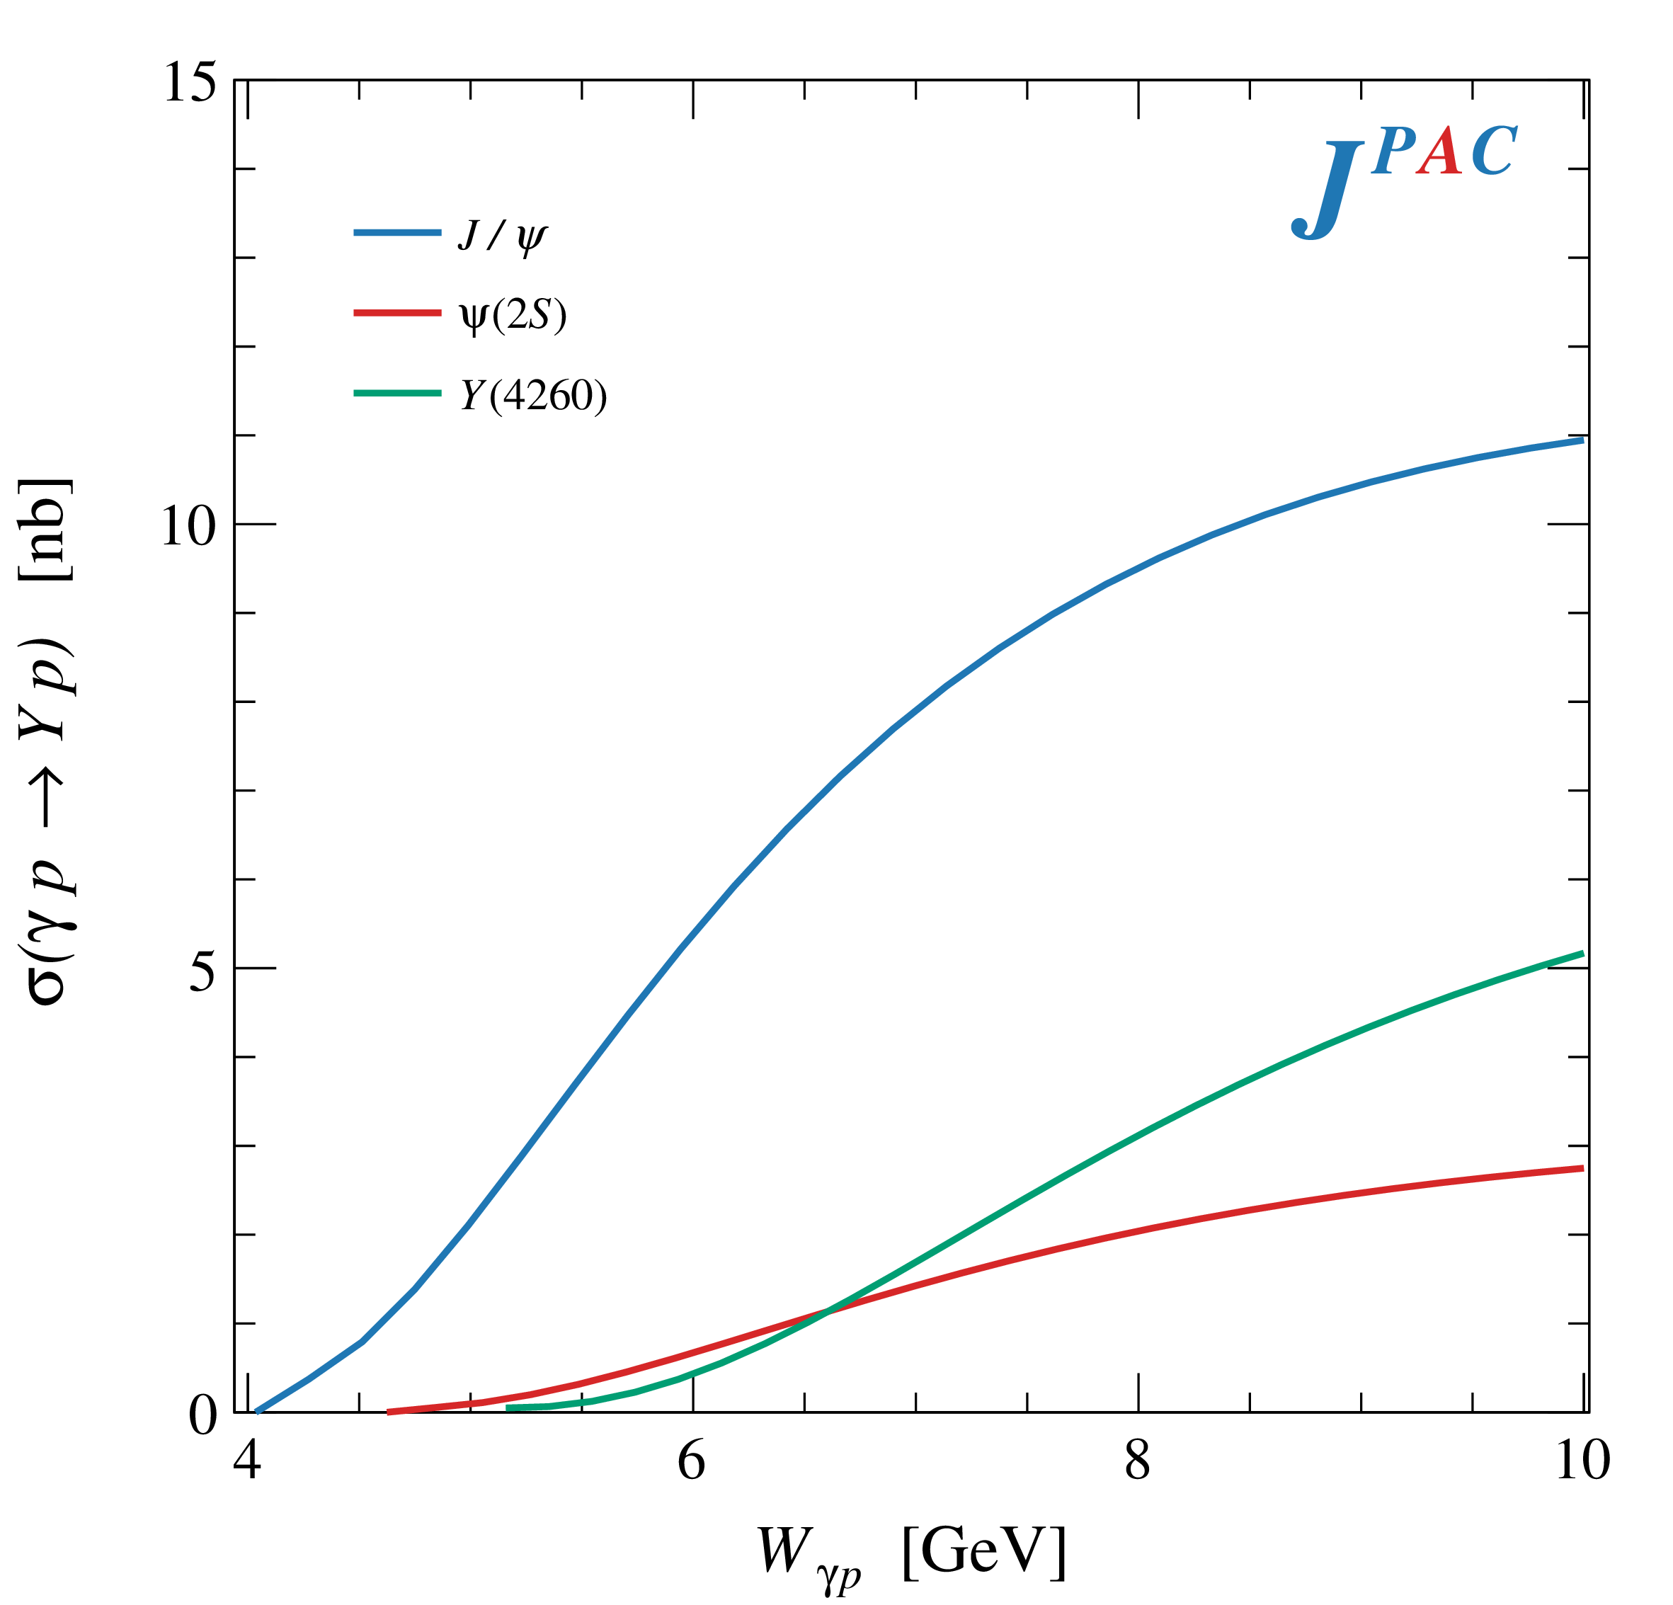
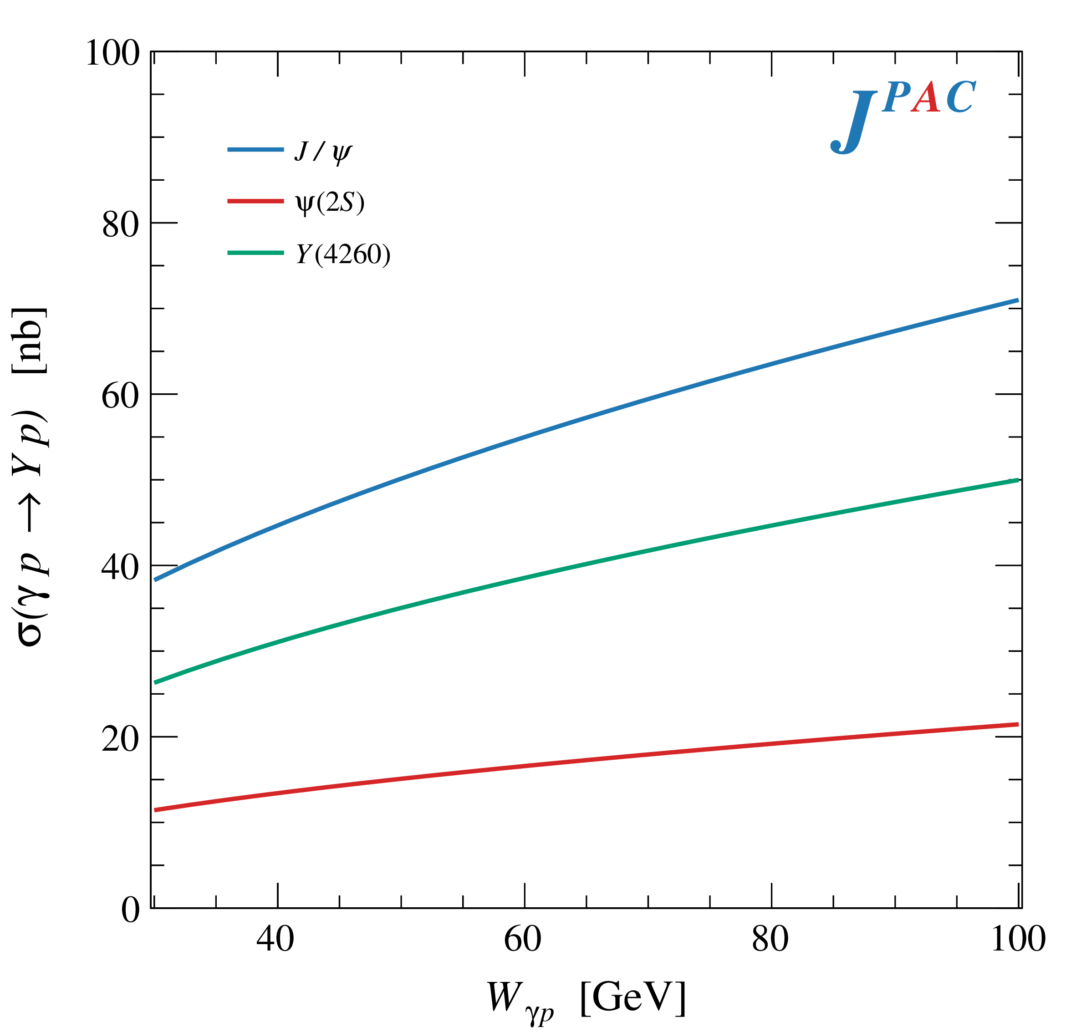
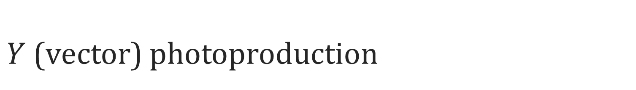
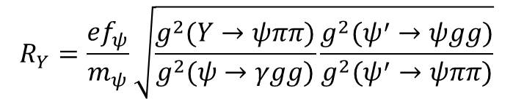
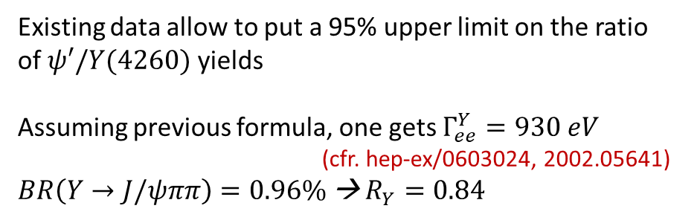
$Y$ (vector) photoproduction
Diffractive production, dominated by Pomeron (2-gluon) exchange
Existing data allow to put a 95% upper limit on the ratio of $ψ′/Y(4260)$ yields
Assuming previous formula, one gets $Γ_{ee}^{Y}=930 eV$
(cfr. hep-ex/0603024, 2002.05641)
$BR\left(Y→J/ψππ\right)=0.96\%$ → $R_{Y}=0.84$
$$R_{Y}=\frac{ef_{ψ}}{m_{ψ}}\sqrt{\frac{g^{2}(Y→ψππ)}{g^{2}(ψ→γgg)}\frac{g^{2}(ψ^{′}→ψgg)}{g^{2}(ψ^{′}→ψππ)}}$$
A. Pilloni – The ePIC The ePIC detector at the EIC

Slide 20
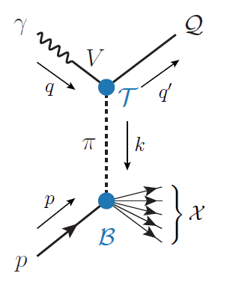
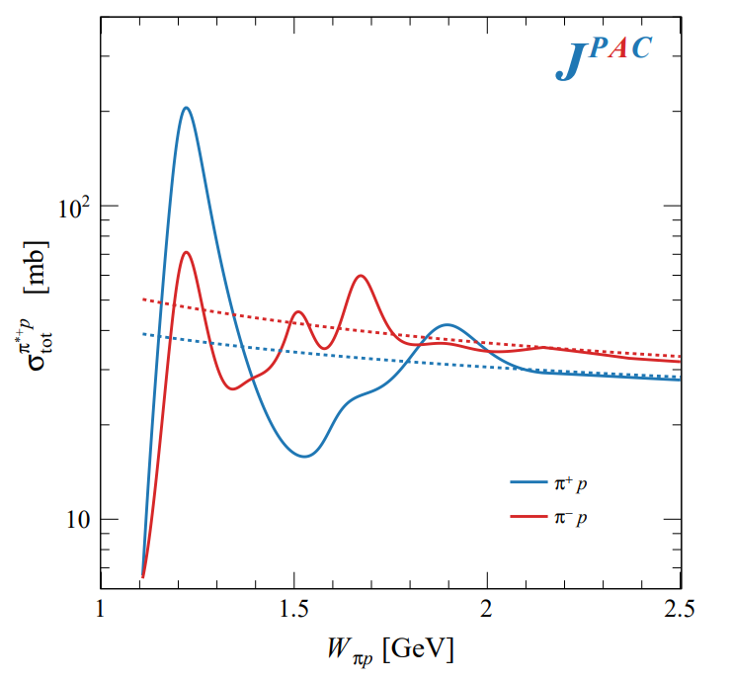
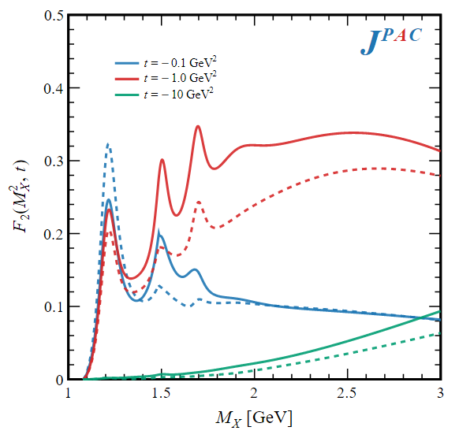

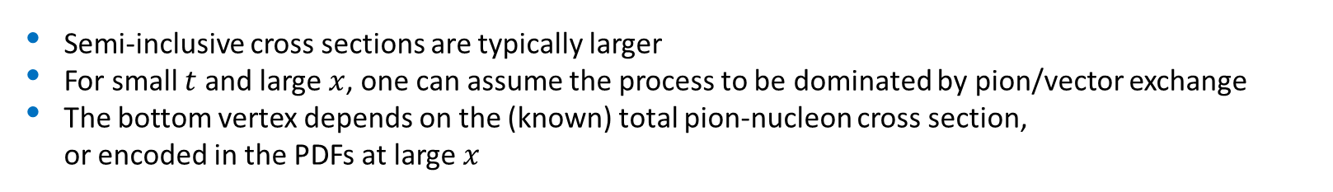
Semi-inclusive photoproduction
Semi-inclusive cross sections are typically larger
For small $t$ and large $x$, one can assume the process to be dominated by pion/vector exchange
The bottom vertex depends on the (known) total pion-nucleon cross section, or encoded in the PDFs at large $x$
$$π, ρ, ω$$
A. Pilloni – The ePIC The ePIC detector at the EIC

Slide 21
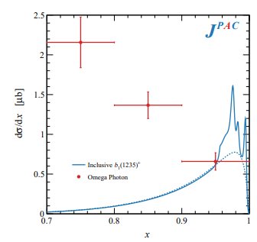
Semi-inclusive photoproduction
Semi-inclusive cross sections are typically larger
For small $t$ and large $x$, one can assume the process to be dominated by pion/vector exchange
The bottom vertex depends on the (known) total pion-nucleon cross section, or encoded in the PDFs at large $x$
Model benchmarked on $b_{1}$ production
Model underestimates lower bins, conservative estimates
$$π, ρ, ω$$
The model is expected to hold in the highest bin
A. Pilloni – The ePIC The ePIC detector at the EIC

Slide 22
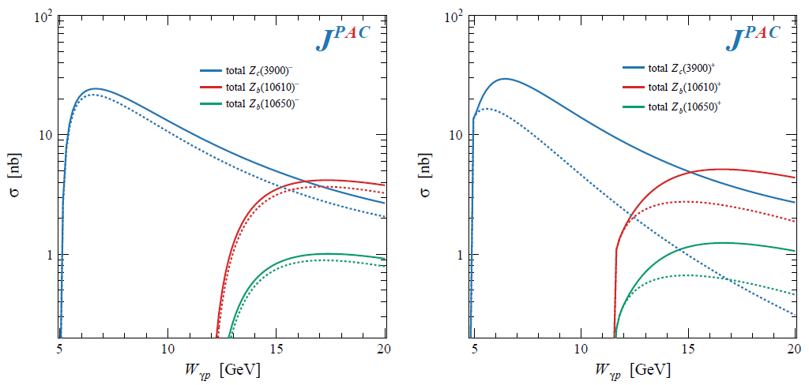
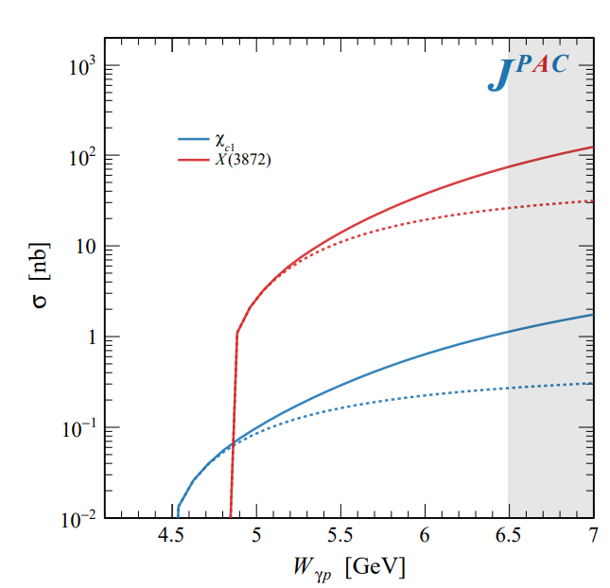

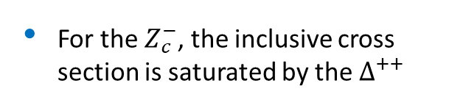




Semi-inclusive photoproduction
For the $Z_{c}^{+}$, the inclusive cross section is sizably larger than the exclusive process
For the $X$, the inclusive cross section is larger than the exclusive process
For the $Z_{c}^{−}$, the inclusive cross section is saturated by the $Δ^{++}$
$$Z_{c}^{−}Δ^{++}$$
$$X p$$
$$Z_{c}^{+}n$$
A. Pilloni – The ePIC The ePIC detector at the EIC

Slide 23
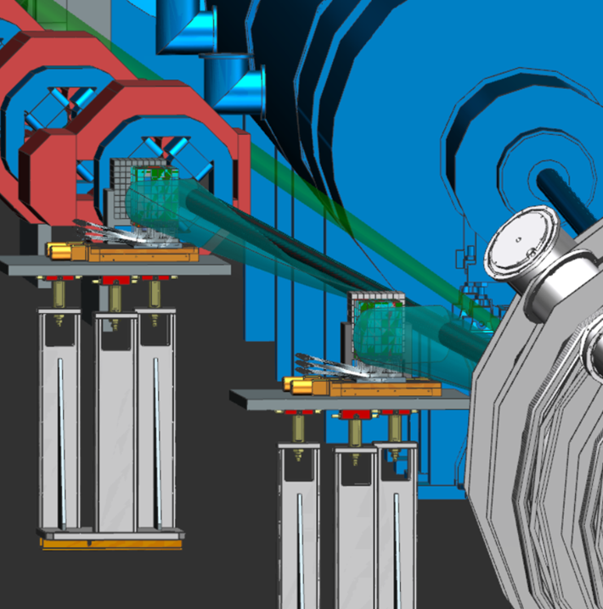
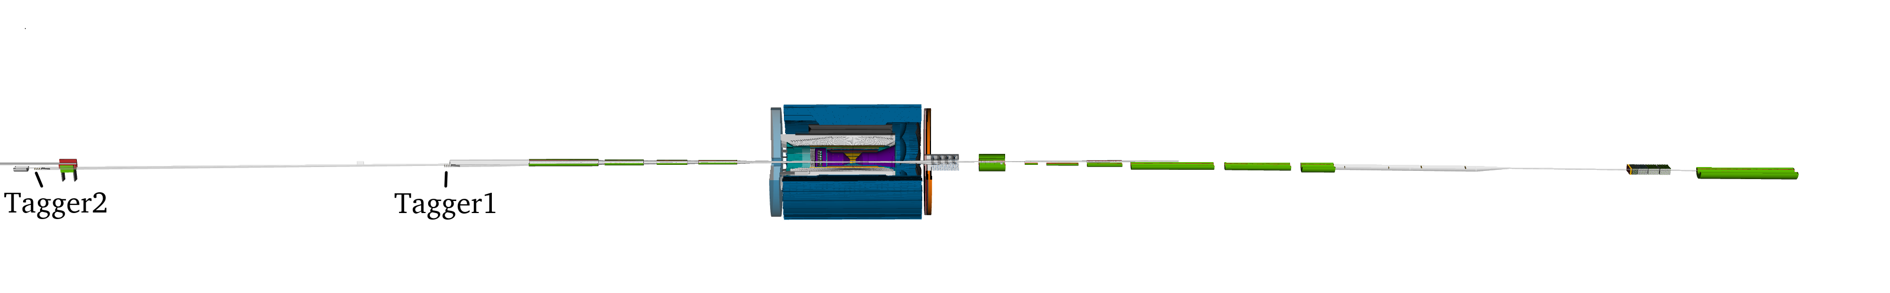

EIC Low $Q^{2}$ Tagger – Glasgow University
The ePIC Low-Q2 Tagger extends the reach of
the central detector down to effectively Q²=0.
Located after the first group of beamline steering and focusing magnets.
Scattered electrons follow deflected through the magnetic optics into tagger facilitating momentum reconstruction through tagger tracks.
Trackers consisting of 4 layers of Timepix4 pixel detectors (50μm pitch)
e-
Taggers
e-
Central Detector
A. Pilloni – The ePIC The ePIC detector at the EIC
Notes:
Click to add Notes

Slide 24
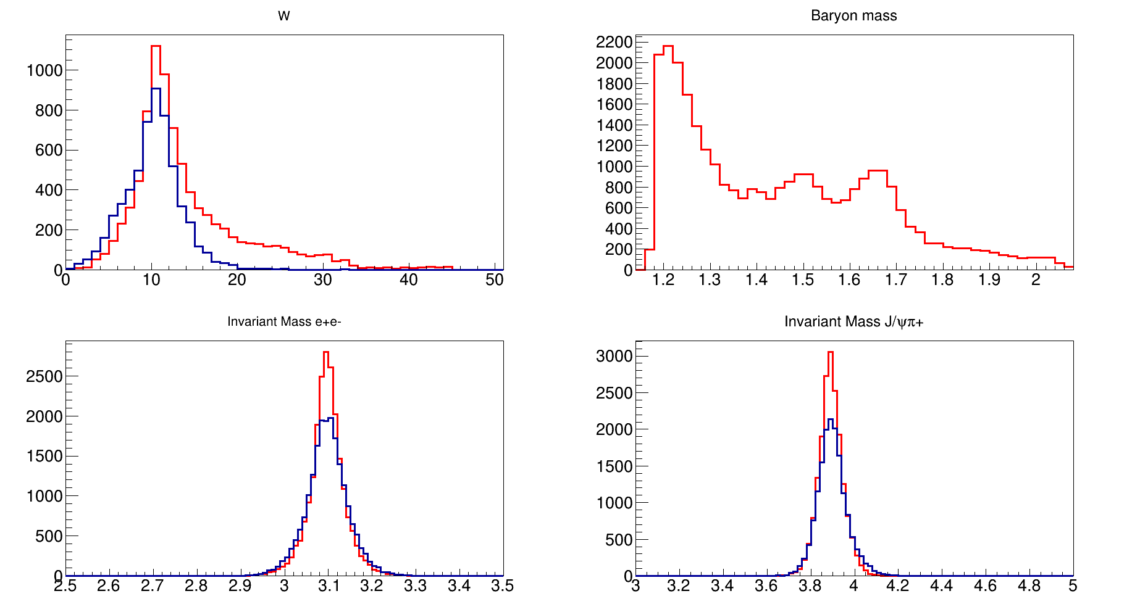
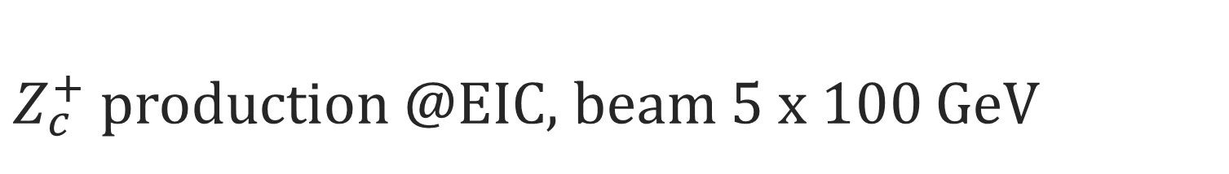
$Z_{c}^{+}$ production @EIC, beam 5 x 100 GeV
D. Glazier
Δ⁰
Require e-’ detection
Quasi-real tagger
0.45 E₀< E <0.9 E₀
θ<6 mrad, σ_{E} = 1%
Z⁺n
Z⁺N*⁰
N*
“Simulations” with
Eic-smear fastmc
10fb-1 (~2 weeks)
Semi-inc σ 30% lower
But weighted to high W
=> better e- acceptance
better Z+ acceptance
Do not detect Δ⁰
W (GeV)
Mass N*
J/ψ
Z_{c}
Invariant Mass (e+e-)
Invariant Mass (e+e-π)
A. Pilloni – The ePIC The ePIC detector at the EIC
Notes:
Click to add Notes

Slide 25


$Z_{c}^{−}$ production @EIC, beam 5 x 100 GeV
D. Glazier
Require e-’ detection
Quasi-real tagger
0.45 E₀< E <0.9 E₀
θ<6 mrad, σ_{E} = 1%
Z⁺n
Z⁻X⁺⁺
Δ⁺⁺
“Simulations” with
Eic-smear fastmc
Semi-inc σ similar
Weighted to high W
=> better e- acceptance
better Z+ acceptance
Do not detect Δ⁺⁺
W (GeV)
Mass Δ*
J/ψ
Z_{c}
Invariant Mass (e+e-)
Invariant Mass (e+e-π)
Overall factor ~ 10 more events with inclusive channels
A. Pilloni – The ePIC The ePIC detector at the EIC
Notes:
Click to add Notes

Slide 26



$X(3872)$ and nuclei at EIC
M. Durham
Switching from high multiplicity to high density environments, the picture does not change
Study of nuclear modification factors is informative about the size, thus the structure
See also Esposito, Ferreiro, AP, Polosa, Salgado EPJC 81 (2021) 7, 669
A. Pilloni – The ePIC The ePIC detector at the EIC
Notes:
2 slides su Zc, a Bes e a Belle
2 slide su tetraquark model: dall’hamiltoniana di Jaffe al calcolo delle masse
1 slide su molecular models, dove sono i carichi? (non in Tornqvist, si in Hanhart, vedere Braaten, citare Nefediev)
2 slides su decay channels, dove si dovrebbe vedere, e a seconda del modello, vedere qualche plot
1 slide su Y(4260), tetraquark? C’è lo strano (si vede la f0)
1 slide su Zc a cleo (anche il neutro)

Slide 27
Conclusions
EIC is the only novel HEP collider in the next 10-20 years
Broad physic scope and key science questions: EIC will allow high-precision ultimate QCD exploration
Mix of established and novel detector technologies
Photoproduction of exotics and interaction with cold nuclear matter can offer new insights on the nature of exotics
Thank you!
A. Pilloni – The ePIC The ePIC detector at the EIC
Notes:
2 slides su Zc, a Bes e a Belle
2 slide su tetraquark model: dall’hamiltoniana di Jaffe al calcolo delle masse
1 slide su molecular models, dove sono i carichi? (non in Tornqvist, si in Hanhart, vedere Braaten, citare Nefediev)
2 slides su decay channels, dove si dovrebbe vedere, e a seconda del modello, vedere qualche plot
1 slide su Y(4260), tetraquark? C’è lo strano (si vede la f0)
1 slide su Zc a cleo (anche il neutro)

Slide 28
Backup

Slide 29







Quarkonium orthodoxy
$$Q$$
$$\overline{Q}$$
Potential models
(meaningful when $M_{Q}→∞$)
$$V\left(r\right)=−\frac{C_{F}α_{s}}{r}+σr$$
(Cornell potential)
$$α_{s}\left(M_{Q}\right)∼0.3$$
(perturbative regime)
OZI-rule, QCD multipole
Solve NR Schrödinger eq. → spectrum
Effective theories
(HQET, NRQCD, pNRQCD...)
Heavy quark spin flip suppressed by quark mass, approximate heavy quark spin symmetry (HQSS)
Integrate out heavy DOF
↓
(spectrum), decay & production rates
A. Pilloni – The ePIC The ePIC detector at the EIC
Notes:
2 slides su Zc, a Bes e a Belle
2 slide su tetraquark model: dall’hamiltoniana di Jaffe al calcolo delle masse
1 slide su molecular models, dove sono i carichi? (non in Tornqvist, si in Hanhart, vedere Braaten, citare Nefediev)
2 slides su decay channels, dove si dovrebbe vedere, e a seconda del modello, vedere qualche plot
1 slide su Y(4260), tetraquark? C’è lo strano (si vede la f0)
1 slide su Zc a cleo (anche il neutro)

Slide 30




Multiscale system
Systematically integrate out the heavy scale,
$$m_{Q}≫Λ_{QCD}$$
$$m_{Q}≫m_{Q}v≫m_{Q}v^{2}$$
$$m_{b}∼5 \text{GeV}, m_{c}∼1.5 \text{GeV}$$
$$v_{b}^{2}∼0.1, v_{c}^{2}∼0.3$$
Full QCD
NRQCD
pNRQCD
Factorization (to be proved) of universal LDMEs
Good description of many production channels, some known puzzles (polarizations)
A. Pilloni – The ePIC The ePIC detector at the EIC
Notes:
2 slides su Zc, a Bes e a Belle
2 slide su tetraquark model: dall’hamiltoniana di Jaffe al calcolo delle masse
1 slide su molecular models, dove sono i carichi? (non in Tornqvist, si in Hanhart, vedere Braaten, citare Nefediev)
2 slides su decay channels, dove si dovrebbe vedere, e a seconda del modello, vedere qualche plot
1 slide su Y(4260), tetraquark? C’è lo strano (si vede la f0)
1 slide su Zc a cleo (anche il neutro)

Slide 31




Quasi-real photoproduction
Virtual photon flux
+ form factor
e⁻
Photon flux rises rapidly as :
Q² → 0 ; W =√s → M(proton)
Leads to high production rates
e⁻
γ*
XYZ
p
p,n
$$\frac{d^{4}σ}{ds{dQ}^{2}dφdt}=\frac{d^{2}σ_{e,γ∗e′}}{{dsdQ}^{2}}\frac{d^{2}σ_{γ∗+p→V+p}\left(s,Q^{2}\right)}{dφdt}$$
$$\frac{d^{2}σ_{e,γ∗e′}}{{dsdQ}^{2}}=\frac{α}{2π}.\frac{K.L}{E}.\frac{1}{Q^{2}}.\frac{1}{\left(s−M^{2}+Q^{2}\right)}$$
$$K=\frac{W^{2}−M^{2}}{2M}=ν\left(1−x\right)=Ey\left(1−x\right)=ν−\frac{Q^{2}}{2M}$$
$$L=\frac{1+{\left(1−y\right)}^{2}}{y}−\frac{2m_{e}^{2}y}{Q^{2}}$$
A. Pilloni – The ePIC The ePIC detector at the EIC
Notes:
Click to add Notes

Slide 32


Virtual photon polarization
Photon density matrix as Q² → 0
ε = degree of virtual photon polarisation
Pbeam = degree of longitudinal e- beam polarisation
Φ = angle between scattering and production planes
Very similar to real photon
Requires determination of
ε (Ee’, θe) and Φ
i.e. full scattered e- momentum
Get event-by-event polarisation
A. Pilloni – The ePIC The ePIC detector at the EIC
Notes:
Click to add Notes

Slide 33







Primakoff X photoproduction
Using measurement of $Γ(X→γγ^{∗})$ from Belle, one can get predictions for Primakoff
Makes use of ion beams, enhancement of cross sections as $Z^{2}$
W. Schafer
$$X(3872)$$
$$X(6900)$$
A. Pilloni – The ePIC The ePIC detector at the EIC

Slide 34



In defense of VMD
The weak point of the whole approach is the use of VMD While in the light sector it works reasonably, for heavy states is not justified There are hints that it fails badly for $J/ψ$ photoproduction
The X(3872) observed in purely hadronic and photonic modes gives us unique clue to efficacy of VMD
Belle extracted the coupling $X\left(3872\right)→γγ^{∗}$, that can be compared with the VMD predictions from $X\left(3872\right)→J/ψ γ$
Other estimates give results within a factor of 3
A. Pilloni – The ePIC The ePIC detector at the EIC

Slide 35


Semi-inclusive photoproduction (pion ex)
At higher energies the triple Regge regime is reached, cross sections saturate
A. Pilloni – The ePIC The ePIC detector at the EIC

Slide 36





In practice
Burkert et al. 2211.15746
Desiderata
Low beam energies
Low solenoidal field strength
Require far forward and backward acceptance and resolution
We should expect to reconstruct around 10% fully exclusive events (most events lost in far forward/backward regions)
$$ψ′$$
$$X$$
$$Y$$
D. Glazier
A. Pilloni – The ePIC The ePIC detector at the EIC

Slide 37


Exotics with EIC : ECCE
ePIC design/simulation/reconstruction in progress.
Can consider previous studies instead
But Tagger acceptance too high here (factor several)
ecce-note-phys-2021-12
*
X,Y,ψ(2s)
*
* only J/ψ from given Meson decays.
Many more actual J/ψ production.
* COMPASS measured 314 ψ(2s)
A. Pilloni – The ePIC The ePIC detector at the EIC
Notes:
Click to add Notes

Slide 38


Idealistic Proposed Tagger
Acceptance
Resolutions
Preliminary
Preliminary
p
θ
φ
Low e- Energy acceptance limit
by magnets
High e- Energy acceptance limit
by beam
* Final design/performance dependent on beam pipe/vaccuum/integration
A. Pilloni – The ePIC The ePIC detector at the EIC
Notes:
Click to add Notes

Slide 39





Models
Compact
Hybrids
Containing gluonic degrees of freedom
Multiquark
Several (cluster) of valence quarks
Hadroquarkonium
Heavy core interacting with a light cloud via Van der Waals forces
$$π$$
$$π$$
$$J/ψ$$
$$π$$
Rescattering effects
Structures generated by cross-channel rescattering, very process-dependent
Molecule
Bound or virtual state generated by long-range exchange forces
Extended
A. Pilloni – The ePIC The ePIC detector at the EIC

Slide 40





Nuclear modification factors
We can use deuteron data to extract the values of the nuclear modification factors (caveat: for RAA data have different $\sqrt{s}$)
$$R_{CP}=\frac{N_{coll}^{P}{\left(\frac{dN}{dp_{T}}\right)}_{\text{C}}}{N_{coll}^{C}{\left(\frac{dN}{dp_{T}}\right)}_{P}}$$
$$R_{AA}=\frac{{\left(\frac{dN}{dp_{T}}\right)}_{\text{Pb}\text{−}\text{Pb}}}{N_{coll}{\left(\frac{dN}{dp_{T}}\right)}_{pp}}$$
Larger than 1 at $p_{T}>2\text{.5 }\text{GeV}$
A. Pilloni – The ePIC The ePIC detector at the EIC
Notes:
2 slides su Zc, a Bes e a Belle
2 slide su tetraquark model: dall’hamiltoniana di Jaffe al calcolo delle masse
1 slide su molecular models, dove sono i carichi? (non in Tornqvist, si in Hanhart, vedere Braaten, citare Nefediev)
2 slides su decay channels, dove si dovrebbe vedere, e a seconda del modello, vedere qualche plot
1 slide su Y(4260), tetraquark? C’è lo strano (si vede la f0)
1 slide su Zc a cleo (anche il neutro)

Slide 41



Light nuclei at ALICE vs. $X(3872)$
Esposito, Guerrieri, Maiani, Piccinini, AP, Polosa, Riquer, PRD92, 034028
We assume a pure Glauber model (RAA = 1) and a value RAA = 5 to rescale Pb-Pb data to pp
The $X\left(3872\right)$ is way larger than the extrapolated cross section
Are they similar objects?
Exponential extr.
Blast-wave extr.
A. Pilloni – The ePIC The ePIC detector at the EIC
Notes:
2 slides su Zc, a Bes e a Belle
2 slide su tetraquark model: dall’hamiltoniana di Jaffe al calcolo delle masse
1 slide su molecular models, dove sono i carichi? (non in Tornqvist, si in Hanhart, vedere Braaten, citare Nefediev)
2 slides su decay channels, dove si dovrebbe vedere, e a seconda del modello, vedere qualche plot
1 slide su Y(4260), tetraquark? C’è lo strano (si vede la f0)
1 slide su Zc a cleo (anche il neutro)

Slide 42













Prompt production of $X(3872)$
However, the applicability of Watson theorem is challenged by the presence of pions that interfere with $DD^{∗}$ propagation
$$D^{∗}$$
$$π$$
$$π$$
(CDF acceptance)
$$π$$
$$π$$
$$π$$
$$\overline{D^{0}}$$
A solution can be FSI (rescattering of $DD^{∗}$), which allow $k_{max}$ to be as large as $5m_{π}$, $σ\left(p\overline{p}→DD^{∗}|k<k_{max}\right)≈230 \text{nb}$
Artoisenet and Braaten, PRD81, 114018
However, this is controversial because of the presence of comovers that interfere with $DD^{∗}$ propagation
Bignamini et al. PLB684, 228-230
Esposito, Piccinini, AP, Polosa, JMP 4, 1569
Guerrieri, Piccinini, AP, Polosa, PRD90, 034003
$$σ_{MC}\left(p\overline{p}→DD^{∗}|k<k_{max}\right)≈0.1 \text{nb}$$
$σ_{exp}\left(p\overline{p}→X(3872)\right)≈30−70 \text{nb}$!!!
The comparison of production of other light nuclei suggests a different behavior
Esposito, Guerrieri, Maiani, Piccinini, AP, Polosa, Riquer, PRD92 (2015) 3, 034028
Bignamini et al. PRL103 (2009) 162001
A. Pilloni – The ePIC The ePIC detector at the EIC
Notes:
2 slides su Zc, a Bes e a Belle
2 slide su tetraquark model: dall’hamiltoniana di Jaffe al calcolo delle masse
1 slide su molecular models, dove sono i carichi? (non in Tornqvist, si in Hanhart, vedere Braaten, citare Nefediev)
2 slides su decay channels, dove si dovrebbe vedere, e a seconda del modello, vedere qualche plot
1 slide su Y(4260), tetraquark? C’è lo strano (si vede la f0)
1 slide su Zc a cleo (anche il neutro)

Slide 43







Multiplicity dependence
The $X(3872)$is more and more suppressed wrt $ψ(2S)$when more comovers are present Does it make the $X(3872)$a fragile molecule? No.
The $X(3872)$is more and more suppressed wrt $ψ(2S)$when more comovers are present Does it make the $X(3872)$a fragile molecule?
LHCb 2009.06619
Deuteron is a molecule, but it increases
CMS JHEP04(2014), 103
ALICE EPJC80, 9, 889
$Υ(2S)$ and $Υ\left(3S\right)$ are not molecules, but they decrease
$Υ(2S)$ and $Υ\left(3S\right)$ are not molecules, but they decrease
A. Pilloni – The ePIC The ePIC detector at the EIC
Notes:
2 slides su Zc, a Bes e a Belle
2 slide su tetraquark model: dall’hamiltoniana di Jaffe al calcolo delle masse
1 slide su molecular models, dove sono i carichi? (non in Tornqvist, si in Hanhart, vedere Braaten, citare Nefediev)
2 slides su decay channels, dove si dovrebbe vedere, e a seconda del modello, vedere qualche plot
1 slide su Y(4260), tetraquark? C’è lo strano (si vede la f0)
1 slide su Zc a cleo (anche il neutro)

Slide 44



The comover model
The interaction with final state comoving particles can help create/destroy a hadron
Baym PLB138, 18
For a compact state in 𝑝𝑝 collisions the number evolves following
hadron yield
destruction cross section
$$τ\frac{dN_{𝒬}}{dτ}=−⟨vσ⟩_{𝒬}ρ_{c}N_{𝒬}$$
comover density at initial time (Glauber model) $∝N_{ch}$
In the Comover Interaction Model one takes $⟨vσ⟩_{𝒬}∼πr_{𝒬}^{2}$
This has proved to be successful at describing 𝑝Pb and PbPb data
Ferreiro PLB749, 98
Ferreiro, Lansberg JHEP10(2018), 94
A. Pilloni – The ePIC The ePIC detector at the EIC
Notes:
2 slides su Zc, a Bes e a Belle
2 slide su tetraquark model: dall’hamiltoniana di Jaffe al calcolo delle masse
1 slide su molecular models, dove sono i carichi? (non in Tornqvist, si in Hanhart, vedere Braaten, citare Nefediev)
2 slides su decay channels, dove si dovrebbe vedere, e a seconda del modello, vedere qualche plot
1 slide su Y(4260), tetraquark? C’è lo strano (si vede la f0)
1 slide su Zc a cleo (anche il neutro)

Slide 45





Bottomonia & $X(3872)$
Further validate the model using CMS $pp$ data Using same cross sections as in 𝑝Pb and PbPb
Same model for a compact $X(3872)$
Esposito, Ferreiro, AP, Polosa, Salgado EPJC 81 (2021) 7, 669
A. Pilloni – The ePIC The ePIC detector at the EIC
Notes:
2 slides su Zc, a Bes e a Belle
2 slide su tetraquark model: dall’hamiltoniana di Jaffe al calcolo delle masse
1 slide su molecular models, dove sono i carichi? (non in Tornqvist, si in Hanhart, vedere Braaten, citare Nefediev)
2 slides su decay channels, dove si dovrebbe vedere, e a seconda del modello, vedere qualche plot
1 slide su Y(4260), tetraquark? C’è lo strano (si vede la f0)
1 slide su Zc a cleo (anche il neutro)

Slide 46



Deuteron in coalescence model
Solution of the evolution equation with recombination
$$\frac{N_{m}}{N_{h}}=\frac{{\left\langle vσ\right\rangle }_{m}}{{\left\langle vσ\right\rangle }_{m}+{\left\langle vσ\right\rangle }_{hh}}+\left(\frac{N_{m}^{0}}{N_{h}^{0}}−\frac{{\left\langle vσ\right\rangle }_{m}}{{\left\langle vσ\right\rangle }_{m}+{\left\langle vσ\right\rangle }_{hh}}\right)e^{−\left({\left\langle vσ\right\rangle }_{m}+{\left\langle vσ\right\rangle }_{hh}\right)ρ_{c}\ln\left(ρ_{c}/ρ_{c}^{pp}\right)}$$
Numbers of molecule at $t=0$,
$≈0$ in Pythia
The coalescence momentum for deuteron is known to be $Λ=50 ÷200 \text{MeV}$
Cross sections calculated from scattering of constituents
A. Pilloni – The ePIC The ePIC detector at the EIC
Notes:
2 slides su Zc, a Bes e a Belle
2 slide su tetraquark model: dall’hamiltoniana di Jaffe al calcolo delle masse
1 slide su molecular models, dove sono i carichi? (non in Tornqvist, si in Hanhart, vedere Braaten, citare Nefediev)
2 slides su decay channels, dove si dovrebbe vedere, e a seconda del modello, vedere qualche plot
1 slide su Y(4260), tetraquark? C’è lo strano (si vede la f0)
1 slide su Zc a cleo (anche il neutro)

Slide 47


$X(3872)$ again
The coalescence momentum for the $X(3872)$ is $Λ=30 ÷300 \text{MeV}$
Controversies for $N_{m}/N_{h}$: How is the 𝑋 produced?
Through ${\overline{D}}^{0}D^{∗0}$: $N_{m}/N_{h}≈0$
Through $χ_{c1}(2P)$: $N_{m}/N_{h}≈1$
The difference shown with a green band
A. Pilloni – The ePIC The ePIC detector at the EIC
Notes:
2 slides su Zc, a Bes e a Belle
2 slide su tetraquark model: dall’hamiltoniana di Jaffe al calcolo delle masse
1 slide su molecular models, dove sono i carichi? (non in Tornqvist, si in Hanhart, vedere Braaten, citare Nefediev)
2 slides su decay channels, dove si dovrebbe vedere, e a seconda del modello, vedere qualche plot
1 slide su Y(4260), tetraquark? C’è lo strano (si vede la f0)
1 slide su Zc a cleo (anche il neutro)

