Slide 1
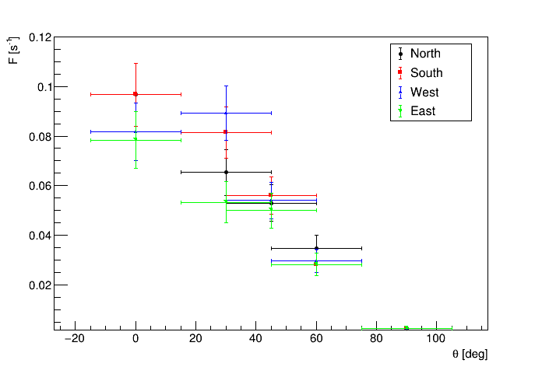
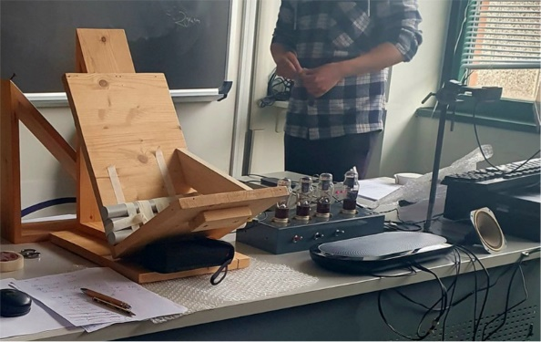
The hidden world of
cosmic rays in Florence
I.I.S.T.L "B. Russell - I. Newton" (FI), Liceo Classico Statale "Michelangiolo" (FI), Liceo Scientifico Statale "L. da Vinci" (FI), Liceo Scientifico Statale "A. Gramsci" (FI), Istituto Paritario "M. Ficino" (FI), Educandato Statale "SS. Annunziata" (FI), I.S.I.S.S. "Cicognini - Rodari" (PO), I.S.I.S. "A. Gramsci - J. M. Keynes" (PO), Liceo Statale "C. Salutati" (PT)
ITALY
Who are you?
We are a group of teenagers interested in astroparticle physics. We want to share our passion for physics with our peers around the world.
What have you done?
What did you find out?
In two days, we carried out extensive research into the phenomenon of cosmic rays. We measured the rate of atmospheric muons reaching the ground. We analysed the data obtained by varying the zenith and azimuth angles of incidence. For this purpose, we used Bruno Rossi’s apparatus, consisting of three aligned Geiger tubes and a circuit with triodes. This allowed us to detect the triple coincidence of muons, in order to select the direction of the incoming particles.
We found out that by changing the pointing direction of the instrument, the recorded muons rate changes. The maximum value of the rate is recorded when the zenith angle is 0°, while the minimum value is obtained in the direction perpendicular to the zenith.
The rate decreases as the zenith angle increases: this trend is the same for each azimuth direction.
What's your take-home message?
Through this experience, we met new friends who share the same passion for physics and we learnt how to cooperate with each other.

