Slide 1
SC magnet study
Ptolemy Collaboration Meeting
INFN Genoa, 22th Nov 2024
Santiago Sanz, Sonia Garcia, Mikel Cruz, Unai del Amo, Joseba Bastarrarena, Alex Lopez, Gustavo Sarmiento (SUPRASYS)
Matteo Tropeano, Lirza Luerdo, Gianni Grasso, Roberto Marabotto, Mauro Lorenzo, Alessio Capelluto, Alessio Verardo, Riccardo Morasso (ASG)

Slide 2
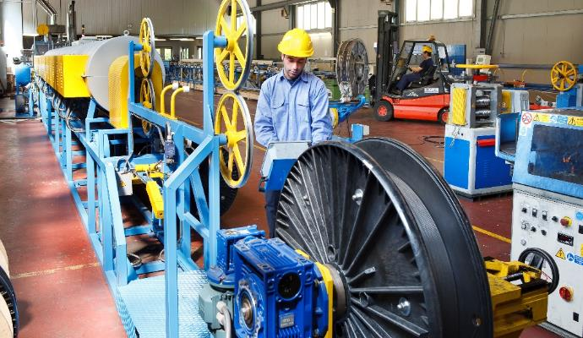
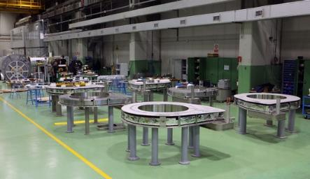
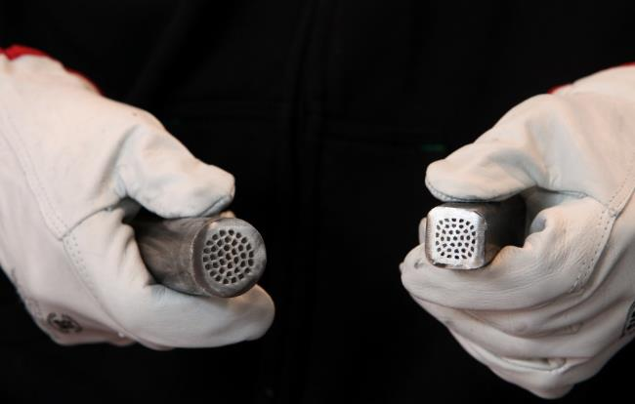
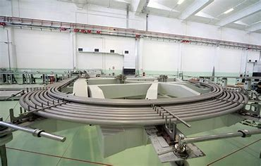
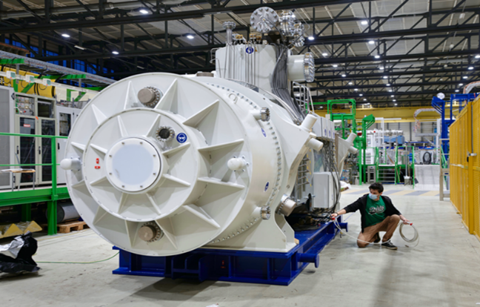
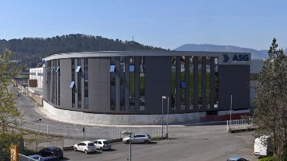
The company
A global leader in superconductivity
Main supplier of the most relevant end users of the sector
Three production sites in Liguria, Italy
220 employees, mainly engineers
Direct presence in France, US and UK
Genova San Desiderio site
Materials
Components
Systems
Wires
Coils, conductors, magnets, assemblies
Cable systems, MRI, FCL
Genova Campi site
World leader in MgB₂
Unique winding capabilities
System integration
Integrated proprietary processing route based on conventional wire processing routes and relying entirely on EU machineries and supplies
Design & manufacturing of superconducting components with unique winding & cabling know-how to match end-user specs
Full integration of the superconducting components in complete systems ready for in-field installation
La Spezia site

Slide 3
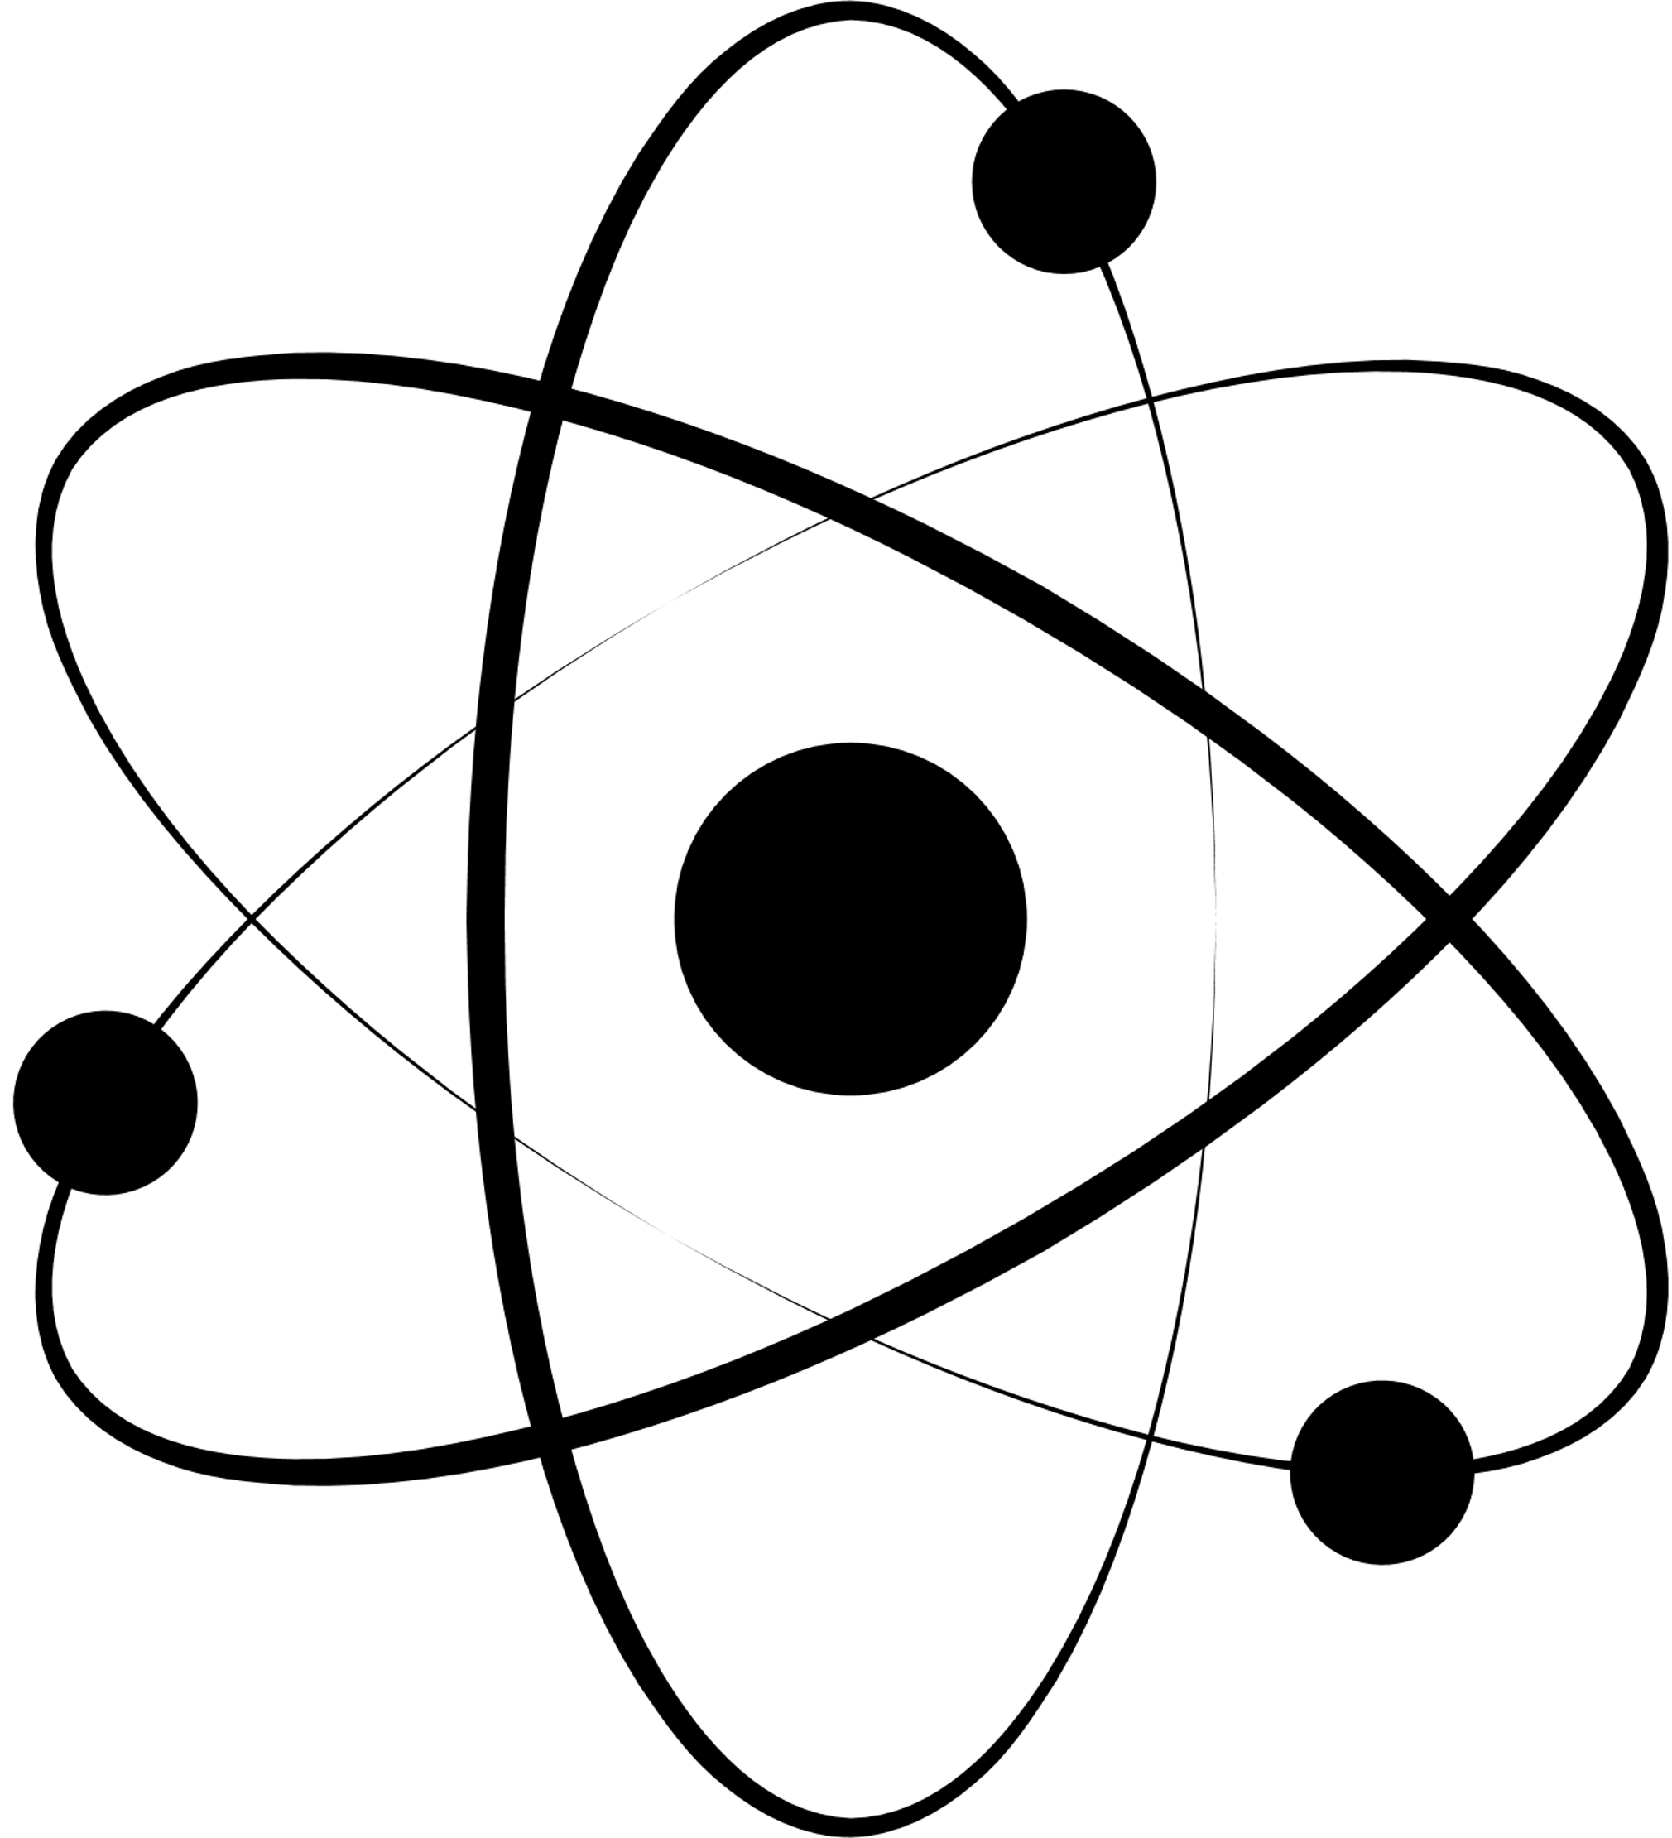
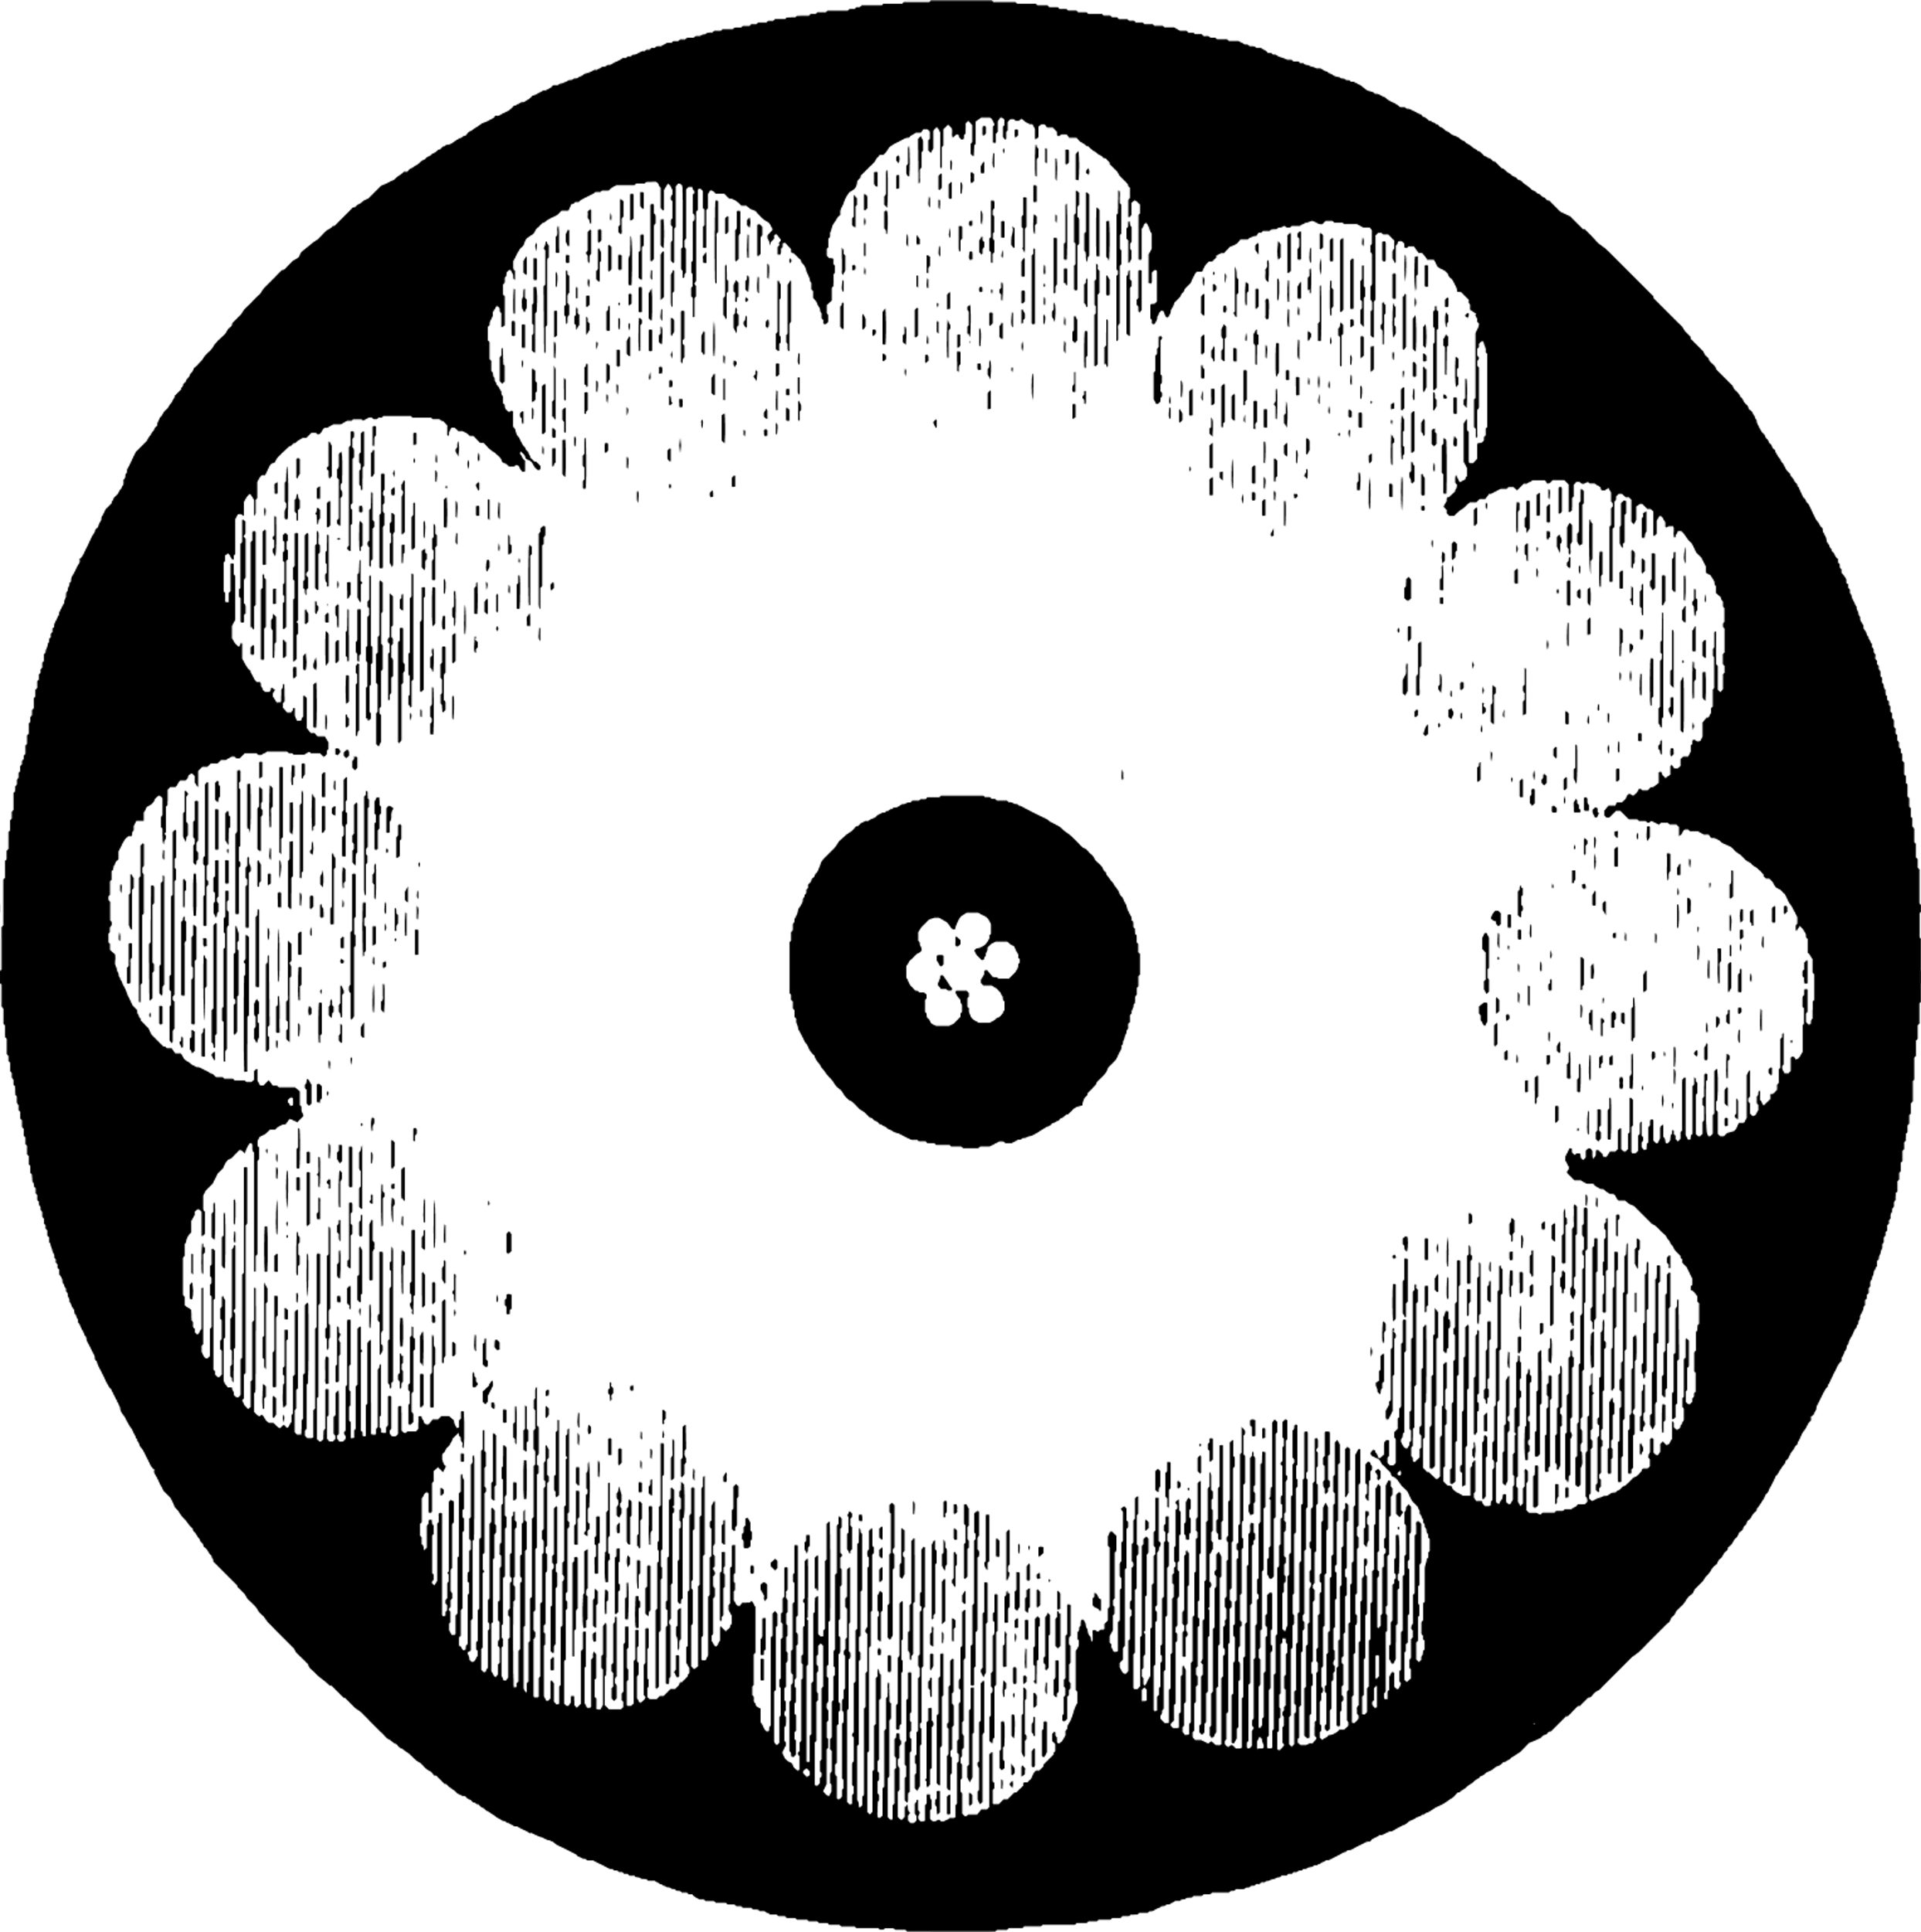
Asg organization: four strategic business units to match our markets at best
Industry and energy
Big science
medical
ASG is currently the largest European producer, and among the market leaders worldwide, of superconducting magnets for applications in high-energy physics and in fusion energy magnetic confinement.
ASG is among the market leaders in manufacturing of bespoke magnets for MRI imaging and oncologic therapy applications. Furthermore, ASG has developed a full value chain for manufacturing and integrating cryogen free MRI systems, based on a proprietary technology of MgB2 superconductors.
ASG is at the forefront of the technology for the development of superconducting magnetic energy confinement systems (SMES), superconducting power cables and superconducting fault current limiters (SFCL).
materials
ASG is heavily engaged in superconducting wire development and production with a dedicated plant, controlling the materials manufacturing and supply is a critical advantage in this fast-developing business, eliminating the dependence from non-EU suppliers of HTS materials. MgB2 is our material of choice

Slide 4
ptolemy visit
asg superconductors technology showcase
14.30
Welcome/Arrival
The INFN & Princeton delegation will be divided in n.2 groups
14.45
Factory tour
6 steps tour of ASG superconducting technology
LOCATION
ASG Superconductors Headquarter corso F.M. Perrone 73R, Genova
DATE
22 November 2024
15.45
Greetings and photo opportunity
To know more about ASG Superconductors visit our website:
www.asgsuperconductors.com

Slide 5
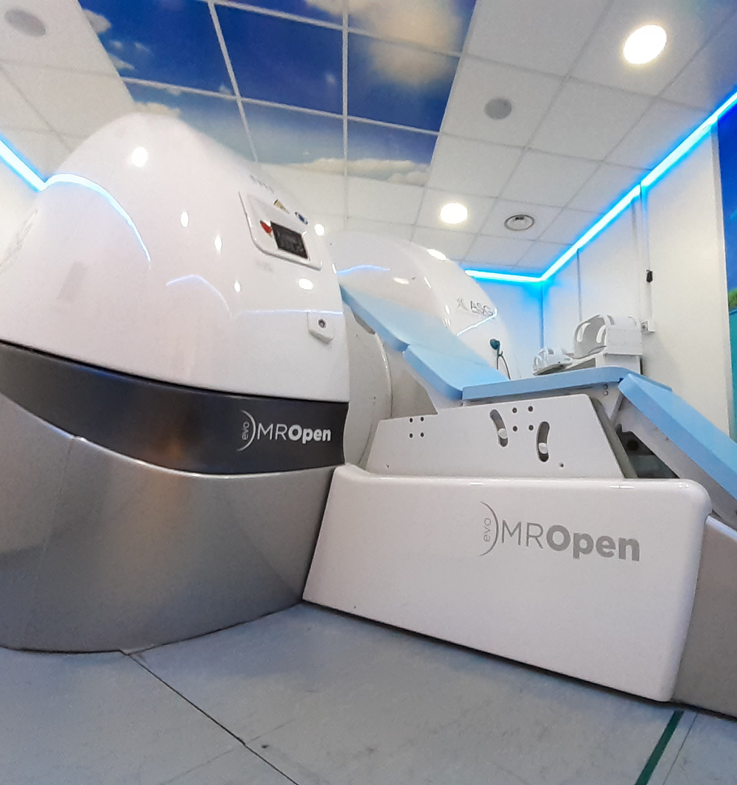
LOCATION 1: mropen evo DEMO ROOM
The MROpen EVO is the only superconductive MRI with a “totally open” magnet design based on MgB2 technology, that allows Multi-position imaging including advanced weight-bearing and functional studies, besides providing the highest comfort for patients.

Slide 6
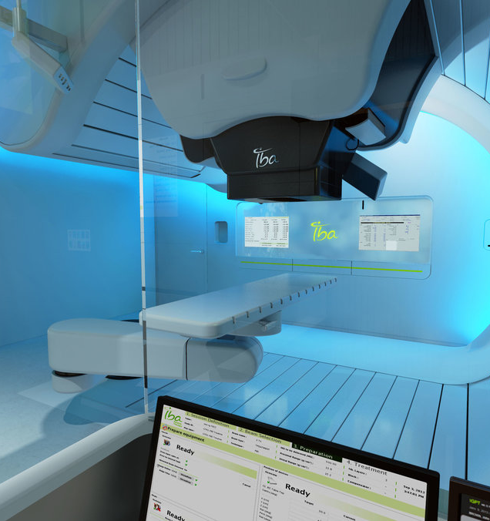
LOCATION 2: S2C2 SYNCHROCYCLOTRON FOR IBA
Particle therapy is used to treat many types of cancer, particularly in situations where normal treatments and radiotherapy are too risky for patients, including tumours of the central nervous system, eye, spine, prostate, liver, breasts and in childhood.
The coils used in this type of application are made up of cryogen-free niobium titanium windings.

Slide 7
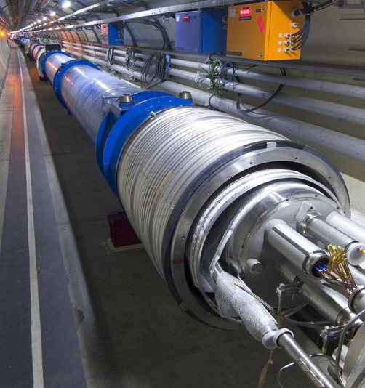
LOCATION 3: Superconducting Dipole D2 for HL-LHC
Showcase of D2 magnet for the project HL-LHC.

Slide 8
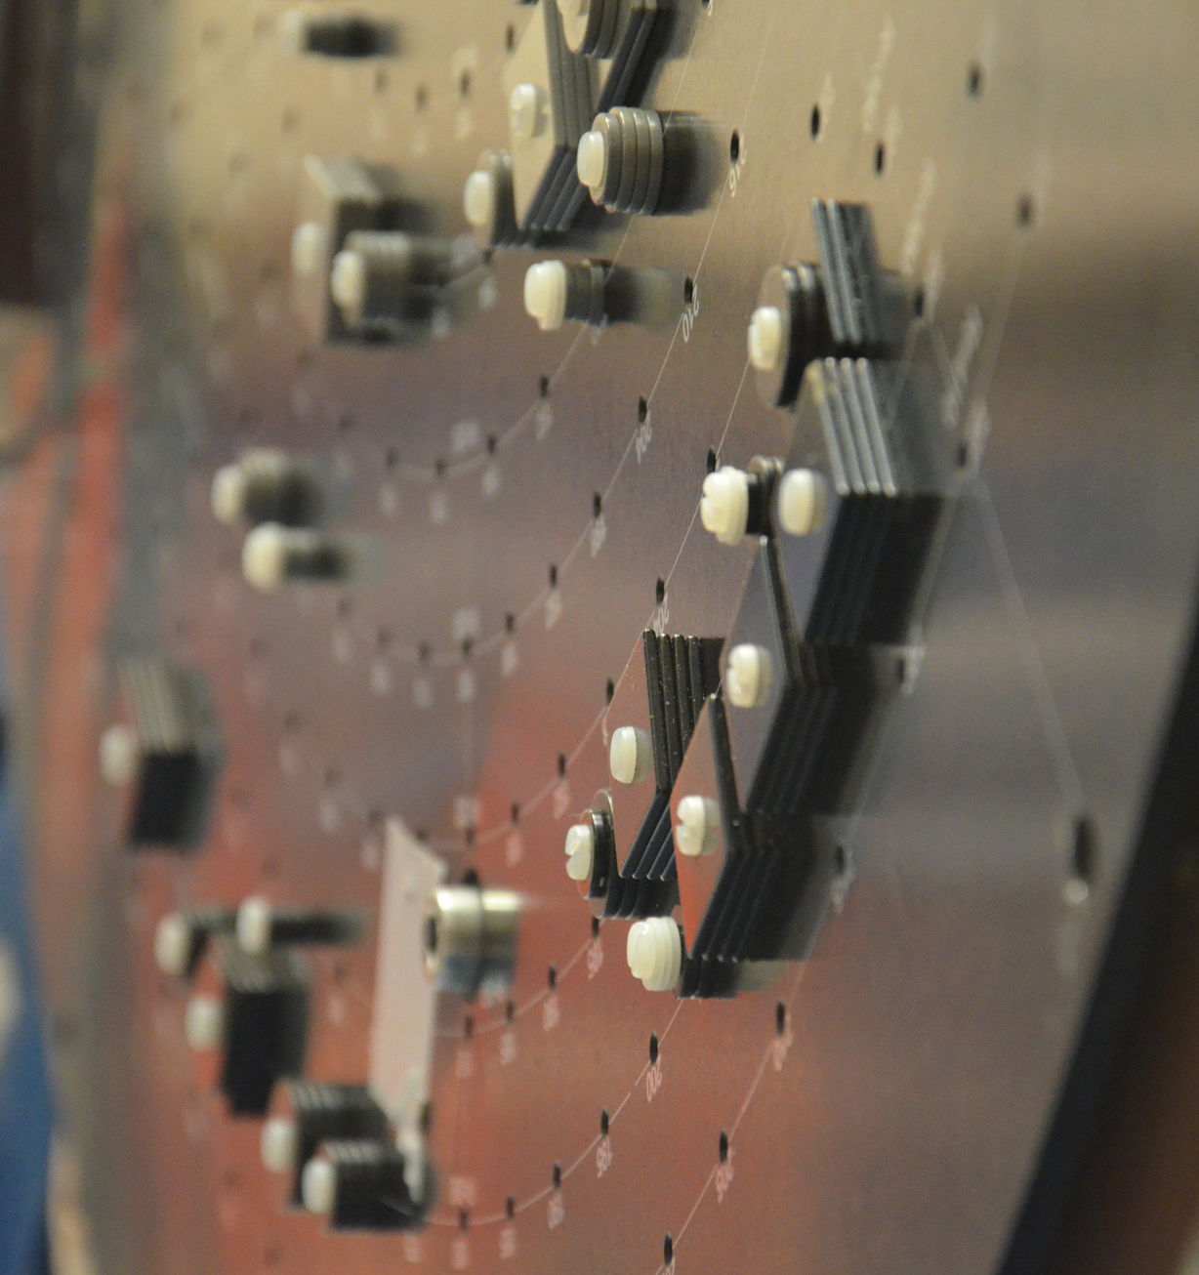
LOCATION 4: mri systems
Merging design innovation with leading-edge medical technology, ASG Superconductors provides advanced solutions in diagnostic imaging and cancer therapy, delivering exceptional value to the global community of Healthcare Providers.

Slide 9
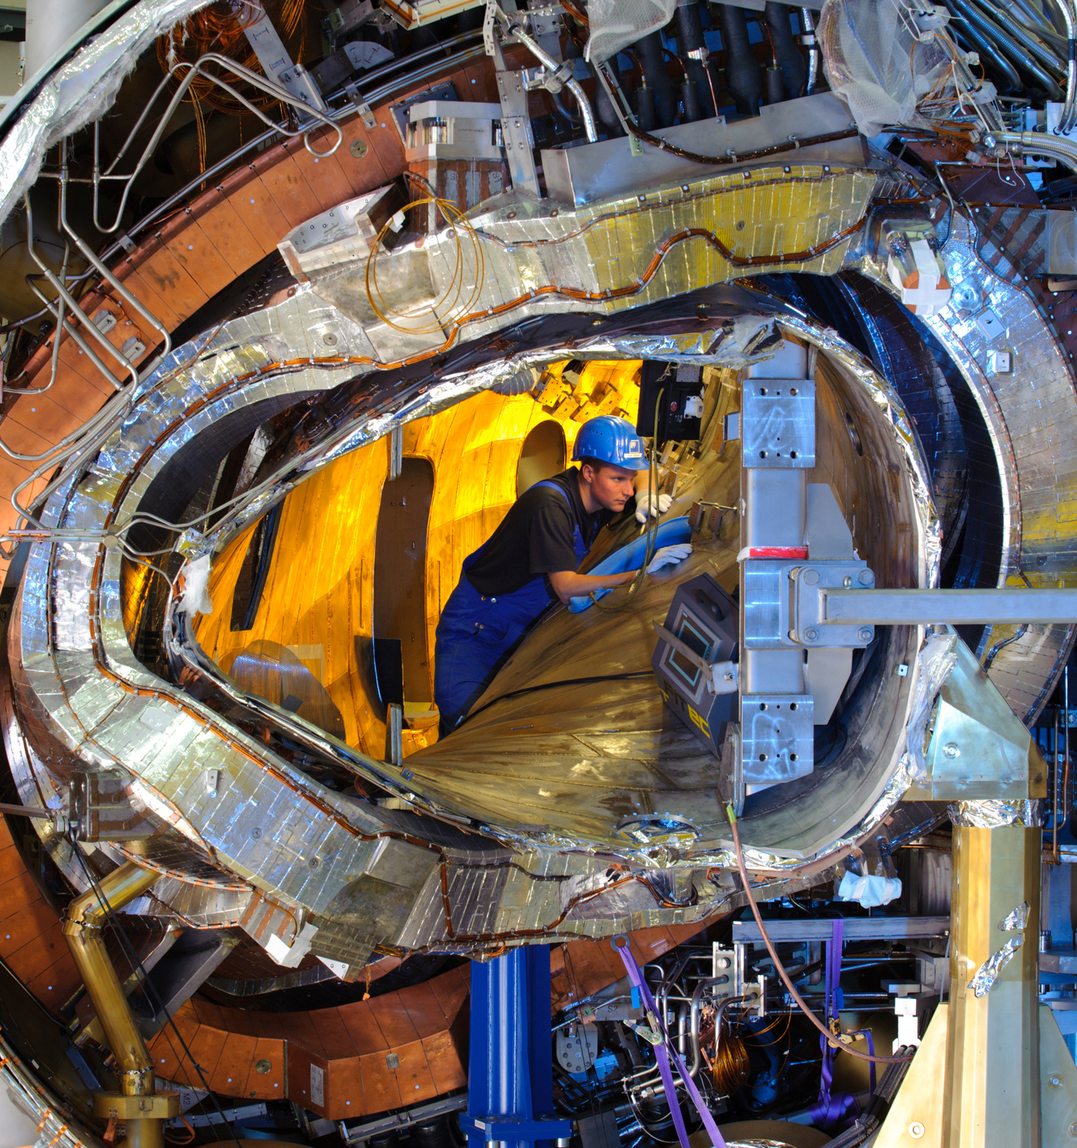
LOCATION 5: fusion
The quality of ASG's nuclear fusion offering is the result of unequalled technical and productive expertise; thanks also to its continuous dialog with the main institutes and research centers worldwide - including ENEA, UKAEA, CEA, IPP, ITER and Fusion4Energy, our magnets have been used in all the main fusion experiments undertaken so far in Europe during the last 70 years.

Slide 10
LOCATION 6: ptolemy
Showcase of PTOLEMY MgB2 magnet project and technical discussion.

Slide 11
Index
First steps
Advances
Conclusions and future works
11
SUPRASYS’ AND ASG SUPERCONDUCTORS PROPIETARY AND CONFIDENTIAL INFORMATION. Total or partial sharing of the information is not permitted without agreement.

Slide 12
PTOLEMY Full-Scale Prototype at LNGS
SUPRASYS’ AND ASG SUPERCONDUCTORS PROPIETARY AND CONFIDENTIAL INFORMATION. Total or partial sharing of the information is not permitted without agreement.

Slide 13
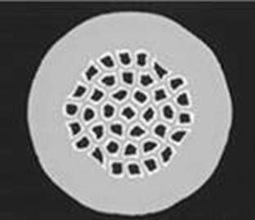
MgB₂ coil design
High and narrow coil, 3 layers of conductor, total of 436 turns.
1 mm diameter wire with 37 strands per wire.
Magnetic iron grade is Steel 1020.
ID | Feature | Value | Note
1 | Overall copper plated conductor diameter [mm] | 1 mm
2 | Overall Area [mm²] | 0.78 mm²
3 | MgB₂ area [mm² and %] | 0.09 mm² - 12%
4 | Monel area [mm² and %] | 0.36 mm² – 46%
5 | Nickel area [mm² and %] | 0.12 mm² – 15%
6 | Niobium area [mm² and %] | 0.10 mm² – 13%
7 | Copper area [mm² and %] | 0.11 mm² – 14%
8 | Copper plated conductor Fill Factor [%] | 12%
9 | Twist pitch [mm] | 85 | Clockwise
11 | Minimum bending radius [mm] | 100 | Corresponding to a Ic value degradation of 2% with respect to a non-bent sample.
12 | Maximum allowable strain [%] at room temperature. | 0.28 | Same as above
11 | Number of filaments | 37
SUPRASYS’ AND ASG SUPERCONDUCTORS PROPIETARY AND CONFIDENTIAL INFORMATION. Total or partial sharing of the information is not permitted without agreement.

Slide 14
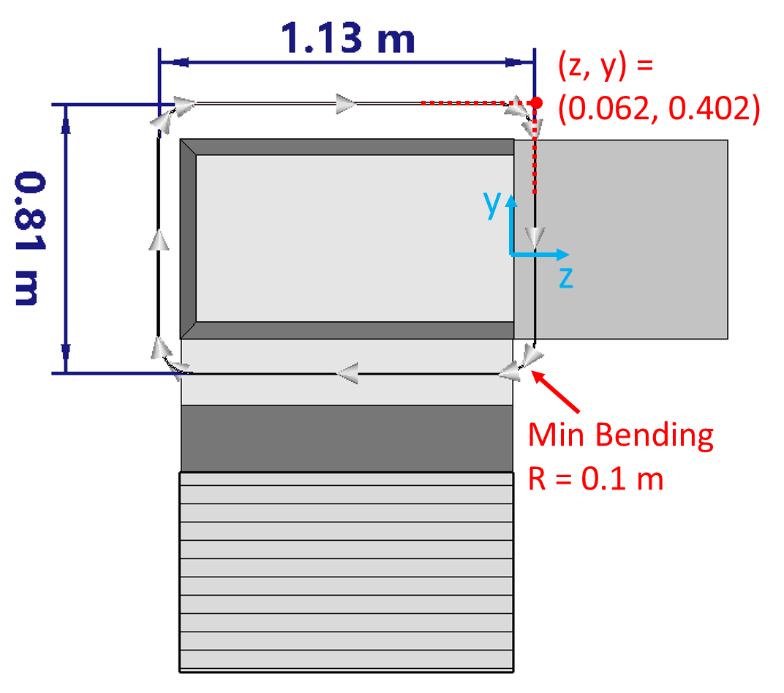
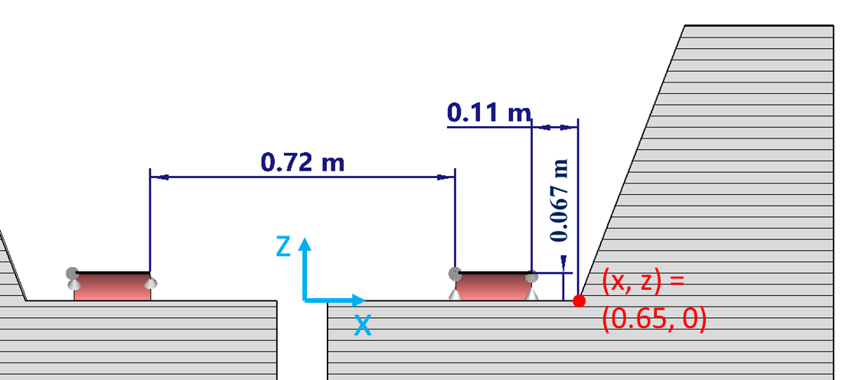
Electromagnetic coil design
Final position of the coil have been set by Princeton.
The electromagnetic models have been checked with the University.
Small changes in the straight part of the coil.
SUPRASYS’ AND ASG SUPERCONDUCTORS PROPIETARY AND CONFIDENTIAL INFORMATION. Total or partial sharing of the information is not permitted without agreement.

Slide 15
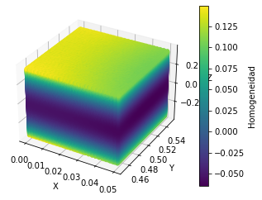
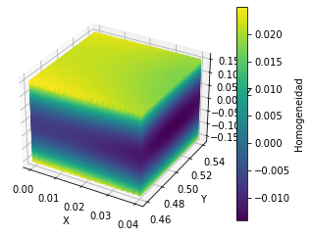
Electromagnetic design
The magnet has been optimized to obtain 1T field value.
The magnet has been optimized to obtain specific field homogeneity.
Influence of the coil position on the homogeneity due to vibrations.
Dipolar field has been analyzed.
Homogenity 100 x 100 x 700 mm // 80 x 80 x 300 mm centred in the airgap
SUPRASYS’ AND ASG SUPERCONDUCTORS PROPIETARY AND CONFIDENTIAL INFORMATION. Total or partial sharing of the information is not permitted without agreement.

Slide 16
Index
First steps
Advances
Conclusions and future works
16
SUPRASYS’ AND ASG SUPERCONDUCTORS PROPIETARY AND CONFIDENTIAL INFORMATION. Total or partial sharing of the information is not permitted without agreement.

Slide 17
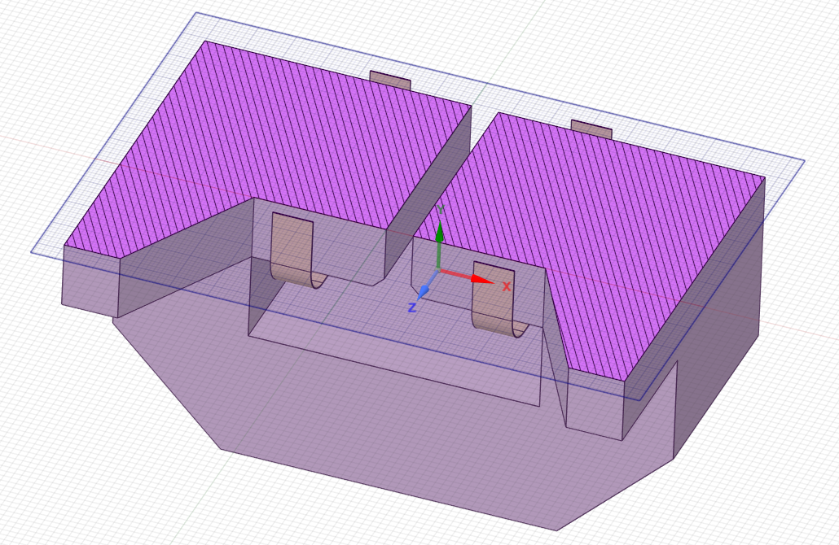
Magnetic calculations including manufacturing effects
Lack of paralelism | Homogeneity
2 mm | 0.71 %
0.5 mm | 0.29 %
0.2 mm | 0.207%
0 mm | 0.1493 %
0.05 mm | 0.1641 %
Parallelism in the airgap faces affects a lot to the homogeneity.
Airgap distance tolerance don’t affect too much on the homogeneity.
To take into account manufacturing tolerances, the air gap has been increased from 120mm to 140mm. This will give us space for optimizing the iron shape and eventually for shimming after magnetic measurements if necessary.
The operating current has been increased accordingly from 140A to 160A.
2D model to optimize the homogeneity.
SUPRASYS’ AND ASG SUPERCONDUCTORS PROPIETARY AND CONFIDENTIAL INFORMATION. Total or partial sharing of the information is not permitted without agreement.

Slide 18
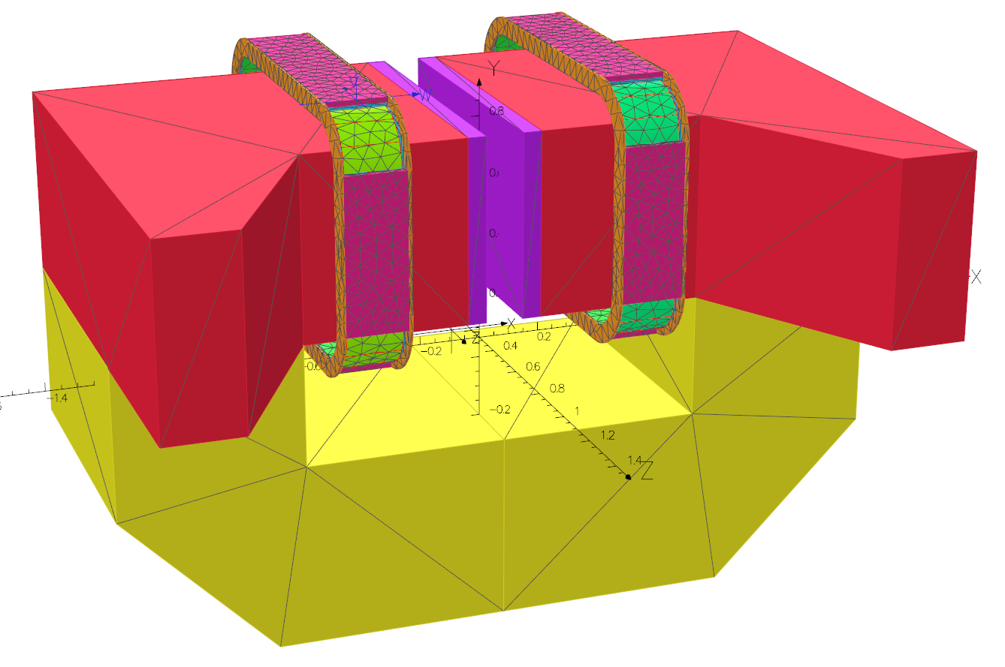
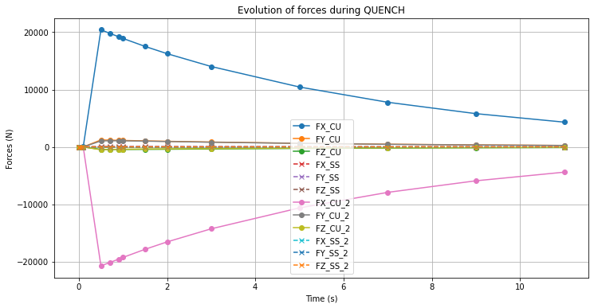
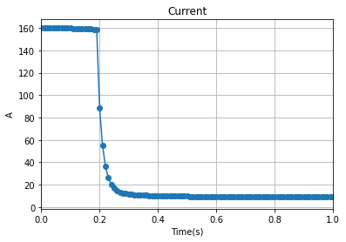
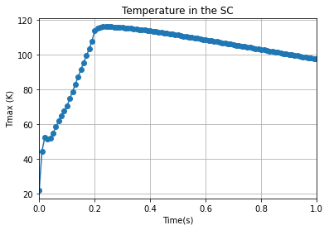
QUENCH protection system
The calculation of the QUENCH system has been updated.
The copper and stainless steel structure has been modelled to calculate the forces induced by eddy currents during QUENCH.
The forces generated during QUENCH are used in the mechanical calculations.
Operating current | 160A
Voltage drop for the detector | 0.5 V
Time delay | 0.1s
Maximum SC temperature | <120K
Coil voltage drop | <400V
Dump resistor voltage drop | <650V
Minimum QUENC energy | 0.3J
SUPRASYS’ AND ASG SUPERCONDUCTORS PROPIETARY AND CONFIDENTIAL INFORMATION. Total or partial sharing of the information is not permitted without agreement.

Slide 19
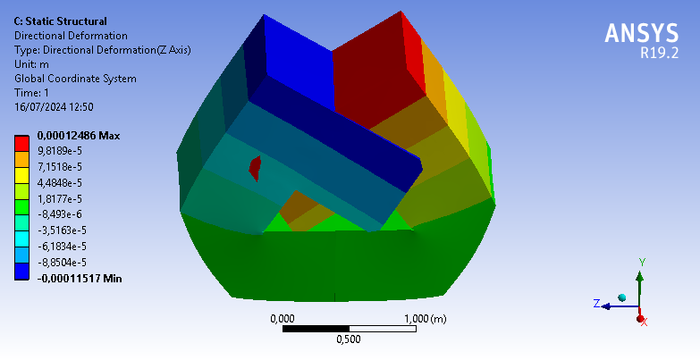
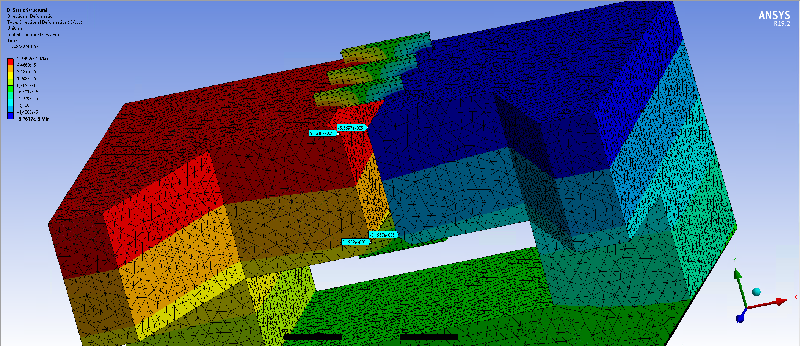
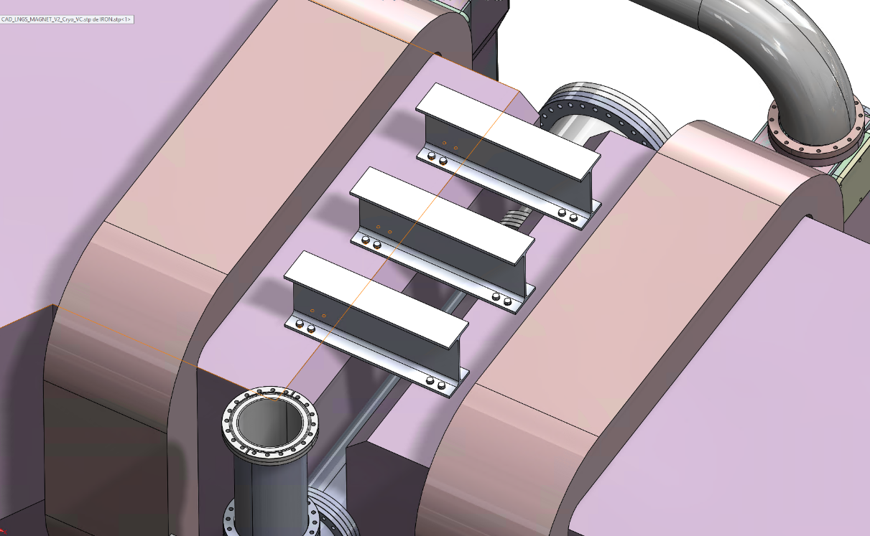
Stainless steel profiles to mitigate deformations due to electromagnetic forces
We realize a deformation above 50um in the airgap. (Bigger than 50 um limit).
6 IPE 160 profiles (length 400mm), 3 at the top and 3 at the bottom of the air gap.
In coordination with INFN to avoid collisions with the vacuum chamber.
The maximum deformation is now 29 um.
SUPRASYS’ AND ASG SUPERCONDUCTORS PROPIETARY AND CONFIDENTIAL INFORMATION. Total or partial sharing of the information is not permitted without agreement.

Slide 20
Magnet and coil assembly

Slide 21
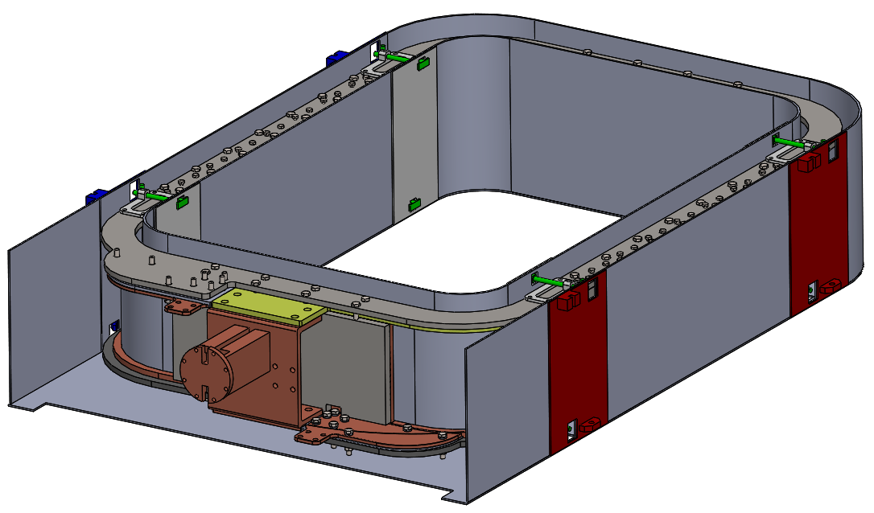
Coil assembly
Magnet terminals
The two coils are refrigerated by the same cool head connected by a copper bar.
The coils are connected in series by a superconducting wire housed in the arc.
The coil assembly (20K) is fixed by titanium supports to radiation shield (80K), which is attached to the second stage of the cryocooler.
The radiation shield (80K) is fixed also by titanium supports to vacuum chamber (300K), which is attached to iron.
SUPRASYS’ AND ASG SUPERCONDUCTORS PROPIETARY AND CONFIDENTIAL INFORMATION. Total or partial sharing of the information is not permitted without agreement.

Slide 22
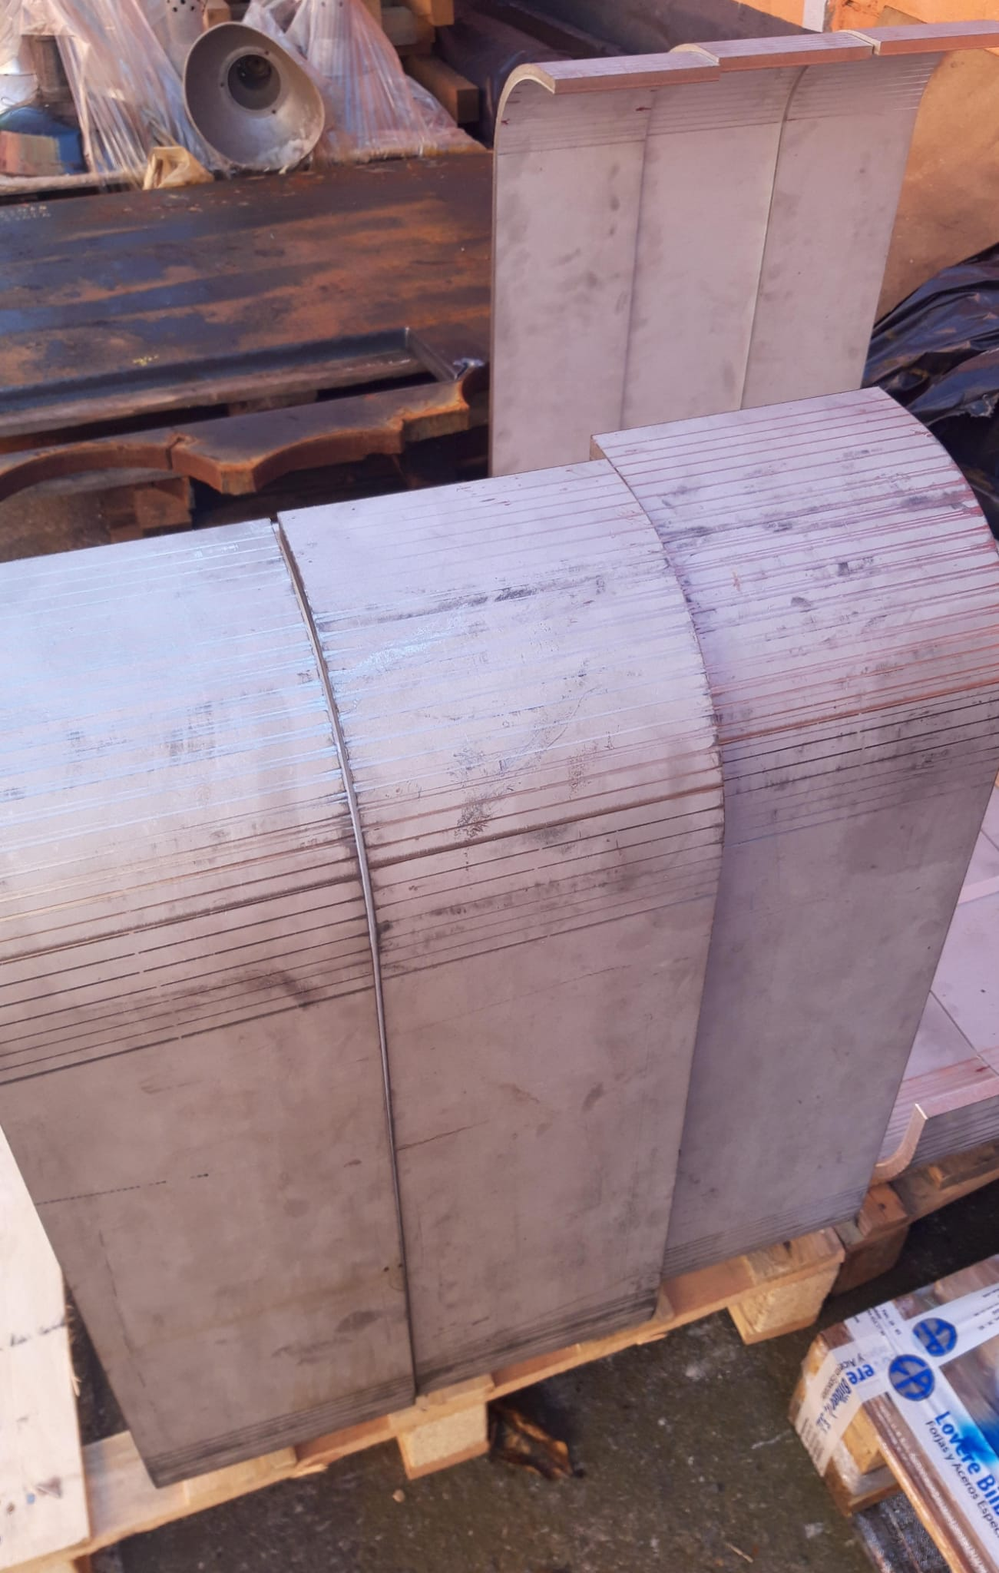
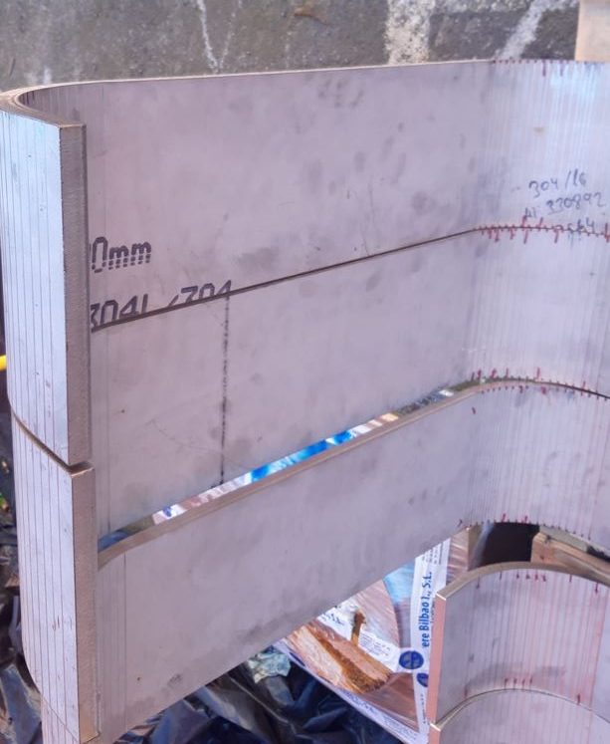
Material supply and manufacturing: Coil assembly
The mandrel is made of austenitic stainless steel 304.
After the manufacturing process, the mandrel is electrically insulated.
The MgB₂ superconducting wire is wound around the mandrel to form the coil.
It is manufactured from pieces which are welded together.
SUPRASYS’ AND ASG SUPERCONDUCTORS PROPIETARY AND CONFIDENTIAL INFORMATION. Total or partial sharing of the information is not permitted without agreement.

Slide 23
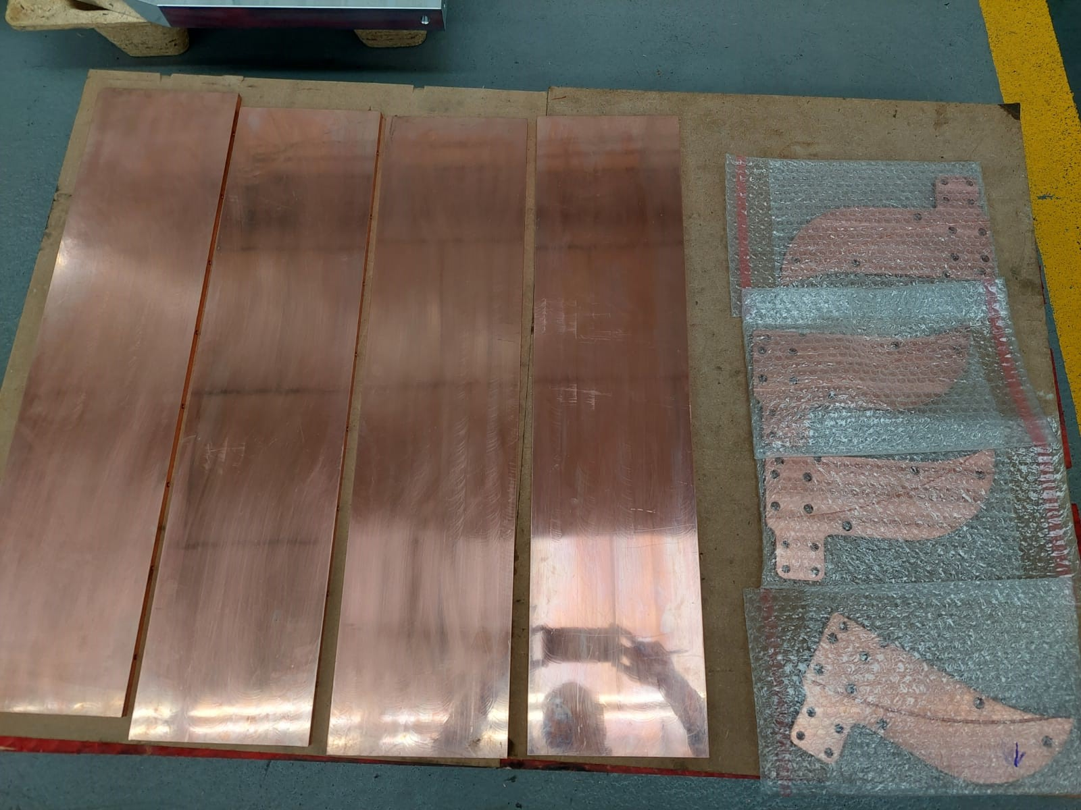
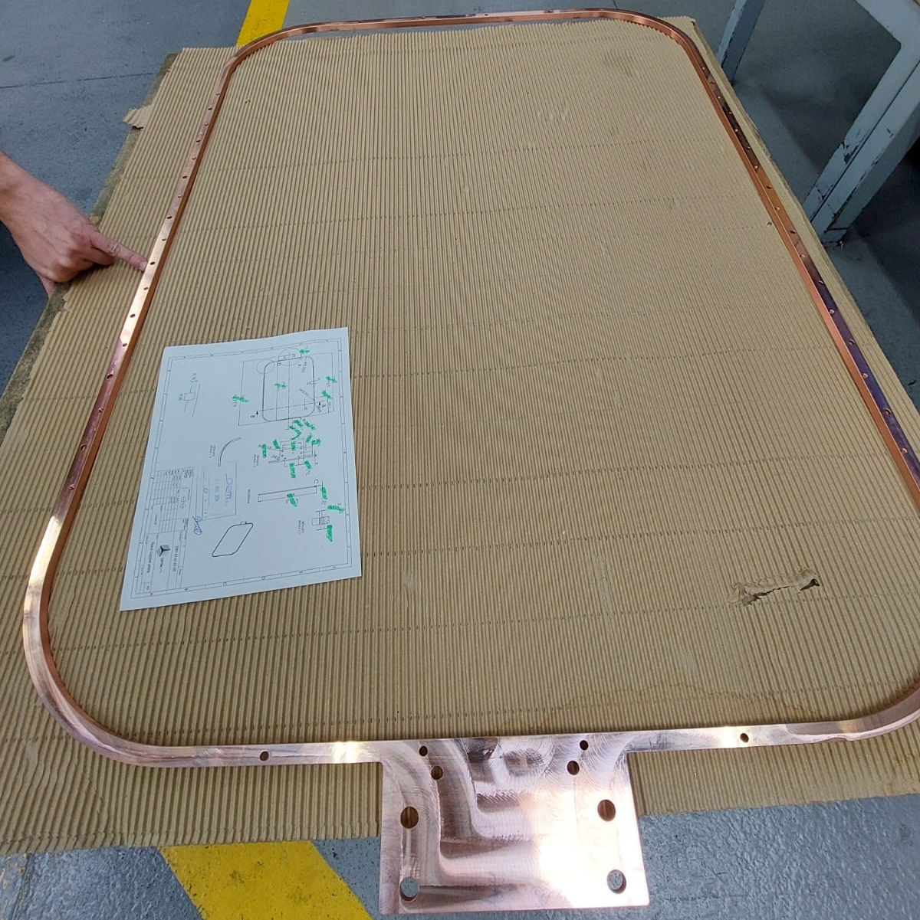
Material supply and manufacturing: Coil assembly
SS Mandrel
Fixed copper plate, insulated.
SS lower plate
Soldering of MgB2
Copper terminal
Teflon insulator
The MgB₂ will be wound around the SS mandrel.
SUPRASYS’ AND ASG SUPERCONDUCTORS PROPIETARY AND CONFIDENTIAL INFORMATION. Total or partial sharing of the information is not permitted without agreement.

Slide 24
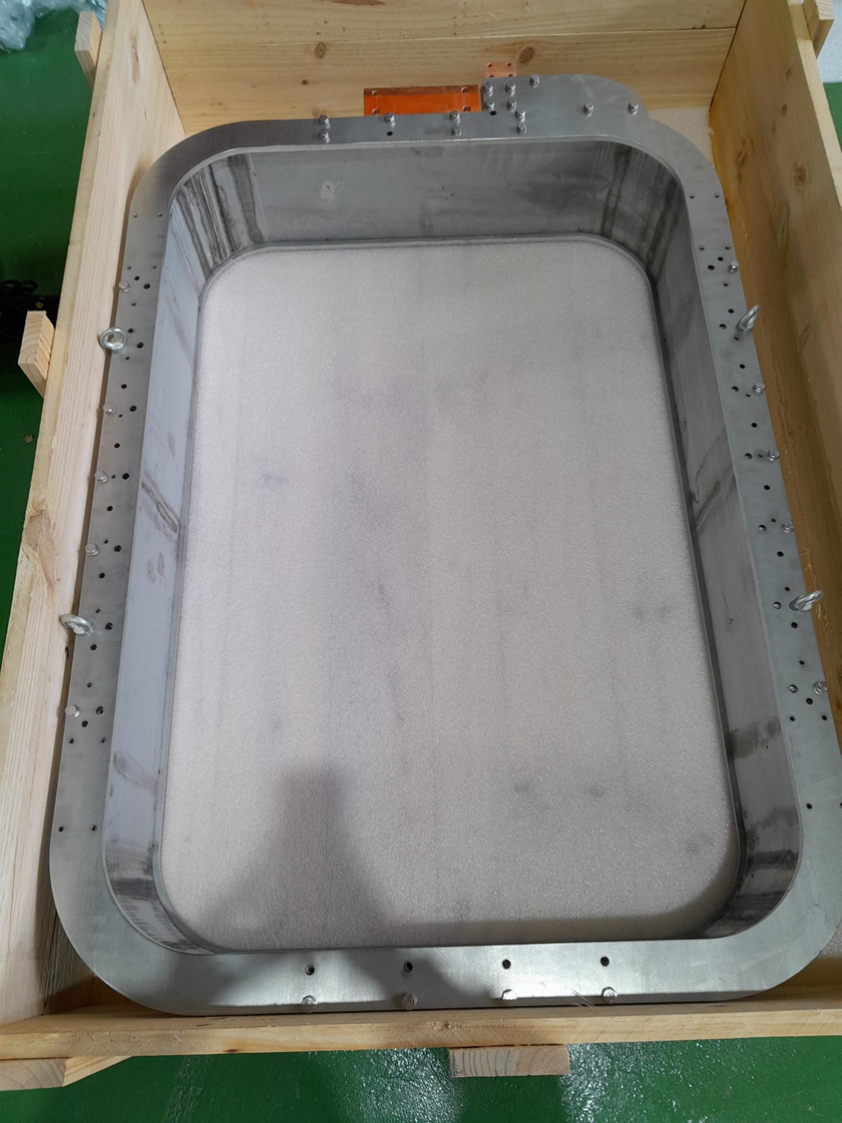
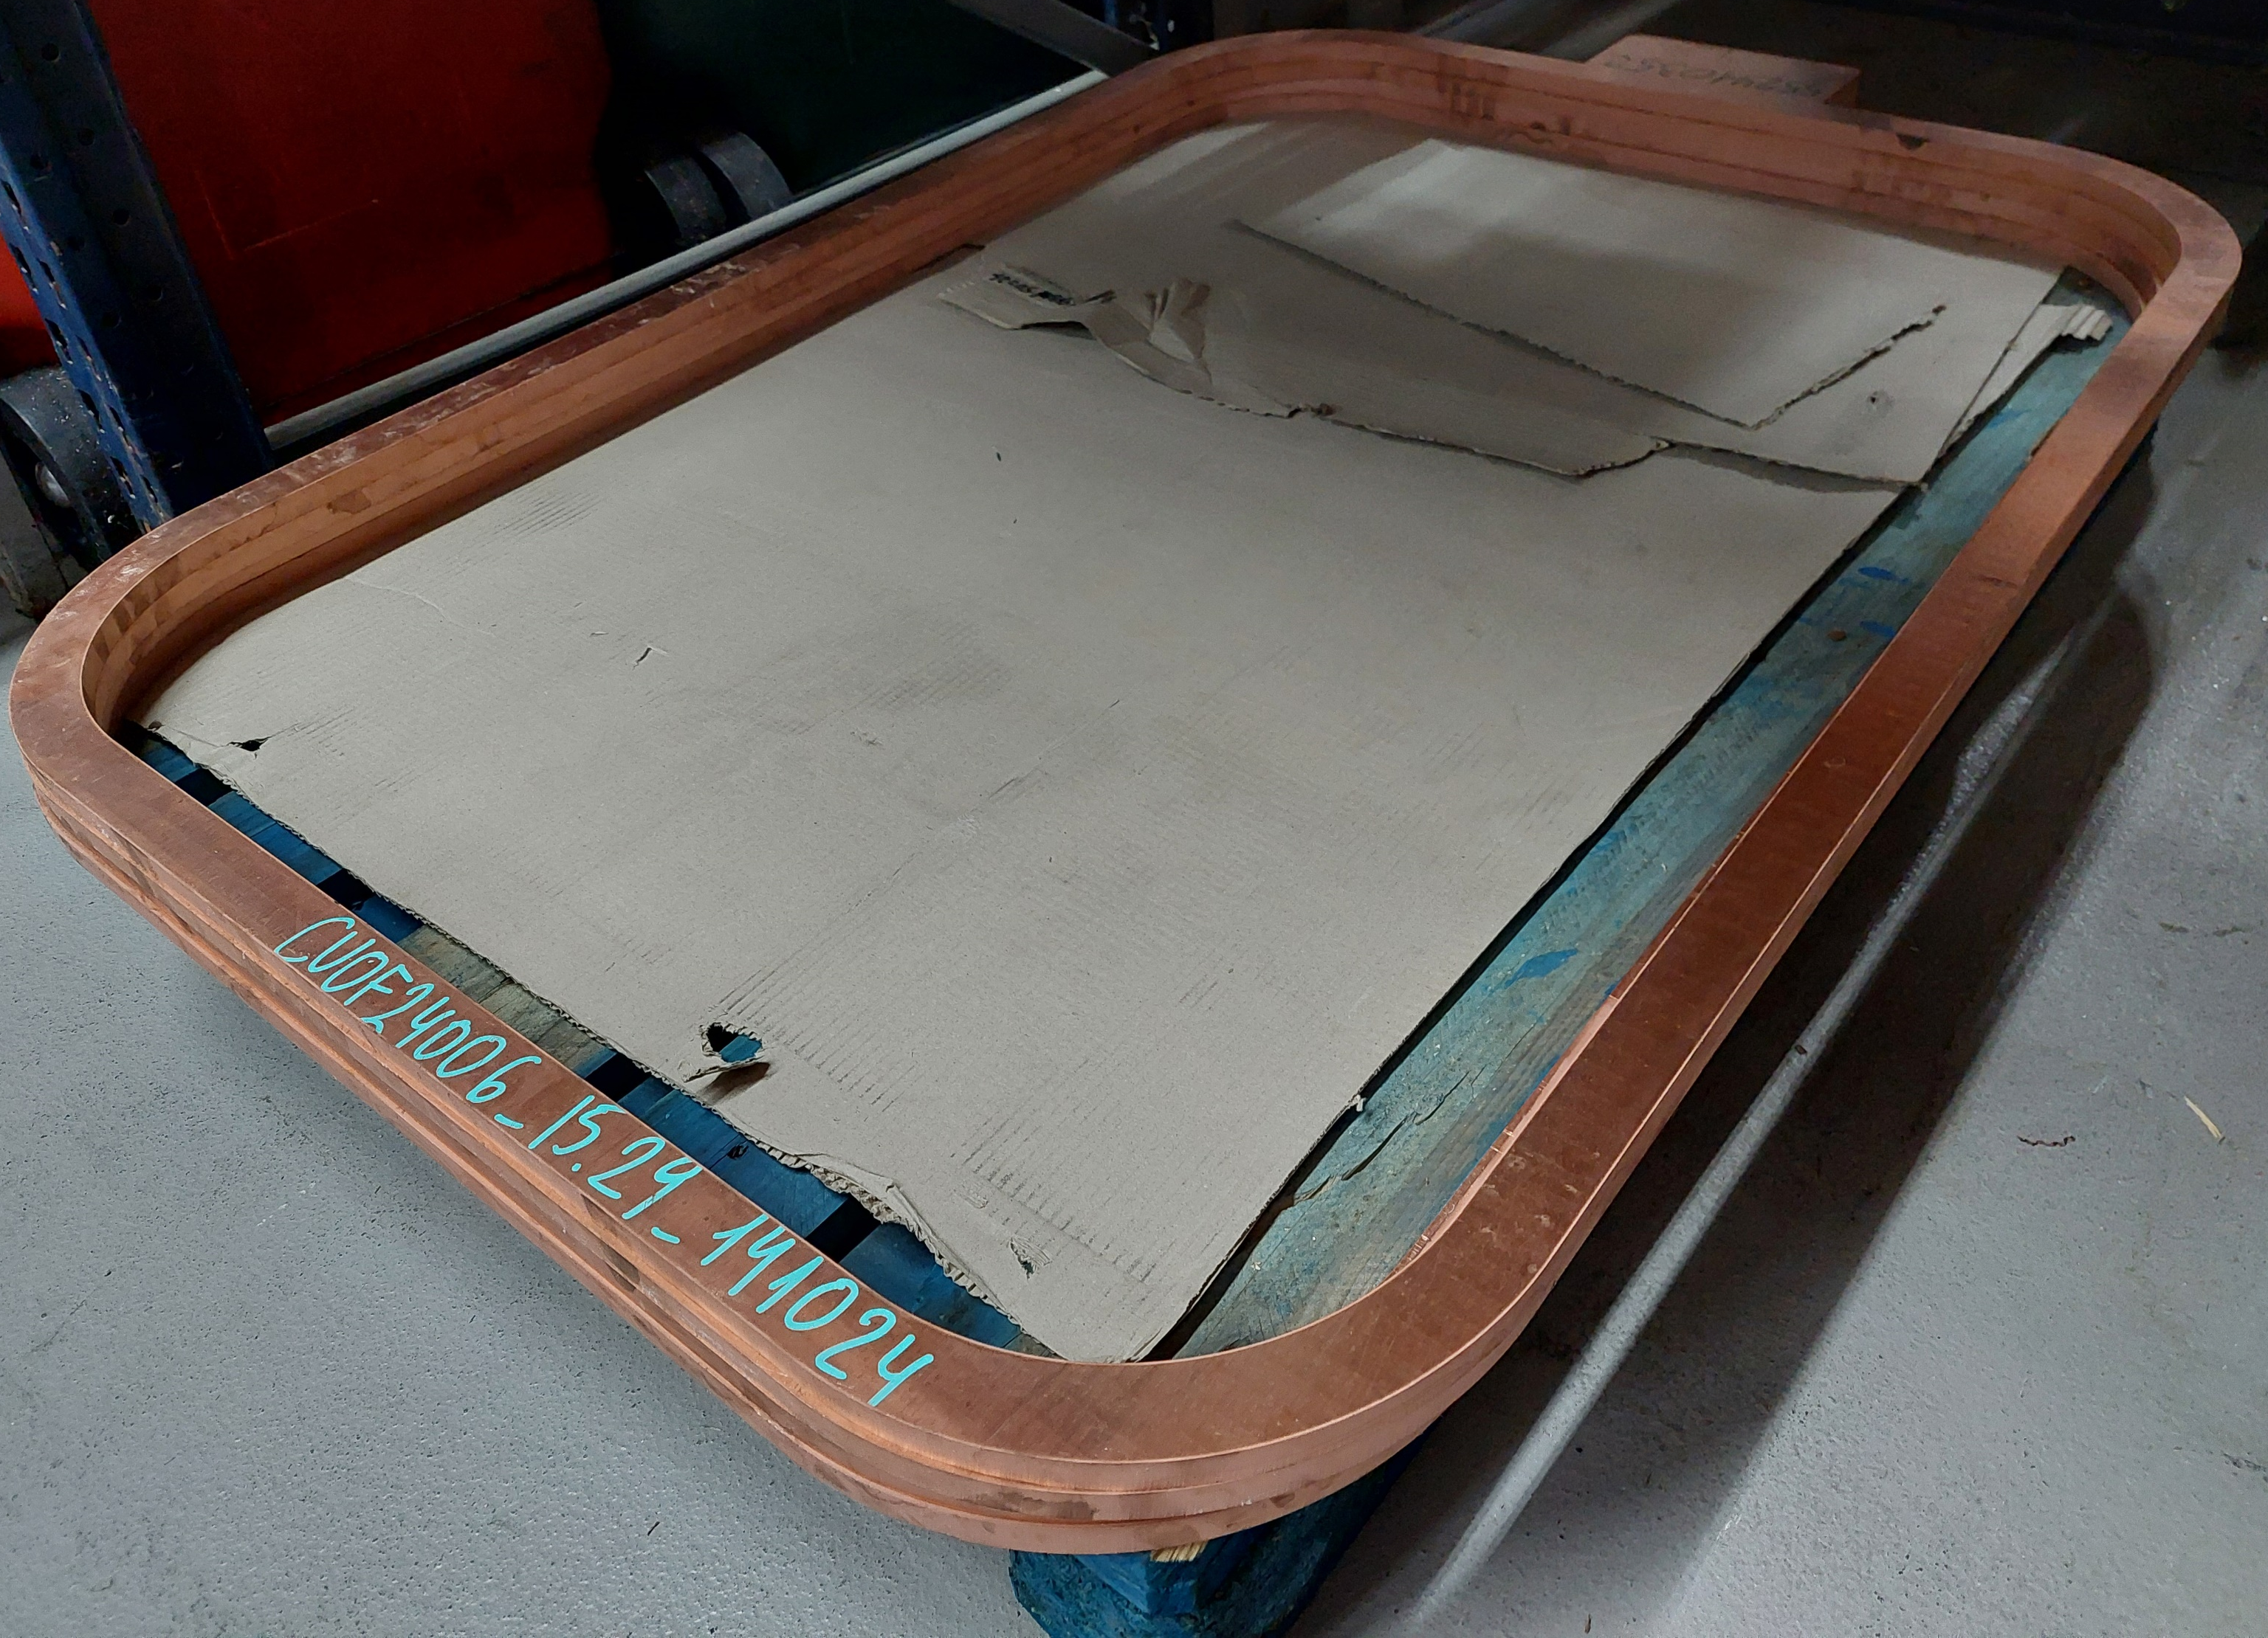
Material supply and manufacturing: Coil assembly
437 turns
SS upper plate
A sliding copper plate will be placed on the top to fix the height after the first winding layer.
The sliding copper plate will be held with a stainless steel top plate.
Teflon and copper terminal
Sliding copper plate, insulated
SUPRASYS’ AND ASG SUPERCONDUCTORS PROPIETARY AND CONFIDENTIAL INFORMATION. Total or partial sharing of the information is not permitted without agreement.

Slide 25
Material supply and manufacturing: Coil assembly
After winding, MgB₂ wire will be assembled with copper plates in the straight parts for thermalization.
After impregnation the assembly will be reinforced with stainless Steel (SS) plates.
Impregnation
SUPRASYS’ AND ASG SUPERCONDUCTORS PROPIETARY AND CONFIDENTIAL INFORMATION. Total or partial sharing of the information is not permitted without agreement.

Slide 26
Magnet assembly
Four alignment references on the top of the iron yoke.
Hooks were also included to facilitate the mounting of the horns.
SUPRASYS’ AND ASG SUPERCONDUCTORS PROPIETARY AND CONFIDENTIAL INFORMATION. Total or partial sharing of the information is not permitted without agreement.

Slide 27
Instrumentation
In order to be able to control and guarantee correct operation, it is foreseen to install:
Temperature sensors in the cold head, 1st and 2nd stage.
Voltage, current and temperature measurements in the coil.
Temperature measurements in the radiation shield.
Vacuum measurements.
SUPRASYS’ AND ASG SUPERCONDUCTORS PROPIETARY AND CONFIDENTIAL INFORMATION. Total or partial sharing of the information is not permitted without agreement.

Slide 28
Index
First steps
Advances
Conclusions and future works
28
SUPRASYS’ AND ASG SUPERCONDUCTORS PROPIETARY AND CONFIDENTIAL INFORMATION. Total or partial sharing of the information is not permitted without agreement.

Slide 29
Conclusions and future works
Components have been verified by numerical simulations.
Assembling procedure has been validated.
Engineering design has been completed.
Coil assembly components sent to manufacturing.
First winding tests carried out.
Next actions:
Winding, impregnation and test of coils (January-February).
Iron yoke and cryostat manufacturing (March).
Magnet assembly and tested in ASG (April).
SUPRASYS’ AND ASG SUPERCONDUCTORS PROPIETARY AND CONFIDENTIAL INFORMATION. Total or partial sharing of the information is not permitted without agreement.

Slide 30
Thank you for your attention!
Matteo Tropeano Columbus MgB2 Unit
M. +39 3929995030
tropeano.matteo@as-g.it
Via delle Terre Rosse, 30
16133 Genoa – Italy
ASG Superconductors SpA
www.asgsuperconductors.com
Joseba Bastarrarena Segurola
Ingeniero eléctrico
Joseba.bastarrarena@suprasys.es
T +34 946 85 58 37
M +34 668 71 33 34
www.suprasys.es
Avda. Lehendakari Aguirre, 11, 7º Dpto. 7
48014 Bilbao (Spain)
SUPRASYS’ AND ASG SUPERCONDUCTORS PROPIETARY AND CONFIDENTIAL INFORMATION. Total or partial sharing of the information is not permitted without agreement.

