Slide 1
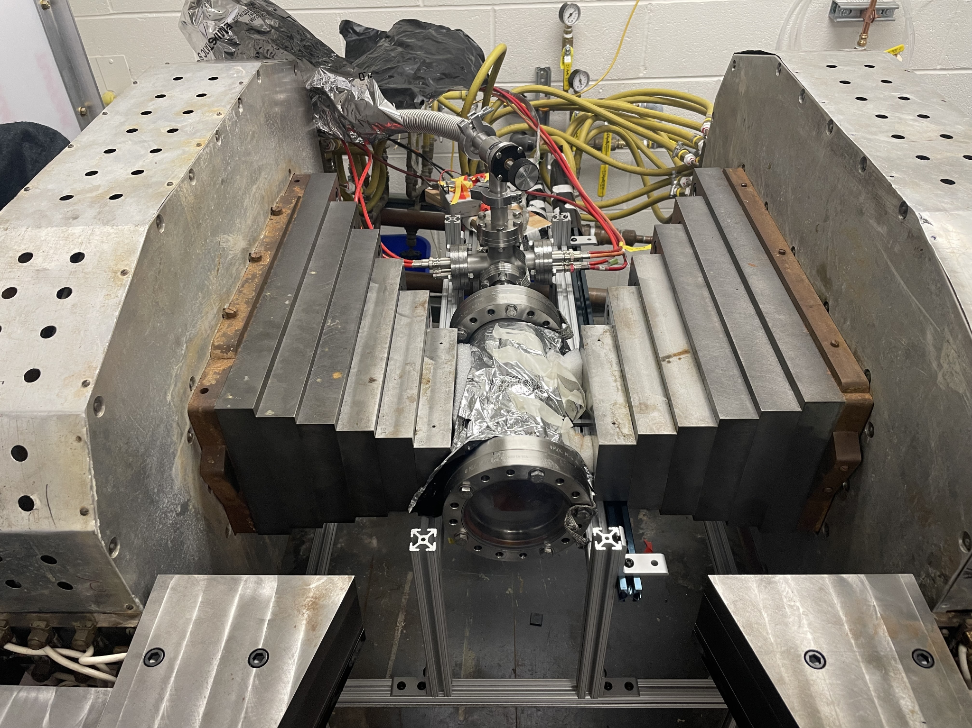
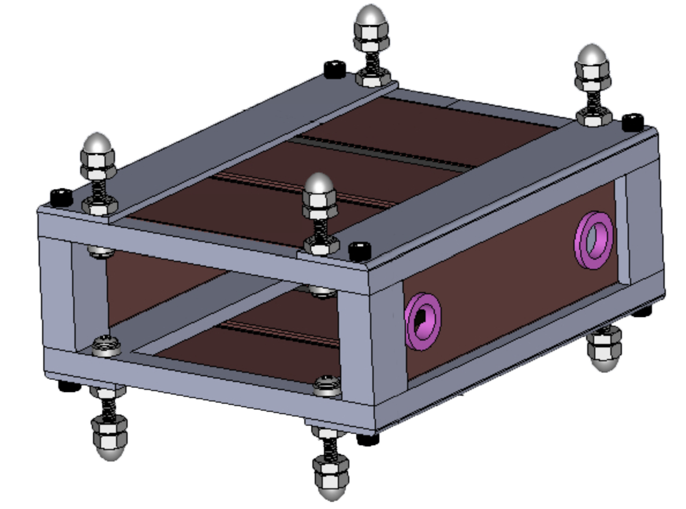
Electron ExB Slow Drift Demonstration
Mark Farino, Andi Tan

Slide 2
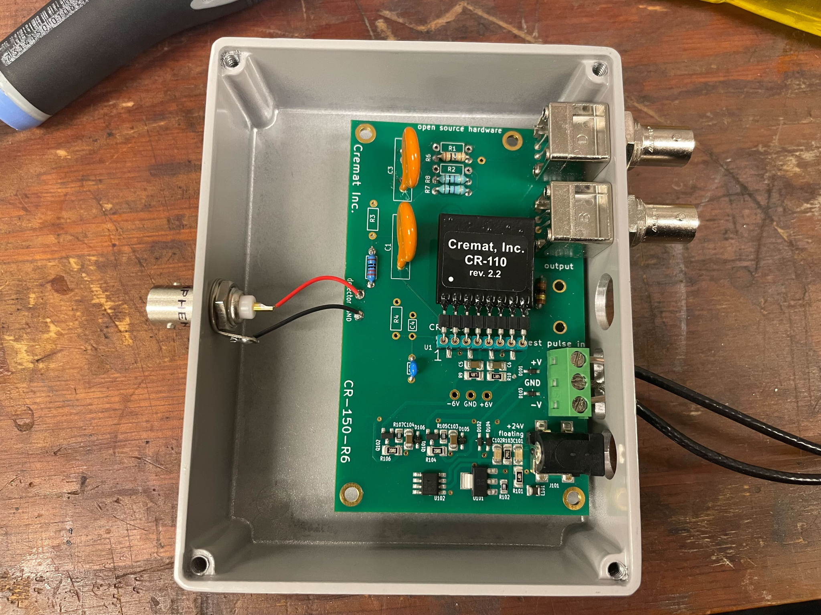
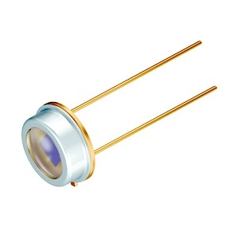
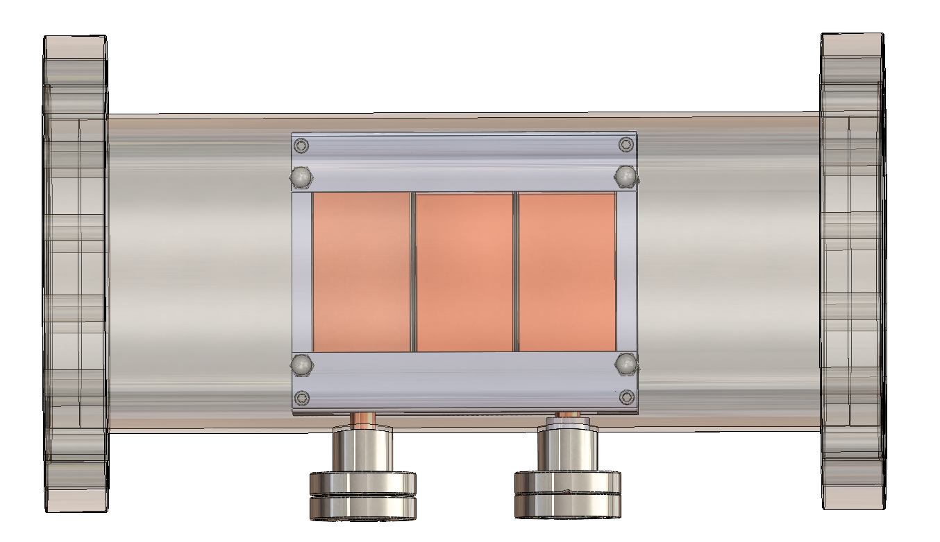
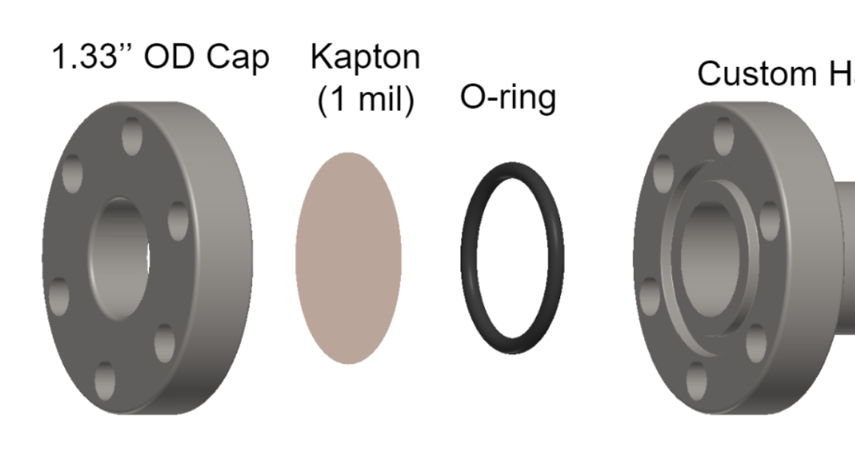
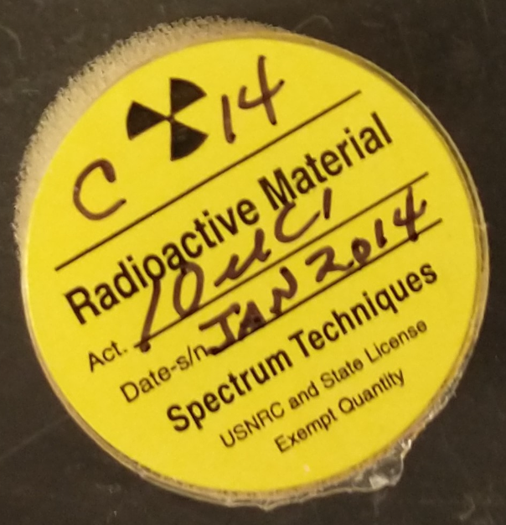
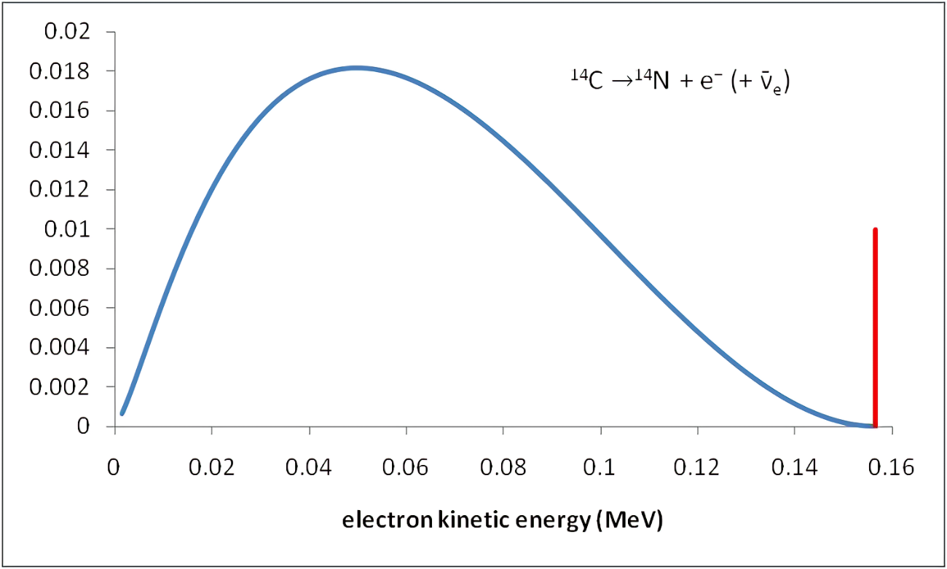
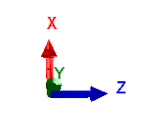
At Pollica…
Successfully measured difference in event rates of electrons emitted by C-14 (through Kapton film) using windowless PIN Diode based on ExB drift
Readout system consists of BPX-61 PIN Diode with protective glass removed, Cremat Evaluation Board, and shaping amplifier
(presented March 2024)
System maintained at ~10e-6 Torr and immersed in 0.3 T magnetic field
Electron-permeable thin film window. Electrons pass losing ~15-20 keV (presented april 2023)
10uCi source with maximum electron energy ~160 keV
Mark Farino

Slide 3
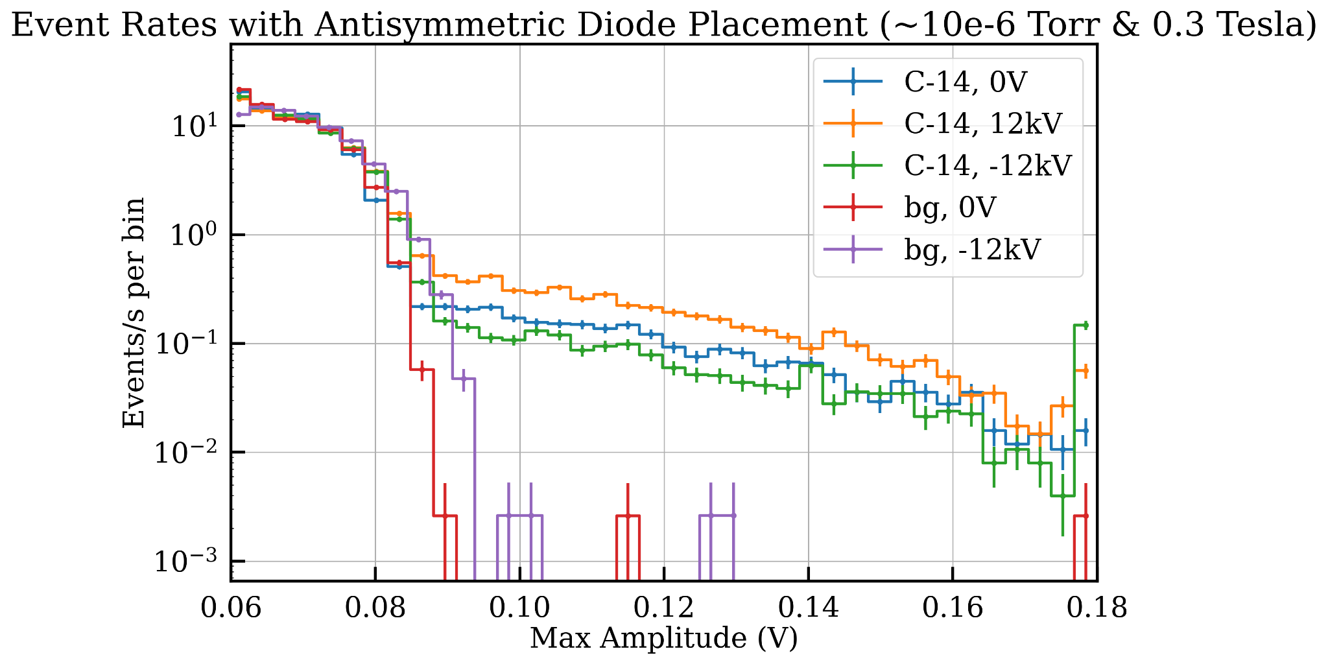
At Pollica…
Successfully measured difference in event rates of electrons emitted by C-14 (through Kapton film) using windowless PIN Diode based on ExB drift
Mark Farino

Slide 4
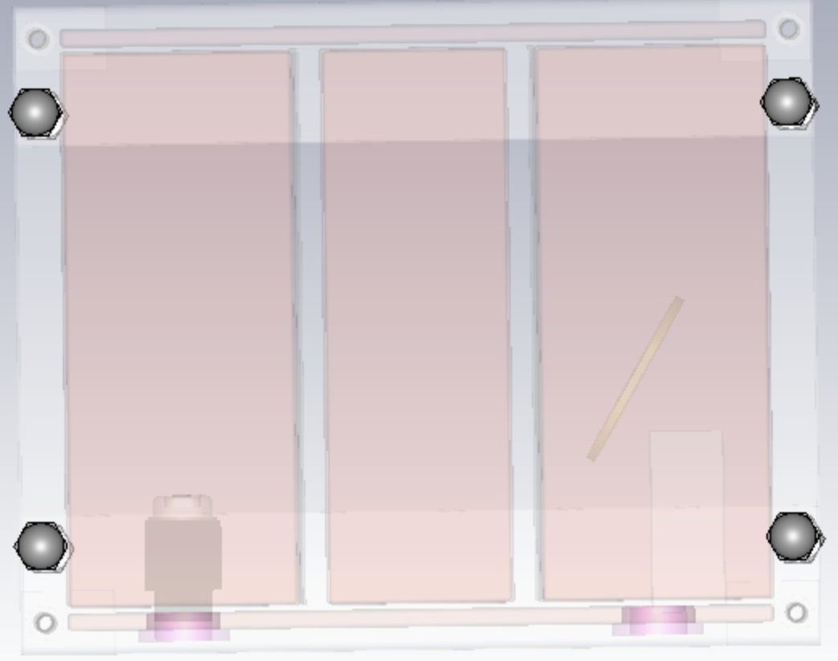
Steps Toward Multibounce Slow Drift
-6kV
-6kV
Mark Farino

Slide 5
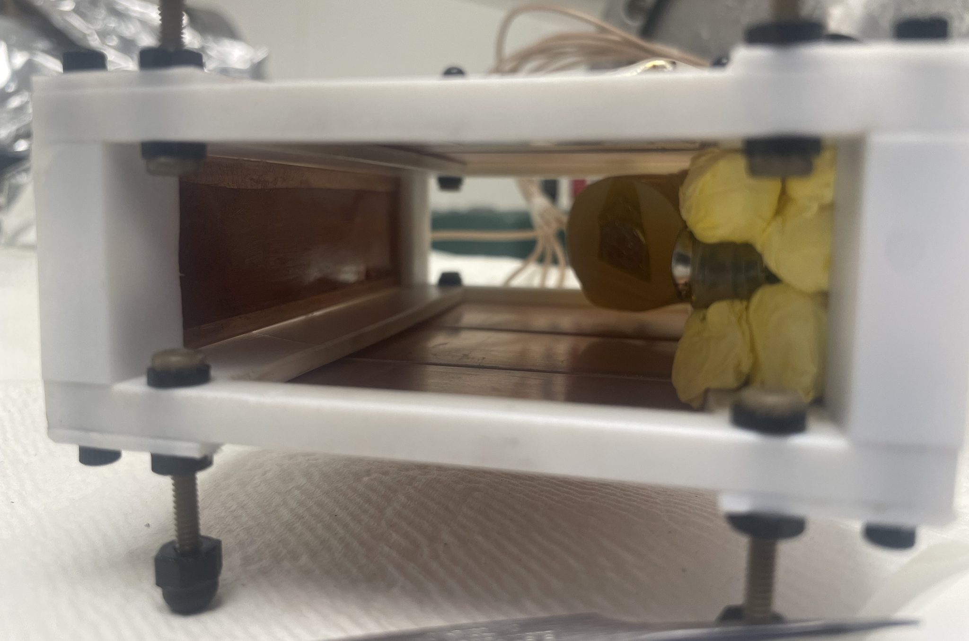
Steps Toward Multibounce Slow Drift
To increase event rate:
C-14 source disk and PIN Diode placed inside chamber
Mark Farino

Slide 6
Steps Toward Multibounce Slow Drift
To increase event rate:
C-14 source disk and PIN Diode placed inside chamber
C-14 source disk set at 60 degree angle
Mark Farino

Slide 7
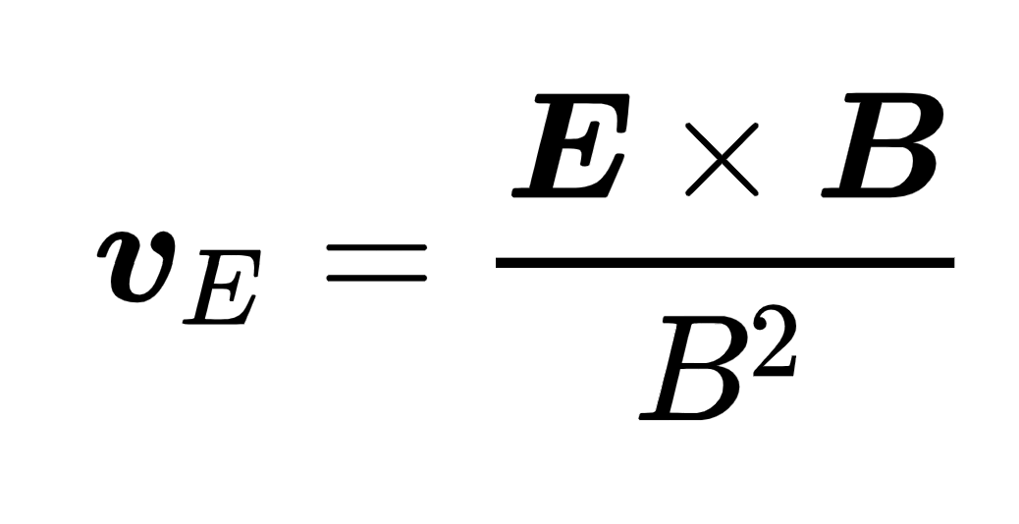
Steps Toward Multibounce Slow Drift
To increase event rate:
C-14 source disk and PIN Diode placed inside chamber
C-14 source disk set at 60 degree angle
B-field lowered to 0.16 T
Mark Farino

Slide 8
Steps Toward Multibounce Slow Drift
To increase event rate:
C-14 source disk and PIN Diode placed inside chamber
C-14 source disk set at 60 degree angle
B-field lowered to 0.16 T
To mitigate backgrounds & sparking:
Center Electrodes width reduced (1.25’’ => 1’’)
3 mil thick Kapton lined inside vacuum chamber & electrodes
Mark Farino

Slide 9
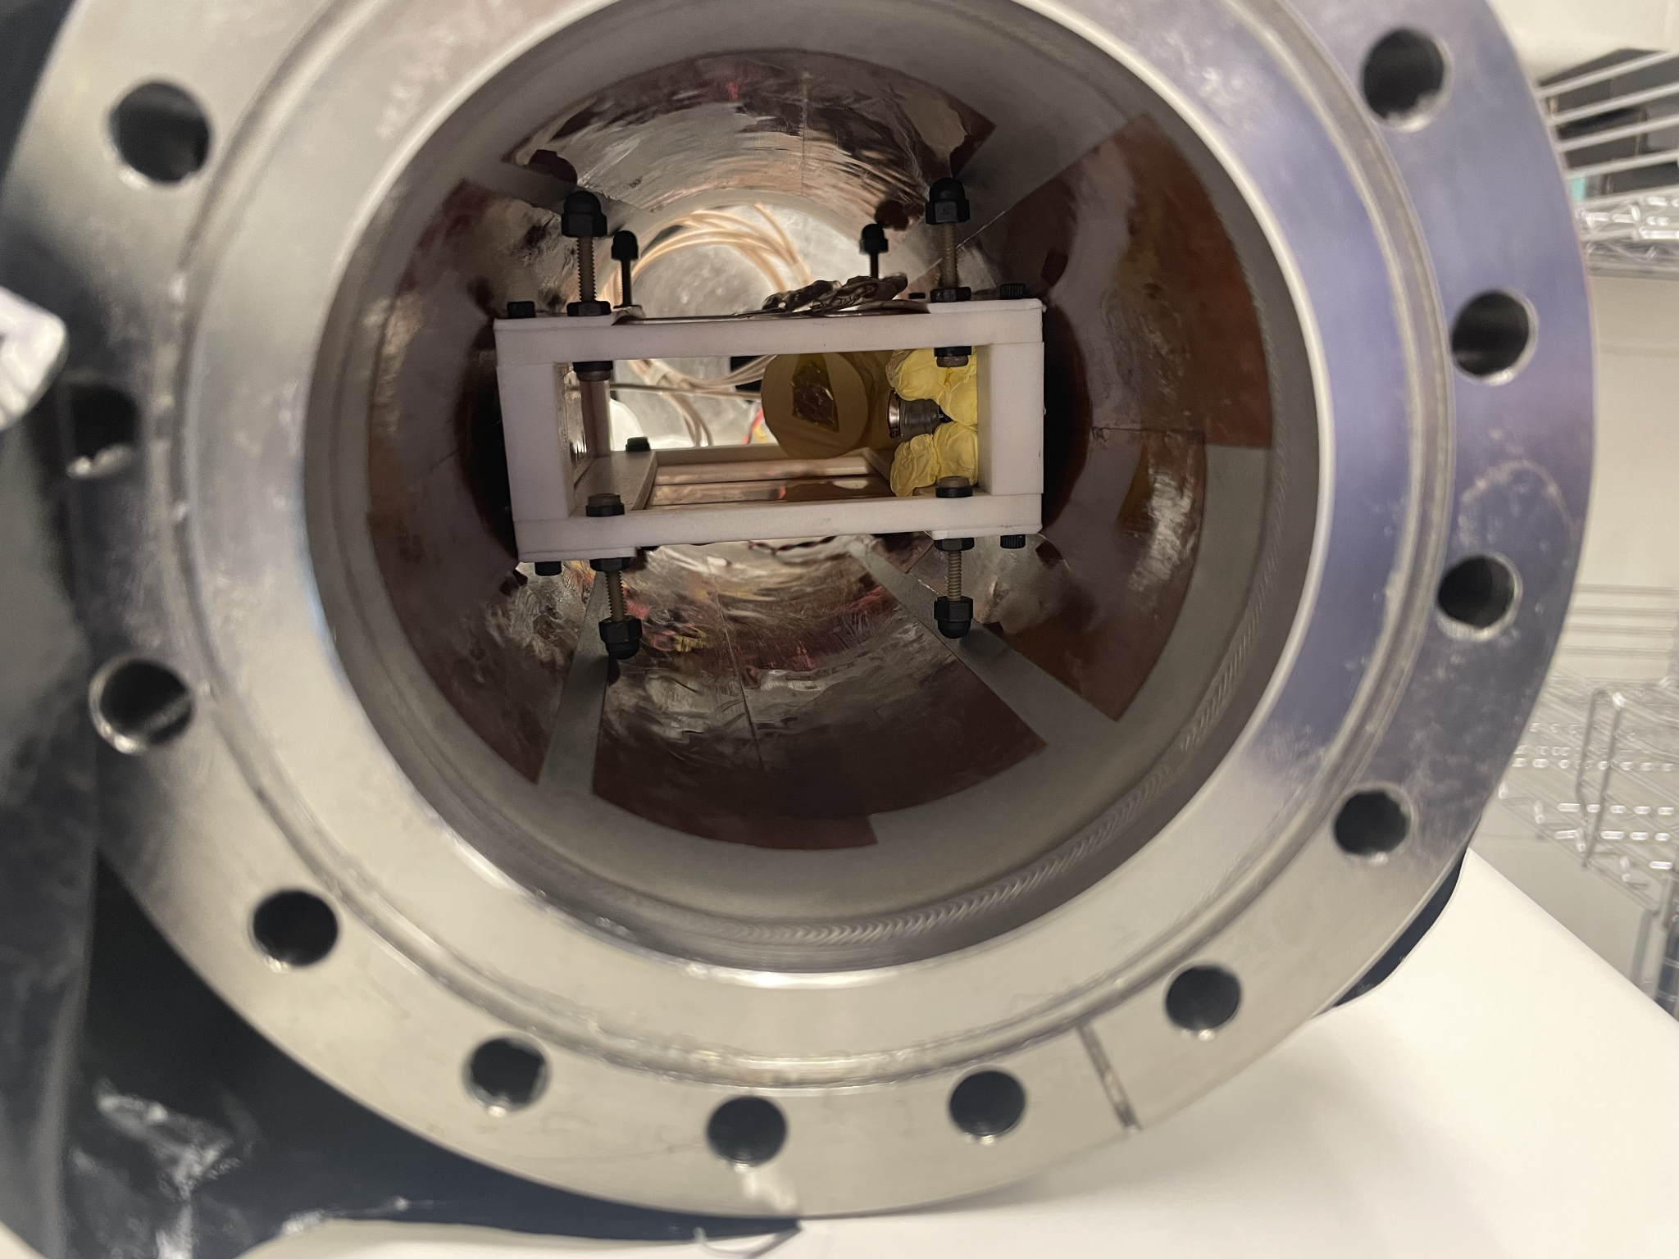
Steps Toward Multibounce Slow Drift
To increase event rate:
C-14 source disk and PIN Diode placed inside chamber
C-14 source disk set at 60 degree angle
B-field lowered to 0.16 T
To mitigate backgrounds & sparking:
Center Electrodes width reduced (1.25’’ => 1’’)
3 mil thick Kapton lined inside vacuum chamber & electrodes
Mark Farino

Slide 10
Steps Toward Multibounce Slow Drift
To increase event rate:
C-14 source disk and PIN Diode placed inside chamber
C-14 source disk set at 60 degree angle
B-field lowered to 0.16 T
To mitigate backgrounds & sparking:
Center Electrodes width reduced (1.25’’ => 1’’)
3 mil thick Kapton lined inside vacuum chamber & electrodes
Entire system cleaned, polished, and rewired
Mark Farino

Slide 11
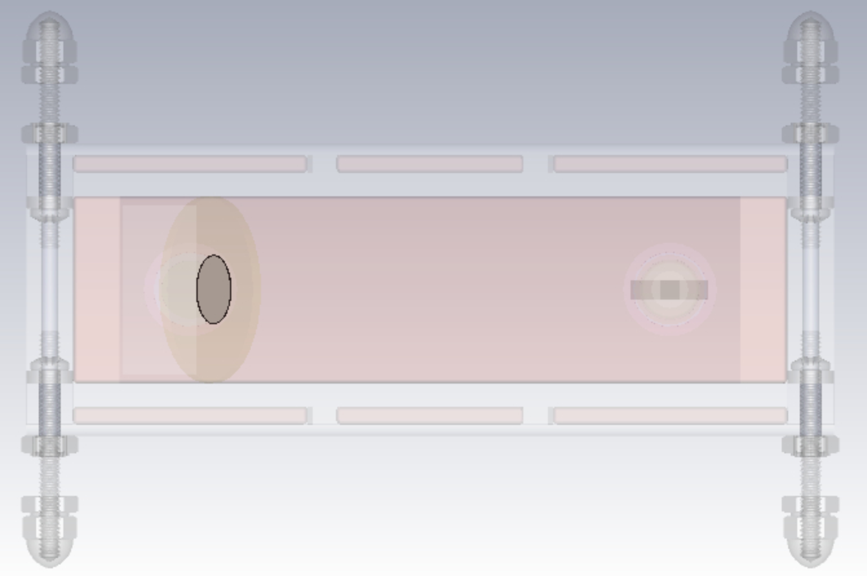
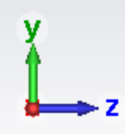
Procedure
Operate 0.16 T B field and set voltages on drift electrodes to generate an upward E field
Mark Farino

Slide 12
Procedure
Operate 0.16 T B field and set voltages on drift electrodes to generate an upward E field
Apply maximum voltage difference (+ 6kV) to outer pairs of electrodes (maximal drift velocity).
-6kV
-6kV
+6kV
+6kV
Mark Farino

Slide 13
Procedure
Operate 0.16 T B field and set voltages on drift electrodes to generate an upward E field
Apply maximum voltage difference (+ 6kV) to outer pairs of electrodes (maximal drift velocity).
Set center pair to smaller voltage difference to achieve slow drift (e.g., + 2kV for ⅓ drift speed)
-6kV
-2kV
-6kV
+6kV
+2kV
+6kV
Mark Farino

Slide 14
Procedure
Operate 0.16 T B field and set voltages on drift electrodes to generate an upward E field
Apply maximum voltage difference (+ 6kV) to outer pairs of electrodes (maximal drift velocity).
Set center pair to smaller voltage difference to achieve slow drift (e.g., + 2kV for ⅓ drift speed)
Record data with bouncing plate operated both at -6kV and 0kV (to account for scattering). Difference between rates indicates successful transport
-6kV
-2kV
-6kV
-6kV/0kV
+6kV
+2kV
+6kV
Mark Farino

Slide 15
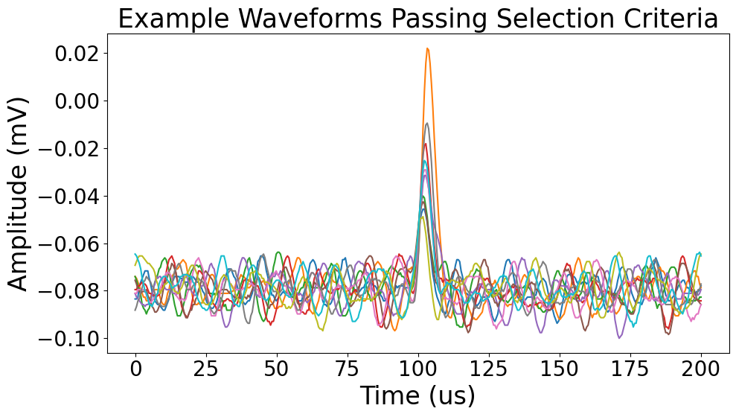
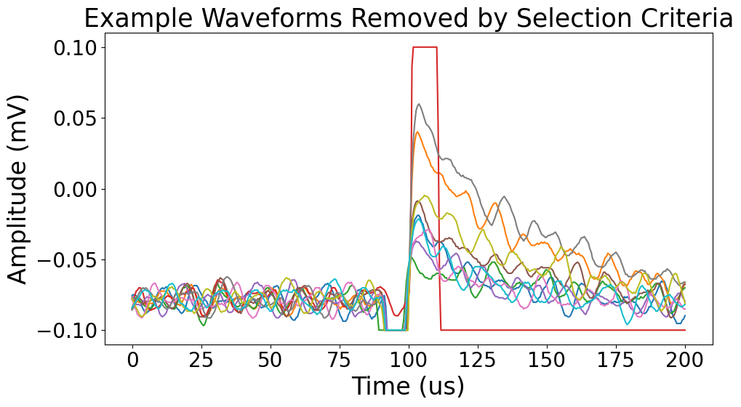
Procedure
Operate 0.16 T B field and set voltages on drift electrodes to generate an upward E field
Apply maximum voltage difference (+ 6kV) to outer pairs of electrodes (maximal drift velocity).
Set center pair to smaller voltage difference to achieve slow drift (e.g., + 2kV for ⅓ drift speed)
Record data with bouncing plate operated both at -6kV and 0kV (to account for scattering). Difference between rates indicates successful transport
Discard remaining noise/background via mean and standard deviation selection criteria (~97% efficient)
Mark Farino

Slide 16
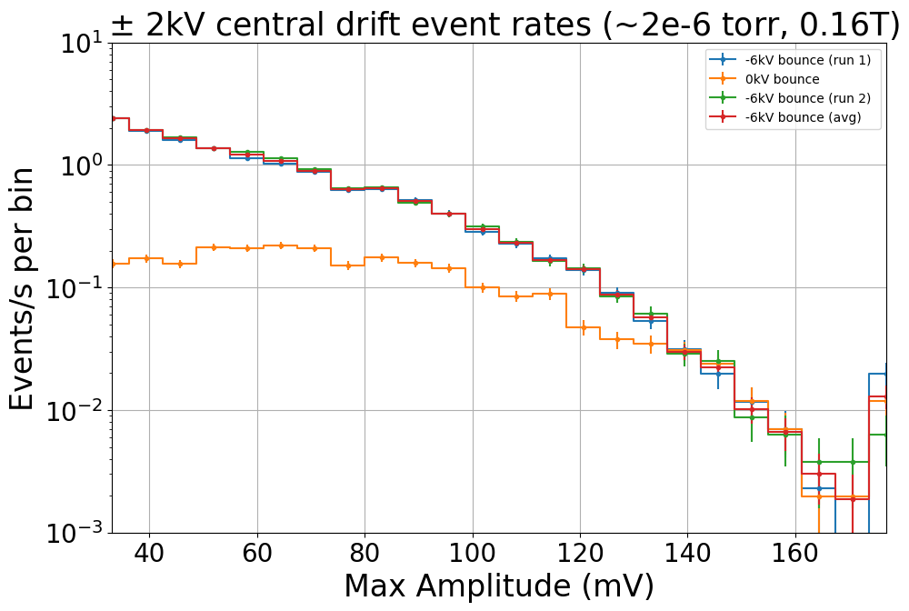
Procedure
Multiple runs taken to ensure consistent behavior
Operate 0.16 T B field and set voltages on drift electrodes to generate an upward E field
Apply maximum voltage difference (+ 6kV) to outer pairs of electrodes (maximal drift velocity).
Set center pair to smaller voltage difference to achieve slow drift (e.g., + 2kV for ⅓ drift speed)
Record data with bouncing plate operated both at -6kV and 0kV (to account for scattering). Difference between rates indicates successful transport
Discard remaining noise/background via mean and standard deviation selection criteria (~97% efficient)
Max amplitude of waveform output
Mark Farino

Slide 17
Modes of Operation
Symmetric Slow Drift
Symmetrically lower magnitude of top and bottom electrodes
-6kV
-X
-6kV
-6kV/0kV
+6kV
+X
+6kV
Mark Farino

Slide 18
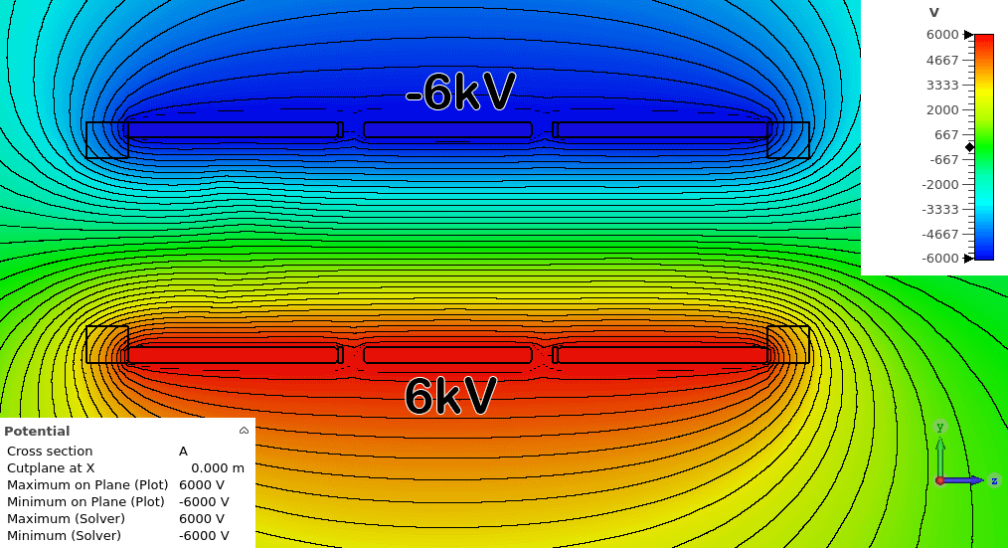
Modes of Operation
Symmetric Slow Drift
Symmetrically lower magnitude of top and bottom electrodes
Expectation: as X decreases, so too does event rate (electrons, following potential lines, more likely to terminate on wall)
-6kV
-X
-6kV
-6kV/0kV
+6kV
+X
+6kV
Mark Farino

Slide 19
Modes of Operation
Voltage Scan (2kV)
Record event rates within 2kV window around varying center voltage X
-6kV
X - 1kV
-6kV
-6kV/0kV
+6kV
X + 1kV
+6kV
Mark Farino

Slide 20
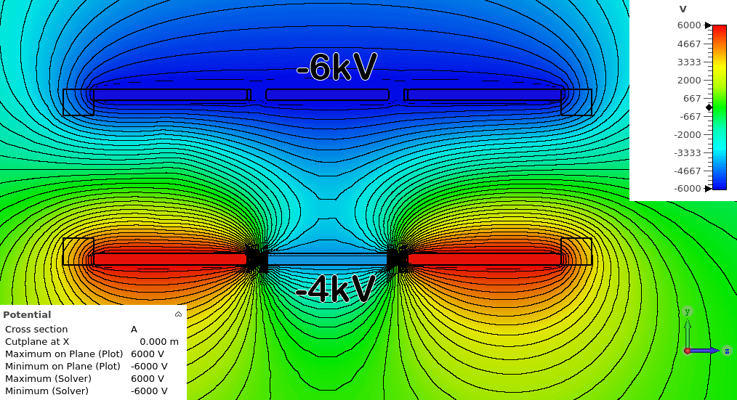
Modes of Operation
Voltage Scan (2kV)
Record event rates within 2kV window around varying center voltage X
Useful to study profile of source activity by ‘zooming in’ on a specific potential window
-6kV
X - 1kV
-6kV
-6kV/0kV
+6kV
X + 1kV
+6kV
Mark Farino

Slide 21
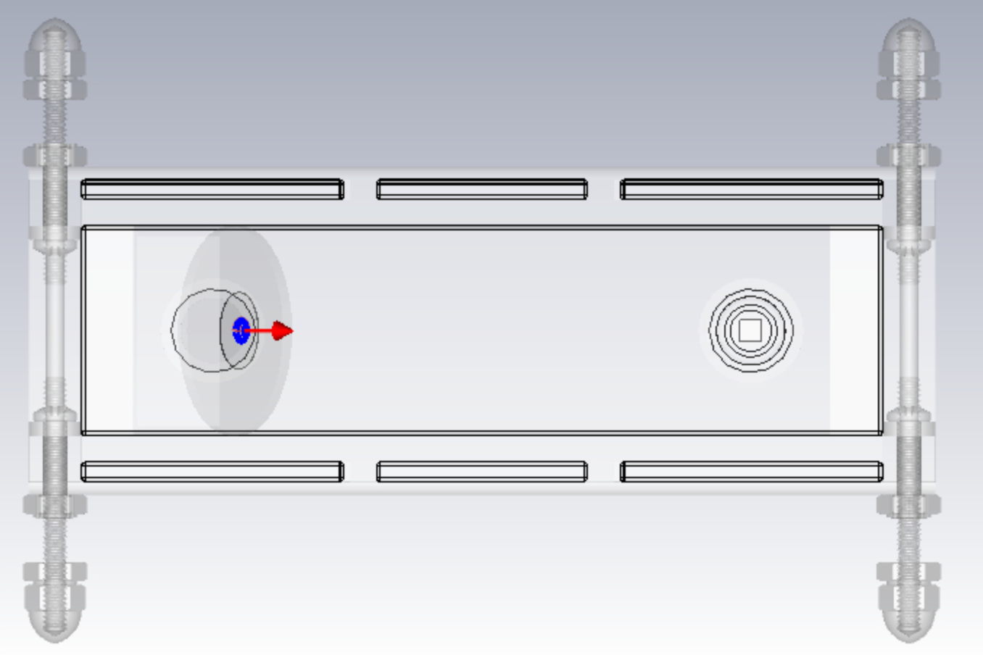
Simulation
1 million particles (2pi solid angle, uniform energy distribution) between 0-160keV launched for each voltage setting
Mark Farino

Slide 22
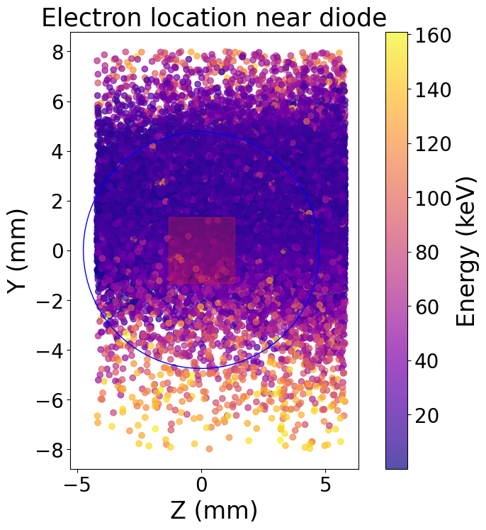
Simulation
1 million particles (2pi solid angle, uniform energy distribution) between 0-160keV launched for each voltage setting
Terminal location recorded via particle monitor; those impinging silicon active region of diode are saved
Mark Farino

Slide 23
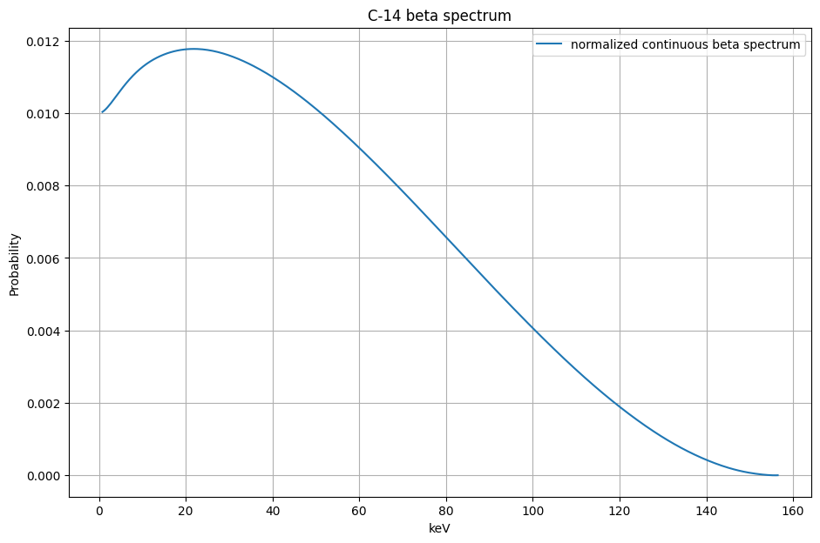
Simulation
1 million particles (2pi solid angle, uniform energy distribution) between 0-160keV launched for each voltage setting
Terminal location recorded via particle monitor; those impinging silicon active region of diode are saved
Output weighted (relatively) by C-14 spectrum (convolved with gaussian based on posited energy resolution)
Mark Farino

Slide 24
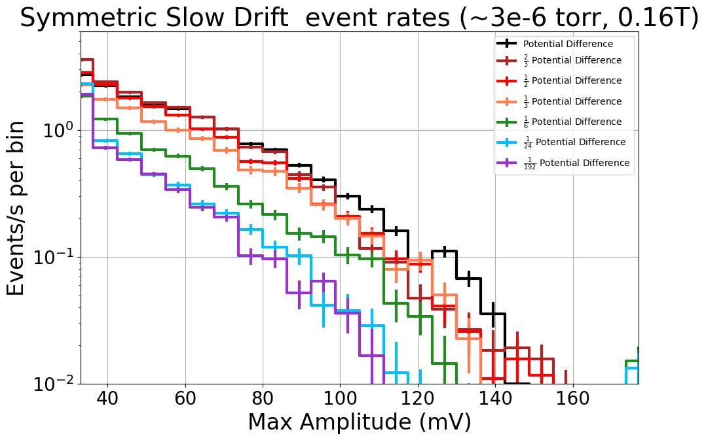
Symmetric Slow Drift Results
Reduction in event rate corresponding to potential difference
Fewer high-energy events as potential difference decreases
Mark Farino

Slide 25
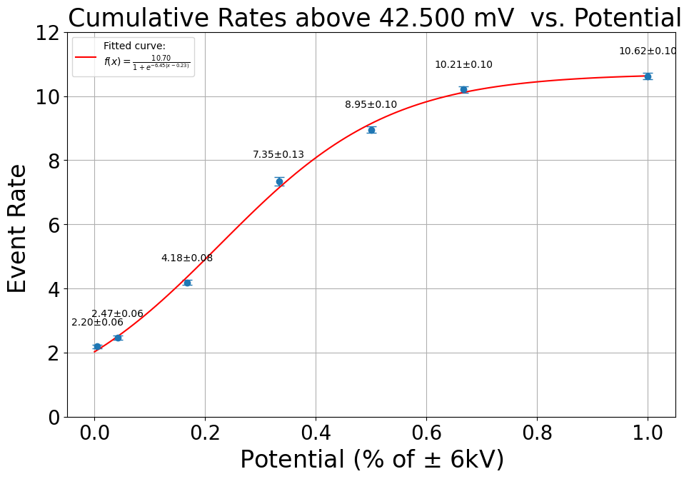
Symmetric Slow Drift Results
Count event rate above certain threshold
Reduction in event rate corresponding to potential difference
Fewer high-energy events as potential difference decreases
Increases, though rate of change plateaus as potential % -> 1
Non-zero event rate at 0
Mark Farino

Slide 26
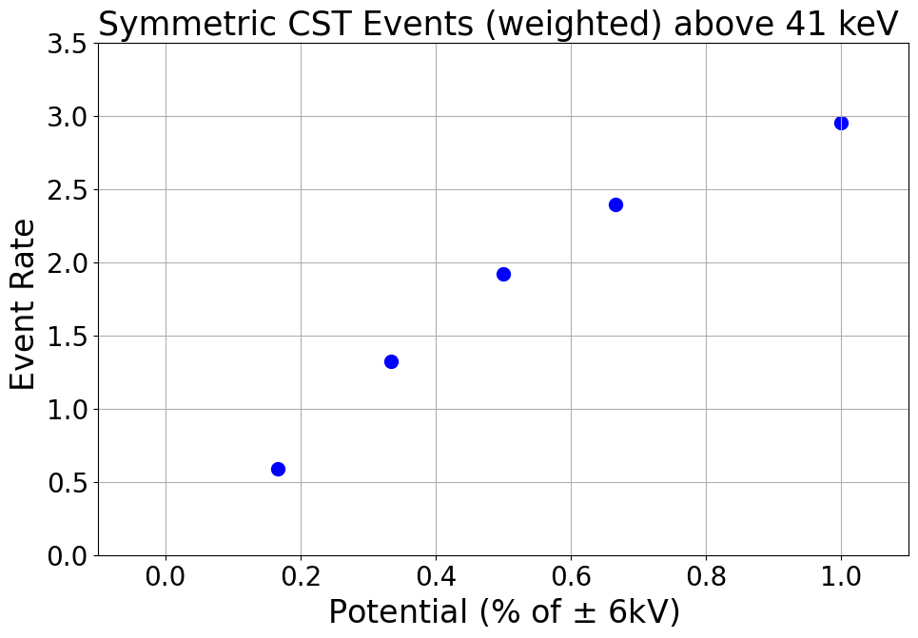
Symmetric Slow Drift Simulation Comparison
Similar plateauing shape
Simulations still running to study event rate at 0
Mark Farino

Slide 27
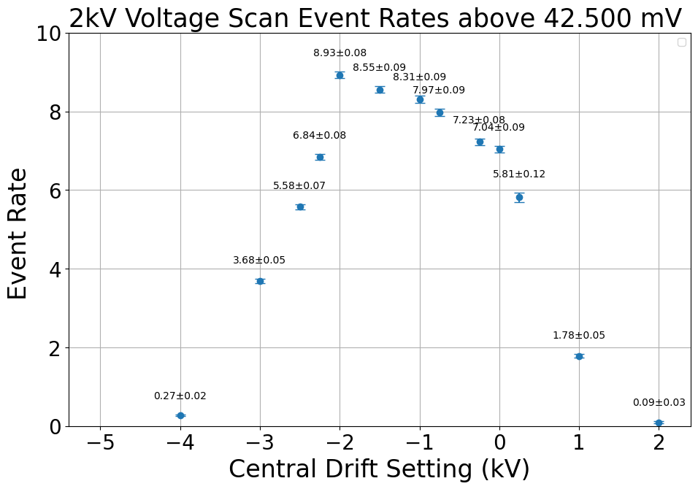
2kV Voltage Scan Results
Asymmetric and not centered around 0, why?
Average of central plate voltages
Mark Farino

Slide 28
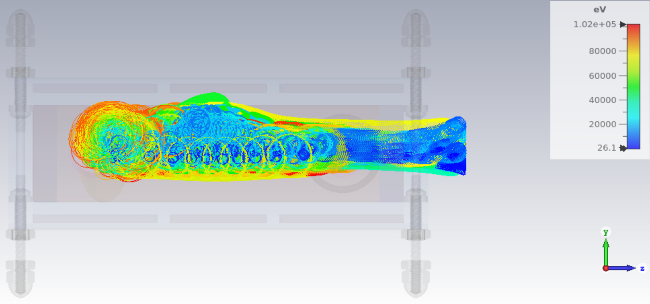
2kV Voltage Scan Results
Asymmetric and not centered around 0 because tilting the source disk favors electrons with cyclotron radii located in the upper half of the cage
-2kV
+2kV
Average of central plate voltages
Mark Farino

Slide 29
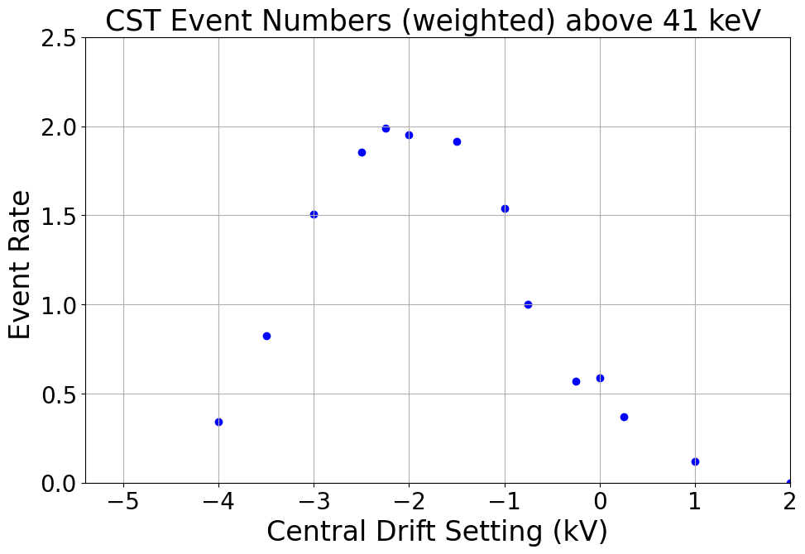
2kV Voltage Scan Simulation Comparison
Resembles shape of data, though horizontally offset with a smaller plateau
Mark Farino

Slide 30
Next Steps & Outlook
- Run more voltage scan settings
Develop more rigorous methods to compare data and simulation
Document findings and draft paper
Mark Farino

