Slide 1
Quantum Hall effect in hydrogenated graphene
21 November 2024
Inge van Rens
Radboud University Nijmegen, the Netherlands

Slide 2
Why?
Understanding graphene and the effect of hydrogen on the system
  If we know the band structure, we can predict behaviour
Low resistivity to limit potential differences
  Influenced by temperature, magnetic field and doping
  Fully hydrogenated graphene is an insulator

Slide 3
Why & how?
Understanding graphene and the effect of hydrogen on the system
  If we know the band structure, we can predict behaviour
Low resistivity to limit potential differences
  Influenced by temperature, magnetic field and doping
  Fully hydrogenated graphene is an insulator
Temperature dependence
Magnetic field effects
Band structure simulations

Slide 4
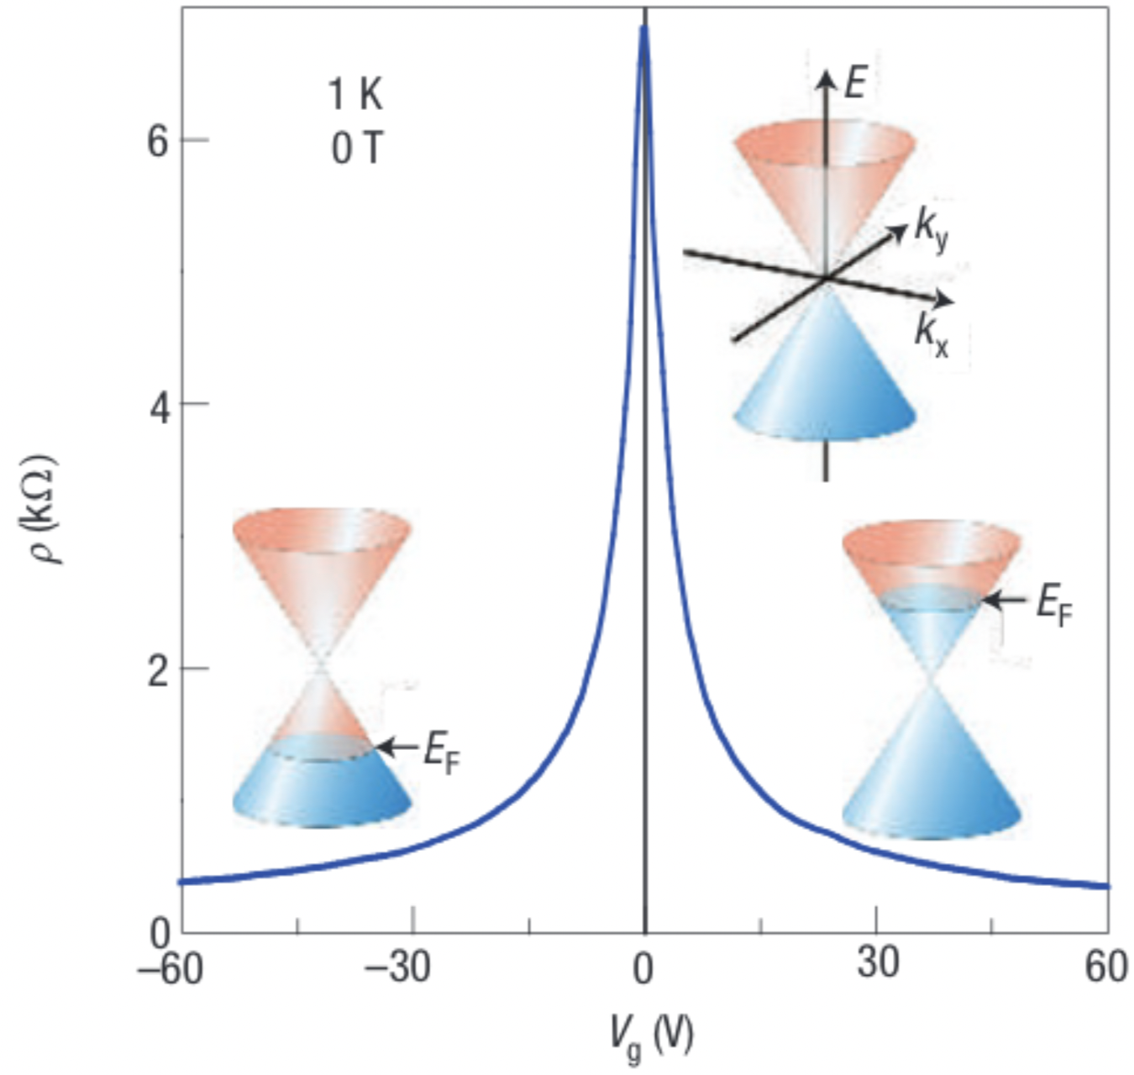
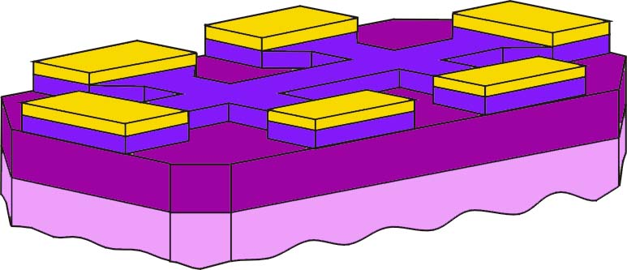
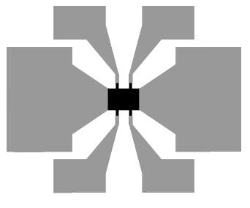
Graphene Field Effect Transistor
Au contacts
graphene
SiO₂
gate insulator
Si backgate
Graphenea, GFET-S10 data sheet
Geim, A. K. & Novoselov, K. S. The rise of graphene. In Nanoscience and technology: a collection of reviews from nature journals, 11–19 (World Scientific, 2010)

Slide 5
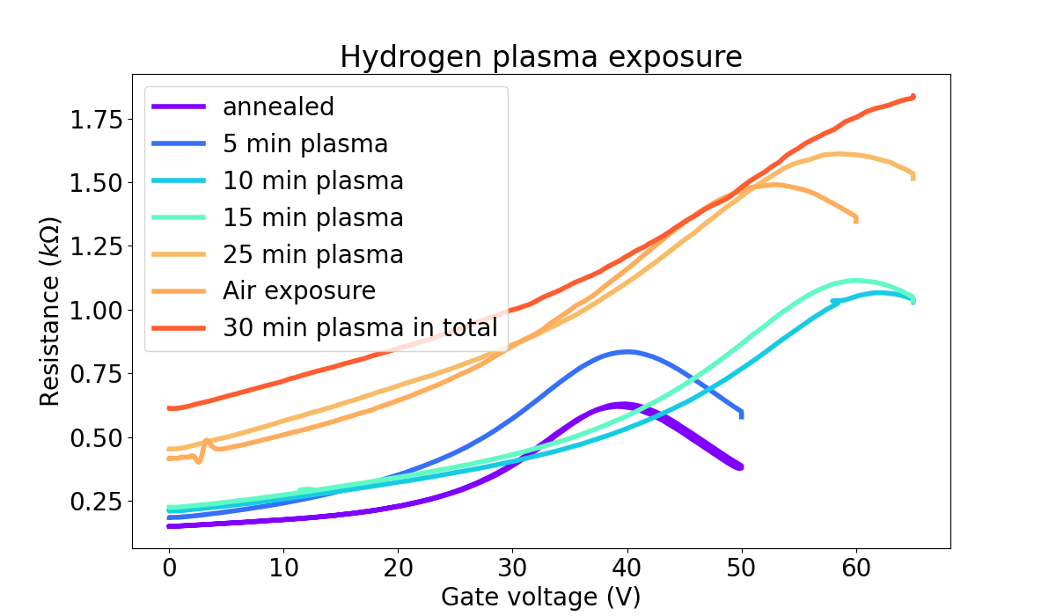
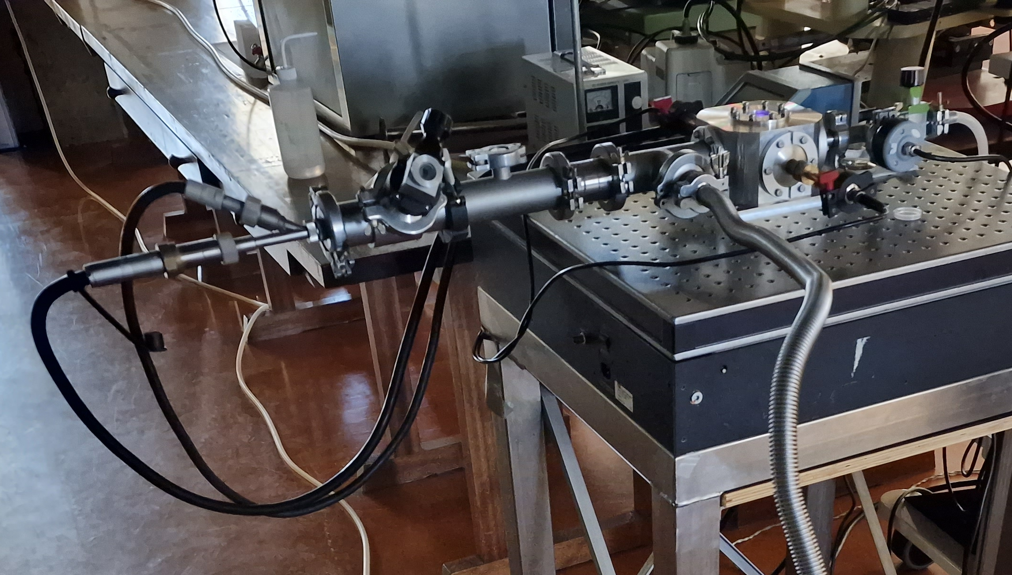
Hydrogenation process
Start with annealed sample
Exposed 1 mbar hydrogen plasma for 5 minutes
Exposed to air for 10 minutes
Repeat until we reach the wanted state
Notes:
Hydrogenated both samples, meanwhile cooling them with liquid nitrogen to check when the band gap starts to open -> 80s for first sample, 25 min for second

Slide 6
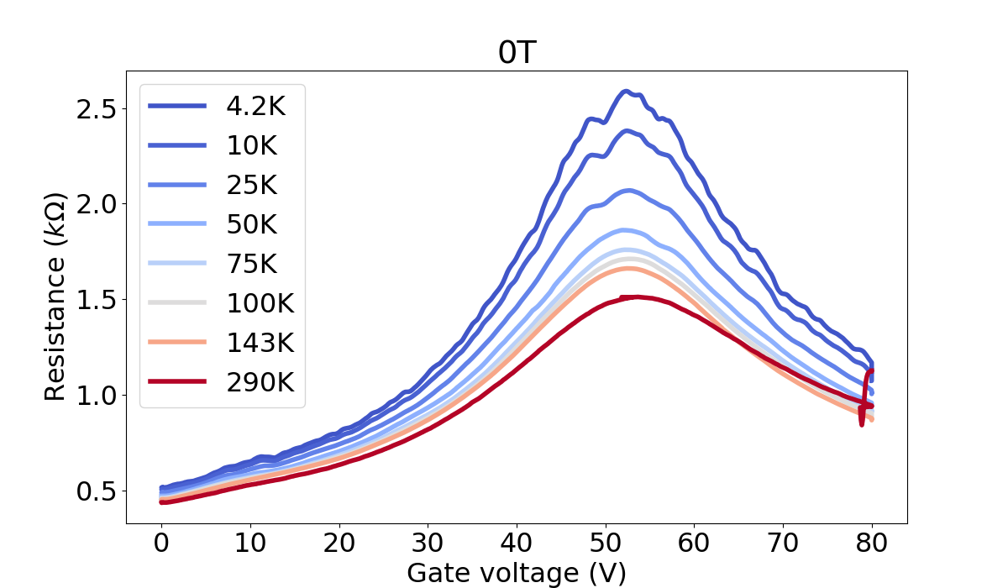
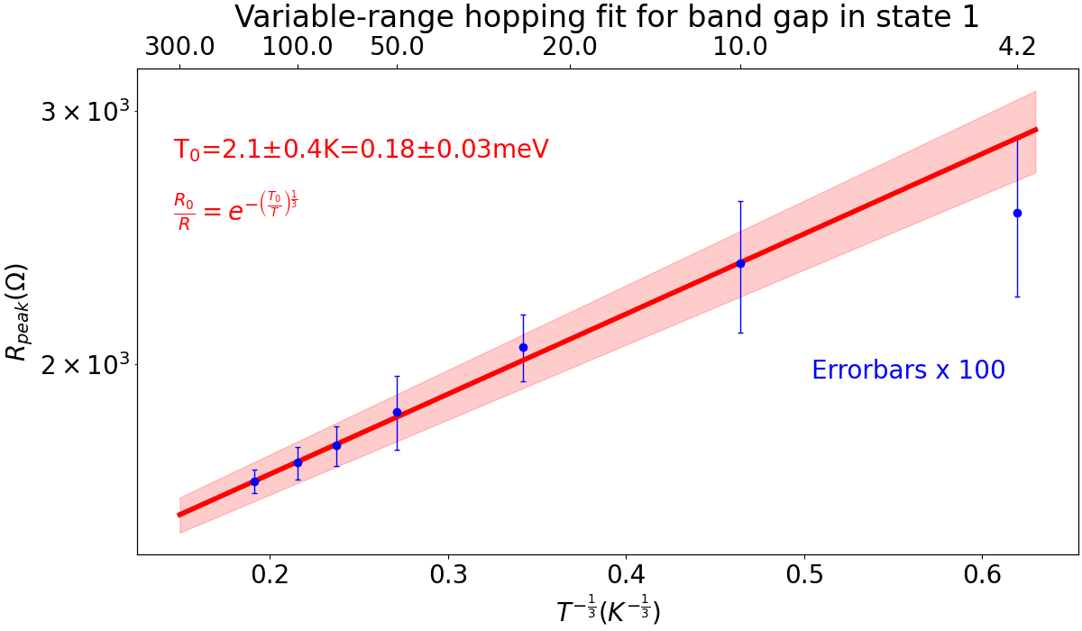
Temperature dependence
Peak resistance increased as temperature decreased
Pristine state: no temperature dependence
From vrh fit: band gap 2.1±0.4K

Slide 7
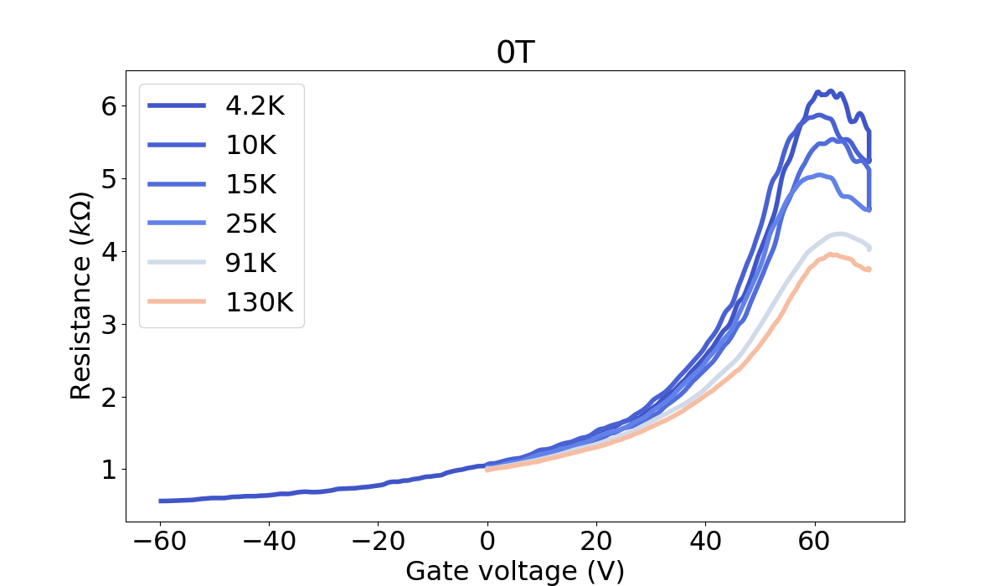
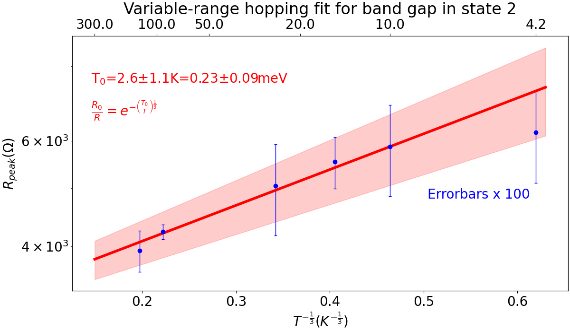
Temperature dependence
Neutrality point shifted
Temperature dependence similar
From vrh fit: band gap 2.6±1.1K

Slide 8
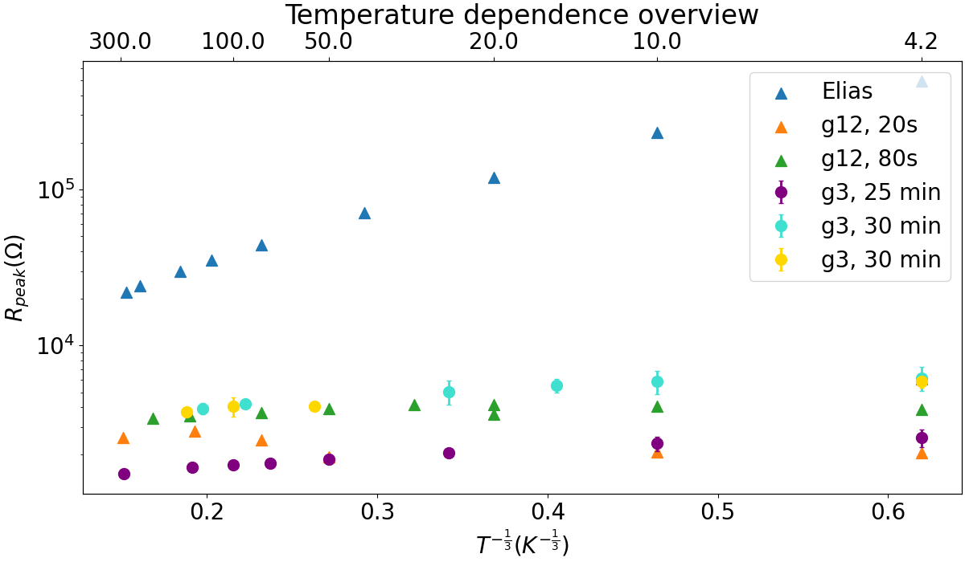
Temperature dependence
Compare samples g12 and g3
Similar band gap opening
Band gap is far smaller than for a fully hydrogenated graphene sample (Elias et al., Science 323, 610-613 (2009))

Slide 9
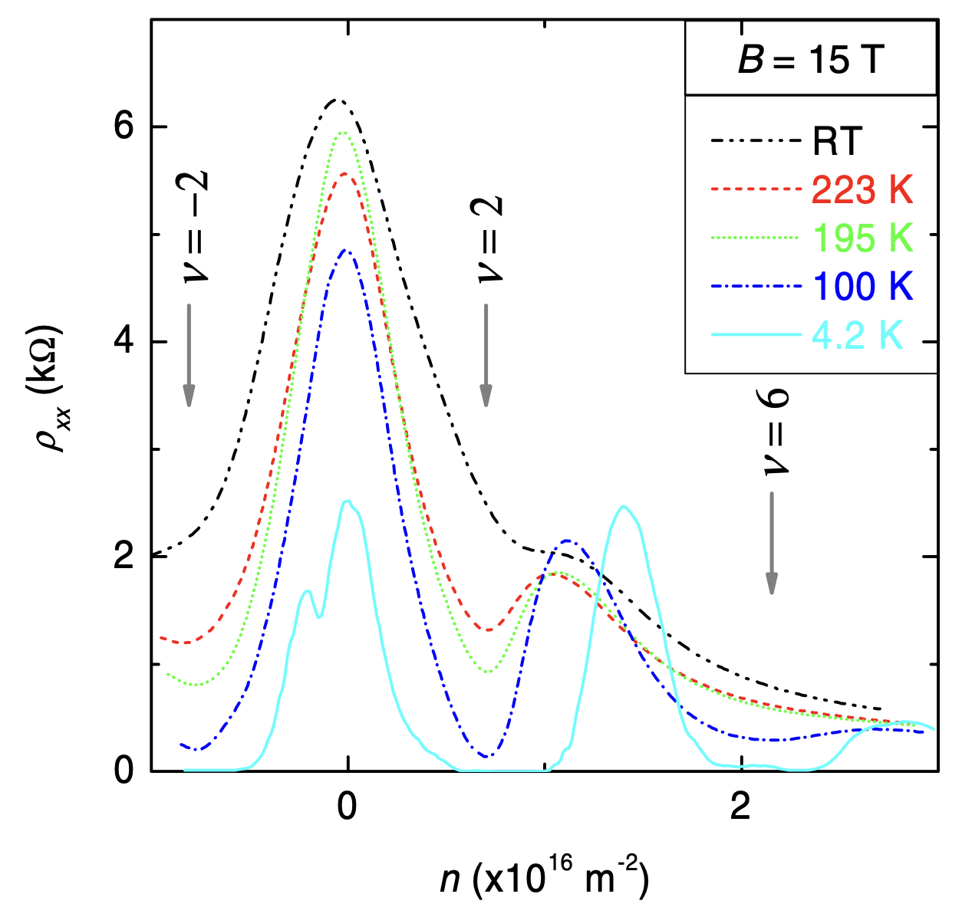
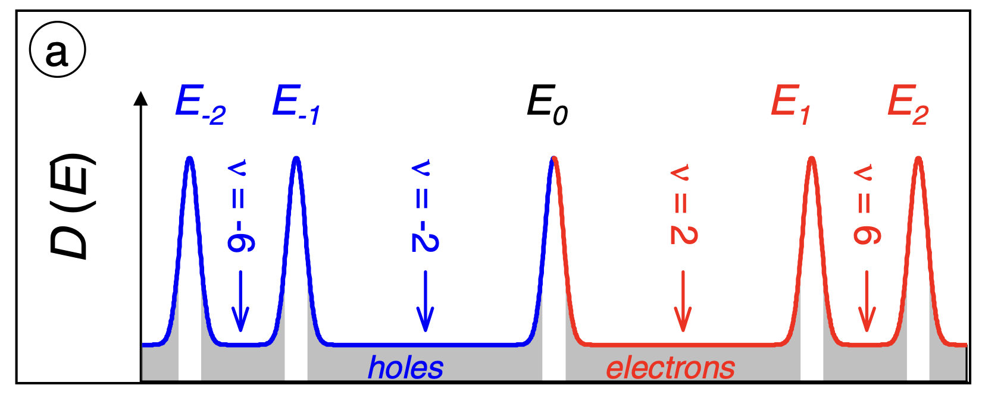
Magnetic field effects
A. J. M. Giesbers, U. Zeitler, M. I. Katsnelson, L. A. Ponomarenko, T. M. Mohiuddin, and J. C. Maan, Quantum-Hall Activation Gaps in Graphene. In PRL 99, 206803 (2007)
Notes:
At nu -2: only localised states -> no charge carriers -> no potential difference? Check with Uli

Slide 10
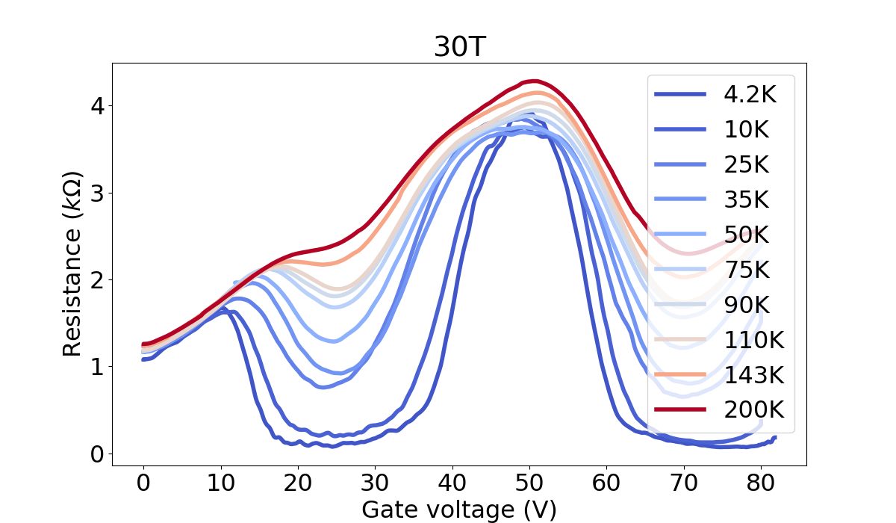
Quantum Hall Effect
𝜈=-2
𝜈=+2

Slide 11
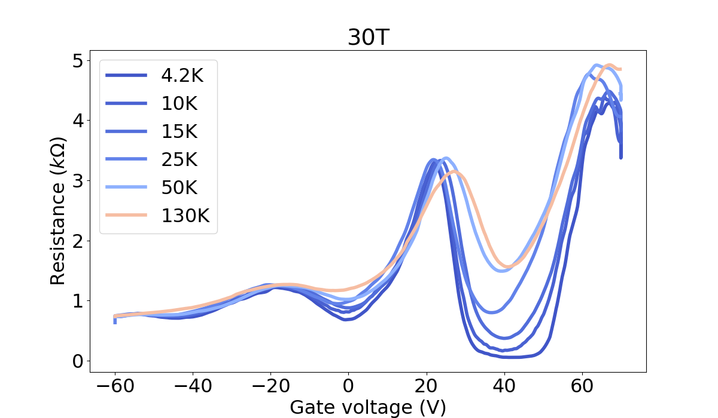
Quantum Hall Effect
𝜈=-6
𝜈=-2

Slide 12
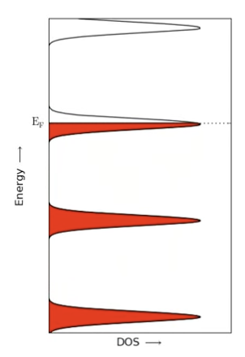
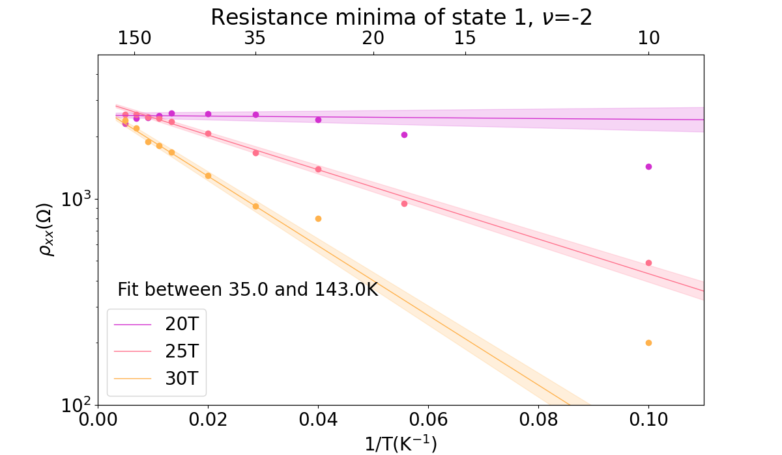

Activation energy
$$R∝exp\left(−Δ_{a}/k_{B}T\right)$$
Notes:
Pristine graphene: activation sqrt in B
Hydrogenated becomes linear due to curved band structure

Slide 13
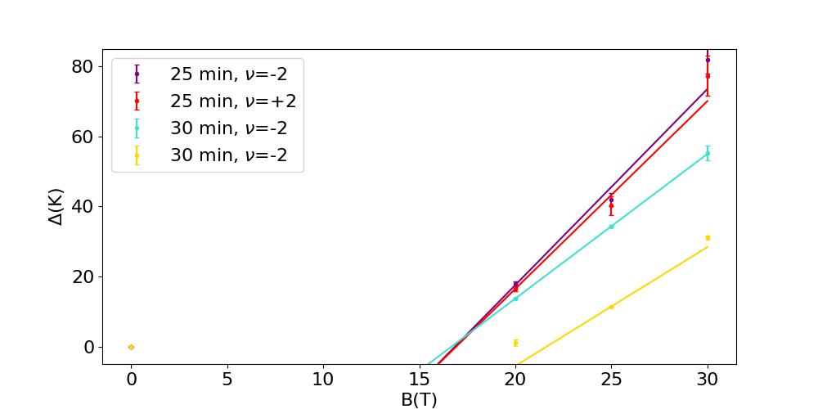

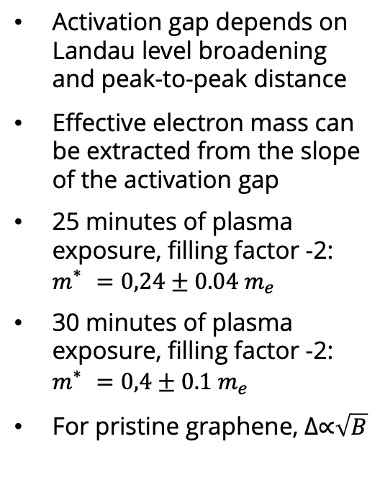
Activation energy
Activation gap depends on Landau level broadening and peak-to-peak distance
Effective electron mass can be extracted from the slope of the activation gap
25 minutes of plasma exposure, filling factor -2: $m_{}^{∗}=0,24±0.04 m_{e}$
30 minutes of plasma exposure, filling factor -2: $m_{}^{∗}=0,4±0.1 m_{e}$
For pristine graphene, Δ∝$\sqrt{B}$
$$Δ=\frac{ℏeB}{m^{∗}}−Γ$$

Slide 14
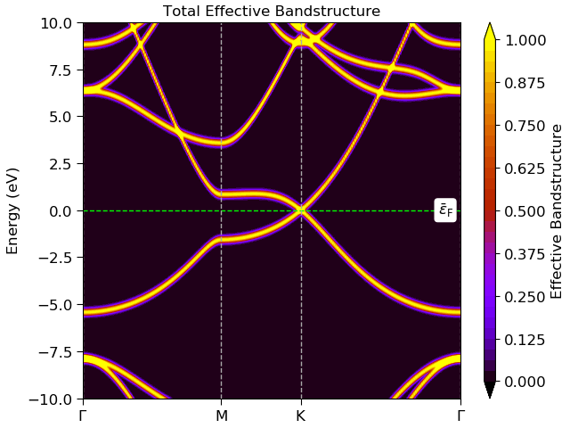
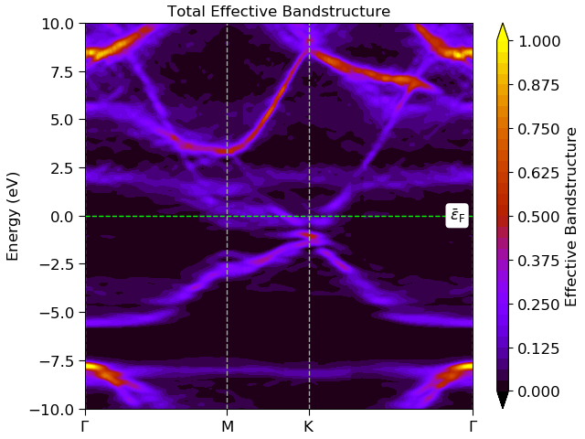
Simulations
Pristine graphene
12.5% H coverage

Slide 15
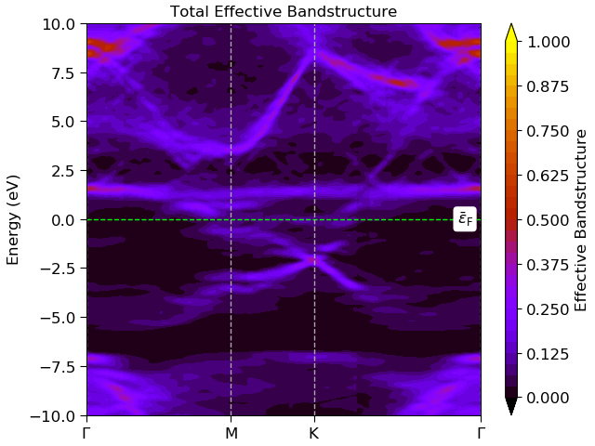
Simulations
Pristine graphene
25% H coverage

Slide 16
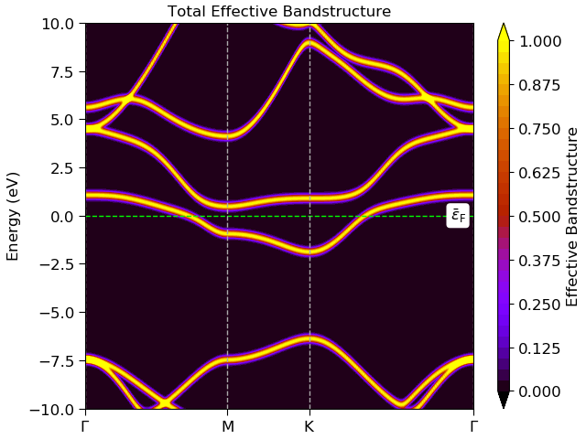
Simulations
Pristine graphene
50% H coverage

Slide 17
Implications for PTOLEMY
H-graphene resistance depends on temperature, magnetic field, electric field, doping and coverage
A small electric field at the target might help reduce the resistance, and the risk of potential differences on the surface, significantly
We might be able to reduce the resistance by doping the sample or applying a electric field

Slide 18
Implications for PTOLEMY
H-graphene resistance depends on temperature, magnetic field, electric field, doping and coverage
A small electric field at the target might help reduce the resistance, and the risk of potential differences on the surface, significantly
We might be able to reduce the resistance by doping the sample or applying a electric field
Contact with KIT for tritium measurements

Slide 19
Backup slides

Slide 20
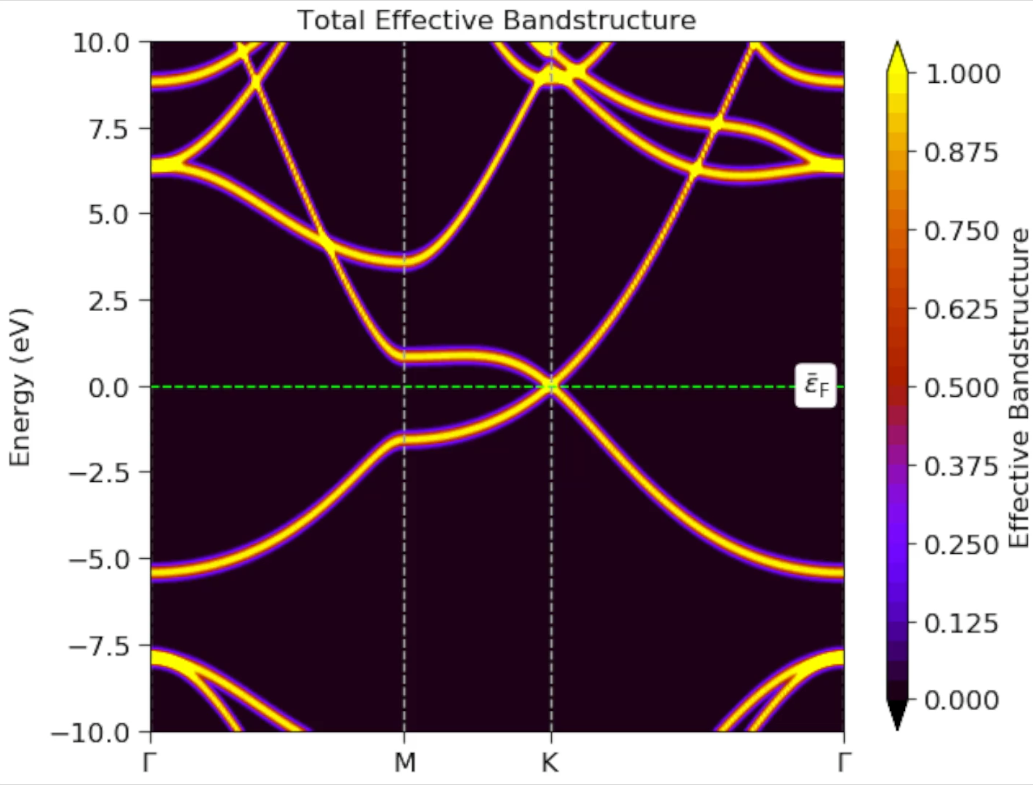

Slide 21

Quantum hall resistance
$ρ_{xx}=\frac{σ_{xx}}{σ_{xx}^{2}+σ_{xy}^{2}}$
Only localised states:
  $σ_{xx}=0$
  $σ_{xy}$ finite

Slide 22
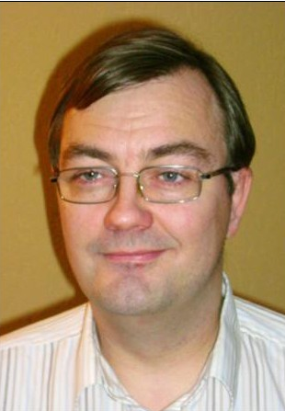
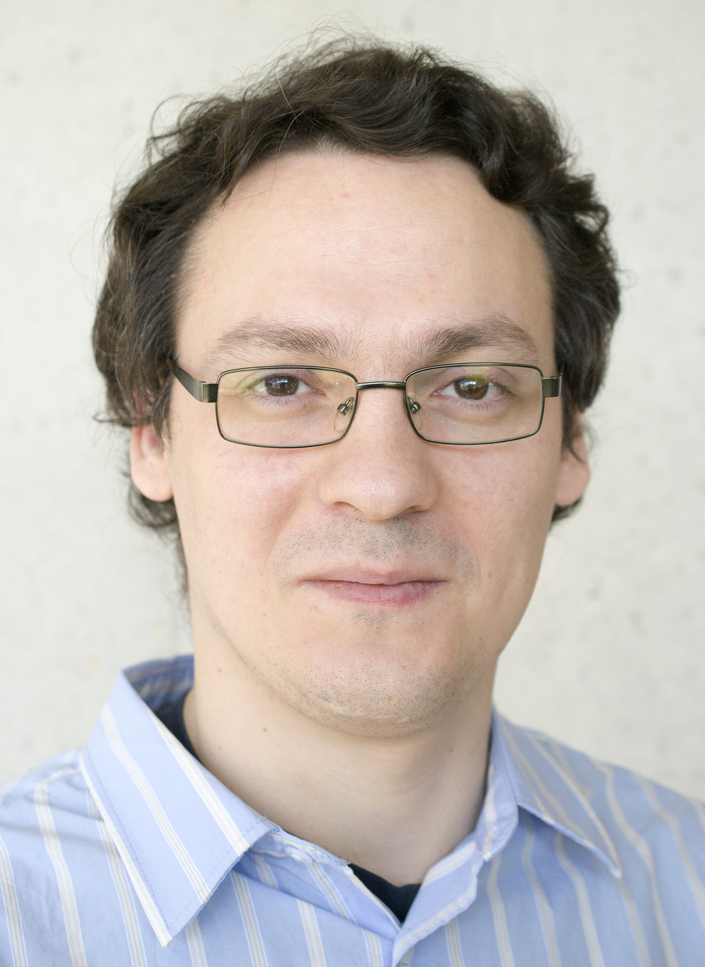

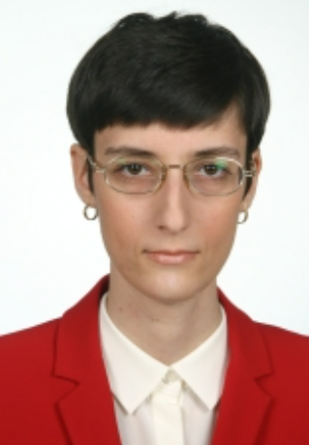
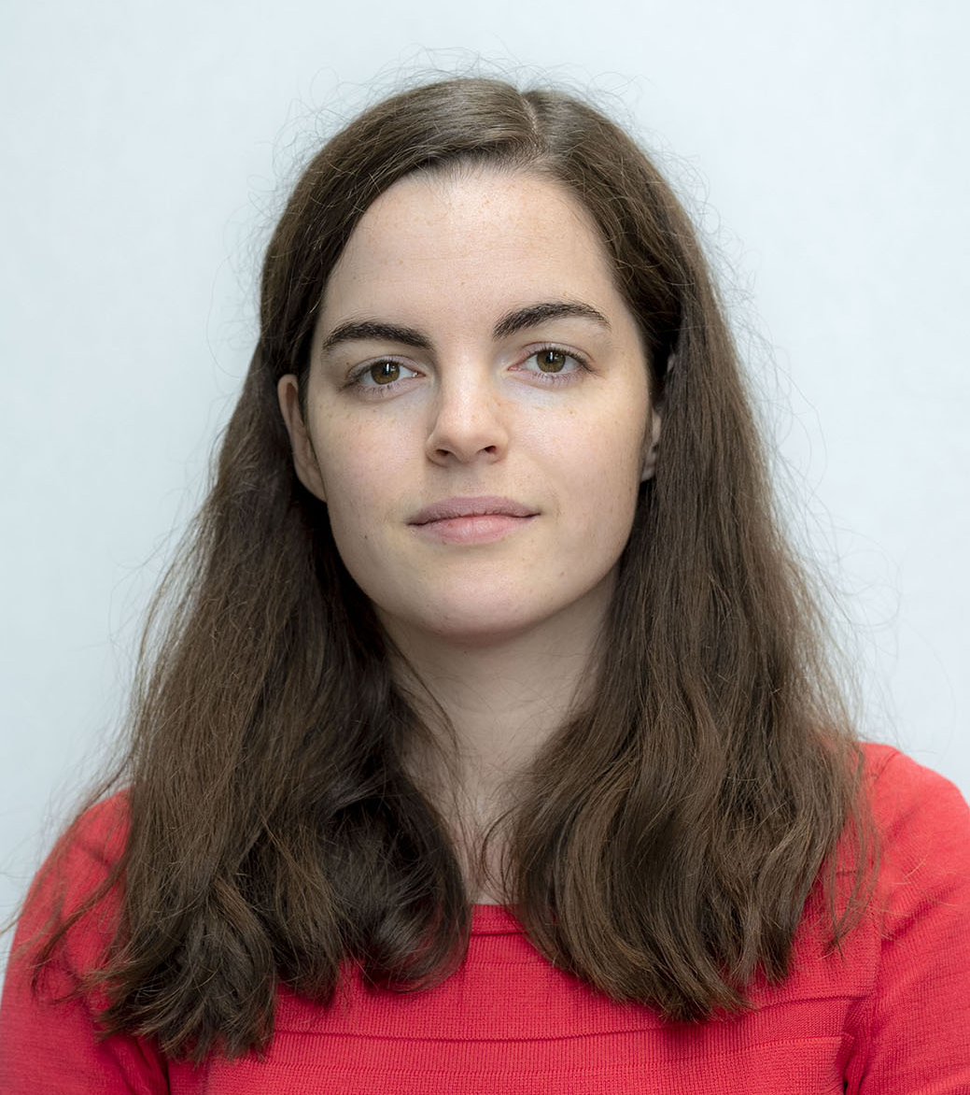


The Nijmegen Group
Uli Zeitler
(RU HFML-FELIX)
Oleksandr Zheliuk
(RU HFML-FELIX)
Nicolo de Groot
(RU IMAPP)
Nicoleta Cucu-Laurenciu
(RU IMAPP)
Inge van Rens
(RU IMAPP)
And our students:
Martijn Velders
(RU IMAPP)
Bram Breugelmans
(RU HFML-FELIX)
Thomas Derks
(RU HFML-FELIX)

Slide 23
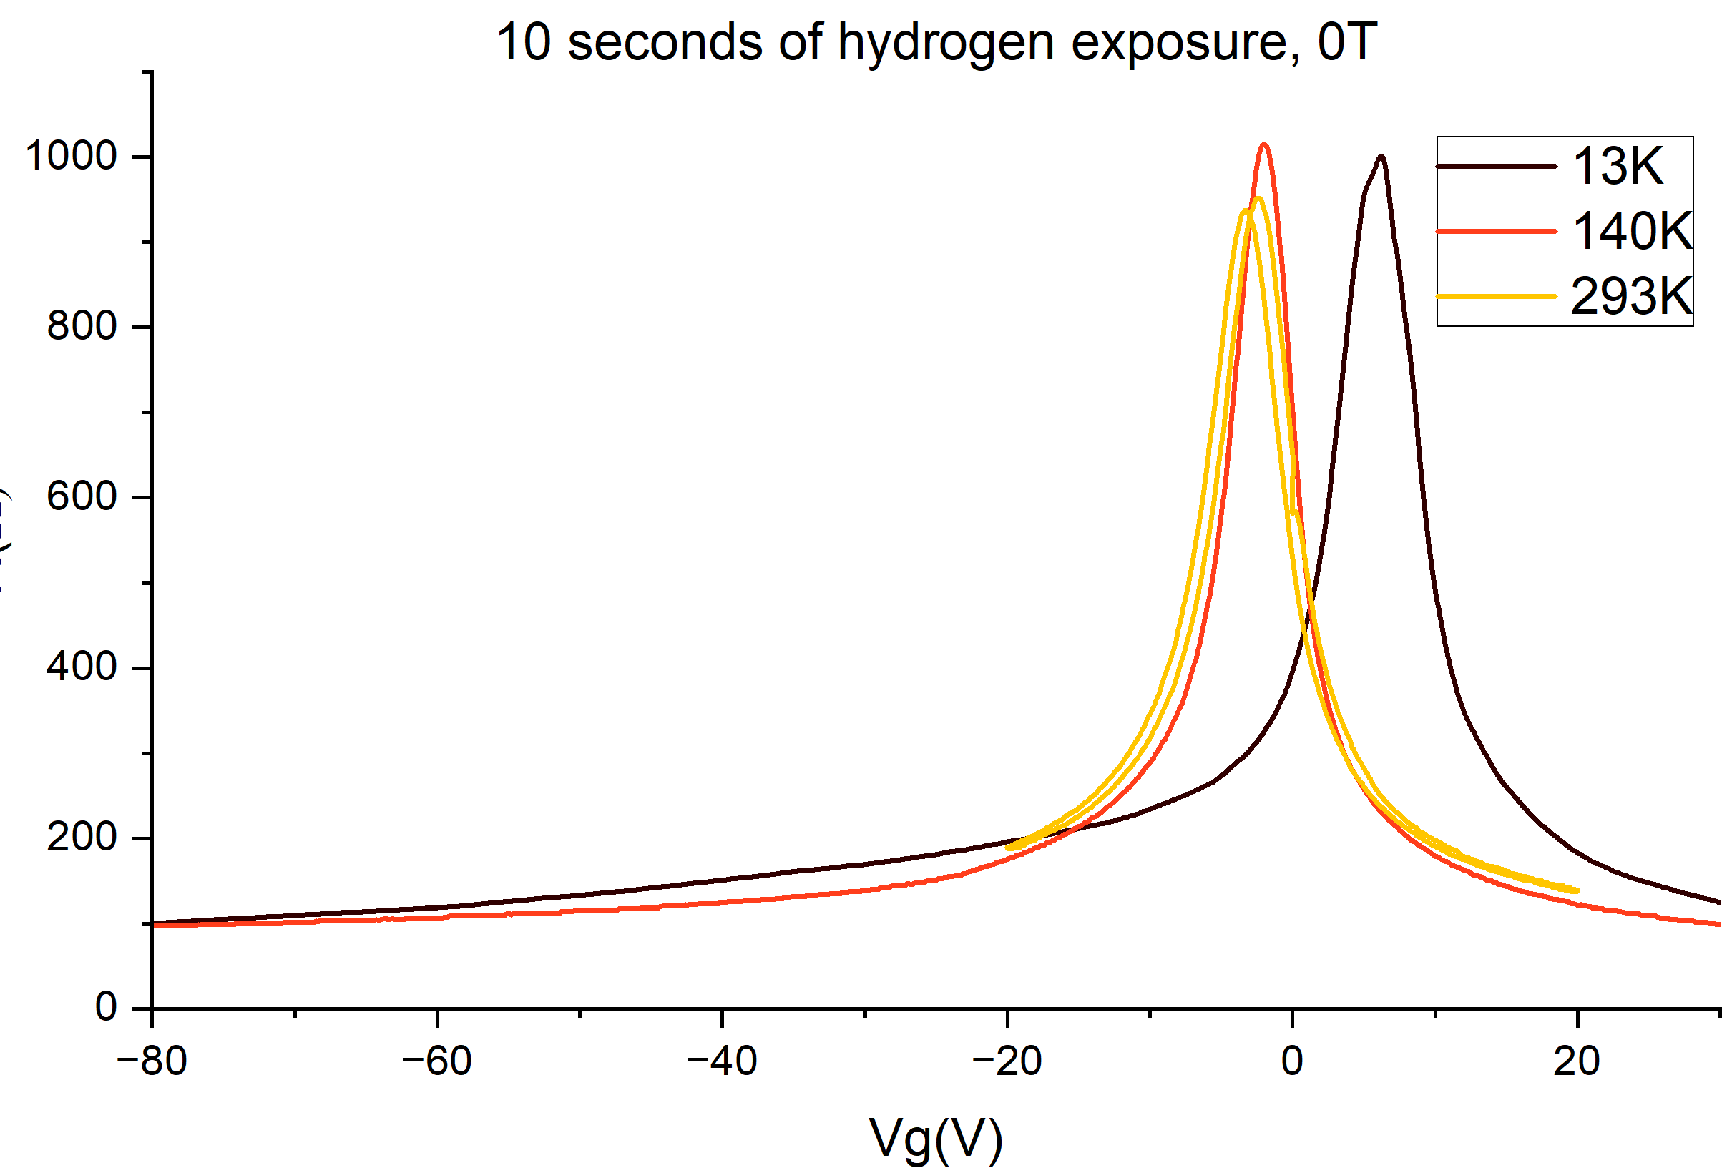
Temperature dependence

Slide 24
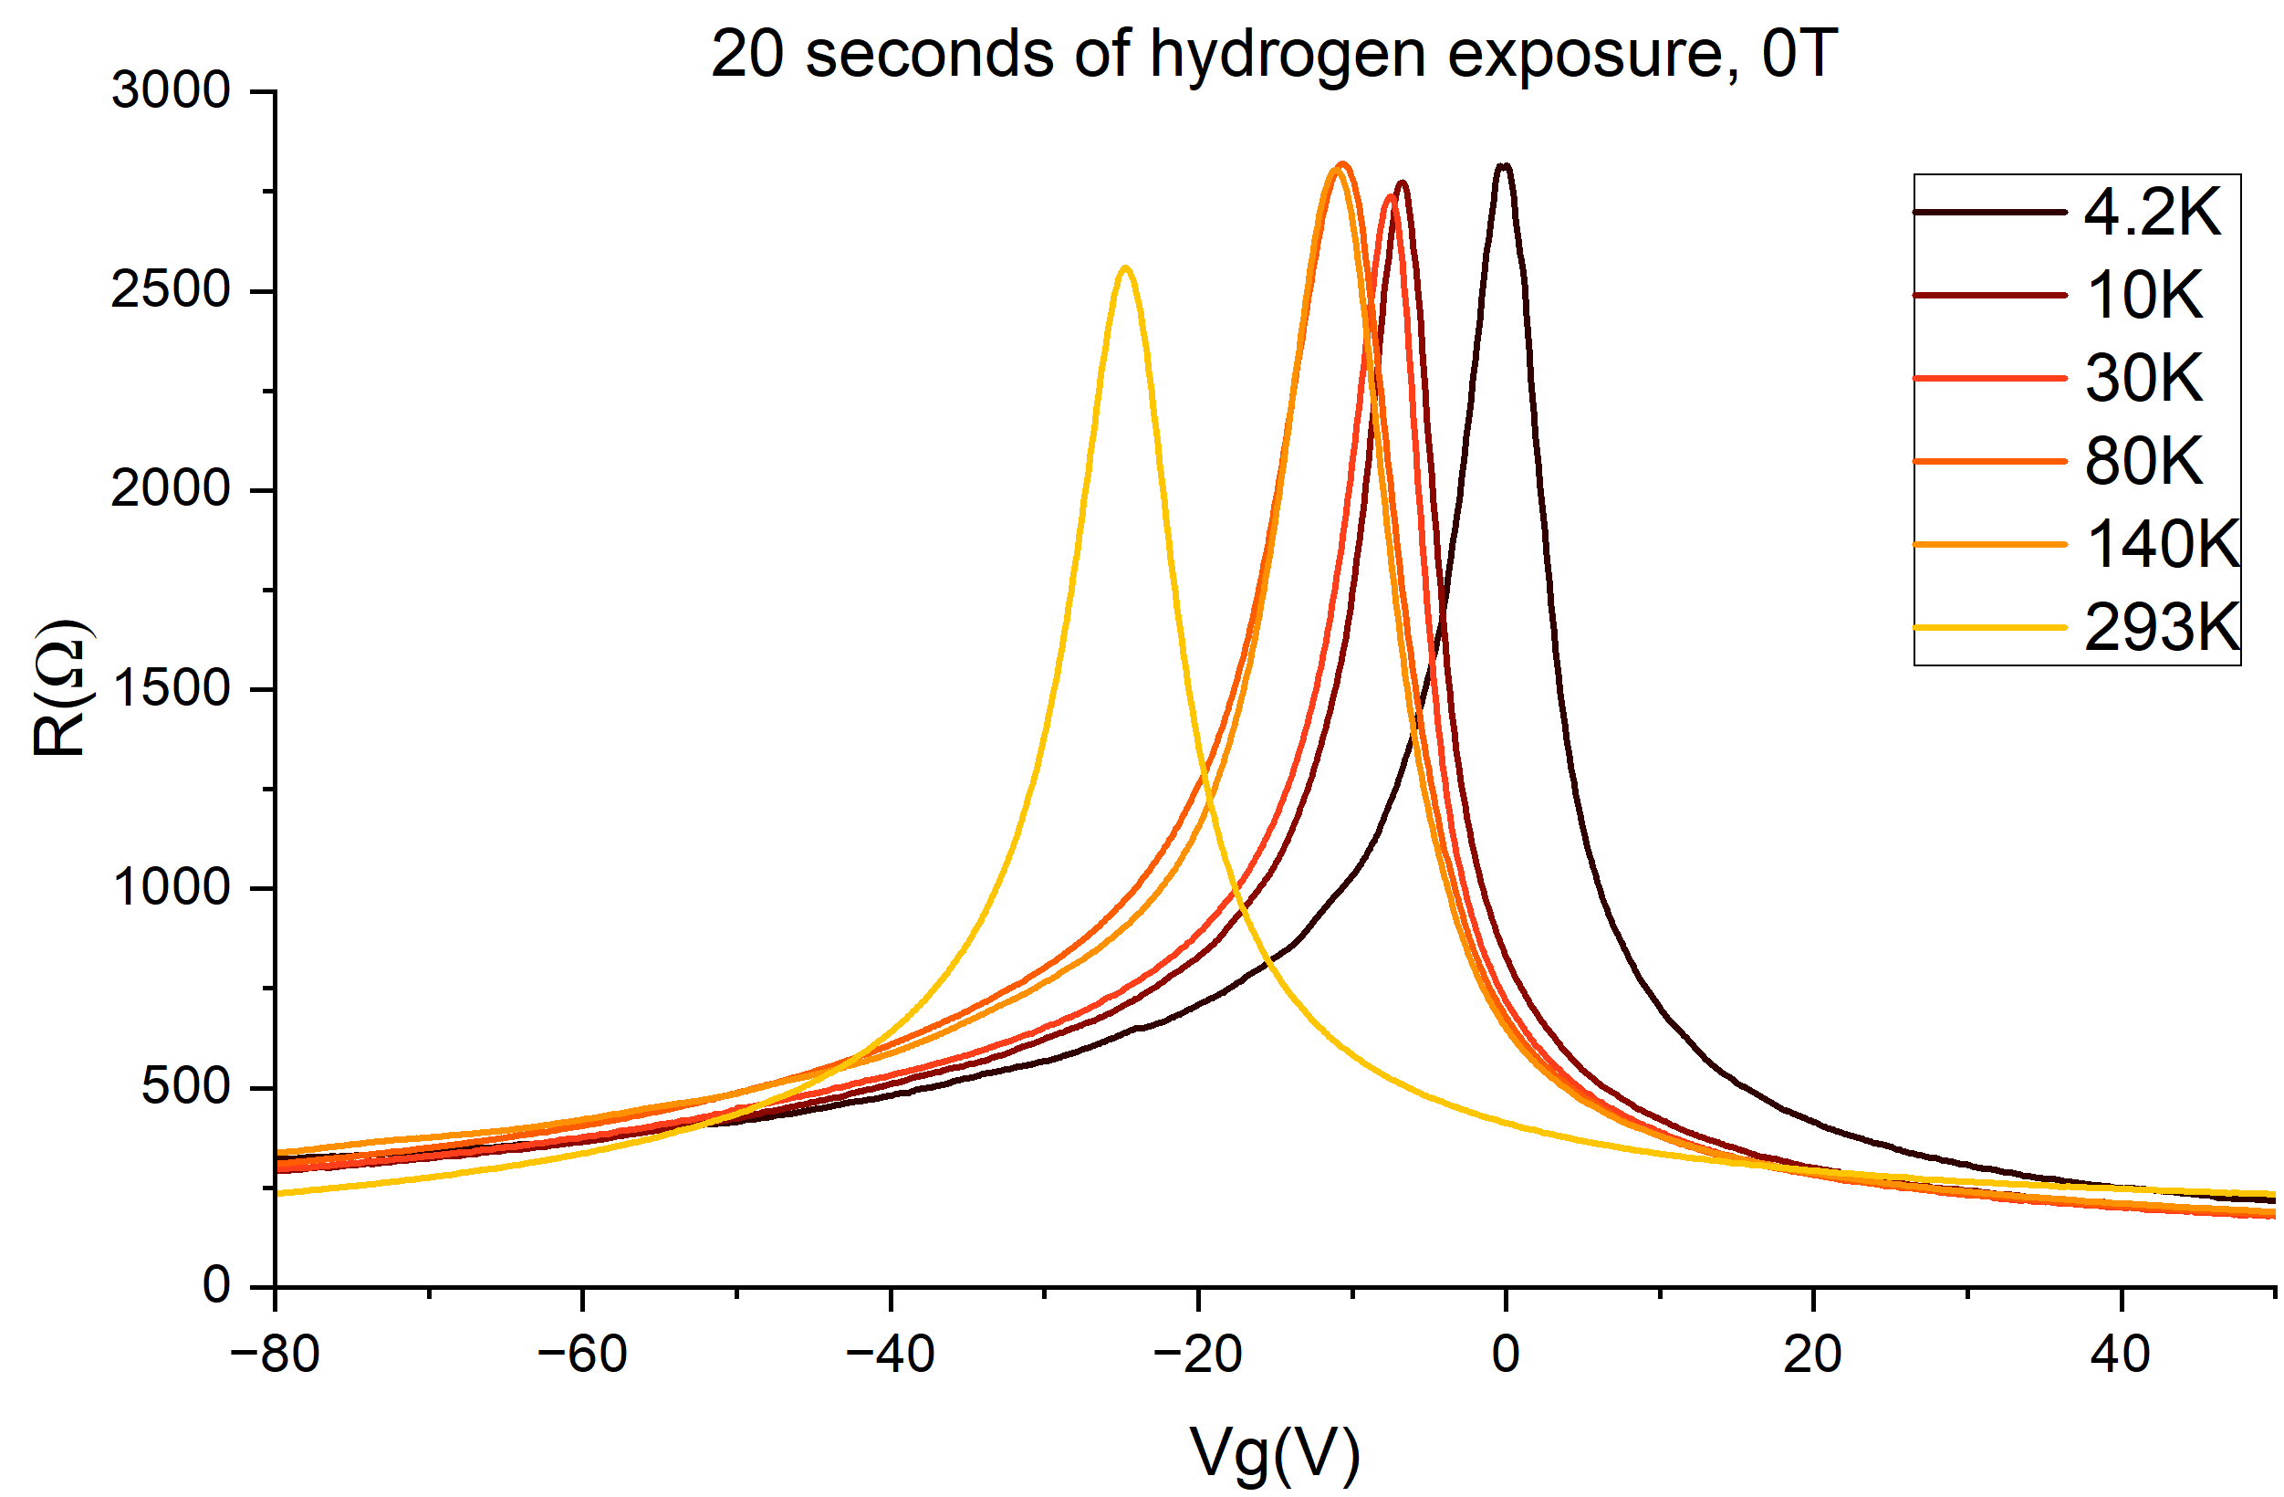
Temperature dependence

Slide 25
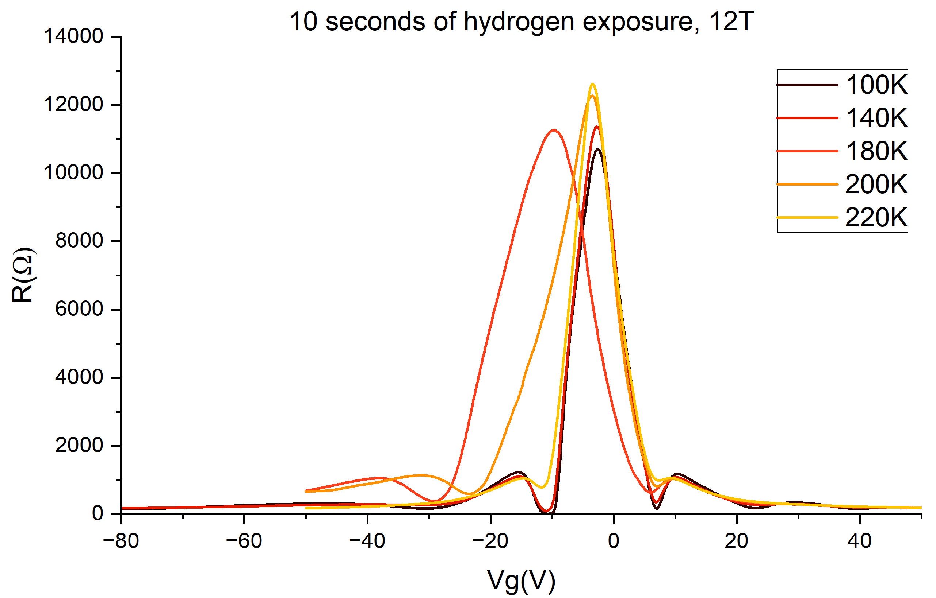
Quantum Hall effect

Slide 26
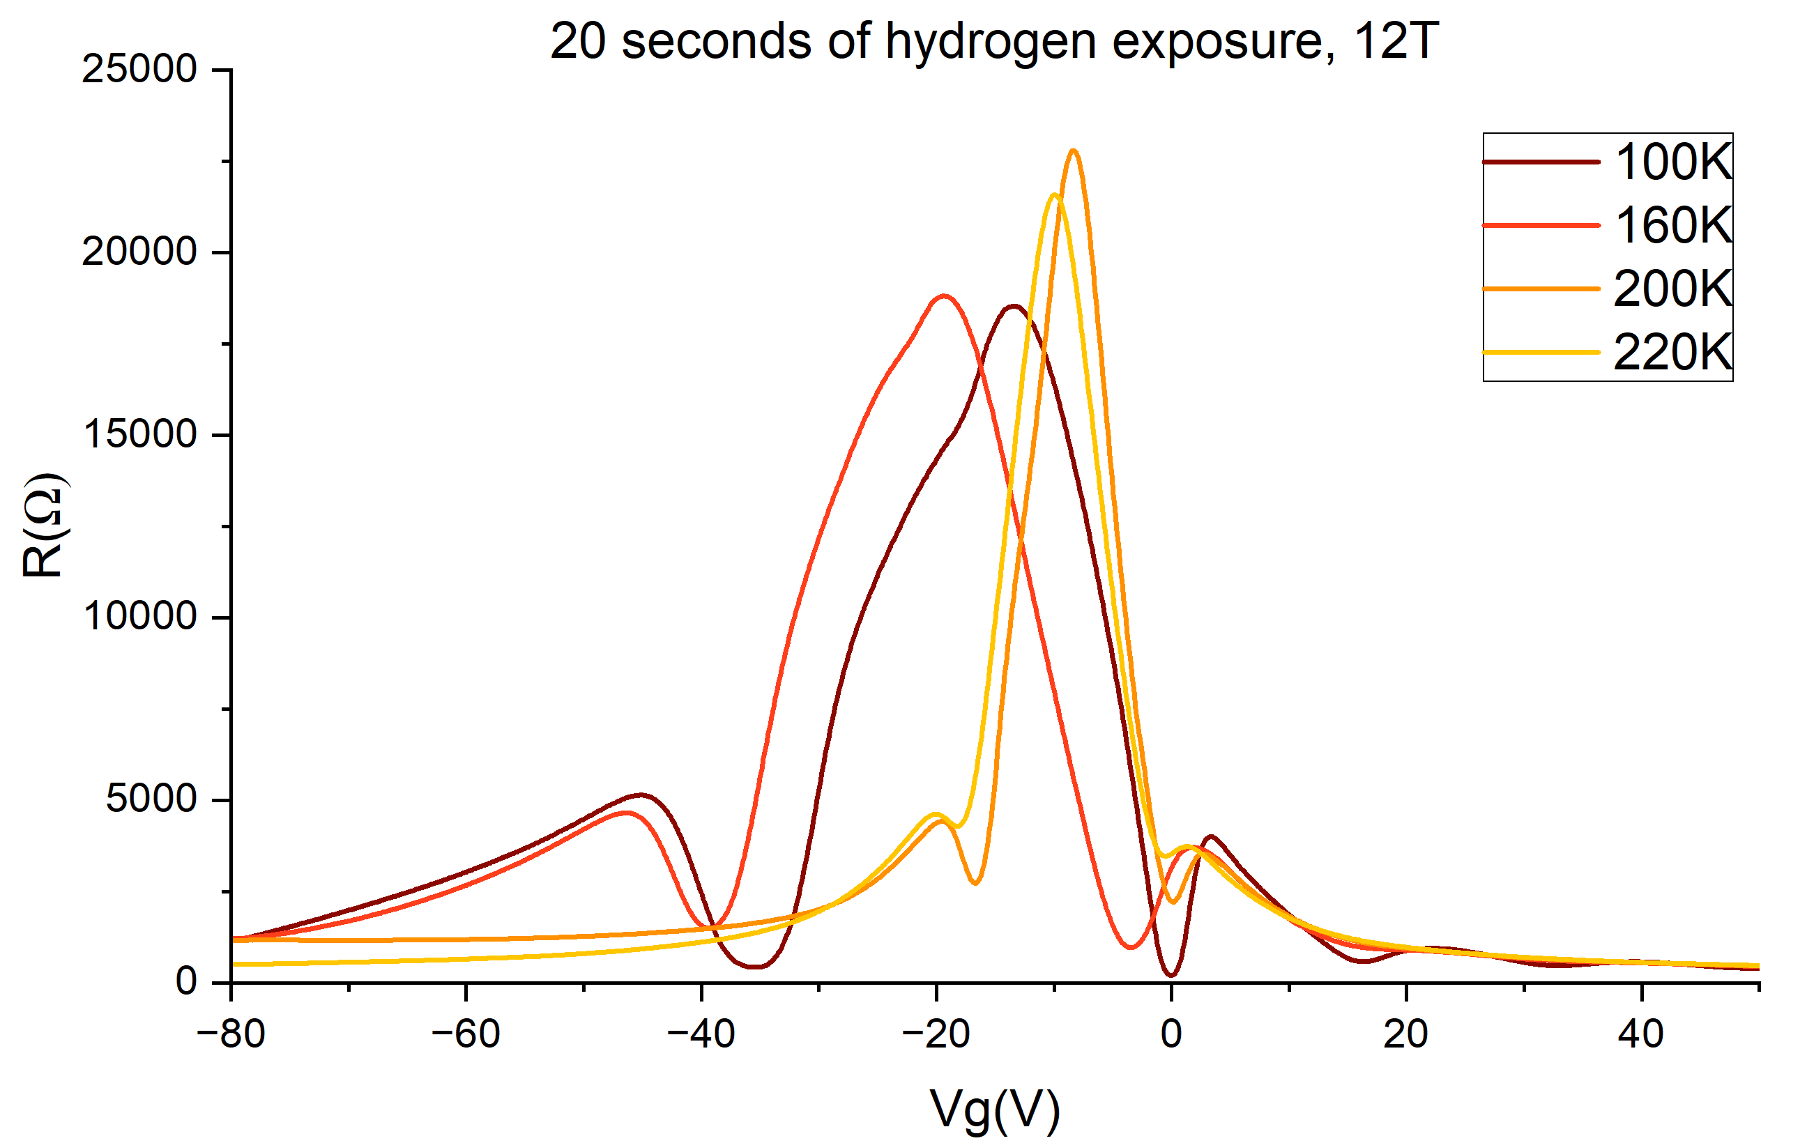
Quantum Hall effect

Slide 27
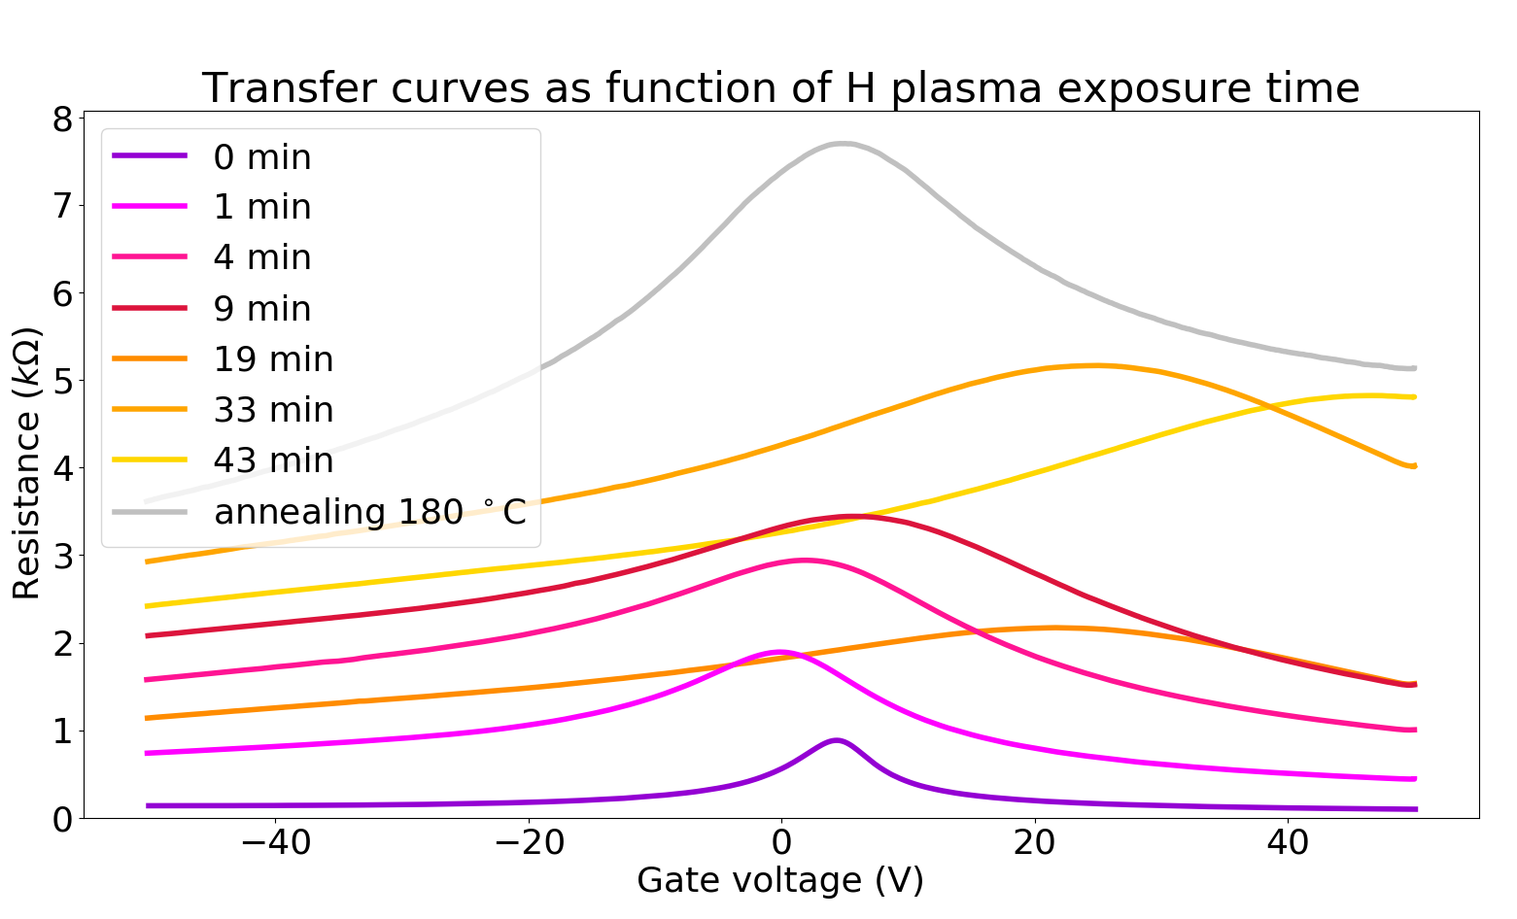
Transfer curves after hydrogenation

Slide 28
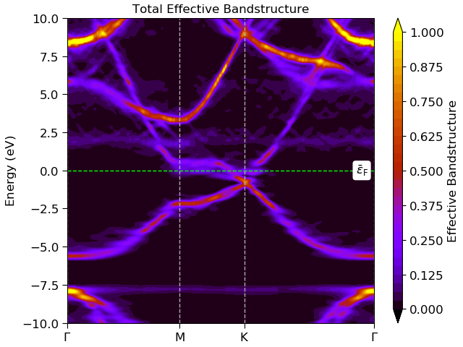
Compare simulations to hydrogenation results

Slide 29
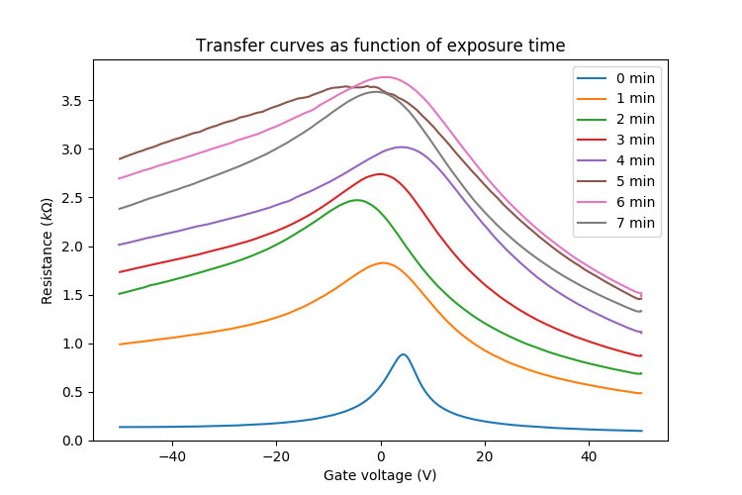
H exposure

Slide 30
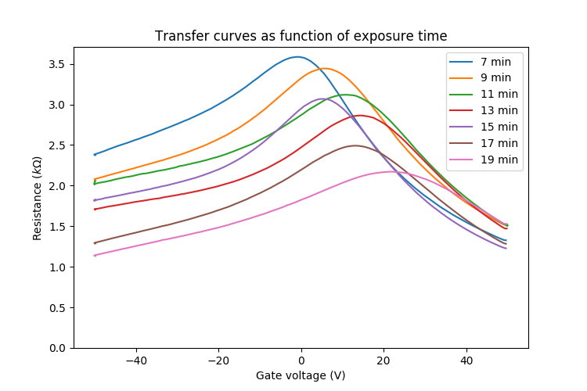
H exposure

Slide 31
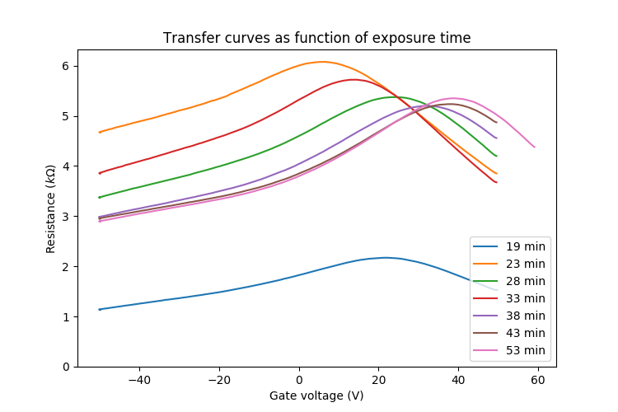
H exposure
Hydrogen exposure may increase or decrease resistance

