Slide 1











In silico optimization of tritiated graphene for Ptolemy
Valentina Tozzini
Istituto Nanoscienze - CNR (Pisa –Italy)
INFN Sez Pisa
Guido Menichetti UniPi, IIT
Angelo Esposito UniRoma1
Andrea Casale Comumbia Univ
Luca Bellucci NANO-CNR
Francesca Maria Pofi GSSI
PTOLEMY collaboration

Slide 2
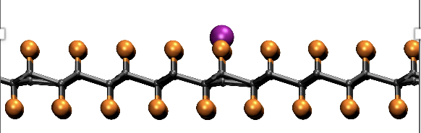
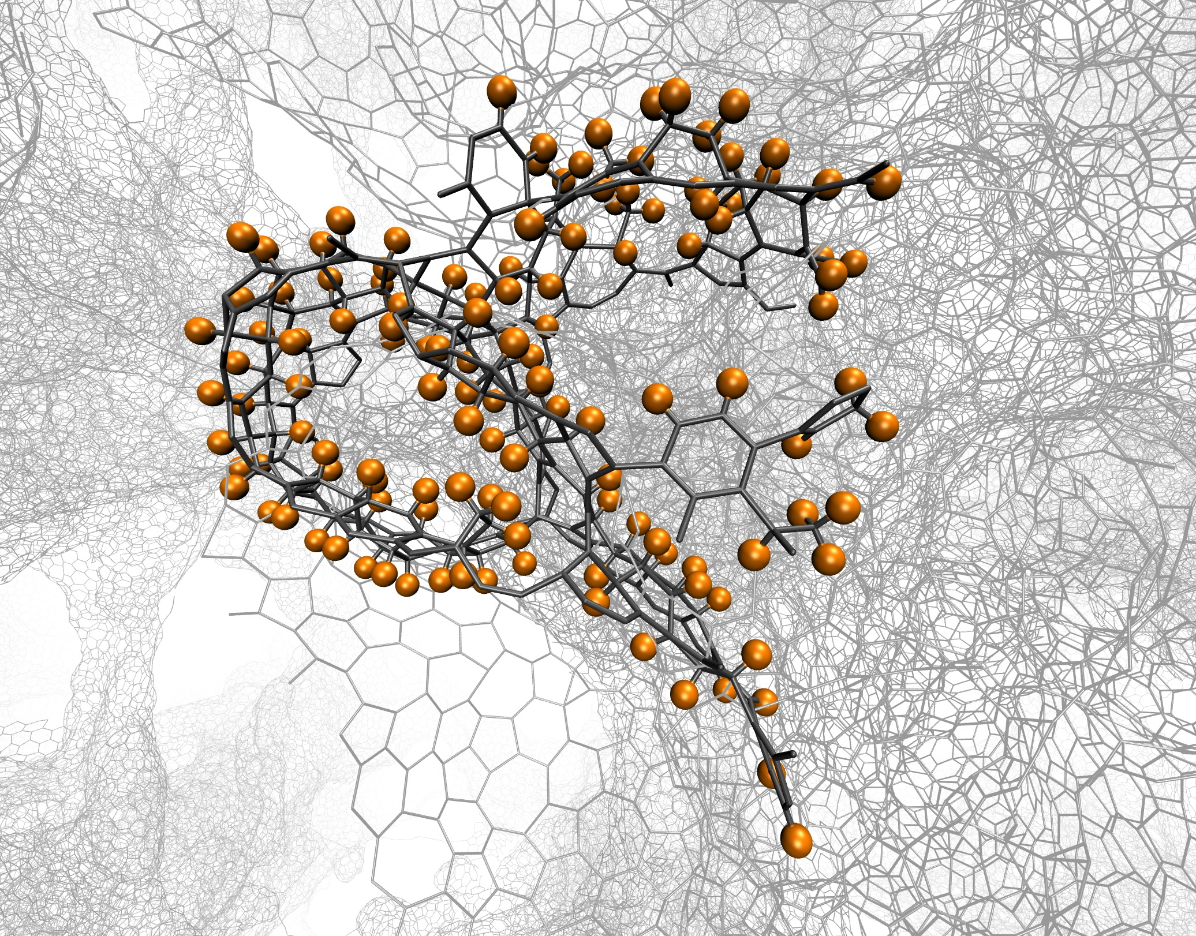
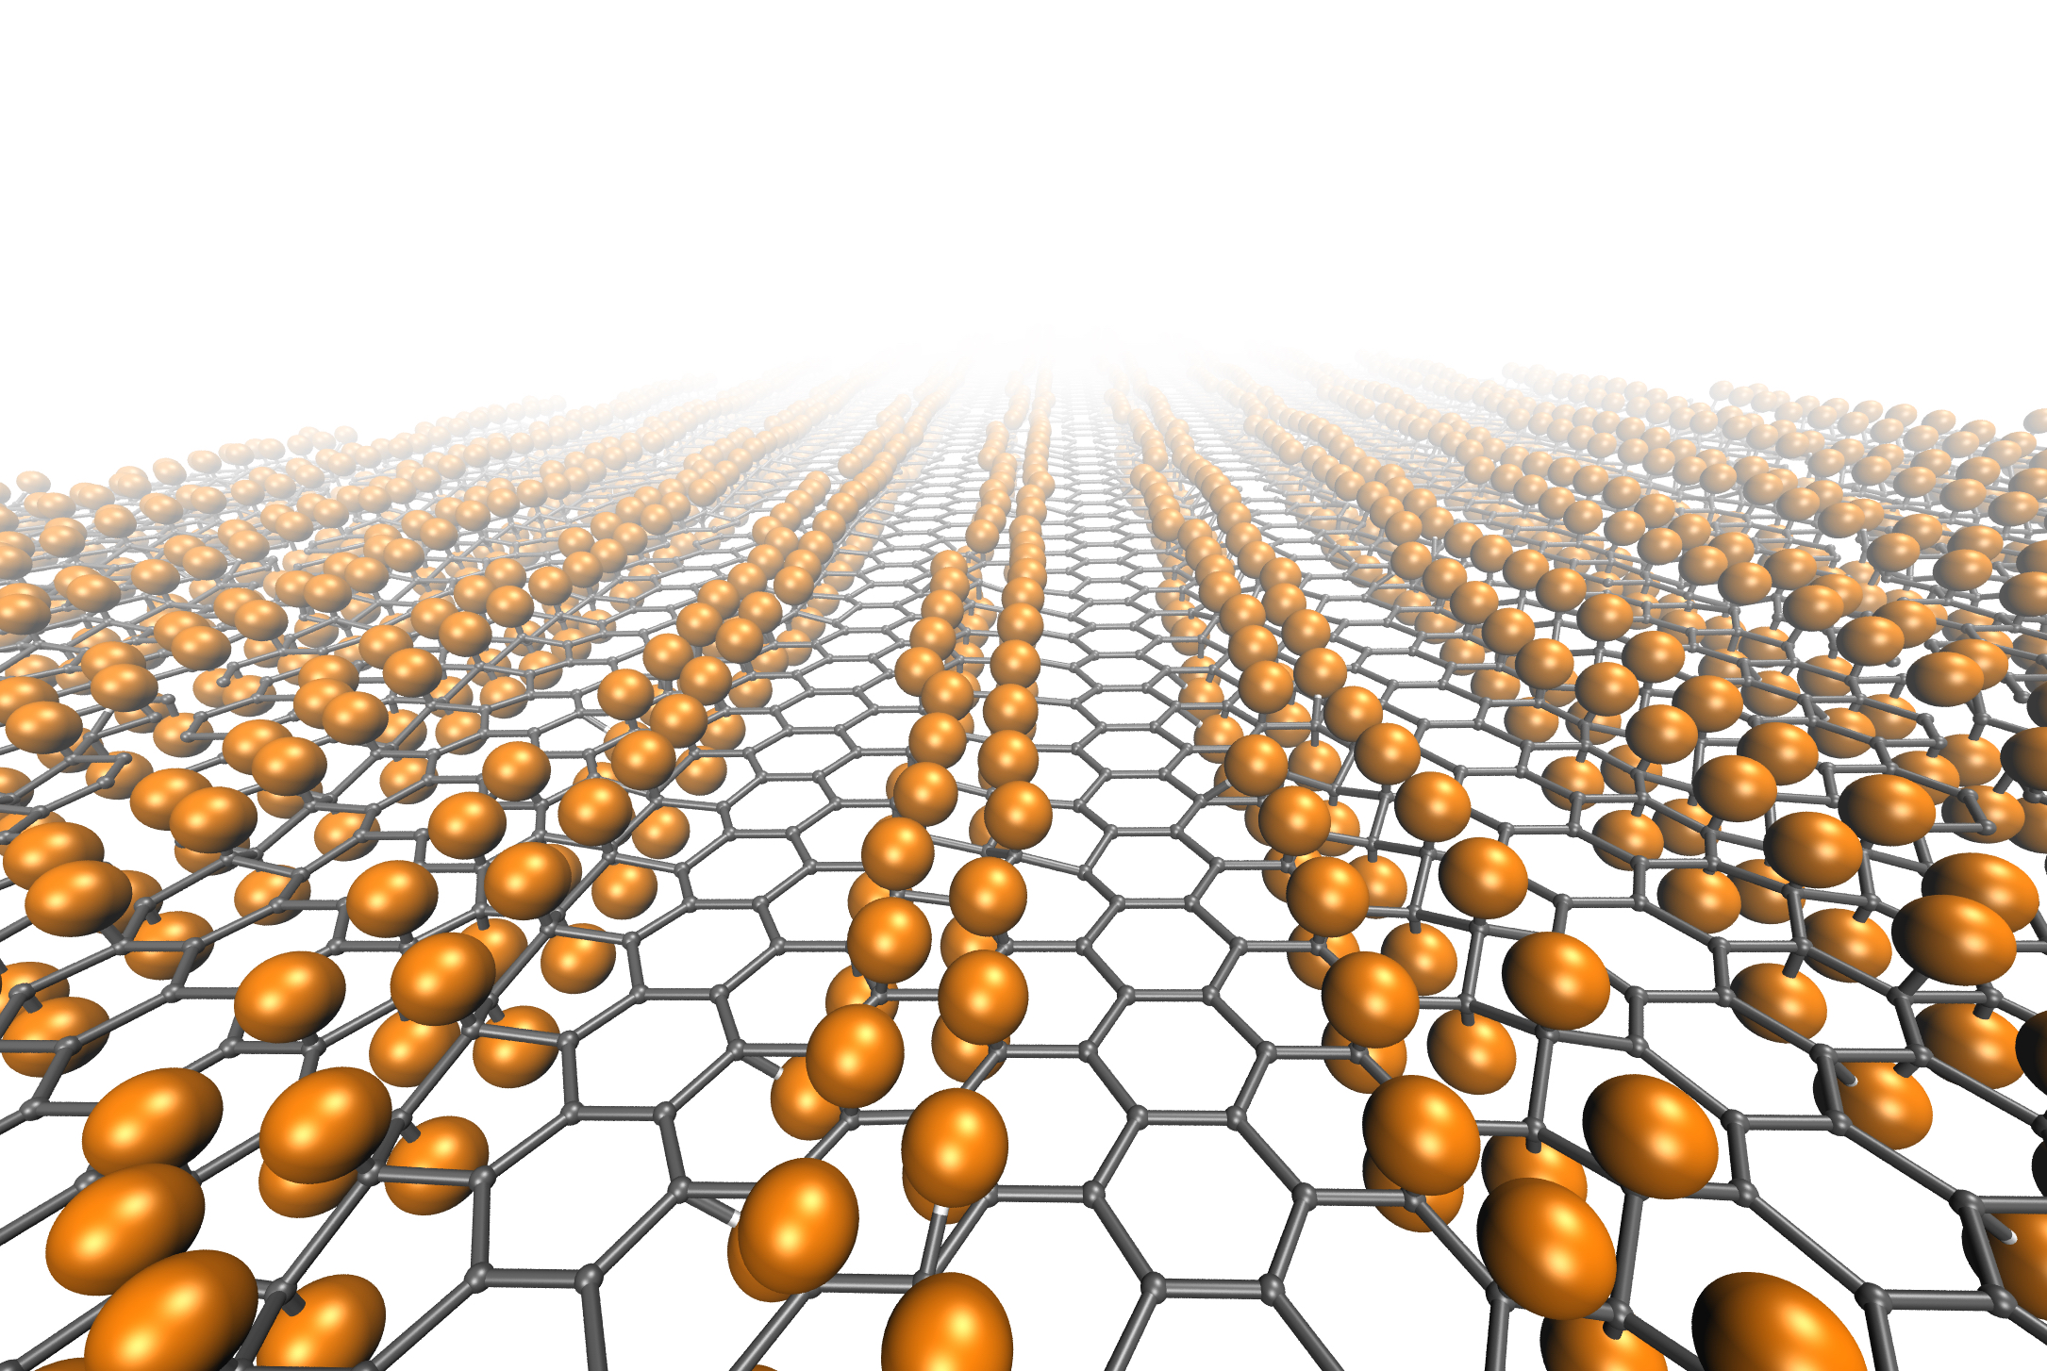
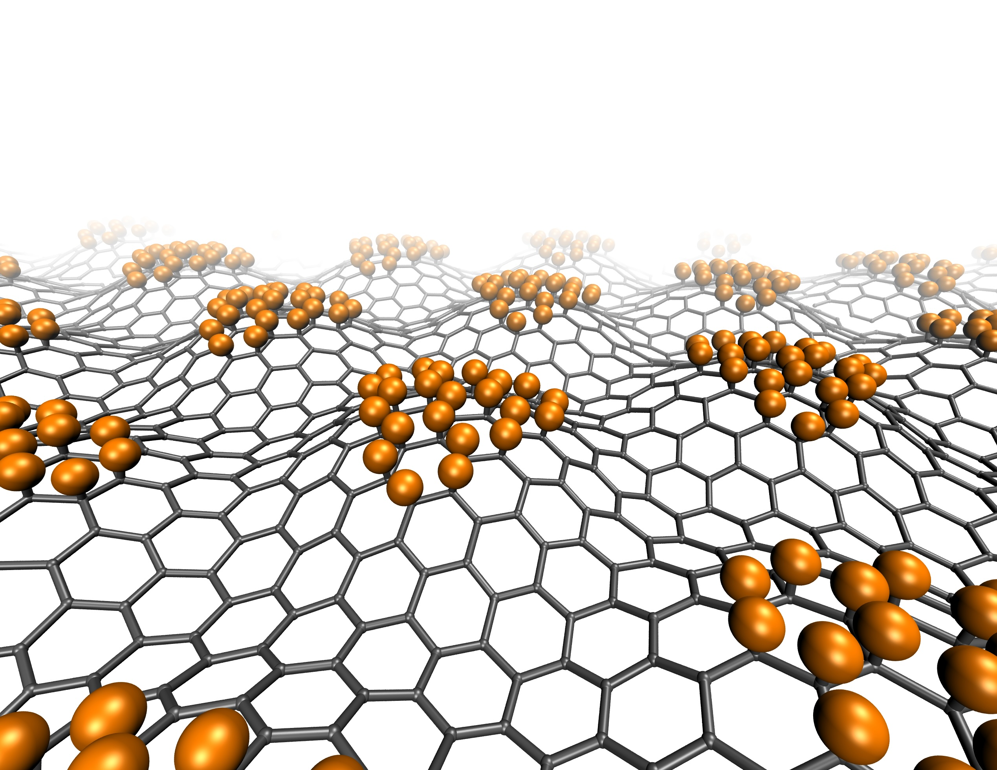
Outline
What happens during 3H decay
  Potential of tritium on graphene → quantum uncertainty corrections
What happens after decay(/capture)
  Electronic structure relaxation
  He dynamics and interaction with the material
  Interaction of β electrons with the material
  → Energy loss function & MC simulations
How do we optimize the material?
  Structure of the nanoporous scaffold
  Level of tritium loading & distribution

Slide 3
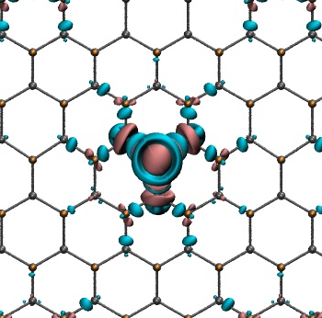
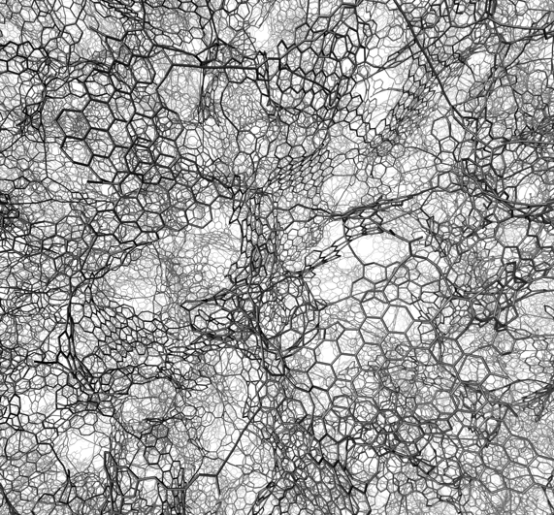
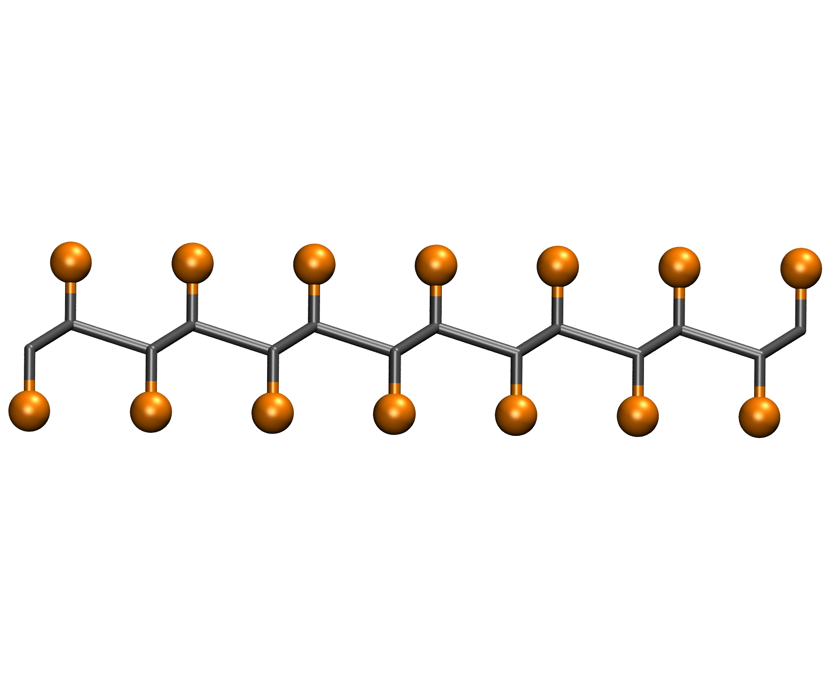
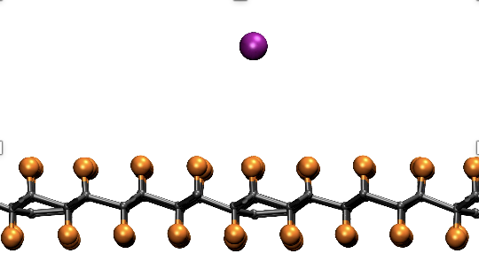






























He and β diffusion & interaction
Heating up
Material damage
T release
Timeline
Electronic relaxation
from 3H to He el struct
He detachment
decay
$$\overline{ν}$$
$$e^{−}$$
$$e^{−}$$
t=0
t~fs-ps
t~ ns-μs
$$\overline{ν}$$
(capture)

Slide 4
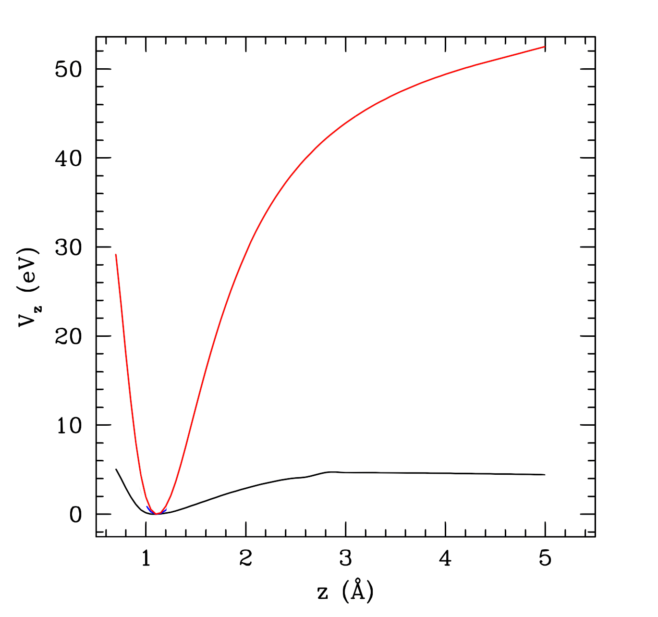
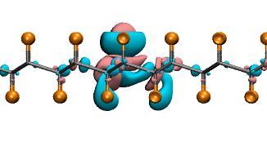

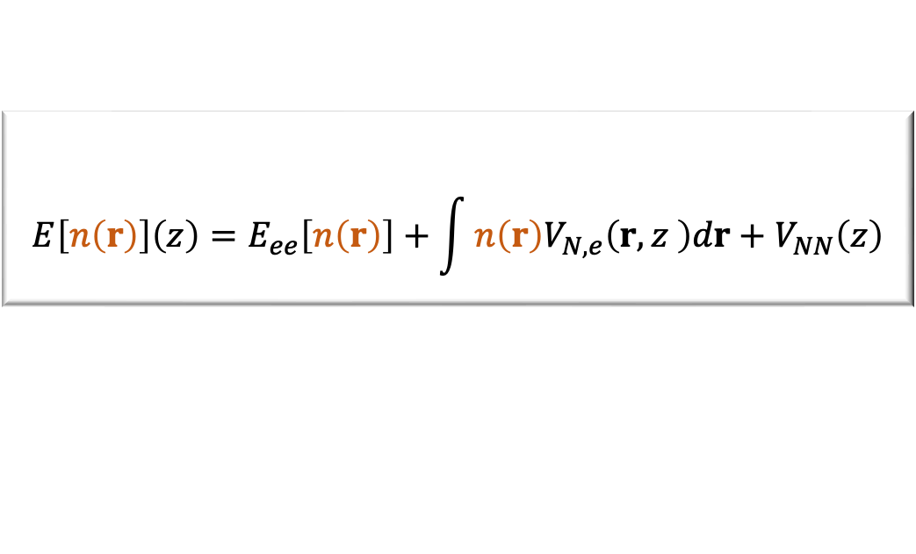
On the ultra-fast time scale
$$E\left[n\left(r\right)\right]\left(z\right)=E_{ee}\left[n\left(r\right)\right]+\int{n\left(r\right)V_{N,e}\left(r,z \right)dr}+V_{NN}\left(z\right)$$
Electrons space density
El-el interaction
Nuclei-electrons interaction
nuclei
int
Before decay/capture:
n(r) is relaxed in the electronic ground state
The T interaction potential U(z) is calculated within BO-DFT moving a T atom
T binding energy ranges from 5 eV to ~0 depending on T loading, local curvature of the sheet, on E-B external fields and electronic doping
Just after decay:
He+
(sudden approx)
³H becomes He⁺ and the electronic structure has not time to rearrange
Sudden approximation: U(z) evaluated with n(r) frozen at the configuration with T
The potential is strognly attractive
z
U(z)
T BO
Vertical pot
After electronic relaxation:
Electrons move to He (He⁺ → He)
The potential turns strongly repulsive
The relaxation time depends on the opto-electronic properties of the material, and therefore on the T loading
U(z)
U(r)
lateral potential
U(z)
He BO

Slide 5
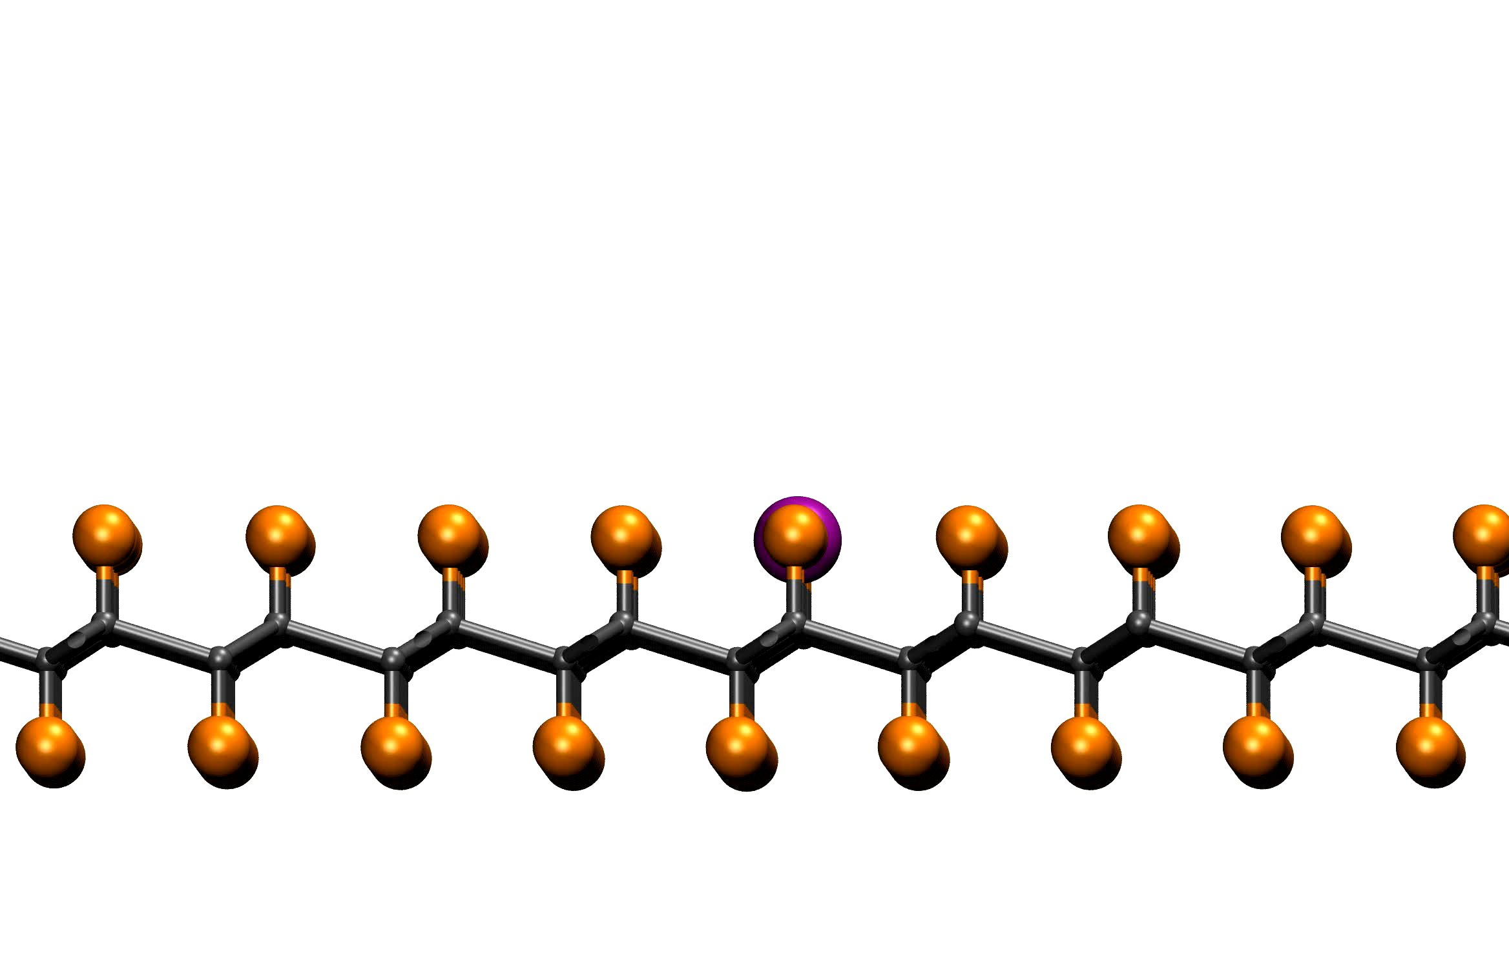
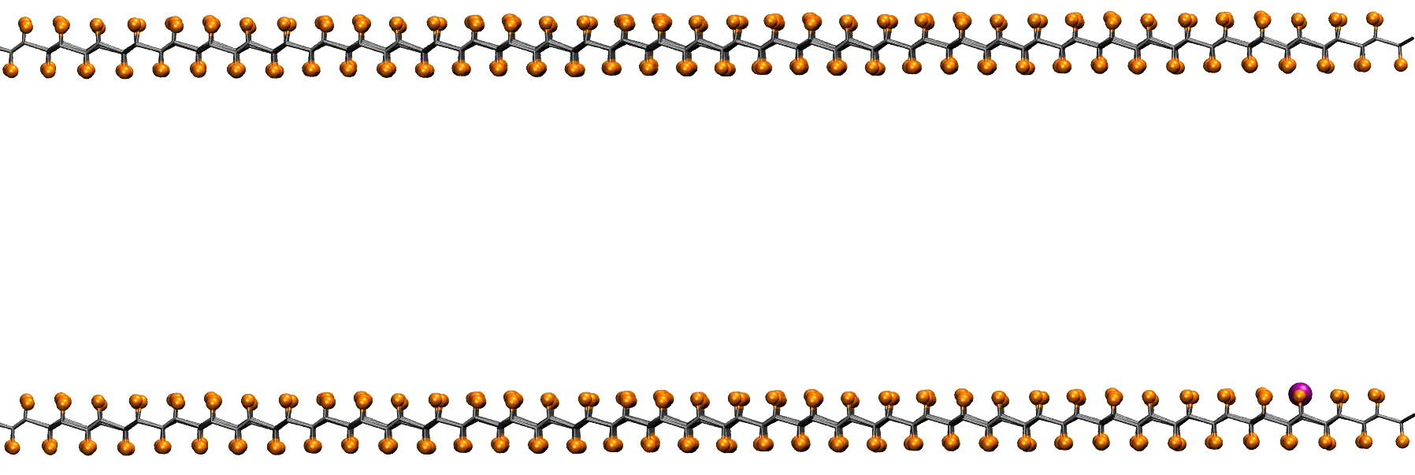
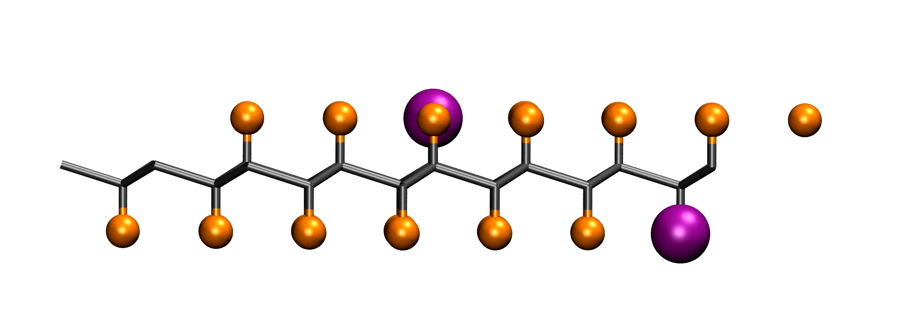
The repulsive potential produces He release
For each He released, the system gains
~2 eV if isolated (ch +1)
~4 eV if neutralized
Charge +1
T (K)
Charge 0
He transfer energy to the sytem during ~10-100 ns.
A single event can heat locally (~1nm²) up to 600K but given the low rate of events on the large scale heating is negligible
Double decay/release events (extremely unlikely) could have sufficient energy to create a vancancy in the sheet
Overall, it seems that He release would not make substantial damage to the system

Slide 6
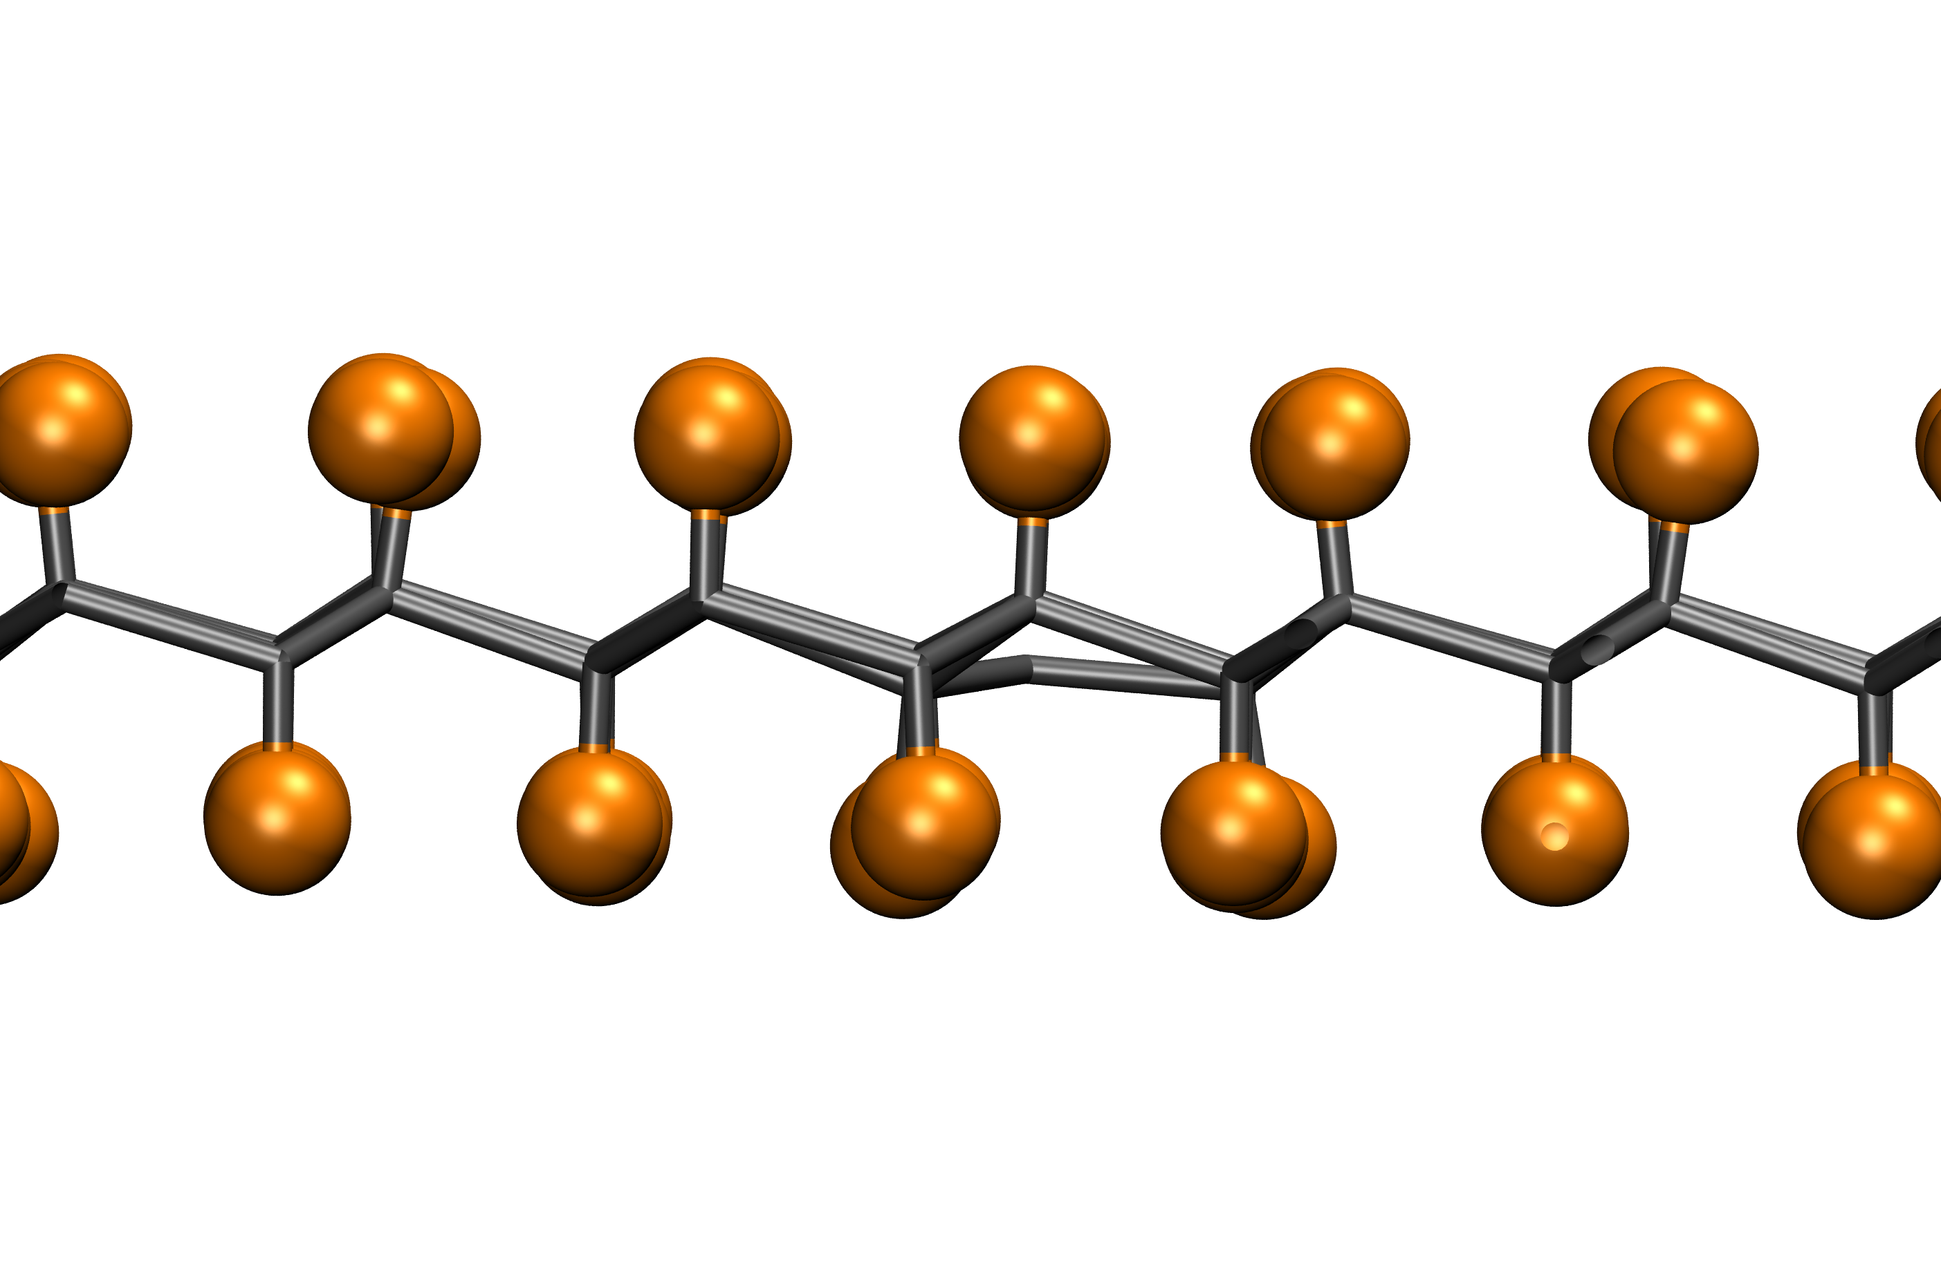
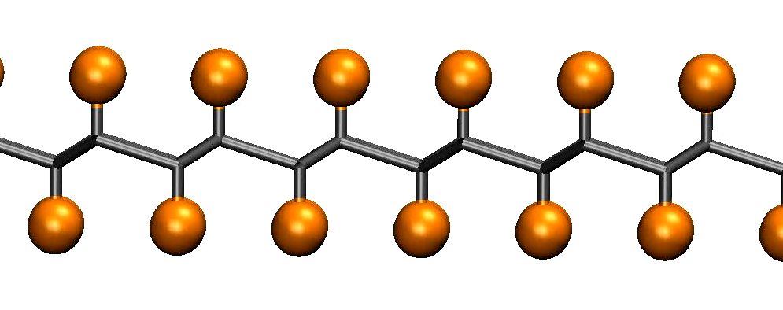
The He release excites specific modes of the sheet
After He is released, the vacant site is distorted and its relaxation excite specific vibrational modes
These are visible in the beats and involve: stretching-bending and rocking + out of plane mode of the sheet
Specific frequencies may appear as enhanced peaks in IR or Raman
The frequencies however, depends on the amount and distribution of tritium
Vibrational spectra calculations are in progress

Slide 7
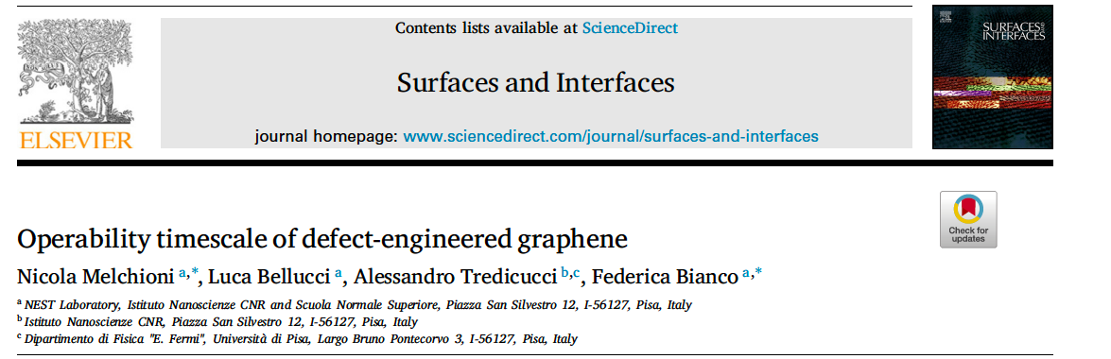
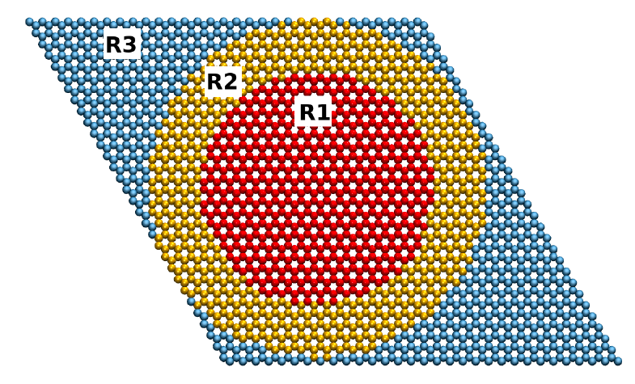
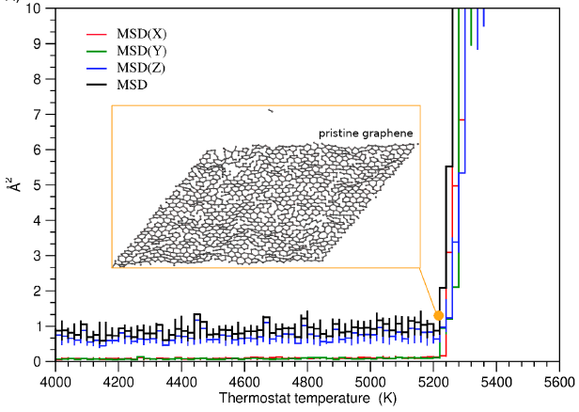
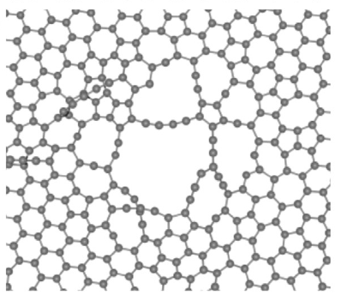

The β electrons interact with the material
In the low energy range (up to 20-100K) electrons interact with the material and release energy with several mechanisms
$$e^{−}$$
Primary scattering
Production of secondaries and scattering
Dissipation by interactions with electrons of the material
Dissipation by interaction with phonons of the material
Moleculary dynamics simulations (L Bellucci) were previously done for EMB electron beams (20keV) with very large fluence (5x10⁹ el/nm² sec) considering only primary scattering and other effects a producing an average gradual eating in the local spot of the beam
The single scattering event can transfer to C ~3eV
⇒ This cannot generally break C=C bonds
However, the local heat up of the sheet due to secondaries and dissipation can combine with the scattering and create defects

Slide 8
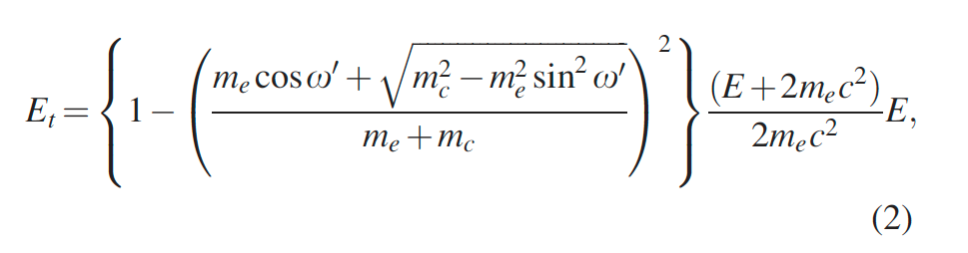
The β electrons interact with the material
In the low energy range (up to 20-100K) electrons interact with the material and release energy with several mechanisms
$$e^{−}$$
Primary scattering
Production of secondaries and scattering
Dissipation by interactions with electrons of the material
Dissipation by interaction with phonons of the material
In our case
The primary scattering can release up to 15 eV to ³H (due to smaller mass) and possibly break C-H bond
On the other hand, we have much lower fluence (10⁻⁷ el/nm² sec) but we want to properly consider the distribution of secondaries and their scattering into the material
Additionally, we have a complex material, both in composition and structure, and we must consider the dissipation both by electronic structure and phonons
See e.g. Asayama et al, J Vac Sci Tech B 30 06fj02 2012

Slide 9
The β electrons interact with the material
In the low energy range (up to 20-100K) electrons interact with the material and release energy with several mechanisms
$$e^{−}$$
IDEA: combine Monte Carlo (NEBULA) with MD
From MC simulation calculate the energy distribution in the structure
Use that energy distribution to create the starting condition of in a structurally realistic model and evlove it with MD
Primary scattering
Production of secondaries and scattering
Dissipation by interactions with electrons of the material
Dissipation by interaction with phonons of the material
Issues:
The effects to be described in MC simulations DEPEND on the material composition AND structure
Tritiated graphene is two dimensional, nano-porous and disordered

Slide 10
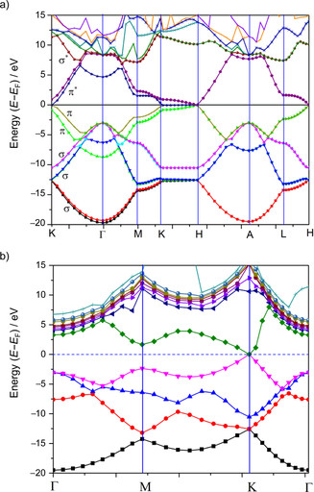
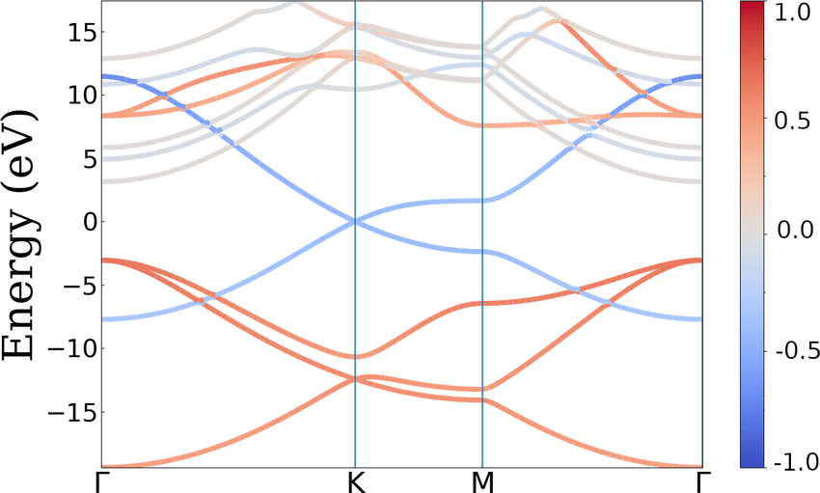
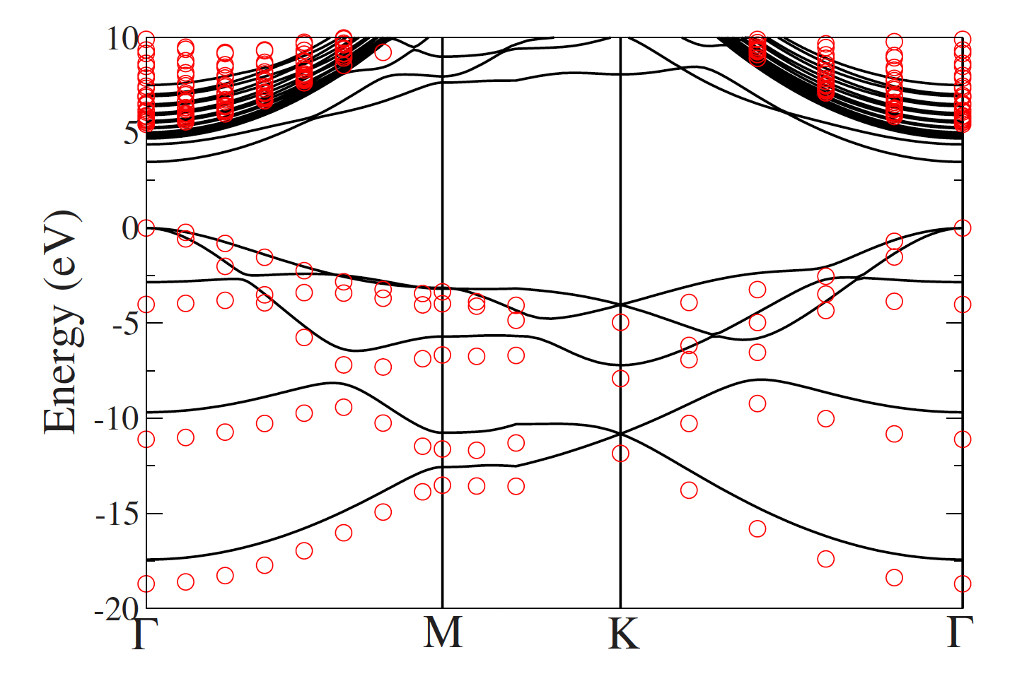
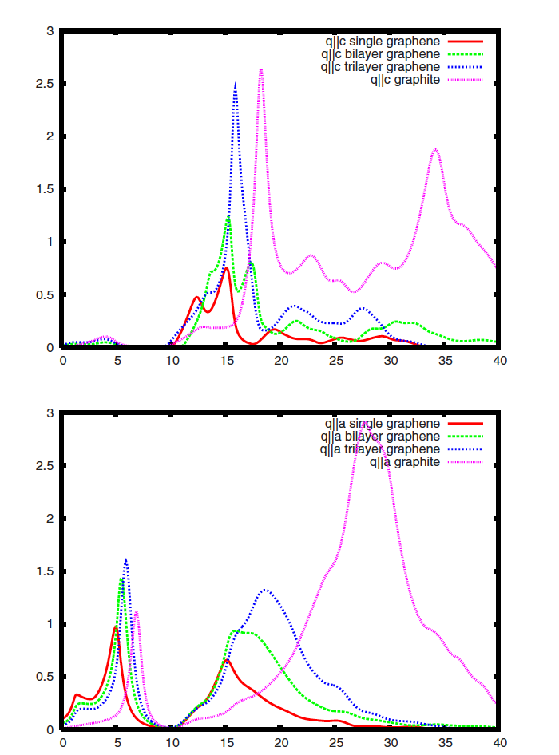

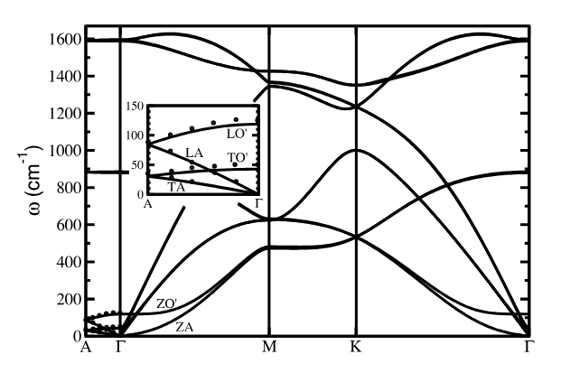
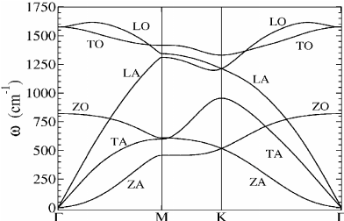
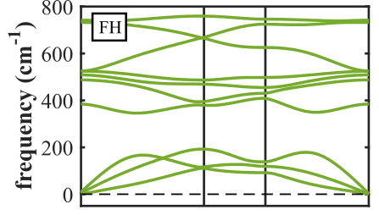

The β electrons interact with the material
$$e^{−}$$
Primary scattering
Production of secondaries and scattering
Dissipation by interactions with electrons of the material
Dissipation by interaction with phonons of the material
Chemical composition
Electronic structure
Phonons dispersion
Issues:
The effects to be described in MC simulations DEPEND on the material composition AND structure
Tritiated graphene is two dimensional, nano-porous and disordered
Graphite
Graphene
GraphAne (fully loaded)
Electronic band structure
graphite: anisotropic conductor graphene: conductor 2D
graphAne: insulator 2D
Energy loss function/
conductivity
graphite: extremely anisotropic and dominated by plasmon peak
graphene/graphane: 2D, and strongly dependent on momentum transfer
Phonons
graphite: strongly anysotropic graphene: quadratic branch
graphAne: quadratic branch and specific C-H optical modes

Slide 11
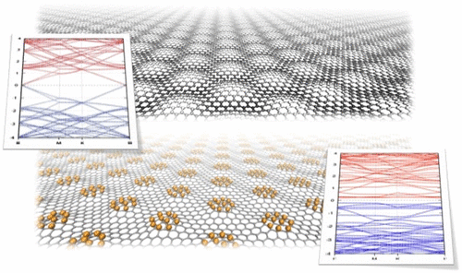
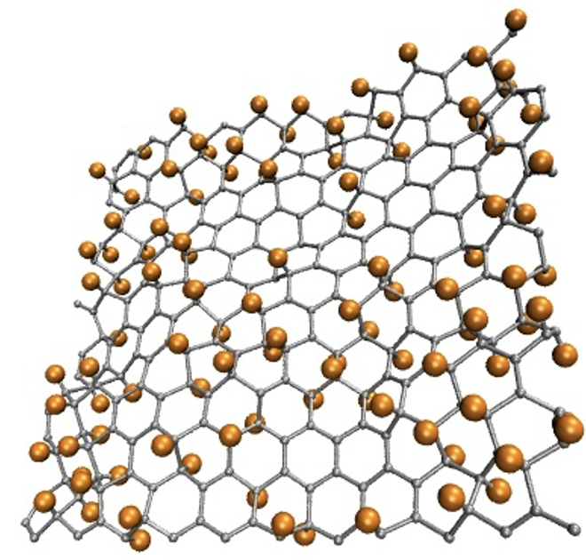
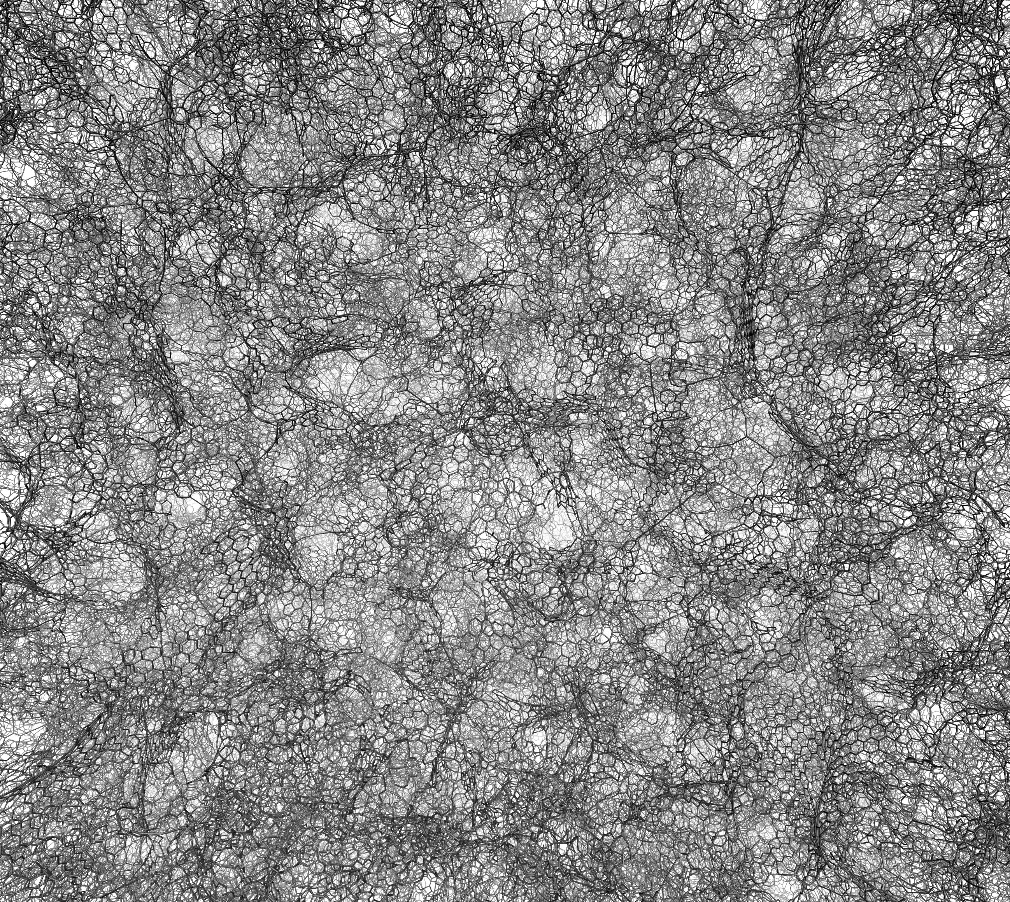
The “real” material and its properties
Our material is 2D → Some of the properties are intrinsically different (density of states, phonons dispersion, conductivity, ELF)
Our material is not entirely graphene or graphAne
Our material is not even regularly loaded, but probably disordered
→ Properties like conductance, ELF, vibrational spectra are a mixture of those of graphene/graphAne, depending on loading and configuration of tritium
A=3.5 (8) w*=1.1
W=40Å. δ=3Å
M single side
I double side
R single side
R double side
Graphene is nanoporous
  → tritium loading, diffusion of He, β electrons interaction and vibrational properties are influenced by the structure
Everything depends on graphene structure, on tritium loading level and distribution!

Slide 12
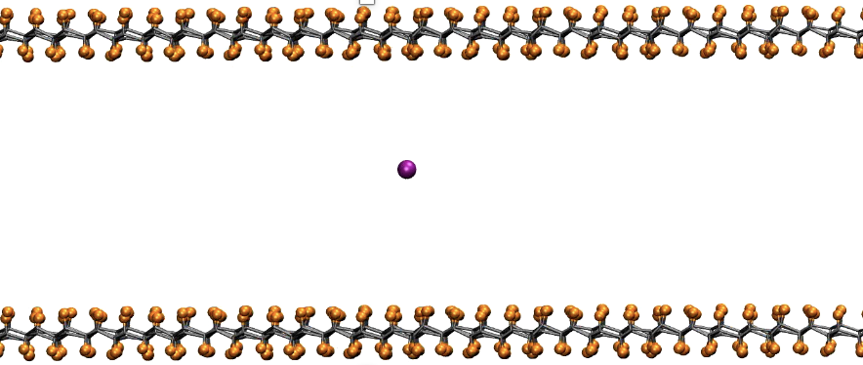
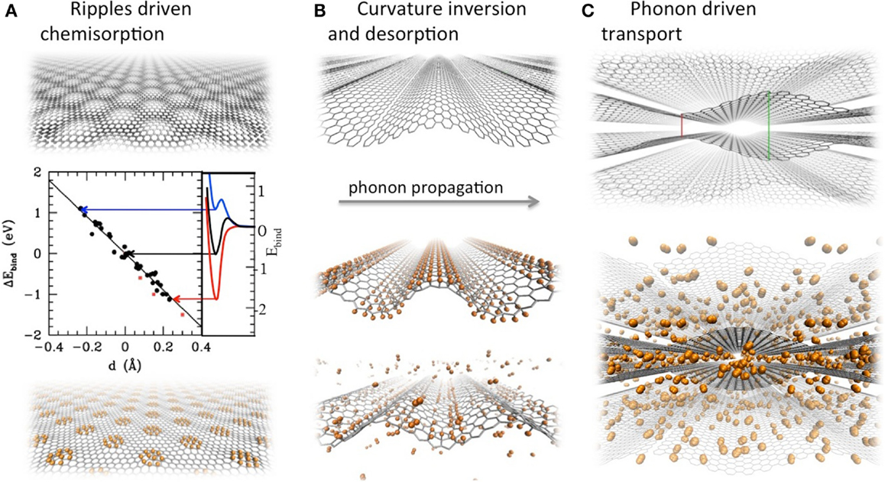
Summary
Vertical pot
The ³H-He potential for the rate calculation depends on loading level and distribution of tritium
He detaches and diffuses through the structure
Specific vibrational modes are activated that could be detected in coincidence with the decay/capture
β electrons may create defects in the material in very specific conditions
β electrons interaction and effect depends on tritium loading and distribution and is under study combining MC with MD
U(z)
In conclusion, almost each effect depends on the amount and distribution of tritium
Simulations are in the course to optimize loading

Slide 13
Thank you for your attention
Guido Menichetti UniPi, IIT
Angelo Esposito UniRoma1
Andrea Casale Columbia Univ
Luca Bellucci NANO-Cnr
Francesca Maria Pofi GSSI
PTOLEMY Collaboration

Slide 15
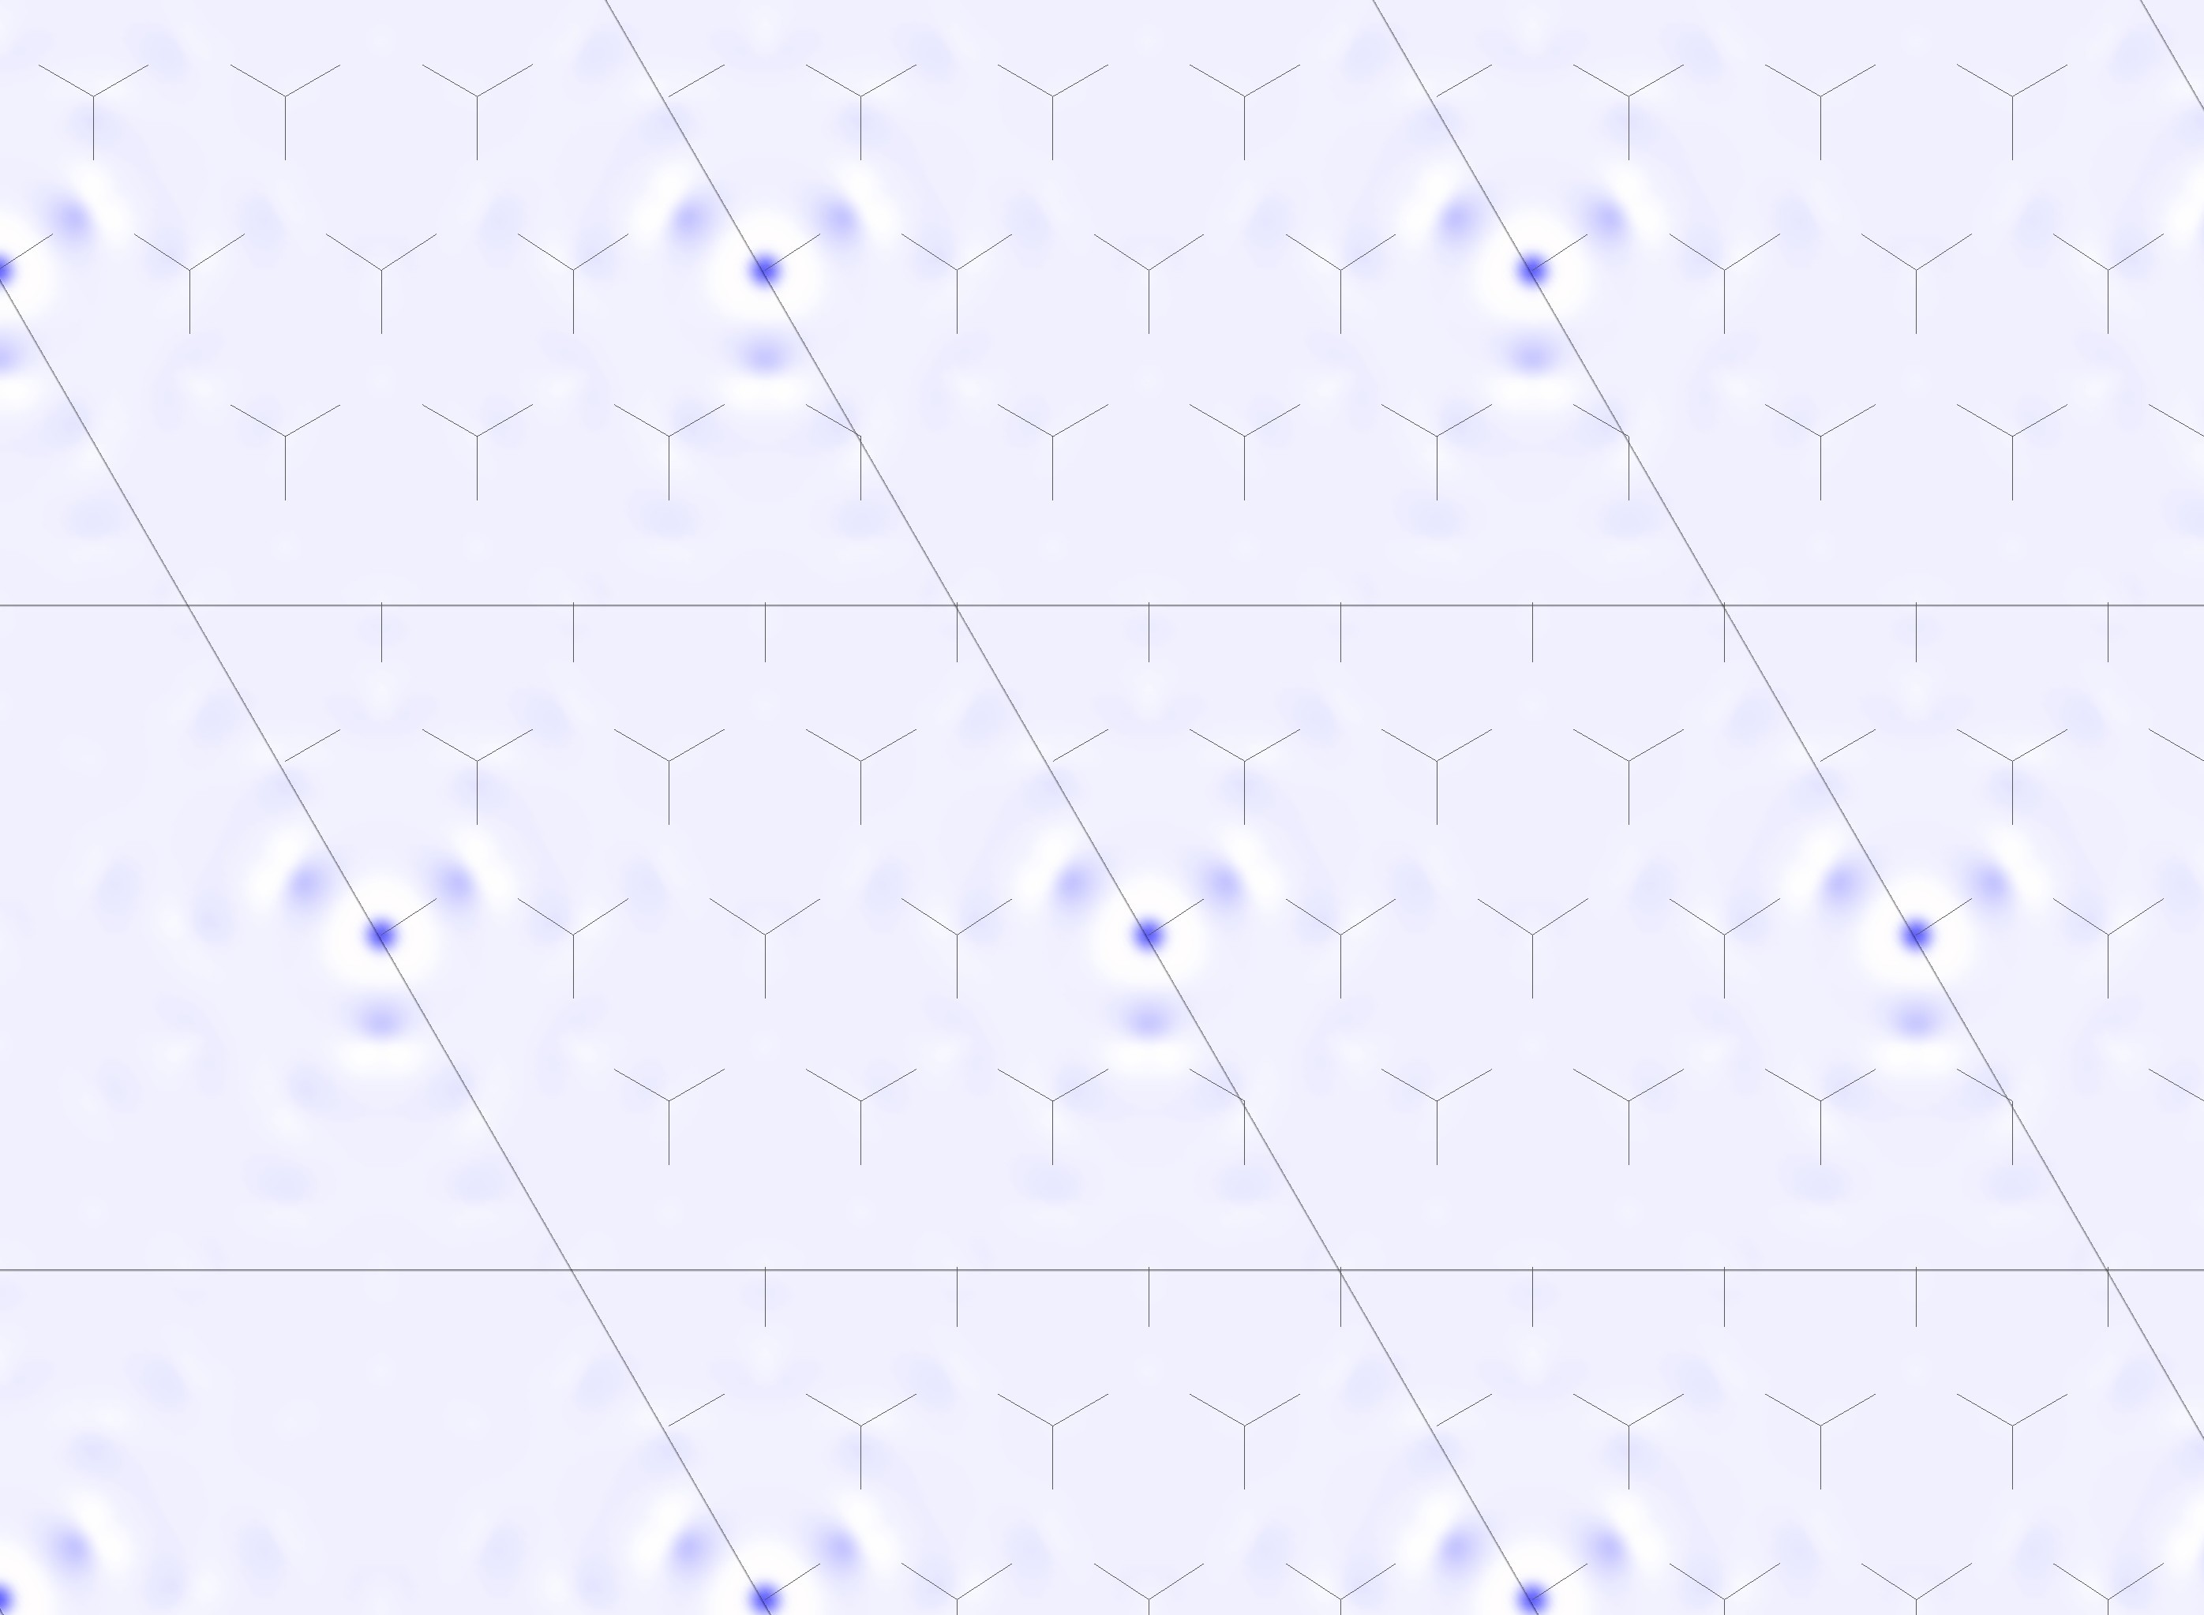
Electrons interaction with the hydrogenated graphene
(to T at most 15 eV) -> single events cannot generally break a C-C bond but can break a T-C bond
However, the sub-breaking energy is transferred to the material, which heats up. With the fluency of EM beams (fluence ~ 5x10⁹ el/nm² sec) the heat up is fast and defects occurs when local temperature reaches high values.
Secondary electrons effect is not considered in this work, and the Ekin distribution is very roughly described
In our case: we have a probability of decay (and fluence of electrons) that is about 10⁻⁷ el/nm² sec ) 17 orders of magnitude less -> fast heat up is certainly not likely
But:
We have additional heating caused by He release and diffusion within the structure: each event distributes 2-4 eV of energy per nm² resulting in a heat up of 300-500 K/event = at most 500Kx10⁻⁷ sec⁻¹ (i.e. 300K /year)
C-T bonds can be directly broken by the primary electrons
We can properly evaluate the kinetic energy distribution by MC simulations, including secondary electrons
->NEBULA calculations allow to include the material properties.

Slide 16
Gap vs coverage
Band gap generally decreases with T loading
graphEne
graphAne
GW or B3LYP
Bare DFT
But data from calculations (and exp as well) are very messy mainly because of different hydrogenation modality
  one or two side
  clusters or random
  geometry of hydrogenation (strips, islands, …)

Slide 17
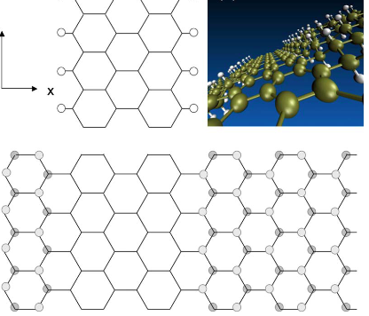


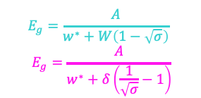
focusing on simple geometries: Tritiation per stripes
Gap vs coverage
Nanoribbons sculpted in graphane (PRB 2011)
The gap-vs-stripes width dependence is similar to that of graphene nanoribbons…
… leading to simple behavior of gap vs coverage
$$E_{g}=\frac{A}{w^{∗}+W(1−σ)}$$
$$E_{g}=\frac{A}{w^{∗}+δ(\frac{1}{σ}−1)}$$
w
δ
graphEne
graphAne
tritiated stripe
W
graphene ribbon
$$E_{g}=\frac{A}{w^{∗}+W\left(1−\sqrt{σ}\right)}$$
$$E_{g}=\frac{A}{w^{∗}+δ\left(\frac{1}{\sqrt{σ}}−1\right)}$$
Tritiation per islands
In the per-island tritiation a similar trend can be derived
W
δ

Slide 18

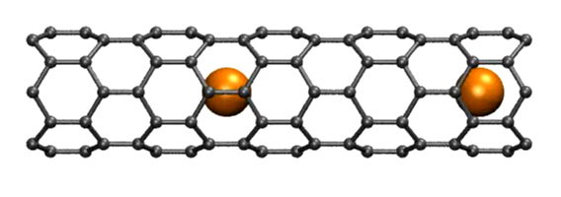
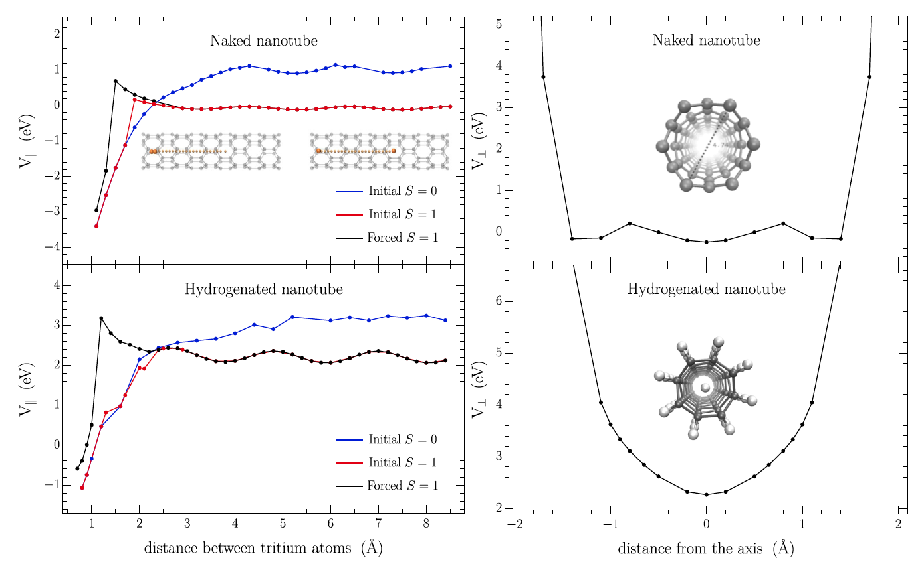
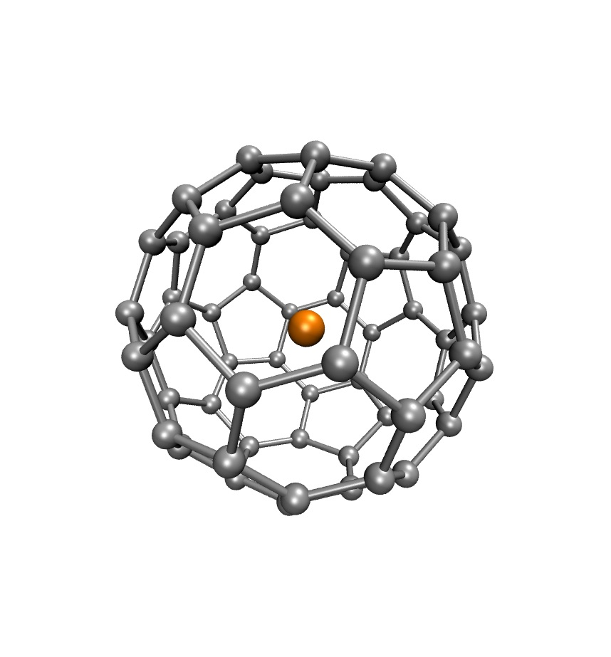
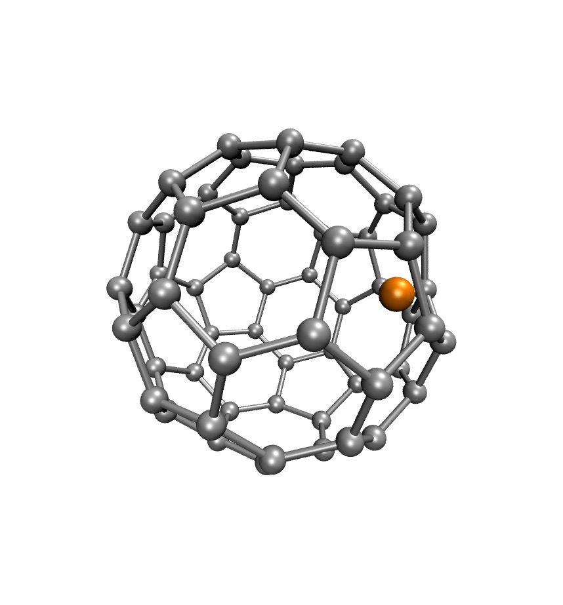




Neutrino capture
$$ν$$
Requirements
The material must be conductive for high precision β peak determination
$$e^{−}$$
$${{}_{}^{3}H}^{}$$
$${{}_{}^{3}{He}}^{+}$$
A=3.5 (8) w*=1.1
W=40Å. δ=3Å
M single side
I double side
The band gap and conductance depend on distribution of T on graphene
# events
R single side
R double side
→ optimization of the material is in the course
electron energy
2. The quantum uncertainty on the ³H/He momentum spoils the resolution
The binding potential must be the flattest possible
➔ Encapsulation into nanotubes or fullerenes
The ³H/He momentum state must be controlled
➔ excitation of coherent vibrational states
S=1 triplet
S=0 singlet
Not restrained

Slide 19
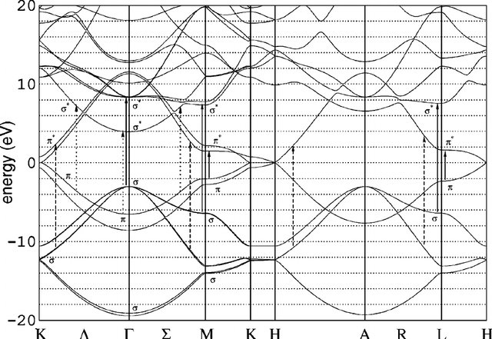
14 Novembre 2024. Input for GRAPHITE/graphene: q parallel to plane
graphite.yaml
name: graphite
density: 2.2600 g/cm³
elements:
C: { count: 1, Z: 6, M: 12.0116 g/mol }
band_structure:
model: metal
fermi: 7.5 eV
work_function:
4.7-4.8 eV from basal plane, from different literature sources
optical:
df_file: elf/df_graphite.dat
phonon:
lattice: 2.461 Å
m_dos: 1.0 m_e
m_eff: 0.1 m_e
longitudinal:
alpha: 3.0 e-7 m²/s
c_s: 21000 m/s
ac_def: 4.5-6.8-7.8 eV
transversal:
alpha: 4.0 e-7 m²/s
c_s: 13800 m/s
ac_def: 4.5-6.8-7.8 eV
This is the distance of FL to bottom of conduction band Considering that the pi bands are those contributing more to conduction in plane, I put here the bottom of the main pi bands (average)
NB: this is the a lattice constant (in-plane) but I’m not really sure what should be put here. First of all, due to anisotropy, the out of plane lattice constant is much larger (6.708). Second, graphite has 2 atoms per cell, and symmetry of the crystal is not given anywhere. Therefore, if one has to put a single value here, that should probably be 1.42, that is the C-C distance. It is possible that an effective lattice constant to be used for in plane calculation is more around 2 angstrom.
Discussed in next slides
The effective masses m_eff for conduction bands are very small, 0.04-0.05 m_{e}, but for graphite at K point, the effective mass approximation is poor. In the literature one often finds 0,87, but this is the mass associated to pi-sigma plasmon. Therefore, I’m not even sure of these values. I would try values in the range 0.05-0.5 for the second and ~1 for the first, but we need to search little more, and see exactly how the parameters are used
The acoustic phonon deformation potential ac_def was taken from estimates on graphene, giving effective isotropic values. Therefore the same value is used for the two branches
The transverse sound speed is defined only for TA (in plane polarization mode). For the ZA mode (out of plane polarization), it is null, since the dispersion is quadratic. Therefore the effective value of the “transverse sound” velocity may be smaller.
The alpha parmeter (curvature) is set to approximately reproduce the zone boundary acoustic branch bending (see plot aside)

Slide 20
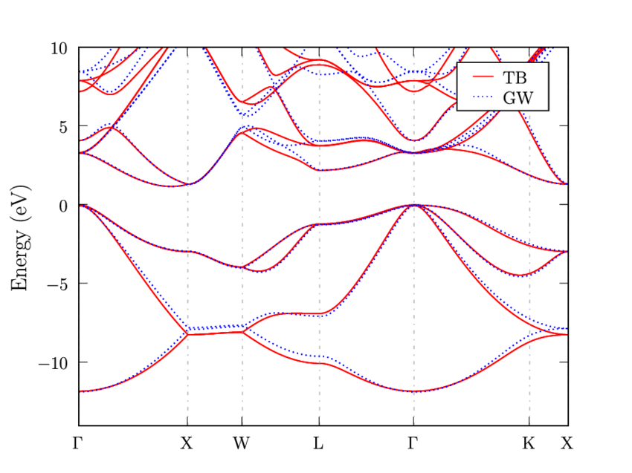
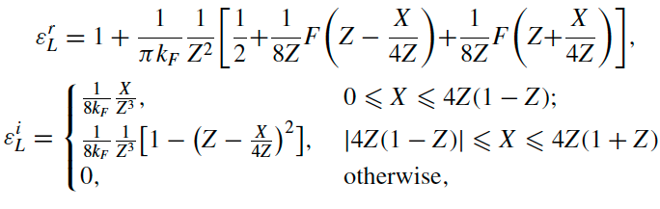




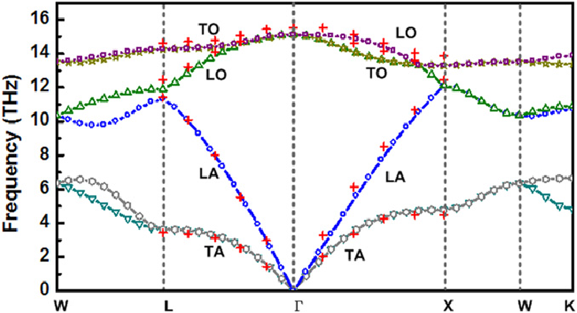
14 Novembre 2024. How does NEBULA represent the material
The case of SILICON
How optical properties are treated
The q dependent ELF is expanded from that at q=0 in terms of the Lindhard function
Silicon silicon.yaml
Silicon electronic band structure
name: silicon
density: 2.3290 g/cm³
elements:
Si: { count: 1, Z: 14, M: 28.0855 g/mol }
band_structure:
model: semiconductor
valence: 7.27 eV
band_gap: 1.12 eV
affinity: 4.05 eV
optical:
df_file: elf/df_Si.dat
phonon:
lattice: 5.430710 Å
m_dos: 1.08 m_e
m_eff: 0.26 m_e
longitudinal:
alpha: 2.00e-7 m²/s
c_s: 9130 m/s # Landolt-Bornstein Vol. III/41A1a 872
ac_def: 9.2 eV # Landolt-Bornstein Vol. III/41A1a 648
transversal:
alpha: 2.26e-7 m²/s
c_s: 5842 m/s # Landolt-Bornstein Vol. III/41A1a 872
ac_def: 5.0 eV # Landolt-Bornstein Vol. III/41A1a 648
2. The lindhard function is approximated by single pole appr
leading to
= level of the bottom of
conduction bands
with respect to
vacuum
with
All depends on the optical epsilon and on the dispersion of plasmons (one or more), and serves to approximate the real epsilon(q,omega) when it is not known. If the plasmon is not dispersive, the q=0 approx is ok.
These effective masses are the curvature of bands (average) of valence and conduction bands for electron damping by phonons calculations
Curvature parameter at zone boundary
Linear part coefficients

Slide 21
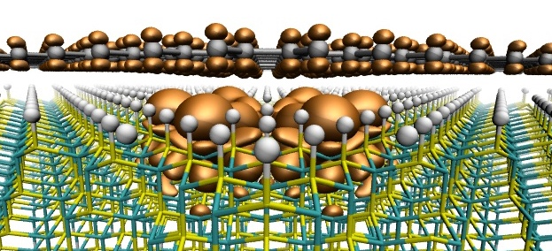
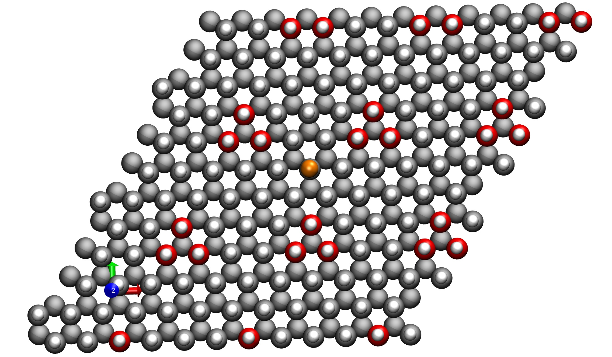
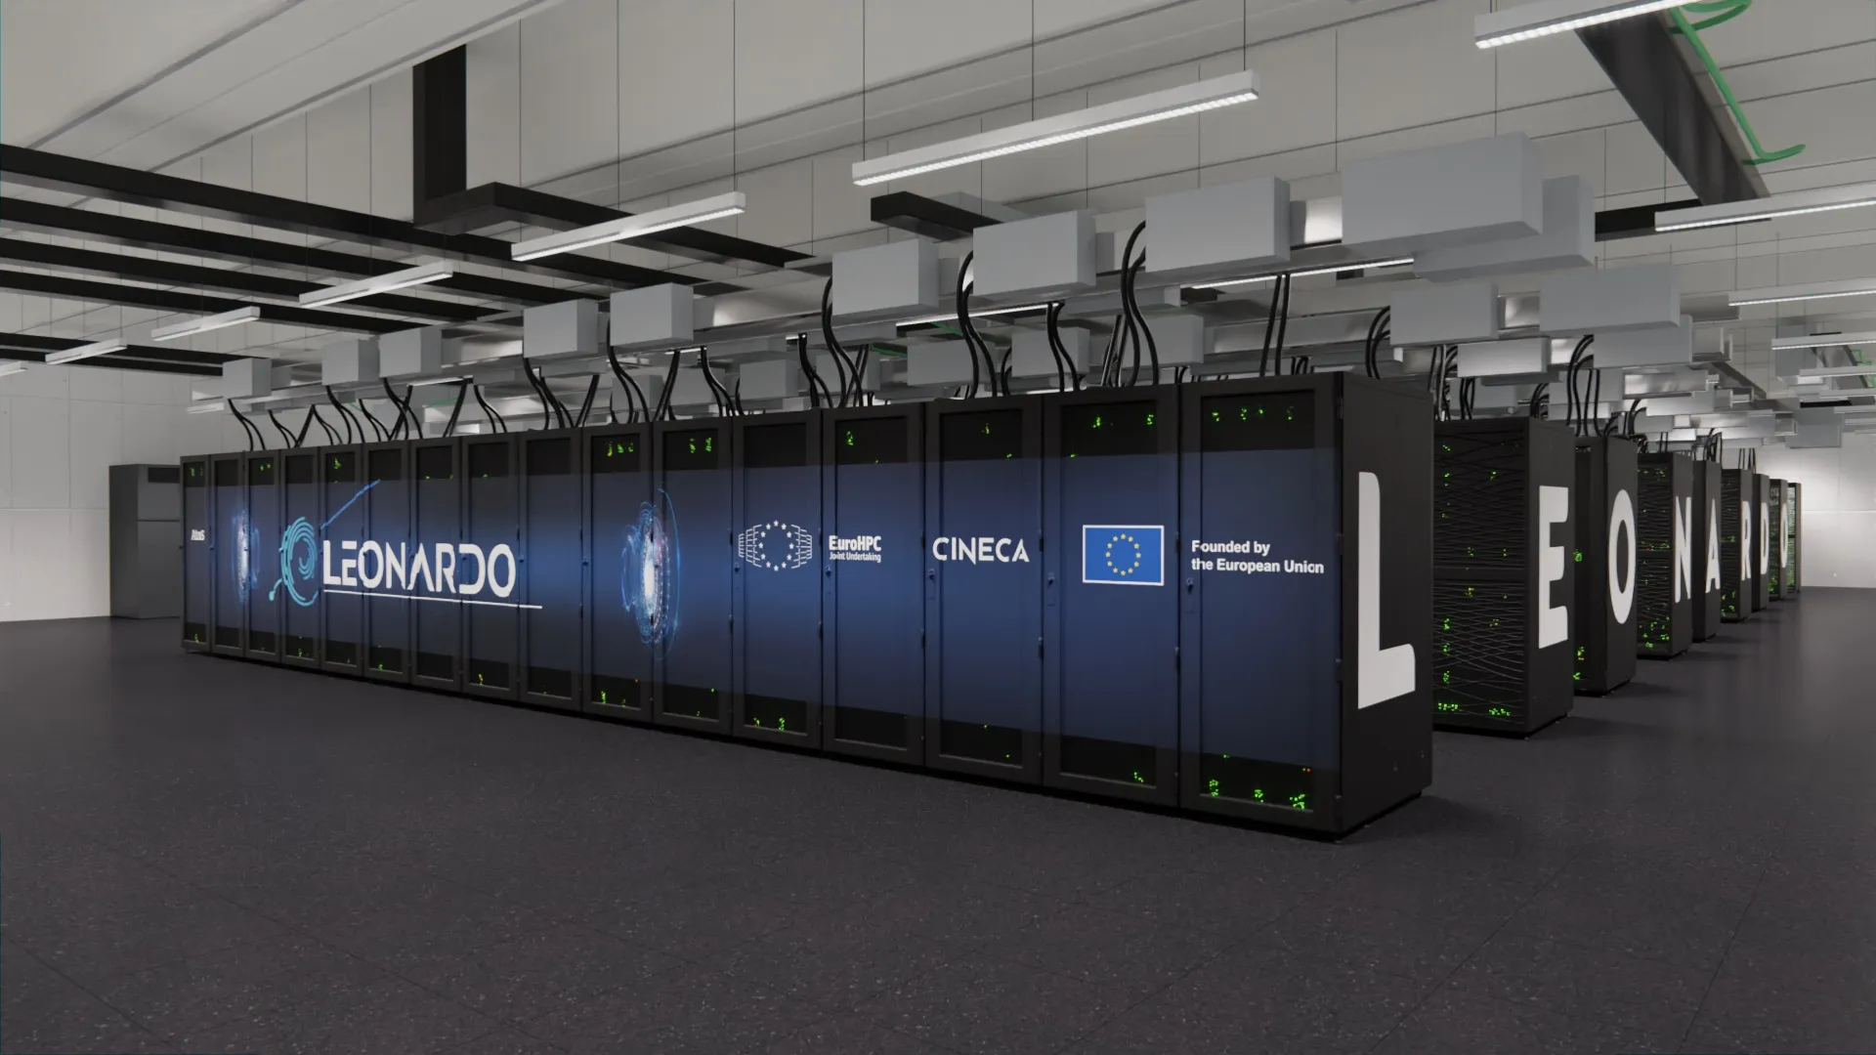
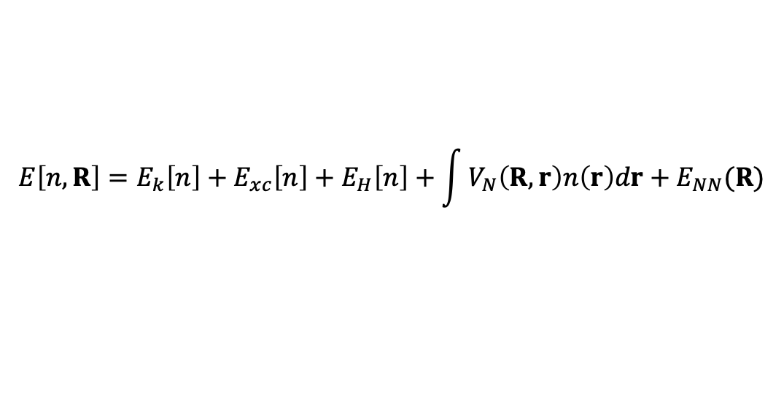
Density Functional Theory calculations
$$E\left[n,R\right]=E_{k}\left[n\right]+E_{xc}\left[n\right]+E_{H}\left[n\right]+\int{V_{N}\left(R,r\right)n\left(r\right)dr}+E_{NN}(R)$$
Density Functional Theory
BO → self consistent calculation for n at given R
Frozen electrons: non self consistent calculation at given n with variable R
Calculations
  Electron density ρ(r) and full electronic structure → Bands&gaps, Fermi level, optical properties, transport…
  Electron spin density ζ(r) → magnetism
  Forces on nuclei → vibrational properties and molecular dynamics
Calculation setup
  Density Functional E_{xc}[n(r)] = Generalized Gradient Corrected (PBE) + vdW correction + spin resolved
  Augmented Plane Wave expansion (periodic boundary conditions) Quantum Espresso Code, vs 7.2
  Steered, damped or free molecular dynamics for the conformational space exploration
  Run on Leonardo@CINECA 4-8 nodes (4 GPUxnode, 32 core x node) → 128-256 Cores, 14-24 GPUs, or local nodes (test calculations)
supercell

Slide 22

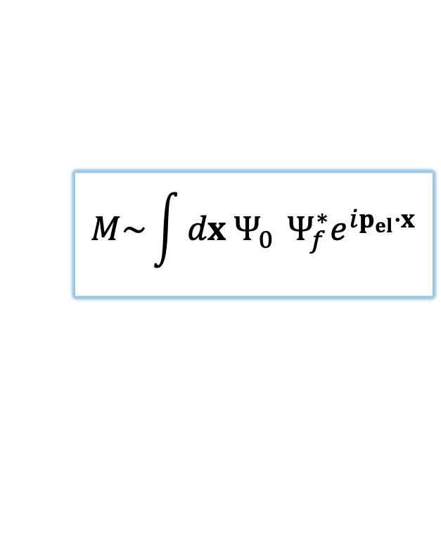

Focus on the beta decay
z
$$M\sim \int{dx {Ψ_{0}^{}Ψ_{f}^{∗}e}^{ip_{el}∙x}}$$
r
Starting state $Ψ_{0}$ : T is relaxed on the substrate
BO standard DFT for evaluation of orthogonal and lateral potential
The binding energy depends on loading level and distribution, and on the local geometry of the substrate
A barrier can be present especially in presence of spin polarization or in concavities

Slide 23


Beta decay
$$\overline{ν}$$
r
z
$$e^{−}$$
t=0
t~fs
t~ps-ns
T (K)
The accurate evaluation of potentials at different stages allow evaluating the β emission spectra endpoint with high precision
          → neutrino mass
# events
electron energy

Slide 24
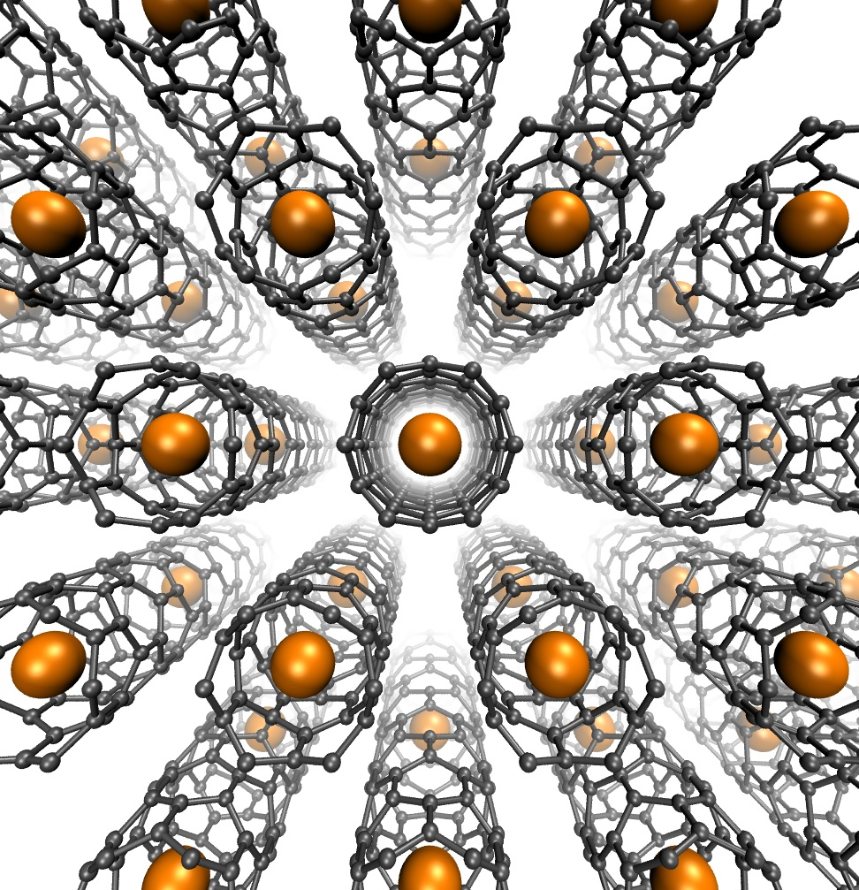





Neutrino capture
… and quantum tech
➔ Encapsulation into nanotubes or fullerenes
The need for high concentration of tritium can be recovered compacting tubes into bundles or fullerene into fullerite
➔ These systems are also considered as bases for quantum bits encoded into the encapsulated atom spin

Slide 25









Neutrinos
… are “elusive”
and “informative”
Their mass is “almost” null and unknown (0.5-0.8 eV)
They are neutral and interact only ”wealkly” with other particles
Their cosmic background bears extremely interesting information on the early universe (decoupled 1 sec after Big Bang)
Interaction with Tritium (³H)
to explore neutrinos
Microwave
cosmic
background (> 380Kyears, 2.7K)
Neutrino capture
$${{}_{}^{3}H}^{}$$
$$e^{−}$$
Gravitational wave cosmic background (VIRGO)
$${{}_{}^{3}{He}}^{+}$$
$$ν$$
1 sec after Big Bang
Relic neutrinos background
Tritium β decay
$$\overline{ν}$$
$${{}_{}^{3}H}^{}$$
$$e^{−}$$
(density ~53 cm⁻³, energy~10⁻⁴ eV)
$${{}_{}^{3}{He}}^{+}$$

Slide 26















Neutrinos interaction with Tritium
Capture and decay: two faces of a coin
Neutrino capture
m_{ν}≠0
$$e^{−}$$
$${{}_{}^{3}H}^{}$$
# events
$${{}_{}^{3}{He}}^{+}$$
m_{ν}=0
$$ν$$
$$\overline{ν}$$
Tritium β decay
electron energy
$${{}_{}^{3}H}^{}$$
2m_{ν}
$$e^{−}$$
$$\overline{ν}$$
$${{}_{}^{3}{He}}^{+}$$
B ⊙
E ↑
Both process can measure neutrino mass
Capture can detect the relic neutrinos
$$e^{−}$$
collector
$$e^{−}$$
$$ν$$
The detector needs
High concentration of tritium for high event rate
High exposure of tritium for efficient e⁻ collection
Conducting material for accuracy in energy measurement
ΔV
Tritium on graphene!

Slide 27



Tritium on graphene
0.019 μg/cm² = 0.19mg/m² 0.1g/cm³ = 100 kg/m³
High concentration of tritium for high event rate
High exposure of tritium for efficient e⁻ collection
Conducting material for accuracy in energy measurement
Accessible surface 2630 m²/g
High electron mobility x 1000 of Cu
Nanoporous graphene can be loaded up to 90%
Betti et al Nanolett 2024
Neutrino capture
# events
Tritium β decay
2m_{ν}
electron energy
Graphene satisfies the requirements, BUT…
The substrate effects must be included in the reactions!
$$M\sim \int{dx {Ψ_{0}^{}Ψ_{f}^{∗}e}^{ip_{el}∙x}}$$
$Ψ$₀(³H) and $Ψ$_{f}(³He⁺) are influenced by the substrate
The spectra turns out considerably different from the case in vacuo
The interaction potential of H/He⁺ with graphene must be known with high precision
The conduction properties of the material must be known during reactions
→ Density Functional Theory calculations in non-standard conditions

Slide 28
Beta decay
$$\overline{ν}$$
r
z
$$e^{−}$$
t=0
t~fs
t~ps-ns
T (K)
The accurate evaluation of potentials at different stages allow evaluating the β emission spectra endpoint with high precision
          → neutrino mass
# events
electron energy

