Slide 1


Nuclear Physics with (p,x) reactions
(while fighting cancer at the same time ;-)
Lee Bernstein^{1,2}
¹ UC Berkeley - Nuclear Engineering Department
² Lawrence Berkeley National Laboratory - Nuclear Science Division
Andrew S. Voyles
13 June 2018 – Program Review for NSSC2 – TA1

Slide 2
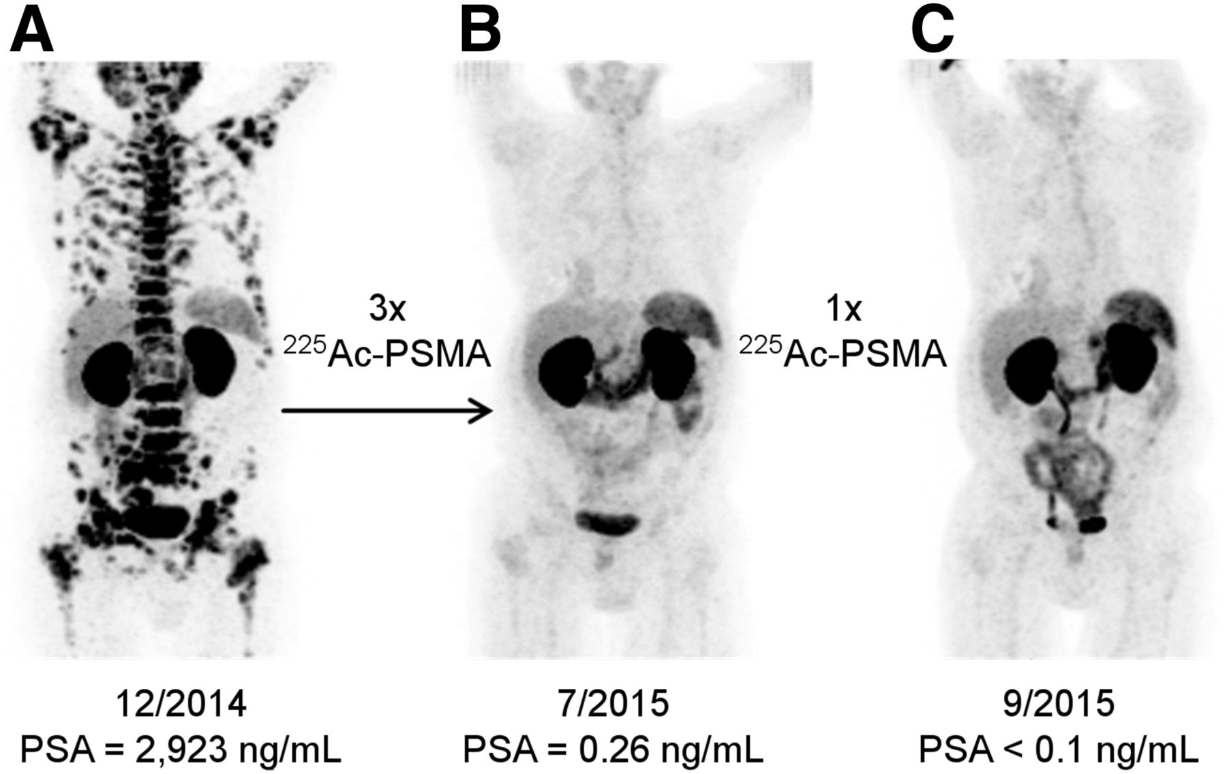
⁷⁵As(p,x)⁷²As, ⁶⁸Ge – Oncological Motivation
Short-lived ⁷²As can be “milked” from with long-lived ⁷²Se for PET imaging
  ⁷²As (PET)/ ⁷⁷As (therapeutic) form a “theranostic pair”
⁷²Se
8.4 d
⁶⁸Ge
270.9 d
⁷²As
26.0 h
88% β⁺
⁶⁸Ga
67.7 m
89% β⁺
⁶⁸Ga has emerged as a significant short-lived radionuclide alongside ¹⁸F for PET.
It can be “milked” from longer-lived ⁶⁸Ge
  ⁶⁸Ga is compatible with the PSMA targeting ligand for improved diagnosis of prostate cancer using ²²⁵Ac
Müller, Cristina et al., J. of Nuclear Medicine. 58. 91S-96S (2017)
What are the cross sections for producing these radioisotopes?
F.T. Tarkanyi et al. Recommended nuclear data for medical radioisotope production : diagnostic positron emitters. Journal of Radio-analytical and Nuclear Chemistry, 319(2):533–666, 2019
C. Kratochwil, F. Bruchertseifer and H. Rathke et al. (2018). Target alpha-therapy of metastatic castration-resistant prostate caner with 225Ac-PSMA-617. Journal of Nuc Med, 59(5):795-802.
Notes:
For arsenic, it’s a cancer driven motivation. There is access to 72As and 68Ga isotopes, both beta plus emitting isotopes relevant to pet.
72As is a favourable… and it can form a theranostic pair with 77As.
68Ga has emerged… it is maybe most importantly recently compatible with…., which falls in line with the popular targeted alpha therapy efforts being developed.
So how do we actually make these radioisotopes of interest from arsenic and what type of work will we need to do to characterize production? Well, as it turns out, because of the short half-lives of 72As and 68Ga, if we want to make them for any reasonable societal use, we can’t produce them directly. There are of course direct paths to these isotopes through proton and alpha reactions, but it’s not useful for us. Instead we recognize that they both have longer-lived parents that decay to them. Hence, we can produce a lot of the long-lived parent to make effective generator systems, where we can essentially milk the daughter out at different points over time. And these generator systems, are accessible through high energy protons with an arsenic target, and this is what ties the collaboration goal together.
These isotopes, something like 68Ga, is in use today, so it’s use is not necessarily the novel component here, but our ability to characterize this new high-energy production pathway is novel. Specifically, if we consider our high energy route vs other established lower energy routes, we find that a key component of this work is that the high energy proton range contributes to production rate increases and makes better use of our linacs.

Slide 3
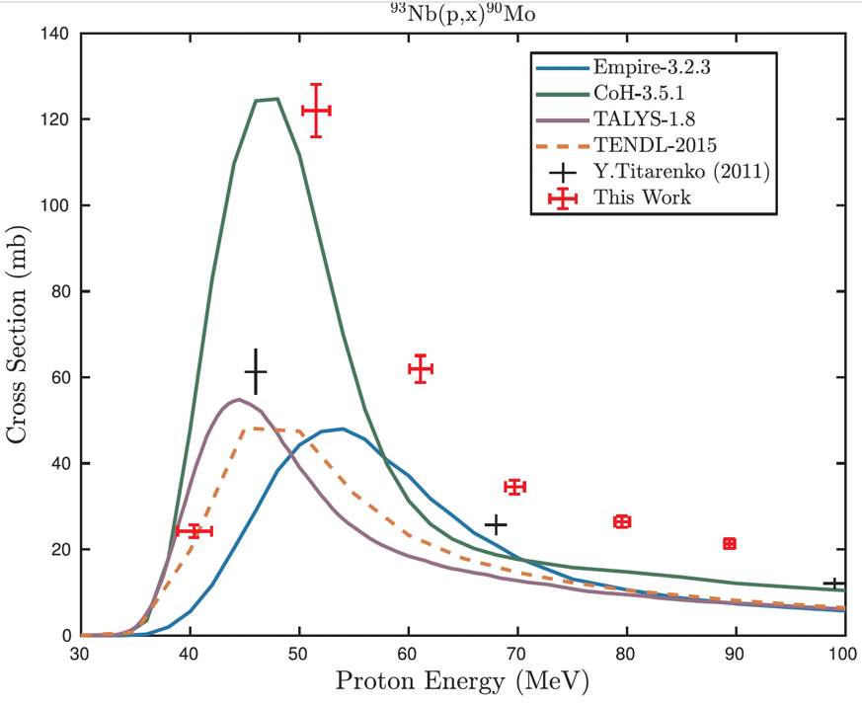
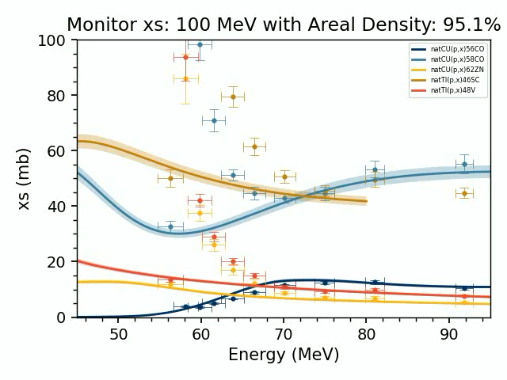
The stacked target method is a well-established way to determine isotope production cross sections over a range of beam energies using
Monitor Foils
Al Degraders (lowers beam energy)
γ-ray
detector
Beam
Foil of Interest
Stopping power uncertainties are addressed by varying ρ_{Al} ☹
Irradiate a stack of foil that includes monitor targets where the reaction rates are known and targets we want to determine the production rate on and “beam degraders” which lower the beam energy.
Put the targets in front of the γ-ray detector after the experiment to measure the decay of the radioactive products formed during irradiation.
This allows the production rate of the unknown target to be determined relative to the known targets.
Notes:
Beam current and energy measured using activation monitors and beam-current integrators. High current (≤1500 W) and modest beam energies allow for very short irradiations and quick sample extraction facilitating the measurement of activities with t-1/2 ≥ 10 min.

Slide 4
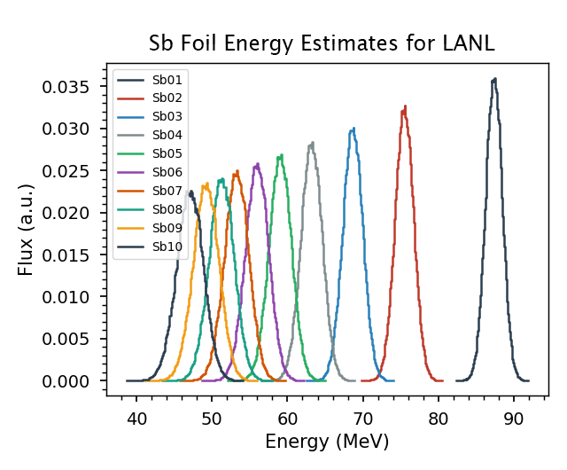
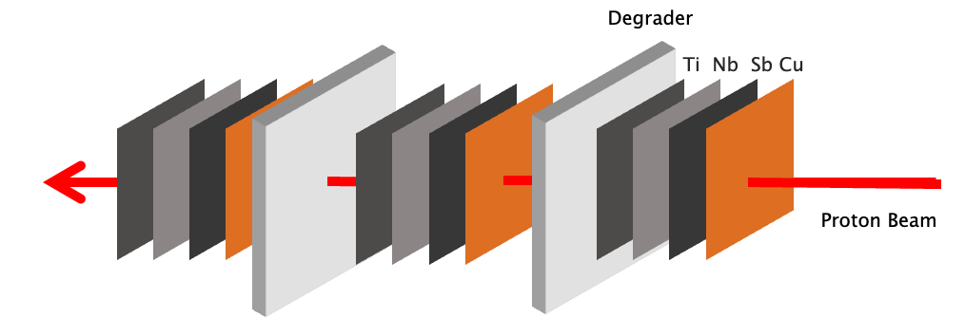
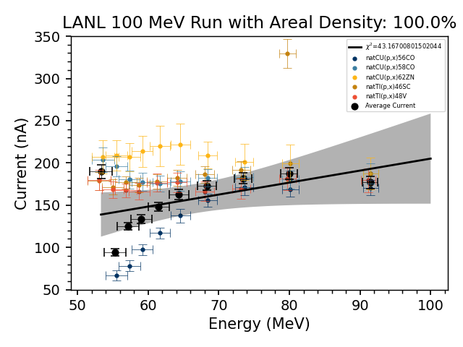
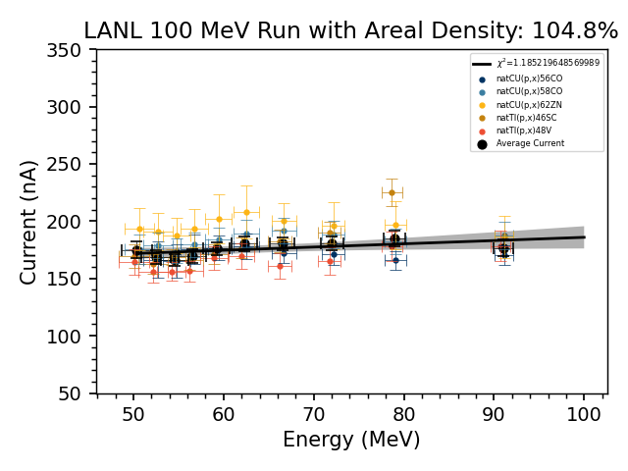
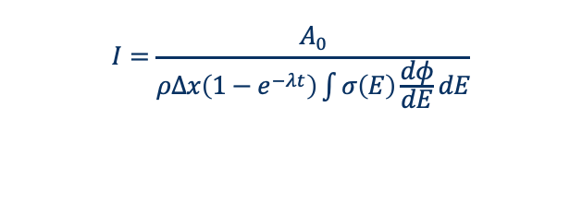
Analysis – Determining current with variance minimization
Energy estimates prior to experiment:
$$I=\frac{A_{0}}{ρΔx\left(1−e^{−λt}\right)\int{σ\left(E\right)\frac{dφ}{dE}dE}}$$
A correction for range straggling and limited stopping power characterization involved treating the density of degraders as a variable to minimize variance in the current.
Monitor yields prior to adjusting density
AFTER adjusting density
4
Notes:
Where $A_{0}$ is initial activity at end of irradiation, $ρΔx$ is areal density,$\int{σ\left(E\right)\frac{dφ}{dE}dE}$ is the average cross section based on incident energy and energy loss within the foil, $λ$ is the decay constant, and t is irradiation time.
The effect of this becomes more pronounced further back in the stack and at reaction threshold energies.

Slide 5
I will discuss the results of four ^{nat}As(p,x) stacked-target experiments were performed to study the production of ⁷²Se & ⁶⁸Ge production:
200 MeV at BNL, 100 MeV at LANL and both 30 & 50 MeV at LBNL
⁷⁵As
100%
23 excitation functions for ⁹³Nb(p,x)
⁹³Nb
100%
26 excitation functions for ⁷⁵As(p,x)
M.B. Fox et al., Phys. Rev. C, vol. 103, no. 3, p. 034601,
Mar. 2021, https://doi.org/10.1103/PhysRevC.103.034601
M.B. Fox et al., Phys. Rev. C 104, 064615 (12/27/21). https://doi.org/10.1103/PhysRevC.104.064615
These data can be used to optimize isotope production and improve reaction modeling
Notes:
Hahha and now finally we can show some results. Here’s a brief summary of the observed products for the arsenic and niobium targets. More results also exist coming off our monitor foils.
And here are our most up to date, two most important arsenic residual products. As I mentioned before, this analysis is not quite complete because the McClellan irradiations are still ongoing to finalize the target areal densities, but this is what we’ve reached at the moment.
You can see some important points just from these plots though. YATC gives us the chance to measure from threshold to 200 MeV and generate the most comprehensive datasets for reaction where very little to no data exists.
You can also point out how 68Ge is expected to threshold before the LBNL energy range and we didn’t see any signature of it at LBNL.
Here is a view of the energy range of the three lab sites.

Slide 6
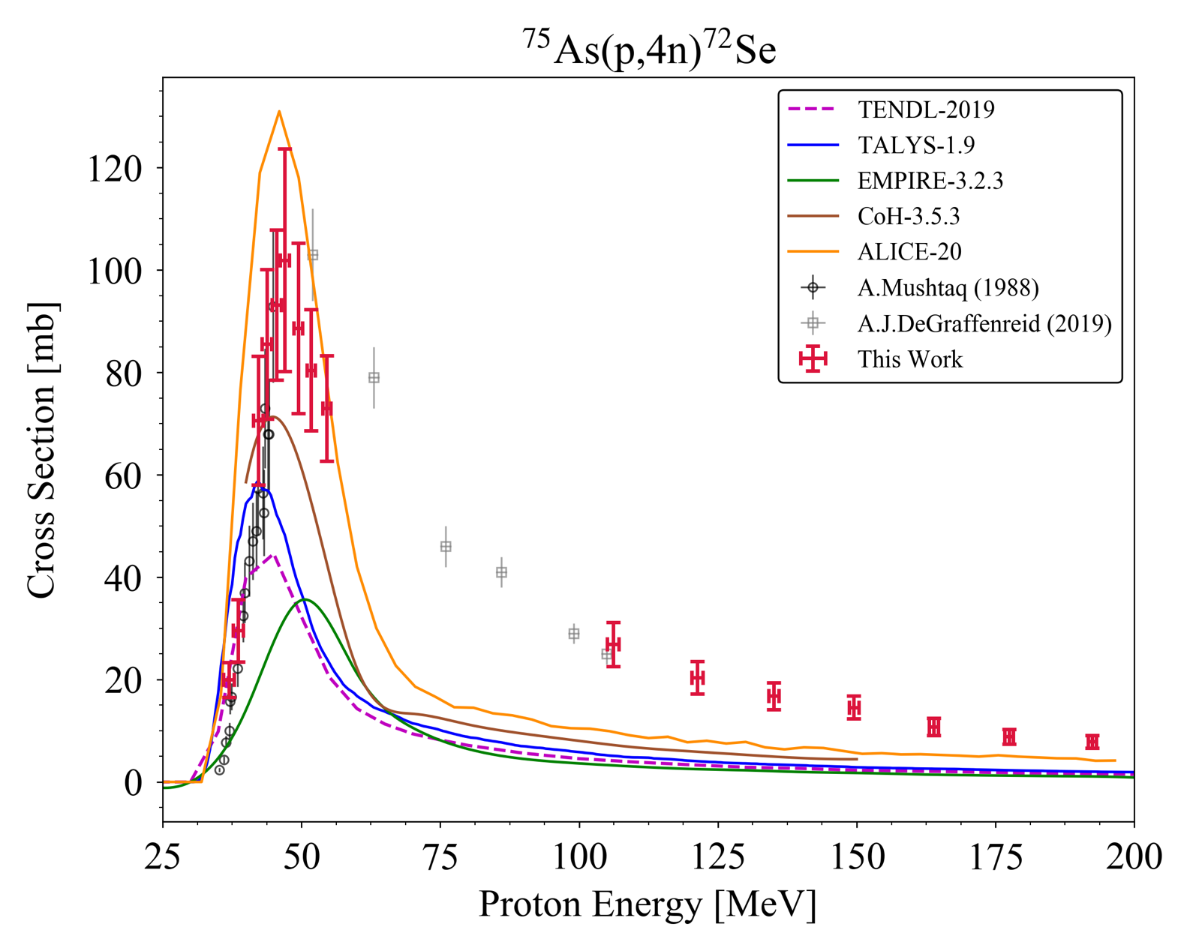
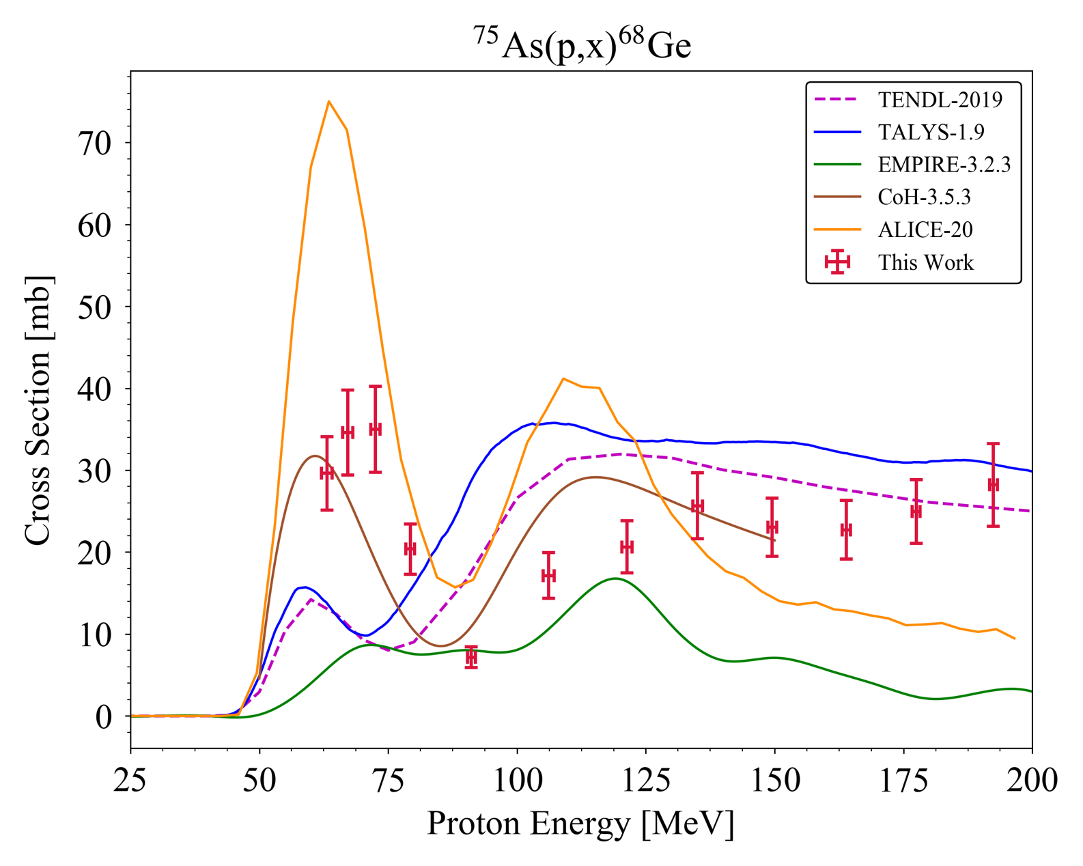
Four ^{nat}As(p,x) stacked-target experiments were performed to study the production of ⁷²Se & ⁶⁸Ge production:
200 MeV at BNL, 100 MeV at LANL and both 30 & 50 MeV at LBNL
LBNL
LANL
BNL
LBNL
LANL
BNL
What are the implications of these cross sections for isotope production?
Notes:
Hahha and now finally we can show some results. Here’s a brief summary of the observed products for the arsenic and niobium targets. More results also exist coming off our monitor foils.
And here are our most up to date, two most important arsenic residual products. As I mentioned before, this analysis is not quite complete because the McClellan irradiations are still ongoing to finalize the target areal densities, but this is what we’ve reached at the moment.
You can see some important points just from these plots though. YATC gives us the chance to measure from threshold to 200 MeV and generate the most comprehensive datasets for reaction where very little to no data exists.
You can also point out how 68Ge is expected to threshold before the LBNL energy range and we didn’t see any signature of it at LBNL.
Here is a view of the energy range of the three lab sites.

Slide 7
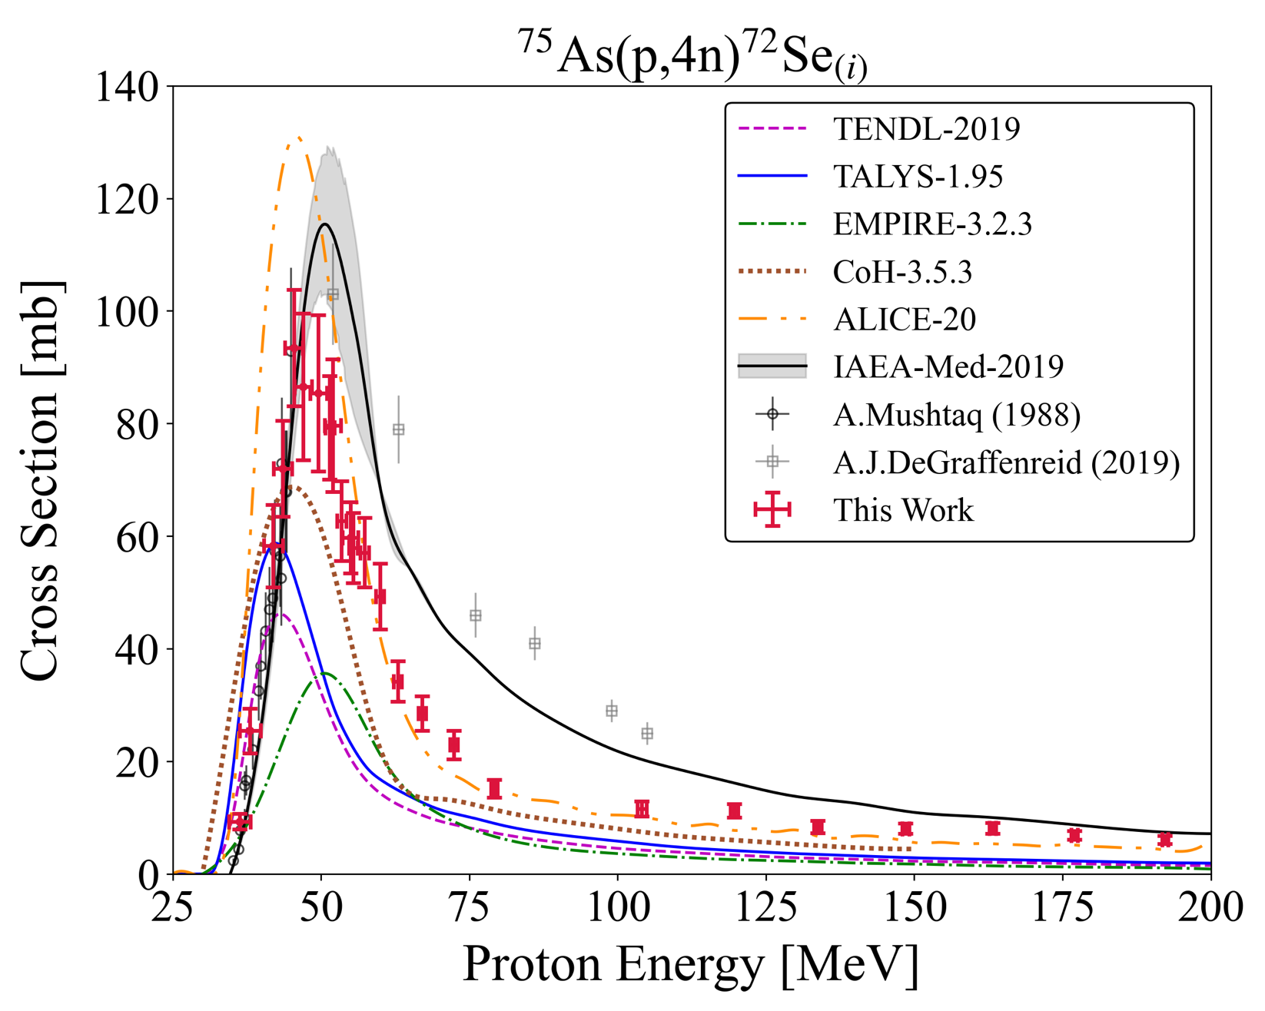
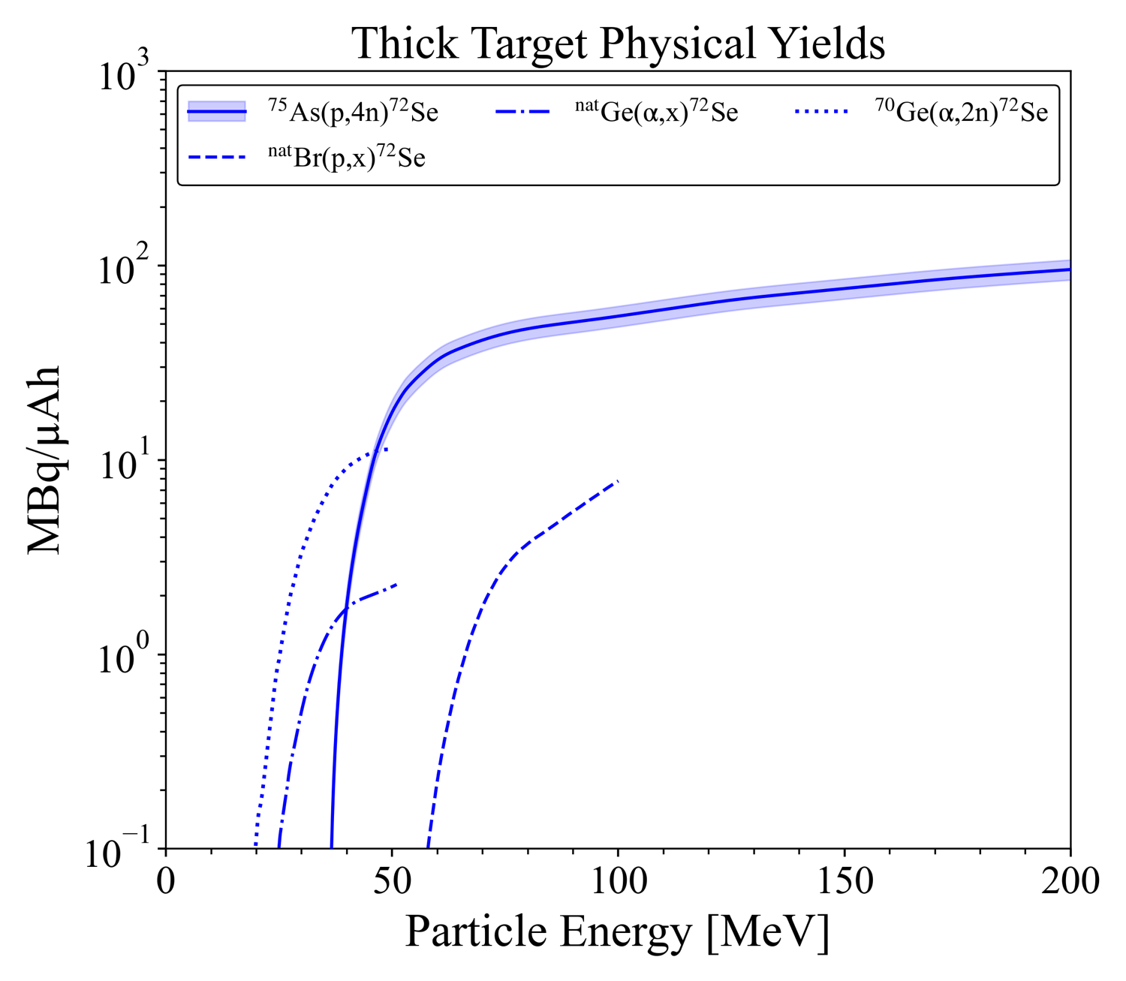


Let’s consider ⁷²Se production via ^{nat}As(p,x)
Four stacked-target experiments were run at 200 MeV at BNL, 100 MeV at LANL and both 30 & 50 MeV at LBNL,
LBNL
LANL
BNL
Arsenic route offers highest yield and purity
Looks pretty good…
Notes:
The data from TREND suggests that across all rele-
vant incident particle energies beyond reaction threshold,
the 75As(p,4n)72Se is the optimal production pathway
to the 72 Se/72 As generator system. The arsenic target
route offers an increase in yield of greater than an order
of magnitude versus the current methods, while still af-
fording radioisotopically pure production as best as pos-
sible. Specifically, no charged-particle production route
to the 72Se/72As generator system is uncontaminated
from 75−73Se co-production.
that 72As will be efficiently separated from the parent 72 75−73Se when needed, and that the co-produced Se will also follow the chemical separation [9, 11]. Additionally, the 75As(p,4n) pathway avoids any potential long-lived 74,73,71As contamination.

Slide 8
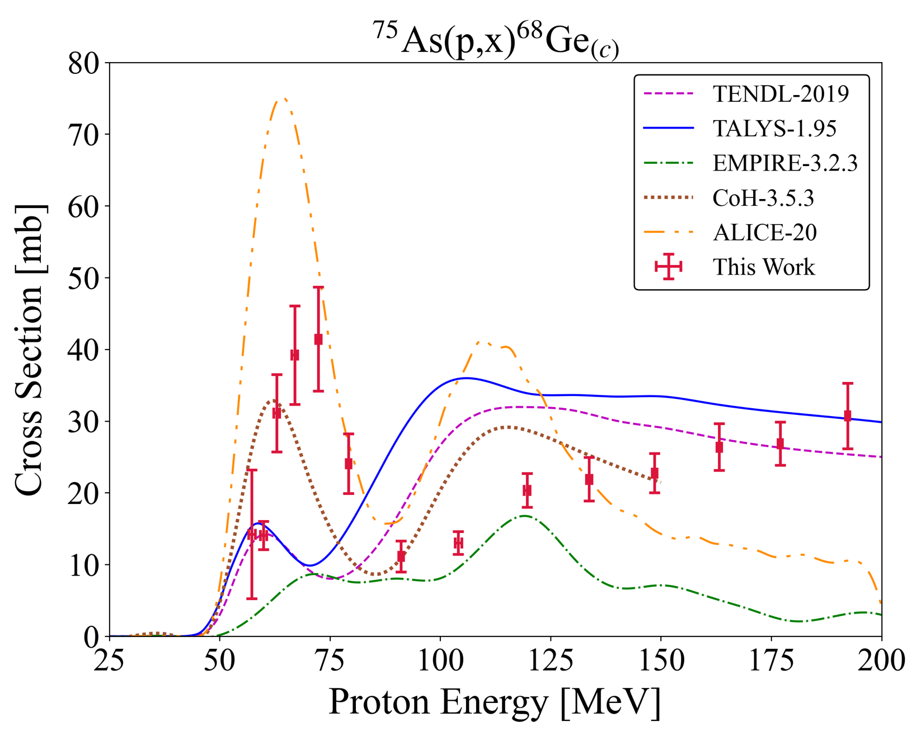
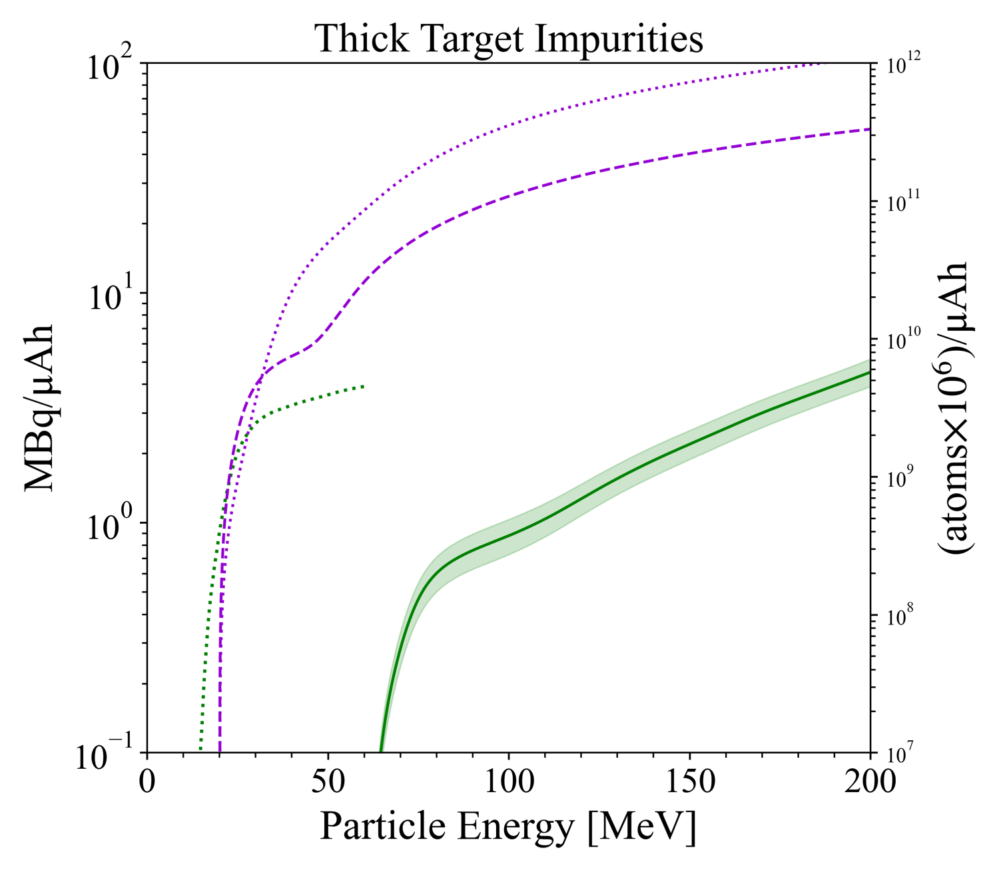
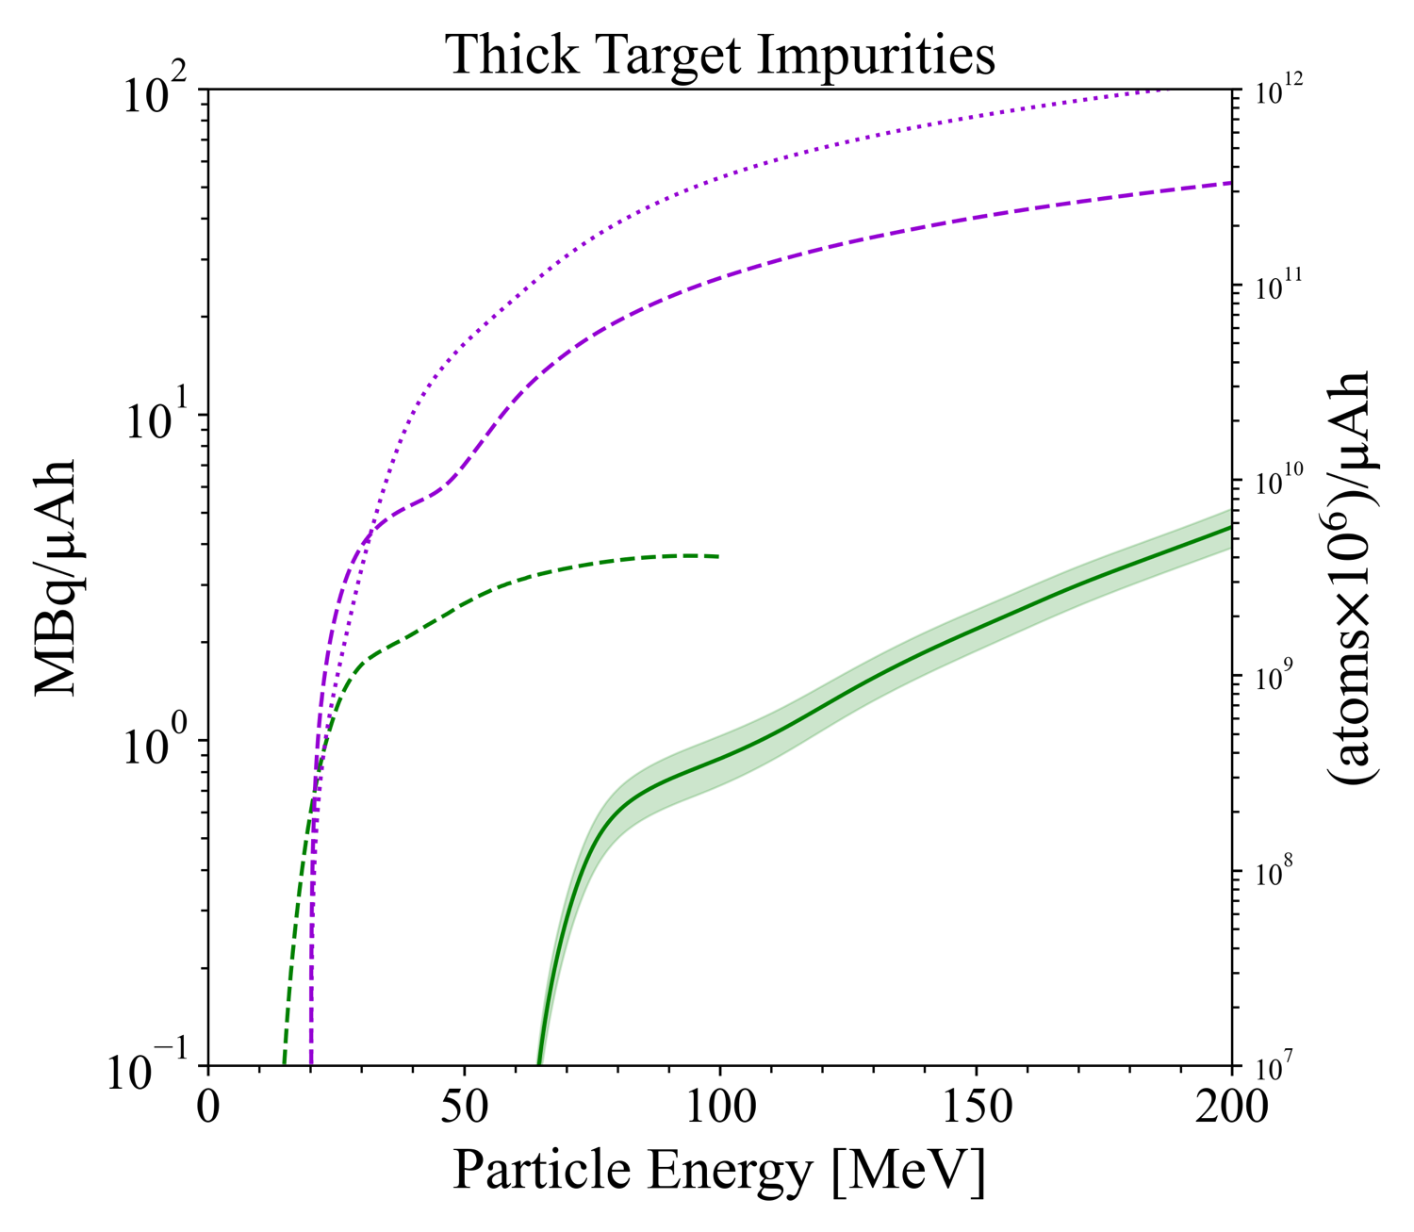


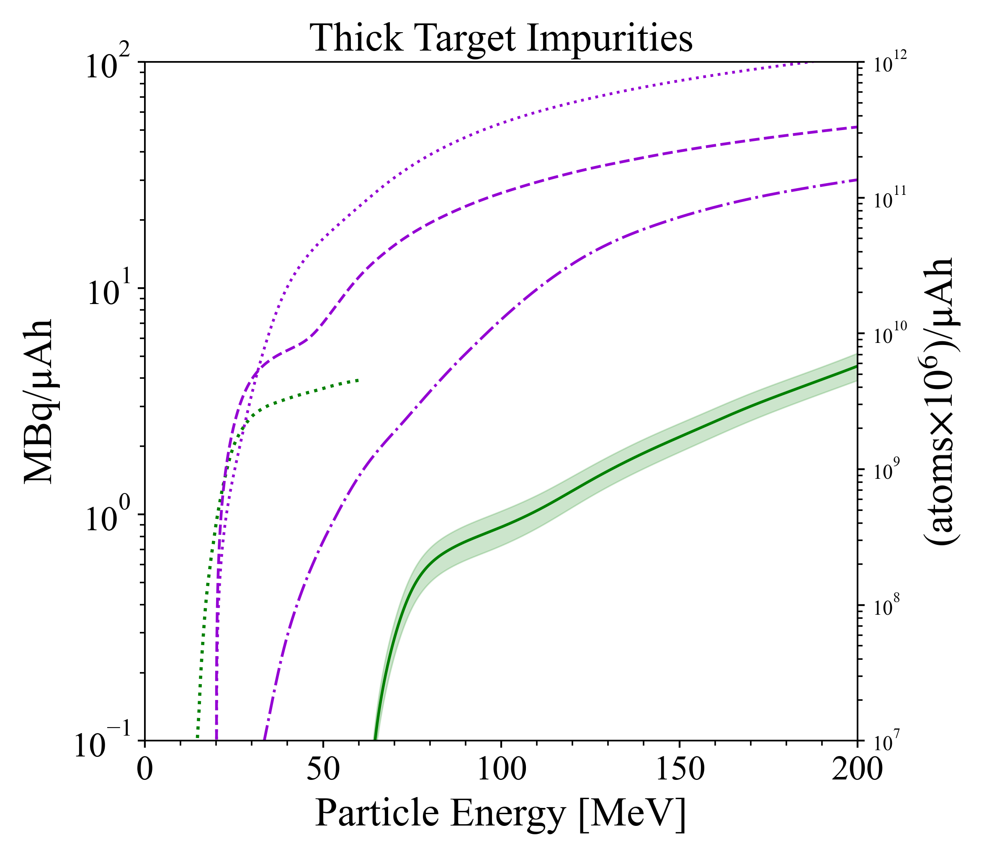
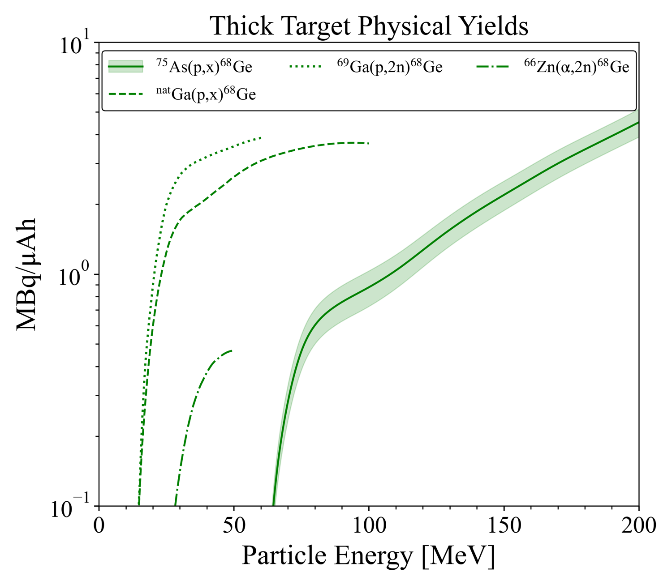

Next, let’s consider ⁶⁸Ge production via ^{nat}As(p,x)
LBNL
LANL
BNL
⁷⁵As(p,x)^{stable}Ge
⁷⁵As(p,x)⁷¹Ge
^{nat}Ga(p,x)^{stable}Ge
^{nat}Ga(p,x)⁷¹Ge
⁶⁹Ga(p,x)⁶⁸Ge
^{nat}Ga(p,x)⁶⁸Ge
⁶⁹Ga(p,$γ$)⁷⁰Ge
The Jury is
still out..
Why are the models so discrepant
(with each other AND reality!)
~18% yield gain relative to ^{nat}Ga(p,x)
Reduced specific activity from Ge co-production ☹
Long-lived As, Se products need separations ☹
IP Strategy Meeting 2021: TREND Morgan Fox
8
Notes:
Long lived zincs and cobalts are contaminants but are generally dealt with well in separation so not shown here. The Zn yield is higher in the case of Ga targets.
﻿In comparison, proton induced reactions on Ge/As targets result in thick target yields for 72As, 69Ge, 66Ga, 71As, 67Ga, 74As and 73As and seleniums that are up to three orders of
magnitude higher than those for 68Ge. Specific efforts would be needed during radiochemical processing to provide 68Ge fractions of high radionuclidic, radiochemical
﻿At BNL, natGa targets are irradiated with 30 ± 2 MeV at the Brookhaven Linac Isotope Producer (BLIP); 81 g of natGa metal is encapsulated in a Nb container (6.98 cm in diameter, 5.08 mm thick). The target itself acts as a beam stopper at BLIP. For a one month irradiation, overall batch yields are 33.3–51.8 GBq (900–1400 mCi) [2.38]. ﻿The radionuclidic purity is >99.9%. Metallic impurities are Zn (2 ppm), Nb (<7 ppm) and Cu, Pb, Co, Cr, Cd, Ni, Fe, Mn and Al (all <1 ppm).
﻿At the IPF, 100 MeV protons are delivered into a stack system of various targets, which are irradiated with individual optimum proton energies of approximately 90, 65 or 40 MeV [2.39]. About 4 g of natGa metal inside a ~5 g Nb encapsulation is irradiated for 20.2 or 16.5 d with a 125 µA proton beam intensity. The production rate is 1.18 MBq (0.032 mCi)/µAh; the batch yield at end of bombardment (EOB) is about 70 or 55 GBq.
﻿At the iThemba Laboratories/NAC, Ga/Ga2O3 targets are initially irradiated with 66 MeV protons, the on Ga target energy being 34 → 0 or 34 → 2.4 MeV. The Ga mass is about 5 g with a thickness of 4 mm. The radionuclidic purity of the processed 68Ge is >99.9%. The final product contains <1 µg of Ga per 37 MBq (1 mCi) of 68Ge [2.41]. At Cyclotron Co., Ltd., Obninsk, Russian Federation, Ga-Ni alloys are used as the target material, prepared on Cu backings. Irradiations are performed at a rather high proton beam intensity of several hundred microamperes at 23 MeV proton energy. Germanium-68 of a high specific activity (>74 GBq (>2 Ci)/mg) and 99.8% radionuclidic purity is obtained [2.6].

Slide 9

Models require data for guidance, especially for weak channels
Cross section measurement efforts have mostly focused on (n,x) reactions due to their importance for applications…
…and only a handful of measurements have been performed for projectiles with E>20 MeV
*A global pre-equilibrium analysis from 7 to 200 MeV based on the optical model potential A.J. Koning and M.C. Duijvestijn. Nuclear Physics A 744 p. 15–76 (2004). https://doi.org/10.1016/j.nuclphysa.2004.08.013
There is a paucity of high energy (p,xn) or (p,xp) data to guide the modeling
Notes:
Emphasis on the last sentence

Slide 10


Comparisons between the measured and modeled cross sections provide insight into reaction modeling and nuclear structure
We’ve established a staged approach in collaboration with the TALYS developer, Dr. Arjan Koning
Initial results for (p,x) on Nb, La and As suggest adjustments are needed in pre-equilibrium model parameters
Nb, La
Morgan Fox
Sb
As
More recent results in Sb suggest large differences in Level Density, Gamma Strength and Optical Model parameters and additional pre-equilibrium adjustments
Catherine Apgar
Notes:
Furthermore, examining level density models in TALYS, both phenomenological (1-3) and microscopic (4-6) consistently overpredict the production of high spin isomers with large spin/parity change with the ground state
Takeaway: for both phenomenological and microscopic level density models, TALYS overpredicts the population of the isomer and underpredicts the ground state population. This is the case even with adjustments, so we need to look at other options

Slide 11
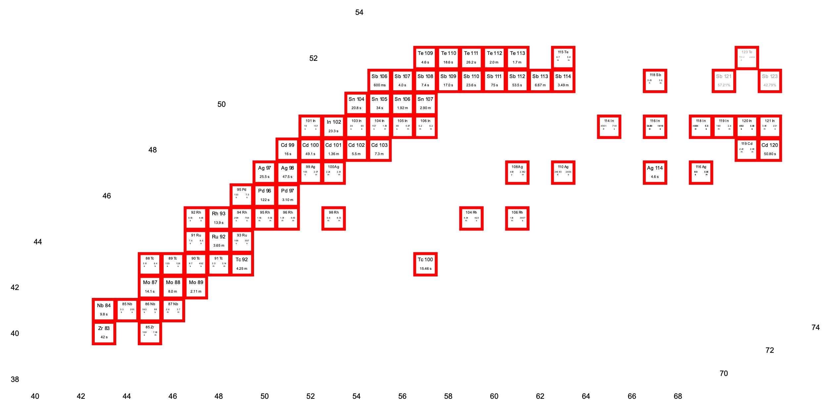
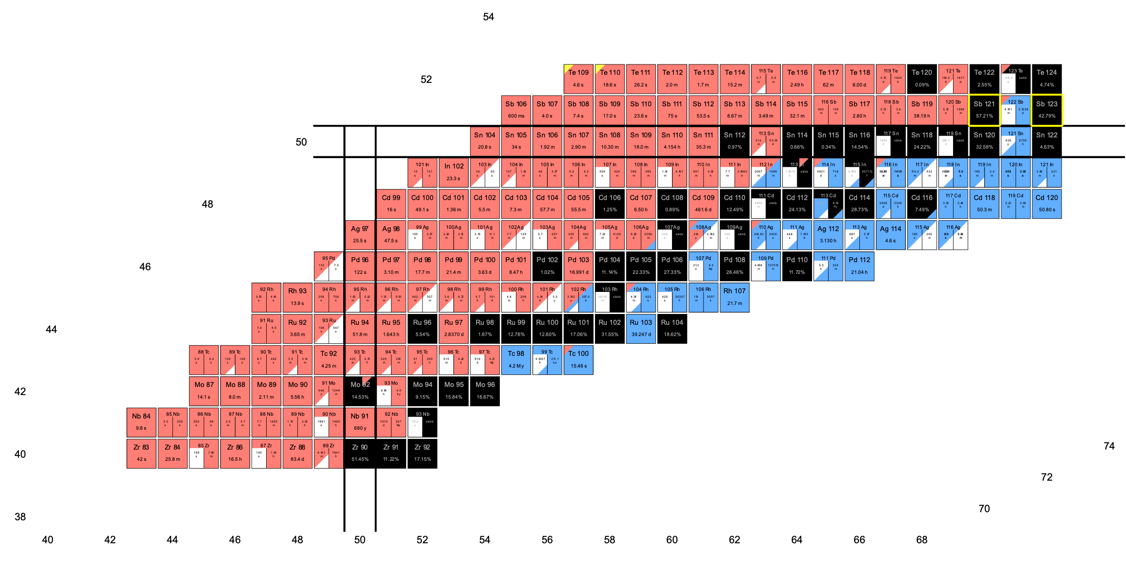
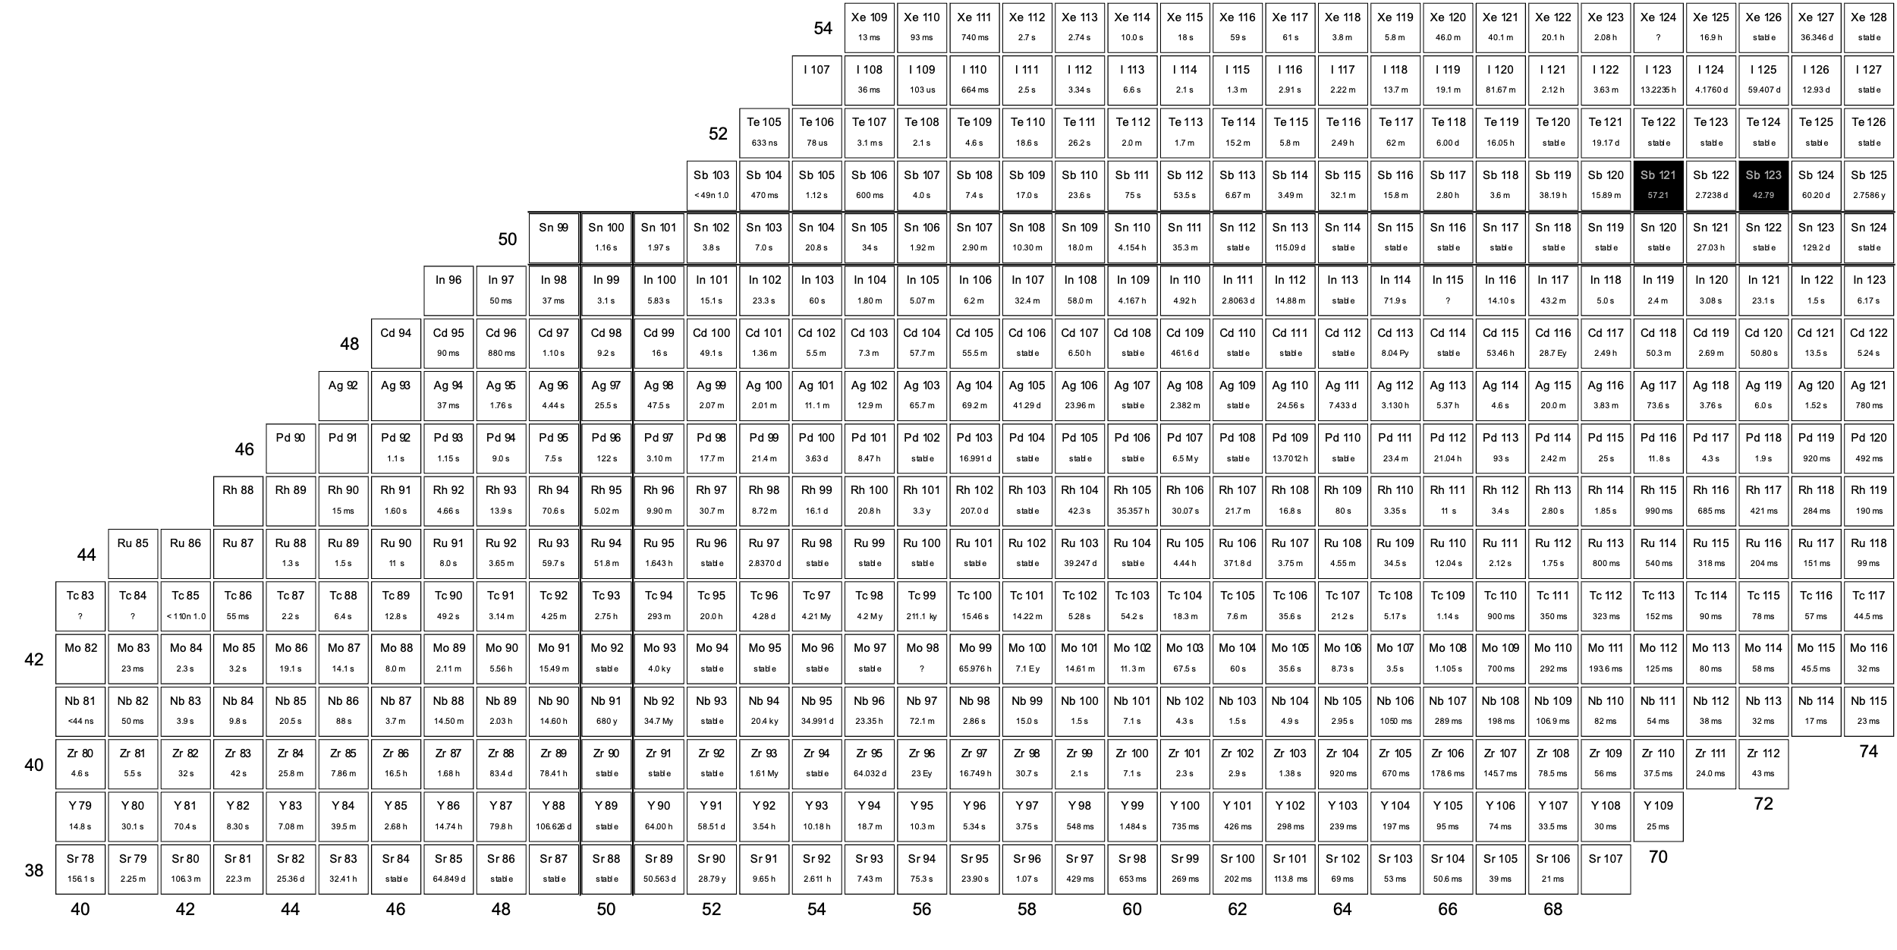
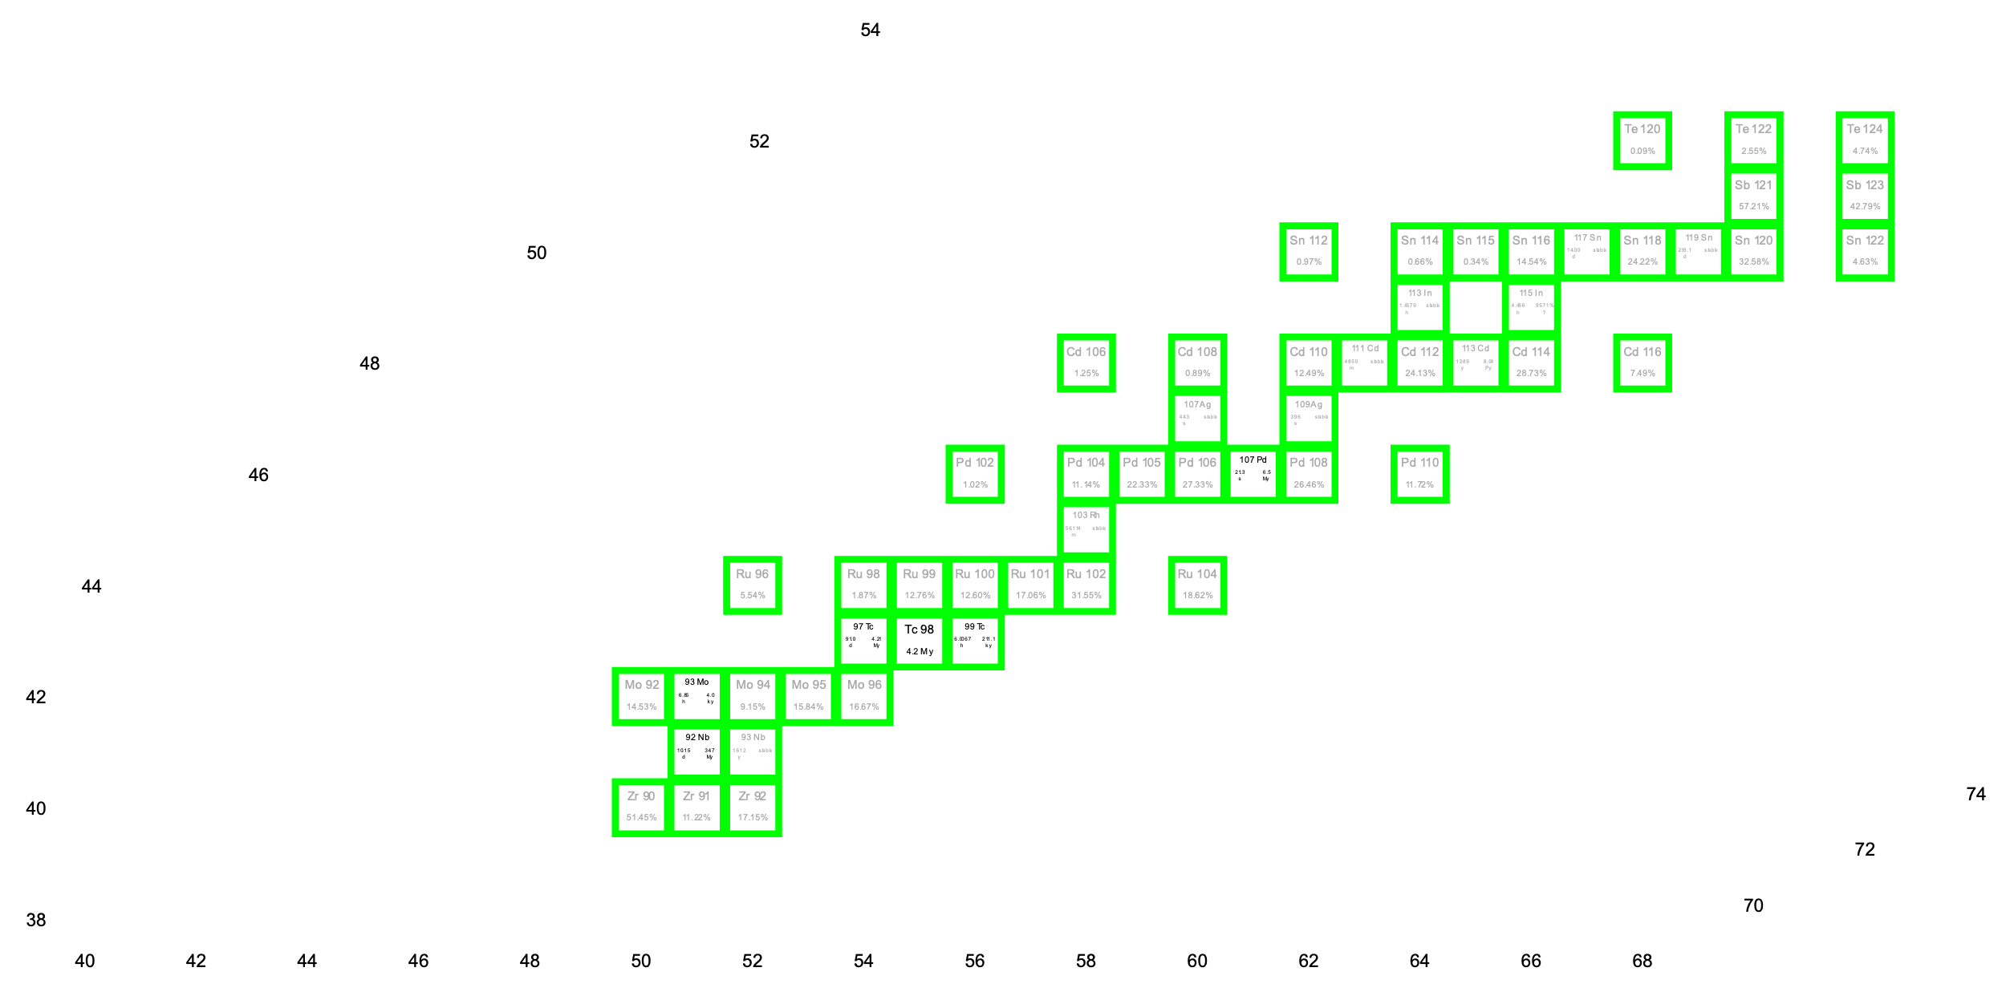
The Sb experiment covered a wide range of nuclei
This data set can also be used to explore reaction modeling capabilities for nuclei in this mass region or around shell closures
200 MeV protons
Cross sections for stable/near stable and very short-lived isotopes cannot be measured using our traditional stacked target method
While cumulative yields are sufficient for isotope production pathways, having improved predictive modeling capabilities is essential.
Notes:
Auger-Meitner therapy with ^{117m}Sn is currently used to treat canine OA and companies are pursuing clinical trials for human treatment.
The high LET and short range makes Auger-Meitner emitters a promising candidate for small mass tumor treatment as well.
These measurements inform appropriate production pathways with high yield, specific activity, and minimal impurities
In addition to its use in the “therapy” portion of theragnostics, because it releases a 158 keV gamma, it has similar imaging results compared to, say, 99mTc (140 keV)

Slide 12
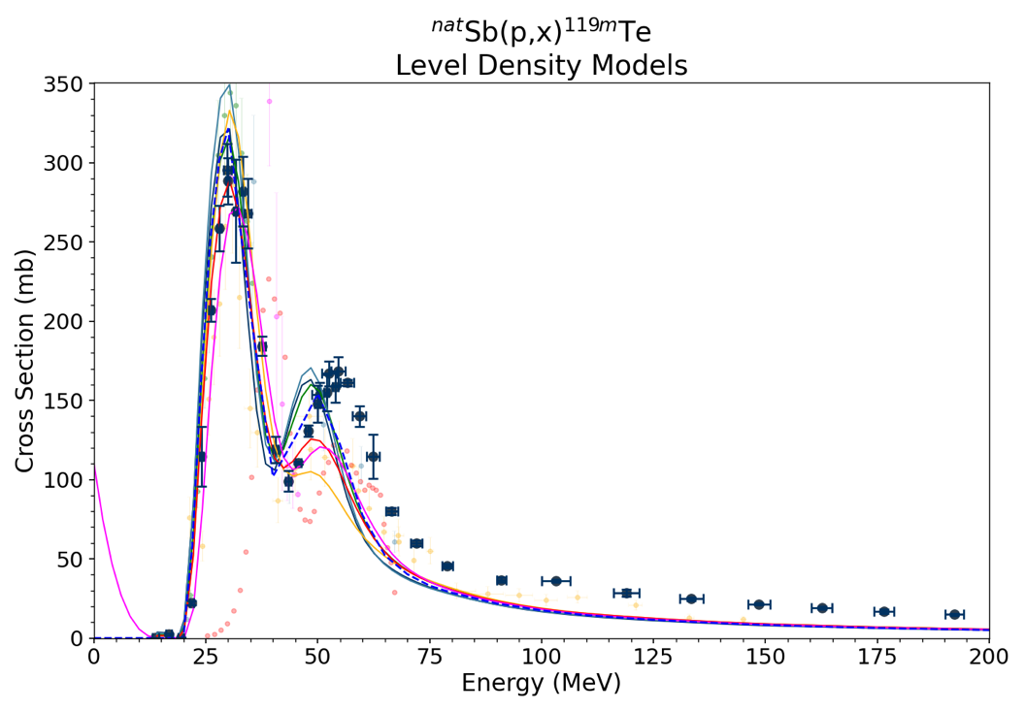
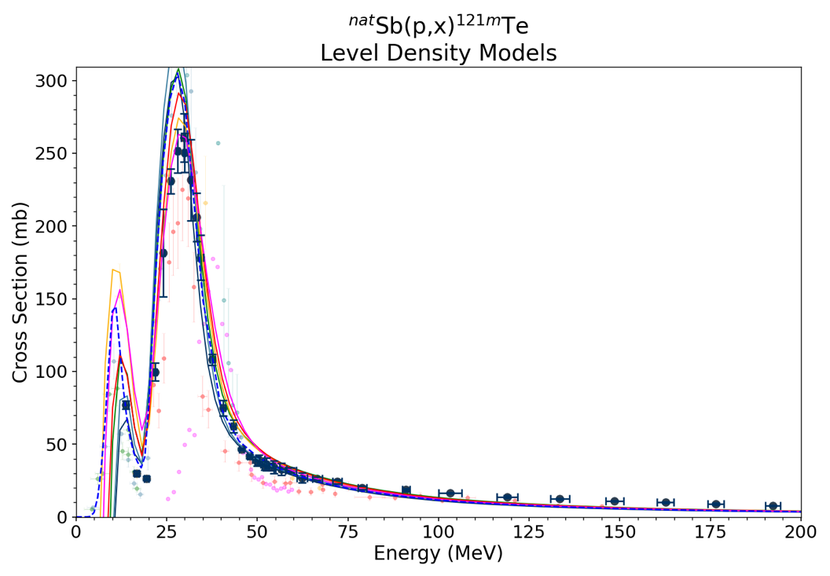
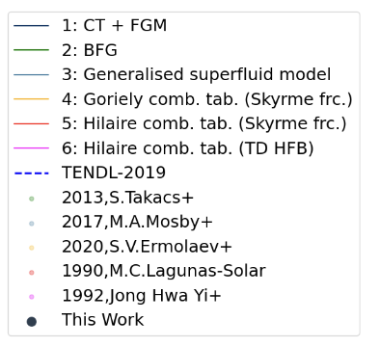
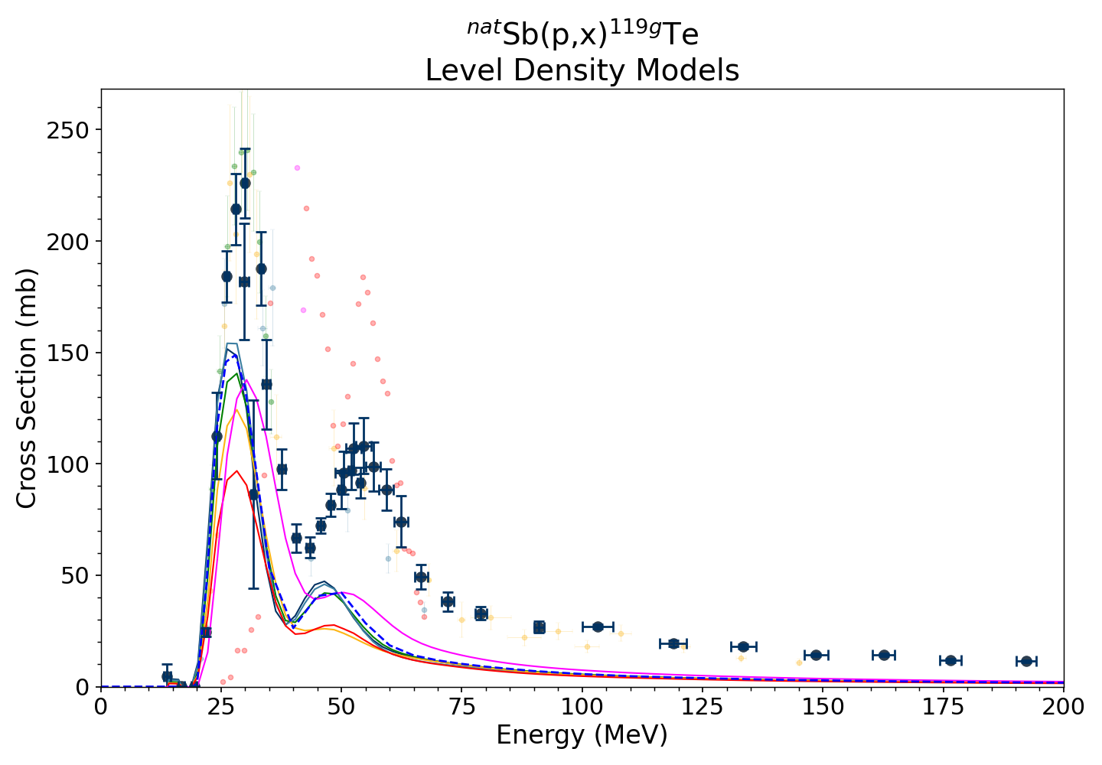
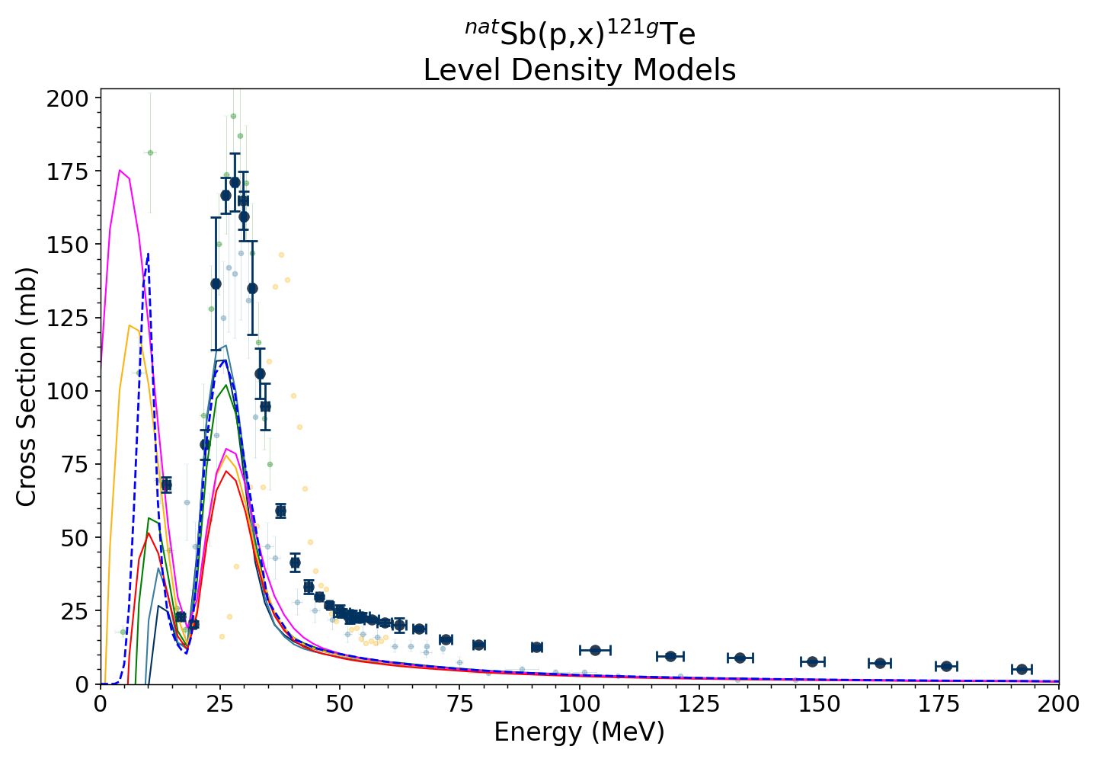





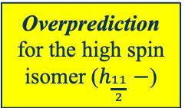





The Sb data showed issues with the Nuclear Level Density’s dependence on J^{π}
^{nat}Sb(p,3n/5n)^{119m}Te
^{nat}Sb(p,n/3n)^{121m}Te
Overprediction for the high spin isomer ($h_{\frac{11}{2}}−$)
Preliminary
$\frac{11}{2}−$
5 d, $ε:100\%$
^{nat}Sb(p,n/3n)^{121g}Te
$\frac{11}{2}−$
^{nat}Sb(p,3n/5n)^{119g}Te
^{119m}Te
164 d, $ε:11\%$
^{121m}Te
$$\frac{1}{2}+$$
<1 d, $ε:100\%$
$$\frac{1}{2}+$$
19 d, $ε:100\%$
$$\frac{5}{2}+$$
$$\frac{5}{2}+$$
¹¹⁹Sb
¹²¹Sb
Underprediction for lower spin ground states
Notes:
Furthermore, examining level density models in TALYS, both phenomenological (1-3) and microscopic (4-6) consistently overpredict the production of high spin isomers with large spin/parity change with the ground state
Takeaway: for both phenomenological and microscopic level density models, TALYS overpredicts the population of the isomer and underpredicts the ground state population. This is the case even with adjustments, so we need to look at other options

Slide 13
…along with systematic underprediction of neutron emission at high energies
^{nat}Sb(p,3n/5n)^{119m}Te
^{nat}Sb(p,n/3n)^{121m}Te
Overprediction for the high spin isomer ($h_{\frac{11}{2}}−$)
Preliminary
$\frac{11}{2}−$
5 d, $ε:100\%$
^{nat}Sb(p,n/3n)^{121g}Te
$\frac{11}{2}−$
^{nat}Sb(p,3n/5n)^{119g}Te
^{119m}Te
164 d, $ε:11\%$
^{121m}Te
$$\frac{1}{2}+$$
<1 d, $ε:100\%$
$$\frac{1}{2}+$$
19 d, $ε:100\%$
$$\frac{5}{2}+$$
$$\frac{5}{2}+$$
¹¹⁹Sb
¹²¹Sb
Underprediction for lower spin ground states
Consistent under-prediction in the high energy “tail”
Notes:
Furthermore, examining level density models in TALYS, both phenomenological (1-3) and microscopic (4-6) consistently overpredict the production of high spin isomers with large spin/parity change with the ground state
Takeaway: for both phenomenological and microscopic level density models, TALYS overpredicts the population of the isomer and underpredicts the ground state population. This is the case even with adjustments, so we need to look at other options

Slide 14
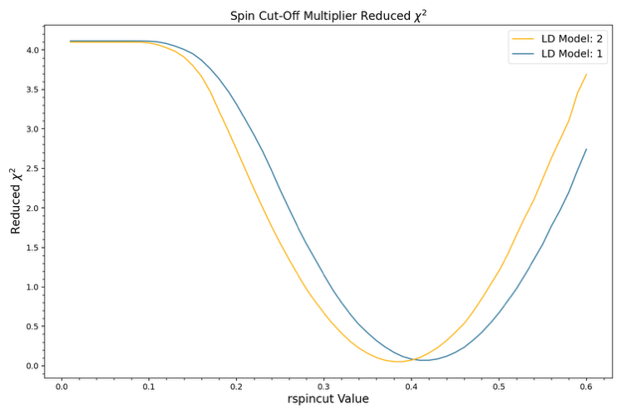
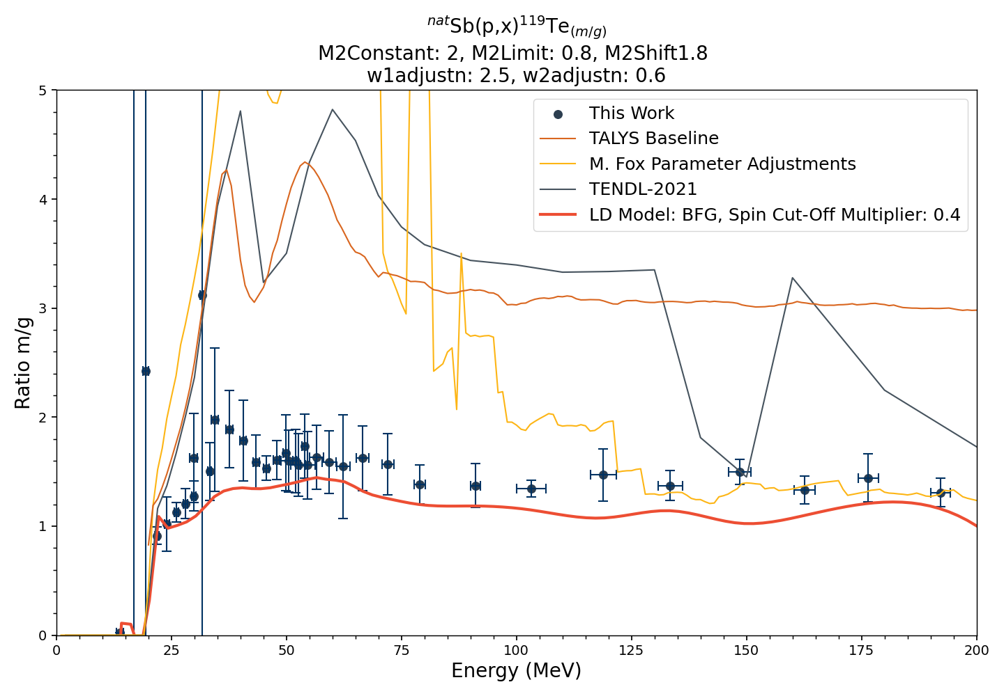
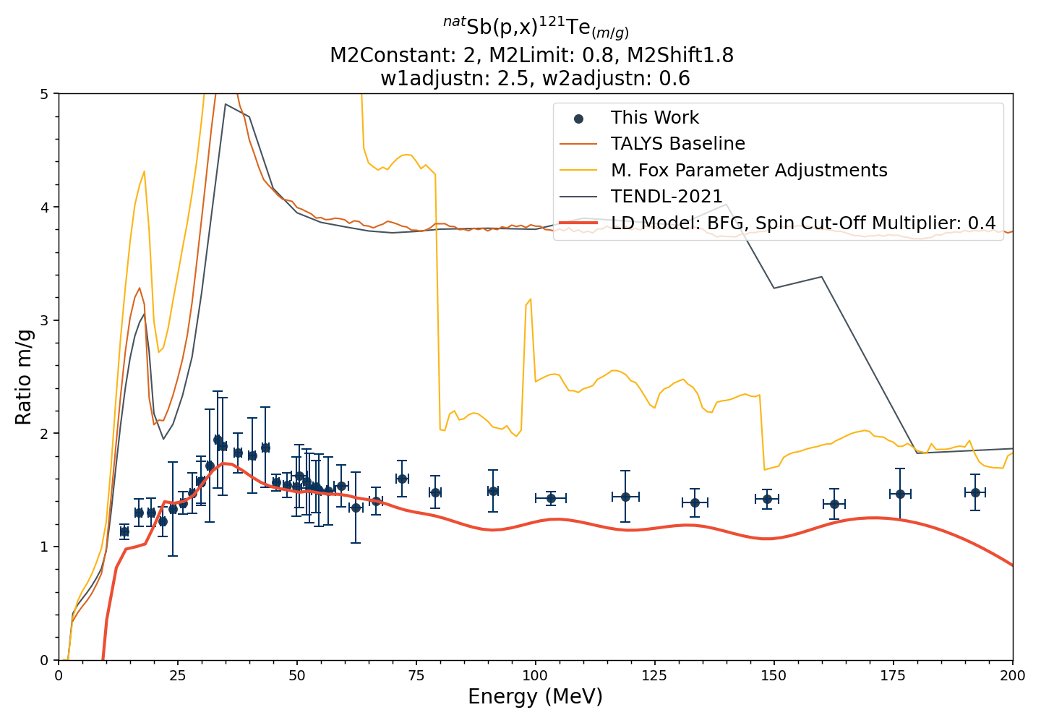
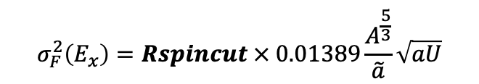
Adjustments to the Spin Cut-Off Parameter in the Backshifted Fermi Gas Level Density Model yielded dramatic improvements in the isomer/ground state ratios
TALYS provides the variable Rspincut, which functions as a global constant applied to the spin cut-off parameter:
4
3
2
1
0
Minimum at 0.4
Preliminary
This is very similar to recent results from Rodrigo et al.,
(Atomic Data and Nuclear Data Tables 153 (2023) 101583)
Reduced χ²
$$σ_{F}^{2}\left(E_{x}\right)=Rspincut × 0.01389\frac{A^{\frac{5}{3}}}{\tilde{a}}\sqrt{aU}$$
0 0.1 0.2 0.3 0.4 0.5 0.6
Rspincut
Notes:
Options to influence the spin cut-off parameter: s2adjust for adjustments based on nuclide or rspincut for a global adjustment.
Either broadening or narrowing the probability discrete levels
This measurement gives us a valuable set of data points for two adjacent Te isotopes and their high spin isomers with Jpi 11/2- ->1/2+,
Parity change, very forbidden transition
Existing TENDL Data overpredicting the population of the ground state
Adjusting spin cut-off, narrowing or broadening the width of the energy levels
Here, we had to adjust the spin cut-off parameter by nearly a factor of 2.5 in order to match the measured cross sections
asymptotic level density parameter ˜a, for a particular nucleus, in MeV−1,
Eta, adjustment (effective moment of inertia/rigid body moment of inertia

Slide 15
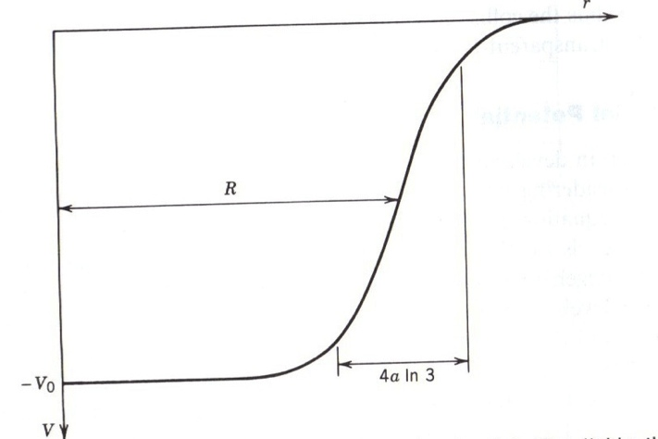
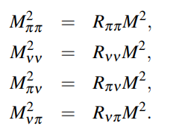


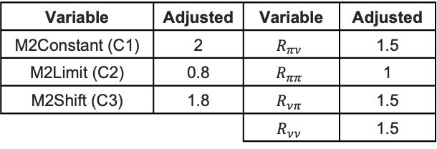
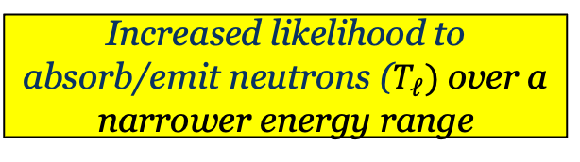
Adjustments to the Imaginary Optical Model Parameters and Exciton Scattering Probabilities implies additional neutron scattering/emission width
W1adjust, w2adjust adjustments to imaginary volume term
R_{xy} and M2 adjustments to exciton scattering matrix elements
Incident Particle
w1>1
w2<1
X
Variable | Adjusted
W1adjust n | 2.5
W2adjust n | 0.6
Variable | Adjusted | Variable | Adjusted
M2Constant (C1) | 2 | $$R_{πν}$$ | 1.5
M2Limit (C2) | 0.8 | $$R_{ππ}$$ | 1
M2Shift (C3) | 1.8 | $$R_{νπ}$$ | 1.5
 |  | $$R_{νν}$$ | 1.5
Increased likelihood to absorb/emit neutrons ($T_{ℓ})$ over a narrower energy range
Increased neutron “exciton” scattering
Notes:
Settling on BFG model as it had consistently better fits out the gate, various phenomenological model adjustments explored. Rspincut is a global adjustment so rather than adjusting for best fit for each nuclide

Slide 16
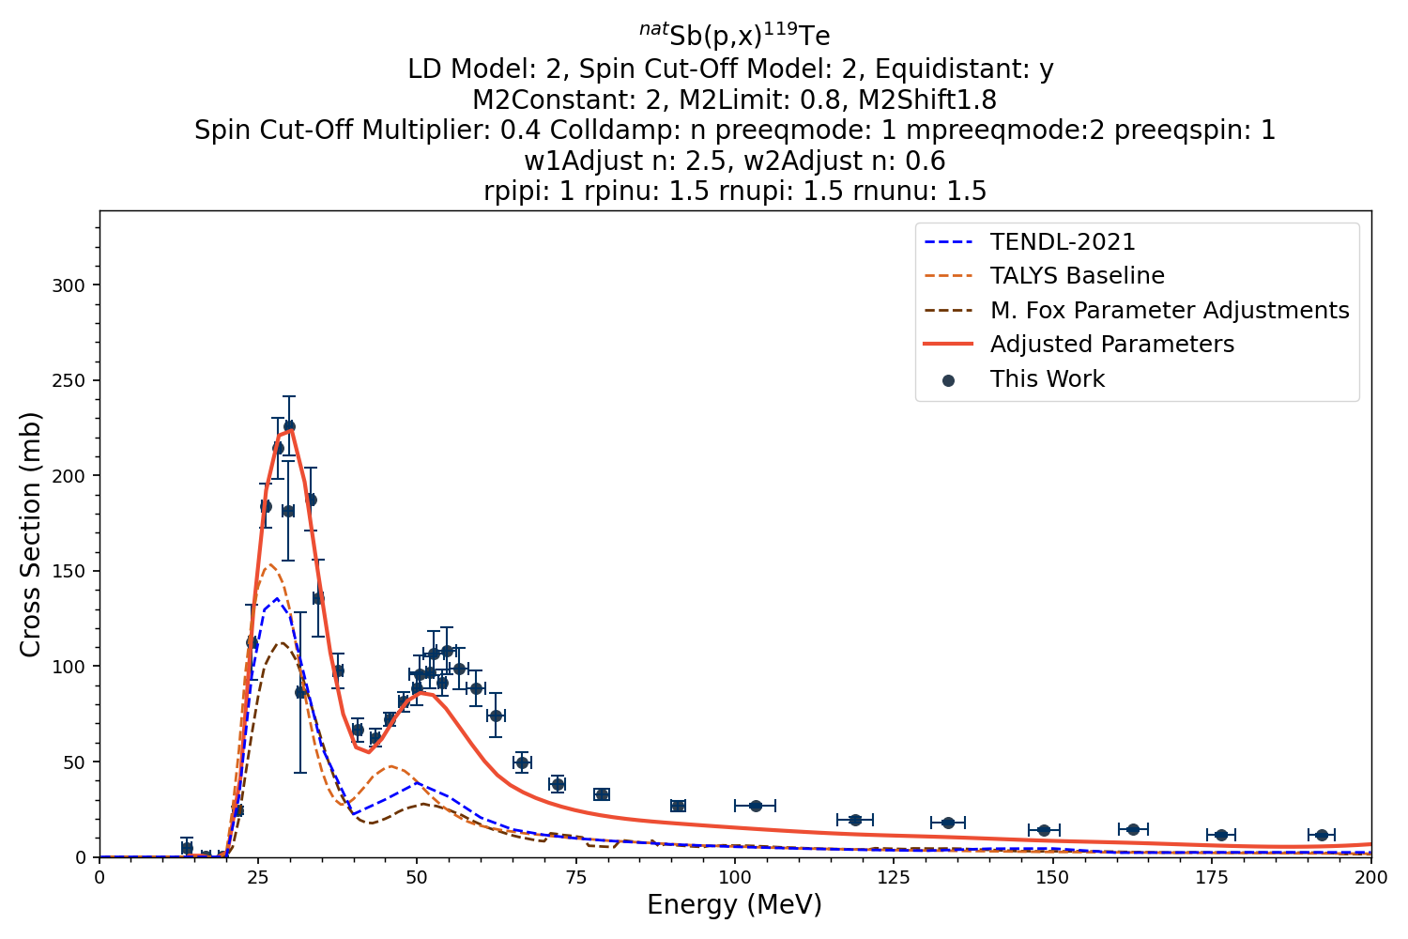
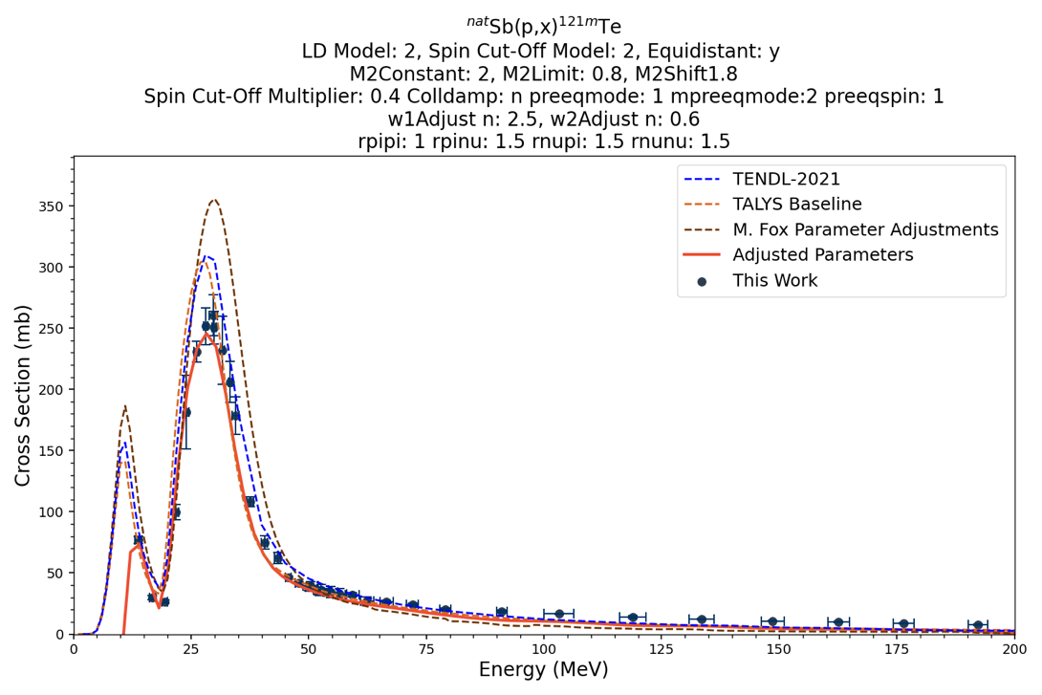
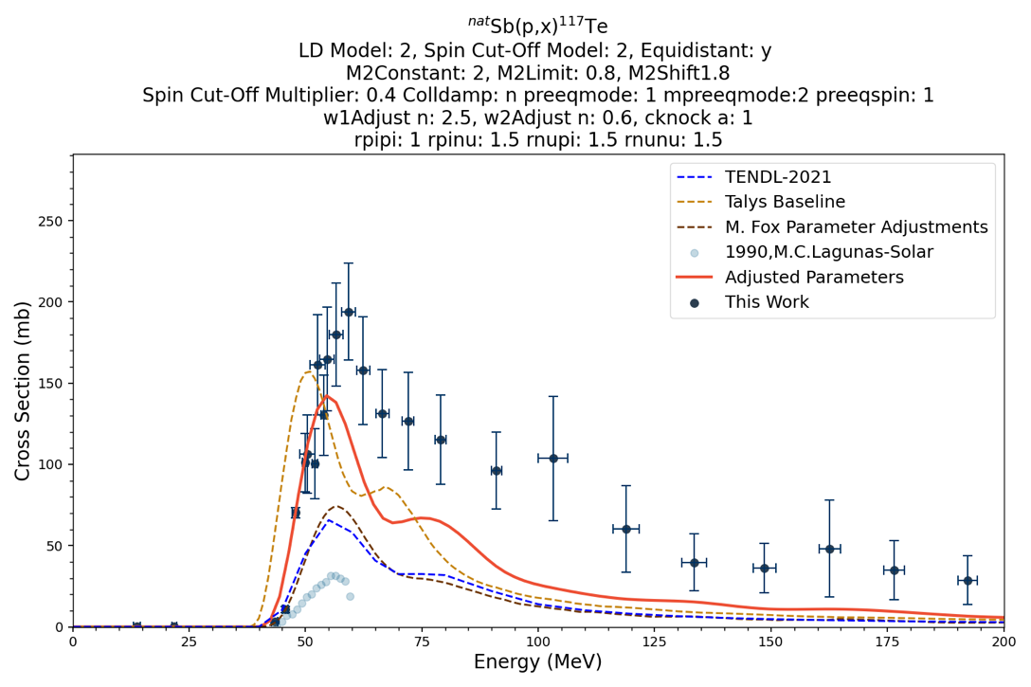
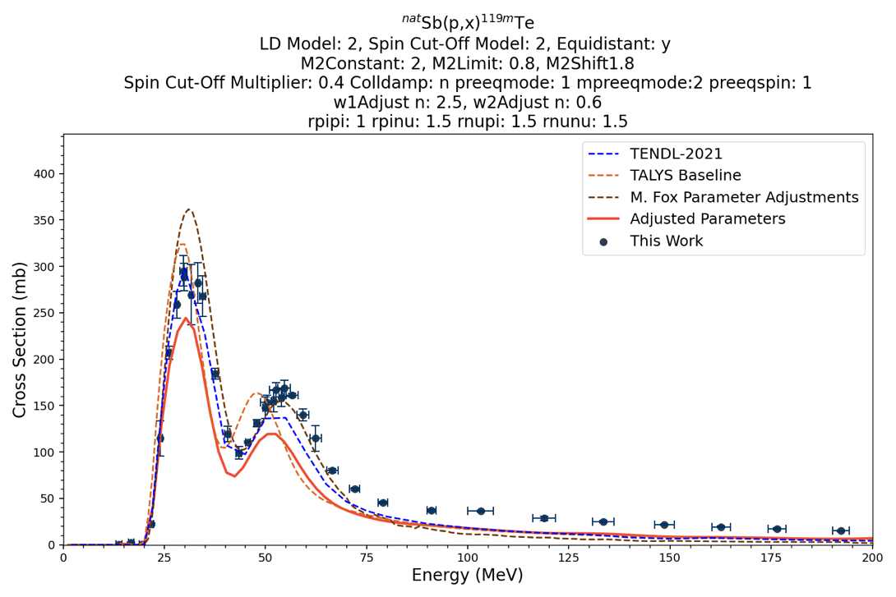
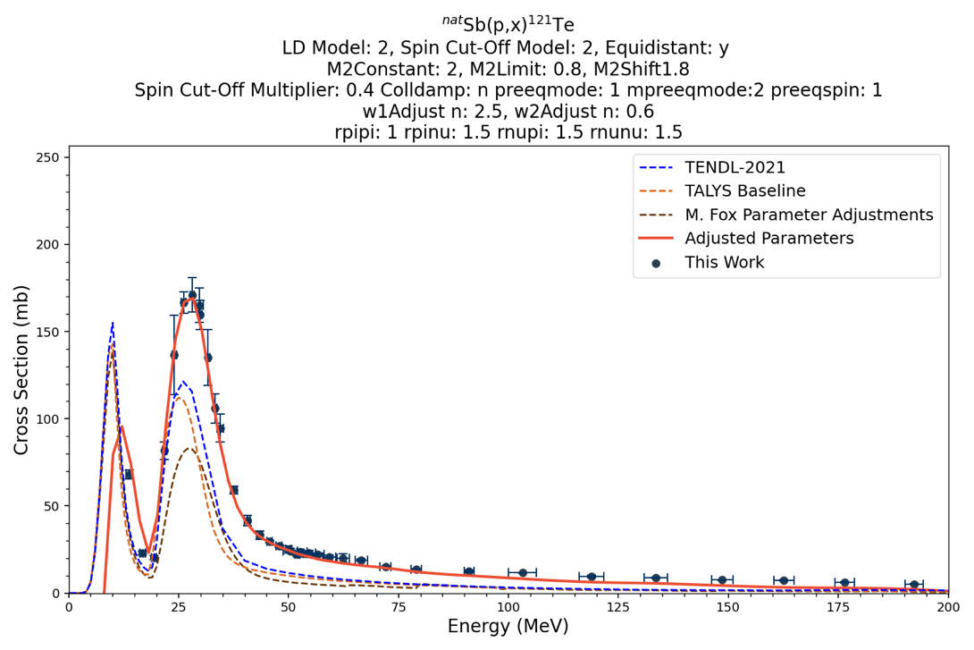
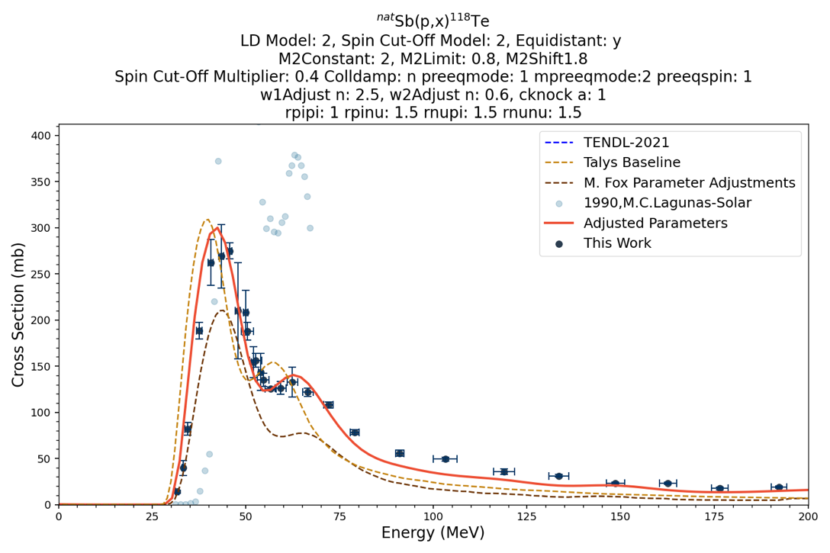
Reaction modeling is dramatically improved → Improved Physics
Preliminary
Notes:
These adjustments greatly improved fitting for pre-equilibrium tail for higher incident energies

Slide 17
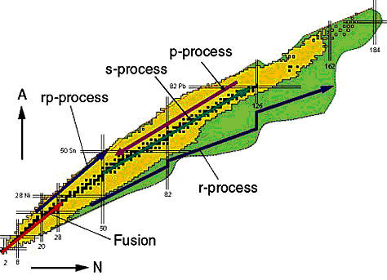
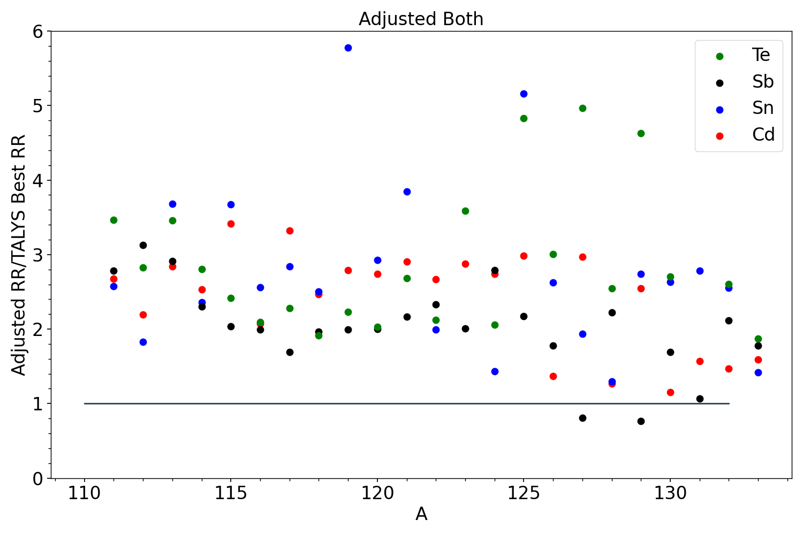
The adjustments we needed to make to reproduce the p+Sb data dramatically changes neutron capture rates for astrophysical nucleosynthesis
Change in Capture Rate from Sb data
6
5
4
3
2
1
0
s-process
²⁰⁹Bi
Adjusted/Talys “Best” Capture Rate
110 115 120 125 130 140
A
r-process
The decreased spin distribution in the nuclear level density (Rspincut) is more likely to be the same than changes in the imaginary optical potential for nuclei far from stability
$$A=πr^{2}$$
Notes:
Title of Presentation
17

Slide 18
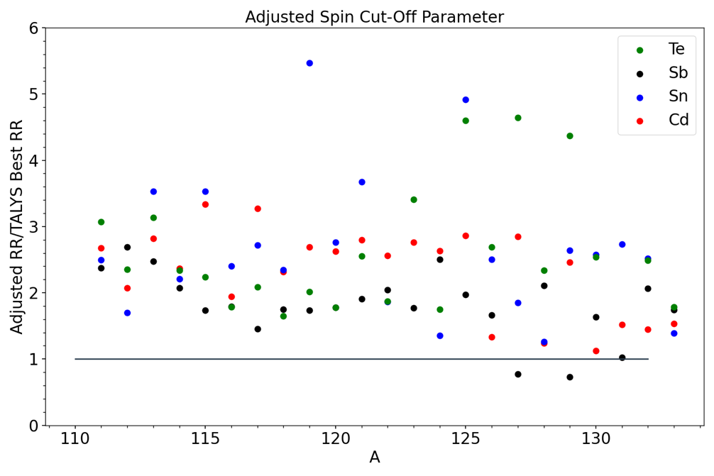
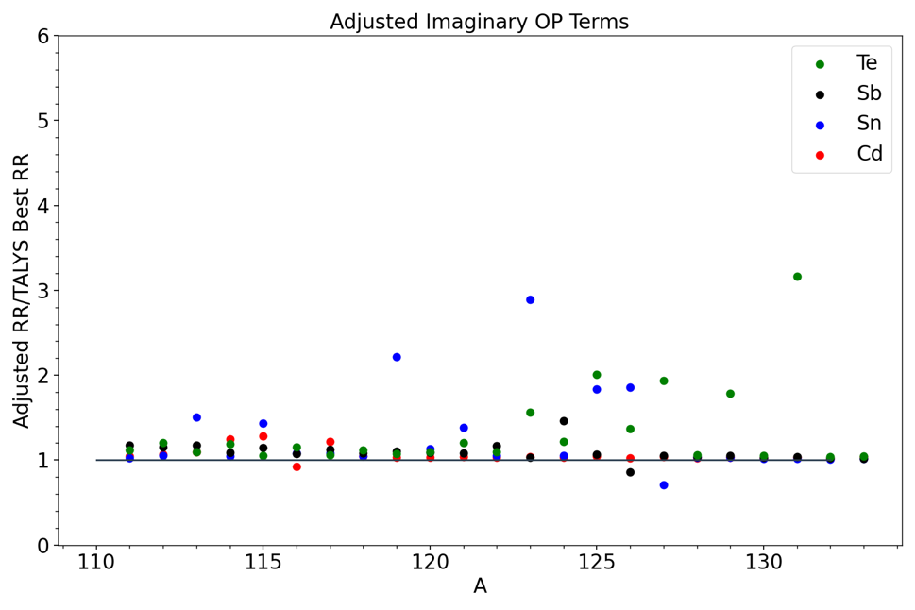
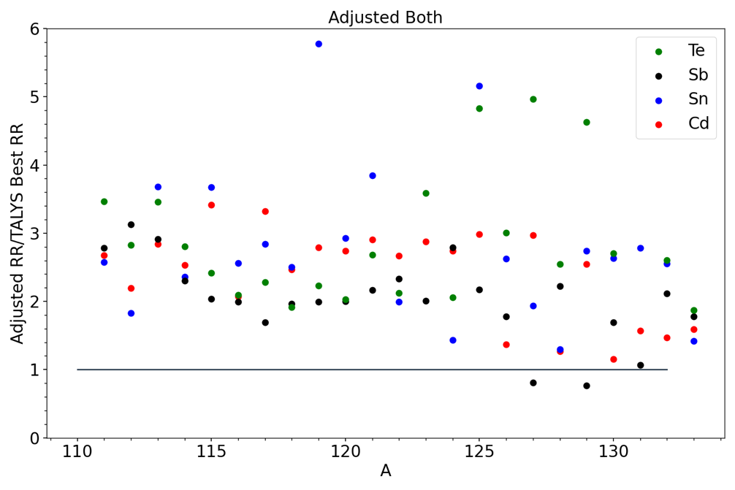
…which in turn has impact on Astrophysical Nucleosynthesis via $\left(n,γ\right) at 30 keV$
Preliminary
Rspincut=0.4
W1adjust n=2.5, W2adjust n=0.6
Both
Changes in J, which reflects quasicontinuum structure, has a bigger effect than changes in the Imaginary Optical Potential (which is likely to differ off stability)
The need for improved reaction modeling for medical isotope production has led to a better understanding of angular momentum and neutron wavefunction properties at MeV energies, which in turn suggests improvements to nuclear astrophysics modeling

Slide 19
Summary
The need for improved reaction modeling for medical isotope production has led to a better understanding of angular momentum and neutron wavefunction properties at MeV energies, which in turn suggests significant changes to astrophysical nucleosynthesis modeling
Andrew S. Voyles¹, Catherine E. Apgar¹, Jon C. Batchelder¹, Lee A. Bernstein^{1,2}, M.S. Basunia²
Eva R. Birnbaum³, Cathy S. Cutler⁴, Morgan B. Fox¹, Arjan Koning⁵, Amanda M. Lewis³, Dmitri Medvedev⁴, Jon T. Morrell⁴, F. Meiring Nortier³, Ellen O’Brien³, Michael A. Skulski⁴, and Christaan Vermeulen³
¹ University of California-Berkeley Dept. of Nuclear Engineering
² Lawrence Berkeley National Laboratory
³ Los Alamos National Laboratory
⁴ Brookhaven National Laboratory
⁵ International Atomic Energy Agency
This research was supported by the U.S. Department of Energy Isotope Program, managed by the Office of Science for Isotope R&D and Production, carried out under Lawrence Berkeley National Laboratory (Contract No. DE-AC02-05CH11231), Los Alamos National Laboratory (Contract No. 89233218CNA000001), and Brookhaven National Laboratory (Contract No. DEAC02-98CH10886).
https://nucleardata.berkeley.edu/

Slide 20
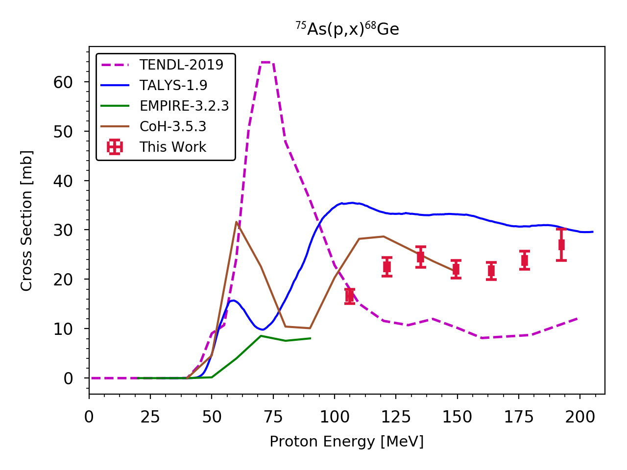
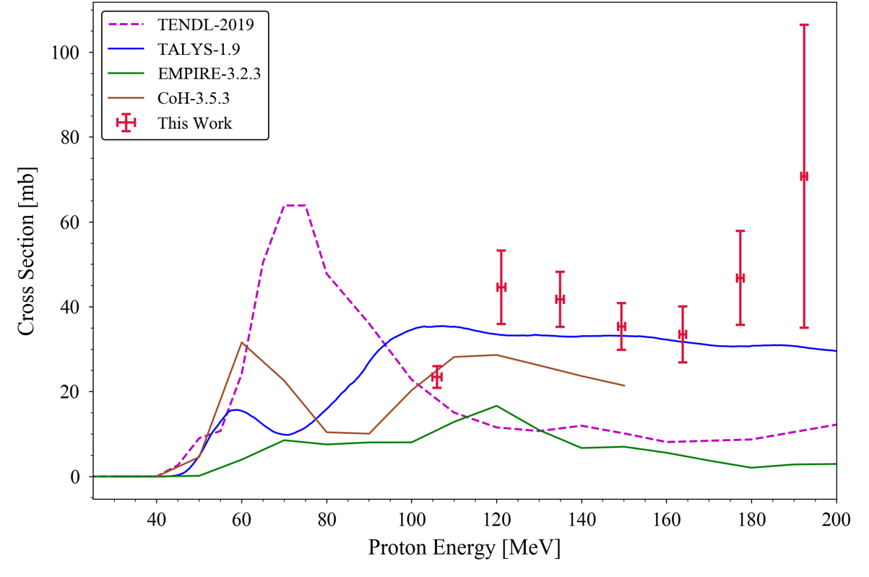
How should we make ⁶⁸Ge? Locally or regionally?
Local (low-energy) reaction: ⁶⁶Zn(α,2n)⁶⁸Ge
Regional (high-energy) reaction: ^{nat}As(p,x)⁶⁸Ge
Limited predictive power
M. Aikawa et al.,
NIMB 427 (2018) 91–94
Which one should we choose?

