Slide 1

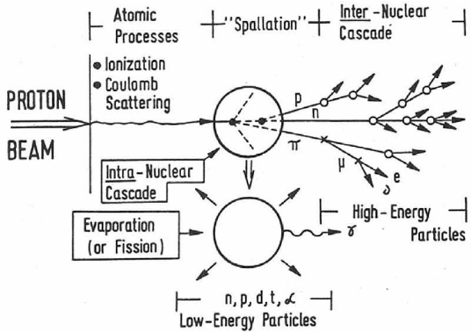
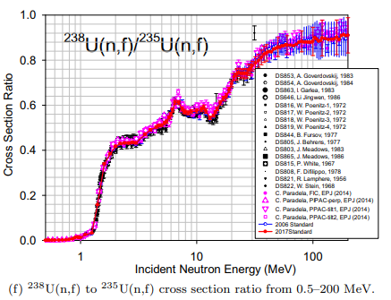
Radiation protection benchmark at SPES-LNL to test nuclear models between a nucleon within energy range 20 and 200 MeV and a light nucleus (C, N, O)
12 May 2025 - Workshop on future research program with the high power Cyclotron of SPES-LNL
Why and How ?!
Michaël PETIT ASNR/France - EURADOS
Task leader in improvement of nuclear data, on behalf of Eurados Working Groups 6, 9 and 11

Slide 2
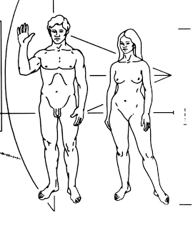

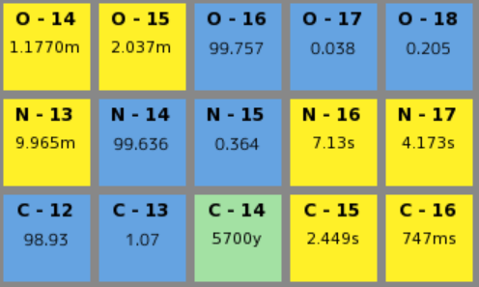

Our sandbox
Average chemical cell composition
from JP. Alard et al. 2022 as deduced from ICRU 44
what about us ?
Element | Cell Nucleus | Cytoplasm
H | 0.1064 | 0.5960
O | 0.7450 | 0.2424
C | 0.0904 | 0.1111
N | 0.0321 | 0.0404
P | 0.0261 | 0.0101
A quite large one !
  Composition of the earth's crust
Atoms | % in wight
O | 46.6
Si | 27.7
Al | 8.1
Fe | 5.0
Ca | 3.6
Na | 2.8
K | 2.6
Mg | 2.1
Other | 1.5
Only 5 chemical elements and so 5 isotopes (¹H, ¹²C, ¹⁴N, ¹⁶O and ³¹P) represent 99.5% of the radiation protection issues for the human body (plus few others for environnent as Si)

Slide 3
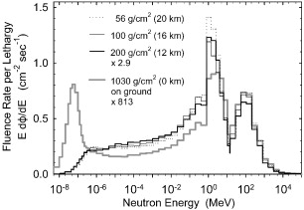
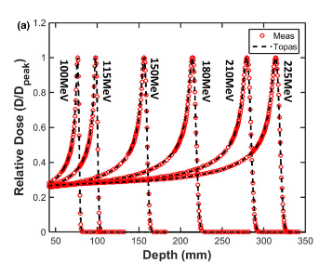
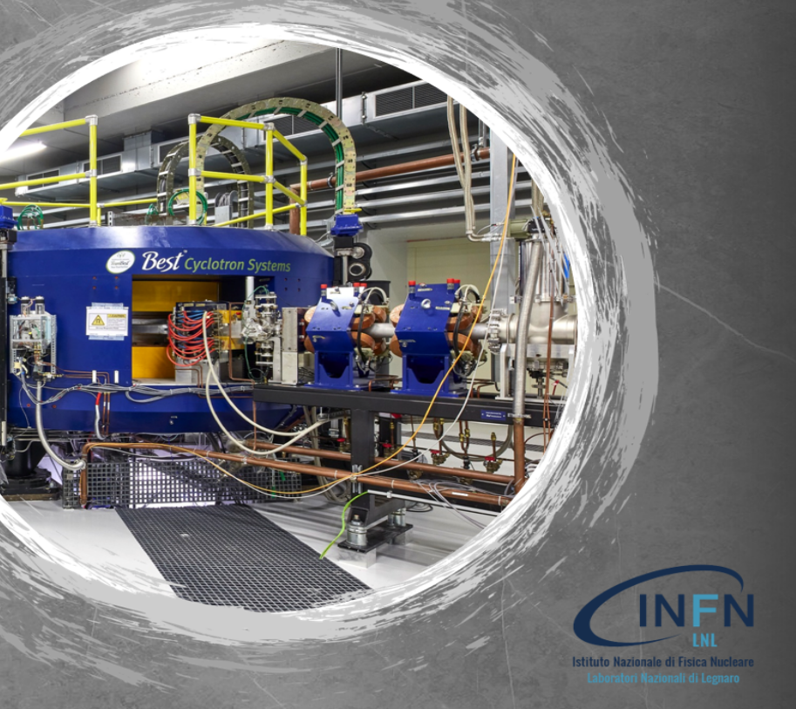
Nucleon energy from 20 MeV to 200 MeV
The energy spectrum of nucleons for radiation protection or medical issues can reach higher energies than in usual fusion/fission applications (thermal to 20 MeV).
Neutrons energy spectrum in atmosphere
Proton dose profile in proton therapy
And around some dedicate machine !
Energy decade between 20 MeV and 200 MeV is important

Slide 4
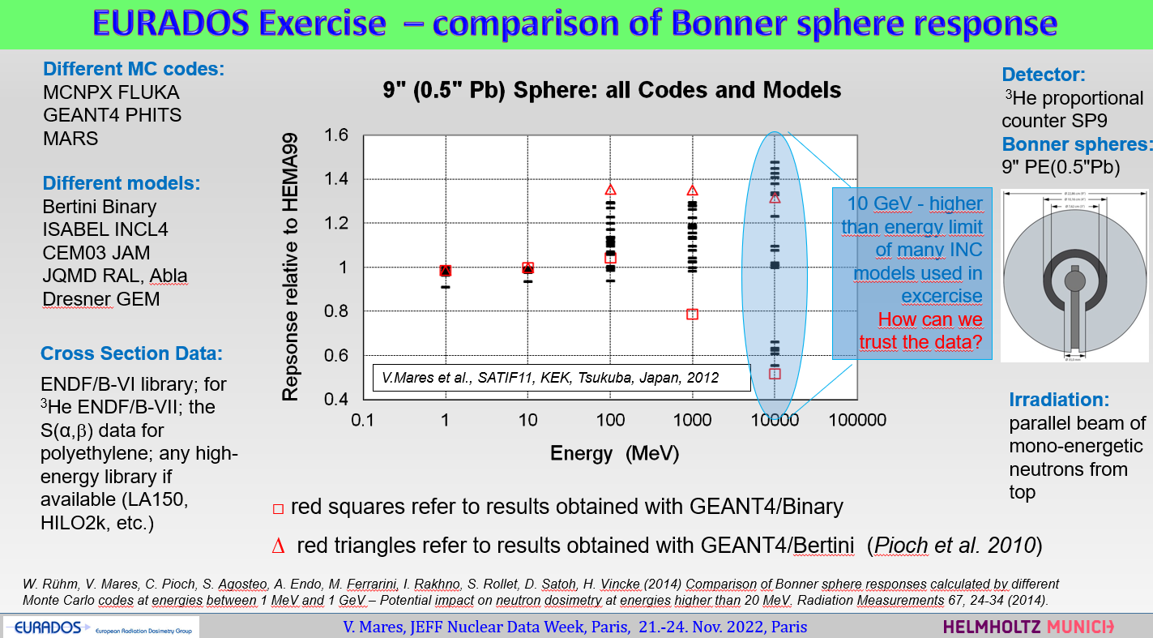
Eurados observation
Reference work
  There is no agreement on the high-energy models and there is no certainty that any of them are correct.

Slide 5
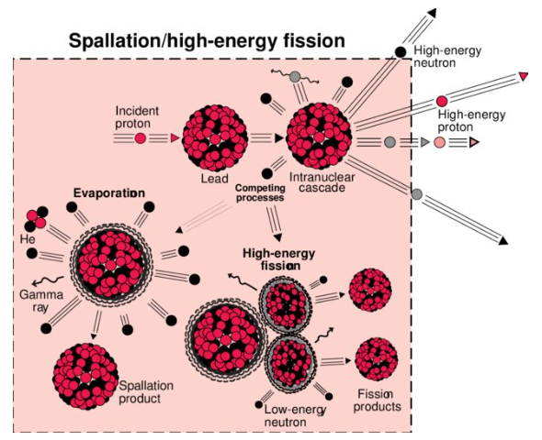
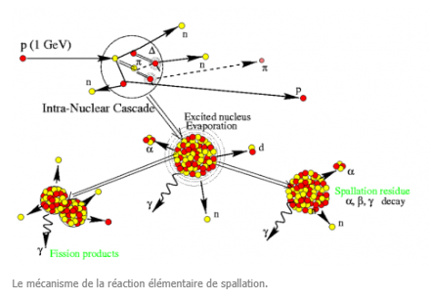
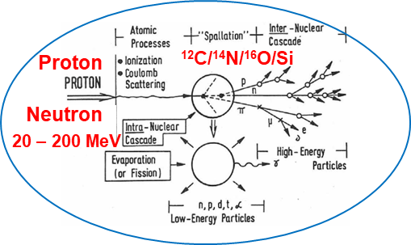
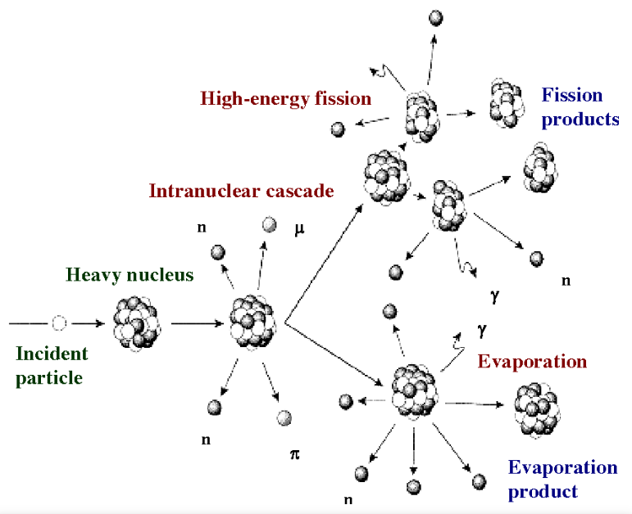
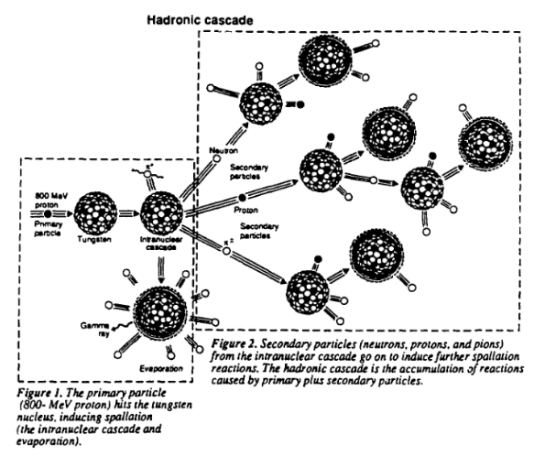
Why this situation ?
What exists
The nuclears models
What is needed ...
The models were not done for radioprotection (or IT or aeronautics) application

Slide 6

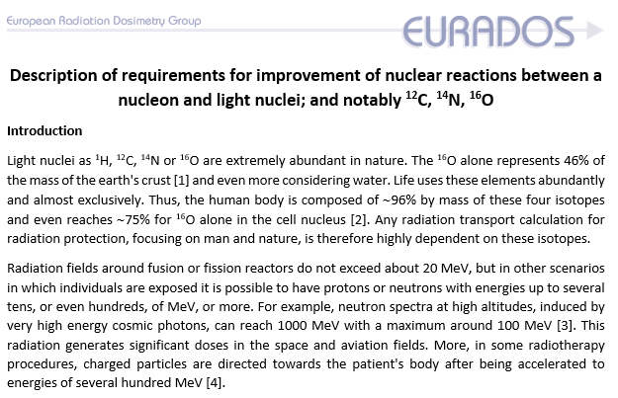
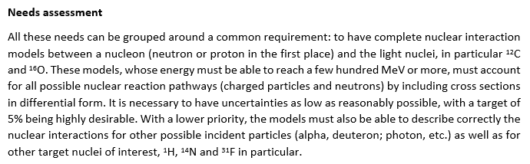
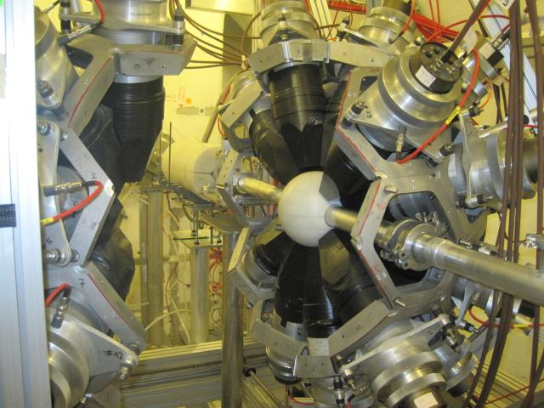
What is the situation
-> Radioprotection benchmark to test dedicated nuclear models ?!
Similarly to ICSBEP (International Criticality Safety Benchmark Evaluation Project).
Proton
¹²C/¹⁴N/¹⁶O
The model needs validation points -> request for measurements -> JEFF
Neutron
(...)
Nuclear model community (theoretician and evaluator)
Measurements for ¹²C, ¹⁴N and ¹⁶O are now in the HPRL list of IAEA/NEA
²⁸Si to be discussed (5 june 2025)
-> WG11 of EURADOS included this topic as an output to be proposed to PIANOFORTE (Bucarest 02/25)
Measurements
community

Slide 7
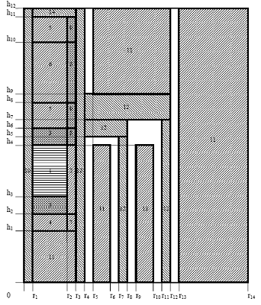
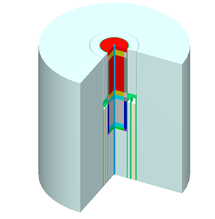
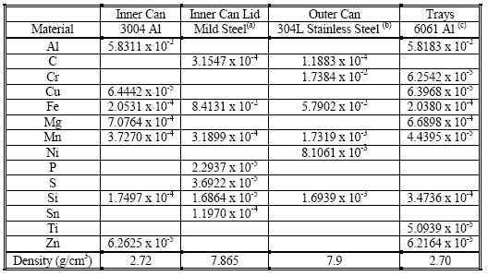
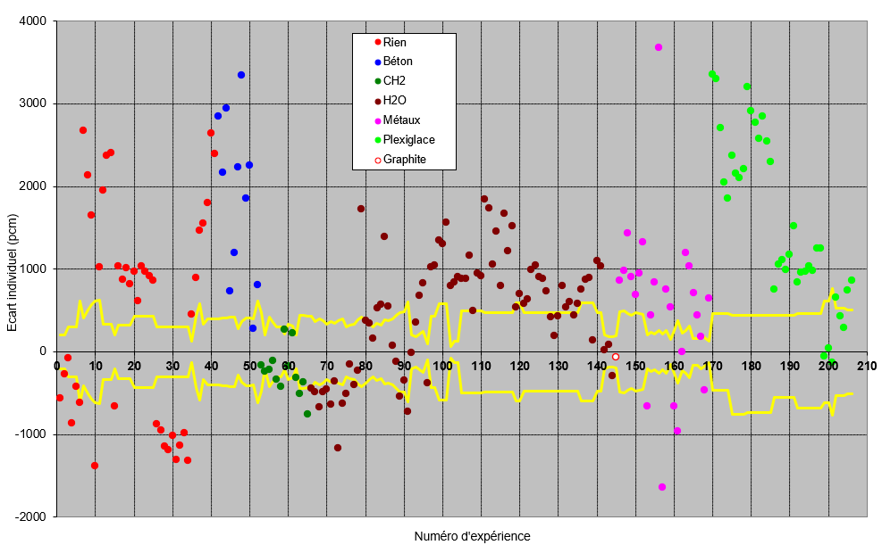
What is a Benchmark – exemple with criticality (keff=1)
Each point is an experience and the uncertainties are between the yellow line.
With this kind of data, one can analyse and try to « guess » what kind of cross section could be improved

Slide 8
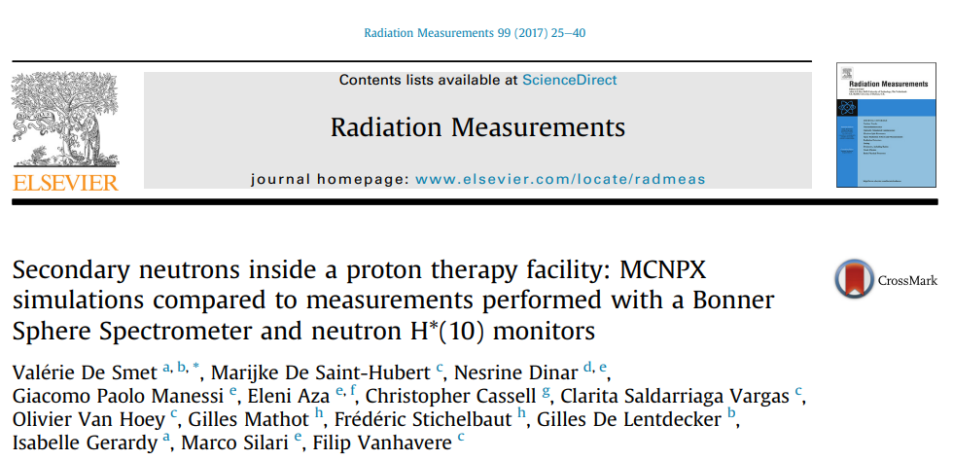
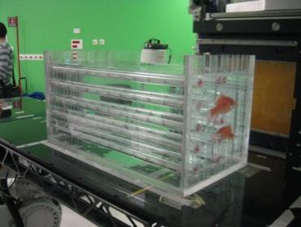
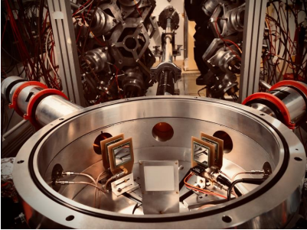
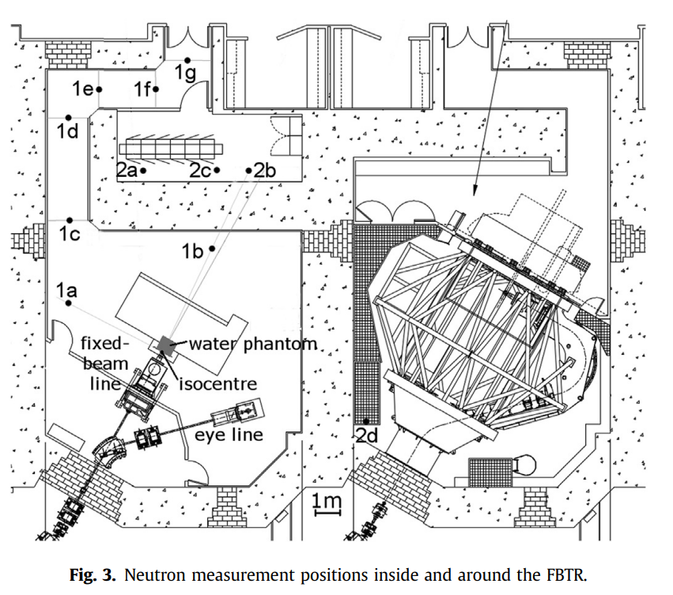
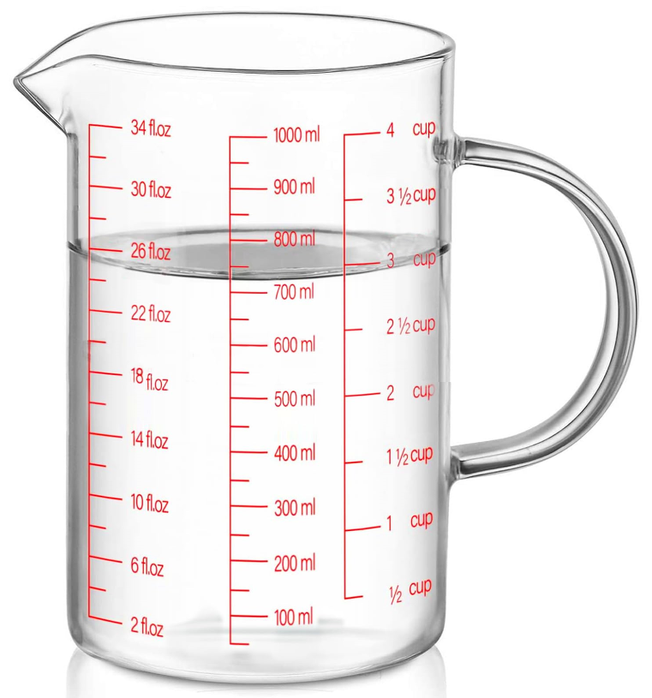
The proposed benchmark
From E. PIROVANO (PTB)
Few interaction
Closest to the need
Close to the need :
Protontherapy secondary dose
Detector response function calculation
My feeling :
Size about 1 liter / 1 kg
One interaction one element -> the measure
Measurements
community
(too) Many interaction many element -> the using

Slide 9
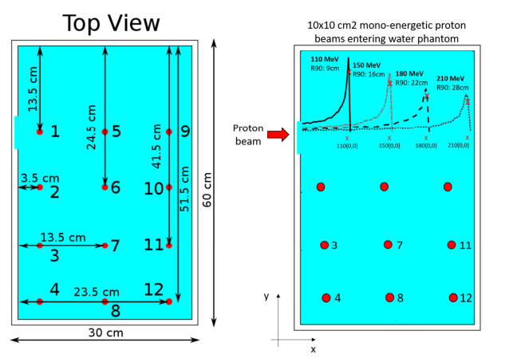
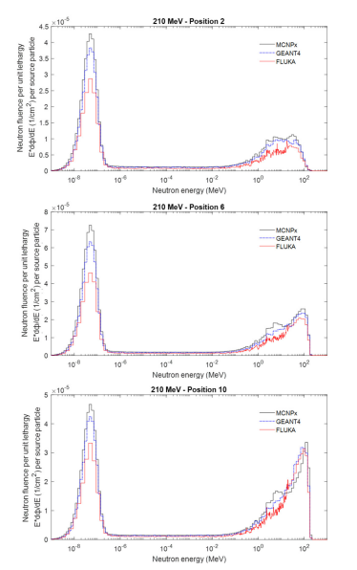
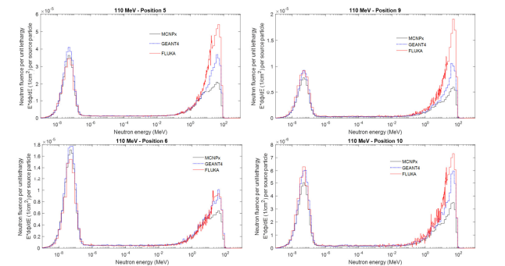
What needs to be checked
Reference work
  “The influence of nuclear models and Monte Carlo radiation transport codes on stray neutron dose estimations in proton therapy” M. De Saint-Hubert and al.
210 MeV
110 MeV
  How can these spectra be checked in fluence and in shape?

Slide 10
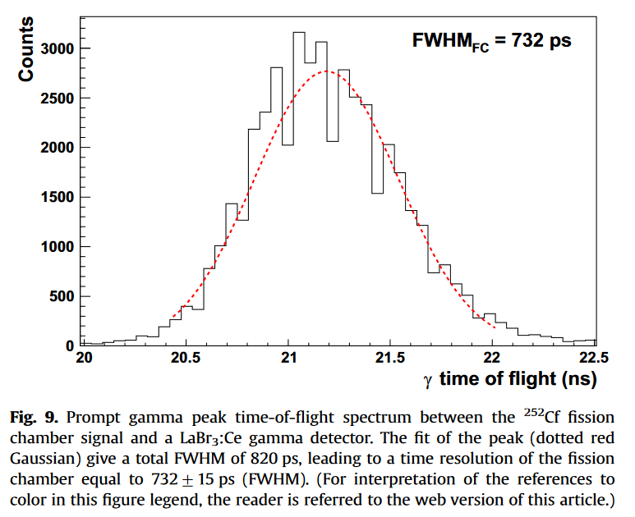
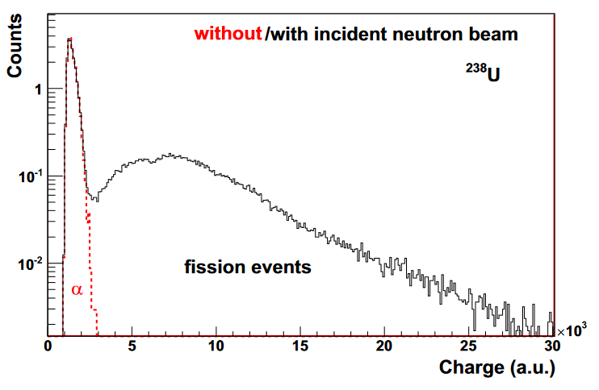
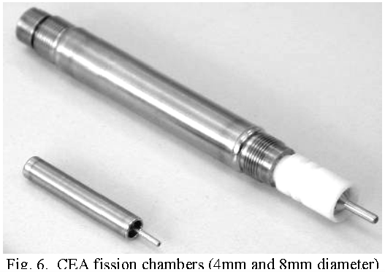

ADvantage of fission for measurement
From J. Taieb et al. / Nuclear Instruments and Methods in Physics Research A 833 (2016)
  Number of target nuclei is easy to determine and there is "no" correction trouble
  Time resolution can be very good (∼1 ns)
  Cross section is well know for ²³⁸U(n,f) and ²³⁵U(n,f) within a large energy range where it is a standard and the only one within
  20 MeV-200 MeV
  Size can be small -> good spatial resolution for measure close to the source
  This is why fission is often the monitoring system for many (all) high energy facilities as on nToF -> and so ²³⁸U(n,f) or ²³⁵U(n,f) are the scientific reference

Slide 11
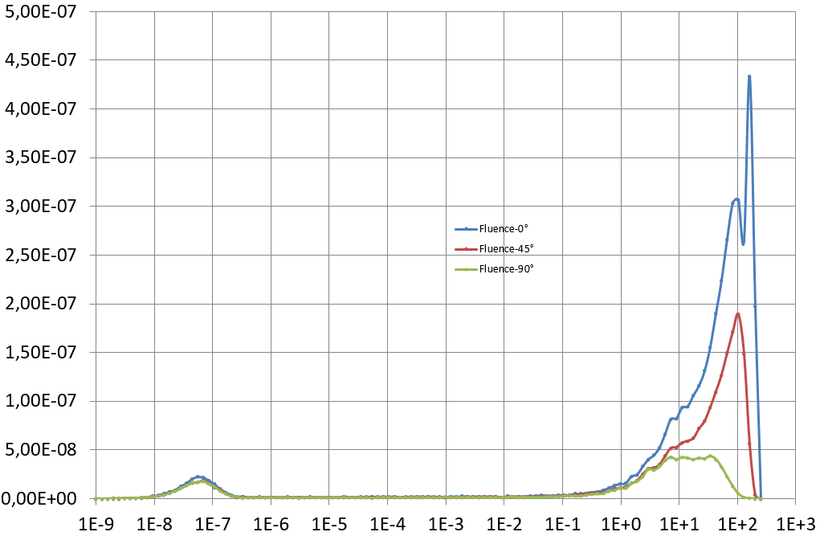
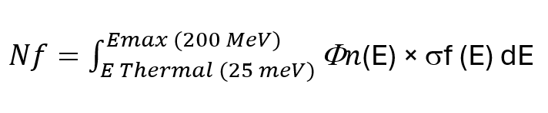
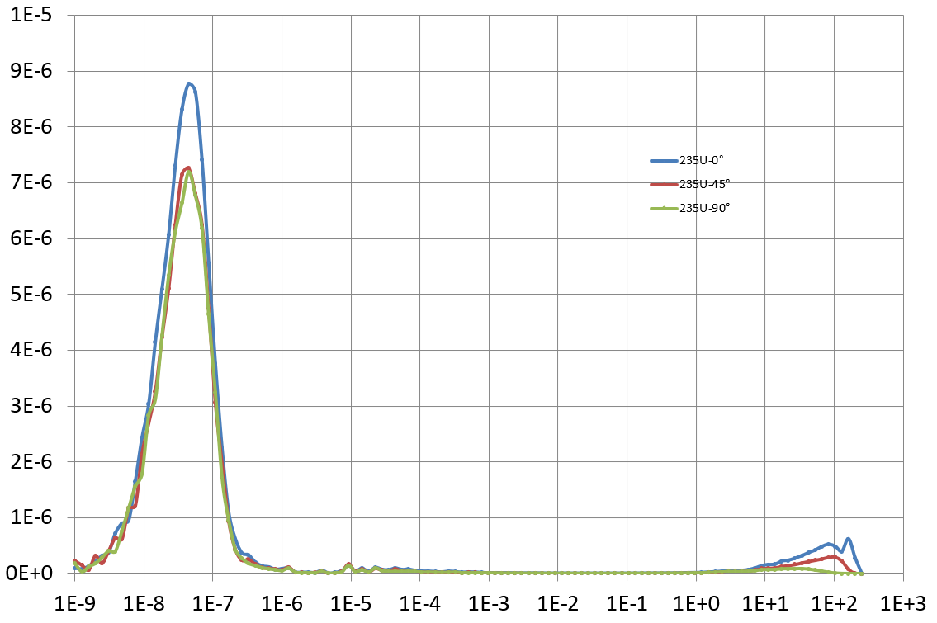
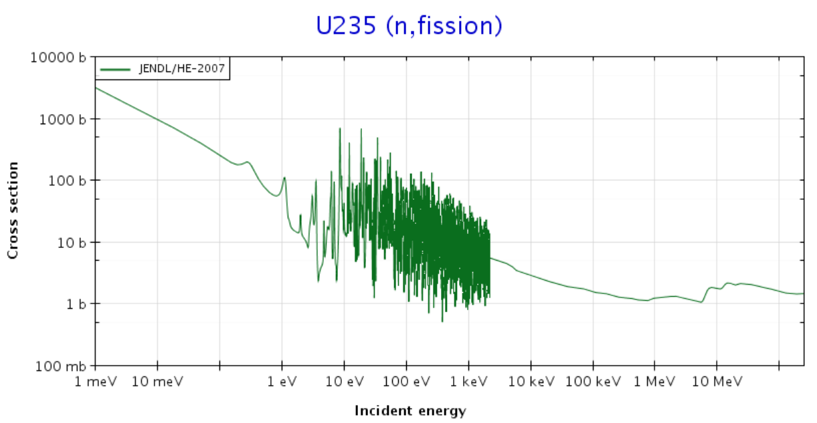
A possible method for "measure" any neutrons flux
Fission contribution from the fluence - integral
  The number of ²³⁵U fission is the integral of the flux by the fission cross section
Fission by ²³⁵U from this neutron spectrum
Thermal cross section ~500 barns
Fast cross section ~few barns (1-3)

Slide 12
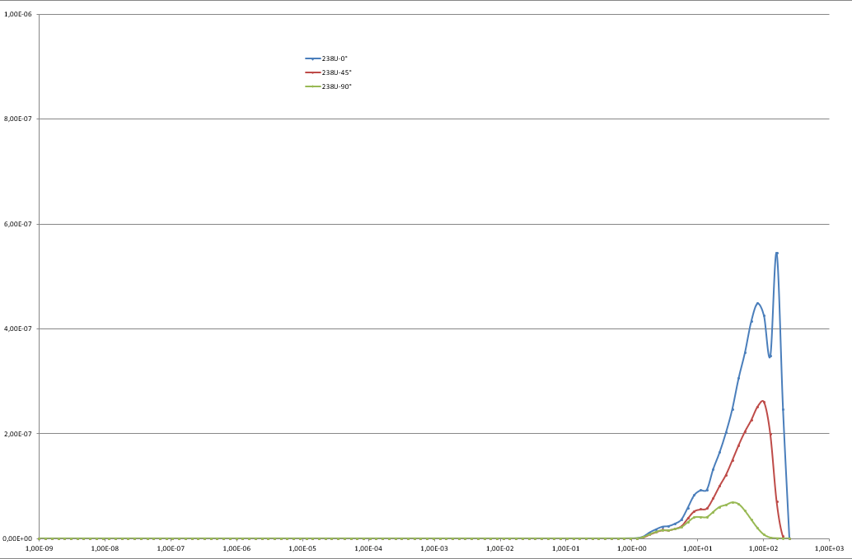
Fission contribution from the fluence - integral
  The number of ²³⁸U(n,f) and ^{235U}(n,f) reaction is the integral of the flux by the fission cross section
Protontherapy at 200 MeV (a typical example)
²³⁸U(n,f)
²³⁵U(n,f)
Integral of the thermal component
(after subtracting the fast component)
Integral of the fast component
Threshold (1 MeV)
The thermal fission exist here …
Same scale ...
Nf(²³⁸U)
Nf(²³⁵U) - k × Nf(²³⁸U)
With "k" is defined by the flux shape between 200 MeV and 1 MeV (the ²³⁸U(n,f) threshold)
If one assume the flux shape, this technique is enough to determine any neutrons fluence within 2 energy groups

Slide 13
Possibility with SPES-LNL
  Some benchmark to constrain the nuclear model(s) … to be create
Detector inside the target -> no pulse beam needed
Proton beam
integral measurement of neutrons fluence (thermal – 1 MeV / 1 MeV – Emax)
(X0 cm × X0 cm × X0 cm)
Various possibilities:
Different proton energy from (35 MeV-70 MeV)
Different size of target (and possible full stop or partial stop)
Different type of target material (Oxygen (H₂O), Carbon (CH₂), Silicon (SiO₂), Nitrogen (Si₃N₄)
Different position of beam and of detector

Slide 14
How TO determine if the shape of the spectrum is correct?
Is it possible to measure it ? -> a proposal of principle
MCNP (M. PETIT) and GEANT4 (A. DI CHICCO) calculation
1 meter distance
angle 0°, 45°, 90°
What is the neutron flux ?
Proton beam 200 MeV (6 cm × 6 cm)
Water
(30 cm × 30 cm × 30 cm)

Slide 15
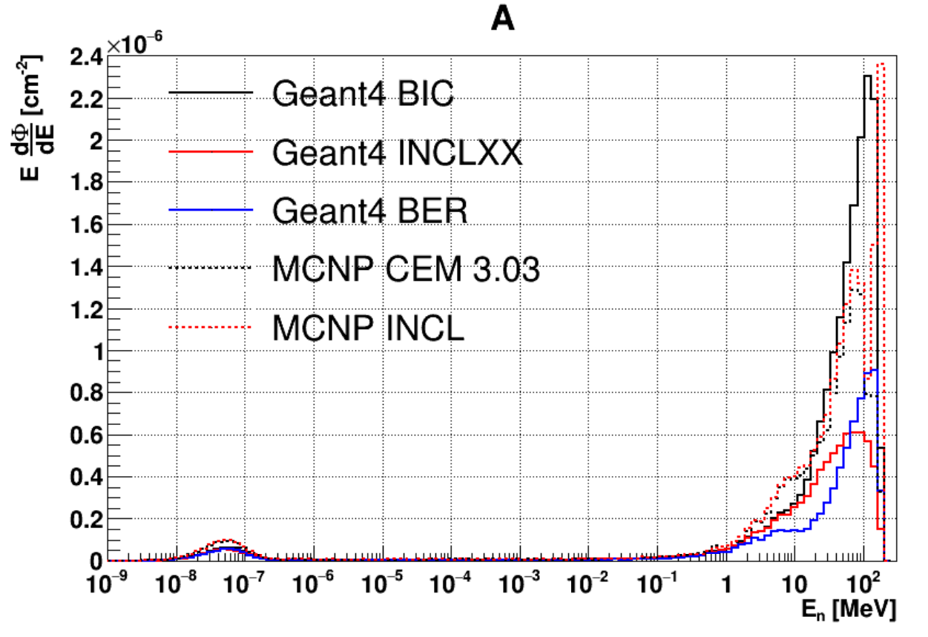
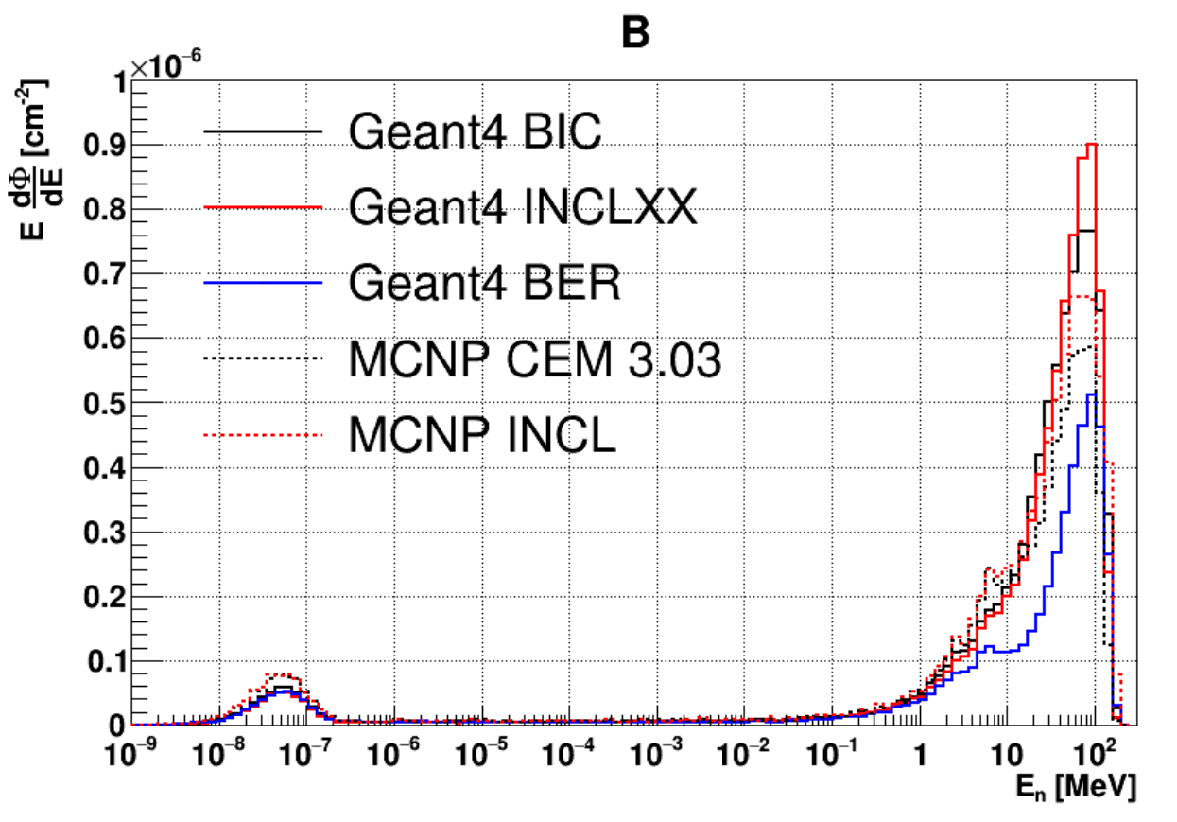
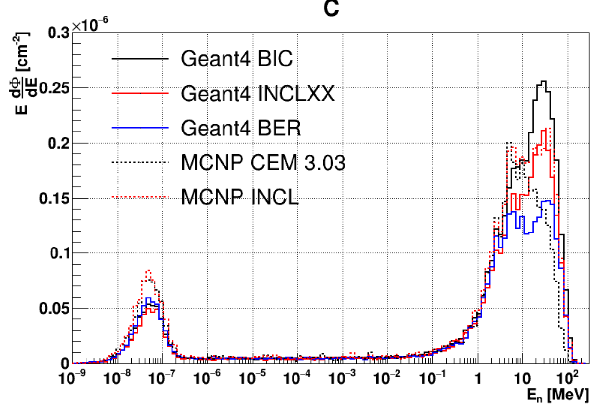
Calculation MCNP/GEANT4
A. DI CHICCO Calculation (PTB) En = 200 MeV at 1 meter
0°
45°
90°
Shape of thermal pic is not an issue.
Shape of fast neutron flux is an issue.

Slide 16
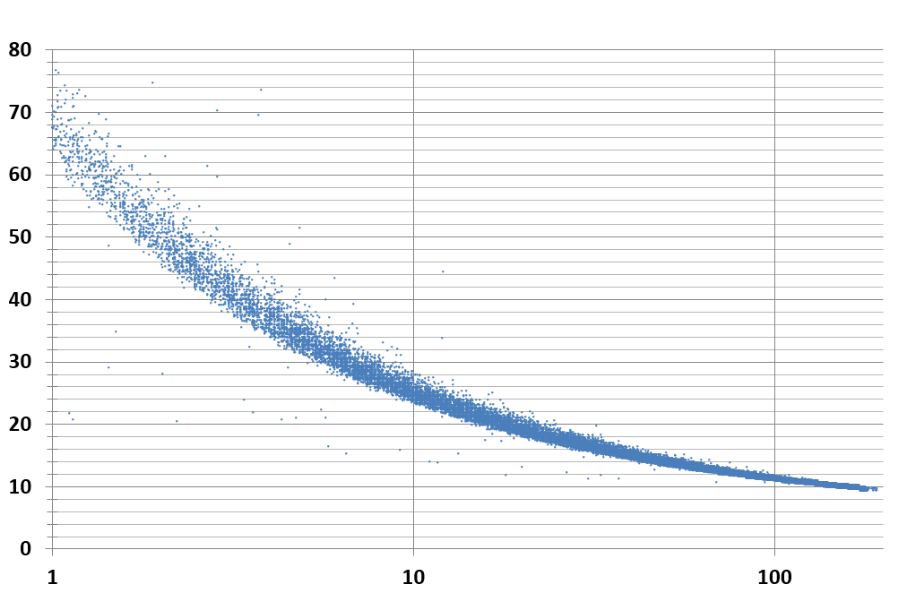
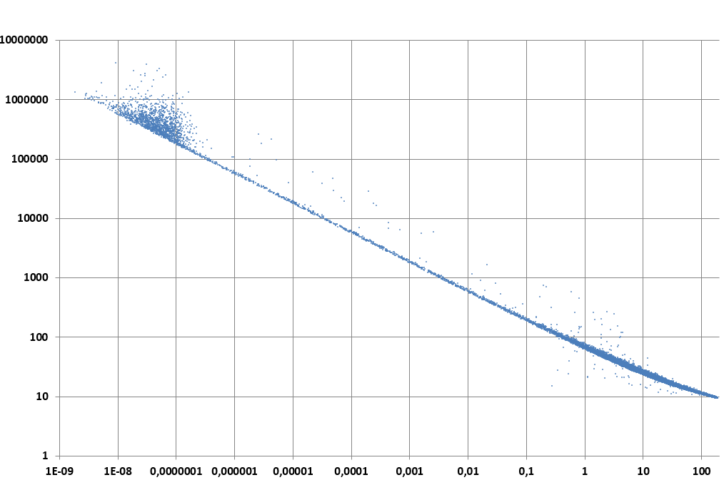
To determine if the shape of the spectrum is correct
M. PETIT Calculation (MCNP) En = 200 MeV at 1 meter and 0°
Thermal neutron
Time (ns)
Time (ns)
Fast neutron
Neutron energy (MeV)
Neutron energy (MeV)
Water
Counting rate (²³⁸U)
~100 events/µC/mg
Proton beam 200 MeV
Pulse time = 0
(30 cm × 30 cm × 30 cm)
100 ns is enough to avoid overlap between 2 pulses

Slide 17
Which machine is needed
The best !
  The proton beam is extracted to air,
  Good time resolution (about 1 ns)
  Space around the set up and ToF possiblility
  All energy available from 20 to 200 MeV
  Frequency lower than 10 MHz (100 ns between pulse)
  Beam current about 1µA or more
  high power Cyclotron of SPES-LNL
  The proton beam is extracted to air,
  Good time resolution (1,8 ns)
  Good possibility for the set up (target, detector, room)
  Energy limited from 35 MeV to 70 MeV
  56 MHz but additional chopper to be implemented to 5-500 kHz
  Beam current 7 µA at 500 kHz
SPES-LNL is a very relevant machine for tests and measurements in the accessible range

Slide 18
Possibility with SPES-LNL
  Neutrons flux shape to be measured
∼3 m
Detector at 3-4 meters from the target and from 0° to 90°
∼4 m
Various possibilities:
Different proton energy from (35 MeV-70 MeV)
Different size of target (full stop or partial stop)
Different type of target (Oxygen (H₂0, Carbon (CH₂), Silicon (SiO₂), Nitrogen (Si₃N₄)
Different position of the beam and of the detector
Proton beam

Slide 19
Conclusion proposed for SPES-LNL
As the requirement of an optimized interaction model have already been done, the only EURADOS possible action is to be able to test the 20-200 MeV nuclear model according to its needs.
Measurement with fissions is a very important way as it offers many and very good experimental data with many flexibility and simplicity.
The best approach (the only one ?) for the fluence could be/is to use the fission of ²³⁸U and ²³⁵U to obtain the integral of the fast and thermal neutrons contributions with a “border” at 1 MeV which corresponds to the fission threshold of ²³⁸U. For information, price of 1 fission chamber is around 20-30 k€ and depend not on material quantity.
SPES-LNL is not the perfect machine for this need, but it is a very relevant machine to make dedicated experiment in this range possibility and thus in proposing benchmark library from 35 to 70 MeV.
To be discussed

