Slide 1
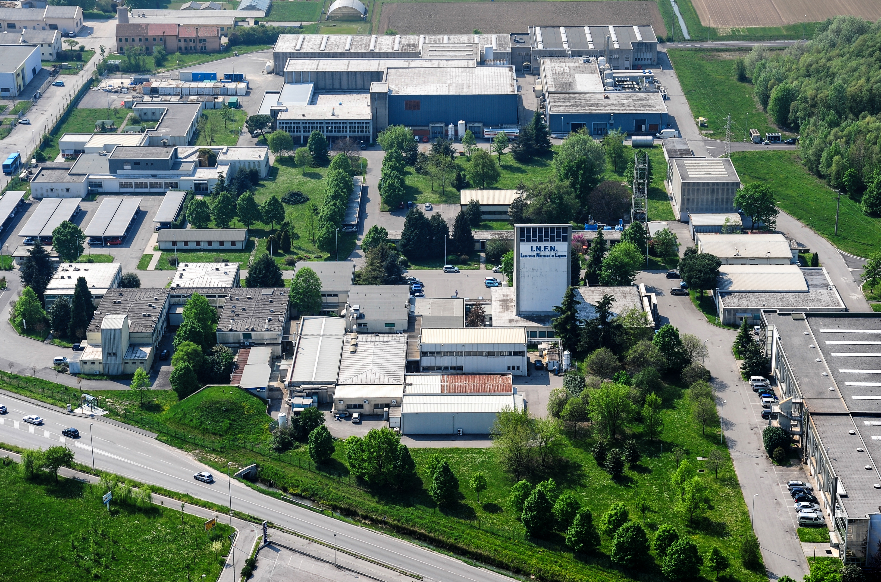
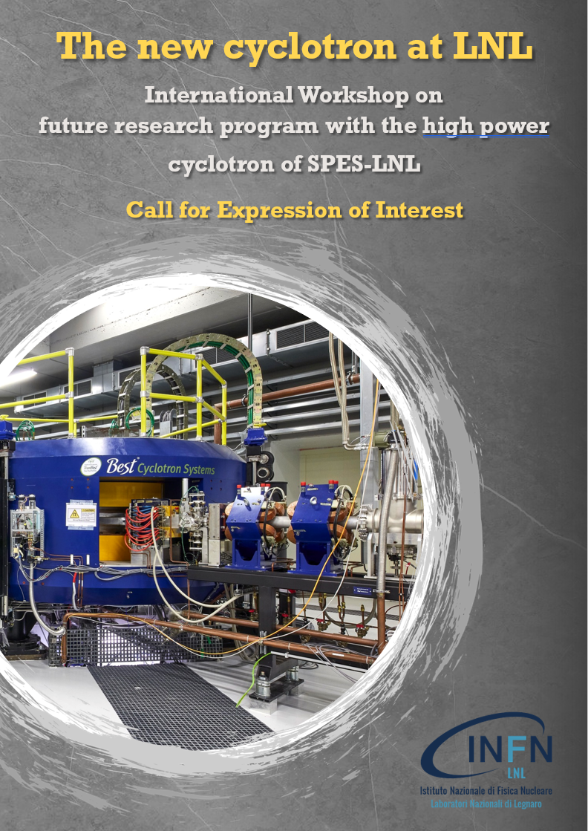
Miniaturized Microdosimeters for Hadron Therapy
12th May 2025
Anna Bianchi ¹
Anna Selva ¹
Linda Eliasson ²
Jan Lillhök ²
Valeria Conte ¹
¹ Laboratori Nazionali di Legnaro – INFN
² Swedish Radiation Safety Authority

Slide 2
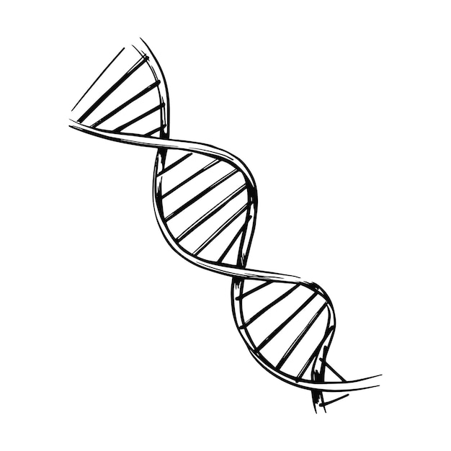


Microdosimetry
Low LET
Medium LET
High LET
Measurement of the stochastic aspect of energy deposition at the subcellular level
2

Slide 3
Microdosimetry for Hadron Therapy
3

Slide 4
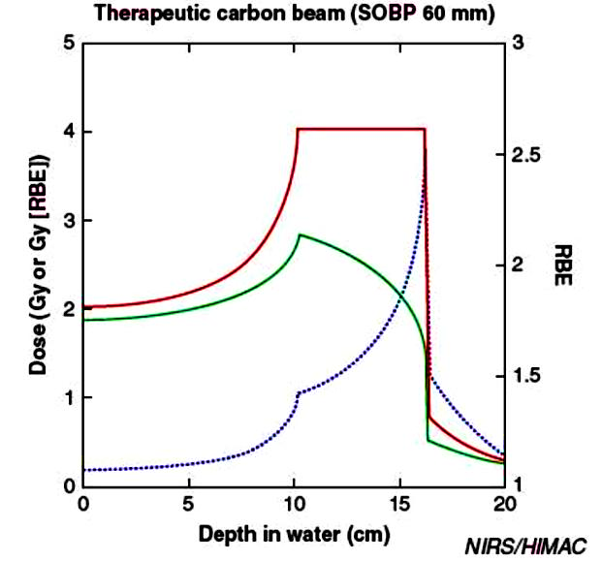
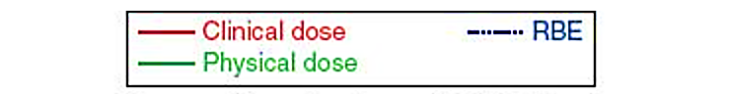
Biological effectiveness in TPS (Treatment Planning Systems)
Radiobiological measurements
OR
Calculations through models
RBE
4

Slide 5
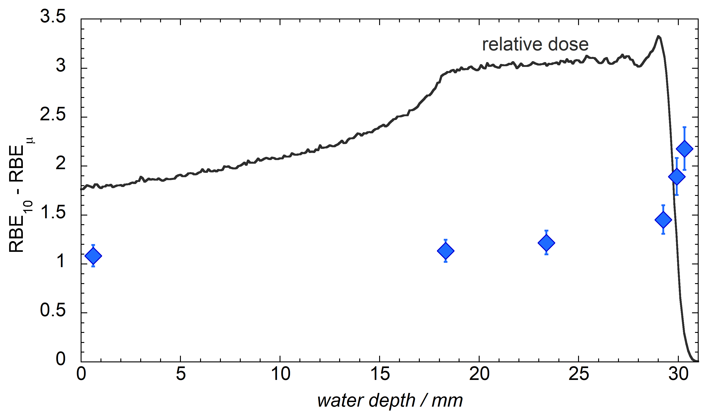
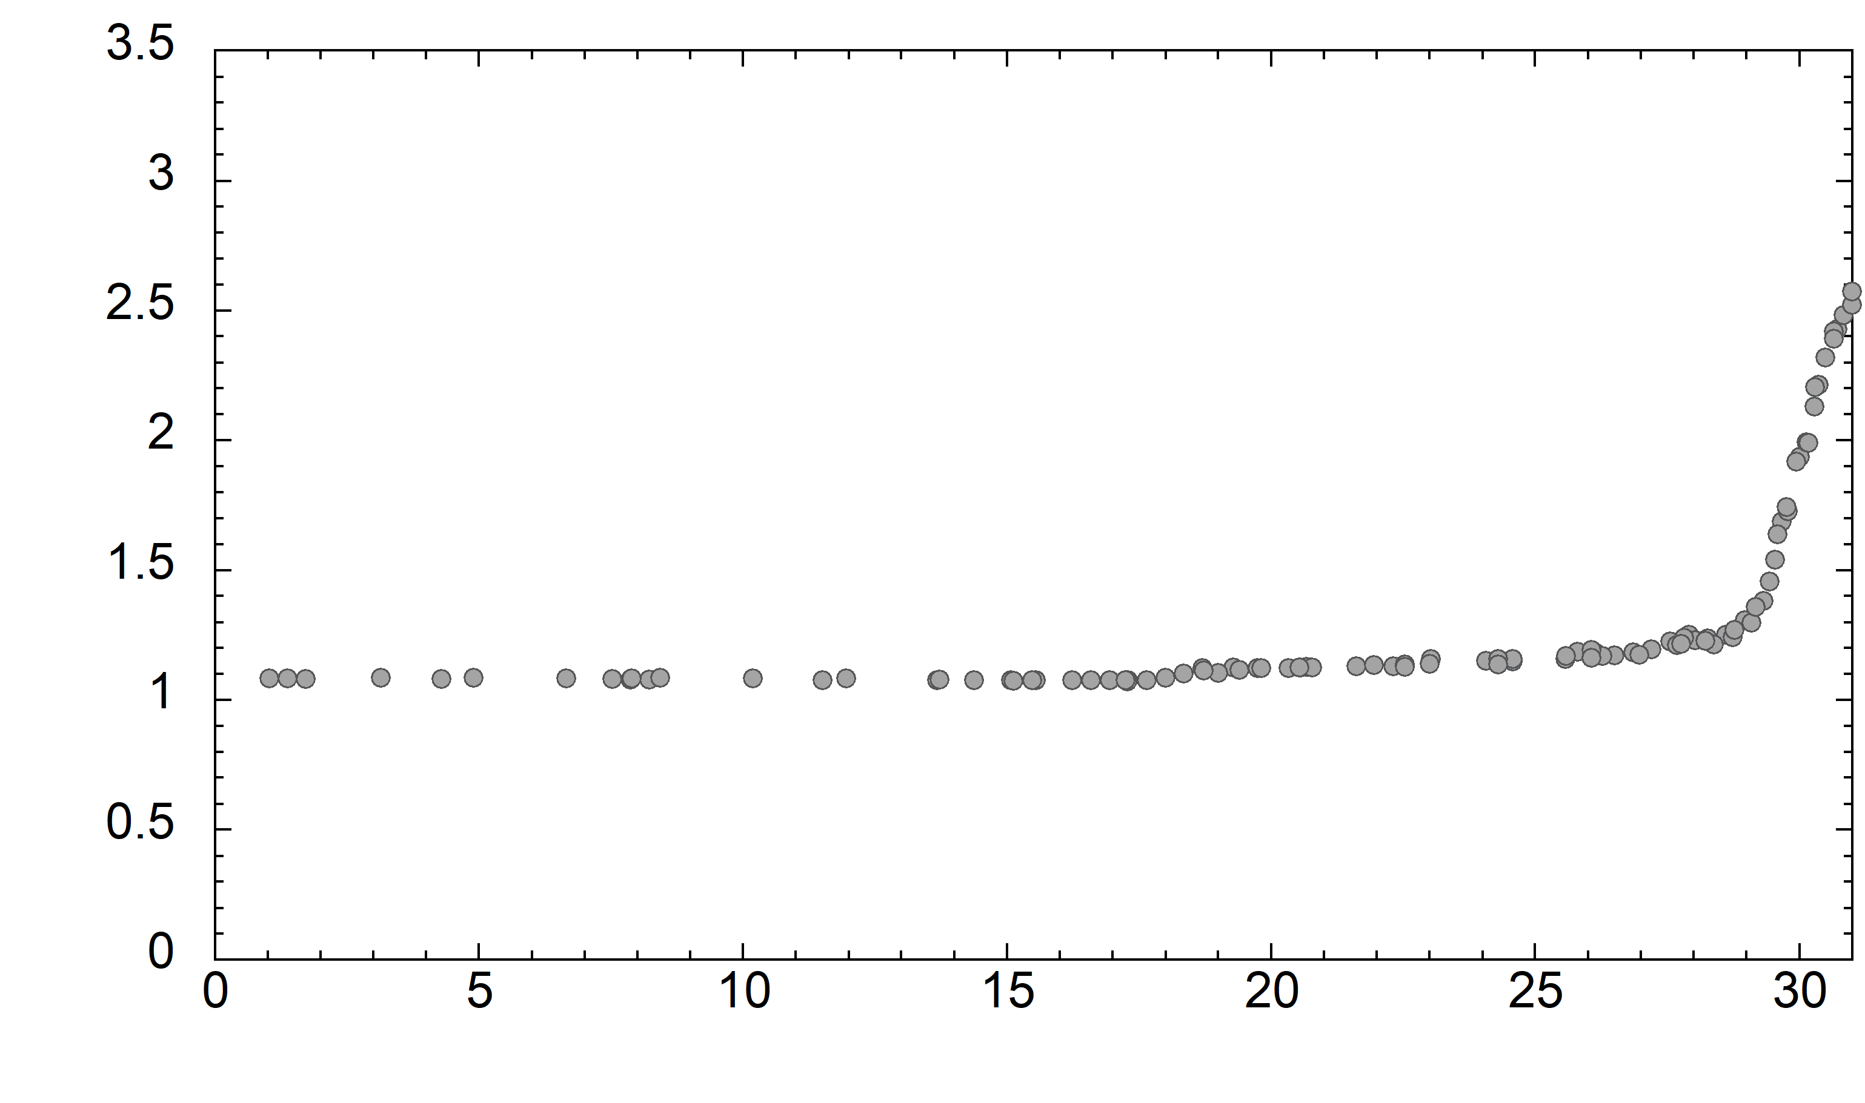
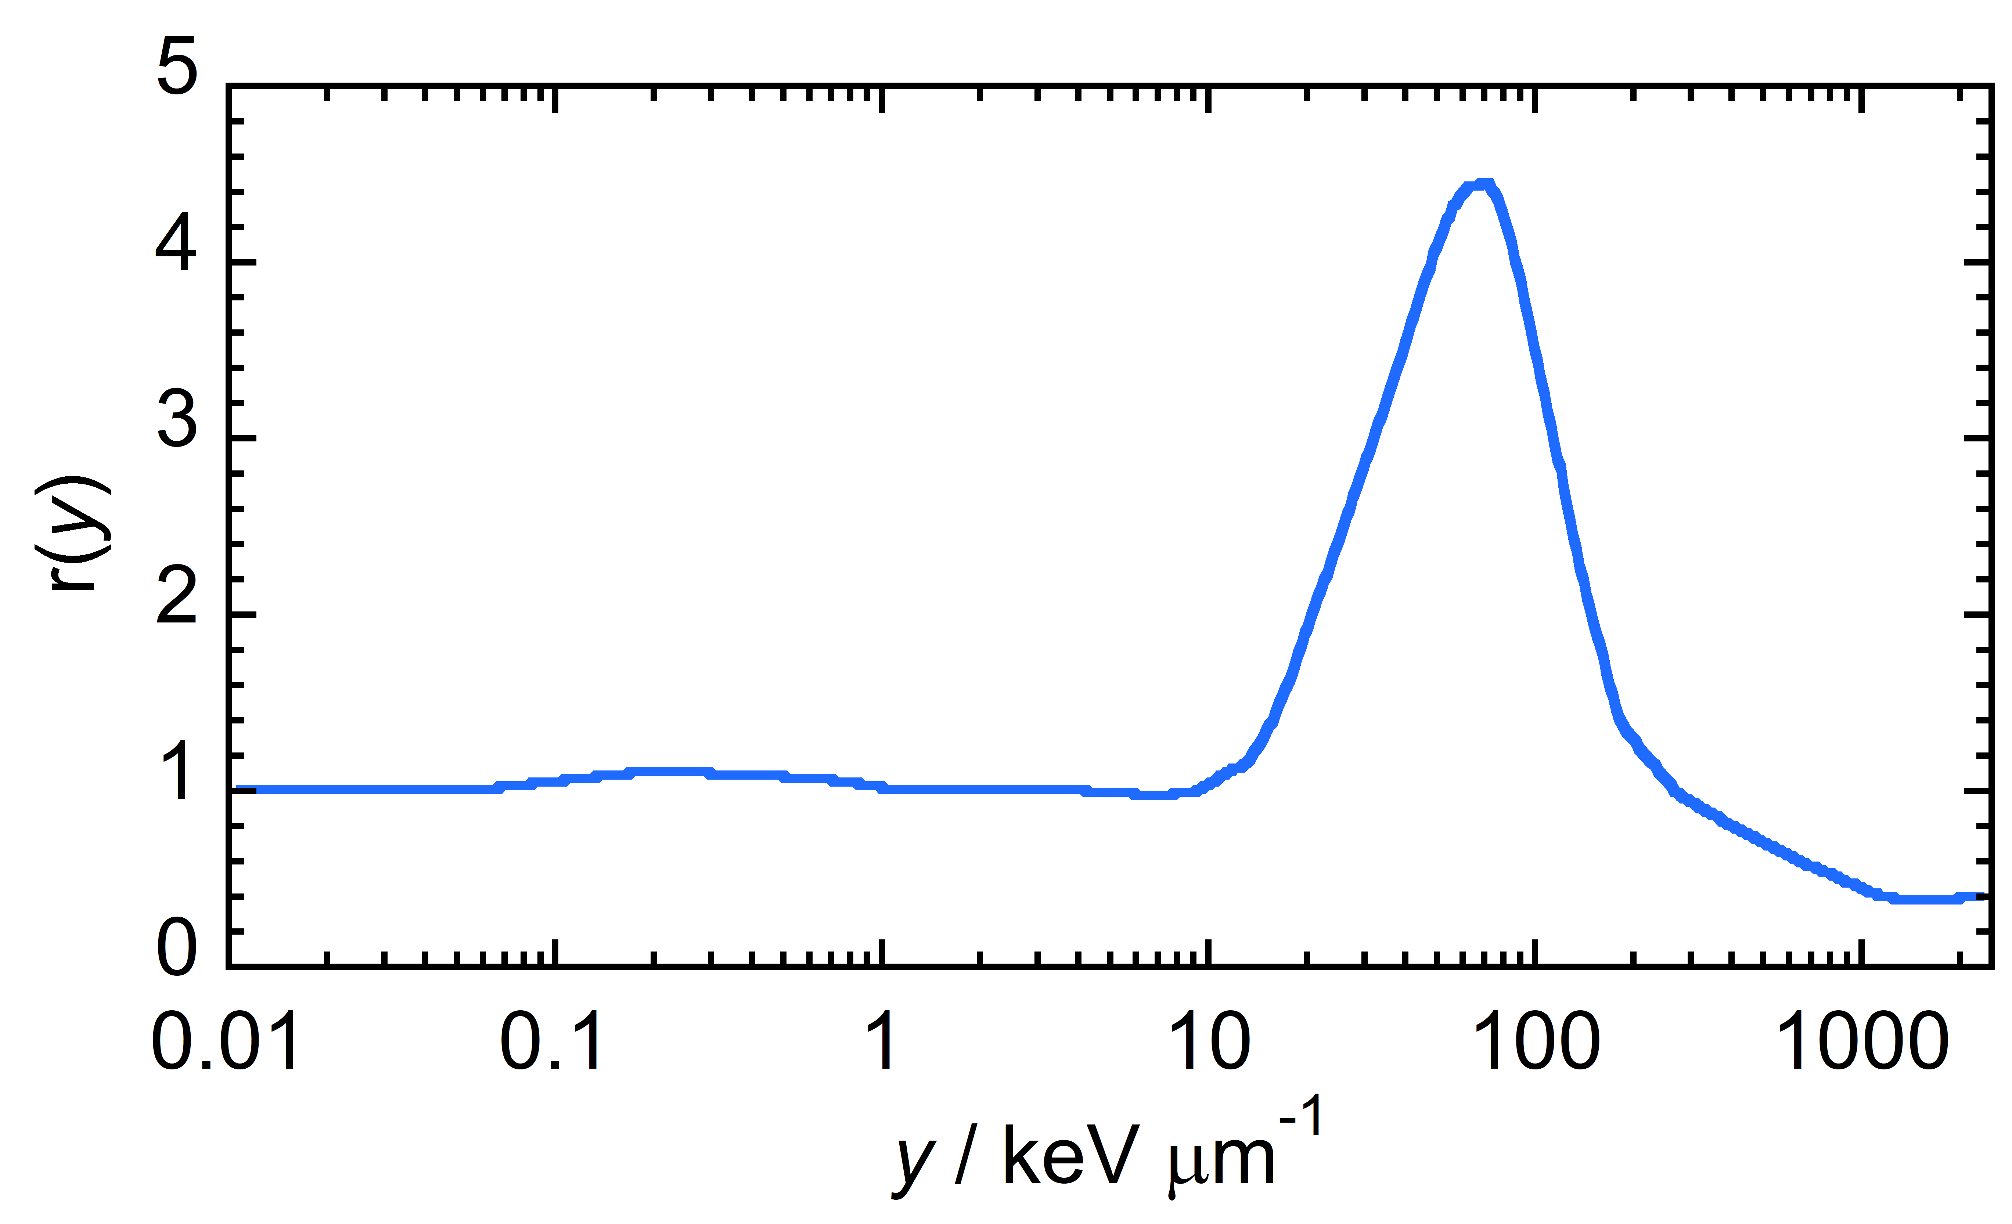
Microdosimetry for Quality Assurance
62 MeV SOBP
CATANA beam line @LNS - INFN
Pihet et al., Radiat Prot Dos, Vol.31(1-4), 1990 https://doi.org/10.1093/oxfordjournals.rpd.a080709
Chaudary et al., Int J Radiat Oncol Biol Phys. 2014 Sep 1;90(1):27-35. doi: 10.1016/j.ijrobp.2014.05.010.
Possibility of reproducing RBE through models
RBE₁₀ – U87 cell line
5

Slide 6


ICRU98 recommendation (2023)
When microdosimetry has to be used
When the mean number of charged particles, including delta rays originating outside the site, interacting with the volume of interest is small, the stochastic nature of the radiation interactions should be considered. Such a situation will arise when the reciprocal of the particle fluence is comparable to or larger than the cross-sectional area of the volume of interest. In mixed radiation fields the fluence of the higher LET components should be considered.
Low ← z → High
$$\frac{1}{φ}>S$$
$$\frac{1}{φ}<S$$
S: cross-sectional area
φ: particle fluence
Microdosimetry is necessary
Conventional dosimetry is sufficient
6

Slide 7
Microdosimetry @LNL
7

Slide 8
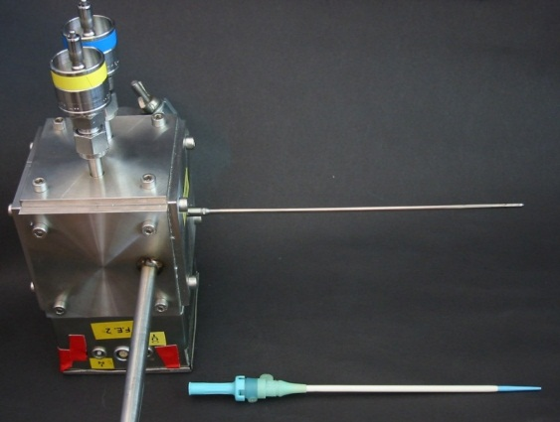
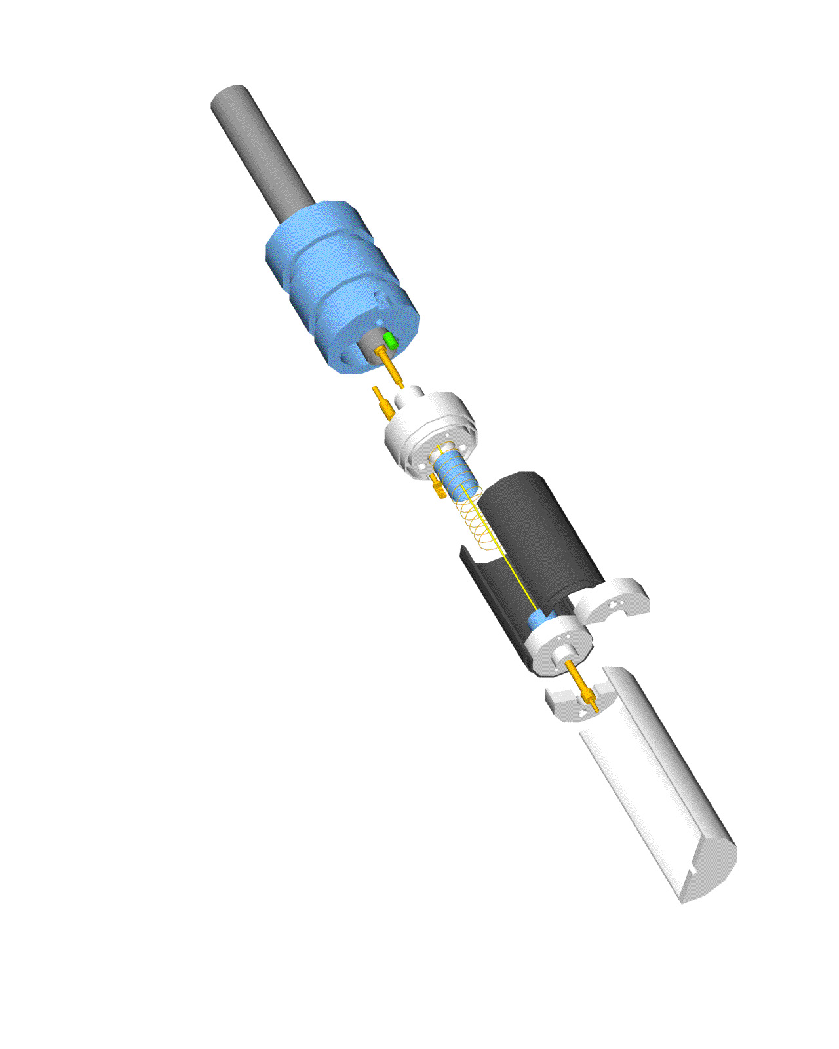
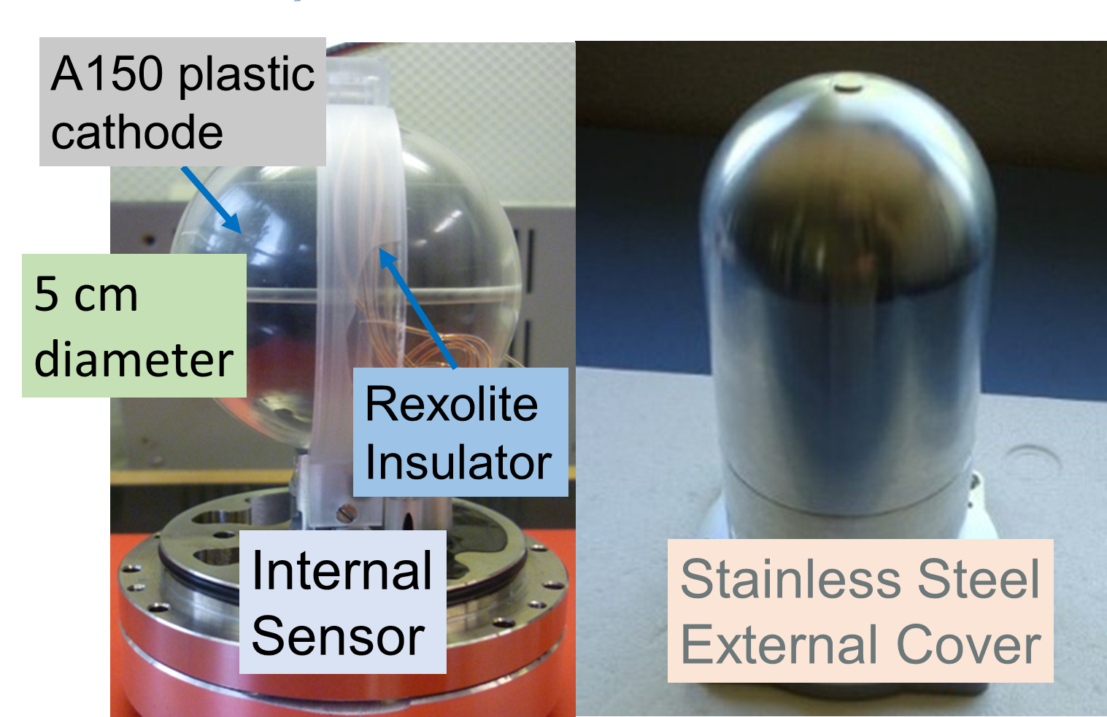
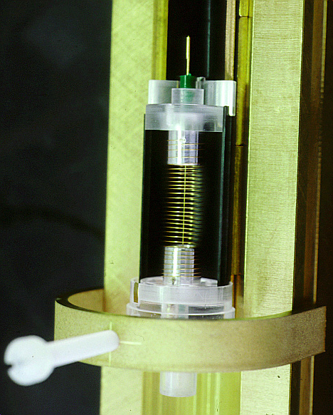
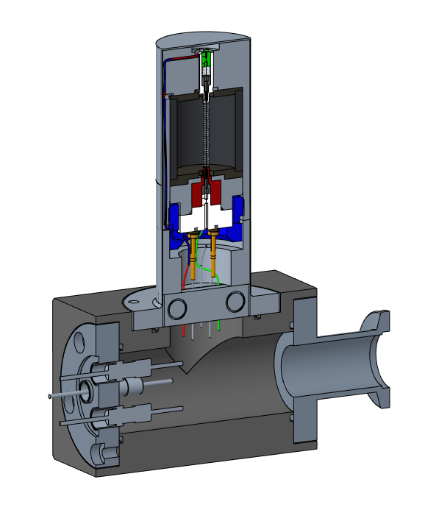
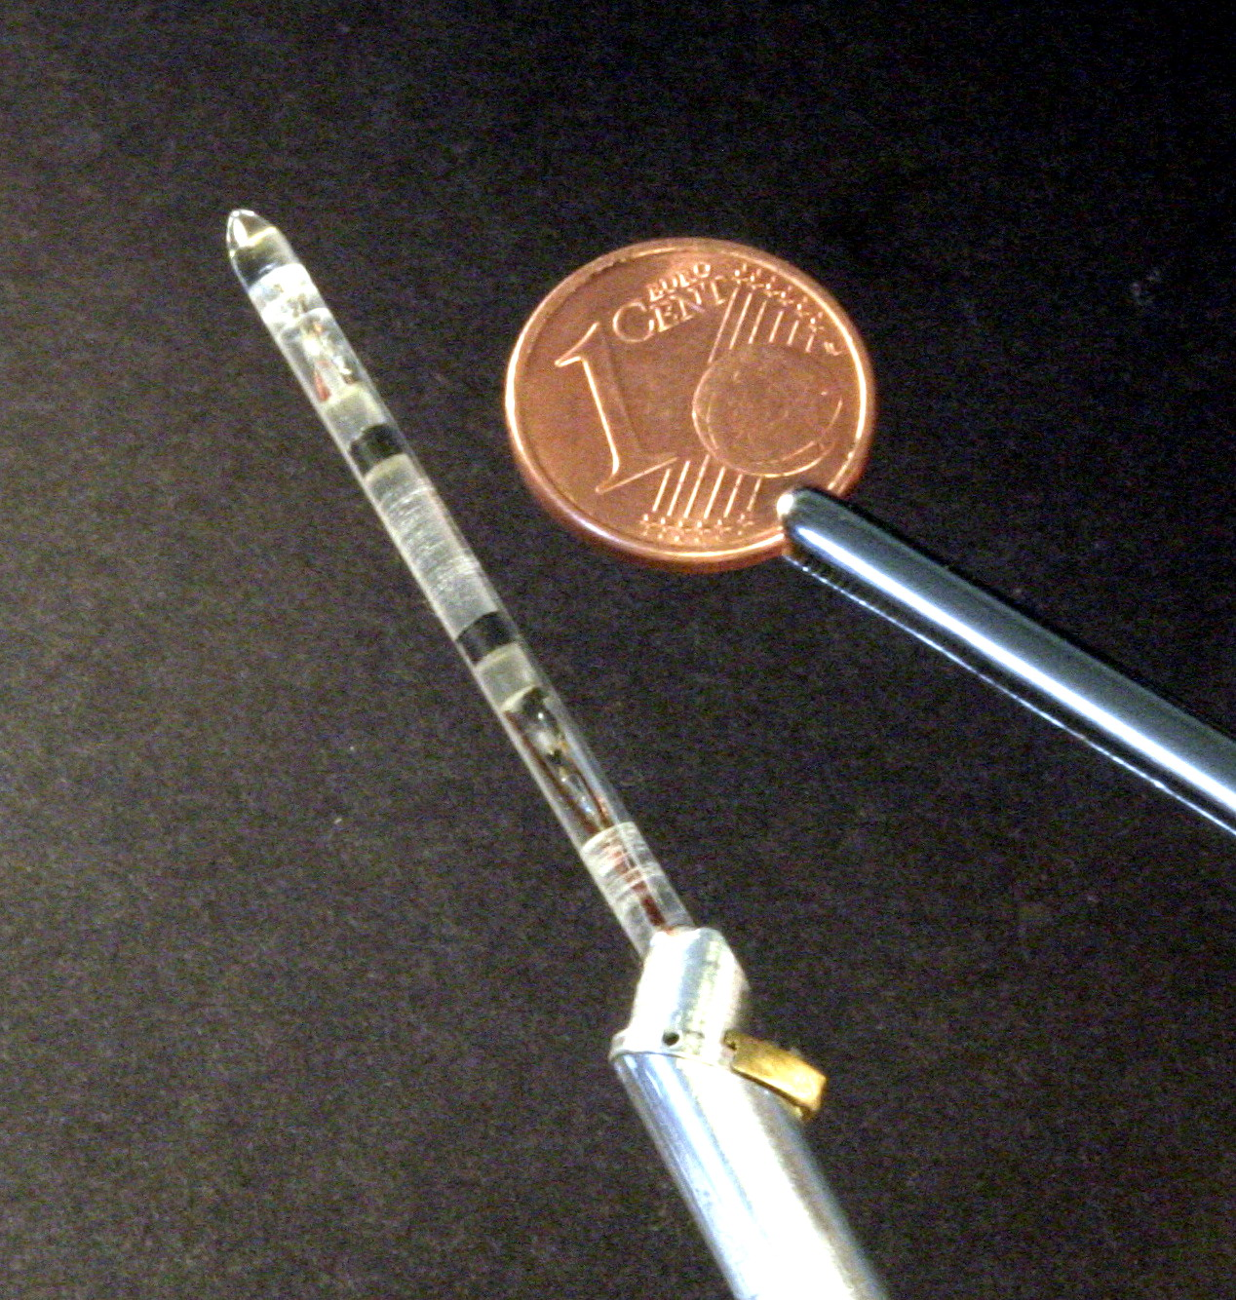
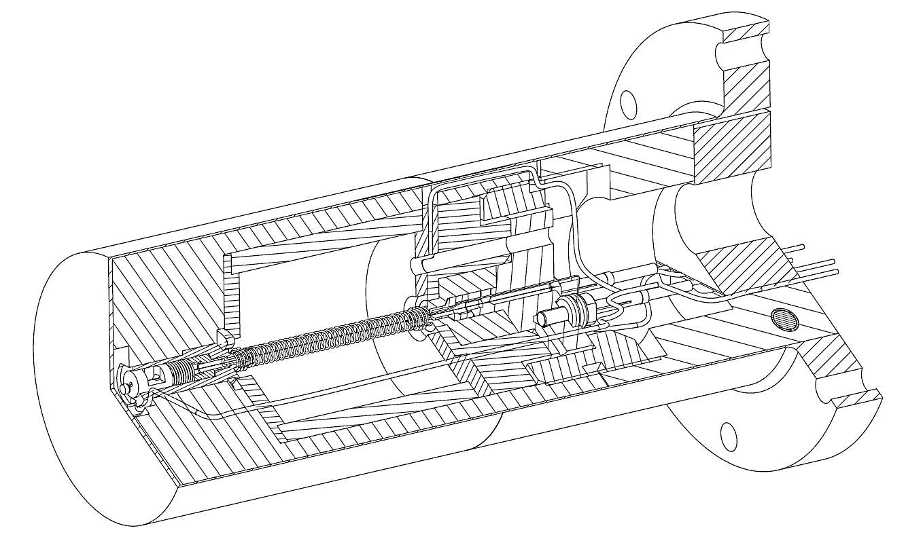
Innovative TEPC developed @LNL
TEPCs for microdosimetry @nanometer level
TEPCs for environmental monitoring
Complex mini-TEPCs
Multi-site TEPC
double TEPCs for BNCT
8

Slide 9

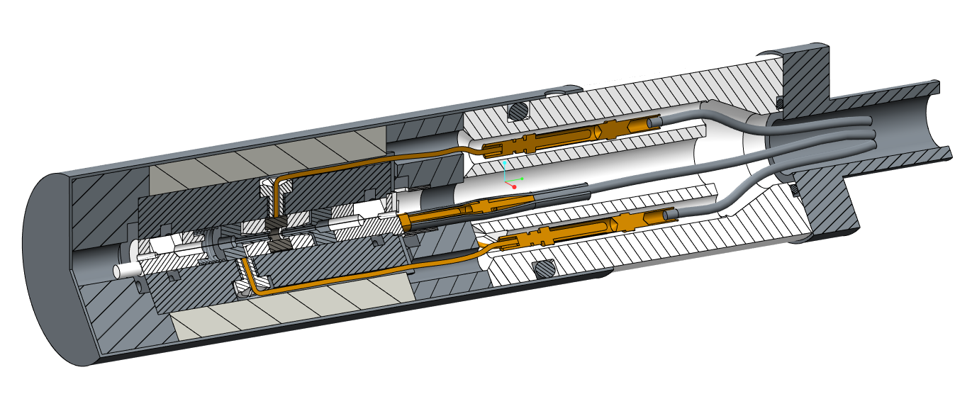
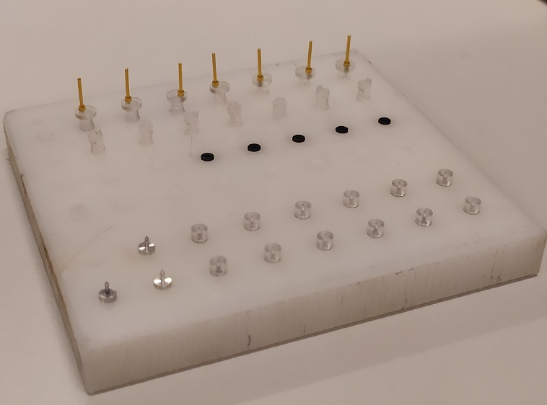
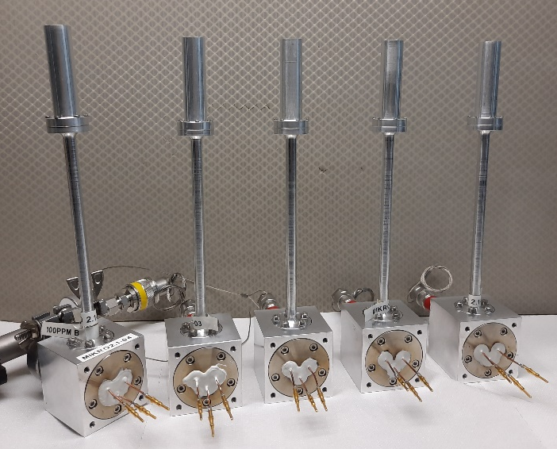
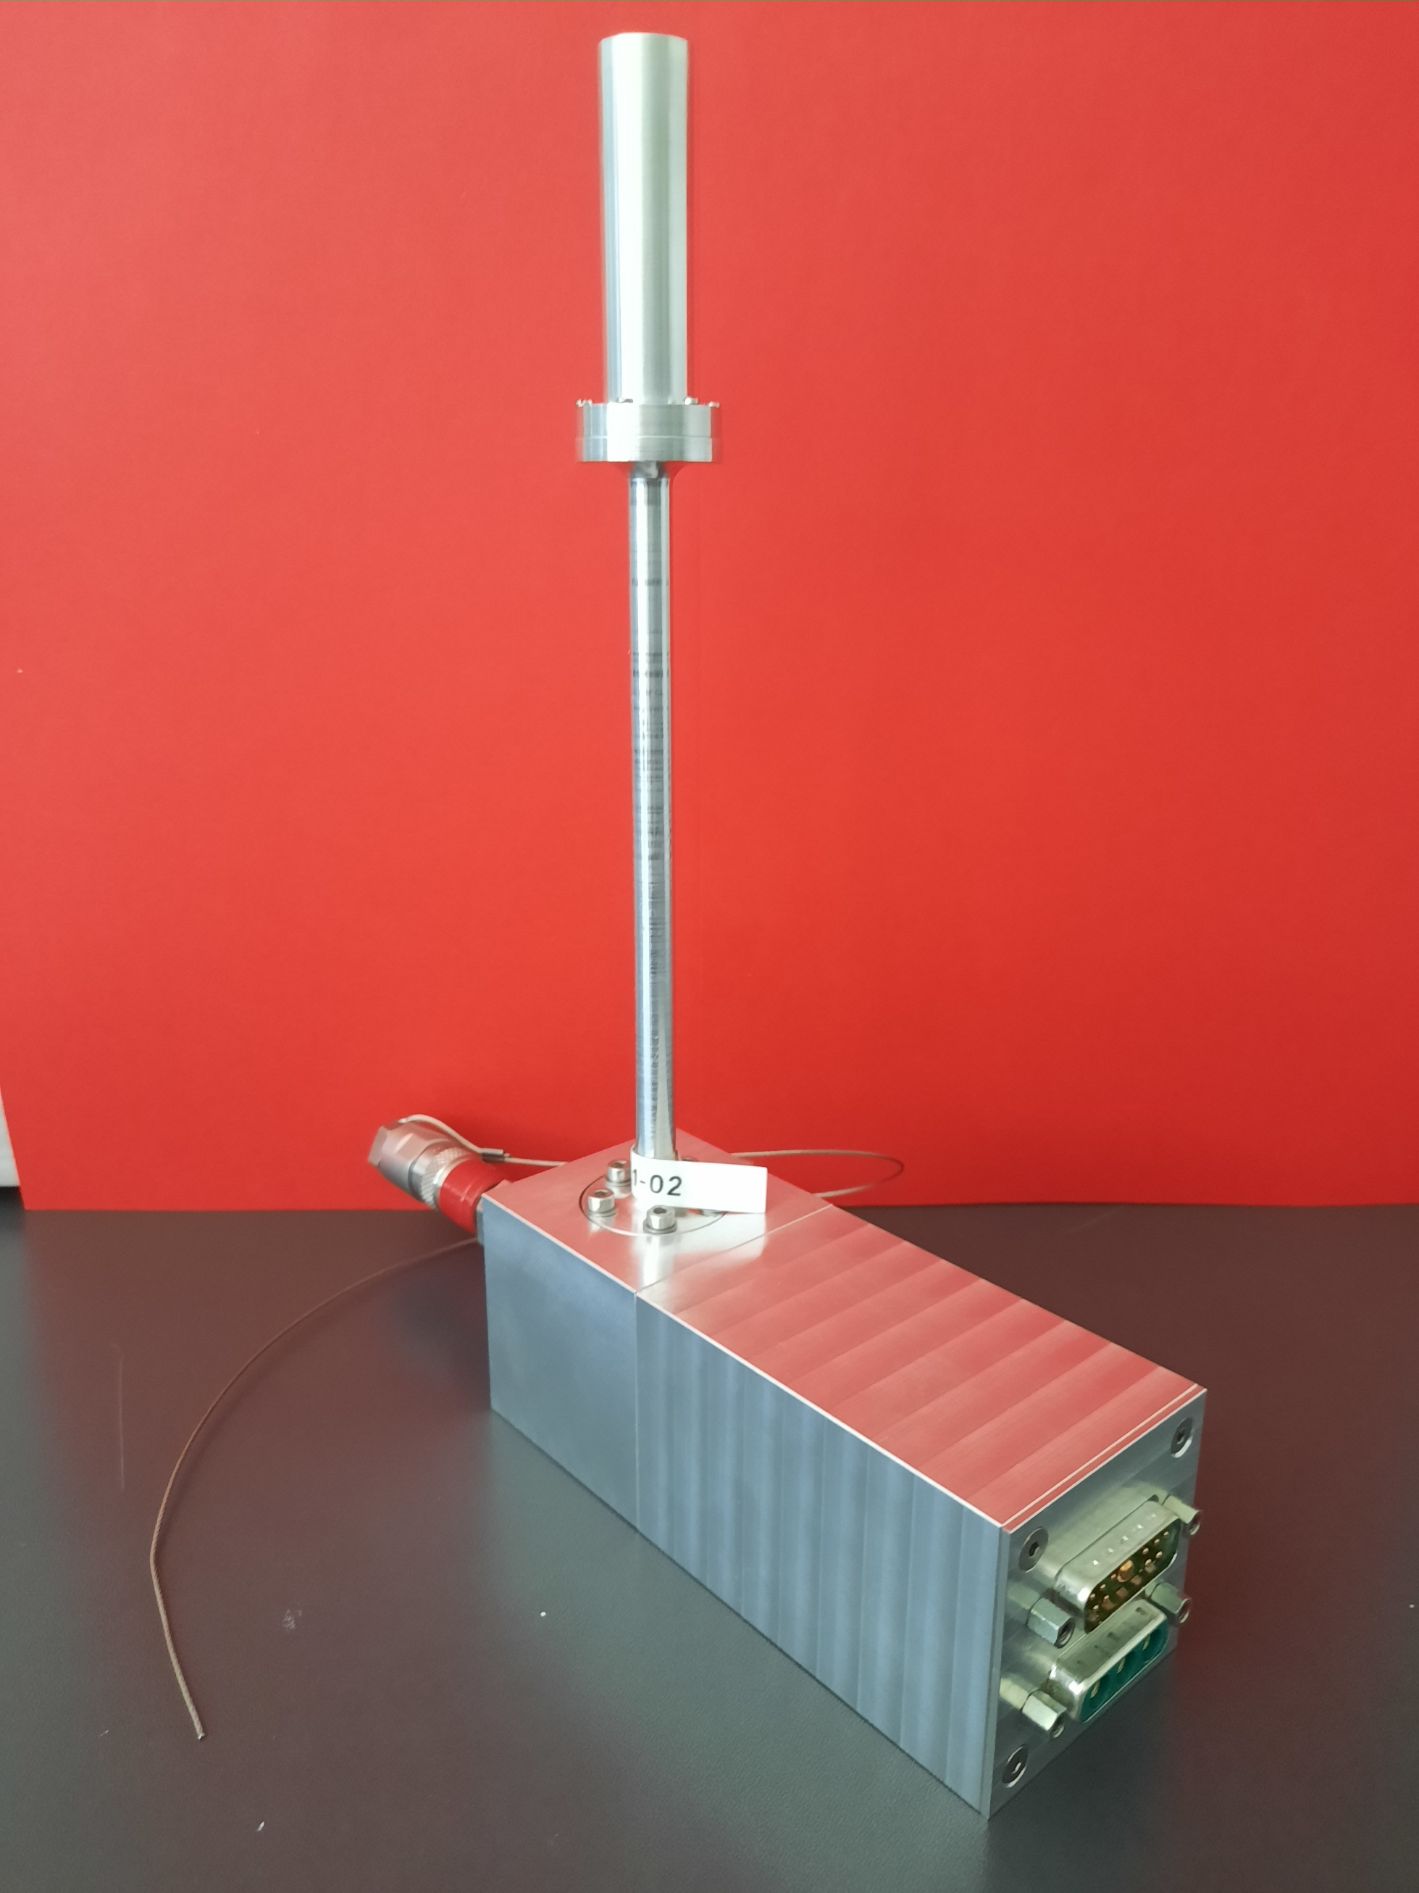
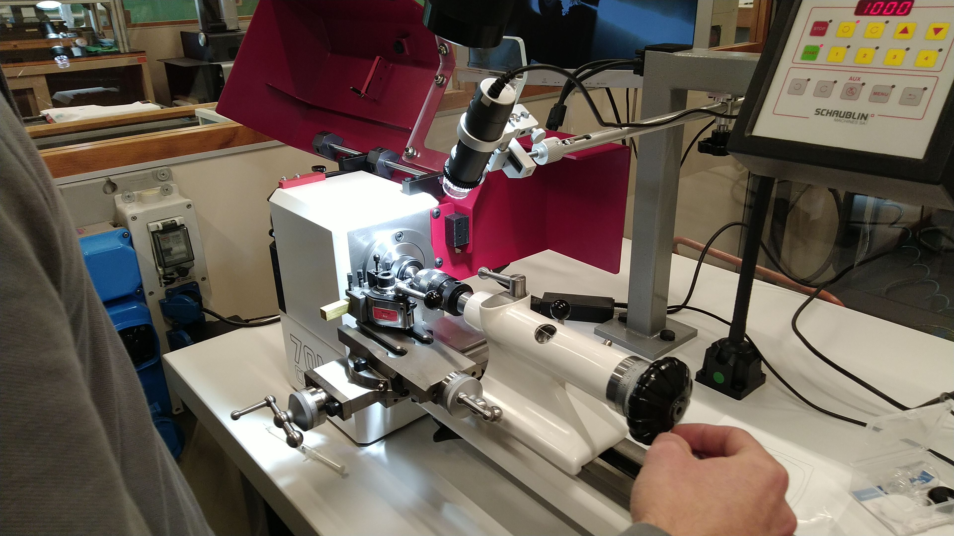
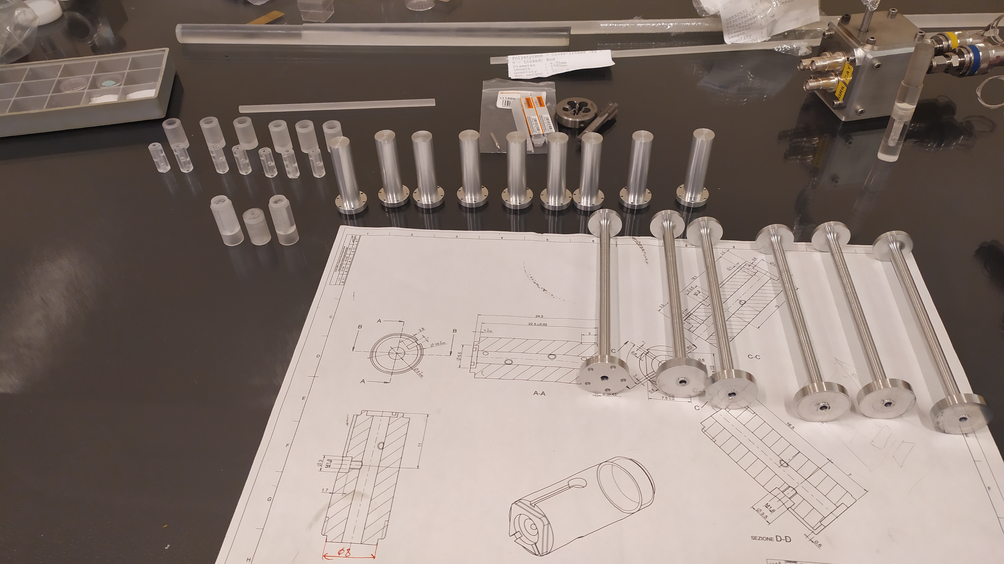
Mini-TEPCs for QA
Sensitive volume 125 times smaller than smallest (ex)-commercial TEPC
DESIGN and construction
Assembling and test
1.0 mm sensor
Micro-mechanical workshop
Engineering of microdosimetric device for clinics.
A Monitor for Quality Assurance of Radiation Quality for intense beams
9

Slide 10
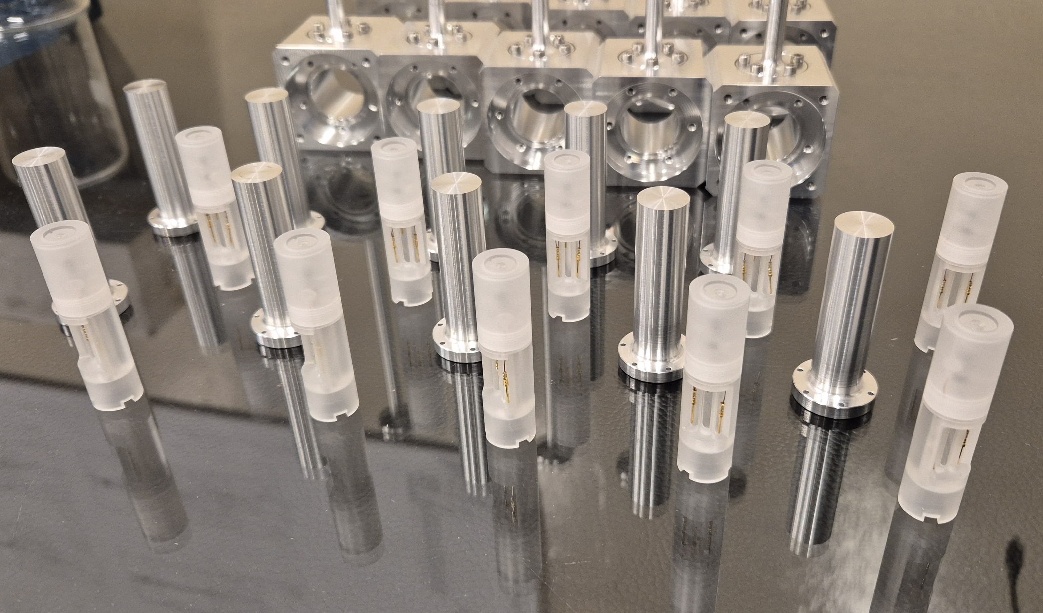
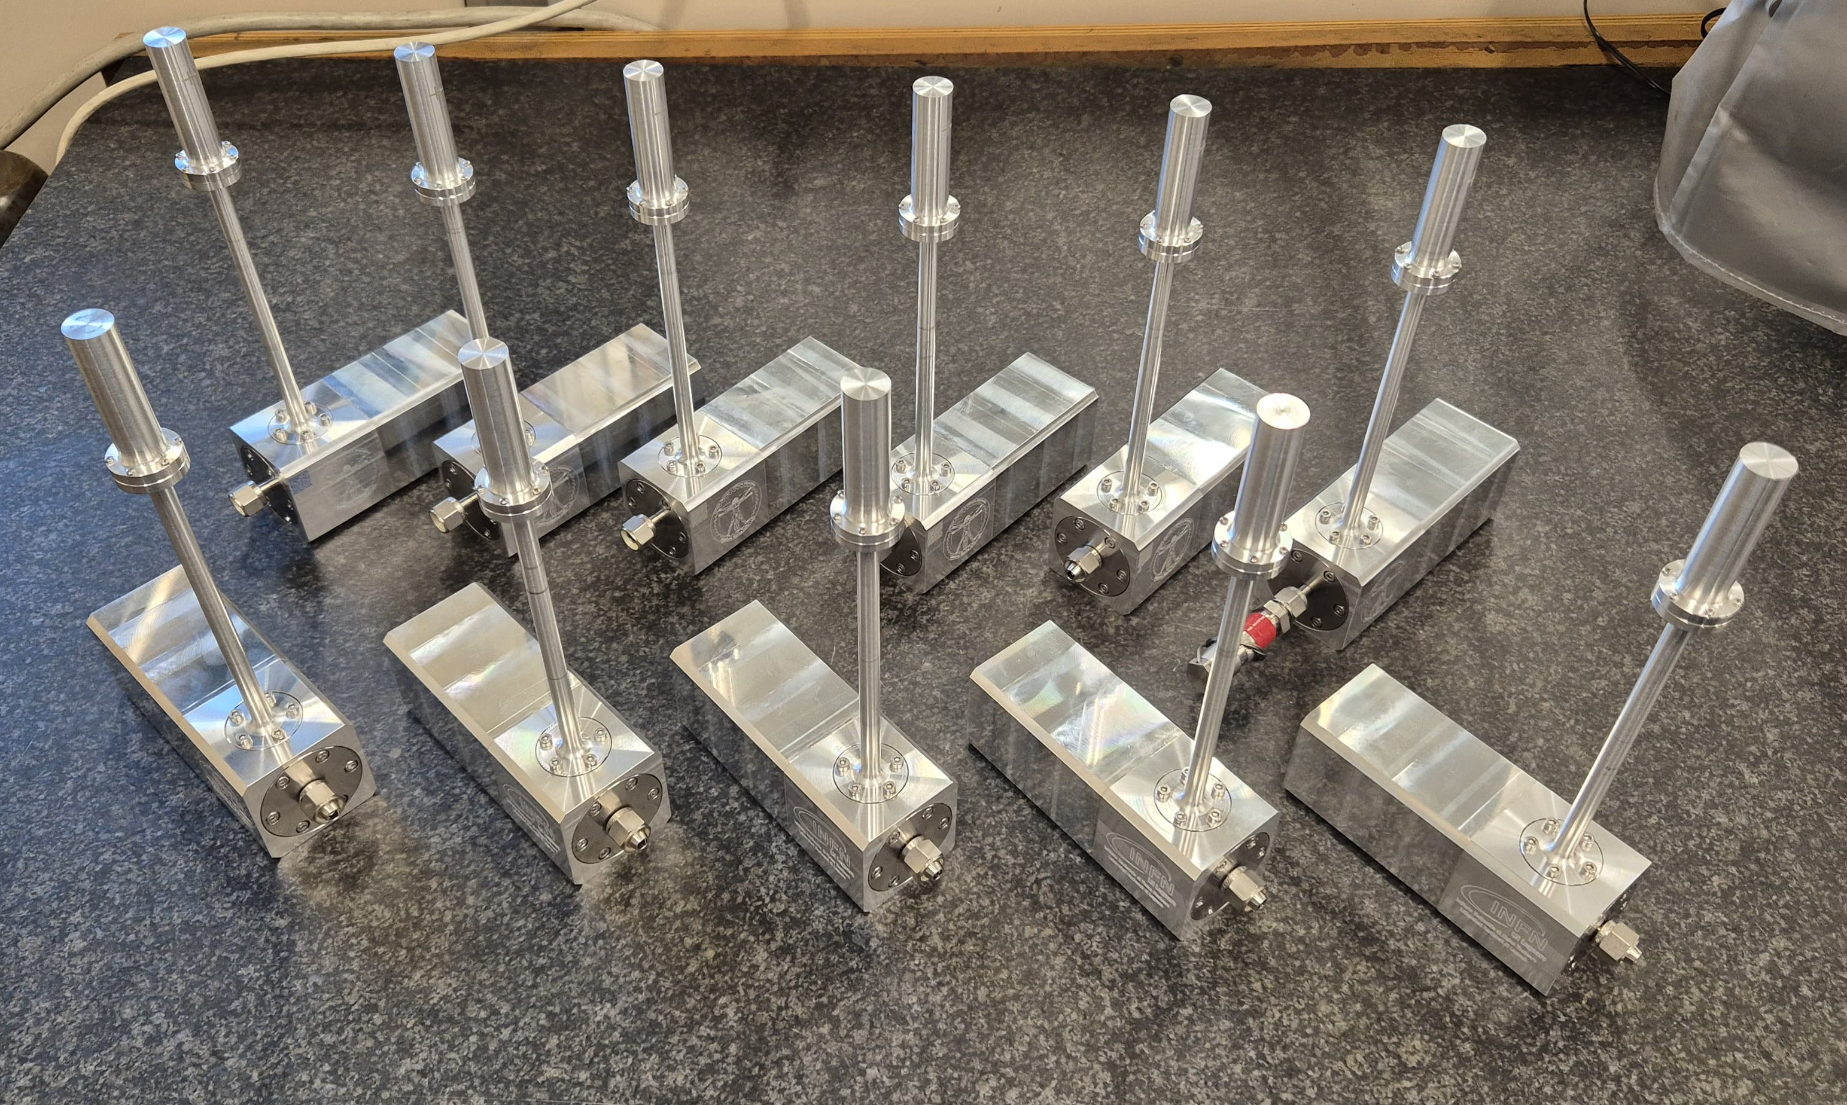

Future construction of more mini-TEPC

Slide 11
Microdosimetry @SPES cyclotron
10

Slide 12
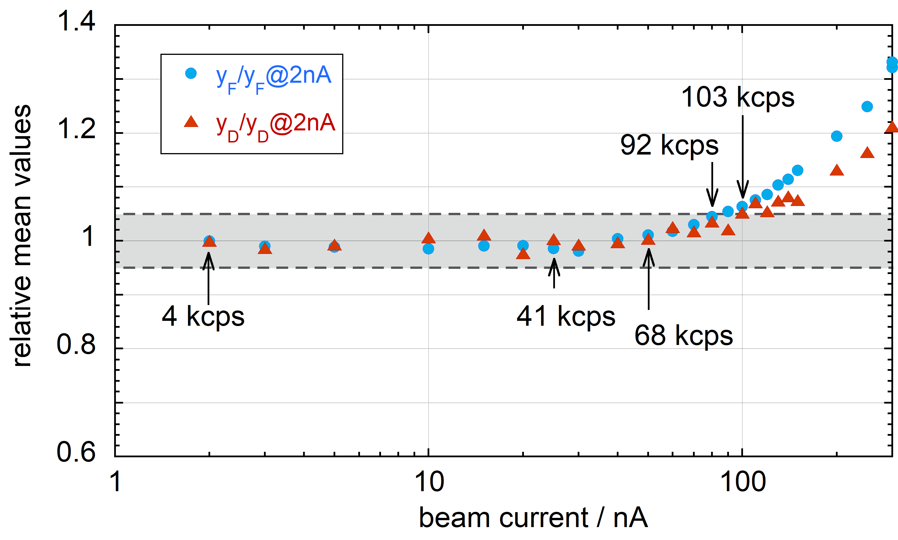
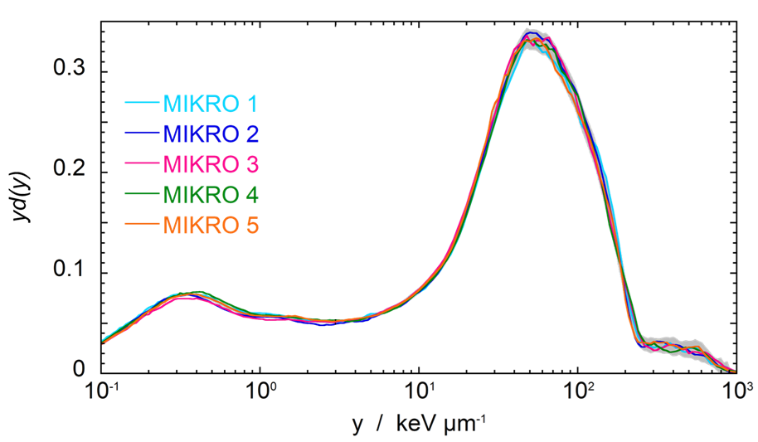
Test of new mini-TEPC @SPES cyclotron
High rate sustainability
Inter-detector reproducibility
11

Slide 13
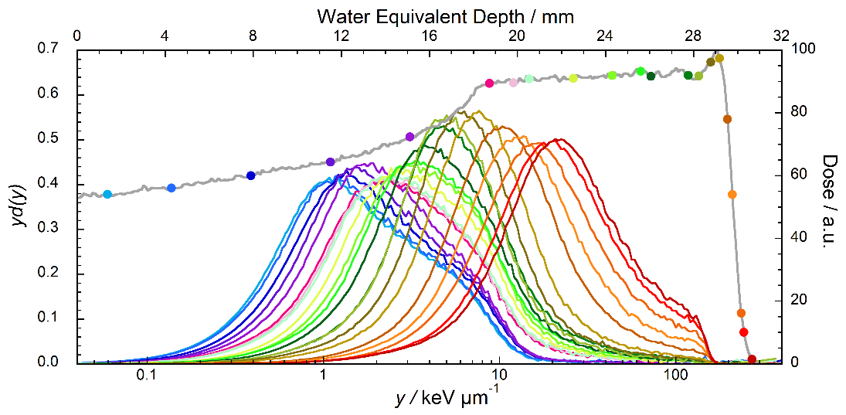
Combined measurements with radiobiology
RBE₁₀ – U87 cell line
Investigation of correlation between microdosimetric measurements and radiobiological response to the same radiation field
Anna Bianchi - International Workshop on future research program with the high power Cyclotron of SPES-LNL
12

Slide 14

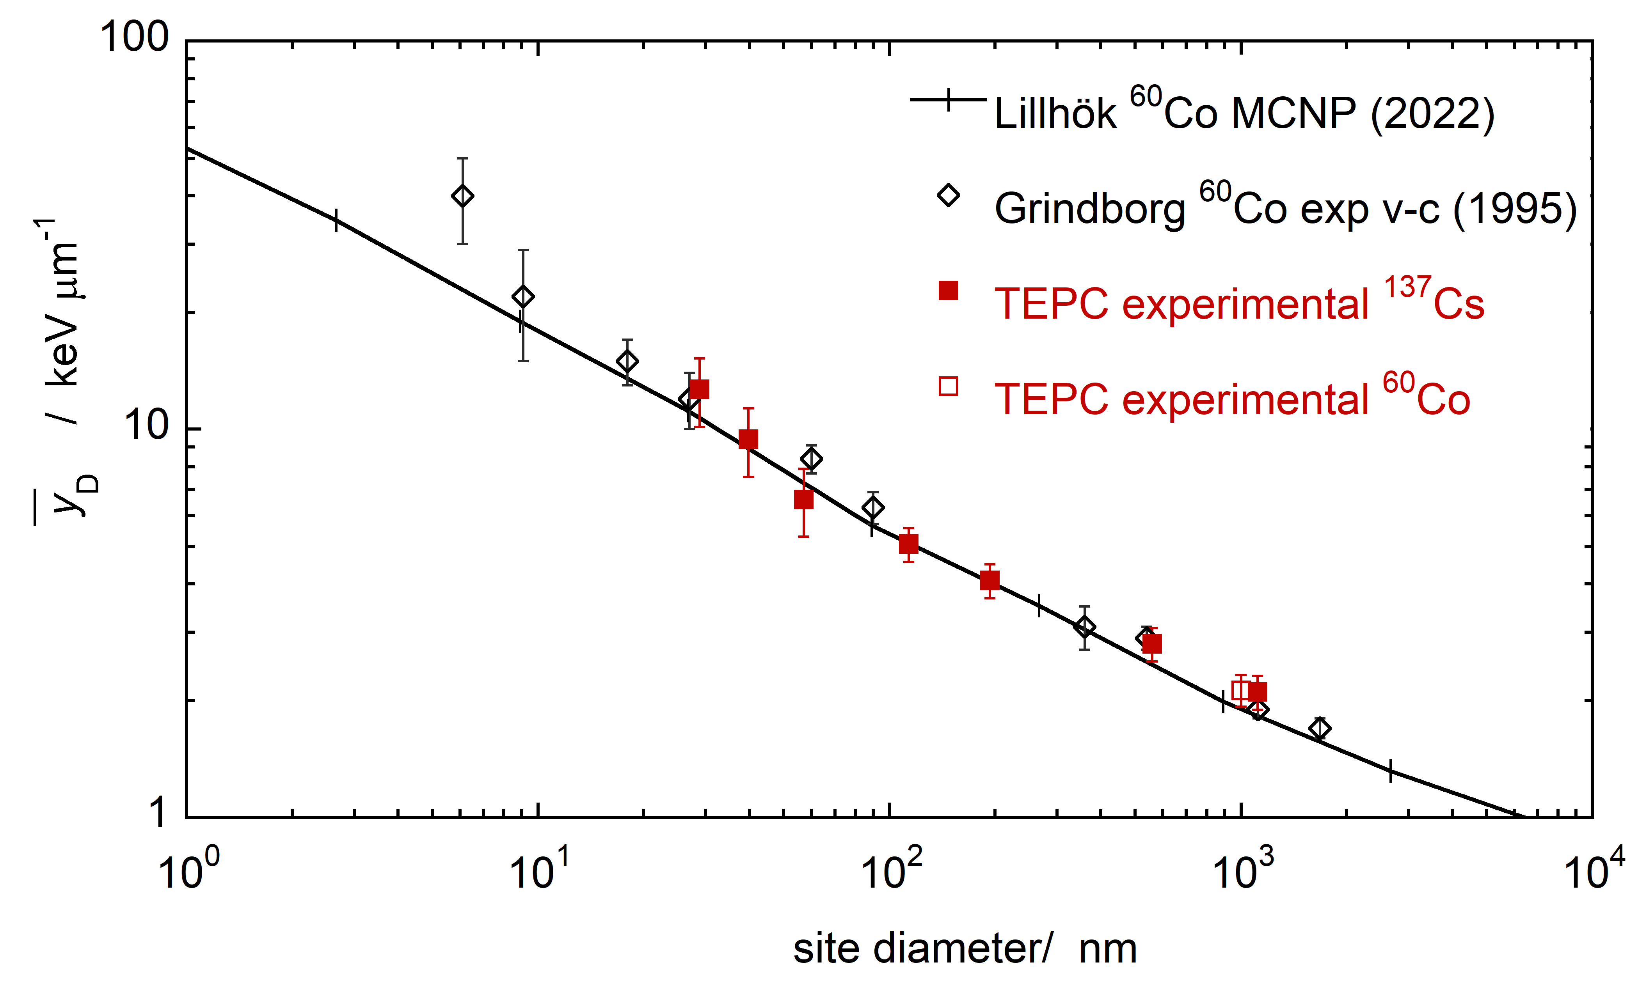

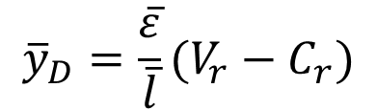
Development of new devices - AToMiQA
Variance – Covariance in microdosimetry
Multi-event measurements to overcome fluence rates limitation of single-event acquisition
$${\overline{y}}_{D}=\frac{\overline{ε}}{\overline{l}}(V_{r}−C_{r})$$
Single-event
Multi-event
Clinical: 10⁷ p s⁻¹ mm⁻²
Microdosimetric device that works in dual mode for high intensity beams
13

Slide 15
Studies of secondary products in proton beams
Gain = 1/1000
Low gain measurements to avoid pile-up from primaries but with high fluence of secondary particles
f(y)
yd(y) & y²d(y)
14

Slide 16
Anna Bianchi
anna.bianchi@lnl.infn.it

Slide 17
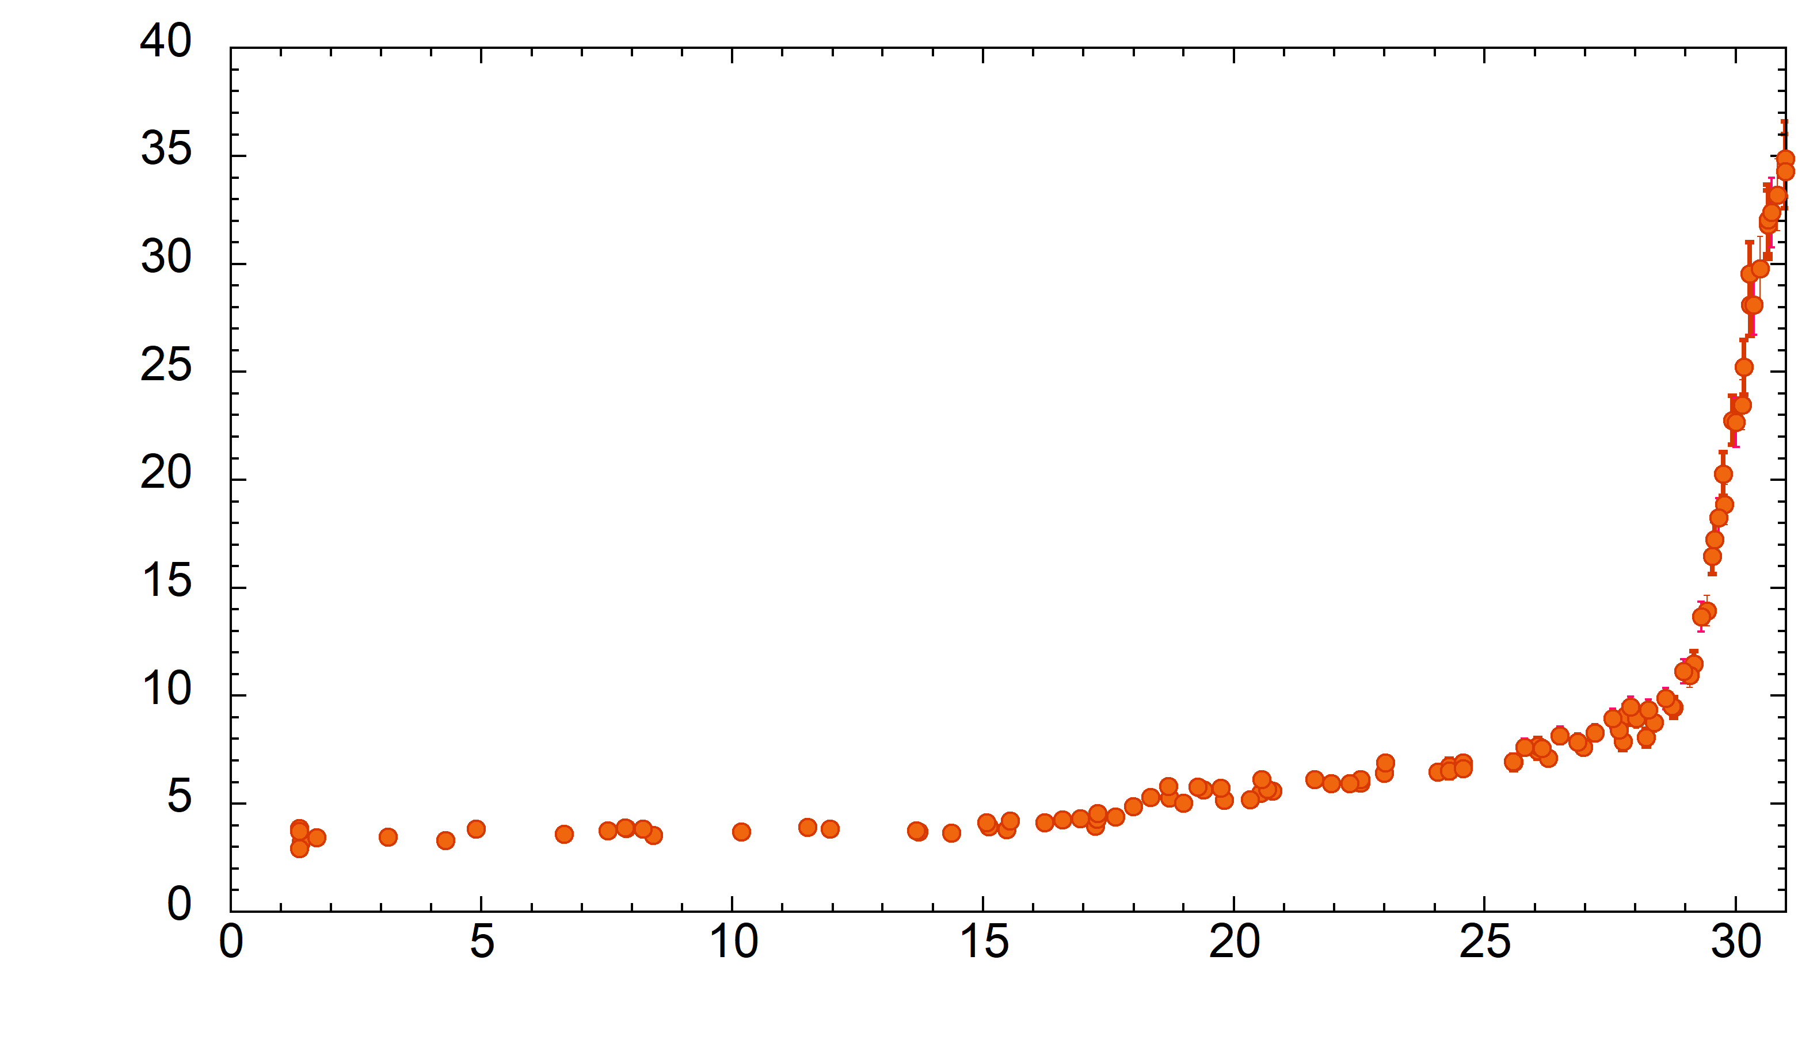
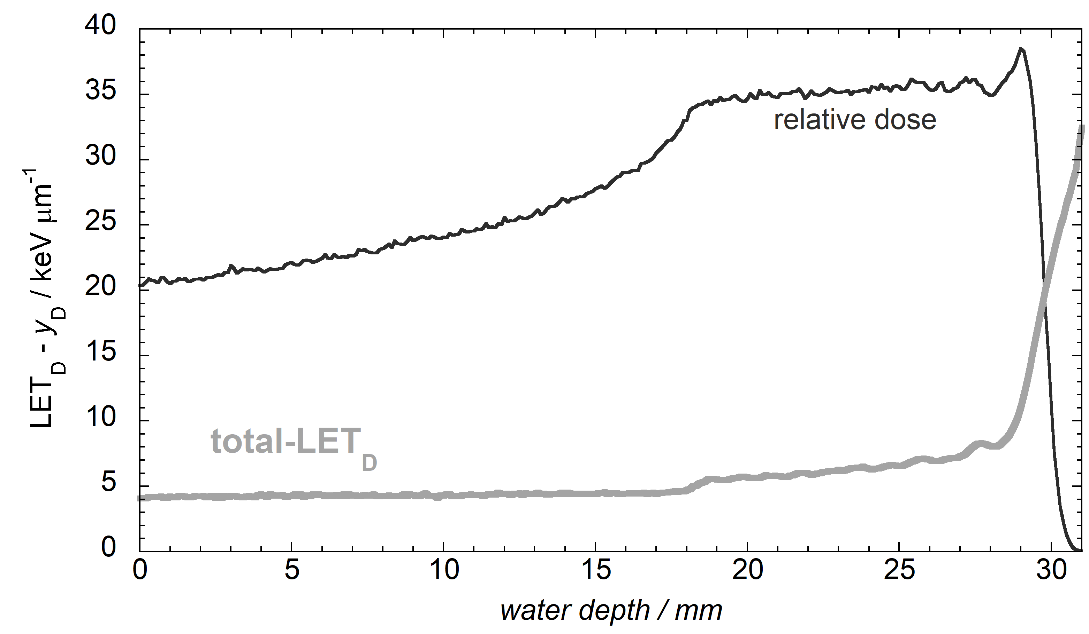
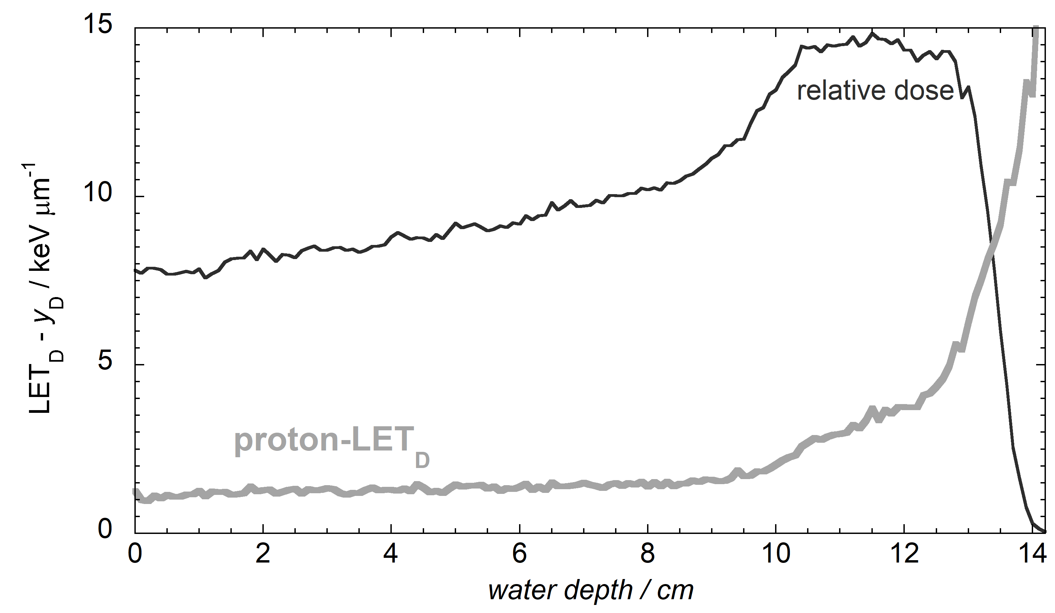
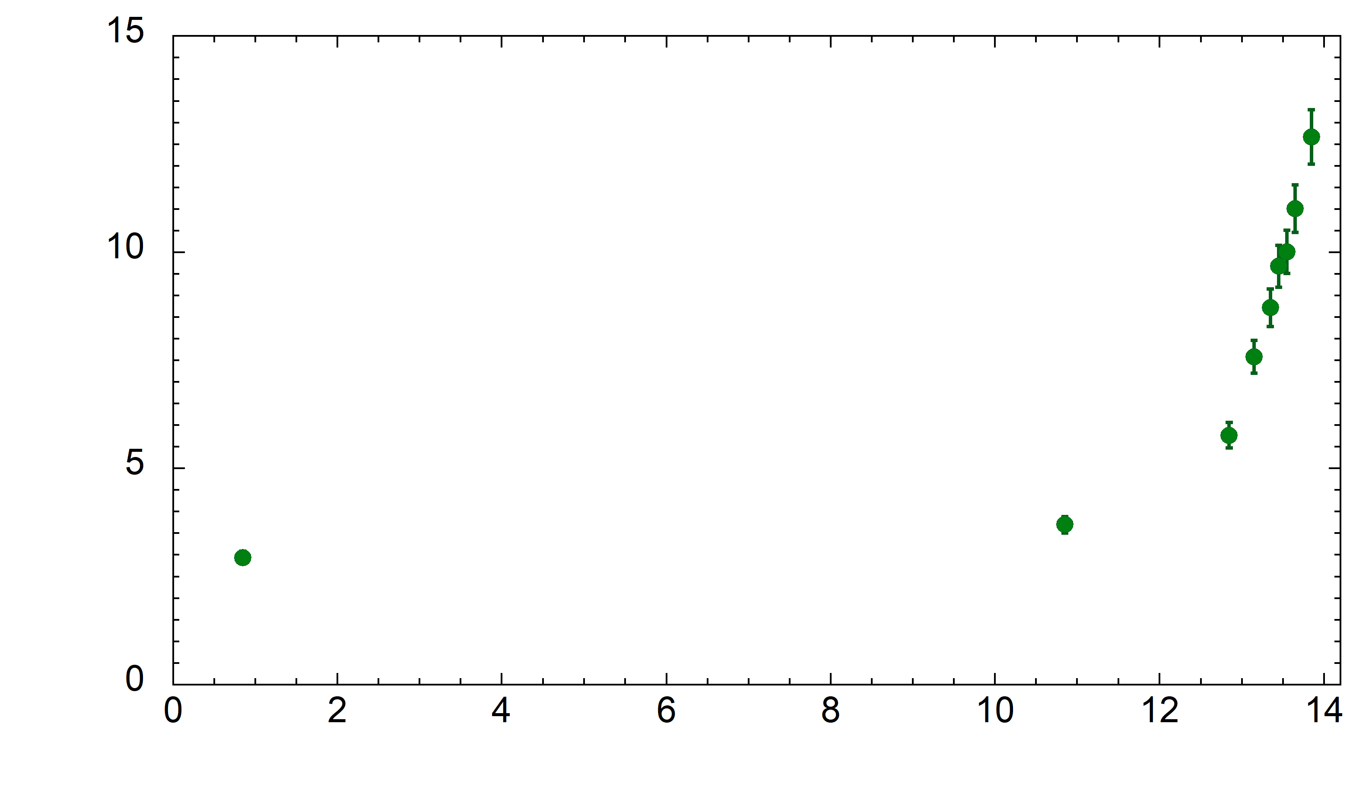
Characterization of clinical beams in terms of LET
62 MeV SOBP
CATANA beam line @LNS - INFN
148 MeV SOBP
Research beam line @Proton therapy centre of Trento
Dose-mean lineal energy as measurable quantity relatable to total-LET_{D}
5

